Slide 1
Printed and Flexible Electronics
Devices
Jin-Woo Han
jin-woo.han@nasa.gov
Universities Space Research Association
NASA Ames Research Center
All images courtesy of NASA

Slide 2
Motivation for Our Work

Slide 3
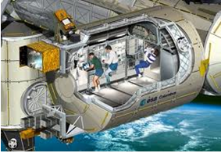
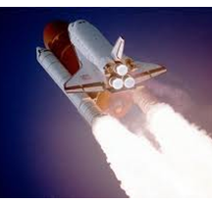

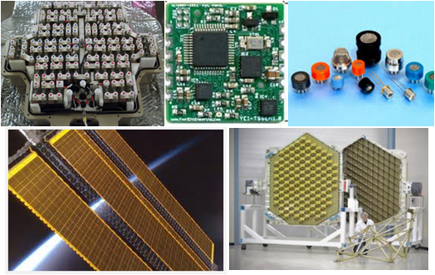
In-Space Manufacturing (ISM) Program
Space flight 2~3 / year
Significant cost as payload
Electronic
Components
In space
On Ground
Not green
Energy waste
All images courtesy of NASA

Slide 4
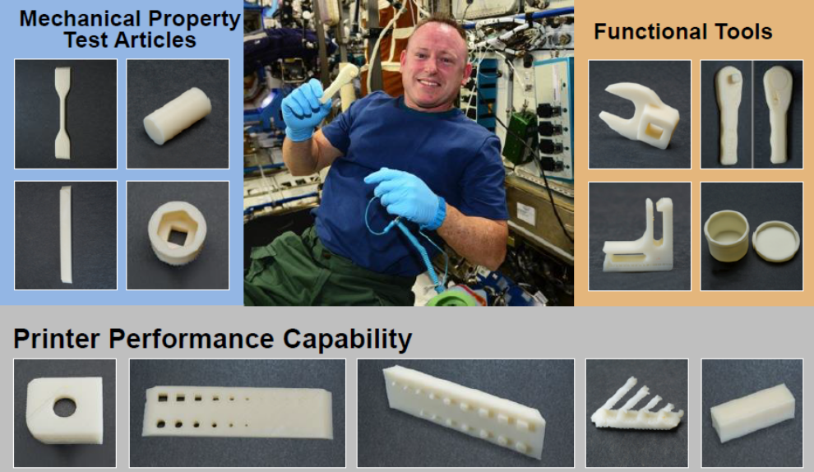
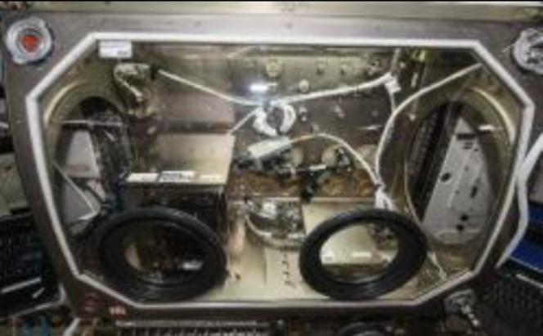
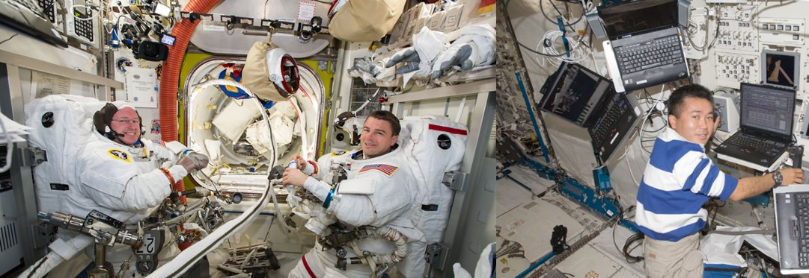
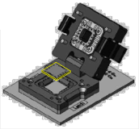
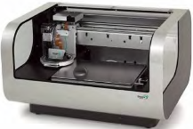

ISM in International Space Station (ISS)
3D printer in ISS
Images: www.nasa.gov
The gas sensor on
my suit is not working ☹
Ok, I’ll print
new device ☺
Design and manufacturing of electronics in space
All images courtesy of NASA

Slide 5
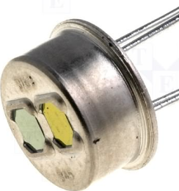

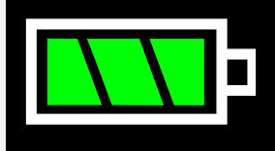
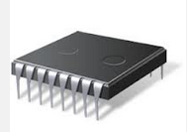


Printable ‘Electronic’ Components
Energy Generation
Solar Panel
Sensors
Gas Sensor
Bio Sensor
Printer/
Material
Energy Storage
Super-Capacitor
Integrated Circuit
Logic
Memory
Communication
Antenna
Display
Lightning

Slide 6
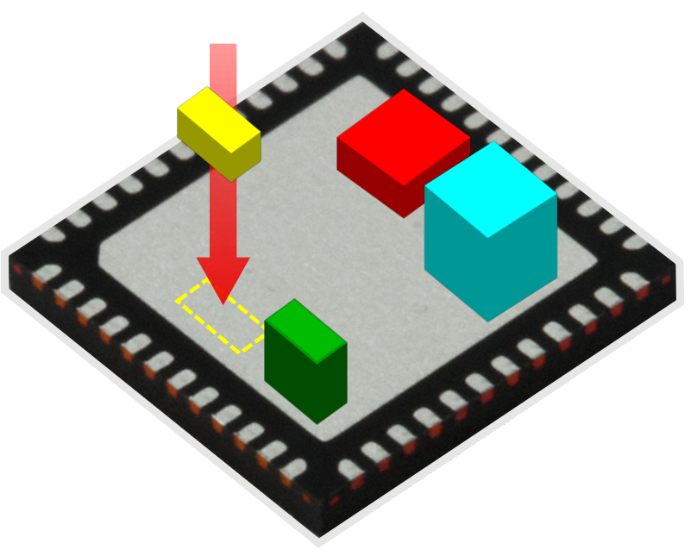
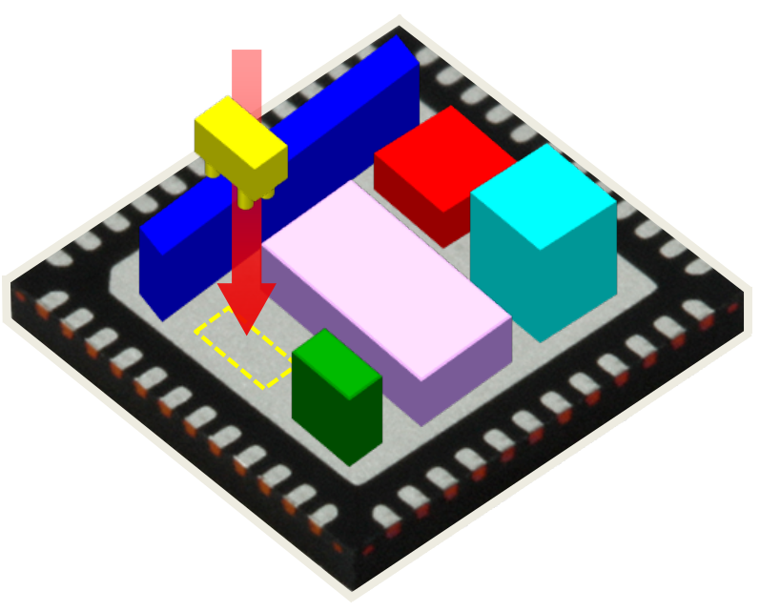
Printed Device Platform: A Universal Kit
User-defined
printing
Printing on demand
Non-volatile memory
Gas
sensor
Radiation
sensor
Energy harvester
Built-in heater
Plug and play based on the universal kit
Temp./RH sensor

Slide 7
Gas Sensors
ACS Sensors, vol. 3, pp. 1782−1788, 2018.
ACS Applied Nano Materials, vol. 2, pp. 6445-6551, 2019.

Slide 8
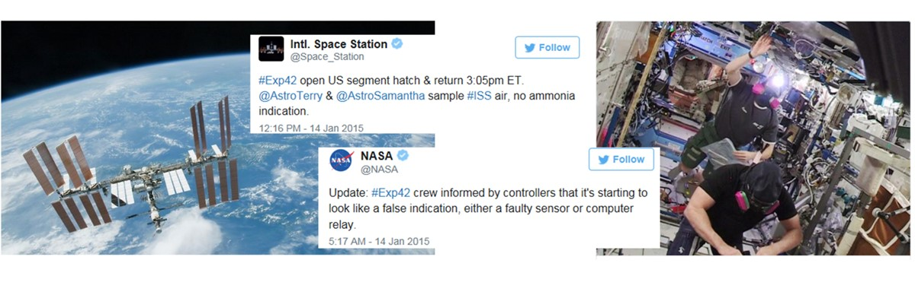
Ammonia Gas Leak Accident in ISS
Space Applications: cabin air quality in ISS, leak detection, planetary atmosphere
Societal Applications: Indoor/outdoor air quality, industrial leaks, breath analysis
All images courtesy of NASA

Slide 9
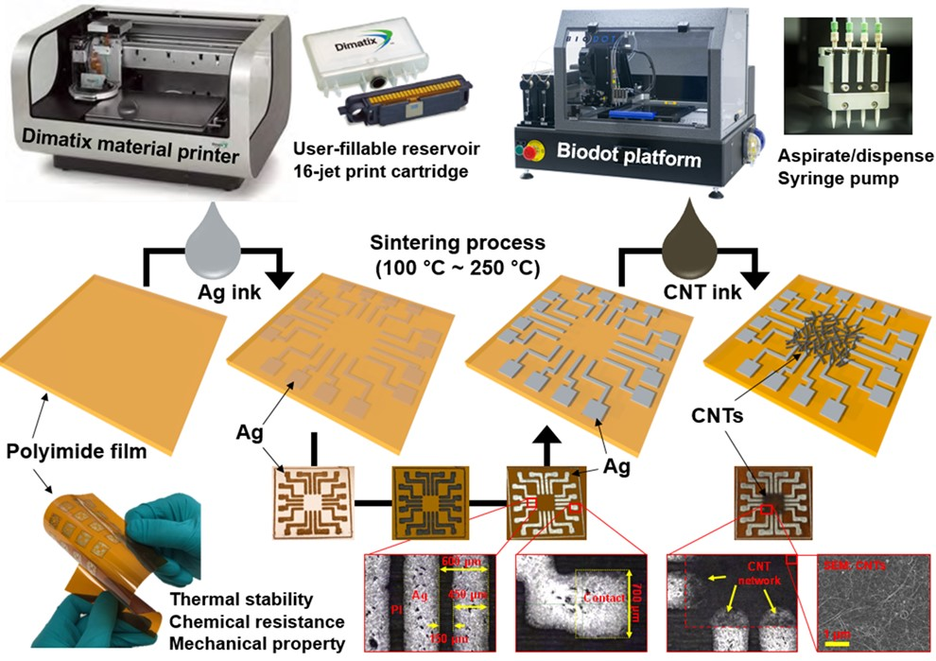
Printing Process

Slide 10
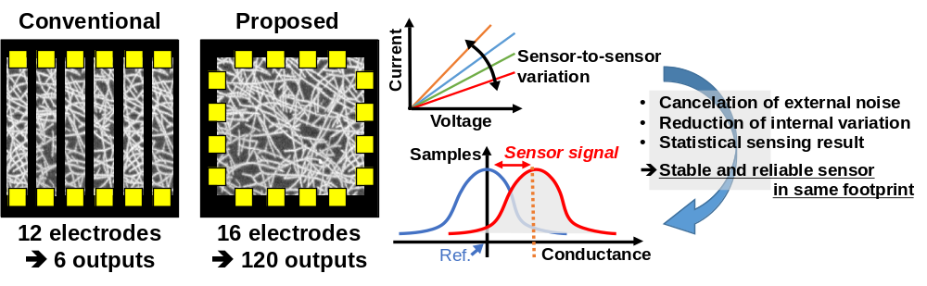
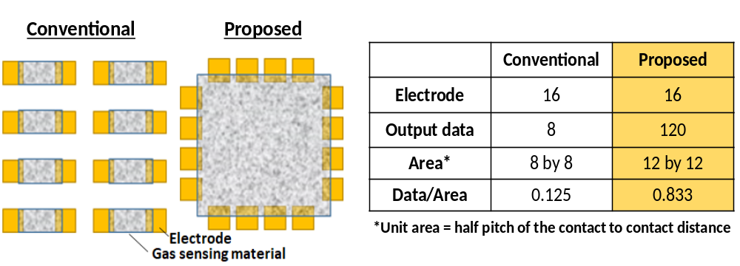
Multiport CNT Gas Sensor

Slide 11
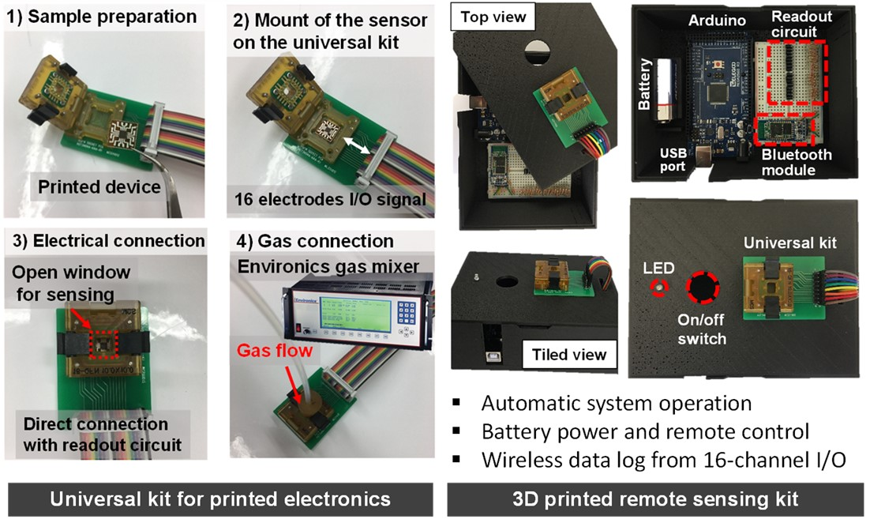
Sensor Experiments

Slide 12
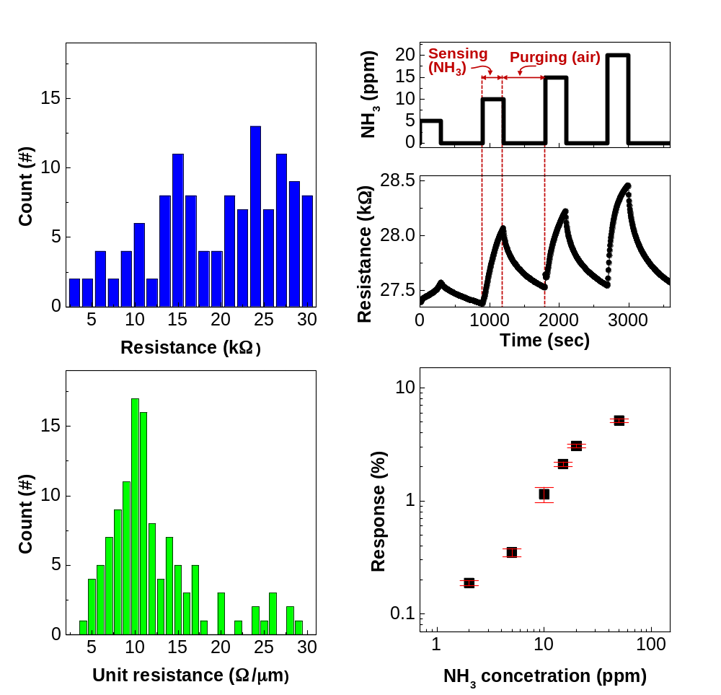
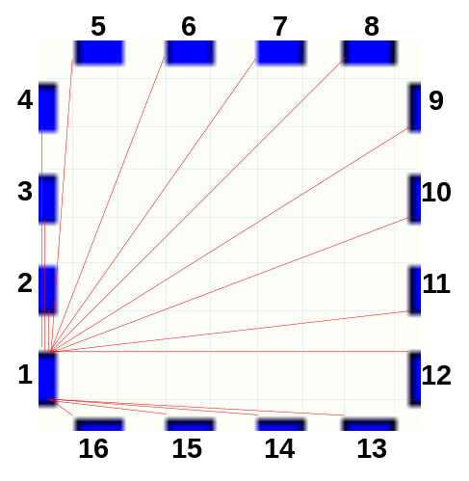
Ammonia Gas (NH₃) Detection
Length normalization

Slide 13
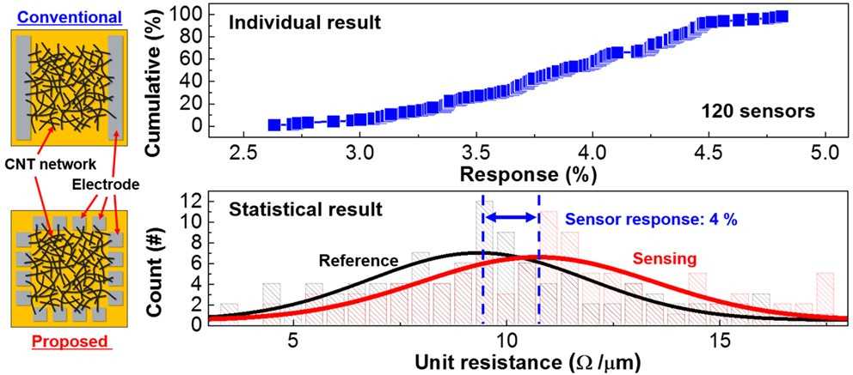
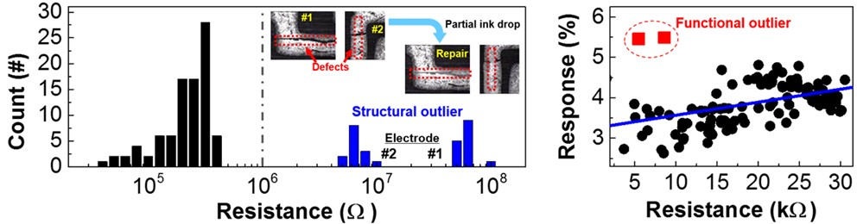
Variation Tolerance

Slide 14
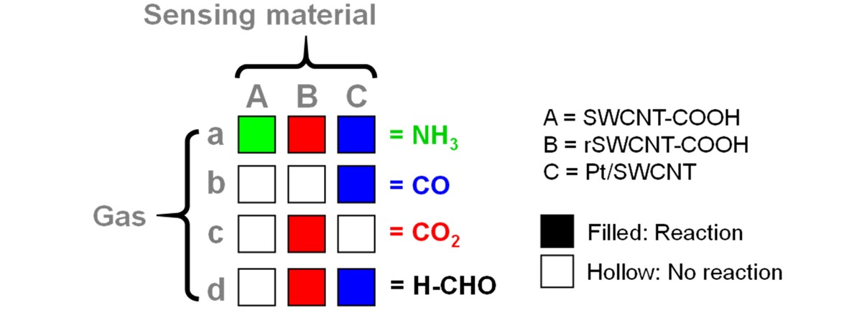
Electronic Nose (E-nose)

Slide 15
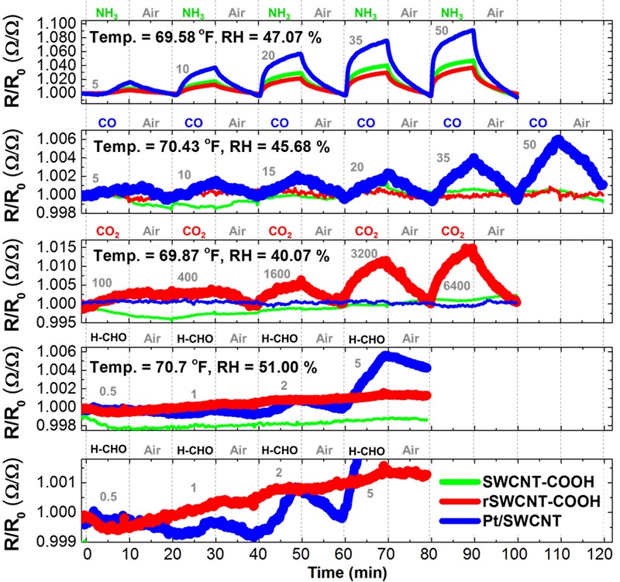
Multiple-Gas Detection

Slide 16
Radiation Sensors
ACS Sensors, vol. 2, pp. 1679-1683, 2018.
ACS Sensors, vol. 4, pp. 1097-1102, 2018.

Slide 17
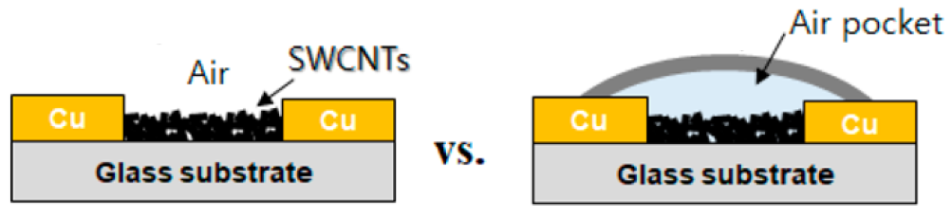
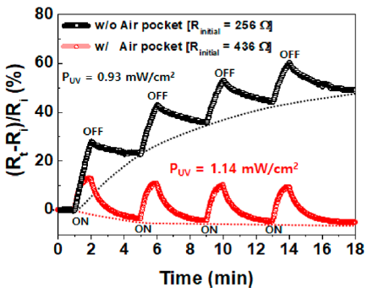
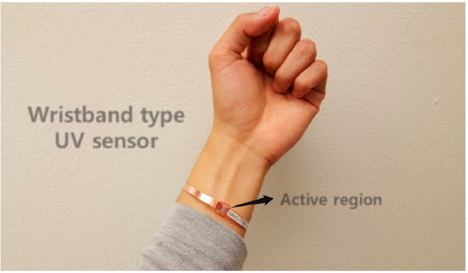
All-Printed UV Sensor
Exposed to Ambient Gas
Isolated Air (Oxygen) in Pocket
UV makes CNT less conductive.

Slide 18
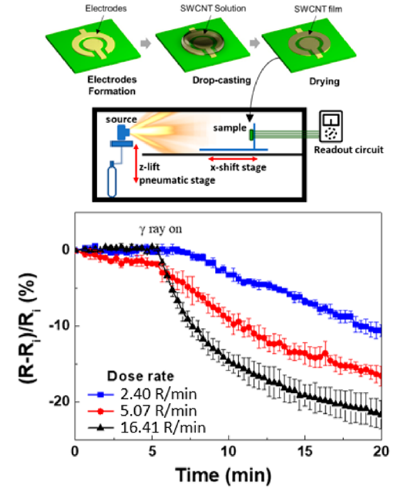
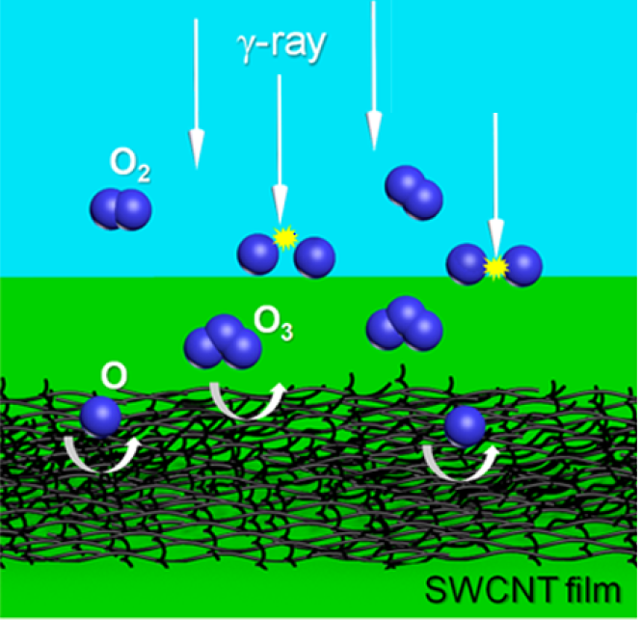
All-Printed Gamma Ray Sensor
Gamma ray makes CNT more conductive.

Slide 19
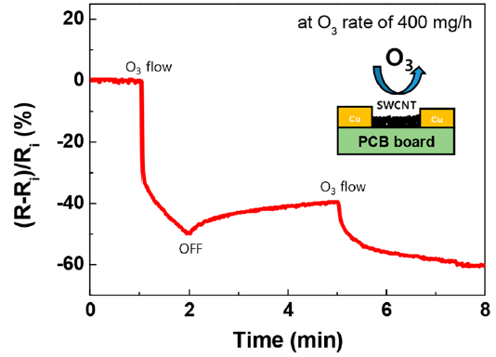
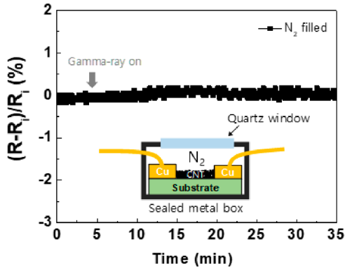
Gamma Sensing Mechanism Experiment
Direct Ozon Exposure
Nitrogen Filled Ambient

Slide 20
Resistive Switching Memory
Nanoscale Adv., Vol. 1, 2990-2998 (2019).

Slide 21
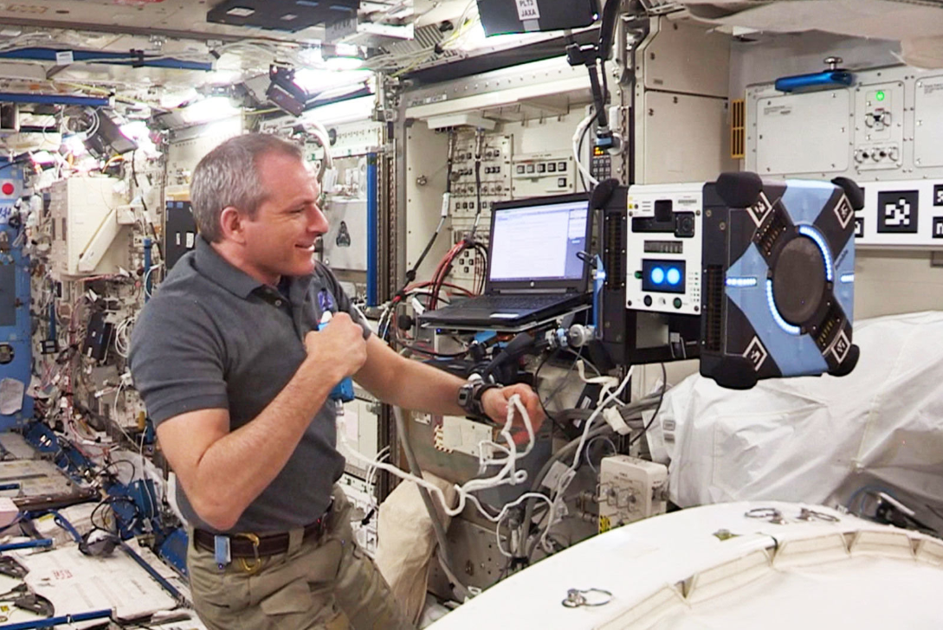
Autonomous Inventory Management Control
All images courtesy of NASA

Slide 22
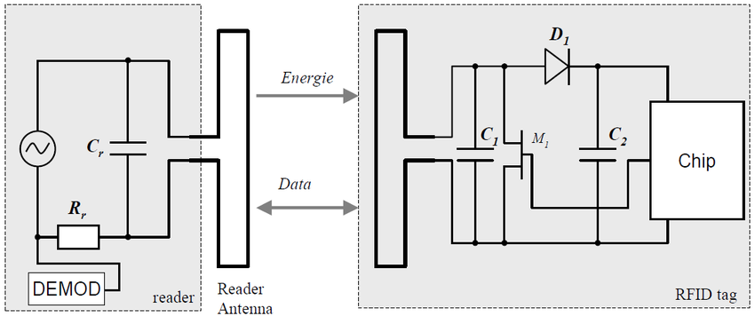
Passive RFID
Printed Memory
16 bit memory = 65,536 IDs

Slide 23
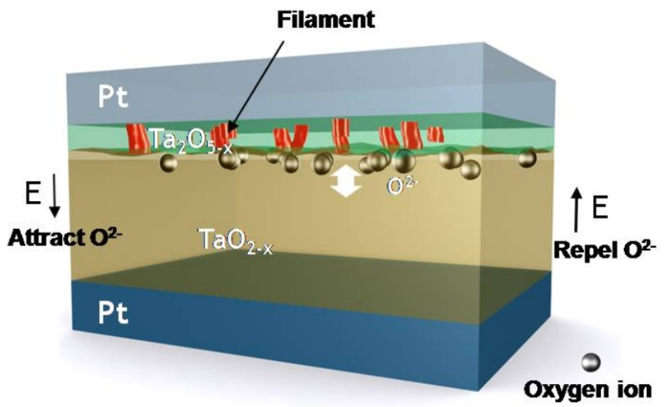
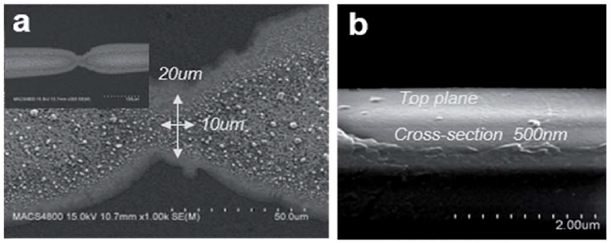
All Printed Resistive Switching Memory
Top view
Ag pattern
Conventional Sandwich Type
Single Material Structural Type

Slide 24
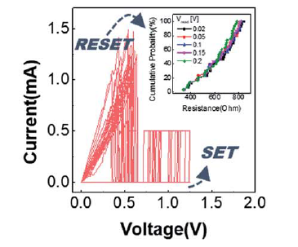
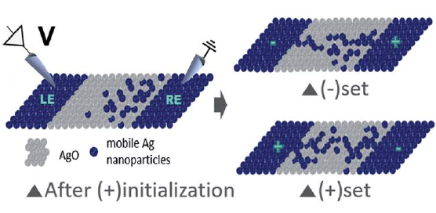
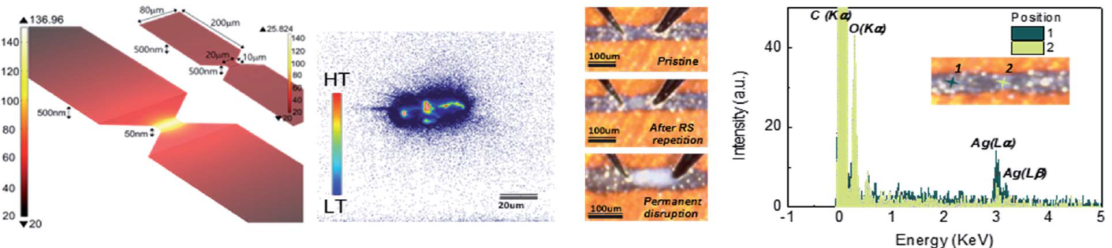
All Printed Resistive Switching Memory

Slide 25
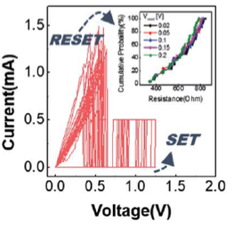
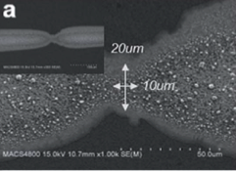
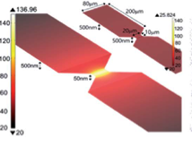
All-Printed Resistive Switching Memory
Clever single Ag ink system to create Ag-AgO-Ag system using
an hourglass-shaped pattern and Joule heating.
Unipolar resistive switching with an on/off ratio of 10⁸ at a
reading voltage of 0.02 V.
Bipolar resistive switching is also available, which is beneficial
in reducing switching current and power.
25
Nanoscale Advances 1, 2990 (2019)

Slide 26
Mechanical Energy Harvester
For both small scale energy scavenging and large scale wind power generation
where the heavy conventional electromagnetic motors are not favored for launch
Nano Energy, vol. 52, pp. 271-278, 2018.
Nano Energy, vol. 44, pp. 82-88, 2018.
Nano Energy, vol. 39, pp. 238-244, 2017.

Slide 27
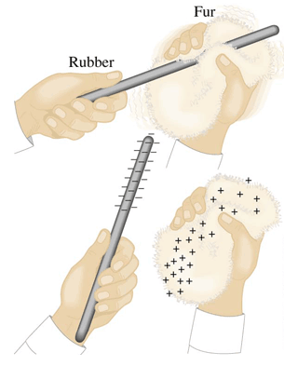


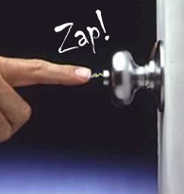
Triboelectricity (Static Electricity)
Rubber
Fur
Triboelectricity is created at any contact interfaces.
Triboelectricity is an unwanted phenomenon because too strong voltage causes breakdown of electronics and fire in environments.
→ Attractive energy source when properly managed
27
Notes:
REF: http://whs.wsd.wednet.edu/
http://sciencevideosblog.blogspot.kr/
http://www.randrheating.com/humidifiers/
http://scienceblogs.com/startswithabang/2015/06/25/throwback-thursday-a-static-electricity-surprise-synopsis/

Slide 28
Printable Mechanical Energy Harvester
 | Electromagnetic | Piezoelectric | Triboelectric
Material | Magnet and coil | PZT, BTO, PVDF | Polymers (PTFE, PDMS)
Mass | Heavy | Light | Ultralight
Power density | 0.29 – 1.85 mW/g | 0.35 – 0.43 mW/g | 0.48 – 8.8 mW/g
Cost | Low | High | Ultralow
Mechanical Durability | Good | Poor | Good
In-Space Manufacturability | No | No | Yes

Slide 29
Operation Principle: Step 1
Step 1. Triboelectric charging (Contact electrification)
Dielectric surface gains static charges by repeated contacts
→ Triboelectric layer
dielectric
Order of electrification (OE)
Positive
Silk
Aluminum
Paper
Cotton, woven
Steel, Nickel, Copper
Brass, Silver
Polyvinyl alcohol
Polyester
Natural rubber
Polyvinylidine chloride
Polyimide (Kapton)
Polyvinvi chloride (PVC)
Polydimethylsiloxane (PDMS)
Polytetrafluoroethylnene (PTFE)
Positive OE material
Negative OE material
Strong triboelectricity!
Negative
29

Slide 30
Operation Principle: Step 2
Step 2. Electrostatic induction
Contact-separation mode
top electrode
I
dielectric
bot. electrode
I
Sliding mode
I
I
30

Slide 31
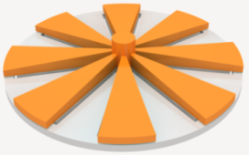

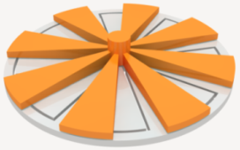
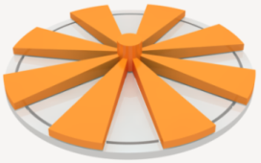
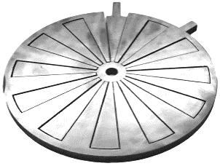




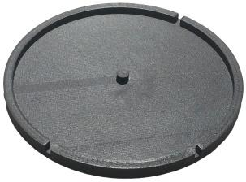
All 3D Printed TENG - Structure
Structure
Operation principle
θ = 0
θ = π / 24
θ = 2π / 24
θ = 3π / 24
Q_{IE} : Q_{OE} = 9:1
Q_{IE} : Q_{OE} = 7:3
Q_{IE} : Q_{OE} = 3:7
Q_{IE} : Q_{OE} = 1:9
3D printed TL
3D printed EL
3D printed case
(bottom to top)
 | Previous device | This device
Source type | Linear motion | Rotation
Manufacturing | 2D + 3D printing | 3D printing
31

Slide 32
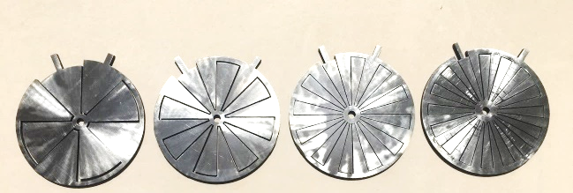
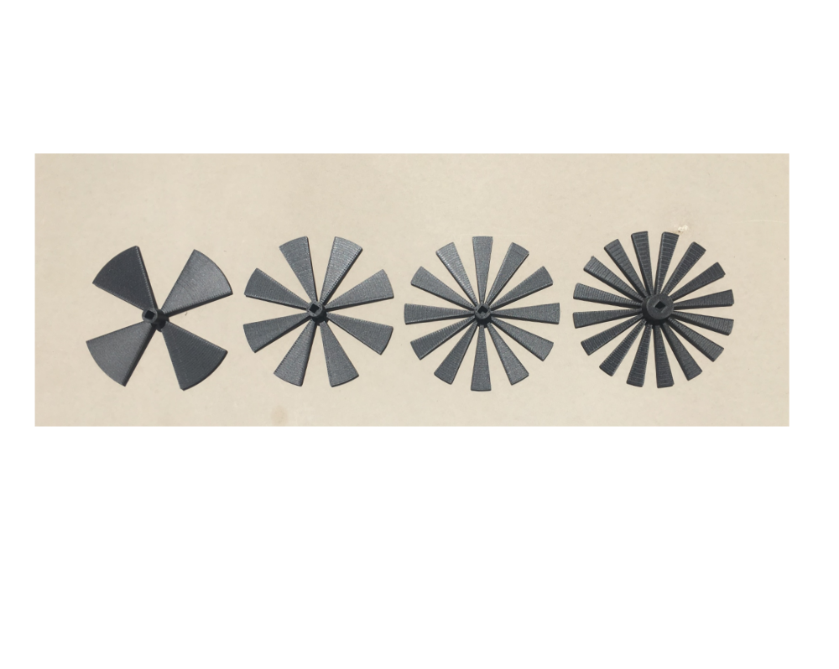

Grating Configuration Effect
Electrode layers
Triboelectric layers
4B
8B
12B
16B
4B
8B
12B
16B
More blades make more frequent charge movement → Higher energy generation
Accurate patterning by 3D printing is beneficial.
32

Slide 33




Printable Material Effect
Nylon
ABS
PLA
MMA
33

Slide 34


Printed Supercapacitors
CNT and other carbon inks, Ag ink for electrode
Specific capacitance ~ 170 F/g. Energy density ~ 15 Wh/Kg
Power density ~ 2 KW/Kg, 100,000 cycles without loss of performance
34

Slide 35
Thank you

