Slide 1

Crop Production in Support Exploration
“Feeding Exploration and Enabling Earth Independence”
Mr. Ralph Fritsche
NASA, Kennedy Space Center, FL

Slide 2

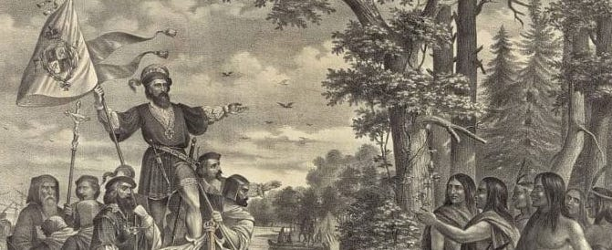
The Long History of Food and Exploration
Before the invention of refrigeration and canning explorers like Columbus, Magellan and Cook carried dried foods and foods preserved in salt and brine
They also brought crops familiar to them and central to their European diet
On his second voyage, Columbus introduced wheat, rice, barley, oats, coffee, sugar cane, citrus fruits and melons to the Americas
Over time, the cultivation of wheat and other European foodstuffs would drastically change the cultural and ecological landscape of the Americas

Slide 3
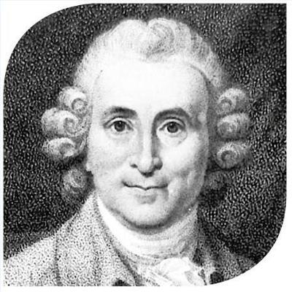

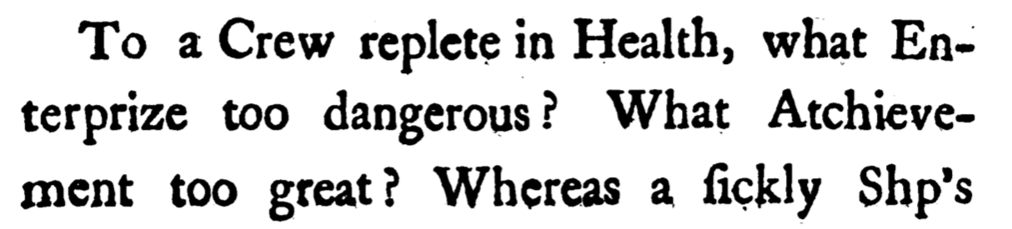
Food and the Health and Welfare of the Crew
James Lind was a Scottish Doctor and pioneer of naval hygiene for the Royal Navy In the mid 18th century
He was responsible for some of the first clinical trials which led to his theory that citrus fruits cured scurvy.
Lind was also a strong proponent for growing and incorporating fresh vegetables in the diet of seamen in order to maintain crew health and performance.

Slide 4
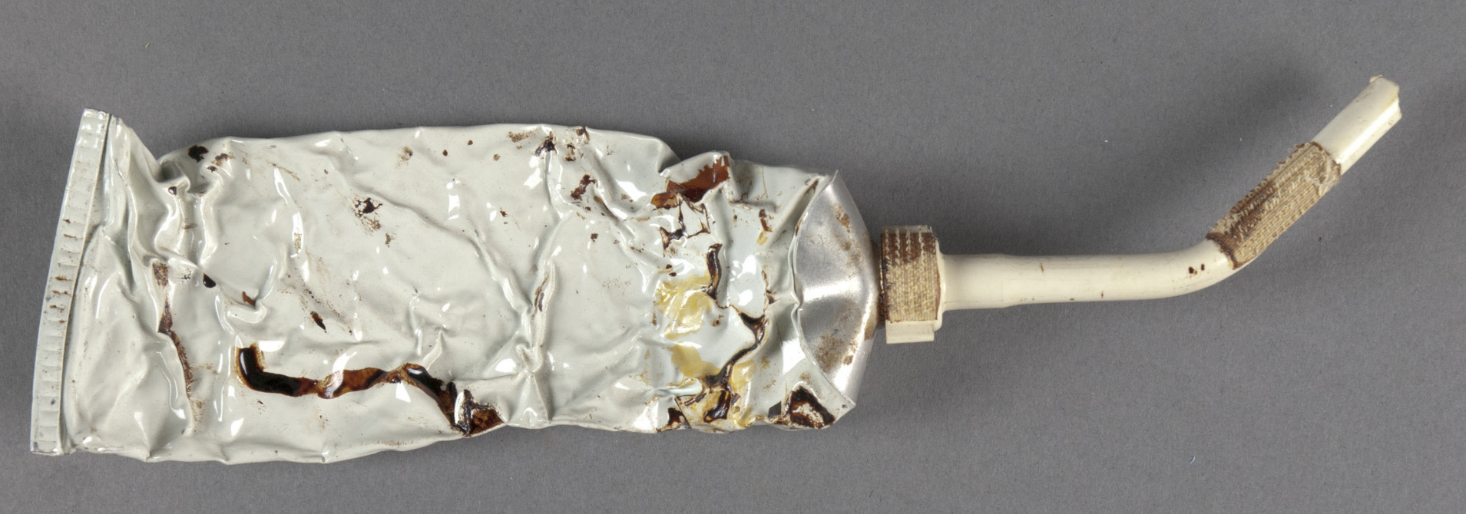
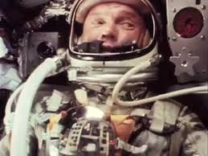
NASA Space Food Then and Now
John Glenn was the first American to eat in space aboard Friendship 7 in 1962
At that time it was not known if ingestion and absorption of nutrients were possible in a state of zero gravity.
Glenn ate applesauce, packed in a tube, and xylose sugar tablets with water he demonstrated that people could eat, swallow, and digest food in a weightless environment.

Slide 5
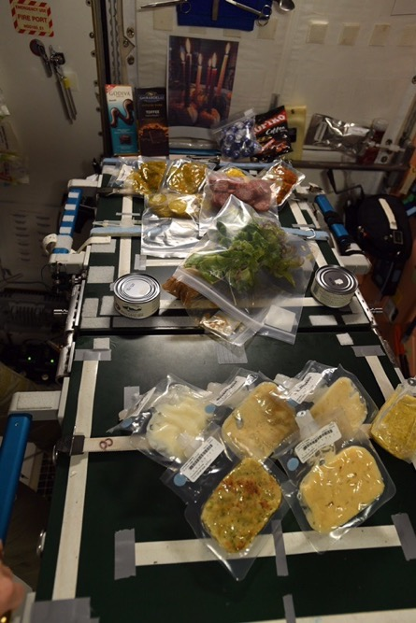
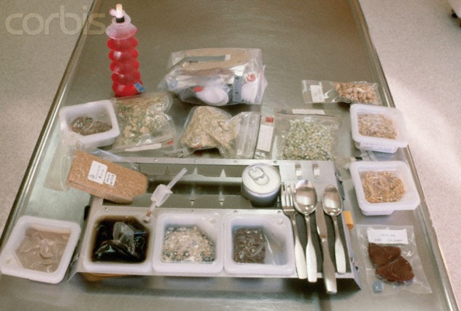
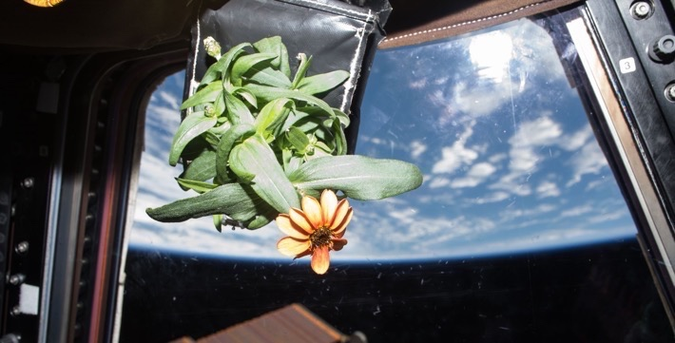
International Space Station Food System
No refrigerators or freezers for food storage
All food processed and prepackaged
Eight day menu cycle for 6 month mission
Fresh food only available at resupply
Testing of “Pick-and-Eat” food grown in space
We can grow more than just food!
Zinnia Action Shot

Slide 6
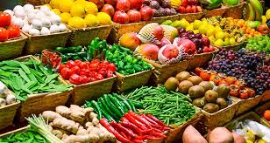

The Space Crop Production Vision
Ensure Food System Security* on Long Duration Missions Beyond Low Earth Orbit (LEO)
Food and nutrition are the first line of defense for crew health and performance
Provide safe, nutritious and acceptable fresh food
Add variety to crew diet
Enhance morale
* Food security is the condition in which crew have
continuous access to sufficient safe and nutritious
food which meets both their dietary needs and food
preferences in order to maintain peak health and
performance.

Slide 7
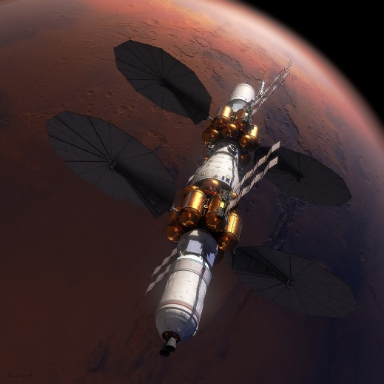
Near Term Goal
Nutrient Supplementation of the Prepackaged Food System
Fresh produce supplements vitamins (B₁, K, C) and bioactive compounds that degrade in the stored food system on multi-year exploration missions
“Pick-and-Eat” crops that require no processing and minimal preparation will provide variety, customization, and psychological appeal
Enable testing and demonstration of dependable
crop production before reliance on system.
Limiting factors are vehicle resources
mass, power, volume, water, air, crew time
“It is possible to support life for 7-8 months upon a diet of canned food; but after this period there is something in the human system which makes it refuse to utilize the elements of nutrition contained in tins. Against such food, even for a short period, the stomach protests…” - FA Cook (1900)
Needed for:
Deep Space Transport

Slide 8
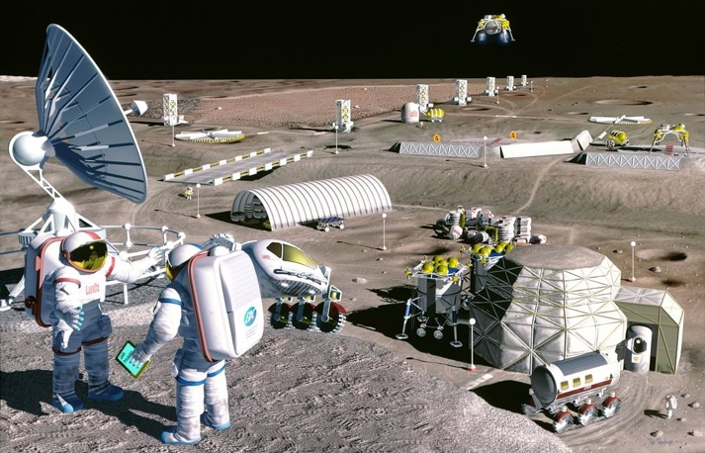
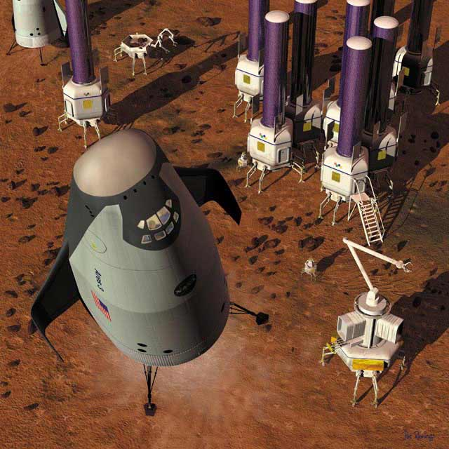
Long Term Goal
Caloric Replacement to Facilitate Earth Independence
Reduce up-mass associated with pre-packaged food
In addition to “pick and eat” crops, include staple crops that require processing and preparation
Bioregenerative capability will be required for long duration surface missions
Needed for: Long duration Surface missions on the Moon and Mars

Slide 9


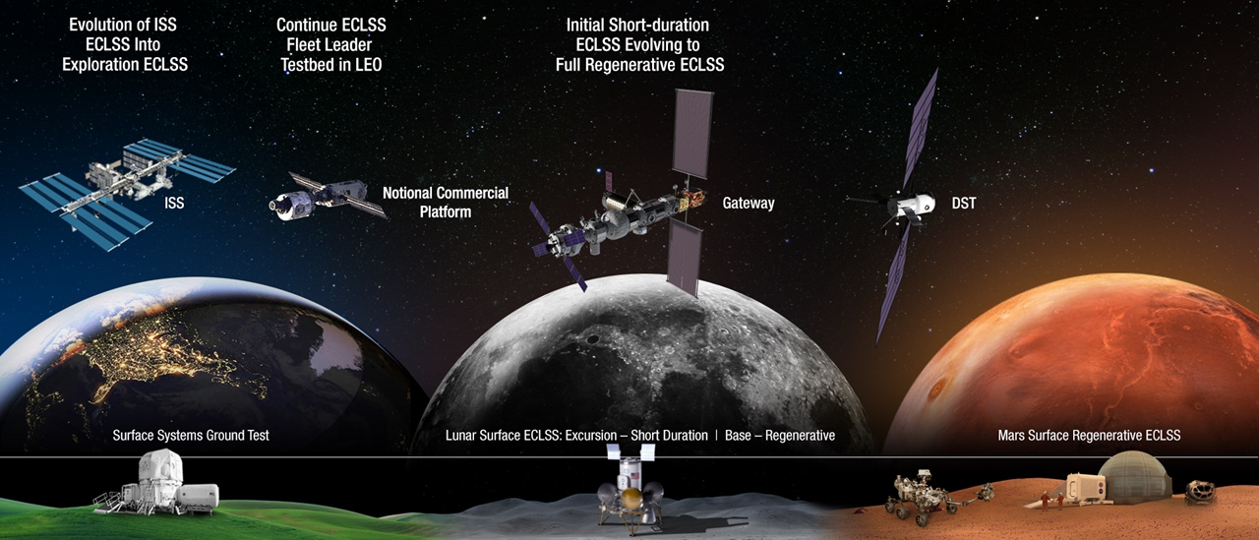



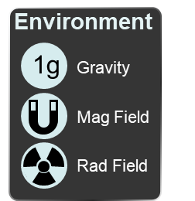
SPACE CROP PRODUCTION ROADMAP FOR EXPLORATION
MARS TRANSIT (Crop Production)
GATEWAY (Plant Research)
Operational µg Food Production capability for pick and eat crops to supplement crew diet
ISS (Plant Research and H/W Technology)
Proving Ground to study the effect of deep space radiation on pick and eat crops in µg
Identify challenges and solutions for growing pick and eat crops in µg to support crew nutrition
Scale: One to Two EXPRESS Racks (8-16 Lockers)
Scale: Single Locker
Scale: Single Locker to EXPRESS Rack (8 Lockers)
LUNAR SURFACE (Research/Production)
Ground (Plant Research and H/W Technology)
Develop and deploy operational partial gravity systems for both nutritional support and caloric replacement as both a source of food for long duration lunar missions and as a demonstration for Mars
MARTIAN SURFACE (Production)
Develop space crop production concepts and strategies in support of destinations along the exploration roadmap
Leverage Lunar Surface experience in Food Production systems to extend Earth Independence for Mars missions
Scale: Single Locker to Module
Scale: Single Locker to Module
Scale: Single Locker to Module

Slide 10
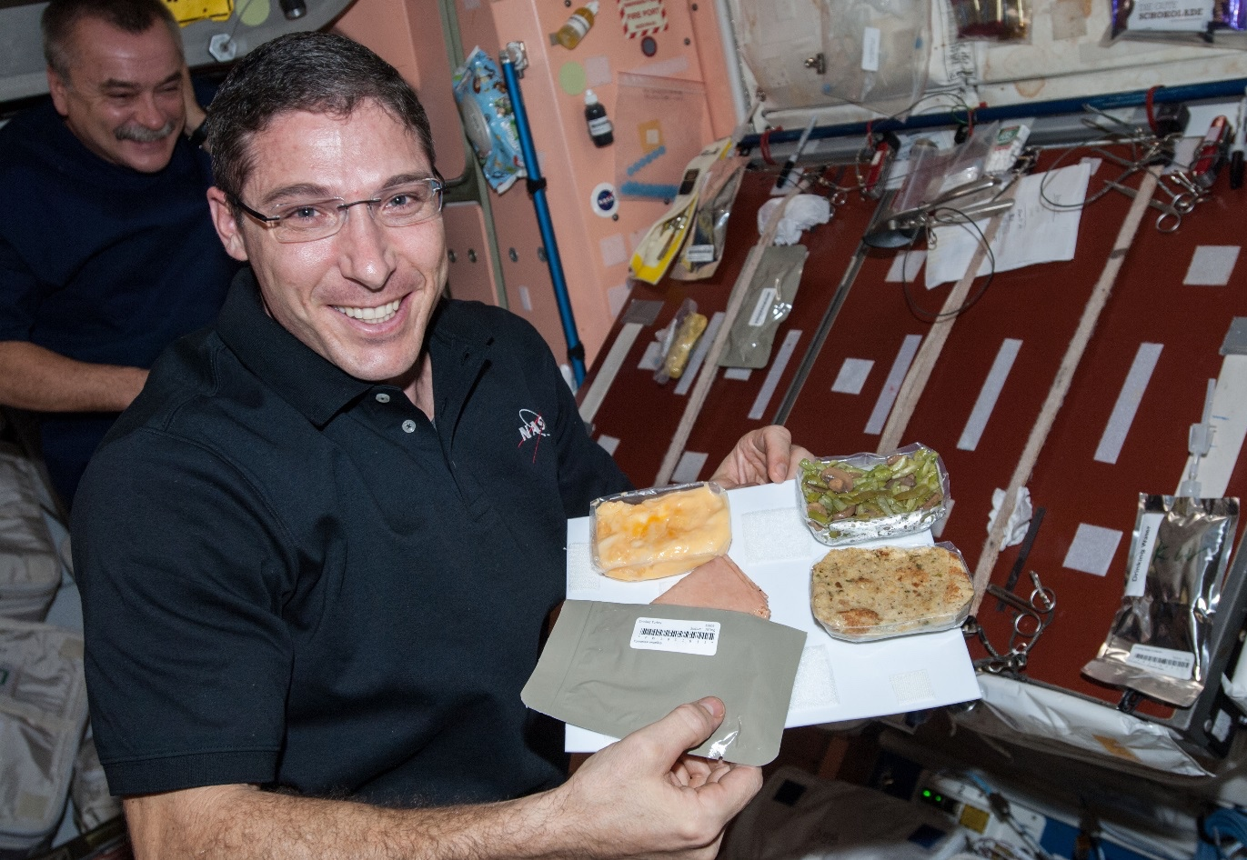
Current Food System Challenges
Packaged diet is diverse but low in several key nutrients
Vitamins and quality degrade over time
We do not currently have a diet that will support lunar or Mars missions
Menu fatigue over longer mission durations (currently at 200 items)
Psychological support
Bioavailable nutrients
Food safety is paramount but we do not have standards for fresh produce

Slide 11
Space Crop “Production” Challenges
Deep Space
Surface
Water
Recycling
Radiation
Pressure
Microgravity
Fluid movement
No convection
Dust
Micrometeorites
Partial gravity
Plant Size
High CO₂
Nutrient output
Microbiome
Sustainability
Abiotic stresses
Vehicle resources
Crew time
Waste
Productivity
Stress tolerance
Environmental optimization
Crop scheduling
Current focus areas
Crop

Slide 12
Technology and Knowledge Gap Focus
Identify and demonstrate effective options to provide both water and oxygen to the root zone in microgravity
Investigate benefits of both passive and active systems
Understand the deep space radiation impacts on seeds and plants
Investigate the relationship between microbiomes and food safety
Effectively sanitize produce with few consumables and low inputs
Control biotic stresses and pathogens
Use the microbiome to protect crops or enhance growth
Identify potential crops
Yield, nutrition, organoleptic attributes, psychosocial benefits
Light recipes, elevated CO₂ impacts, fertilizer requirements
Custom space crops
Automation and human factors
Identify operations and capabilities that require automation
Understand which crew activities are desirable and at what scale
Storage and handling of seeds to ensure they are viable, free of contaminants and long-lived
Scalability for different concepts and architectures

Slide 13
Technology and Knowledge Gap Focus
Identify and demonstrate effective options to provide both water and oxygen to the root zone in microgravity
Investigate benefits of both passive and active systems
Understand the deep space radiation impacts on seeds and plants
Investigate the relationship between microbiomes and food safety
Effectively sanitize produce with few consumables and low inputs
Control biotic stresses and pathogens
Use the microbiome to protect crops or enhance growth
Identify potential crops
Yield, nutrition, organoleptic attributes, psychosocial benefits
Light recipes, elevated CO₂ impacts, fertilizer requirements
Custom space crops
Automation and human factors
Identify operations and capabilities that require automation
Understand which crew activities are desirable and at what scale
Storage and handling of seeds to ensure they are viable, free of contaminants and long-lived
Scalability for different concepts and architectures

Slide 14
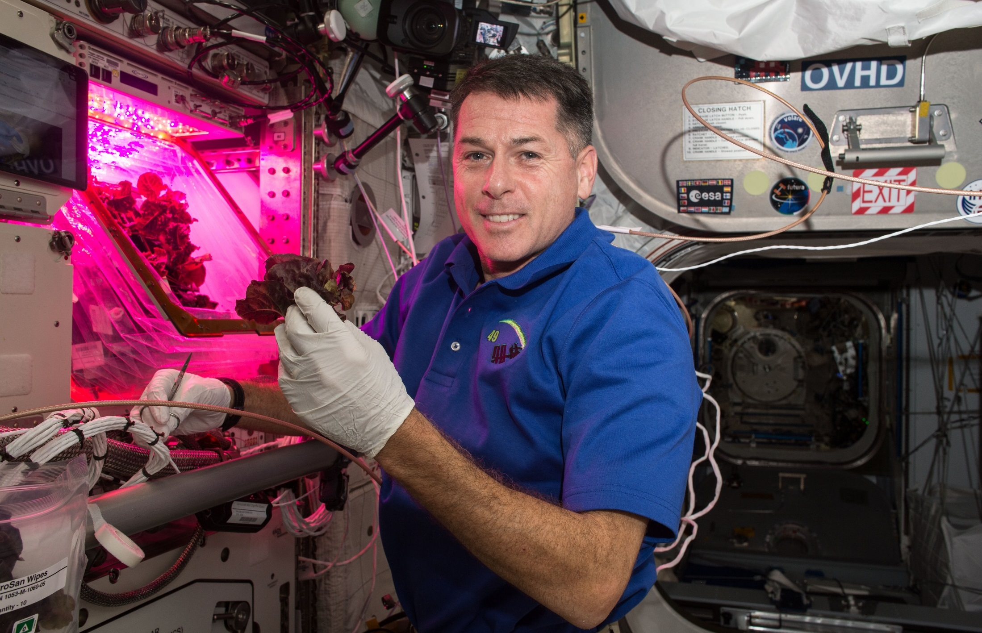
Veggie on ISS
Shane Kimbrough
Expedition 49/50

Slide 15


Veggie Technology Validation Tests
VEG-01
VEG-03
2014-2016
‘Outredgeous’ lettuce and ‘Profusion’ Zinnia
Crew consumption approval
Watering challenges
Fungus
2016-Present
‘Outredgeous’ lettuce, ‘Tokyo Bekana’ Chinese cabbage, Mizuna, ‘Waldmann’s Green’ lettuce, ‘Red Russian’ kale, ‘Dragoon’ lettuce, ‘Wasabi’ mustard, ‘Extra dwarf’ Pak Choi
Cut-and-come-again harvesting
Mixed cropping

Slide 16
Crop Production Challenge
Identify and demonstrate effective options to provide both water and oxygen to the root zone in microgravity.

Slide 17
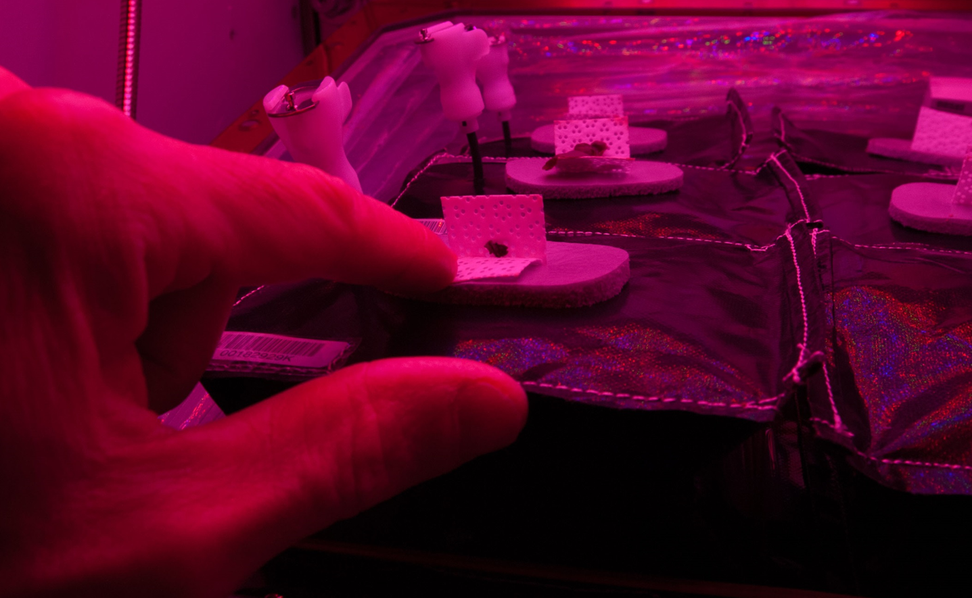
Root Zone Water – Insufficient

Slide 18
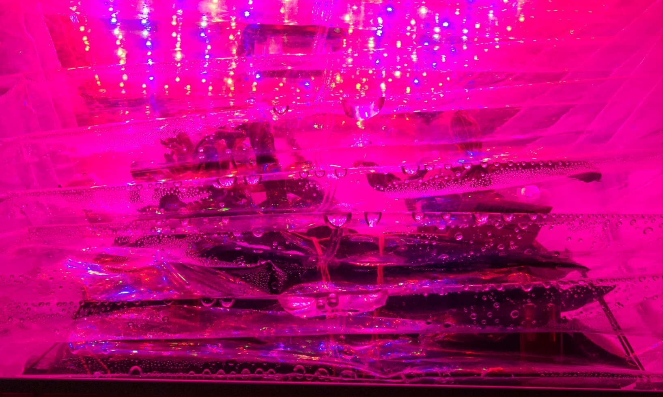
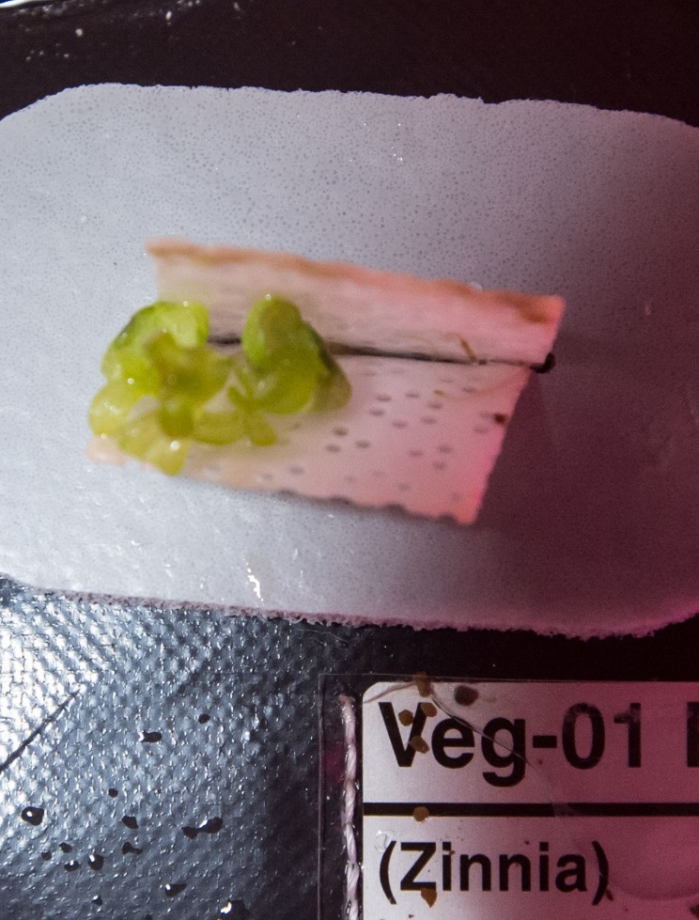
Root Zone Water – Excess
Condensation on Bellows
Stunting and Chlorosis

Slide 19
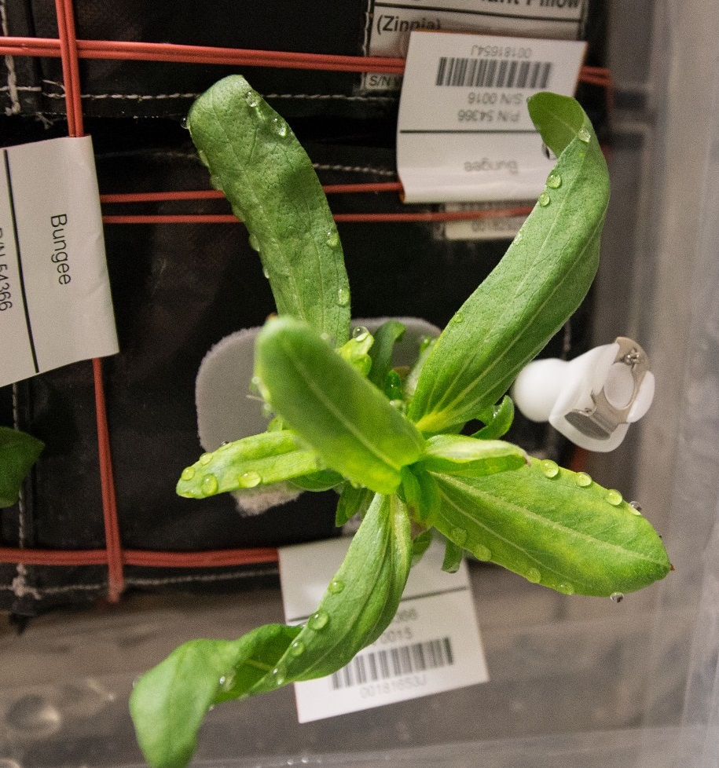
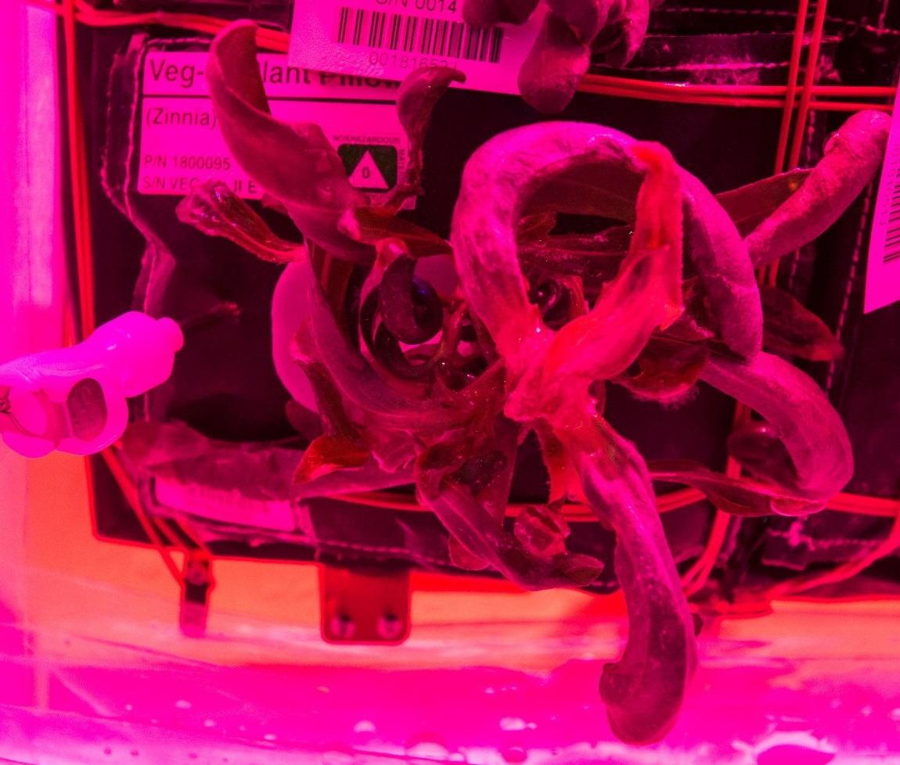
Root Zone Water – Excess
Guttation and Leaf Curling
Abnormal Growth

Slide 20
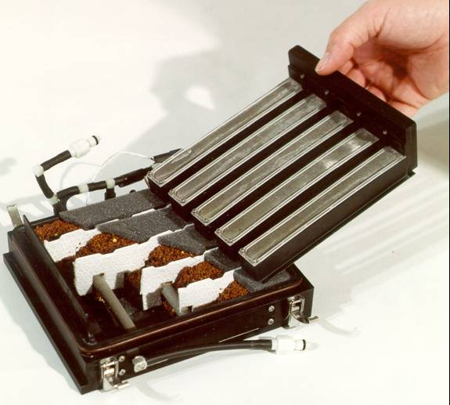
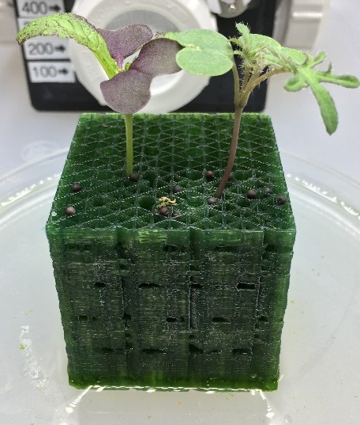
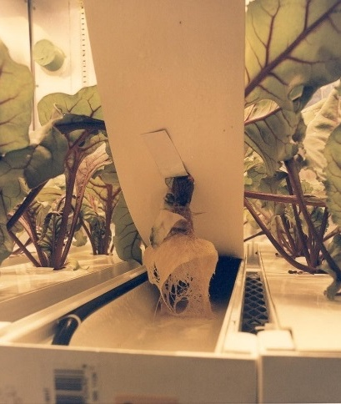
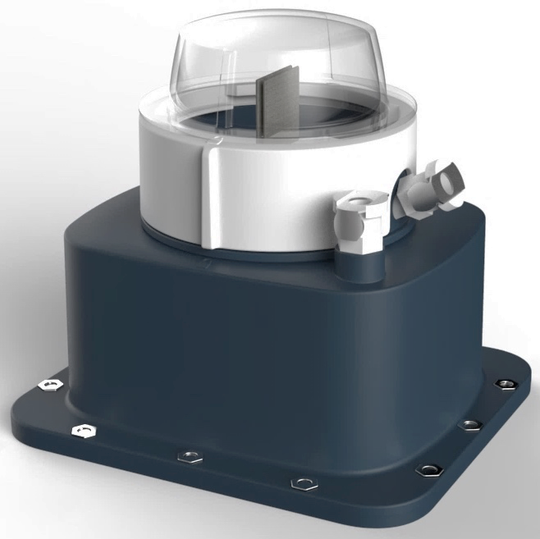
Current and Future Activities
Testing in ground-based Food Production Demonstration Unit test bed to evaluate and compare candidate solutions.
Testing active and passive concepts
Collaborative work between plant scientists, microgravity fluid physicists, and engineers with student design teams also participating.
Image courtesy of Techshot
and Tupperware Brands

Slide 21
Crop Production Challenge
Investigate the relationship between microbiomes and food safety:
Effectively sanitize produce with few consumables and low inputs
Control biotic stresses and pathogens
Use the microbiome to protect crops or enhance growth.

Slide 22
Veggie Microbiology Food Safety
NASA standards for non-thermostabilized food

Slide 23
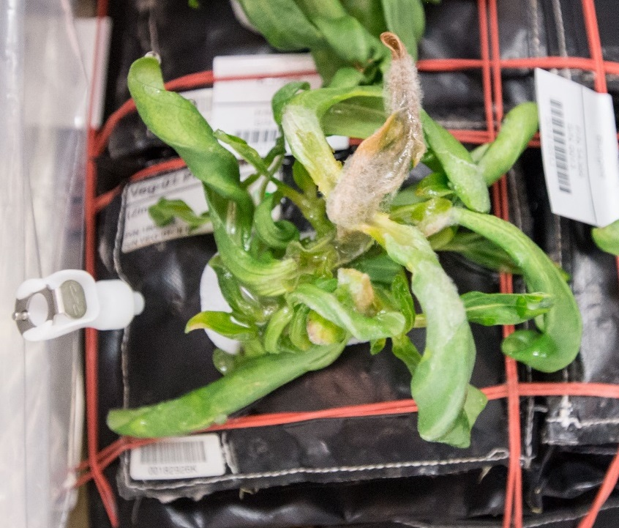
Veggie Microbiology Plant pathogenesis

Slide 24
Veggie Microbiology Microbiome analysis

Slide 25
Current and Future Activities
Conducting ground-based microbial food safety and microbiome testing of candidate crops.
Developing fresh produce food safety standards for space.
Use of on orbit resources when applicable.
Developing process flow for on-orbit sampling of fresh produce microbiome, nucleic acid isolation, library generation, sequencing, and data analysis.

Slide 26
Crop Production Challenge
Identify potential crops:
Yield, nutrition, organoleptic attributes, psychosocial benefits
Light recipes, elevated CO₂ impacts, fertilizer requirements

Slide 27
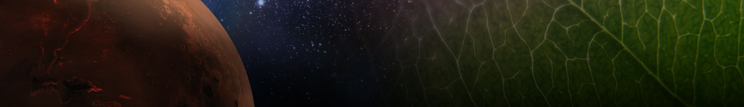
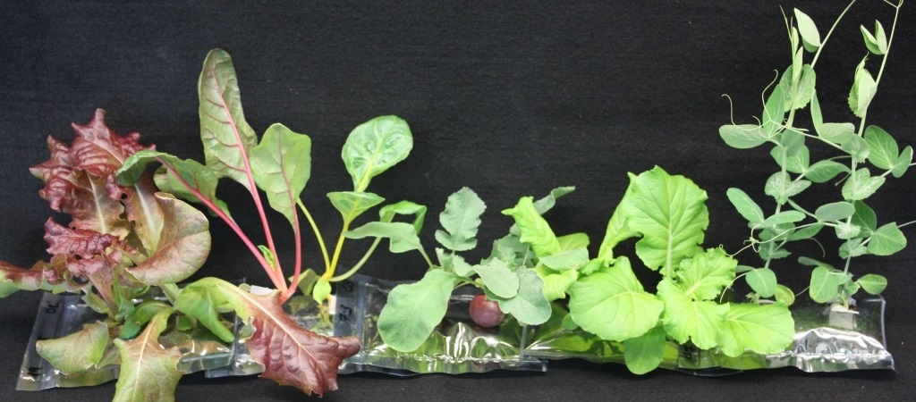
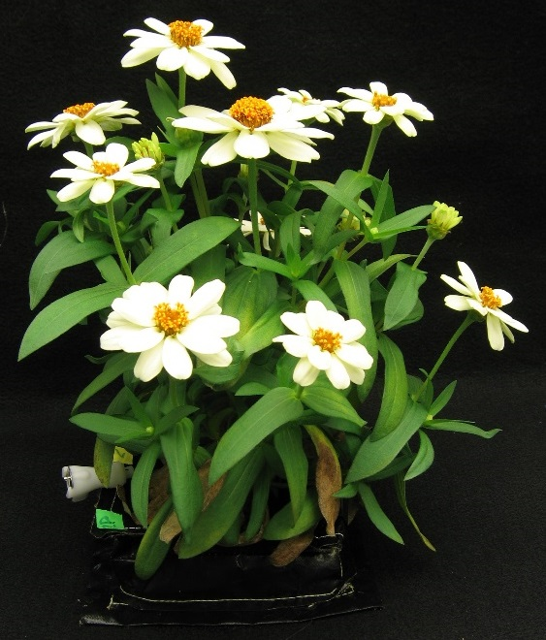
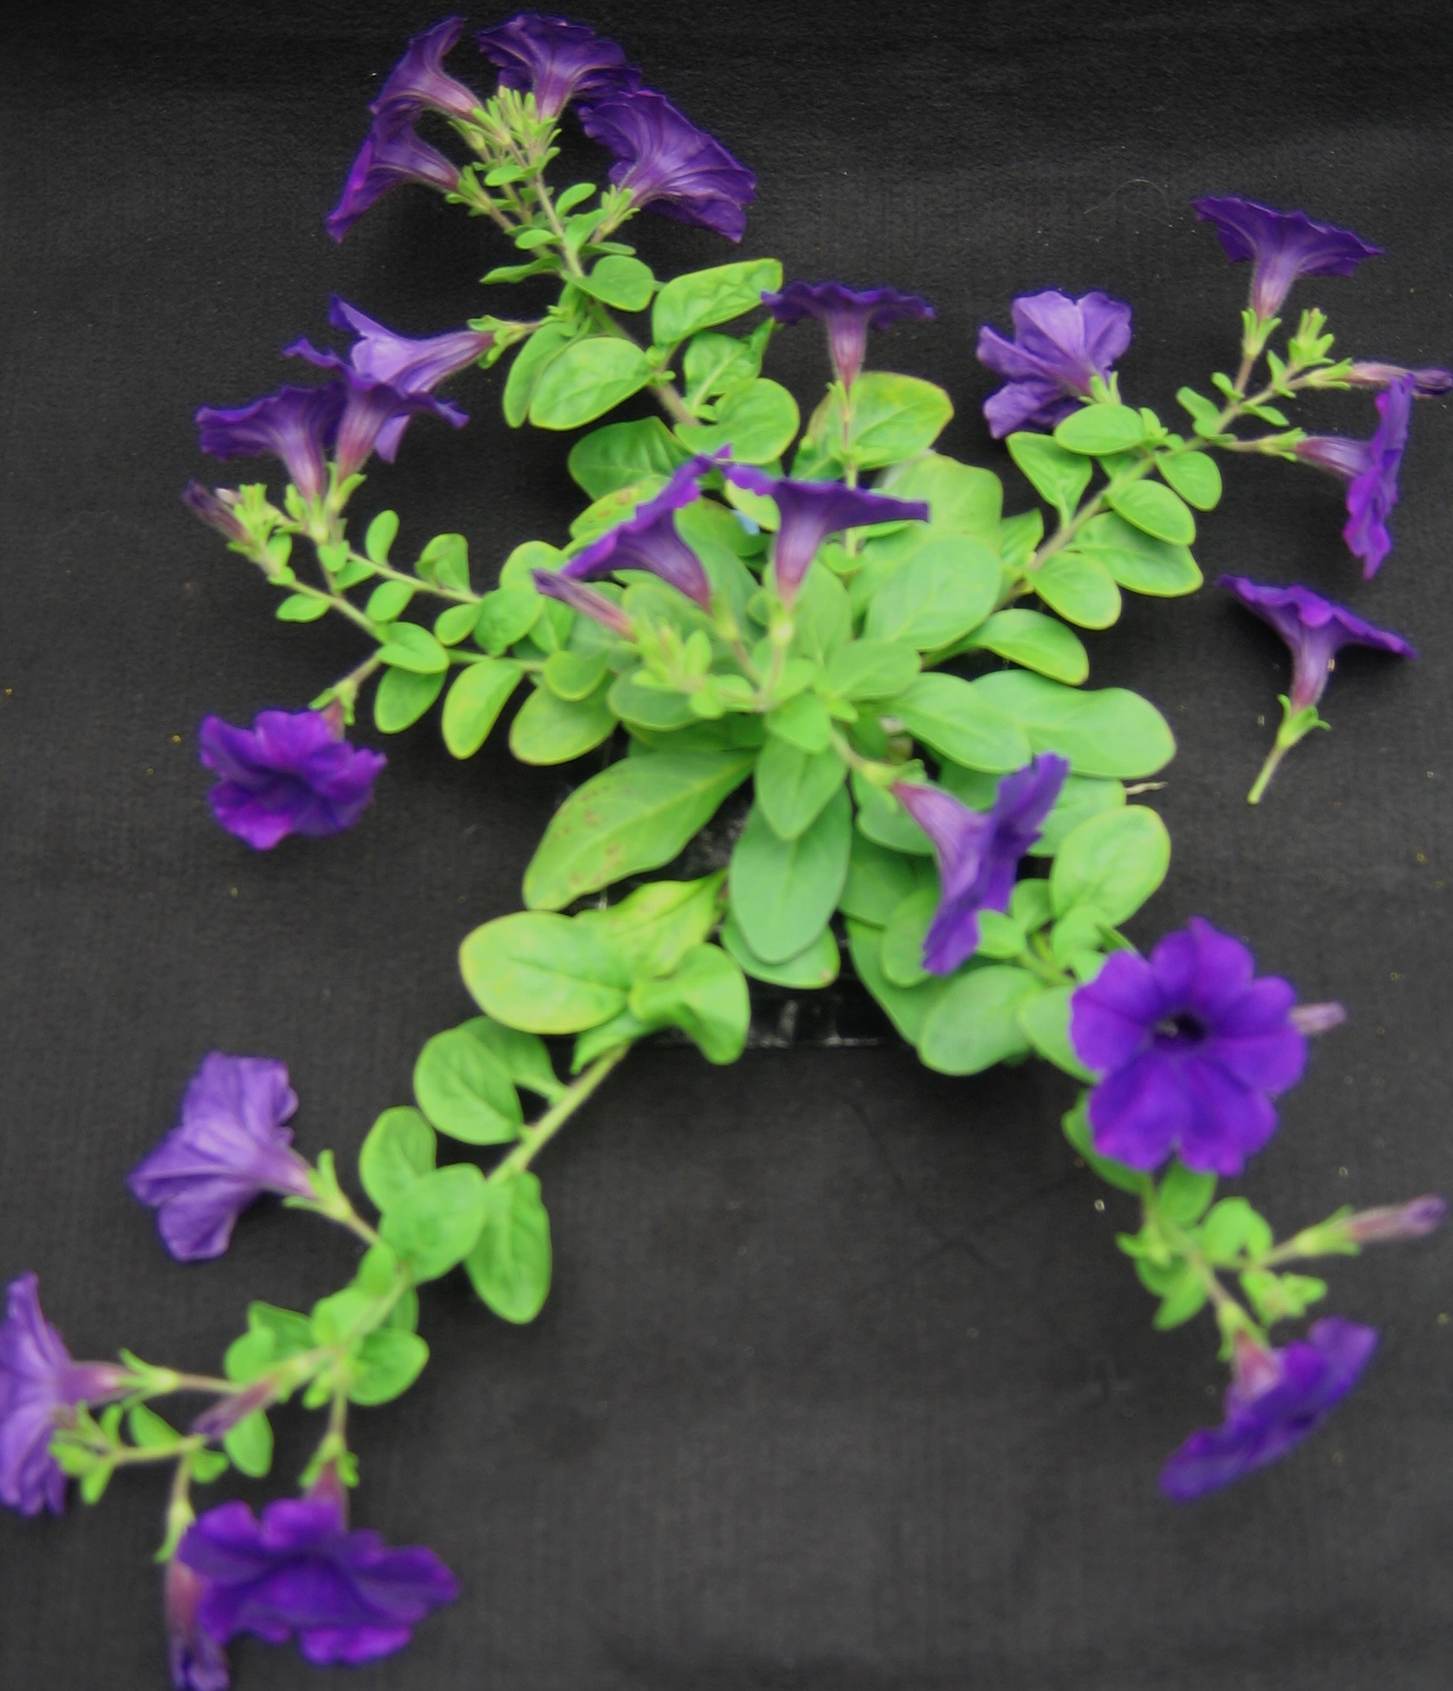
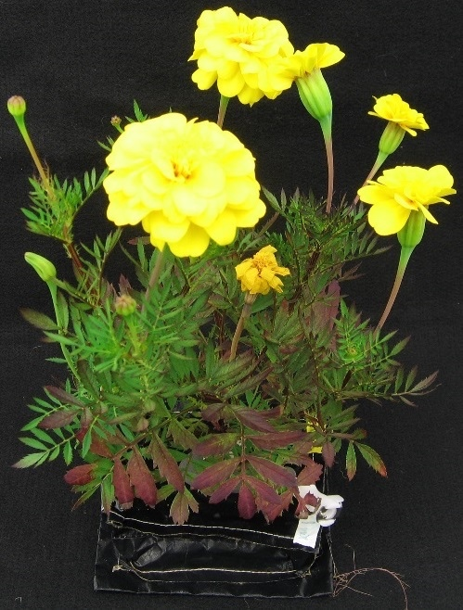
Example crops tested in plant pillows
Snow pea
Swiss chard
Red lettuce
Dwarf
Chinese
cabbage
Radish
Zinnia
Petunia
Marigold

Slide 28
Nutrient Levels – Veg-01 lettuce
Fe, Ca, Mo & P and Anthocynains = between flight and ground.
B, Cu, Mg, Mn, Na & S were slightly > in flight plants.
K slightly > in ground plants.
Ni & Zn considerably > in flight plants.

Slide 29
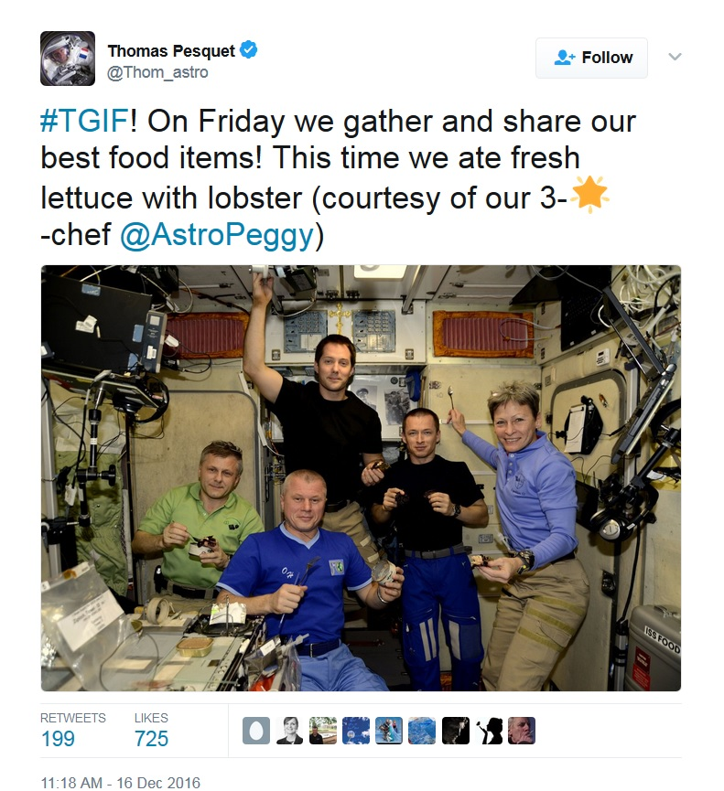
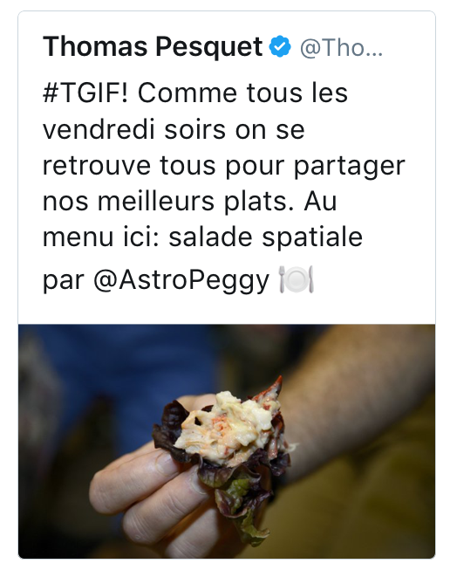
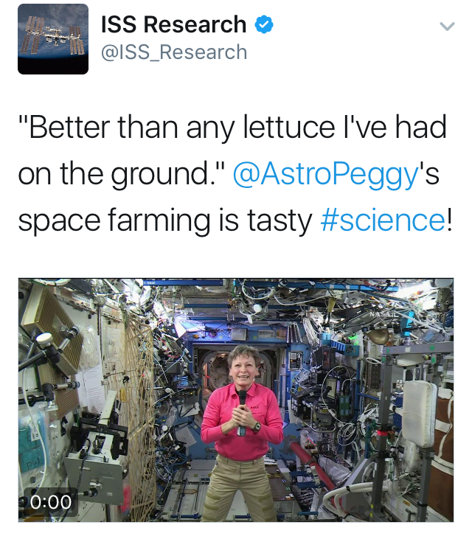
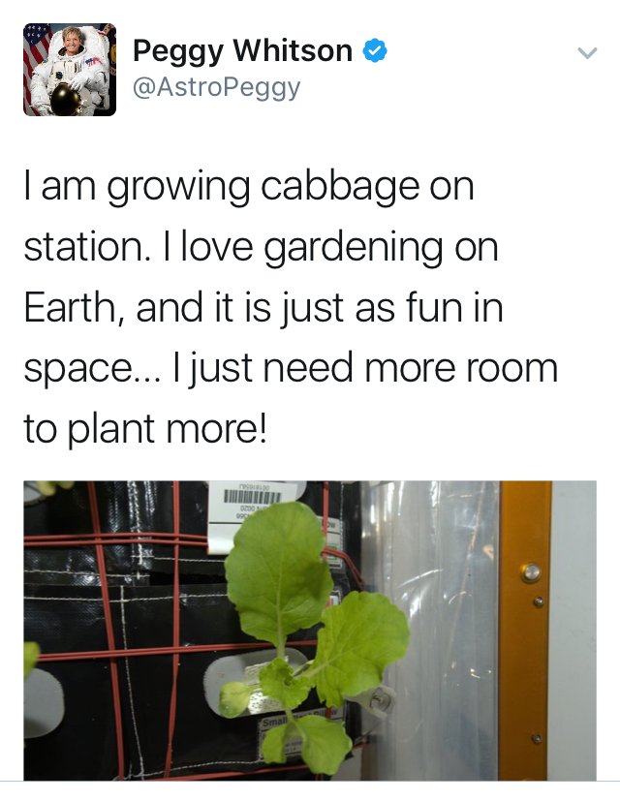
Happy Crew

Slide 30
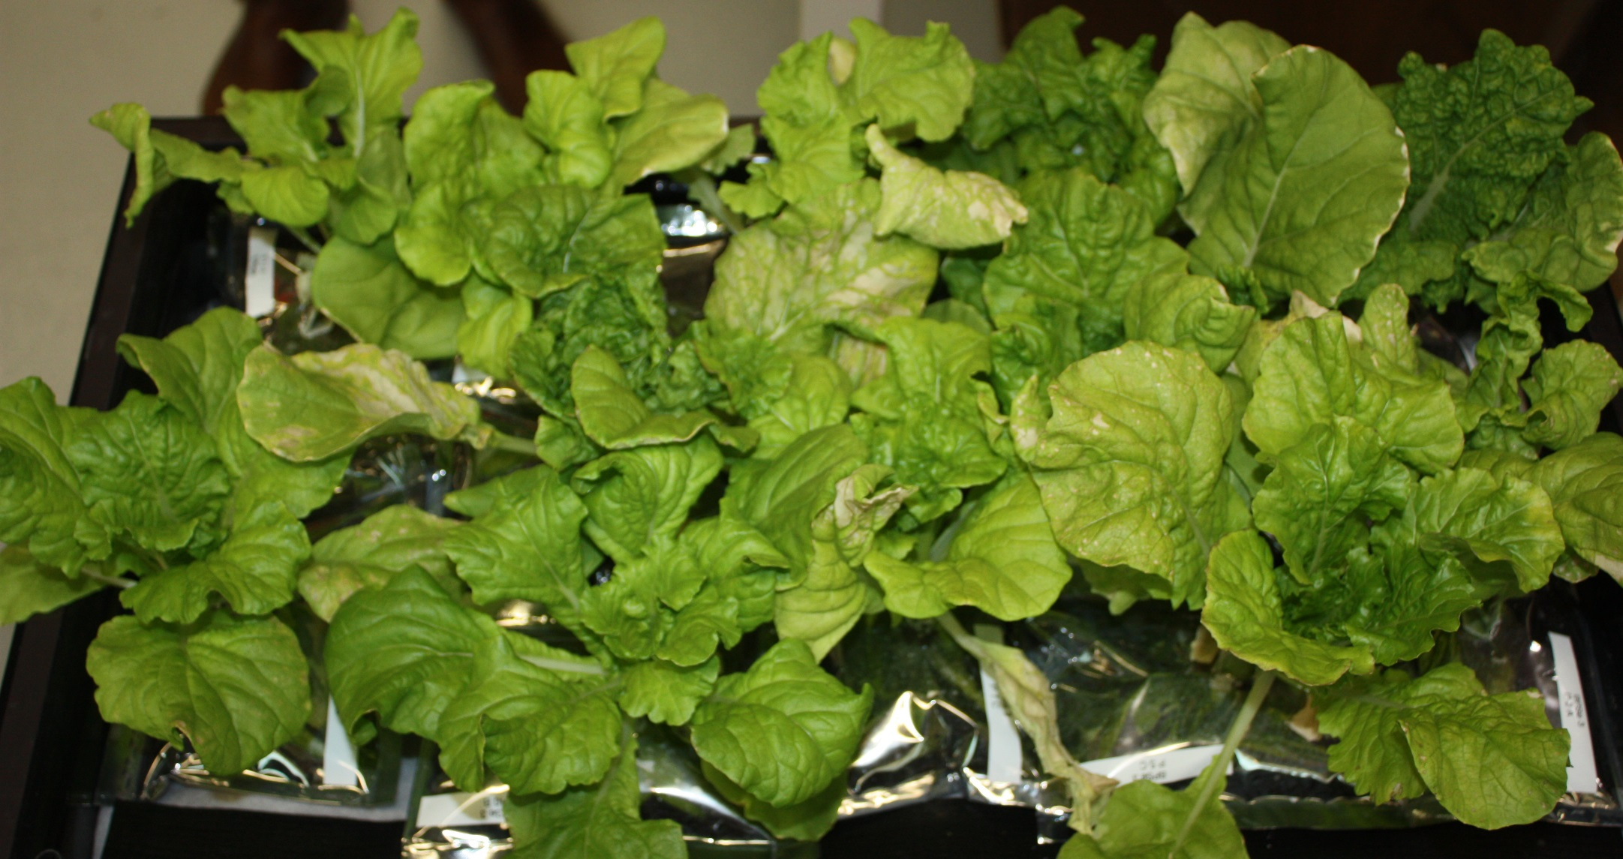
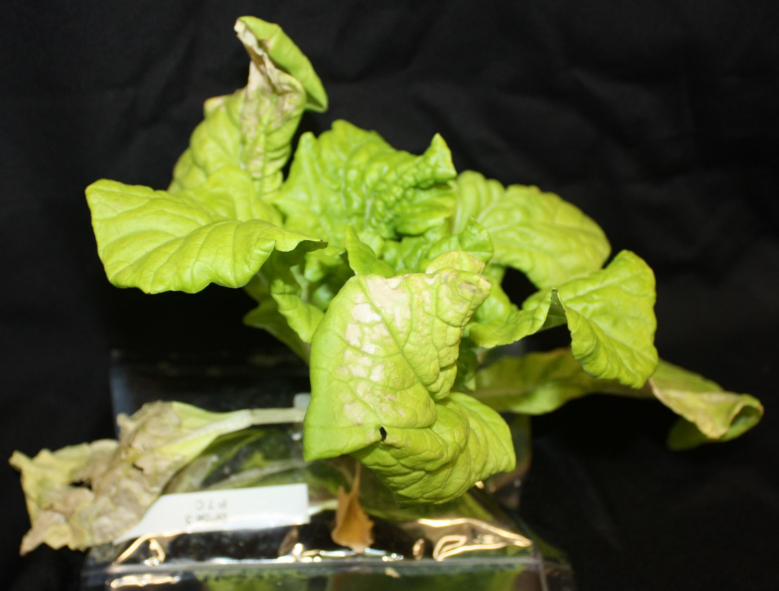
LED and Elevated CO₂ Impacts on Chinese Cabbage

Slide 31
Current and Future Activities
Assessing new crop candidates:
Preliminary screening at >230 middle and high schools in Fairchild Garden’s Growing Beyond Earth Challenge.
Down-selected varieties will be tested in high-fidelity environments at KSC.
Two student-selected varieties have flown in Veggie
Recent and upcoming experiments (VEG-04, VEG-05) include psychosocial and organoleptic evaluations to measure produce impacts on microgravity life.

Slide 32
Crop Production Challenge
Automation and human factors:
Understand which crew activities are desirable and at what scale
----------------------------------------------------------------
Estimate crew time and compare activities with estimates
Gather data in crew debriefs
----------------------------------------------------------------
What’s Next: Create capability for 100% automation and crew independence.

Slide 33
Crop Production Challenge
Storage and handling of seeds to ensure they are viable, free of contaminants and long-lived.

Slide 34
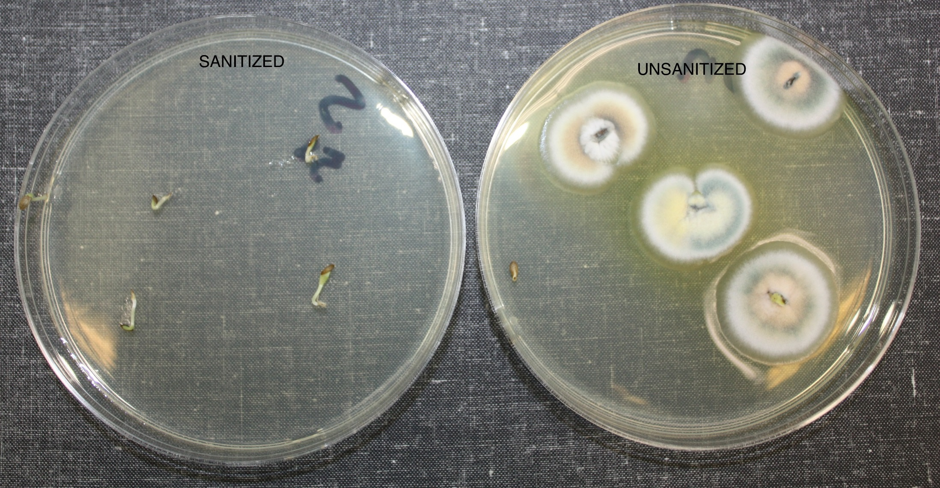
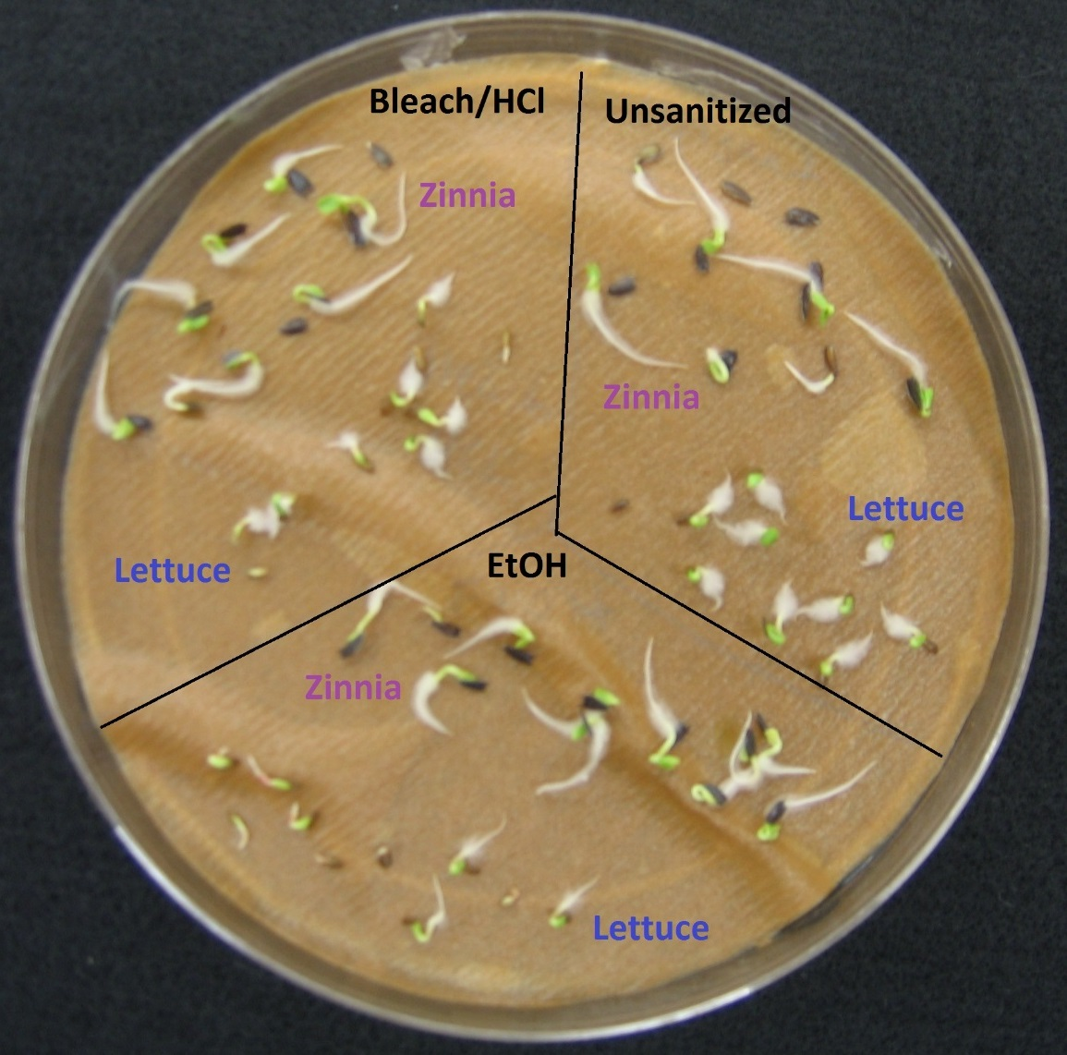
Veggie Microbiology Seed Sanitizing

Slide 35
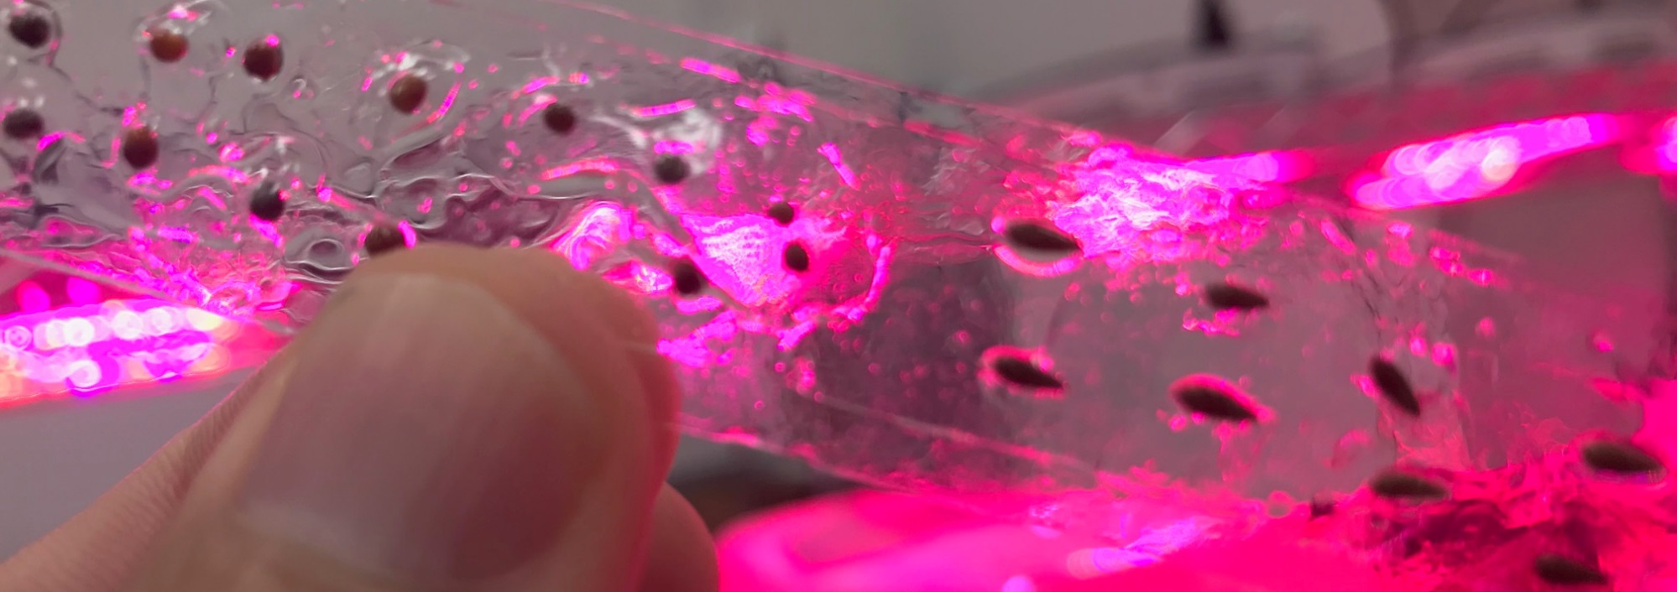
Current and Future Activities
Testing each new seed type with different sanitation approaches (chlorine gas, ethanol, plasma)
Learning from commercial growers and seed producers
Testing methods to handle and store seeds with ease in microgravity

Slide 36
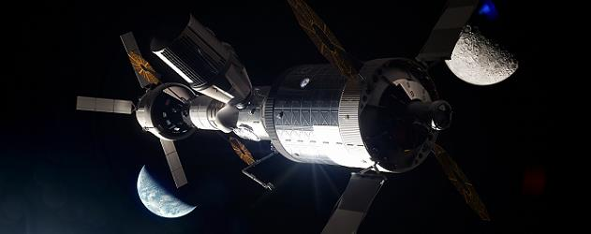
Crop Production Challenge
Operations Beyond Low Earth Orbit (LEO)
LEO Operations Overview
Hardware is designed around ORU’s and spares sent from the ground
Operations are controlled and monitored from the ground with crew Acting in the role of technicians
Continuous presence of crew is assumed
As Distances Increase Access Decreases
The return journey from ISS (LEO) takes Hours
From the moon Days
From Mars Years

Slide 37
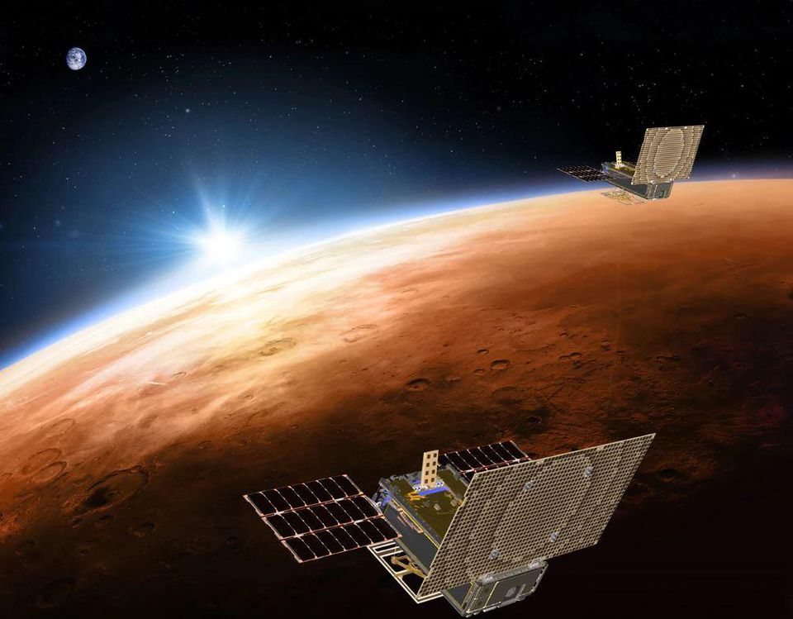
As Distances Increase Communications are Delayed
LEO virtually instantaneous
Moon 2.5 seconds round trip
Mars between 6 – 44 minutes round trip depending on distance
Reduce reliance on permanently staffed ground control centers

Slide 38
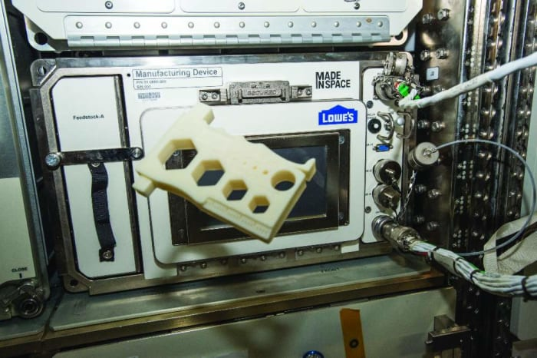
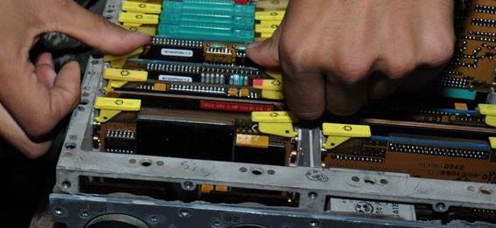
As Distances Increase the Focus Must Change from Replacement to Repair
Systems designed with repair in mind
Leverage in space manufacturing for repair
Minimize non-reusable components
Reduce reliance on non renewable consumable commodities

Slide 39
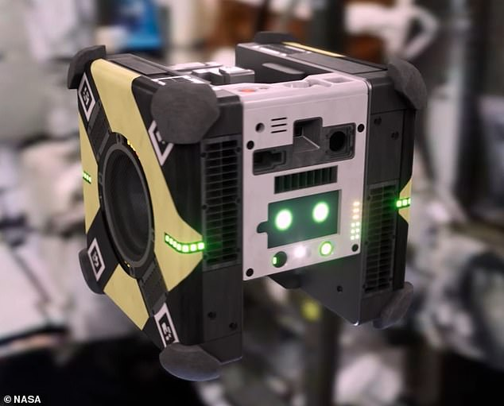
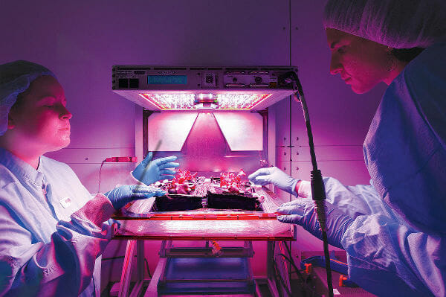
As Distances Increase Systems and Software Controls will need to Detect, Decide and Do
Autonomy and robotics will be widely incorporated into all facets of crop production operations
Smart sensors will collect and provide real time information on plant health
As Distances Increase Systems must be Evolvable
Initial systems capabilities must ensure core functions are provided
Enhancements should be iterative and not require system replacement

Slide 40
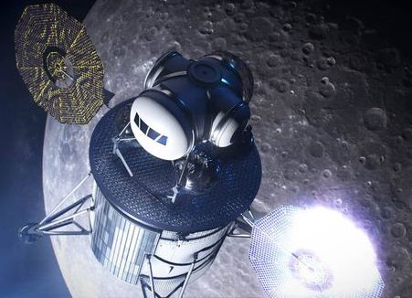
As Distances Increase System Dormancy will be a Design Driver
For early exploration missions there will be long durations of time when crews will not be present nor systems powered

Slide 41
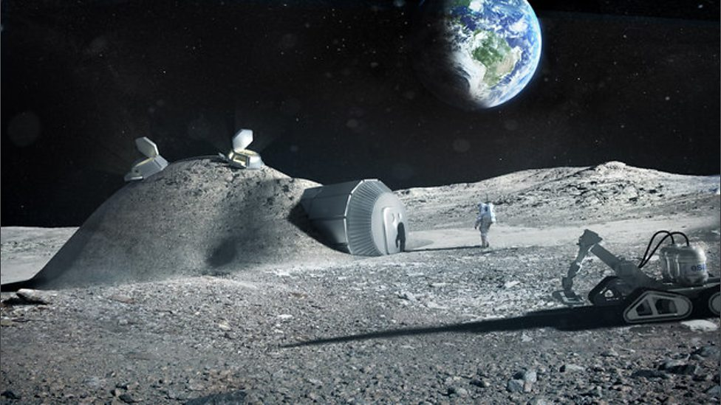
Lunar Surface: The Moon as an Analog for Mars
Early opportunities to perform research in the radiation and partial gravity environment are a priority
Initial crop production capability will likely be an adaptation of the microgravity hydroponic systems developed on the ISS
A lunar outpost three days from Earth will provide needed practice for "living off the land" before making the long trek to Mars
The Prototype Lunar Greenhouse (LGH)
A lunar habitat will serve to demonstrate technologies for a future Mars habitat
Start with pick-and-eat crops and eventually include staple crops

Slide 42
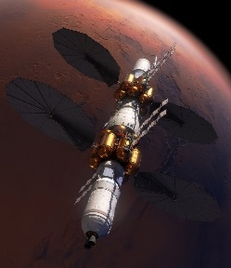
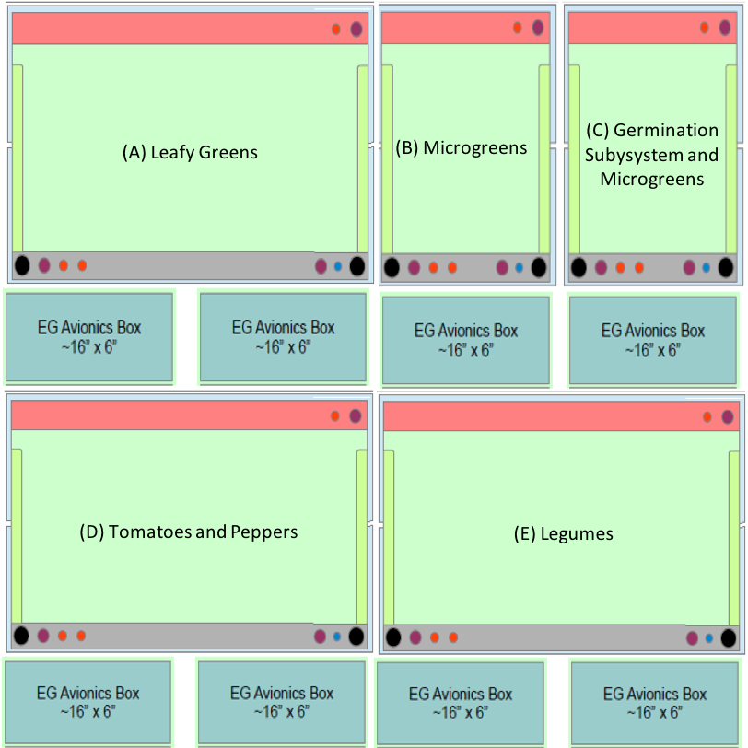
Deep Space Transit Crop Production System
Based on hardware concepts currently under development for the ISS
Chambers designed to accommodate a variety of Pick-and-Eat Crops
Hydroponic growth systems
Reliable for 2.5 to 3 year mission duration
Tomato Seed Preliminary Testing

Slide 43

Mars Surface: Crop Production as a Component of a Bioregenerative Life Support System
Will use systems demonstrated and proven on the lunar surface and the trip to Mars
Long term presence on Mars will result
in a permanent bioregenerative capability
as a part of a life support system
Benefits of a bioregenerative system:
Lower food stowage mass
Water and waste treatment
Air revitalization
Improved nutrition and acceptability
Personalized preparation
Psychosocial benefit

Slide 44

Crop Production and Bioregenerative Life Support
Challenges of a bio-regenerative system:
Hydroponic verses regolith based systems
Envision dedicated module(s) to produce both Pick-and-Eat and Staple Crops
Long term radiation effect on nutrition and acceptability
Safe handling and advanced micro testing
Additional hardware required for food preparation and storage
Crew time
Staple Crop Candidates
Rice
Beans
Wheat Berries
Soybeans
Peanuts
Wheat

Slide 45


How Space Crop Research Benefits Earth
History
LED lighting for plants was patented through NASA funding
NASA use of Nutrient Film Technique (NFT) for Potato production led to the development of production techniques for seed potatoes
Similar Challenges
Limited Resources
Need for Reliable, Efficient Production
Time as a Resource (Humans Vs. Automation)
Importance of Early Detection of Issues
Si

Slide 46


Hardware and Growth System Technology
Lighting Advancements
Imaging Systems for Plant Health and Food Safety Monitoring (NDVI, Hyperspectral Imagery, Fluorescence)
Component Reliability, Maintenance and Miniaturization
Sensor Development
Autonomy and Robotics
Sensor Fusion
Control Systems Development
NASA Approach to System Selection for Specialized Applications

Slide 47

Horticulture and Growth System Operations
Cultivar selection (Edible Biomass, Yield Verses Volume)
Genetic Engineering (Environmental Stress Tolerance)
Microbiome (Plant, Growth System, Vehicle and Crew)
Optimized Growth Recipes
Food Safety

