Slide 1
Interplanetary Trajectory Optimization ISP
Lecture 2
Local and Global Optimization

Slide 2
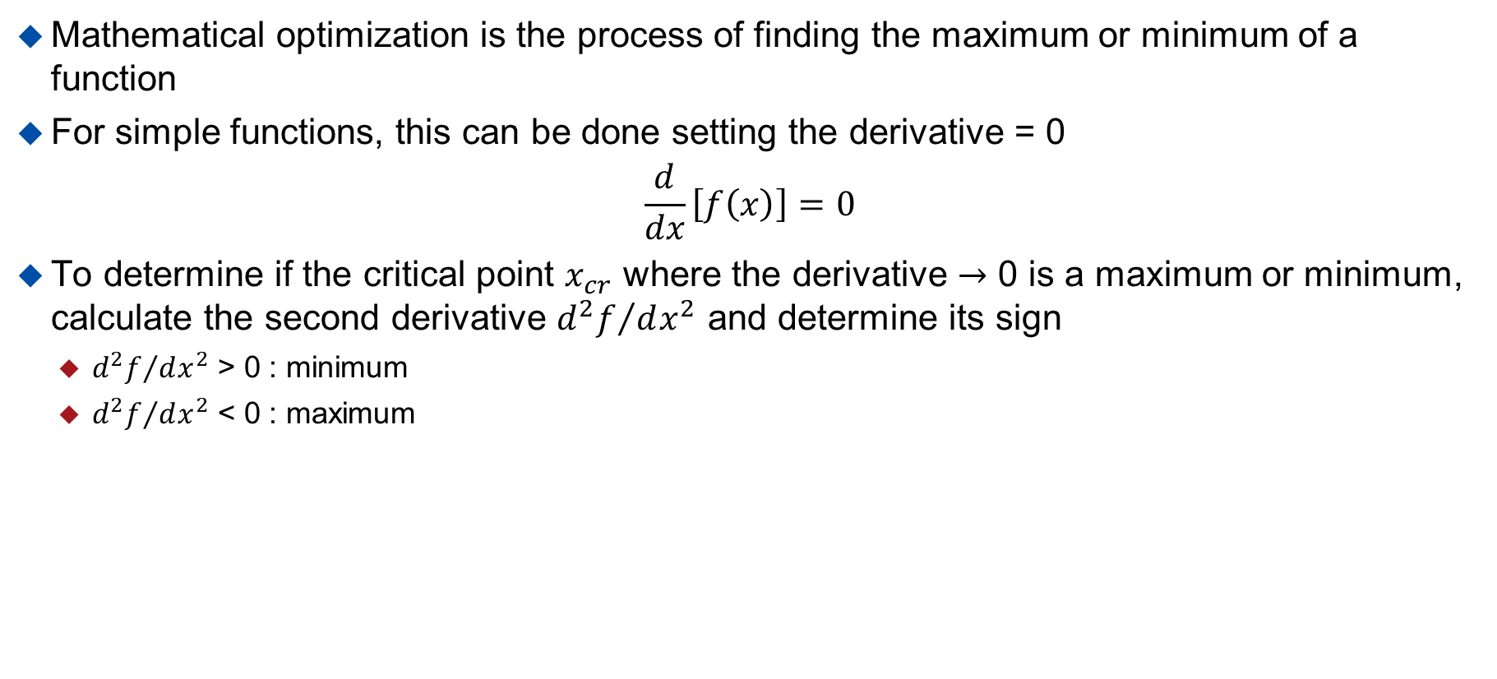
Introduction
Mathematical optimization is the process of finding the maximum or minimum of a function
For simple functions, this can be done setting the derivative = 0
$$\frac{d}{dx}\left[f\left(x\right)\right]=0$$
To determine if the critical point $x_{cr}$ where the derivative $→$ 0 is a maximum or minimum, calculate the second derivative ${d^{2}f}/{dx^{2}}$ and determine its sign
  ${d^{2}f}/{dx^{2}}$ > 0 : minimum
  ${d^{2}f}/{dx^{2}}$ < 0 : maximum

Slide 3

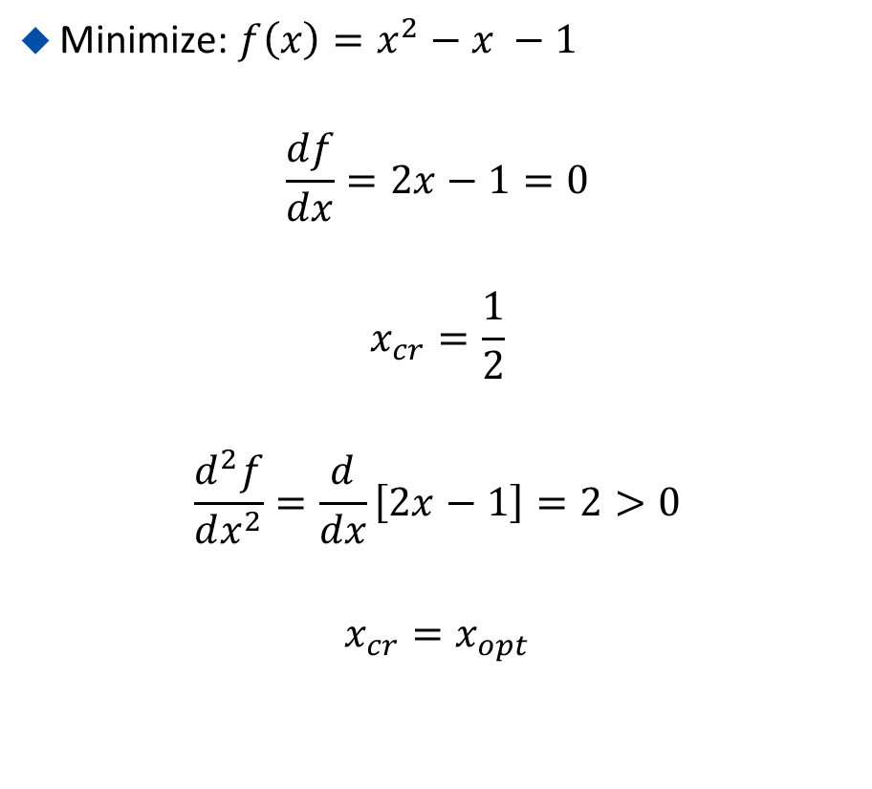
Example 1: Quadratic Function of 1 Variable
Minimize: $f\left(x\right)=x^{2}−x −1$
$$\frac{df}{dx}=2x−1=0$$
$$x_{cr}=\frac{1}{2}$$
$$\frac{d^{2}f}{dx^{2}}=\frac{d}{dx}\left[2x−1\right]=2>0$$
$$x_{cr}=x_{opt}$$

Slide 4
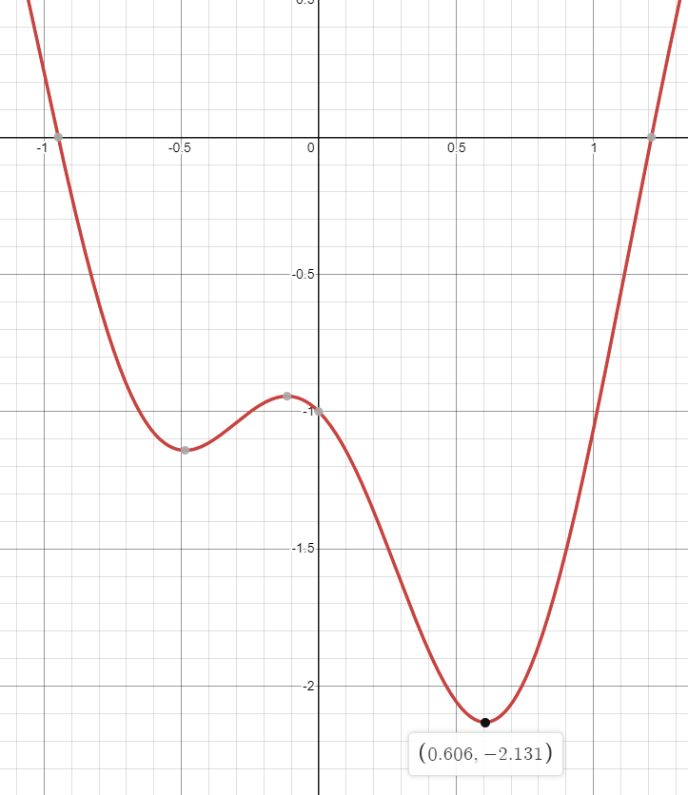
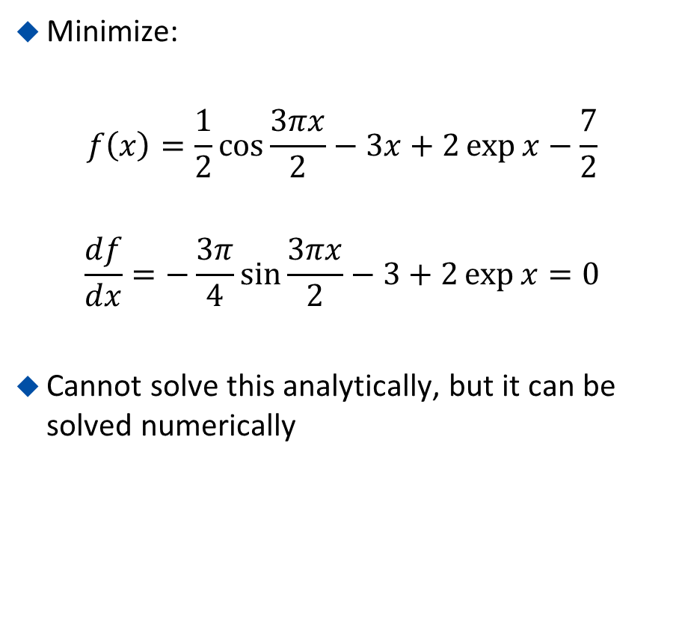
Example 2: Transcendental Function
Minimize:
$$f\left(x\right)=\frac{1}{2}\cos{\frac{3πx}{2}}−3x+2\exp{x}−\frac{7}{2}$$
$$\frac{df}{dx}=−\frac{3π}{4}\sin{\frac{3πx}{2}}−3+2\exp{x}=0$$
Cannot solve this analytically, but it can be solved numerically

Slide 5
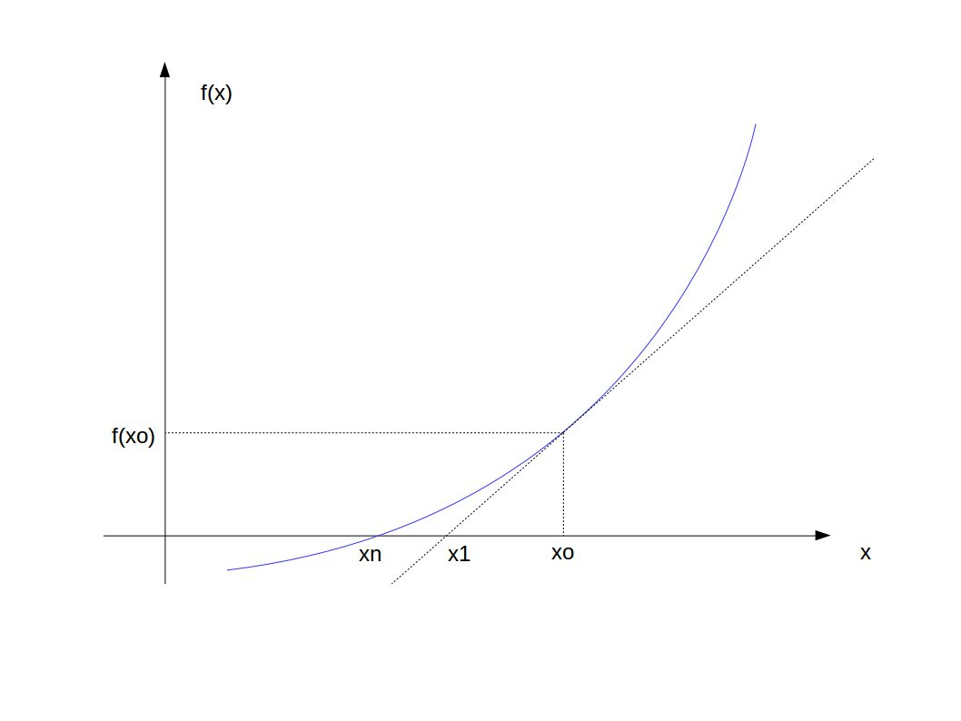
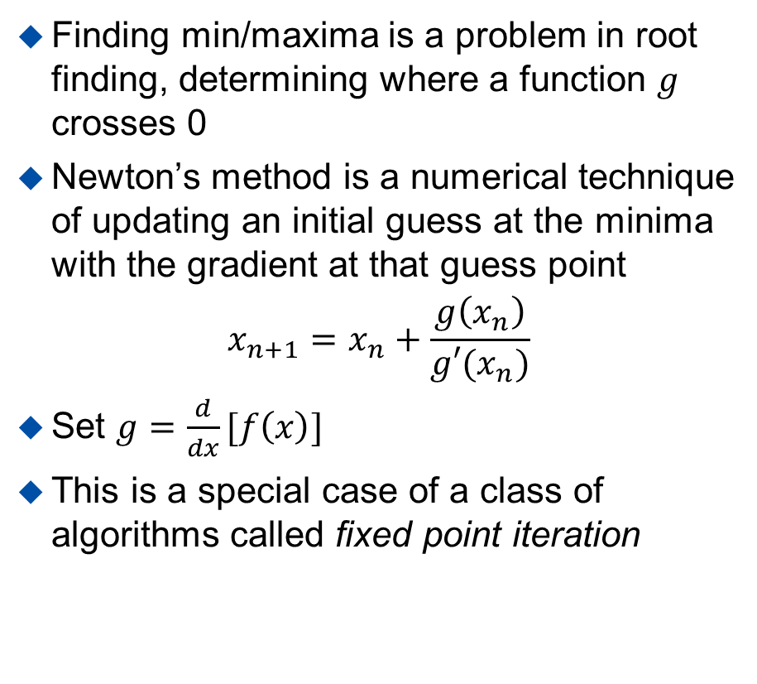
Root Finding – Newton’s Method
Finding min/maxima is a problem in root finding, determining where a function $g$ crosses 0
Newton’s method is a numerical technique of updating an initial guess at the minima with the gradient at that guess point
$$x_{n+1}=x_{n}+\frac{g\left(x_{n}\right)}{g′(x_{n})}$$
Set $g=\frac{d}{dx}[f\left(x\right)]$
This is a special case of a class of algorithms called fixed point iteration
Source

Slide 6
Example 2: Transcendental Function
This function has multiple minima: multimodal
By inspection of the plot, a point near the right minima is x=0.5
By applying Newton’s method, we arrive at the minima via successive calculations of the function and its derivative
Step | X | dx | g(x)
0 | 0.5000 | 1.000 | -1.368
1 | 0.6227 | 0.1227 | 0.2441
2 | 0.6060 | 0.0167 | 0.0022
3 | 0.6058 | 0.0001 | 0.0000
4 | 0.6058 | 0.0000 | 0.0000

Slide 7
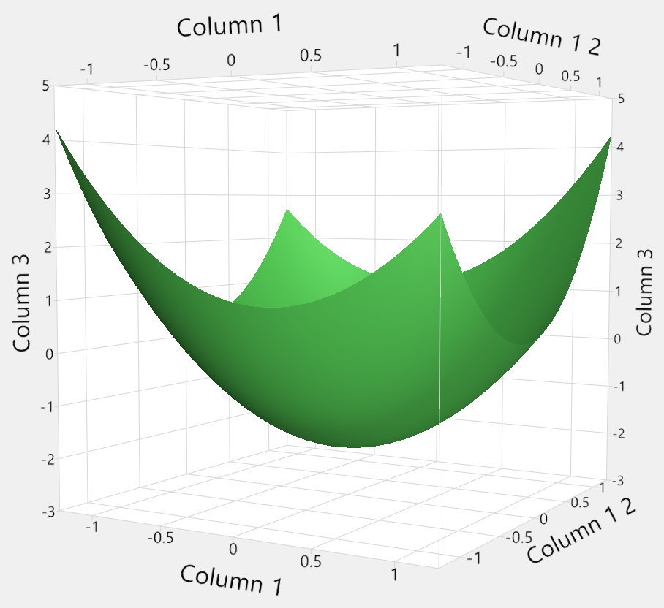
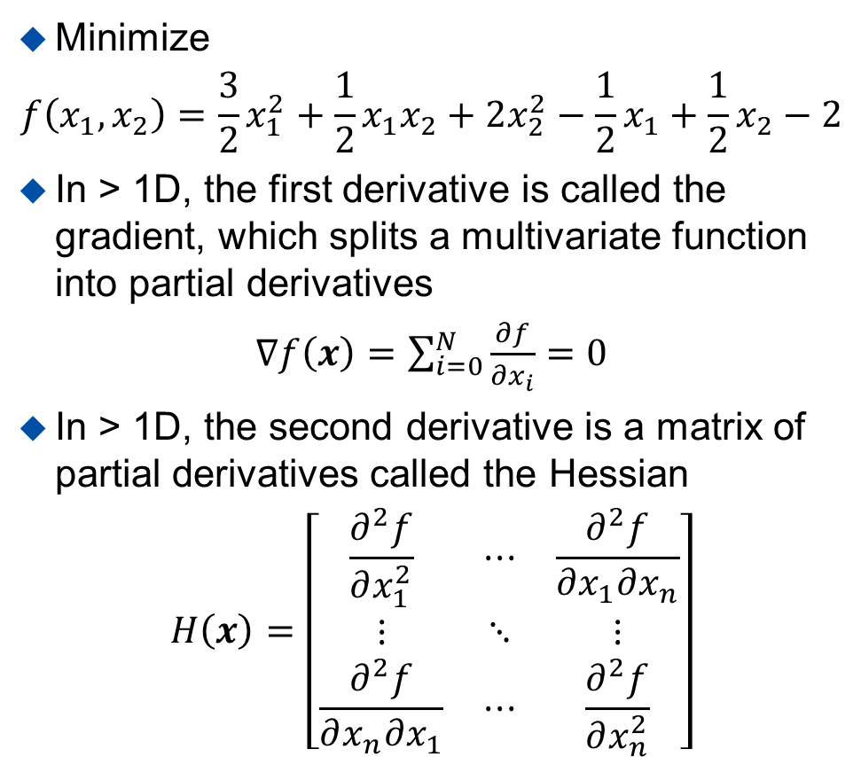
Example 3: Quadratic Function of 2 Variables
Minimize
$$f\left(x_{1},x_{2}\right)=\frac{3}{2}x_{1}^{2}+\frac{1}{2}x_{1}x_{2}+2x_{2}^{2}−\frac{1}{2}x_{1}+\frac{1}{2}x_{2}−2$$
In > 1D, the first derivative is called the gradient, which splits a multivariate function into partial derivatives
$∇f\left(x\right)=\sum_{i=0}^{N}{\frac{∂f}{∂x_{i}}}=0$
In > 1D, the second derivative is a matrix of partial derivatives called the Hessian
$$H\left(x\right)=\left[\begin{matrix}\frac{∂^{2}f}{∂x_{1}^{2}} & ⋯ & \frac{∂^{2}f}{∂x_{1}∂x_{n}} \\ ⋮ & ⋱ & ⋮ \\ \frac{∂^{2}f}{∂x_{n}∂x_{1}} & ⋯ & \frac{∂^{2}f}{∂x_{n}^{2}}\end{matrix}\right]$$

Slide 8
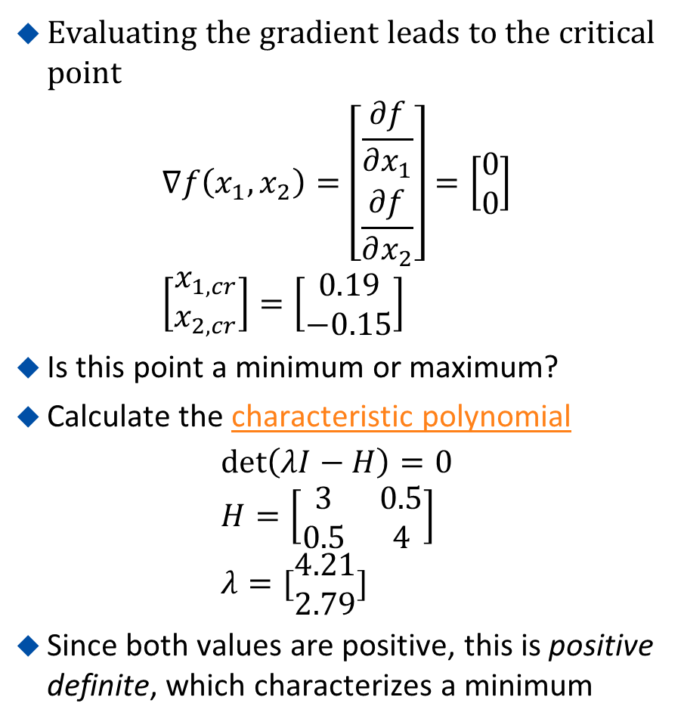
Example 3: Quadratic Function of 2 Variables
Evaluating the gradient leads to the critical point
$$∇f\left(x_{1},x_{2}\right)=\left[\begin{matrix}\frac{∂f}{∂x_{1}} \\ \frac{∂f}{∂x_{2}}\end{matrix}\right]=\left[\begin{matrix}0 \\ 0\end{matrix}\right] \\ \left[\begin{matrix}x_{1,cr} \\ x_{2,cr}\end{matrix}\right]=\left[\begin{matrix}0.19 \\ −0.15\end{matrix}\right]$$
Is this point a minimum or maximum?
Calculate the characteristic polynomial
$$\det\left(λI−H\right)=0 \\ H=\left[\begin{matrix}3 & 0.5 \\ 0.5 & 4\end{matrix}\right] \\ λ=[\begin{matrix}4.21 \\ 2.79\end{matrix}]$$
Since both values are positive, this is positive definite, which characterizes a minimum

Slide 9
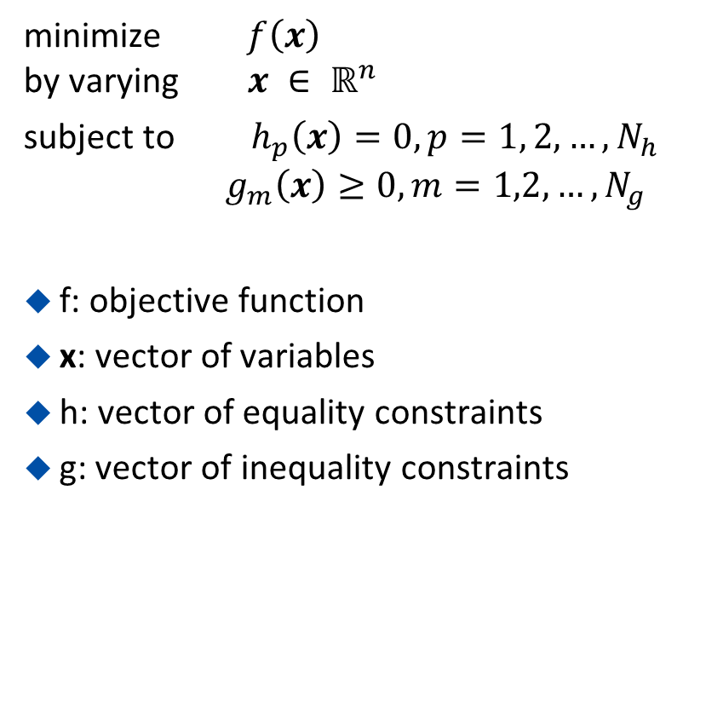
Problem Formulation
minimize $f\left(x\right)$
by varying $x ∈ ℝ^{n}$
subject to $h_{p}\left(x\right)=0, p=1, 2, …, N_{h}$
$g_{m}\left(x\right)≥0, m=1,2,…,N_{g}$
f: objective function
x: vector of variables
h: vector of equality constraints
g: vector of inequality constraints

Slide 10
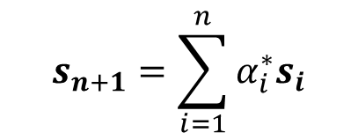
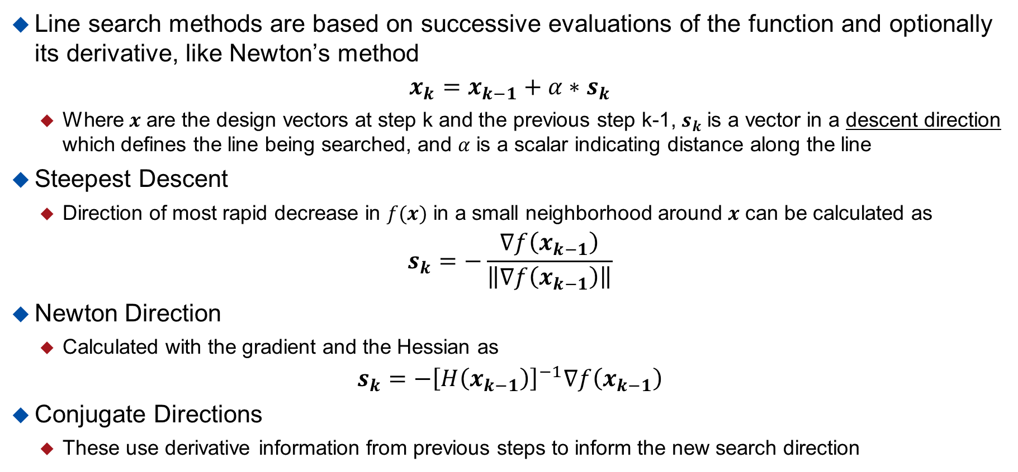
Unconstrained Optimization – Line Search
Line search methods are based on successive evaluations of the function and optionally its derivative, like Newton’s method
$$x_{k}=x_{k−1}+α∗s_{k}$$
  Where $x$ are the design vectors at step k and the previous step k-1, $s_{k}$ is a vector in a descent direction which defines the line being searched, and $α$ is a scalar indicating distance along the line
Steepest Descent
  Direction of most rapid decrease in $f(x)$ in a small neighborhood around $x$ can be calculated as
$$s_{k}=−\frac{∇f\left(x_{k−1}\right)}{\left\|∇f\left(x_{k−1}\right)\right\|}$$
Newton Direction
  Calculated with the gradient and the Hessian as
$$s_{k}=−{\left[H\left(x_{k−1}\right)\right]}^{−1}∇f\left(x_{k−1}\right)$$
Conjugate Directions
  These use derivative information from previous steps to inform the new search direction
$$s_{n+1}=\sum_{i=1}^{n}{α_{i}^{∗}s_{i}}$$

Slide 11
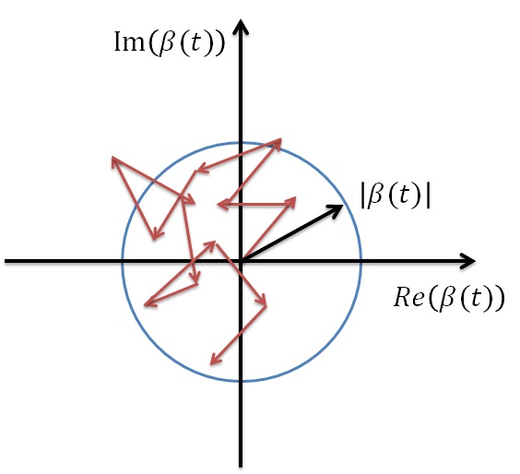
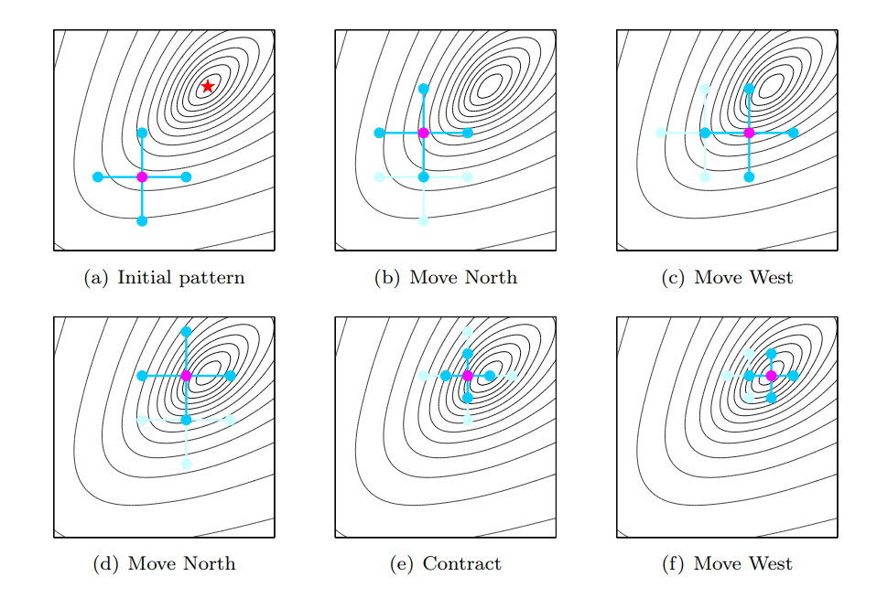



Unconstrained Optimization – Direct Search
Grid Search
Random Search
Direct search does not use gradient information
Examples
  Grid Search
  Random Search
  Random Walk
  Compass Search
$$x_{2}$$
$$x_{2}$$
$$x_{1}$$
$$x_{1}$$
Random Walk
Compass Search
Source
Source

Slide 12



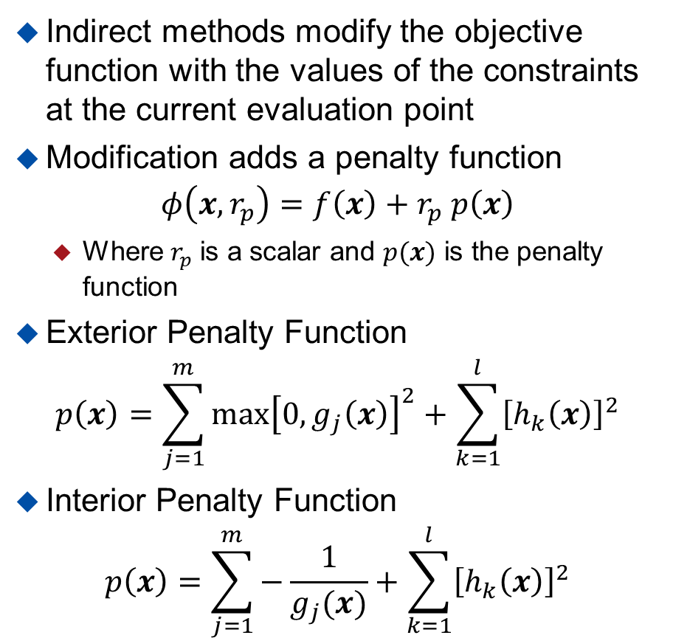





Constrained Optimization – Indirect Methods
Indirect methods modify the objective function with the values of the constraints at the current evaluation point
Modification adds a penalty function
$$φ\left(x,r_{p}\right)=f\left(x\right)+r_{p} p\left(x\right)$$
  Where $r_{p}$ is a scalar and $p(x)$ is the penalty function
Exterior Penalty Function
$$p\left(x\right)=\sum_{j=1}^{m}{\max{{\left[0,g_{j}\left(x\right)\right]}^{2}}+\sum_{k=1}^{l}{{\left[h_{k}\left(x\right)\right]}^{2}}}$$
Interior Penalty Function
$$p\left(x\right)=\sum_{j=1}^{m}{−\frac{1}{g_{j}(x)}}+\sum_{k=1}^{l}{{\left[h_{k}\left(x\right)\right]}^{2}}$$
Exterior Penalty Function
$$P(x)$$
$$x$$
$$a$$
$$b$$
Interior Penalty Function
$$P(x)$$
$$x$$
$$a$$
$$b$$

Slide 13
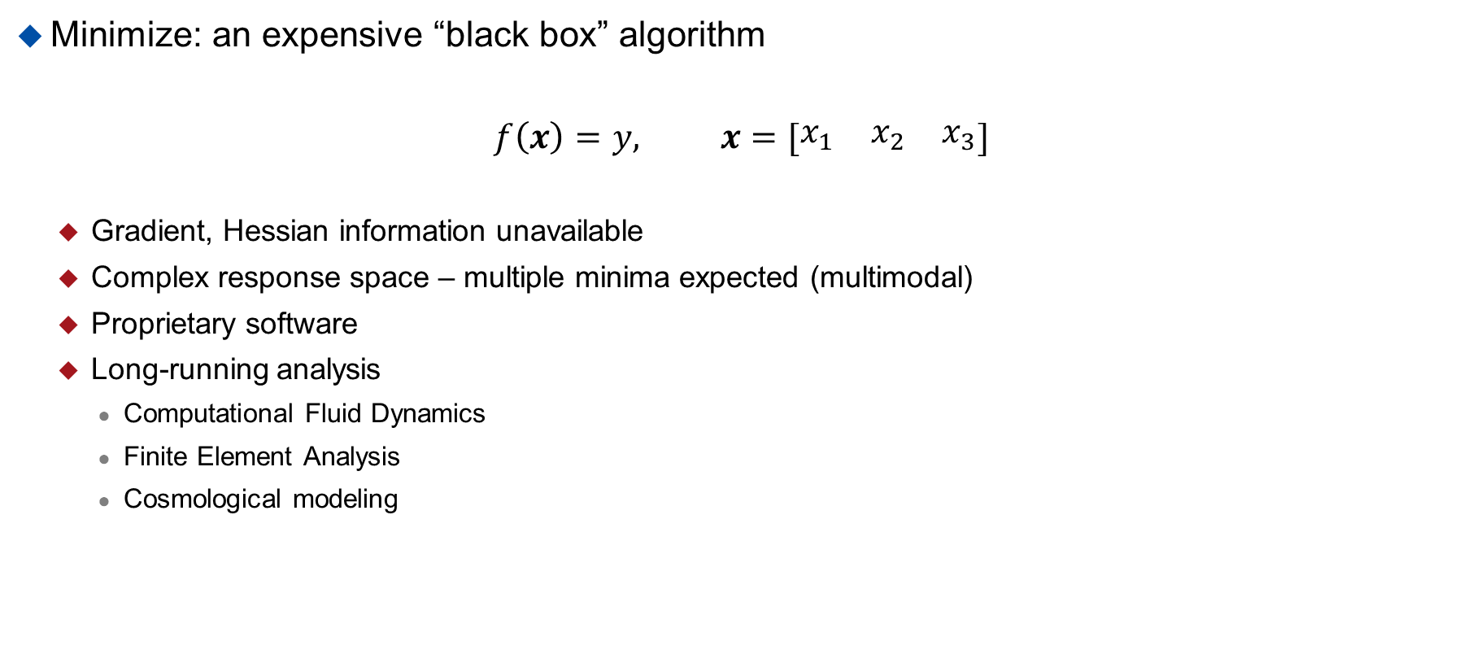
Example 4 – Expensive Black Box Analysis
Minimize: an expensive “black box” algorithm
$$f\left(x\right)=y, x=[\begin{matrix}x_{1} & x_{2} & x_{3}\end{matrix}]$$
  Gradient, Hessian information unavailable
  Complex response space – multiple minima expected (multimodal)
  Proprietary software
  Long-running analysis
    Computational Fluid Dynamics
    Finite Element Analysis
    Cosmological modeling

Slide 14
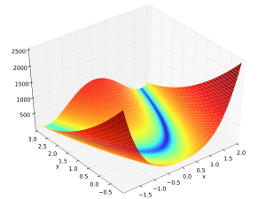
Global Optimization
Gradient or local optimization techniques are good at finding a single minima
What if there are multiple minima?
Global optimization techniques employ a wide range of heuristics and biologically inspired algorithms to more thoroughly explore a function
May or may not use gradient information
Many are stochastic (random)
Mathematically there is no way to determine if a minima is the global minimum
Global methods increase confidence that the global minimum has been found
Source

Slide 15
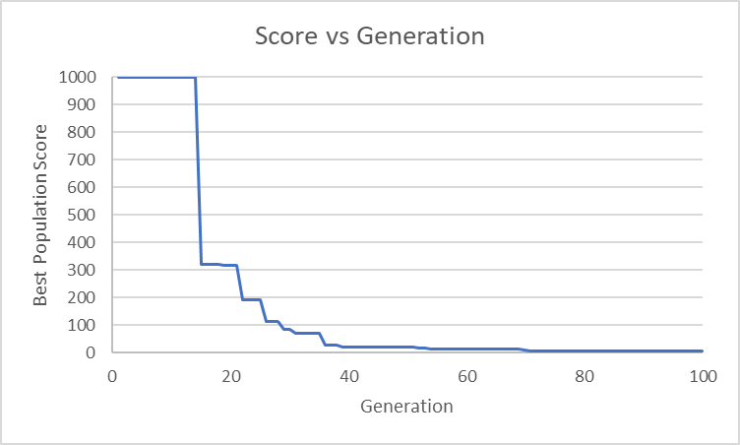
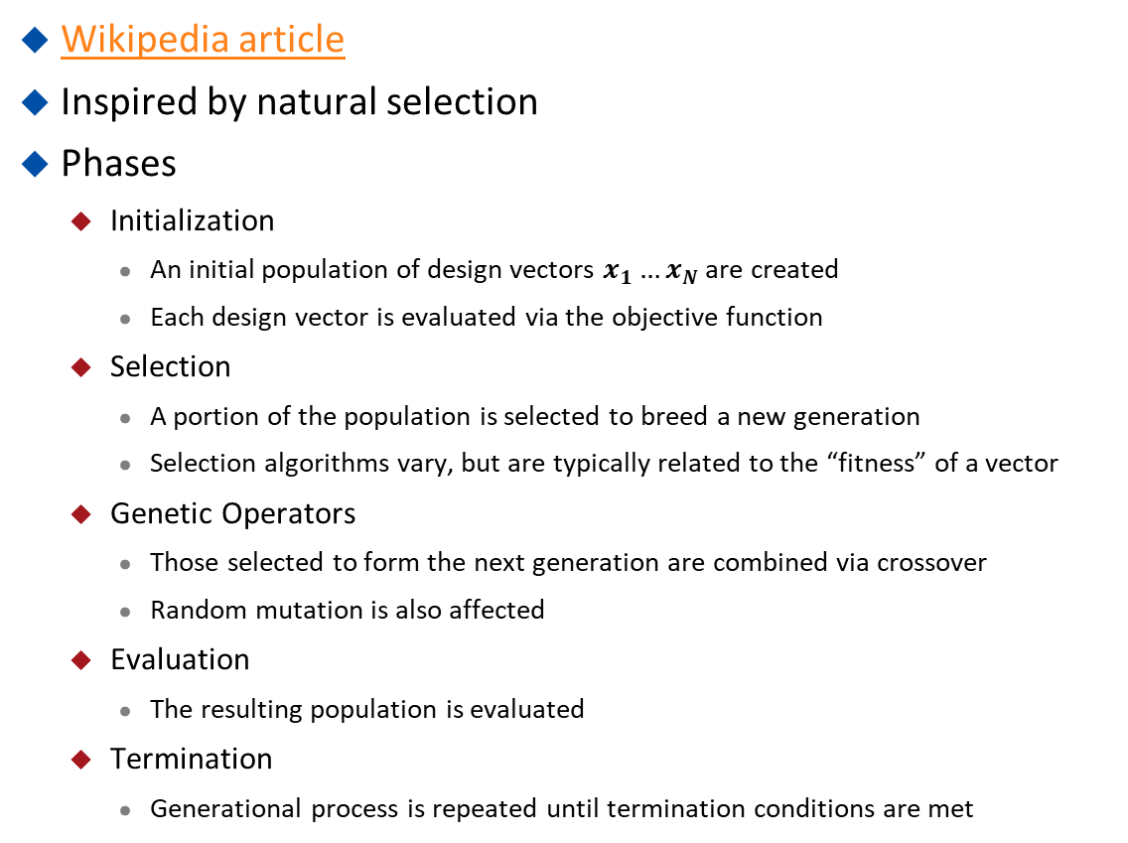


Genetic Algorithms
Wikipedia article
Inspired by natural selection
Phases
  Initialization
    An initial population of design vectors $x_{1}…x_{N}$ are created
    Each design vector is evaluated via the objective function
  Selection
    A portion of the population is selected to breed a new generation
    Selection algorithms vary, but are typically related to the “fitness” of a vector
  Genetic Operators
    Those selected to form the next generation are combined via crossover
    Random mutation is also affected
  Evaluation
    The resulting population is evaluated
  Termination
    Generational process is repeated until termination conditions are met
$$\begin{matrix}Ind1: \begin{matrix}0 & 0\end{matrix} & \begin{matrix}0 & 0\end{matrix} & \begin{matrix}0 & 0\end{matrix}\end{matrix}$$
Gene
$$\begin{matrix}Ind2: \begin{matrix}1 & 1\end{matrix} & \begin{matrix}1 & 1\end{matrix} & \begin{matrix}1 & 1\end{matrix}\end{matrix}$$
Chromosome
Population

Slide 16
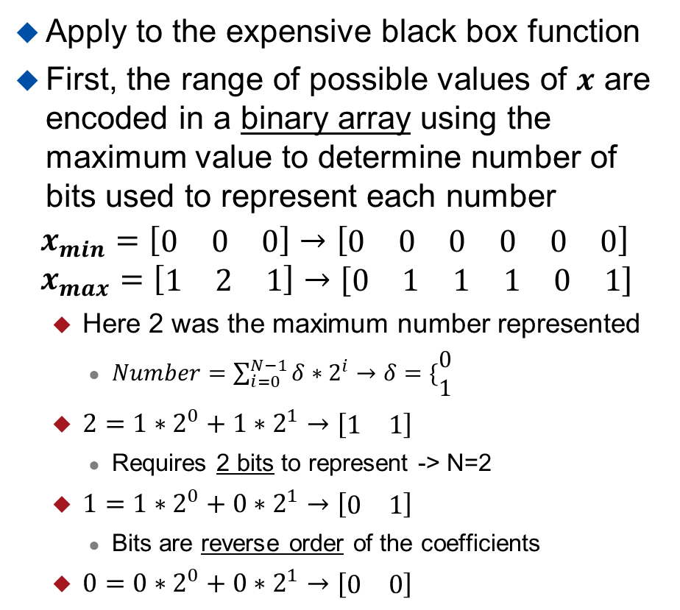
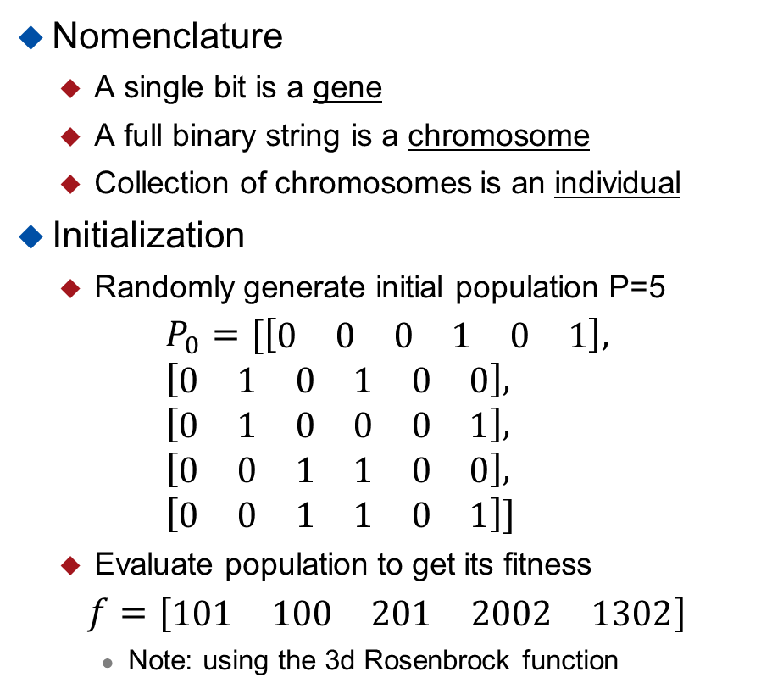
Genetic Algorithms - Example
Apply to the expensive black box function
First, the range of possible values of $x$ are encoded in a binary array using the maximum value to determine number of bits used to represent each number
$$x_{min}=\left[\begin{matrix}0 & 0 & 0\end{matrix}\right]→\left[\begin{matrix}\begin{matrix}0 & 0\end{matrix} & \begin{matrix}0 & 0\end{matrix} & \begin{matrix}0 & 0\end{matrix}\end{matrix}\right] \\ x_{max}=\left[\begin{matrix}1 & 2 & 1\end{matrix}\right]→[\begin{matrix}\begin{matrix}0 & 1\end{matrix} & \begin{matrix}1 & 1\end{matrix} & \begin{matrix}0 & 1\end{matrix}\end{matrix}]$$
  Here 2 was the maximum number represented
    $Number=\sum_{i=0}^{N−1}{δ∗2^{i}}→δ=\{\begin{matrix}0 \\ 1\end{matrix}$
  $2=1∗2^{0}+{1∗2}^{1}→[\begin{matrix}1 & 1\end{matrix}]$
    Requires 2 bits to represent -> N=2
  $1=1∗2^{0}+{0∗2}^{1}→\left[\begin{matrix}0 & 1\end{matrix}\right]$
    Bits are reverse order of the coefficients
  $0=0∗2^{0}+{0∗2}^{1}→[\begin{matrix}0 & 0\end{matrix}]$
Nomenclature
  A single bit is a gene
  A full binary string is a chromosome
  Collection of chromosomes is an individual
Initialization
  Randomly generate initial population P=5
$$P_{0}=[\left[\begin{matrix}\begin{matrix}0 & 0 & 0\end{matrix} & \begin{matrix}1 & 0 & 1\end{matrix}\end{matrix}\right], \\ \left[\begin{matrix}\begin{matrix}0 & 1 & 0\end{matrix} & \begin{matrix}1 & 0 & 0\end{matrix}\end{matrix}\right], \\ \left[\begin{matrix}\begin{matrix}0 & 1 & 0\end{matrix} & \begin{matrix}0 & 0 & 1\end{matrix}\end{matrix}\right], \\ \left[\begin{matrix}\begin{matrix}0 & 0 & 1\end{matrix} & \begin{matrix}1 & 0 & 0\end{matrix}\end{matrix}\right], \\ \left[\begin{matrix}\begin{matrix}0 & 0 & 1\end{matrix} & \begin{matrix}1 & 0 & 1\end{matrix}\end{matrix}\right]]$$
  Evaluate population to get its fitness
$$f=[\begin{matrix}\begin{matrix}101 & 100\end{matrix} & \begin{matrix}201 & 2002 & 1302\end{matrix}\end{matrix}]$$
    Note: using the 3d Rosenbrock function
Source

Slide 17
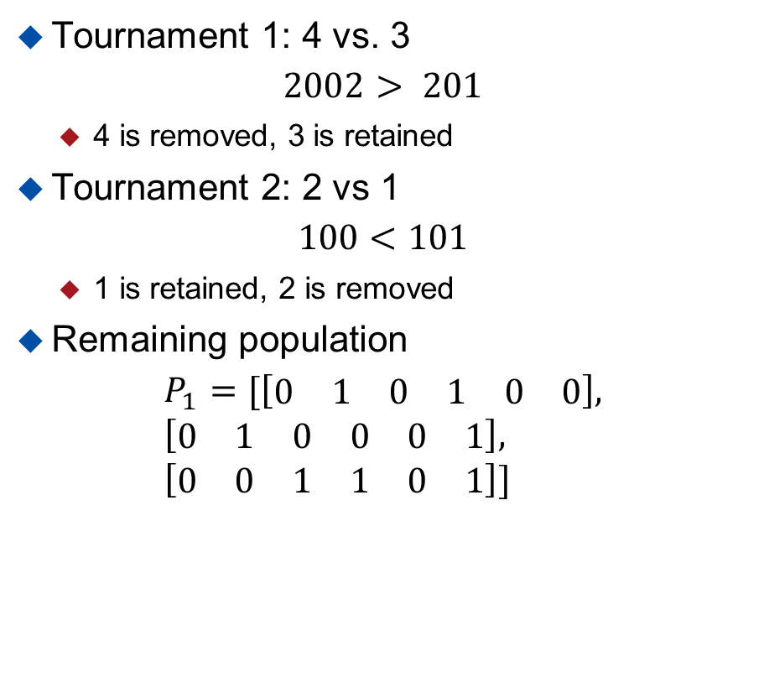
Genetic Algorithms - Example
Selection – Wiki article
  Many different algorithms exist
  Tournament – two randomly selected individuals’ fitness are compared, lower fitness removed
  Roulette Wheel – probability of retaining an individual to next generation is related to its fitness compared to the fitness of the population
  Elitism – best fitness individuals continue to next generation
For this example, we’ll use Tournament
To retain a population size of 5, 2 individuals will be removed and the remaining best crossed
  Elitism: individuals surviving tournament are retained
Tournament 1: 4 vs. 3
$$2002> 201$$
  4 is removed, 3 is retained
Tournament 2: 2 vs 1
$$100<101$$
  1 is retained, 2 is removed
Remaining population
$$P_{1}=[\left[\begin{matrix}\begin{matrix}0 & 1 & 0\end{matrix} & \begin{matrix}1 & 0 & 0\end{matrix}\end{matrix}\right], \\ \left[\begin{matrix}\begin{matrix}0 & 1 & 0\end{matrix} & \begin{matrix}0 & 0 & 1\end{matrix}\end{matrix}\right], \\ \left[\begin{matrix}\begin{matrix}0 & 0 & 1\end{matrix} & \begin{matrix}1 & 0 & 1\end{matrix}\end{matrix}\right]]$$

Slide 18
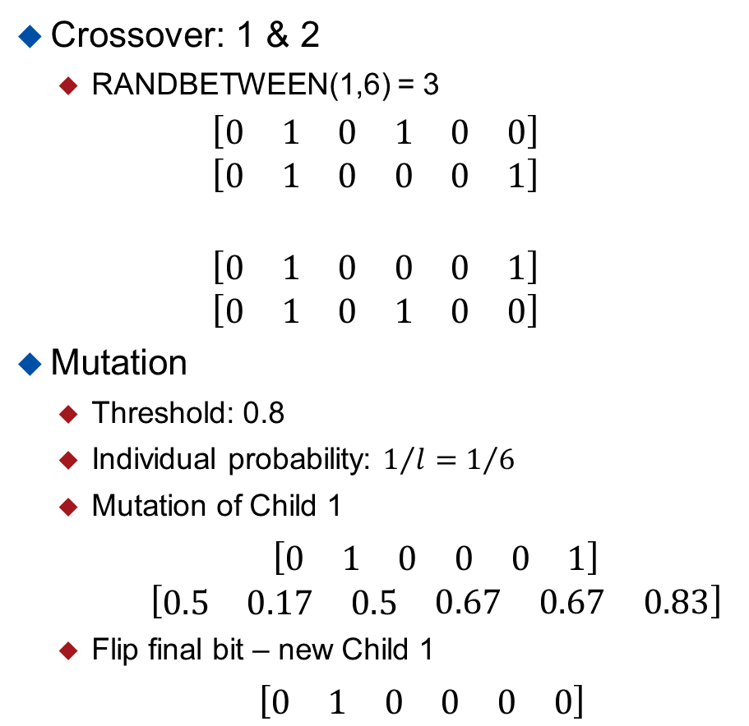
Genetic Algorithms - Example
Genetic Operators
  The remaining members of the population are now combined to create offspring, and the resultant offspring are randomly mutated
  Crossover – Wiki article – One-point
    Randomly select a gene in chromosome
    Bit information is exchanged between individuals from that point on
  Mutation – Wiki article
    Individual genes have a probability their bit will be flipped after crossover
    Typically, this rate is set high at the start to explore more of the response space, and is reduced as iterations of the algorithm continue
Crossover: 1 & 2
  RANDBETWEEN(1,6) = 3
$$\left[\begin{matrix}\begin{matrix}0 & 1 & 0\end{matrix} & \begin{matrix}1 & 0 & 0\end{matrix}\end{matrix}\right] \\ \left[\begin{matrix}\begin{matrix}0 & 1 & 0\end{matrix} & \begin{matrix}0 & 0 & 1\end{matrix}\end{matrix}\right]$$
$$\left[\begin{matrix}\begin{matrix}0 & 1 & 0\end{matrix} & \begin{matrix}0 & 0 & 1\end{matrix}\end{matrix}\right] \\ \left[\begin{matrix}\begin{matrix}0 & 1 & 0\end{matrix} & \begin{matrix}1 & 0 & 0\end{matrix}\end{matrix}\right]$$
Mutation
  Threshold: 0.8
  Individual probability: $1/l=1/6$
  Mutation of Child 1
$\left[\begin{matrix}\begin{matrix}0 & 1 & 0\end{matrix} & \begin{matrix}0 & 0 & 1\end{matrix}\end{matrix}\right]$
$\left[\begin{matrix}\begin{matrix}0.5 & 0.17 & 0.5\end{matrix} & \begin{matrix}0.67 & 0.67 & 0.83\end{matrix}\end{matrix}\right]$
  Flip final bit – new Child 1
$\left[\begin{matrix}\begin{matrix}0 & 1 & 0\end{matrix} & \begin{matrix}0 & 0 & 0\end{matrix}\end{matrix}\right]$

Slide 19
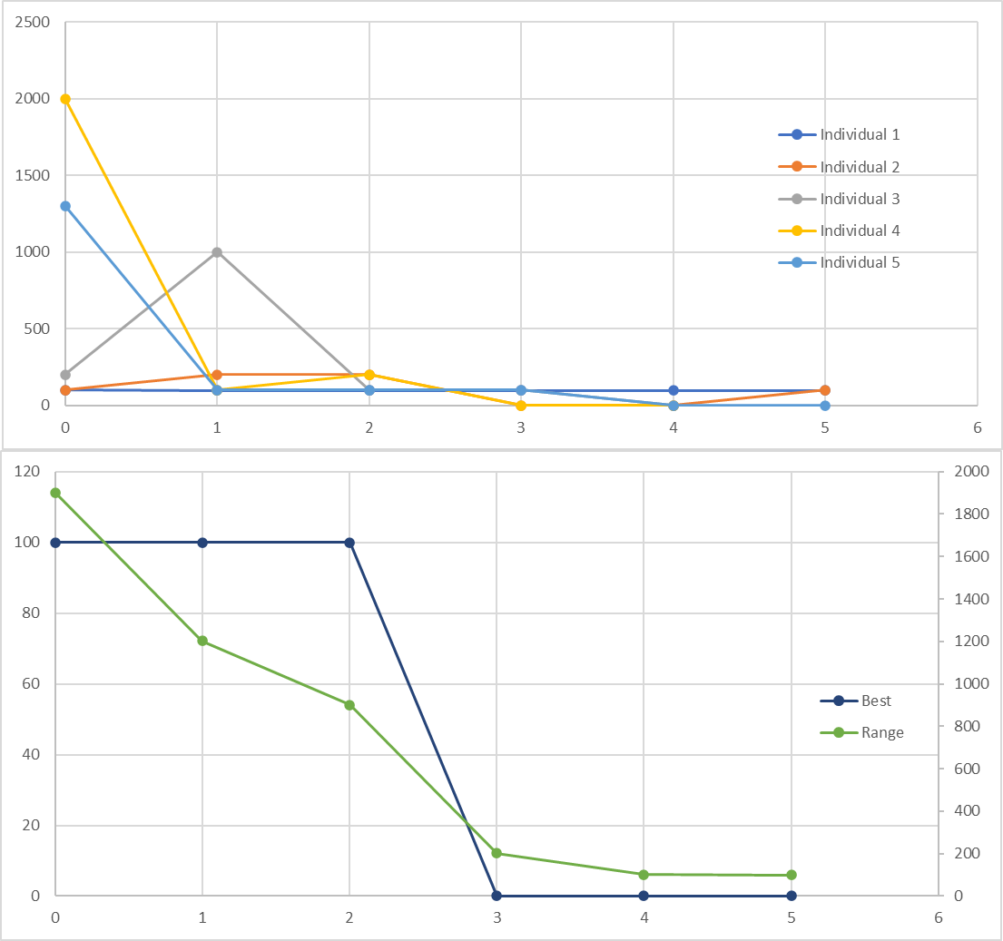
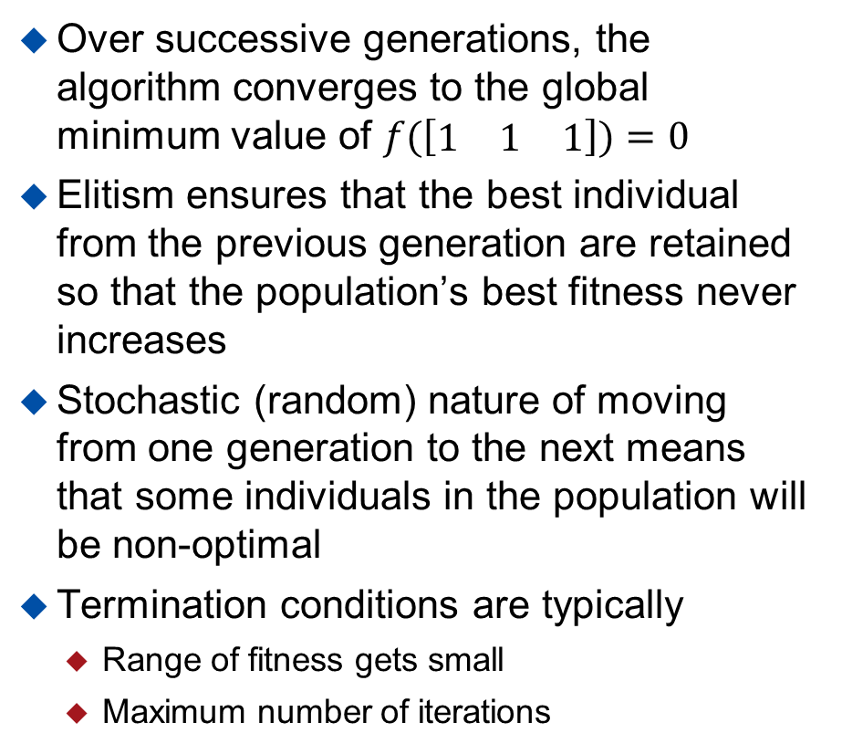
Genetic Algorithm - Example
Over successive generations, the algorithm converges to the global minimum value of $f(\left[\begin{matrix}1 & 1 & 1\end{matrix}\right])=0$
Elitism ensures that the best individual from the previous generation are retained so that the population’s best fitness never increases
Stochastic (random) nature of moving from one generation to the next means that some individuals in the population will be non-optimal
Termination conditions are typically
  Range of fitness gets small
  Maximum number of iterations

Slide 20
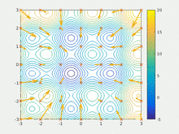
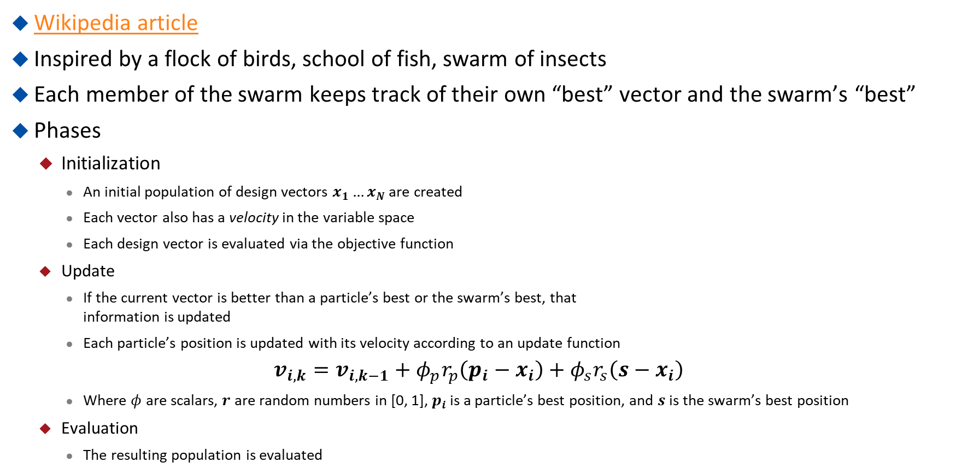
Particle Swarm
Wikipedia article
Inspired by a flock of birds, school of fish, swarm of insects
Each member of the swarm keeps track of their own “best” vector and the swarm’s “best”
Phases
  Initialization
    An initial population of design vectors $x_{1}…x_{N}$ are created
    Each vector also has a velocity in the variable space
    Each design vector is evaluated via the objective function
  Update
    If the current vector is better than a particle’s best or the swarm’s best, that
    information is updated
    Each particle’s position is updated with its velocity according to an update function
$$v_{i,k}=v_{i,k−1}+φ_{p}r_{p}\left(p_{i}−x_{i}\right)+φ_{s}r_{s}\left(s−x_{i}\right)$$
    Where $φ$ are scalars, $r$ are random numbers in [0, 1], $p_{i}$ is a particle’s best position, and $s$ is the swarm’s best position
  Evaluation
    The resulting population is evaluated
Source
  Termination
    Generational process is repeated until termination conditions are met

Slide 21
Basinhopping
Used widely in the field of chemical physics
Designed to “hop” over barriers – positive gradient
This high-level behavior is paired with a local
optimizer to find the minimum within a region
Phases
  Initialization
    Create a candidate solution
    Evaluate solution via the objective function
  Perturbation
    Add a random number to the solution
  Optimization
    Apply a local optimizer to find a local minima
  Termination
    Process is repeated until termination conditions are met
local minimization
hopping
basin

