Slide 1
Impact of Space Radiation on Plant Seeds:
from Arabidopsis thaliana to Crops
J.T. Richards, L.E. Spencer, A. Dixit, M. Cameron, B. Richardson, J.J. Torres, J.A. Fischer, M. Hada, I. Plante, A.H. Feiveson, H. Wu, G.D. Massa, H.G. Levine, G.L. Douglas, and Y. Zhang
Ye Zhang, Ph.D.
Utilization & Life Sciences Office
Exploration Research and Technology Programs
NASA John F. Kennedy Space Center

Slide 2
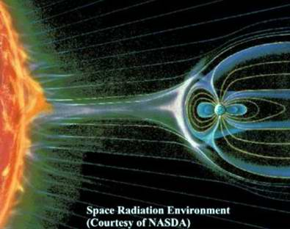
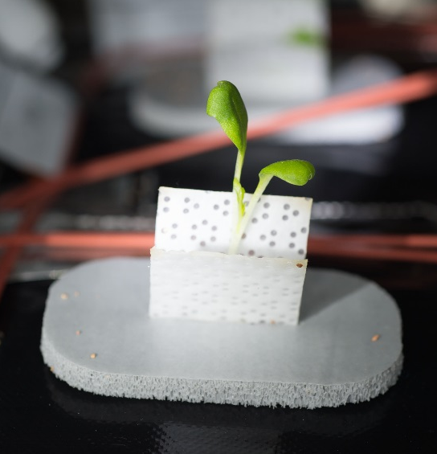
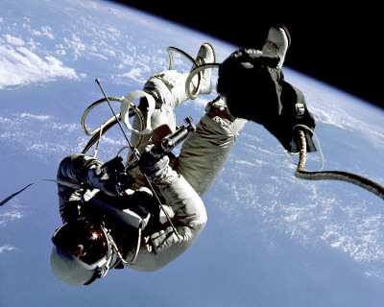
Space Radiation Risks
Cosmic Rays:
Galactic Cosmic Rays (GCR) and Solar Particle Events (SPE)
Human
Microorganisms
Plants

Slide 3
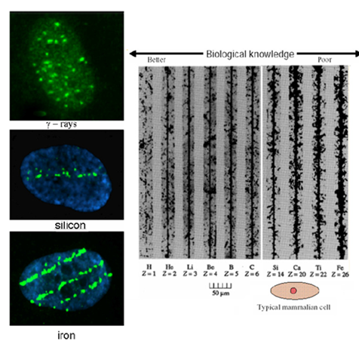
Space Radiation Risks
GCR Dose Equivalent Rate (mSv/day) at different locations.
Condition | Mars Mission (Mars Science Lab)¹ | Lunar Mission (Apollo)² | On ISS (~400 km)^{3*} | Sub-orbital (~120 km)^{4*} | Stratosphere above Antarctica (30-37 km)^{5*}
Transit Journey | 1.84±0.33 | 0.7-3 | ~0.5 (50-80% from GCR particles) | ~0.0035 mSv per 15 min ~0.00031 mSv per 15 min (Mercury 3) | 0.4-0.6
Surface | 0.64±0.12 (Solar min) | 0.24-0.30 (Solar max); 0.67-1.04 (Solar min)
¹ Zeitlin et al, 2013; Hassler et al, 2014; Köhler et al, 2015; ² Reitz et al, 2012; Durante, 2012;³ Cucinotta et al, 2012; ⁴ For sub-orbital flight, the measurement/estimate is total dose equivalent per 15 min flight (Jurist, 2005; Copeland, 2013); ⁵ Benton, 2012; Möller, 2013; *Total dose equivalent rate, including GCR particles.
(Left) A comparison of particle tracks in nuclear emulsions; and (Right) Gamma-H₂AX staining indicating DNA damages (mostly double strand breaks) in a cell nuclear caused by charged particles (Cucinotta and Durante, 2006).

Slide 4
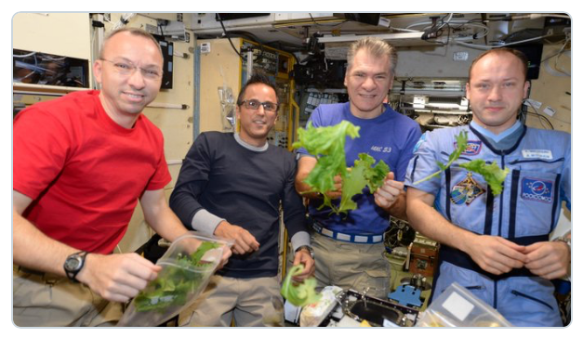

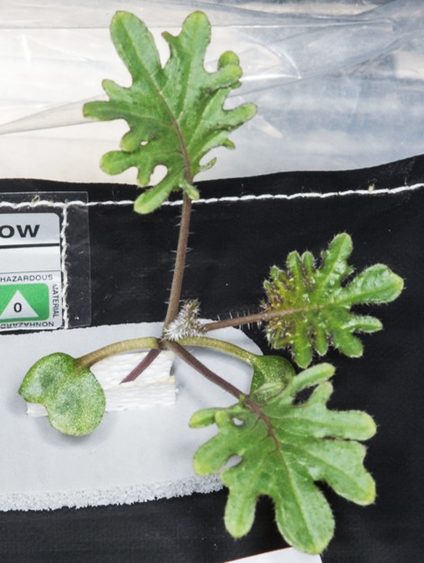
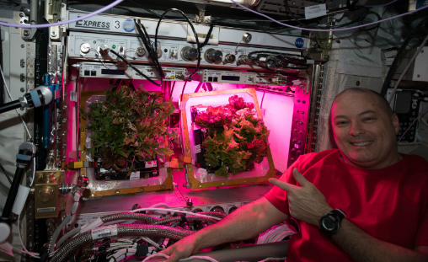
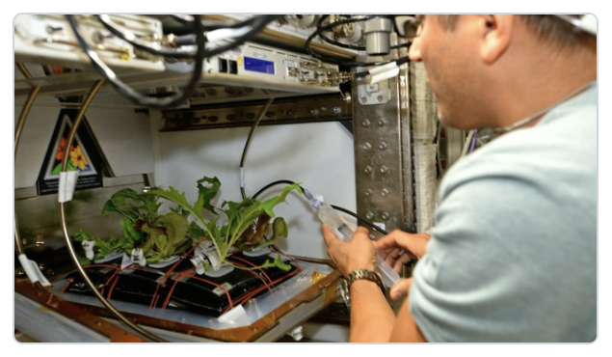
Crops in Space
Various types of crops have been successfully grown on the ISS. Some of the produce was for crew consumption.
The crew members have tasted fresh produce from space grown mizuna, pak choi, kale, wasabi, radish, and various types of lettuce. Amara and chili pepper were successfully grown on ISS in 2021.
Grow Vegetables in Space
Grow Vegetables in Space
Enjoy the Fresh Produce!
Mizuna in Space
Kale in Space

Slide 5
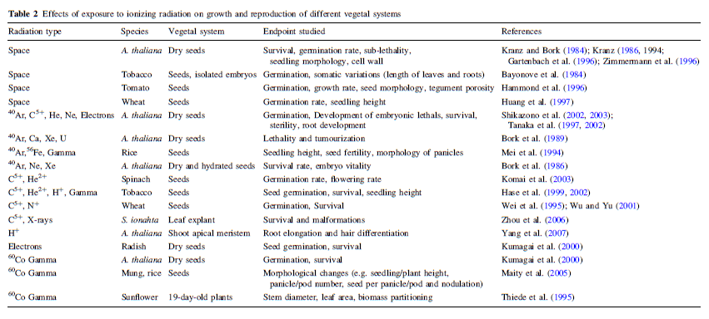
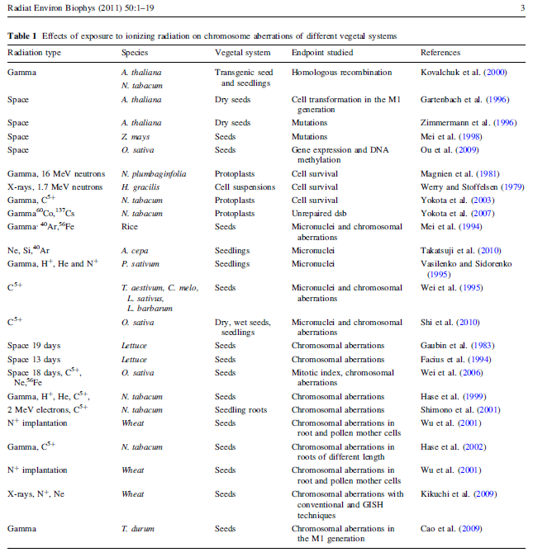
Radiation Studies on Plants
Significant number of studies on evaluating the response of plants to irradiation;
Chernobyl and Fukushima accidents;
Lack of studies using comparable radiation quality and quantity targeting deep space missions and potential space food production.
De Micco et al., Radiat Environ Biophys 50:1-19, 2011.

Slide 6
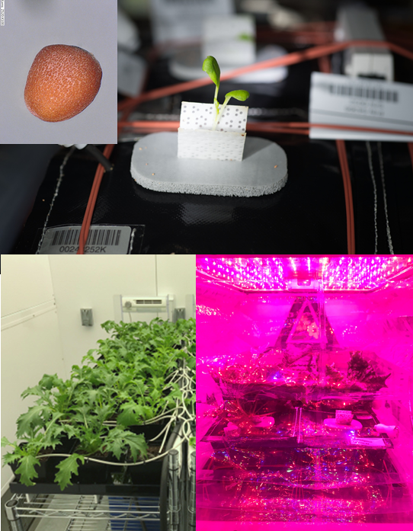
Goals of this Study
Descriptive graphic suitable for publishing on the web (2500 – 3500 pixels wide is ideal).
Caption required
A
B
Our study investigated two fundamental questions:
Whether deep space GCR or SPE protons impacts plant seeds and their growth.
Which factors such as species, dose, dose rate, particle type, or some combination of these produce the most detrimental effects.
In this study, we evaluated the effect of simulated GCRs and SPEs on the seeds of Arabidopsis thaliana, mizuna mustard, ‘Outredgeous’ red romaine lettuce, and ‘Red Robin’ dwarf tomato.
C
D
An example of Mizuna plant from a seed (A) to a seedling (B) growing in a ground environmental chamber (C) or an ISS Veggie unit (D).

Slide 7
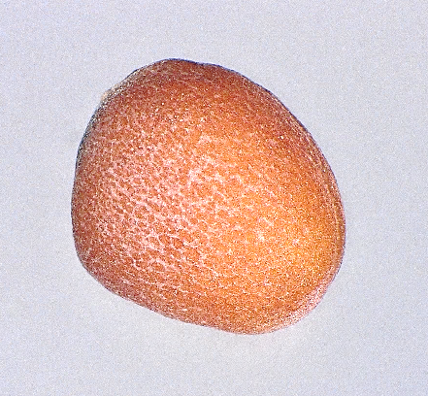
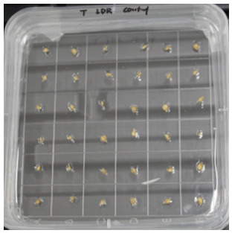
Experimental Schemes
Control
Control
Germination Rate
Exposure
Signs of Stress
Sanitization
Phytogel Based
Dry
Plant Size
GCR
GCR
Shipped to BNL
Adding Water
Transcriptomic
Shipped Back to KSC and Storage
Grow-out
Packed
Emergence Rate
Control
Control
Hydrated
Soil Based
Exposure
Signs of Stress
Plant Size
SPE
SPE
Chlorophyll Content
Edible Biomass
Refrigerated in Dark
Nutrition Value
Control or SPE
Refrigerated in Dark

Slide 8
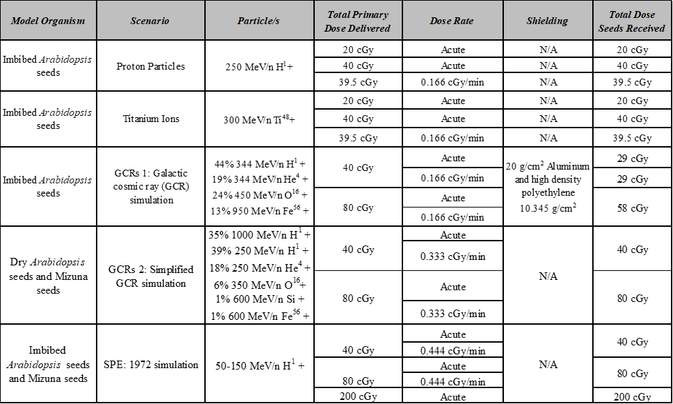
Radiation Scenario Design
Considerations:
40 cGy was chosen to simulate the total GCR dose expected during a 3-year Mars mission based on the measurements from the MSL Curiosity Rover Mission during 2011-2012. We also evaluated the dose response and possible maximum GCR impact on seeds using 80 cGy.
Compared to GCR, the occurrence time, duration, and fluence of an SPE are not predictable. Therefore, for the SPE simulation, we used the simulation provided by the NSRL based on combining characteristics of two large historical events, namely the fluence of the August 1972 event along with an energy spectrum similar to the March 1989 event. Three dose points, 40, 80, and 200 cGy were selected.
Acute and lower dose rate (LDR) were applied as well.

Slide 9
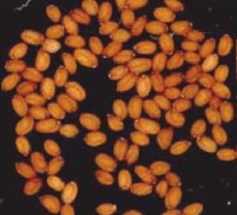
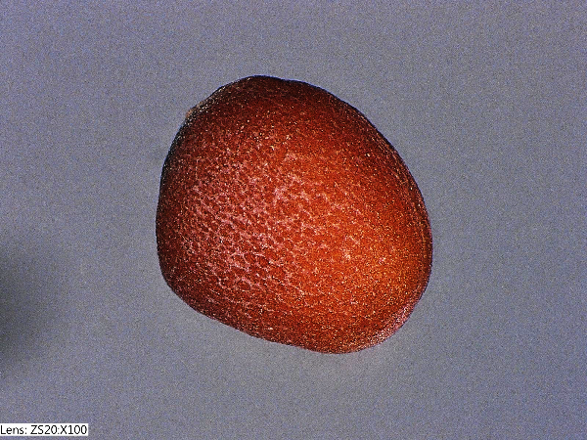
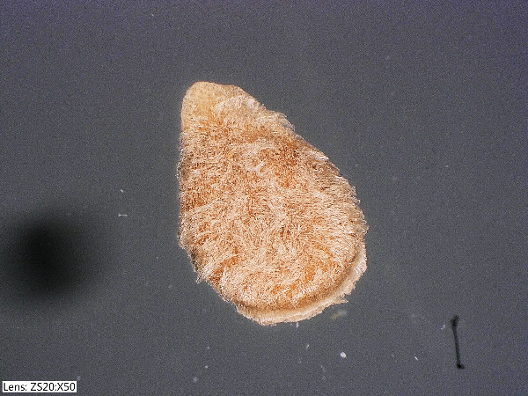
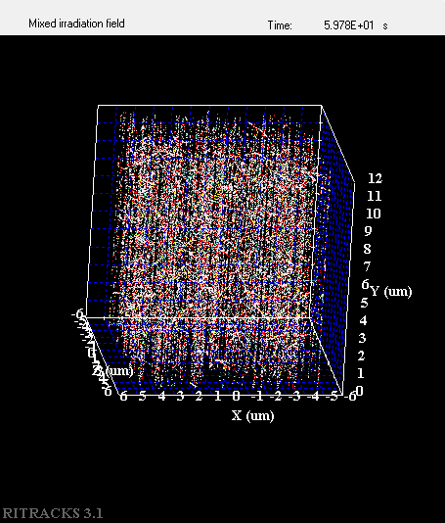
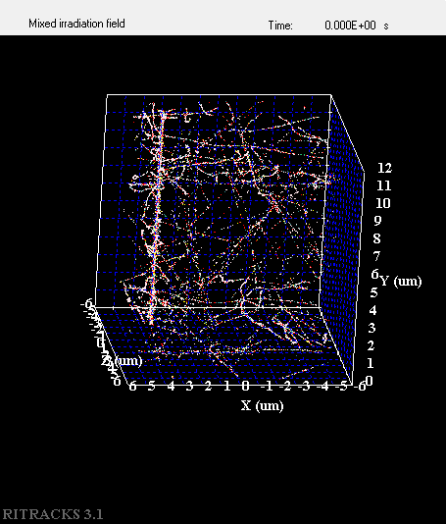
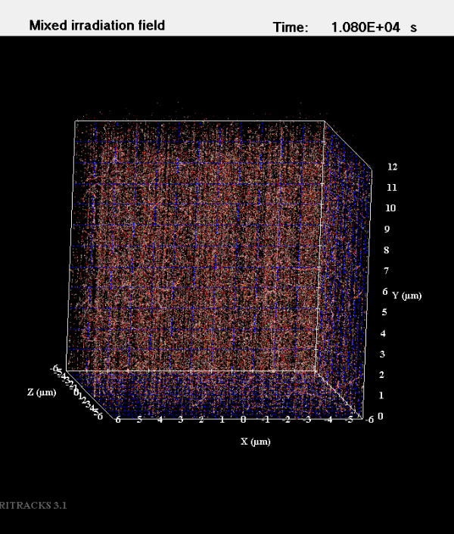
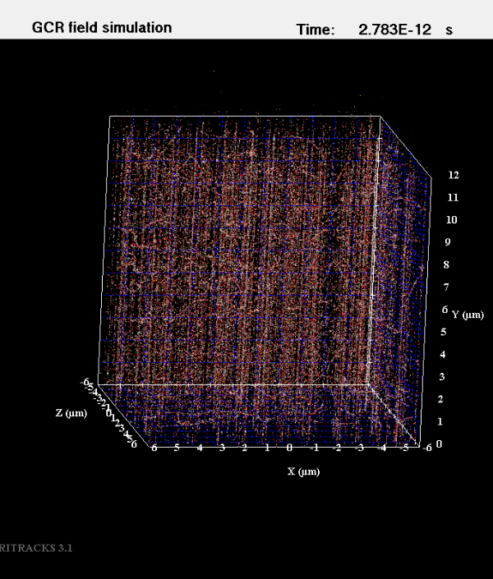
Plant Model Organisms and Radiation Track Analysis
Arabidopsis
Mizuna
Tomato
Protons: 250MeV/n, 40 cGy
800,000 hits per seed
Approximately ≈200 hits per cell
Ti ions: 300MeV/n, 40 cGy
1750-2000 hits per seed
Approximately ≈ 0.5 hits per cell.
Fluence similar to that of 250MeV/n Protons

Slide 10
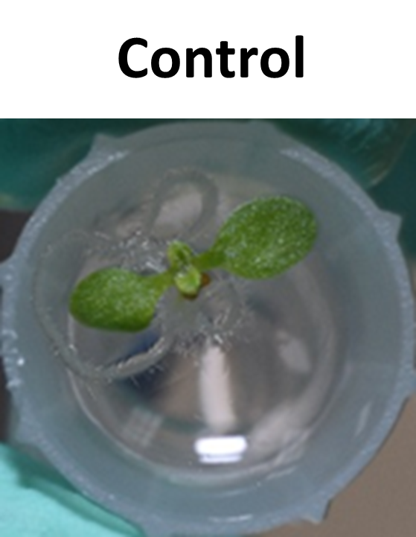
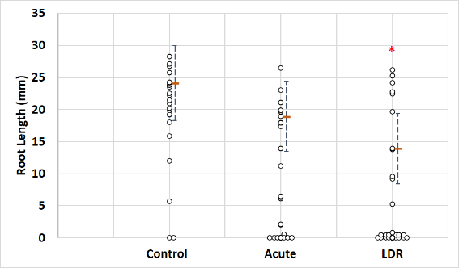
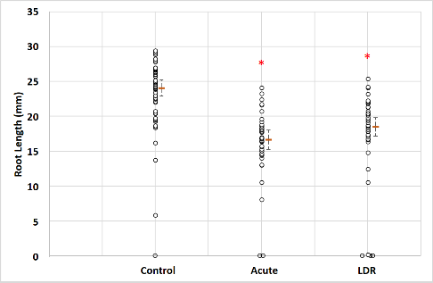
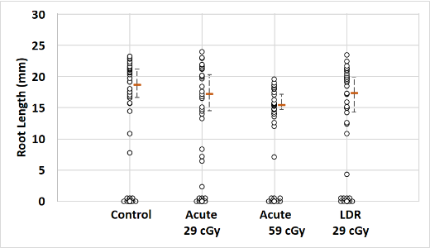
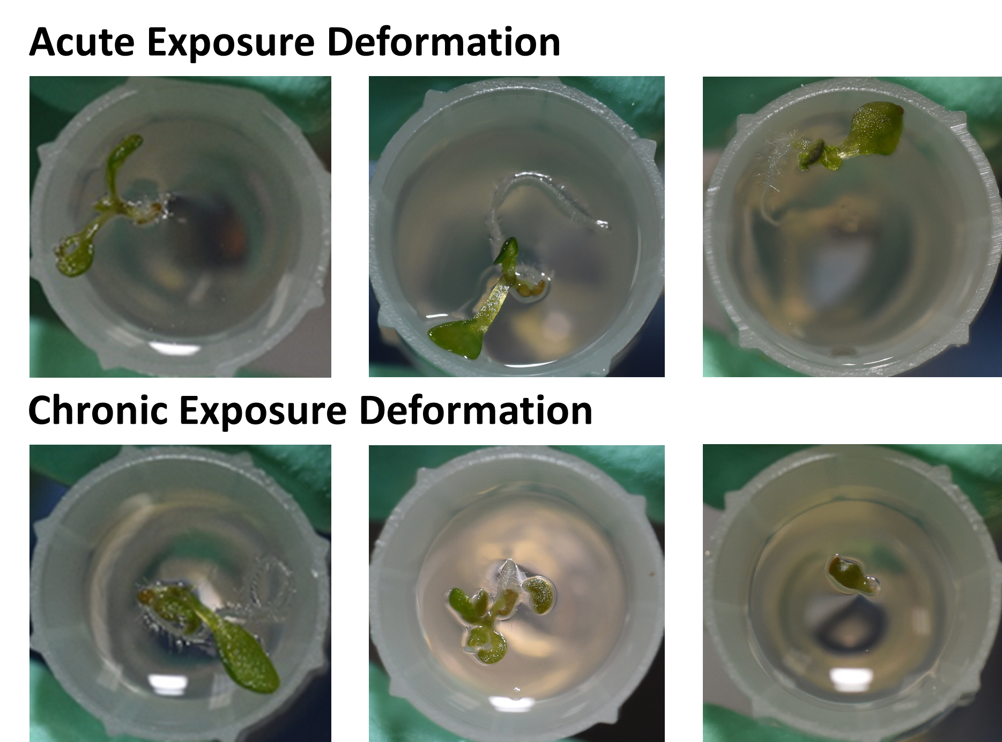
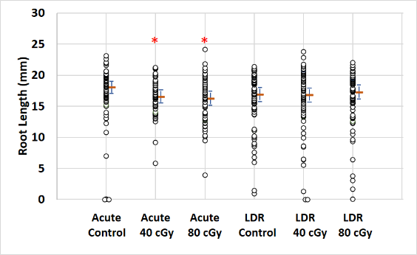
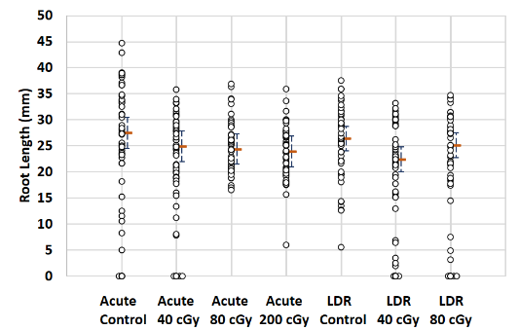
Radiation Effects on Arabidopsis Seeds
Germination Rate: No significant changes in germination rate within different treatment groups (n=26-72 per group).
Titanium
(300 Mev/n, 40 cGy)
Root Length:
Ti
Proton
GCR1
GCR2
SPE
Zhang et al, Life 2022

Slide 11
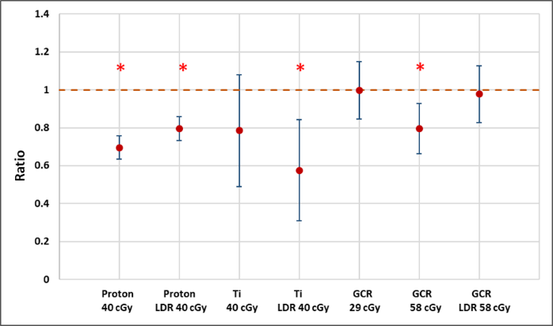
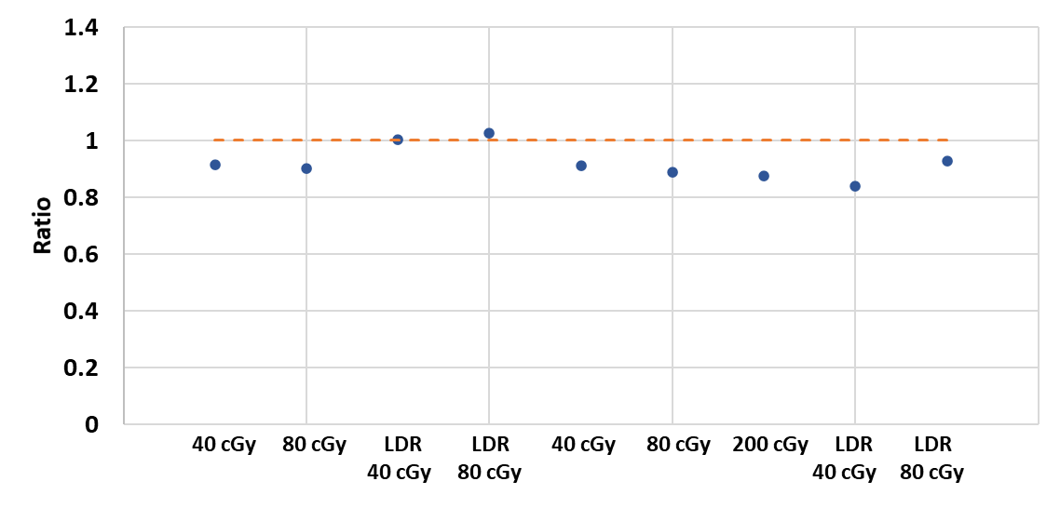
Characterization of Radiation Effect on Arabidopsis Seeds
Protons (H)
Ti Ions (H)
GCR1 (H)
GCR2 (Dry)
SPE (H)
*
*
250 MeV/n
300 MeV/n
GCR1 (H)
>250 MeV/n protons and heavier particles
50-150 MeV/n protons
Observation I: The impact is ion quality-dependent. For hydrated Arabidopsis seeds, Ti > 250 MeV proton> GCR1 > SPE.

Slide 12
Characterization of Radiation Effect on Arabidopsis Seeds
Protons (H)
Ti Ions (H)
GCR1 (H)
GCR2 (Dry)
SPE (H)
*
*
250 MeV/n
300 MeV/n
GCR1 (H)
>250 MeV/n protons and heavier particles
50-150 MeV/n protons
Observation II: The effect is dose Rate Dependent. High LET: LDR>Acute vs. Low LET: Acute>LDR

Slide 13
Characterization of Radiation Effect on Arabidopsis Seeds
Protons (H)
Ti Ions (H)
GCR1 (H)
GCR2 (Dry)
SPE (H)
*
*
250 MeV/n
300 MeV/n
GCR1 (H)
>250 MeV/n protons and heavier particles
50-150 MeV/n protons
Observation III: Some of the radiation effects are dose dependent.
Short Summary: Morphological changes of the seedlings cultured from irradiated seeds were found to be dose-, dose rate- and ion quality-dependent, with heavier ions causing more severe damages.

Slide 14
Characterization of Radiation Effect on Arabidopsis Seeds
Protons (H)
Ti Ions (H)
GCR1 (H)
GCR2 (Dry)
SPE (H)
*
*
250 MeV/n
300 MeV/n
GCR1 (H)
>250 MeV/n protons and heavier particles
50-150 MeV/n protons
Observation IV: The effect is specimen condition dependent. 40 cGy: Dry seeds (GCR2)<hydrated seeds (250 MeV/n), and Dry seeds in GCR2 (80 cGy)<hydrated seeds in GCR1 (58 cGy).

Slide 15
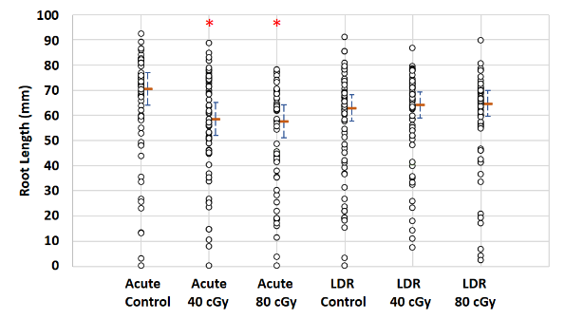
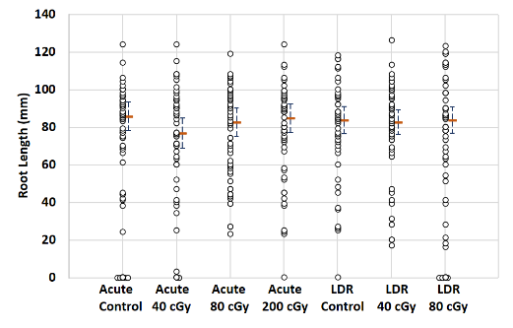
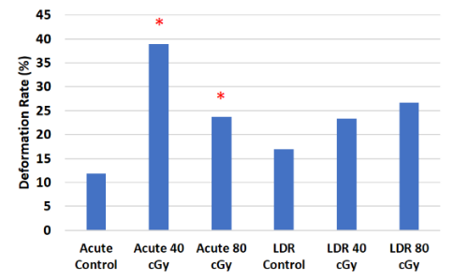
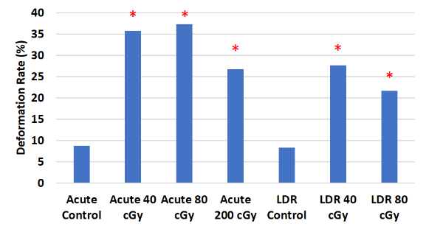
Radiation Effect on Mizuna Seeds
Germination Rate: No significant changes in germination rate within different treatment groups (n=48-60 per treatment group).
GCR (Dry)
SPE (Hydrated)
Short Summary:
Root length changes were only observed in GCR irradiated groups, indicating heavier particles may have more impact on the root development.
Plants from both GCR and SPE irradiated seeds showed signs of stress.
Only plants developed from seeds exposed to SPE LDR radiation showed significant signs of stress, but not those from GCR LDR group.
Zhang et al, Life 2022

Slide 16
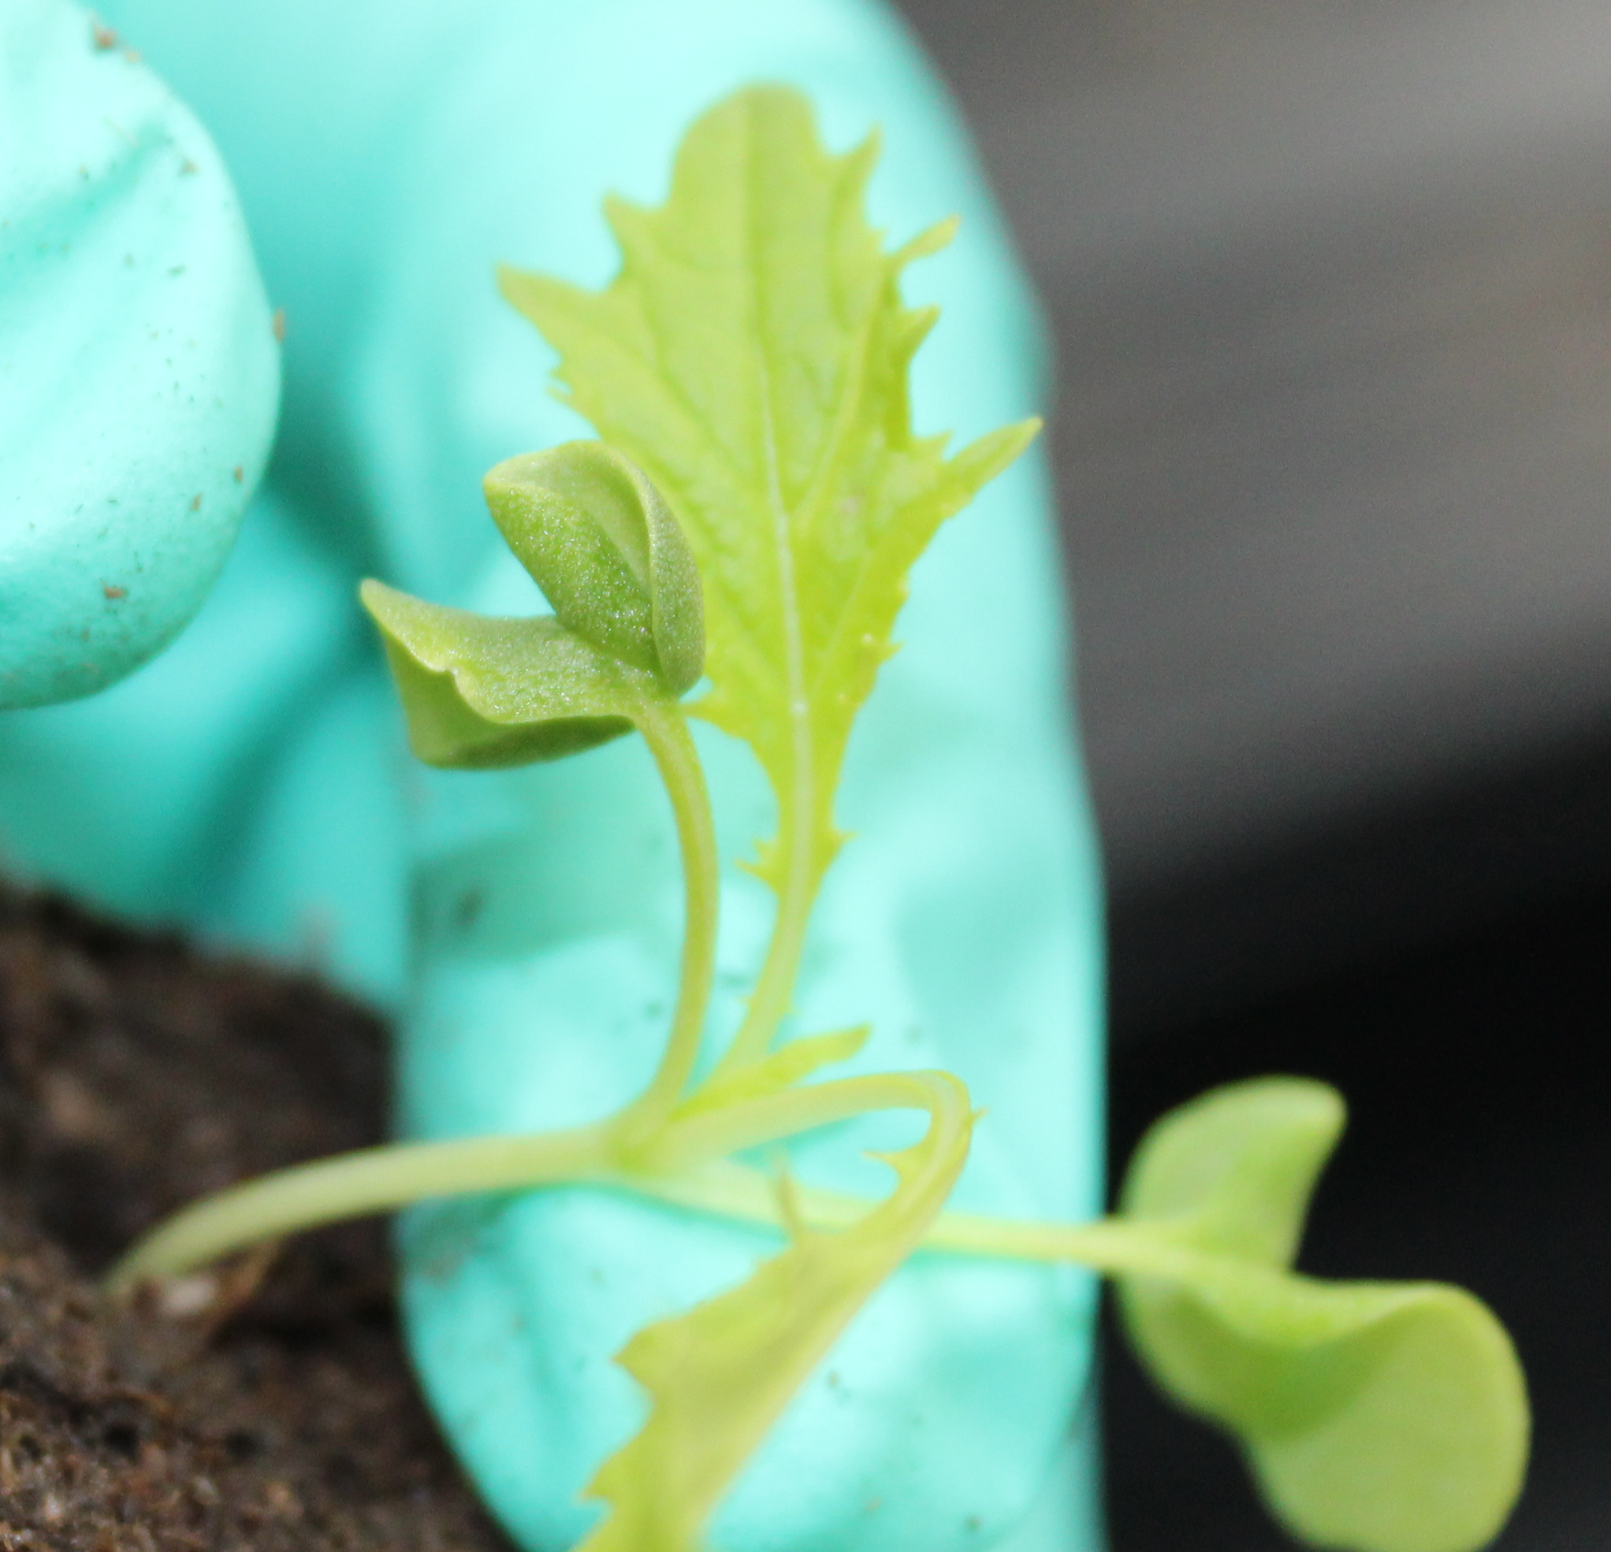
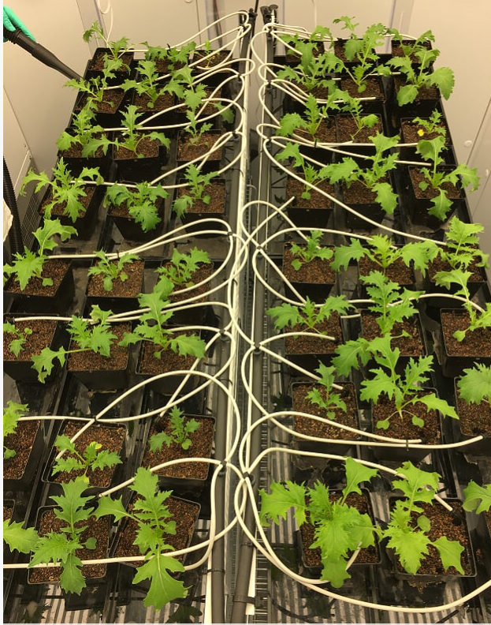
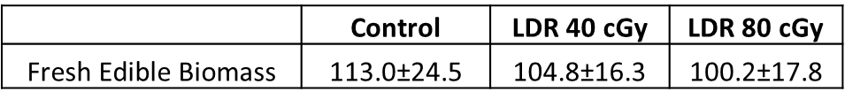
Radiation Effect on Mizuna Seeds
Emergence Rate: No significant changes in emergence rate within different treatment groups (n=25-36 per treatment group).
GCR (Dry)
SPE (Hydrated)
SPE Soil Based Grow-out
DAP 10 (n=36 per group)
DAP 14 (n=16 per group)
DAP 28 (n=16 per group)
Short Summary: 1. Simulated GCR, at LDR, had no significant impact on plant size, weight of edible biomass, and chlorophyll content. 2. Simulated SPE exposure affected early seedling development up to 14 days.

Slide 17
Radiation Effect on Mizuna – Nutrition Value
Ratio to Controls
*
*
*
*
*
*
*
>40% changes
20-40% changes
5-20% changes
In contrary to plant growth results, significant changes were found in nutritional content in plants grown from GCR irradiated seeds (* p<0.05 compared to the controls).

Slide 18
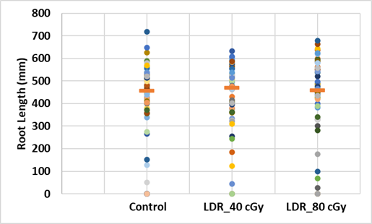
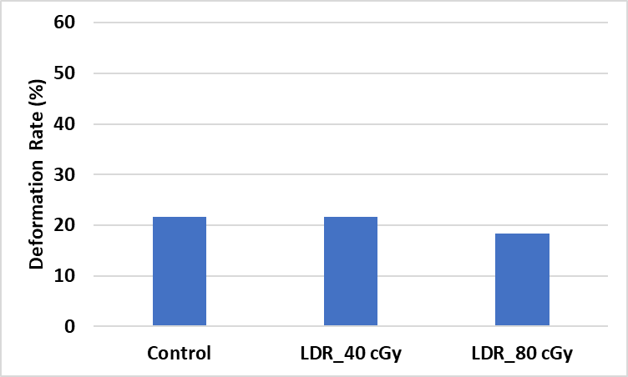
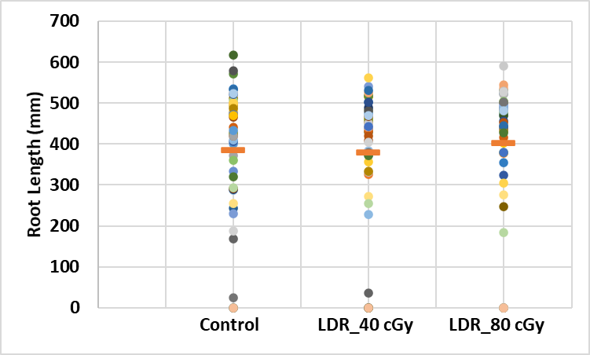
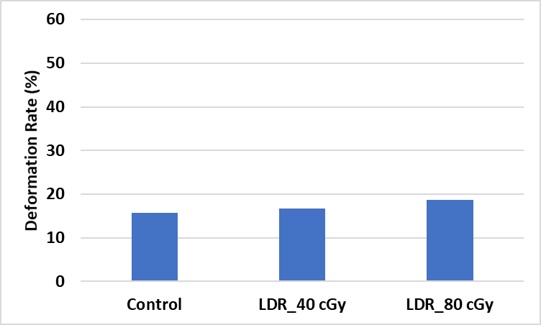
Radiation Effect on Tomato Seeds
Germination Rate: No significant changes in germination rate within different treatment groups (n=48-60 per treatment group).
GCR (Dry)
SPE (Hydrated)
No significant changes were found in root length and signs of stress/deformation in plants from LDR irradiated seeds from Phytogel Petri plate assay.

Slide 19
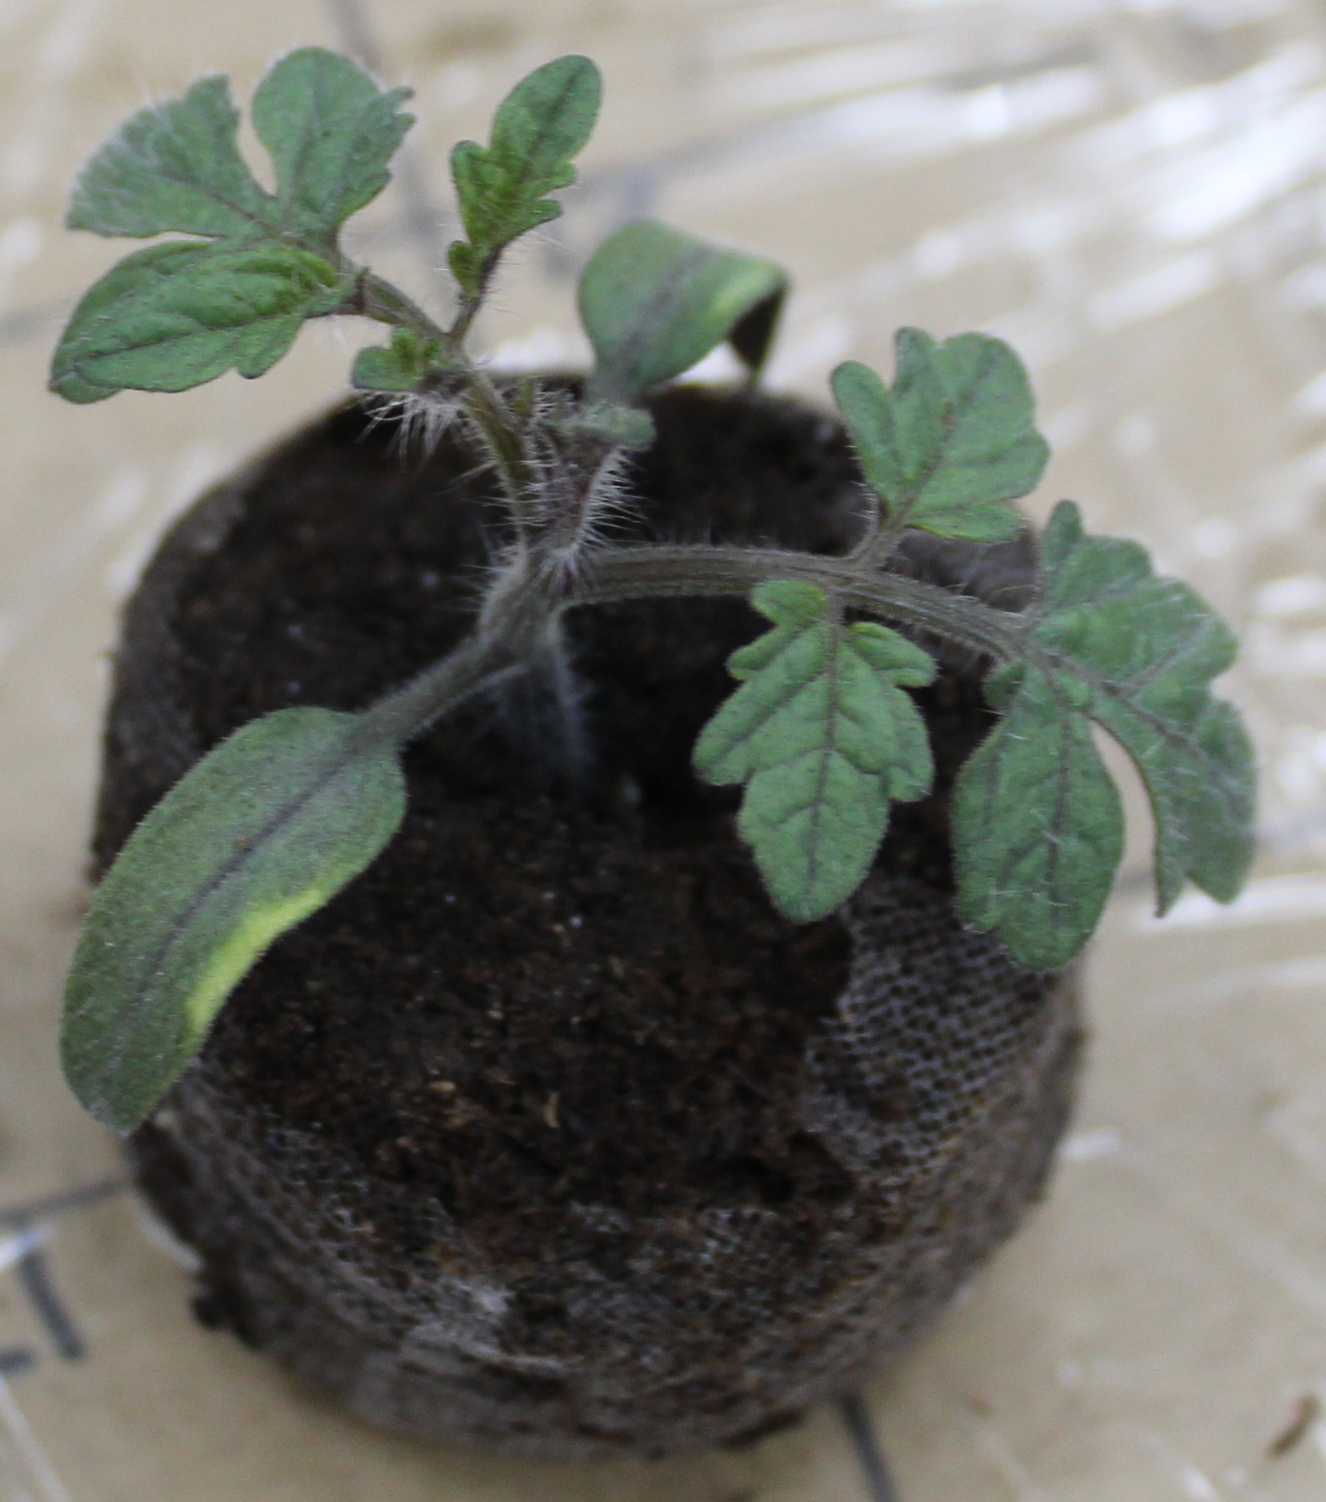
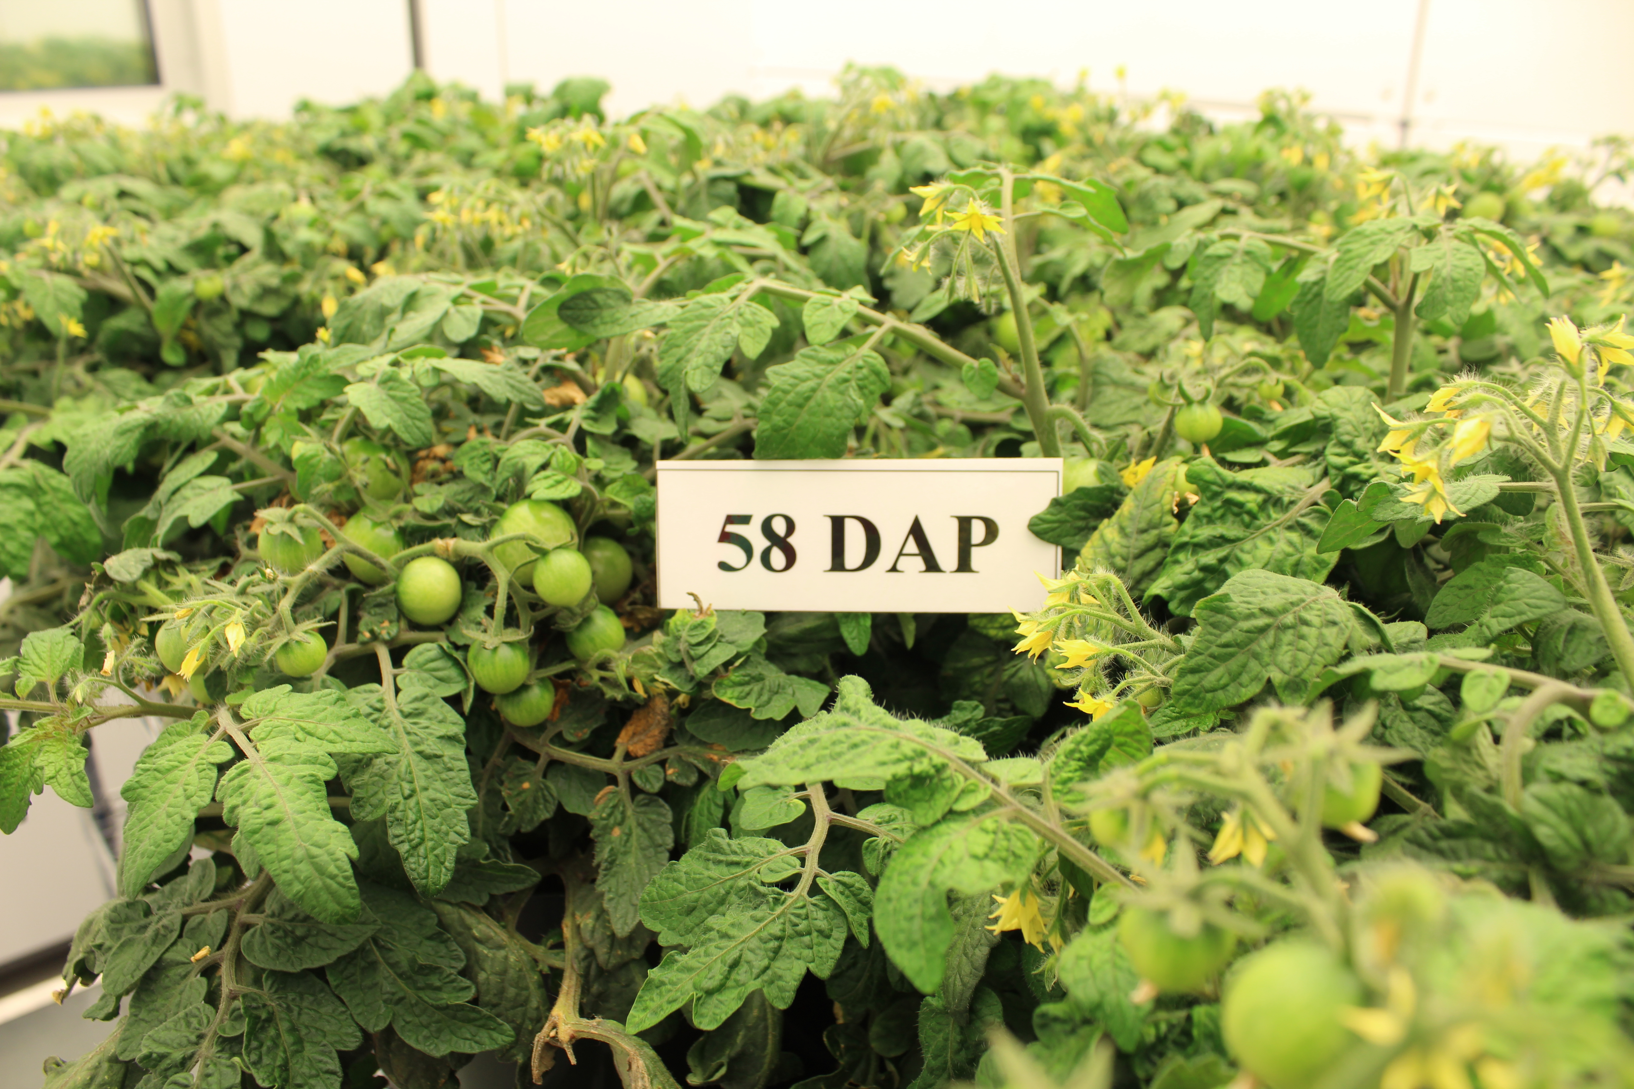
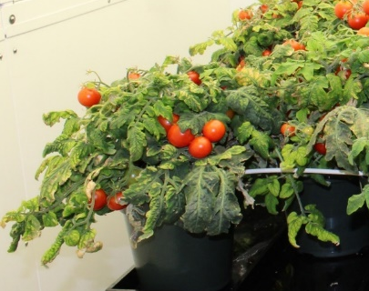
Radiation Effect on Tomato Seeds
GCR
DAP 14 | Emergence Rate (%) | Healthy Seedling (%) | Shoot height (mm) | Shoot diameter (mm x mm)
Controls | 76 | 64 | 34 | 46 x 41
40 cGy | 88 | 48 | 26 | 34 x 27*
80 cGy | 68 | 32 | 18* | 24 x 22*
SPE
DAP 14 | Emergence Rate (%) | Healthy Seedling (%) | Shoot height (mm)
Controls | 100 | 97 | 39
40 cGy | 92 | 86 | 40
80 cGy | 92 | 72 | 32*
 | DAP 72 |  | DAP 79 |  | DAP 91 |  | Total
Per Plant | # of tomatoes | SD | # of tomatoes | SD | # of tomatoes | SD | # of tomatoes | SD
Control | 4 | 5 | 14 | 7 | 65 | 29 | 83 | 18
40 cGy | 4 | 4 | 16 | 6 | 76 | 20 | 96 | 16
80 cGy | 0* | 0 | 8* | 6 | 59 | 30 | 67* | 22
 | DAP 86 |  | DAP 93 |  | DAP 105 |  | Total
Per Plant | # of tomatoes | SD | # of tomatoes | SD | # of tomatoes | SD | # of tomatoes | SD
Control | 30 | 14 | 41 | 15 | 50 | 16 | 121 | 31
40 cGy | 34 | 15 | 27 | 9 | 28 | 18 | 89* | 24
80 cGy | 3** | 9 | 32 | 15 | 44 | 18 | 79** | 20
 | Total Ripe Fruit Mass (g) | Ripe Fruits (Qty) | Unripe Fruits (Qty)
Controls | 662 | 63 | 20
40 cGy | 699 | 75 | 21
80 cGy | 481 | 47 | 20
 | Total Ripe Fruit Mass (g) | Ripe Fruits (Qty) | Unripe Fruits (Qty)
Controls | 1092 | 121 | 24
40 cGy | 773 * | 89 * | 19
80 cGy | 663 * | 79 * | 28
*
*
However, significant changes in tomato plants from early seedling to fruit development in soil based grow-out. The changes are dose-dependent (*p<0.05 compared to the controls).

Slide 20
Radiation Effect on Tomato – Nutrition Value
*
*
*
*
*
*
>40% changes
20-40% changes
5-20% changes
In contrary to plant growth results, the changes in nutrition value were not that significant in tomatoes grown from irradiated seeds (* p<0.05 compared to the controls).

Slide 21
Cross-Species Comparison
 |  | Ti | Protons | GCR1 | SPE | GCR2
Arabidopsis | Seedling Development
Mizuna | Seedling Development _ Plate
 | Seedling Development _ Soil
 | 28 Day Plants
 | Nutritional Value
Tomato | Seedling Development _ Plate
 | Seedling Development _ Soil
 | 90-110 Day Plants
 | Flowering and Fruiting Delay
 | Total Edible Biomass
 | Nutritional Value
Lettuce | Seedling Development _ Plate
 | Seedling Development _ Soil
 | 28 Day Plants
 | Nutritional Value
>40%
20-40%
5-20%
5-10% Promotion
Not significant

Slide 22
Conclusions
Exposure to simulated GCR or SPE has significant impact on early seedling development. Seedlings from irradiated seeds showed cotyledon deformation, discoloration, and other morphological changes.
Simulated pace radiation also significantly affect the yield of fresh produce, especially for tomato, and potentially changing their ability to adapt to other environmental stresses.
Nutrition value of the fresh produce from irradiated seeds was significantly altered, such as folate acid, vitamin C and vitamin K1, which may correlate with how plants respond to radiation induced oxidative stress.
Radiation induced changes were found to be dose-, dose rate- and ion quality-dependent, with heavier ions causing more severe damages. The changes were also plant type and seed condition dependent.
Transcriptomic analysis of Arabidopsis seedlings revealed dose-dependent alterations in pathways showing upregulated DNA repair and DNA damage response and downregulated metabolic signaling pathways.
SPE may cause synergic detrimental effects on seeds (and the plants grown from these seeds), which are constantly exposing to GCR during a long-term deep space mission. Radiation shielding is highly recommended for deep space long-term seed storage, and for protecting plants from SPE caused damages.

Slide 23
Effect of Space Radiation on Plants
Many questions need to be addressed :
Impacts of space radiation on plants in different stages of a plant life cycle, e.g. seeds, germination, seedling growth, embryogenesis, edible biomass, seed maturation.
Impacts on the susceptibility to diseases and plant-microbial interactions.
Impacts on the responses to other environmental stresses, e.g. water, light, CO₂, ethylene, etc.
Impacts on seeds and fresh produce storage.
Determination of the tolerance range for radiation quality and quantity and the shielding requirements for a wide variety of potential space crops.
Descriptive graphic suitable for publishing on the web (2500 – 3500 pixels wide is ideal).
Caption required
More space crop candidates need to be evaluated in combination with other space environment factors, e.g. microgravity, water stress, and hardware constraints.
An example of Mizuna plant from a seed (A) to a seedling (B) growing in a ground environmental chamber (C) or a ISS Veggie unit (D).

Slide 24
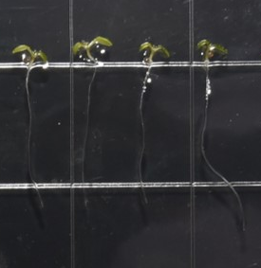
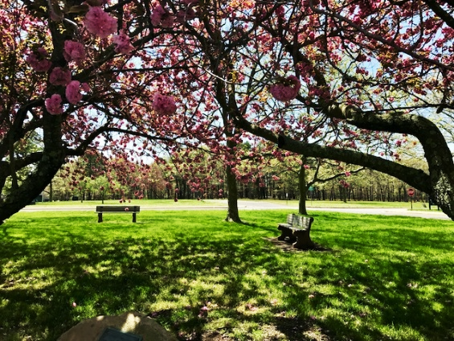
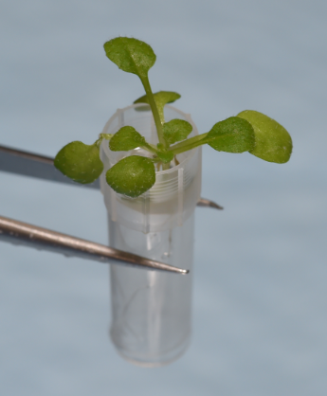
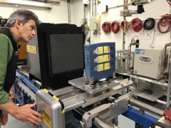
Acknowledgement
Kennedy Space Center
The Utilization & Life Sciences Office and the Food Production Team.
Johnson Space Center
Advanced Food Technology Lab
Radiation Biophysics Lab
Case Western Reserve University
Prairie View A&M University
NASA Space Radiation Laboratory
Our friends at NSRL for supporting our research.
This work was supported by the NASA HRP HHC Element. The preliminary test was supported by the Space Biology Program.
Thank you!

