Slide 1


NASA’s Commercial Smallsat Data Acquisition Program Data Stewardship and Data Management
Wednesday, 26 January 2022; 8:30 - 10:00 AM CST
Aaron Kaulfus¹. Manil Maskey¹, Alfreda Hall², Brian Freitag¹, Anthony Lukach³, Matthew Hicks⁴, Brad Baker⁴ , Ashish Acharya⁴, Chuck Daniels³, Edward Keeble³, Deborah Smith⁴, Damian Ugalde¹, Nia Asemota², Jayanthi Srikishen¹,
Derek Koehl⁴, Will McCarty², Renee Pieschke³
¹NASA Marshall Space Flight Center, ²NASA Goddard Space Flight Center, ³Development Seed, ⁴University of Alabama in Huntsville
102nd American Meteorological Society Annual Meeting, 21st Conference
38th Conference on Environmental Information Processing Technologies

Slide 2
NASA CSDA Program
Pilot Program established in November 2017 transitioning to a sustained Program in early 2020 with the following objectives:
Establish continuous and repeatable processes to onramp new commercial data vendors and evaluate data for its potential to advance NASA’s Earth science research and application activities
Enable the sustained use of purchased data for broader use and dissemination by NASA scientific community
Ensure long-term data preservation through the establishment of data management processes and systems to support rapid evaluation, access and distribution of purchased data, and long-term access to purchased data for scientific reproducibility
Coordinate with other U.S. Government agencies and international partners on the evaluation and scientific use of commercial data
https://earthdata.nasa.gov/csda

Slide 3
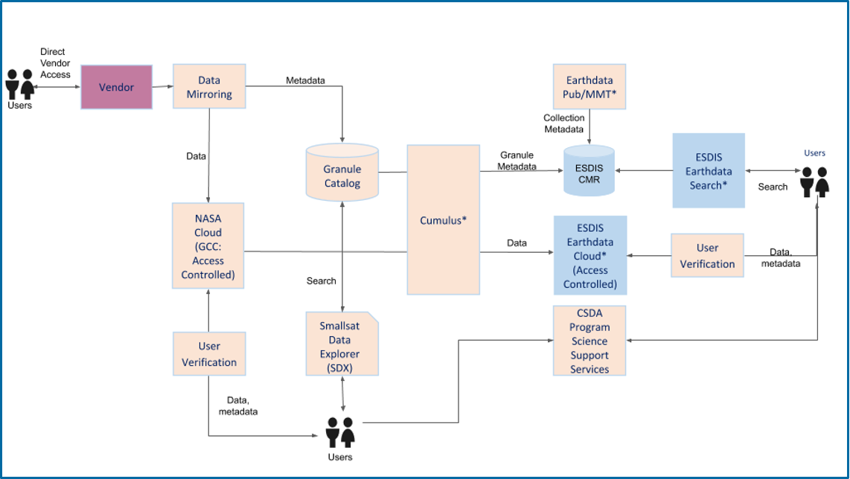
CSDA High Level Data System
The CSDA data team has develop a system to support end science user access to data through three possible scenarios:
Direct from the vendor user vendor provided interfaces
From cloud-based tools developed by the CSDA
Standard NASA Earthdata infrastructure services

Slide 4
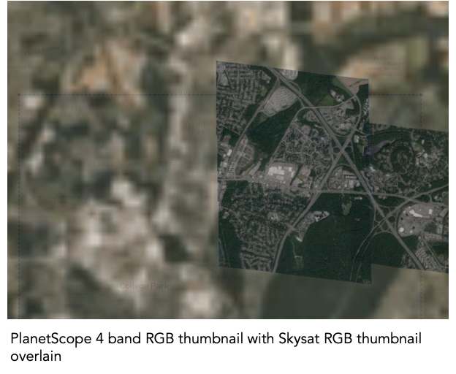
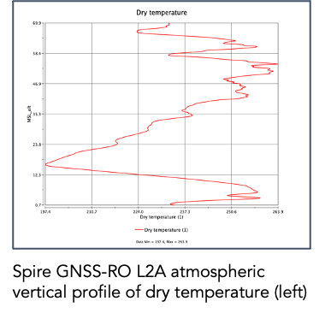
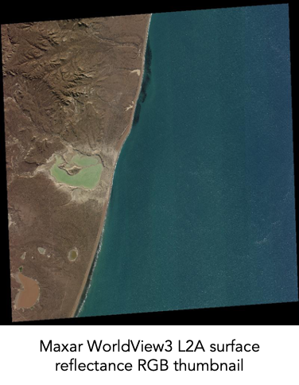
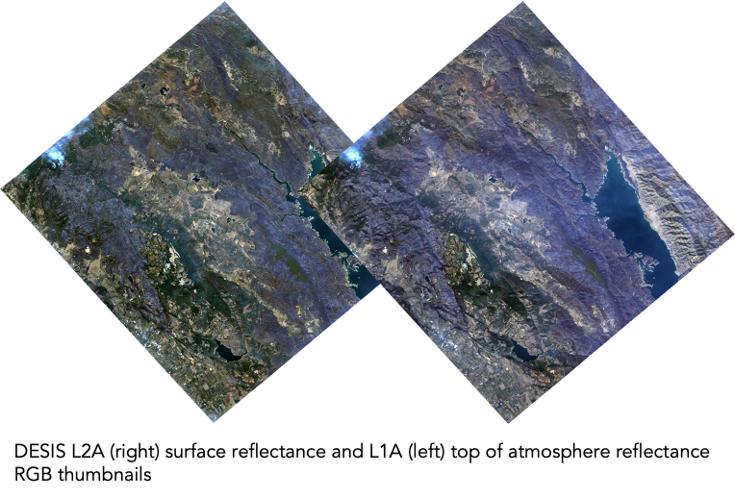
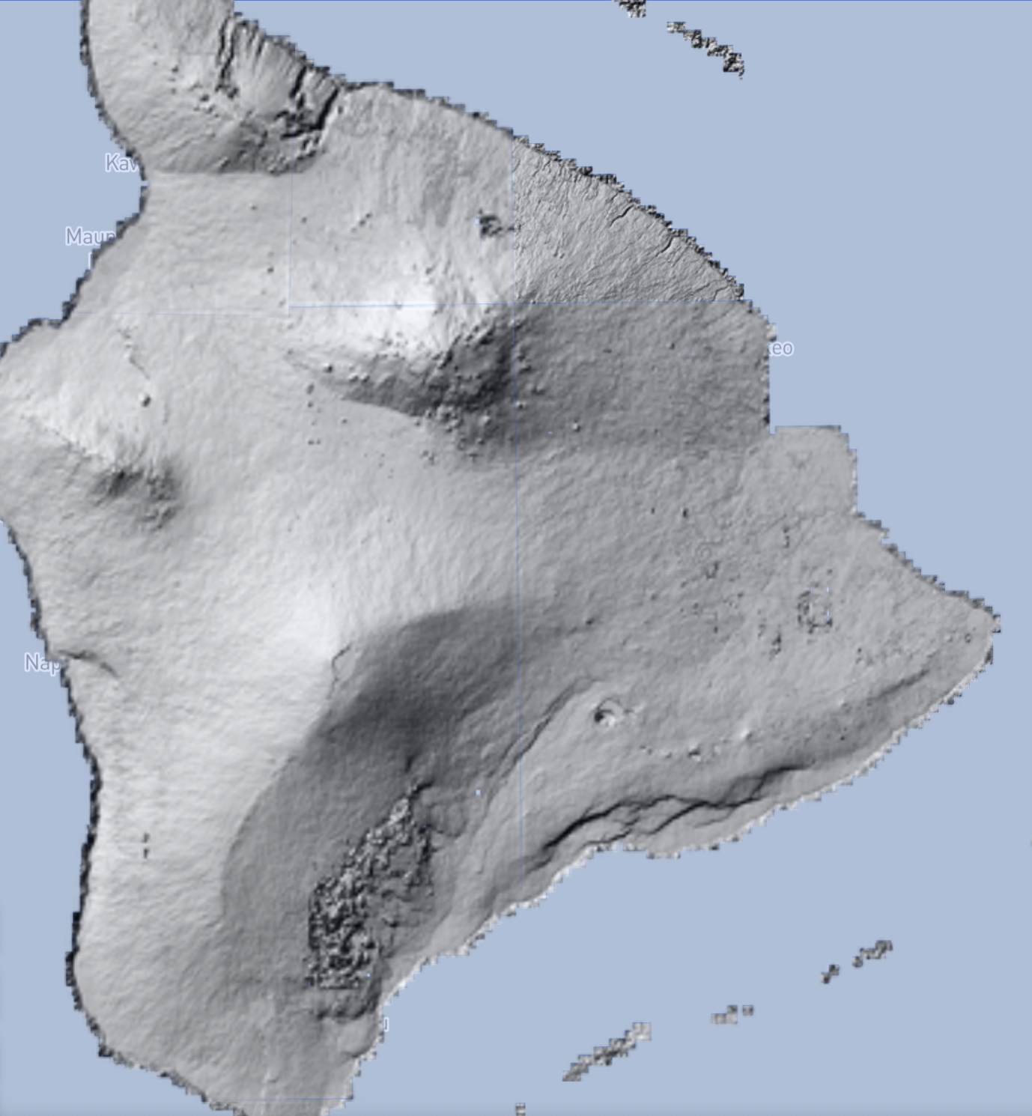
Vendor and Data Product Overview
Vendor | Constellations/ Products | Availability Dates | Orbit Characteristics | Spatial Resolution | Spectral Characteristics | Sample
Planet | PlanetScope, RapidEye | 12/31/2005 - Present | Sun Synchronous | 3 - 6.5 meters | RGB, NIR (440-860 nm), Panchromatic
 | SkySat | 3/10/2015 – 12/12/2019 |  | < 1 meter | RGB, NIR (450-900 nm), Panchromatic
Spire Global, Inc | GNSS Radio Occultation, GNSS Grazing Angle Reflectometry, Satellite Precise Orbit Determination (POD) and Satellite Attitude, Total Electron Content, Ionospheric Profiles, Scintillation, Magnetometer, Raw IF | 9/24/2018 - 4/18/2019 (partial) 11/1/2019 - Present (all) | GNSS-R and GNSS-RO receivers satellites: 37° and Sun Synchronous
Maxar Technologies | Worldview 1-4, GeoEye-1, QuickBird, IKONOS | 10/24/1999 - Present | Sun Synchronous | 0.31 - 4.0 meters | Multispectral and Panchromatic (400 - 2245 nm)
Teledyne Brown Engineering, Inc. | DESIS L1B, L1C, and L2A | 11/21/2018 - Present | Non Sun Synchronous 52° N - 55° S (ISS) | 30 meters | 235 channels, 2.5nm from 402 to 1000 nm
EarthDEM | individual strips and mosaics | 2009 - Present |  | 2 meters
EarthDEM mosaics for Hawai’i

Slide 5
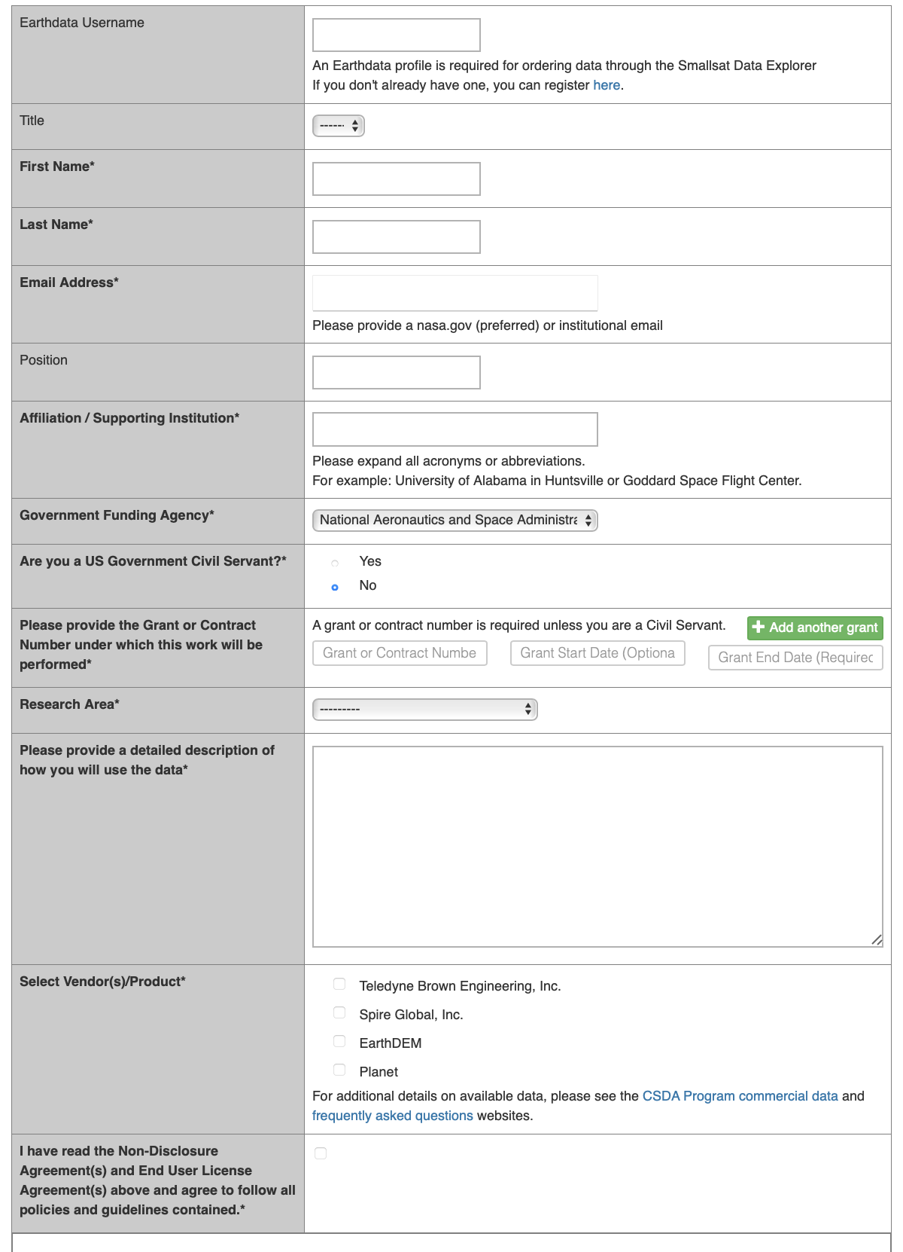
Data Access and Scientific Non-Commercial Use License
All prospective users are subject to authorization prior to approving any data distribution request
Agreement to the vendor specific science end user license agreement
Ability to copy, store, share and use data and derivatives including in scientific and technical articles and publishing academic, technical or professional journals, symposia proceedings, or similar works.
Verification of funding support
Single service authorization request form captures basic user information for account creation and concurrence with respective license agreements

Slide 6
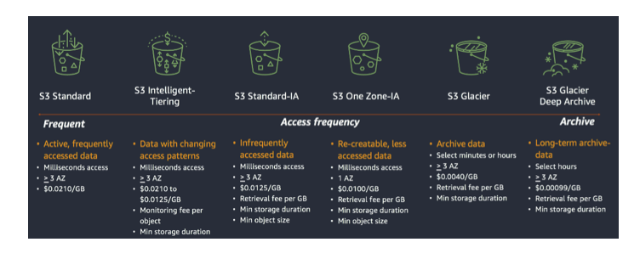

Data Delivery and Storage
The entire CSDA Program data system is cloud native deployed in Amazon Web Services in NASA managed environments
Established repeatable system for vendors upload of data and metadata into S3 buckets
Usage-based, cost efficient storage solution implemented
Inventory and hash based data integrity verification
Upon delivery, all data is indexed in a SpatioTemporal Asset Catalog (STAC)
Standardized metadata schema for describing geospatial data
Flexible means to organize disparate data
Provides uniformity for indexing data assets
CSDA collaborate with vendors to ensure metadata needed for long-term preservation is curated
AWS S3 storage scaling and cost architectures. From https://catalog.us-east-1.prod.workshops.aws/v2/workshops/f238037c-8f0b-446e-9c15-ebcc4908901a/en-US/002-services/002-storage/003-s3
STAC logo from https://stacspec.org

Slide 7
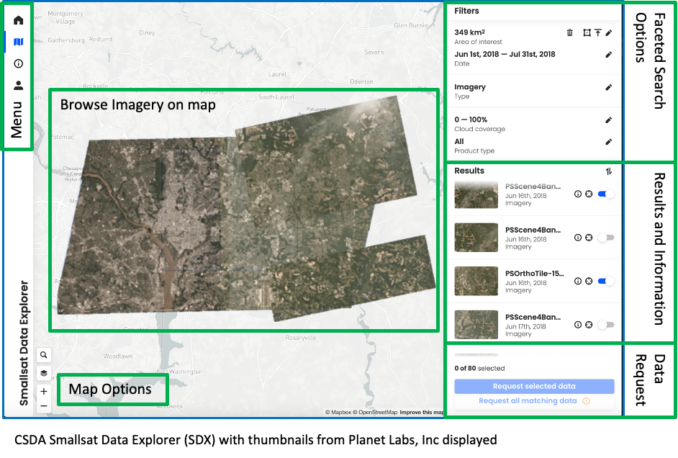
Smallsat Data Explorer
Front-end web application for search, discover, and download of commercial data
Data Faceted Search
  Spatial filtering by drawing on map interface, uploading geojson, or specifying area of interest
  Specify desired temporal extent
  Filter on key medata
Data Discovery
  Geographic representations and quick view display
  Display of product specific, key metadata
Select and Request
  Individual selection of desired granules or requesting all granules that meet search criteria
  Distributed using user specific, signed URLs

Slide 8
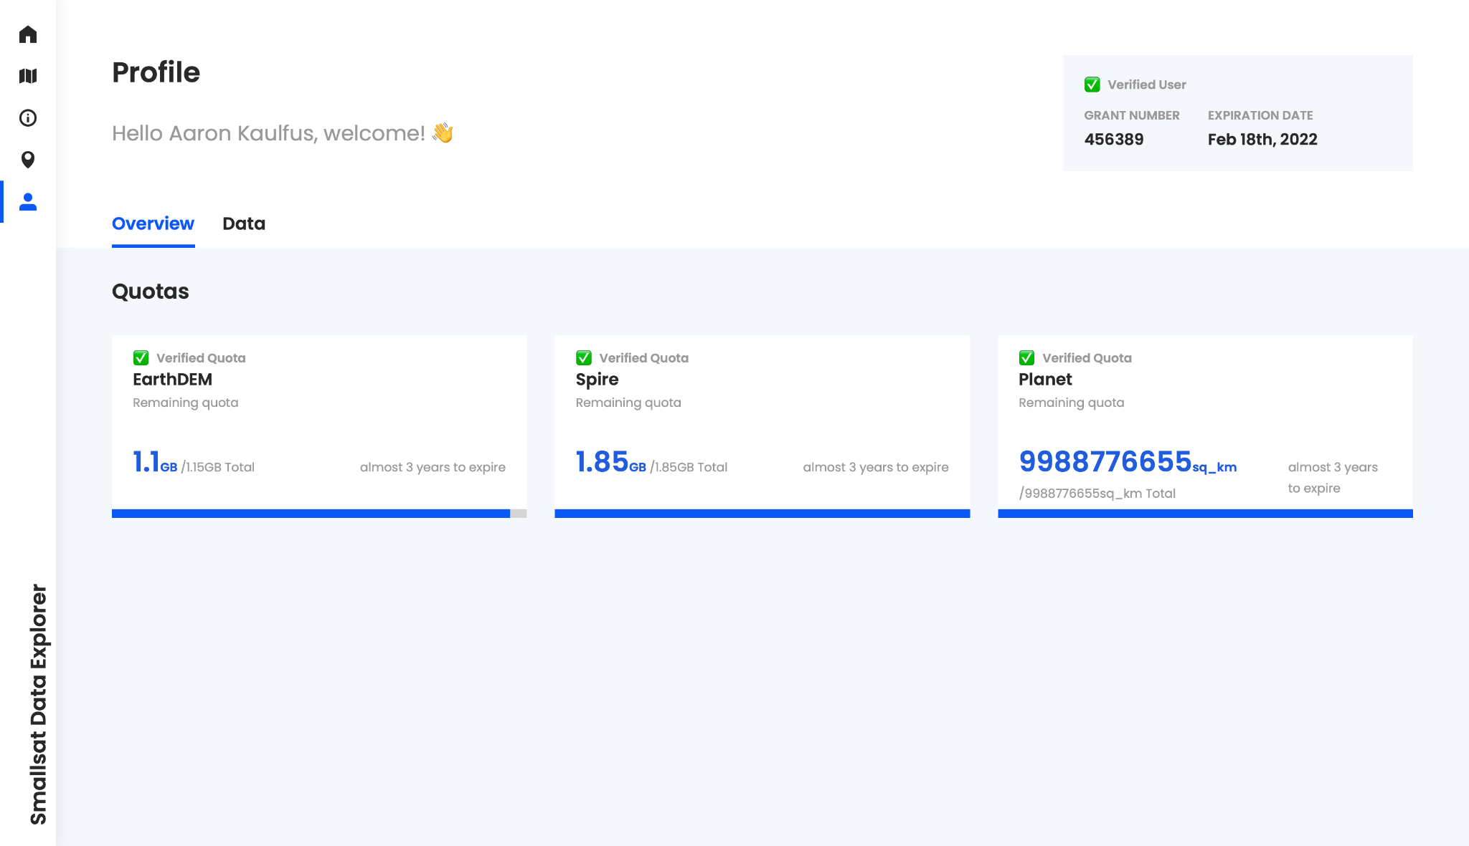
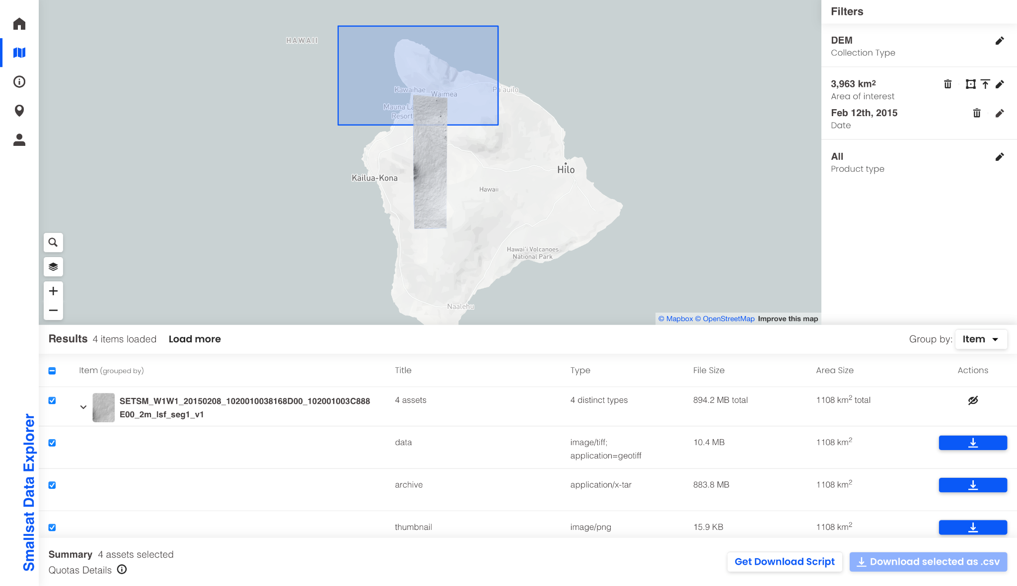
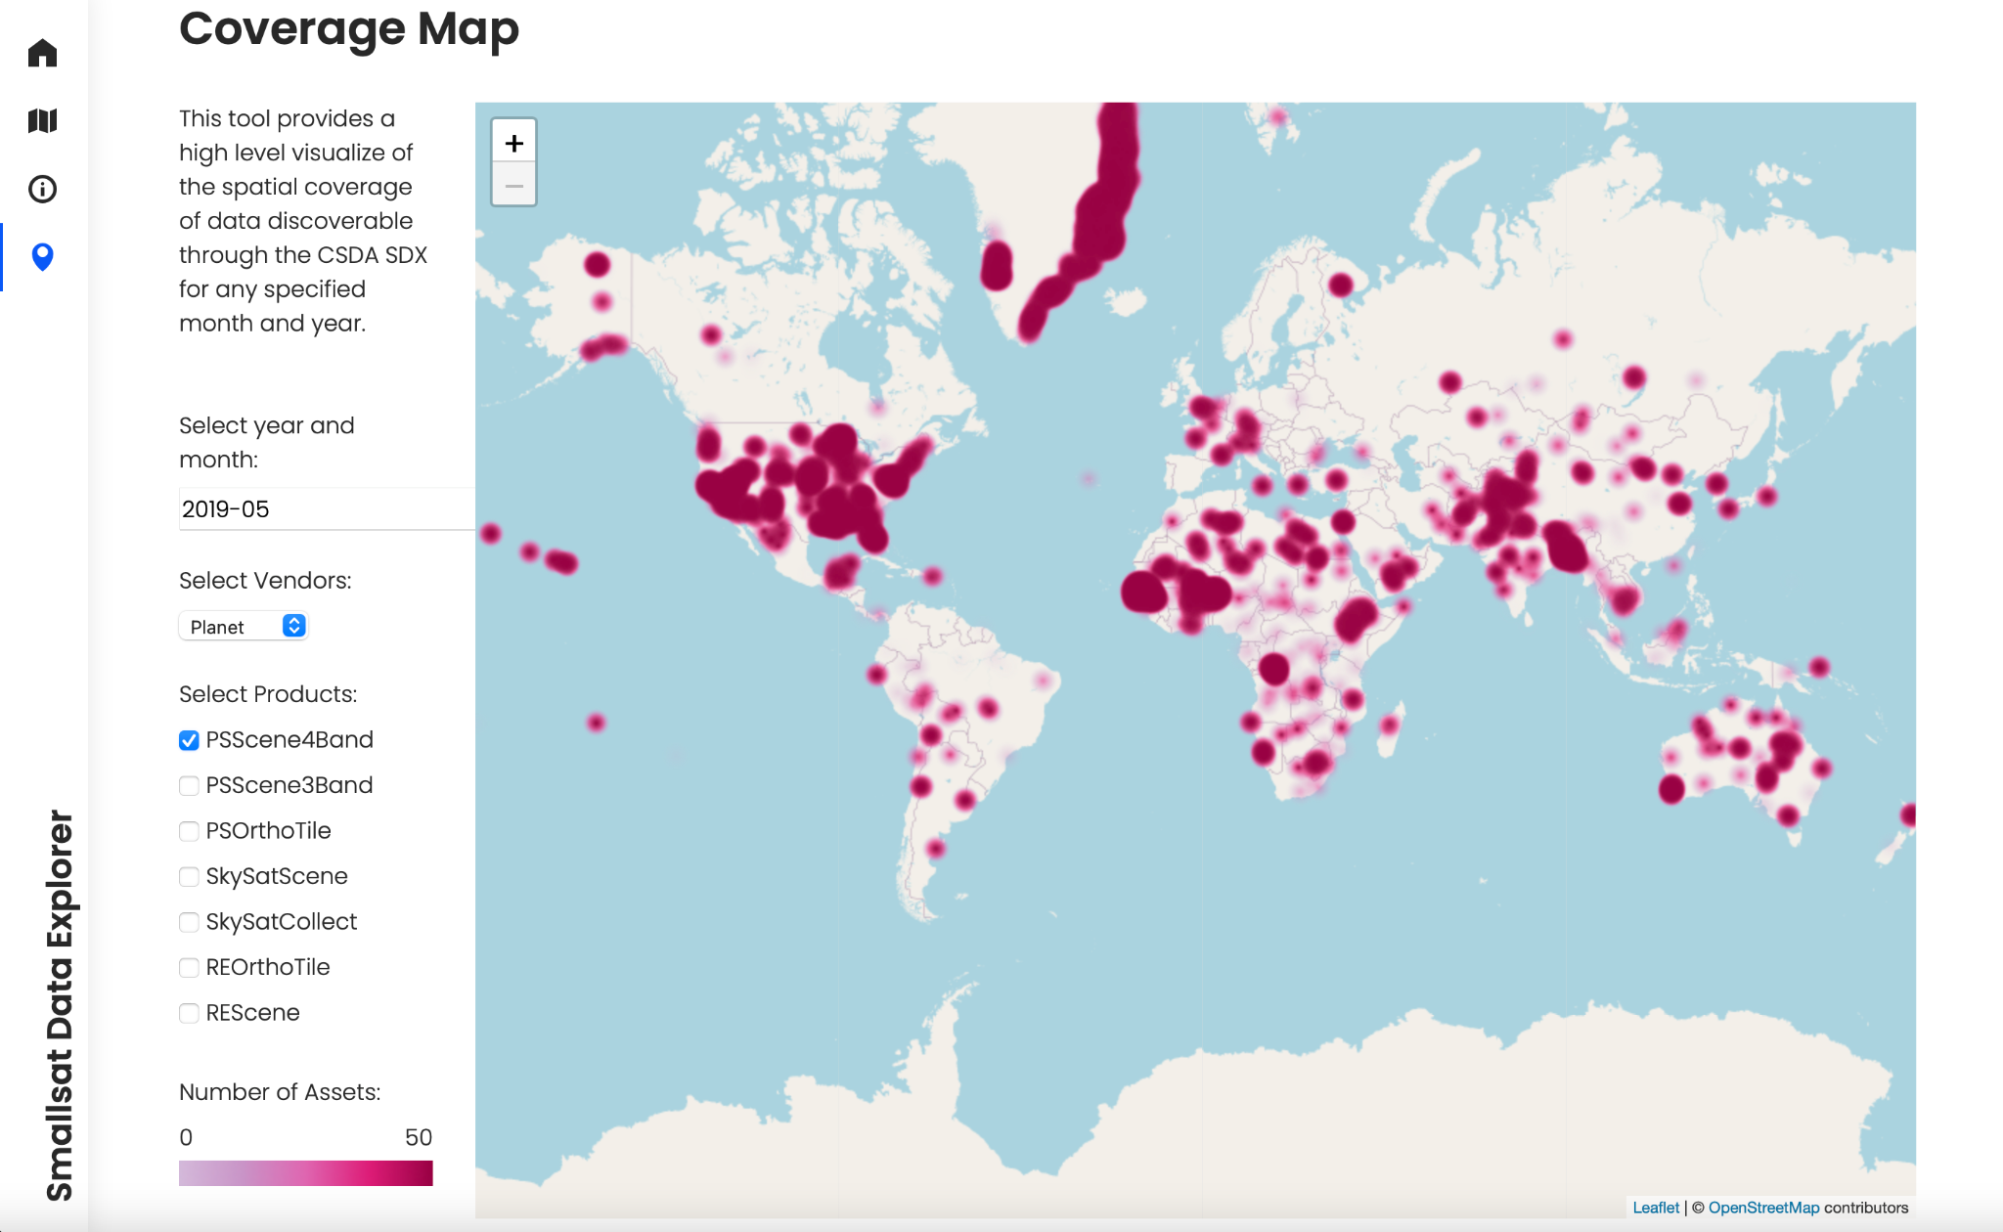
Smallsat Data Explorer - New Features
Revamp of download capabilities transitioning from data request to quota based download system
Removes the current administrator review and deliver system thereby decreasing time from data discovery to download
Enables direct download from the interface for small orders or use the bulk download script provided for scalable download
User profiles provide available quota and downloaded data inventory
Coverage Map for data collections
Supports quick view to determine if data exists in the desired region and time period prior to detailed search
Monthly aggregation with dynamic spatial aggregation using leaflet heatmap
Aggregation from STAC metadata

Slide 9
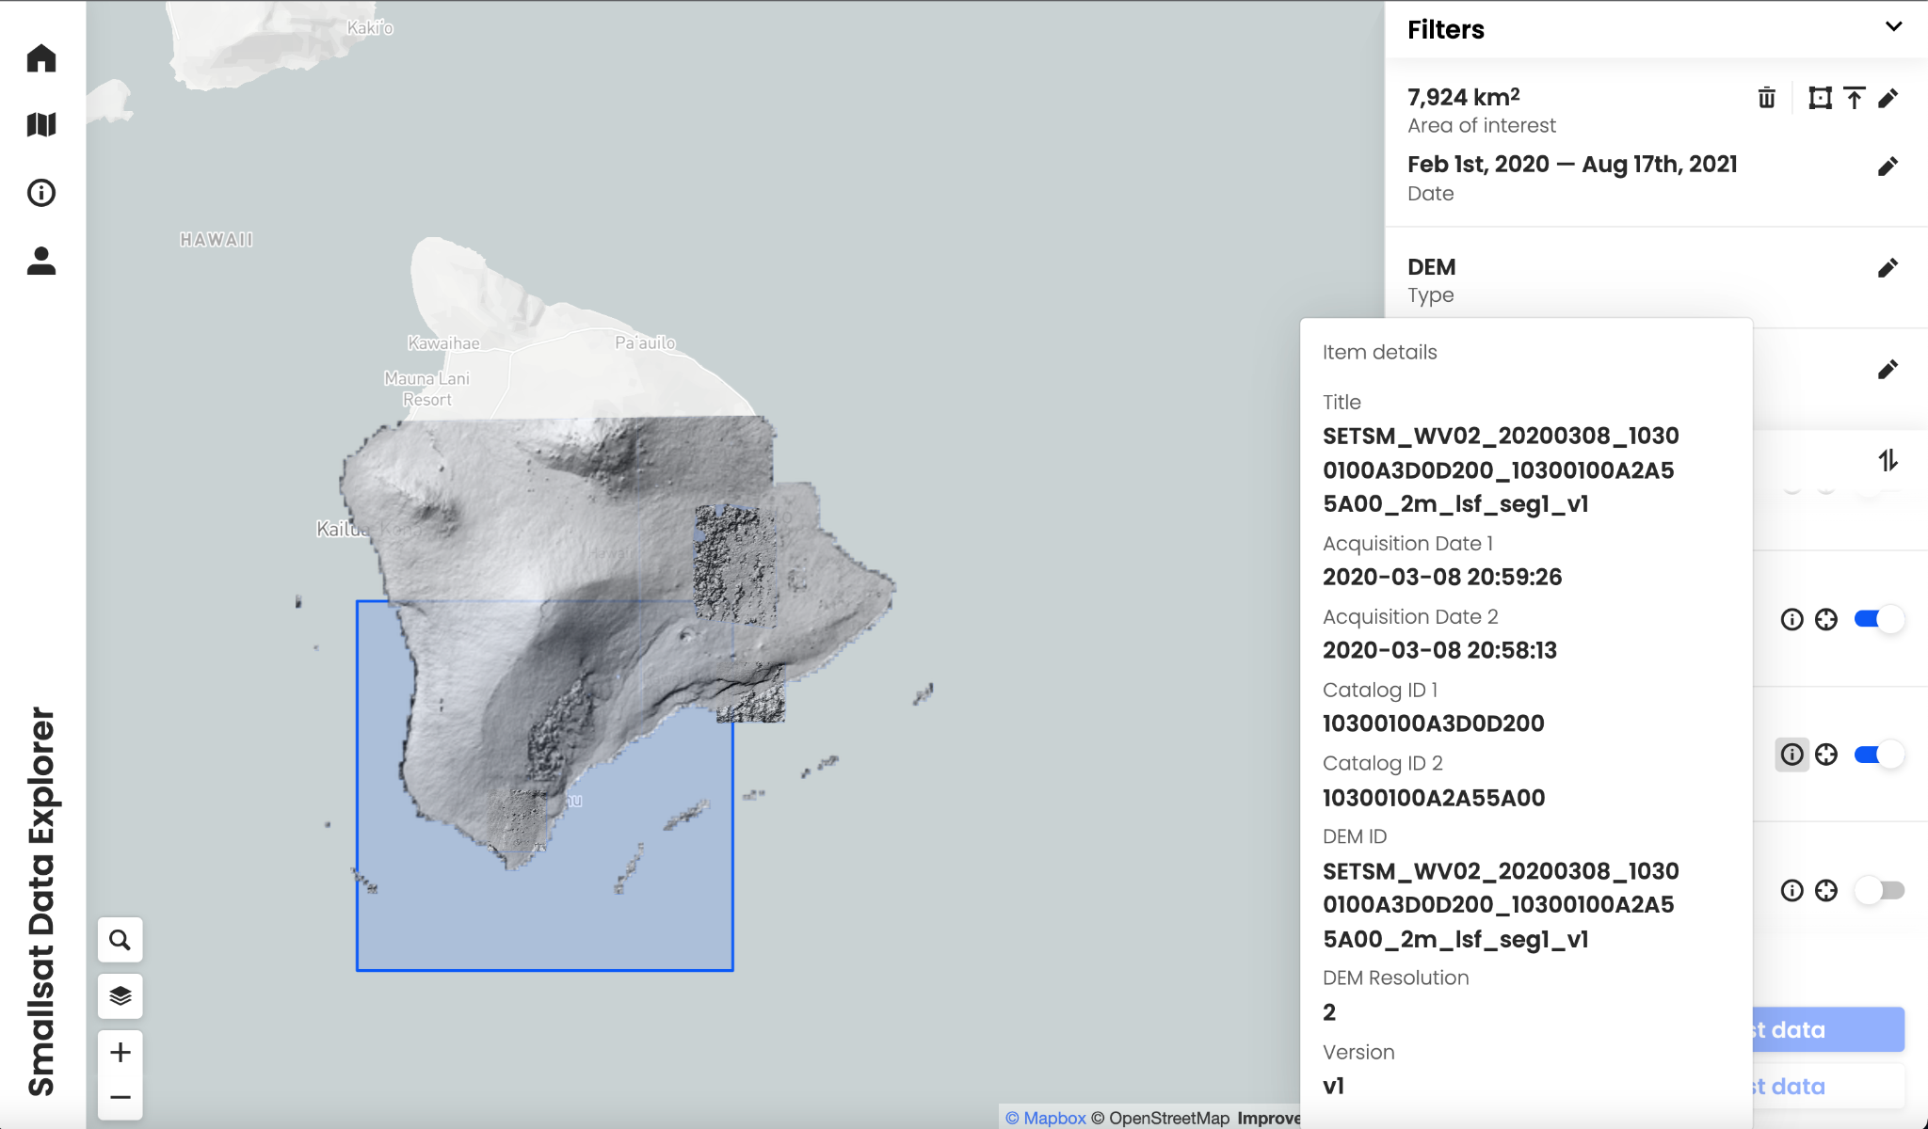
EarthDEM data distribution
High-resolution terrain maps for temperate and tropic regions constructed from DigitalGlobe (Maxar) satellite imagery obtained through the NGA Nextview license. https://www.pgc.umn.edu/data/earthdem
Limited area release to gather feedback on format and usability of 2 meter DEMs
Mosaic tiles (50 km x 50 km)
Individual strip
Integrated into Smallsat Data Explore largely using previously developed, repeatable processes

Slide 10
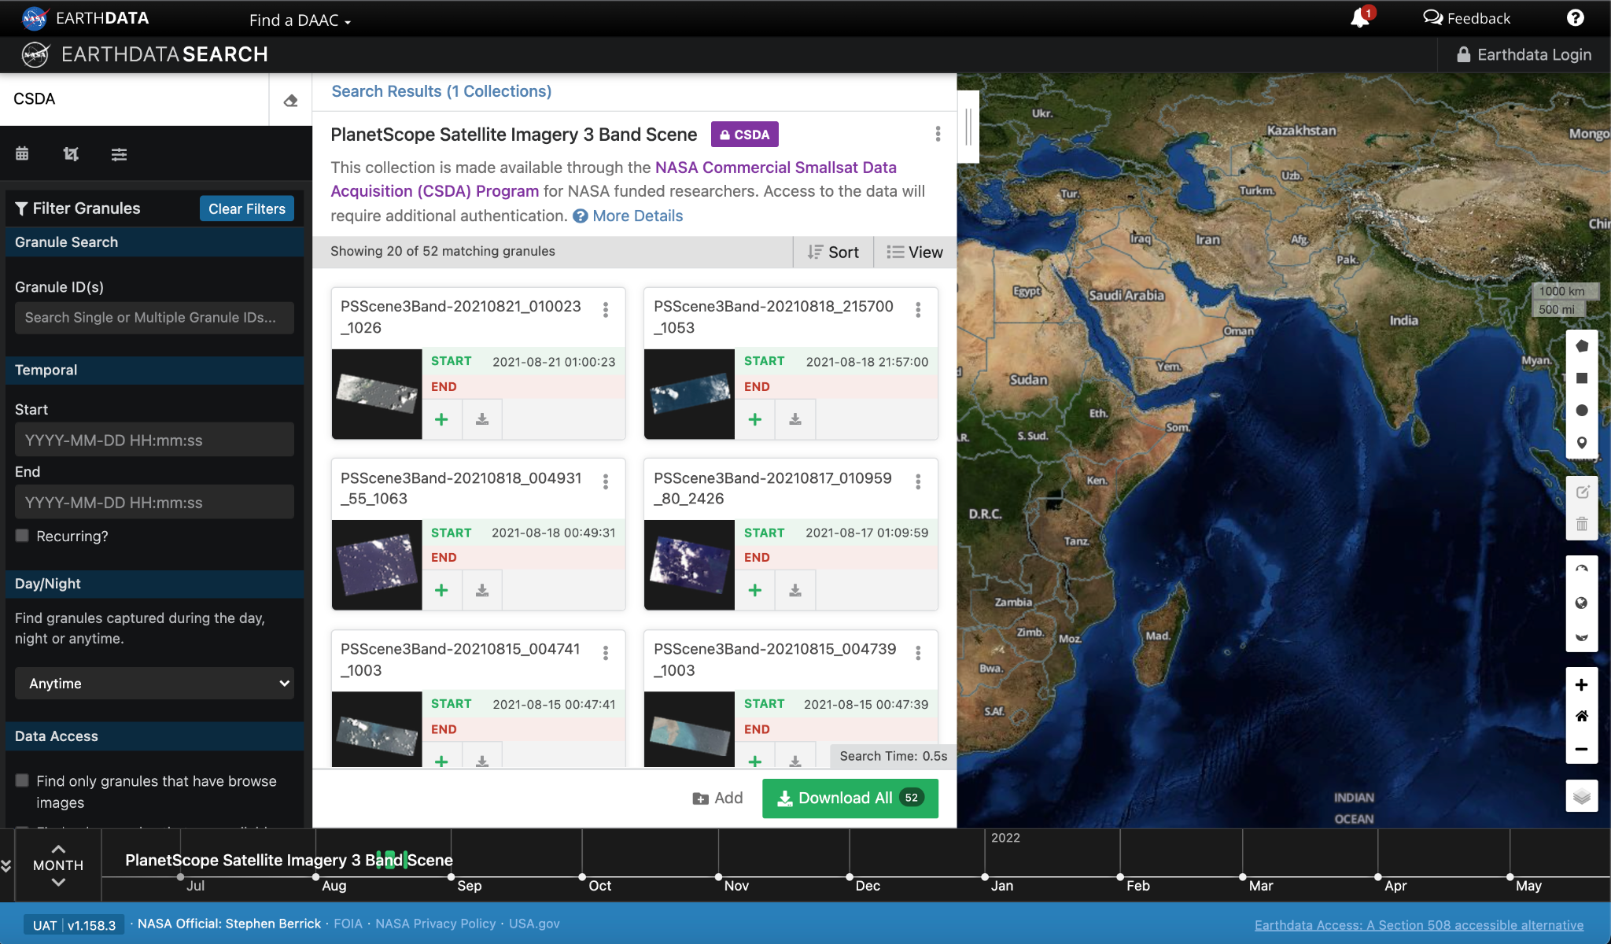
NASA EOSDIS Incorporation
Post to NASA’s Common Metadata Repository (CMR) in Unified Metadata Model (UMM) format
Collection metadata generated using the Metadata Management Tool (MMT)
  Landing page generated from this metadata
  Digital Object Identifier (DOI) created
Created scalable cloud workflow for generating granule metadata
Ingest and archive using the Cumulus service with cloud data backup automated using the Operational Recovery Cloud Archive (ORCA) service
Data discoverable and downloadable through NASA’s CMR, Earthdata Search Client

Slide 11
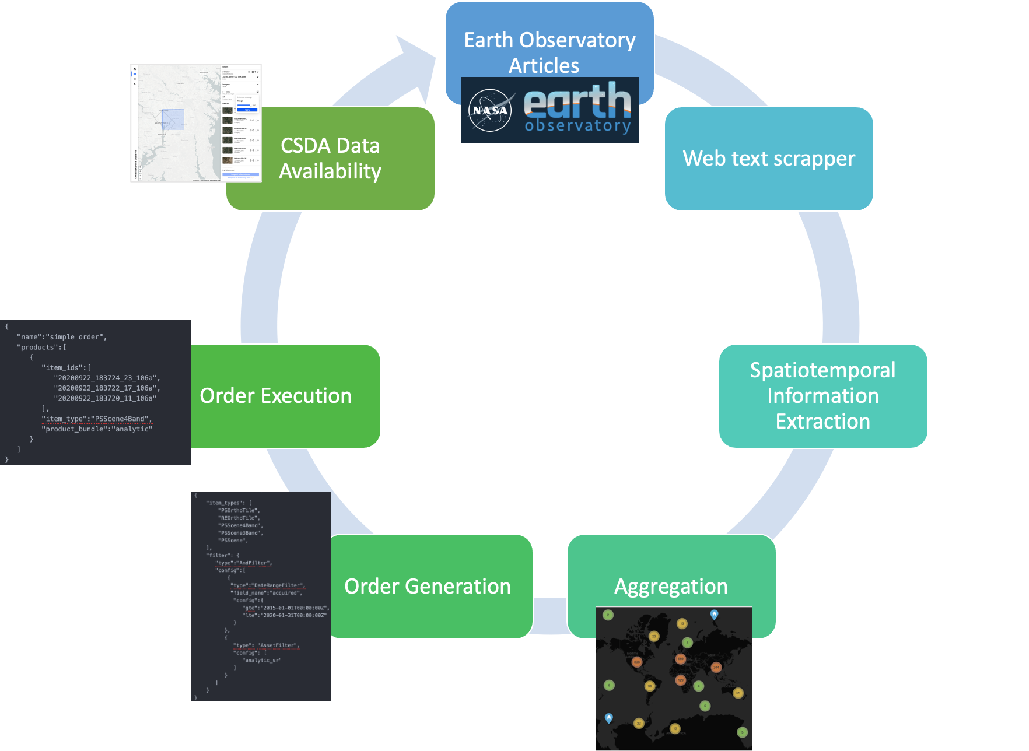



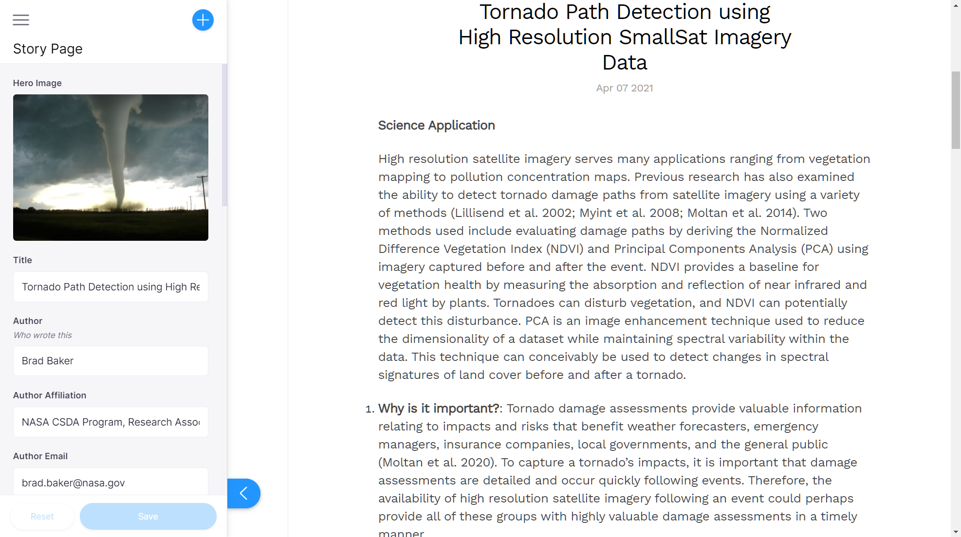
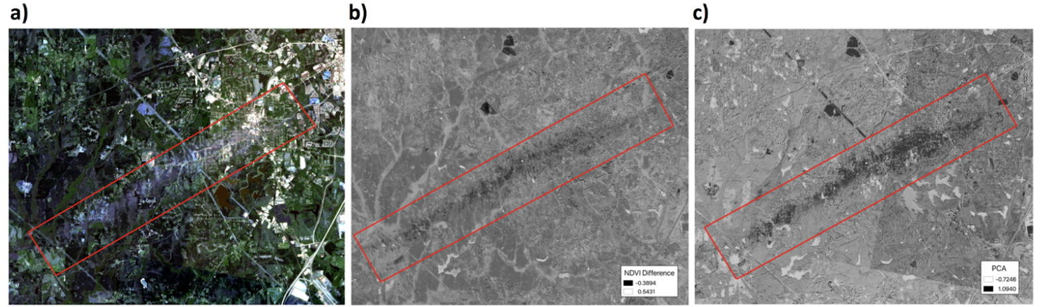
Data Discovery
Data in Action
Provide data information and code through stories highlighting science use cases
High Value Target Acquisitions
Contribute to building a valuable data archive by utilizing NASA resources to identify and acquire data from areas of interest
Story submitted to website
Committed to directory, call Actions to generate Approver HTML
Once reviewers approve story
Call Github Actions to create story HTML and list on site

Slide 12
FY22 Activities and Beyond
Onramp and Evaluation
CSDA releases a new Request For Information for commercial vendors every 12-18 months with the goal of identifying new evaluation candidates
Recently entered into agreement with Blacksky and Airbus for data evaluation
Data from selected vendors will be evaluated by Principal Investigators (PIs) selected through Research Opportunities in Space and Earth Science (ROSES) solicitations
Sustained Use Activities
Consolidate and enhance search, discovery, and distribution for all commercial data products to the SDX
Data service user community research and feedback; update SDX data ordering and distribution system
Long-term Preservation Activities
Continued transfer of Planet data and Maxar data to NASA ESDIS Earthdata cloud infrastructure

Slide 13
Summary
NASA has established the CSDA Program to evaluate and acquire commercial satellite data that supports NASA’s science and application goals
The CSDA data team continues to develop data management procedures which support search, discovery, and access for sustained use of acquired commercial data
To request access to CSDA managed data, subject to review and approval
Planet, Spire, DESIS, EarthDEM - CSDA user authorization request form
Maxar - sign up through CAD4NASA

Slide 14

Thank you.

