Slide 1
Human Specimen Repository: Sample Collection for the Future [#1133-000445]
C. P. Torres¹, D. Byerly², and A. Jeevarajan²
¹KBR (2400 NASA Pkwy, Houston, TX 77058, JSC-HSR@mail.nasa.gov)
²NASA (2101 NASA Pkwy, Houston, TX 77058)

Slide 2
Why a Comprehensive Inventory
March 2014- Executive Memo “Improving the Management of and Access to Scientific Collections”.
HRP directed project to create a repository for all residual human samples to be inventoried, stored, and available for future redistribution to the scientific community at-large for additional research opportunities.
HHPD, Biomedical Research and Environmental Sciences Division review of all samples in long-term storage began in May 2018 to find possible candidates for inclusion in Human Specimen Repository (HSR).

Slide 3
Challenges to a Comprehensive Inventory
Multiple sample types (Urine, Saliva, Whole Blood, Serum, Plasma, Extra Cellular Fluid)
Multiple sample sizes: 0.5, 1.0, 2.0, 4.0, 10, 12, 30, 50, 60 milliliter sample containers with various volumes of sample
Non-uniform and hand-written sample labels which included short- hand from multiple projects and laboratories
Requirement for a secure, comprehensive sample information management system

Slide 4
Sample Processing Best Practices
Two person teams for sample inventory data collection
Samples separated into small batches for ease of handling and to minimize exposure time
All sample processing conducted on dry ice and with appropriate PPE
Ultra Low freezer continuously monitored to ensure temperature stabilization
All sample files were stored on secured servers
Sample data post-processing included validation with LDSA records and originating laboratory when possible
All Samples transported by lab personnel in dry ice

Slide 5
Human Specimen Information Management System (HSIMS)
NASA IT developed a specimen information management system
Fully integrated into NASA IT environment
Meets 2-factor authentication and NAMS workflow requirements
Use of LSAH servers to leverage data security
HSIMS
Capable of handling multiple data sets
Highly customizable to user criteria
Allows for individualized access authorization down to individual sample records
Comprehensive search and multiple reporting capabilities
Automatic encoding of subject identification
Fully integrated with LSDA website

Slide 6
Current Sample Collections
Archival Residual Sample Collection
16,691 Current samples in inventory Dates: May 1973 thru May 2007 No standard pre-analytics | General Characteristics: 5 NASA Programs 53 Missions 139 Test Subjects 6 Sample Types
NASA Biological Specimen Repository (NBSR)
5218 Current Samples in Inventory Dates: August 2007 thru January 2019 Pending Samples: 44 (January 2019 thru Present) CAP Certified Pre- and Post- flight collection Pre-analytics provided by Clinical Laboratory | General Characteristics: 1 NASA Program (ISS) 52 Increments 61 Test Subjects 3 Sample Types

Slide 7
Archival Residual Sample Collection

Slide 8
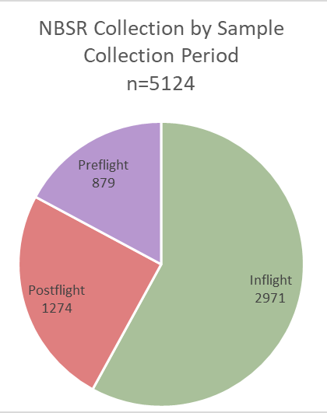
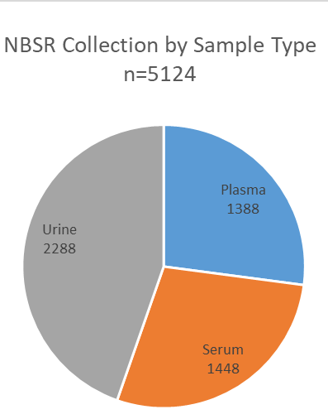
NASA Biological Specimen Repository
Sample Meta-data include:
Unique Sample HSIMS ID
NBSR Accession number
Test Subject (de-identified)
Sample type
Sample collection period (pre-,in, post-)
Sample collection dates (actual and relative, if available)
Mission/Increment
Pre-analytics performed by clinical laboratory

Slide 9
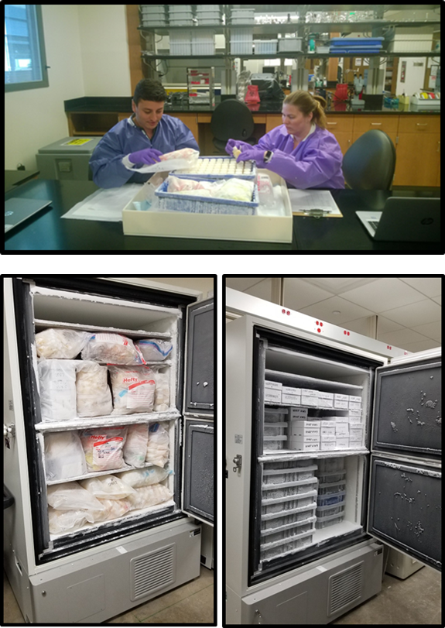
Results of the Comprehensive Inventory
Generate a tube-by-tube inventory
Archival Residual samples from 265 batch records to 27,335 sample records
NASA Biological Specimen Repository (NBSR) samples from 985 accession records to 5,124 sample records
Standardize and secure storage of samples
Moved from plastic bags and racks to standard cardboard freezer storage boxes and hard plastic boxes which allow for row/column identification of samples
De-identification and Uniform Labeling
All PII and PHI was removed from historic samples and replaced with new label with 3-D barcode
Secure and accessible long-term data storage

Slide 10
Future Sample Collections
NASA Biological Specimen Repository (NBSR)
Samples from close-out of the study
NASA Omics Archive (NOA)
Pilot study set to begin Q3 FY21
Full Project to activate NLT FY22
Pending completed studies from internal investigators:
Nutritional Biochemistry Laboratory
Immunology & Virology Laboratory
Pending completed studies from external investigators:
Twins Research Project and others

Slide 11
Participation Options
To contribute archival residual samples to HSR
Initial contact through jsc-hsr@mail.nasa.gov
HSR Coordinator will request sample information and send appropriate shipping labels
Sample Requests:
Not yet operational
HRP is currently developing protocols for approval of sample use and distribution
All requests will be tied to a reviewed and approved proposal

Slide 12
Acknowledgements
Special thanks to the Human Research Program for funding and support
SK Team
Antony Jeevarajan, NASA Project Lead
Marci Paden, NASA Project Management
Cruz P. Torres, KBR HSR Lead
Sample Processing and Data Collection:
Jimmy Zaid
Shelly Chauvin
Jayati Roy Choudhury
Teresa James
Joel Patlan
Lisa Marie Martinez
Linda Johnson
Clinical Laboratory
Kathleen McMonigal, M.D.
Ryan Linde
AMES LSDA
Helen Stewart
Alan Wood
Laboratory SMEs
Scott Smith
Brian Crucian
Diane DeKerlegand
Mayra Nelman
Amanda Lauret
Eden Fields
Patti Gillman
Joan Robertson
LSDA/LSAH Team
Mary Van Baleen
Diedre Thomas
Carol Warren
SA IT Team
Nina Ebiteh
Abul Chowdhury
Daniel Febus
Andrew Howes
Peter Lawrence

Slide 13
Back-up Slides

Slide 14
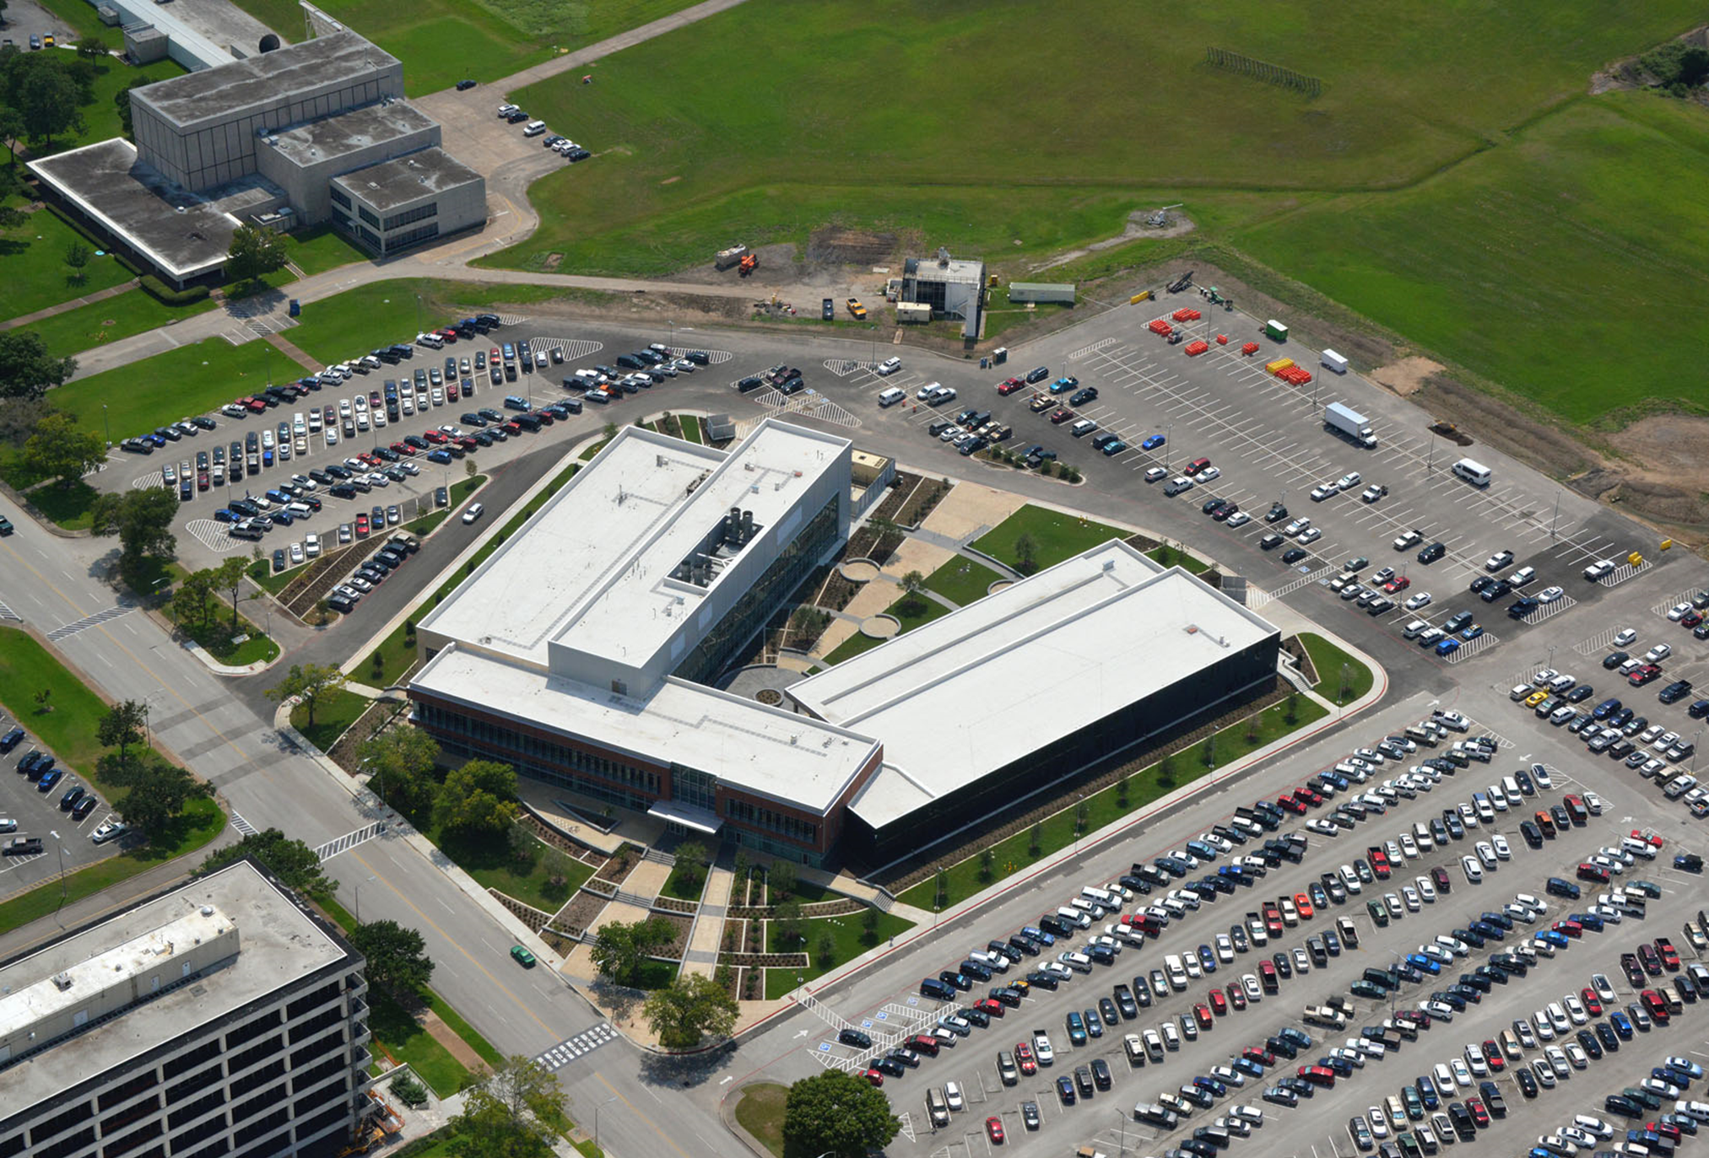

Slide 15
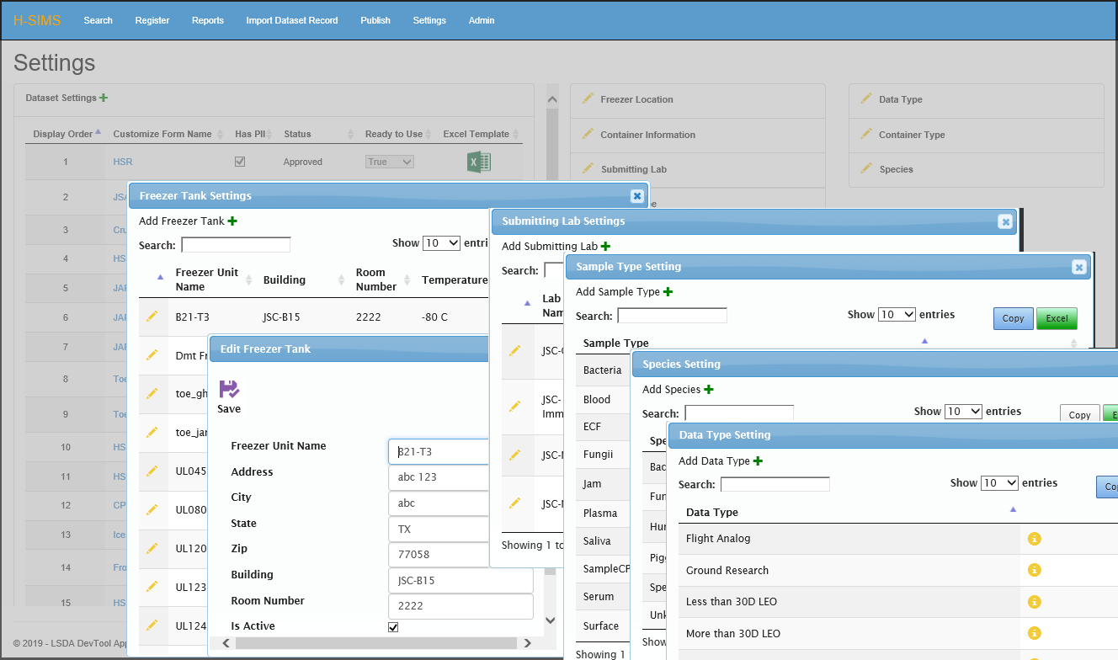
Human Specimen Information Management System Data Entry Forms

Slide 16
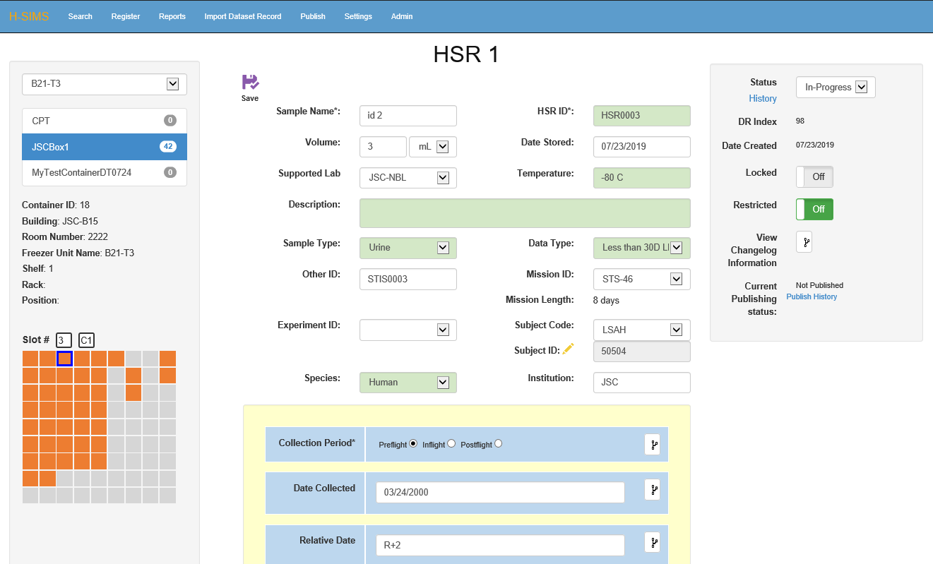
Human Specimen Information Management System Sample Record

