Slide 1
LTV Proposed Acceleration Requirements
K. Dolick¹, N. Newby², T. Reiber², J. Somers³, D. Adelstein⁴, L. Stone⁴
¹GCS, Houston, TX
²KBR, Houston, TX
³NASA Johnson Space Center, Houston TX
⁴NASA Ames Research Center, Mountain View, CA

Slide 2
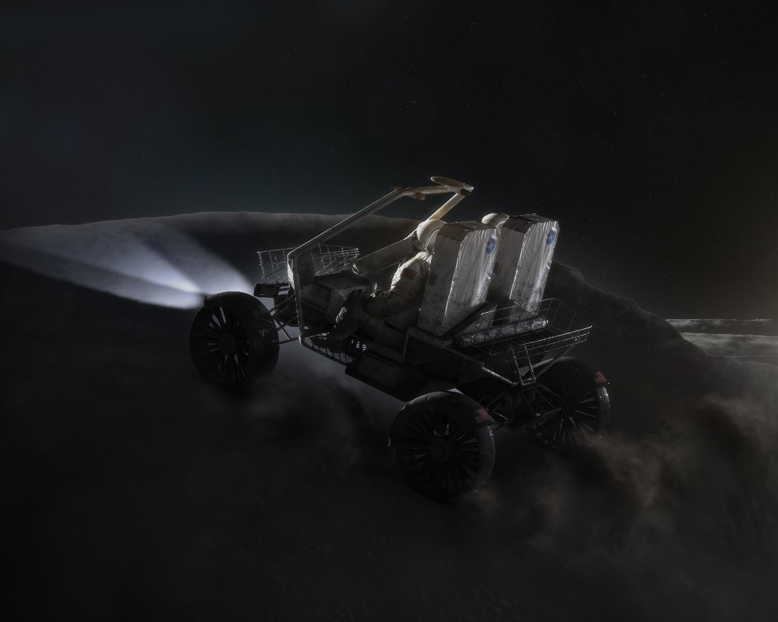
Applied Injury Biomechanics
Background, Tasks & Deliverables
NASA is preparing for future Artemis missions that will return humans to the lunar surface
A Lunar Transport Vehicle (LTV) is planned to enhance exploration capabilities
We have been tasked to develop preliminary standards (with accompanying rationale) for LTV on acceleration, jerk, vibration, comfort and blunt trauma
A TIM was held to review/update the LTV draft requirements
  External SME Participants:
    Suzanne Smith, USAF – Vibration & Comfort
    Greg Goetchius, Joby Aviation – Vibration & Comfort
    John Bolte, Ohio State University – Blunt Trauma
Final requirement set delivered to NASA June 2021
Concept image of Artemis LTV – Source: nasa.gov
2

Slide 3
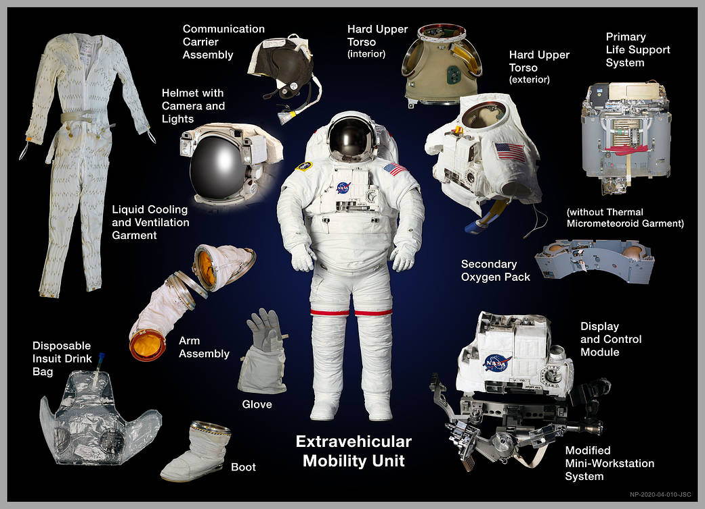
Applied Injury Biomechanics
Considerations & General Assumptions
Unpressurized crewed rover
Crew will be wearing an EVA spacesuit
Intra-suit restraints vs no intra-suit restraints
Performance & Crew Health limits
Occupant centric requirements
EMU Suit & Components – Source: nasa.gov
3

Slide 4
Applied Injury Biomechanics
Basis for Requirements
Acceleration requirements tailored from the SLS Emergency Egress System requirements
  Based on ASTM F2291 standard for amusement park ride design
Jerk requirements tailored from the SLS Emergency Egress System requirements
  Based on ASTM F2291 standard for amusement park ride design
Vibration health and comfort requirements tailored from NASA-STD-3001, ISO 2631-1, MIL-STD-1472H, and MIL-STD-1472G
Blunt trauma requirements based on Anthropometry & Biomechanics Facility (ABF) human volunteer testing data
4

Slide 5
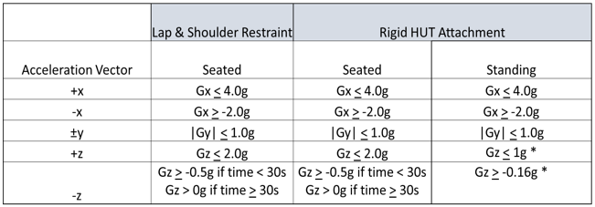
Applied Injury Biomechanics
LTV Sustained Translational Acceleration Requirements
The LTV system shall limit the magnitude of crew exposure to sustained (>0.5 seconds) translational acceleration by staying below the limits in Table 1, which specify the ±Gx, ±Gy , and ±Gz translational acceleration limits appropriate for specific restraint conditions.
Table 1: Lunar Transport Vehicle Sustained Translation Acceleration Limits
5

Slide 6


Applied Injury Biomechanics
Thank you!
Email:
kevin.r.dolick@nasa.gov

Slide 7
Applied Injury Biomechanics
Backup Slides

Slide 8
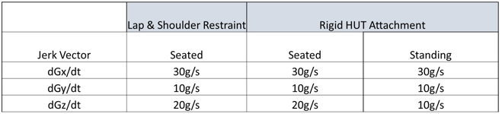
Applied Injury Biomechanics
Jerk Requirements
The LTV system shall limit the crew exposure to translational jerk by staying below the limits in Table 2, which specify the ±Gx, ±Gy , and ±Gz translational jerk limits appropriate for specific restraint conditions.
Table 2: Lunar Transport Vehicle Translation Jerk Limits
8

Slide 9
Applied Injury Biomechanics
Vibration Requirements Derived from ISO2631-1, MIL-STD-1472H, & MIL-STD-1472G
The LTV system shall limit the crew exposure to vibration such that the frequency-weighted acceleration between 0.5 and 80Hz, vectorially summed for the body x, y, and z axes does not exceed the limiting values in Table 3, which specify the allowable accumulated dosage over any 24hr interval for either seated or standing crew and all specified restraint conditions.
Zone | A | B | C
Acceleration Limit (ISO-weighted RMS) | 3.0m/s² | 0.5m/s² | 0.315m/s²
Allowable accumulated duration, t (dosage per 24hr interval) | 1s < t < 17s | 17s < t < 6hr | 6hr < t < 24hr
Table 3: Lunar Transport Vehicle Vibration Limits (Seated or Standing Vehicle Occupants)
9

Slide 10

Applied Injury Biomechanics
Blunt Trauma Requirements
Additional blunt trauma metrics were obtained from Dr. John Bolte during the TIM process as they pertained to superficial boney points of interest
  Given that the lowest fracture threshold of identified superficial boney locations of concern is the clavicle (36 lbf to fracture), a threshold of 18 lbf shall be applied to all boney locations of concerns to mitigate the risk of fracture or other trauma
  SME opinion is that 50% of the fracture threshold would potentially result in soft tissue or bone bruising

Slide 11
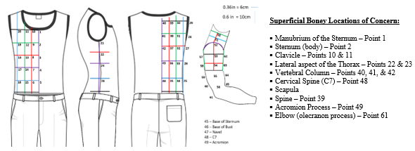
Applied Injury Biomechanics
Blunt Trauma Requirements
The LTV system shall limit the crew exposure to blunt trauma forces by staying below 18 lbf across bony locations of concern outlined in Figure 3.
Figure 3: Anthropometric Locations for Blunt Trauma Limits & Boney Locations of Concern

