Slide 1
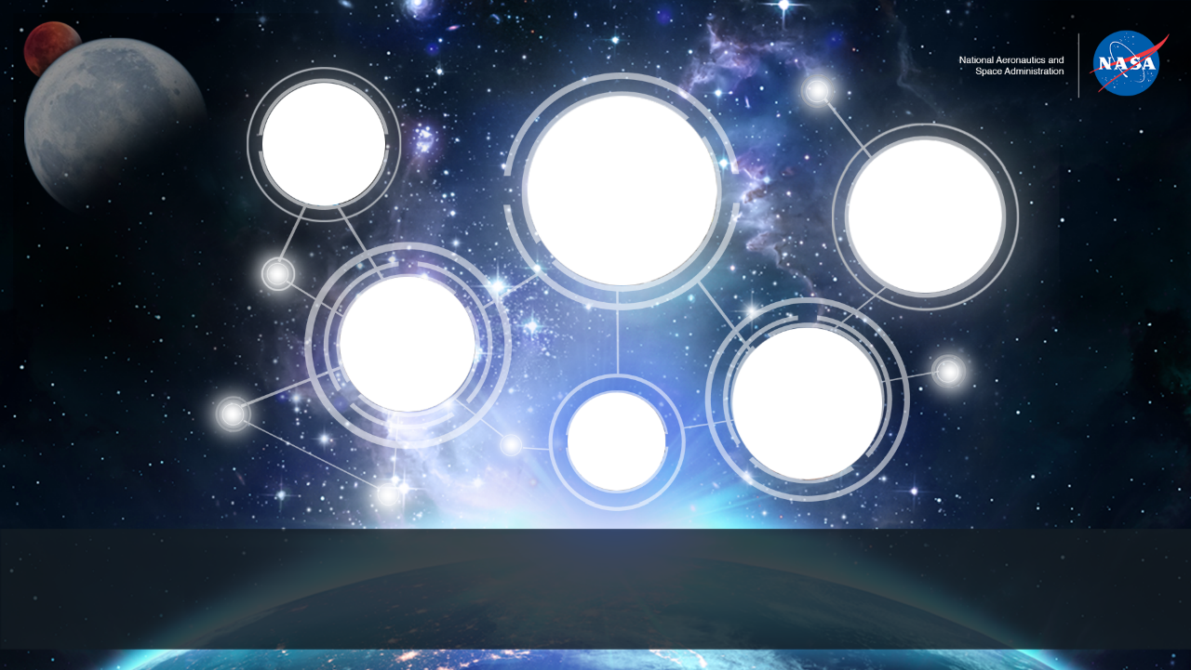
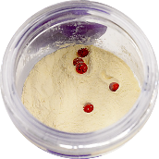
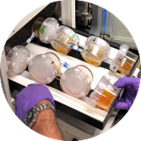
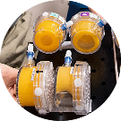
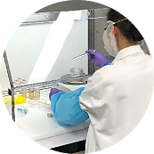
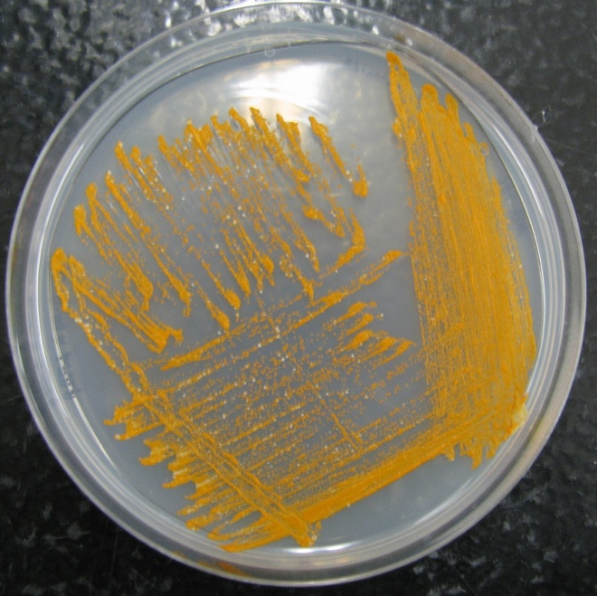
BioNutrients: Microbial on-demand production of short shelf-life micronutrients in space
Frances M. Donovan, Ph.D.
Synthetic Biology Project, STMD Game Changing Development, NASA Ames Research Center

Slide 2
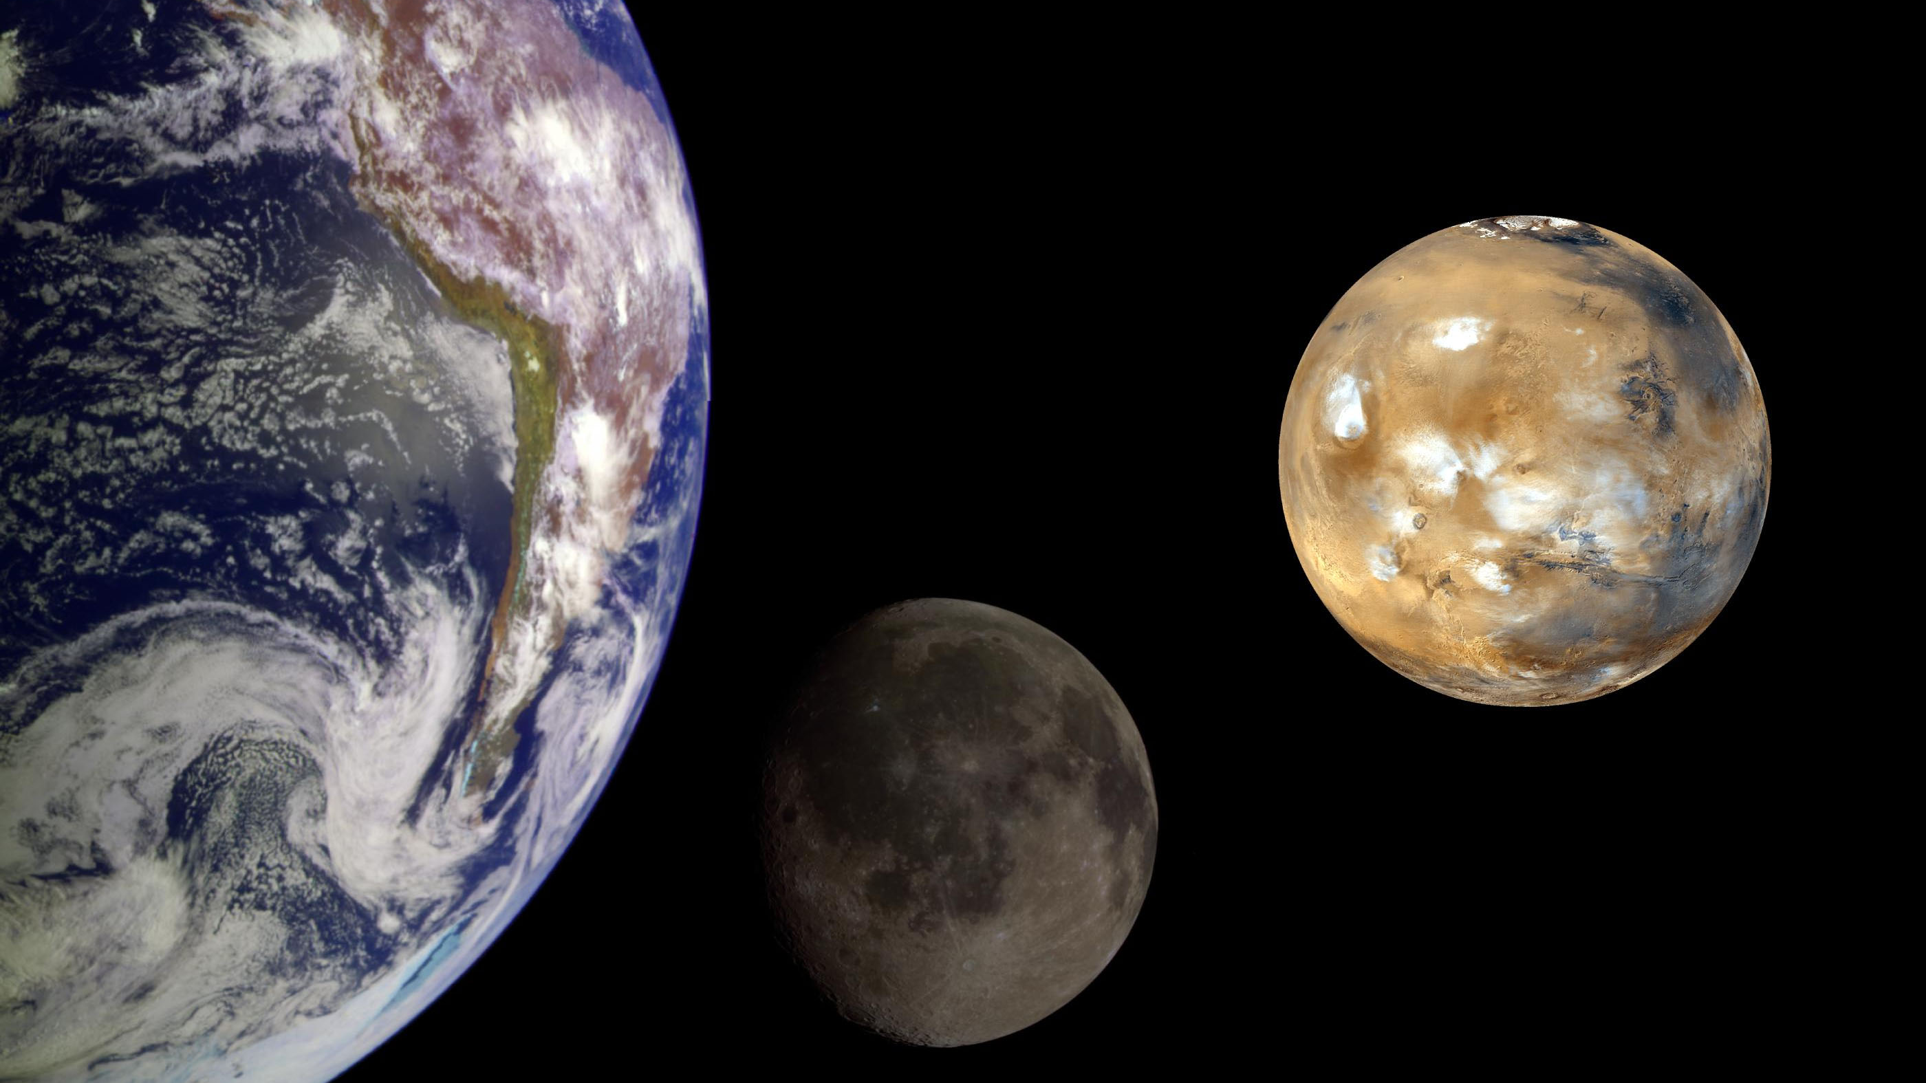
Sustained human exploration of deep space will stress re-supply capacity and
surpass current shelf life limitations for critical nutrients and therapeutics.
Credits: NASA

Slide 3
Nutrients are a critical supply risk: Essential nutrients degrade in long-duration storage
Studies of the NASA pre-packaged food system have found declines in:
Folic acid/Folate
Vitamin A
Thiamin (Vitamin B₁)
Riboflavin (Vitamin B₂)
Vitamin B₆
Vitamin B₁₂
Vitamin C
Vitamin E
Vitamin K
Need to produce some foods in situ
Adapted from Zwart et al (2009) Food Science 74(7):H209-H217.
https://doi.org/10.1111/j.1750-3841.2009.01265.x

Slide 4
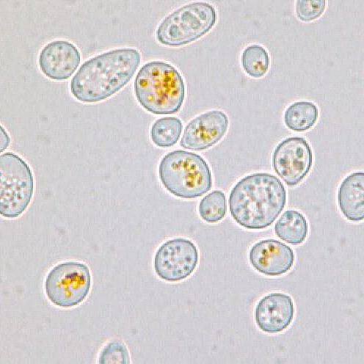
BioNutrients: In Mission production of nutrients as an alternate strategy
Microbially fermented foods engineered to produce essential nutrients or protein therapeutics, on-demand, surviving ambient storage conditions.
Rationale: Engineer yeast and/or bacteria to produce essential nutrients when grown for a short period of time in edible media.
Rapid, on-demand production
Room temperature storage of organisms
Enriches pre-packaged foods with labile nutrients
Carotenoids selected as initial nutrient:
Light sensitive and degrades in packaged foods
Important to protect from macular degeneration
Antioxidant activity to protect against DNA damage
S. boulardii producing β-carotene

Slide 5
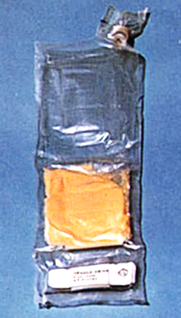
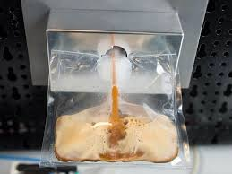
Future implementation concept
Premixed dry media and microbes
Ambient temperature storage
Hydrate and dissolve media
Incubate to grow microbes
Deactivate microorganisms
Consume as a supplement
Image Credits: NASA

Slide 6
BioNutrients Development Plan
Mission | Objectives | Launch
BN-1 | 5-year test of storage and production on the ISS Engineer yeast strains to produce carotenoids in edible media Test media and related packaging Develop Gen-0 bioreactor Test other microorganisms for long-duration storage | NG-11, April 2019
BN-2 | <1-year flight test Expand products to yogurt and kefir, continue carotenoid testing Engineer medical countermeasure product (follistatin) Develop Gen-1 bioreactor to decrease system mass Develop HACCP food safety plan | Target NG-18, August 2022
BN-3 | Engineer system to produce multiple nutrients in low ESM package Develop Gen-2 bioreactor Demonstrate reliability of HACCP plan | FY24

Slide 7
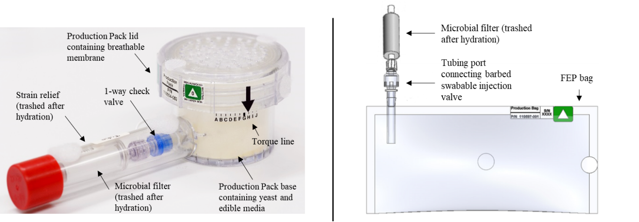
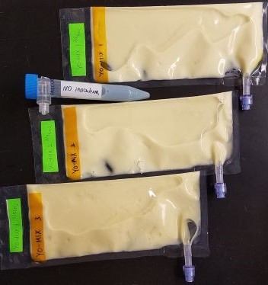
BioNutrients 1 hardware vs BioNutrients-2: Reduced Mass, Volume
BN-1: 117 g Bioreactor
BN-2: 10 g Bioreactor
BN-2: Change to a Fluorinated Ethylene Propylene (FEP) bag bioreactor – lower mass and volume, performance to be compared to BN-1 hard shell with gas permeable membrane.
FEP is gas permeable.
For more detail please see Ball et al. (2021) Proc. Int. Conf. Envir. Systems. ICES-2021-331.
https://ttu-ir.tdl.org/handle/2346/87260
BN-1 hardshell bioreactor growing yeast expressing carotenoids in SABL on the ISS. BN-2 FEP bag growing yogurt with a pH indicator dye on during pre-flight testing

Slide 8
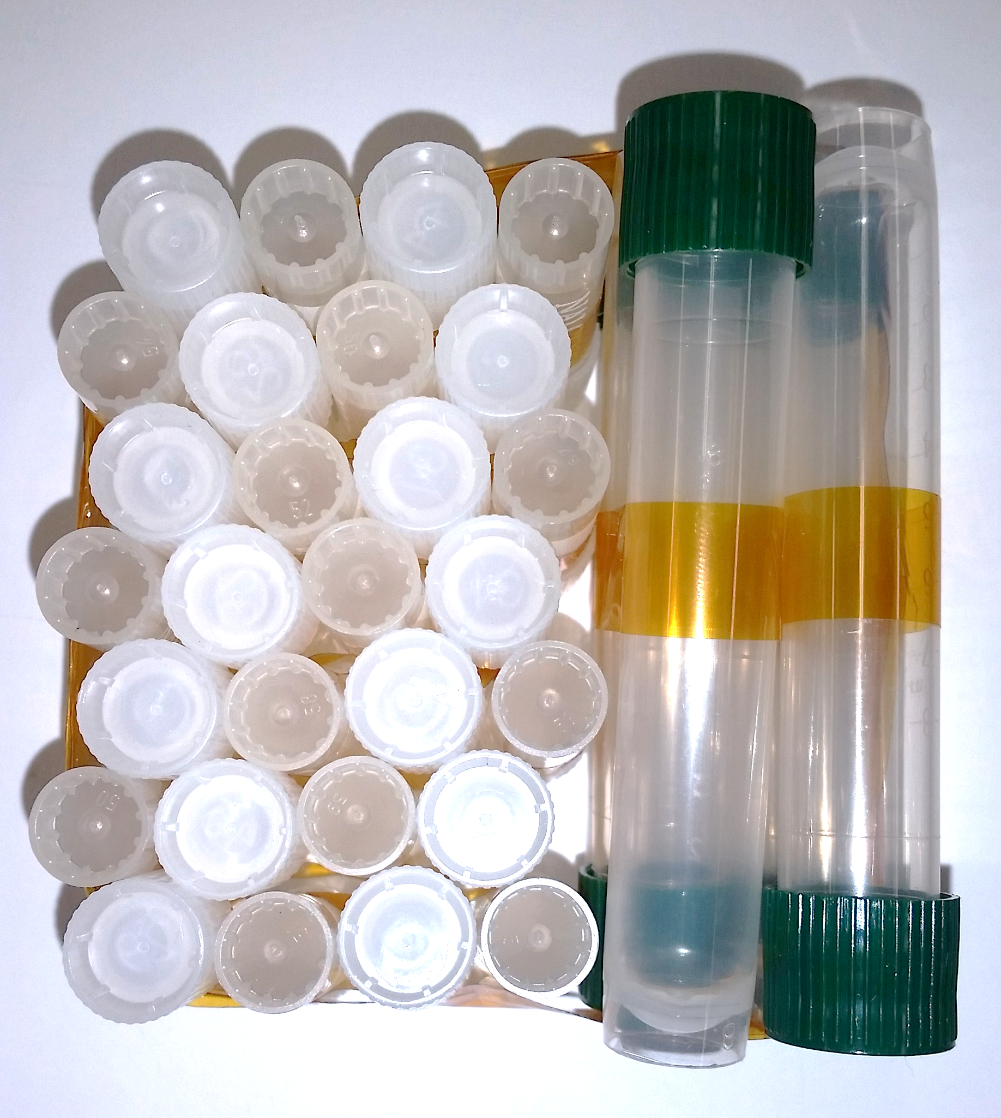
BioNutrients-1 Stasis Packs
Stasis packs seek to identify species and conditions that will provide 5-year shelf life in ambient temperature storage.
9 microbe species investigated
Baker’s yeast and probiotics
Species for yogurt
Species that can metabolize diverse carbon sources
Varied storage and pre-flight treatments
vary storage preparation (encapsulation, pellet forms, additives)
mutagenize for genetic screens
3 media formulations
Compare ground control to ISS storage.
Assay for viability at 3- to 6-month intervals over 5 years.
Variation in viability observed by 2 years of storage.
Santa Maria et al (2020) found yeast to be stable for 2 years at room temperature storage.
Santa Maria et al (2020) Astrobiology. https://doi.org/10.1089/ast.2019.2073

Slide 9
Summary
Fermented foods provide an additional strategy to produce essential nutrients for extended shelf life.
Microbes can be engineered to produce multiple nutrients or countermeasures.
Media and microbes need to be shelf stable for 5 years (current production pack tested >2 years to date).
Growth cycles are short, on the order of <1-3 days instead of weeks to months.
Ongoing development needed for full implementation
More comprehensive microbe engineering, product development.
Critical products, testing of palatability, crew acceptance of nutrient supplementation via microbial production.
Engineering food safety and process controls.
In mission: cooking or other methods to end microbial growth and assess safety of products.
HACCP planning and other ground based processes to ensure safety.

Slide 10
GCD Synthetic Biology Project Team
BioNutrients Authors
Natalie Ball
Aditya Hindupur
Hiromi Kagawa
Aphrodite Kostakis
Amy Gresser
Julie Levri
Kevin Sims
Sean Sharif
Alyssa Villanueva
Frances Donovan
A. Mark Settles
John Hogan
Acknowledgements
Michael Dougherty
Jon Galazka
Harry Jones
Jessica Kong
Paul Milazzo
Marilyn Murakami
Satro Narayan
Matthew Paddock
Mathangi Soundararajan
Daniel Varnum-Lowry
Astronauts
David Saint-Jacques
Drew Morgan
Shannon Walker

