Slide 1
Evaluating the Impact of Agricultural Soil NOx Emissions on Air Quality Using Advanced Satellite, Ground-based, and Model Data
Aaron R. Naeger¹, Clay B. Blankenship², Kelley M. Murphy¹, Emily B. Berndt³
¹University of Alabama in Huntsville, Huntsville, AL; ²Universities Space Research Association, Huntsville, AL; ³Marshall Space Flight Center, Huntsville, AL
2022 AMS Annual Meeting

Slide 2
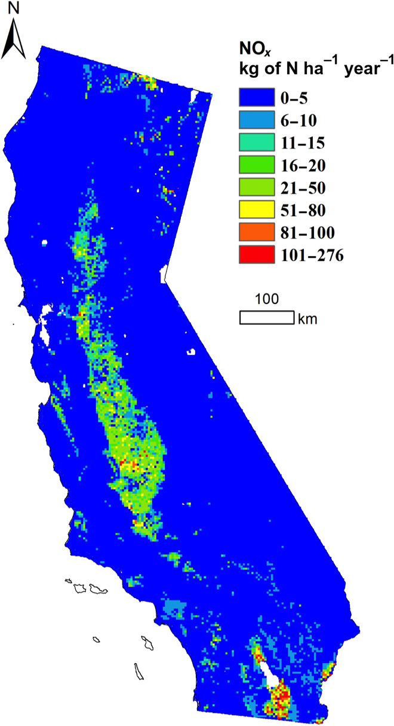
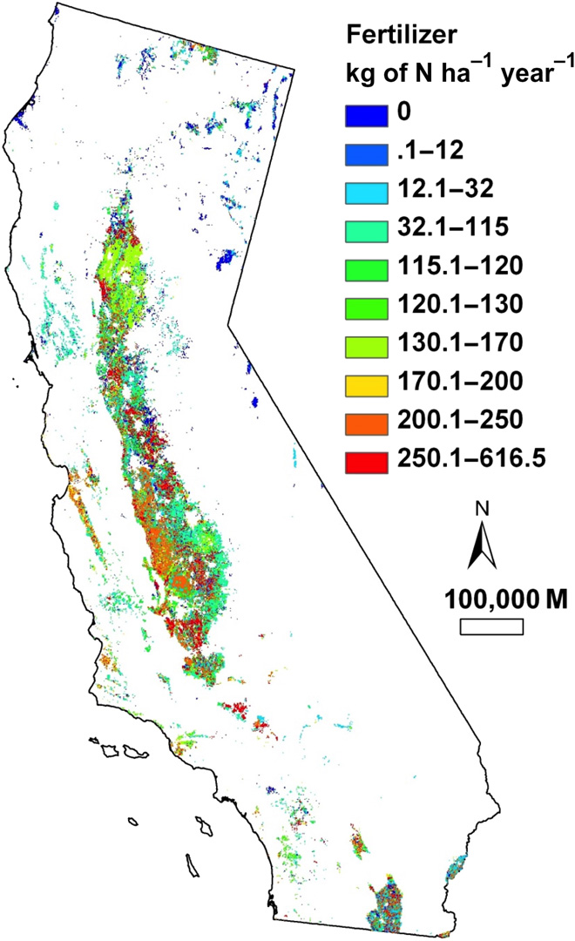
Introduction & Motivation
Soil moisture can influence nitrogen oxide emissions (NOx = NO + NO2) from agricultural fields and consequently contribute to air pollution
Irrigation demand and methods can play an important role in controlling soil moisture and NOx emissions
Nitrogen fertilizer use has been shown to increase soil NOx emissions, fertilized soils in high temperature regions (e.g., Imperial Valley of California) have been shown to produce some of the highest NOx
A better understanding of how different factors contribute to NOx in agricultural areas can reduce model uncertainties and improve forecasts
However, there is much debate in the literature on the extent to which soil NOx emissions contribute to air pollution
Almaraz et al. (2018)

Slide 3
Literature Review
CARB estimated that ~3.8% of the state’s NOx budget was attributed to cropland soils in a 2013 report.
Oikawa et al. (2015) - extremely high soil NOx emissions from high temperature soils in California, and these sources are underestimated in models, leading to much too low NO2 in the troposphere
Almaraz et al. (2018) - agricultural soils are a dominant source of NOx pollution in California, cropland soil can increase NOx budget by 20 to 51%
Gao et al. (2020) - soil NOx contribute about 1% of the total anthropogenic NOx emissions in the state, and have limited impacts on PM2.5 formation in the atmosphere
Sha et al. (2021) – soil NOx contributed ~40% of the California’s total NOx emissions in July 2018, enhancing NO2 columns by ~35% and surface ozone by ~23%
Sha et al. (2021)

Slide 4
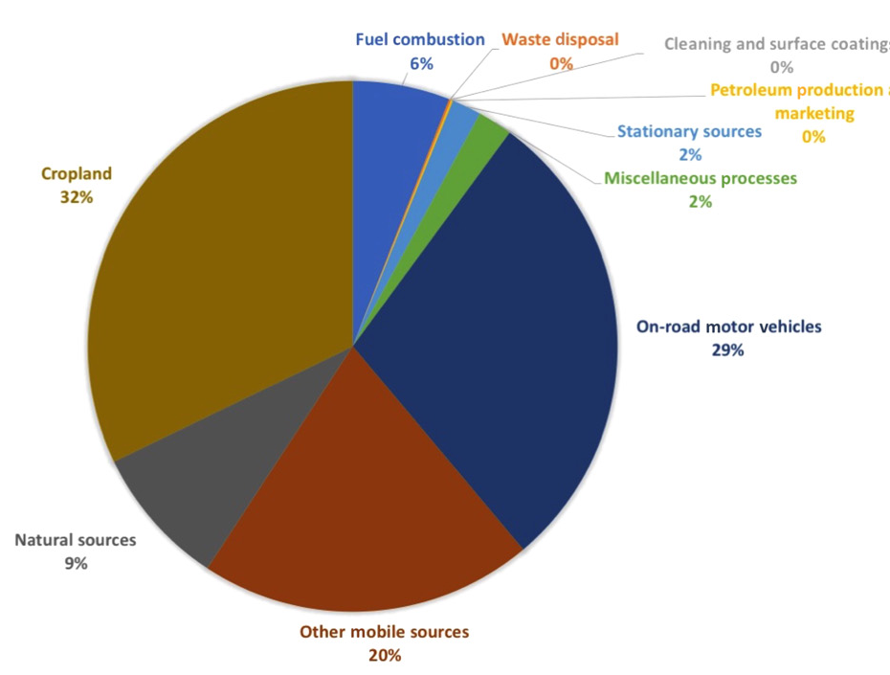
Objectives & Science Questions
Objective: Use a suite of satellite, ground-based, and model data to improve our understanding of how natural and anthropogenic factors influence NOx emissions and govern air quality in agricultural areas of California
What are the long-term trends and statistical relationships between soil moisture and temperature and NOx emissions in the agricultural regions?
To what extent do agricultural soil NOx emissions contribute to NO2 and O3 production and degraded air quality conditions in the state?
What are the separate contributions of rainfall, irrigation, and fertilizer practices on the diurnally varying NOx emissions and air quality throughout the agricultural region?
Contribution of soils to statewide NOx emissions based on CARB estimates (Almaraz et al., 2018)

Slide 5
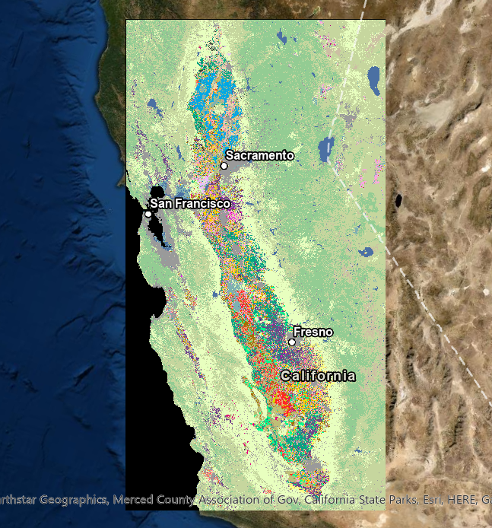
Major Project Tasks
Assess capabilities of SMAP and SMAP LIS for monitoring soil moisture enhancements from irrigation activities over agricultural areas
Use trace gas observations from new space-based sensors to monitor air pollutants over crop fields, with special attention on locations and periods of soil moisture enhancements
Analyze precipitation, soil, and meteorological data from ground-based networks and model reanalysis
Diagnose the diurnal evolution of NO2 and ozone pollution over soil NOx emission locations
Synthesize satellite, ground-based, and model data to evaluation contributions from rainfall, irrigation, and nitrogen fertilizer on soil NO_{x} and air quality

Slide 6
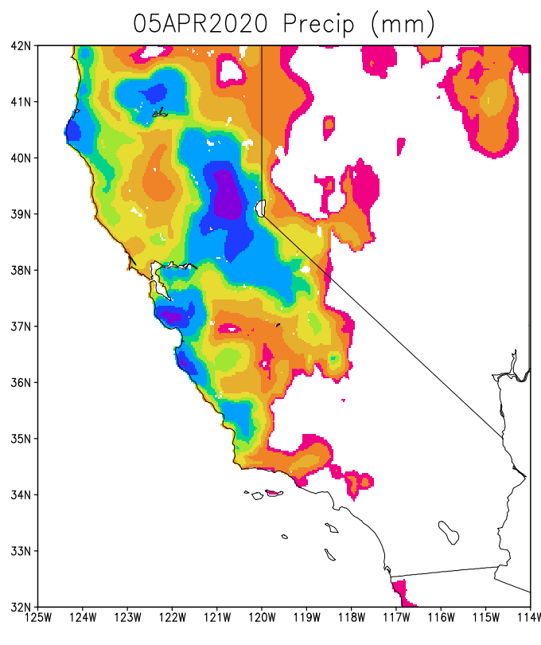
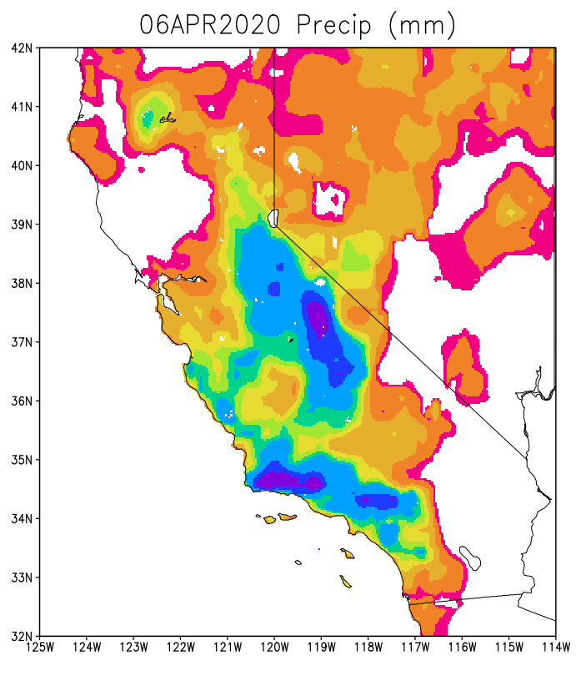
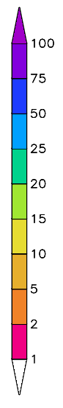
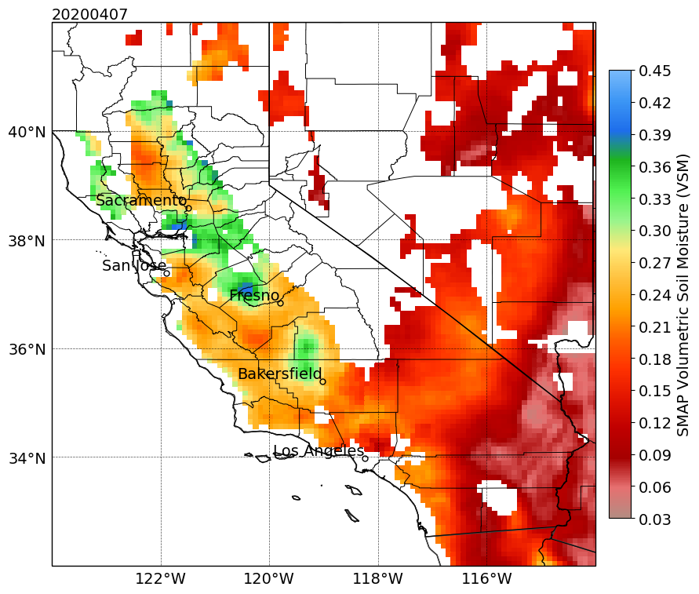
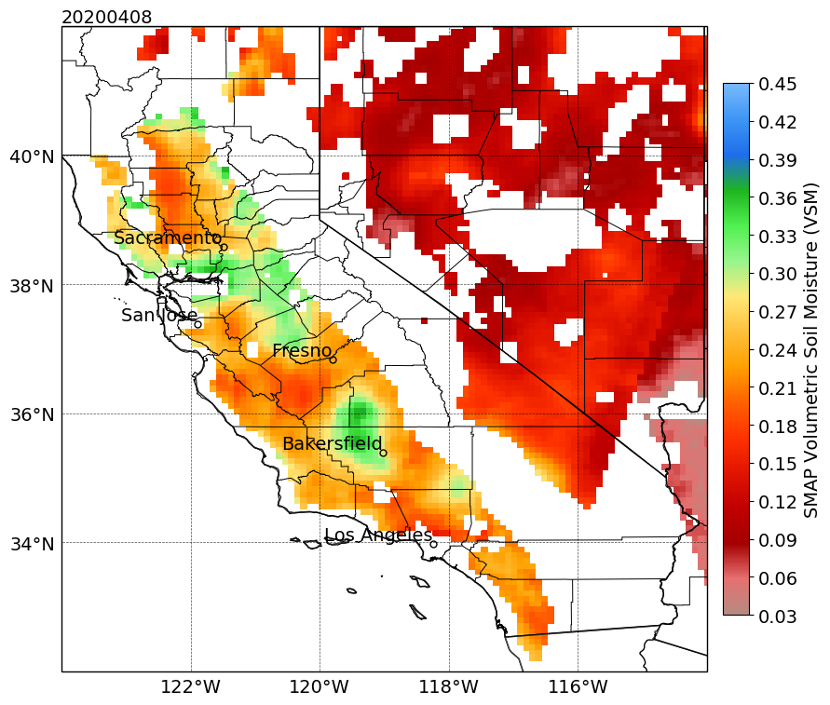
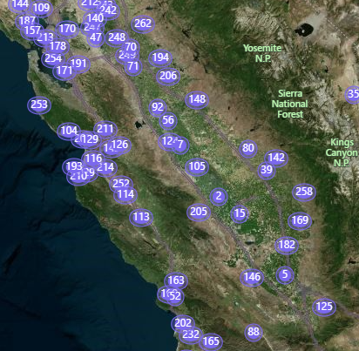
Land & Soil Analysis
SMAP Enhanced L3 Daily Gridded product
  Volumetric soil moisture in the top 5 cm of the soil on 9 km grid
Land Information System with SMAP L2 soil moisture assimilation (SMAP LIS)
  Volumetric soil moisture for 0-10 cm layer on 3 km grid and 3 hr frequency
Multi-Radar Multi-Sensor (MRMS) Quantitative Precipitation Estimate (QPE)
  Daily precipitation totals on 0.01° grid, based on radar precipitation corrected by gauge measurements
California Irrigation Management Information Center (CIMIS)
  Over 140 weather stations including soil information
Cropland Data Layer (CropScape) – annual crop type maps with more than 100 crops at 56 m resolution
Total applied nitrogen fertilizer per crop during survey year
MRMS
SMAP

Slide 7
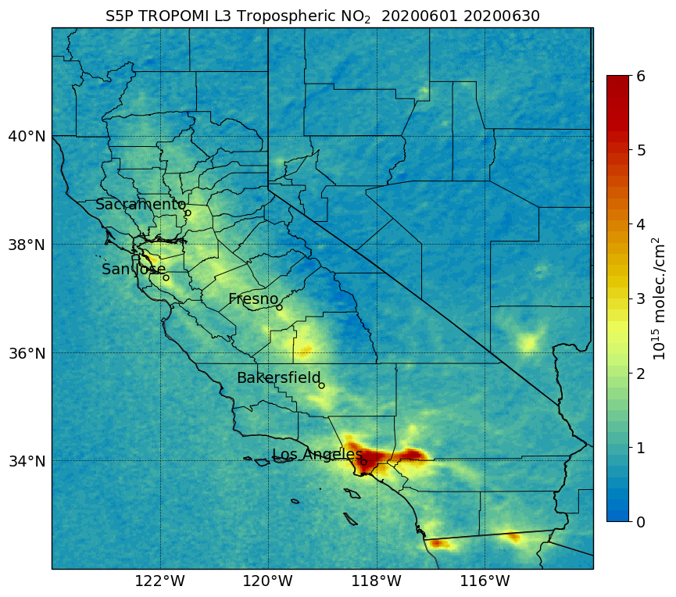
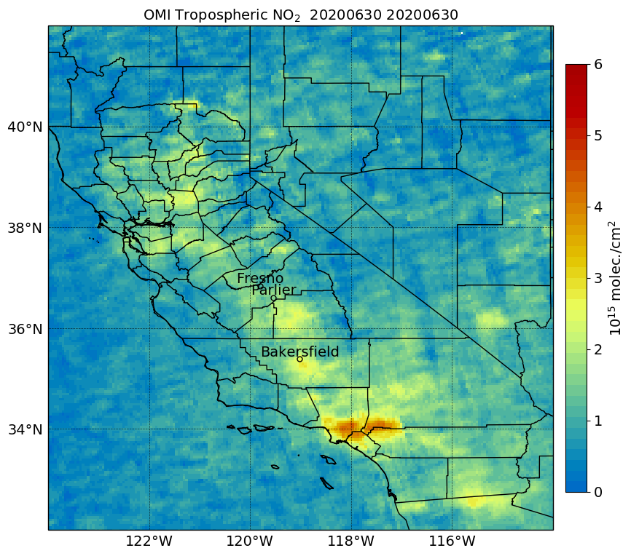
Pollution, Sources, & Meteorological Analysis
June 2020
OMI Trace Gas Products from midday scans
  L2 and L3 Tropospheric NO2 (13 x 24 km², ~0.05°)
TROPOMI Trace Gas Products from midday scans
  L2 Tropospheric NO2 (5.5 x 3.5 km²) and Ozone Profile (28 x 28 km²)
  L3 Tropospheric NO2 (0.02°) and Ozone Profile (0.08°)
  L2 and L3 HCHO and CO are also being assessed (secondary products)
TEMPO Trace Gas Products from hourly and sub-hourly scans
  Tropospheric NO2 & HCHO (2 x 4.75 km²), Ozone profile (8 x 4.75 km²)
  Test implementation of proxy products during pre-launch phase
Fire detections from MODIS & VIIRS, CARB Pollution Mapping Tool, Daily traffic monitoring data from Caltrans
3 km HRRR Reanalysis for meteorology (winds, temperature)
GEOS-CF model for assessing possible emission sources and contributions
TROPOMI
OMI

Slide 8
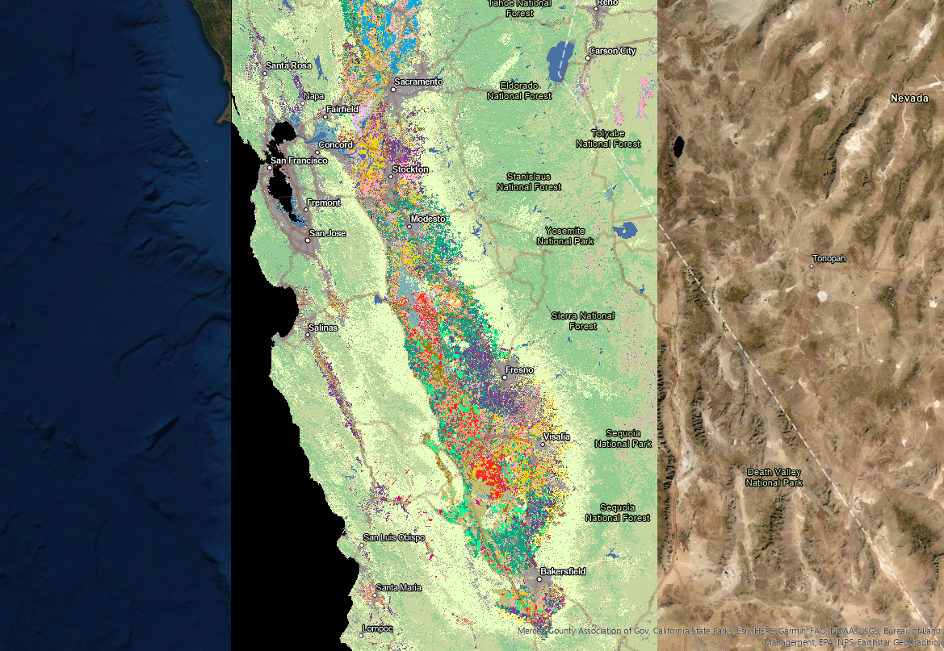
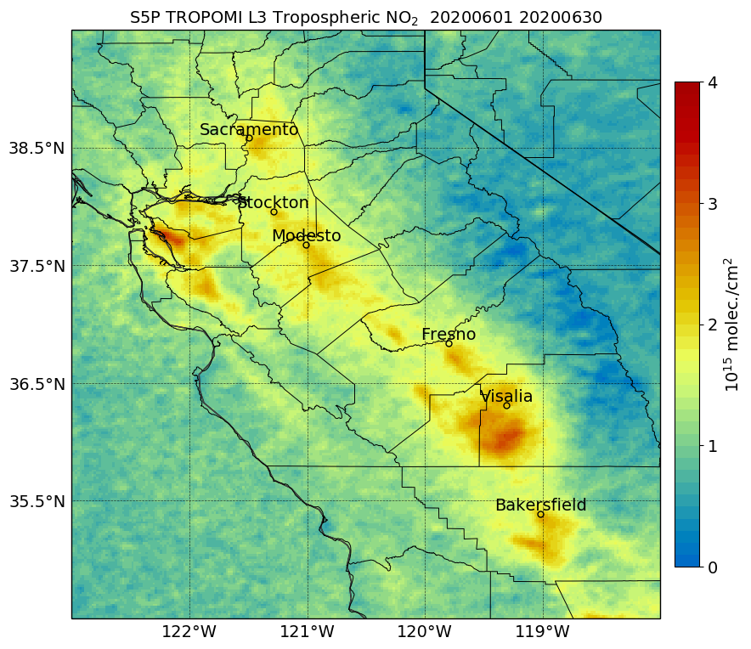
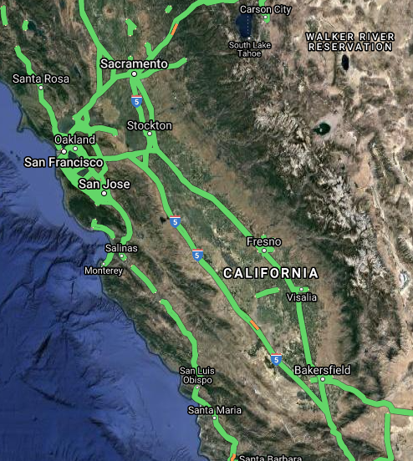
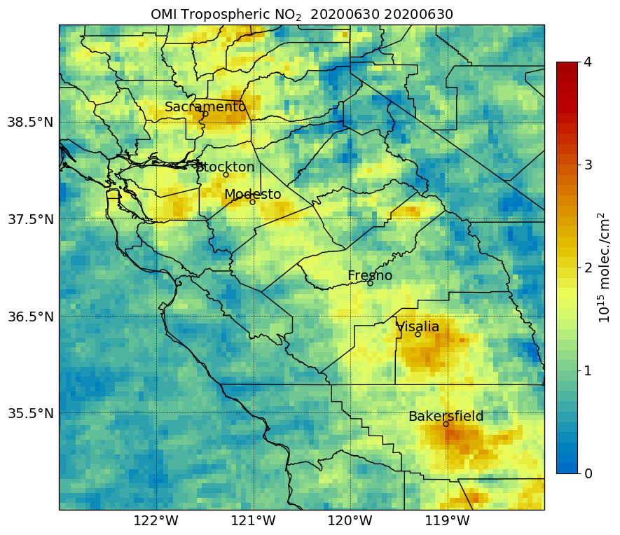
Application of Data Products
June 2020
CropScape shows a wide variety of crops throughout the region
  Grapes, Wheat, Rice, Cotton, Almonds, Tomatoes, Alfalfa are common crop types
Dominant period for soil NOx emissions occurs from early spring to summer
  Period when dominant crops (see above) are growing and harvested
Caltrans monitors vehicle miles traveled for vehicles, distinguishes trucks
  California’s transportation sector is the dominant contributor to NO2 and PM pollution
TROPOMI observes NO2 enhancements along traffic corridors, not shown by OMI
Areas of potential soil NOx emissions are being analyzed using suite of data products
Traffic Corridor
Grapes
Wheat
Some Areas of Interest
CropScape
TROPOMI
Traffic Corridor
Caltrans
OMI

Slide 9
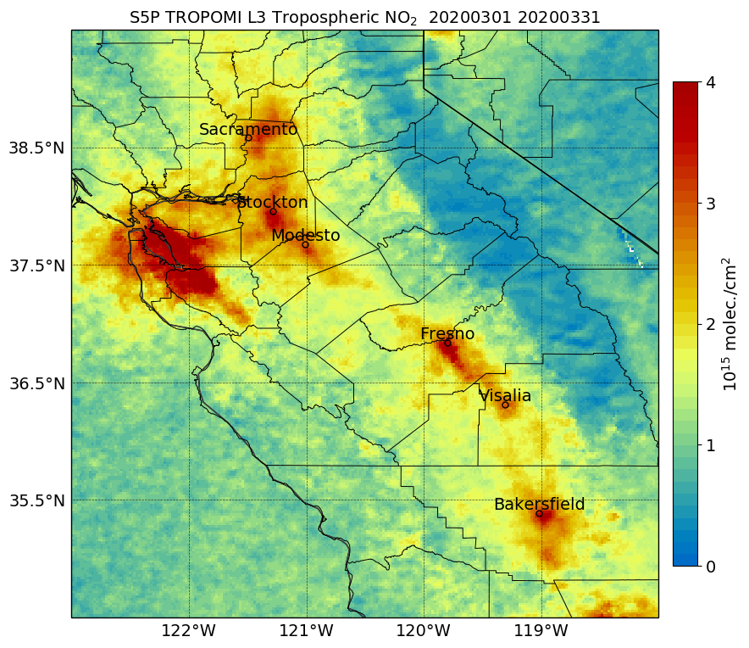
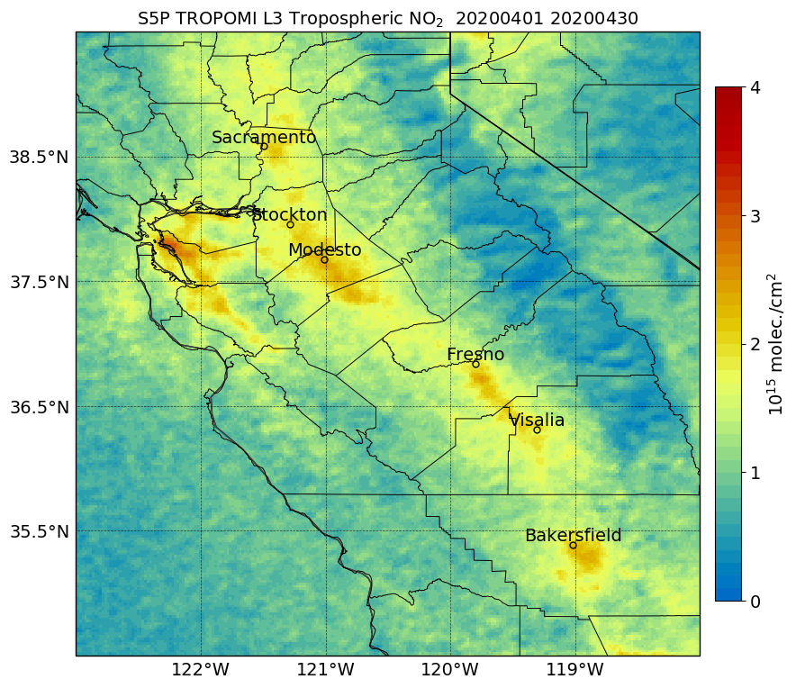
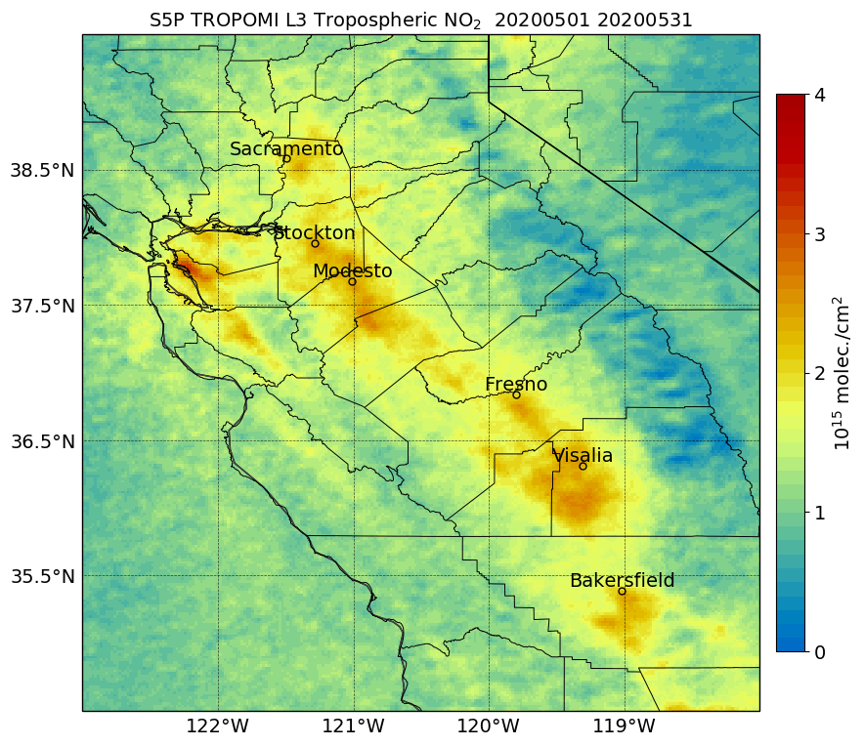
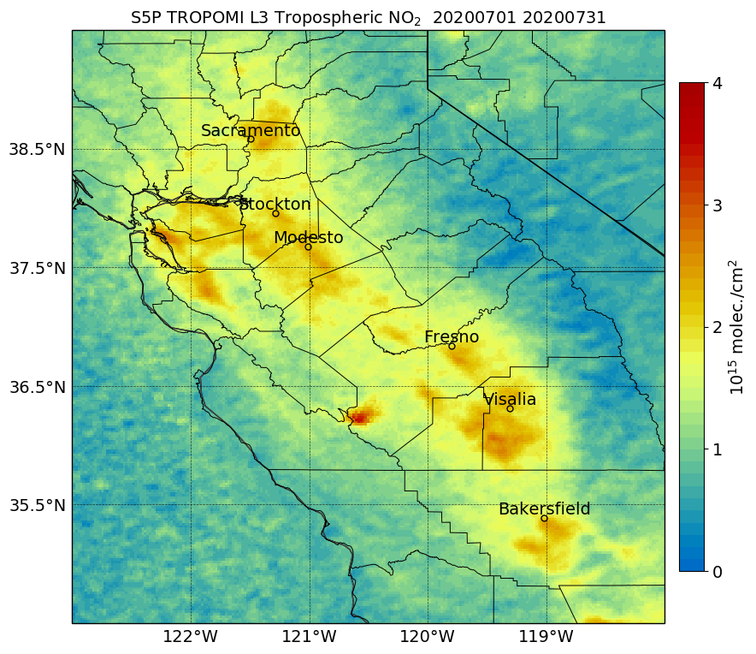
Monthly Maps of TROPOMI NO2
March 2020
April 2020
May 2020
June 2020
Some Areas of Interest
July 2020
Monthly TROPOMI maps during primary growing season show distinct NO2 columns from traffic corridors and major urban centers
Areas of interest for potential soil NOx contributions show distinct increase beginning in May when most active soil NOx can occur
Several fires initiated over the region beginning mid-July, contributed to background NO2 with distinct signal over far west Central Valley
  Very active fires and smoke began by mid-August
Fire Smoke

Slide 10
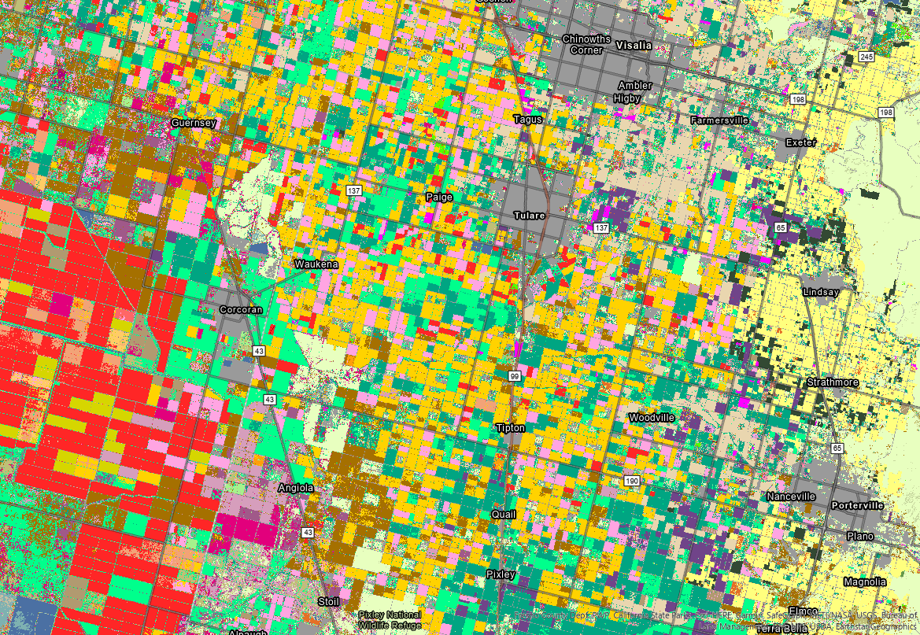
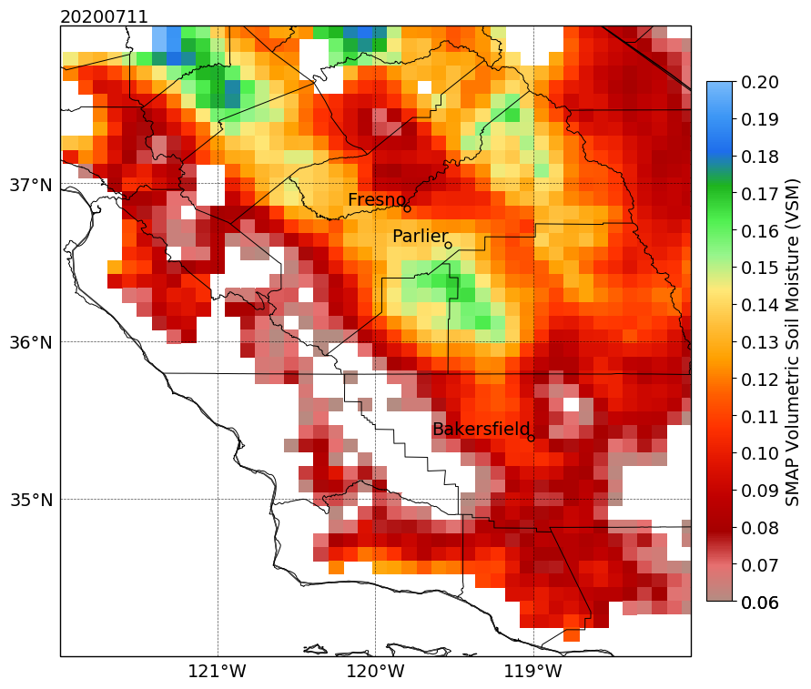
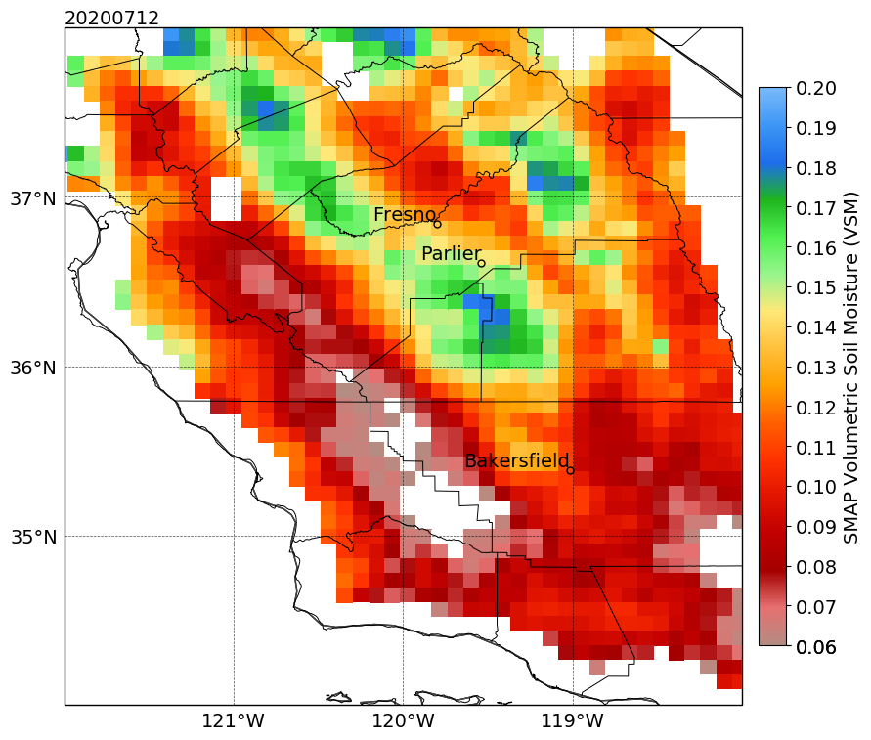
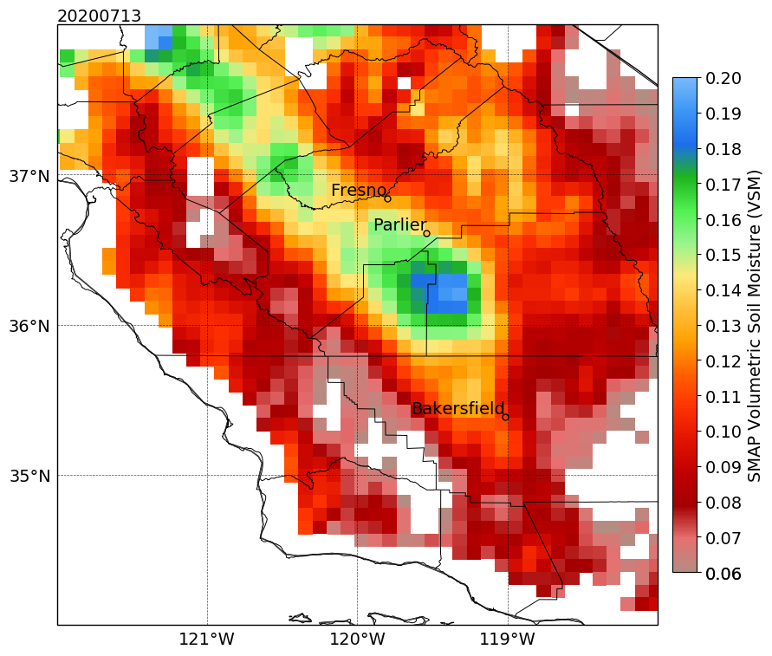
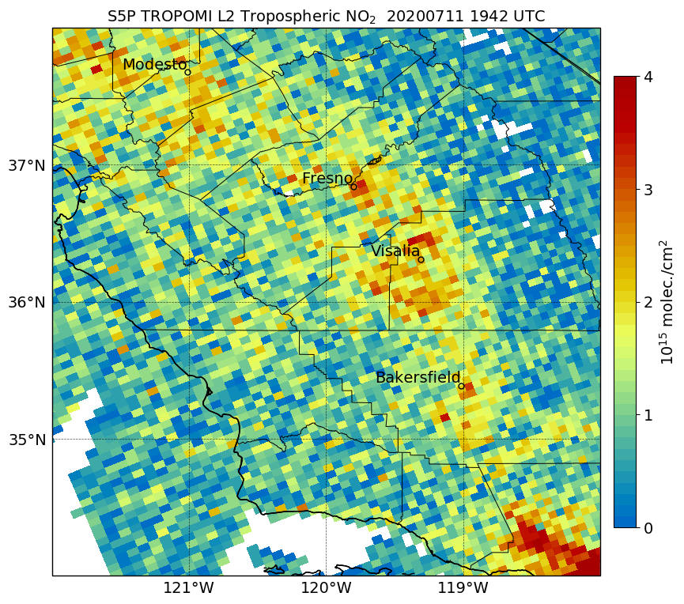
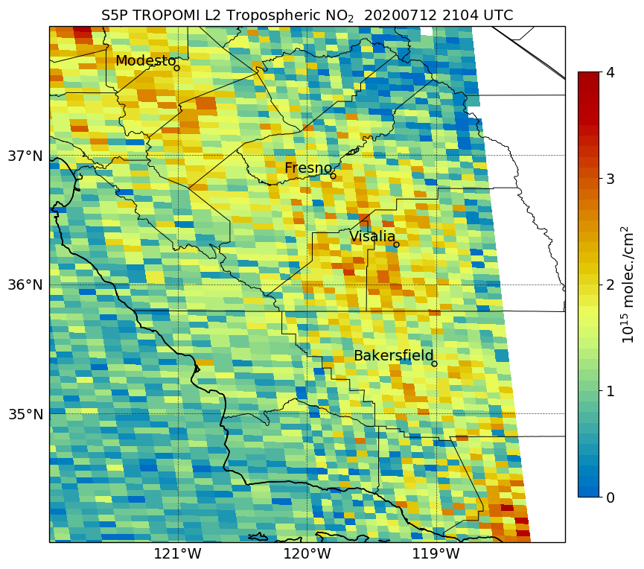
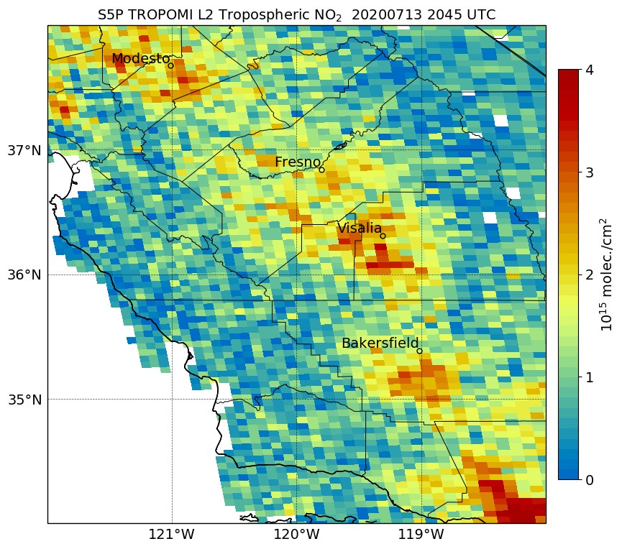
Irrigation Use Case – Satellite Data
SMAP
Wheat & Corn
SMAP shows increases in soil moisture during dry period over region
TROPOMI observes an increase in NO2 columns in the same vicinity
Possible soil NOx contribution under further investigated
TROPOMI

Slide 11
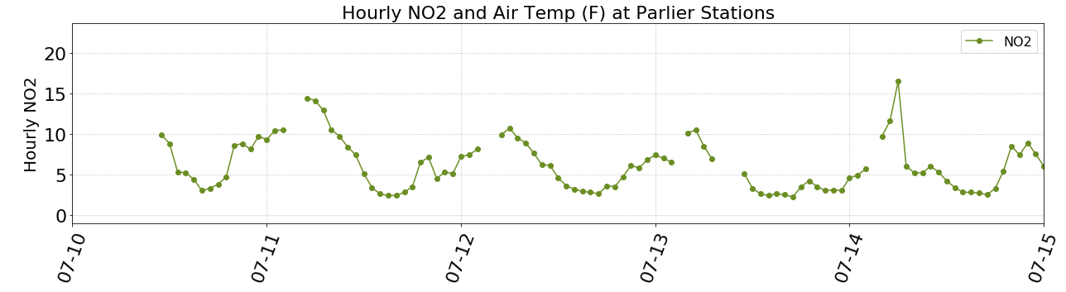
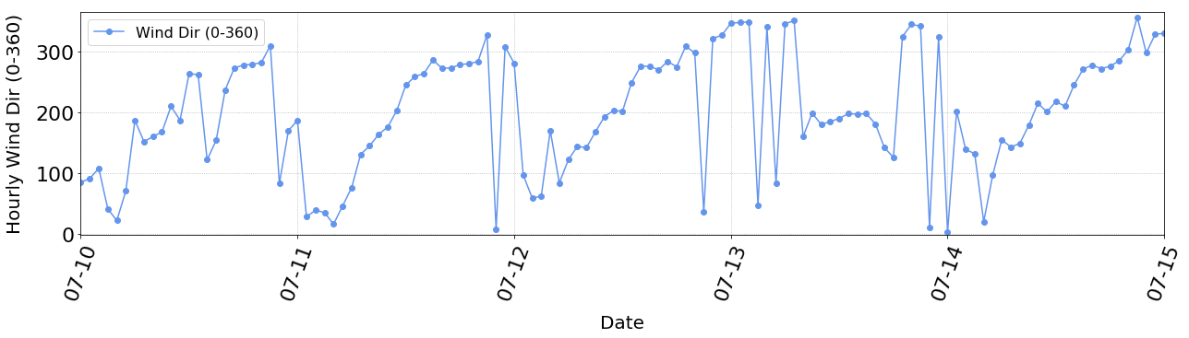
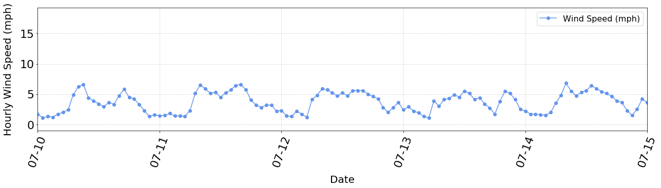
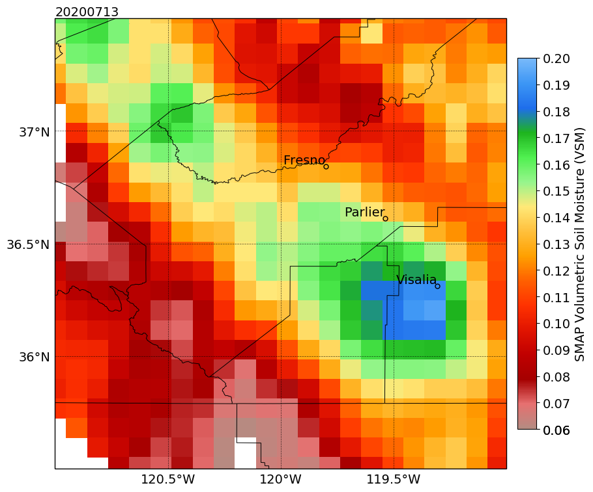
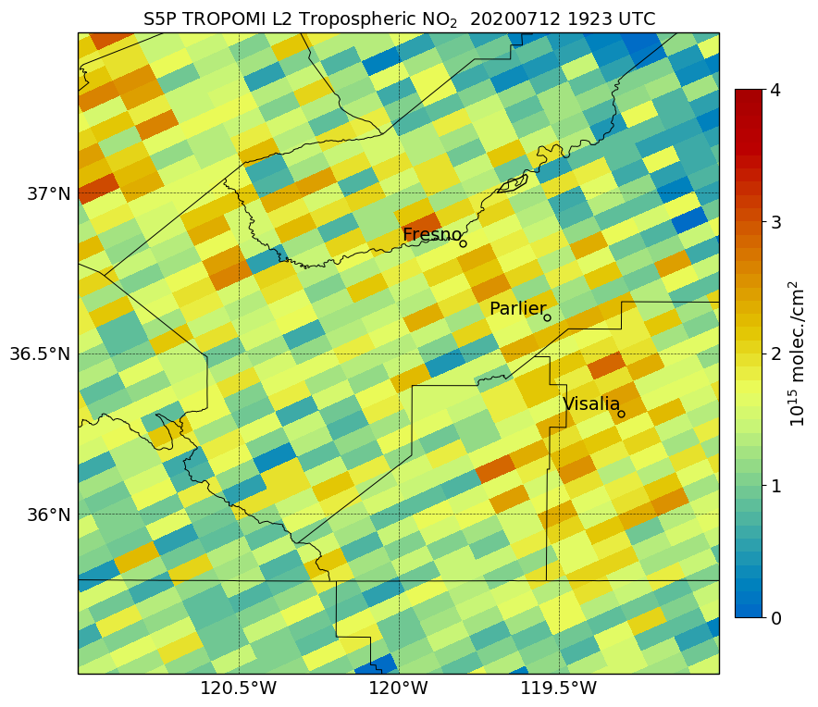
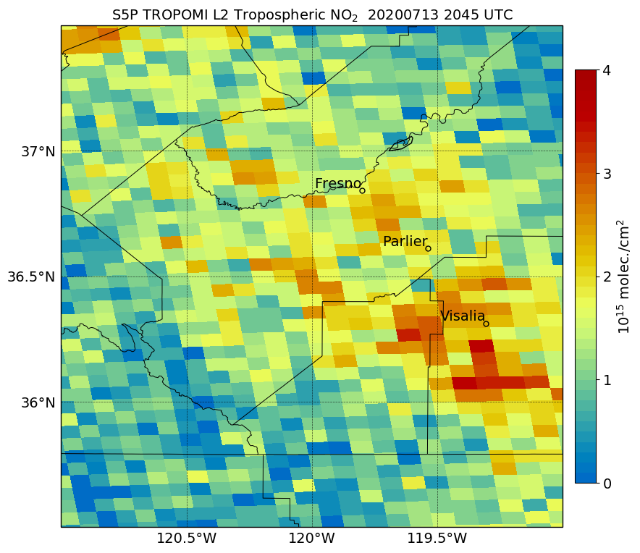
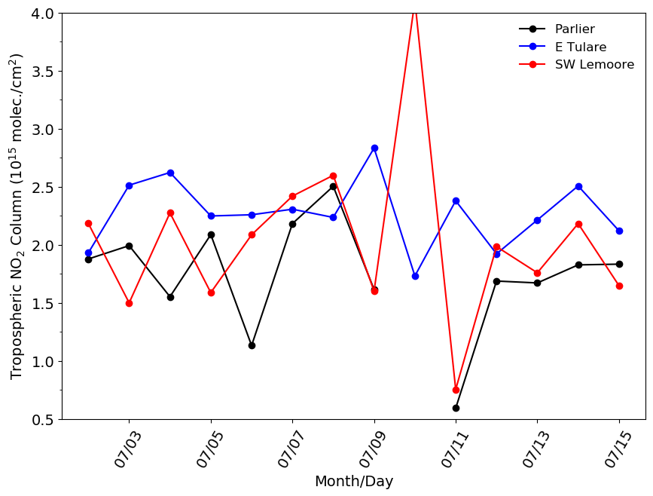
Irrigation Use Case – Surface Data
Nearest EPA surface monitor outside of urban area measures an increase in NO2
Collocated CIMIS site shows winds shifting more southerly during afternoon on the 13th
TROPOMI NO2 time series shows an increase of ~0.6 x 10¹⁵ in area of maximum soil moisture (East Tulare location)
Possible NO2 transport from soil NOx emissions to Parlier along with local production around site
SMAP

Slide 12
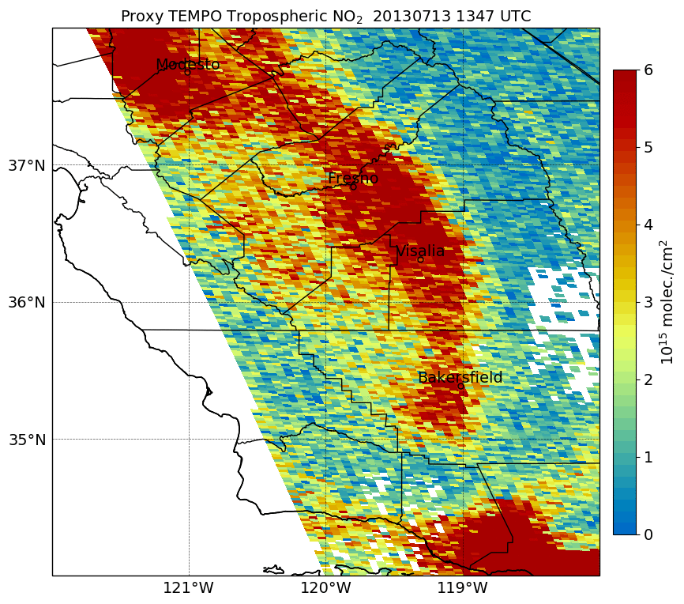
Summary & Future Work
SMAP shows capability to detect increases in soil moisture due to irrigation in California’s Central Valley
SMAP LIS has proven little utility so far but will continue to analyze the data
We have detected areas of possible NO2 enhancements due to soil NOx emissions
TROPOMI has much improved capability to monitor and assess pollution from soil NOx emissions compared to OMI
Additional data products are currently being analyzed (e.g., meteorology, traffic, fires) to better separate and quantify the pollution contribution from soil NOx emissions
Ozone data from EPA monitors and new TROPOMI Ozone profile product will be incorporate into project soon
Immediate use of TEMPO data once available after launch!
TEMPO Proxy Data

