Slide 1


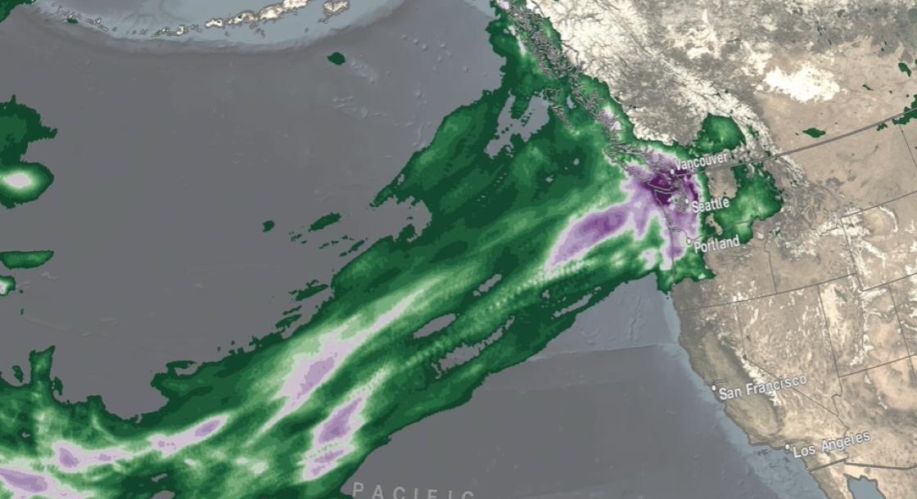

GPM Project Status
Scott Braun
GPM Project Scientist
NASA Goddard Space Flight Center
JAXA Precipitation Measurement Missions Meeting
January 12, 2022
gpm.nasa.gov
Twitter: NASAAtmosphere
Facebook: NASAAtmosphere
Pacific NW floods from atmospheric rivers. IMERG precipitation accumulations, November 10-16, 2021

Slide 2
PMM Meeting At A Glance & Agenda
Outline
NASA GPM Organization and Science Team
Mission and Data Status
GES-DISC Status
Science/mission highlights

Slide 3
Status—PMM Project Teams
GPM Program Scientist
(Will McCarty)
GPM Project Scientist
(Scott Braun)
Mission Operations
(Anthony Scaffardi)
Precipitation Processing System (PPS)
(Erich Stocker; Deputy PS for Data)
Application and Communications Team (Dalia Kirschbaum; DPS for Applications)
Ground Validation
(David Wolff ; DPS for GV and WFF GV Manager)
Good luck Joe Munchak!
Algorithm Development (Iguchi, Meneghini, Liao; Grecu, Olson; Kummerow; Huffman, Lang)
Happy retirement Tao!
Intersatellite Calibration
(Rachel Kroodsma)
Happy retirement Wes Berg!
U. S. Science Team –
36 NASA funded PIs,
7 work packages
International Science Team –
33 no-cost international PIs

Slide 4
NEW U.S. PMM Science Team
36 of 114 proposals funded
New PMM Selections
Ian Adams (GSFC) | Jiun-Dar Chern (GSFC/UMD) | Matthew Igel (UCD) | Claire Pettersen (UM)
Rebecca Adams-Selin (AER) | Anthony Didlake (PSU) | Chris Kidd (GSFC/UMD) | Grant Petty (UWisc)
Anantha Aiyyer (NCSU) | Ardeshir Ebtehaj (UM) | Dalia Kirschbaum (GSFC) | Derek Posselt (JPL)
Sarah Bang (MSFC) | Greg Elsaesser (GISS/CU) | Chris Kummerow (CSU) | Kristen Rasmussen (CSU)
Ali Behrangi (UA) | Efi Foufoula-Georgiou (UCI) | Tim Lang (MSFC) | Courtney Schumacher (TA&MU-CS)
Edward Beighley (NEU) | John Galantowicz (AER) | Chuntao Liu (TA&MU-CC) | Baijun Tian (JPL)
Alexis Bloom (JPL) | Mircea Grecu (GSFC/MSU) | Daniel McCoy (UWyo) | Joe Turk (JPL)
Raphael Bras (GTU) | Gerald Heymsfield (GSFC) | Lisa Milani (GSFC/UMD) | Chris Williams (UC)
Chandra Chandrasekar (CSU) | Svetla Hristova-Veleva (JPL) | Vasubandhu Misra (FSU) | Daniel Wright (UWisc)
First-time PIs

Slide 5
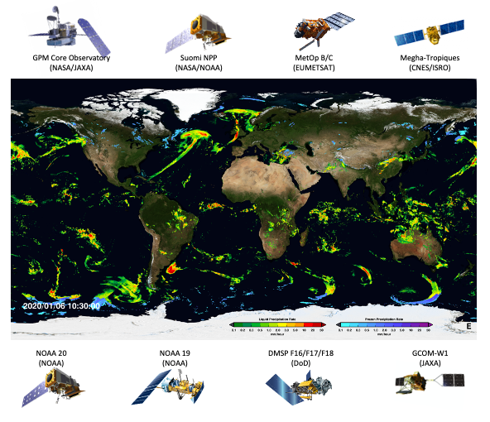
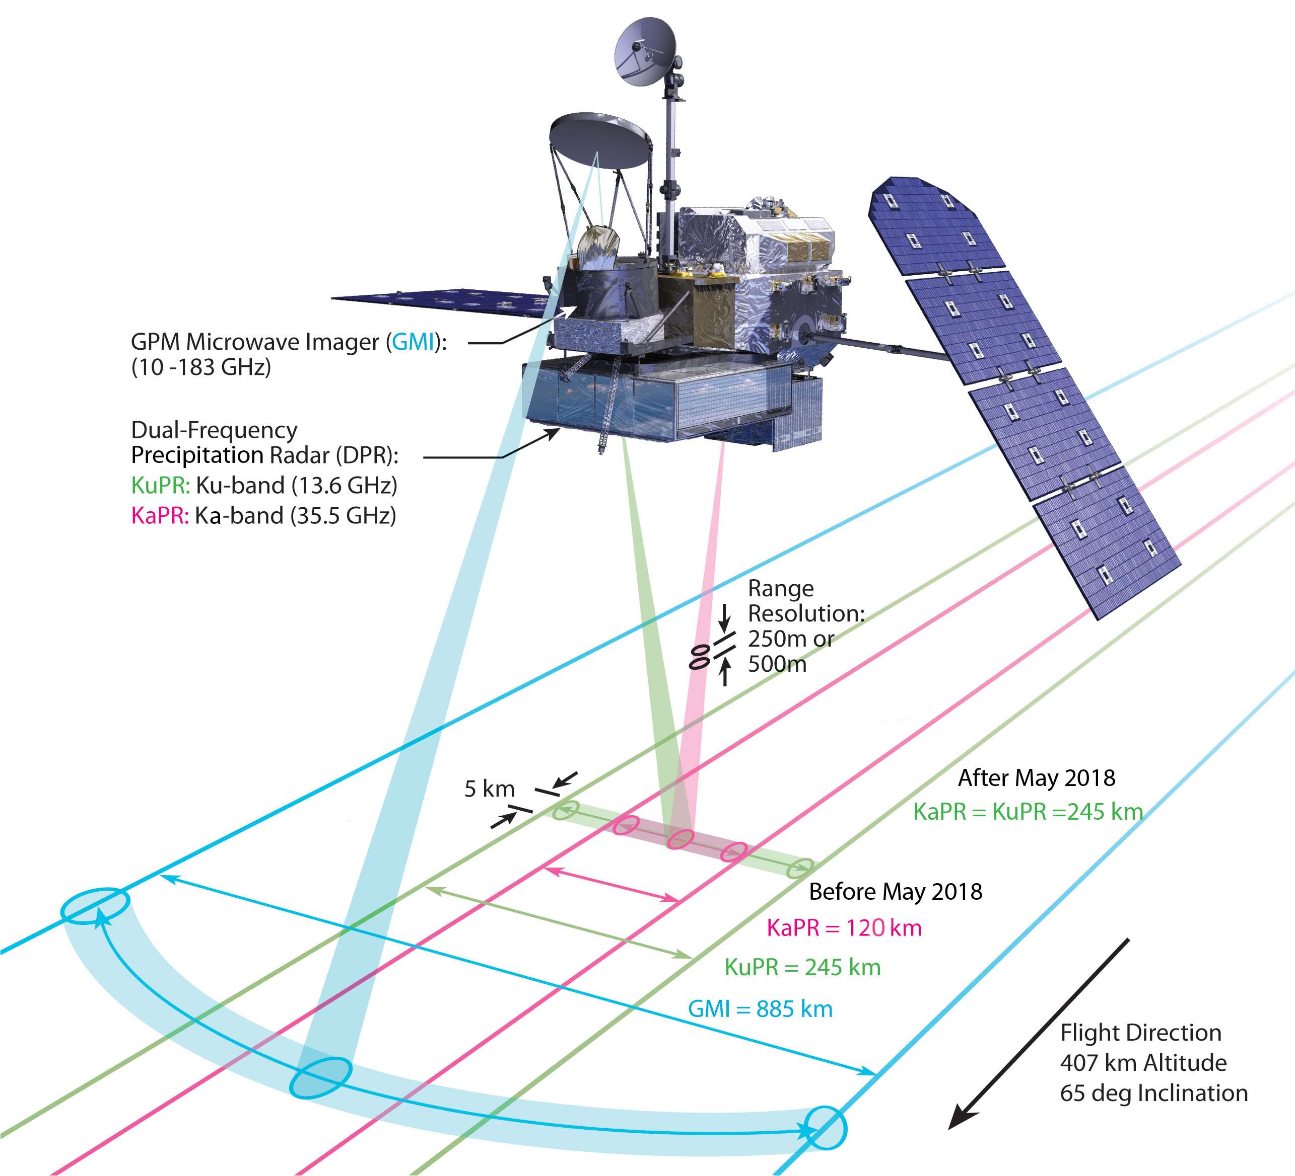
Status—GPM Core Observatory
GPM Core Observatory:
• Launched: Feb. 27, 2014
• ~8 years of operations
• Instruments working nominally
• Spacecraft system anomalies
– Reaction wheel #2 failed in 2019
– Reaction wheel #5 issues began in 2020
• Mission operations developing plans for operations if more RW failures
The Current GPM Constellation
Megha-Tropiques data processing discontinued

Slide 6
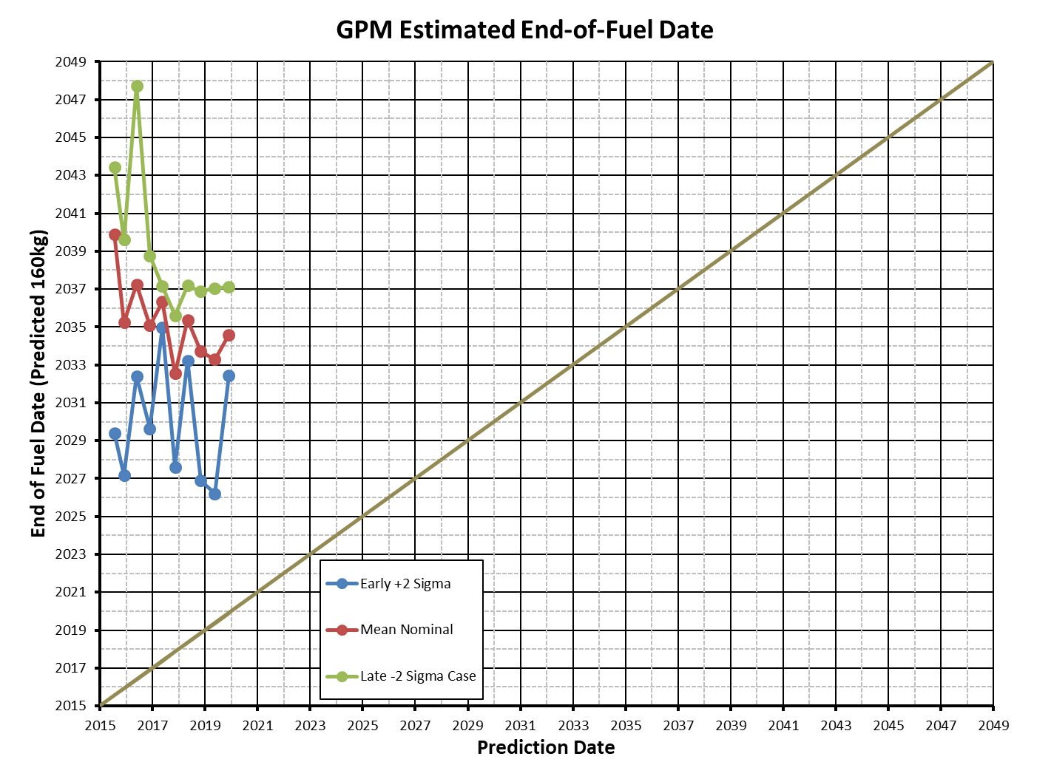
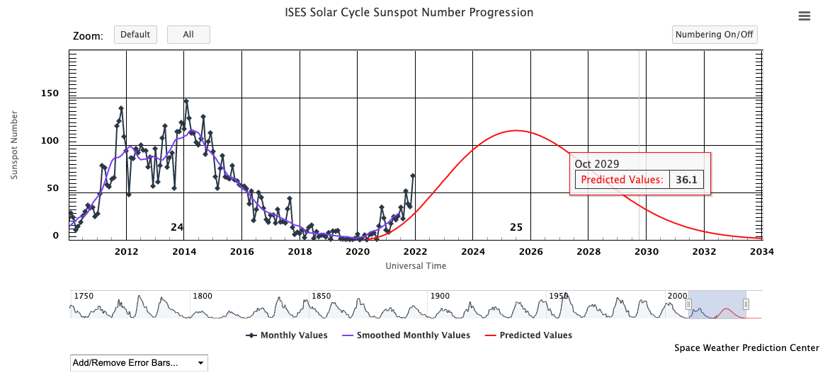
Fuel Summary
Prediction | Plus/ Early | Mean/ Nominal | Minus /Late
June-2015 | 05/2029 | 11/2039 | 06/2043
Nov-2015 | 03/2027 | 03/2035 | 08/2039
May-2016 | 06/2032 | 04/2037 | 10/2047
Nov-2016 | 08/2029 | 01/2035 | 10/2038
May-2017 | 12/2034 | 05/2036 | 02/2037
Nov-2017 | 08/2027 | 07/2032 | 08/2035
May-2018 | 03/2033 | 05/2035 | 03/2037
Nov-2018 | 11/2026 | 09/2033 | 11/2036
May-2019 | 03/2026 | 04/2033 | 01/2037
Nov-2019 | 06/2032 | 08/2034 | 02/2037
May-2020 | 03/2034 | 12/2035 | 10/2037
Nov-2020 | 01/2031 | 01/2034 | 07/2036
May 2021 | 03/2029 | 11/2032 | 09/2035
GPM Annual Review 2020 - Introduction

Slide 7
GPM V07 Status
Effective December 2021, radar products were updated to JPST-approved V07
  L1B Ku/Ka
  L2 Ku/Ka/DPR
  L3
SLH running at V07 since December 2021
Effective December 2021, processing hybrid combined products
  Ceased being produced in the science production environment
  NRT combined products produced as a V07 hybrid
    Radar input products are V07 products
    GMI radiometer input is at V05
    Format is combined V07 format
V07 combined algorithms have been run in the PPS Integration and Test Environment (ITE).
  Used for creating databases for GPROF
  Currently being analyzed
  Some bug fixes (no science changes) are being worked on

Slide 8
GPM V07 Status (2)
Radiometer L1B and L1C product V07 algorithms are complete and ready to use
  Additional fields in the format
  No calibration changes for GMI
  Additional emissive antenna corrections in TMI (no major change)
  Corrections in intercalibration and geolocation for SSMI/S
GPROF
  GMI initial algorithms have been received and run
  Additional small bias corrections were necessary before next run
  Post-boost TMI algorithm completed by CSU but pre-boost not yet completed
  ITE testing of V07 GPROF (GMI and TMI) will begin late January/early Feb
  L3 GPROF completed and ready for update (also used for L2 analysis)
CSH V07 algorithms have not been received by PPS for testing in ITE but need final combined before any test can be run
Combined/radiometer 1B/1C/GPROF V07 reprocessing rescheduled to 1 March 2022

Slide 9
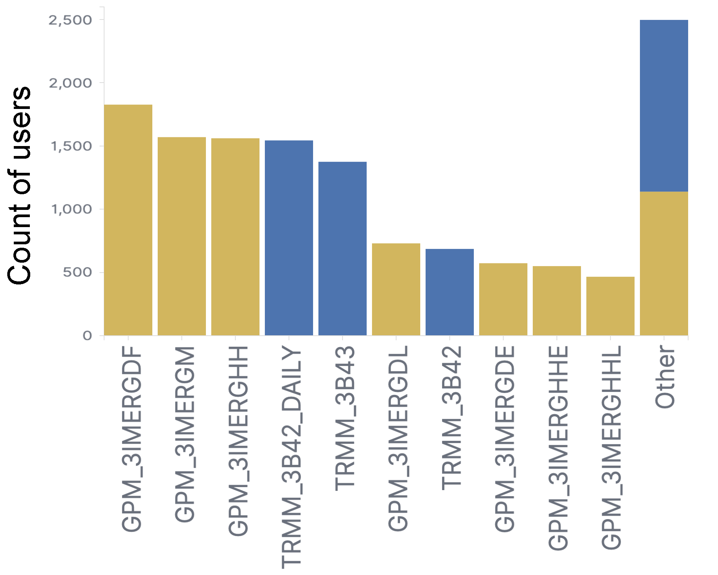
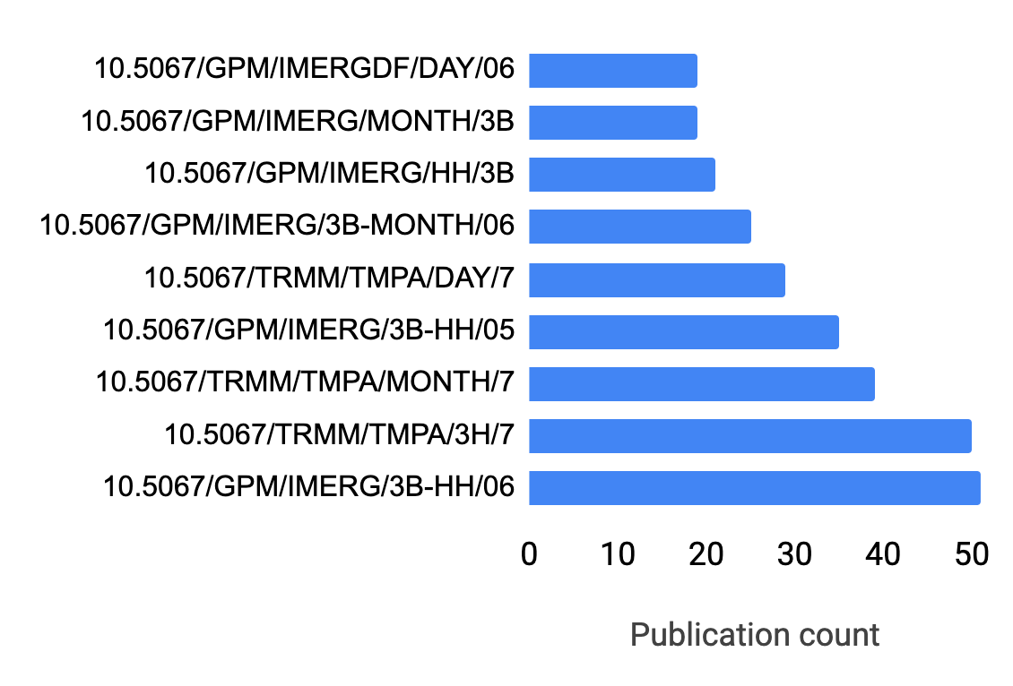
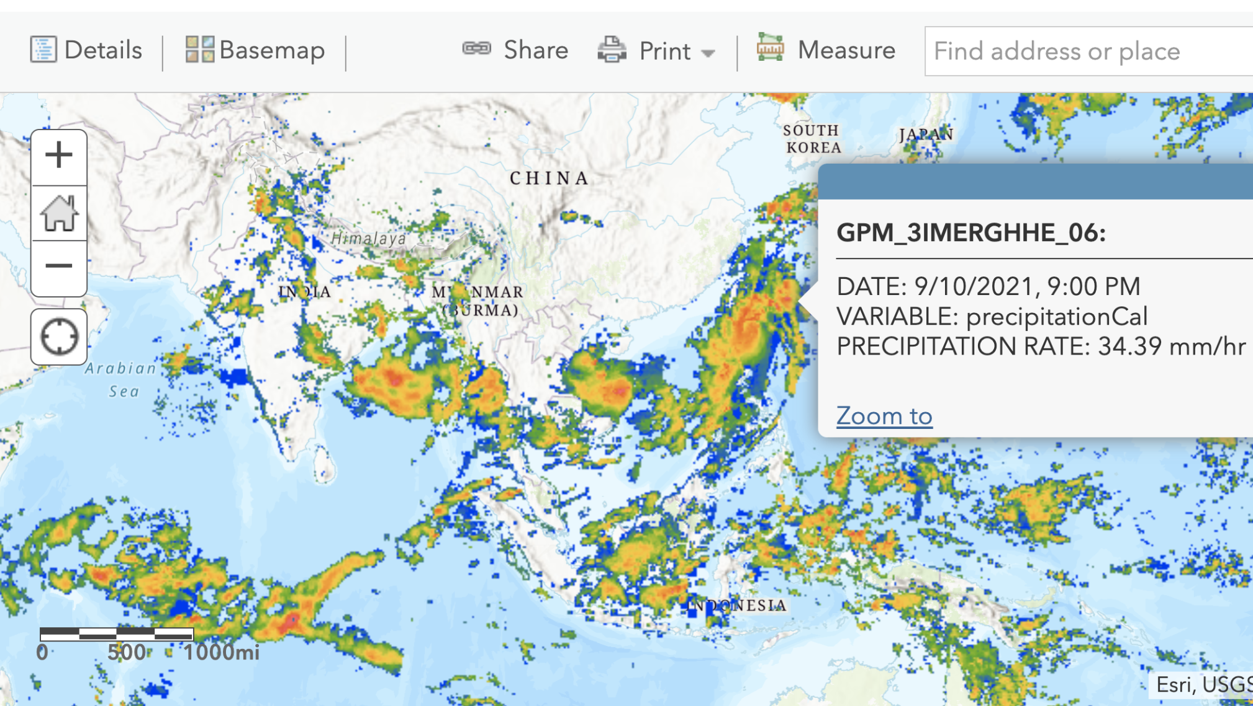
GES-DISC Activites
Popular products distributed in the past year:
Support existing services:
OPeNDAP, GDS, OGC, Variable/Spatial subset, Giovanni, Assign DOI, Help Desk
(https://disc.gsfc.nasa.gov/datasets/GPM_3IMERGHH_06/summary)
GPM
TRMM
New: IMERGHH in the Cloud (Cumulus)
1 PB
8000
users
New: “My Dashboard”: save and share favorite search/subset scenarios and histories
https://disc.gsfc.nasa.gov/dashboard (requires Earthdata login)
New: Knowledge database relating datasets and publications
New: ArcGIS Image Service (IMERG Early)
Popular Datasets cited by DOI, to date
https://disc.gsfc.nasa.gov/information/publications

Slide 10
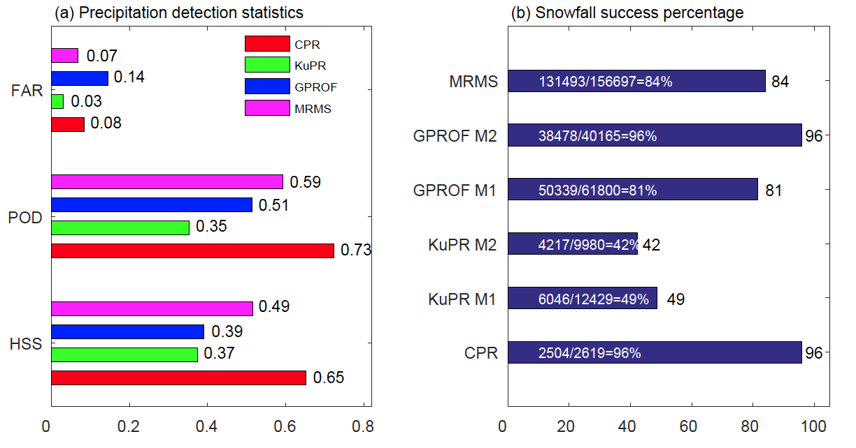
PMM Meeting At A Glance & Agenda
Detection of Snowfall
Study examines ability of different products to detect surface snowfall
CPR performs best; high sensitivity, smaller blind zone, and temperature profile information
GPROF: Higher detection but higher FAR; uses 2-m wet bulb temperature
DPR: Sensitivity issues; uses phase at lowest observation rather than surface, misses low-level phase transitions
FAR=False Alarm Rate
POD=Probability of Detection
HSS=Heidke Skill Score
Snowfall success %= # of detections/
# of ground observations
DPR M1 uses T at clutter-free height
DPR M2 uses Ku, Ka refl. differences
GPROF M1: Snowfall rate (SR) >0
GPROF M2: SR>0, SR-PR>0.01 mm h⁻¹
PR=Precipitation rate
You et al. (2021, GRL)

Slide 11
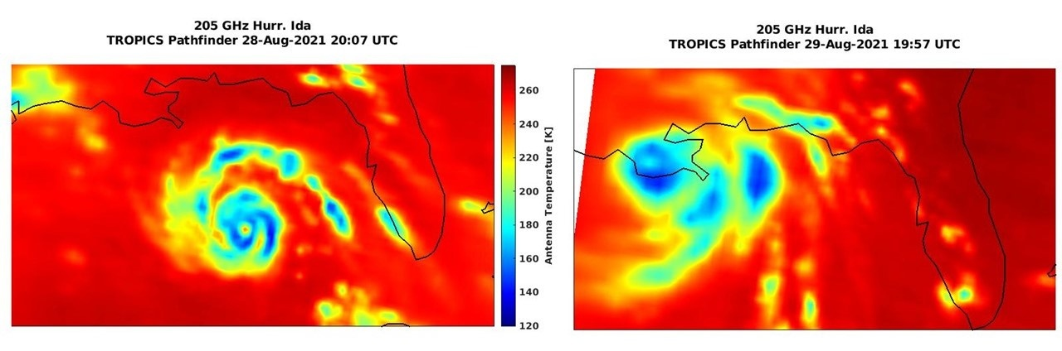
TROPICS Status
TROPICS Pathfinder launched into polar orbit on June 30, 2021
Set of 3 launches of full constellation expected over January to July, 2022
Minimum lifetime of 1 year
TROPICS Pathfinder Views of Hurricane Ida (2021)

Slide 12
Questions?

