Slide 1
Interplanetary Trajectory Optimization ISP
Lecture 3
Designing an Interplanetary Trajectory

Slide 2
Introduction
Designing an Interplanetary Trajectory combined knowledge of spacecraft & orbital dynamics and optimization theory
Selecting an appropriate level of fidelity for your analysis is also crucial
A common method is to use an iterative fidelity approach, where detail is added in incrementally

Slide 3
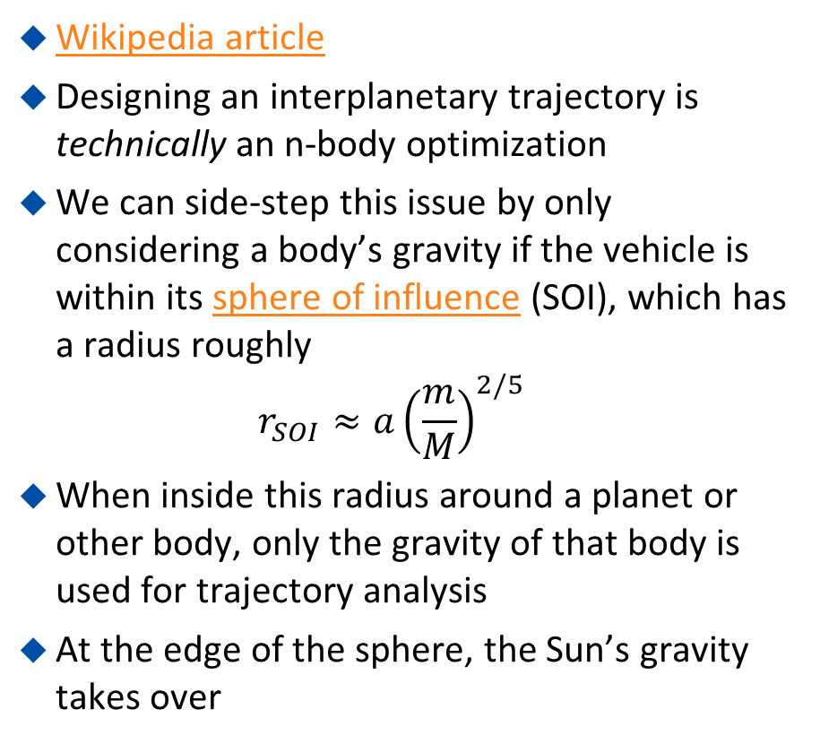
Patched Conic Method
Wikipedia article
Designing an interplanetary trajectory is technically an n-body optimization
We can side-step this issue by only considering a body’s gravity if the vehicle is within its sphere of influence (SOI), which has a radius roughly
$r_{SOI}≈a{\left(\frac{m}{M}\right)}^{2/5}$
When inside this radius around a planet or other body, only the gravity of that body is used for trajectory analysis
At the edge of the sphere, the Sun’s gravity takes over

Slide 4
Patched Conic Method
Within the first (blue) body’s SOI a hyperbolic escape trajectory is used to begin
Then when in the Sun’s (yellow) SOI an elliptical orbit is used to transfer over to the next body (red)
Optimization constraints are used to enforce that the position and velocity of the vehicle is consistent at each interface between one body’s SOI and another

Slide 5
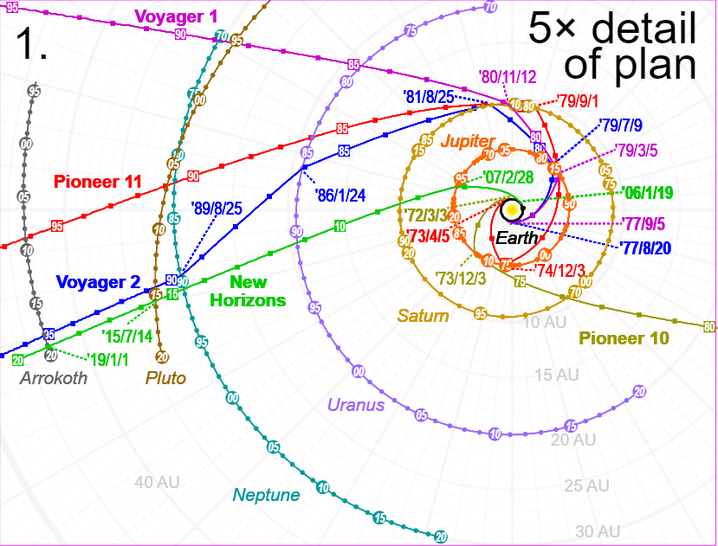
Voyager 1 - Trajectory
Wikipedia
Voyager Grand Tour
Launch
  September 5, 1977
  Titan IIIE
  Initial orbit aphelion 8.9 astronomical units
Jupiter closest approach
  March 5, 1979
  349,000 km from planet center
Saturn closest approach
  November 12, 1980
  124,000 km from planet center
Exit from heliosphere
  February 17, 1998
  69 (AU) from the Sun
Source

Slide 6
Project 1 - Voyager
Work with the following assumptions
  Voyager starts at its initial energy state (orbit) at the location of Earth at its departure date
  Fly-by plane orientation = 0°
Create a program to answer the following questions
  What argument of periapse in Voyager’s initial orbit would make it roughly coincide with Jupiter?
  What is the angle of departure from Earth’s orbit?
  How long is the transit from Earth to Jupiter?
  What angle of deflection does the flyby at Jupiter produce?
  What is the angle of departure from Jupiter’s orbit?
  How long is the transit from Jupiter to Saturn?
  What angle of deflection does the flyby at Saturn produce?
  What is the angle of departure from Saturn’s orbit?
  How long is the transit from Saturn to the heliosphere edge?
Produce a plot of the trajectory

Slide 7
Project 1 – Voyager 1 - Additional
Use pykep’s trajopt module to compute the trajectory
Produce a plot of the trajectory
Compare the result with Project 1
Why are they different?

Slide 8
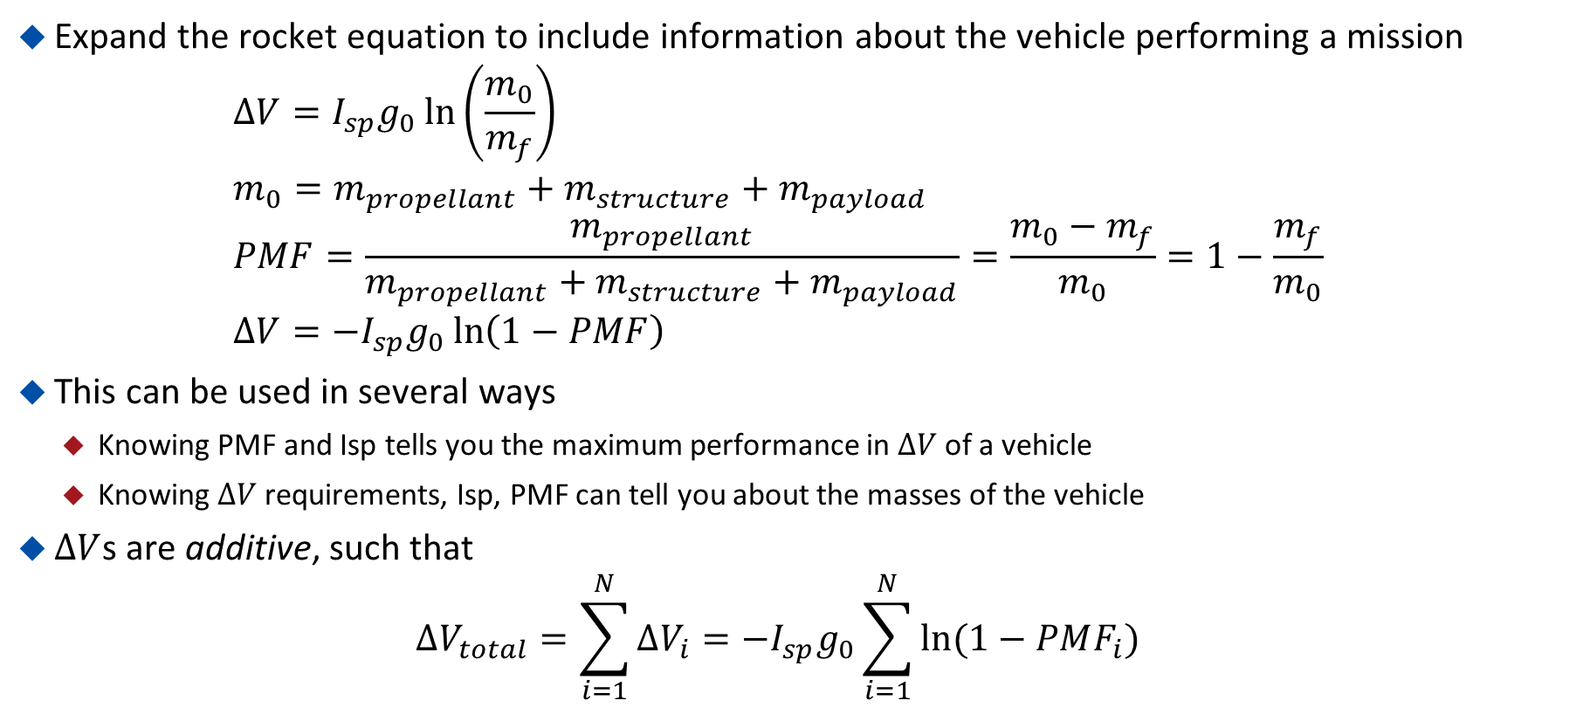
Linking Performance and Design
Expand the rocket equation to include information about the vehicle performing a mission
$∆V=I_{sp}g_{0}\ln\left(\frac{m_{0}}{m_{f}}\right)$
$m_{0}=m_{propellant}+m_{structure}+m_{payload}$
$PMF=\frac{m_{propellant}}{m_{propellant}+m_{structure}+m_{payload}}=\frac{m_{0}−m_{f}}{m_{0}}=1−\frac{m_{f}}{m_{0}}$
$∆V=−I_{sp}g_{0}\ln\left(1−PMF\right)$
This can be used in several ways
  Knowing PMF and Isp tells you the maximum performance in $∆V$ of a vehicle
  Knowing $∆V$ requirements, Isp, PMF can tell you about the masses of the vehicle
$∆V$s are additive, such that
$∆V_{total}=\sum_{i=1}^{N}{∆V_{i}=−I_{sp}g_{0}\sum_{i=1}^{N}{ln⁡(1−PMF_{i})}}$

Slide 9
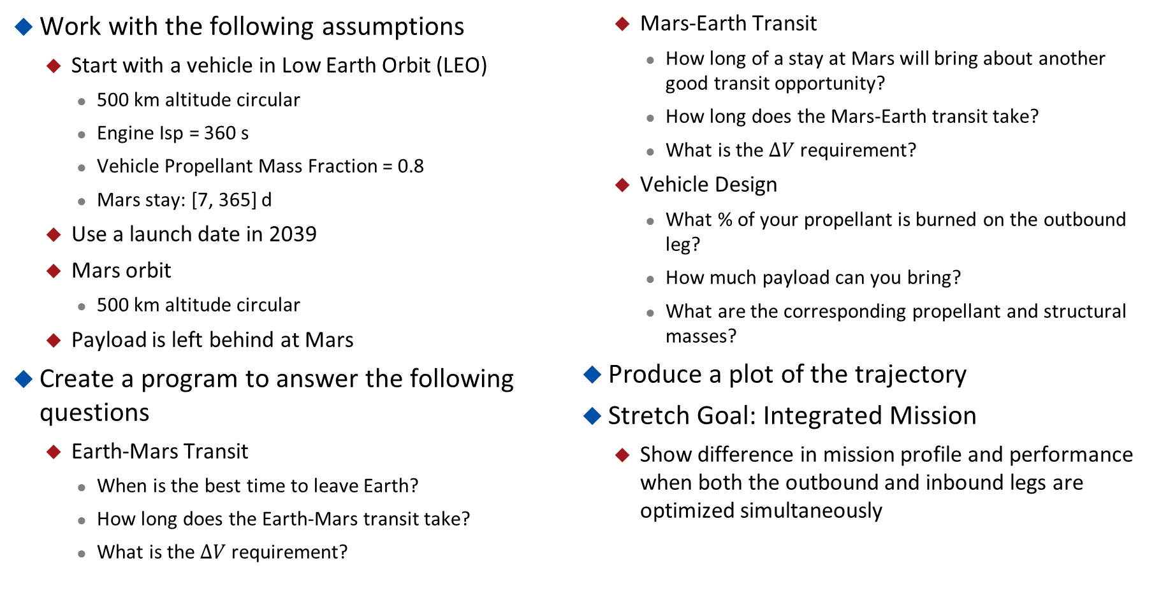
Project 2 – Mars Colonization
Work with the following assumptions
  Start with a vehicle in Low Earth Orbit (LEO)
    500 km altitude circular
    Engine Isp = 360 s
    Vehicle Propellant Mass Fraction = 0.8
    Mars stay: [7, 365] d
  Use a launch date in 2039
  Mars orbit
    500 km altitude circular
  Payload is left behind at Mars
Create a program to answer the following questions
  Earth-Mars Transit
    When is the best time to leave Earth?
    How long does the Earth-Mars transit take?
    What is the $∆V$ requirement?
  Mars-Earth Transit
    How long of a stay at Mars will bring about another good transit opportunity?
    How long does the Mars-Earth transit take?
    What is the $∆V$ requirement?
  Vehicle Design
    What % of your propellant is burned on the outbound leg?
    How much payload can you bring?
    What are the corresponding propellant and structural masses?
Produce a plot of the trajectory
Stretch Goal: Integrated Mission
  Show difference in mission profile and performance when both the outbound and inbound legs are optimized simultaneously

