Slide 1
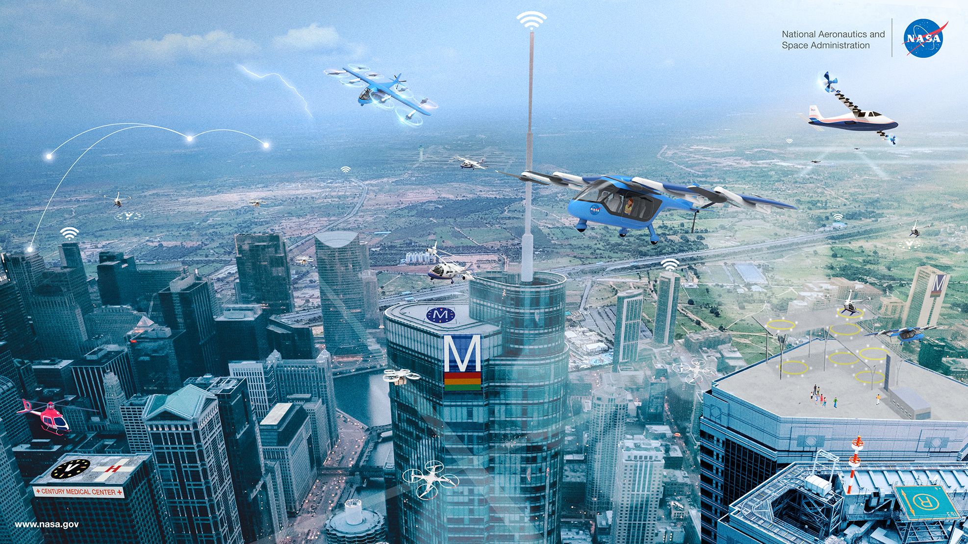
Flight Path Management (FPM) and Digital Flight (DF)
  Briefing to SC-147, 2022 Feb 08

Slide 2

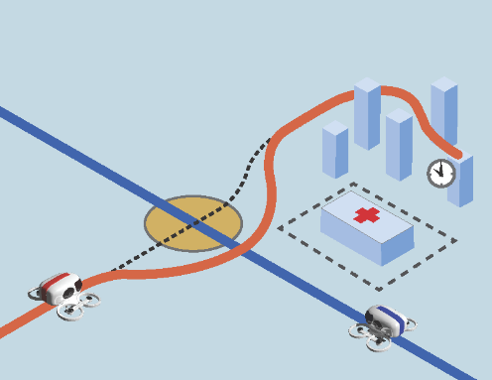

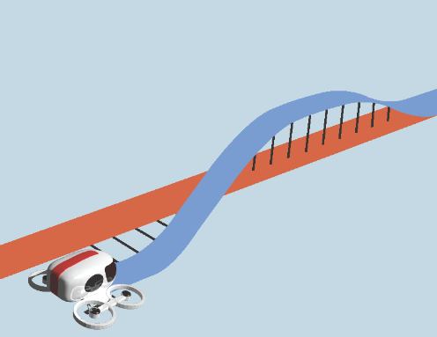
Flight Path Management (FPM) in Context
Mission Management
Flight Path Management
Tactical Operations
Vehicle Control
Functional
Establish mission objectives
and associated information requirements
Monitor, decide, revise the
mission parameters as needed
Achieve mission objectives
through flight path creation, monitoring, and revision
Account for constraints
in the operating environment
Suspend mission objectives
until safety is restored
Respond to urgent,
unforeseen hazards
Accurately fly the mission plan
Safely fly an established flight path and land the vehicle
Communicate performance constraints to FPM, Mission Management
AFCM IPR
Integrated Pilot Requirements
AFCM FPM
Flight Path Management
AFCM HPA
Hazard Perception & Avoidance
AFCM AHO
Aircraft Handling & Operations
Project
AFCM ARA: Assurance of Responsible Automation
Develop guidance for achieving requisite assurance levels for responsible automation under AAM operational paradigm
AAM Advanced Air Mobility
AFCM Automated Flight & Contingency Management

Slide 3
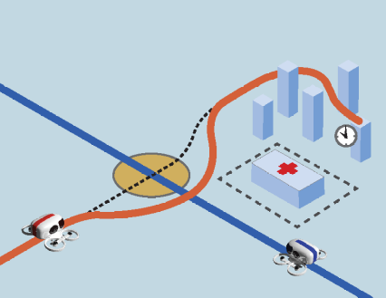
FPM Automation Goals and Objectives
FPM Automation Goals
  Ensure that a safe and operationally acceptable flight path is available to the vehicle operator through the life of the flight
  Achieve mission objectives within established mission parameters
  Remain adaptable to evolving mission objectives, constraints, and external stimuli
FPM Objectives: Create | Monitor | Evaluate | Revise Flight Path to be:
Feasible – Conforms to aircraft performance and range; Complies with airspace structure, rules, and constraints
Deconflicted – Avoids unsafe proximity to known traffic, terrain, obstacles, weather, and airspace hazards
Coordinated – Follows cooperative rules and procedures to harmonize with other airspace users
Flexible – Provides adequate degrees of freedom to enable future flight path changes
Optimal – Achieves business objectives and preferences of the pilot and fleet operator
*Conflict Management
Challenge: No certified FPM automation system or industry standards currently exist.
  Question: At what point do FPM automation standards become necessary?
  Consider: When the operating rules dictate that FPM automation functions are safety-critical*

Slide 4







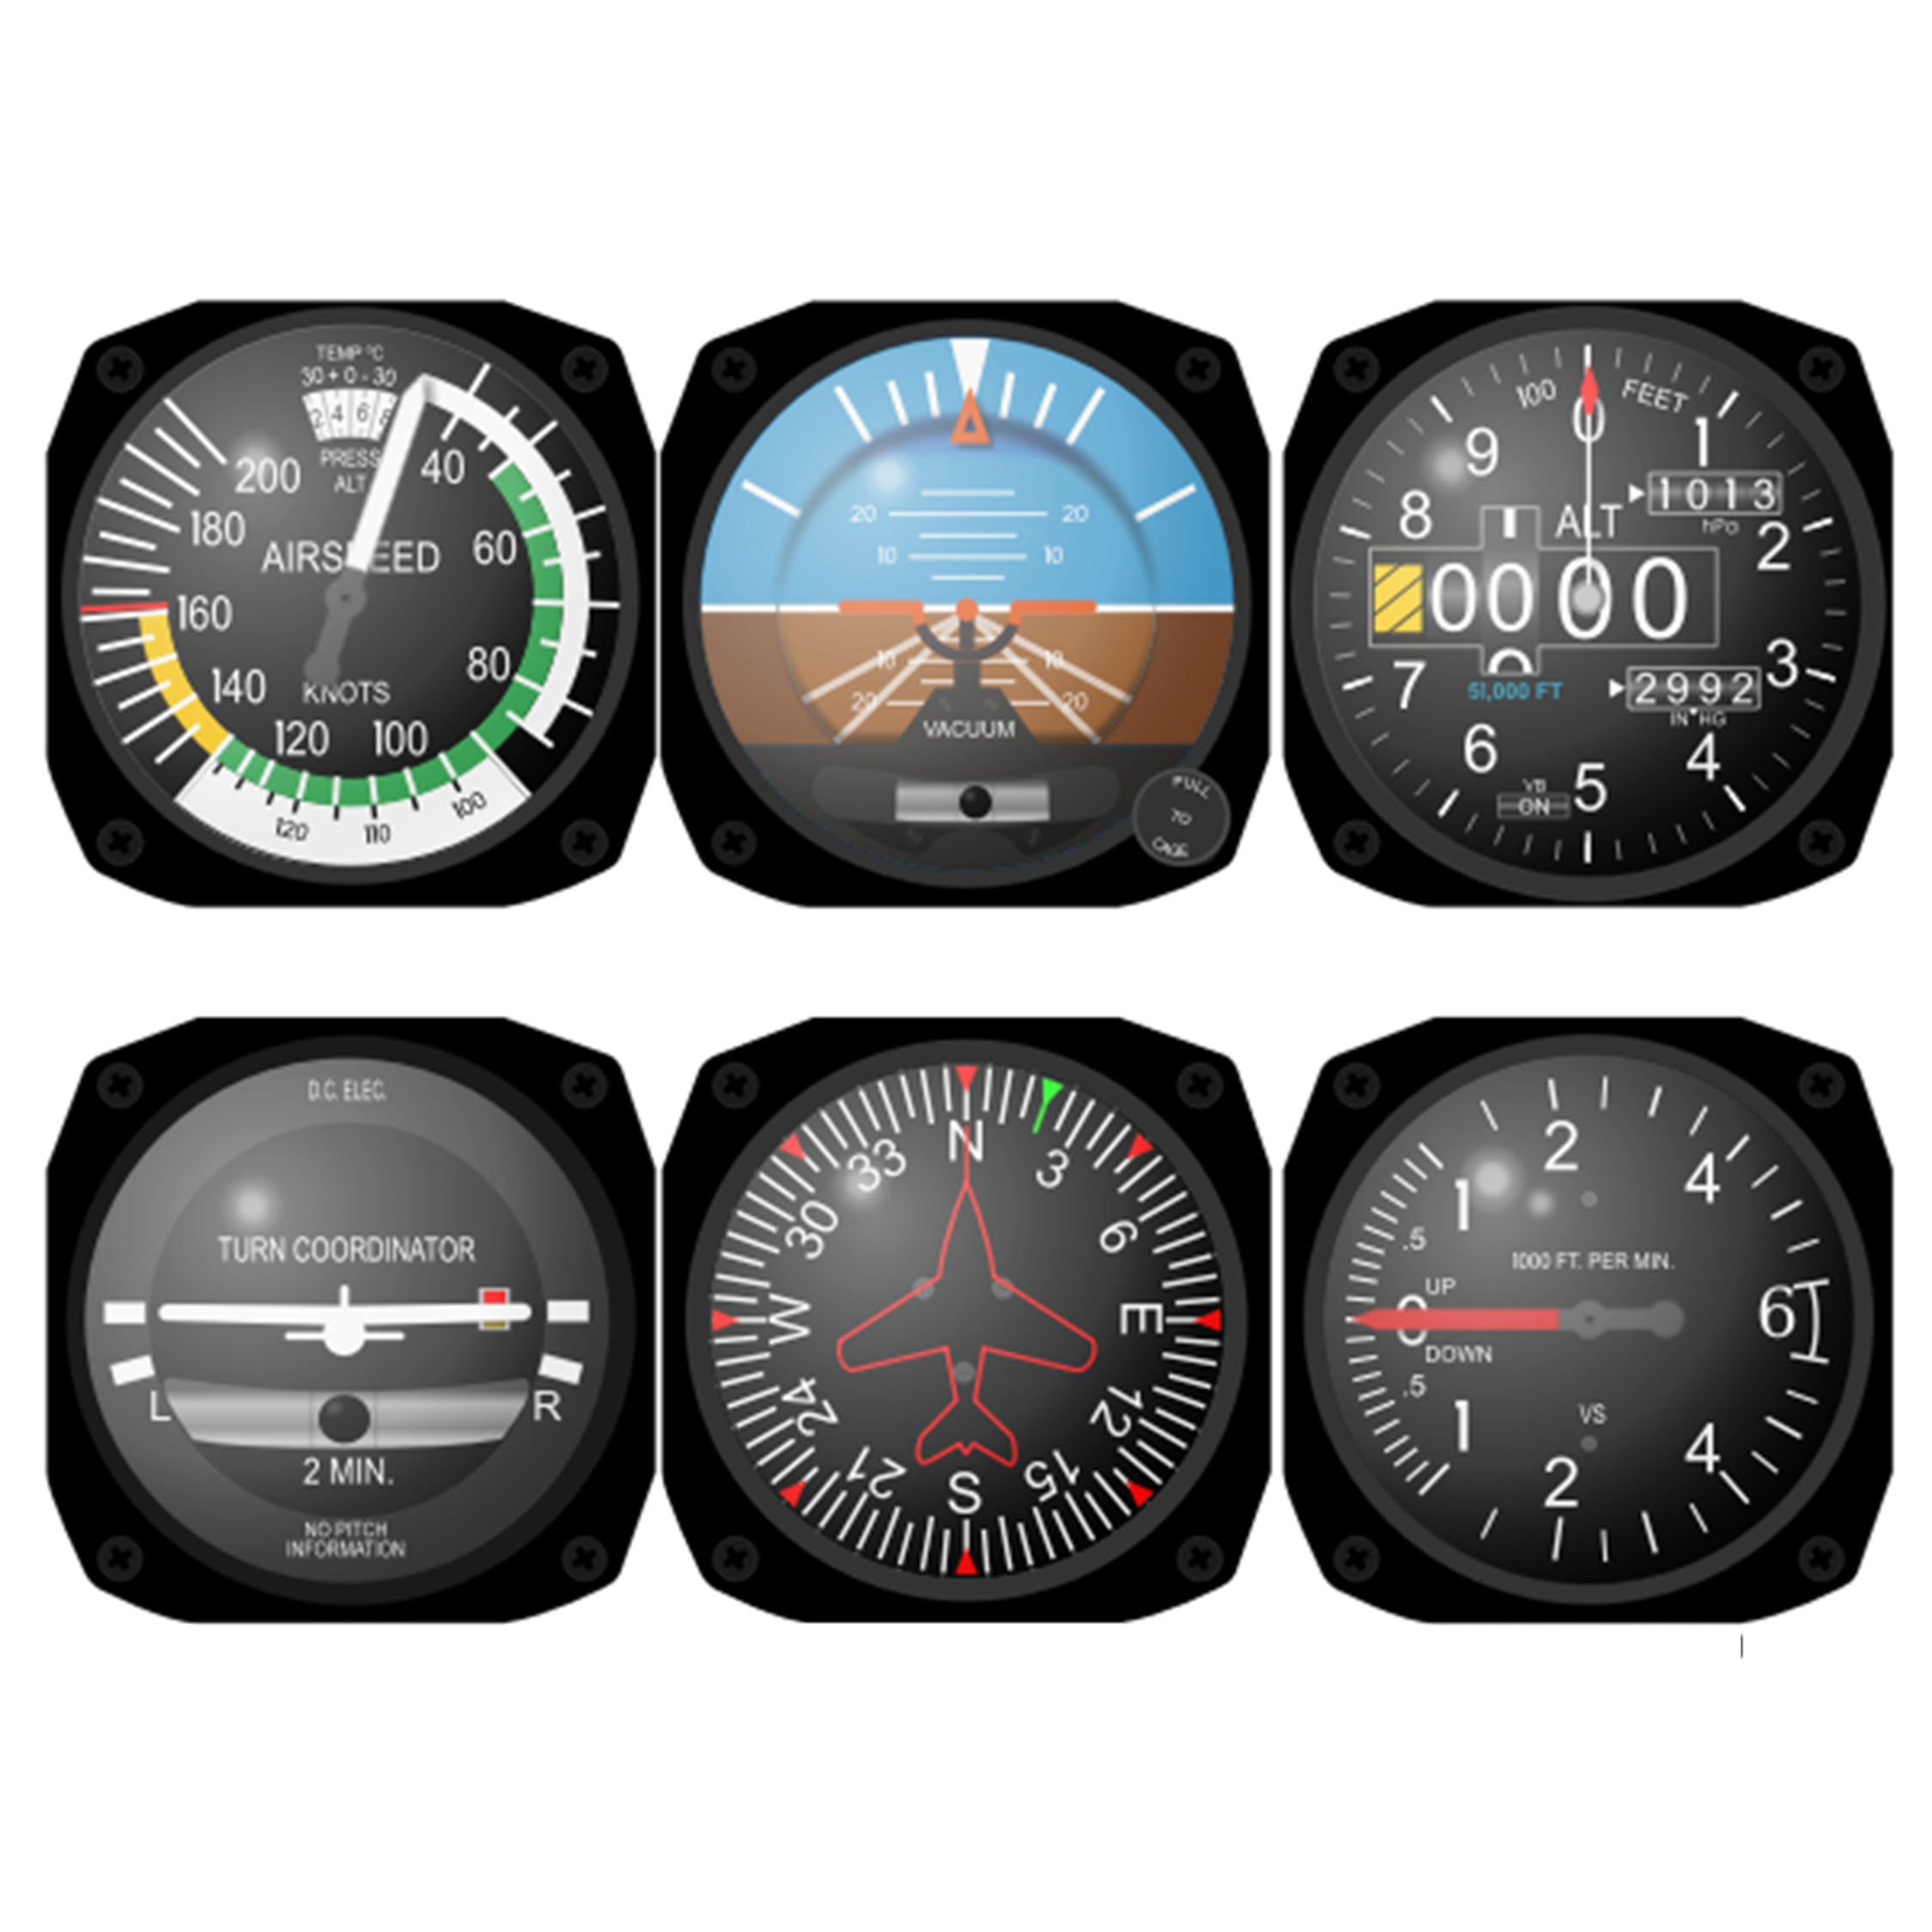

Mode of Operation Enabled by Digital Technology
Visual Flight
Pilot is the separator
Self-managed by cooperative procedures and rules
Distributed decision-making without centralized coordinator
Pilot
Flexible
Scalable
Operator is the separator
(relying upon automation services)
Proposed: Digital Flight
Self-managed by cooperative operating practices
Traffic awareness, including intent
Connectivity to centralized information services for shared situation awareness
Highly-automated separation through flight path management automation
Decision-Maker
Operator
Automation
Operating
Environment
Predictable
Accessible
ATC is the separator
(providing instructions to the pilot)
Instrument Flight
Sharing of intent (i.e., flight plan)
Centralized strategic and tactical conflict management
ATC
Pilot

Slide 5

National Airspace System (NAS) User Constituencies
Unified Mechanism for All Operators to Achieve Their Aviation Visions
Regional Air Mobility
“Community-friendly regional travel”
High Altitude Operators
“Cooperative separation”
Airline / Business Aviation
“Reduced operating costs”
  DF could increase scale
  of access to non-towered airports
  DF could optimize flexible operations in Upper Class E airspace
  DF could increase flexibility to optimize under dynamic conditions
Regional UAS
“Seamless integration in the NAS”
General Aviation
“Simplified Vehicle Operations”
  DF could reduce lost link contingency impacts and maximize NAS access
  DF could reduce pilot training costs while increasing safety and access
Urban Air Mobility
“High density/complexity urban operations”
Small UAS
“Beyond visual line of sight”
  DF could enable expansion beyond
  capacity-limited corridors
  DF could enable access above 400 ft and beyond visual line-of-sight
Opportunity for Operational Convergence and Harmonization
through Common Capability of Digital Flight (DF)

Slide 6
FPM Interactions with UAM Operational Elements
Operator
Fleet Operator
Pilot in Command
Mission Parameters
& Analysis
Settings, Conflict Alerts & Path Change Selections
FPM Operates at
the Intersection
Operator
Mission objectives
Airspace / community Constraints & coordination
Operating environment Dynamic conditions
Ownship aircraft
Capabilities
Avionics Data
Community Based Rules
FPM Automation
Path Changes
Coordination
Other Operators / Services
Agile response
Performance-based outcomes:
Feasible | Deconflicted | Coordinated
Flexible | Optimal
Flight Paths
Ownship Aircraft
Active
Data
Vehicle Control
Cross Checks
Provider of Services to Operator
Common Operating Picture
Supplemental
Data
Override
Hazard Perception
& Avoidance
Traffic
Weather Hazards
Airspace Restrictions
Atmosphere
Vehicle to Vehicle
Supplemental Data Service Provider
Onboard Sensors
Operating Environment

Slide 7
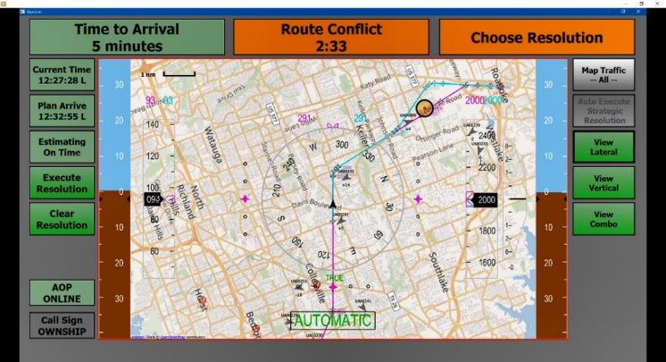
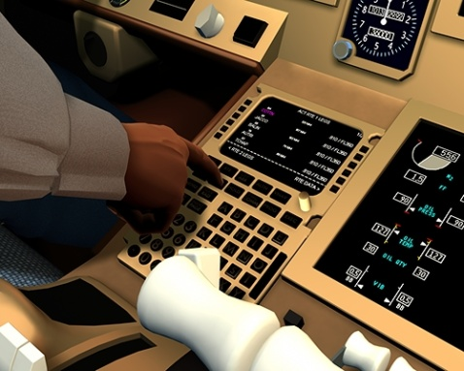
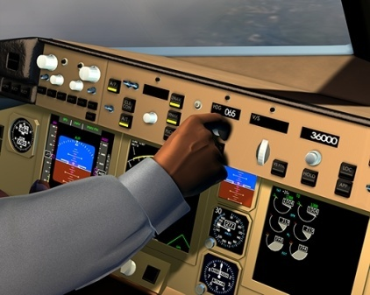
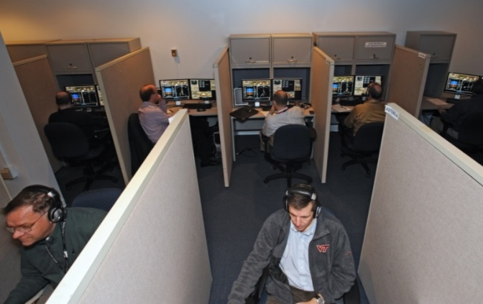
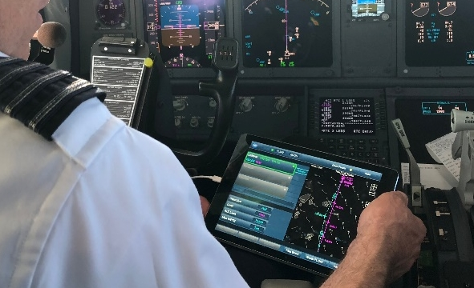
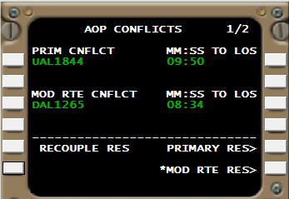
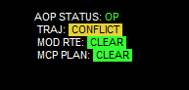
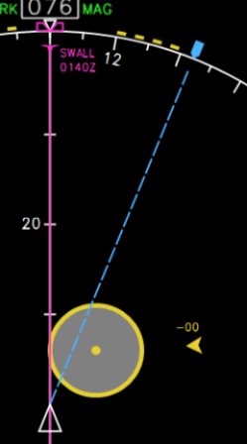
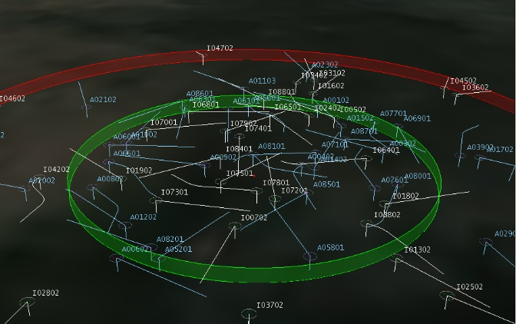
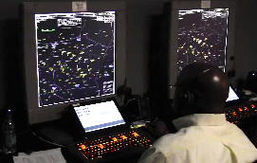
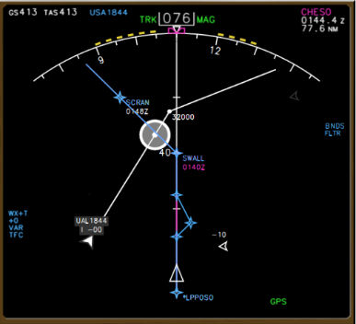
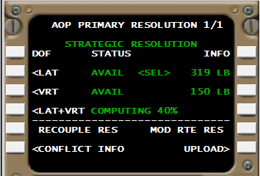
Autonomous Operations Planner (AOP)
AFCM Reference Automation System for FPM Research
Supporting NASA autonomy R&D for 20+ years
Platform for assessing FPM system requirements
Advanced algorithms for complex FPM operations
Adapting AOP to AAM / UAM (Current)
  Predicts trajectories w/ bounded uncertainty
  Detects conflicts w/ traffic & area hazards
  Resolves conflicts strategically & tactically
  Prioritizes safety and coordination
  Complies with arrival time constraints
  Supports conflict-free maneuvering
  Optimizes for time, fuel, and cost index ($)
AOP
Functional
Capabilities
UAM Implementation for
UML-4 Research (2019 start)
-NEW-
5
Strategic FPM Functionality
Tactical FPM Functionality
Human Testing for Pilot Procedures
Derivative Evaluation for Commercial Use
Initial Implementation for Autonomy Research
in Commercial Transport Operations (2001-2019)
1
4
Batch Testing for Distributed Scalability
Integrated Testing for Mixed Operations
Strategic / Tactical Integration
2
3

Slide 8
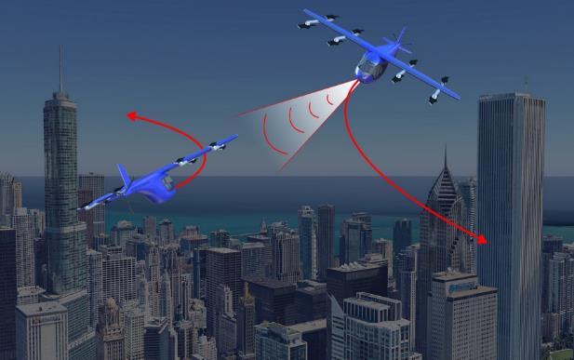
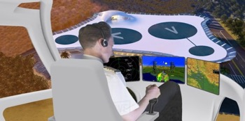
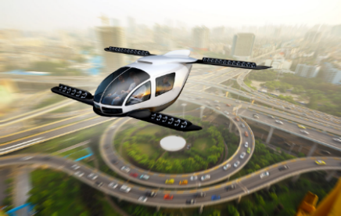
AFCM FPM Integration & Testing
Flight Path Mgmt
(FPM)
FY21 FY22 FY23
Batch
HITL
V&V
FY23
FY24
FY25
IAS-1 Flight Test
HITL / Tech Integration
IAS-2 Flight Test / Sys. Integration
Tactical Operations
(HPA)
AFCM Guidance to Industry
Vehicle Control
(AHA)
Mission Mgmt
(IPR)
Flight-Evaluated Prototypes
Design Guidelines / Best Practices
Input to Standards Development
Suggested Means of Compliance
HITL Human-in-the-Loop Simulation
IAS Integration of Automated Systems Flight Test

