Slide 1
Integrated Design for the MSR
SRC Mars Ascent Vehicle
Isabeta Rountree
Darius Yaghoubi
Shawn Maynor
NASA Marshall Space Flight Center
March 2022
IEEE Aerospace Conference

Slide 2
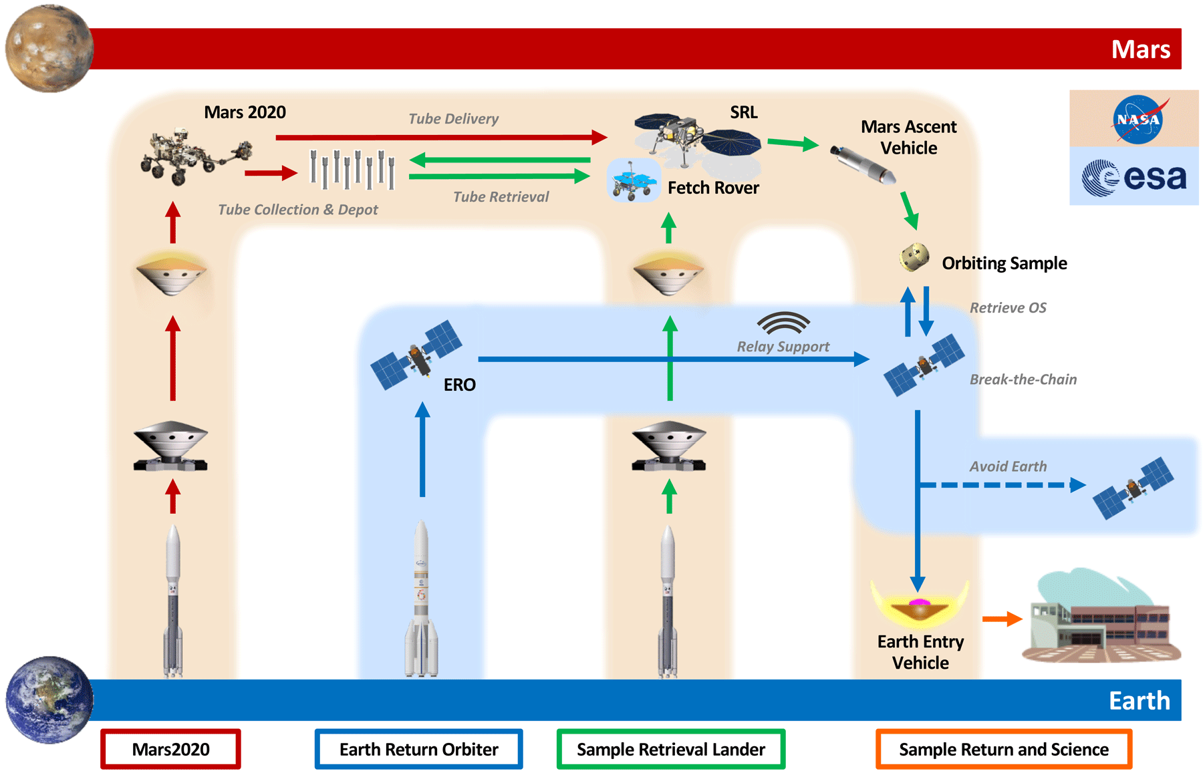
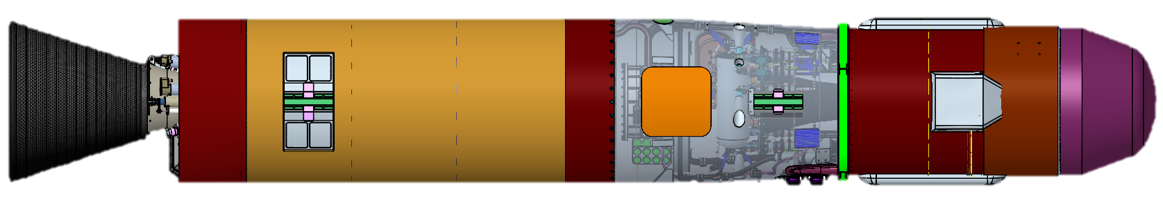
Mars Sample Return and MAV
MSR Mission Objective:
Retrieve Mars samples and return to Earth.
Mars 2020 rover collects Mars samples and leaves tubes in place.
Earth Retrieval Orbiter (ERO) sent to Mars orbit.
Mars Lander Platform (MLP) with Mars Ascent Vehicle (MAV) sent to Mars.
Fetch rover tasked with retrieving sample tubes on Mars surface.
MAV is loaded with the Orbiting Sample (OS) containing the sample tubes. MAV carries the OS to Mars orbit.
ERO rendezvous with OS, retrieves OS, and returns OS to Earth.
Earth Entry Vehicle returns OS to Earth’s surface.
*Note, this reflects MSR CONOPS at time that paper was written. Since then, Fetch Rover and Lander have moved to a new dual-launch architecture, increasing MAV mass allocation.
MAV
Pre-decisional. For planning and discussion purposes only.

Slide 3
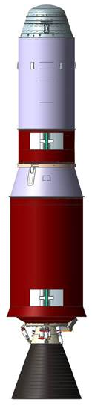
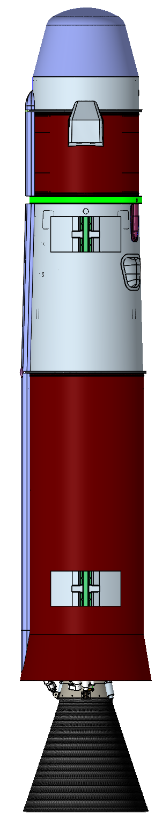
Major Changes from Previous Publications
SSGU second stage is unguided and spin-stabilized
Overall vehicle dimensions are smaller
Mass has decreased
Orbit trim thrusters removed
Resized SRMs with associated performance and burn times
Avionics and RCS have moved to first stage
Second stage avionics will consist only of a timing circuit, beacon, antenna, and associated batteries/heaters
Second stage features two spin and two de-spin motors
Unguided second stage has reduced orbital insertion accuracy
From:
DAC-0.0 SSGG
To:
SRC SSGU
525kg
380kg

Slide 4
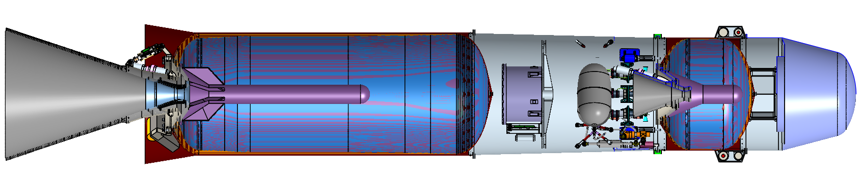
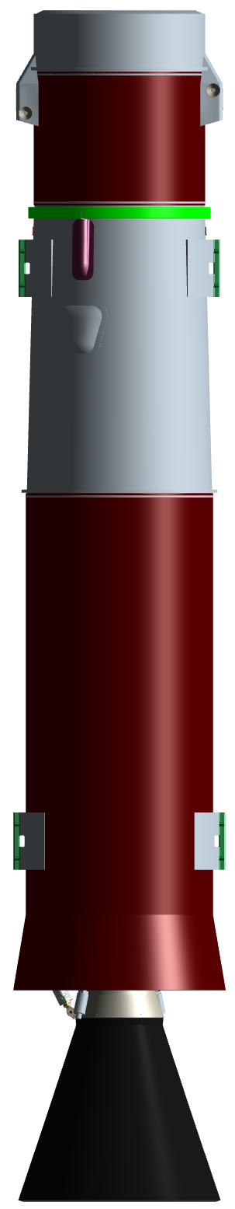
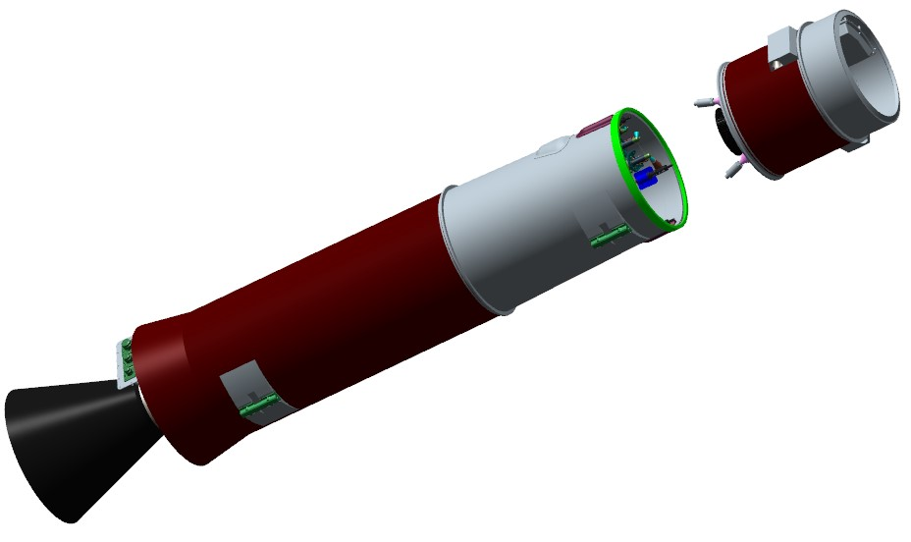
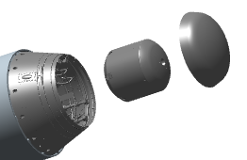
MAS Overview
SRC Mars Ascent System (MAS) consists of:
Mars Ascent Vehicle (MAV)
  Two-stage (guided, unguided) solid motor vehicle
  Pyrotechnic stage separation
  Electrical-mechanical Thrust Vector Control (TVC) with supersonic splitline nozzle on 1st stage
  2x Spin Motors and 2x De-spin motors on 2nd stage
  Monopropellant Reaction Control System (RCS)
MAV Payload Assembly (MPA)
  Ejectable fairing
  Orbital Sample (OS)
Spin/De-spin SRMs
2nd Stage Solid
Rocket Motor
Separation System
RCS Prop. Tank
Interstage Structure
Avionics Package
<3 m
OS
1st Stage Solid
Rocket Motor
MPA
Fairing
MPA
~0.5 m
2nd Stage
Aft Ramp Structure
1st Stage TVC
1st Stage

Slide 5
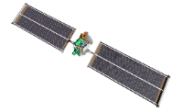







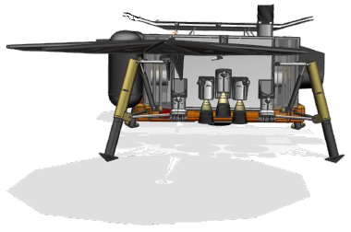

MAV Ascent Mission Operations Overview
4
2nd Stage Burn to Burnout and Spin-Down
2nd stage SRM 2 burn to burnout
Post-2nd burnout transients wait
De-spin motor burn
5
OS Payload Delivery
MAV 2nd stage-commanded OS release
Enable beacon (baseline)
3
Staging and Spin-Up
Separate 1st stage
Hi-speed spin motor burn
Enable beacon (earliest opportunity)
2
Coast and MPA Fairing Separation
Depart sensible atmosphere
Orient vehicle for MPA fairing separation
Separate MPA fairing
Reorient vehicle back to flight vector
1
Launch and 1st Stage Burn to Burnout
VECTOR launch
1st stage SRM 1 burn
Max Q
SRM 1 burnout
*Conceptual elements shown. Not to scale.
1st Burn
Coast, Staging and Spin-Up
2nd Burn and Spin-Down
OS Release
Loiter
~78s
~374s
~22s and ~Minutes
~Minutes
~Days

Slide 6
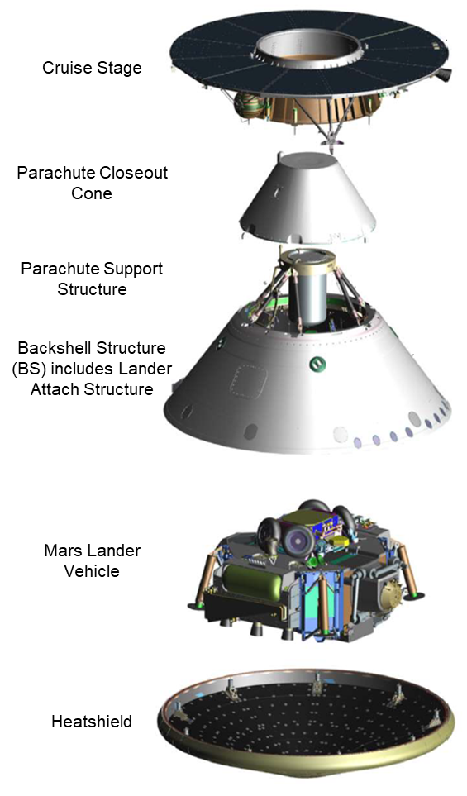
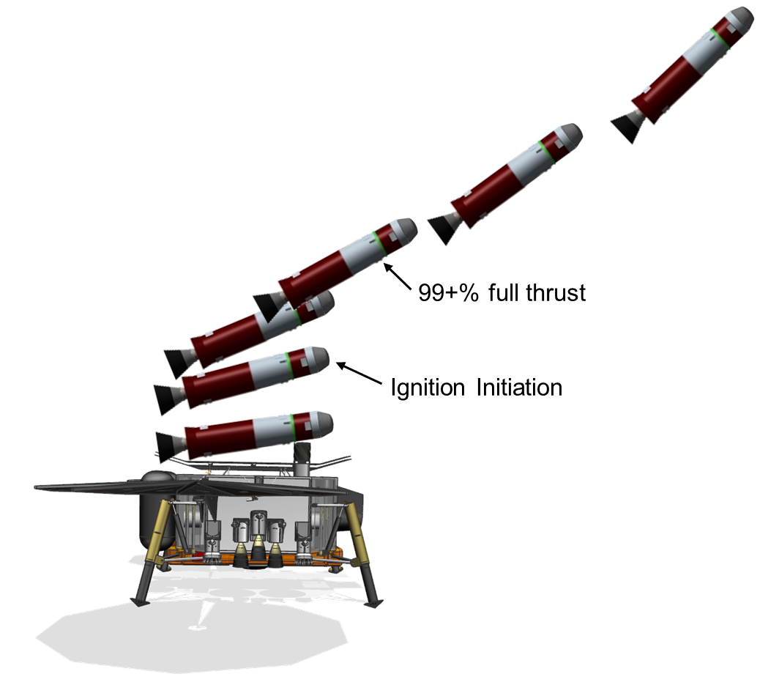
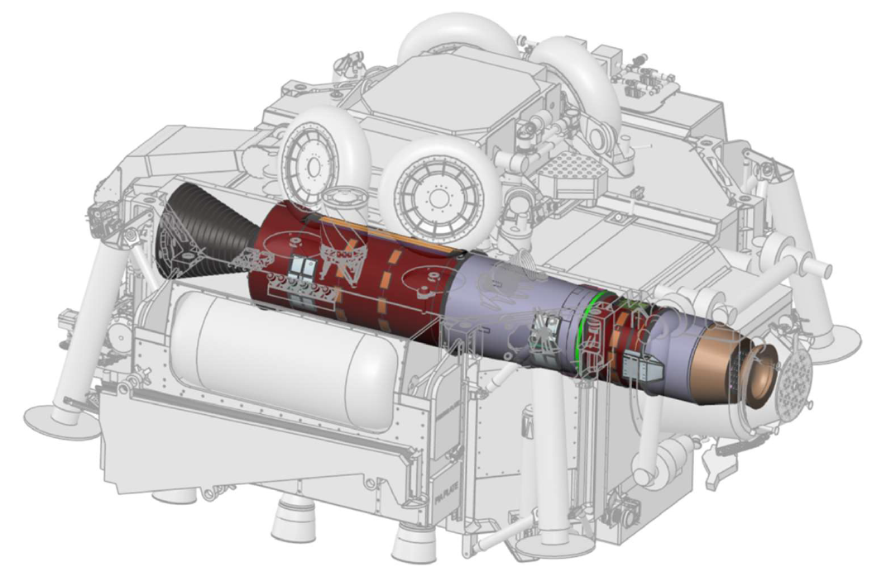
Systems Requirements Cycle
SRC performed November 2020 - June 2021. This was MAV’s second major development cycle.
The primary purpose of SRC was to develop the system-level requirements for the vehicle in preparation for the System Requirements Review (SRR), held November 2021. SRR passed successfully.
Although not principal goal, technical fidelity of vehicle design was also advanced.
  Technical design based upon preliminary high-level requirements
  MAV risk class increased to Class A. MAV was now designated a “Flagship Mission”.
MAV Stowed Within Lander
VECTOR: Vertically Ejected, Controlled Tip-Off Rate
MAV Integration with Cruise Stage
*Conceptual elements shown.

Slide 7
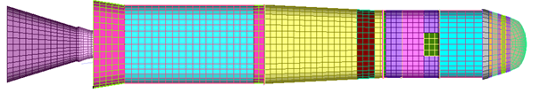
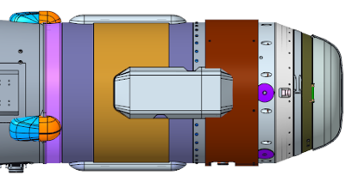
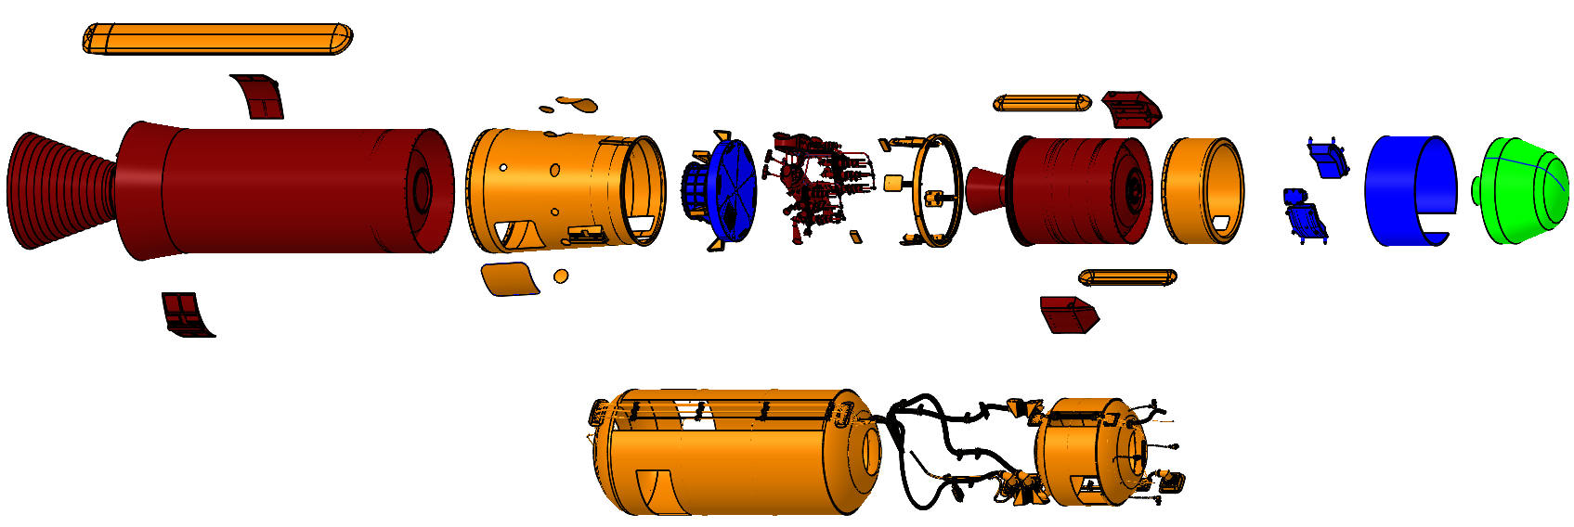
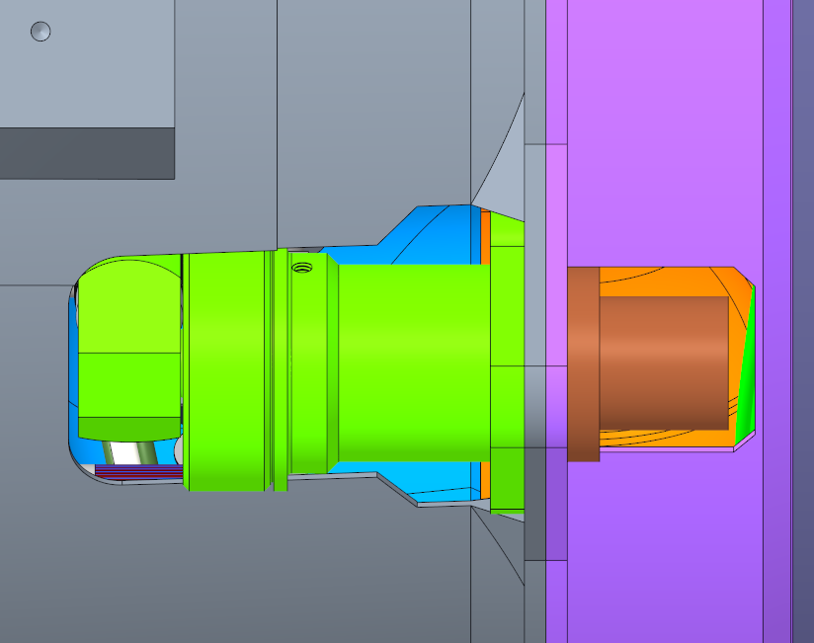
Structural and Mechanical Design
Unique structural design challenge as vehicle must survive approximately 15g lateral loads during Mars EDL.
Primary load path travels through SRM1 and interstage via VECTOR attach points.
Structural design based upon quasi-static loads analysis during Earth ascent/EDL and dynamic loads during VECTOR ejection and Mars ascent. FEM developed.
Non-propulsive structural elements designed of high TRL machined monocoque construction from simple ring forgings.
Detailed trade study determined Low-Shock Separation Nuts (LSSN) as most viable mechanism for stage separation.
Mars Ascent
FEM
Sep System
Interstage
Forward Structure
Monocoque Structural Elements
LSSN Separation Mechanism

Slide 8
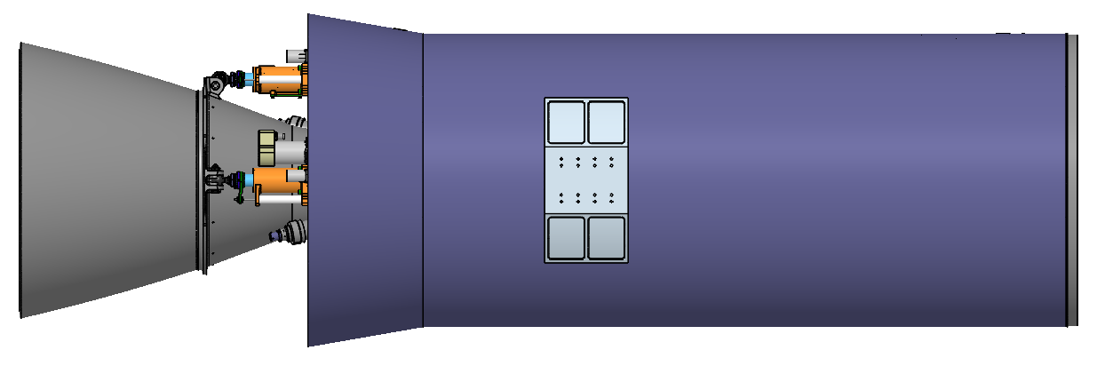
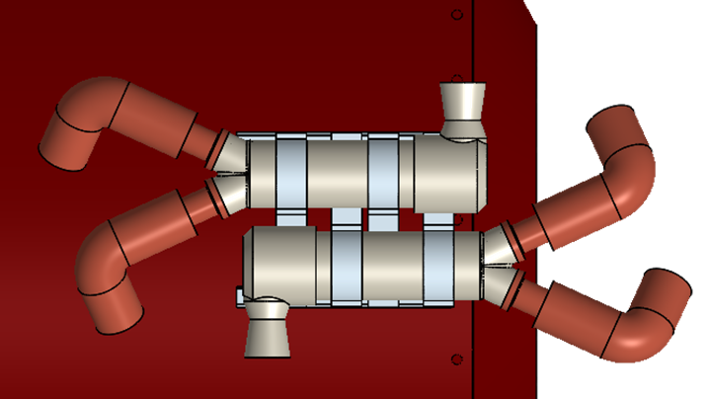
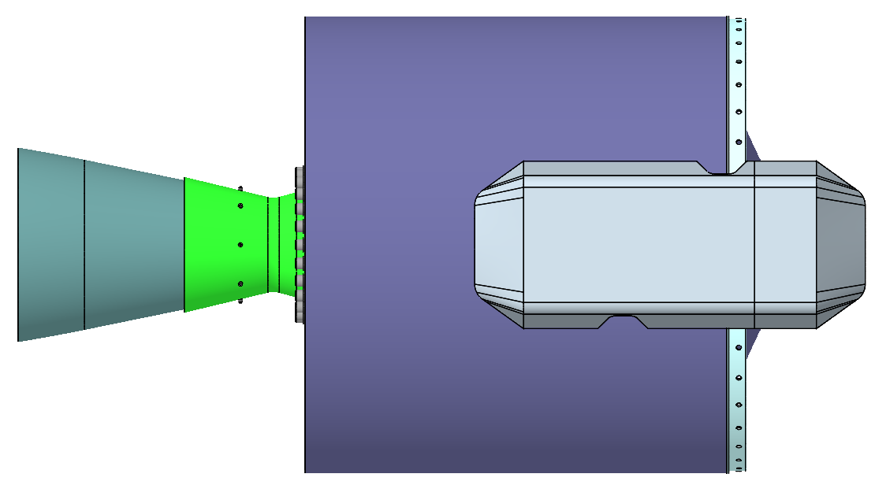
Main Propulsion Design
Main propulsion system consists of two solid rocket motors, using high Technology Readiness Level (TRL) propellant with heritage in Mars missions.*
TVC on SRM1, with no active control on SRM2.
Entire main propulsion system designed for 400kg Gross Liftoff Mass (GLOM).
Computational Fluid Dynamics (CFD) used to optimize nozzle designs for increased performance.
SRM cases feature carbon-composite design, driven by expected loads and thermal environments.
Four small-scale SRMs on SRM2 used for spin-up and spin-down on unguided second stage. Each spin/de-spin motor mounted tangentially with redundant pyrotechnic igniters.
Solid Rocket Motor (SRM) 1
SRM2
Spin & De-Spin Motors
(No Aero Housing)
*TP-H-3062 solid propellant, used in Mars exploration rovers Spirit and Opportunity and Mars Pathfinder Entry/Descent/Landing

Slide 9
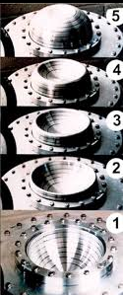
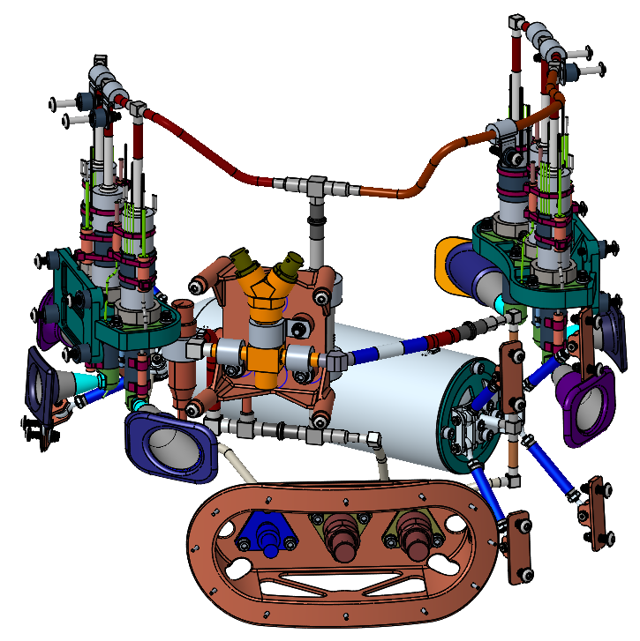
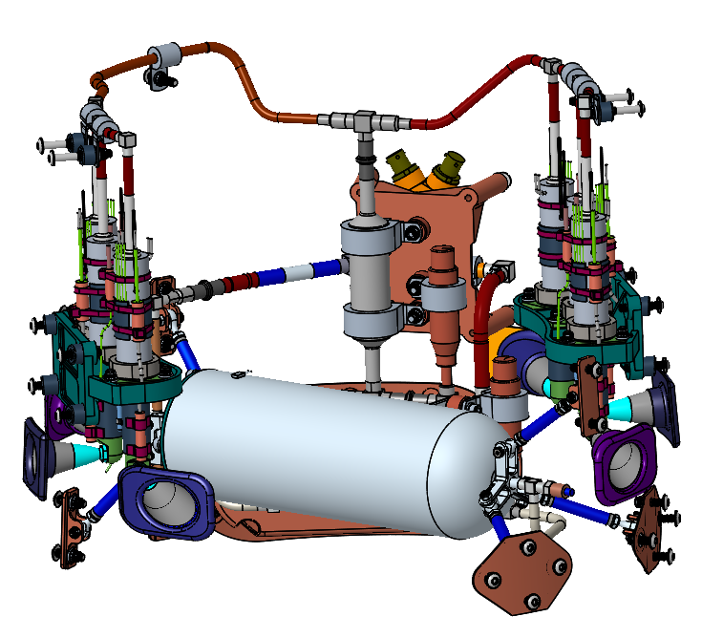
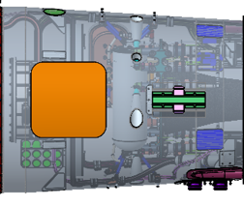
Reaction Control System Design
RCS provides roll control during SRM1 burn and full attitude control during coast. No RCS hardware exists following stage separation.
RCS consists of monopropellant hydrazine 2:1 blowdown system with high TRL commercial hardware.
Six lateral thrusters with customized propellant tank with elastomeric diaphragm. Thrusters angled from pitch and yaw axes due to packaging constraints.
Unique design constraint in that RCS cannot be located on unguided S2. Location on interstage creates a very short control moment arm.
Relatively high freezing point of hydrazine (+2°C) requires additional heaters.
Nozzles
Service Ports
Prop Tank
RCS Located Between
Avionics and SRM2
Example Diaphragm
RCS Internals, +Z and –Z sides (Mech Coord. Frame)

Slide 10
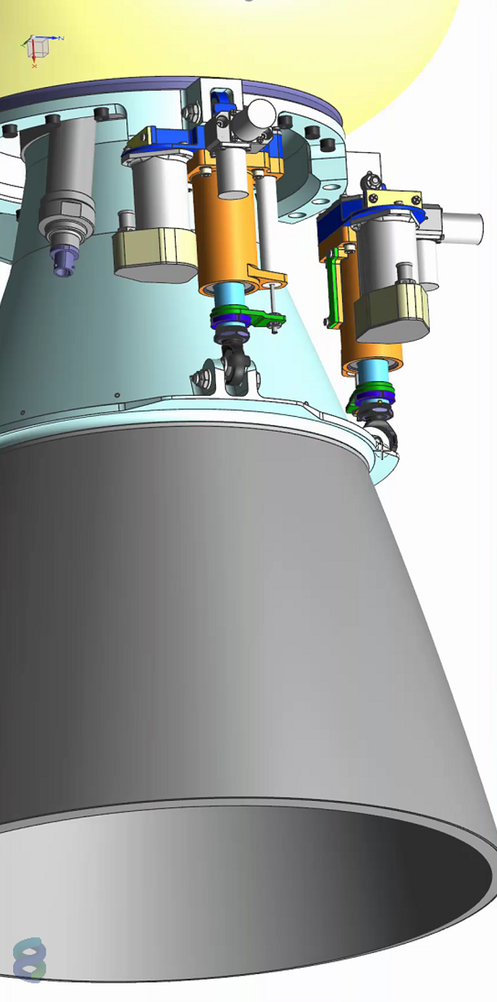
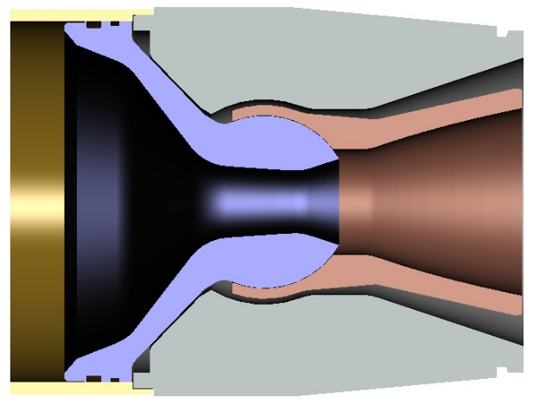
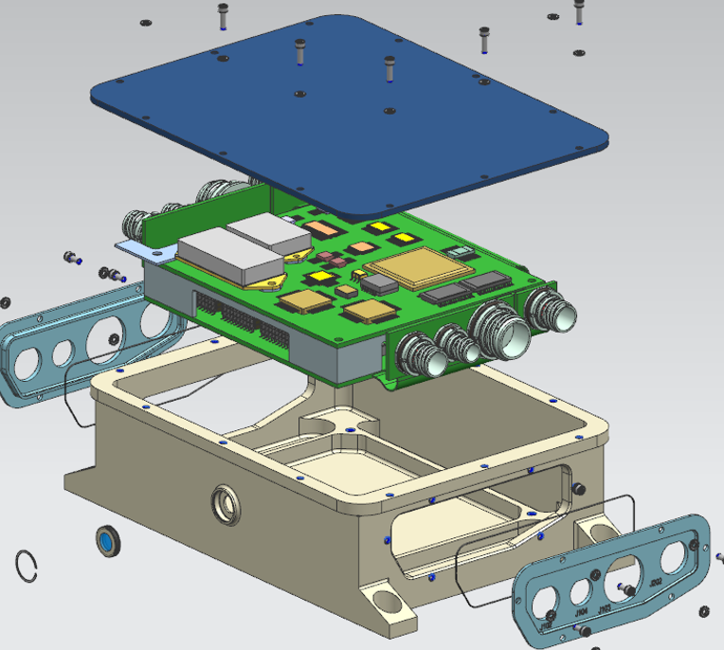
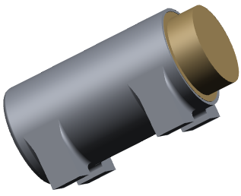
Thrust Vector Control Design
TVC provides pitch and yaw control during motor burn.
Nozzle gimbal performed with traditional ElectroMechanical Actuators (EMAs), mounted on aft end of SRM1. No TVC on SRM2.
Actuators sized to gimbal SRM1 nozzle while under expected mission propulsive loads ascent loads.
Additional hardware includes pyro-activated thermal battery, and Field-Programmable Gate Array (FPGA) controller. Commands sent to FPGA from flight computer.
Gimbal nozzle features a Supersonic Splitline (SSSL) with a trapped ball design.
  Joint is located downstream of nozzle throat, reducing erosion.
  Typical TVC systems do not operate at such low temperatures due to material incompatibilities. SSSL does not feature any elastomerics.
Pitch & Yaw Actuators
Concept Thermal Battery
Sample SSSL
TVC Controller
TVC Design

Slide 11
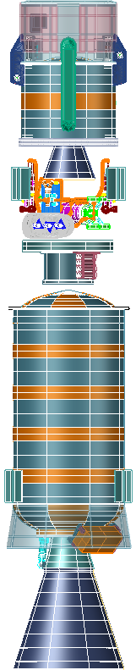
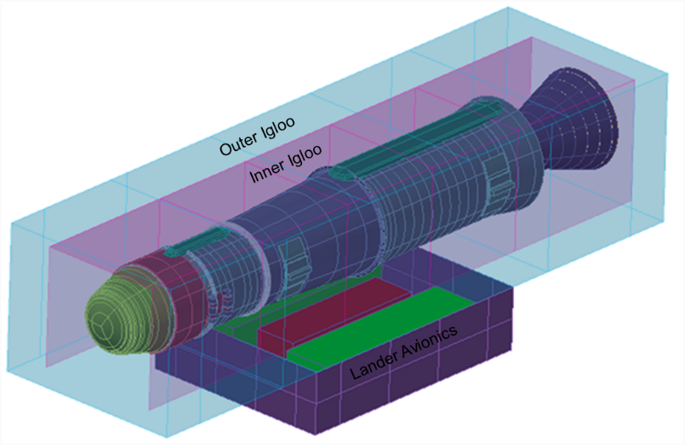
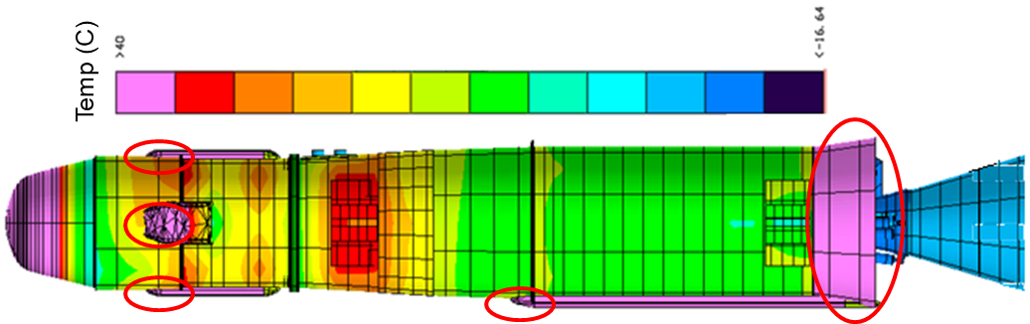
Thermal Design
MAV stored within thermal “igloo” during cruise to Mars and on surface, maintaining constant external temperature.
Expected worst-case hot and cold mission environments used to bound heater design. 15 active heater zones.
  Each zone has different components with different thermal constraints
  RCS considered a special case due to freezing point of hydrazine.
  No active heating* during ascent due to relatively short ascent mission time.
Passive thermal protection based upon ascent heating profile, considering induced environments such as aeroheating, plume radiation, and SRM nozzle soak back.
Additional passive thermal protection may be necessary to add in future design revisions.
Zone
1
Zone
2
Zones
3-5
Zones
6-9
Zone
10
Zones
11-15
Thermal Igloo Enclosure Concept
Thermal Distribution During First Stage Flight
Thermal Control Zones
*Excluding beacon operation.

Slide 12
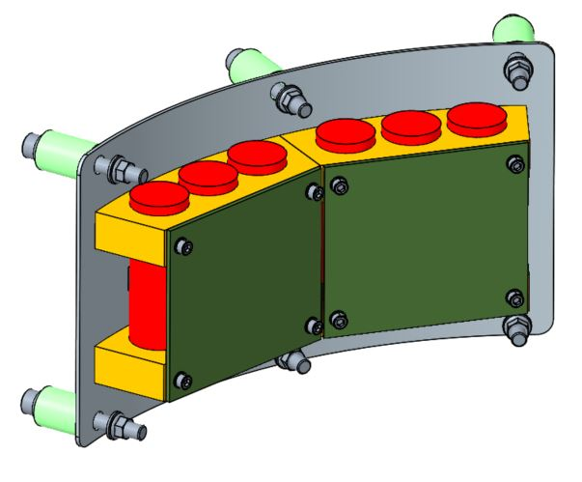
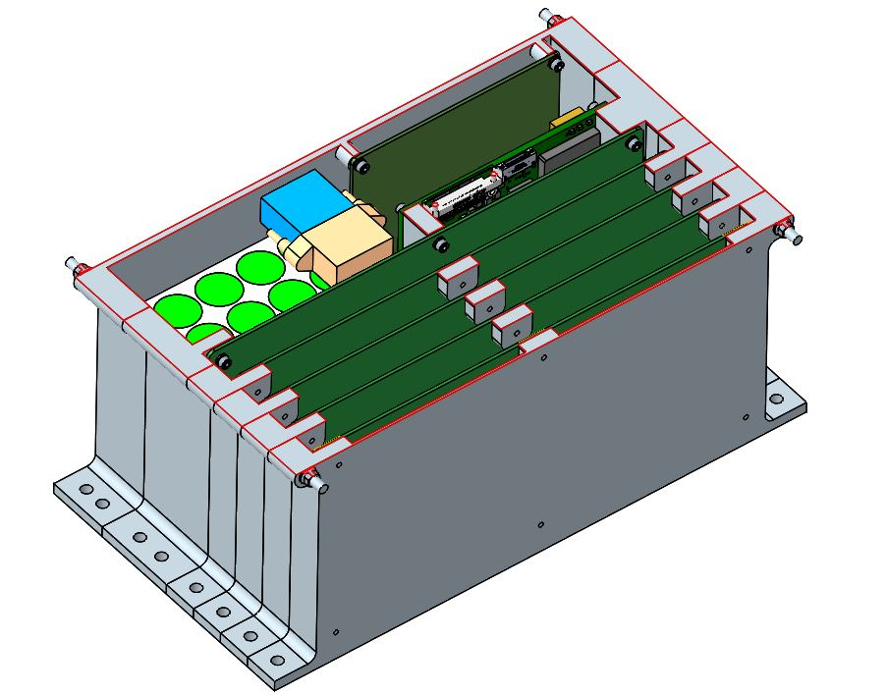
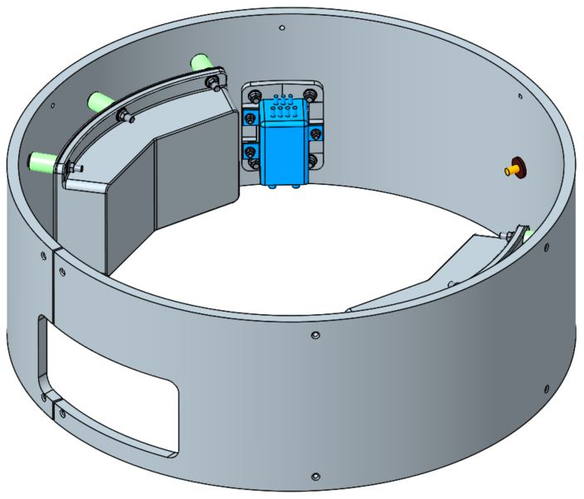
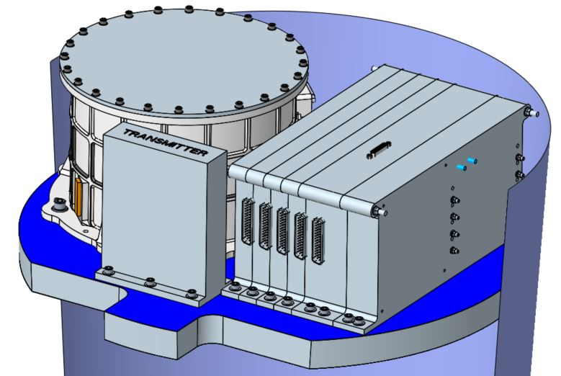
Avionics Design
Avionics divided among stages, providing command and data handling, communication, and power.
  Primary avionics on S1, holding IMU, flight computer, transmitter, batteries, and various controller/distribution boards
  Secondary avionics on S2, holding timing circuit, antenna, batteries, and beacon
Flight software algorithms loaded into computer. Autonomous control of entire flight including ignition and mechanisms.
Beacon in operation for up to 25 days* following orbital insertion. Beacon will aid in rendezvous and capture of OS by ERO.
Umbilicals with lander provides power and direct control of several systems while stowed, including pyro inhibits.
All avionics have to function in extremely atypical environments such as temperature, radiation, and shock.
Secondary Avionics Battery/Beacon Boards
IMU
S1 Batteries
Primary Avionics (inverted for clarity)
Computer/Controller/Battery Stack
Secondary Avionics, Wraparound Antenna Omitted
*Recently reduced to 15 days

Slide 13
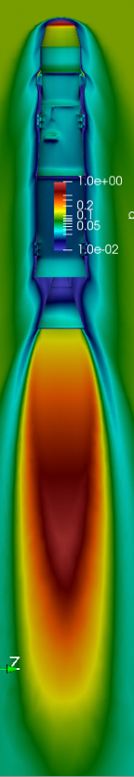
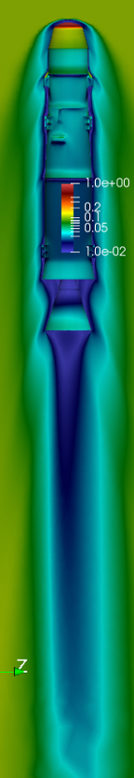
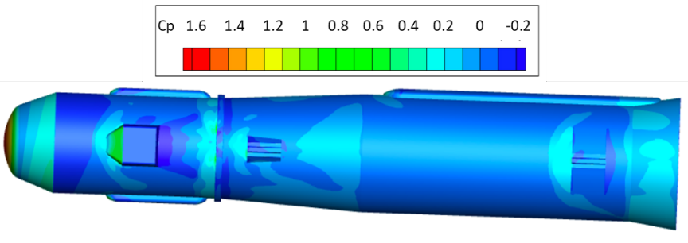
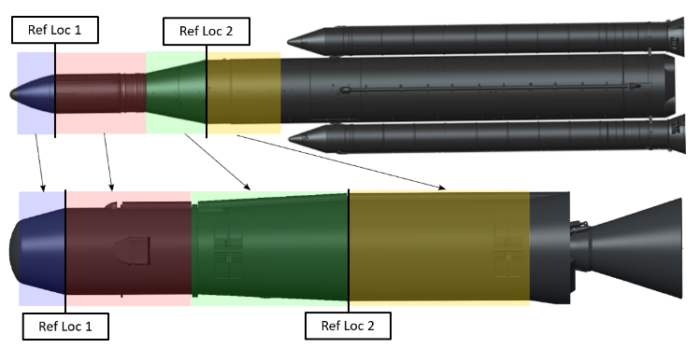
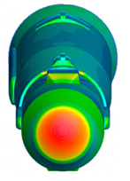
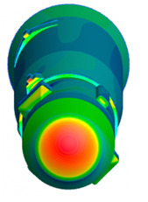
Aeroscience Environments
Vehicle performance affected by interaction with thin Martian environment
  Aerodynamics, aerothermodynamics, buffet environments, and induced acoustics analyzed.
CFD performed to assess aerodynamic stability and develop aero coefficients, aerothermal environments, and aero line loads for other aspects of vehicle design.
  Included aerodynamic contributions of SRM1 plume
  Vehicle found to be aerodynamically unstable for most of ascent
  Passive thermal system sized based upon aerothermal considerations.
Buffet environments, liftoff acoustics, plume-induced acoustics, and ascent aeroacoustics used as inputs to integrated vehicle loads model.
Buffet Model Scaled from SLS Wind Tunnel Model
SRM Plume Contributions to Aero Environment
Sample Pressure Distributions

Slide 14
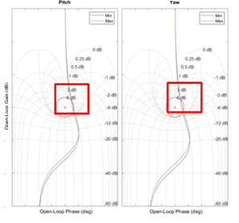
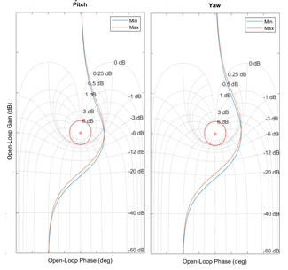
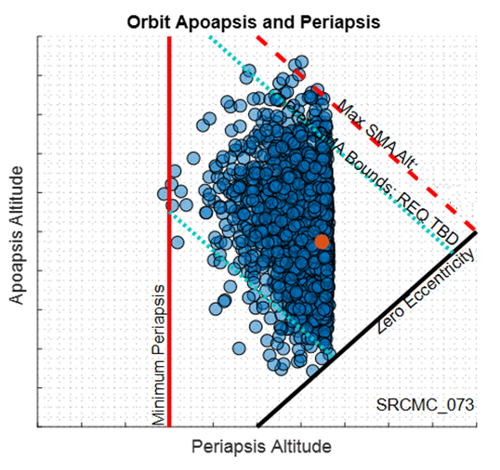
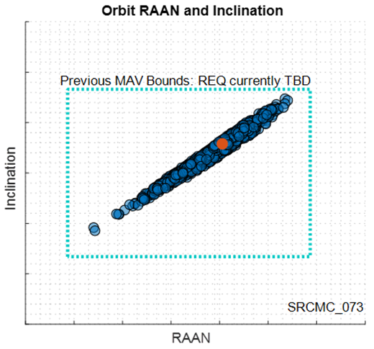
Guidance, Navigation, and Control Design
Vehicle designed to deliver 16kg payload to 380km @ 27º inclination. Unguided second stage meant a robust GNC scheme was necessary following stage separation.
High fidelity 6 Degree of Freedom (6DOF) simulation developed, considering mass, motor performance, environments, and mission-specific activities such as spin-stabilization.
Closed-loop guidance employed during first stage flight. Energy management maneuver employed prior to stage separation to reduce dispersions from solid motor performance.
Uncertainty parameters addressed via Monte Carlo simulations. Significantly more scatter compared to previous guided configurations.
Small RCS moment arm initially resulted in stability violations in pitch & yaw. Although improved through controller optimization, a larger moment arm was still deemed necessary.
Pitch & Yaw Phase Margin Violations & Effect of Controller Optimization
MC Simulation Orbit Dispersions

Slide 15
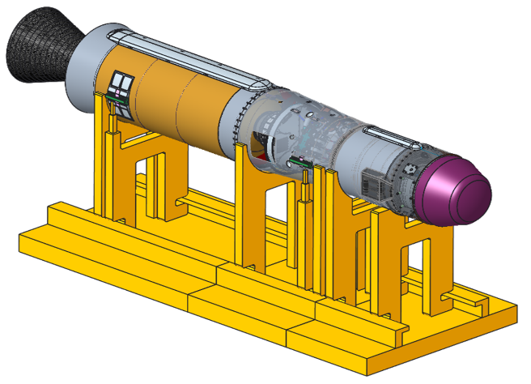
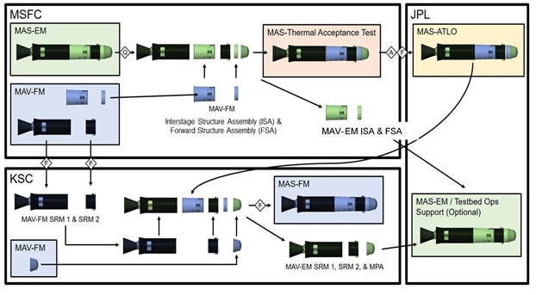
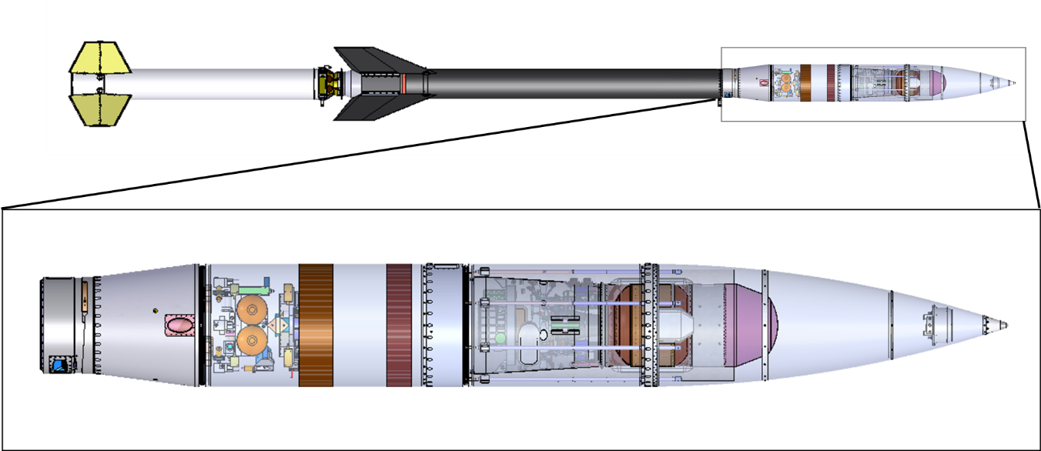
Assembly, Integration, & Testing
AI&T planning included vehicle assembly from subsystem components, integration with external elements, Verification & Validation (V&V) activities, and the development of a concept for an Earth-based flight test program.
Four MAV units planned as part of SRC: Engineering Model (EM), Flight Test (FT) unit, Assembly/Test/Launch Operations (ATLO) unit and Flight Mission (FM) unit.
Rigorous ground-based qualification and acceptance testing planned for individual subsystem assemblies, including hardware-in-the-loop and flight software integration, where applicable. Eleven major test activities for V&V.
Integrated S2 Earth-based flight test planned, delivered to high altitude via sounding rocket to replicate Martian surface environments.
Notional Qualification
Test Article
Assembly & Integration of EM, FM, and ATLO
Flight Test Unit as Payload in Sounding Rocket

Slide 16
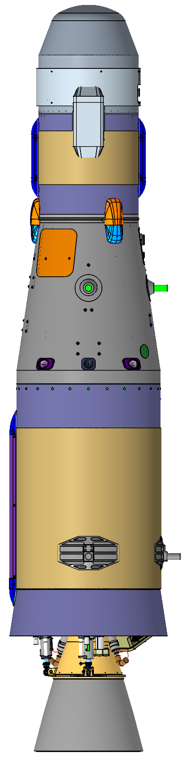
SRC Technical Design and Beyond
SRR held November 2021. System requirements passed.
SRC vehicle analysis concluded concept can successfully deliver 16kg payload including 30 sample tubes to target Martian orbit, meeting all stowage size and mass constraints.
Architecture shift to unguided upper stage allowed for significant mass savings in overall vehicle at expense of orbital insertion accuracy.
Following SRR, design advanced based campaign architecture shift to dual landers. SRL on separate lander meant increased mass allocation for MAV at expense of budget.
  Refined MAV allowed for larger SRMs with larger mass margins.
  Budget restraints resulted in reduced scope of flight test.
Current design cycle in work ahead of Preliminary Design Review, Feb 2023
SRC Rev2 Design
May 2021
PDC Rev1 Design December 2020

Slide 17
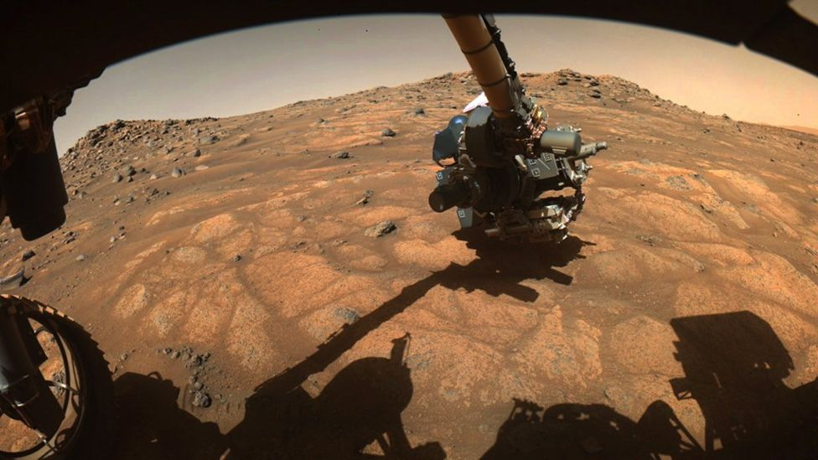

Isabeta Rountree – isabeta.e.rountree@nasa.gov
Darius Yaghoubi - darius.f.yaghoubi@nasa.gov
NASA Marshall Space Flight Center
Questions?
Perseverance Rover drill arm collecting surface samples.
Jezero Crater, Mars. Future launch site of MAV.

