Slide 1

Liquid Hydrogen Technologies Workshop
February 23rd, 2022
Angela Krenn
Thermal Principal Technologist/Space Technology Mission Directorate/NASA

Slide 2
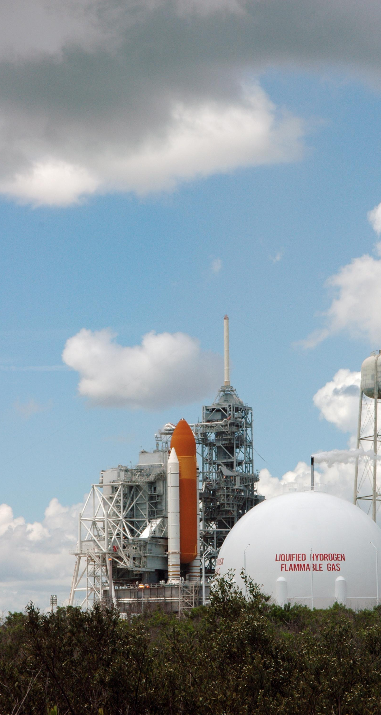
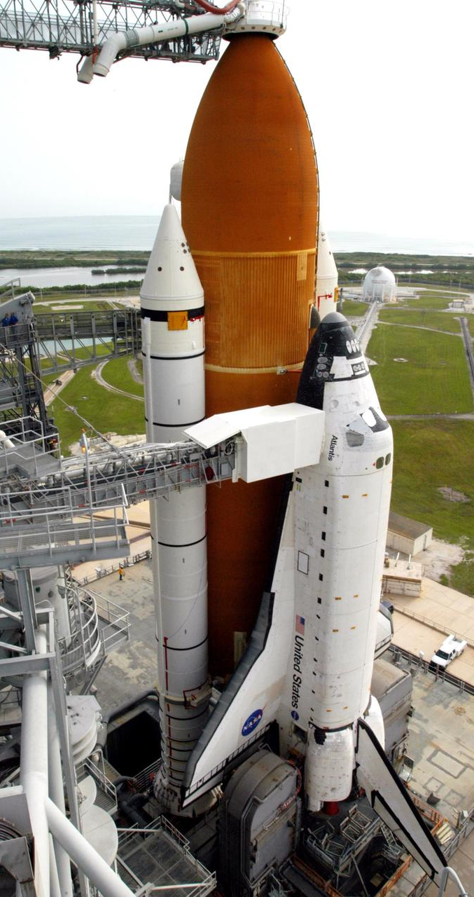
CONTENTS
SPACE SHUTTLE LH2 SYSTEM OVERVIEW
STANDARD PRACTICES
LH2 TANKER OFFLOAD
LH2 SYSTEM LEAK CHECK & SAMPLING
ET LH2 LOADING
LH2 TANKER FILL
LH2 TANK DRAIN

Slide 3
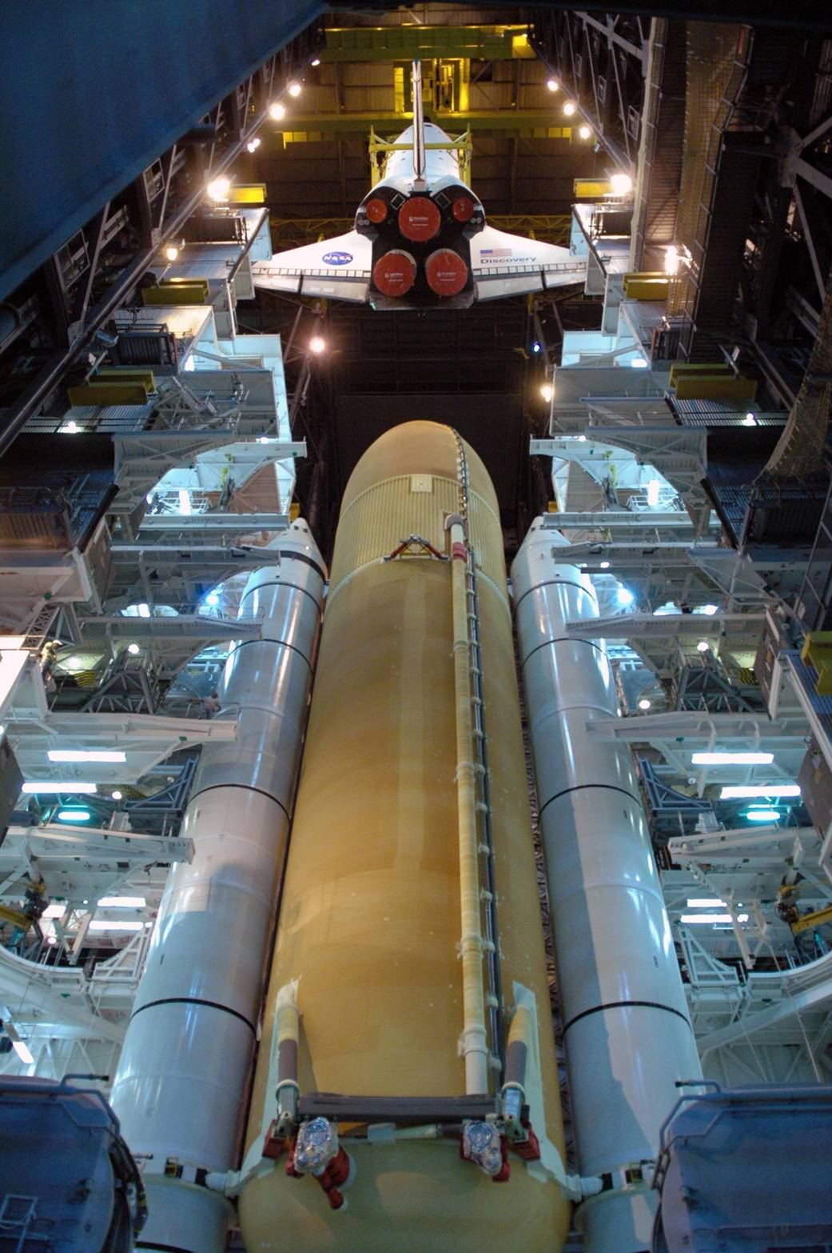
Space Shuttle External Tank
Approximately 385,000 gallons of liquid hydrogen

Slide 4
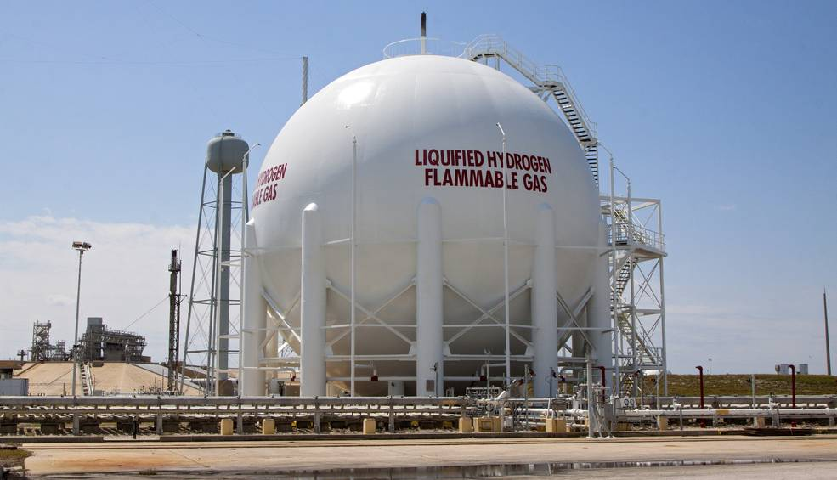
LIQUID HYDROGEN STORAGE SPHERE
850,000 GALLON LH2 STORAGE SPHERE
APPROXIMATELY 400 M OF TRANSFER LINES

Slide 5
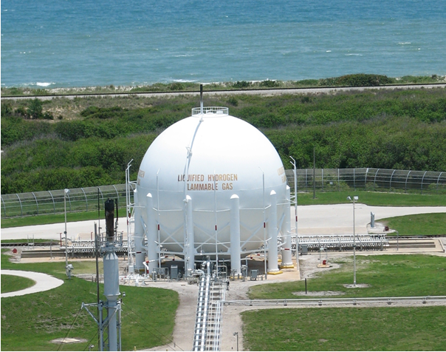
STANDARD PRACTICES
OSHA 1910.119
Process safety management of highly hazardous chemicals
NFPA 497
Recommended practice for the classification of flammable liquids, gases, or vapors and of hazardous (classified) locations for electrical installations in chemical process areas
AIAA/ANSI G-095A-2017
Guide to safety of hydrogen and hydrogen systems
Maintain helium blanket purges in stand-by configuration
Extensive training and certifications for operators
Limit personnel during haz ops
Wear PPE during haz ops (flame retardant coveralls, cryo gloves, face shields, non-porous footwear, etc.)
Pre-planned procedures documented for off-nominal scenarios (isolate, vent, purge)
Verify <1% oxygen in lines prior to flow
Ground all hardware
For flow operations, flare vent gas
Flow-through and pulse purge with helium post flow
Verify <1% hydrogen in lines post flow

Slide 6
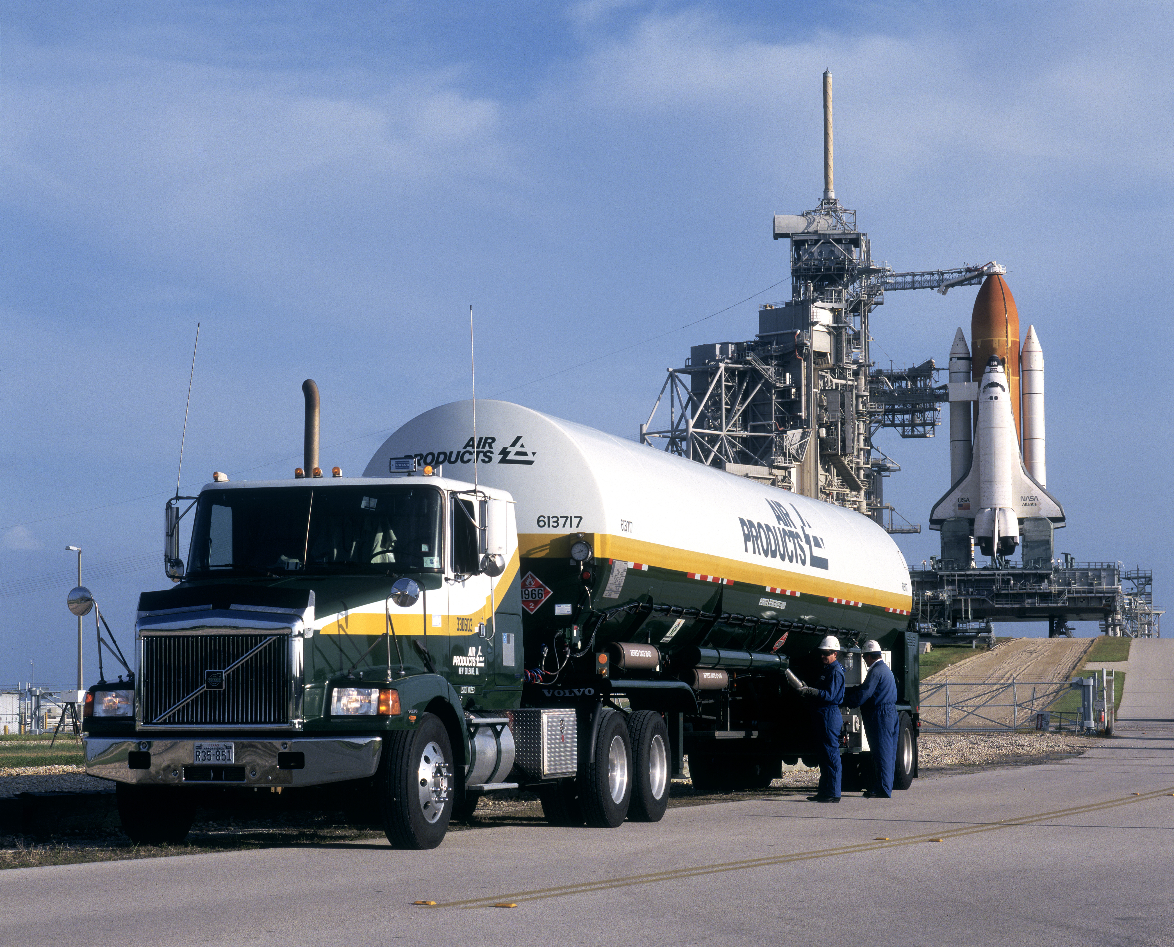
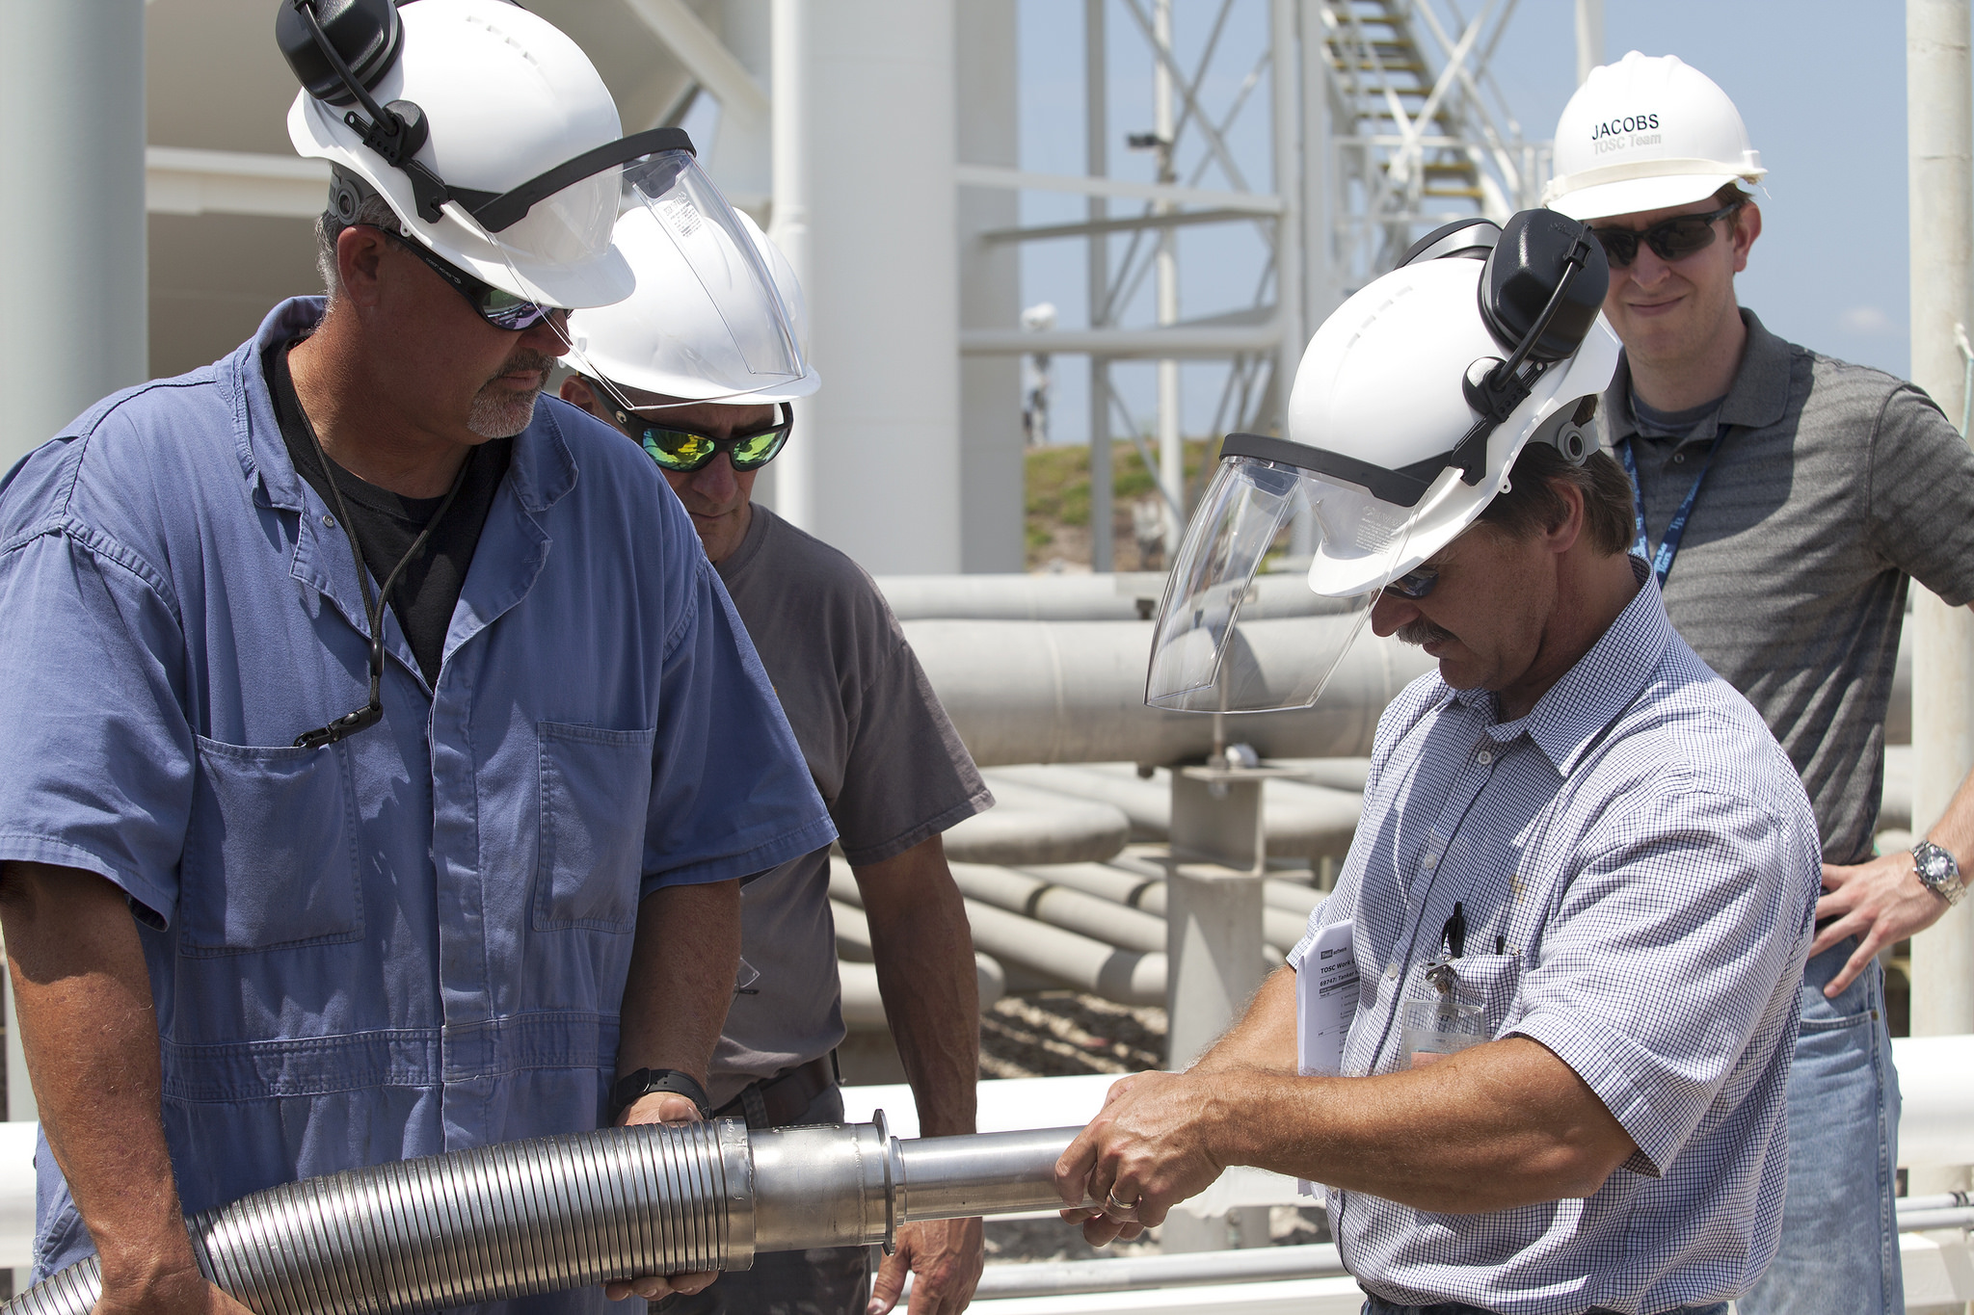
LH2 TANKER OFFLOAD
Verify certification of purity
Offload a maximum of 5 tankers at a time
Install VJ flexhoses for transfer between tanker and pad system
Monitor mechanical connections for icing – leakage
Maintain cognizance of liquid air forming on and dripping from uninsulated surfaces
Image courtesy of Air Products and Chemicals, Inc.

Slide 7
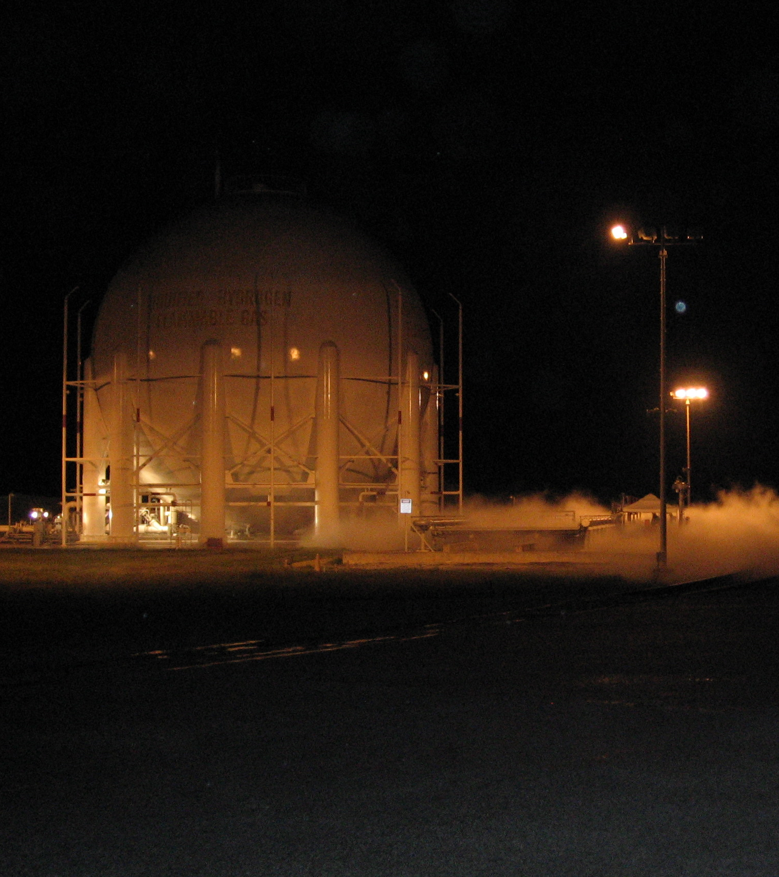
LH2 SYSTEM LEAK CHECK & SAMPLING
Part of the annual system maintenance plan
Utilize the main vaporizer to pressurize the storage tank
Leak check the system for hydrogen leakage
Obtain a sample of liquid hydrogen from the bottom of the storage tank and send for purity analysis in the lab
Utilize the auxiliary vaporizer to pressurize the storage tank
Leak check the auxiliar lines for hydrogen leakage

Slide 8
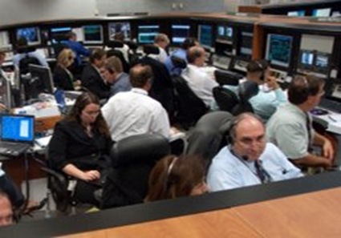
ET LH2 LOADING
Open manual block valves, evacuate the pad
Initiate unpressurized CHILLDOWN by venting system and opening fill valves
SLOWFILL to 5% using chilldown valve
FASTFILL to 85% by opening main transfer line valve
Lower flowrate for REDUCED FASTFILL to 98% by reducing storage tank pressure and partially restricting flow path
TOPPING to 100% through chilldown valve
Maintain 100% fill level using a modulating valve during REPLENISH
~2.5 - 3 hours
Automated operations
Monitor for anomalies
Execute pre-planned procedures

Slide 9
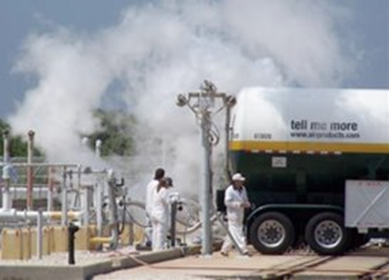
LH2 TANKER FILL
August 2005, Hurricane Katrina caused significant damage to KSC’s LH2 supplier, Air Products
Plant damage resulted in a critical national shortage of LH2
NASA transferred ~660,000 gallons back to Air Products to support national needs
Limited to fill of a single tanker at a time due to local venting
Remotely pressurized the storage tank
Reversed flow from the fill line in order to drain the storage tank to fill each tanker
U.S. Congressional Record, Dec. 5, 2006
“NASA’s generous actions allowed for the continued, albeit reduced, supply of liquid hydrogen to most commercial customers across the United States and prevented the shutdown of numerous manufacturing facilities and commensurate job losses throughout the nation.”

Slide 10
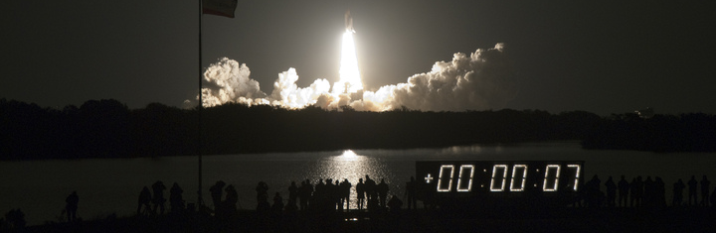

LH2 TANK DRAIN
January 2010 – dozens of tanker loads of hydrogen drained from Pad B tank and transferred to Pad A LH2 tank prior to STS-130 loading
August/September 2011 – dozens of tanker loads of hydrogen drained from Pad A tank and transferred to other government users
Residual hydrogen was burned through the flare system in both cases

Slide 11
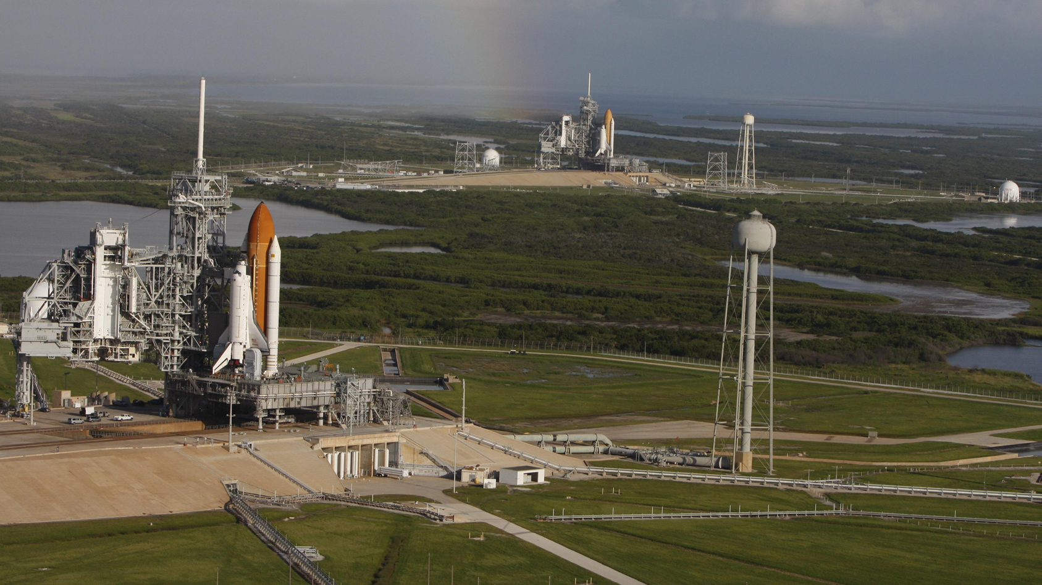
QUESTIONS?

