Slide 1
Chandra X-ray Observatory
Dr. Steven Ehlert (steven.r.ehlert@nasa.gov)
NASA Marshall Space Flight Center
Notes:
Hello everyone and thank you for listening to my talk. My name is Dr. Steven Ehlert, and I am an X-ray Astronomer at NASA’s Marshall Space Flight Center. I am going to be speaking with you today about one of Marshall’s Science Missions – The Chandra X-ray Observatory. Now because you are all associated with the student launch, I will make sure to describe a lot about the hardware and launch of Chandra as well as a quick overview as to some of the science goals of this science mission. If you have any questions about anything I cover in this talk please don’t hesitate to email me and I will be glad to chat – you can see my email address right here.

Slide 2
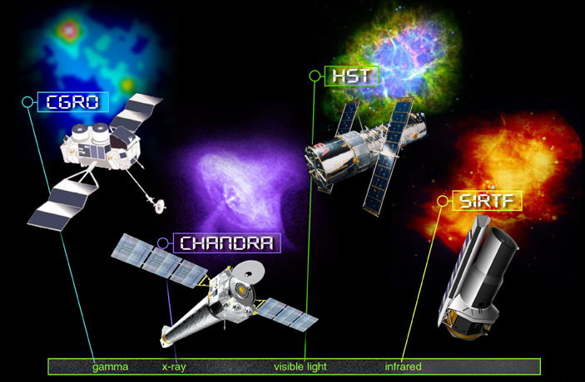
Chandra is one of NASA’s four Great Observatories from the 80’s and 90’s.
Notes:
So let’s start with the very basics of Chandra. It is one of NASA’s Great Observatories, which was a NASA program from the 80’s and 90’s that NASA to launch into space four science observatories, each optimized to different wavelengths/frequencies/energies of light. You can see them each here – CGRO stands for Compton Gamma Ray Observatory, which survey of the sky in gamma rays, HST is the Hubble Space Telescope which observes the sky in optical/visible light, Spitzer Infrared Telescope Facility, which observes infrared light “redder than red”. Chandra, which I am talking about today, is an X-ray observatory. You can see each of these telescopes have very different shapes, which is because they have all been very carefully designed for their missions. Even though they launched in the 90’s and early 00’s, Chandra and Hubble are still operating. Spitzer retired just last year after 17 years of observations, and CGRO observed the gamma ray sky from 1991 – 2000.

Slide 3


Chandra was launched on July 23rd , 1999 aboard Space Shuttle Mission STS-93.
Notes:
The next thing I wish to focus on for this talk is the launch of Chandra itself, because this group probably has a disproportionate interest in rockets launching. Chandra was launched with the Columbia Space Shuttle in 1999, which you can see in both photos. For those of you who don’t know much about the Shuttle, its main payload bay can be seen here (point to cargo area). The woman you see here is Eileen Collins, the commander of STS-93. This is the first NASA mission with a female commander, which is a nice bit of history trivia. On the right, you can see an image of Chandra’s launch from KSC with all of the fireworks required to get to space.

Slide 4
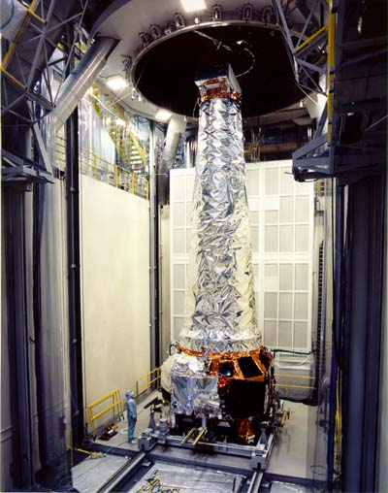

Chandra is the largest spacecraft ever launched with the Space Shuttle.
Notes:
Chandra’s launch holds a few additional records for shuttle launches – it was the longest and heaviest payload ever carried by the Shuttle. You can see in the left photo just how big it is compared to the human inspecting it on the ground. It is 45 (14m) feet long deployed and weighed 13,000 lbs (5800 kg) at launch. I’ll explain a bit as to why it needs to be so long in a few slides, but for now I also wanted to show you this image on the right, which was taken as Chandra was being released from the Shuttle cargo bay. We are looking towards the back of the shuttle and you can see the Earth below.

Slide 5
This is what Chandra looks like in flight (show model)
Notes:
So you have seen some pictures of Chandra, but I now wish to show you what the

Slide 6
A complete understanding of how objects in space live and die requires observations using many wavelengths of light
Notes:
So you may be asking yourselves – why do we need so many telescopes? Well, it turns out that space doesn’t simply reveal itself in optical light with standard telescopes. To really understand why practically any object in space is behaving the way it is, observing only one type of radiation is usually not enough. And for some objects, a lot of different wavelengths are necessary to gather a complete understanding of them. Each telescope provides different insights into the physics at the heart of the object, or insights into different physical processes that are operating. We therefore develop and deploy telescopes at every wavelength we can think of, collect the data, and see what those data reveal about the objects of interest. So, for many objects, we are interested in how they appear in many different wavelengths/frequencies/energies. As you can see from the bottom of this figure, each of these great observatory telescopes is designed to view the sky at different wavelengths.

Slide 7

Chandra observes the sky in X-rays.
Notes:
Chandra is the great observatory that observes X-rays. You probably have two main experiences with X-rays: getting X-ray images at your local doctor or dentists office and getting your luggage screened at the airport. The X-rays we are observing with Chandra are a bit lower in frequency/energy than those used in a medical X-ray machine or an airport security scanner, but other telescopes do observe these same “commercial” energies. X-rays and other high energy radiation are very important for the most “explosive” events in space, and I will show you a few images later in this talk. One last thing I wish to impart upon you about Chandra is that X-ray astronomy HAS to take place in space. Fortunately for all life on this planet, the Earth’s atmosphere does a very good job of absorbing X-rays and preventing them from reaching anywhere near the surface. In that context, I thought it would be fun for you to all see some of the hardware that makes Chandra possible.

Slide 8
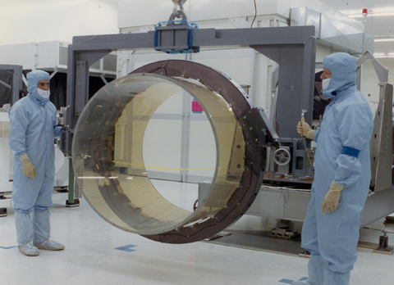
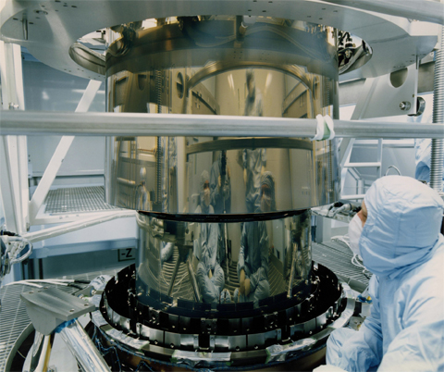
An X-ray telescope looks different than the telescopes you may have at home.
Notes:
These are the mirrors at two different stages of fabrication. They do not look anything like an optical telescope’s mirrors. The telescopes you might have at your house probably are either a series of glass circular lenses or a curved mirrors where you can see reflections very easily. X-ray mirrors are these cylindrical barrels, which are then coated and polished to tremendous accuracy and precision to create a reflective surface. The base layer of the shells, for Chandra, is a ceramic glass called Zerodur, and the metal coating you see is Iridium. So why are they shaped like this?

Slide 9
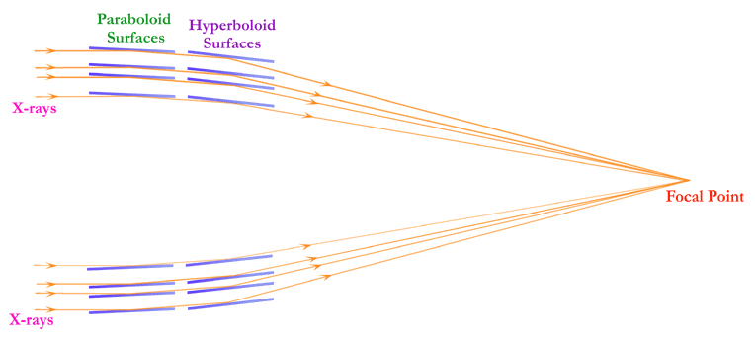
An X-ray telescope operates on a similar physical principle to skipping stones on the surface of a lake.
Notes:
The reason is the wavelengths of X-rays. It turns out that X-ray wavelengths are comparable to or smaller than the spacing of atoms in a crystal structure, so they generally pass right through the first layers of any material if they impact it head on. Instead, what an X-ray mirror does is focus X-rays that arrive at the telescope at extremely shallow angles. Like when you skip rocks, if angle is shallow enough the rock won’t sink, but instead “reflect” off the surface of the water. In this figure, the orange arrows correspond to the X-rays being focused by the four pairs of mirrors. Having four pairs of mirrors nested within each other makes it possible to collect more X-ray photons than one mirror pair can. For technical reasons, most X-ray telescopes actually do two reflections on slightly different surfaces. This figure should also give you some insight as to why the telescope is so long – you need a lot of distance to focus when dealing with such narrow angles. Because the angles are so shallow, the precision of this mirror assembly must be superlative – the shapes, alignment, and surface quality must all be extremely accurate for this series of reflections to work properly.

Slide 10
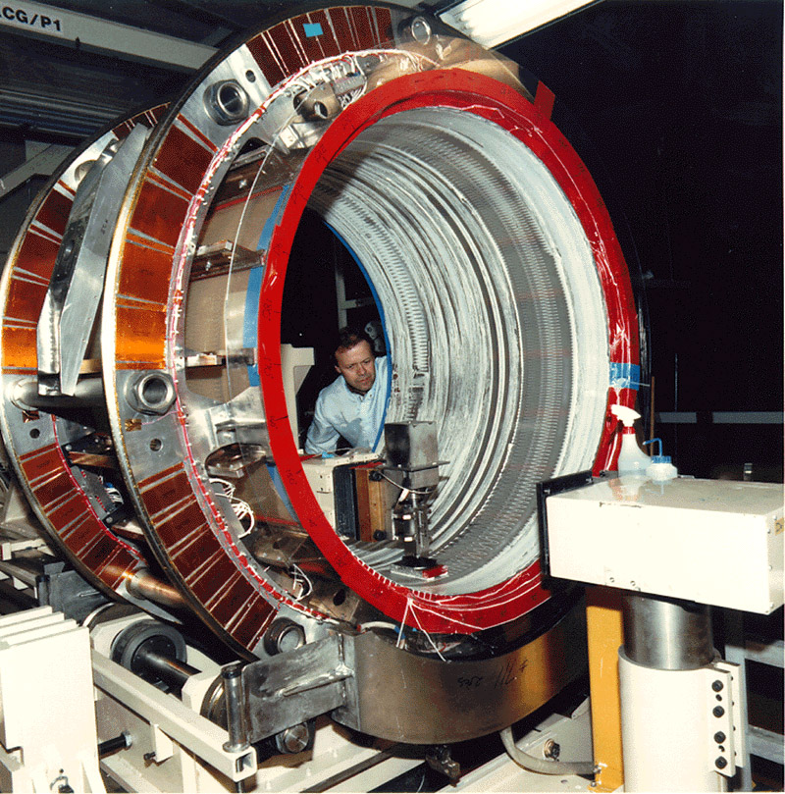
X-ray mirrors require exquisitely polished surfaces to create sharp images
Notes:
This is a photo of one of the mirrors being polished. Notice that the INSIDE surface is the one that really matters here. That machine in the middle is the polisher, and the mirror spins around in the larger ring structure. Chandra has the very best mirror quality in the world, and is so smooth that, if we scaled it up to the size of Colorado, the Rocky Mountains (such as Pike’s Peak) would be less than 1 inch tall. Or the largest mountain on Earth would be about 6.5 feet tall – think Michael Jordan or slightly shorter than Lebron James. And then you have to launch these phenomenally well polished mirrors into orbit without them moving relative to one another.

Slide 11
Chandra’s greatest strength is its high-resolution imaging capability, which is roughly 10x better than any mission that has flown prior or since
Notes:
The result of all of that preparation and planning can be seen here. This is the same object, called the Crab Nebula, observed with two different X-ray telescopes. The color is false in both cases, so don’t focus on those differences. On the left is one of the most advanced X-ray telescope before Chandra, called ROSAT. On the right is the Chandra image of this same source, where you can see just a stunning amount of additional structure around this neutron star and its nebula. All of those wisps and rings are “real”, and it is with this vastly sharper imaging capability that Chandra has made its most important contributions to our understanding of space. So now let’s look at a few more images and describe them in a bit more detail.

Slide 12
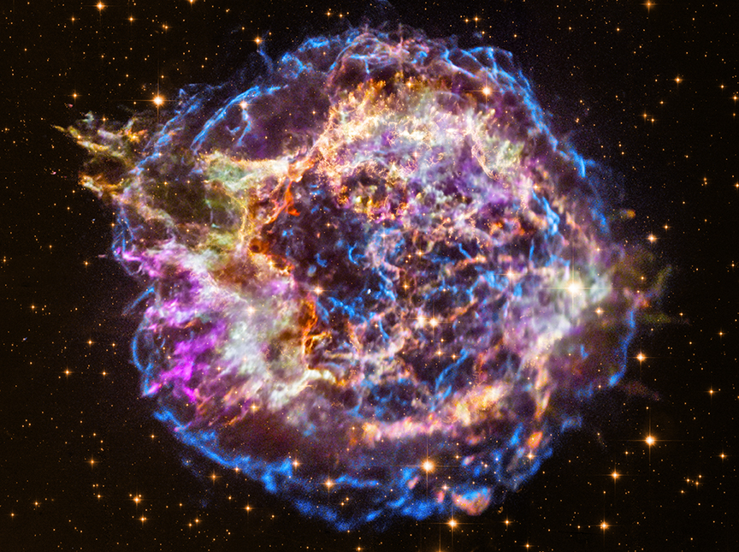
X-rays provide crucial insights into populations of particles that have been accelerated to very high energies, such as in Cas A.
Notes:
This image, in all of this multi-color glory, is a supernova remnant known as Cassiopeia A, or Cas A for short. This remnant originates from a star that exploded approximately 300-400 years ago in the direction of the Cassiopeia constellation. The blue and green filaments around the outer regions are the X-ray emission – red and gold correspond to infrared (from Spitzer) and optical images (from Hubble), respectively. Within these X-ray regions, protons and electrons are being accelerated to energies comparable to those reached in particle accelerators like CERN here on Earth. Of course, other structures in space can accelerate particles to far faster than CERN- the higher energy particles observed from space have energies estimated to be almost a billion times higher than what is achievable with the LHC. But by observing the locations and structure of the X-rays in objects like supernovae, their remnants, and neutron stars, we can begin to infer how these particles are being accelerated to such high energies near the speed of light. One last thing I want to mention is that Chandra was the telescope that was able to identify the little blue dot just off-center in this image that is in fact the neutron star that was born out of this supernova explosion.

Slide 13
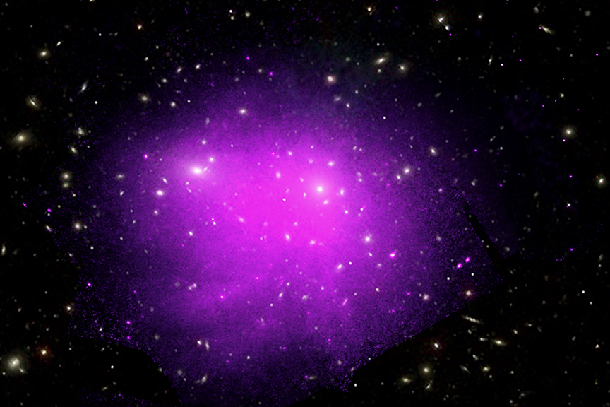
X-rays are also crucial for observing gas at the very highest temperatures observed in nature, such as in the Coma Cluster.
Notes:
But Chandra doesn’t simply see accelerated electrons – it turns out that X-rays are very good for observing the very hottest gas in the Universe. This image here is of one of the largest gravitationally bound structures in the Universe, a galaxy cluster called Coma. You can see the galaxies as those yellow ellipses and blobs, that are all orbiting around the center of the cluster like a very complicated solar system. But remember, each of those ellipses is a galaxy like the entire Milky Way. In fact, this image shows an enormous range – it is approximately 7 million light years across! That means that if you started on one side of the image and sent a radio signal to the other it would be about 7 million years before any receiver on the other side could gather it and listen to it.
But in a galaxy cluster, there is more than just galaxies – those galaxies are flying through a very hot, low density intracluster medium (ICM) that has temperatures in excess of 10 million degrees (at that point the units don’t really matter all that much), which is hotter than the CORE of the Sun. The densities are also exceedingly low – only a few electrons per cubic centimeter, which is about a billion-trillion times less dense than the gas in a balloon. These objects are studied extensively by Chandra for many different science cases.

Slide 14
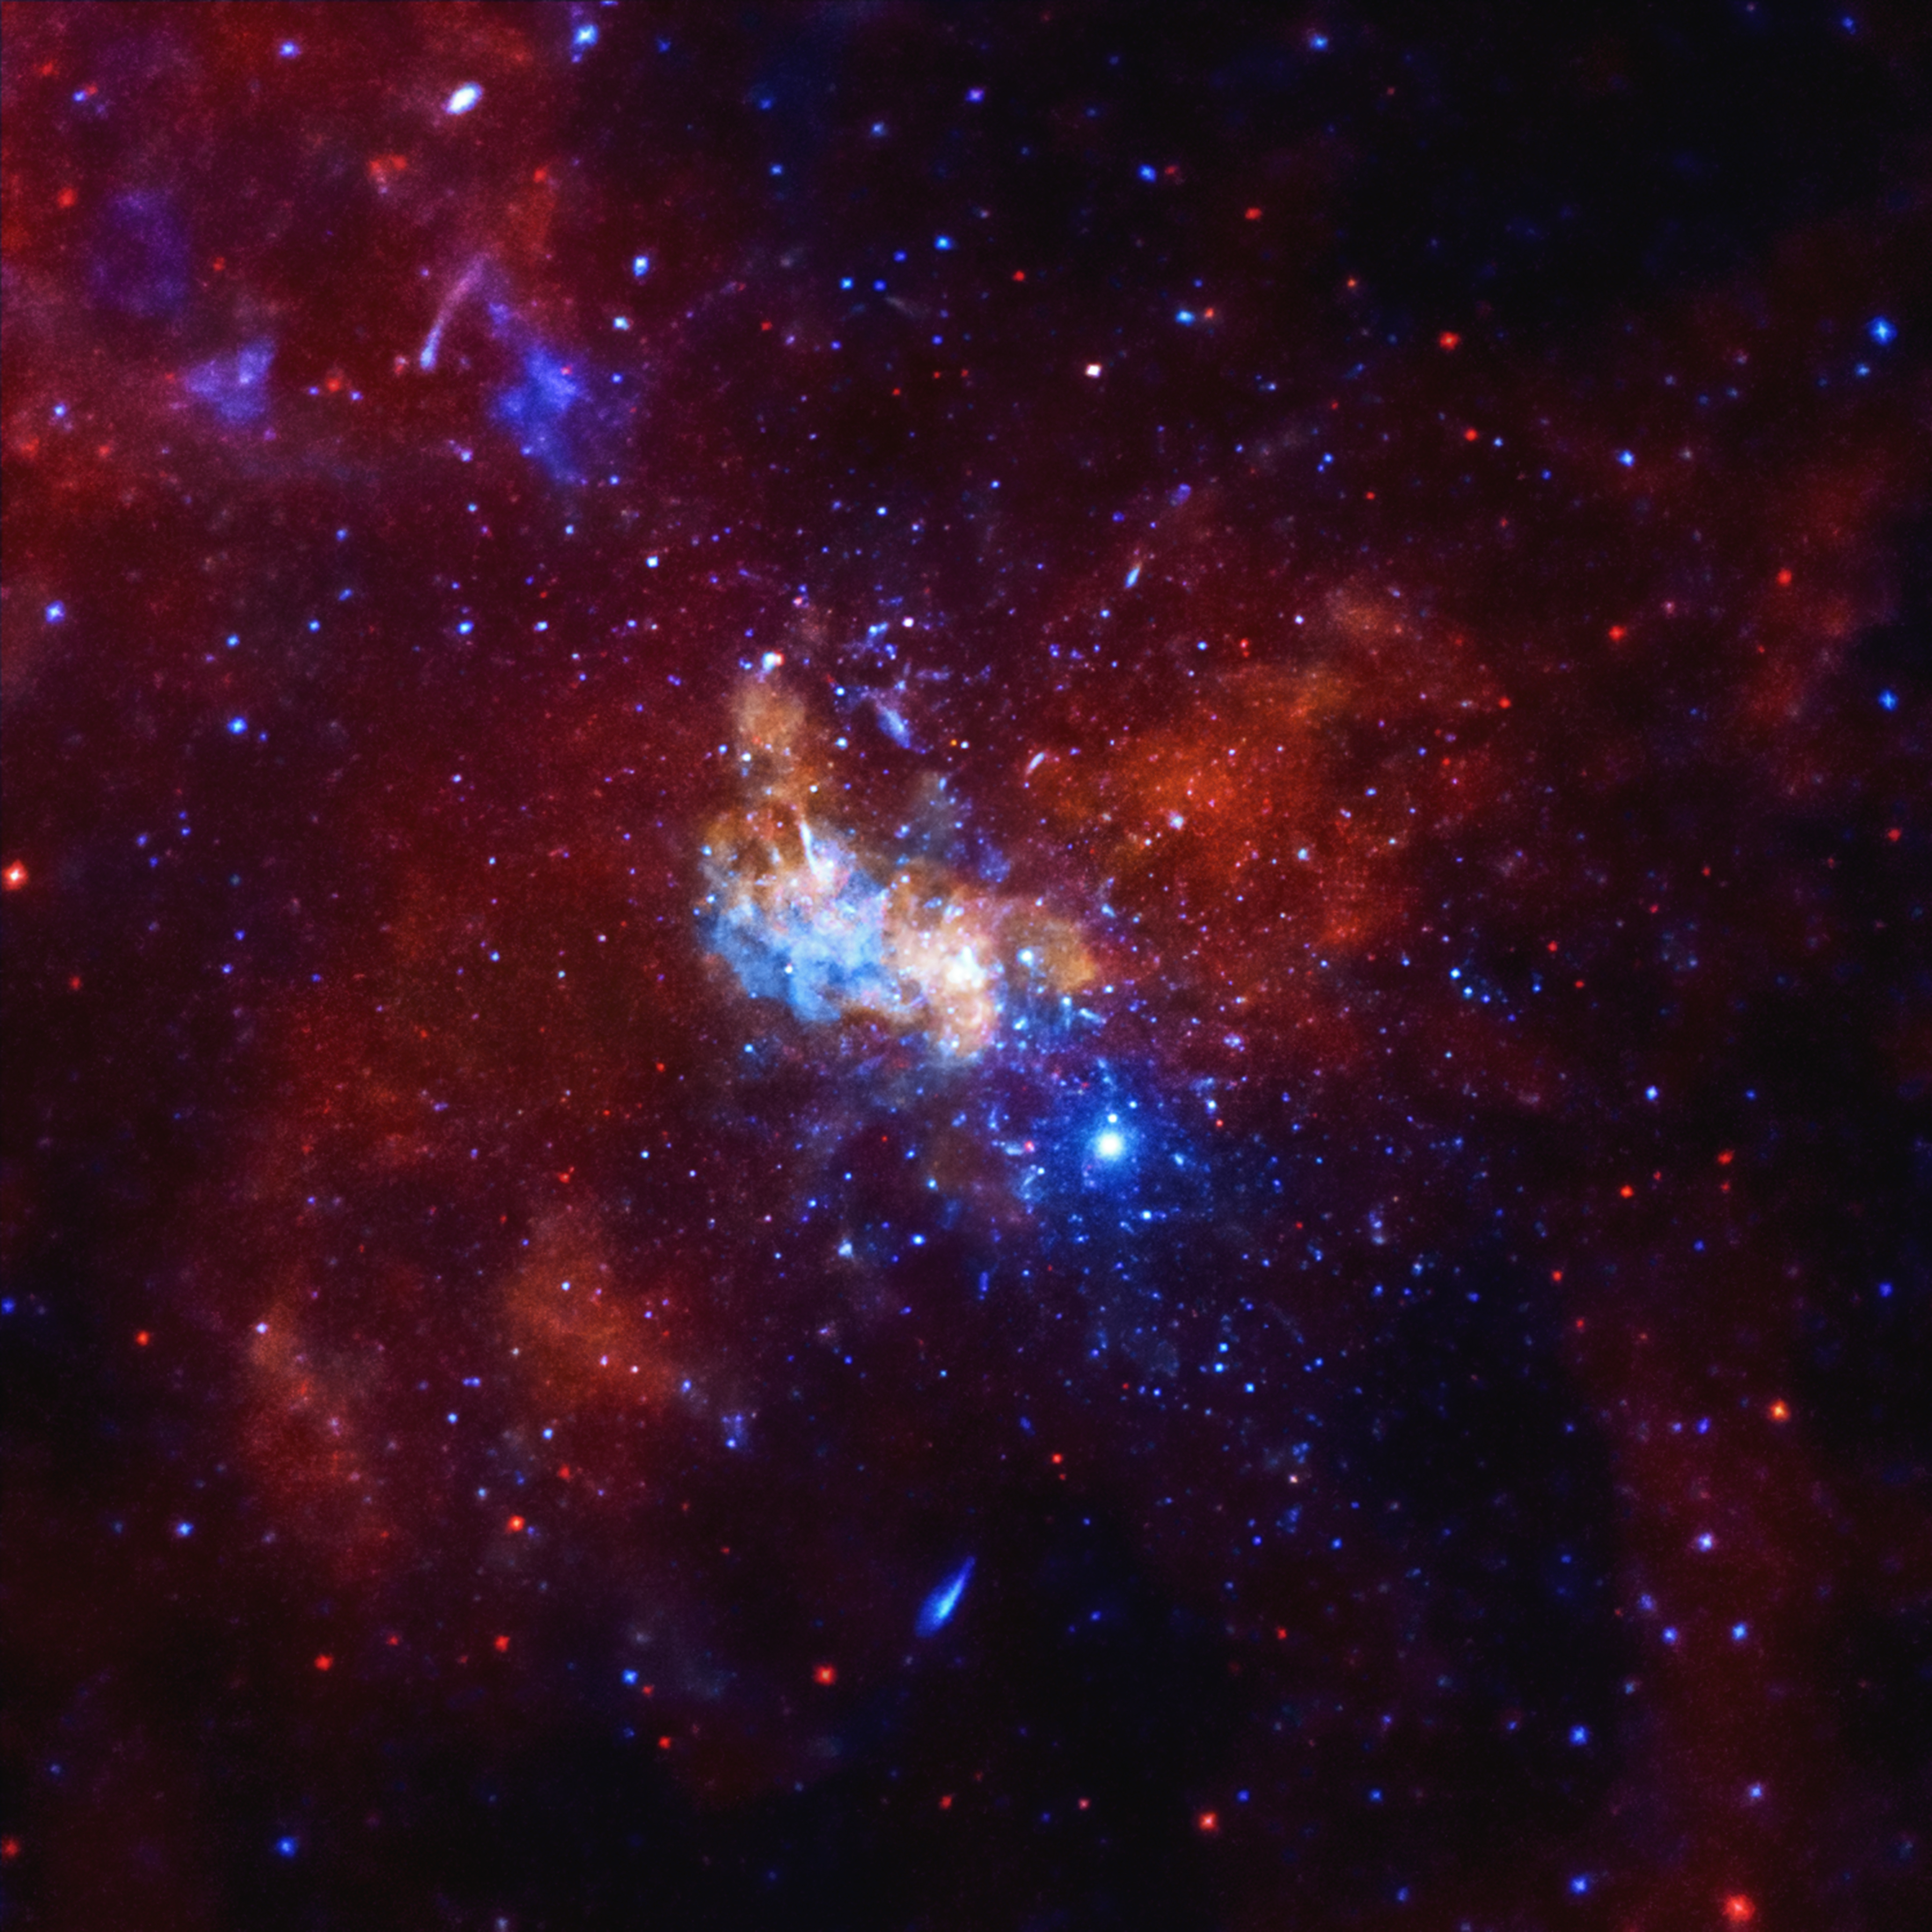
X-rays are visible at the center of the Milky Way Galaxy
Notes:
This is the very center of the Milky Way galaxy, and each color corresponds to a different frequency/wavelength of X-rays.

Slide 15
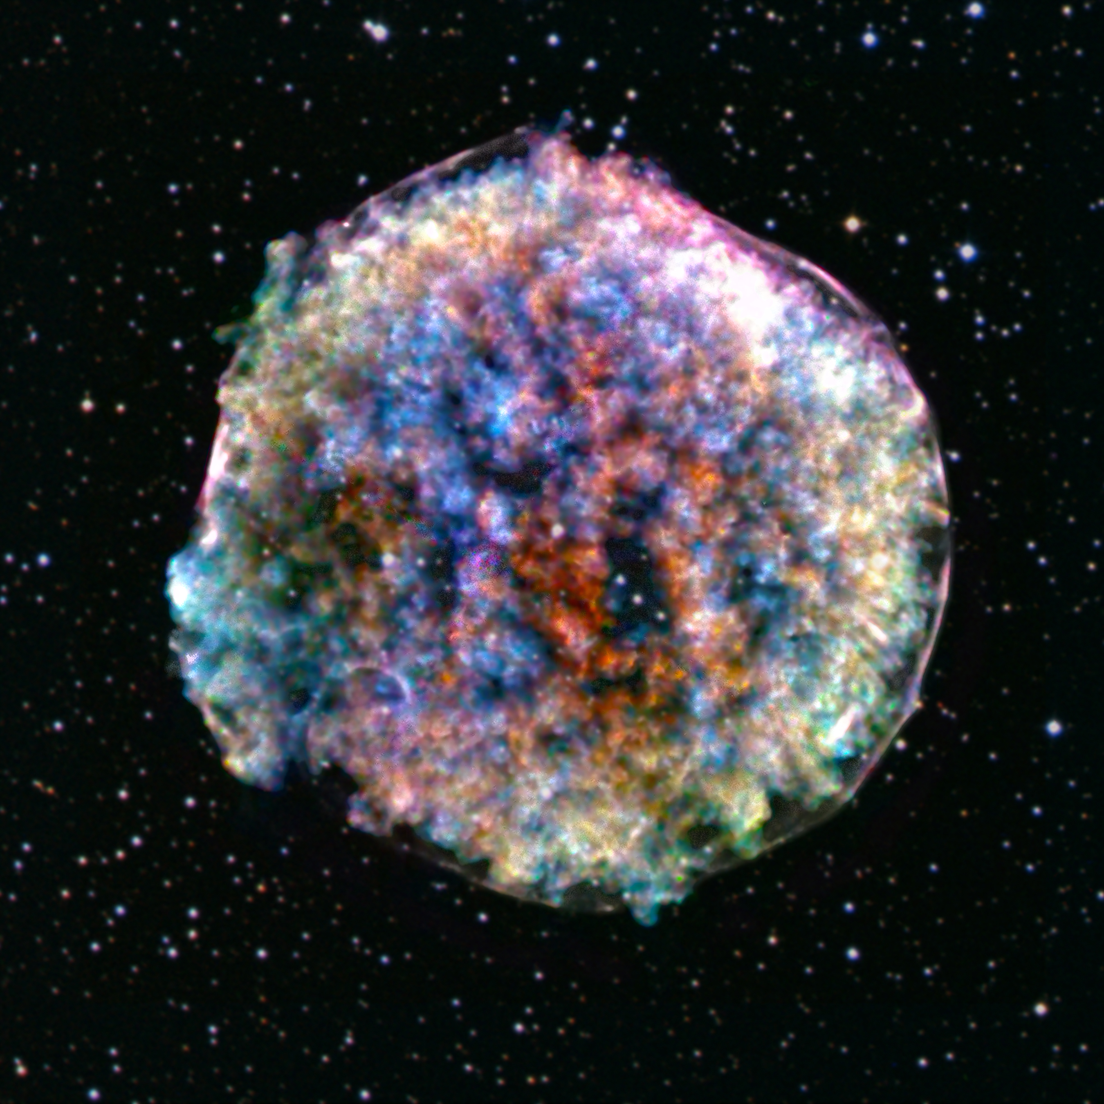
This supernova remnant observed by Tycho Brahe in 1572, now has lots of X-ray emission at different elements.
Notes:
This is another supernova remnant, known as Tycho’s SNR, observed by Tycho Brahe in 1572. You can also see the front of the blast wave at the perimeter of this rather fluffy round structure.

Slide 16
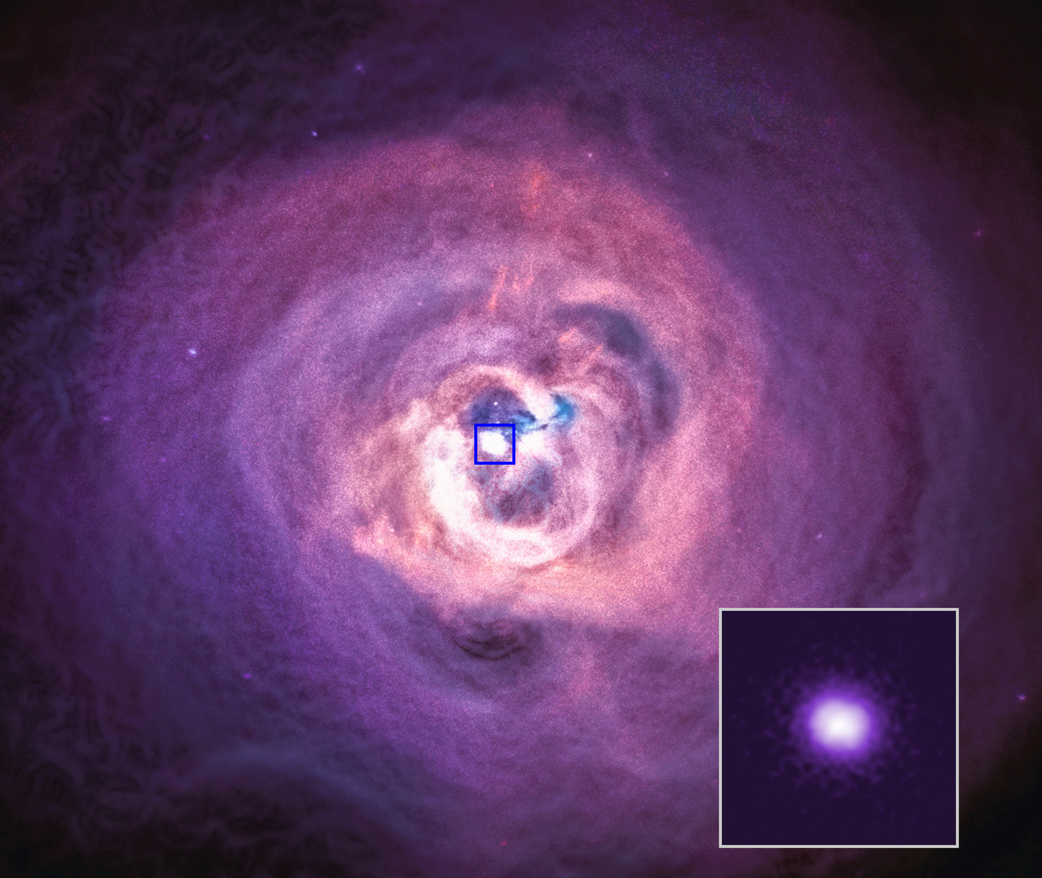
The gas in galaxy clusters isn’t simply static and ”boring” but can have shocks and ripples, like those seen in the Perseus Cluster.
Notes:
Another example of a galaxy cluster is the Perseus Cluster shown here, where the image can be processed to make ripples and cavities in the cluster gas very clear. These arise from intermittent outbursts of a supermassive black hole at the center of the galaxy at the center of this cluster. That galaxy is located within the blue box here.

Slide 17
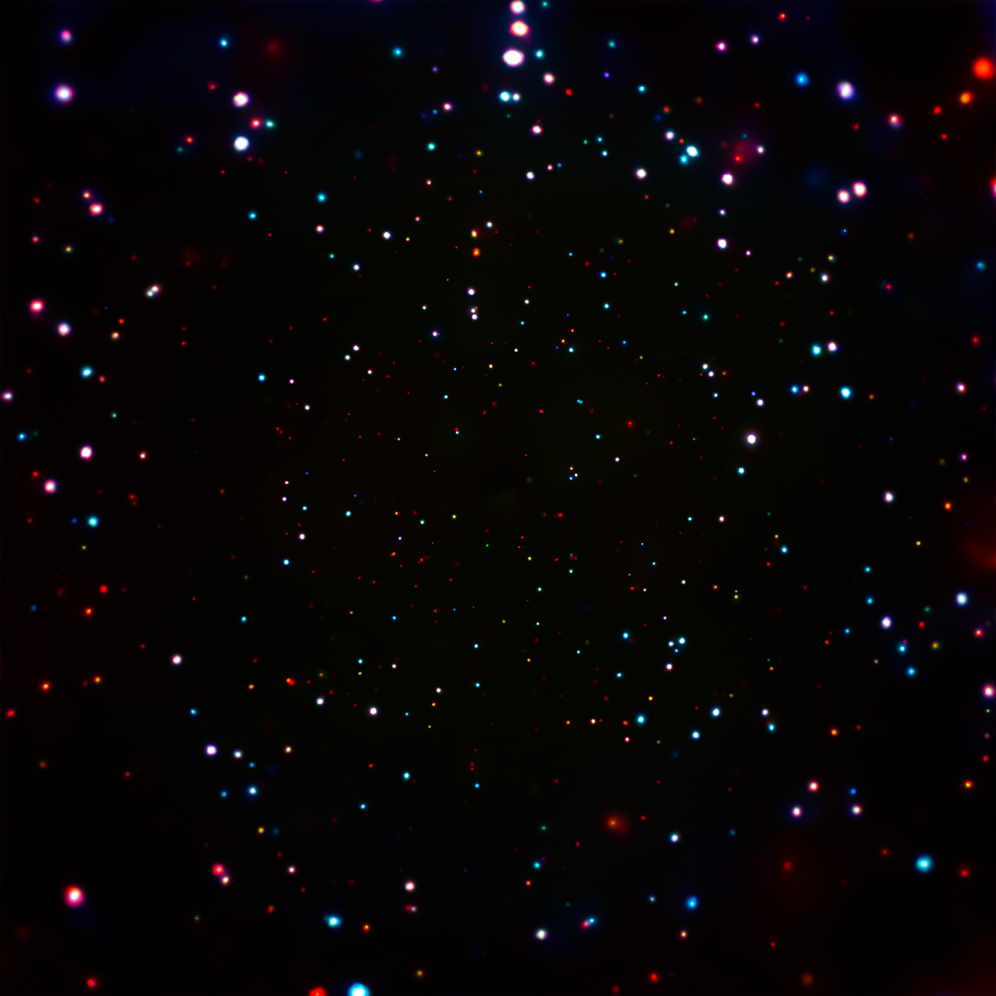

After 20+ years, Chandra will hopefully continue to operate for another decade of cutting edge science
https://www.nasa.gov/mission_pages/chandra/main/index.html
Notes:
Finally, I want to show you one last image from Chandra – it may not look as exciting as some of the others but in many ways, it is even more fascinating than the supernovae and galaxy clusters. This is known as the Chandra Deep Field South, a rather boring patch of sky with no obvious sources observable with earlier generations of telescopes. But when Chandra pointed there for long periods of time, huge numbers of sources became visible. Each dot here corresponds to a different source, the majority of which are supermassive black holes billions of light years away fueled by the infall of nearby gas. This field circumscribes the famous Hubble Deep Field, which you can see on the right. I’ll finish up here, mainly to state that while Chandra was launched almost 22 years ago it is still able to perform cutting edge science, and in many ways is still unmatched in its performance. I hope you learned a bit more about its design, launch, and current science capabilities. If you have any other question, you can check out NASA’s Chandra website or ask me right now...

