Slide 1
Updated Human Mars Ascent Vehicle Concept in Support of NASA’s Strategic Analysis Cycle 2021
Douglas J. Trent, NASA ESDMD Mars Architecture Team
2022 IEEE Aerospace Conference, Big Sky
March 5-12, 2022

Slide 2



Updated Human Mars Ascent Vehicle Concept in Support of NASA’s Strategic Analysis Cycle 2021, IEEE Aerospace Conference, 2022
Douglas J. Trent
NASA Marshall Space Flight Center
Huntsville, AL 35812
douglas.trent@nasa.gov
Herbert D. Thomas
NASA Marshall Space Flight Center
Huntsville, AL 35812
herbert.d.thomas@nasa.gov
Michelle A. Rucker
NASA Johnson Space Center
Houston, TX 77058
michelle.a.rucker@nasa.gov
The authors recognize the following team members as key contributor to the MAV design refinements presented here: Mike Baysinger, Jay Garcia, Pete Capizzo, Leo Fabisinski, Quincy Bean, Thomas Brooks, Bill O’Neil, and Michael Interbartolo. Additionally, the Surface Mobility Team, led by Mike Gernhardt, provided key technical details relating to the surface propellant transfer concept, unique to this concept.
2022 IEEE Aerospace Conference

Slide 3






















SAC21 Reference First Human Mars Mission Concept
Rucker, M.A., et al., “NASA’s Strategic Analysis Cycle 2021 (SAC21) Human Mars Mission Architecture”, IEEE Aerospace Conference, Big Sky, 2022
WHO
WHAT
Current analysis includes 4 crew
2 remain in Mars orbit while 2 explore the Mars surface
Nuclear Transportation
Landers and Surface Systems
Mars Ascent and Earth Return
WHERE
WHEN
WHY
Cislunar, Deep Space and 5-sol Mars orbit
Mars Surface
2039 opportunity analyzed
Crew away from Earth ~2.5 years
~30 sols on Mars
Science, Exploration, and U.S. leadership
HOW
1
Pre-Deployed Cargo Phase
Crewed Surface Exploration Phase
“Light” Exploration Footprint
2
2022 IEEE Aerospace Conference

Slide 4
SAC21 Objectives Drive MAV Design Requirements
WHO
WHAT
Current analysis includes 4 crew
2 remain in Mars orbit while 2 explore the Mars surface
Nuclear Transportation
Landers and Surface Systems
Mars Ascent and Earth Return
WHERE
WHEN
WHY
What
Crew are to return to Earth healthy implies the need for a system to deliver crew from the surface of Mars
Cislunar, Deep Space and 5-sol Mars orbit
Mars Surface
2039 opportunity analyzed
Crew away from Earth ~2.5 years
~30 sols on Mars
Science, Exploration, and U.S. leadership
HOW
1
Pre-Deployed Cargo Phase
Crewed Surface Exploration Phase
“Light” Exploration Footprint
2
2022 IEEE Aerospace Conference

Slide 5
SAC21 Objectives Drive MAV Design Requirements
WHO
WHAT
Current analysis includes 4 crew
2 remain in Mars orbit while 2 explore the Mars surface
Nuclear Transportation
Landers and Surface Systems
Mars Ascent and Earth Return
WHERE
WHEN
WHY
Who
System must support the delivery of 2 crew from the surface of Mars
Cislunar, Deep Space and 5-sol Mars orbit
Mars Surface
2039 opportunity analyzed
Crew away from Earth ~2.5 years
~30 sols on Mars
Science, Exploration, and U.S. leadership
HOW
1
Pre-Deployed Cargo Phase
Crewed Surface Exploration Phase
“Light” Exploration Footprint
2
2022 IEEE Aerospace Conference

Slide 6
SAC21 Objectives Drive MAV Design Requirements
WHO
WHAT
Current analysis includes 4 crew
2 remain in Mars orbit while 2 explore the Mars surface
Nuclear Transportation
Landers and Surface Systems
Mars Ascent and Earth Return
WHERE
WHEN
WHY
Where
System must delivery the crew to a 5-sol Mars orbit, where they will proceed to return to Earth via a deep space transport system
Assumes a mid-northern latitude landing site
Cislunar, Deep Space and 5-sol Mars orbit
Mars Surface
2039 opportunity analyzed
Crew away from Earth ~2.5 years
~30 sols on Mars
Science, Exploration, and U.S. leadership
HOW
1
Pre-Deployed Cargo Phase
Crewed Surface Exploration Phase
“Light” Exploration Footprint
2
2022 IEEE Aerospace Conference

Slide 7
SAC21 Objectives Drive MAV Design Requirements
WHO
WHAT
When
2039 opportunity limits time for technology maturation and system development
30 sols surface duration limits time available for system preparation prior to crew departure
Current analysis includes 4 crew
2 remain in Mars orbit while 2 explore the Mars surface
Nuclear Transportation
Landers and Surface Systems
Mars Ascent and Earth Return
WHERE
WHEN
WHY
Cislunar, Deep Space and 5-sol Mars orbit
Mars Surface
2039 opportunity analyzed
Crew away from Earth ~2.5 years
~30 sols on Mars
Science, Exploration, and U.S. leadership
HOW
1
Pre-Deployed Cargo Phase
Crewed Surface Exploration Phase
“Light” Exploration Footprint
2
2022 IEEE Aerospace Conference

Slide 8
SAC21 Objectives Drive MAV Design Requirements
WHO
WHAT
Current analysis includes 4 crew
2 remain in Mars orbit while 2 explore the Mars surface
Nuclear Transportation
Landers and Surface Systems
Mars Ascent and Earth Return
WHERE
WHEN
WHY
How
Limited surface duration necessitates pre-deployed cargo for sufficient time to prepare system for utilization
“Light” exploration footprint indicates a desire to minimizing surface infrastructure supporting the system
Cislunar, Deep Space and 5-sol Mars orbit
Mars Surface
2039 opportunity analyzed
Crew away from Earth ~2.5 years
~30 sols on Mars
Science, Exploration, and U.S. leadership
HOW
1
Pre-Deployed Cargo Phase
Crewed Surface Exploration Phase
“Light” Exploration Footprint
2
2022 IEEE Aerospace Conference

Slide 9
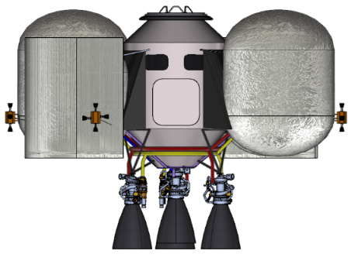
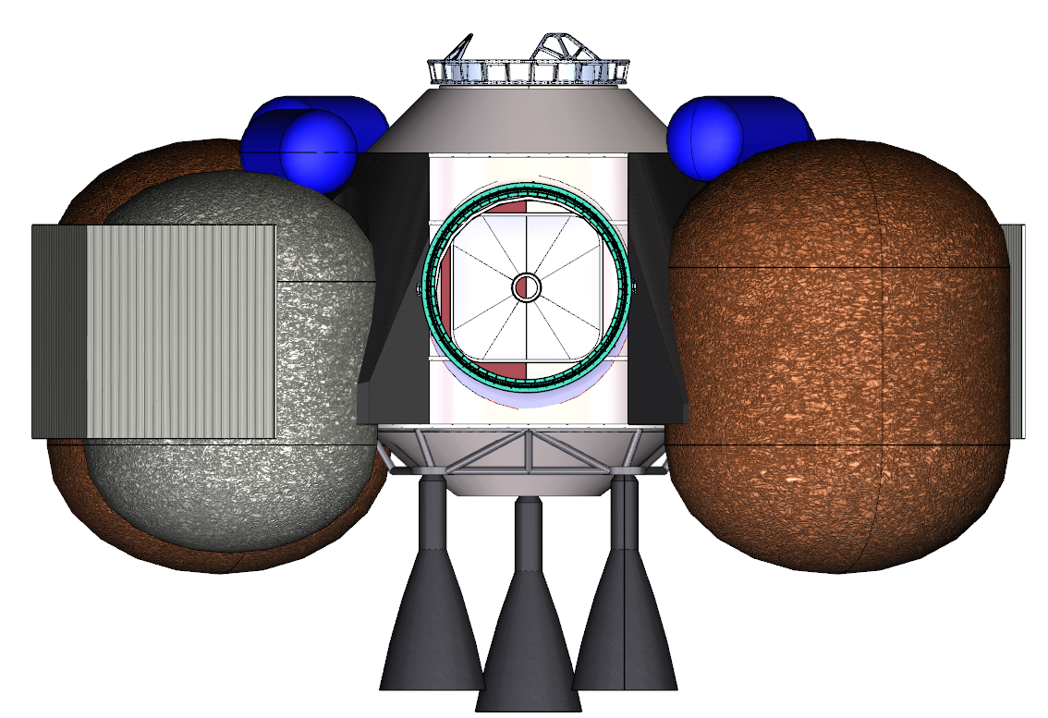
MAV Update Comparison
Reduced diameter constraint imposed by SLS shroud diameter of 8.4m
 | c. 2019 | SAC21
Crew Size (max) | 4 | 2
Surface duration | 1.5-2 years prior to crew 500 days crewed surface mission | 5.5 years prior to crew 30 days crewed surface mission
Ascent Delta V (m/s) | 5,274 m/s | 5,109 m/s
Stages | 2 | 2
Crew module press. Volume | 17.5 m³ | 10.5 m³
Ascent vehicle mass | 47,100 kg at liftoff 18,400 kg delivered | 36,830 kg at liftoff 21,067 kg delivered
Ascent vehicle engines | 3 + 1 pump-fed throttling, LOX/LCH4 | 4 + 1 pump-fed throttling, NTO/MMH
Ascent engine thrust | 100 kN (22.5 klbf) | 44.5 kN (10 klbf)
9.1 m
7.2 m
2-crew support as dictated by SAC21 architecture
5.8 m
4.5 m
Increased lifetime driven by extended pre-deployment timeline
Much reduced crew cabin volume resulting from lower number of crew support
Significant mass reduction resulting from reduced dry mass
Increased delivered mass due to propellant selection change
NTO/MMH propulsion to leverage existing lunar developments, removes need for surface ISRU in the architecture
2022 IEEE Aerospace Conference

Slide 10
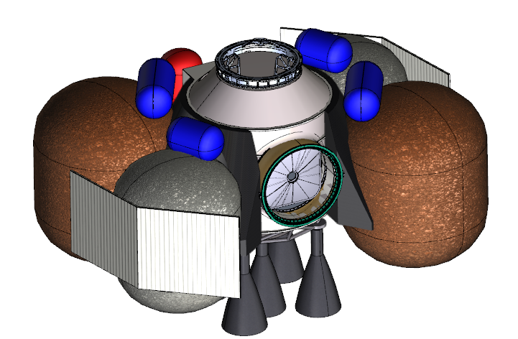
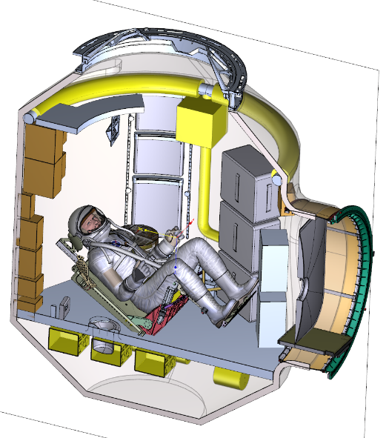
Configuration/Operation
Two-stage vehicle with integrated crew cabin
  Axial docking port for interface with deep space transportation
  Radial hatch to support surface ingress of crew
NTO/MMH Propulsion
  Removes need for surface ISRU in architecture
  Leverages existing developments in lunar campaign
  Launched defueled (NTO only) to meet landing system payload constraints
    Propellant resupplied via pre-positioned propellant and surface propellant transfer systems
Mars Ascent Vehicle (MAV)
Stage 2
Crew Cabin
Stage 1
2022 IEEE Aerospace Conference

Slide 11
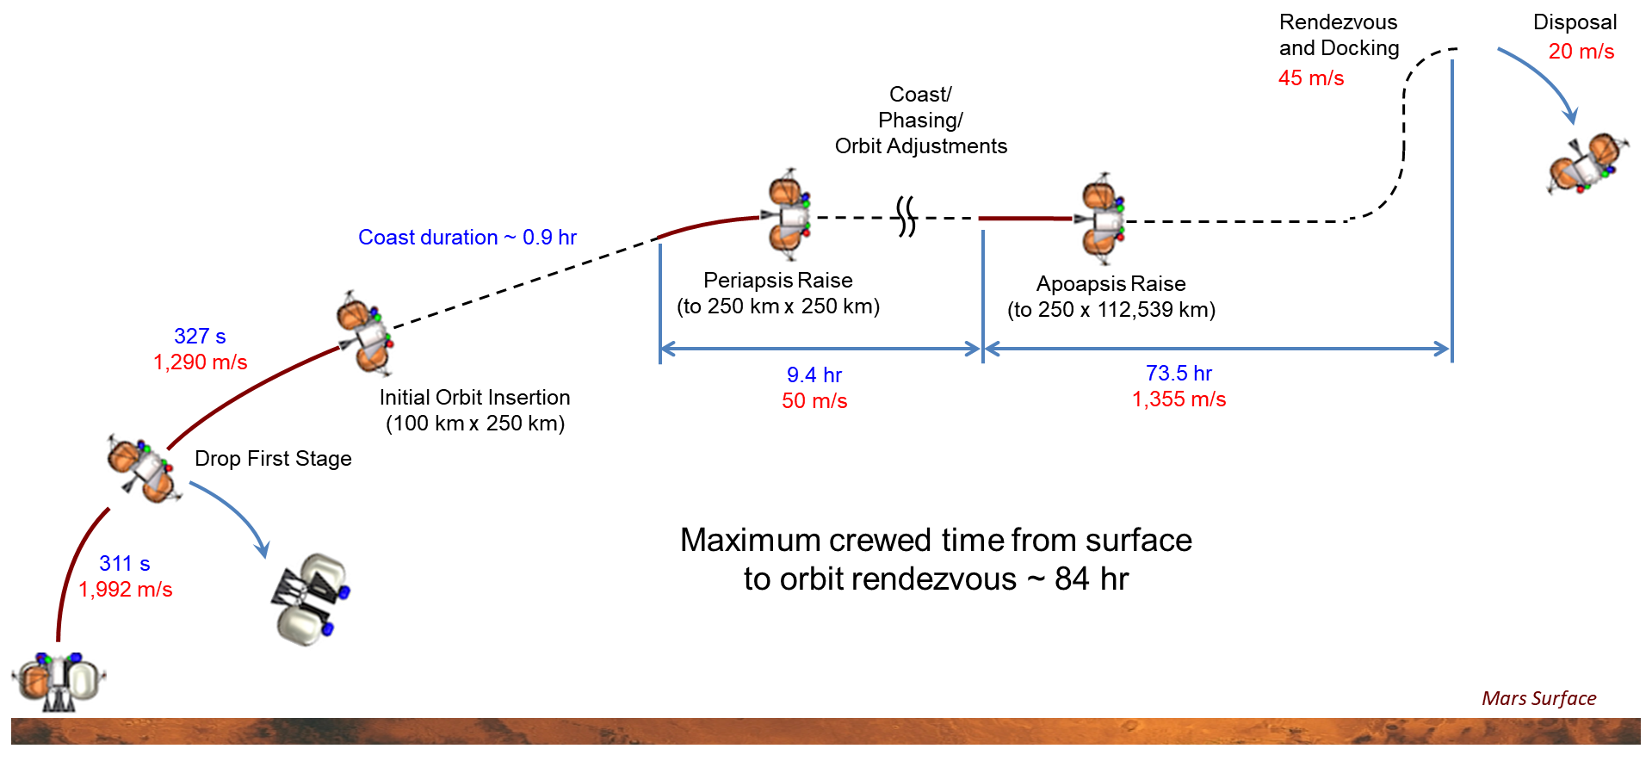
Trajectory
SAC21 architecture assumes a target 5-sol parking orbit
  Drives crewed duration requirements
Liftoff to rendezvous with deep space transport requires roughly 84 hours
  Only 11 minute to reach low Mars orbit
  Most time spent phasing/coasting
  Shorter durations are possible at the cost of increased propellant and reduce Mars launch availability
MAV is disposed of to heliocentric space
  Design does not currently support retrofit and reuse
MAV Trajectory Overview
2022 IEEE Aerospace Conference

Slide 12
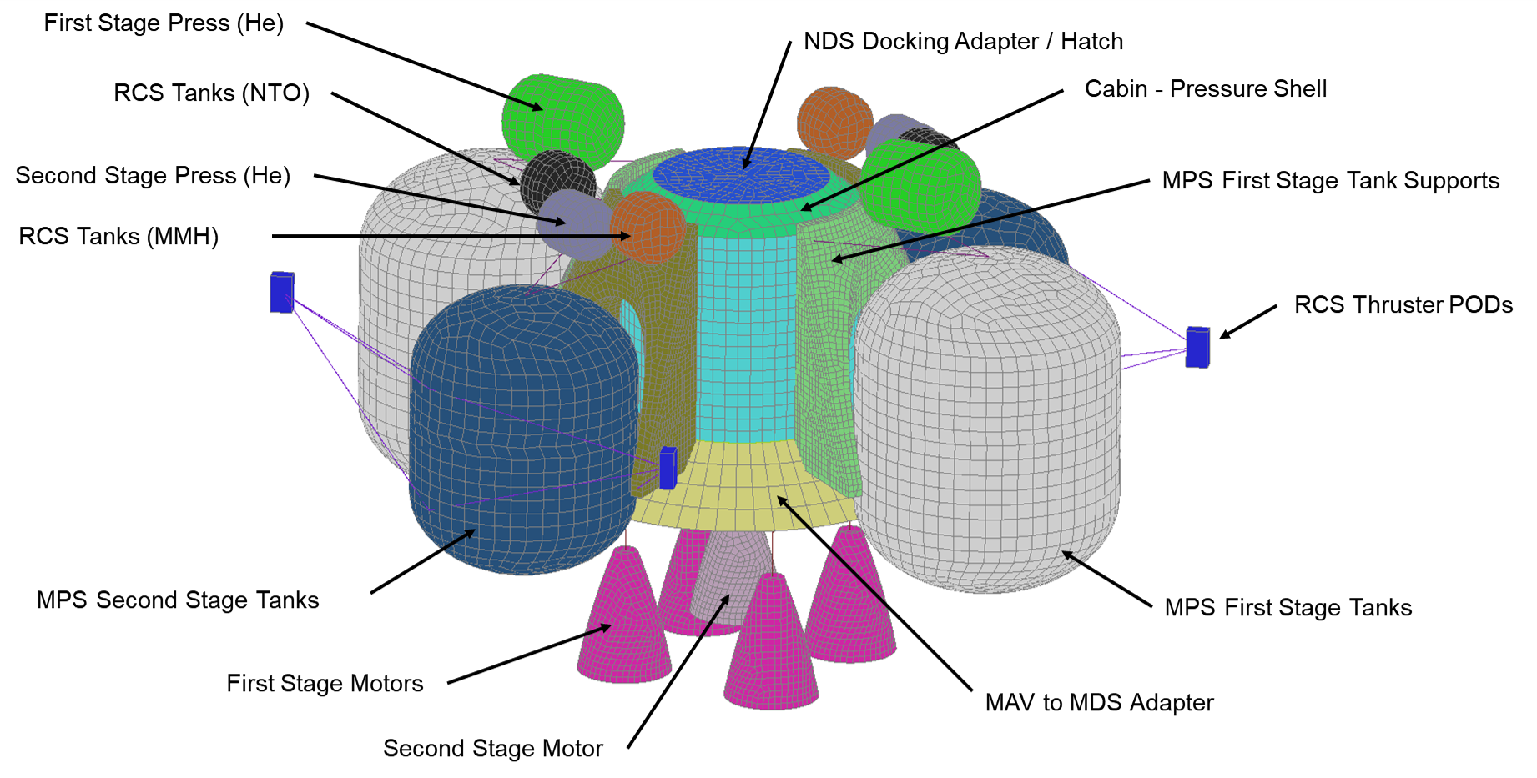
Structures
Mostly metallic aluminum construction
  MPS tank supports assume a composite carbon fiber construction
All structures designed to meet the 4.1G axial and 1.5G lateral accelerations, as well as 8 Hz first lateral mode constraints for SLS payloads
MAV Structures Finite Element Model
2022 IEEE Aerospace Conference

Slide 13
Crew Cabin
Supports 2-crew during powered ascent only
  No support for extended surface habitation
Open loop environmental control and life support system based on Orion flight heritage
  3.5 days nominal support
  Additional 5 days of provisions for contingencies
Provides a 100 kg science allocation
  Includes accommodation of up to 150 watts average electrical and 75 watts of average thermal loads
MAV ECLS System Diagram
Item (# items) | Assumption
Crew (2) | 98.5 kg/person
Food | 1 kg/day/person
Crew Provisions | 2.5 kg/day/person
Total Mission Provisions | 30 kg/person
Safety | 36 kg
Sleep Systems | 8.2 kg/person
Recumbent Seats (2) | 22.7 kg/seat
OCSS Pressure Suite | 23 kg/suit
Utilization | 100 kg
Cargo and Human Factors Equipment
2022 IEEE Aerospace Conference

Slide 14
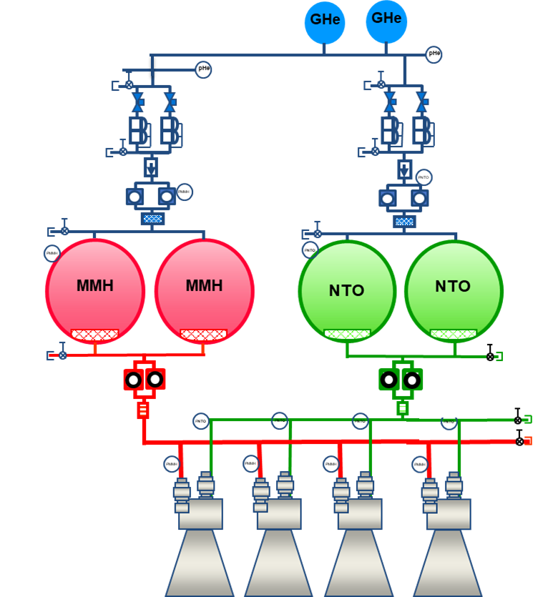
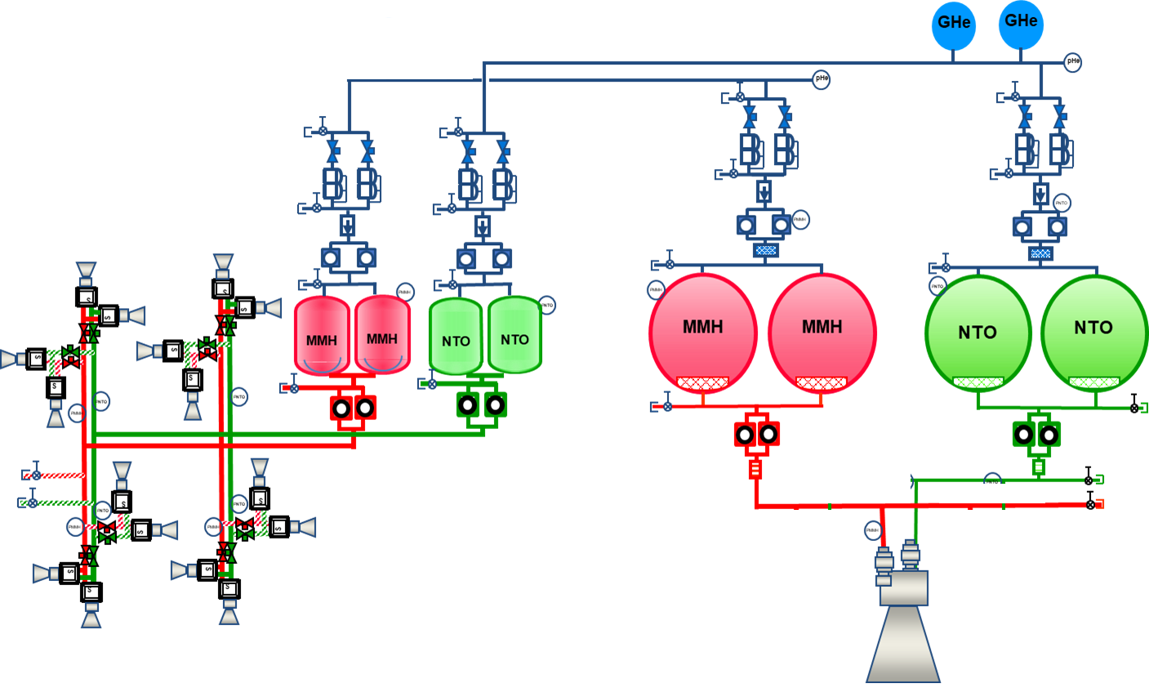
Propulsion
Two-stage, NTO/MMH-based propulsion system
  Pump-fed gas generator cycle main engines, achieving up to 340 s Isp
  4 engines on the first stage
  1 engine on the second stage
Fully independent pressure-fed reaction control system integrated with the second stage
  Utilizes 16 R-4D thrusters in pods of four to provide
  fine roll and axial control for minor trajectory
  maneuvers and docking operation
Stage 1 Propulsion Schematic
Stage 2 Propulsion Schematic
2022 IEEE Aerospace Conference

Slide 15
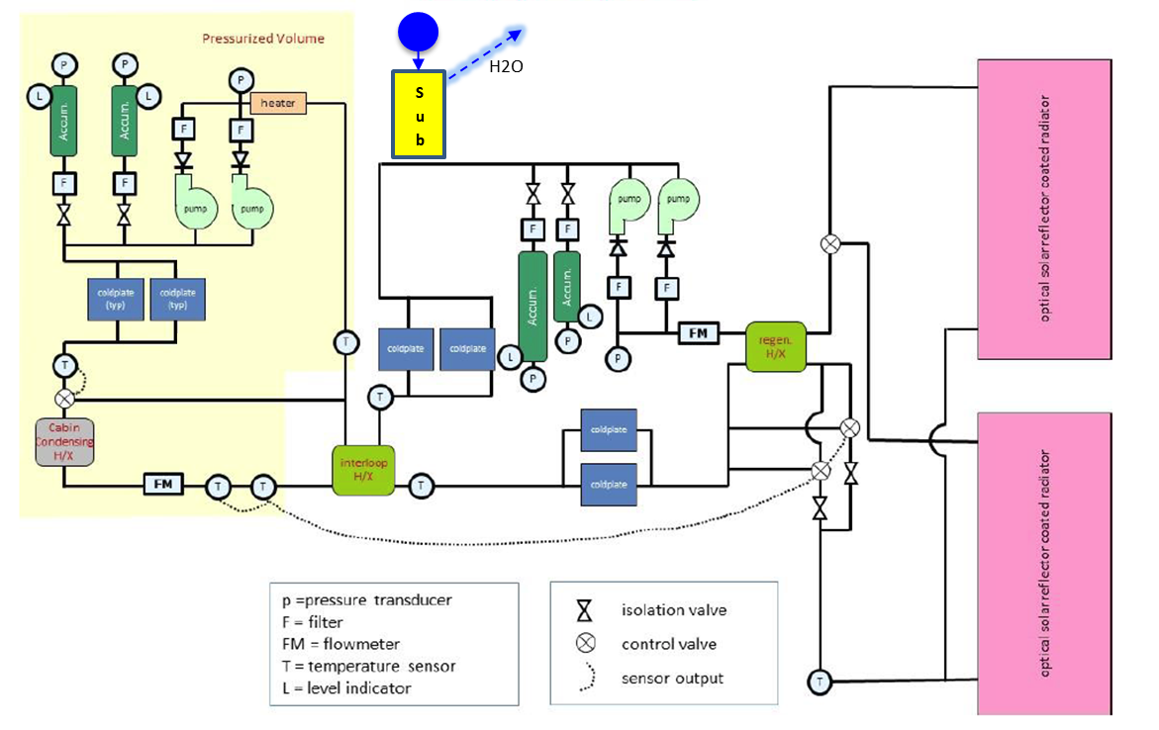
Thermal
Greatly simplified over previous iteration due to the selection of storable propellants
  Heaters required to maintain propellant temperatures
Dual-loop, pump-driven heat transport and rejection system
  Supports crew cabin heat rejection, as well as all other subsystems
  Sublimator required to accommodate peak loads during crewed operation
Thermal System Schematic
2022 IEEE Aerospace Conference

Slide 16
Power
Gaseous oxygen/methane fuel cell
  Found to be minimal mass compared to equivalently capable solar/battery system
Three parallel fuel cells feed two parallel power distribution units for redundancy
  Provides 120-volt and 28-volt supplies for vehicle systems
7.8 kilowatts peak power, 185 kilowatt-hours of energy
Power System Schematic
Power Budget
2022 IEEE Aerospace Conference

Slide 17
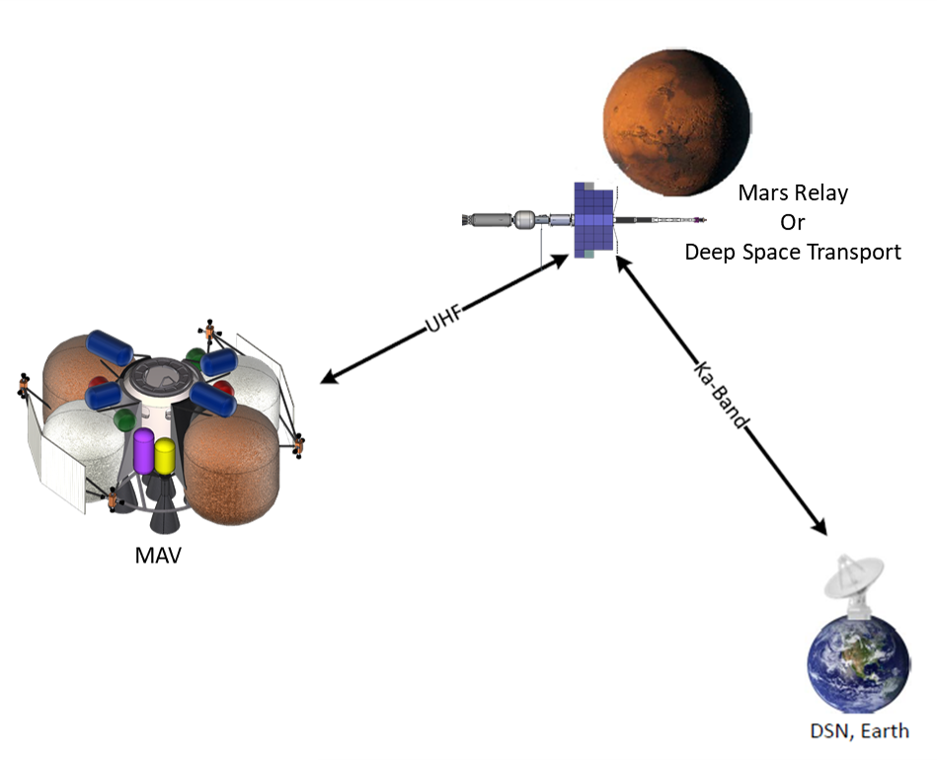
Avionics
Utilizes Orion-derived flight controllers and the mustang avionics suite as a baseline
  Redundant computers for robustness
MAV is assumed to be the active vehicle during rendezvous and proximity operations with other vehicles
MAV communicates to Earth and deep space transport via relay from other orbital assets
  Greatly reduces avionics system mass and power requirements
  Provides constant communication with little to no blackouts
MAV Communication Architecture
2022 IEEE Aerospace Conference

Slide 18
Conclusion
The overarching architecture and subsequent MAV concept presented here inform an often-overlooked corner of the trades space to help inform leadership of potential options and impacts
  NASA continues to refine and explore Mars architecture concepts to support decision makers as they chart the course of humans to Mars
Subsystem | Mass w/ MGA (kg)
 | Mars Delivery | Mars Ascent
Ascent Cabin (AC) | 2,798 | 3,212
Structures | 918 | 918
Power | 472 | 472
Avionics | 337 | 337
Thermal | 211 | 211
ECLSS | 473 | 473
Crew Systems | 110 | 110
Cargo | 0 | 414
Non-Prop. Fluids | 277 | 277
Ascent Stage 1 (AS1) | 12,556 | 18,940
Dry Mass | 1,633 | 1,633
NTO | 5,020 | 11,404
MMH | 5,903 | 5,903
Ascent Stage 2 (AS2) | 6,065 | 13,999
Dry Mass | 1,273 | 1,273
NTO | 425 | 8,359
MMH | 4,367 | 4,367
System Intg. Margin | 676 | 676
TOTALS | 22,095 | 36,827
MAV Mass Summary
2022 IEEE Aerospace Conference

Slide 19

Thank You

Slide 20


