Slide 1

Regenerative ECLSS and Logistics Analysis for Sustained Lunar Surface Missions
Chel Stromgren, Binera, Inc.
Presenting: Callie Burke, Binera, Inc.
Co-Authors:
Callie Burke, Jason Cho, Binera, Inc.
William Cirillo, Andrew Owns, David Howard, NASA Langley Research Center
March 11th, 2022

Slide 2
Outline
Introduction
Background
  Logistics Requirements
  ECLSS Architecture Options
  Assumed ECLSS Masses
Analysis
  Mission Parameters
  Sensitivity Analysis: ECLSS Cases
Results
Recommendation: ECLSS Architecture to Minimize Tradeoff
  A/L Recovery, OGA, HP O₂
Acronyms
ECLSS | Environmental Control and Life Support System
SH | Surface Habitat
PR | Pressurized Rover
EVA | Extravehicular Activity
A/L Recovery | Airlock Gas Recovery
OGA | Oxygen Generation Assembly
HP O₂ | High Pressure Oxygen Compressor
WPA | Water Processor Assembly
UPA | Urine Processor Assembly
BPA | Brine Processor Assembly

Slide 3
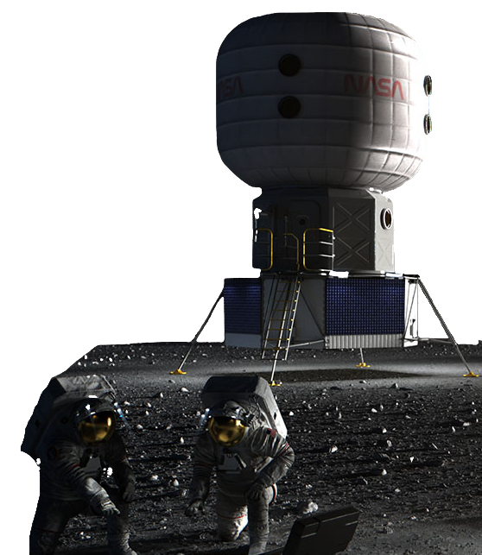
Introduction
NASA is going back to the Moon!
Sustained Lunar Campaign:
  Annual crew missions to the lunar surface with 2 to 4 crewmembers living in a Surface Habitat (SH) and/or a Pressurized Rover (PR) for 30 days or longer.
Missions will require annual resupply of logistics to the lunar surface.
  Logistics include consumables, EVA consumables and spares, carriers, surface system spares and maintenance, and science and utilization.
Water and gas (may) dominate the total logistics resupply.
  Water and gas = a direct function of the level of closure provided by the ECLSS in the Surface Habitat (SH) and the Pressurized Rover (PR).
Logistics requirements will drive the number of required resupply landers, launch vehicles, and resupply costs.
Goal of Paper: Determine a recommended regenerative ECLSS architecture option to minimize the tradeoff between ECLSS Delivery Mass and Logistics Resupply Mass

Slide 4
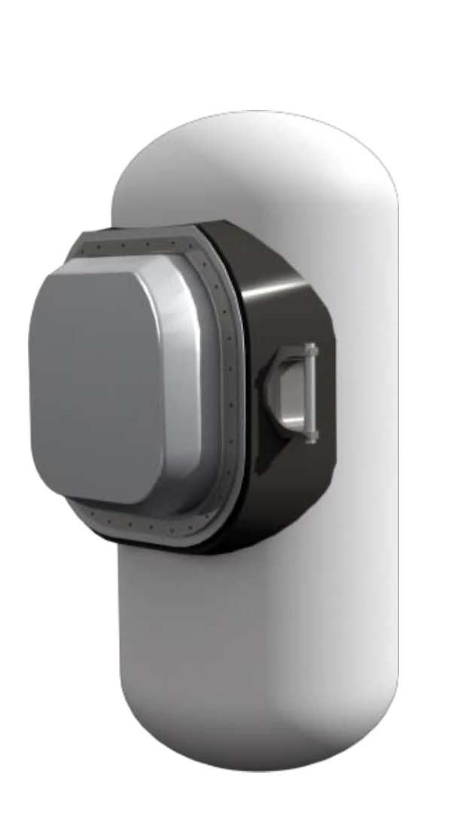
Logistics Requirements
CONSUMABLES
CARRIERS
EVA LOGISTICS
SOLID GOODS
Maximum Absorbency Garments (MAGs)
Drink Bags
EVA Spares (a single static mass)
Food
Clothing
Waste Collection
Wipes/Gloves
Towels
Hygiene Supplies
Health Care Consumables
Operational Supplies
Recreation and Personal Items
Cargo Transfer Bags
(CTBs)
SPARES & MAINTENANCE
Small Pressurized Logistics Carriers
(SPLCs)
Maintenance Items
Spares
Iodine Compatible Water Containers
(CWC-Is)
Not Included: Science & Utilization
ECLSS Closure will drive Water & Gas Mass
WATER
OXYGEN
High Pressurized Gas Carriers
(HPGCs)
NITROGEN

Slide 5
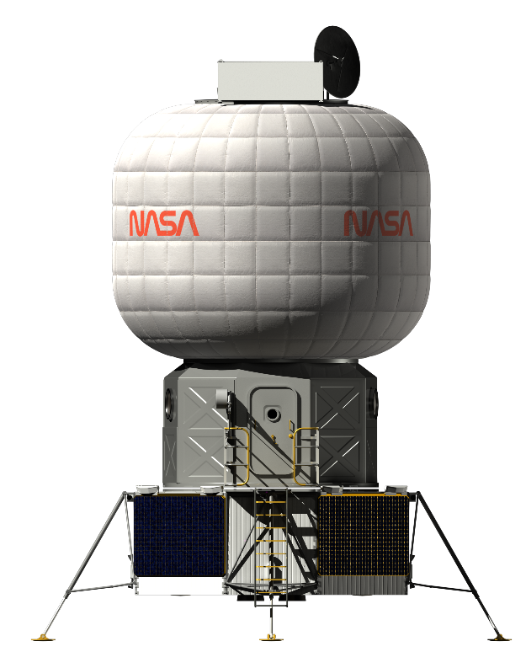
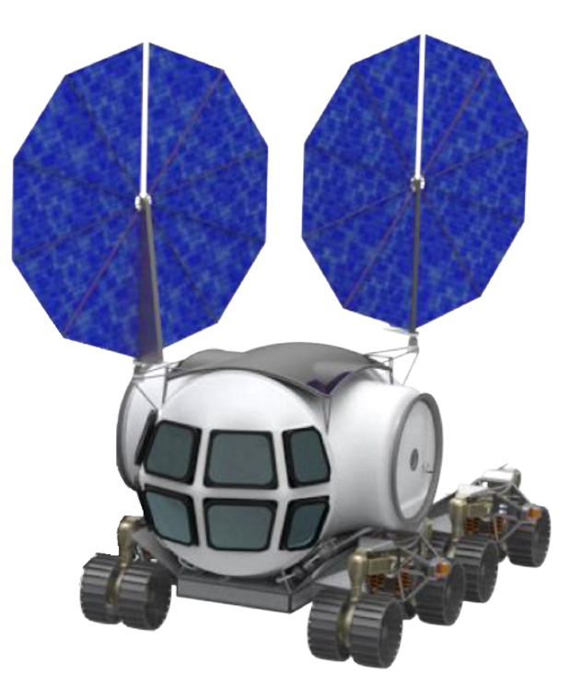
Regenerative ECLSS Options
Surface Habitat Regenerative ECLSS
Airlock Gas Recovery (A/L Recovery)
  “saves” atmosphere from the SH Airlock as it is being depressurized for EVA operations.
Oxygen Generation Assembly (OGA)
  produces metabolic oxygen from water.
High Pressure Oxygen Compressor (HP O2)
  purifies and pressurizes oxygen from the OGA for tank storage and EVA suit recharge.
Water Processor Assembly (WPA)
  purifies condensate, waste (grey) water, and urine distillate into potable water.
Combined Urine Processor Assembly (UPA) / Brine Processor Assembly (BPA)
  purify urine and flush water into urine distillate.
Carbon Dioxide Reduction Assembly & Sabatier Process (SABATIER)
  recovers waste CO2 from the cabin atmosphere and H2 from the OGA. Sabatier produces grey water from the two gases.
Pressurized Rover Regenerative ECLSS
Water & Oxygen Transfers from the SH to the PR
  The SH supplies water and oxygen to the PR.
Wastewater Transfer from the PR to the SH
  Wastewater is collected in the PR then transferred to the SH for recovery in the SH regenerative ECLSS.
Surface Habitat (SH)
Pressurized Rover (PR)
Required Base ECLS Sub-Systems
A/L Recovery
OGA
HP O₂
WPA
UPA/BPA
SABATIER
Required Base ECLS Sub-Systems
Transfers
SH to PR
HP O₂
Water
PR to SH
  Grey Water
  Urine/Flush

Slide 6
ECLSS Options: Assumed Systems Masses
OPTION | Predicted Mass (kg)
Airlock Gas Recovery | 139
Oxygen Generator Assembly | 467
HP O₂ Compressor | 120
Water Processing (WPA) | 528
Modified Urine Processing w/ Brine (UPA/BPA) | 357
CO₂ Reduction (SABATIER) | 210
Water/O₂ Transfer SH --> PR* | 50
Grey Water/Urine Transfer PR --> SH* | 50
To determine initial delivery mass, the team estimated masses for each ECLS Sub-System option.
Predicted masses are derived from current and projected ISS systems and adapted for use on the lunar surface.
Masses also include the spares that would be delivered with each sub-system.
* Estimates based on preliminary design for transfer hardware

Slide 7
Analysis: Mission Parameters and Assumptions
Lunar Surface Integrated ECLSS Analysis Tool
  Calculates total delivered logistics mass required to support a lunar surface mission.
  The tool takes in mission parameter inputs:
    crew size, mission duration, EVA cadence, and ECLSS configuration.
  Masses are broken down by crew consumables, system spares and maintenance, water, and gases.
  Also determines number and mass of carriers.
The tool can simulate missions occurring in either the SH, the PR, or both elements operating together, including commodity transfers between the two.
Assumed Mission Parameters
Parameter | Input
# of Crew | 4 crewmembers (2 in SH, 2 in PR)
# of Days | 30 days (crews swap between the SH and PR at the mission’s midpoint)
SH EVAs | 16 hours of EVA per crew per week; using an Airlock
PR EVAs | 24 hours of EVA per crew per week; using a Suitport

Slide 8
Analysis: ECLSS Cases
 | Transfer Options
Regenerative ECLSS Options | No Transfer | Water/Gas Transfer from SH to PR | Water/Gas Transfer from SH to PR + Wastewater Transfer from PR to SH
OPEN LOOP (Base ECLS Sub-systems) | 1
+ A/L GAS RECOVERY | 2
+ OGA | 3
+ OGA + HP O₂ COMP | 4 | 9
+ OGA + HP O₂ COMP + A/L GAS RECOVERY | 5 | 10
+ OGA + HP O₂ COMP + A/L GAS RECOVERY +WPA | 6 | 11 | 14
+ OGA + HP O₂ COMP + A/L GAS RECOVERY +WPA + UPA/BRINE | 7 | 12 | 15
+ OGA + HP O₂ COMP + A/L GAS RECOVERY +WPA + UPA/BRINE + SABATIER | 8 | 13 | 16
16 Cases modeled using the Lunar Surface Integrated ECLSS Analysis Tool
Begin with an Open Loop ECLSS and no gas or water transfers between the SH and the PR.
Each subsequent case adds regenerative ECLSS capability options and eventually different transfer options.
For each case, the team calculated total Logistics Resupply Mass required for a 4 crew, 30-day mission (and a breakdown of that mass)

Slide 9
Results
Annual Outyear Logistics vs Added ECLSS Mass
ECLSS Case Results
Case | Description | Transfer | Added ECLS System Mass (kg) | Total Recurring Mass (kg)
1 | OPEN LOOP | None | 0 | 2,635
2 | + A/L GAS RECOVERY | None | 349 | 2,494
3 | + OGA | None | 833 | 2,607
4 | + OGA + HP O₂ COMP | None | 939 | 2,554
5 | + OGA + HP O₂ COMP + A/L GAS | None | 1,063 | 2,355
6 | + OGA + HP O₂ COMP + A/L GAS + WPA | None | 1,852 | 2,206
7 | + OGA + HP O₂ COMP + A/L GAS + WPA + UPA + BRINE | None | 2,359 | 2,125
8 | + OGA + HP O₂ COMP + A/L GAS + WPA + UPA + BRINE + SABATIER | None | 2,641 | 2,087
9 | + OGA + HP O₂ COMP | Water/Gas to PR | 981 | 2,459
10 | + OGA + HP O₂ COMP + A/L GAS | Water/Gas to PR | 1,105 | 2,259
11 | + OGA + HP O₂ COMP + A/L GAS + WPA | Water/Gas to PR | 1,894 | 2,110
12 | + OGA + HP O₂ COMP + A/L GAS + WPA + UPA + BRINE | Water/Gas to PR | 2,401 | 2,030
13 | + OGA + HP O₂ COMP + A/L GAS + WPA + UPA + BRINE + SABATIER | Water/Gas to PR | 2,683 | 1,989
14 | + OGA + HP O₂ COMP + A/L GAS + WPA | Water/Gas to ROVER + Grey Water/Urine to SH | 1,936 | 1,966
15 | + OGA + HP O₂ COMP + A/L GAS + WPA + UPA + BRINE | Water/Gas to ROVER + Grey Water/Urine to SH | 2,443 | 1,651
16 | + OGA + HP O₂ COMP + A/L GAS + WPA + UPA + BRINE + SABATIER | Water/Gas to ROVER + Grey Water/Urine to SH | 2,725 | 1,609
1
3
2
4
9
5
10
6
11
7
8
14
12
13
15
16
No Transfer
Water/Gas Transfer from SH to PR
Water/Gas Transfer from SH to PR + Waste Transfer from PR to SH

Slide 10
Results: Grouped by Regen ECLSS Capability
No Transfer
Water/Gas Transfer from SH to PR
Open Loop
+ OGA
+ A/L Gas Recovery
Water/Gas Transfer from SH to PR + Waste Transfer from PR to SH
+ OGA & HP O₂
+ A/L Gas Recovery & OGA & HP O₂ & WPA
+ A/L Gas Recovery & OGA & HP O₂ & WPA & UPA/Brine
+ A/L Gas Recovery & OGA & HP O₂ & WPA & UPA/Brine & Sabatier
+ A/L Gas Recovery & OGA & HP O₂

Slide 11
Recommendation
Systems mass and logistics resupply mass are not the only factors driving ECLSS design decisions.
  Other Impacts: Budget availability, transportation system limitations, crew time requirements, and spares testing and reliability.
However, some level of regenerative ECLSS in the SH can reduce annual resupply requirements with comparatively small investments in initial system and spares mass.
Three systems that provide most substantial reduction in logistics resupply with low increase in initial mass:
  Airlock Gas Recovery
  OGA
  HP Oxygen Compression
If commodity and waste transfer between the PR and SH is viable, WPA and UPA/Brine systems could be considered.
  As long as, the additional systems mass, volume, and crew time can be accommodated in the SH.

Slide 12



