Slide 1
Digital Lunar Exploration Sites (DLES)
Presenter: Cory Foreman
Authors:
Sam Lawrence, Ph.D., Edwin Z. {Zack} Crues, Ph.D., Andrew Britton, Paul Bielski, Jonathan Schlueter, Amy Jagge, Chris Raymond, Nick Davis, Cory Foreman
10 March 2022
Presentation to the IEEE Conference, Big Sky, MT 2022

Slide 2
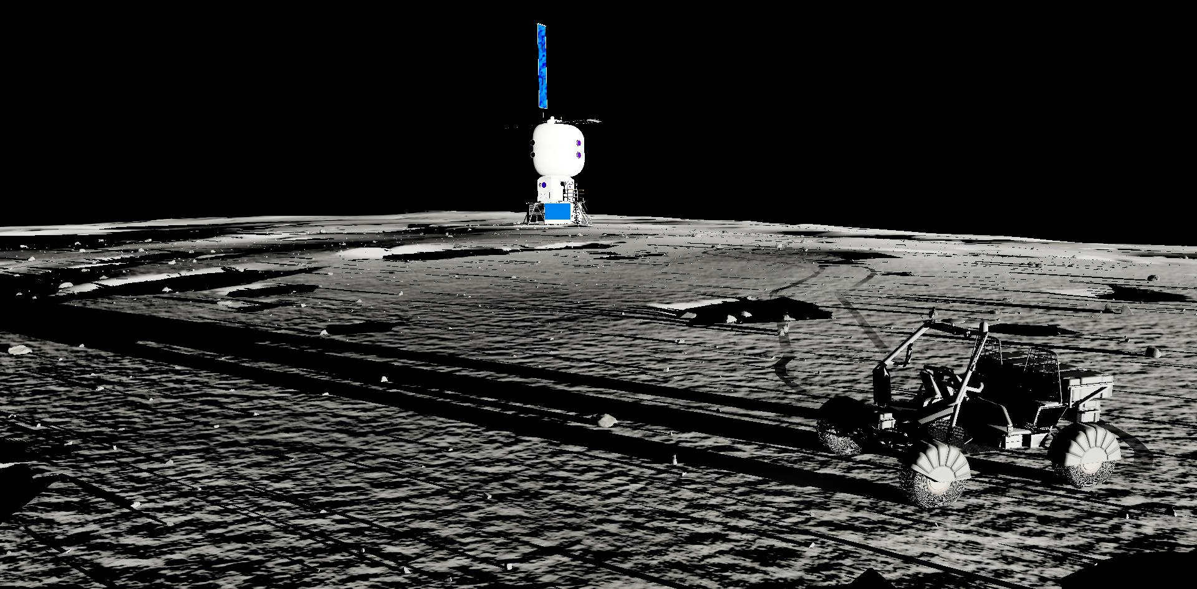
Overview
Introduction
The Need for DLES
Building DLES
DLES Products
DLES In Use
Future Work
Conclusions
Questions

Slide 3
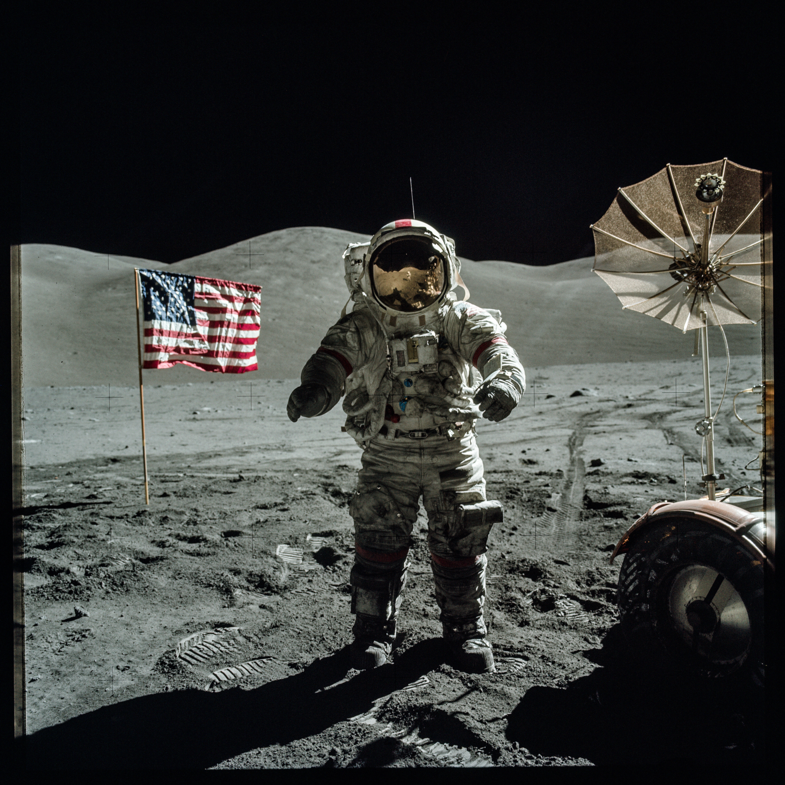
Introduction
Apollo 17:
Last time humans set foot on the moon
December 1972 – almost 50 years ago!
Made significant use of modeling and simulation
Provided a wealth of data about the lunar surface
https://apolloinrealtime.org
Artemis:
Return Date: mid-2020s
Will rely heavily on simulation
Better data describing lunar surface
Developing Digital Lunar Exploration Sites (DLES) products
AS17-140-21391.jpg

Slide 4
The Need For DLES
The Artemis program is currently focusing on exploration sites at the Lunar South Pole (LSP).
Rugged, mountainous, and cratered terrain.
Low Sun and Earth angles.
Lighting conditions will be challenging.
Limited information at the LSP
No system has soft-landed at the LSP.
Apollo missions focused on equatorial regions
We do have significant imagery, terrain elevation, and resource information from remote observations.

Slide 5
Building DLES
NASA collaboration between planetary science and space systems simulation
Astromaterials Research and Exploration Sciences (ARES) Team (JSC)
NASA Exploration Systems Simulations (NExSyS) Team (JSC)
Engineering Simulation and Graphics Lab (ESGL) (JSC)
NASA Planetary Geology, Geophysics and Geochemistry Laboratory (GSFC)
Data sources
Data processing
Data generation
Infrastructure

Slide 6
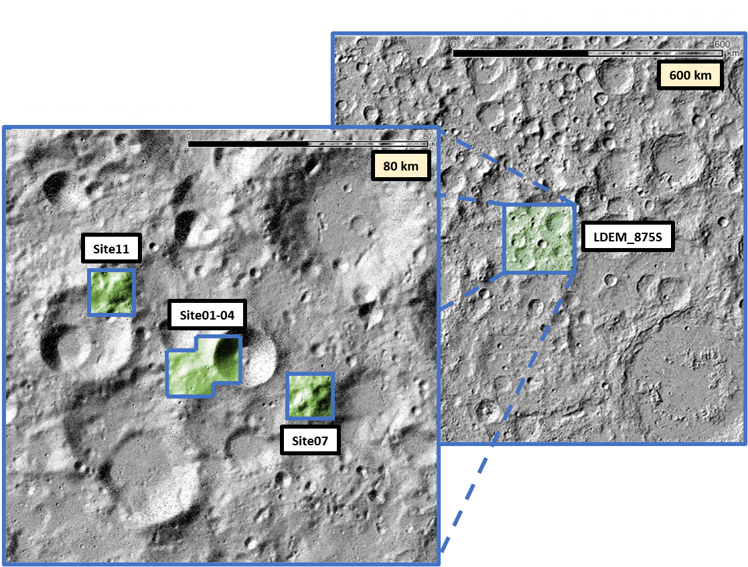
Building DLES: Data Sources
Lunar Reconnaissance Orbiter (LRO)
Launch Date: June 18, 2009
Lunar Orbiter Laser Altimeter (LOLA)
Able to generate 5 meter per pixel (mpp) Digital Elevation Models (DEM)
2x LRO Camera Narrow Angle Cameras (NAC)
Able to generate 1-4mpp surface imagery
Depends upon altitude
Stereo images can be processed to generate higher resolution DEM
Filename | Resolution | Description
Site01-Site04_merge-fillseam-crop.tif | 5 mpp | Blended and mosaicked DEM defining an area of roughly 25km x 25km around Connecting Ridge and Shackleton Rim
Site07_final_adj_5mpp_surf-reproj_scaled.tif | 5 mpp | DEM defining an area of 16km x 16km around Site 007. Reprojected pixel units to m from km
Site11_final_adj_5mpp_surf-reproj_scaled.tif | 5 mpp | DEM defining an area of 16km x 16km around Site 011. Reprojected pixel units to m from km
LDEM_875S_5M_geotiff.tif | 5 mpp | Regional LOLA DEM extending from -90° to -87.5° latitude
LRO_LOLA_DEM_SPole75_30m.tif | 30 mpp | Regional LOLA DEM extending for -90° to -75° latitude
NAC DTMs | 2 mpp | DTMs
SFS | 1 mpp | NASA Ames product from Beyer et al.

Slide 7
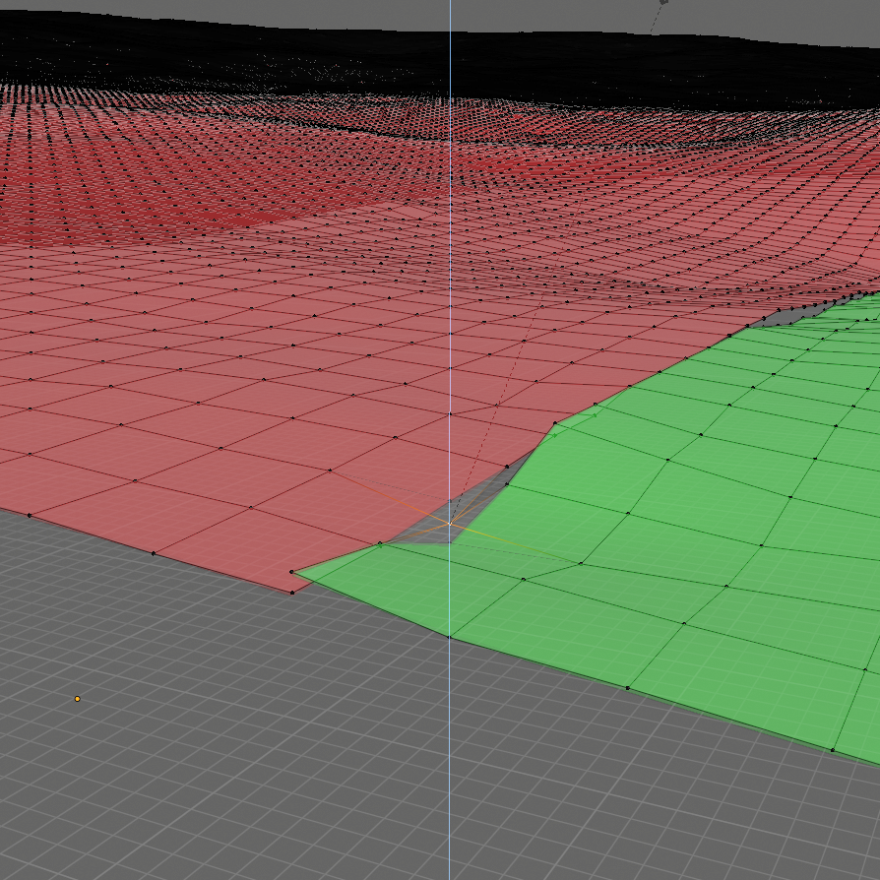
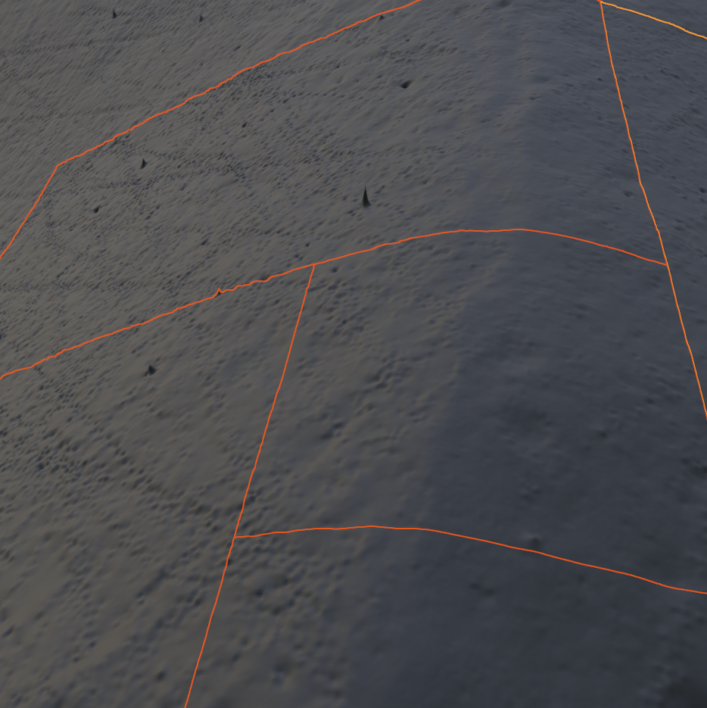
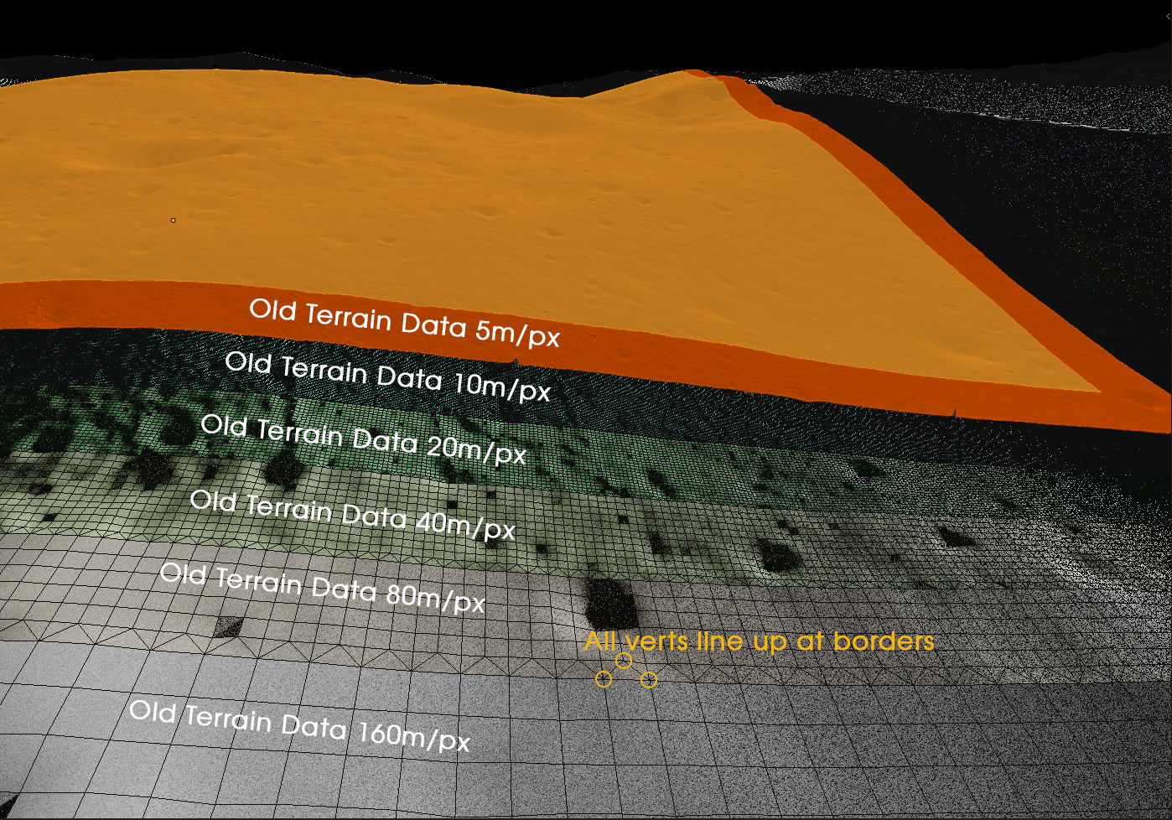
Building DLES: Data Processing
Artifacts
Orbital errors
Spurious noise points
DEM data can be processed, reducing artifacts around regions of interest
Gaps
Occur at seams between or overlapping DEM data
Must be properly stitched together
Resolution Changes

Slide 8
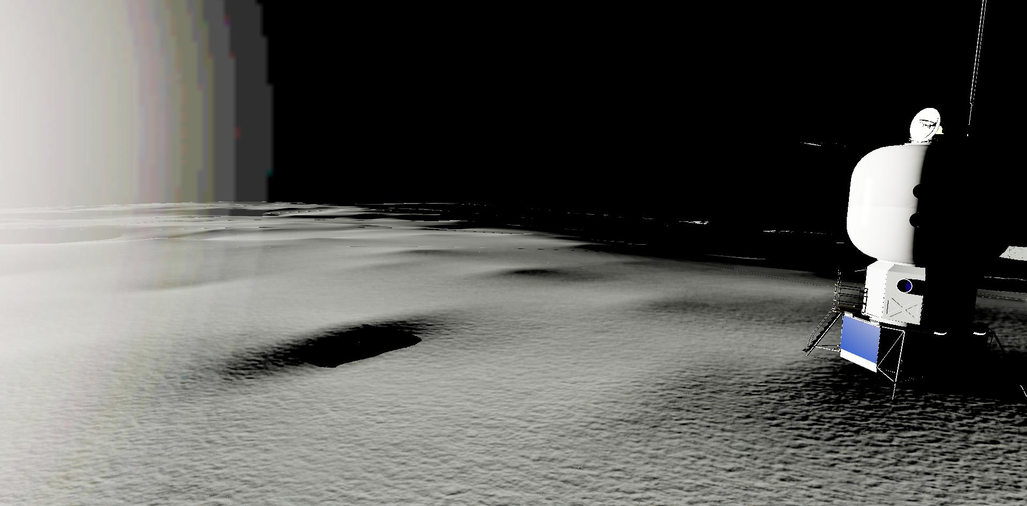
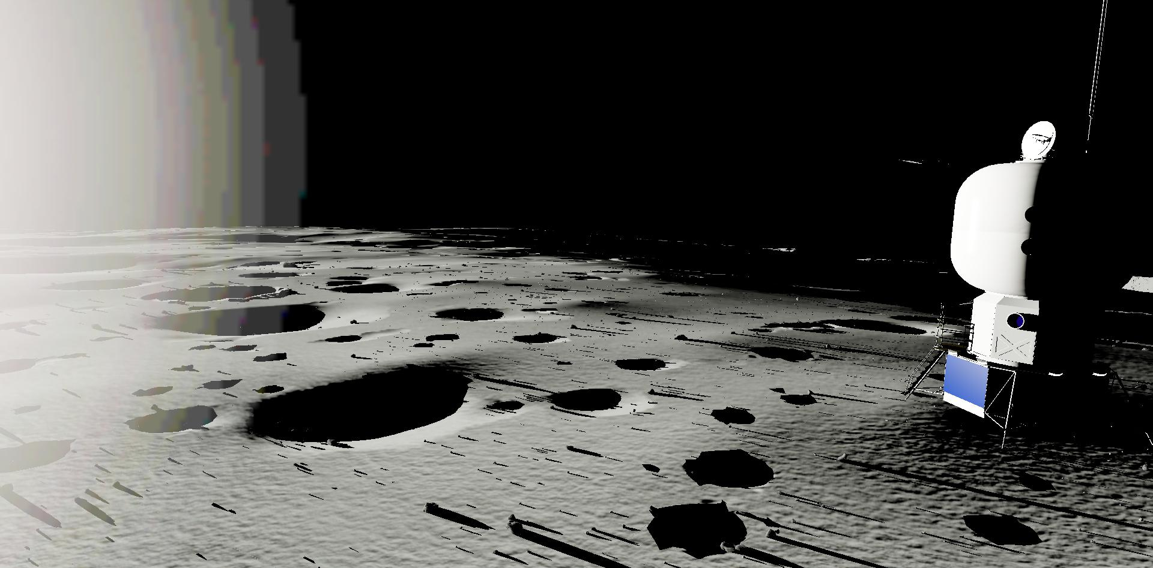
Building DLES: Data Generation
Truth data provides good base
Not able to capture smaller surface details
Artificial Features:
Rocks and Craters are used to enhance surface level detail
Built on top of 5mpp truth data
Populations are believed to be statistically representative
Information is stored in the Persistent Object Database (PODB)

Slide 9
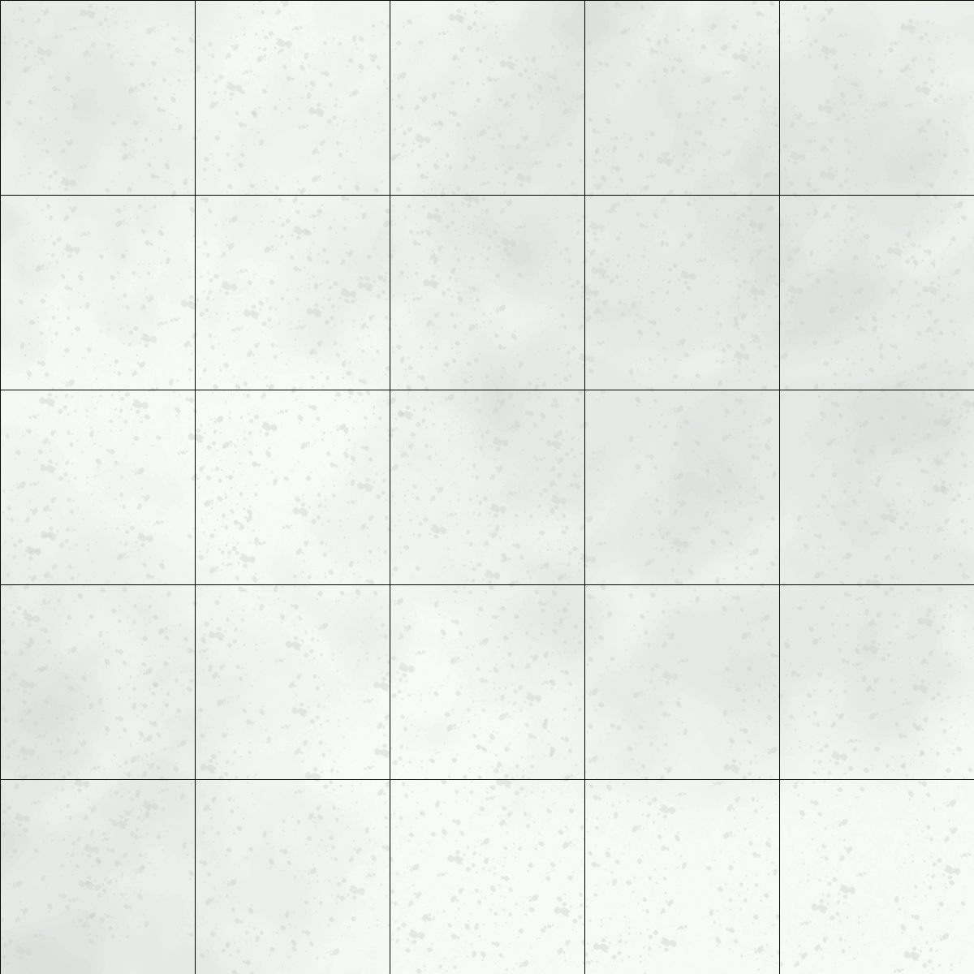
Building DLES: Infrastructure
Persistent Object Database (PODB)
Tracks information of persistent objects on the surface of the MOON
Position, Orientation, and Metadata
Web interface and API
Rocks:
Currently tracks: 1,483,507 rocks
Data is stored such that retrieval of items in a region is very fast
This feature is heavily used in simulations when scattering rocks
Functions like a level of detail (LOD) system
Only the rocks near the viewpoint are displayed in the rendering engine

Slide 10
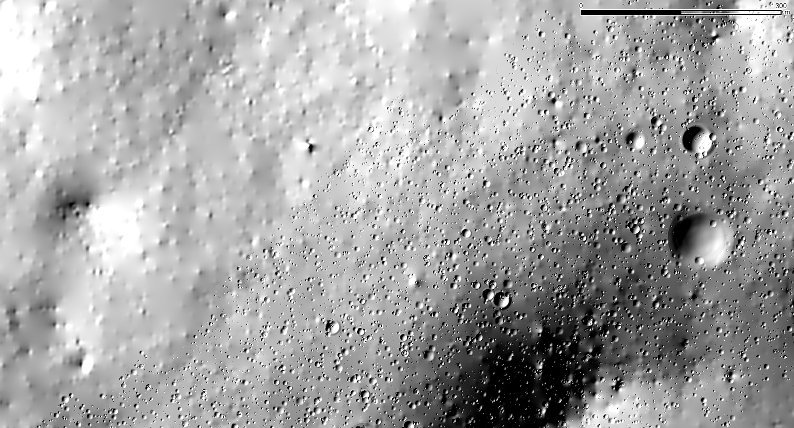
Building DLES: Infrastructure
Persistent Object Database (PODB)
Craters:
Currently Tracks: 128,559 craters
Offline process, unlike rocks
5mpp DEMs are upscaled to 20cmpp
Craters are then inserted into the DEM
Upscaled DEM can then be used like any other DEM
Upscaled 20cmpp DEM Hill-shade Image
300 m

Slide 11
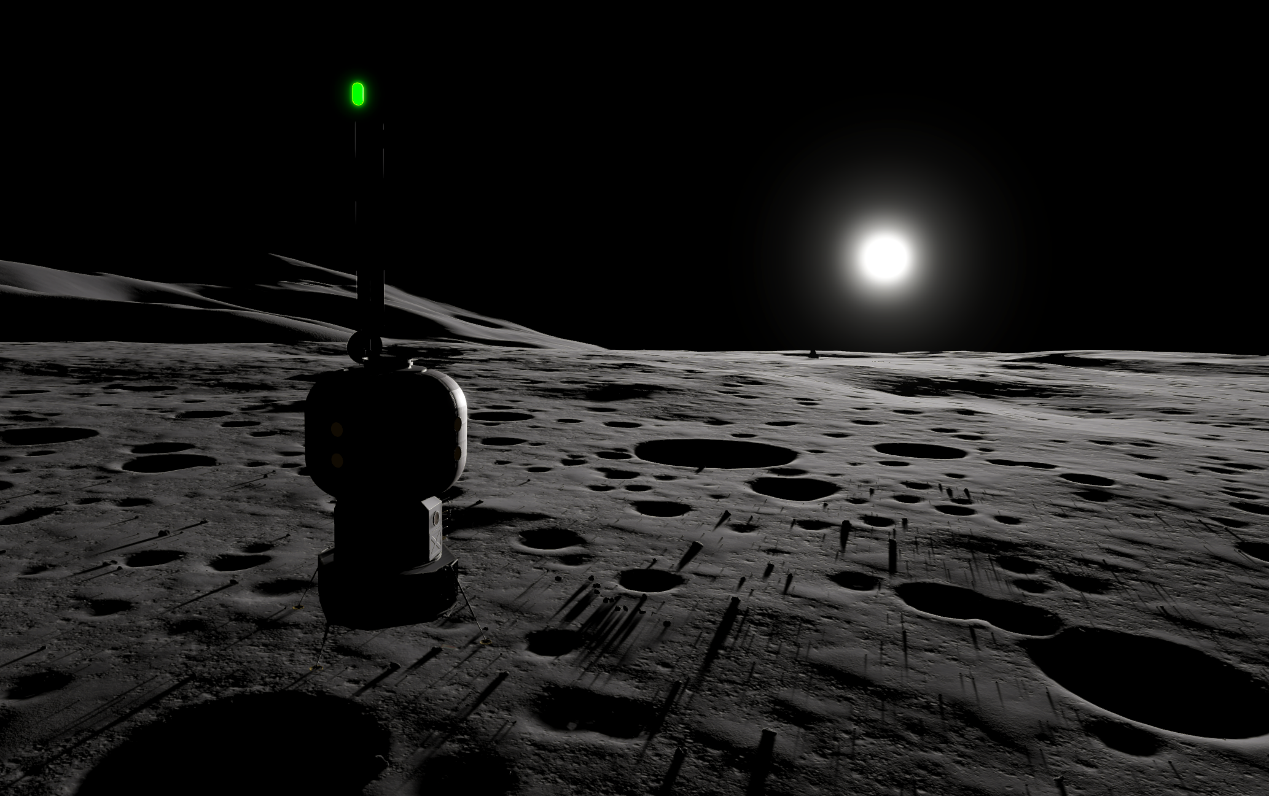
DLES Products
Truth Data DEMs:
5mpp - 1mpp
Upscaled DEMs:
20cm per pixel with craters inserted
FBX models:
Generated from DEMs of region
Sub-resolution features via PODB:
Craters
Rocks
Unity FBX Rendering

Slide 12
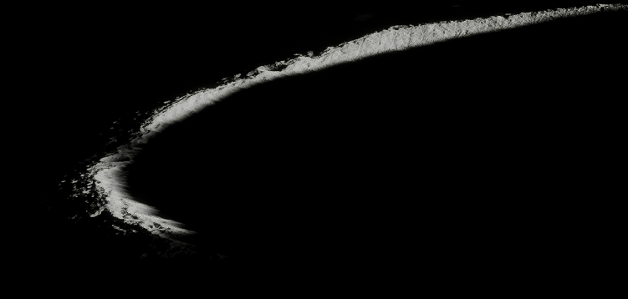
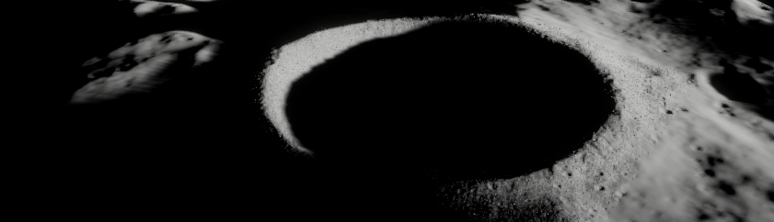
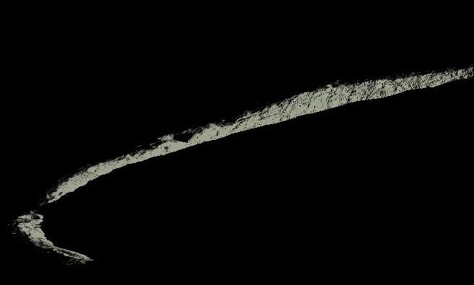
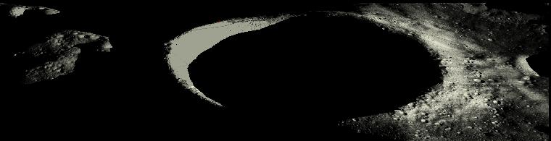
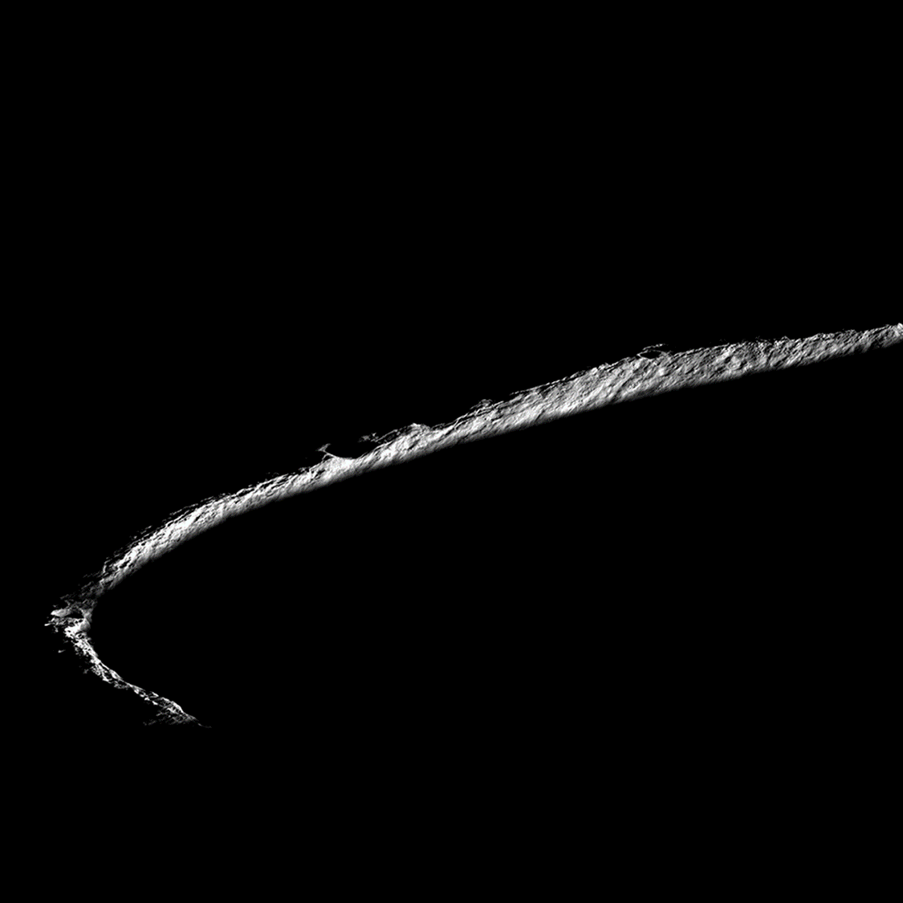
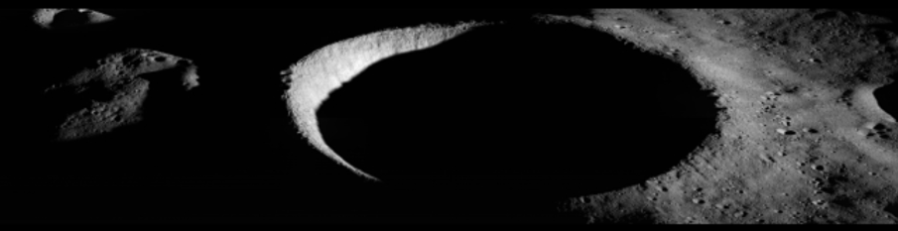
DLES Products: Validation
Validation Efforts:
LRO imagery is replicated
Side by side comparisons
Images:
NAC M1224655261
Date: 08-01-2016 1:46:34
NAC M1195011983
Date: 8-23-2015 23:31:55
NAC M1224655261
NAC M1195011983
Unity
EDGE
LROC

Slide 13
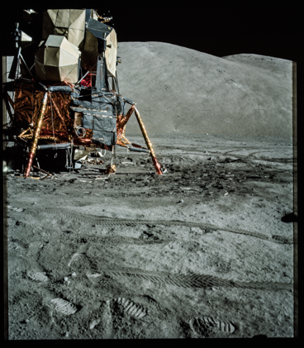
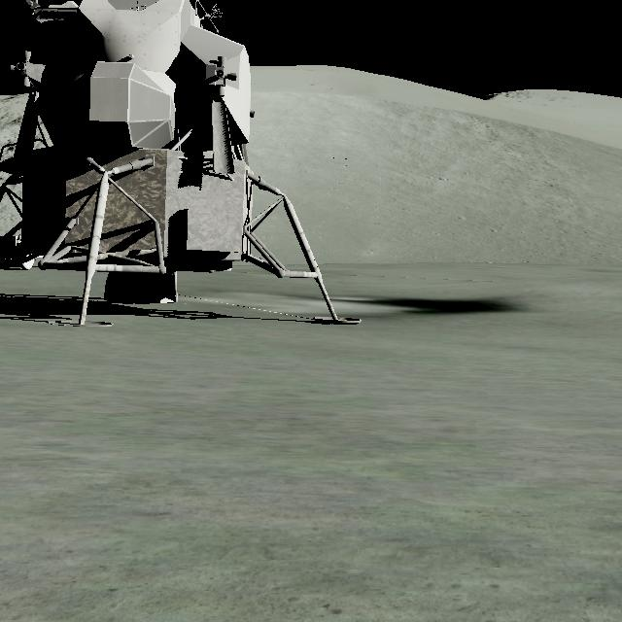
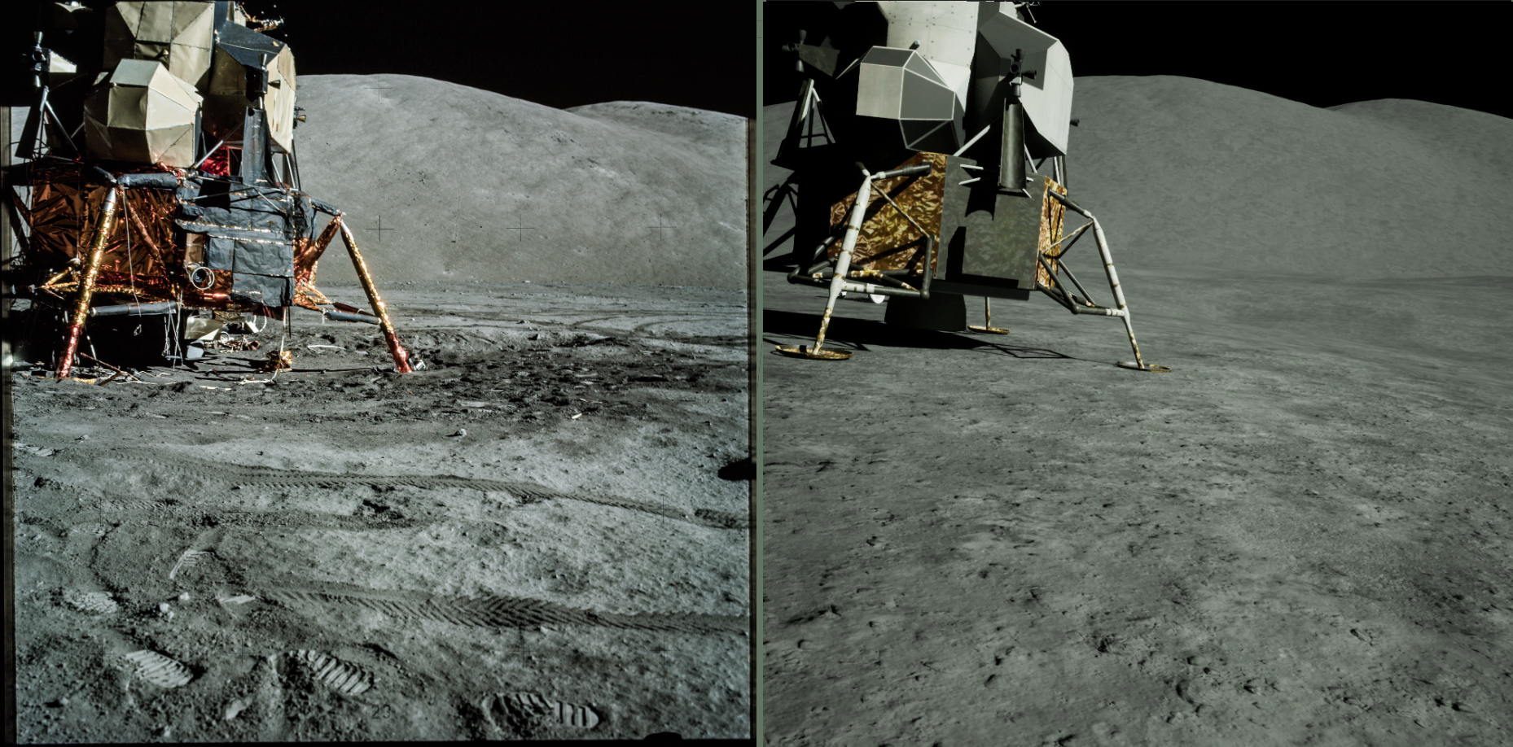
DLES Products: Validation
Surface image comparisons
Apollo 17: AS17-137-20874, Capture Date: Dec. 12th, 1972, 8:31:52 PM
Apollo Image
EDGE
Unreal Engine 5

Slide 14
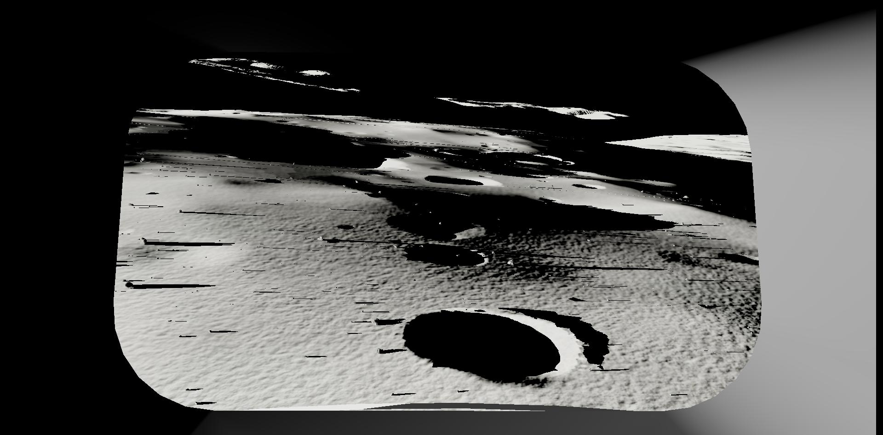
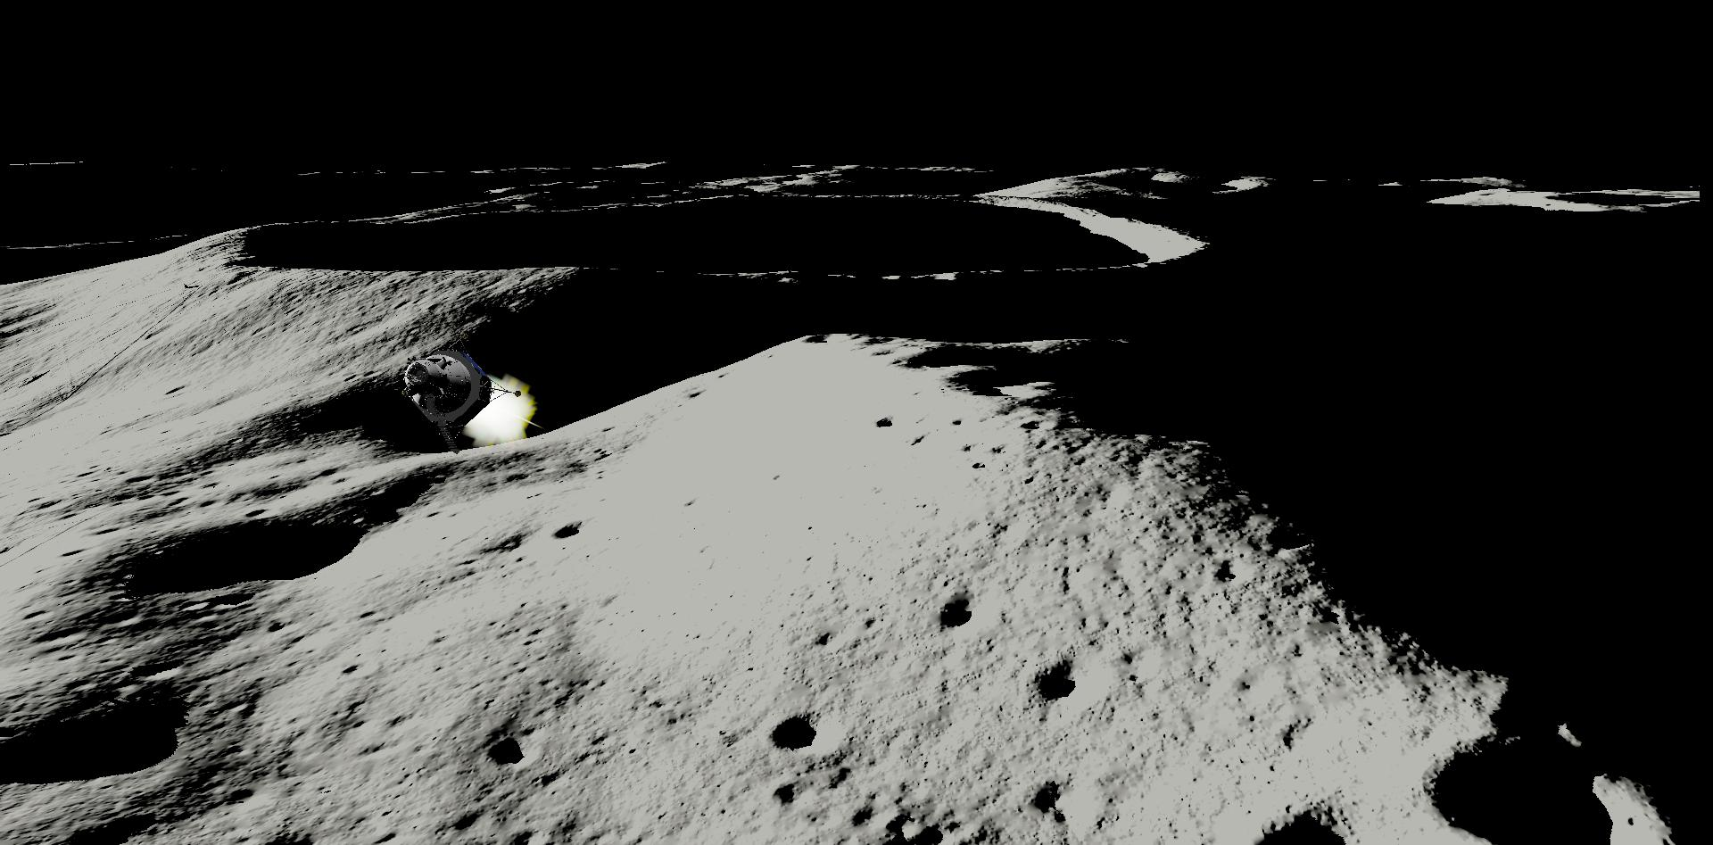
DLES In Use: Lunar Landing
Realtime Lander Simulations
NASA Artemis Program:
Human Landing Systems (HLS)

Slide 15
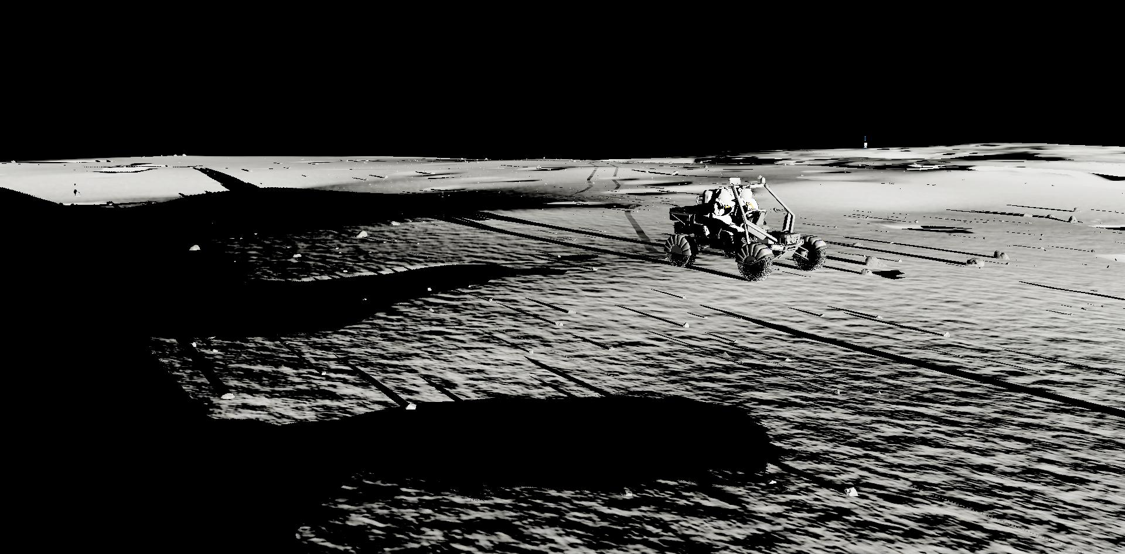
DLES In Use: Lunar Surface Exploration
Realtime Rover Simulations
NASA Artemis Program:
EVA and Human Surface Mobility (EVAHSM)

Slide 16
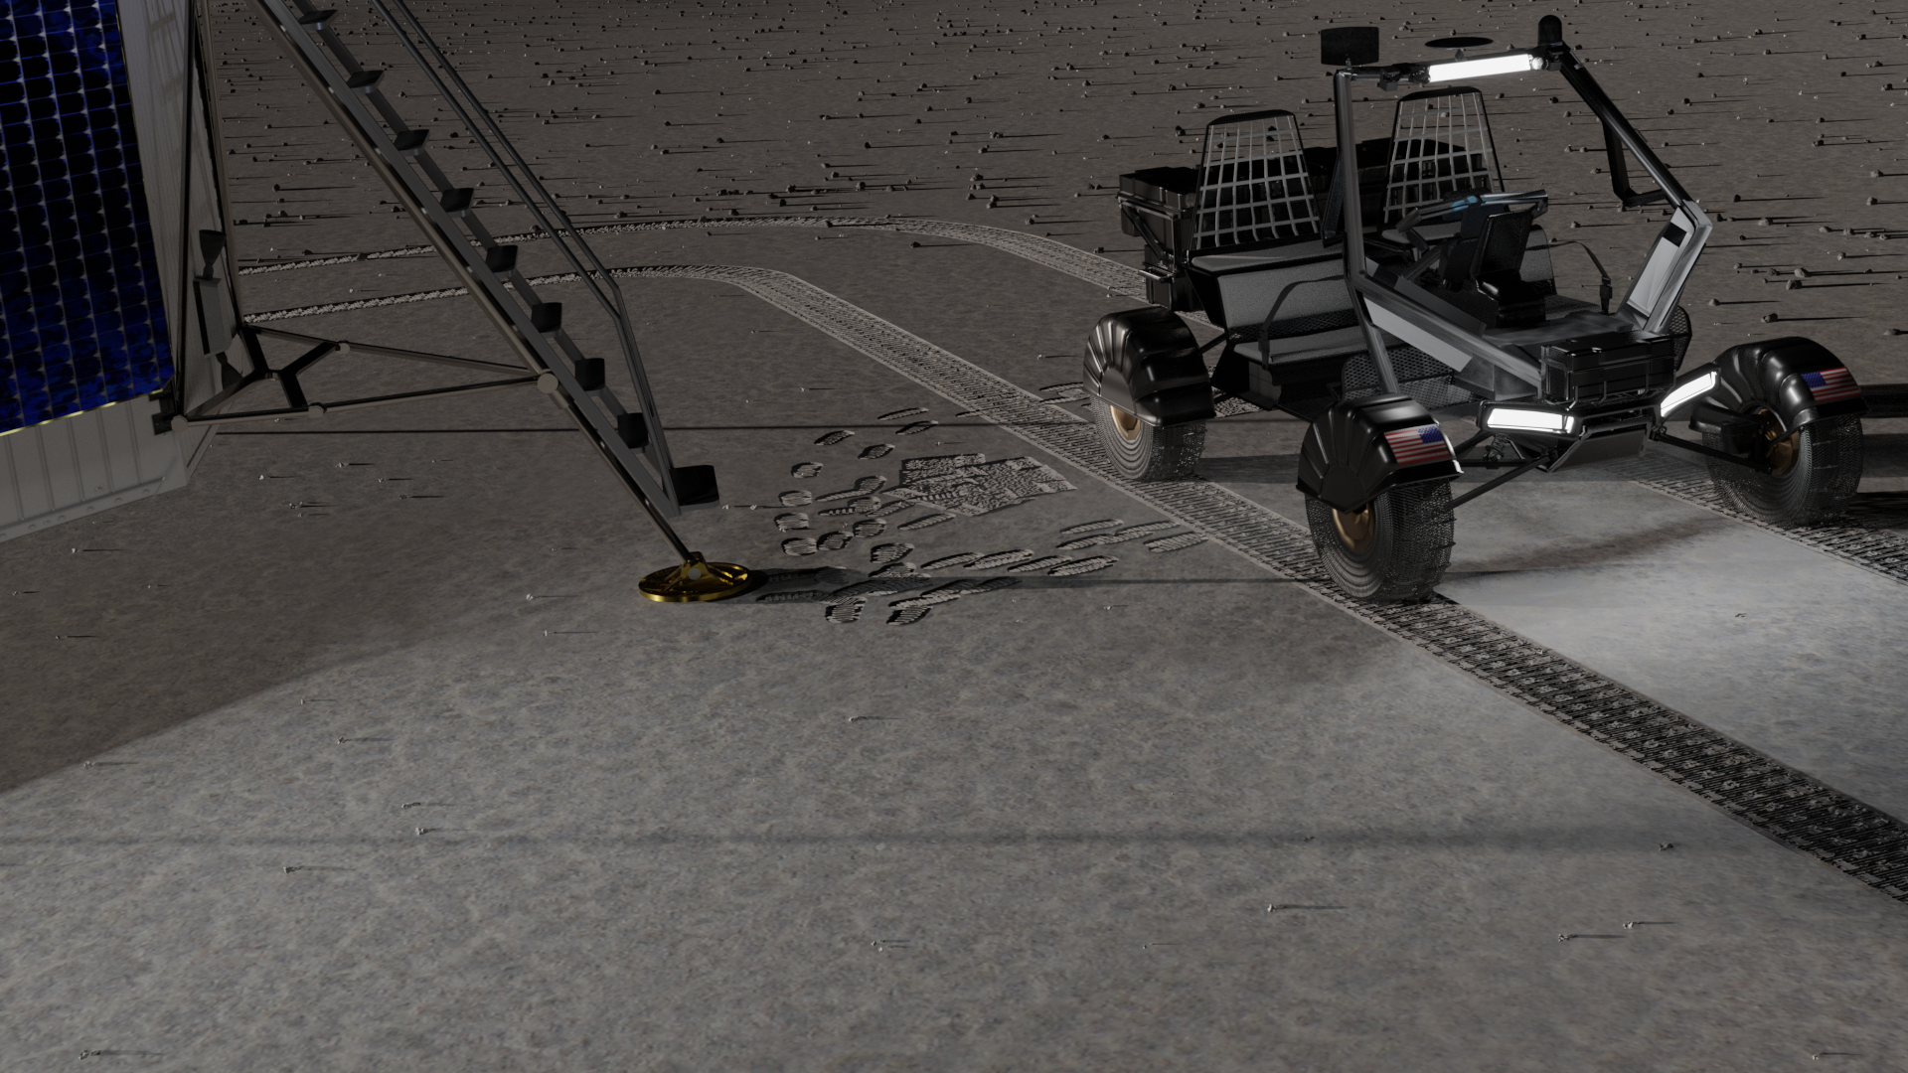
Future Work
Rover tracks
Footprints
Tools
Working with ARES
1mpp & 2mpp DEMs
PODB Development
Migrate to PostgreSQL / PostGIS
Push for public release

Slide 17
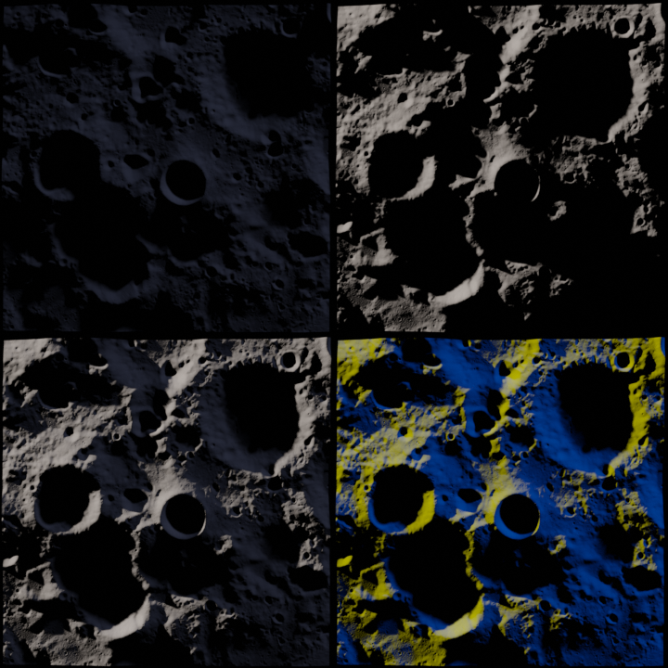
Future Work
Earth Illumination
Sun Illumination
Earthshine
Roughly 50x more powerful than a full Moon on Earth
Combined
Combined-Colored

Slide 18
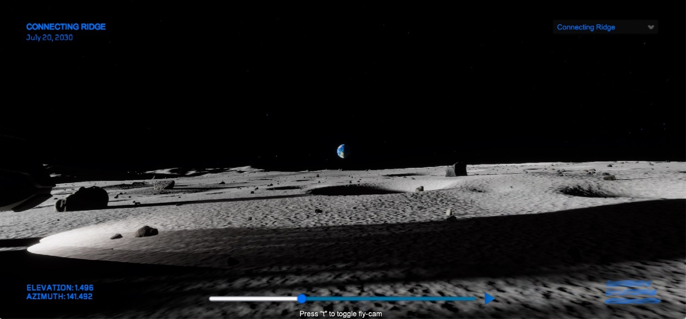
Future Work
DLES Visualization Tool (DVT)
3D site exploration tool
Unity3D based tool
Available on Windows, Mac, and Linux
Date and planetary data based on JPL Spice package

Slide 19
Conclusions
DLES provides a functional digital model of the Lunar South Pole region
Elevation data
Environmental lighting
Derived from the best available lunar data sources
Supports the ‘addition’ of higher resolution site detail
Rock distributions
Smaller craters
Supports the addition and management of ancillary data that needs to persist across simulation runs and analysis (PODB)
Footprints
Rover tracks
Exploration artifacts
Upgradeable as new and improved data sets become available

Slide 20


Questions?

Slide 22
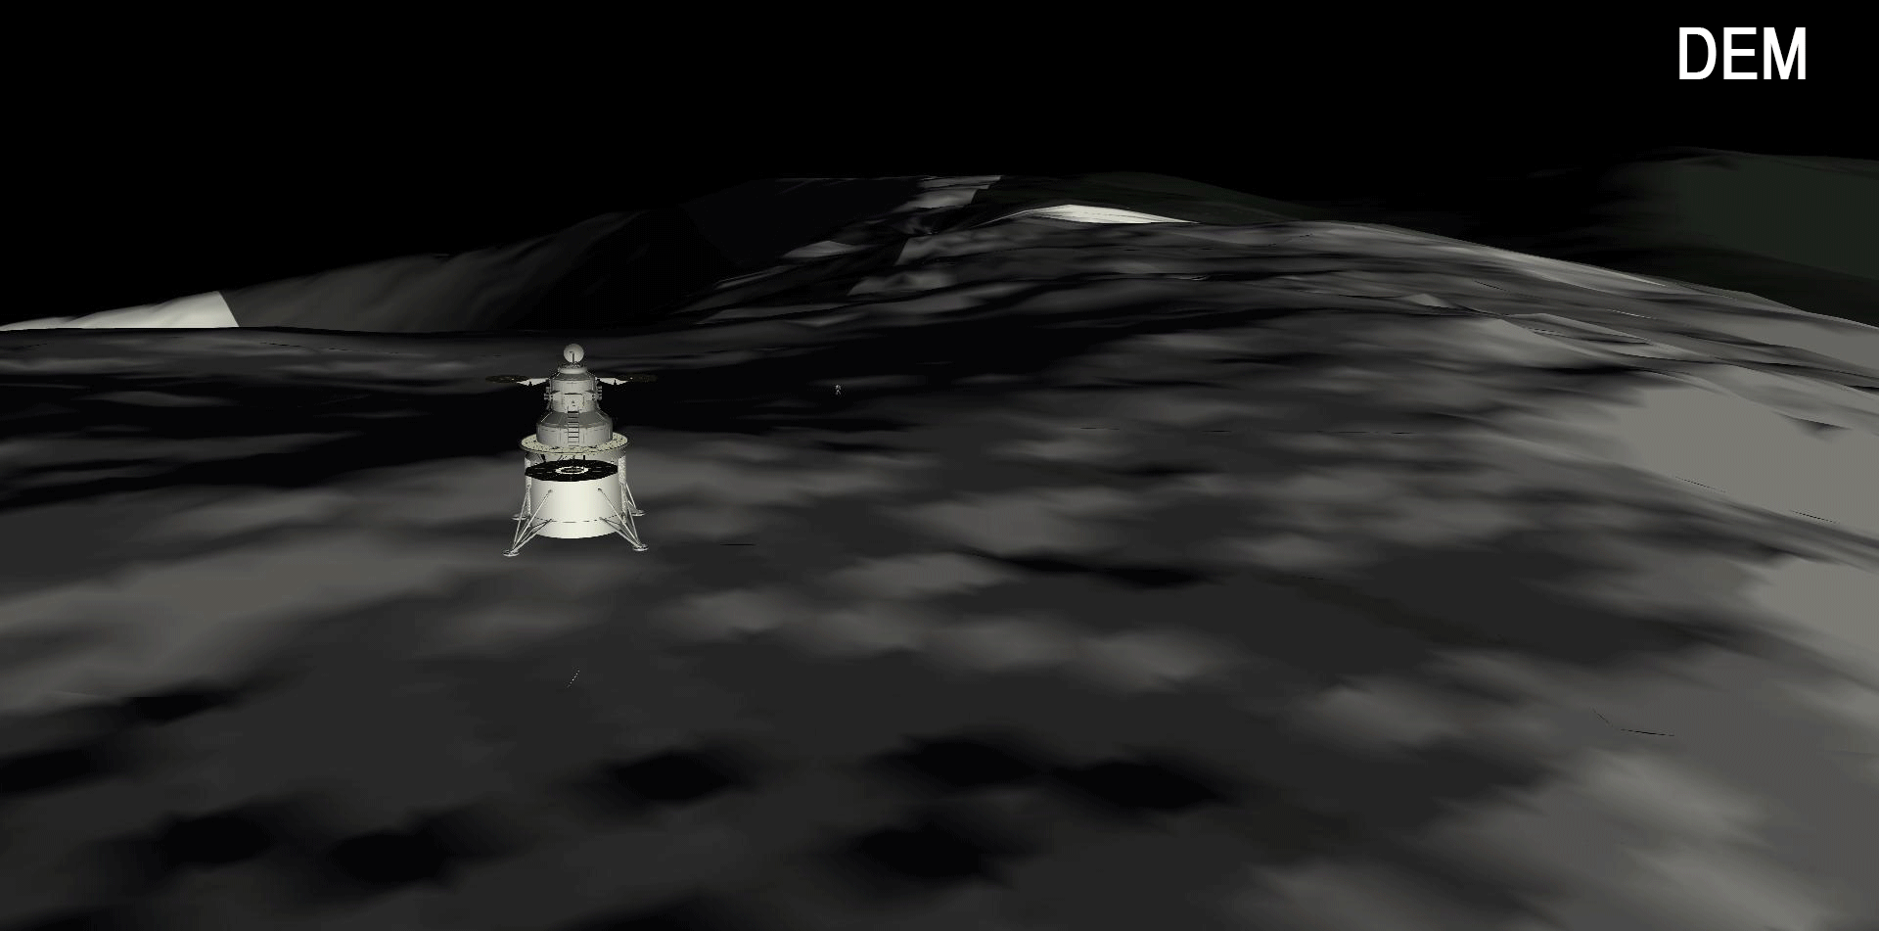
Backup

Slide 23
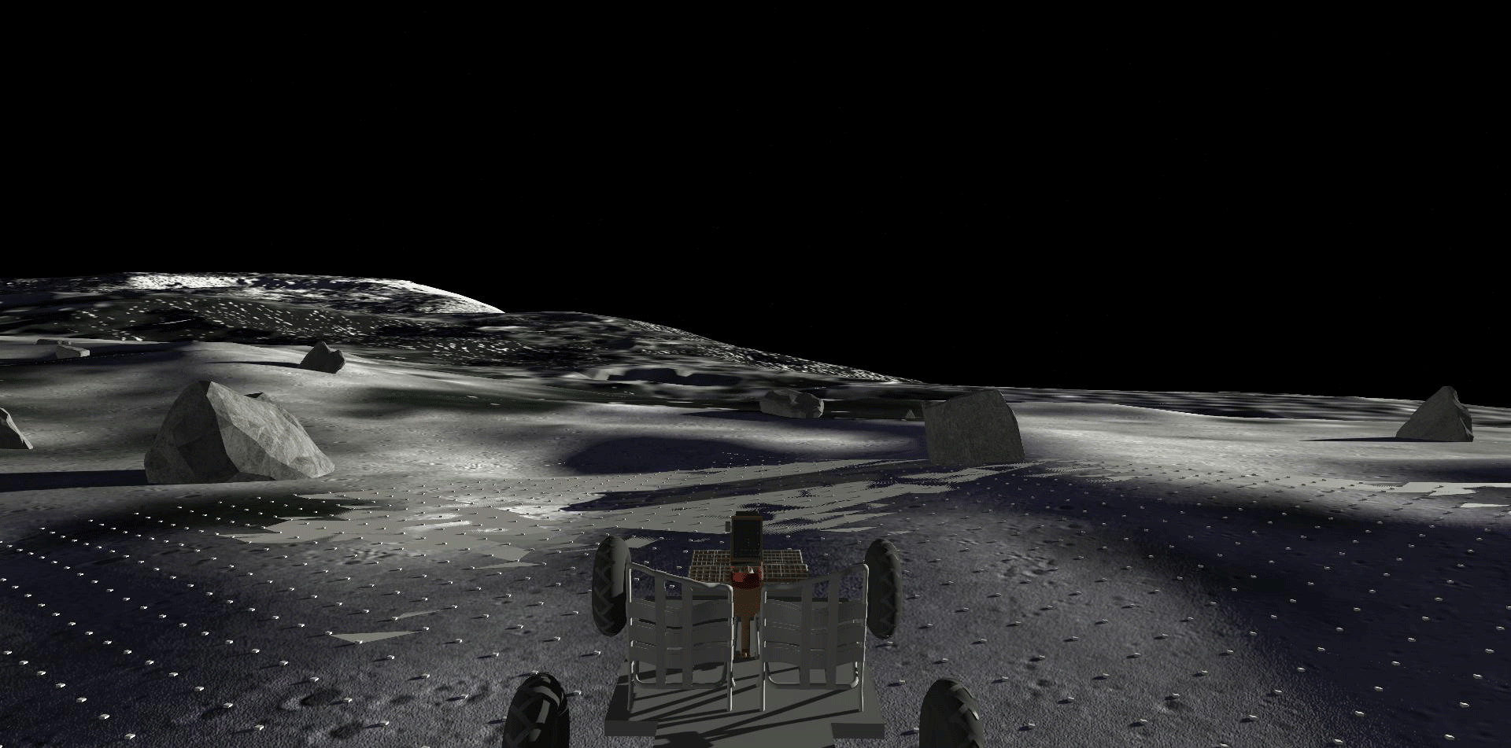
Backup

