Slide 1
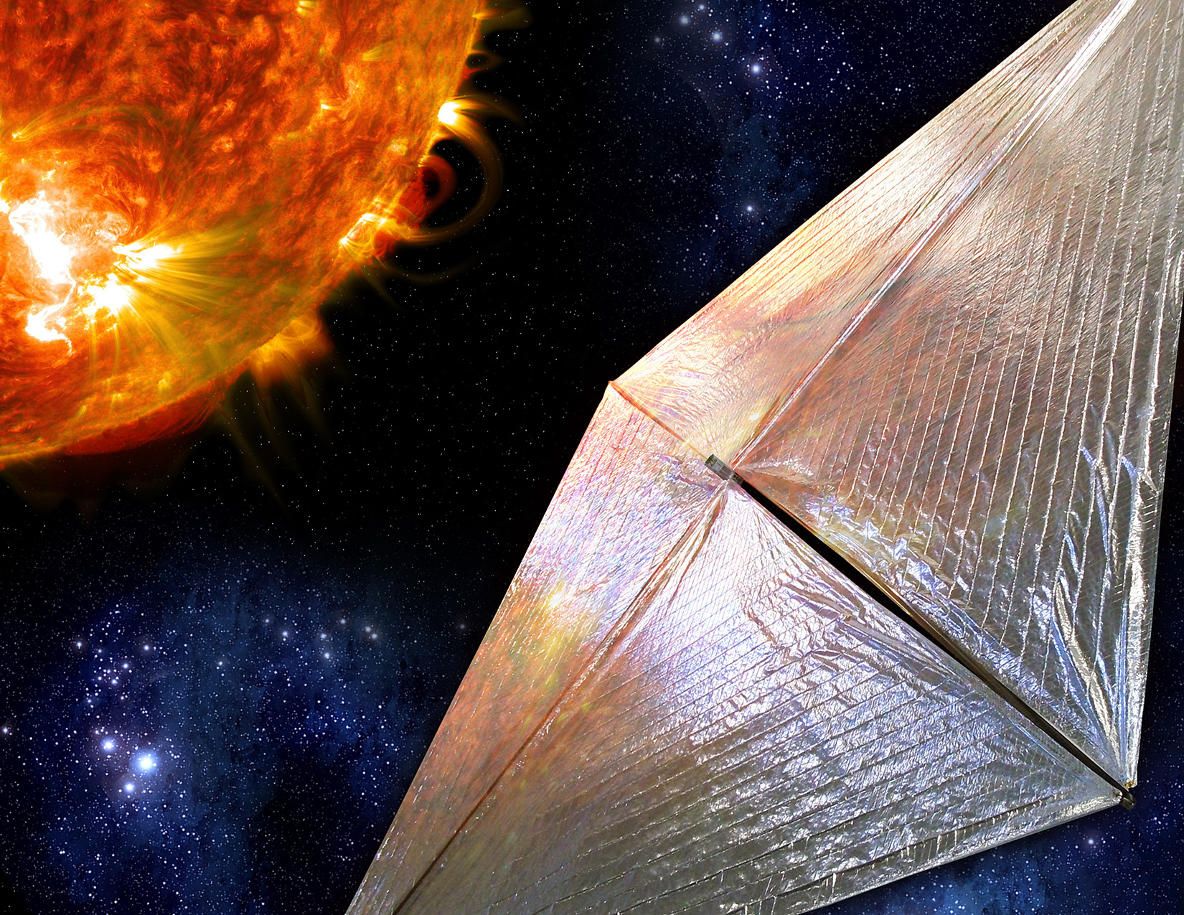



An Integrated Software Architecture for Solar Cruiser Mission Design and Navigation
Jason Everett
NASA MSFC
Guidance, Navigation & Mission Analysis Branch

Slide 2
Introduction
Problem
Solar Cruiser is a solar sailing mission, riding as a secondary payload to the Interstellar Mapping and Acceleration Probe (IMAP) mission, expected to launch in February of 2025
The extreme low-thrust nature of the solar sail will leave Solar Cruiser highly sensitive to external environmental effects (such as solar radiation pressure and high-order gravitational perturbations)
Preliminary & operational optimization routines must be intricately tied to high-order predictive propagation models to ensure the greatest possible confidence in mission success
Solution
The Solar Cruiser Mission Design and Navigation (MDNav) team has designed a software tool suite, employing the latest in software containerization technology, to accomplish this task, allowing for seamless development across several users and operating systems
The MDNav software suite itself is separated from the development and operational scripts to be used in flight, which allows for maintaining a low-footprint version control profile – thus avoiding unnecessary file bloating
Overview
The Dependency and Environment Problems
The Solar Cruiser Mission
The Solar Cruiser Software Solution
Extended Implications

Slide 3
The Dependency and Environment Problems
The Environment Problem
  Pertains to the need for maintaining an up-to-date development environment (and operating system), while still ensuring that heritage design and software tools remain compatible with these updated environments
The Dependency Problem
  The “opposite” of the problem above, which arises when several engineers plan on developing several different tool suites (all with their own use-case, build instructions, and dependencies) intended for one specific operating machine
Operational OS, No Containerization
Clash of Dependency Versions
Dependency 1, v1.0
Dependency 1, v2.0
Dependency 1, v3.0
Software Suite 1
Complex Dependency Mapping
Clash of Software Suites
Software Suite 2
Clash of OS to Dependency
Dependency 2, v1.0
Dependency 2, v2.0
Software Suite 3
Clash of Different Dependencies
Dependency 3, v1.0

Slide 4
Employing Containerization Technology
Software Containerization
A software suite is completely “packaged” with everything the suite needs to run (dependencies/libraries, a low-level OS kernel, etc.)
A software suite can be executed completely independent of the main operational environment, so long as that said operational environment has the proper container management software installed
Operational OS, Containerization
Image 2
D1, v2
SS2
Container 2
Image 1
Image 3
D1, v1
D2, v1
D2, v2
SS1
D2, v2
SS3
D3, v1
D1, v3
Container 1
Container 3
Container Management Layer

Slide 5
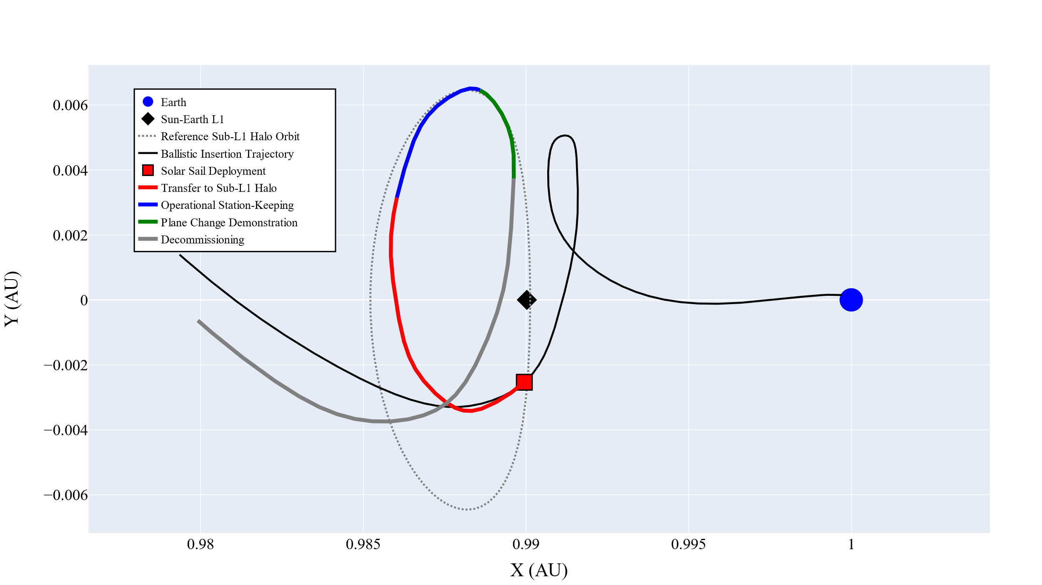
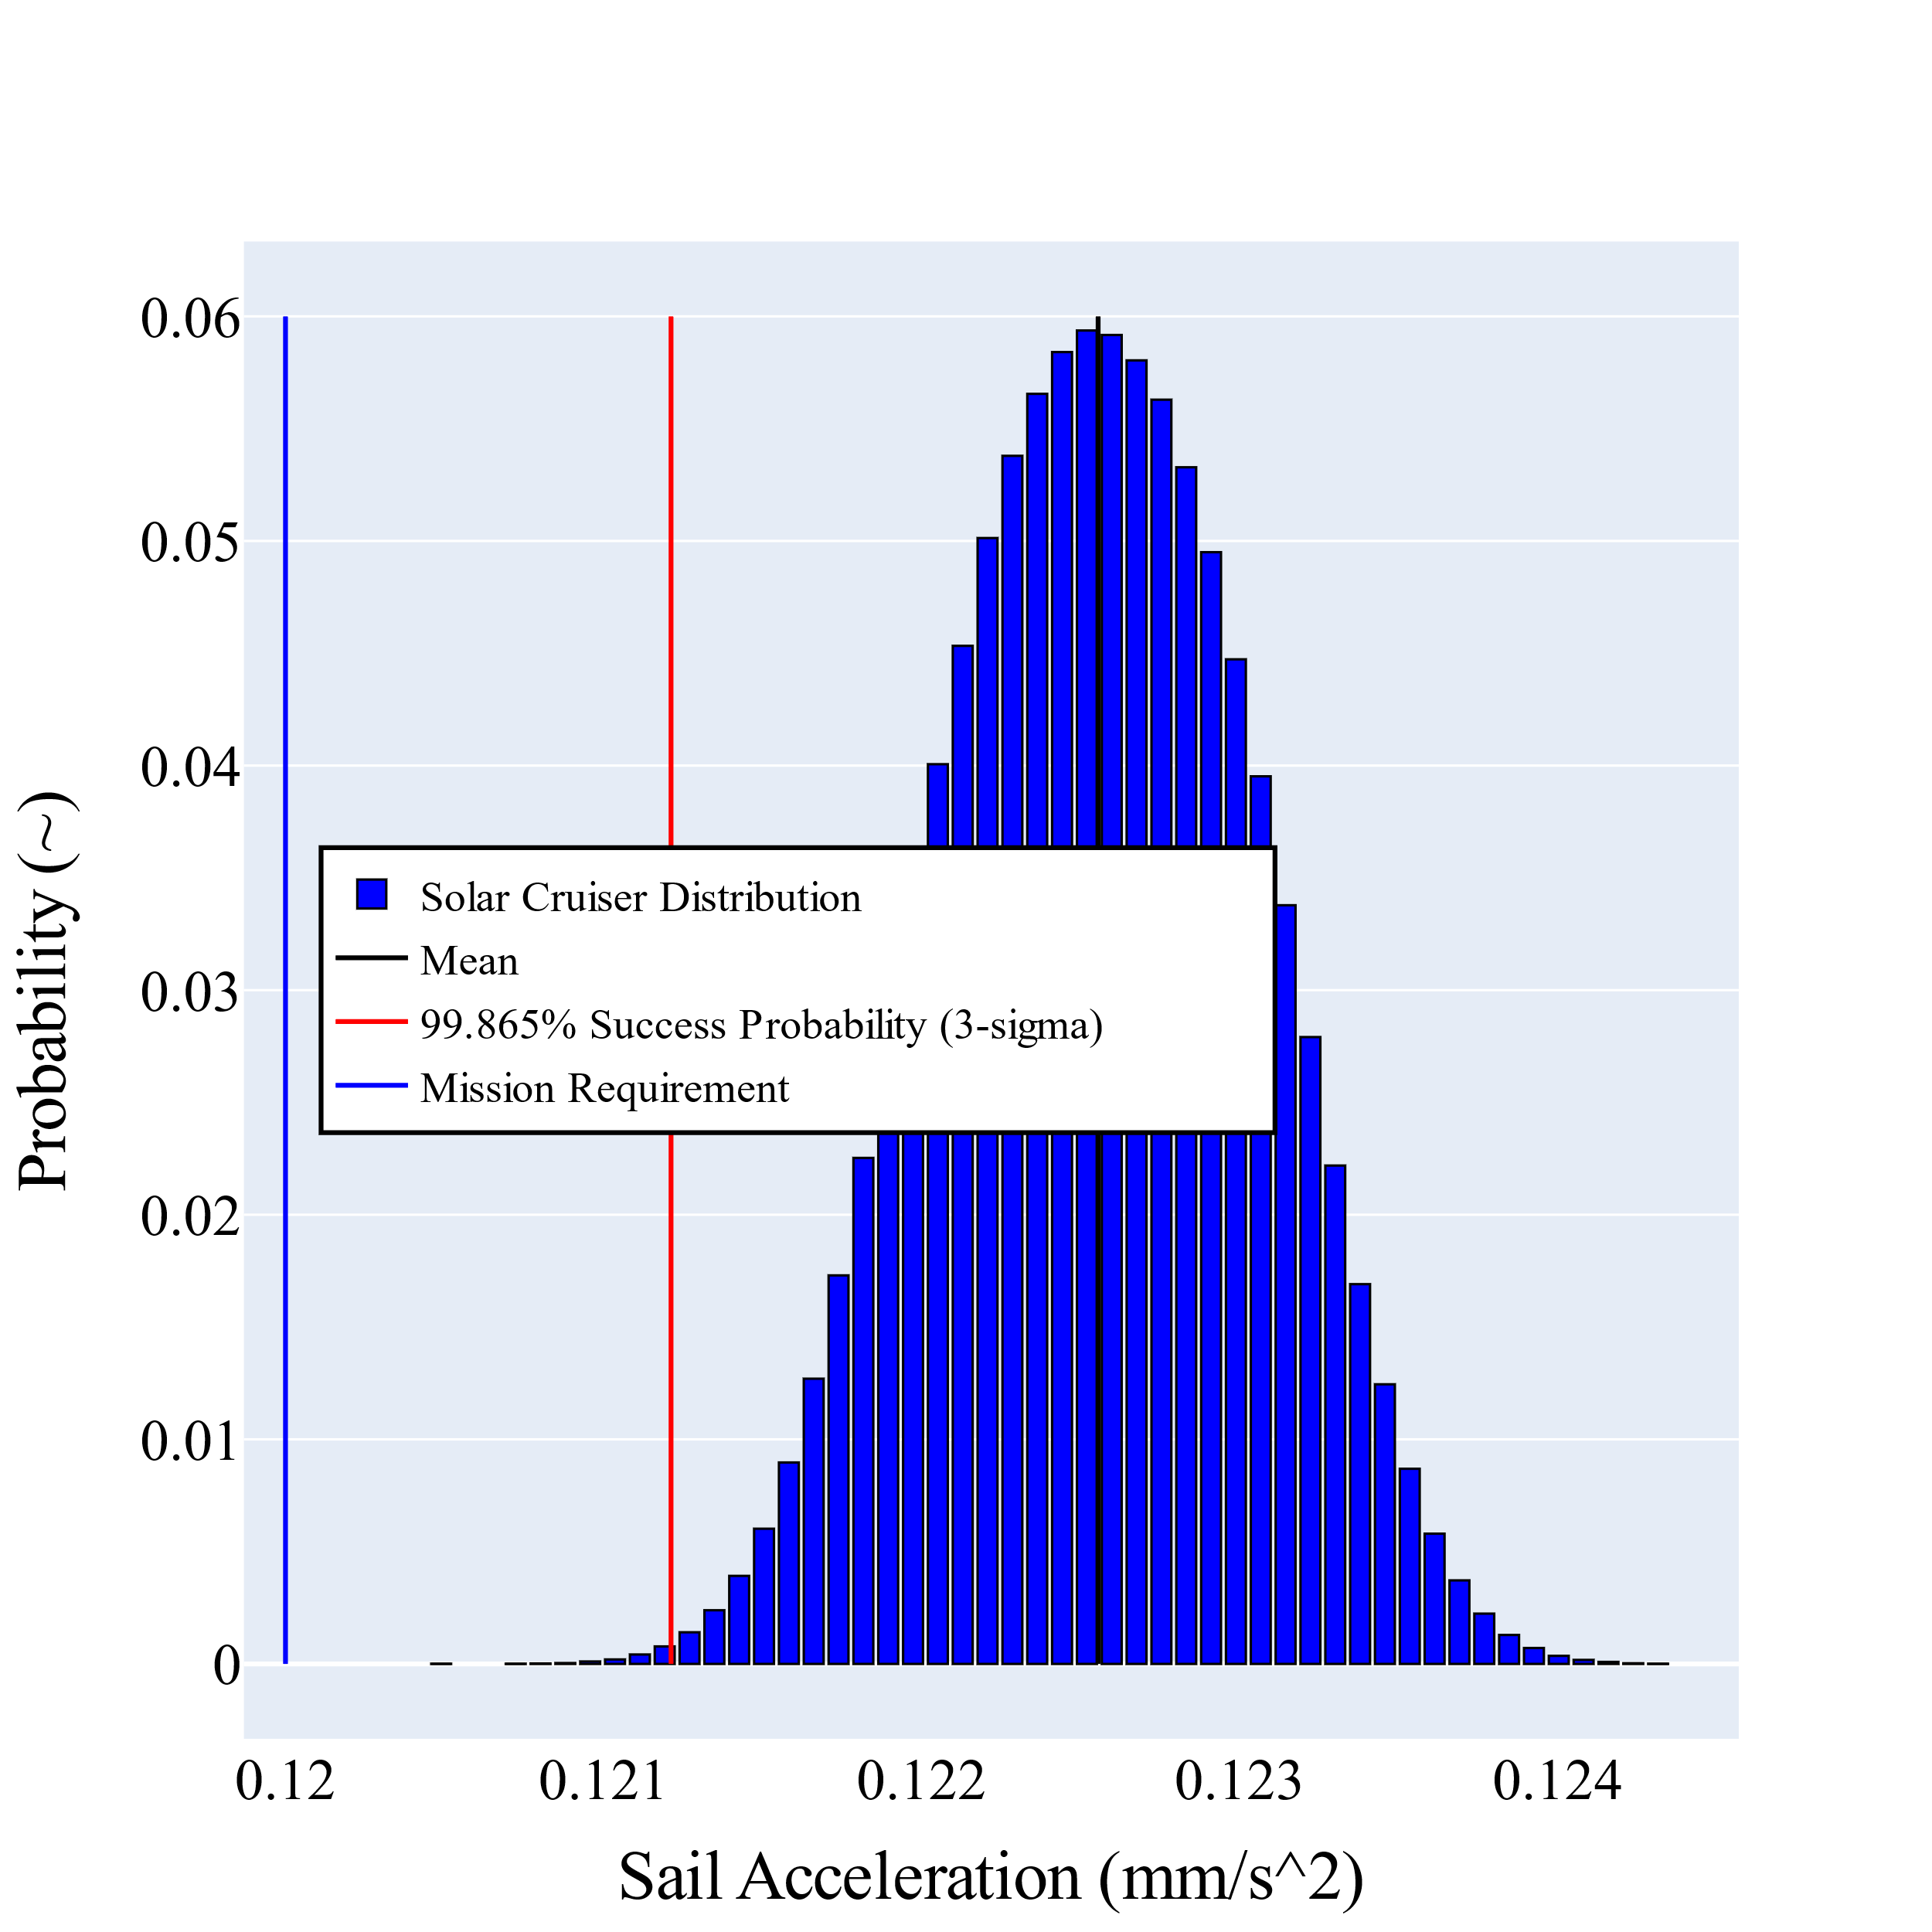
The Solar Cruiser Mission

Slide 6
The Solar Cruiser Software Solution
MDNav Tool Suite, Heritage
MDNav Tool Suite, Current
Lengthy Dependency Installs
Doc Image
Port Forwarding
Access on local machine via localhost:<port>
Visual Studio 2019
Optimization Software
Documentation
Doc
Doc
Port Forwarding
LLVM
Optimization Code Repository
Container 2
Python v3.8
Dev Image
OS
M
Operational Code
Dependency Clashing
Repository Mangling
Operational Code
Python v3.7
OD/Nav Code Repository
Mounted
LLVM
Python v3.7
Container 1
Monte Tool Suite
Limited User Access
Local
Several other Dependencies
Documentation
Docker Engine
Remote SSH

Slide 7
Extended Implications
Low-level maintenance
  If an update occurs to one of the Linux machines that would require a re-installation of Monte into Linux, Docker can be installed onto the Linux machine and the MDNav tool suite images would instantly become compatible with the Linux machines
Report distributions
  An image could be constructed that contains a minimalistic web server
  Allows users across NASA to instantly view the reports or documentation
    Documentation updates could even be automated through a CI/CD pipeline
Future Tools
  If other complex mission design or navigation tools are required in future design phases or operational phases of Solar Cruiser, they could either be added to the same development image that has already been created or added to an entirely new image and distributed to the team

Slide 8

Any Questions?
The Solar Cruiser Mission Design and Navigation Team
  Jason Everett (team lead)
  Aaron Houin
  Andy Heaton
  Kyle Miller
  Dr. Sood (University of Alabama Space Act Agreement)
References
[1] Lugo, R, et. al., “Launch Vehicle Ascent Trajectory Simulation using the Program to Optimize Simulated Trajectories II (POST2)”, 2017 AAS GNC Conference, Breckenridge, CO, AAS 17-274.
[2] Murri, D., et. al., “Improvements to the Copernicus Trajectory Design and Optimization System for Complex Space Trajectories”, 28 February 2019, NASA/TM 2019-220247.
[3] J. S. Hale, L. Li, C. N. Richardson and G. N. Wells, "Containers for Portable, Productive, and Performant Scientific Computing," in Computing in Science & Engineering, vol. 19, no. 6, pp. 40-50, November/December 2017, DOI 10.1109/MCSE.2017.2421459.
[4] Pezent, J. B., et. al., “Preliminary Trajectory Design for NASA’s Solar Cruiser: A Technology Demonstration Mission”, June 2021, Acta Astronautica, Volume 183, DOI 10.1016/j.actaastro.2021.03.006.
[5] McInnes, Collin, “Solar Sailing: Technology, Dynamics and Mission Applications”, 1999, DOI 10.1007/978-1-4471-3992-8
[6] Thomas, Dan, et. al., “Solar Polar Imager Concept”, 16 November 2020, AIAA Ascent Virtual Conference, DOI 10.2514/6.2020-4060
[7] Smith, J., et. al., “MONTE Python for Deep Space Navigation”, 2016, 15th Python in Science Conference.
[8] Pezent, J. B. et., al., “ASSET: Astrodynamics Software and Science Enabling Toolkit”, January 2022, AIAA SciTech Conference
[9] Boettiger, Carl. "An introduction to Docker for reproducible research." ACM SIGOPS Operating Systems Review 49.1 (2015): 71-79.
[10] Docker Compose. https://docs.docker.com/compose/

