Slide 1
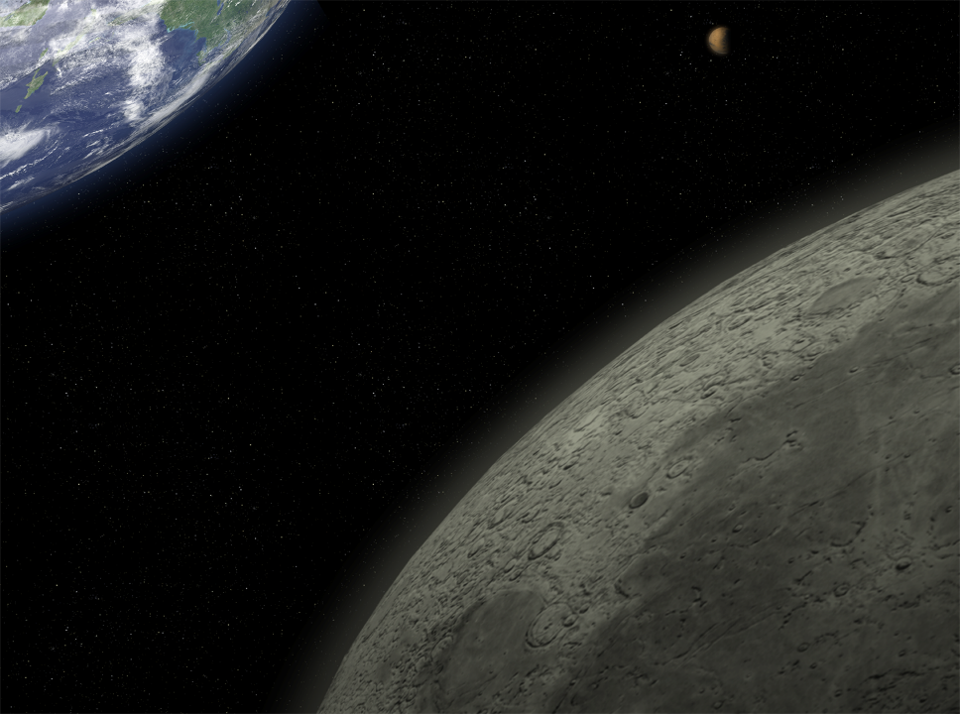

Supporting Life in Space:
Waste Management
John A. Hogan, Ph.D.
Bioengineering Branch
NASA Ames Research Center

Slide 2
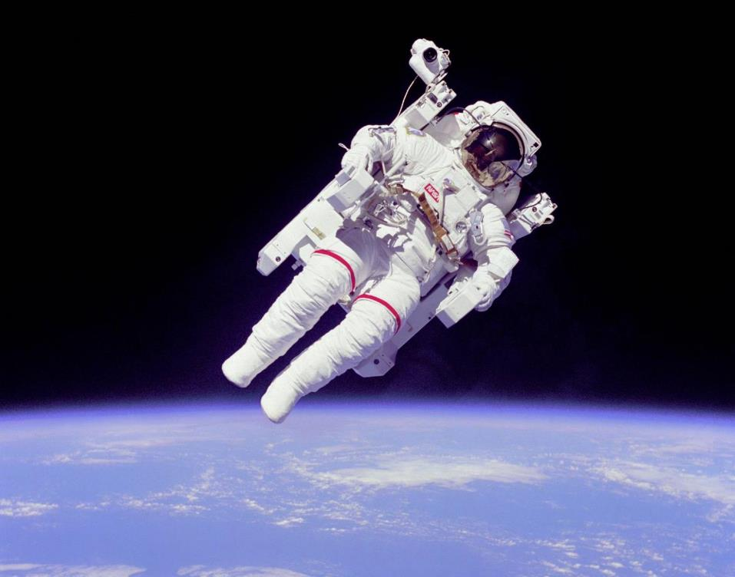
Temperature
Radiation Protection
Air
Food
Waste Removal
Water
Gravity
Pressure

Slide 3


Earth’s Life Support Systems (ELSS)
Physical/Chemical Properties & Processes
Resource diversity/distribution/cycling
Radiation protection – Earth’s core
Proper gravitational field
Stable rotation
Proper solar radiation levels
Proper atmospheric pressure

Slide 4
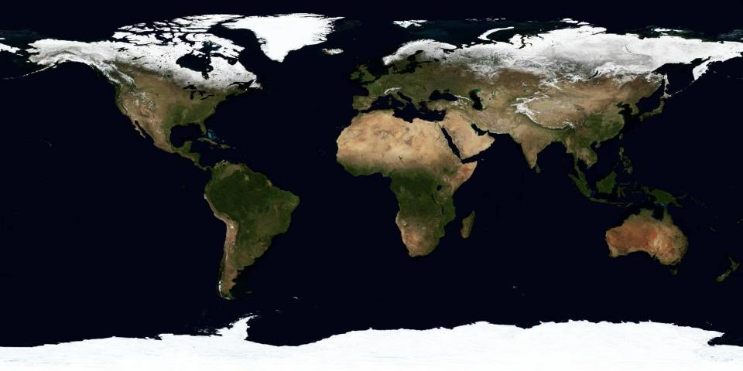
Earth’s Ecosystem Services
Water/waste
purification
Air quality
regulation
Aesthetic/Spiritual values
Recreation/Ecotourism
Crops,
Livestock,
Fisheries
Aquaculture
Wild foods
Climate
regulation
local
Erosion
regulation
Genetic
resources
Water
regulation
Fresh
water
Pollination
Timber,
Cotton, Hemp, Silk
Wood fuel
Climate
regulation
global
Biochemicals,
natural medicines,
pharmaceuticals
Pest
control
Disease
regulation
Natural hazard
regulation
Source: Millennium Ecosystem Assessment
United Nations Environment Programme (2005)

Slide 5
Human Life Support Systems
Government
Defense
Education
Transportation
Communications
Industry
Manufacturing
Energy Production
Housing
Sciences
Medicine
Finances
Waste Management
Fishing
Agriculture
Water Treatment

Slide 6


Slide 7
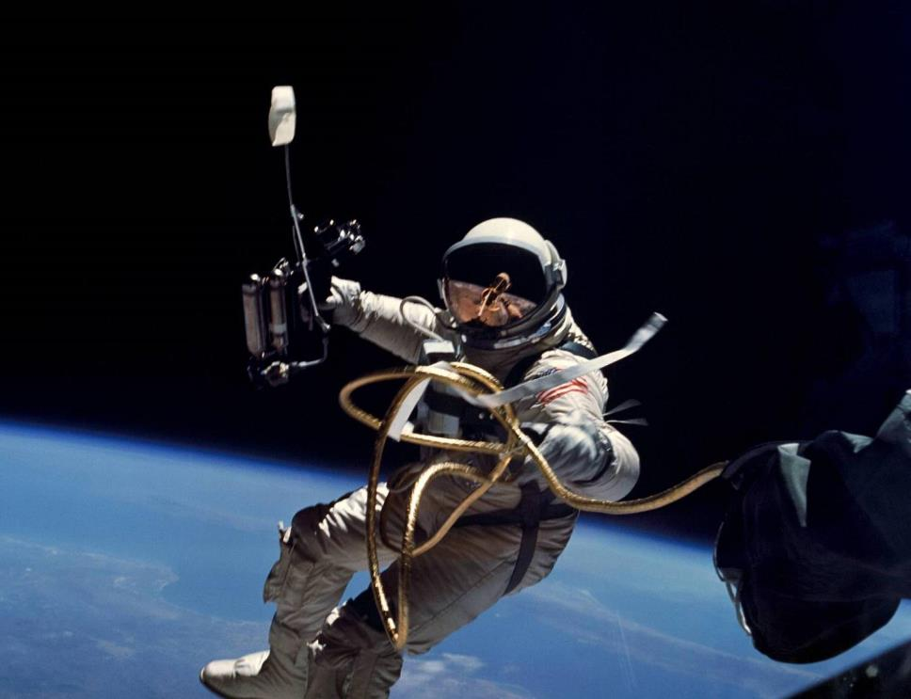
Human Space Exploration

Slide 8
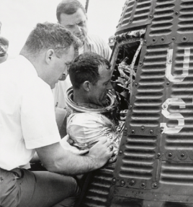
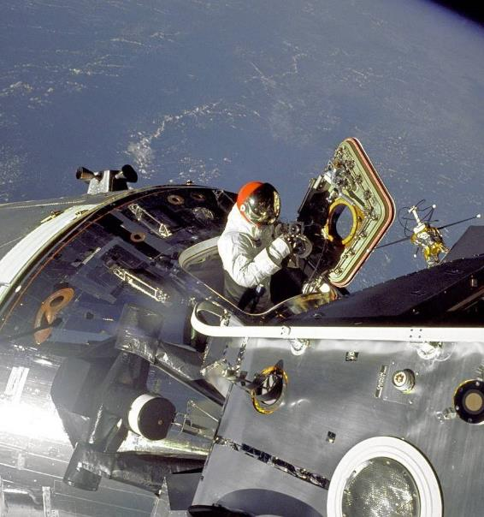
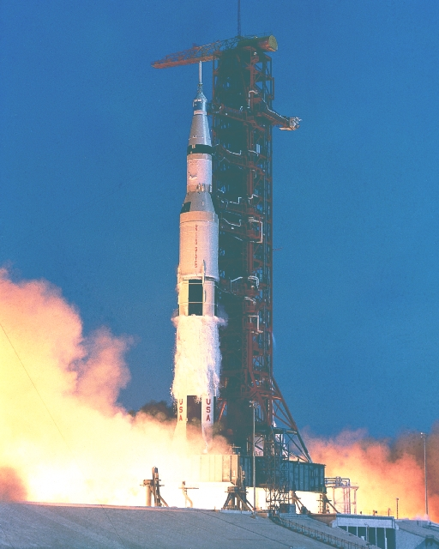
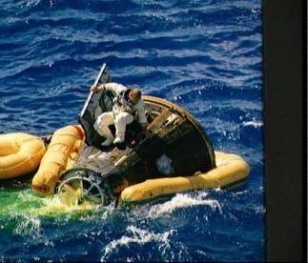
Early Missions
Mercury
Apollo 11
Apollo
Gemini

Slide 9
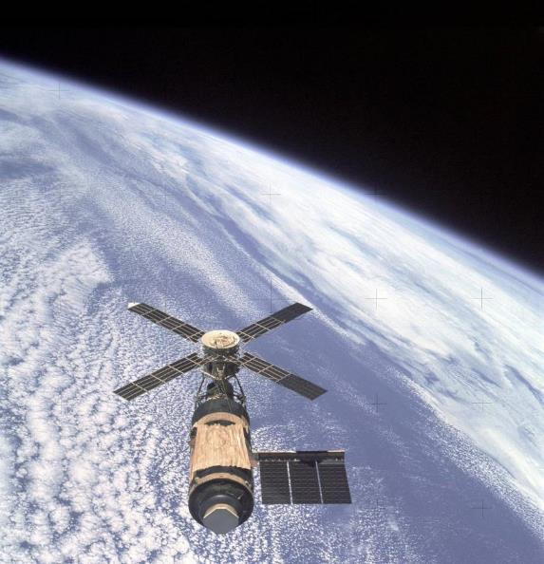
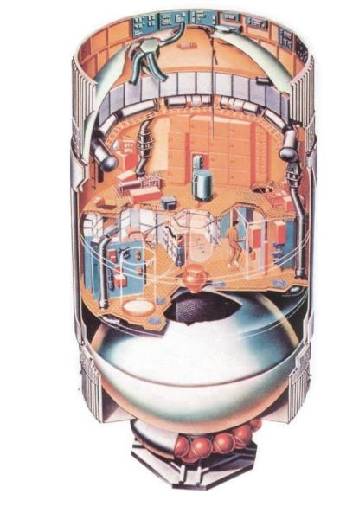
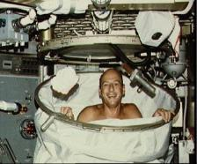
SKYLAB
1973-74
3 Missions - 28, 59, 84 days
Refuse Tank - ~ 80 m³
^{(vented to space vacuum)}

Slide 10
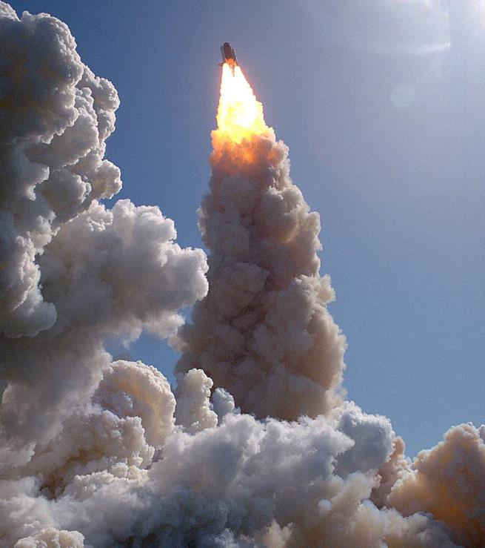
STS

Slide 11
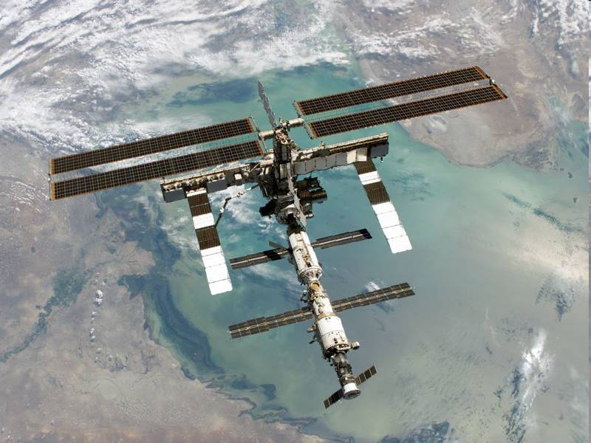
ISS

Slide 12
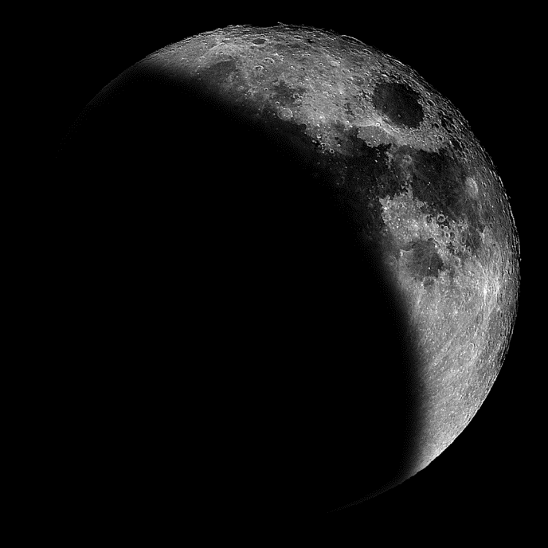
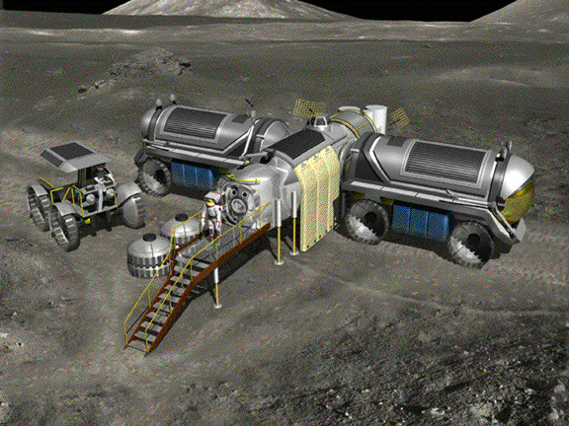
Luna

Slide 13
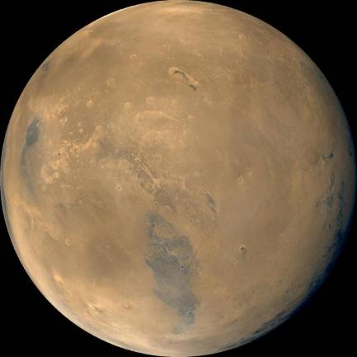
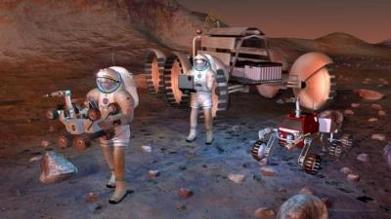
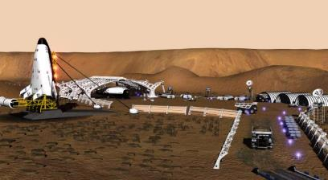
Mars

Slide 14
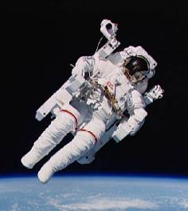
Life Support Requirements
Mass Breakdown
(Per Person-Day)
DAILY INPUTS - NOMINAL
DAILY OUTPUTS - NOMINAL
kg
kg
Oxygen 0.84
Food Solids 0.62
Water in Food 1.15
Food Prep Water 0.79
Drink 1.62
Hand/Face Wash Water 1.82
Shower Water 5.45
Clothes Wash Water 12.50
Dish Wash Water 5.45
Flush Water 0.50
TOTAL 30.74
Carbon Dioxide 1.00
Respiration and 2.28 Perspiration Water
Urine 1.50
Feces Water 0.09
Sweat Solids 0.02
Urine Solids 0.06
Feces Solids 0.03
Hygiene Water 6.68
Clothes Wash Water 11.90
Clothes Wash 0.60 Latent Water
Other Latent Water 0.65
Dish Wash Water 5.43
Flush Water 0.50
TOTAL 30.74
5.02 - 30.74 kg per person-day
11.3 Metric Tons Per Person-Year

Slide 15
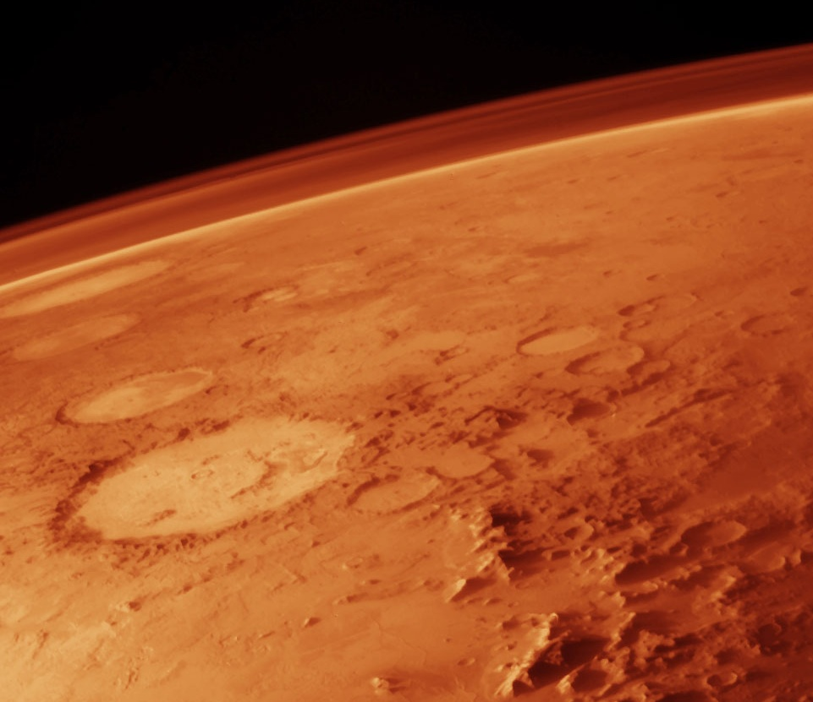
Atmosphere Management

Slide 16
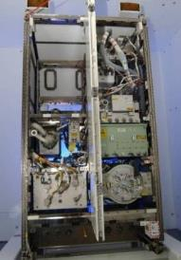
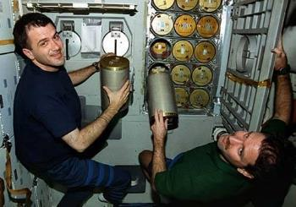
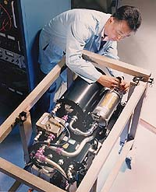
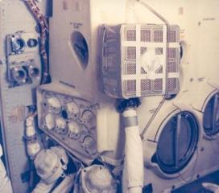
Air Revitalization
O₂ Generation
CO₂ Removal
Contaminant Control
Particulate Control

Slide 17
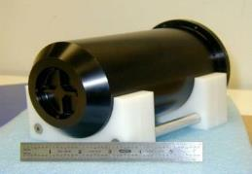
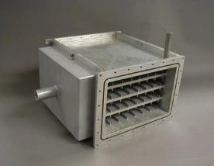
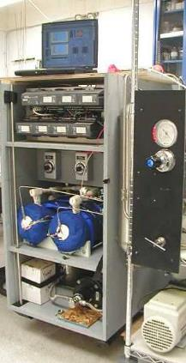
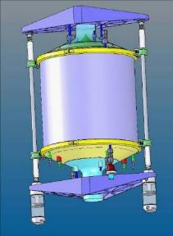
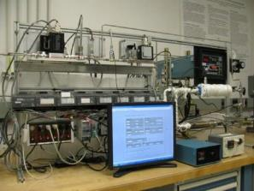
CO₂ Capture and Sequestration

Slide 18
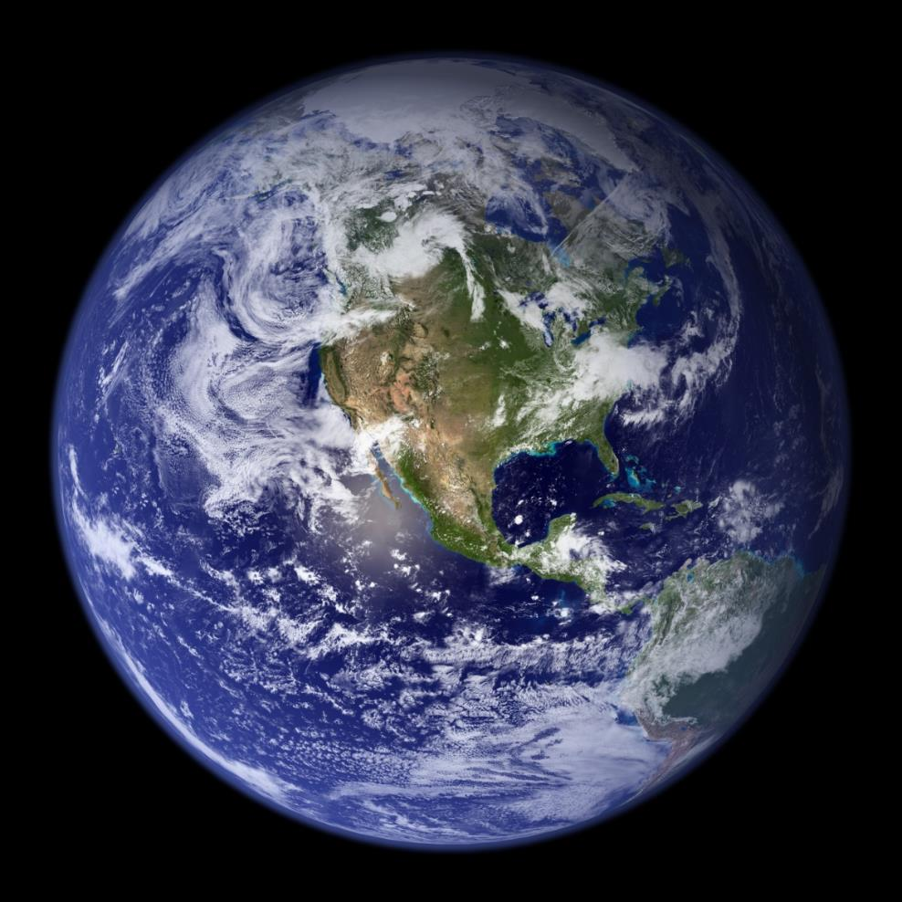


CO₂-Based Manufacturing: Spaceship Earth
FEEDSTOCK
ENERGY
PROCESSING
PRODUCTS
Oxygen
Food
Wood
Fiber
Oil
Coal
Natural gas
etc…
Sun
Photosynthesis

Slide 19
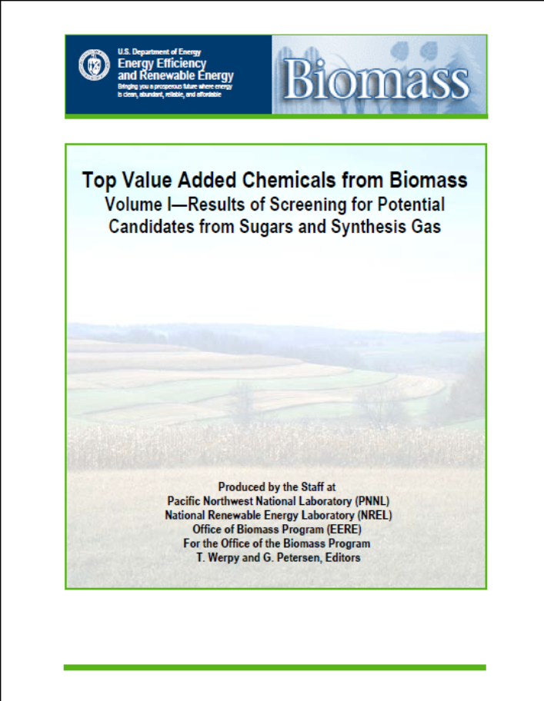
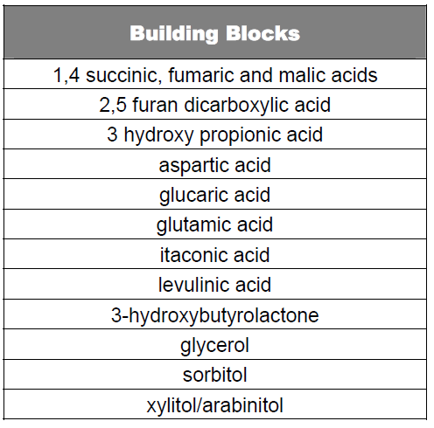
DOE “Top 10” Biomass Building Blocks
From: Top Value Added Chemicals from Biomass Vol.1. US DOE 2004

Slide 20
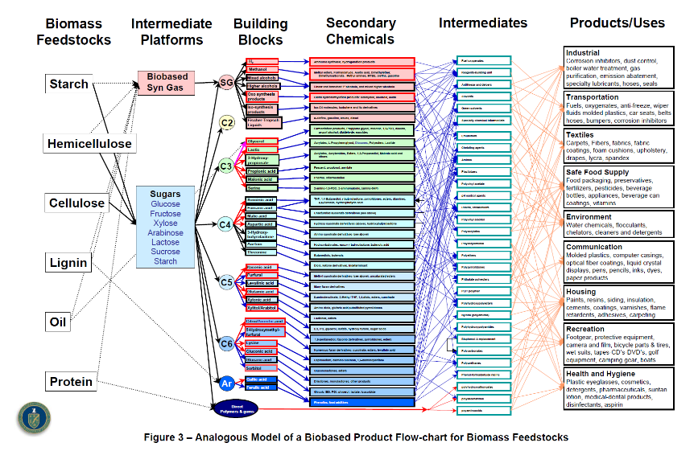


Biomass-Based Feedstocks
From: Top Value Added Chemicals from Biomass Vol.1. US DOE 2004

Slide 21
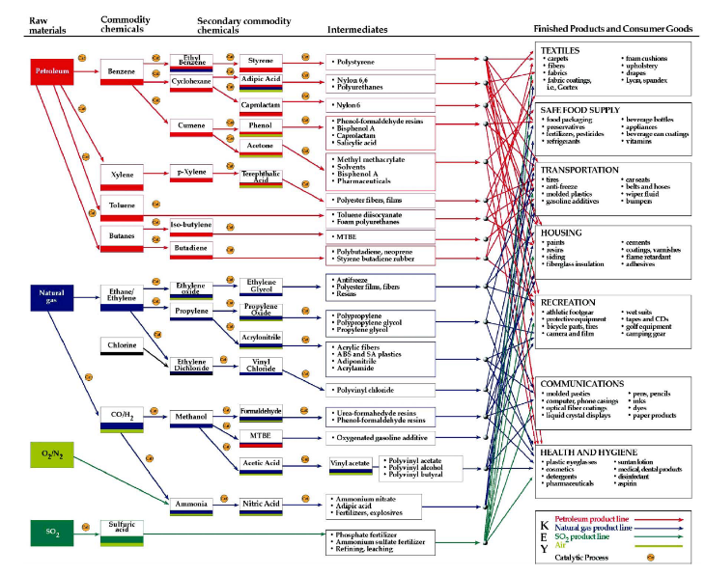


Petroleum-Based Feedstocks
From: Top Value Added Chemicals from Biomass Vol.1. US DOE 2004

Slide 22
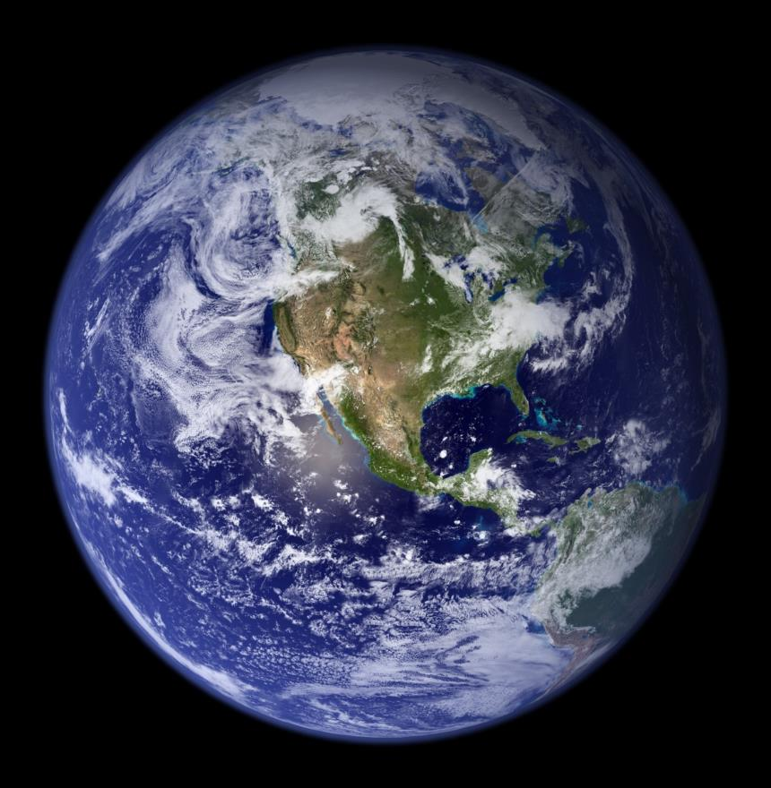
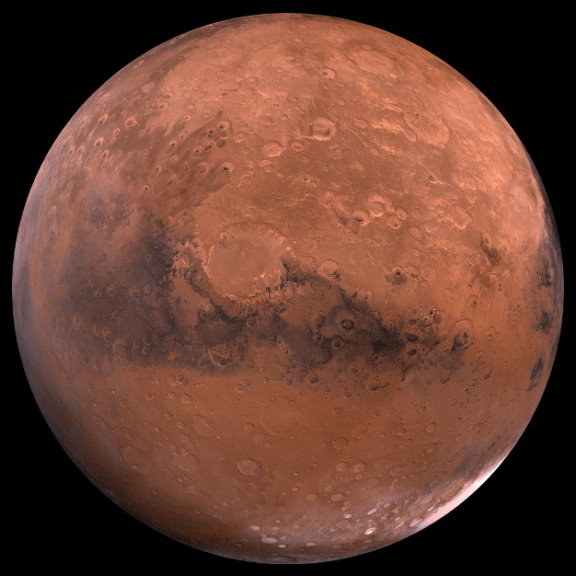


CO₂-Based Manufacturing: REMADE
FEEDSTOCK
ENERGY
PROCESSING
1º PRODUCTS
Photosynthesis (PS)
Re-engineered PS
Non-PS biological
Bioelectrochemical
Catalysis
Electrochemical
Photochemical
Photoelectrochemical
Plasma
Enzymatic
Fixation to carbonates
Sun
Nuclear
Future Advances
Building
blocks for
manufacturing
Wind
Geothermal
Hydroelectric

Slide 23
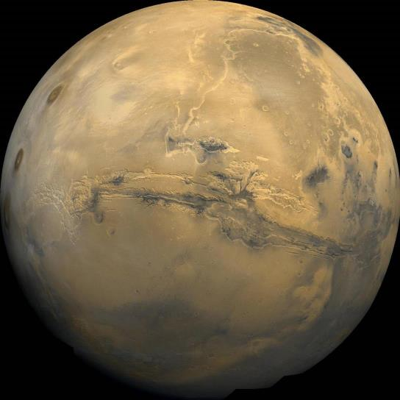
Water Treatment

Slide 24
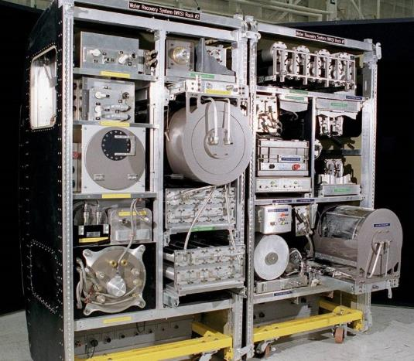
ISS Water Recovery Subsystem
Wastewater to Drinking Water
Disinfection
Organic Removal
Inorganic Removal
Maximize Recovery

Slide 25
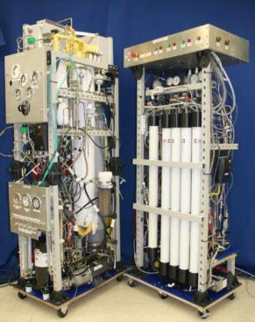
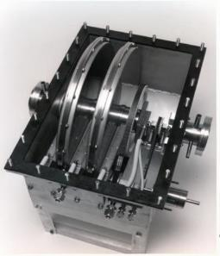
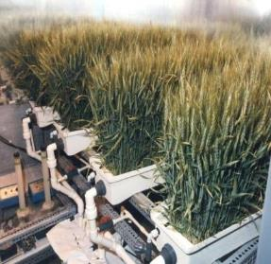
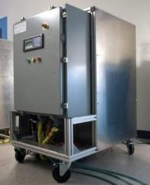
Closed-Loop Water Treatment
Notes:
Objective: Develop a flexible, membrane-based water recovery system that, coupled with a catalytic post-treatment system, will produce potable water.
Technology Description:
The direct osmotic concentration (DOC) system is a highly integrated membrane treatment process for reclamation of spacecraft wastewater. It incorporates forward osmosis (FO), membrane evaporation process, reverse osmosis (RO) desalination, and a catalytic oxidation post-treatment. The system is designed to accept separated hygiene, urine, and humidity condensate wastewater streams and produce a potable quality product.

Slide 26
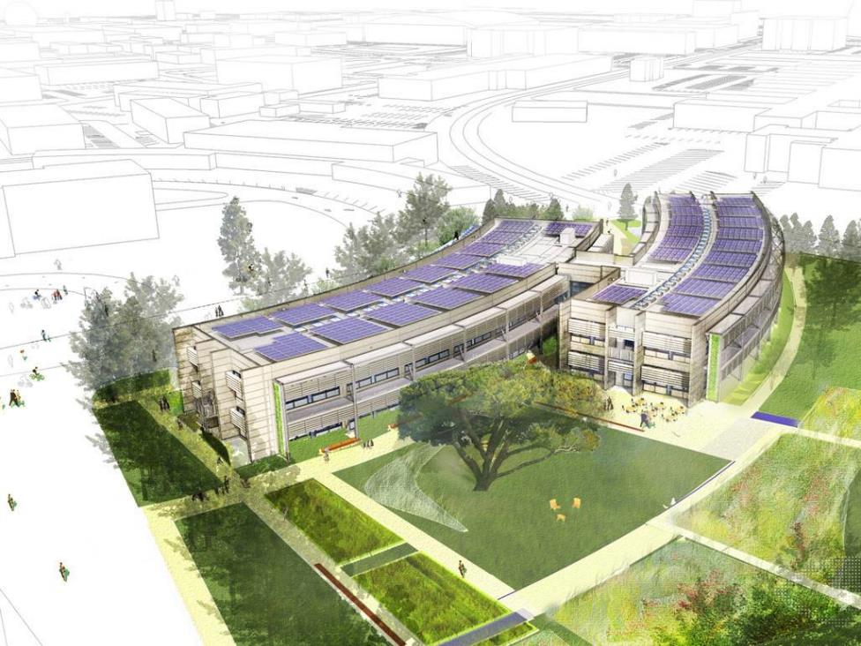
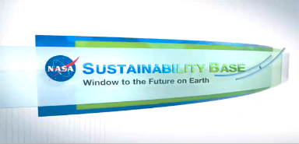

Project Goals:
Zero net energy consumption
Reduce water use > 90%
Significantly reduce building maintenance

Slide 27
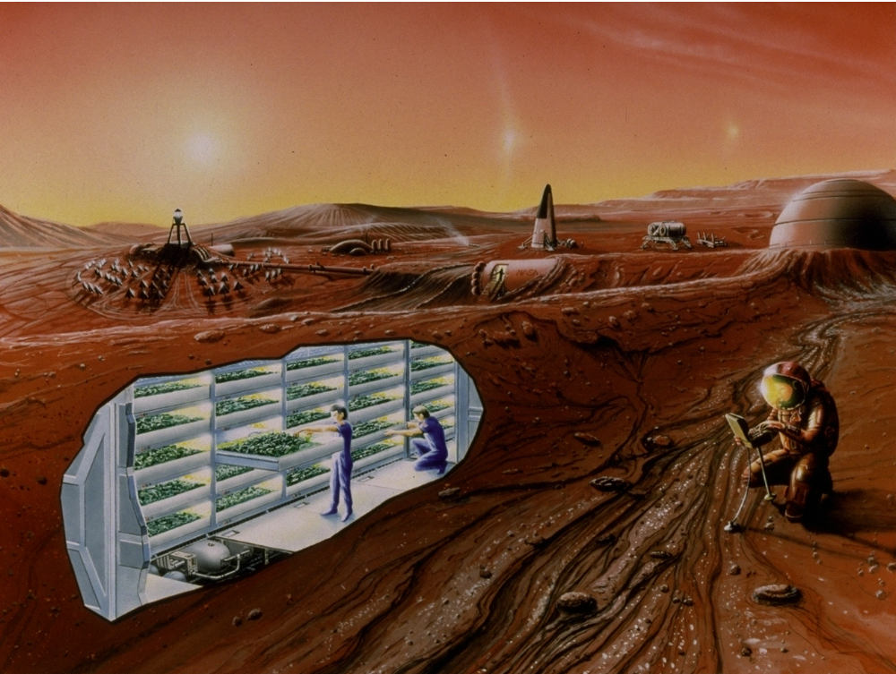
Food Production

Slide 28
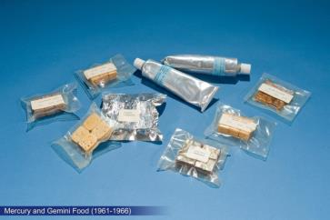
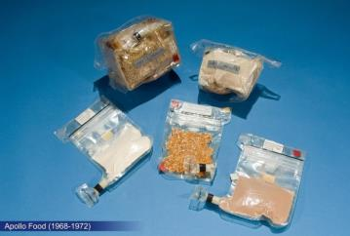
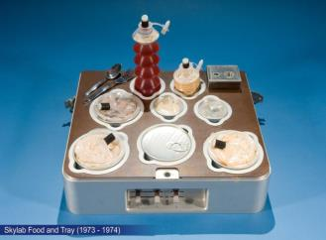
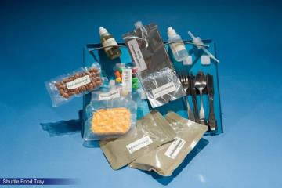
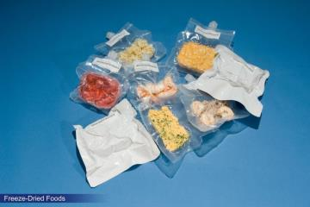





Slide 29




Closed System Agriculture
Maximize Yield
Low Water
Efficient Lighting
Use recovered
nutrients

Slide 30

Waste Management

Slide 31

Apollo CM Temporary Trash Stowage Bags
Notes:
VW Bags
The temporary stowage bags are used for temporary stowage of small items and permanent stowage of dry refuse or "trash". The waste bag, nicknamed the "VW" bag, is a two-pocket unit. The outer pocket is deep, about 3 feet by 1 foot by 3 inches and is held shut by a bar spring. The inner pocket is flat, about 1 by 1 foot and is held shut by a rubber bungee. The bags are attached to the girth shelf and LEB by snaps. The outer bag is for dry uncontaminated waste matter and the inner bag serves as temporary stowage for small items. There are three waste bags, one for each crewman. The Commander's bag attaches to the left girth shelf, the LM pilot's to the right girth shelf, and the CM pilot's, the LEB. They are stowed in a storage locker at launch and entry.

Slide 32



SkyLab Solid Waste System
3 Missions - 28, 59, 84 days

Slide 33




STS Trash Management

Slide 34

STS – 35 EDO Trash Compactor

Slide 35


Slide 36

Fecal Waste Collection System
SEAT
THIGH BAR
COMPACT0R
FOOT RESTRAINT
URINAL INLET HOSE
FECAL CAN
FAN/SEPs

Slide 37


Slide 38


Progress

Slide 39




“Waste” Conversion and Reuse
Volume Reduction
Odor Control
Sanitize
Generate H₂O, O₂, CO₂, Fuel, Nutrients, Building Materials

Slide 40



“Cradle to Cradle” Philosophy
Maximize “Upcycling” by designing materials for
reuse, recycling, remanufacturing
Eliminate toxins in source materials
Vehicle Trash Model
Experimental Heat Melt Compactor
Stable Plastic Disk –
Potential Radiation Shielding

Slide 41





Physicochemcial Solid Waste Technologies
Drying -
  Thermal
  Lyophilization
Sterilization -
  Chemical treatment
  Thermal treatment
Oxidation -
  Super Critical Water Oxidation
  Incineration
  Electrochemical
  Hydrogen peroxide
Reduction -
  Pyrolysis
  Gasification (magnetically-assisted)
Exhaust

Slide 42







Biological Solid Waste Technologies
Composting
  Aerobic
  Anaerobic
Food production from wastes
  Single cell protein
  Fungi
Continuously Stirred Tank Reactor
Conversion Technologies
  Paper
  Plant media
  Ethanol
Nutrient Recovery

Slide 43

Systems Engineering

Slide 44


Systems Engineering
From: NASA ALS Reference Missions Document

Slide 45
Thank You
john.a.hogan@nasa.gov

