Slide 1
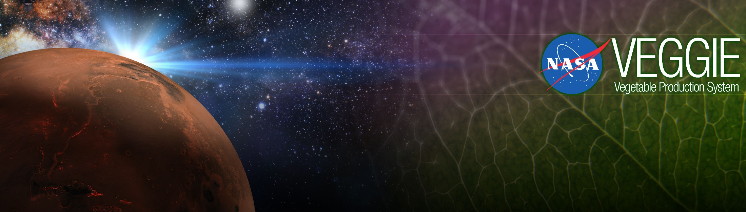
Space Crop Production
Gioia Massa
NASA, Kennedy Space Center, FL, USA
Life Science Research Enabling Long-term Space Habitation
13th Australian Space Forum

Slide 2
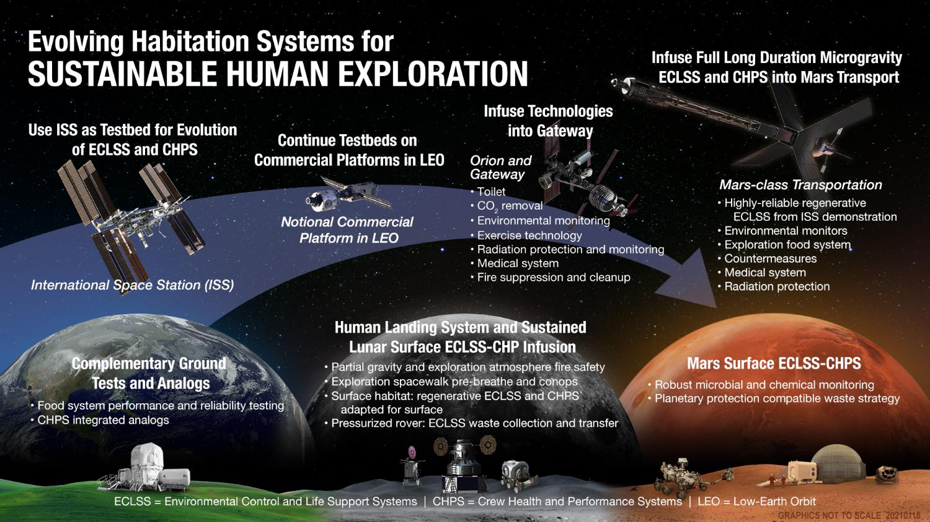

Slide 3
Human Life Support Requirements:
Inputs
Daily (% total
Rqmt. mass)
Oxygen 0.83 kg 2.7%
Food 0.62 kg 2.0%
Water 3.56 kg 11.4%
(drink and
food prep.)
Water 26.0 kg 83.9%
(hygiene, flush
laundry, dishes)
TOTAL 31.0 kg
Outputs
Daily (% total
mass)
Carbon 1.00 kg 3.2%
dioxide
Metabolic 0.11 kg 0.35%
solids
Water 29.95 kg 96.5%
(metabolic / urine 12.3%)
(hygiene / flush 24.7%)
(laundry / dish 55.7%)
(latent 3.6%)
TOTAL 31.0 kg
Source: NASA SPP 30262 Space Station ECLSS Architectural Control Document
Food assumed to be dry except for chemically-bound water.

Slide 4
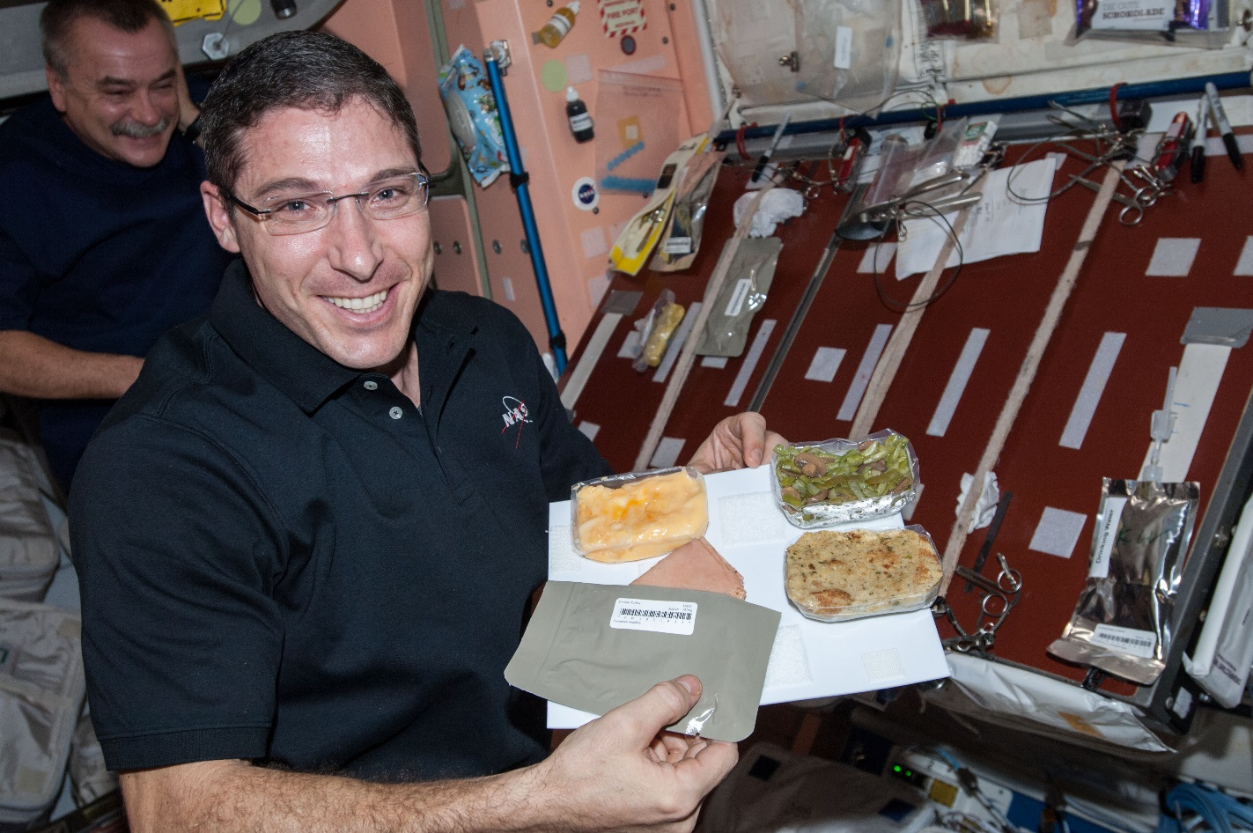
Why grow plants in space?
Food
Psychological well being
Atmosphere
Water

Slide 5
The Space Crop Production Vision
Ensure Food System Security on Long Duration Missions Beyond LEO
Near-Term Goal
Nutrient Supplementation of Prepackaged Food
Long-Term Goal
Caloric Replacement to Move Towards Earth Independence
Notes:
Ralph
Ensure Food System Security on Long Duration Missions Beyond Low Earth Orbit (LEO)
Food and nutrition are the first line of defense for crew health and performance
Provide safe, nutritious and acceptable fresh food
Add variety to crew diet
Enhance morale
* Food security is the condition in which crew have continuous access to sufficient safe and nutritious food which meets both their dietary needs and food preferences in order to maintain peak health and performance.
Nutrient Supplementation of the Prepackaged Food System - Needed for: Deep Space Transport
Fresh produce supplements vitamins (B₁, K, C) and bioactive compounds that degrade in the stored food system on multi-year exploration missions
“Pick-and-Eat” crops that require no processing and minimal preparation will provide variety, customization, and psychological appeal
Enable testing and demonstration of dependable crop production before reliance on system.
Limiting factors are vehicle resources mass, power, volume, water, air, crew time
Caloric Replacement to Facilitate Earth Independence - Needed for: Long duration Surface missions on the Moon and Mars
Reduce up-mass associated with pre-packaged food
In addition to “pick and eat” crops, include staple crops that require processing and preparation
Bioregenerative capability will be required for long duration surface missions

Slide 6



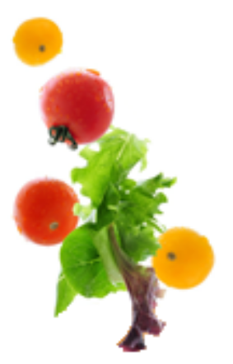





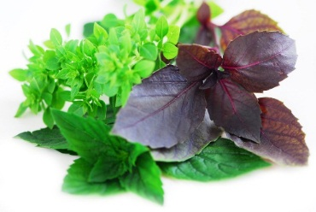


Space Crop Production Candidates
Salad
Leafy Greens
Tomato
Pepper
Radish
Strawberry
Green Onion
Pea
Carrot
Lettuce, Chinese cabbage, Swiss chard, Mizuna, Spinach
Staple Crops
White Potato
Sweet Potato
Rice
Wheat
Dried Bean
Soybean
Peanut
MINIMAL PREPARATION / COOKING
SIGNIFICANT PREPARATION / COOKING
CONSUMED FRESH WITHOUT PROCESSING
Herbs
Basil
Mint
Chives
Dill

Slide 7


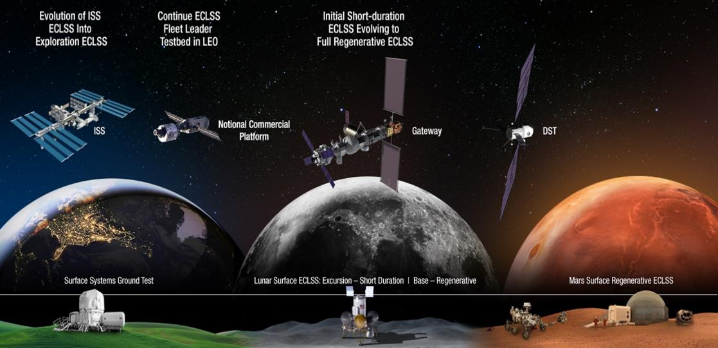


Space Crop Production Roadmap For Exploration
MARS TRANSIT (Crop Production)
GATEWAY (Plant Research)
Operational µg Food Production capability for pick-and-eat crops to supplement crew diet
ISS (Plant Research and H/W Technology)
Proving ground to study the effect of deep space radiation on pick-and-eat crops in µg
Identify challenges and solutions for growing pick-and-eat crops in µg to support crew nutrition
Scale: One to Two EXPRESS Racks (8-16 Lockers)
Scale: Single Locker
Scale: Single Locker to EXPRESS Rack (8 Lockers)
LUNAR SURFACE (Research/Production)
Ground (Plant Research and H/W Technology)
Develop and deploy operational partial gravity systems for both nutritional support and caloric replacement as both a source of food for long duration lunar missions and as a demonstration for Mars
MARTIAN SURFACE (Production)
Develop space crop production concepts and strategies in support of destinations along the exploration roadmap
Leverage Lunar Surface experience in Food Production systems to extend Earth Independence for Mars missions
Scale: Single Locker to Module
Scale: Single Locker to Module
Scale: Single Locker to Module

Slide 8
Space Crop Production Challenges
Deep Space
Water
Recycling
Radiation
Pressure
Micrometeorites
Surface
Microgravity
Fluid movement
No convection
Dust
Partial gravity
Plant Size
High CO₂
Food Safety & Microbiome
Nutrient output
Sustainability
Abiotic stresses
Vehicle resources
Crew time
Waste
Productivity
Stress tolerance
Environmental optimization
Crop scheduling
Crop

Slide 9
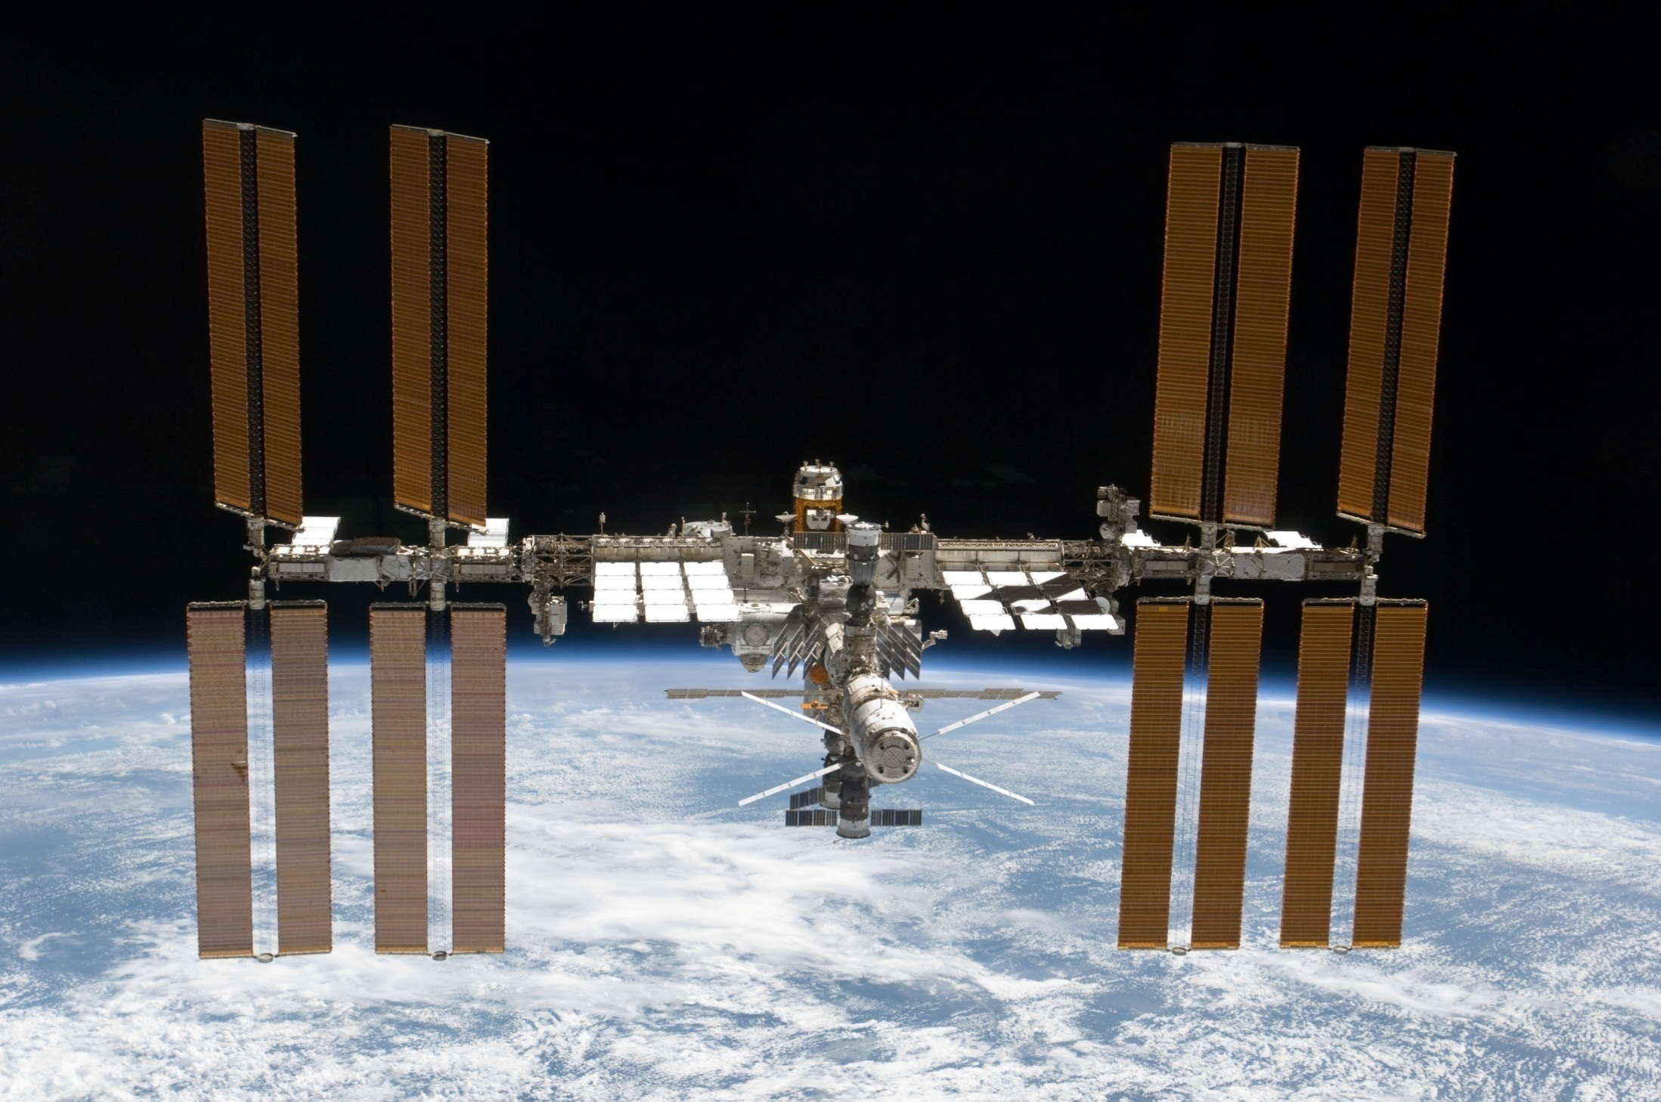
The International Space Station

Slide 10
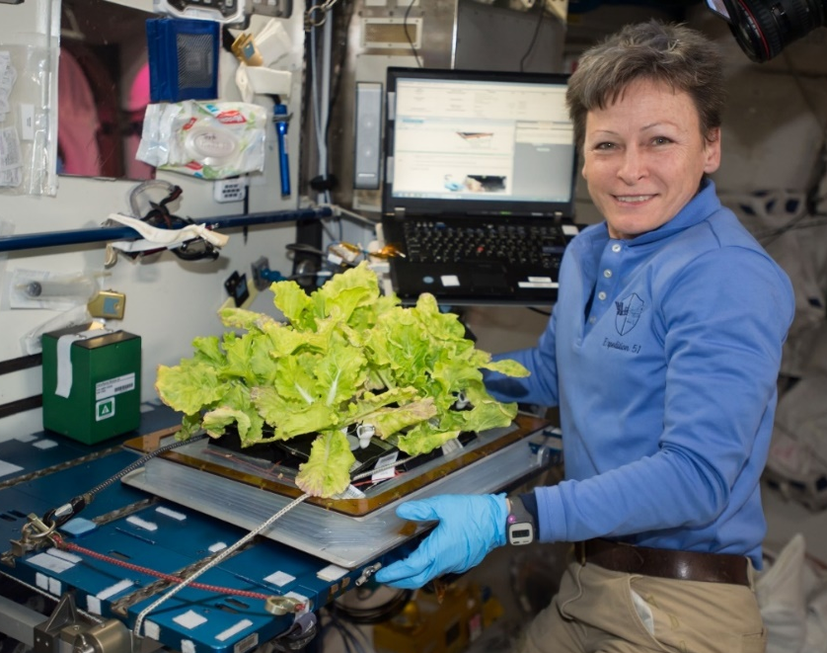
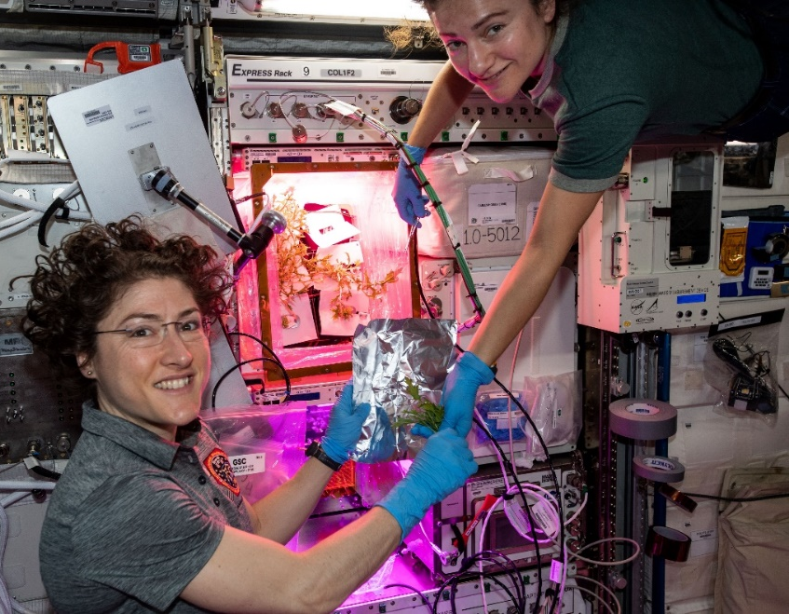
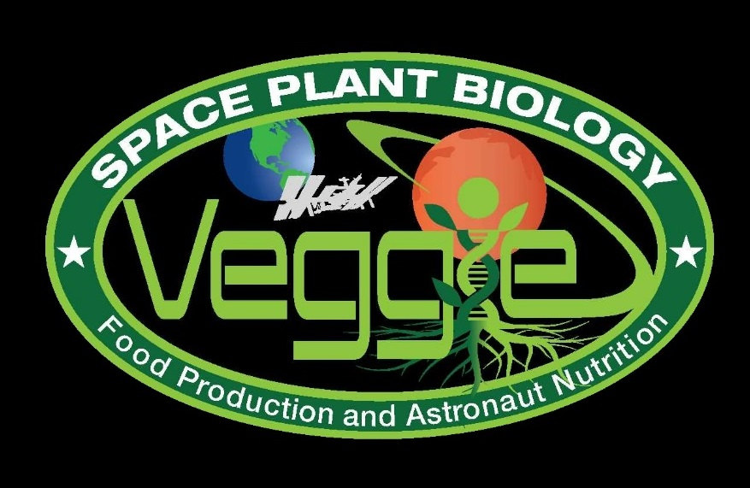
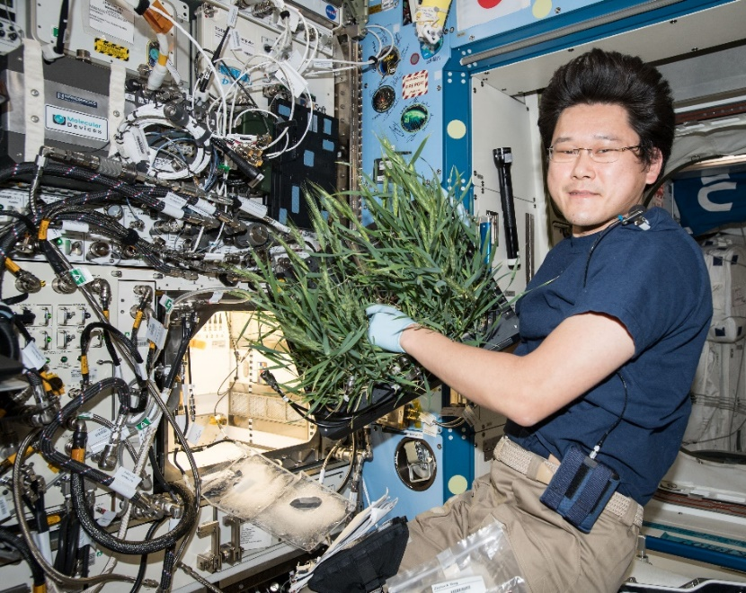
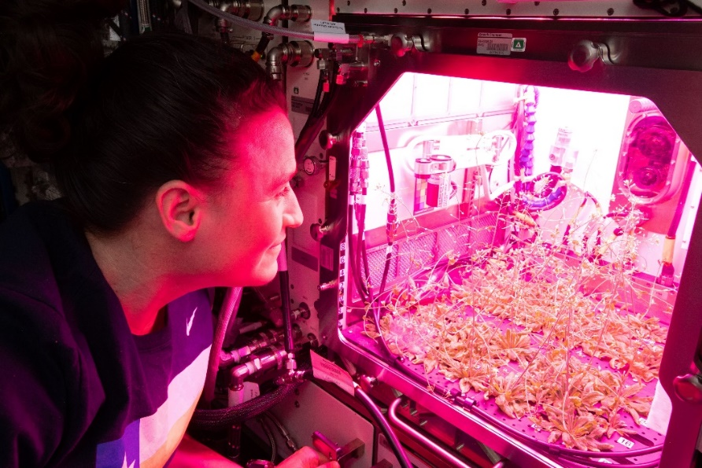

Current NASA Large Plant Research Capabilities On ISS
Notes:
Veggie and the Advanced Plant Habitat

Slide 11
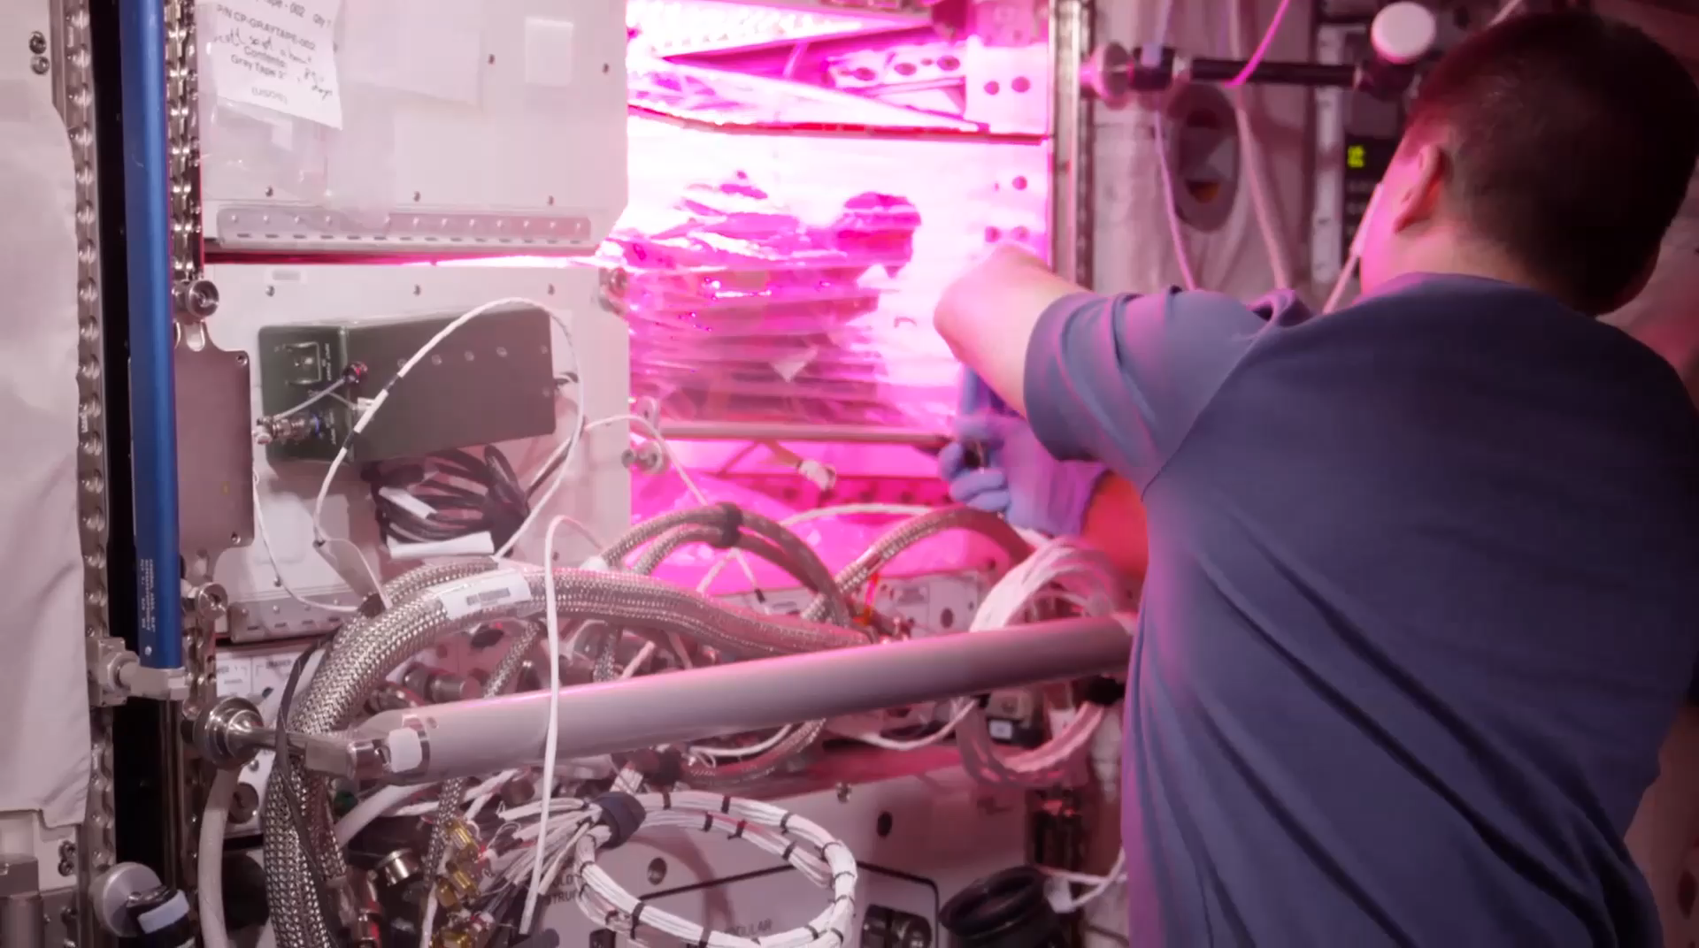
VEG-01B Harvest (August 2015)
Notes:
Veg-01 second crop, first consumption

Slide 12
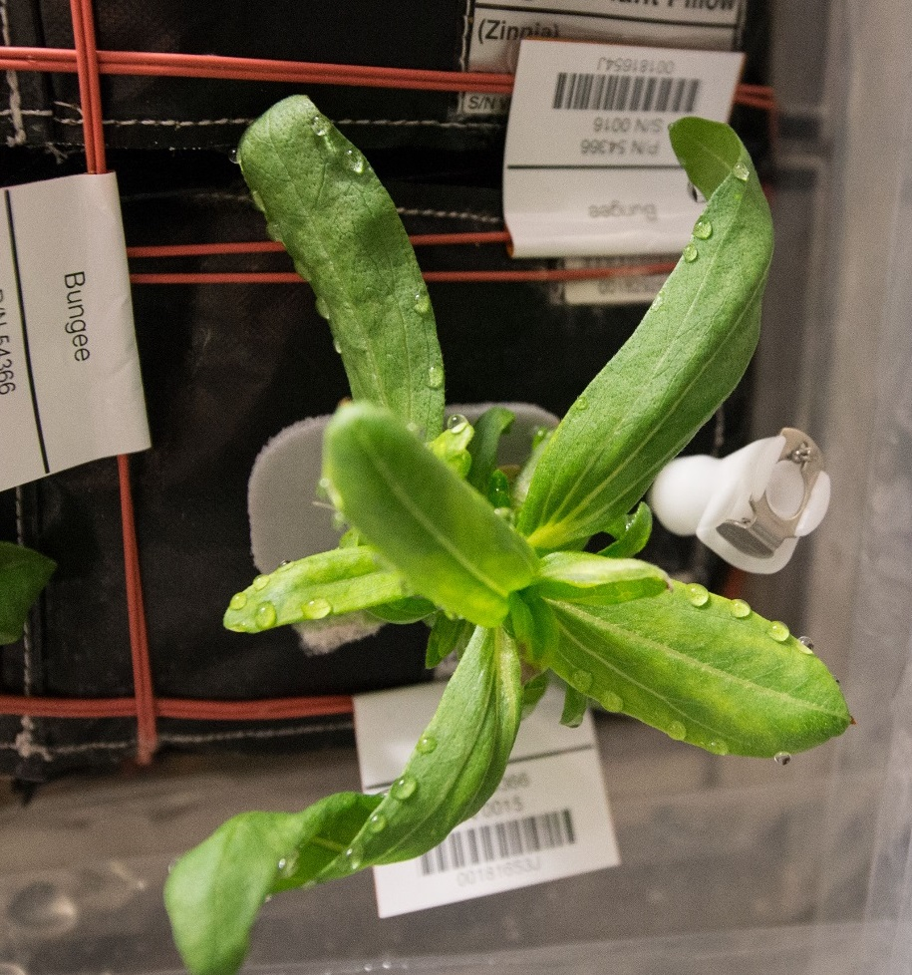
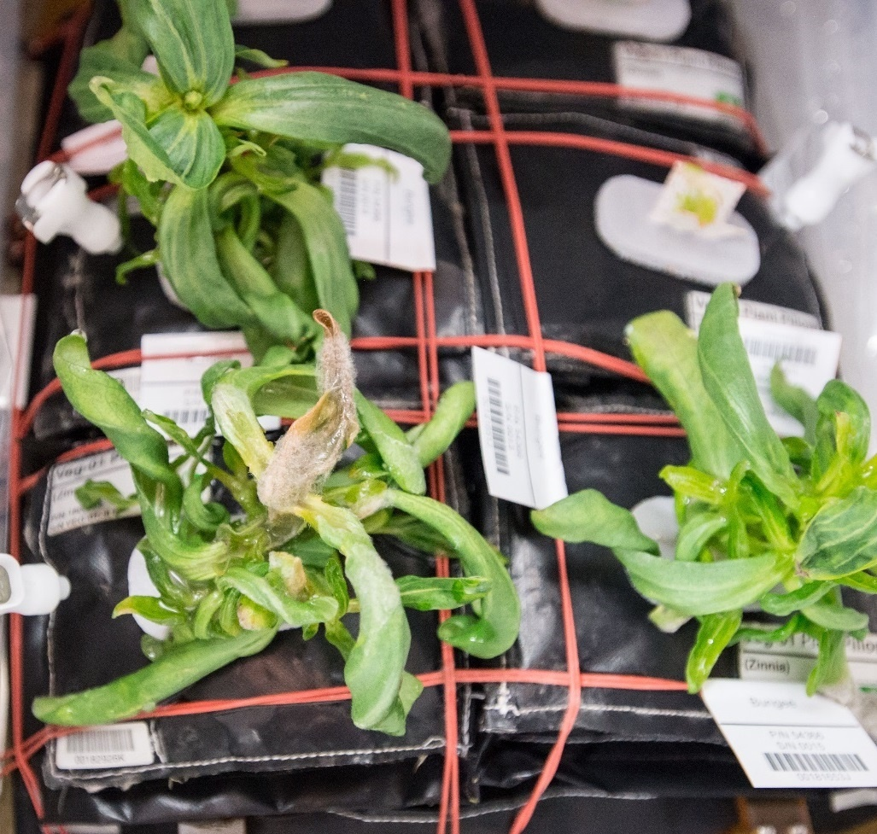
Ventilation and Water Issues & Consequences in Zinnia
Guttation and Leaf Curling
Fungal Development & Abnormal Growth

Slide 13
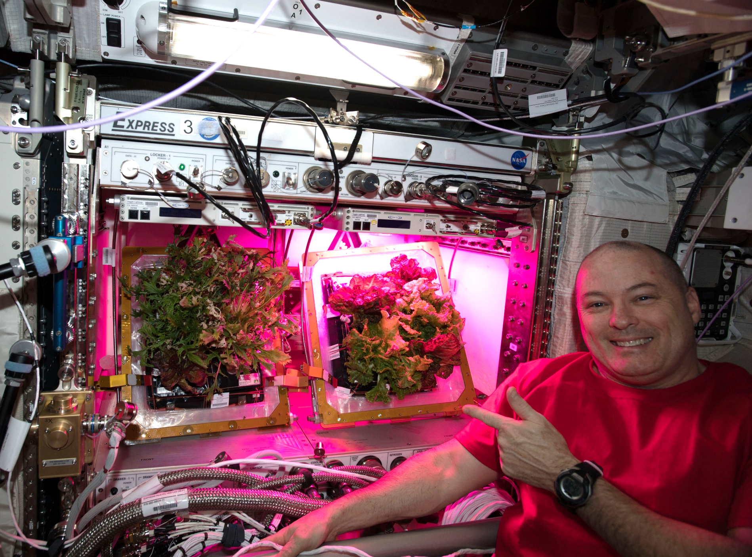
A Tale of Two Veggies

Slide 14
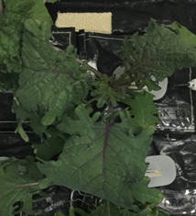
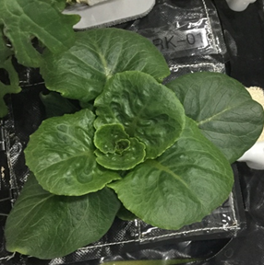
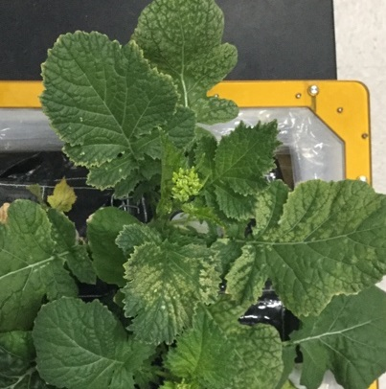
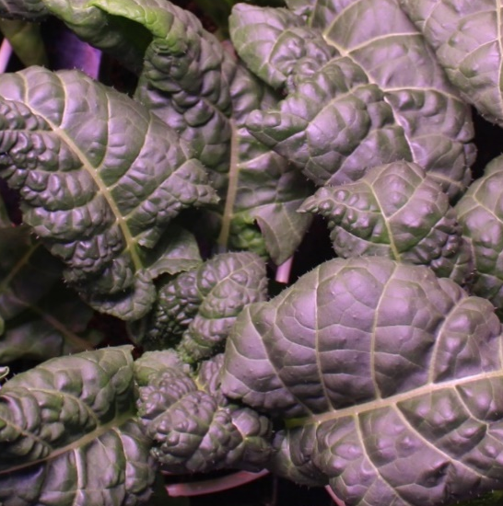
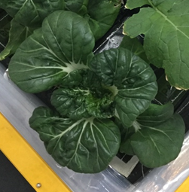
VEG-03 Crop Testing
Red Russian Kale
*Dragoon Lettuce
Wasabi Mustard
*Extra Dwarf Pak Choy
Amara Mustard
*= Student Selected Crops!

Slide 15
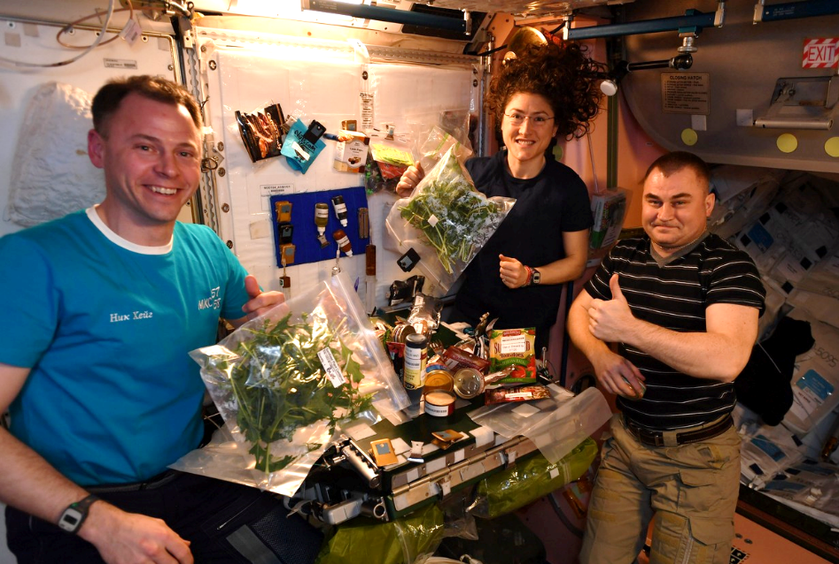
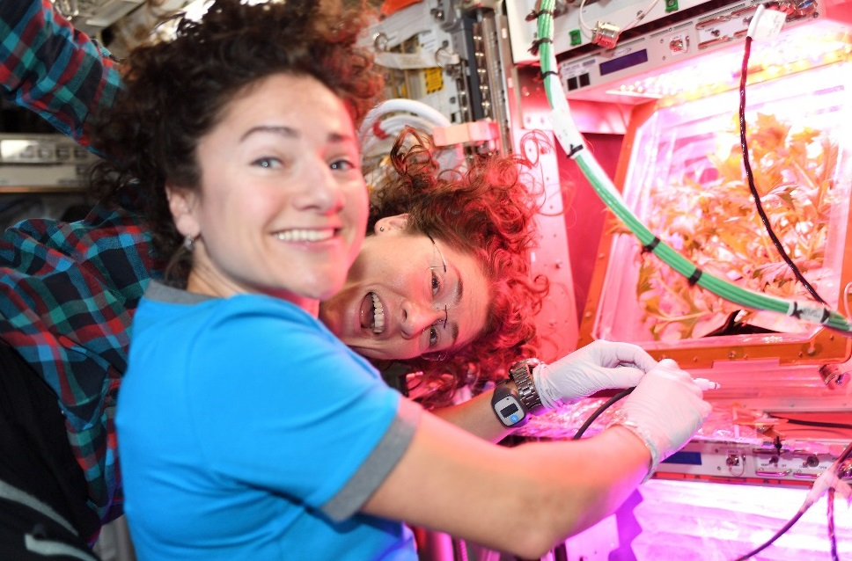
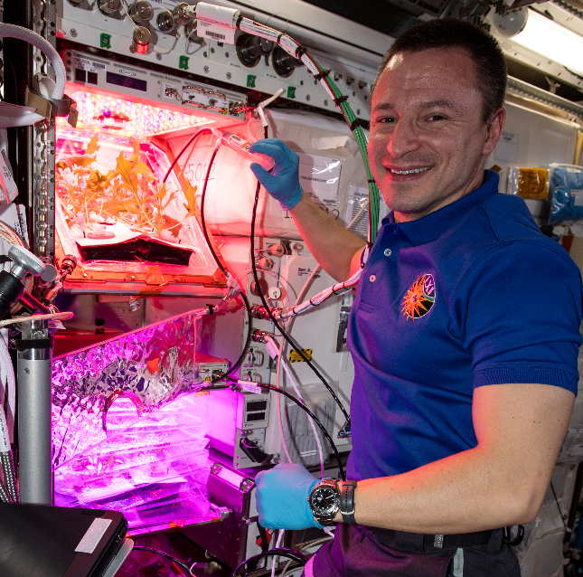
VEG-04 Crew Engagement

Slide 16
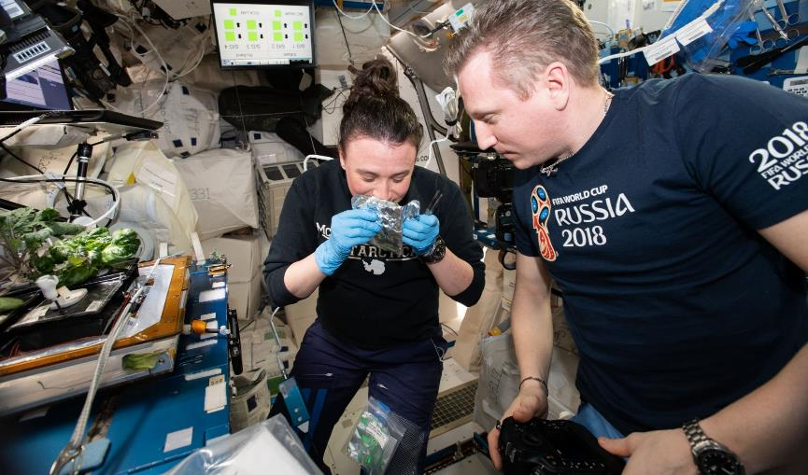
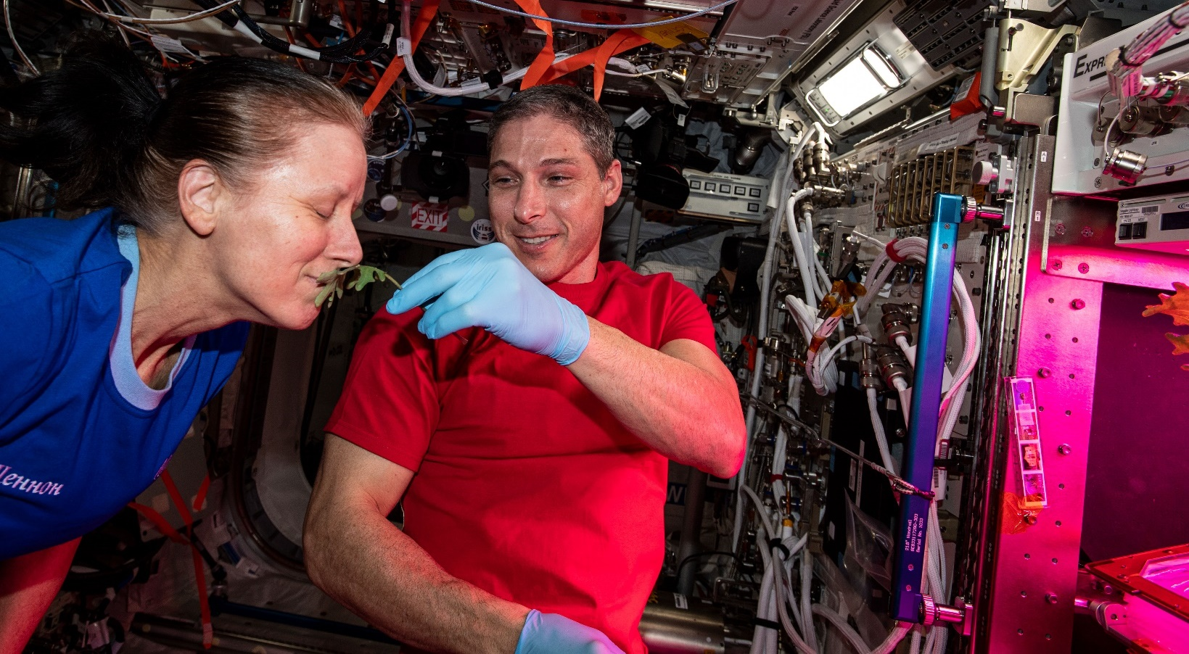
Plant Aromas Also Enhance Astronaut Experiences

Slide 17
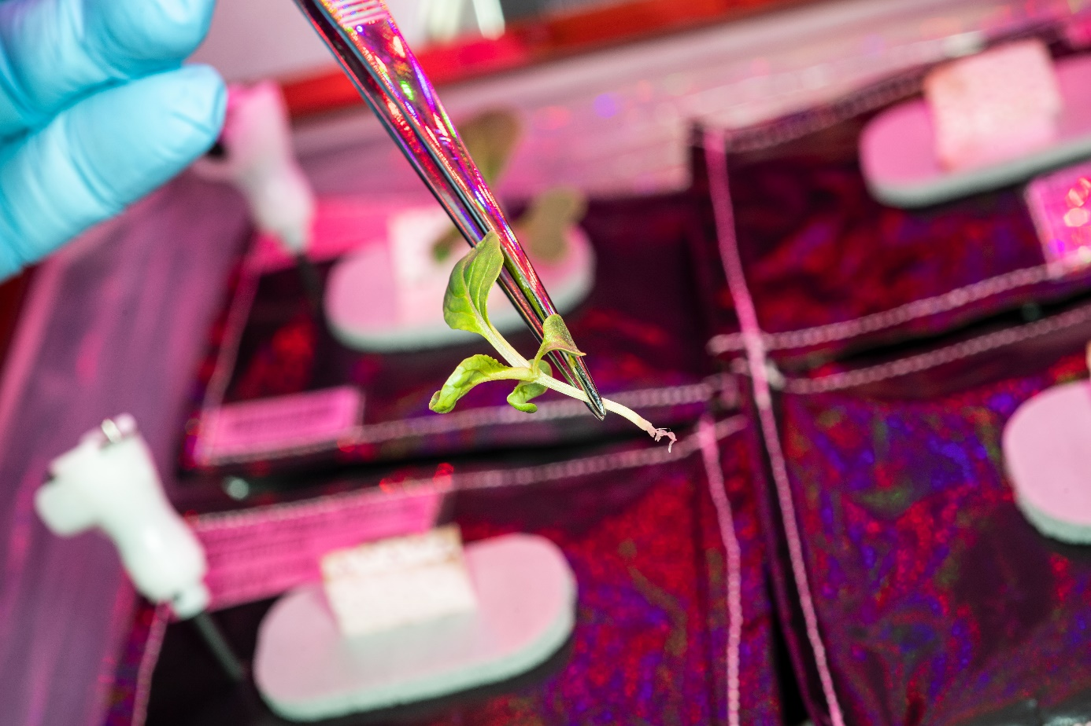
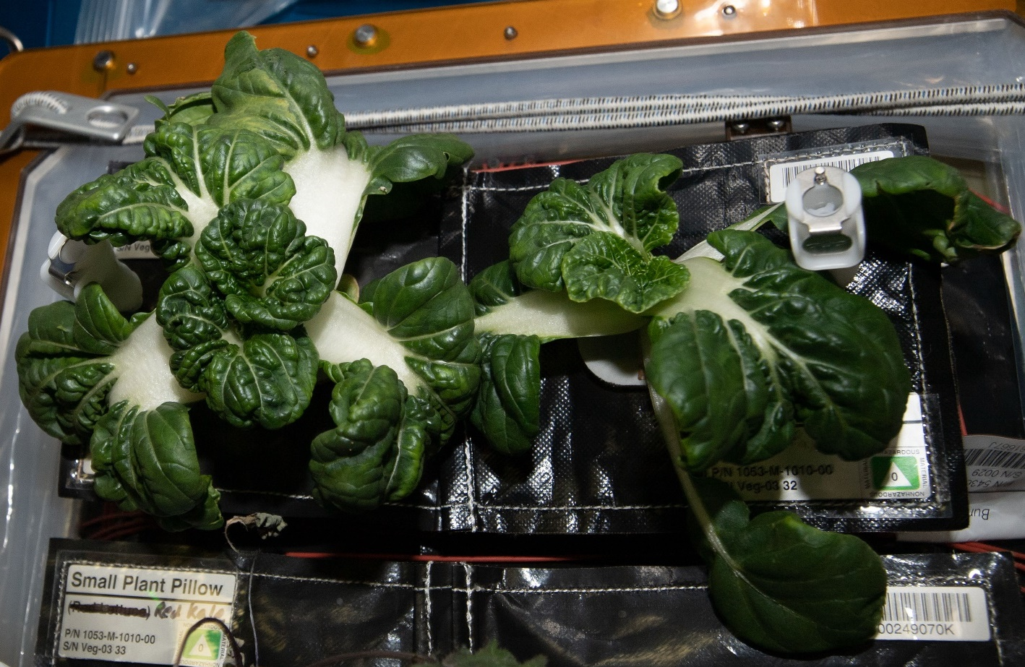
Recent ISS Crop Research
Transplanting 10 Days after initiation
Original
Transplant
Harvest at 29 days
Successful transplanting of ‘Extra Dwarf’ Pak Choi in VEG-03 I

Slide 18
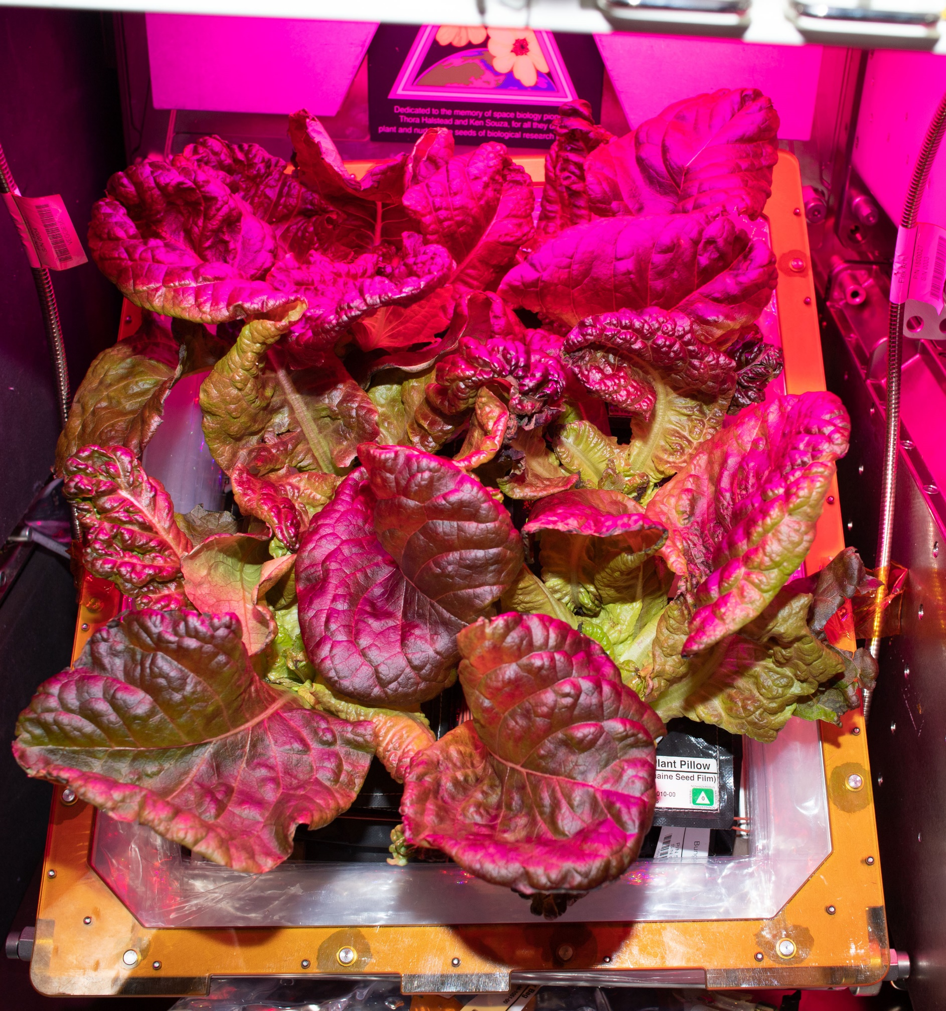
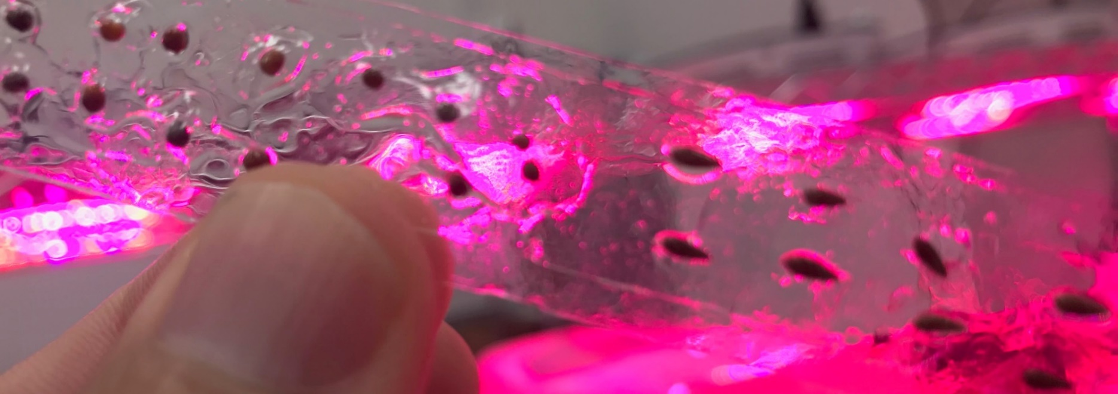
Recent ISS Crop Research
Seed Film technology tested successfully in VEG-03 J

Slide 19
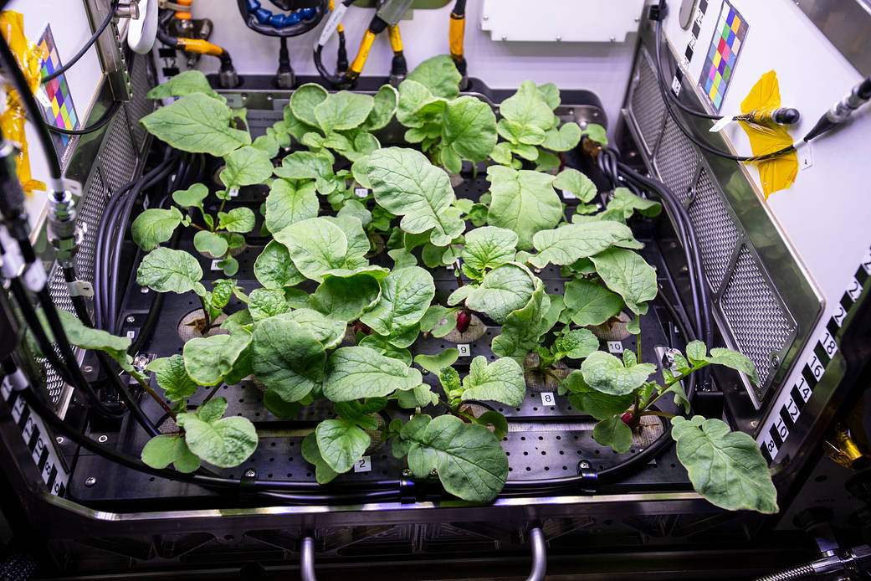
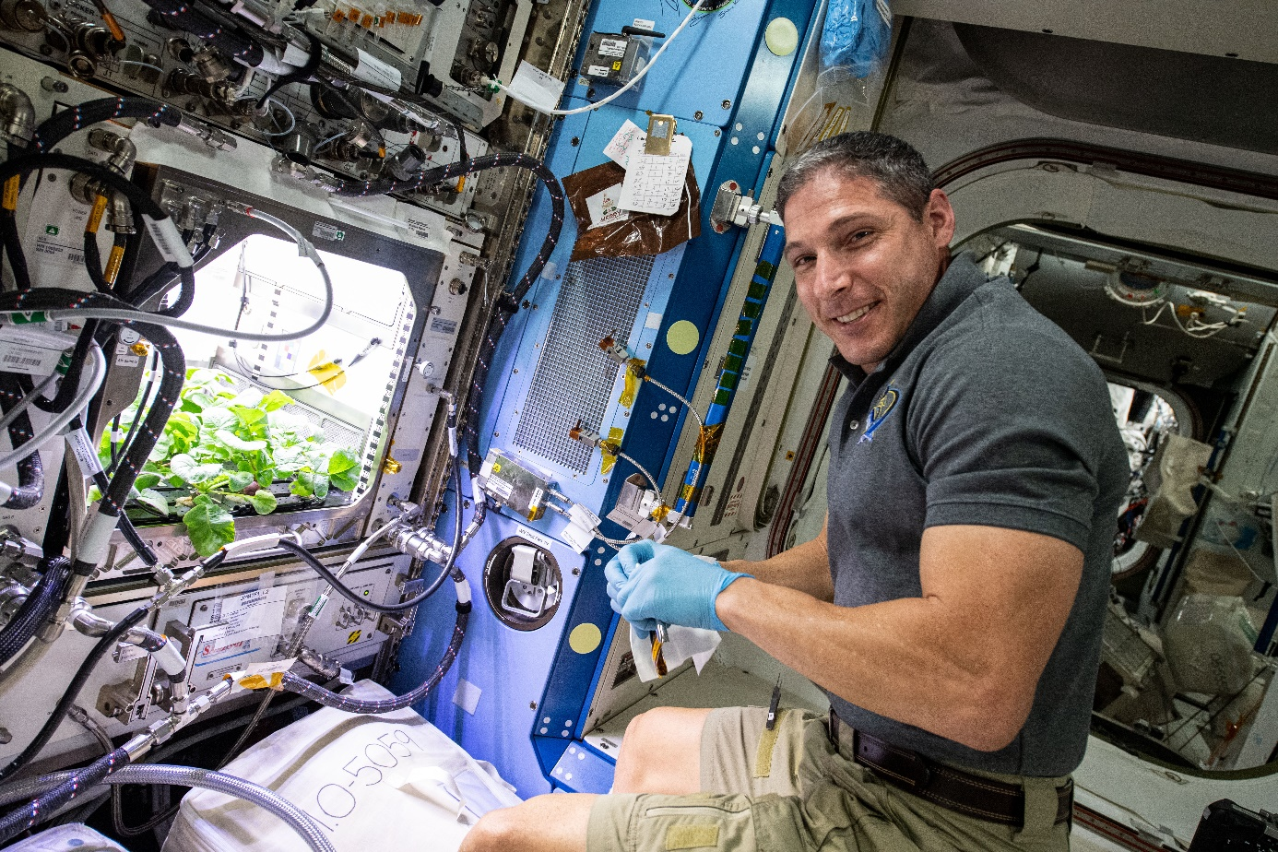
APH Crop Research
PH-02 Radish Experiment
PI Karl Hasenstein – University of Louisiana, Lafayette

Slide 20
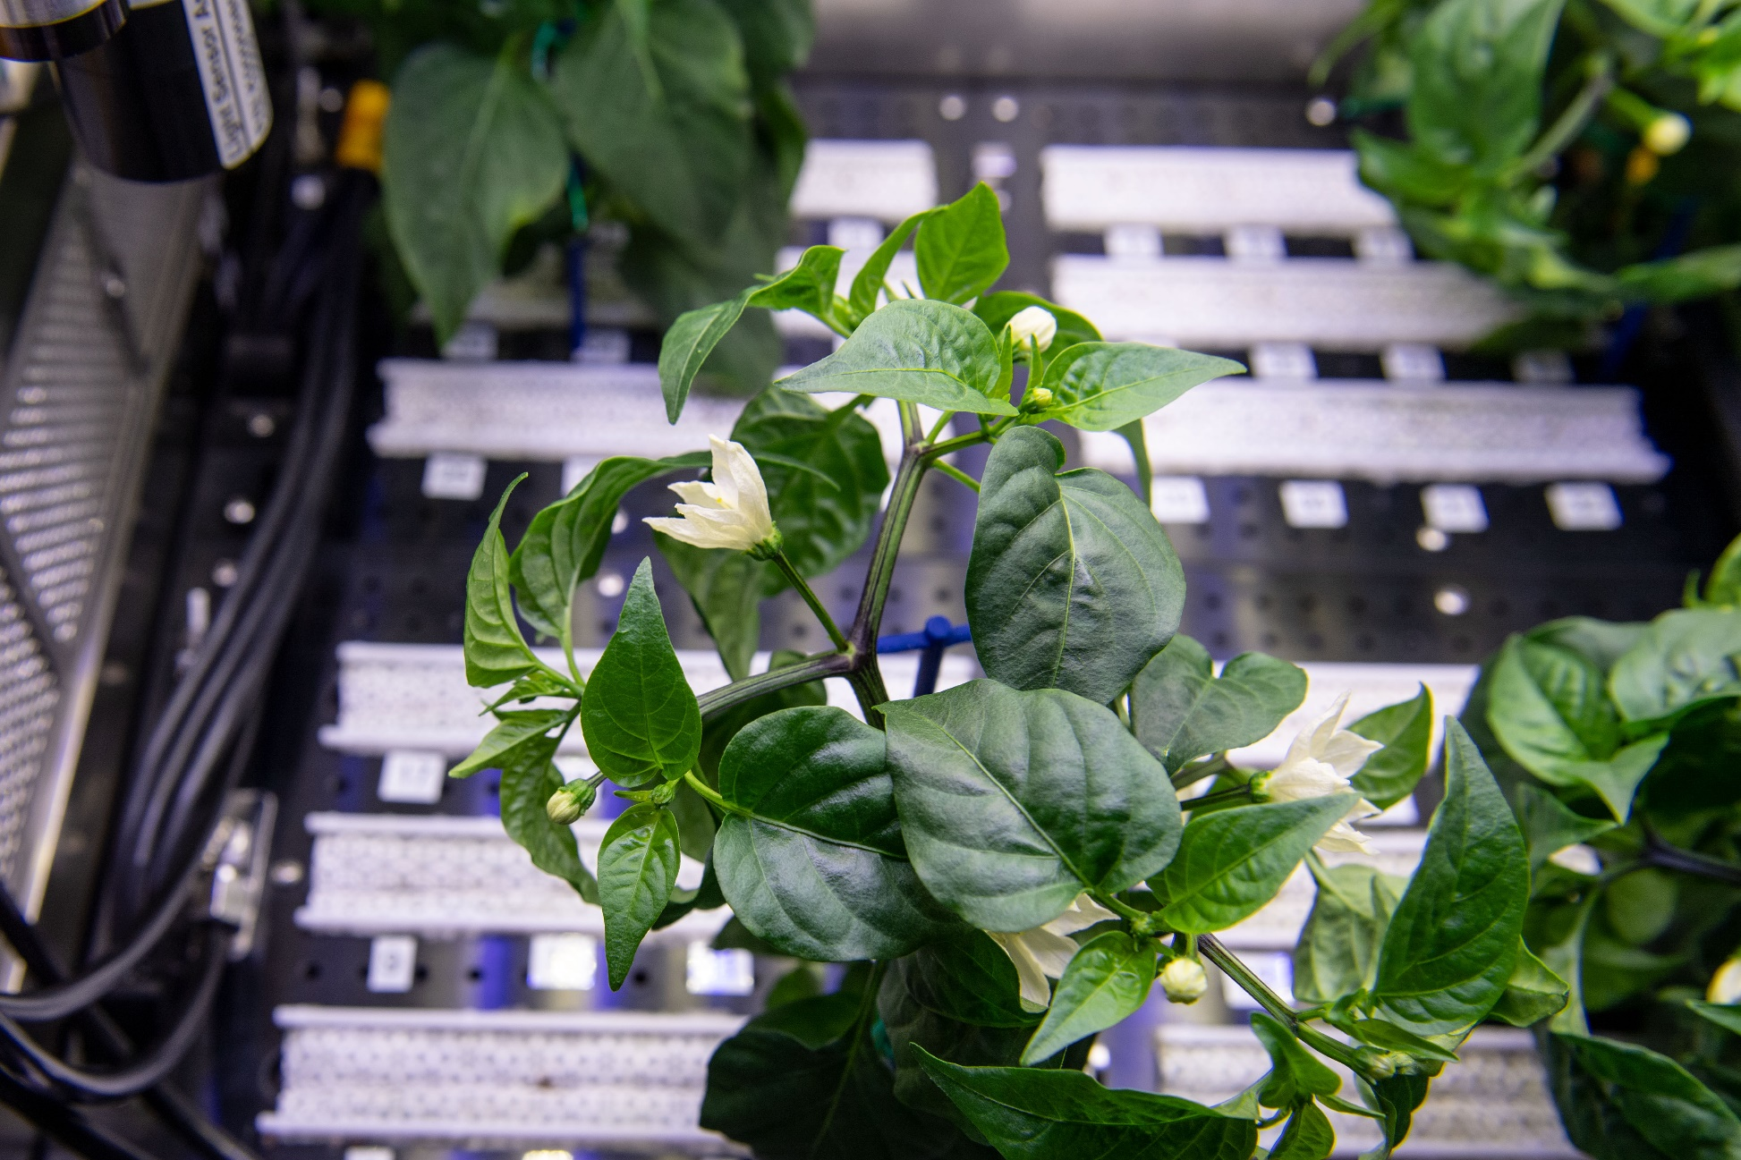
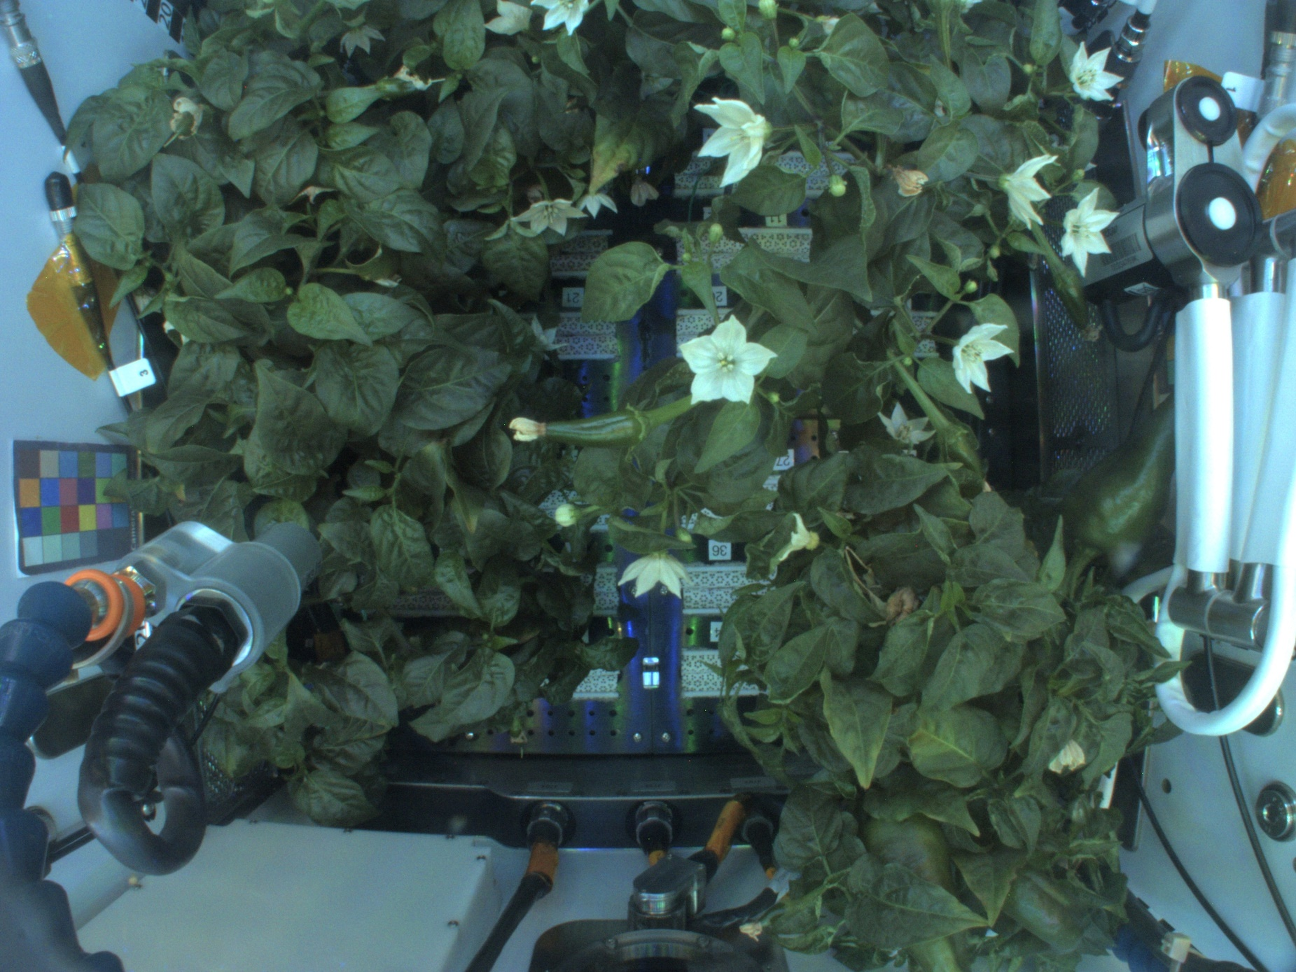
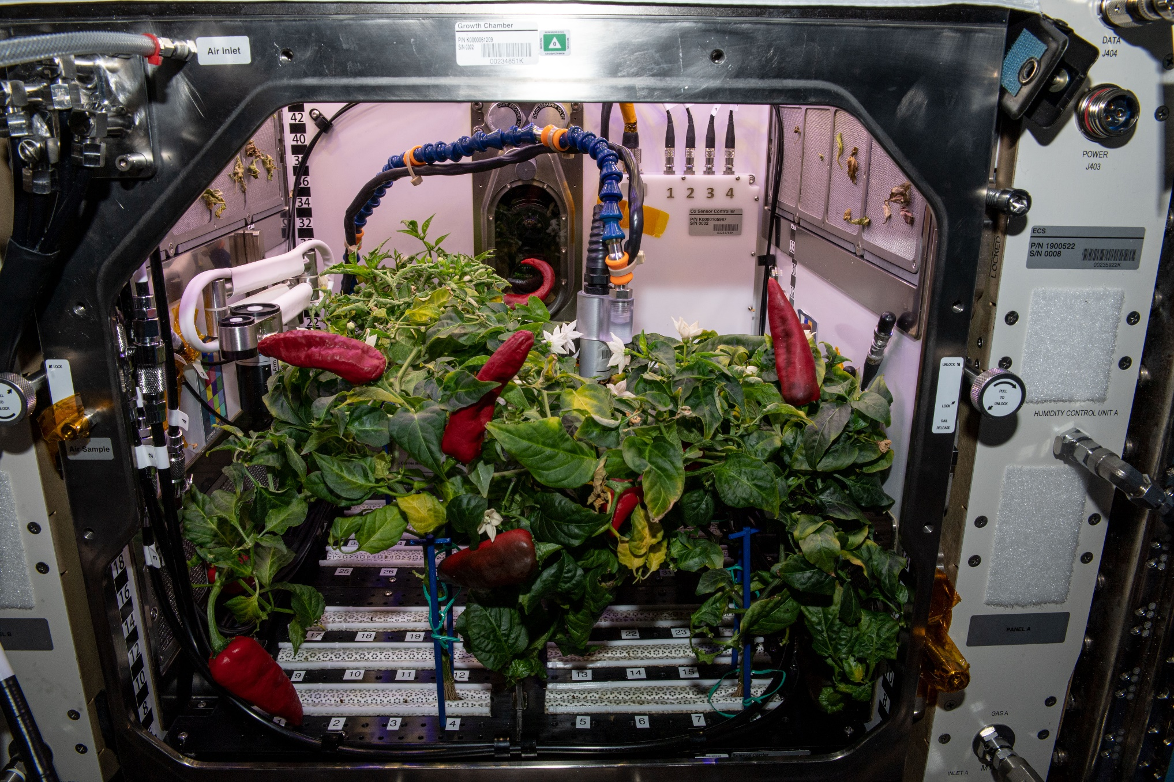
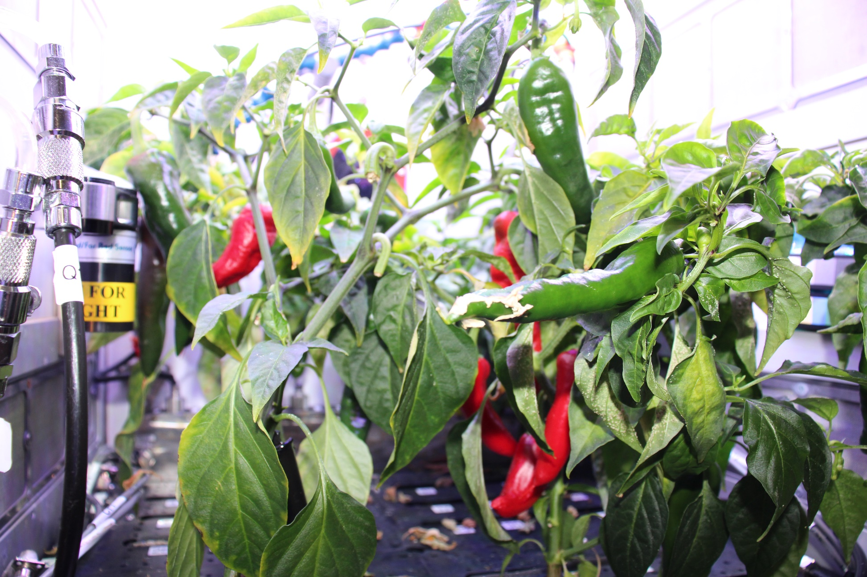
Space Chile!
Española Improved Hatch Chile Peppers in APH
PH-04 mission July – Nov. 2021
Red or Green?

Slide 21
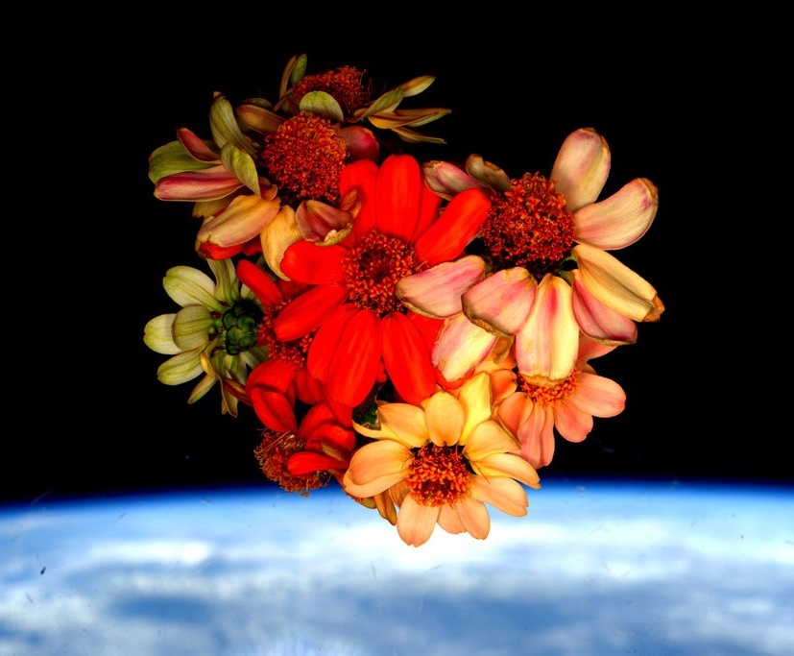
Thank you!
Slides from:
  Jim Broyan
  Ray Wheeler
  Ralph Fritsche
  Christina Johnson
Veggie and Space Crop Production teams
NASA’s astronauts
NASA’s Space Biology Program, ISS Program, Human Research Program

Slide 22

