Slide 1
Secondary Neutron Modeling
Tony C. Slaba
NASA Langley Research Center, Hampton, VA, USA
WANDA 2022
March 2, 2022

Slide 2
Outline
Space Radiation Protection – Neutron Interactions
Neutron Transport Methods for Space Radiation
Model Comparisons and Validation
Summary

Slide 3
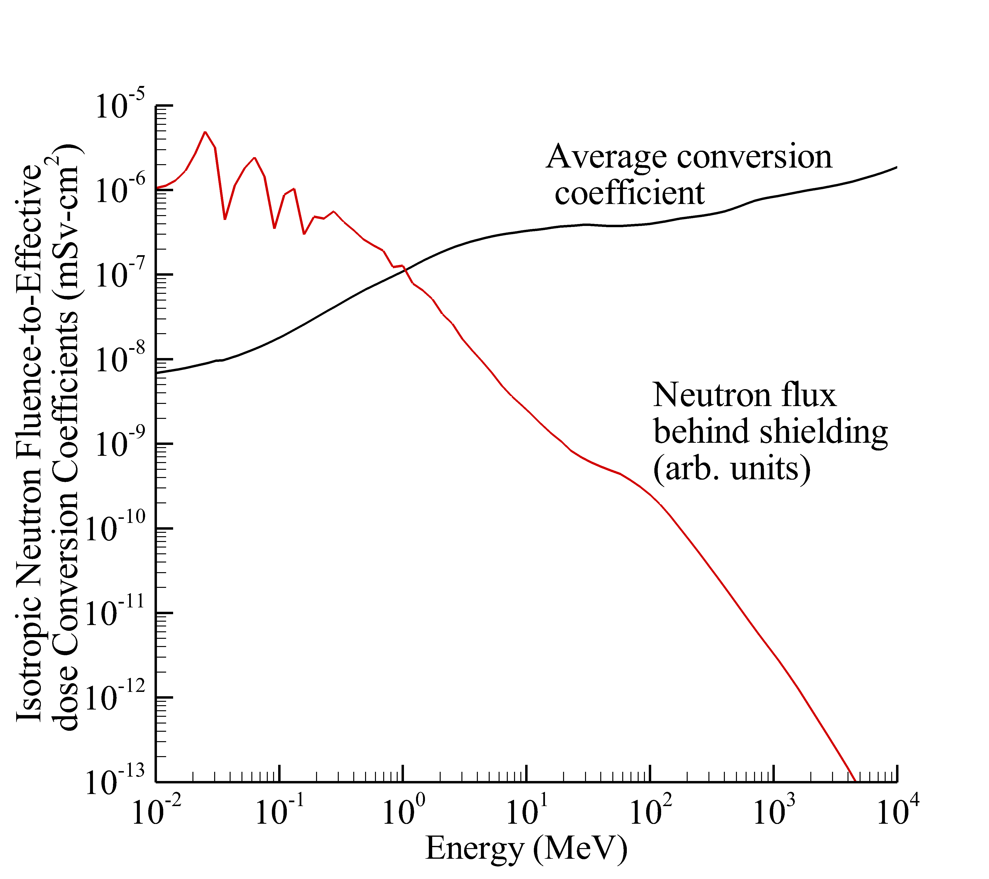
Space Radiation Protection – Neutron Contributions
Secondary neutrons account for 10-30% of the biological dose in space
  Depends on shielding characteristics and biological endpoint being considered
Neutrons between 1 MeV → 1 GeV matter most for space radiation protection⁽¹⁾
  Flux above 1 GeV is relatively small in space
  Carcinogenic impact below 1 MeV is comparatively small (other health risks not well studied)
  Slaba et al., Rad. Res. 176: 827-841; 2011.
  (1) Heilbronn et al. Life Sci. Space Res. 7: 90-99; 2015.

Slide 4
Space Radiation Protection – Neutron Interactions
High energy galactic cosmic rays (GCR) interact with shielding and tissue
  Incoming GCR ions are fragmented
  Target nuclei constituents may be broken up
  De-excitation of intermediate state nuclei
Neutron interactions
  Inelastic reactions dominate at energies above ~100 MeV
  Elastic scattering dominates below ~20 MeV
  Neutron capture has negligible impact on space radiation protection

Slide 5
Neutron Transport Methods for Space Radiation
Monte Carlo methods difficult to use for space radiation protection
  No simulations with fully detailed geometry in a GCR environment have ever been published
  Constrained by computational cost imposed by geometry, source complexity, and particle tracking
  Codes: Geant4 (ESA), PHITS (JAXA), FLUKA (CERN), MCNP6 (LANL)
Deterministic methods developed to enable shield design and optimization
  Initially based on several physical approximations⁽¹⁾
  Trade-off between computational cost and model accuracy
  Now able to reproduce Monte Carlo simulations if same cross sections are used⁽²⁾
  Codes: HZETRN/3DHZETRN
  (1) Wilson et al., NASA RP 1257; 1991.
  (2) Slaba et al., Life Sci. Space Res. 27: 6-18; 2020.

Slide 6
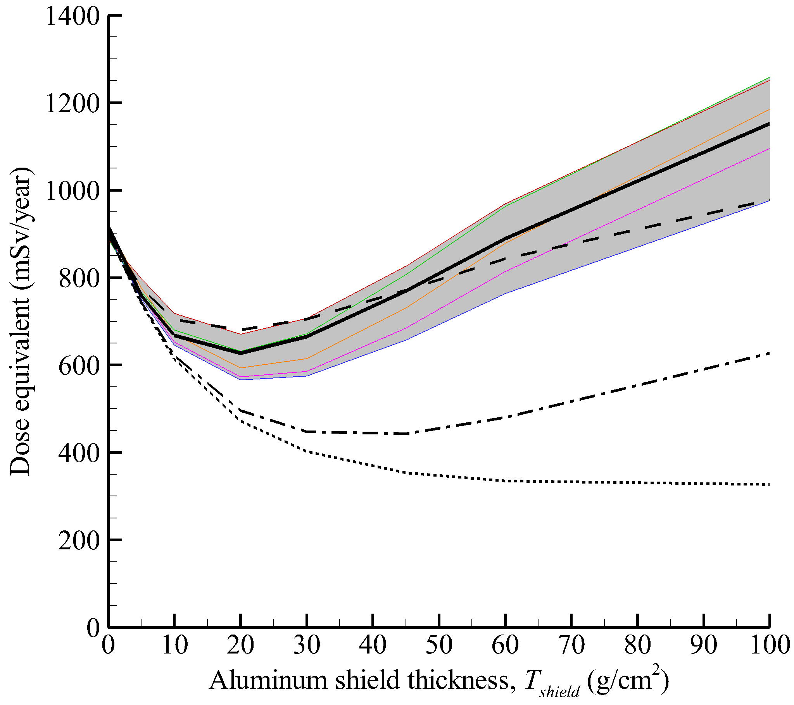
Model Comparisons
  Transport code comparison for 1977 GCR environment incident on aluminum slab shielding
Transport codes in good agreement for integrated quantities such as dose or dose equivalent
HZETRN2020
3D transport
HZETRN2015
HZETRN2010
Simulation setup
Front shield
Back shield
HZETRN2005
1D transport
GCR spectrum
Infinite lateral dimensions
  Gray band: Spread of Monte Carlo simulation results
  Geant4, FLUKA, PHITS, MCNPX
T_{shield}
Thin water target
T_{shield}
  Figure adapted from:
  Slaba et al., Life Sci. Space Res. 12: 1-15; 2017.
  Norbury et al., Life Sci. Space Res. 22: 98-124; 2019.

Slide 7
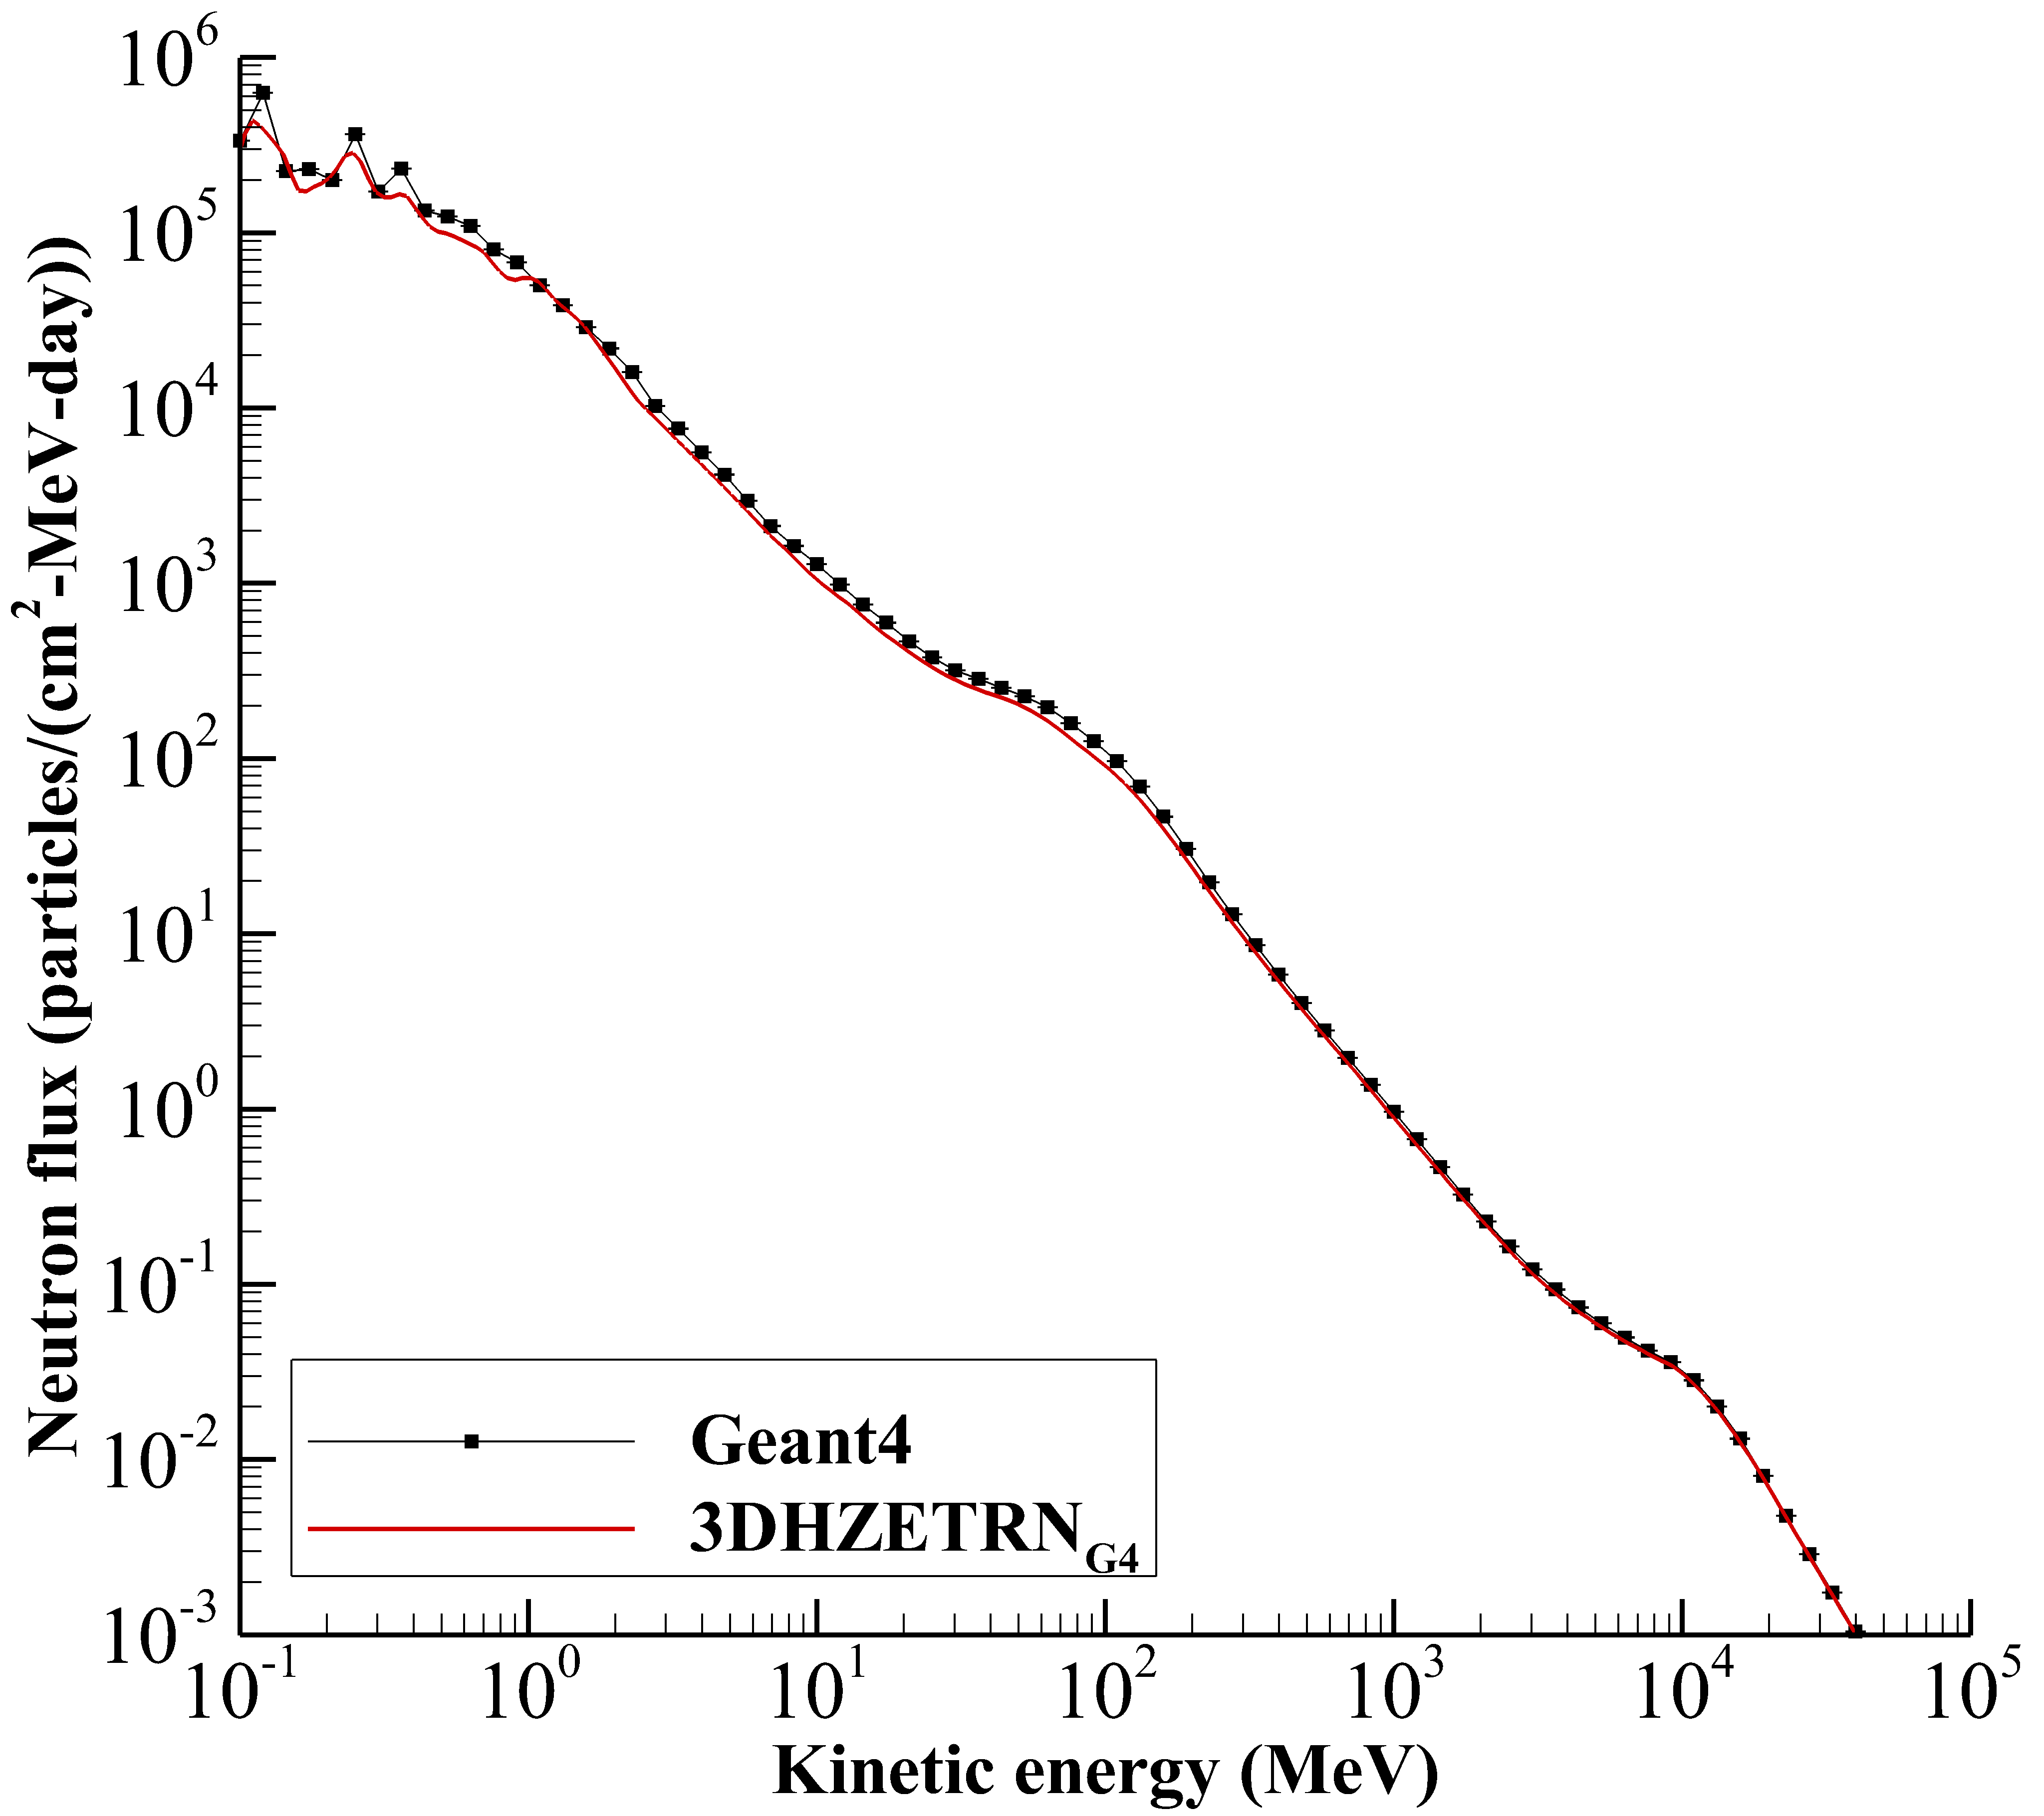
Model Comparisons
  Transport code comparison for Nov. 16-25, 2013 GCR for ISS trajectory segments having vertical cuttoff rigidity between 14-16 GV
Deterministic code can reproduce Monte Carlo simulation if same cross sections are used
Simulation setup
Front shield
Back shield
LEO GCR spectrum
Infinite lateral dimensions
  Slaba et al., Life Sci. Space Res. 27: 6-18; 2020.
60 g/cm²
60 g/cm²
Detector location

Slide 8
Validation
Deterministic code can analyze fully detailed geometry in space environment
Nuclear physics model uncertainties larger than measurement uncertainty in this case
  Original CAD model of ISS
  Trajectory averaged dose rate (μGy/day) inside ISS for Nov. 16-25, 2013.
 | Dose in Si (μGy/day)
Measurement | 107.6 + 5.5
3DHZETRN_{G4} | 92.3 (-14%)
3DHZETRN | 106.3 (-1%)
  Rendered shield geometry interpreted by 3DHZETRN
  Figure and Table from: Slaba et al., Life Sci. Space Res. 27: 6-18; 2020.

Slide 9
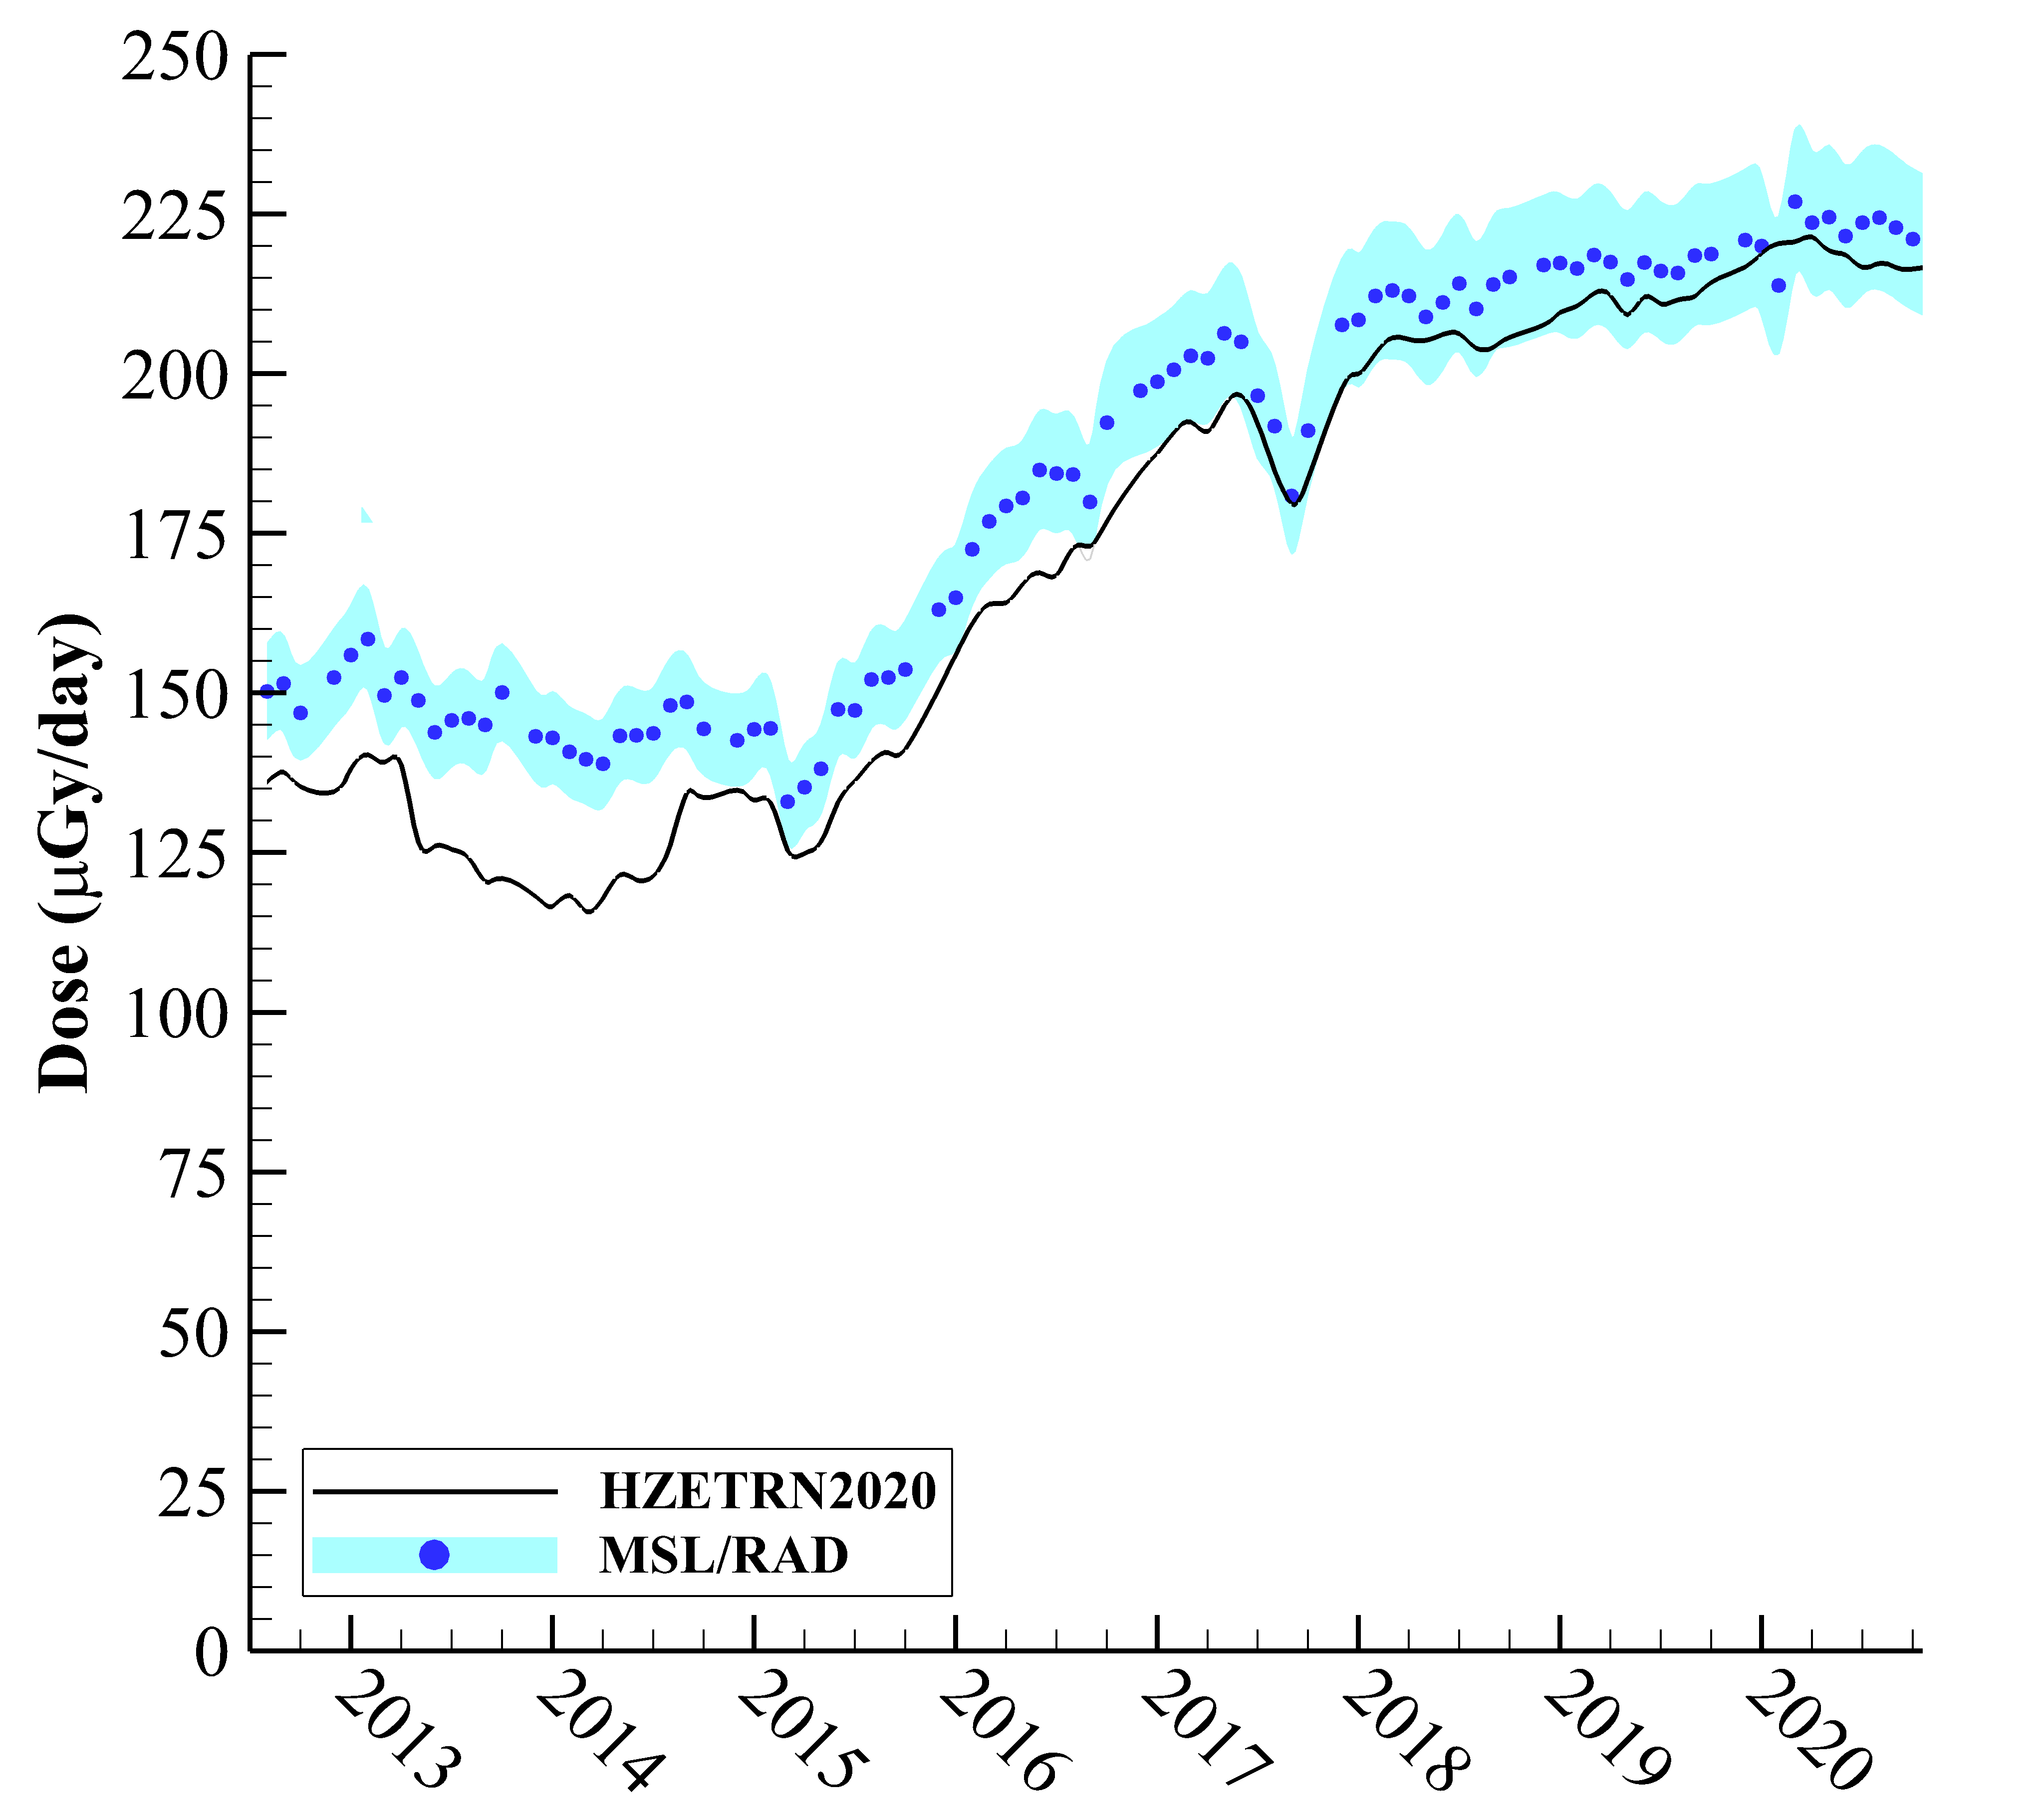
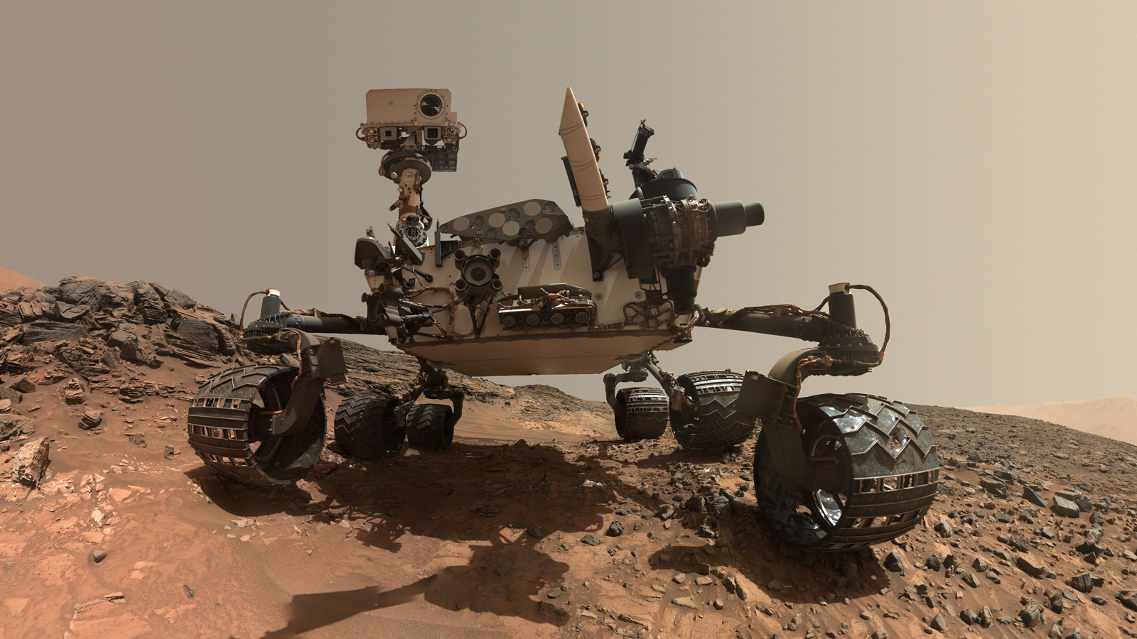
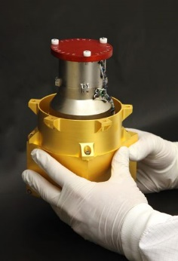
Validation
  Comparison of model calculations to MSL/RAD dose rate measurements on the surface of Mars
Transport codes can accurately calculate Mars surface dose rates
https://mars.nasa.gov/msl/home/
RAD detector
  Slaba, Space Weather 19: e2021SW002851; 2021.

Slide 10
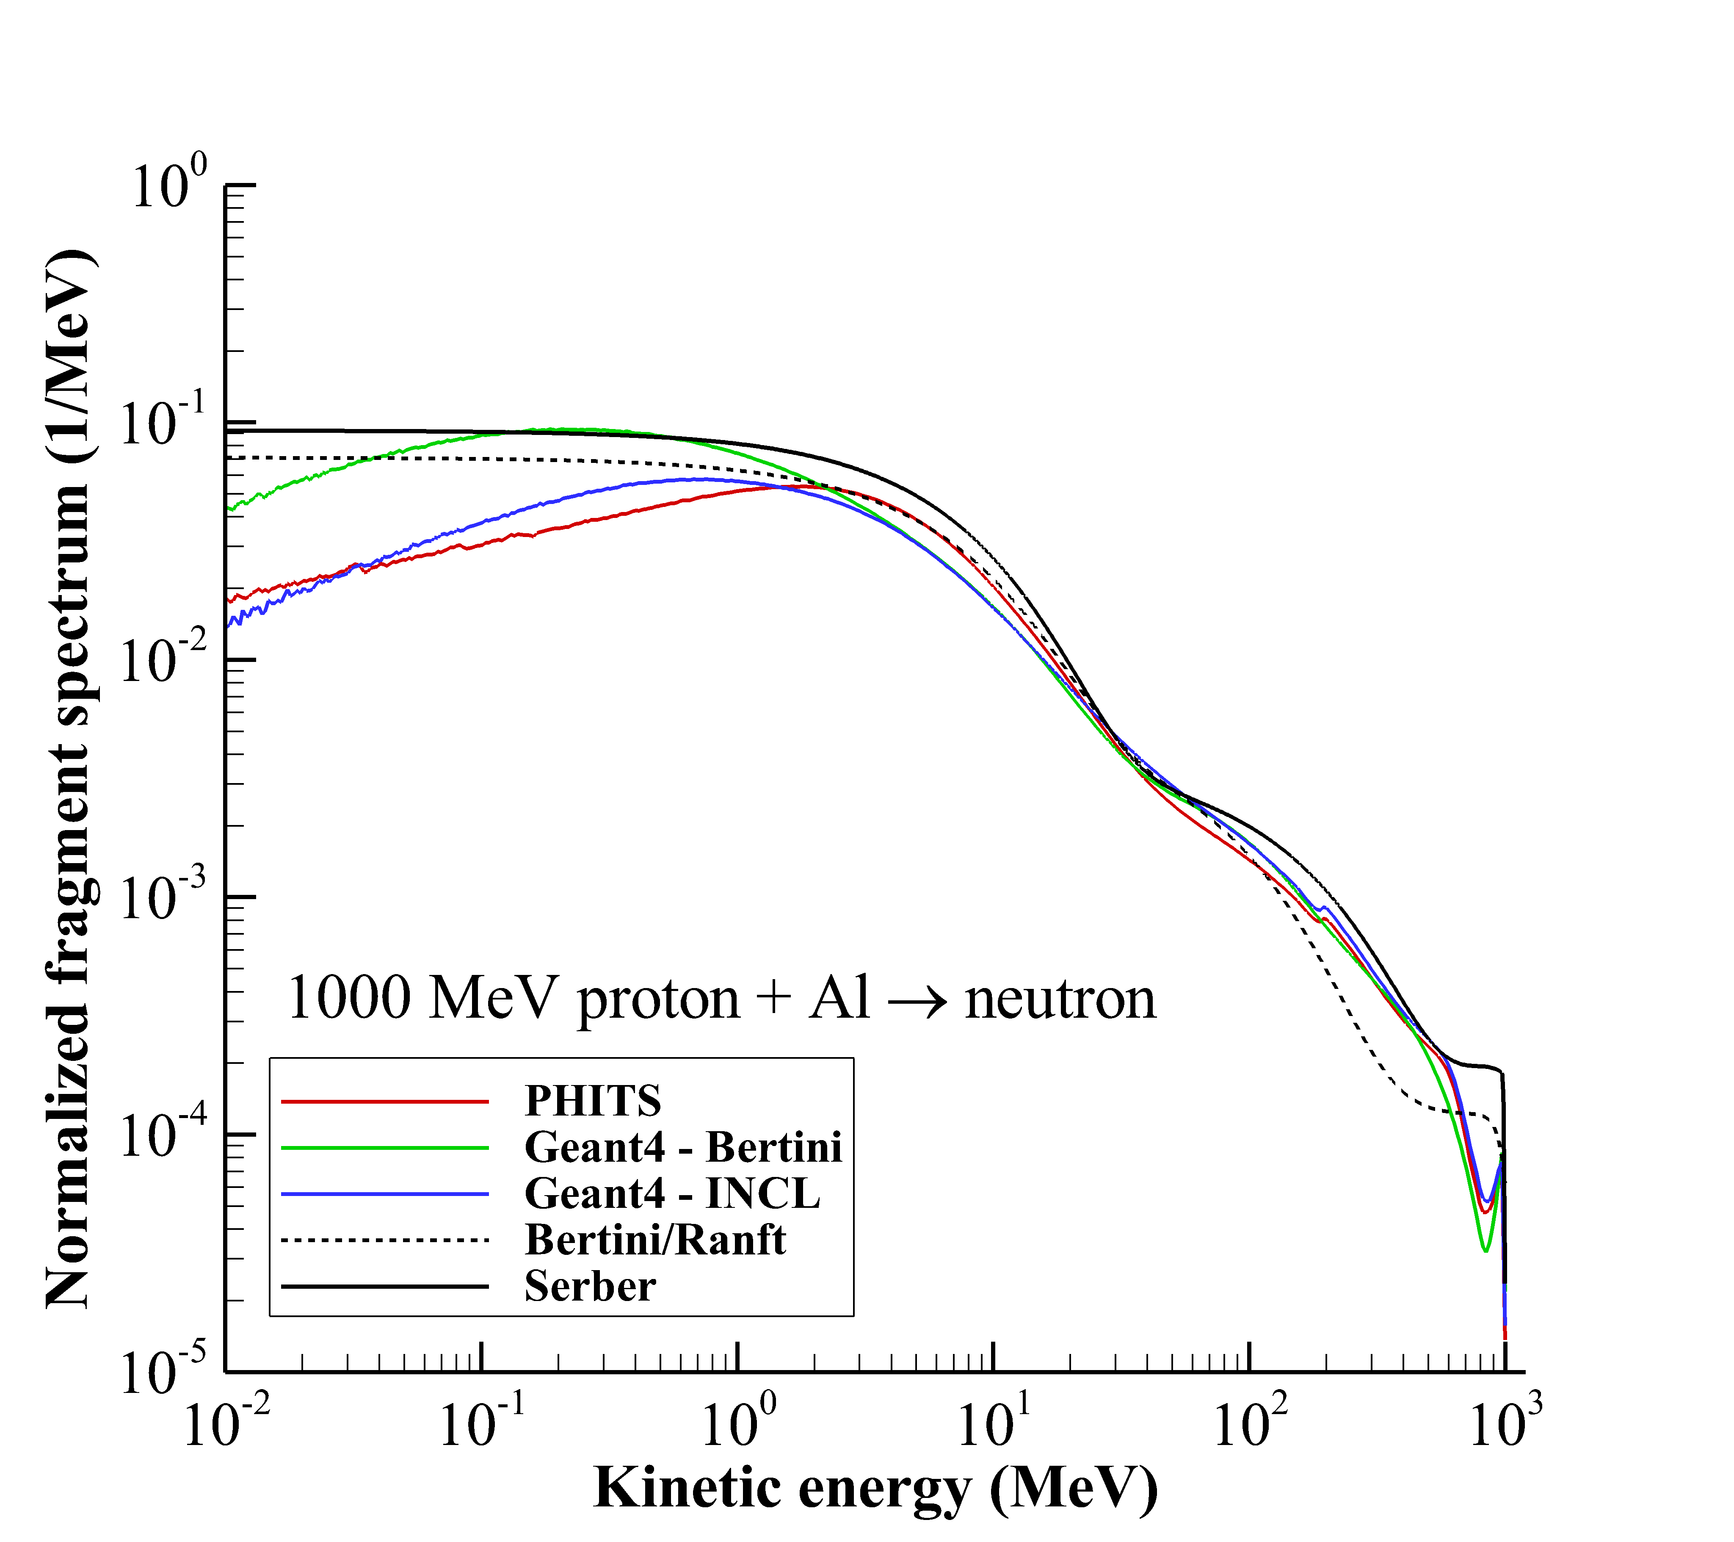
Nuclear Model Uncertainty
  Comparison of neutron production spectra for 1000 MeV protons incident on aluminum.
Nuclear physics models differ for seemingly “well known” reactions
  Wilson et al., Life Sci. Space Res. 26: 10-27; 2020.

Slide 11
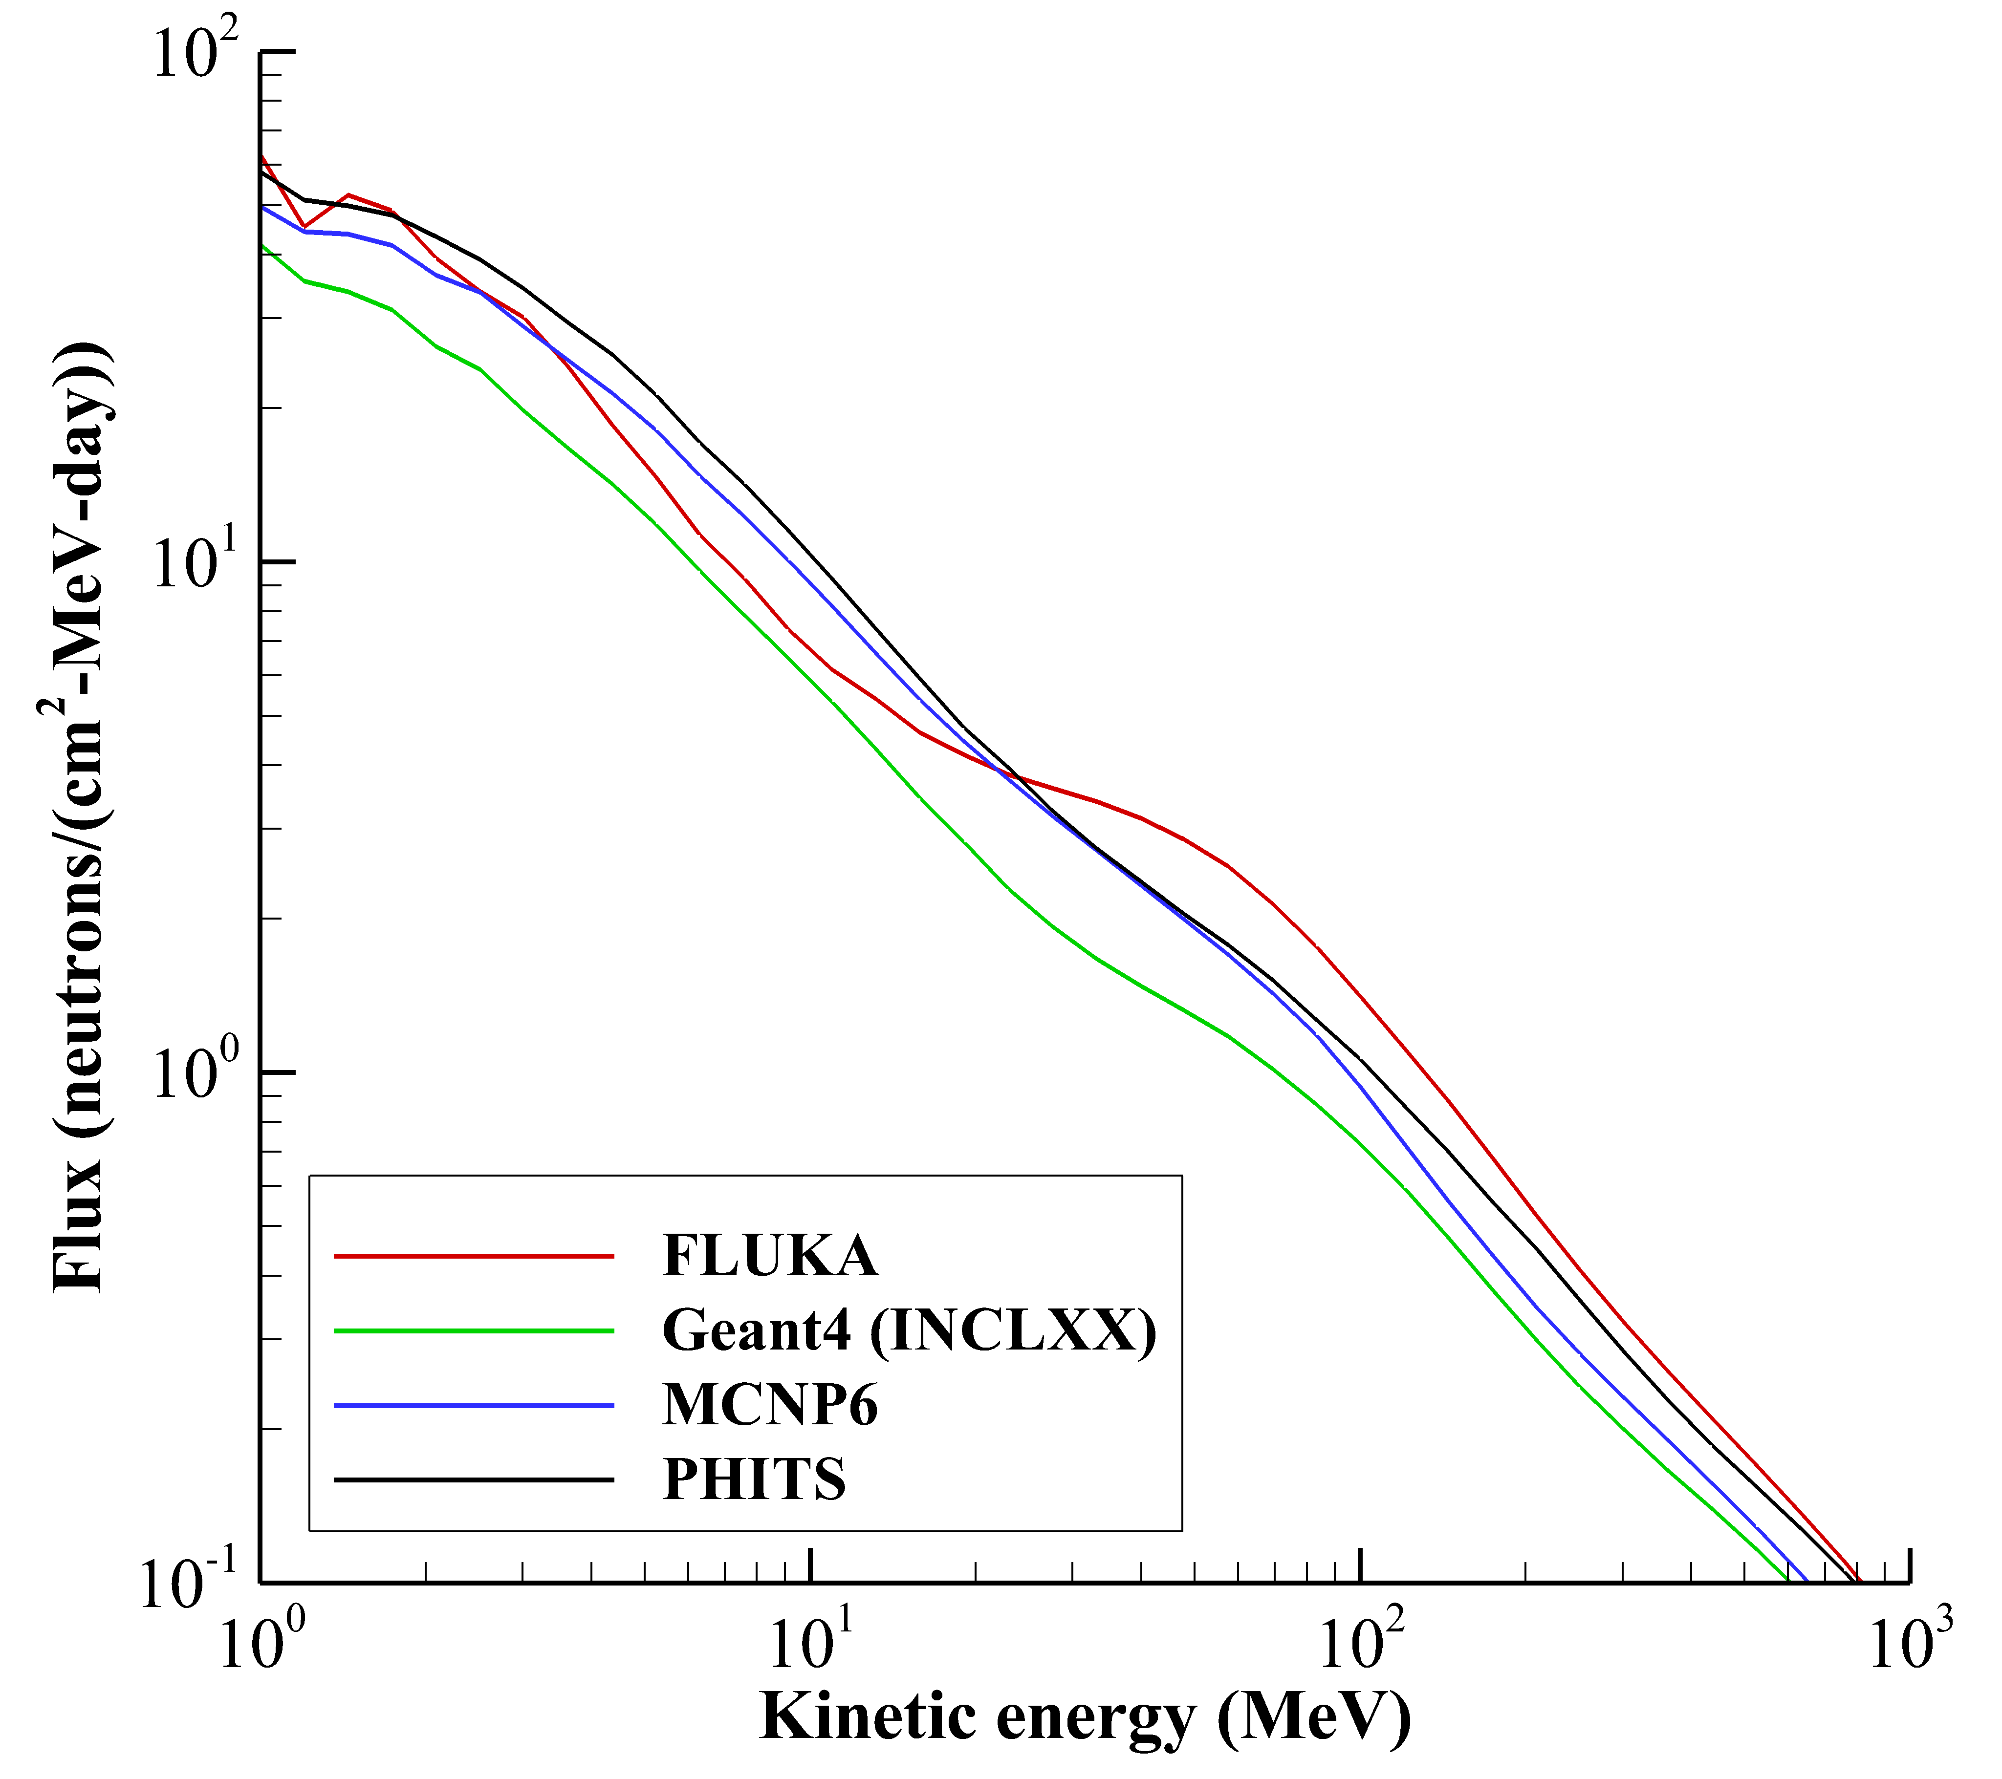
Nuclear Model Uncertainty
  Comparison of neutron spectrum for 5 g/cm² aluminum shielding exposed to Fe GCR spectrum.
Nuclear physics model uncertainties affect space radiation protection quantities
  Traceable to gaps in ground-based data
Factor of 2 difference
Simulation setup
Front shield
Back shield
Fe GCR spectrum
Infinite lateral dimensions
5 g/cm²
5 g/cm²
Thin water target

Slide 12
Summary
Secondary neutrons account for ~10-30% of the biological dose in space
  Neutrons between 1 MeV and 1 GeV are the main region of interest
  Transport physics dominated by low energy elastic scattering and higher energy inelastic collisions
Neutron transport models are in good agreement if same cross sections are used
  Deterministic vs. Monte Carlo code comparisons have been extensively studied for space radiation
Radiation transport codes in good agreement with spaceflight measurements
  Nuclear model uncertainty is the largest remaining influencing exposure calculations
Direct comparison of nuclear models reveals large differences in some cases
  Shown to influence quantities of interest to space radiation protection
  Traceable to gaps in ground-based experimental data

