Slide 1



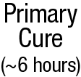

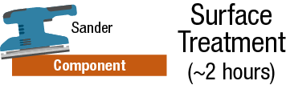
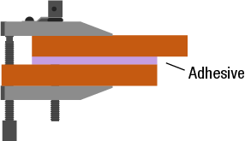
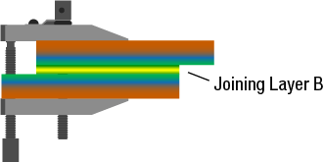

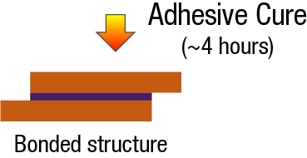
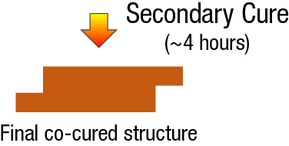
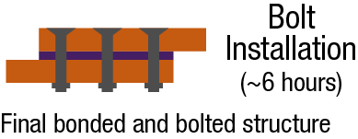
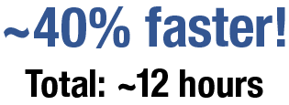


Why is AERoBOND Transformational?
Airframes are assemblies of many parts
Composites can be assembled rapidly with adhesives
Redundant load path (bolts) is required for certification
Thousands of drilling and installation steps
Composites should be replacing metals in aircraft but…
Fastener installation is too slow causing a bottleneck
Production rates cannot meet future demand
  Especially true before pandemic and still valid for projected long-term growth
AERoBOND addresses part of this problem
AERoBOND eliminates the need for surface preparation
Significantly reduces the reliance on redundant fasteners
AERoBOND method projected to be ~40% faster than state-of-art with equivalent or improved mechanical properties.
Joining Layer A
Surface Treatment
Bolt Installation
~40% Faster and ~10% Lighter
“AERoBOND – Enabling Reliable and Rapid Manufacturing for Tomorrow’s Aircraft”

