Slide 1
Thermal InfraRed Sensor TIRS-2 Instrument Development
Synthia Tonn/550
Instrument Systems & Technologies Division
Goddard Space Flight Center

Slide 2
TIRS-2 Project Overview
TIRS-2 will fly on the LandSat 9
  16 day re-visit cycle
Like TIRS on Landsat 8, TIRS-2 will produce radiometrically calibrated, geo-located thermal image data
  TIRS-2 operates in concert with, but independent of, the Operational Land Imager (OLI-2)
  Final scene data generated as part of the Data Processing and Archive Segment at the United States Geological Survey/ Earth Resources Observation and Science (EROS) facility in Sioux Falls, South Dakota
USGS responsible for operational code
  TIRS-2 will deliver algorithms and parameters necessary to evaluate data and produce required outputs
  No changes expected from process used for TIRS on Landsat 8
TIRS-2 image data will have the same performance characteristics as that of TIRS on Landsat 8
  Except better in some cases

Slide 3
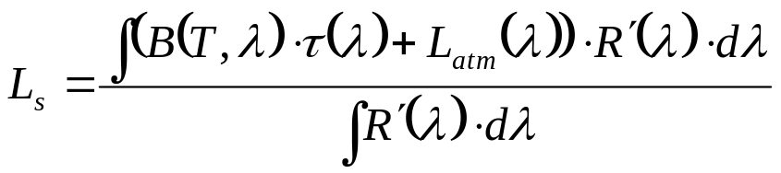






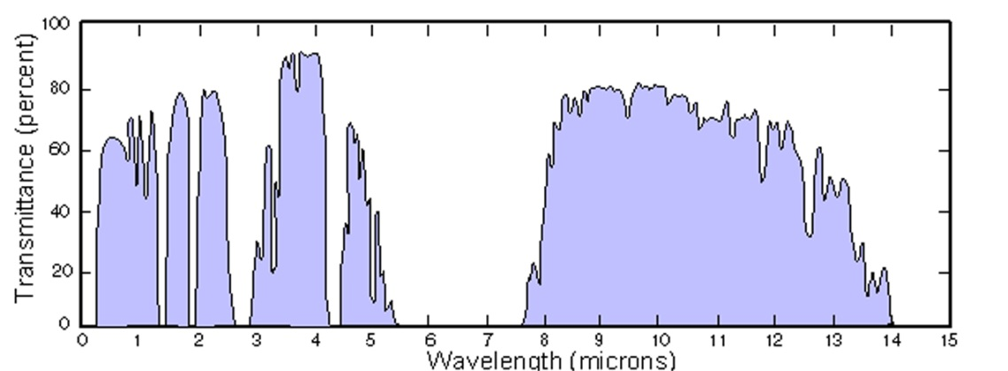


Thermal Radiance Detected by TIRS-2 from Surface and Atmosphere
TIRS
Emitted and reflected surface radiance
Transmission of atmosphere
Emitted and scattered radiance of atmosphere
Spectral response of pixel
Pixel integrated radiance
Atmosphere
TIRS channels
Surface
Two channel “split window” techniques correct for atmosphere and improve retrieved surface temperature

Slide 4
TIRS-2 Science Overview
Landsat satellites have acquired single-band thermal images since 1978
  Landsat 3 (1978 -1983 ) afforded 240 m spatial resolution in the thermal band
  Landsat 4 (1982 - 1989) and Landsat 5 (1984 – 2003) afford 120 m resolution
  Landsat 7 (1999 - present) affords 60 m resolution
TIRS on Landsat 8 (launched 2/11/2013) produces 100 m thermal data in 2 bands
  2 bands allows use of split-window technique to correct for atmospheric absorption
  TIRS-2 on Landsat 9 will do the same
Landsat thermal data are now used operationally to monitor water consumption on a field-by-field basis in the U.S. West and internationally
  Evapotranspiration cools vegetation
  120 meter resolution (or better) sufficient
  Allowed by development of operational energy balanced-based evapotranspiration models
    Parametric models use measured vis/NIR and thermal radiation, surface classification and estimates of soil thermal transport

Slide 5






Example: Water Management Using Surface Energy Balance
R_{NET} = G + ET + H
R_{NET} = (SW_{dn} – SW_{up}) + (LW_{dn}-LW_{up})
Latent heat
(ET)
Sensible heat
(H)
Net radiation
(R_{NET})
Soil heat (G)
Net Radiation is the balance between incoming minus outgoing radiation
  OLI required to calculate the SWup (short wave albedo)
  TIRS data required to calculate the LWup from surface temperature
Notes:
The remainder of the energy is converted into what’s called “sensible heat”, because you can sense it with thermometers. Its driven by the surface-to-air temperature gradient and this is where the thermal data come in most directly.
It’s heat that diffuses and convects upward into the atmosphere – kind of the opposite of the soil heat flux. Sensible heat drives the convective thermals that lifts the water vapor released in latent heating up to cloud-forming heights, so it’s also an important flux in terms of atmospheric dynamics.
The partitioning of net radiation between latent, sensible and soil heating depends strongly on local conditions: what kind of vegetation there is, how moist the soil is, local temperature humidity and wind speed…

Slide 6
Driving Requirements
 | Title | Requirement | Expected Compliance
Spectral | Thermal Spectral Band and Width | Band 10.8 Center 10.8 +/- .2, min/max edge 10.3/11.3 um Band 12.0 Center 12.0 +/-.2, min/max edge 11.5/12.5 um Waiver Approved for 12.5 um Level 3 Requirement | = 10.9 nm center, 10.6 um to 11.2 um = 12.05 nm center, 11.5 um to 12.6 um Model shows band edge around 12.55 um, analysis shows negligible impact on science
Radiometry | Absolute Radiometric Accuracy | Absolute radiometric uncertainty relative to a NIST traceable standard < 2% (1-sigma) | CBE = 1.8% (1-sigma)
 | Radiometric Stability | 12.0 um < 0.70% (1-sigma) 10.8 um < 0.70% (1-sigma) | = 0.53% (1-sigma) = 0.51% (1-sigma)
 | Noise Equivalent Delta Radiance -NE∆L | 10.8um 0.059 W/m2 sr μm 12um 0.049 W/m2 sr μm | Radiance < 0.008 (360K, flood source) Radiance < 0.008 (360K, flood source)
Spatial | Ground Sample Distance | 185 km cross track swath width 120 m cross and in track for each detector element | 185 km 100 m per detector element
 | Relative Edge Response | AT > 0.047/m (originally > 0.007/m) XT > 0.047/m (originally > 0.007/m) Deviation Approved for Level 3 Requirement | 10.9 um: XT: .0059 m AT: .0058m 12um: XT: .0059 m, AT: .0060 m TIRS-2 performance same as TIRS, which met science objectives.
 | Edge Extent (10 to 90%) | AT < 245m (originally <150m) XT < 245m (originally <150m) Deviation Approved for Level 3 requirement | 10.9 urn: XT: 215.6 m, AT: 222.9 m 12um: XT: 214.9 m, AT: 205.5 m TIRS-2 performance same as TIRS, which met science objectives.
Pointing | Absolute Pointing | 2 mrad (3-sigma, per axis) | XT= 556.6 urad, AT= 688.0 urad
 | Alignment Knowledge | < 600 urad each axis | XT= 279.3 urad, AT= 400.0 urad
 | Pointing Stability | < 27 urad (3-sigma, per axis) over 16 days | XT= 7.16 urad, AT= 4.14 urad
 | Timing Accuracy | Timing of each detector column shall be known < 1.5 ms | CBE < 1.5 ms

Slide 7
Driving Requirements
Title | Requirement | CBE / MEV
Engineering
Science Data Rate | < 15Mbps | = 9.747Mbps
Power | Imaging / Calibration (Operational PWR) MEB < 150 W CCE < 225 W | MEB CBE = 97.0 W CCE CBE = 190.0 W
 | Survival PWR< 255 W | CBE = 197.0 W
 | Fault Mode (Operational PWR) MEB <150W CCE <225W | MEB CBE = 81.0 W CCE CBE = 190.0 W
Mass | Total < 350kg Instrument Deck Total <210kg | MEV = 326.0 kg MEV = 201.1 kg
Availability | > 0.95 | > 0.95
Mission Life | 5.25 Years = ops + commissioning | = 6 years (mission life + ground ops)

Slide 8
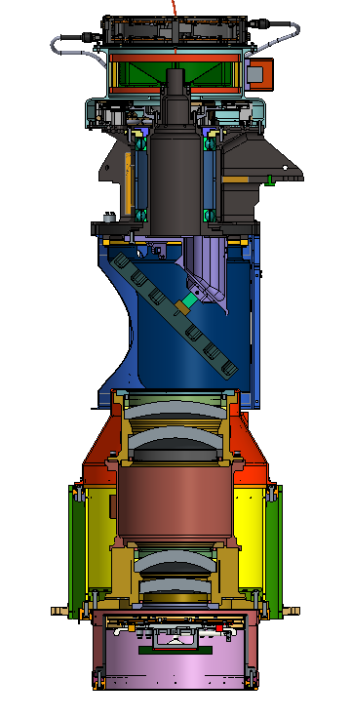
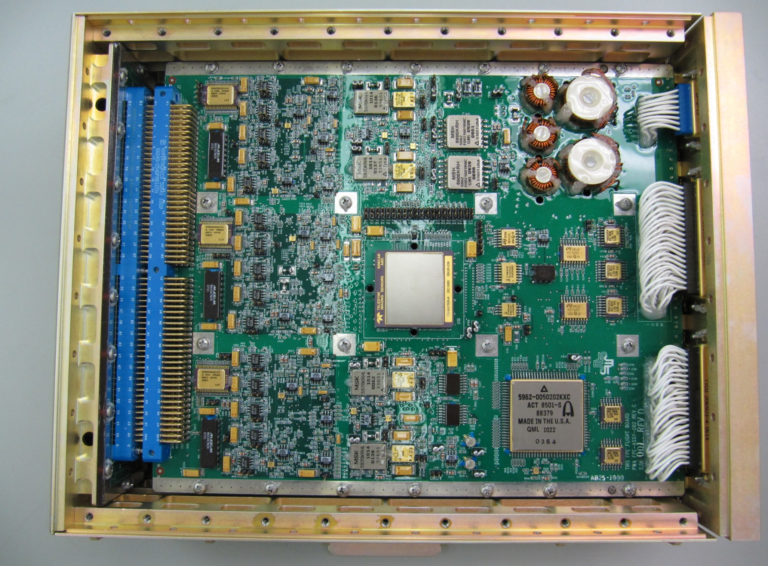
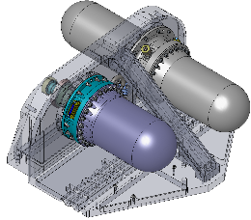
Instrument System
Block Diagram
ESDS NEA
Major Functions:
Cryocooler
Science Data Path
Mechanisms Control/Deployables
Thermal Control
L-9 Spacecraft
CCLL NEA
Mirror Position/ Control
MEB-B
MEB-A
SSM/OP5
MCE
TCB
PWR(x6)
Light
Path
HLDC (x2)
PCB
BBCAL/ OP7
BBCAL Sup./ OP8
BBCAL SUP./OP9
PPS (x2)
1553 (x2)
CDH
Telescope Aft/ OP3
HSIB
Telescope Fwd/ OP4
FPE/OP6
FPE-A
Warm Stage
OP1
FPE-B
FPA
FIB
Photons
SCA
SCAB
SSAC
PWR(x2)
CCE-A
RSE
Communication Interface
CCE-B
Frequency/Temp Control
Key
Optical Path
Communication
Power

Slide 9
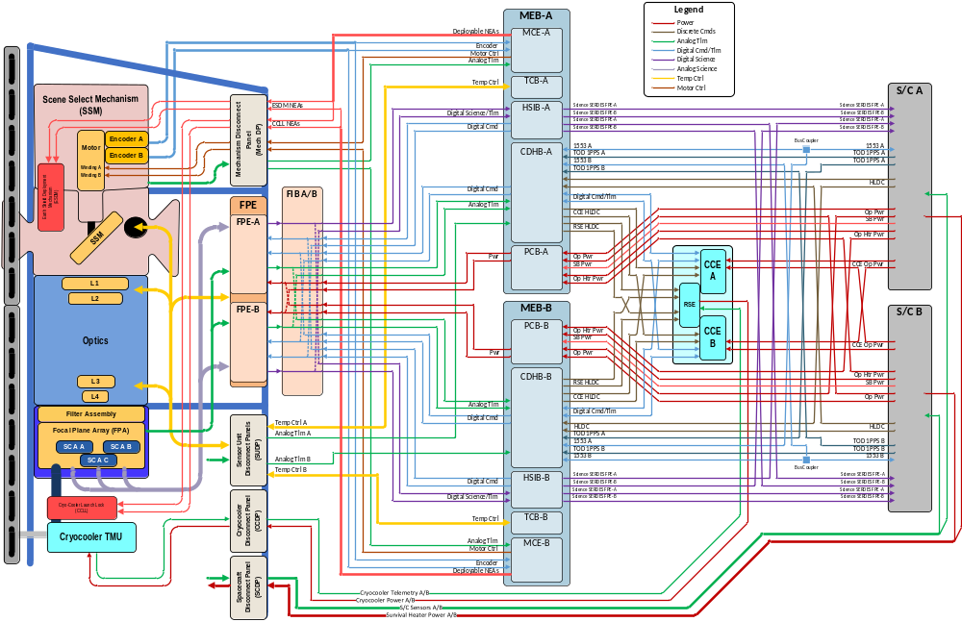
TIRS-2 System Block Diagram

Slide 10
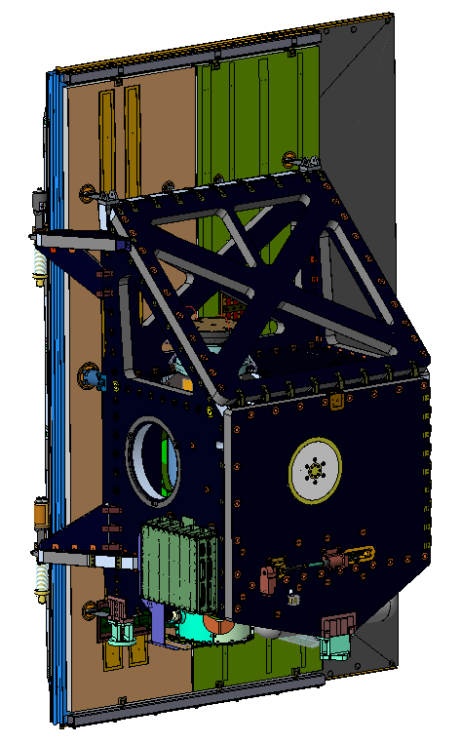
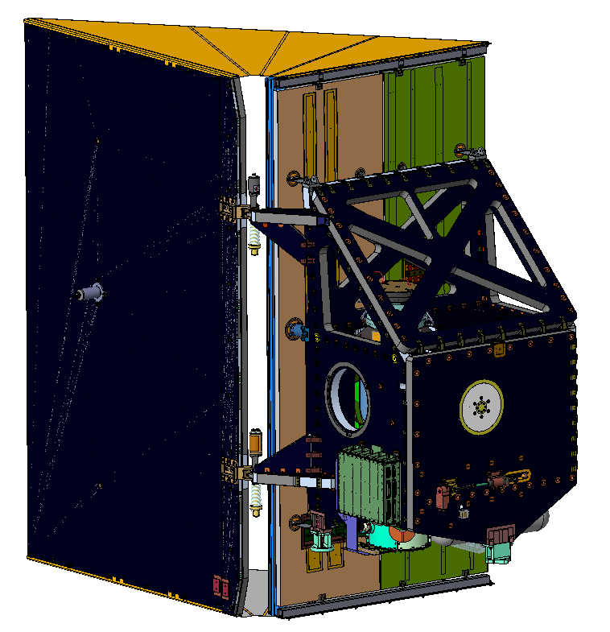
TIRS-2 Sensor Unit Design Overview
TIRS-2 Stowed
TIRS-2 Deployed
Radiator
Flexures
Earth Shield Wing
Telescope
Radiator
Earth Shield
Cryocooler
Radiator
Structure
Earth Shield
Deployment
Hinges
Black Body
Nadir
View
Structure Feet
(I/F to S/C)
Earth View Port
Cryocooler
Launch Lock System
Focal Plane
Electronics (FPE)
Notes:
-update with new wing bracket

Slide 11
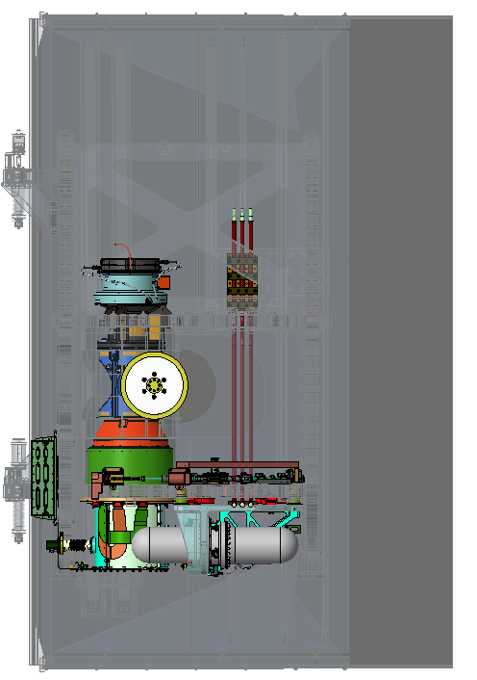
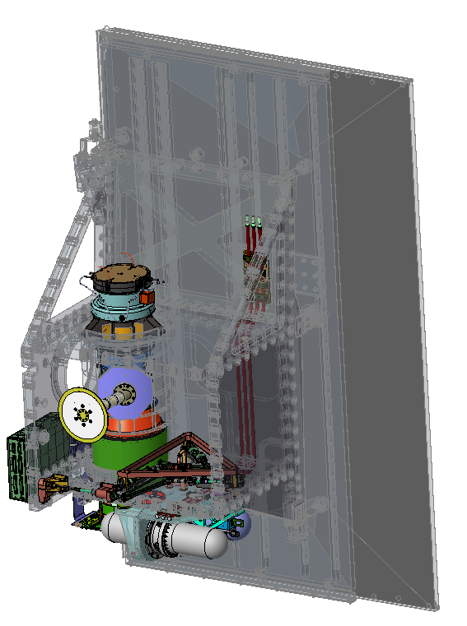
TIRS-2 Sensor Unit Design Overview
Telescope Radiator
Cryocooler Radiator
Embedded
Heat Pipes
Transport
Heat Pipes
Scene
Select
Mirror
Light
Path
Encoder
Electronics
Telescope
Lenses (4)
Scene
Select
Mech.
(SSM)
Blackbody
Target
Blackbody
Radiator
Telescope
Structure
Telescope
Cryocooler
Launch Lock
Focal Plane Array
(FPA) (Detector)
Cryocooler
Vibration
Isolator
Cryo Shells
Cryocooler
Flexible Printed Wiring (FPW)
Keel

Slide 12
Overview of TIRS Sensor, con’t
Scene
Select
Mech.
(SSM)
Telescope
Structure
Scene
Select
Mirror
Telescope Isolation System (TIS)
Telescope Shield
Focal Plane Array
(FPA) (Detector)
Light
Path

Slide 13
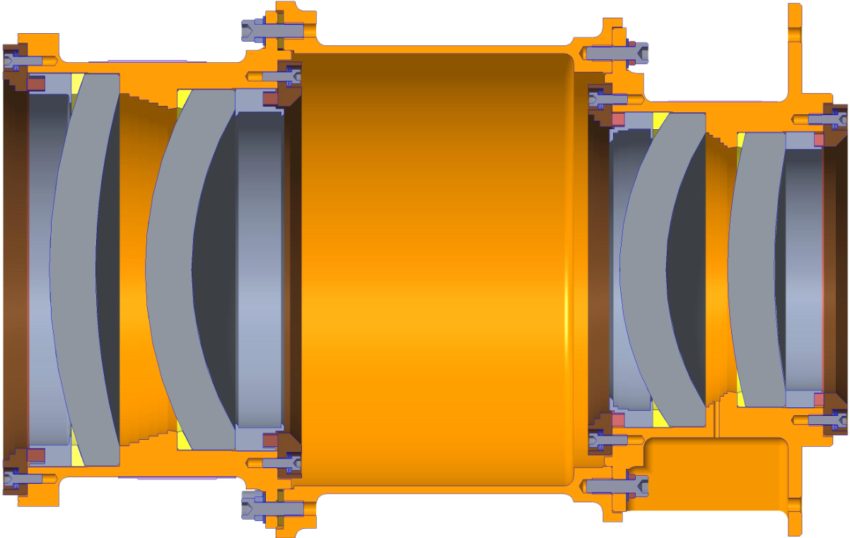
Barrel & Optics Subassembly
Lenses mount to L1-L2 & L3-L4 Subassemblies
Stray light baffles added to Lens 2 & 3 Preload Spreaders
Lens Axial Positioning: performed with Telescope Spacer & Conical Washers
L1-2 Subassembly
Midsection Housing
L3-4 Subassembly
New Baffles Features
(4x Locations)
L4 Conical Washer (Adjusts Lens 3 to Lens 4 Spacing)
Lens 1
Lens 2
Lens 3
Lens 4
L2 Conical Washer (Adjusts Lens 1 to Lens 2 Spacing)
Telescope Spacer (Adjusts L1-L2 to L3-L4 Lens Spacing)
Barrel & Optics X-Section

Slide 14
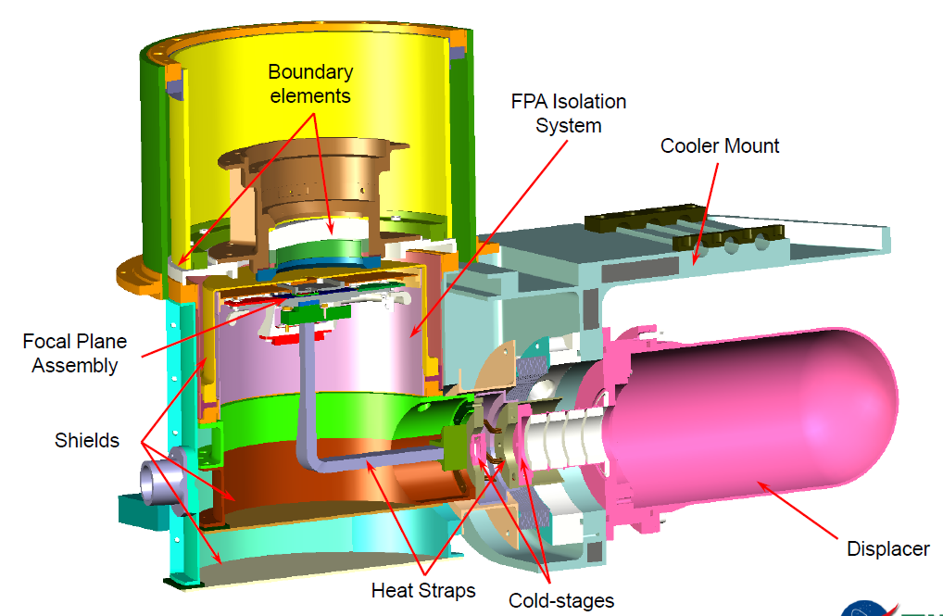
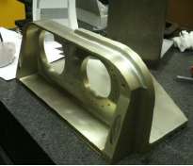
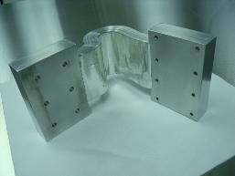
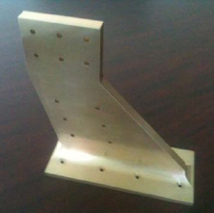
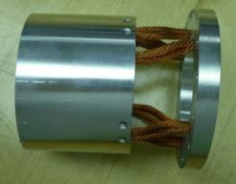
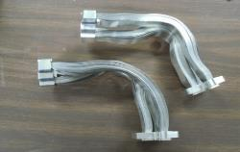
Cryo Subsystem Overview
CC Mount (keel)
Tel Stage FCL
Tel APG Bar
Telescope Link
Warm Stage FCL
Cold Stage FCL

Slide 15
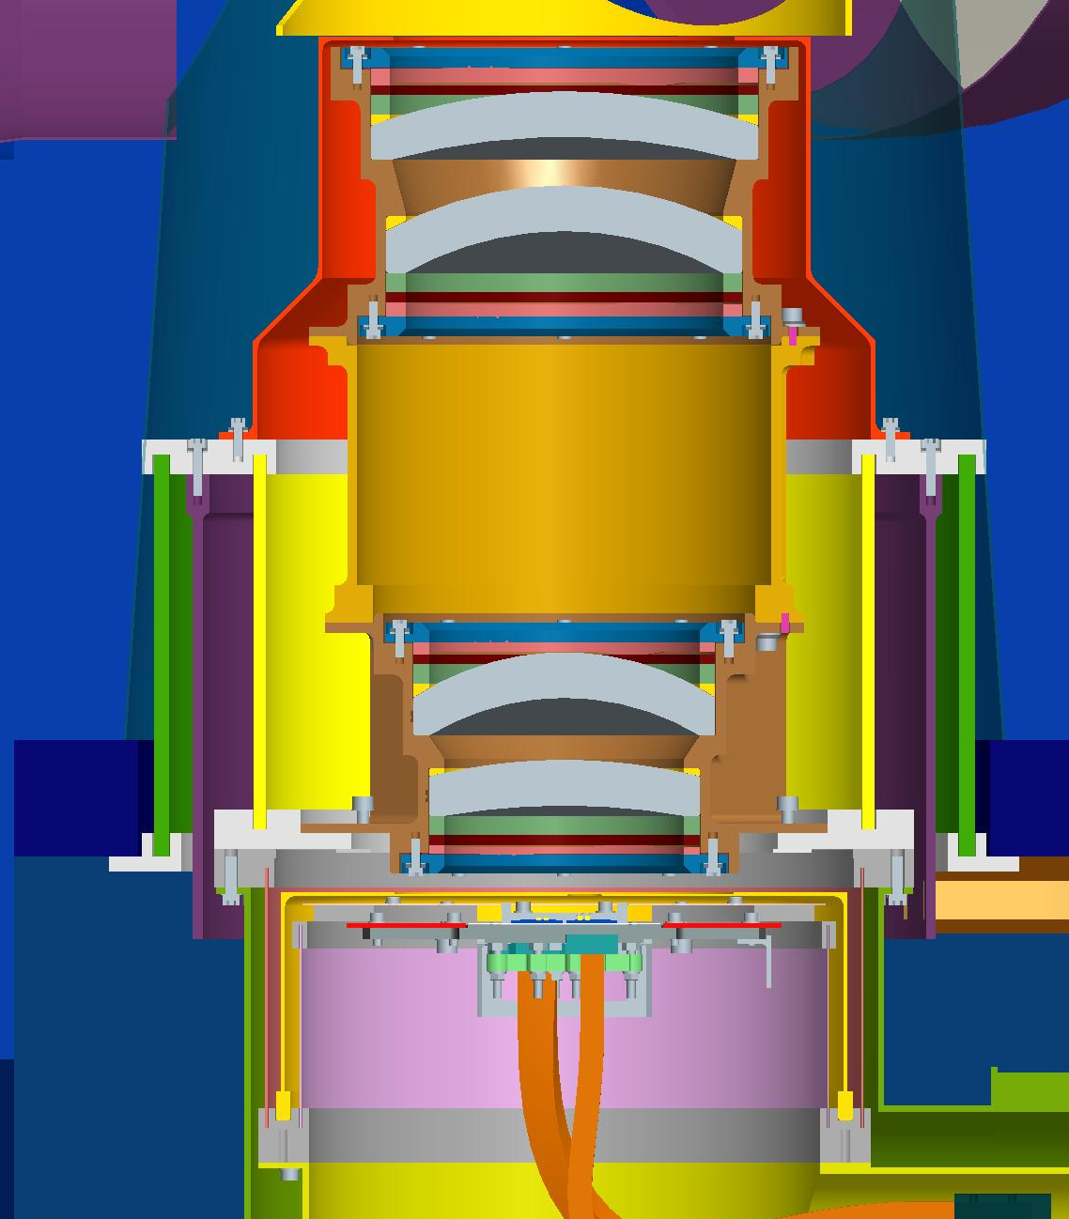
Telescope Structural Thermal Isolation Mount
Telescope 200K Shield (Alum), bolted with Indium at Interface
EA 9309.2NA Adhesive, G10 to Support, Typical
Telescope Support Ring
Telescope 160K Support Ring (Alum)
Telescope G10 Inner Cylinder (.16-inch wall thickness)
Telescope G10 Outer Cylinder (.20 inch all thickness)
Structure Panel
Telescope 200K Shroud (Alum), bolted with Indium at Interface
Telescope Mount Ring (Alum)
Conductive Strap between Shroud and Mid-Stage Radiator (not shown)
FPA Isolation Mount

Slide 16
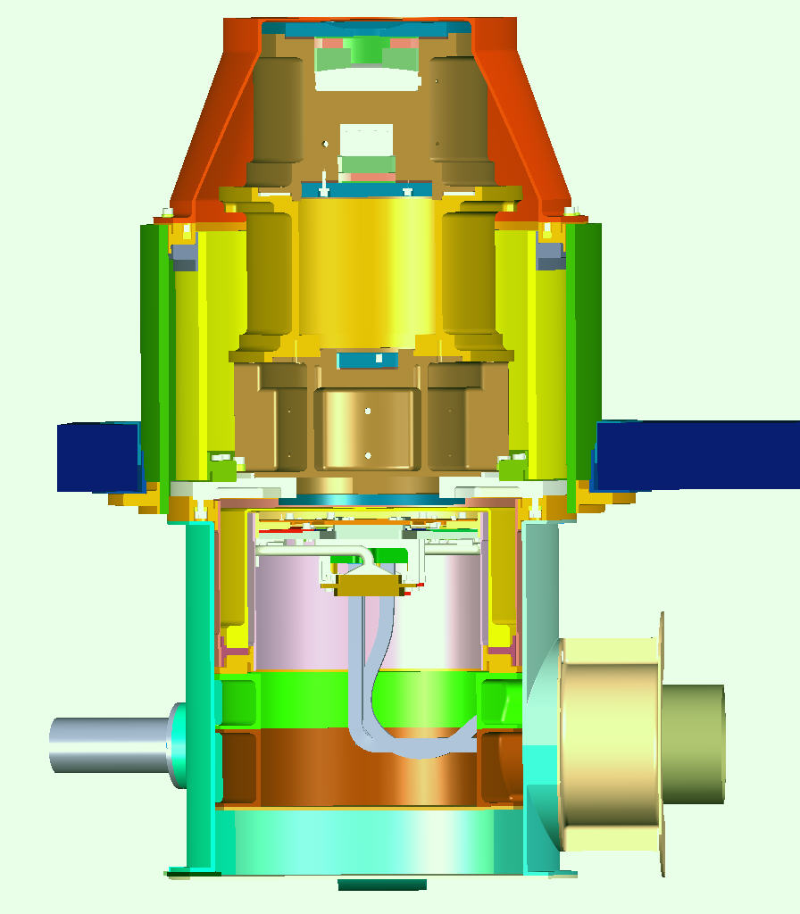
Isolation System Overview
Radiation Shields in green
Outer Telescope Isolator I/F with Structure
Telescope
G10 in blue
FPA
I/F: Inner Telescope Isolator, Outer FPA Isolator, and Telescope
FPA has physical separation from telescope

Slide 17
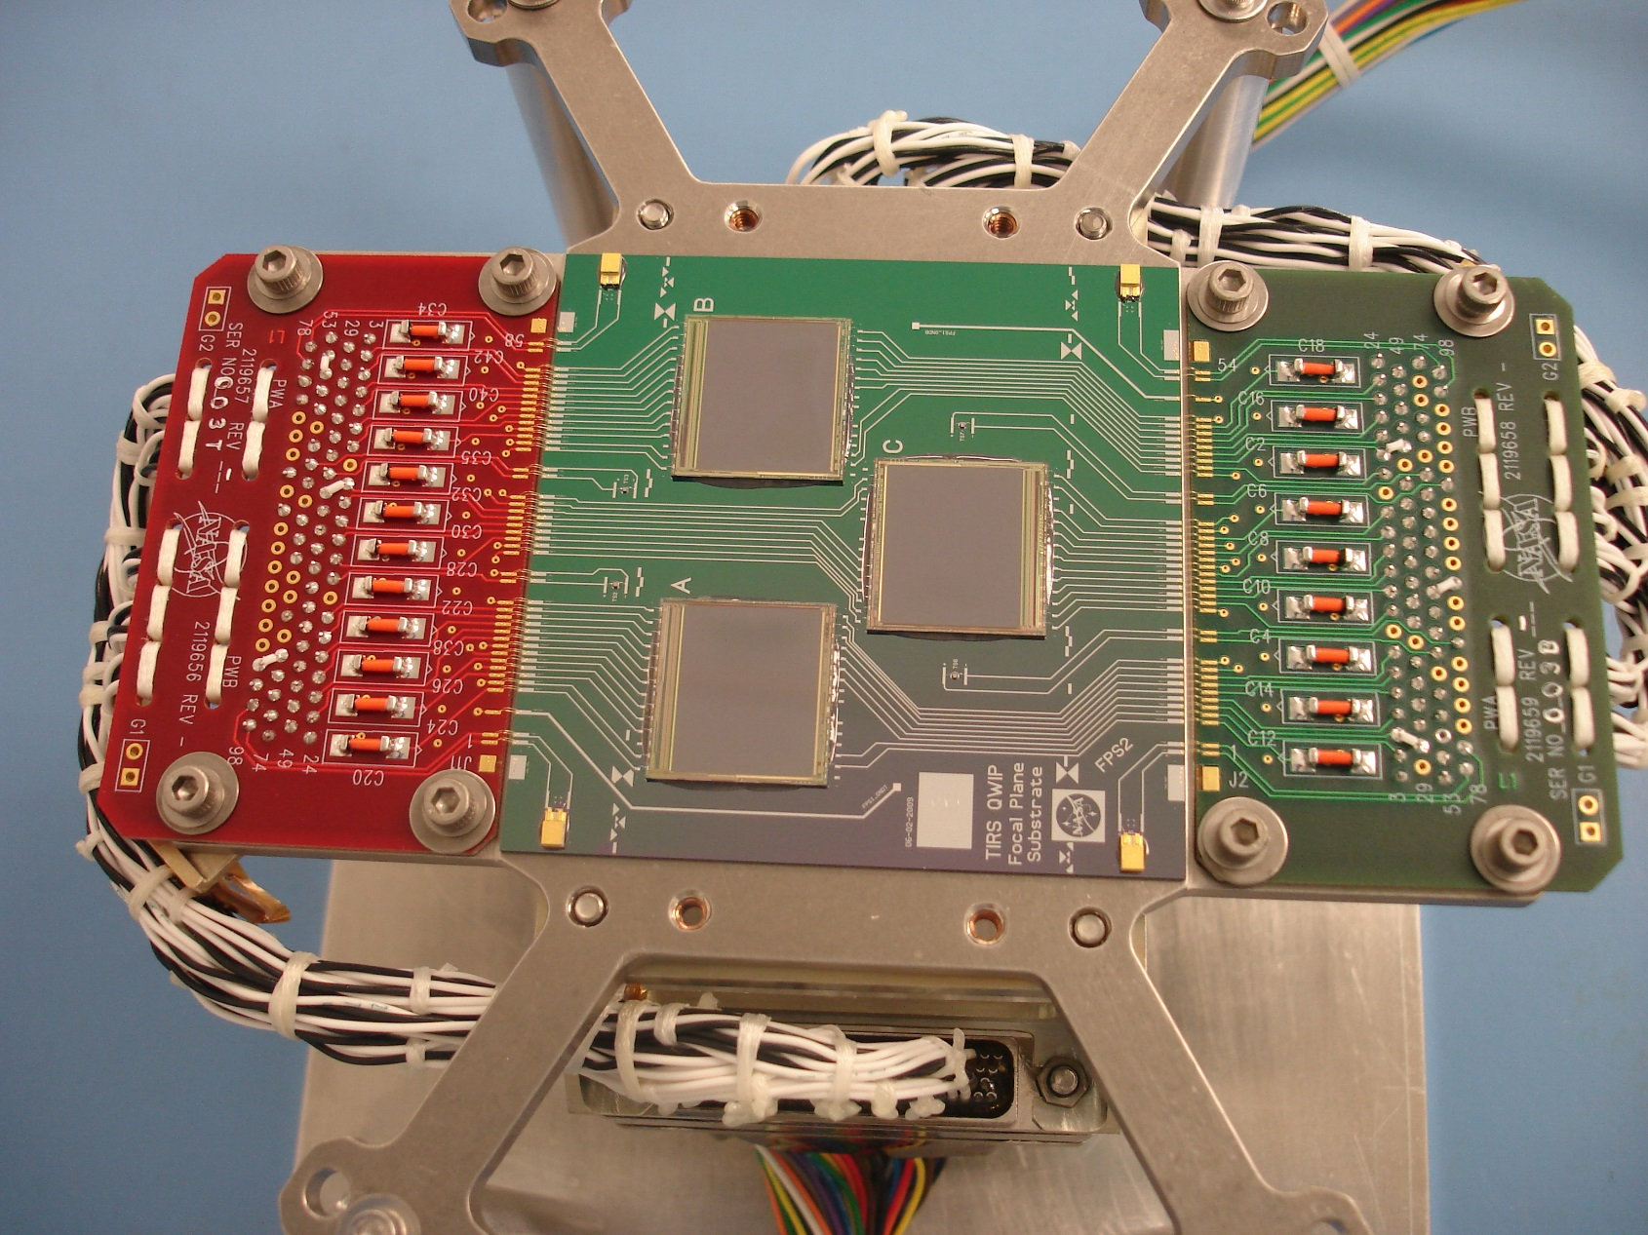
TIRS-2 Flight Focal Plane Assembly

Slide 18
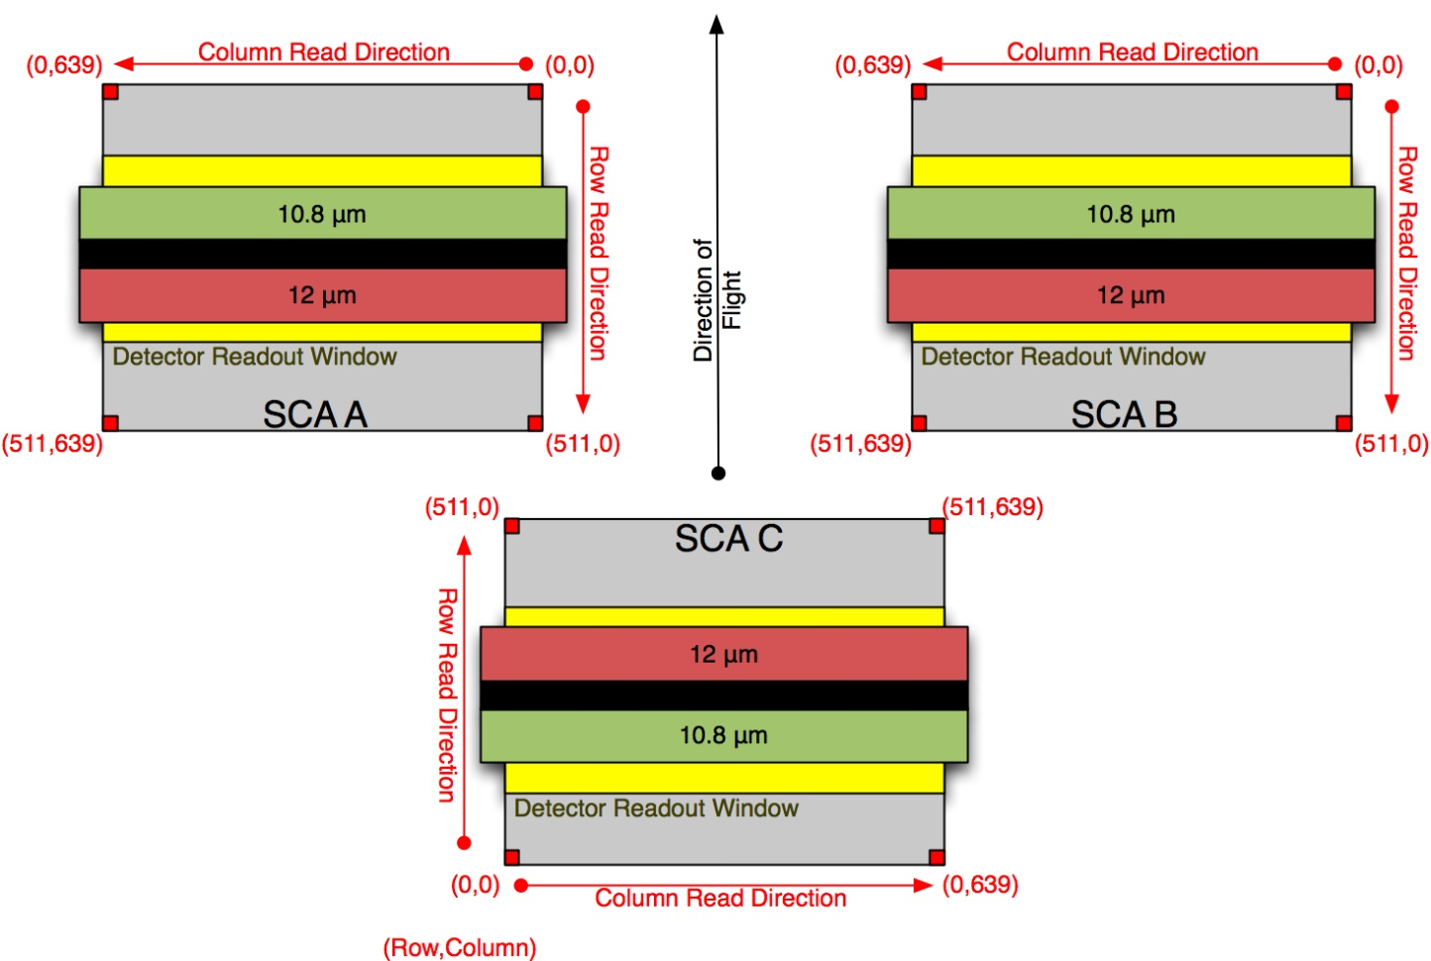
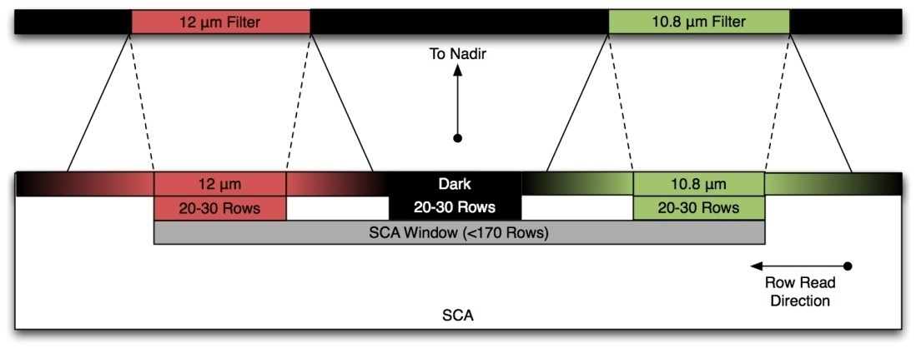
FPA Architecture
FPA has 1850 unique pixel columns
Corresponds to 185 km swath width
In-track FOV < 5.4 degrees
Filter band locations based on FPA
selection . Optimized to best region
on FPA.
35 pixel overlap
Between SCAs
FPA

Slide 19
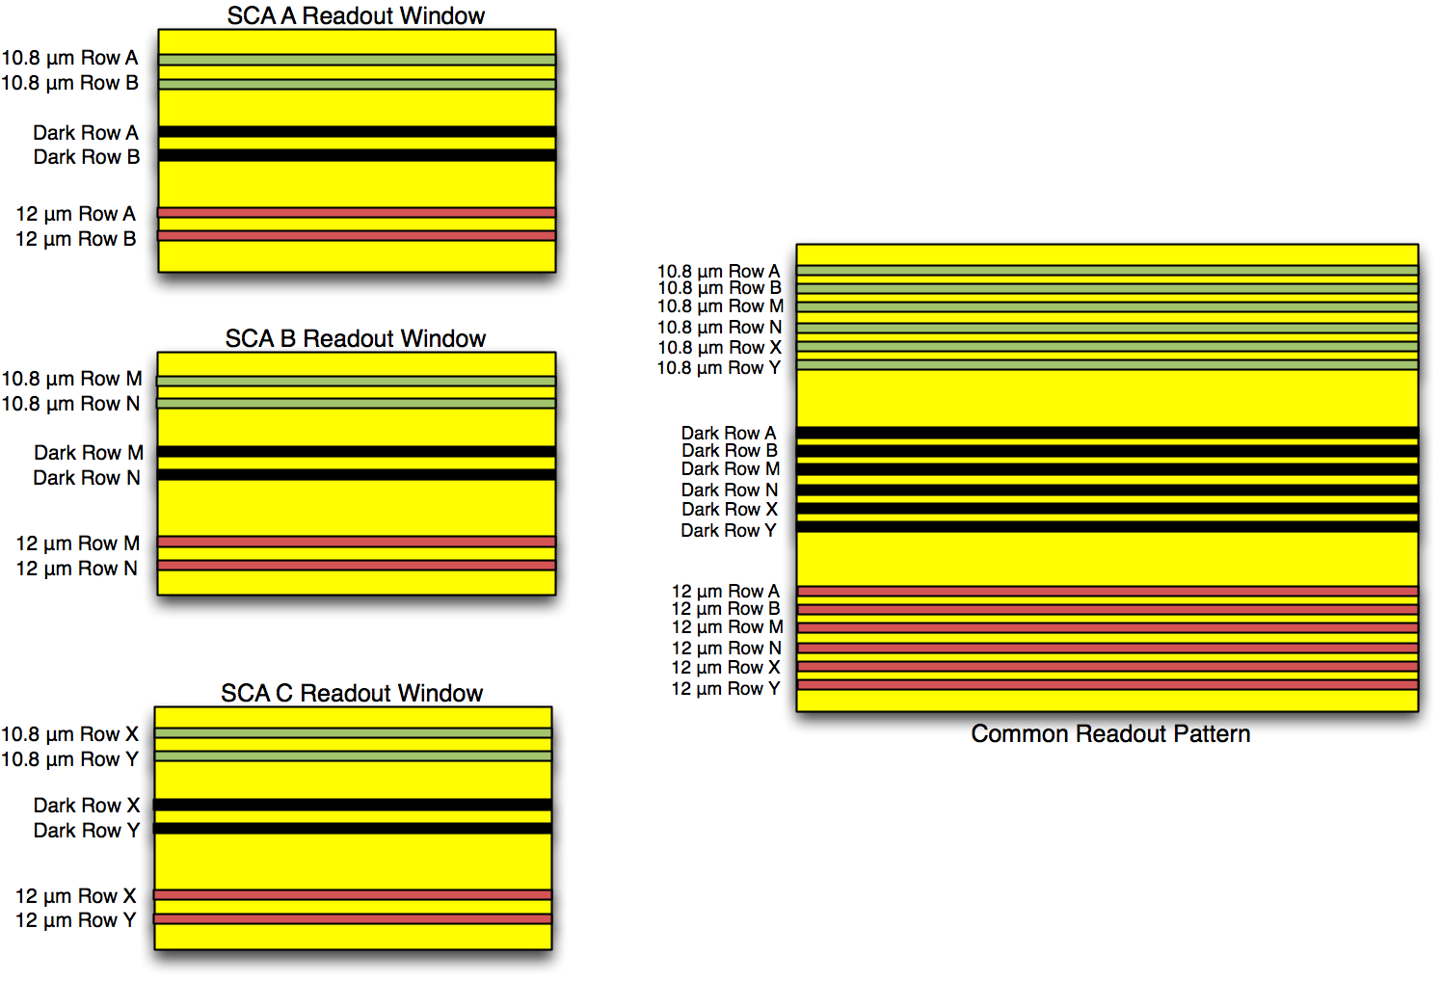
SCA Readout Paterns
Readout from through the FPE at 2 clock rates:
500 kpixel/second “Read”
1 mpixel/second “Skip”
Row mask will be set prelaunch but can be changed through microcode updates on orbit if too many pixels from a row are lost on orbit
Notes:
Update row readout?

Slide 20
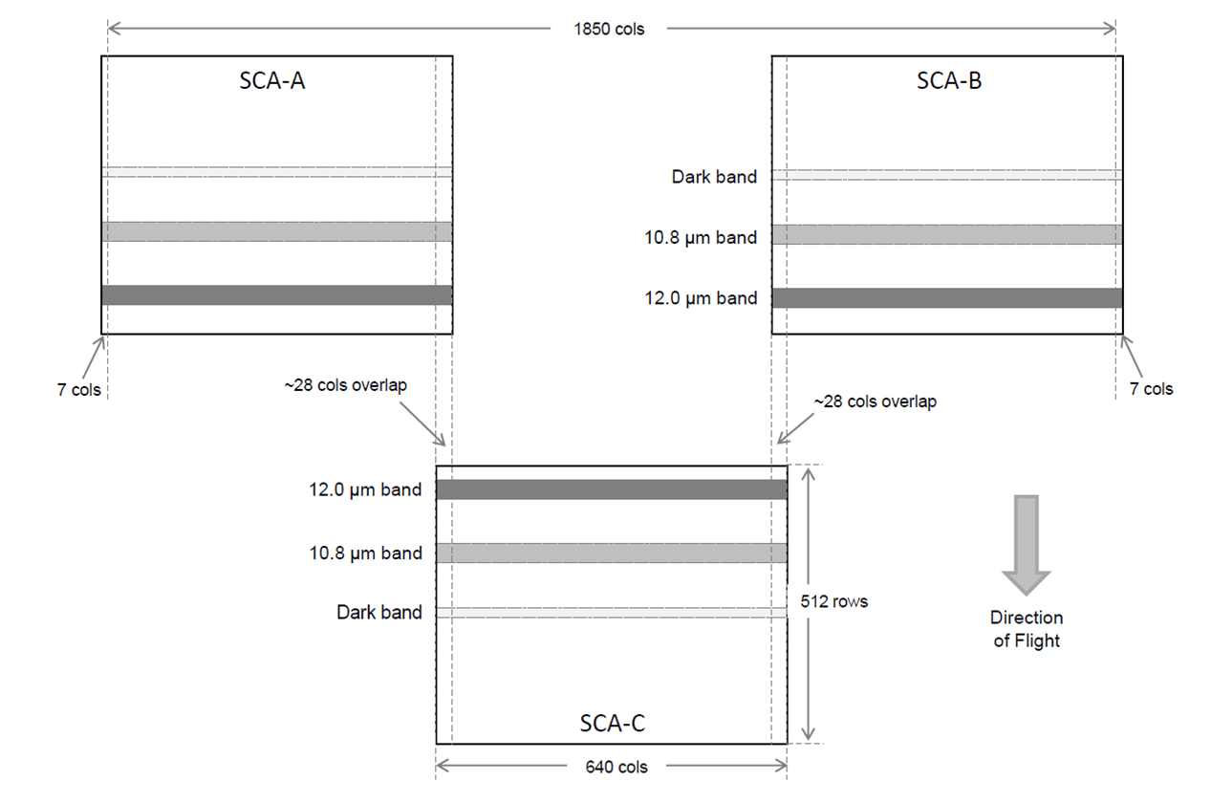
Image Formed on Focal Plane Assembly
FPA has 1850 unique pixel columns
Corresponds to 185 km swath width
In-track FOV < 5.4 degrees
Filter band locations based on FPA selection . Optimized to be in best region on FPA.
Up to 140 rows between channels on a single detector
700 rows before data produced by SCA C aligns with SCAs A and B
Read 2 rows from the central 30 rows for each filter on each array and for dark region (far from filters)
Dark region is an area covered by the filter holder
Combine data on ground to get single best row
Row selection can be changed in flight

Slide 21
How do we make an image?
2 rows of data taken in each channel and in dark area
    Combined into a single effective row on the ground
      Generally all pixels in each row are good.
    Dark only used if detector temperature is not stable – Dark has never been used
Each frame from 700 on gives another full 185 km row in each channel
Frame integration time is ~3.23 milliseconds
  Allows excellent Signal-to-Noise Ratio without significant spatial broadening
Non-science rows are skipped – allows science rows to be read out @ 235 kilopixels/sec
SCA A
SCA B
SCA A
SCA B
SCA C
SCA A
SCA B
SCA C
SCA A
SCA B
SCA C
SCA C
Frame 700
Have 2 full 185 km rows in each channel
12 μm
10.9 μm
dark
Frame 560
First channel in SCA C aligns with SCA A and SCA B
Frame 140
Second channel aligns with first in each SCA
Frame 1
Start Image collection
Notes:
21

Slide 22
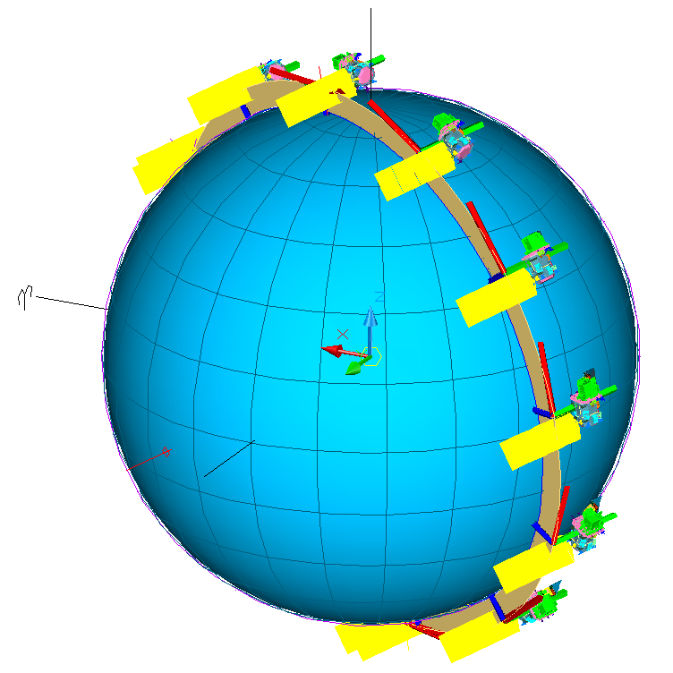
Top Level Operations Requirements
Imaging
  400 WRS-2 scenes/24 hour period
  Image up to 15 degrees off-nadir
  Acquire up to 83 contiguous sun-lit scenes per orbit
  Acquire up to 38 contiguous night scenes per orbit
Calibration Operations
  Onboard calibration capability
    Spaceview and onboard NIST Traceable Black Body
  No calibration maneuvers required
  No planned vicarious calibration sources
Orbit
  705 (-1/+27) km altitude
  98.2 ± 0.015 degrees inclination
  10:00 ± 15 minutes AM equatorial crossing descending node

Slide 23
Calibration
Blackbody
Cal. Type | Temp. | Integration Time
Normal Radiometric (twice per orbit) | Constant | Constant
Integration Time Sweep | Constant | Vary 0.1 to 5.5 msec in 0.1 msec steps
BB Temperature Sweep (every 3 months) | Gradually vary across entire range w/in 24 hours | Constant
Thermal Cal:
Change BB temperature
Nadir
Command SSM to Space View
Duration <30 seconds
Command SSM to Nadir
Duration <30 seconds
Black
Body
Standard
Calibration
Sequence
Total time < 5 minutes
Space
View
30 seconds
30 seconds
BB Temp Sweep
  BBCal setpoint is varied to support a linearity calibration sequence
  Plan to complete a linearity check every 3 months where the BBCal temperature is varied from 270K to 320K within a single day
  Calibration sequences are separated by 37 minute imaging intervals
Command SSM to Blackbody
Duration <30 seconds

Slide 24
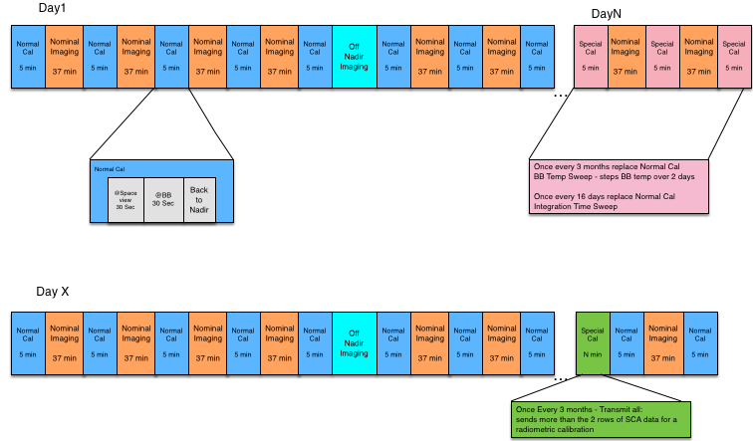
TIRS-2
On-Orbit Operations
Repeating Cycle 16 (governed by the DRC-16)
Up to 37 minutes total imaging bounded by calibrations
Mission planners coordinate Imaging Periods and Calibrations with WRS-2 and OLI-2
Frequent calibrations at least once per orbit repeat cycle

Slide 25
TIRS-2 Modes and States
Survival/ OFF Mode
Power ON
ON Mode
Science Mode
Power OFF
On Submode States:
Standby
Dry-out
Deployment
De-ice
CSS Cool Down
Safe
Fault
Science Mode States:
Normal Imaging Calibration
Mode | Configuration
Survival | Only Survival heaters active
ON Mode
Standby | MEB ON. Other electronics OFF
Dry-out | Prior to Earth Shield deploy: SU components warm
Deployment | S/C Safe Bus enabled for ES dployment
De-ice | Post ES deploy: warm temps, Initial state for CSS cooldown.
CSS Cooldown | Transition to operational temperatures.
Safe | MEB On, FPE and TCB reset, SSM – Nadir, Cryo- retain state
Fault | TIRS-2 Fault Management component safing,
Science
Imaging | Op temperatures. FPE/FPA On
Calibration | Nominal: SSM to Nadir, BB and Space views. BB at 295K Other: BB Calibrator step 270-320 K. Integration Time Sweep 0.1 to 5.5 msec
FOT cmd or S/C autonomous
FOT (GND) commanded
TIRS-2 autonomous

Slide 26
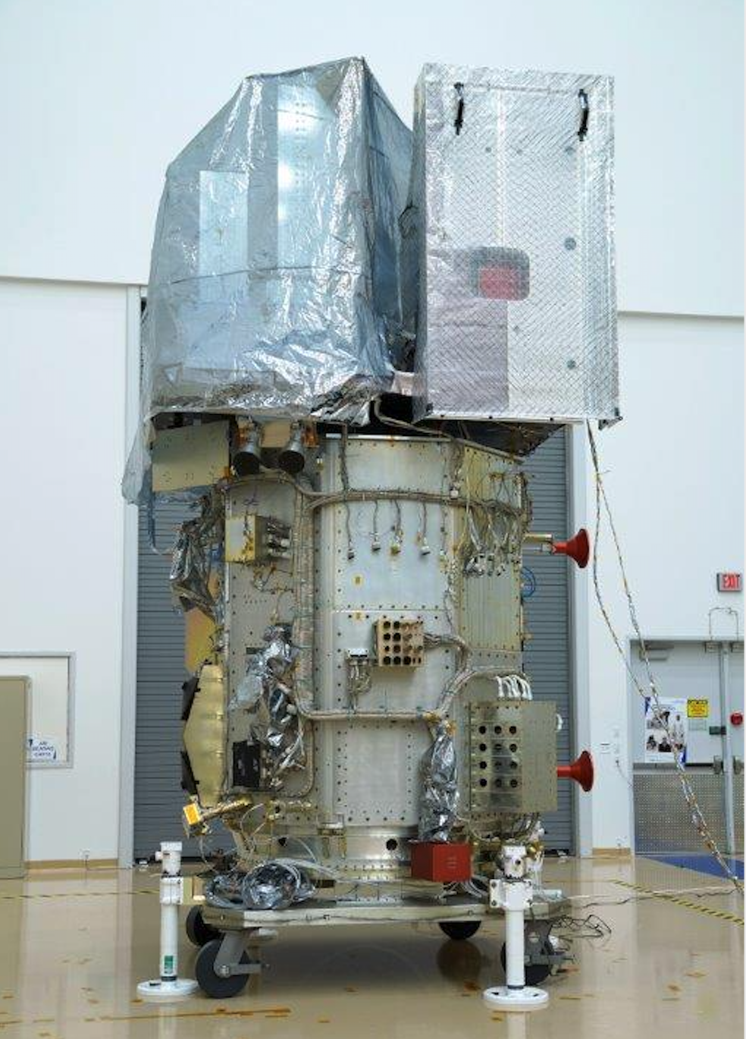
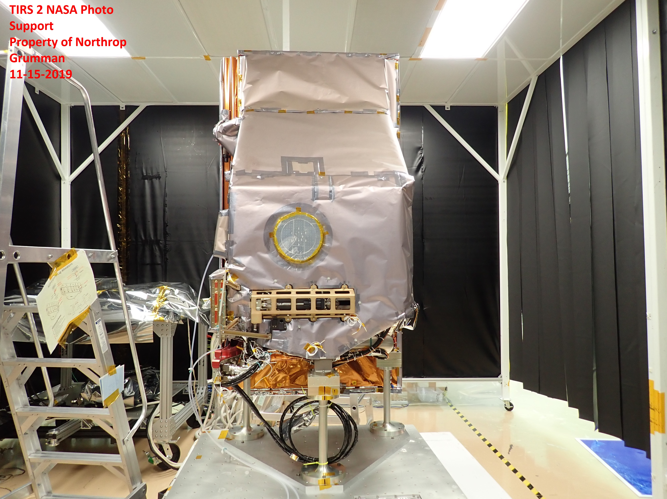
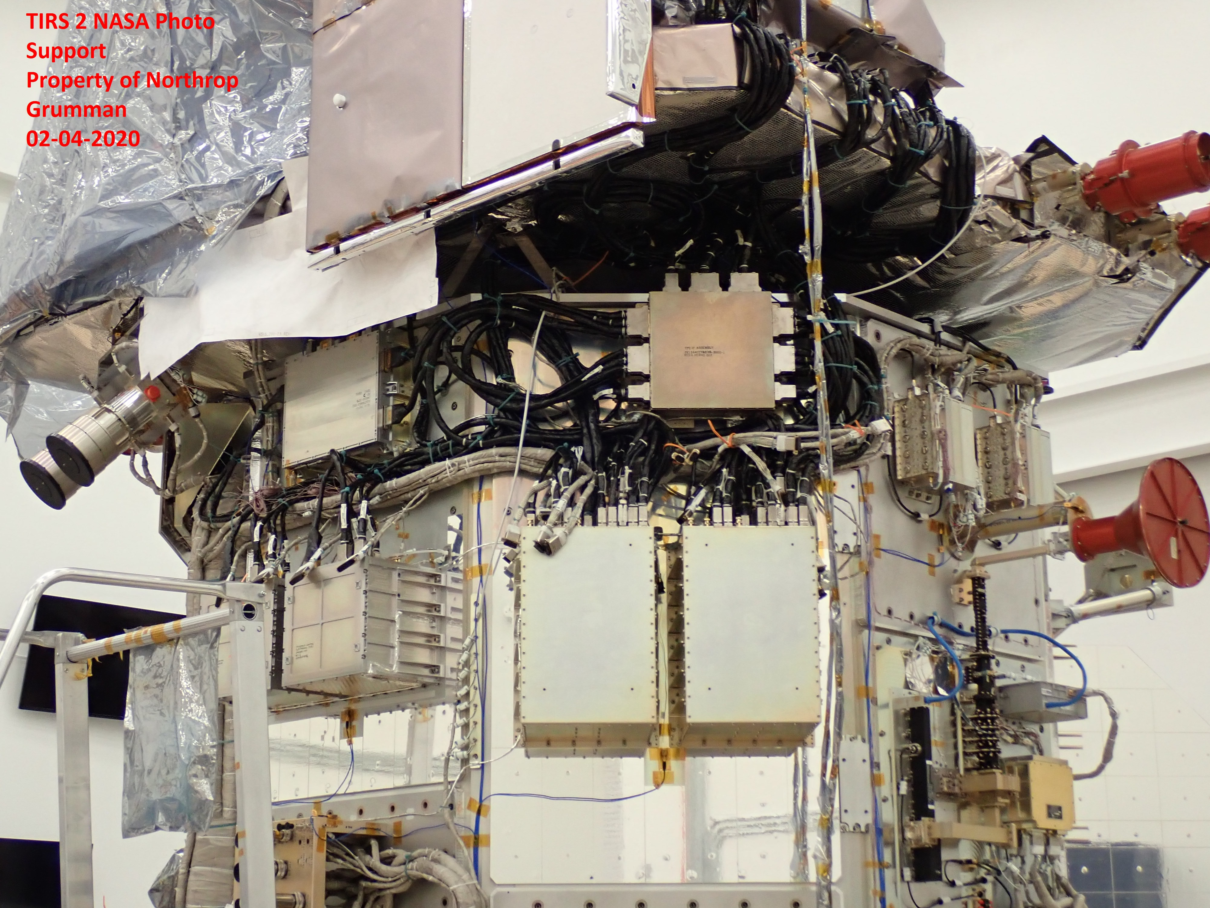
TIRS2 Hardware Photos
“Photos have been approved for public view by the GSFC Export Control Office”

Slide 27
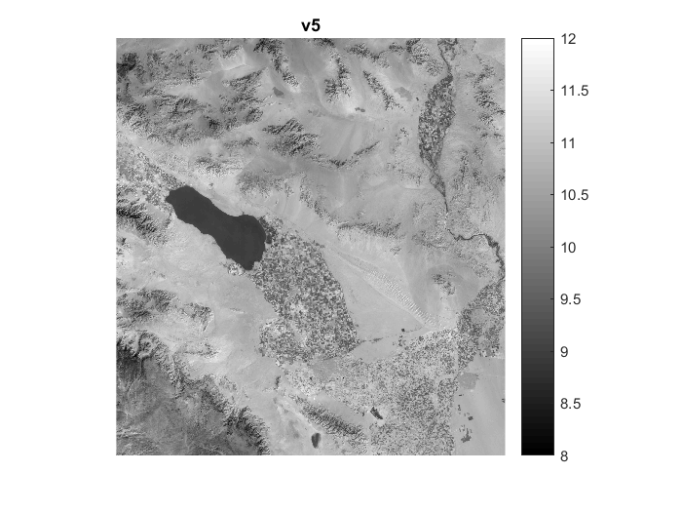
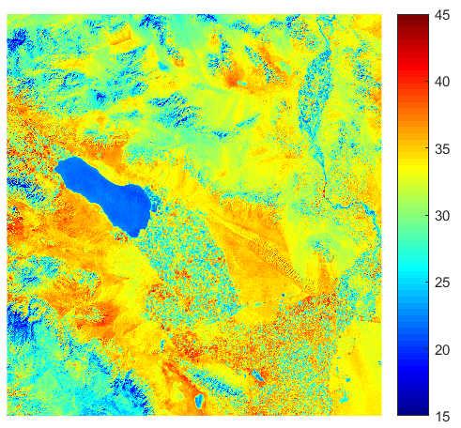
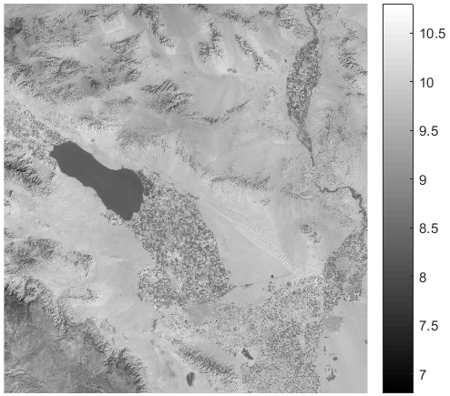
TIRS-2 Dual Thermal Infrared Spectral Bands
Using the Split Window technique, image data from the two thermal bands are used to compensate for the atmosphere and derive surface temperature
TIRS-2 first imaging started 21-301 (Oct 28 2021)
First Obs image (with OLI) started day 21-304 (Oct 31st)
10.8 um band image
Surface Temperature Map*
[C]
Radiance [W/m2/sr/um]
Salton Sea, CA, USA
Approx Lat/Lon: 33.213027 / -115.585342
Acquired: Wed 2021 Nov 03 18:05:19
RFID: 0780000.2021307193014633.SGS
12.0 um band image
Radiance [W/m2/sr/um]
*Split window coefficients supplied by Tania Kleynhans and Aaron Gerace of RIT

Slide 28
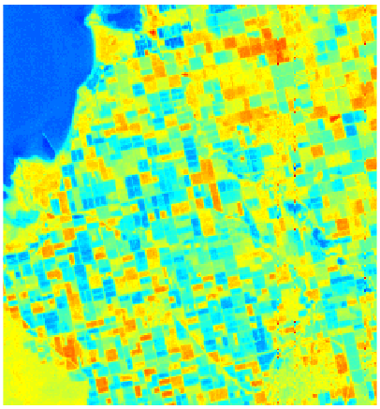
TIRS-2 Plant Health/ Water Use
Salton Sea, CA, USA
Approx Lat/Lon: 33.213027 / -115.585342
Acquired: Wed 2021 Nov 03 18:05:19
RFID: 0780000.2021307193014633.SGS
Red (warmer) fields are stressed or fallow
Blue (cooler) fields are healthy and using water (evapotranspiration)
This plant health/water use measurement ability is a major motivation for the TIRS instrument

