Slide 1
Human Mars Mission Surface Power Impacts on Timeline and Traverse Capabilities
Michael Chappell, NASA ESDMD Mars Architecture Team
2022 IEEE Aerospace Conference, Big Sky
March 9, 2022

Slide 2

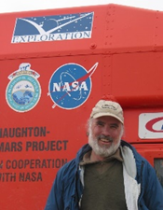

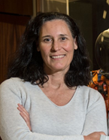
2022 IEEE Aerospace Conference, Paper 8.0113
Human Mars Mission Surface Power Impacts on Timeline and Traverse Capabilities
Michael B. Chappell
NASA Marshall Space Flight Center
Stephen Hoffman
Aerospace Corporation
Omar Bekdash
Aerospace Corporation
Michelle Rucker
NASA Johnson Space Center
Presented by:
2022 IEEE Aerospace Conference

Slide 3
Mars Mission Background
Parameters to conduct this study only, not to be interpreted as NASA “plan”
Minimal surface mission
  Two crew on surface
  Live/work in a pressurized rover only
  30 Sol surface mission duration
Support assets
  Three 25mT landers for predeployed cargo, crew delivery, and base stations
  Pressurized rover (PR) for habitation, surface traverse, and operations
  Unpressurized rover for logistics operations
  Nuclear fission surface power (FSP) supply for primary power
  Crewed Mars ascent vehicle (MAV) for departure
2022 IEEE Aerospace Conference

Slide 4
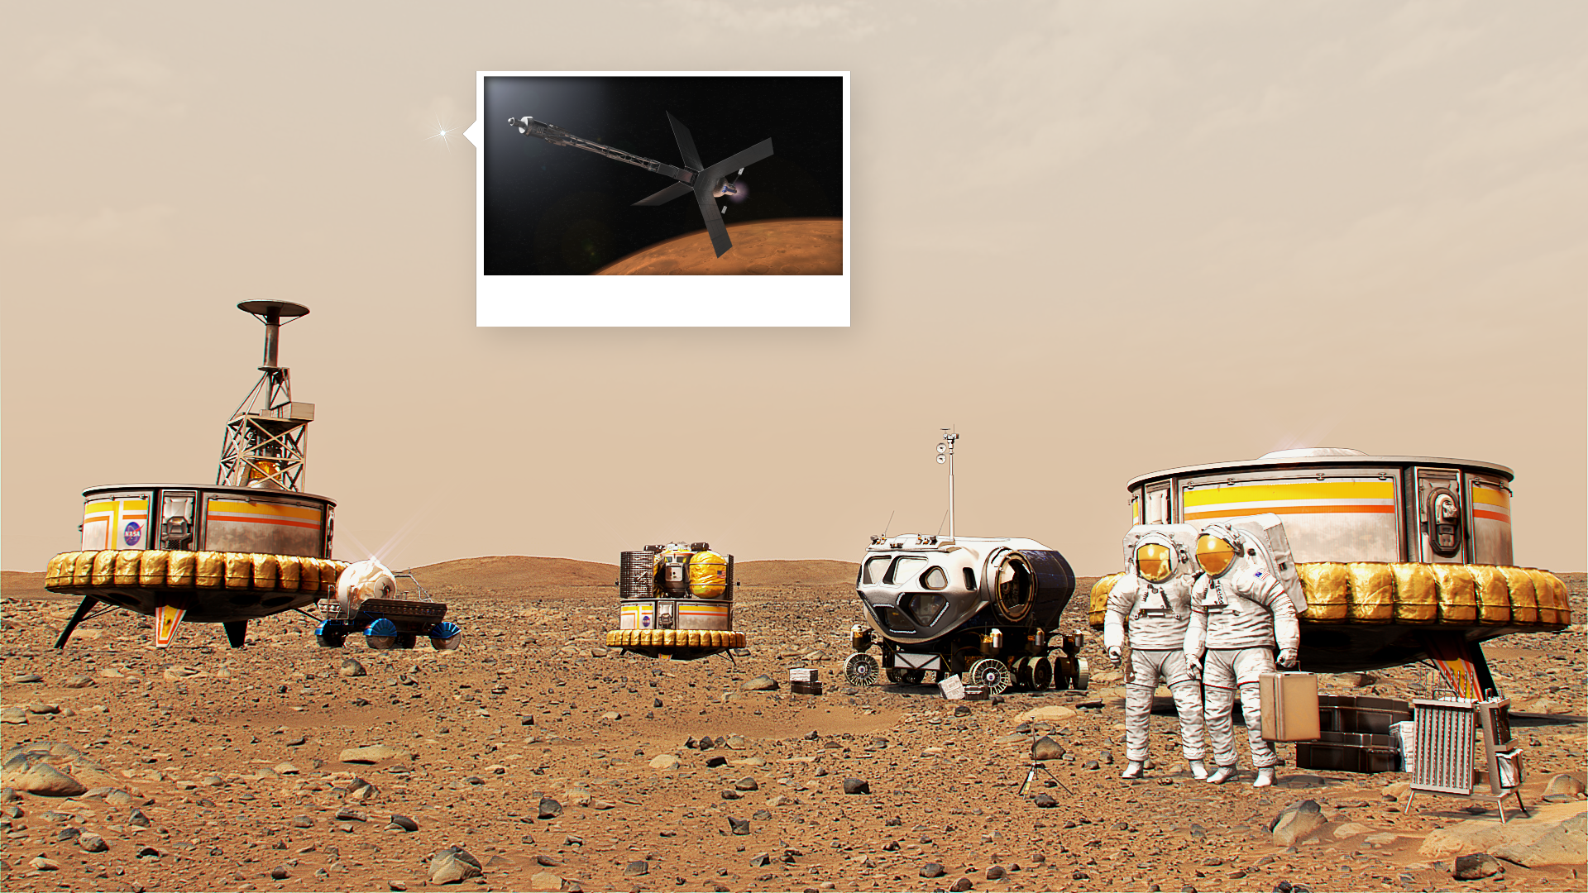
Three Lander Minimal Mars Mission
This architecture is for analysis purposes, and should not be misconstrued as “the plan”
Deep Space Transport
Lander 3
(PR Offloaded)
Lander 1
Pressurized Rover
Lander 2
Fission Surface Power
Mars Ascent Vehicle
Two Crew
Unpressurized Rover
2022 IEEE Aerospace Conference

Slide 5
Foundation
Balance of three primary constraints
Power
  How much power do I have? What all needs power?
Operations
  How much time do I have or need to explore, recharge, and conduct other necessary activities?
Pressurized Rover Hardware
  How much energy can it store? How much energy does it consume when idle/moving?
Ultimate Question: How much exploring (time/distance) can be achieved within these constraints?
2022 IEEE Aerospace Conference

Slide 6
Power
Single 10 kW Fission Surface Power (FSP) supply
  Backup 10 kW FSP unit only available in contingency
  Losses are ignored for simplicity, representative of capturing future technology maturity, design uncertainty, and margin
Total Supply = 10 kW
Margin
  30% added to power needs for margin
  Taken out of the total power available to determine maximum usage capability
Margin = 2.3 kW
Surface asset power
  Constant power for landers as base stations (communications, navigation, etc) and keep alive for MAV, remaining can be used for recharge, unpressurized rover recharges non-interference schedule
Surface assets = 2.85 kW
Total available for PR = 4.85 kW
2022 IEEE Aerospace Conference

Slide 7
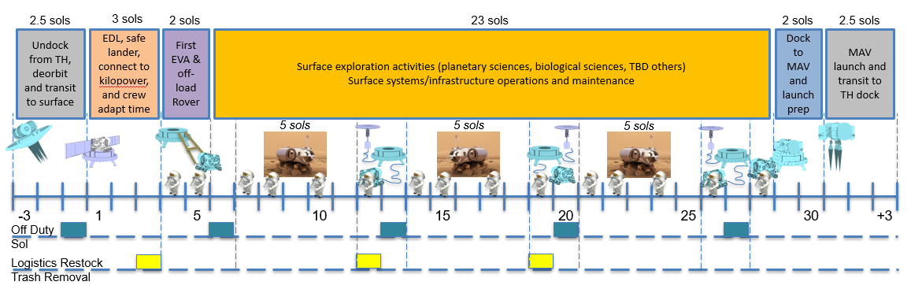
Operations
Representative operations timeline for study purposes
Initial landing, adjustment, and preparation periods
Three exploration excursions
  5 Sols continuous exploration, 1 Sol logistics resupply, 1 Sol rest day
Departure preparation and launch period
Time available to recharge between excursions = 2 Sols
Continuous exploration duration = 5 Sols
2022 IEEE Aerospace Conference

Slide 8
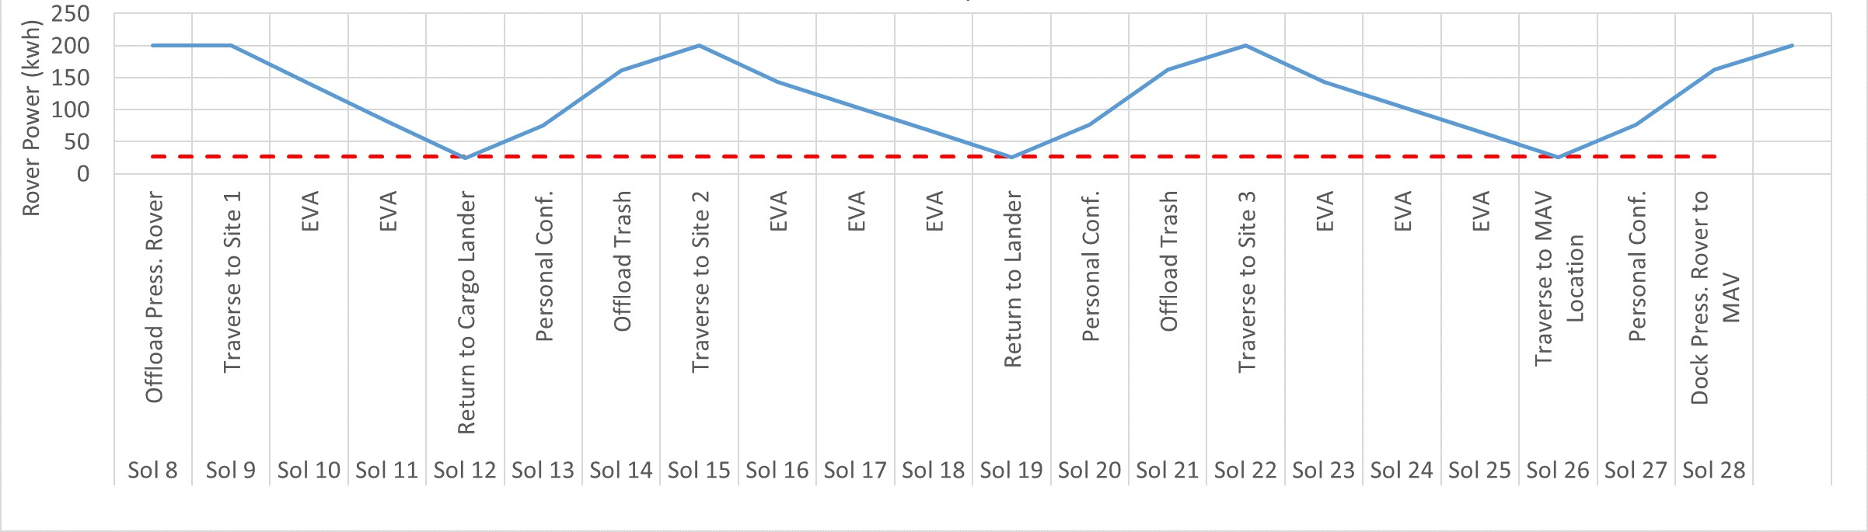
Pressurized Rover
Power from internal battery
  200 kW-hr battery selected to meet continuous operations objectives
Hotel load 1.85 kW
Total recharge power = 3 kW
Total recharge duration = 48 hrs
Integrating recharge capacity with battery capacity and desired operations durations results in the distance and continuous remote operations capability of the rover
2022 IEEE Aerospace Conference

Slide 9
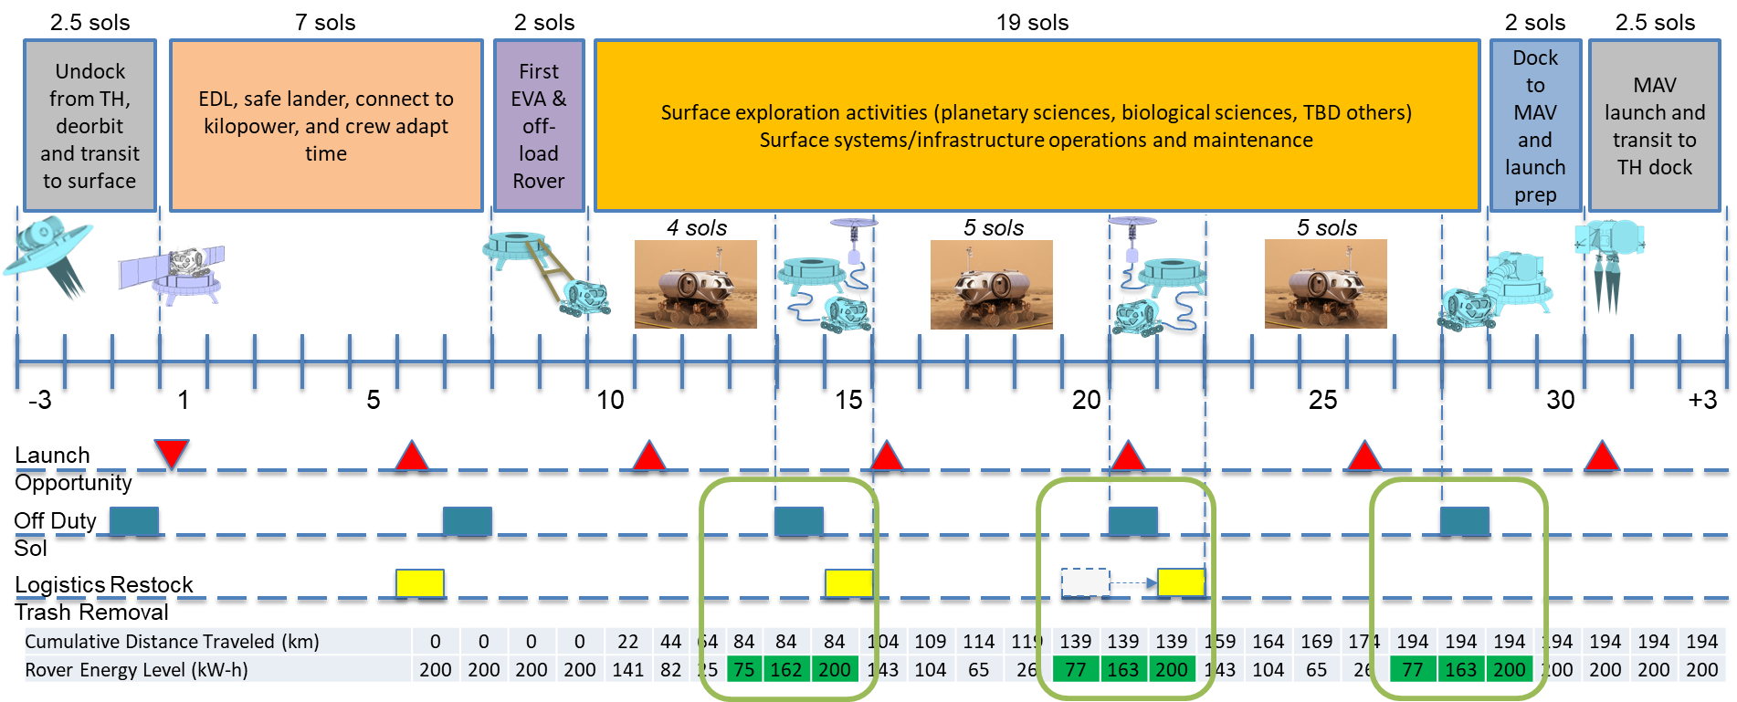
Total Exploration
Integrating power, operations timeline, and rover capabilities, a resulting achievable exploration capability is determined
Total Exploration = 279 hrs away from recharge site with 112 hrs at exploration sites and cumulative traverse distance of 194 km
2022 IEEE Aerospace Conference

Slide 10
Alternate Opcons
As part of the study, the team assessed how alternative operations concepts might work with in the bounds of the power and mobility constraints
While other concepts were achievable, the primary operations described in the study achieved the maximum exploration capability without adding any additional hardware (added mass) or impact to required operational constraints
2022 IEEE Aerospace Conference

Slide 11
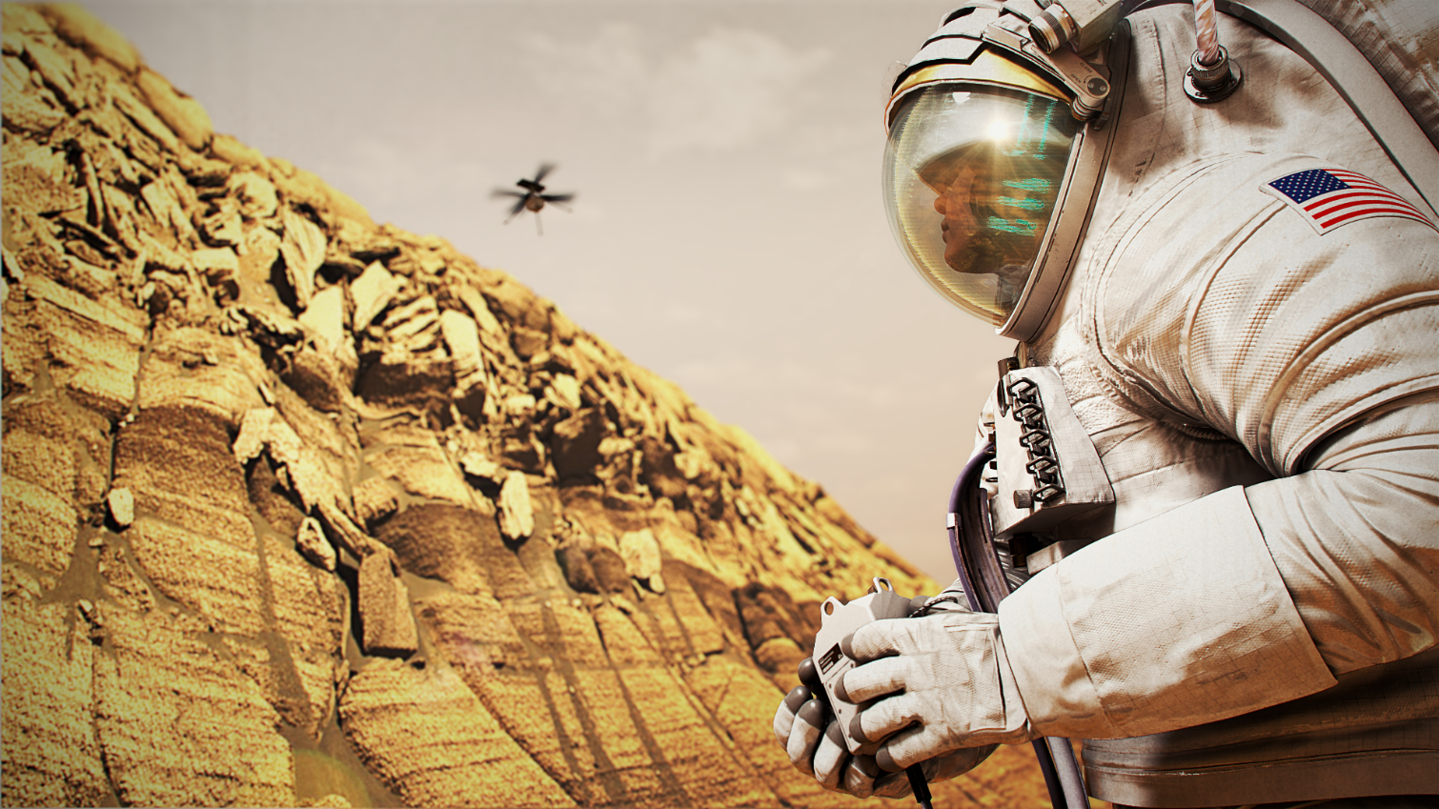
Questions?

Slide 12


