Slide 1
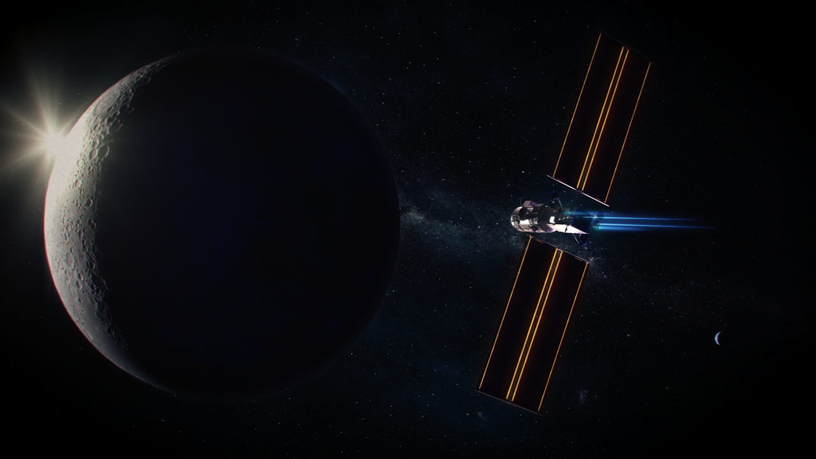
HERMES: A Small External Payload for Gateway with Big Challenges
Presented by: Kristen Brown, HERMES Deputy Project Manager
IEEE Aerospace Conference 2022
March 8, 2022

Slide 2
Co-Authors
Joe Burt – Explorers and Heliophysics Projects Division Deputy Program Manager, Technical – Goddard Space Flight Center
John Blackwood – HERMES Project Manager – Goddard Space Flight Center
Mark Goans – Explorers and Heliophysics Projects Division Deputy Program Manager – Goddard Space Flight Center

Slide 3
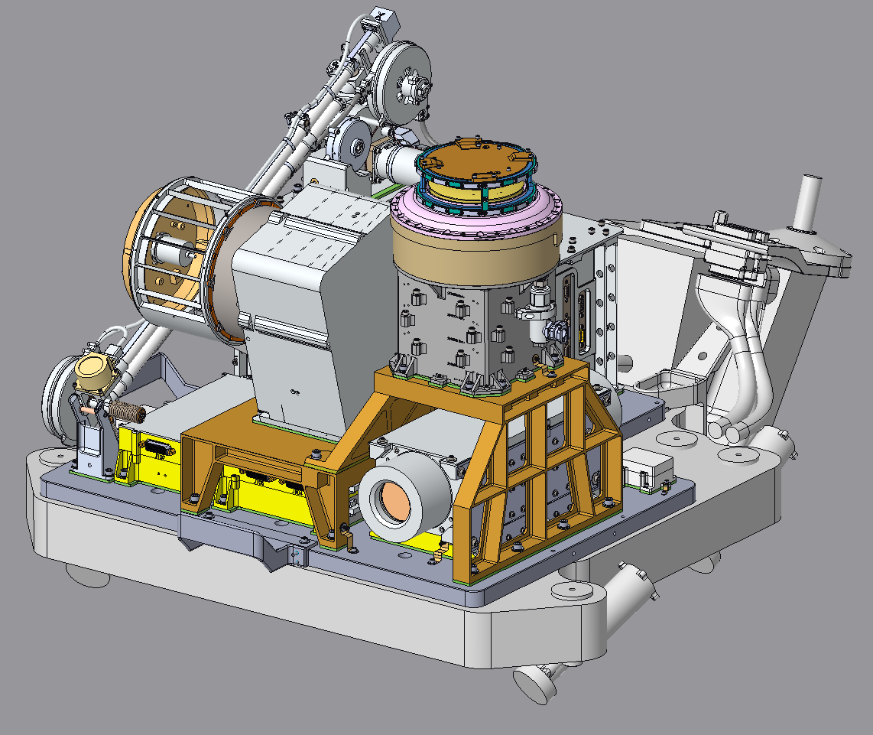
HERMES Mission Overview
HERMES – Heliophysics Environmental and Radiation Measurement Experiment Suite – is a space weather payload that will study the solar wind and the Earth’s magnetotail from the unique polar lunar orbit of the Gateway Habitat And Logistics Outpost (HALO) module.
HERMES will establish capabilities of an on-board space-weather payload to support deep-space and long-term human exploration.
0.5 m
Launch Date: NET 11/2024
Mission Life: 2 years
Class: D
Category: 3
Launch Vehicle: Falcon Heavy
Mission Phase: C
0.5 m
0.5 m

Slide 4
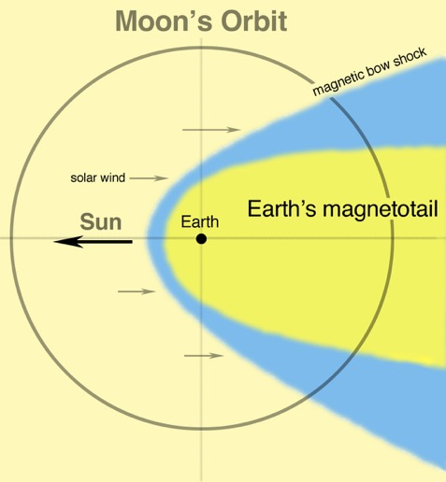
HERMES Science Goals and Objectives
GOAL | OBJECTIVE
A: Determine mechanisms of solar wind mass and energy transport | A1: Determine effects of large-scale structures on plasma transport and particle energies within the solar wind.
 | A2: Determine effects of small-scale structures on plasma transport and particle energies within the solar wind.
B: Characterize energy, topology, and ion composition in the deep magnetotail | B1: Determine structure and dynamics of the magnetotail at lunar orbit.
 | B2: Quantify energy content of the magnetotail at lunar orbit.
 | B3: Quantify transport of atmospheric ions.
C: Establish observational capabilities of an on-board pathfinder payload measuring local space weather to support deep-space and long-term human exploration | C1: Assess the effects of field of view limitations associated with accommodation on Gateway.
 | C2: Assess interference with measurements due to electric currents and surface charging.
Goal A
Solar Wind
80% of Moon’s orbit
Goal B
Magnetotail
20% of Moon’s Orbit

Slide 5
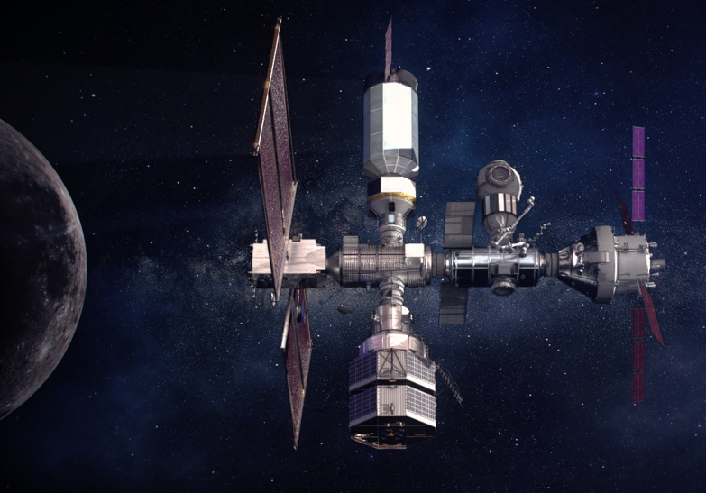
Gateway
Logistics
Module
Airlock
IHAB
PPE
(CMV Launch
Nov 2024)
Orion
HALO
(CMV Launch
Nov 2024)
HLS
CMV – Co-Manifested Vehicle
HALO – Habitation and Logistics Outpost
HLS – Human Landing System
IHAB – International Habitat
PPE – Power and Propulsion Element
5

Slide 6

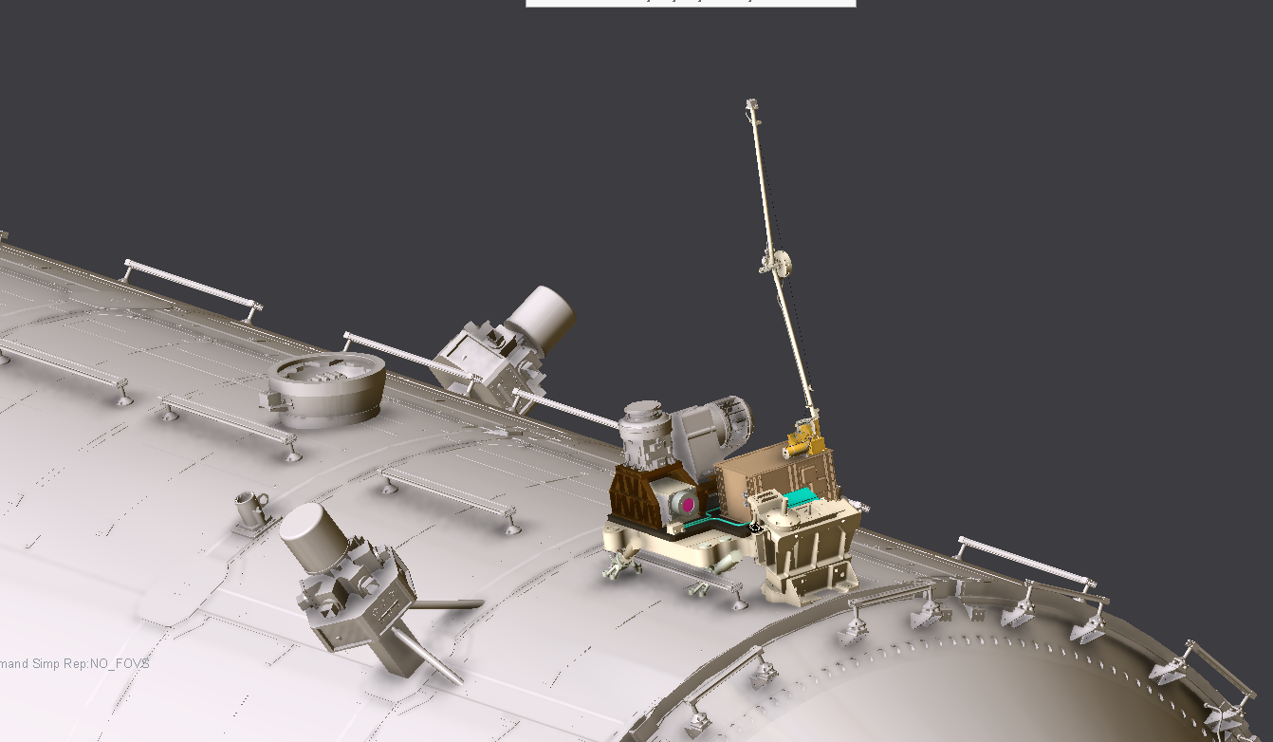
Gateway Co-Manifested Vehicle (CMV)
PPE Module
HERMES will be one of two externally mounted payloads to launch with the first two modules of Gateway (HALO/PPE).
Subsequent payloads will arrive via the Logistics modules.
HERMES will be transferred to the Logistics module for disposal.
HALO Module
HERMES
Location
(on nadir)
HALO – Habitation and Logistics Outpost
PPE – Power and Propulsion Element
6

Slide 7
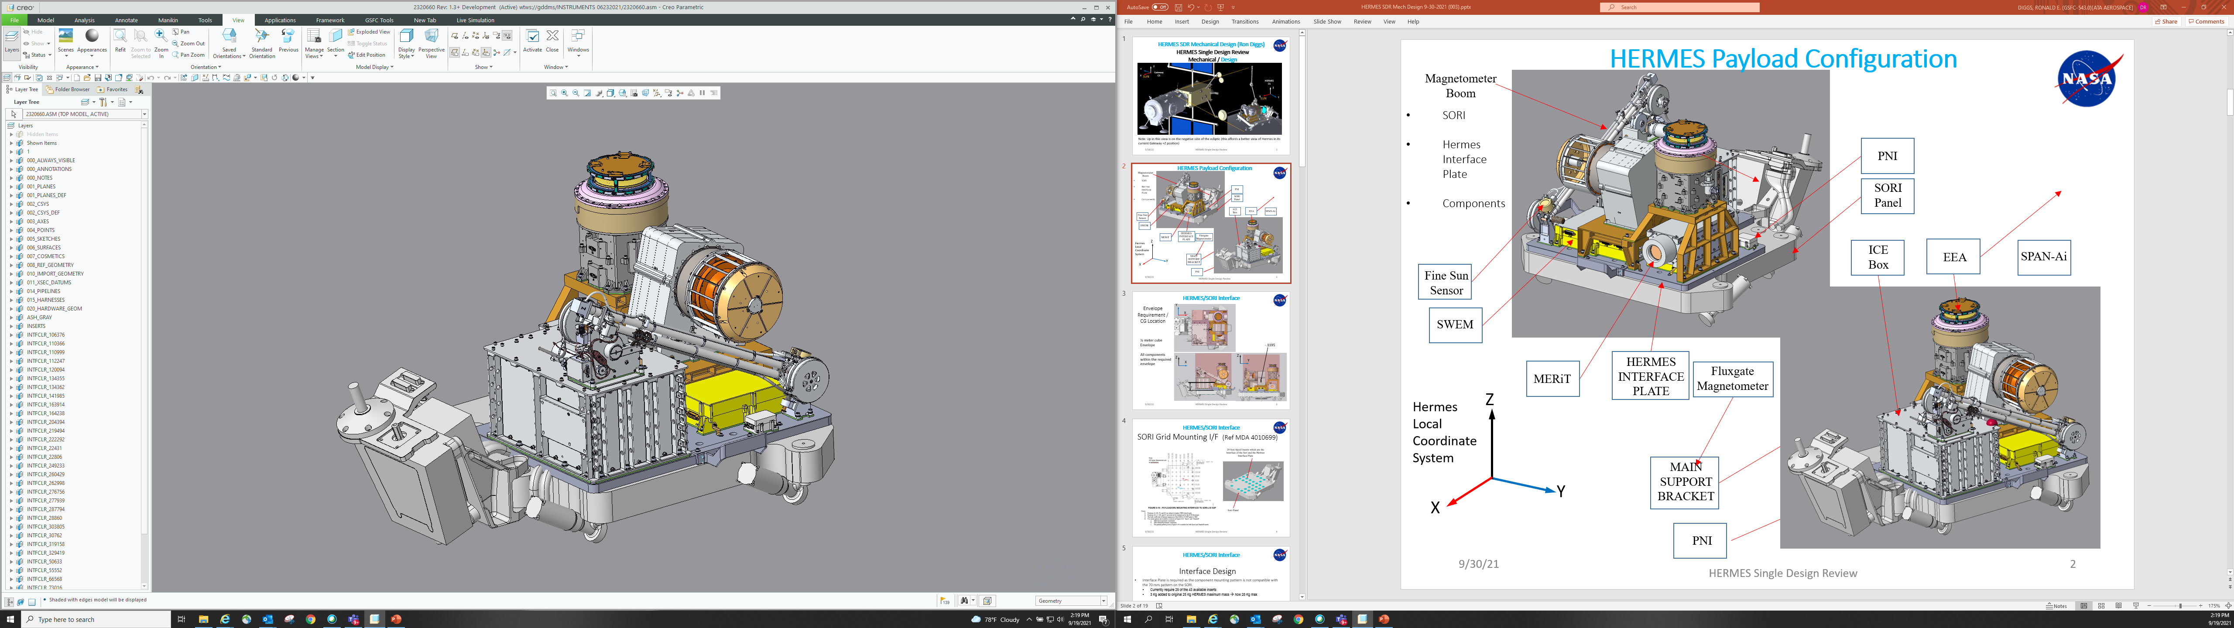
HERMES Payload Configuration
Fluxgate Sensor
[GSFC]
Instrument | Measurement | Provider/PI
EEA: Electron Electrostatic Analyzer | Low energy electron flux, density, temperature | NASA GSFC/ Daniel Gershman
MERiT: Miniaturized Electron pRoton Telescope | High energy electron flux High energy proton flux (i.e., radiation) | NASA GSFC/ Shrikanth Kanekal
NEMISIS: Noise Eliminating Magnetometer In a Small Integrated System | Magnetic field vector (✕3) 1 fluxgate sensor 2 pni sensors | NASA GSFC/ Eftyhia Zesta, U.Mich/Mark Moldwin
SPAN-I: Solar Probe Analyzer - Ions | Low energy ion flux, density, temperature, velocity, Mass/Charge ID | U.C. Berkeley/ Roberto Livi
Mag Boom
[Heliospace]
Fine Sun Sensor
[NewSpace]
MI Sensor #1
[PNI Corp, UM]
EEA
[GSFC]
SPAN-I
[UCB]
SWEM
[UCB]
HERMES
Interface Plate
[GSFC]
Instrument Support Brackets (EEA & SPAN-I)
[GSFC]
MERIT
[GSFC]
Component | Description | Provider
ICE Box: Interface Control Electronics Box | Gateway & Instrument Power & Data Interface | NASA GSFC, Jackson & Tull, Hawaii Aerospace
Magnetometer Boom | 1 m retractable boom | Heliospace
Fine Sun Sensor | Local pointing knowledge | NewSpace
MASS ~ 33 kg or less
(X,Y,Z) < 0.5 ✕ 0.5 ✕ 0.5 m (Boom Stowed)
Magnetometer Boom Extends ~ 1 m
ICE Box
[J&T + Hawaii Aero + GSFC]
MI Sensor #2
[PNI Corp, UM]

Slide 8
Early Mission Challenges
Directed Mission of Opportunity
  Request for instrument package in January 2020; delivery to the PPE for integration in November 2021 to meet a launch date in late 2022
  HERMES would leverage heritage instruments and CubeSat-style C&DH to meet the aggressive schedule
Big changes to the Gateway design caused major impacts to HERMES design
  Initial Gateway concept: PPE and HALO launching separately, without external payloads
  Decision to co-manifest PPE and HALO in May 2020 had significant impacts on the HERMES initial concept
  Changed host vehicle from PPE to HALO for a better Field of View; began working with a new contractor team for HALO
Gateway changing requirements
  Gateway was at the beginning of development, and the mechanical, thermal and electrical interfaces were not fully defined
  The location of the primary interface for the HERMES platform to HALO, the SORI – Small ORU (Orbital Replacement Unit) Robotics Interface – was undetermined, and the SORI was still being designed
HERMES has been in parallel development with Gateway since the beginning, driving Gateway requirements as a pathfinder Payload

Slide 9
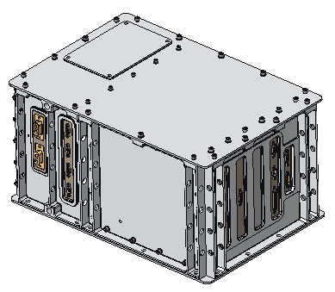
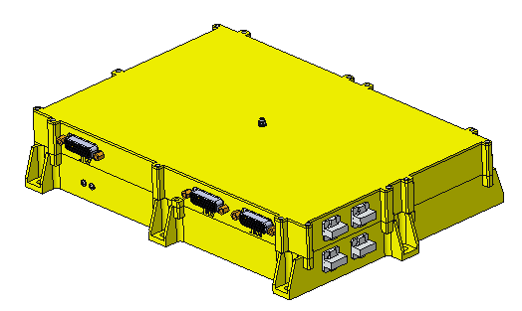
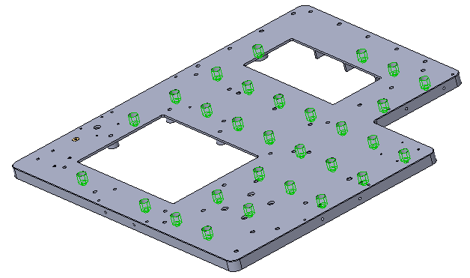
SORI Interface Challenges
HERMES mounts to HALO via the SORI – Small Orbital Replacement Unit Robotic Interface – provided by the Canadian Space Agency
SORI was designed with a standard interface and typically accommodates payloads of up to 250 kg once on Gateway
HERMES is unique in that it is launched with the SORI attached to the CMV on a Falcon Heavy with a newly designed fairing
SORI standardized bolt pattern and top-down fastening scheme required a HERMES Interface Place (HIP)
  29 fasteners required to mate HIP to SORI to provide stiffness to meet Payload natural frequency requirement
  HIP fasteners will be covered by HERMES instruments and components to fit within 0.5 m³ volume
  Late delivery of SORI requires that nearly entire HERMES payload must be de-integrated from the HIP, then reintegrated after mounting the HIP to SORI
  Regression test plans for post-SORI integration are still being worked
HERMES Interface Plate (HIP)
SORI Honeycomb Panel

Slide 10
HERMES Mass Challenge
HERMES faced mass margin challenges from the beginning, which have grown worse
  HERMES was allocated a mass of 25 Kg to hold sufficient structural margin for unknown capability of the SORI in this unique launch configuration
  At initial design, HERMES mass was 24.3 Kg with a mass margin of 3%
  SORI standardized bolt pattern and top-down fastening scheme required HERMES Interface Place (HIP); additional 3 Kg of mass given to HERMES
  As design matured, mass increased, and margin diminished – CBE 29.2 Kg with a mass margin of -3.7% against 28.0 Kg
Recent combined SORI/HERMES structural analyses demonstrate the SORI can accommodate a HERMES mass increase to 33 Kg with positive margins of safety
  This is in part a result of the low center of gravity of the HERMES payload
HERMES initiated a waiver against the 25 Kg mass allocation and requested a new mass allocation of at least 33 Kg
HERMES Interface Plate (HIP)
SORI Honeycomb Panel

Slide 11
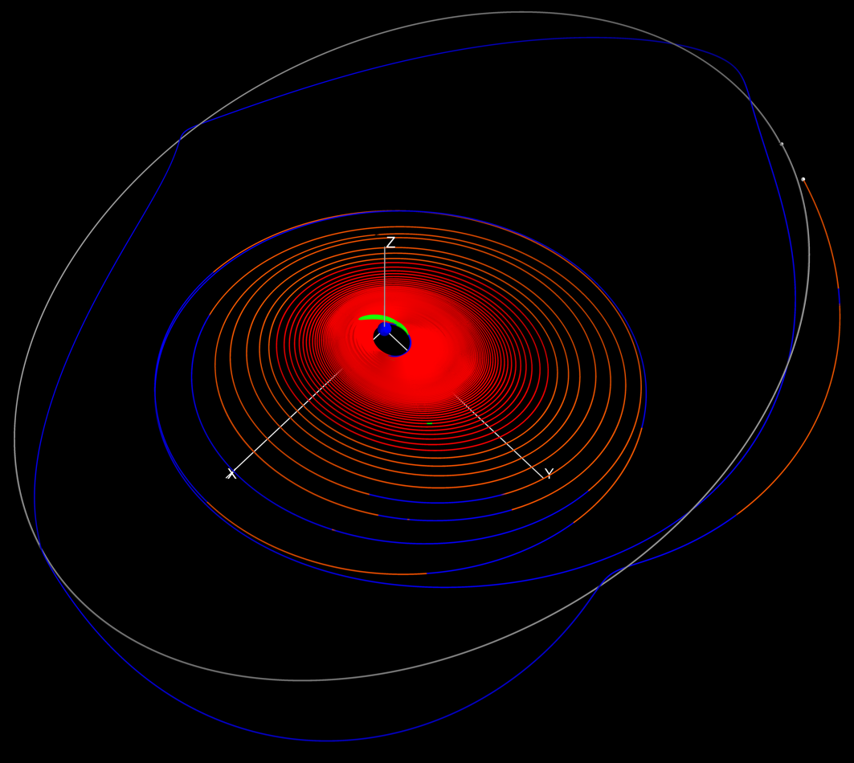
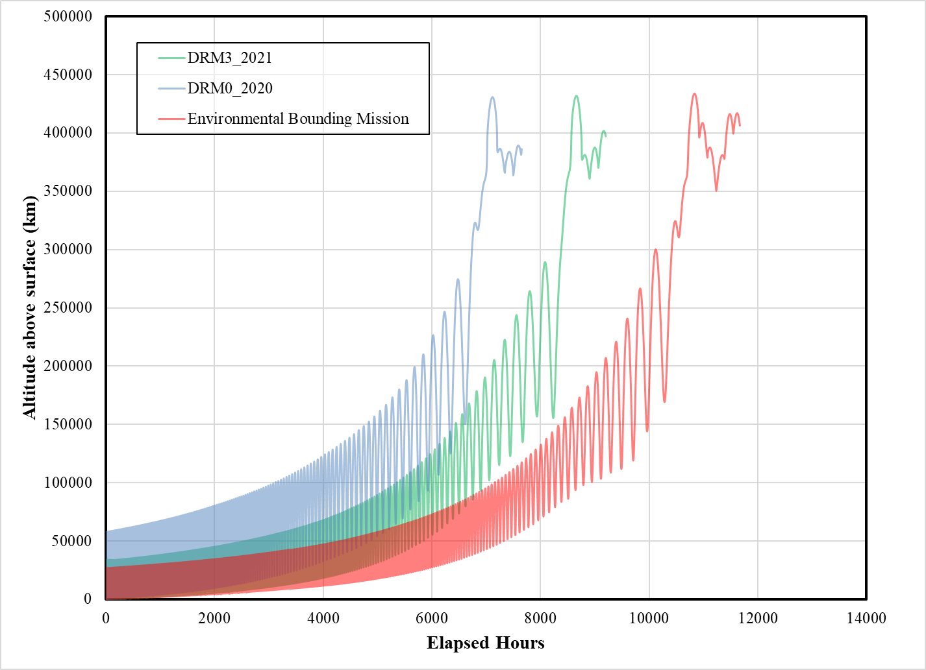
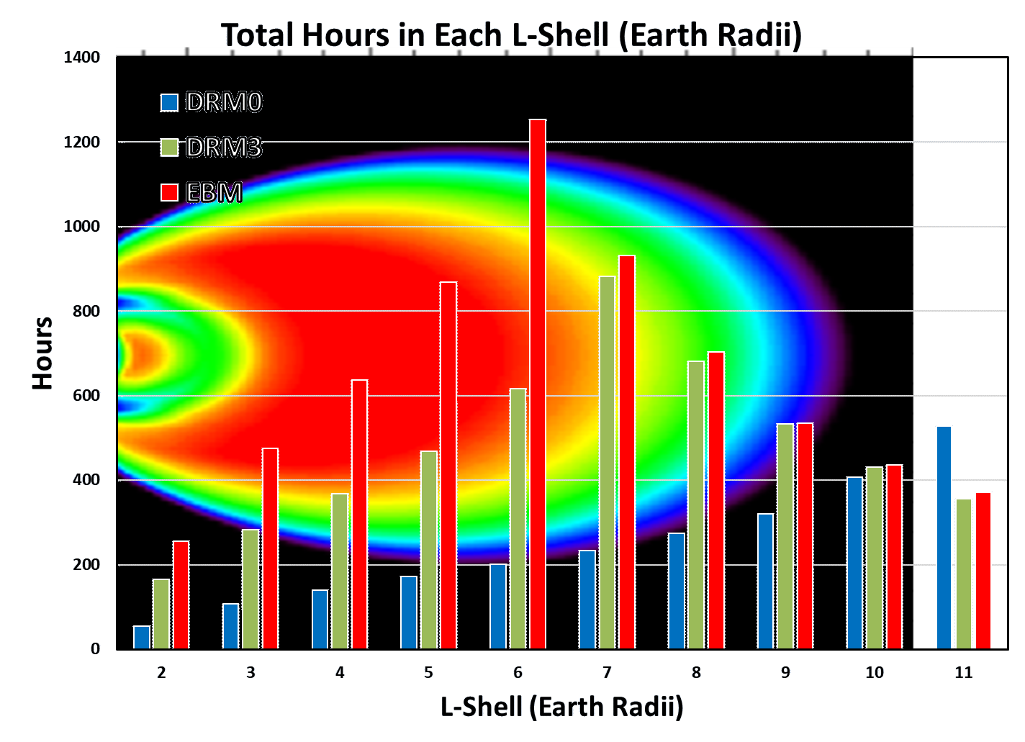
Harsh Radiation Environment
CMV utilizes Solar Electric Propulsion, slowly raising the orbit, resulting in ~13-month transit to lunar orbit
Drastically increases radiation exposure during lengthy transit through Van Allen Belts – TID > 300 kRad for exposed areas
Internal and surface charging pose a significant risk due to the possibility of very large surface discharges
External payload lacks spacecraft shielding
Moon’s Orbit
Spiral Phase
Earth Shadow
Alignment Phase
Insertion Phase
Ballistic Phase
Figure 4-7: EOR Transfer Trajectory in Earth-Centered J2000 Frame [11]
~March 2020
Worst Possible
per Gateway
~March 2021

Slide 12
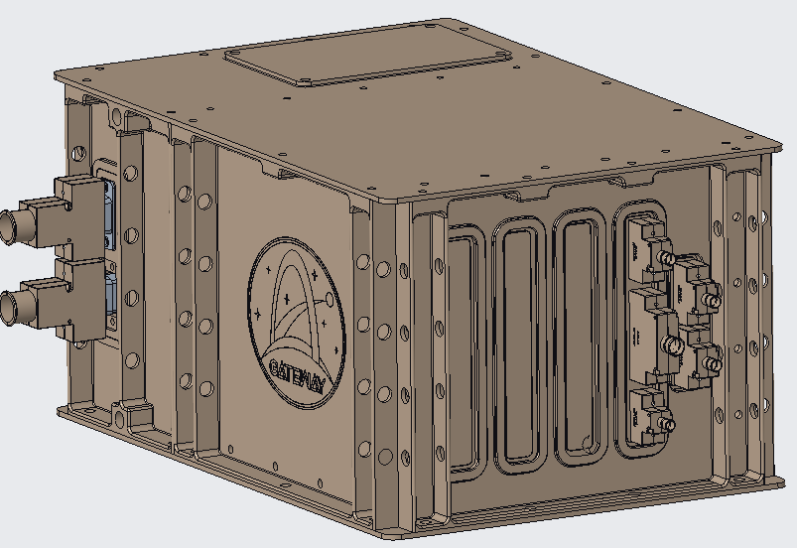
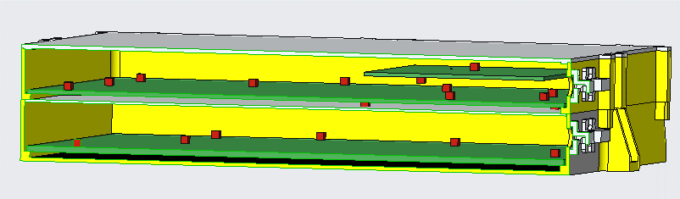
Surviving the Radiation Environment
Ray trace analysis performed with CAD models to characterize effective shielding from surrounding structures and identify areas that need additional shielding
Localized shielding added to minimize mass increase
Rad hard EEE parts selected – above typical Class D mission parts costs
External surface charging mitigated using electrically conductive materials for all exposed surfaces
Transient Voltage Suppression (TVS) diodes, or Transorbs, in addition to bleed-off resistors added to circuit boards and harnesses
Controlled Resistance Conformal Coating, or a conductive conformal coating, used to prevent surface charge build up on circuit boards
Evaluating operational constraints, e.g., power during transit, boom deployed or stowed
CAD model of the SWEM used for ray trace analysis
Rad Hard ICE Box uses 300 krad(Si) processor

Slide 13
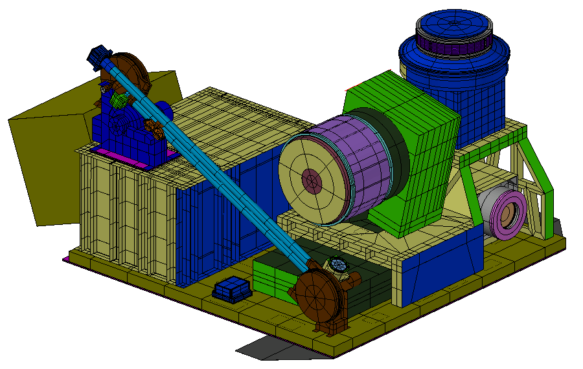
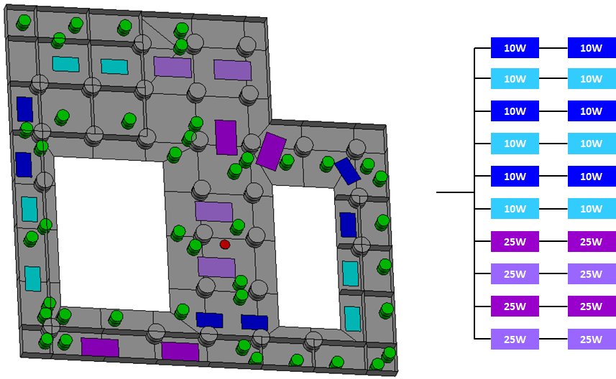
Thermal Management
HERMES is required to be thermally isolated from the SORI
Very compact layout and mass limitations drove a passive thermal control system utilizing radiators, heaters, blankets and coatings.
Most instrument/components are thermally isolated via G10
Gateway 120V power limits use of Kapton heaters
  Wire wound resistor heaters will be used
Numerous analyses for all phases of the HERMES mission
HALO will launch with the survival bus disabled; no survival heater power available until after the PPE solar arrays deploy
  Survival heaters are needed prior to that time to ensure Payload components stay within survival limits
  Refining thermal models and negotiating survival heater power availability
HIP Survival Temperatures: -20C to +40C
HIP Operational Temperatures: -10C to +30C

Slide 14
Other Challenges
ICE Box – a simple C&DH concept became more complex following CMV decision and the harsh radiation environment. The ICE Box also needed to provide a buffer between heritage instruments and the changing Gateway interface.
Astronauts – HERMES needed to address human spaceflight requirements, including the new design of a retractable boom for astronaut safety.
Cyber Security – HERMES was required to implement the new NASA-STD-1006 Space Systems Protection Standard.
COVID-19 – the pandemic began shortly after the mission was selected and has had an ongoing impact to cost and schedule.

Slide 15
Project Status and Key Milestones
Instrument Single Design Reviews complete November 2020
Payload Single Design Review complete October 2021
Mission passed KDP-C and confirmed January 2022
Instrument and component deliveries June-July 2022
  All instruments currently building flight hardware with I&T beginning in March-April 2022
  ICE Box ETU boards are built and under test; ICE Box flight boards to begin assembly in March-April 2022
  Boom Engineering Model currently being qualified; Flight Boom to begin assembly in March 2022
Payload Integration Readiness Review planned May 2022
Payload Pre-Environmental Review planned August 2022
Payload delivery to HALO planned July 2024
HERMES launch on Gateway CMV November 2024

Slide 16
Conclusion
HERMES provides an opportunity to collect space weather data from polar lunar orbit to better understand the environment prior to astronauts returning to the moon
HERMES is proving to be a pathfinder payload for Gateway, helping to drive and define Gateway-Payload interface requirements
HERMES has experienced enormous challenges through significant Gateway changes and ongoing Gateway parallel development
The HERMES team was able to divide and conquer a complex project development with a quick response by utilizing a diverse team of government, academia, and industry small contractors

Slide 17
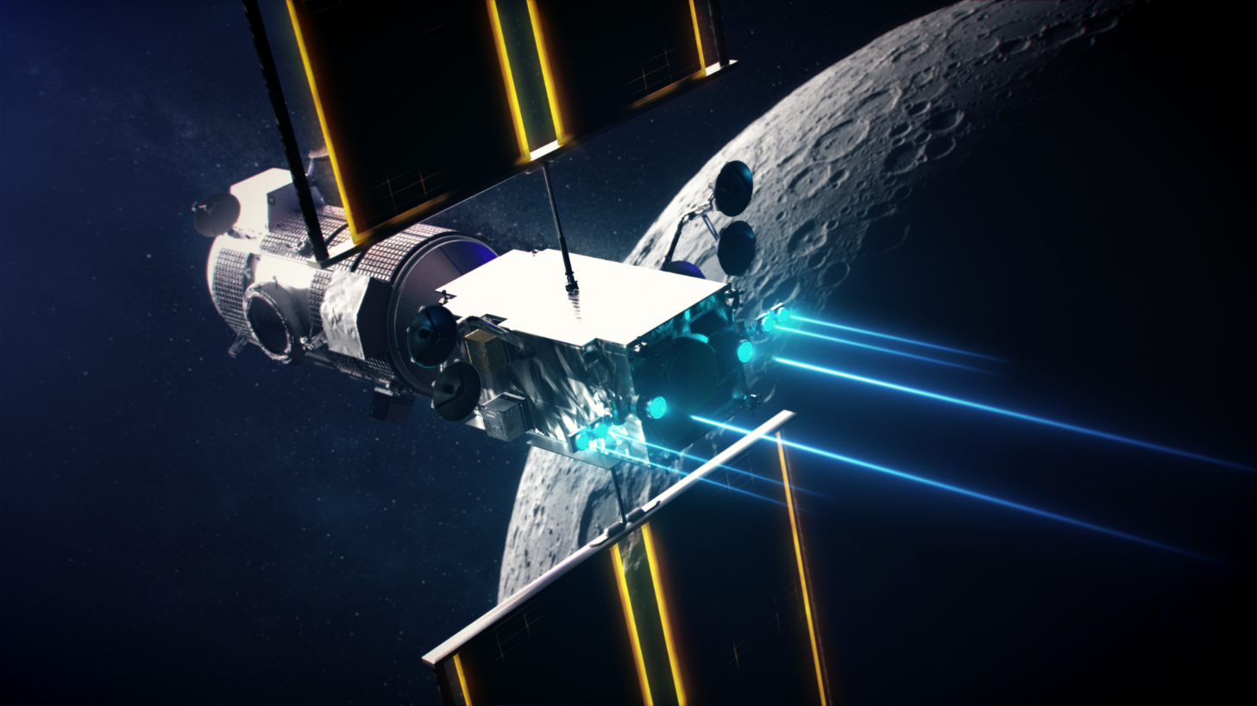
HERMES: A Small External Payload for Gateway with Big Challenges
Presented by: Kristen Brown, HERMES Deputy Project Manager
IEEE Aerospace Conference 2022
March 8, 2022

