Slide 1


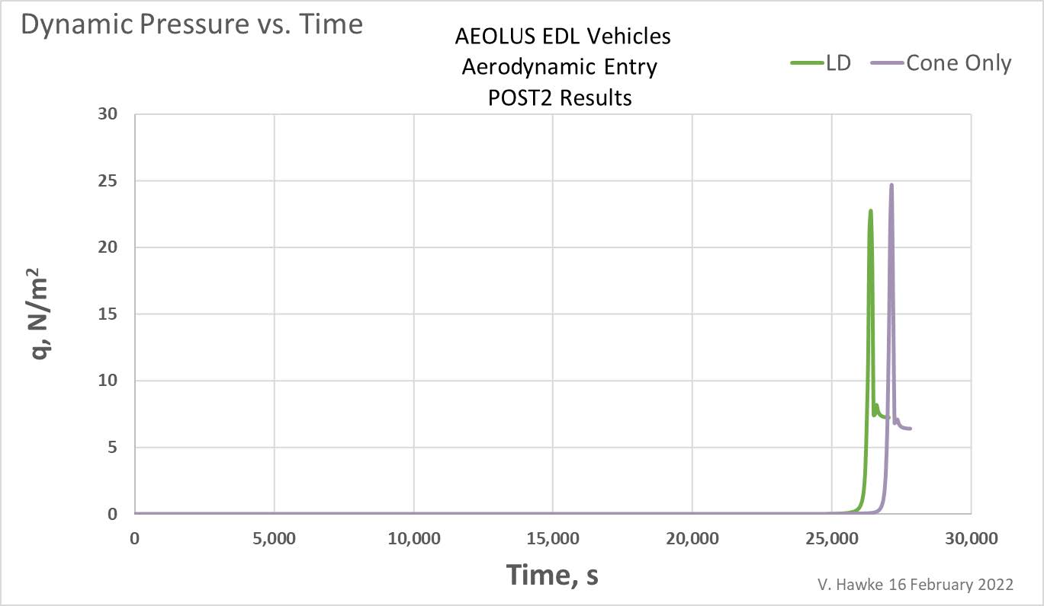
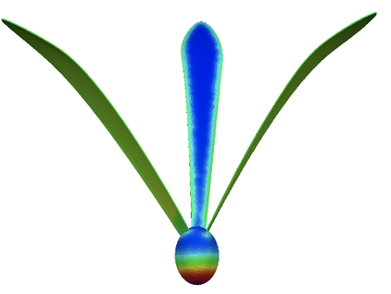
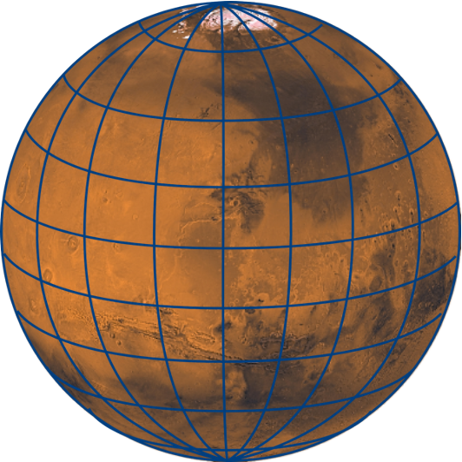
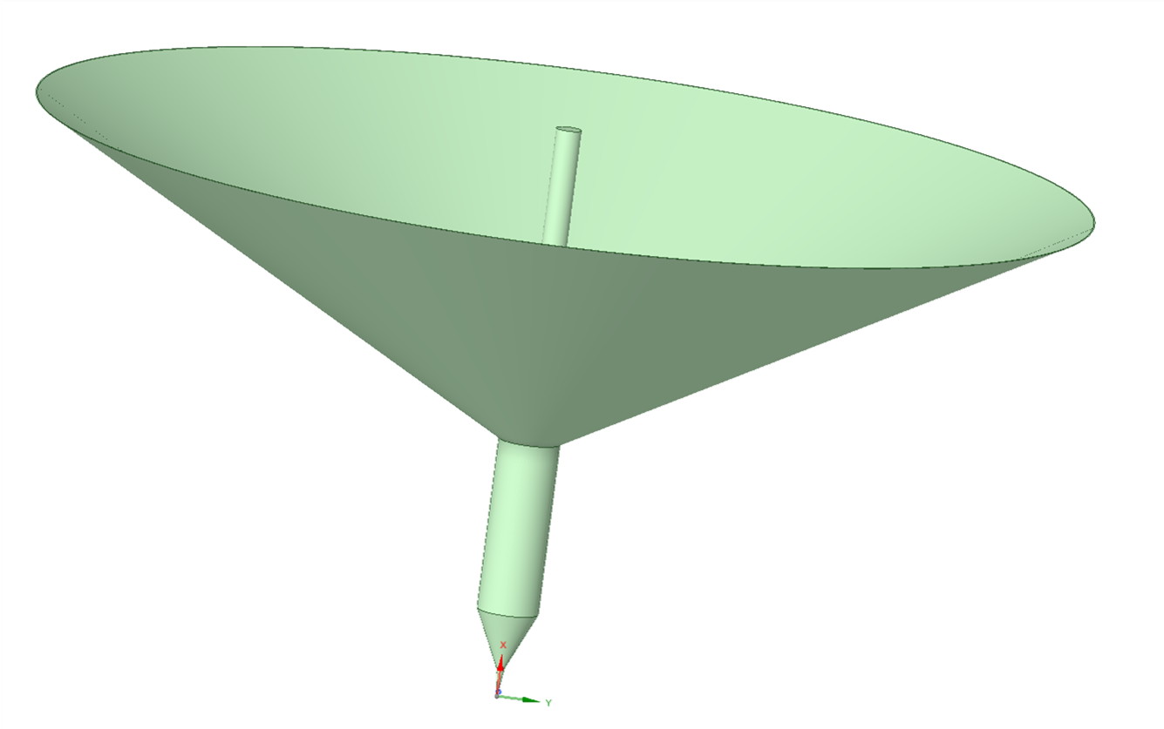
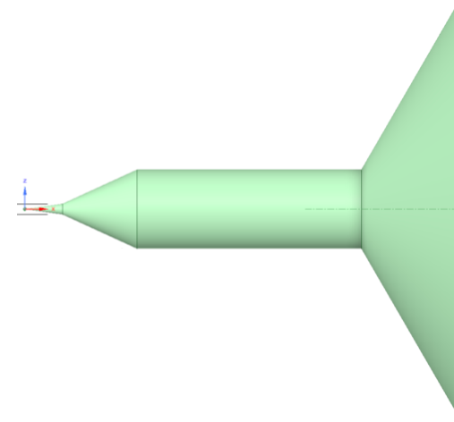
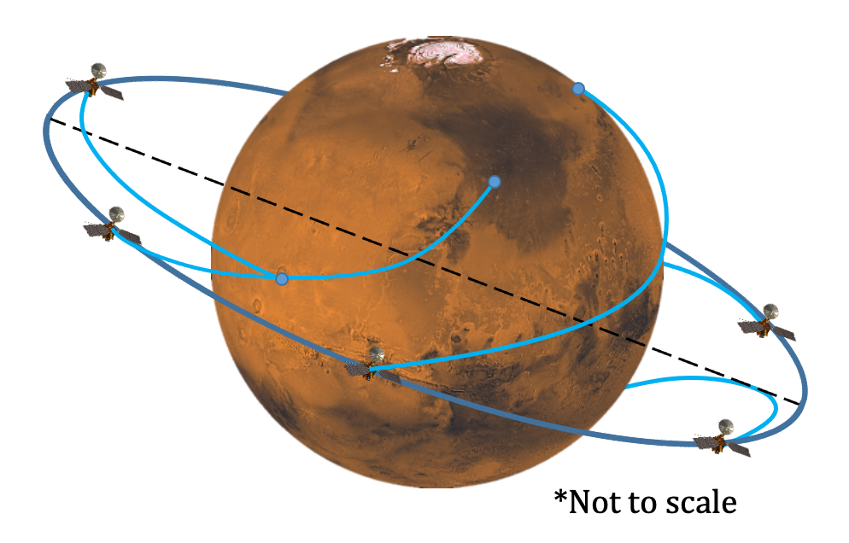
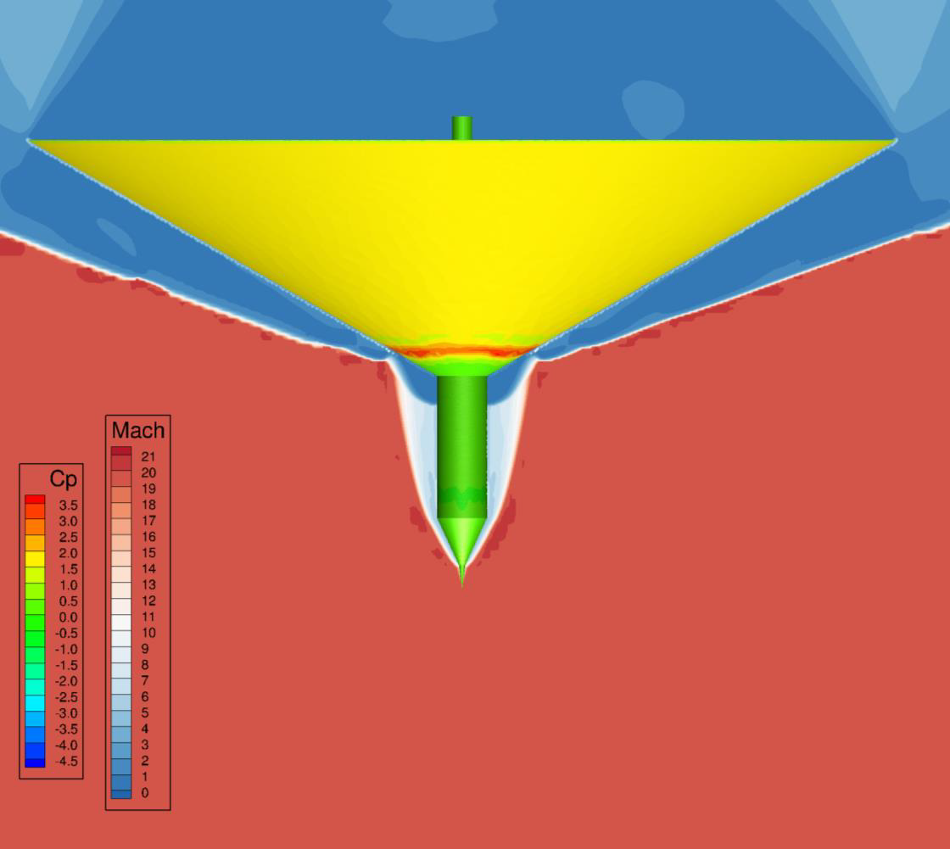
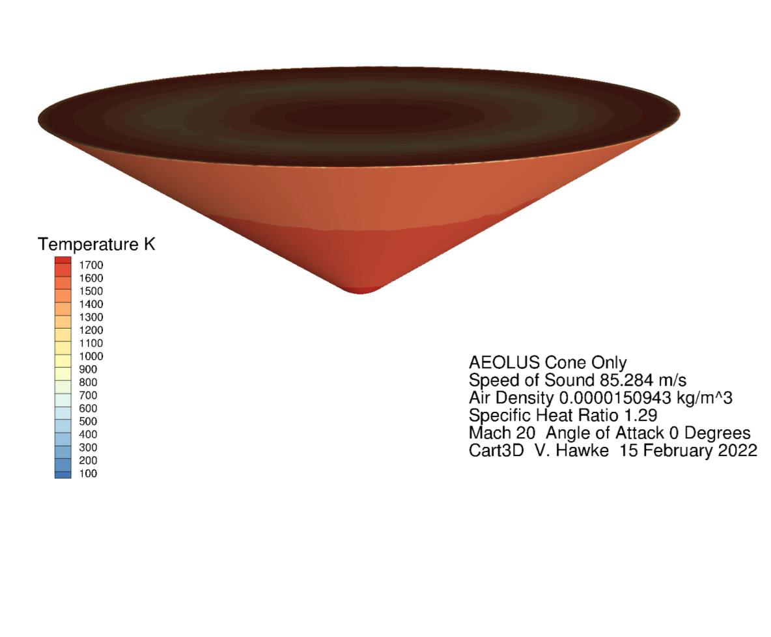
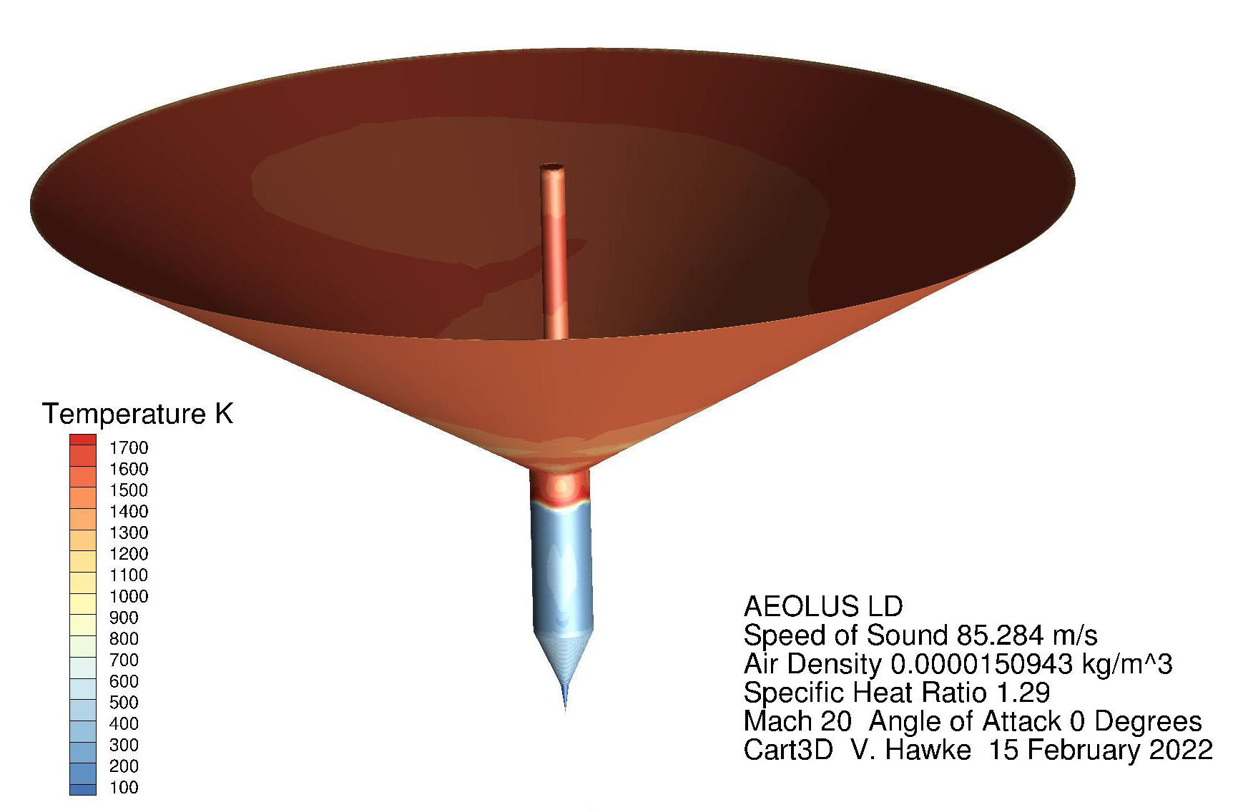
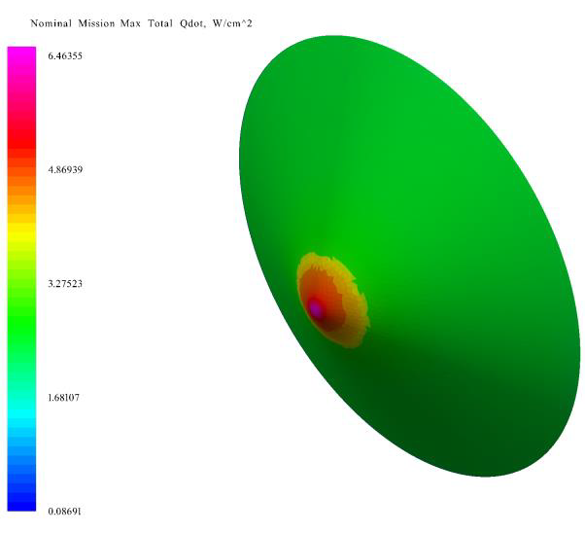
ENTRY, DESCENT, AND LANDING ANALYSIS OF LOW MASS MARTIAN PROBE FOR SURFACE CLIMATE NETWORK
B. Maryatt ¹, S. D’Souza ¹, B. Tackett ², V. Hawke ³, M. Herreras Martinez^{1,4}.
¹NASA Ames Research Center, Moffett Field, CA, ²Analytical Mechanics Associates, Hampton, VA, ³Science and Technology Corporation, Hampton, VA, ⁴Axient, Arlington, VA
Abstract
Probe Design
Flight Performance
Aeolus is a mission to provide the first direct measurements of Martian atmospheric wind speeds and correlate them with thermal and compositional data to bring together a complete systematic description for the global energy balance and climate cycles of Mars. Objective A of the Mars Exploration Program Analysis Group (MEPAG) Goal II cites a Science Investigation Area to develop a network of surface landers to provide global, diurnal and synoptic coverage of the near-surface environment to characterize present Mars climate [1]. Aeolus will characterize the present Martian global climate system via an orbiter element and a novel surface network element. A series of low mass, low power probes will be distributed across the Martian surface and measure pressure, sky opacity, temperature, wind speed, water vapor and other trace gases.
Low mass and power electrical systems designed to operate in extreme cold and daily thermal cycling for one Martian year could facilitate lower cost, Class-D science probes. Aeolus is targeting a total per-probe mass of <5 kg. Recent advances in nanofabrication of chip-scale sensors that are highly robust to temperature and shock, combined with a novel packaging concept (the deployable sensor probe [2]) originally developed by the Aerospace Corp., for the first time enables a Mars surface climate sensor network. These probes are folded flat during transit to Mars and automatically deploy into the final reentry configuration once released from the orbiter. The capability to fold for stowage significantly increases the probe quantity carried by the orbiter.
Several initial probe concept shapes were investigated, including a deployed flap version of the original probe design and several Bio-Inspired shaped like the Maple seed concept, a tri-wing autorotator, and a Tree of Heaven seed design. The Bio-inspired designs were rejected due to aerodynamic unpredictability and uncertain orientation during key stages of flight which could not be easily verified at the proposal stage. The tri-wing autorotator design was rejected due to excessively high rotational velocities which put too much strain on the sensor package. The deployed flap design was found to be the most favorable of all options considered due to its self-orienting nature when two faces were swept back, geometry that protects the sensor package from entry heating on the back-side of the vehicle, and small stowage footprint when folded.
The swept flaps add stability to the probe to prevent tumbling during reentry and, alongside additional weighting on the leading edge, give the shape a preferred flight and impact orientation. This sweep angle was kept small at 30-deg from flat alignment to provide as much drag as possible while maintaining a preferred aerodynamic orientation.
The main flaw discovered with this type of vehicle is that the mass scales at the same rate as the aerodynamic reference area as the vehicle changes size, causing a constant Ballistic Coefficient and no change to the impact velocity or general deceleration profile. There was also a concern that a crushable structure on the leading end of the vehicle would not provide enough orientating stability during or after landing for the vehicle instruments. To adjust for these concerns, a new design has been implemented.
In the new design, the flexible drag skirt is collapsed against a central cylinder for efficient stowage during transit that unfolds after release from the orbiter. Sensors are located around the circumference of the skirt and the rear of the cylinder, with flexible solar panels lining the interior. Electrical equipment is located within the primary forward cylinder. This design decouples the drag area from the impact structural elements of the entry vehicle. The large, thin (2 mm) drag skirt provides a significantly improved drag area at a lighter weight and the central shaft structure takes the primary burden of surface impact, instrument housing, stagnation point heating, and landed orientation assurance.
The performance of the vehicle shape was explored compared to a 60-deg half-angle blunted cone vehicle which was assumed to have the same mass and size as the concept vehicle. (not an achievable for a flight vehicle) The Program-to-Optimize-Simulated-Trajectories II (POST2) was used to simulate the entry trajectories and the resulting flight mechanics are noted here:
The sharp leading edge of the Aeolus shape resulted in a slightly lower drag coefficient than the blunted cone shape, but the mass efficiency of the Aeolus shape still resulted in a low ballistic coefficient and low impact velocity for an unguided Mars entry.
A concern recently observed was that the vehicle orbits the planet several times following release. This is a result of an unpowered flight from release to entry, targeted to a small flight path angle to minimize entry heating. This characteristic is expected to result in large landing uncertainty once atmospheric variation is factored into the trajectory analysis. One point of future work is to determine at what point a steeper flight path angle would require an increase in TPS mass too large for the mission, and whether enough probes can be deployed to make specific targeting unnecessary to guarantee planetary coverage.
Shape | Outer Diameter | Half-Cone Angle | Mass
Aeolus | 1.84 m | 60 deg | 5.62 kg
Blunted Cone | 1.84 m | 60 deg | 5.62 kg
Deployed Flap
Tri-Wing Autorotator
Maple Seed
Tree of Heaven Seed
Original folding/deployable probe concept
Mission Overview
Successful placement of the deployable sensor probe and survivability of the sensor package depends on an Entry, Descent, and Landing (EDL) concept that ensures survivability to entry heating and a mass efficient EDL system. The key performance parameters (KPPs) for this EDL system include peak heat rate, impact velocity, total mass, system complexity and the network footprint. Since the probe is very small, any EDL system needs to ensure sufficient deceleration for survivable impact velocity. Ensuring a mass efficient EDL architecture comes from reduced system complexity and minimized total mass. Two EDL system architectures were assessed:
EDL Con-Ops. Probes are released individually from the orbiter at regular intervals to create a surface network of probes. Probe EDL heating was analyzed to determine thermal protection system (TPS) needs. A variety of probe shapes were assessed on their ability to slow their descent while protecting the sensor package from excessive heating and G forces.
The KPPs stem from the entry probe/vehicle design, aerodynamics analysis, and a 3-DOF trajectory analysis. The aerodynamics analysis are also important for the EDL System, considering the very low probe mass, drag area, and Martian atmosphere resulting in reduced vehicle deceleration. The trajectory analysis, consisting of parametric sweeps of relevant entry conditions (mass, flight path angle, and lift to drag ratio, L/D), provide the flight environments and landing locations for each probe module. The results from this trajectory analysis provides the landing speeds, flight environments, and network footprints for several entry condition combinations which are used in establishing probe module survivability and mass efficient vehicle systems.
Aluminum
Shock Absorber
Fabric + Titanium Foil
Drag Skirt
Instrumentation
Electronics
Aluminum
Central Core
Titanium
Penetration Tip
Entry Environments
Conclusions
the same sizing characteristics as a control shape. Initial results from Cart3D indicate that there may be a region of lower temperatures on the spike due to the tip shock.
Flow temperatures were also estimated for both the Aeolus probe and the drag skirt only control shape in Cart3D; CBAero was also used to estimate preliminary heating on the drag skirt cone shape.
The impactor with drag skirt design appears to provide the entry and descent benefits of a heritage, blunted spherecone vehicle with the additional impact capability of a slender impactor vehicle to maintain landed orientation.
Preliminary findings show that the thin drag skirt model allows for a low ballistic coefficient for an efficient reduction in impact velocity.
A challenge that still needs to be investigated is the landed location uncertainty due to the passive deorbit of the probes after release. The mass penalty for reducing this uncertainty will be weighed against the potential number of landed probes.
Additional fidelity is needed to validate the sub-sonic aerodynamics of the Aeolus probe shape as well as the surface heating of the protruding impactor shaft. These analyses will determine vehicle stability during the descent phase and assist in material selection.
Initial results show that the instruments located on the aft side of the vehicle will be safe from high temperature flow, but additional analysis would be preferred to verify this result.
The current Aeolus probe design was created using an impactor central design attached to a 60 deg half-cone to take advantage of the increased drag area. This shape was analyzed aerodynamically using Cart3D to create a preliminary database for trajectory simulation and compared to a blunted cone assumed to have
References
(a) Drag Skirt Cone Maximum
Flow* Temperature
(b) Aeolus Probe Maximum
Flow* Temperature
(c) Drag Skirt Cone
Total Heat Rate
[1] MEPAG: Mars Science Goals, Objectives, Investigations, and Priorities: 2020, https://mepag.jpl.nasa.gov/reports/MEPAGGoals
_2020_MainText_Final.pdf, [2] Fuller, J. Atmospheric Probe and Dispenser Mechanism, The Aerospace Corp. Private Communication.
*Note: Probe surface temperature expected to be order of magnitude lower than Flow temperature

