Slide 1
Overview of CALIPSO Data Processing and Release Schedule
Brian Getzewich
NASA Langley Research Center

Slide 2
Data Production – Releases since March 2020
V4.20 IIR Level 2: April 2020
  Improved retrieval algorithm developed in France, using the V2.00 IIR Level 1 and V4.20 Lidar Level 2 Layers data products as input.
CALIPSO Browse Images with CloudSat 2B-GEOPROF data: April 2021
  CALIPSO Browse images have been reprocessed to overplot coincident CloudSat radar reflectivity and cloud mask data onto the 532nm Total Attenuated Backscatter image
V1.00 IIR Level 3 GEWEX: September 2021
  Combined IIR and CALIOP Level 3 product to characterize ice and water cloud optical depth and microphysics for a range of cloud types.

Slide 3
Data Production – Major Upcoming Releases
V2.00 Lidar Level 2 Polar Stratospheric Cloud: March 2022
  Improved detection sensitivity using fewer conservative thresholds.
  Improved discrimination between ice and NAT-enhanced under denitrified/dehydrated conditions.
  Retrieval of un-attenuated backscatter and extinction to estimate surface area density and optical depth
V4.5 Lidar Level 1: Spring 2022
  532nm and 1064nm Calibration Mitigation for Low Energies
  1064nm Baseline Shape Correction
  Polarization Gain Ratio Correction
V4.5 Lidar Level 2: Spring 2022
  Total Column Particulate Optical Depths above Opaque Water Clouds
  Improved Classification for Stratospheric Aerosols
  Improved Smoke Layer Accuracy above Clouds
  Correction to Single-Shot Cloud Clearing.
V4.5 IIR Level 2: Summer 2022
  Use V4.5 Lidar Level 2 as input with no expected code changes

Slide 4
Data Production – Major Upcoming Releases (cont.)
V1.00 Lidar Level 2 Blowing Snow - Greenland: TBD
V1.00 Lidar Level 0 – Public Version: TBD
  Data product which merges matched set of three 90-minute L0 binary files into a single HDF file containing the lidar measurements and health / status data from all three channels (532nm parallel, 532nm perpendicular, 1064nm)
  Public version, so no proprietary information contained
V1.00 Payload Instrumentation and Verification Block (PIVB) – Public Version : TBD
  Data product which reports raw backscatter signals from the high and low gain channel prior to on-board merging
  Public version, so no proprietary information contained
V1.00 Lidar Level 2 / Level 3 Ocean Sub-surface: TBD

Slide 5
Data Production – Major Planned/Final Releases
V5.00 Lidar Level 1: Summer 2025
  Time dependent polarization gain ratio
  Update static ancillary data sets (DEM, Snow/Ice)
V5.00 Lidar Level 2: Summer 2025
  Total Column Particulate Optical Depths from Ocean Surface Returns
  Low energy shot mitigation
  Incorporate 1064nm, 532nm perpendicular and depolarization into feature detection
  Clear-air extinction retrievals
V5.00 IIR Level 2: Summer 2025
  Add ice crystal concentration using Lidar extinction profiles
  Update surface emissivity tables
  Update look-up tables
Final Level 3 Products: Summer 2025
  Lidar: Tropospheric Aerosol, Stratospheric Aerosol, Ice Cloud, and Cloud Occurrence
  IIR: (new) Cloud

Slide 6
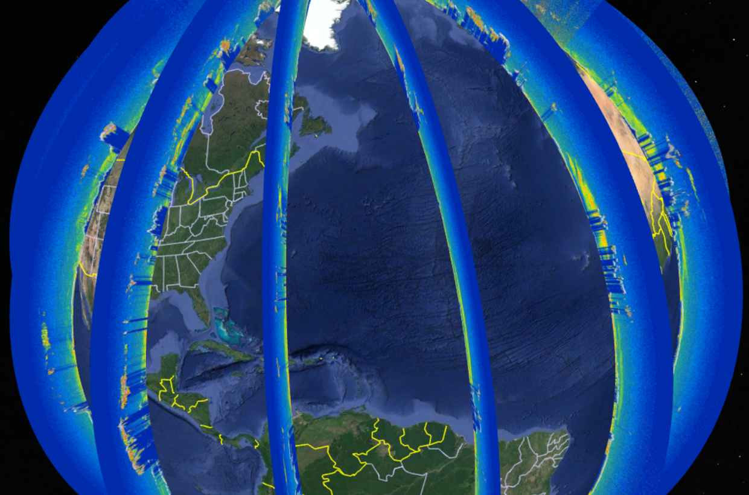
Data Production – Other
Convert final data products from HDF4 to HDF5
Create public versions of existing internal tools
  Example: CALIPSO KMZ Code
    Code (Python) which converts a selected number of CALIOP SDSs into KMZ files that can be opened and displayed in Google Earth.
    Algorithm will be accessible from NASA Software catalog via GitHub
Expedited 532nm Total IAB from April 8th, 2014

