Slide 1
Updates in Upcoming V4.5 Data Releases
Jason Tackett, Brian Getzewich, Mark Vaughan,
Rob Ryan, James Lambeth, Kam-Pui Lee, Anne Garnier, & CALIPSO Data Management Team

Slide 2
Overview of Updates in V4.5
Level 1
Low energy mitigation for calibration (532 nm day, 1064 nm)
Polarization gain ratio updates
1064 nm baseline shape correction
Level 2
Single-shot cloud clearing correction
Stratospheric aerosol subtyping
Smoke base extension
Optical depth over opaque water clouds added
(Hu et al., 2007 method)

Slide 3
Overview of Updates in V4.5
Level 1
Low energy mitigation for calibration (532 nm day, 1064 nm)
Polarization gain ratio updates
1064 nm baseline shape correction
Level 2
Single-shot cloud clearing correction
Stratospheric aerosol subtyping
Smoke base extension
Optical depth over opaque water clouds added
(Hu et al., 2007 method)
= what we’ll discuss

Slide 4
Level 1 Updates

Slide 5
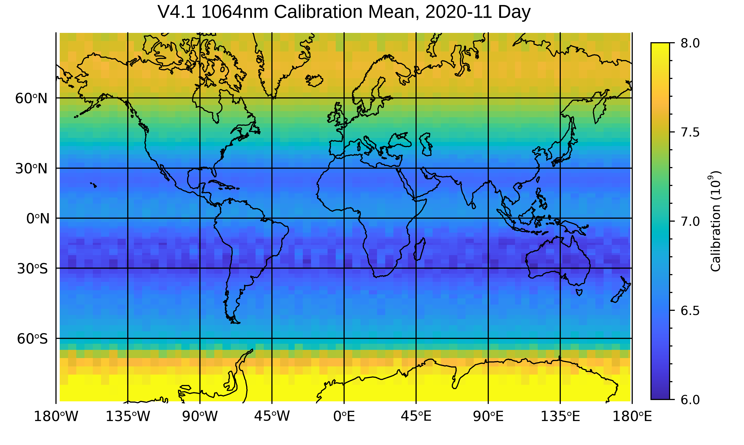
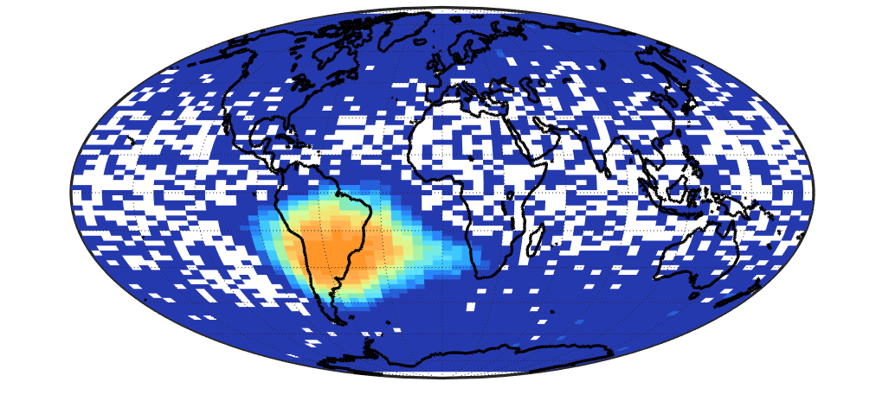
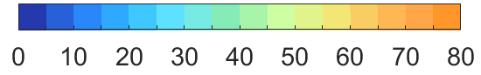
Level 1: Low Energy Mitigation for Calibration
Laser shots with E₅₃₂ < 10 mJ
South Atlantic Anomaly (SAA)
Low bias
Frequency (%)
Oct-Dec 2020
Low energy shots impact 532 nm day and 1064 nm calibrations at SAA latitudes.
Causes low bias, increased variability, and increased uncertainty to calibration coefficients.
532 nm night calibration is unaffected.

Slide 6
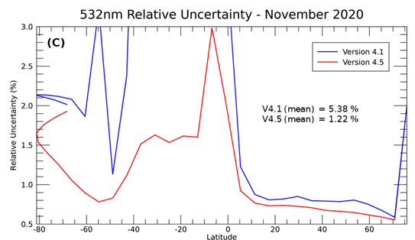
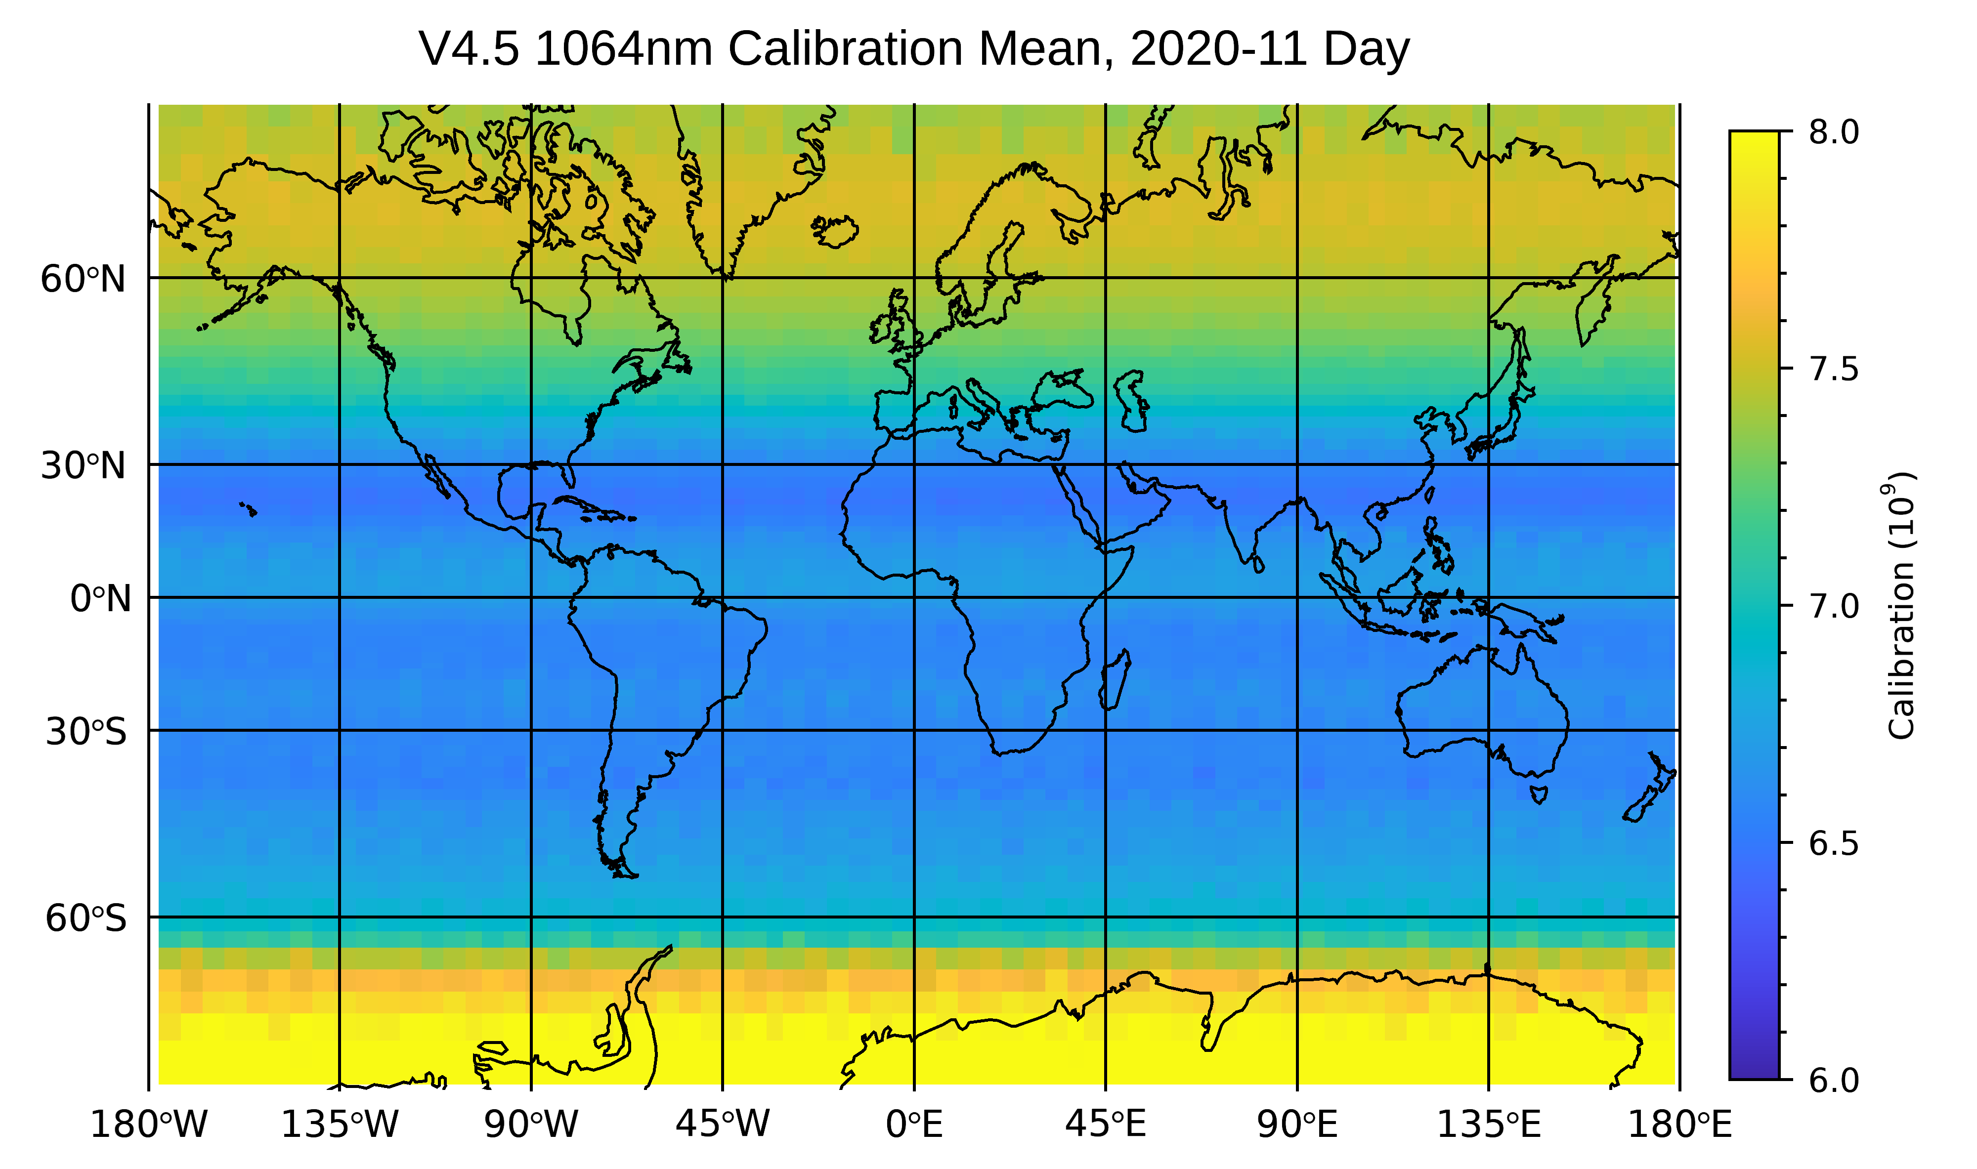
Level 1: Low Energy Mitigation for Calibration
New “Low Energy Mitigation” algorithm identifies and excludes profiles affected by low energy from calibration process for 532 nm day and 1064 nm.
Low bias is corrected
Uncertainty reduced

Slide 7
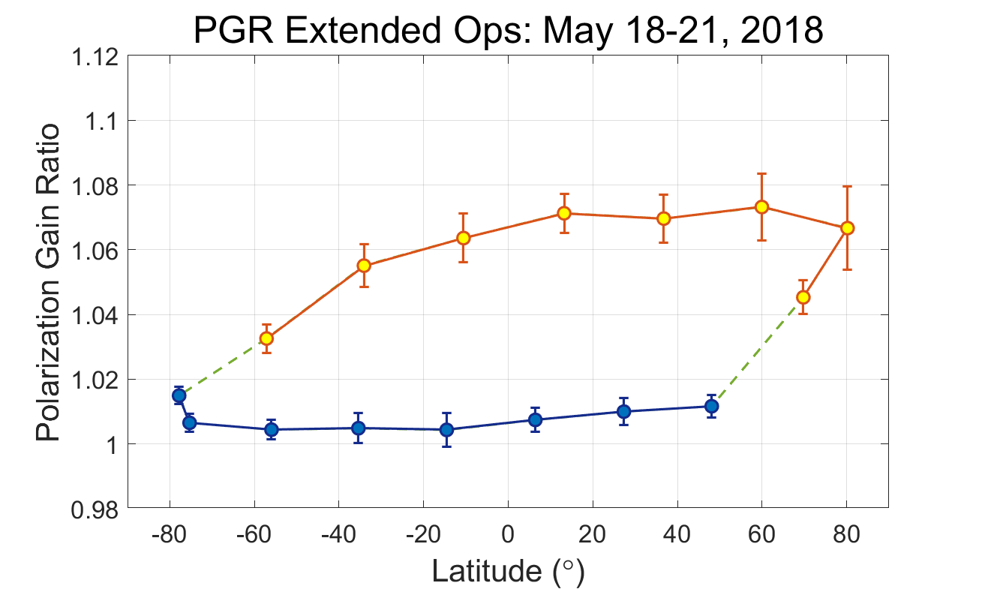
Level 1: PGR Improvements
Polarization gain ratio – relative gain between || and ⊥ detectors
  Biases corrected in PGR calculation
  PGR now calculated separately for day and night.
day
night

Slide 8
Level 2 Updates

Slide 9
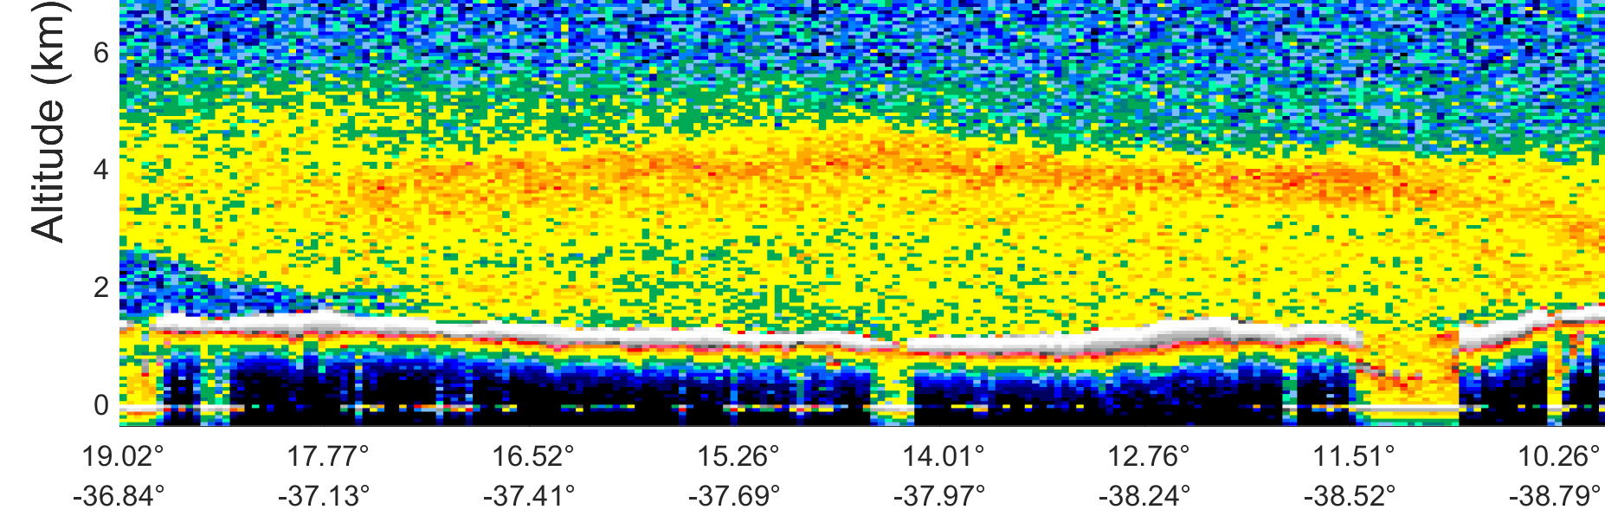
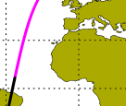
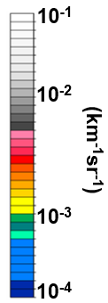
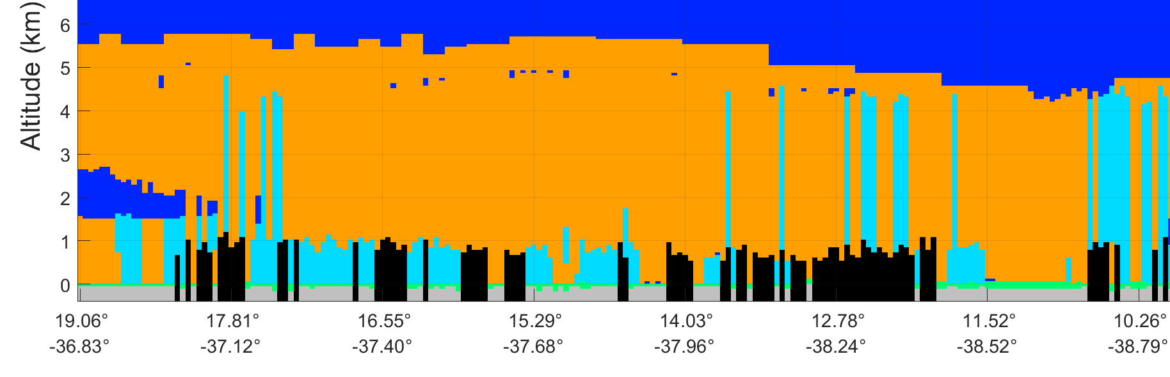
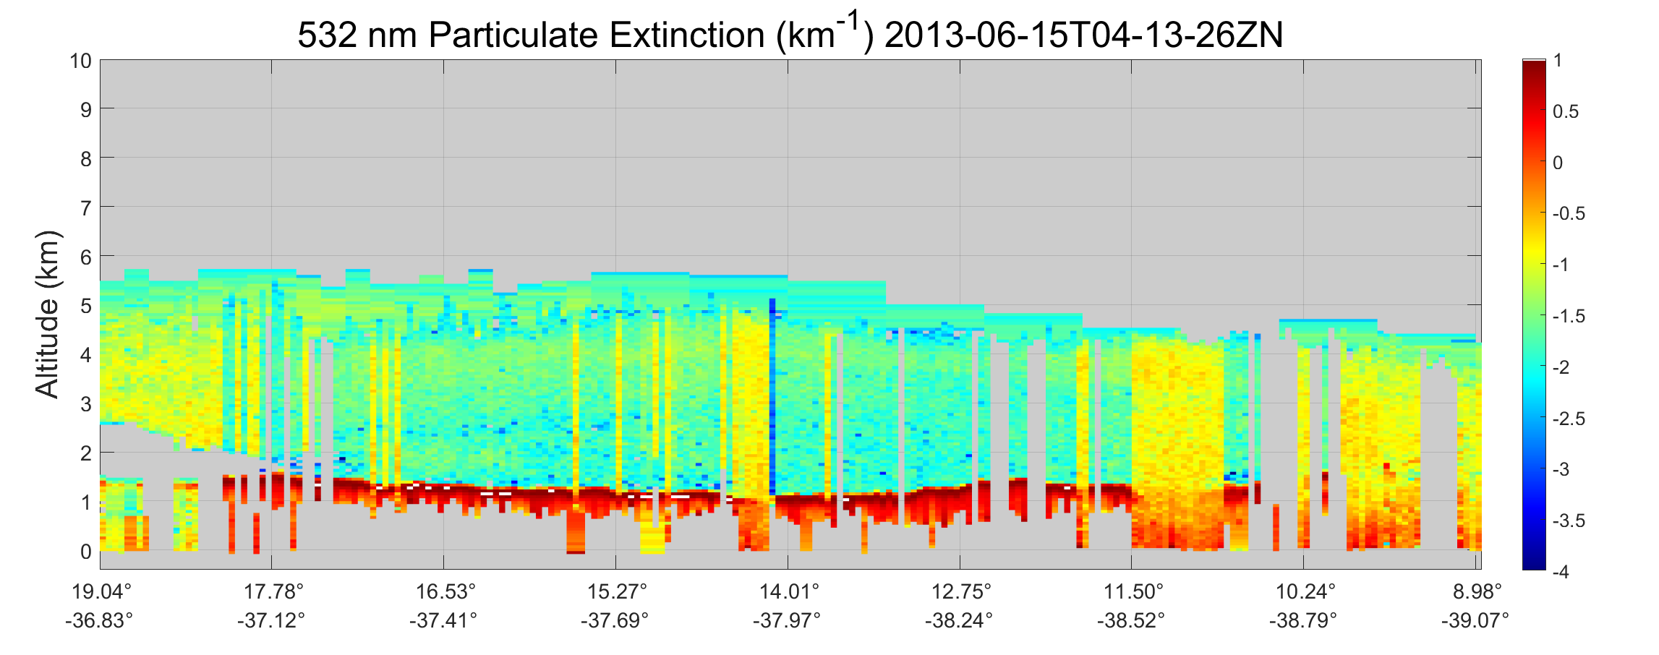
Level 2: Single-Shot Cloud-Clearing Correction
532 nm Attenuated Backscatter
Saharan dust
Clouds detected at single-shot resolution
Version 4.2 Feature Classification (5-km resolution)
aerosol
cloud
Cloud deck and overlying dust layer detected as single layer; single-shot clouds not cleared
Version 4.2 Aerosol Extinction
Log (km⁻¹)
Cloud contamination in retrieved aerosol extinction

Slide 10
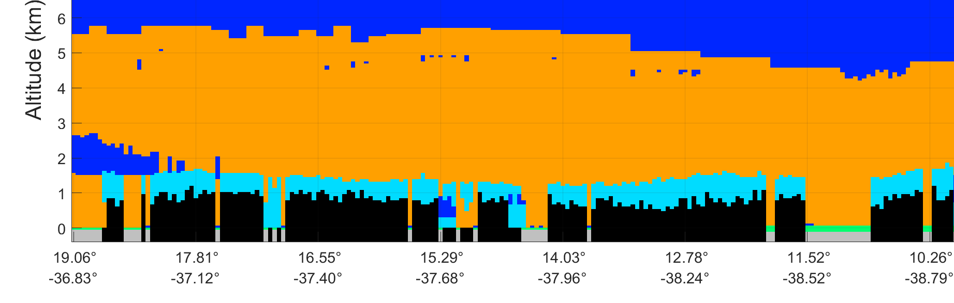
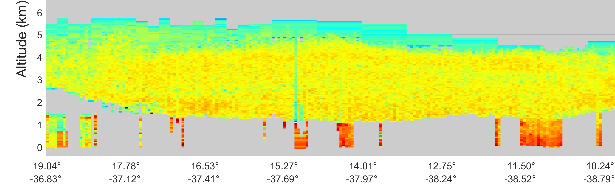
Level 2: Single-Shot Cloud-Clearing Correction
532 nm Attenuated Backscatter
Correction added in V4.5 to properly cloud-clear these situations
Saharan dust
Version 4.5 Feature Classification (5-km resolution)
aerosol
cloud
Preliminary results
Cloud deck now separated from overlying dust layer
Version 4.5 Aerosol Extinction
Preliminary results
Log (km⁻¹)
Aerosol extinction no longer contains cloud contamination

Slide 11
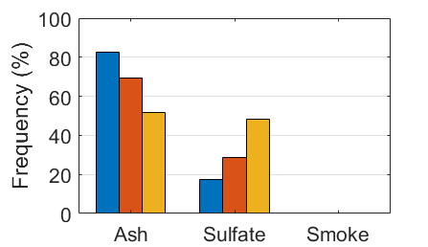
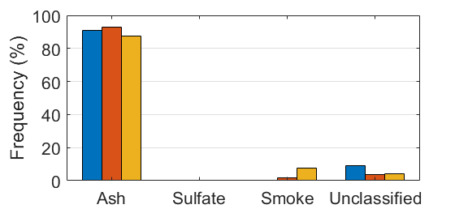
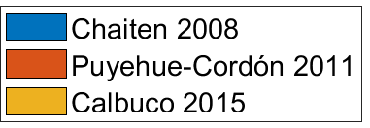
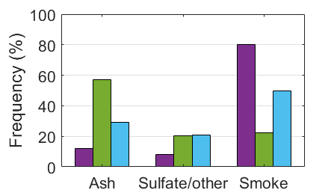
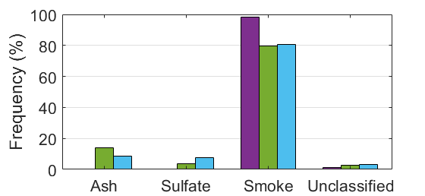
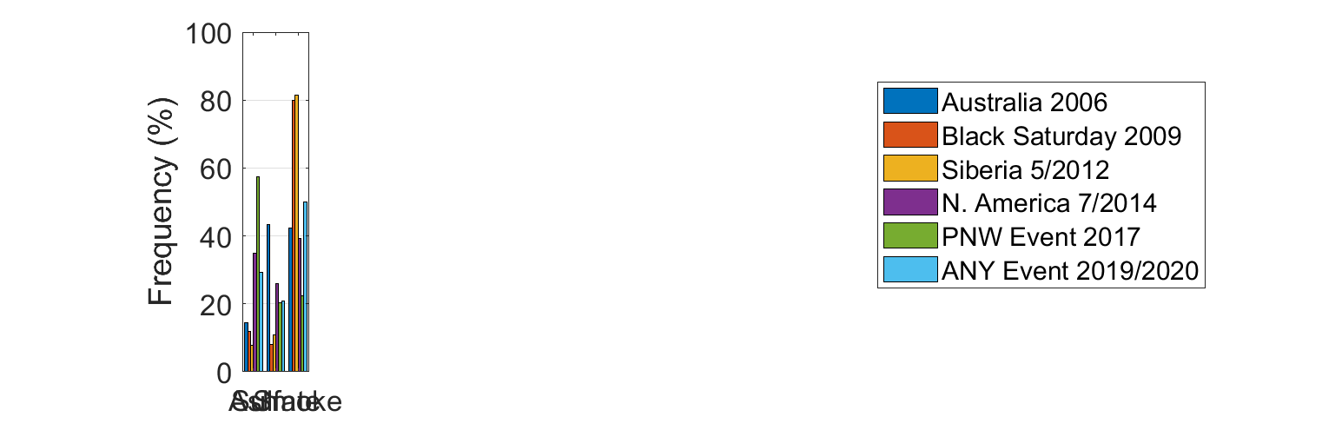
Level 2: Stratospheric Aerosol Subtyping
Changes to stratospheric aerosol subtyping (ash, sulfate, smoke)
  Improved separation between volcanic ash and smoke from pyroCb
  Fewer “unclassified” layers due to weak backscatter
Version 4.2
Version 4.5
Ash
Dominant events
Smoke
Dominant events
Tackett et al., 2022 (in prep)

Slide 12
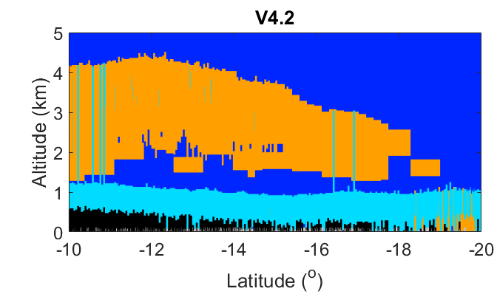
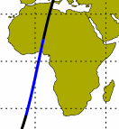
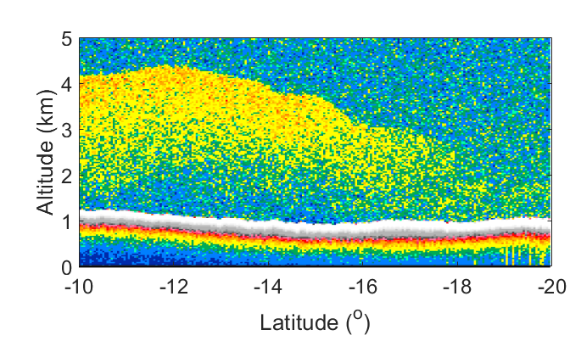

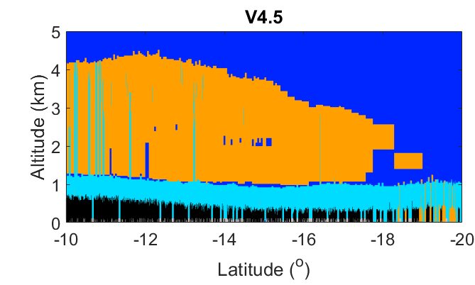
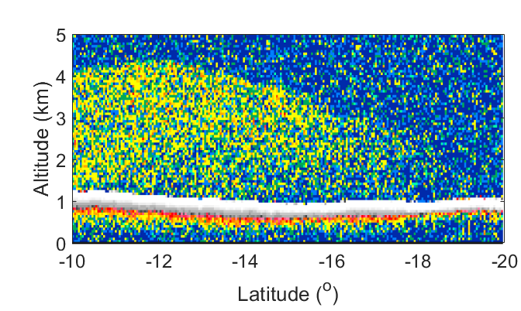
Level 2: Smoke Base Extension
Version 4.2 Feature Classification
apparent gap
Base altitudes of smoke layers over stratocumulus overestimated by in V4.2 (e.g., Rajapakshe et al., 2017).
smoke
In V4.5, smoke layer bases are extended downward to cloud top (+60 m) if the base is within a certain distance to the cloud top and there is usable signal within the gap.
Benefit: improved smoke optical depths
stratocumulus
532 nm attenuated backscatter
Version 4.5 Feature Classification
Smoke bases extended
aerosol
1064 nm attenuated backscatter
cloud
smoke
stratocumulus

Slide 13
Summary
Level 1
Low energy mitigation for calibration (532 nm day, 1064 nm)
Polarization gain ratio updates
1064 nm baseline shape correction
Level 2
Single-shot cloud clearing correction
Stratospheric aerosol subtyping
Smoke base extension
Optical depth over opaque water clouds added
(Hu et al., 2007 method)

