Slide 1
Thermal Control System Architecture and Technology Challenges for a Lunar Surface Habitat
Greg Schunk
Stephanie Babiak
Brian Evans
2022 IEEE Aerospace Conference
Big Sky, Montana
March 5-12, 2022

Slide 2

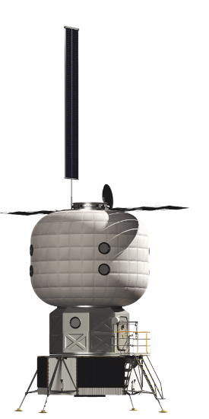
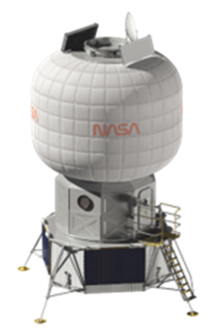
Overview
The NASA Next Space Technologies for Exploration Partnerships (NextSTEP) Broad Area Announcement (BAA) for Habitation (Appendix A) was released in April 2016, with a focus on developing a habitation capability in cis-lunar space through multiple commercial partnerships.
As part of an overall habitation formulation strategy, NASA has developed a Lunar Surface Habitat (SH) Reference Architecture.
The SH is assumed to be comprised of an inflatable volume, an airlock and a propulsive transfer element.
A Thermal Control System (TCS) conceptual design for the SH based on the government design reference is presented with a focus on thermal radiator design, Survive-the-Night challenges and growth potential.
2

Slide 3
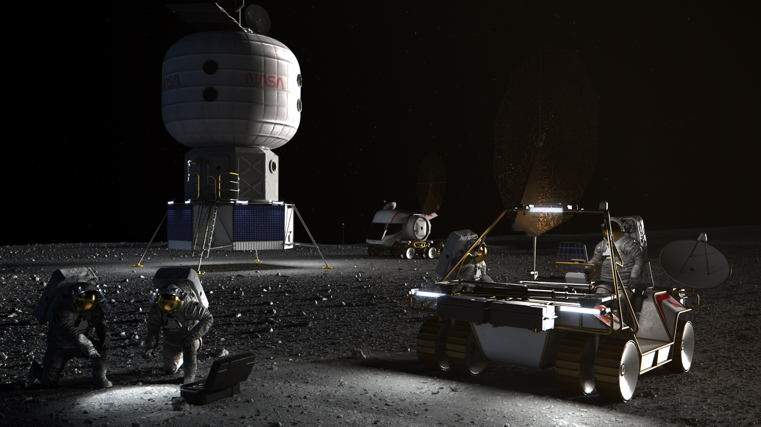
Lunar Surface Habitat
Concept and Ground-rules
Crew: | 2-4
Power: | 15 kW
Night Power: | 2 kW
Eclipse: | 100 hours
Pressure: | 10.2 psia
Lifetime: | 15 years
Mission Duration: | 30-60 days
Mass: | 12 mT
Habitable Volume: | 175 m³
Location: | Lunar South Pole

Slide 4
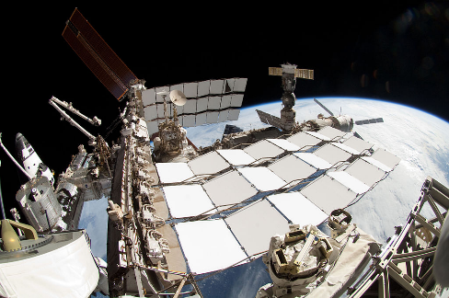
Surface Habitat TCS Description
The Surface Habitat (SH) Thermal Control System (TCS) is designed to reject 15 kWt of heat under nominal conditions at the Lunar South Pole with 48 m² of radiator surface area (double sided). The two-sided deployable thermal radiators are derived from the International Space Station (ISS) design utilizing a honeycomb core.
The TCS has two loops with HFE 7200 as the working fluid externally and a 60/40 water/propylene glycol mixture as the internal fluid.
The internal TCS loop is subdivided to provide both low and moderate temperature service analogous to the ISS ATCS. The low temperature service is intended primarily for ECLSS (e.g. condensing heat exchanger) as well as any payloads that may require it.
Heritage hardware is utilized where possible.
ISS HRS Radiator
X-38 Sublimator

Slide 5
Conceptual Surface Habitat Thermal Control System
Thermal
Radiator
#1
HFE 7200
Independent dual loops both internally and externally. Only one loop in each shown for clarity.
Only major components shown. Expect additional valves, quick disconnects, fluid reservoirs, etc.
Internal ATCS parsed into low and moderate temperature loops.
An external recuperator is added to thermally manage (i.e. minimize) parasitic heat loss during Survive-the-Night.
Full flow through the recuperator during Survive-the-Night; full bypass during peak load.
External Pump
Package
Mixing
Valve
Thermal
Radiator
#2
Recuperator
External
Cold-Plates
LTL
Interface
Heat
Exchanger
Vent
MTL
Interface
Heat
Exchanger
From Airlock
Sublimator
Internal Pump
Package
Mixing
Valve
Cond
Hx
Mixing
Valve
Low Temp
Loads
Regenerative
Heat
Exchanger
Moderate Temp
Loads
To Airlock
Propylene Glycol/Water
5

Slide 6
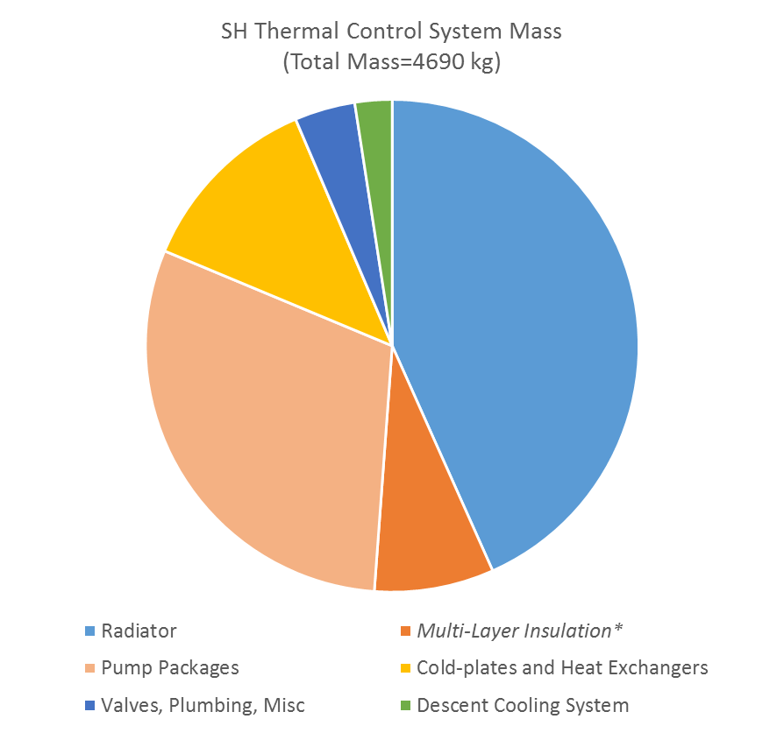
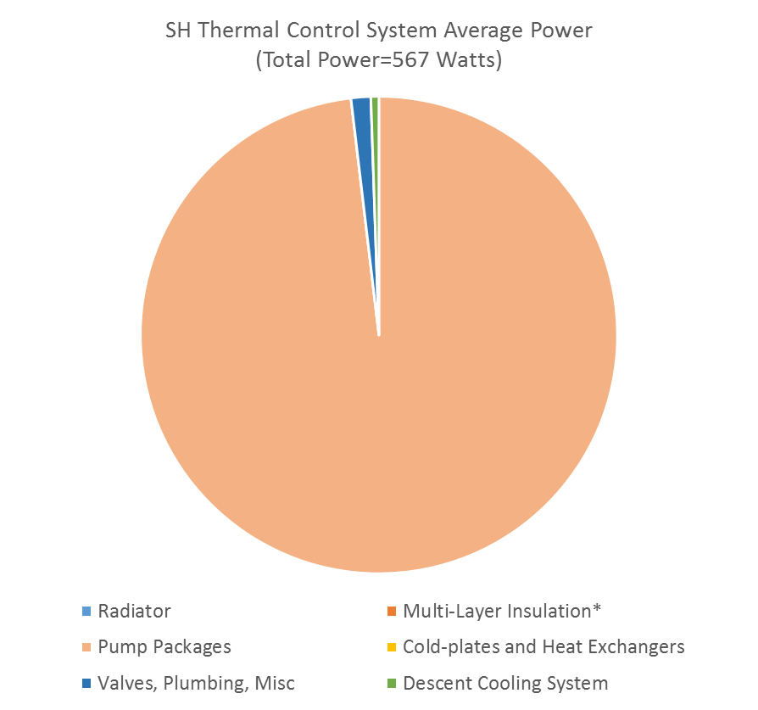
Surface Habitat ATCS Resource Estimates
Primary drivers for mass and power are the thermal radiators and circulating fluid pump packages.
MLI included for reference but is generally considered part of the SH inflatable structure.

Slide 7
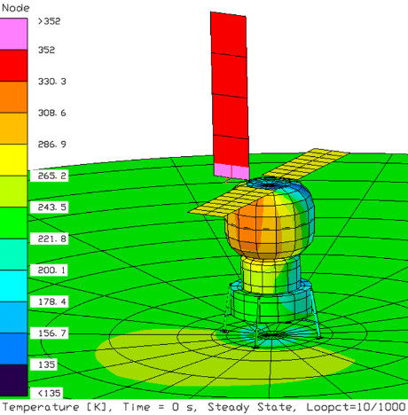
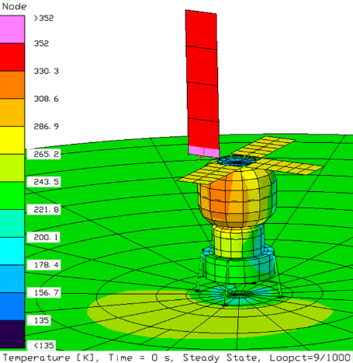
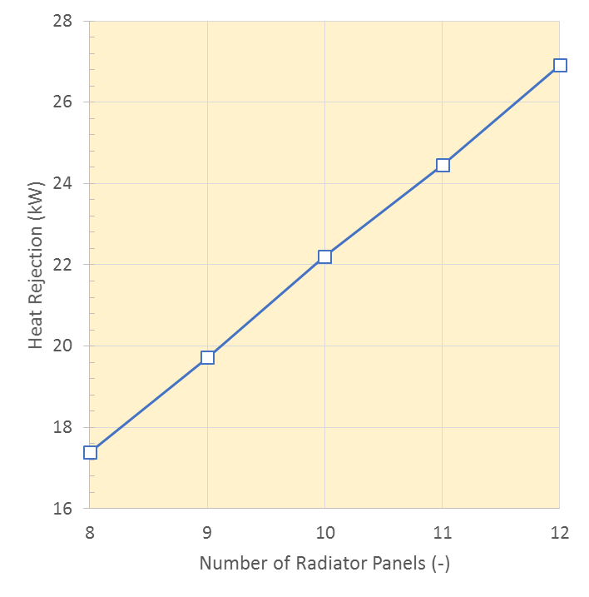
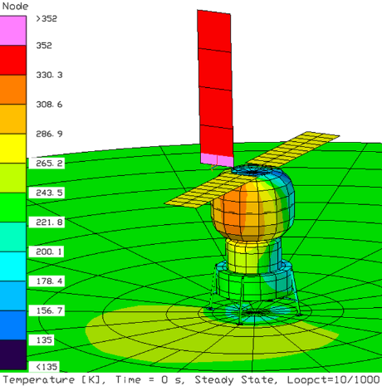
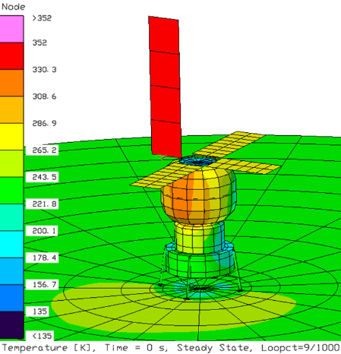
Surface Habitat Heat Rejection and Growth Scenarios
Baseline
8 Panel (4-4)
9 Panel
(3-3-3)
Number of Radiator Panels Required vs Heat Rejection
Radiator Temperature 283K, 85% Efficiency
4-4
10 Panel
(5-5)
11 Panel
(4-3-4)
3-3-3
5-5
4-3-4
4-4-4
Results are for Primary Landing Site, a Lunar Ground Temperature 217K (-70ºF) and Worst-Case Orientation.

Slide 8
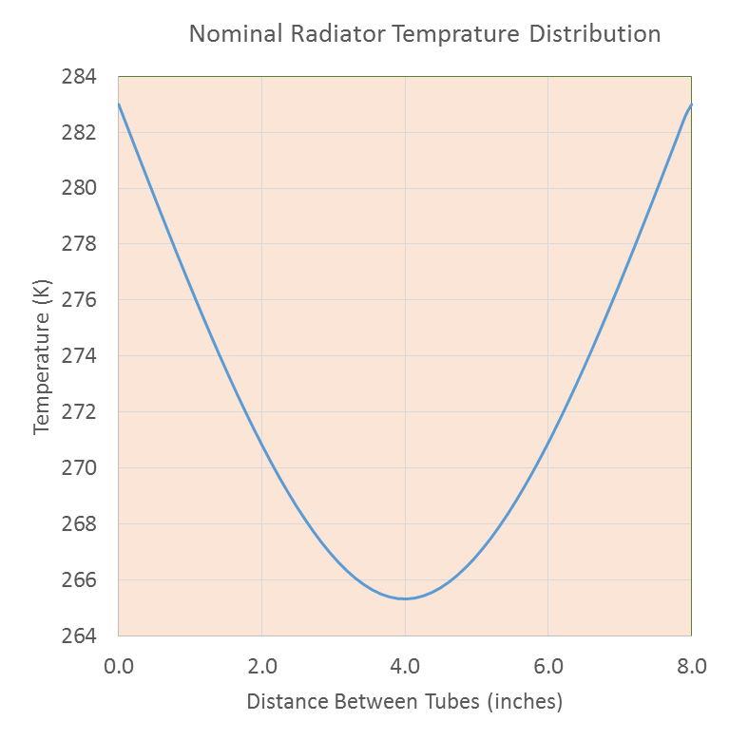
Surface Habitat Thermal Radiator Panel Design
8”
Manifold
Out
2m
In
3m
Fluid enters the radiator via a manifold that splits the flow into 15 tubes. A balance between the spacing of the tubes and radiator efficiency is desired.
At 8” with a nominal fluid temperature of 283K and 0.020” aluminum face-sheets, the predicted temperature profile is shown with an estimated efficiency of 85.5%.
8”

Slide 9
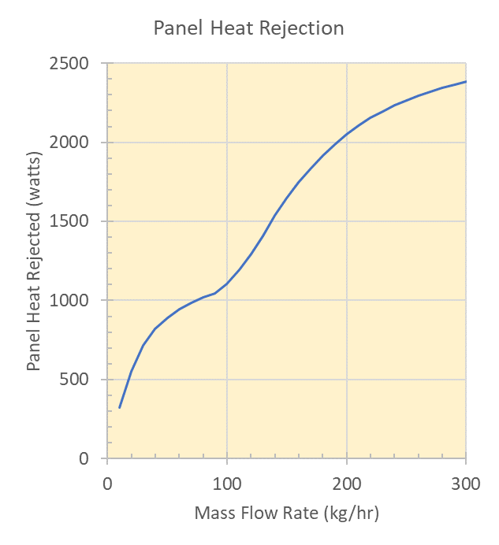
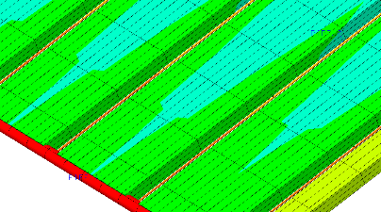
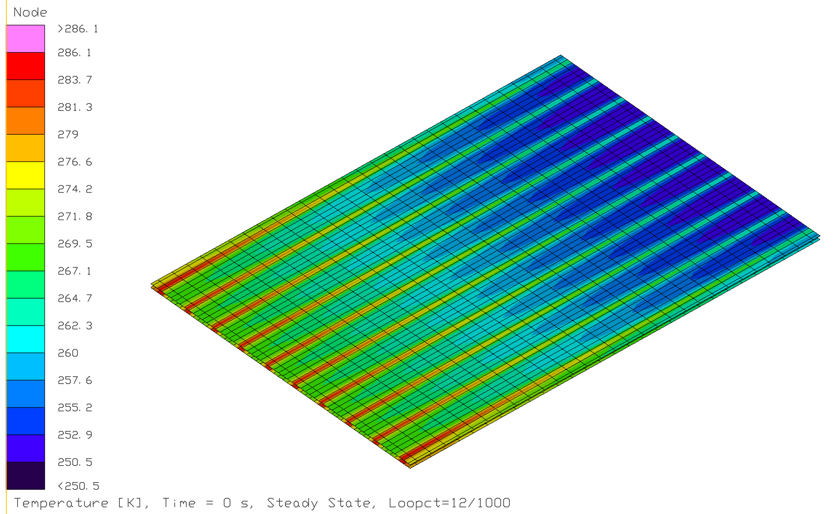
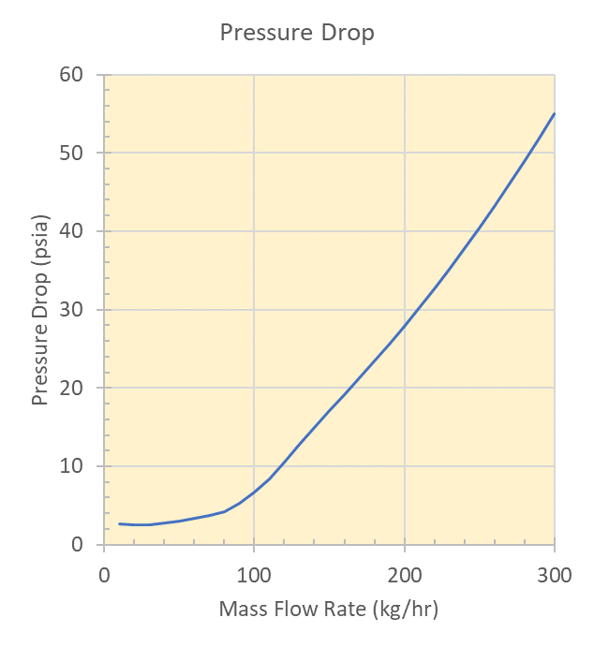
Detailed Thermal Radiator Panel Model
Flow Tubes (1/16”)
Honeycomb
Manifold
Upper and Lower Face Sheets
Out
In

Slide 10
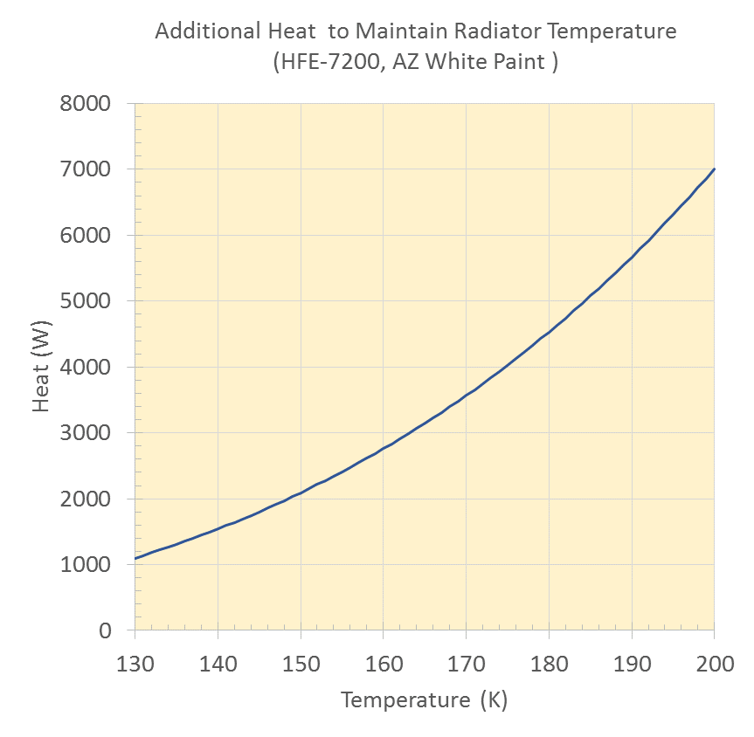
Surface Habitat Survive-the-Night
A 100-hour eclipse is possible at the Lunar South Pole. Additional heat will be needed to maintain the SH inflatable volume and thermal radiators above minimum temperature limits during the dormant Survive-the-Night scenario which may vary in duration and with partial illumination.
To maintain the SH at minimum temperature would require 1550 watts to offset the heat leak through the inflatable volume.
The radiator fluid (HFE 7200) has a lower working temperature limit of -100ºC (-148ºF) and a freezing point of -137ºC (-215ºF). To maintain the radiators just above the working or freezing temperature limits would require nearly continuous heat of at least 3840 or 1353 watts, respectively.
For the fluid working limit, the un-mitigated (i.e. no counter-measures) total energy required would be 540 kWh for the 100 hour Survive-the-Night scenario.
Mitigation strategies to reduce the power requirement, including energy storage, optimizing external optical properties, preconditioning the SH (warm) and stowing or reconfiguring the radiators, are under consideration
HFE 7200
Working Limit
173K (-148 F)
3840 Watts
HFE 7200
Freezing Point
136K (-215 F)
1353 Watts

Slide 11
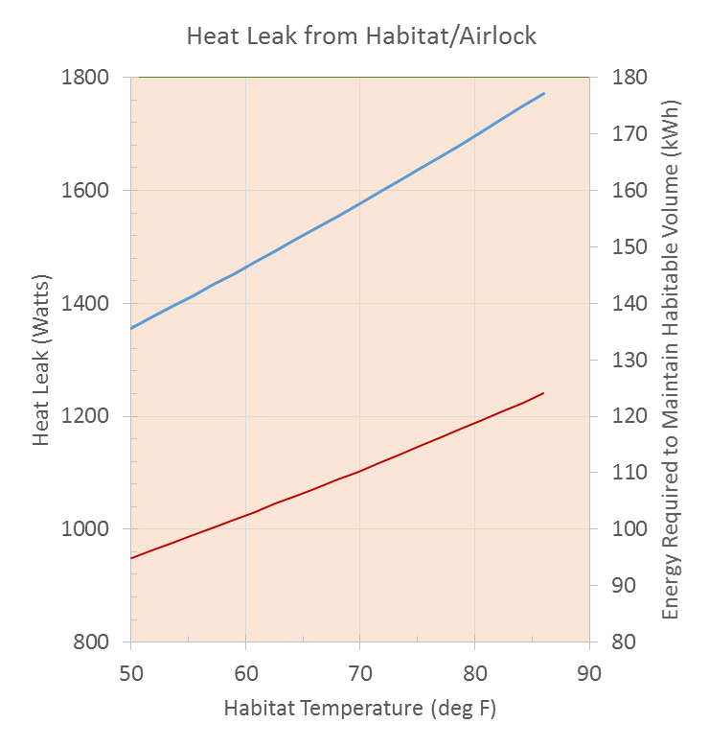

Mitigation Strategy: Lower Emittance Covering
Baseline design utilizes beta cloth for the outer covering of the inflatable structure. Beta cloth has an infrared emittance of 0.9 (along with a solar absorptance of 0.4).
Reducing the emittance could significantly reduce heat leak during survive-the-night periods.
Some margin to reduce the emittance exists as the surface habitat has a net heat loss (~850 watts) during daylight operations. Prefer not to have a net heat gain during operational periods because of extra load for the TCS.
The potential energy savings is on the order of 50 kWh.
Beta Cloth ε=0.90
Savings
50 kWh
New Material ε=0.70

Slide 12
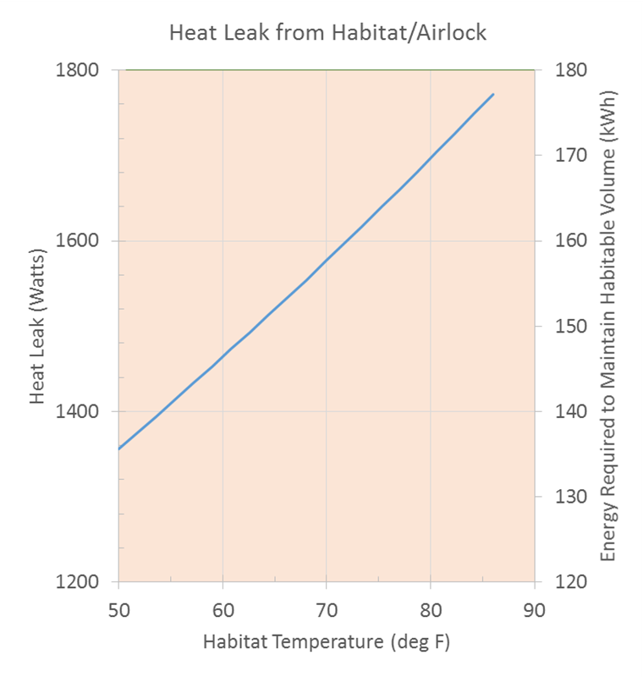
Mitigation Strategy: Habitat Temperature
In addition to the heat loss from the radiators, approximately 1550 watts of make-up heat would be needed to maintain the SH habitable volume above 68ºF during Survive-the-Night.
The heat required is proportional to the habitat internal temperature as shown.
Allowing the un-crewed habitat temperature to sink below respirable atmosphere limits could save on the total energy required (with the atmosphere ostensibly returned before crew arrives).
Pre-heating the habitat to store energy may also mitigate the energy required. For the nominal case, the energy required would be 155 kWh with a potential savings of 43 kWh if preconditioned to 85ºF.

Slide 13
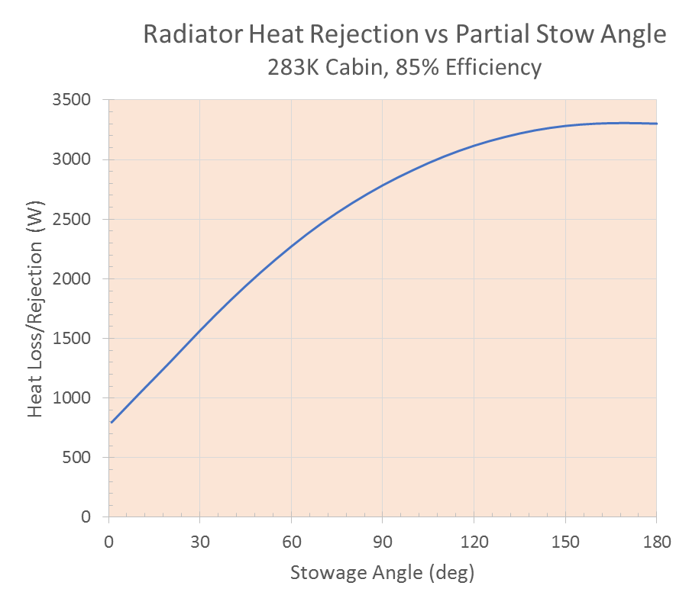
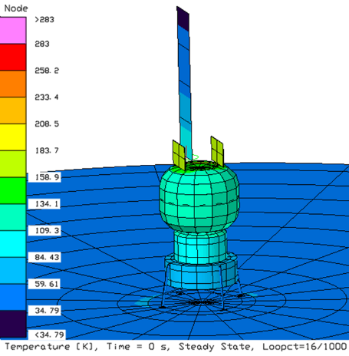
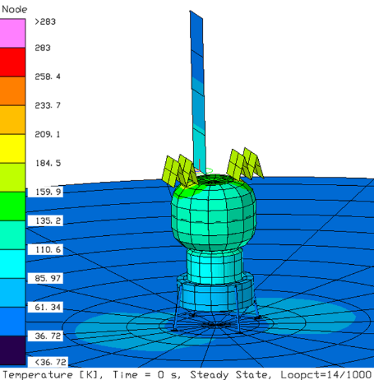
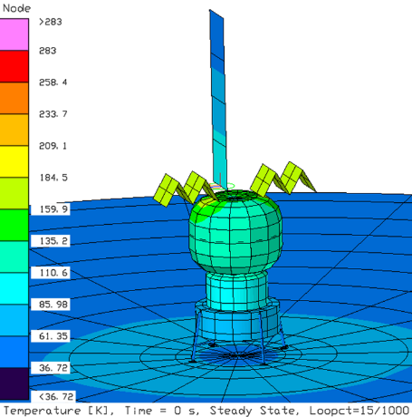
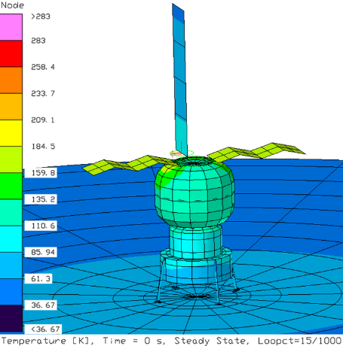
Mitigation Strategy: Retractable Radiators
α=0°
α=30°
α
α=60°
α=150°
Stowing the thermal radiators for Survive-the-Night could greatly reduce energy storage requirements with a potential savings of 234 kWh if stowed to 30º.

Slide 14
Survive-the-Night Thermal/Power Growth Sensitivity
Total Radiator/Photovoltaic/Fuel Cell
Mass vs Electrical Power
In the baseline design, a Regenerative Fuel Cell (RFC) provides energy needed to support a 100 hour Survive-the-Night Scenario for a given thermal radiator size.
RFC electrical power and waste heat are utilized to maintain habitat and prevent radiator freezing during the Survive-the-Night scenario.
The impact of electrical power system growth versus system mass is shown.
Both the thermal radiator and photovoltaic masses increase proportionally with an increase in electrical power.
The regenerative fuel cell mass is nearly constant with increasing power with the primary effect being a small increase in logistics.
Additional Electrical Power System (EPS) mass may be required to scale up peripheral distribution components for increased power requirements.
Fuel Cell Logistics (H₂/O₂)
Regenerative Fuel Cell Mass
Thermal Radiator Mass
Photovoltaic Mass

Slide 15
Summary
A TCS Reference Architecture for a 30-day Surface Habitat mission to the Lunar South Pole is presented.
TCS and energy storage needs may be minimized through Survive-the-Night mitigation strategies.
Fixed re-generable fuel cell mass impacts for Survive-the-Night appear to be slight with increasing radiator size. The amount of water or oxygen/hydrogen required for Survive-the-Night energy storage will grow with increased radiator size (approximately 130 kg per 10 kWe).
Future plans are to continue refinement of the SH ATCS concept with detailed thermal modeling to provide performance predictions and support trade studies.
Special thanks to NextSTEP Habitation Systems Development (NASA/MSFC/HP40) for sponsoring this work.

