Slide 1
Identifying Knowledge Gaps-
Particle Impact Ignition
Presented By: Stephen Peralta/ Jonathan Tylka
NASA Johnson Space Center
White Sands Test Facility

Slide 2
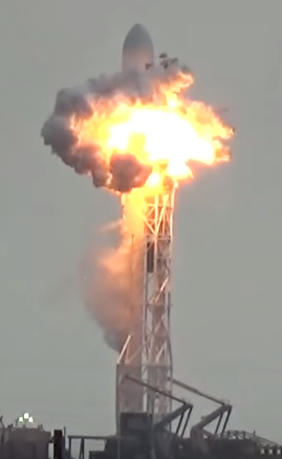
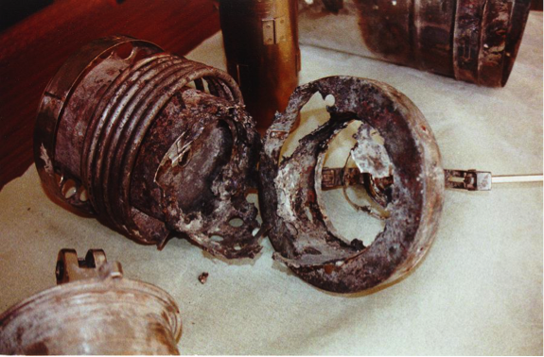
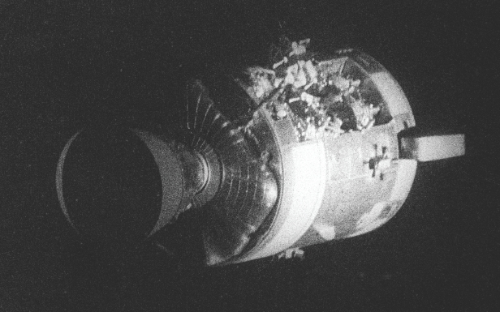
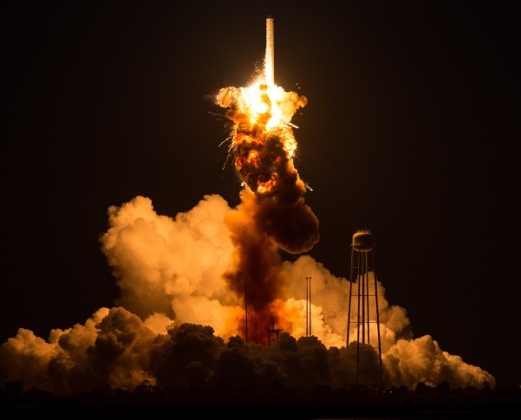
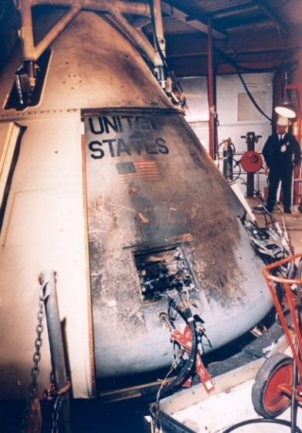
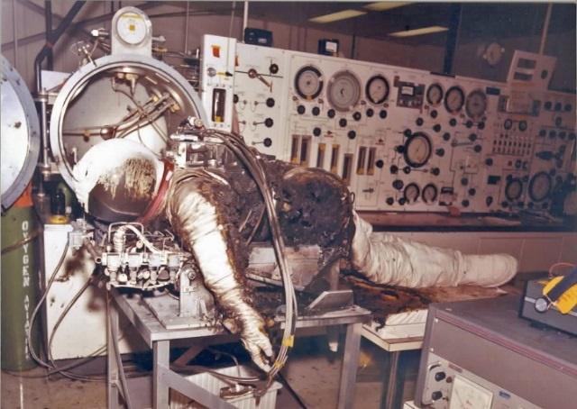
Aerospace Fire History
1960 |  | 1970 |  | 1980 |  | 1990 |  | 2000 |  | 2010
Apollo 1
The EMU Fire
MIR Fire
Cygnus Orb-3
1/27/1967
10/28/2014
Altitude Chamber Fire
Apollo 13
4/15/1980
2/24/1997
3/23/1961
4/14/1970
SpaceX F9-29
9/1/2016
Notes:
Talk about how over time oxygen hazards are increasing as new technology allows for higher pressure, temperature, flow rates.

Slide 3
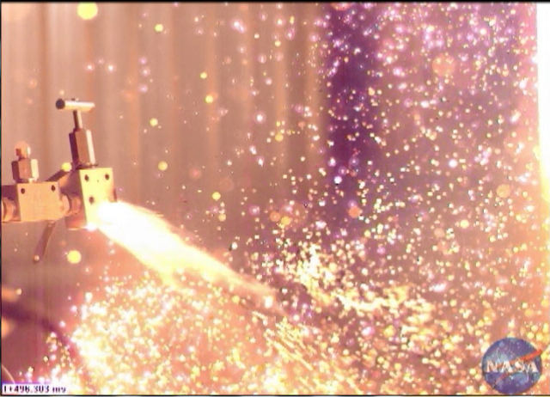
What is Particle Impact?
Heat generated when small particles strike a material with sufficient velocity to ignite the particle and/or the material.
  Most common direct igniter of metals
  Necessary Conditions
    High Oxidizer Concentrations
    Flammable Materials
    Particles (flammable, or inert)
    High Velocities (Typ. >30 m/s)
    Impingement (Typ. >45°)
  Hazards increase with:
    Pressure, temperature, oxygen concentration, velocity, flammable materials
  SLM Components shed metal particles (Lowrey 2016)
Unclassified; Publicly available; Unlimited per JSC-E-DAA-TN67501 and JSC-E-DAA-TN66801

Slide 4
Oxygen Compatibility- Particle Impact
Particle Impact Risks Areas for Oxygen Rich Staged Combustion Engines
  Pre-burners
  Turbines
  Gas Manifolds
  Main Injectors
Recent work showing that ignition depends greatly on configuration
  Tube bends, Venturi, Ball valves
Compatibility studies and testing are a necessity
  Flammability of materials, particle impact testing (materials and configurations), tenacity of coatings
Risks if not pursued:
  Equipment Damage, Loss of Mission, Loss of Life

Slide 5
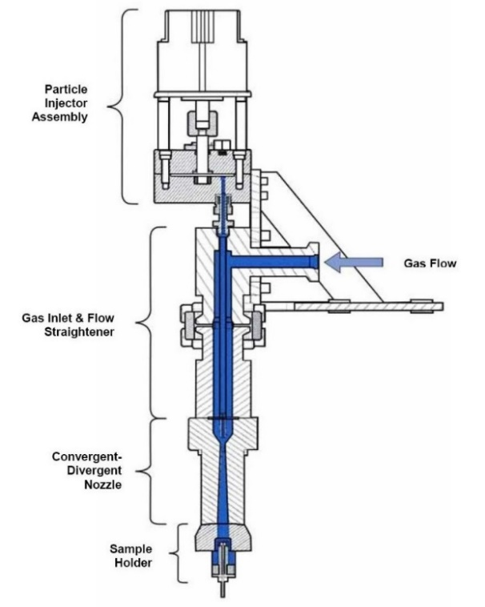
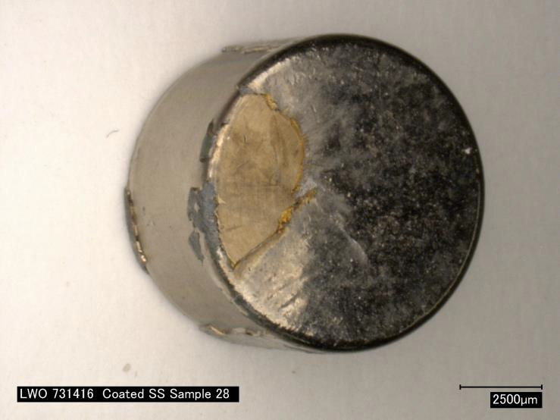
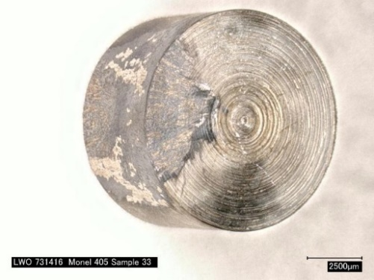
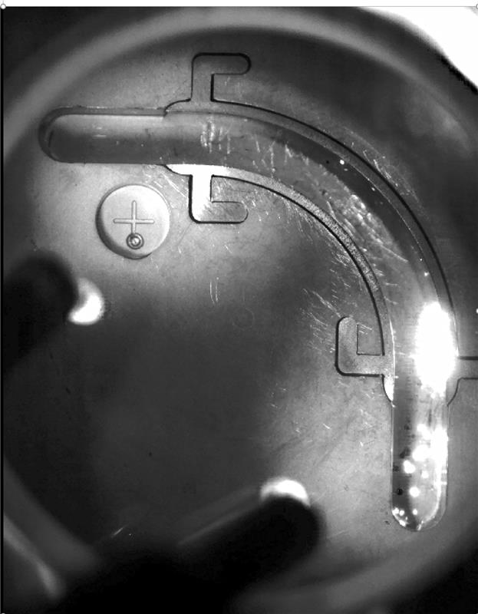
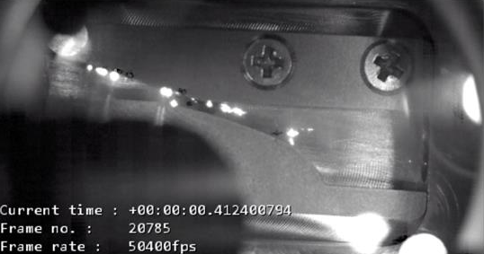
Current WSTF Tests
Unclassified; Publicly available; Unlimited per JSC-E-DAA-TN67501 and JSC-E-DAA-TN66801
Materials Level:
Subsonic
Supersonic
Configuration/ Component

Slide 6
Test Needs Going Forward
Continue using computational fluid dynamics (CFD) analysis with debris transport analysis (DTA) to:
  Better characterize existing materials test configurations
  Identify areas of highest risk in components
  Guide testing parameters to ensure ignition data applicability
Continue developing flowing configuration tests to help with visualization
Better understand materials science/ ballistics of particle impact ignition
Build WSTF’s concept next generation flowing particle impact test system
  Higher Pressures
  Higher Temperatures
  Tighter control over subsonic, transonic, and supersonic flow

Slide 7
Contact Information
Stephen Peralta
NASA White Sands Test Facility
Oxygen Group Lead
stephen.f.peralta@nasa.gov
Jonathan Tylka
NASA White Sands Test Facility
Flight Systems Test Engineer
jonathan.m.tylka@nasa.gov

Slide 8
Back UP

Slide 9

We must manage the risks…
Maximize more
compatible materials
Minimize ignition
mechanisms
Ignition resistant
Burn resistant
Low-damage
potential
What generates heat in
my system?
Control or eliminate
Oxygen Compatibility
Assessment
Fuel
Heat
Oxidizer
Utilize good practices
  Implement all aspects of
  oxygen system safety

