Slide 1
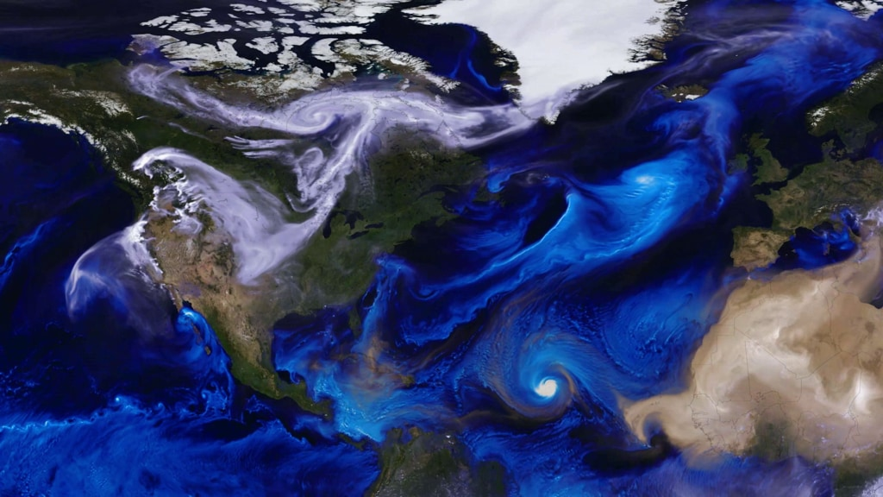

NASA Airborne Science Program
– A Personal View
Melissa Yang Martin
Deputy Airborne Science Program Director - Science
ESSPPO - Earth Venture Suborbitals-3 Mission Manager
March 11, 2022
Notes:
Changed the date

Slide 2
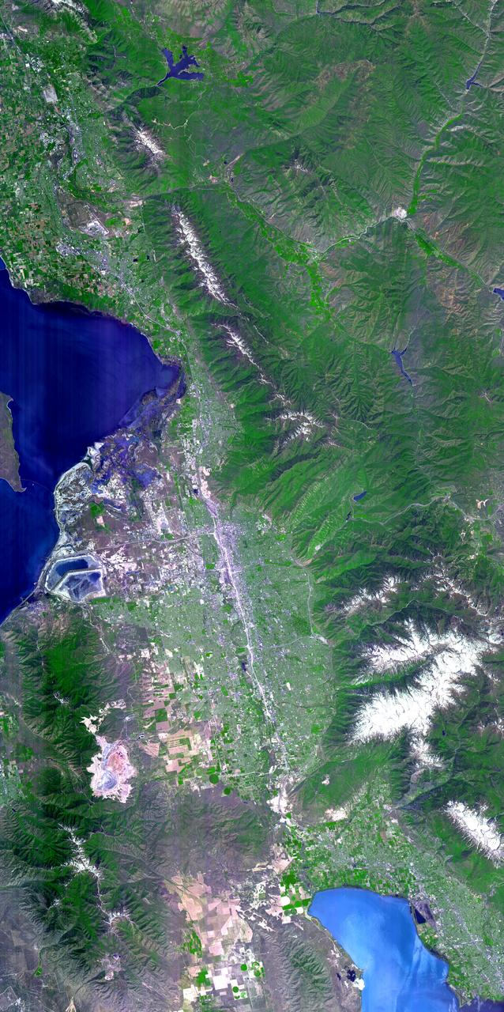
Overview
A Little About Me
NASA Airborne Science Program Overview
NASA DC-8 Aircraft
EVS-3 Missions
Conclusion

Slide 3


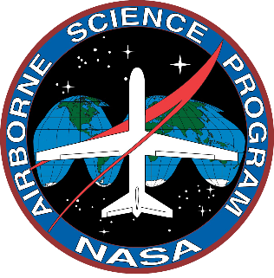
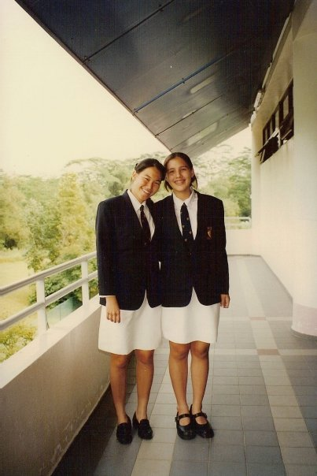
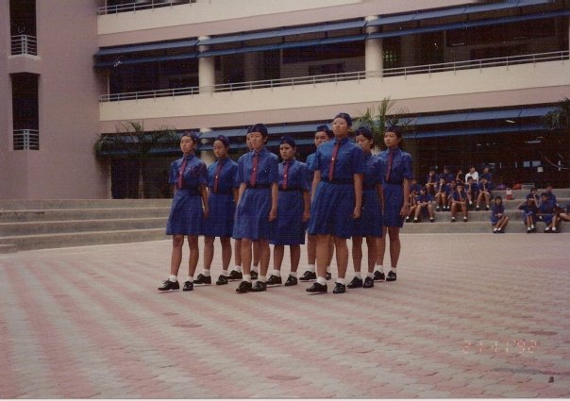
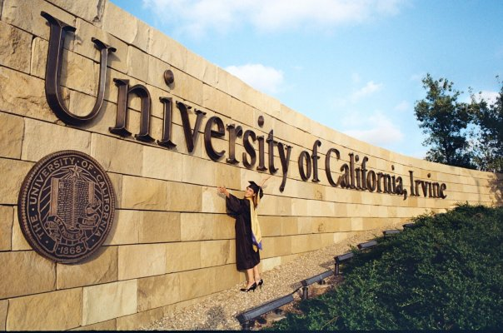
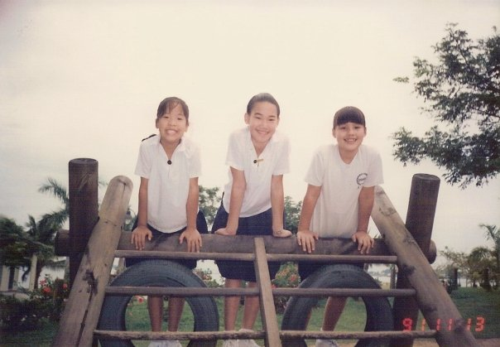
A Little About Me
Born and raised in Singapore
MGS Primary, Secondary
ACJC
Drew University, Madison, NJ (Bachelor’s in Chemistry)
University of California, Irvine (Ph.D. in Atm Chemistry)
Post Doc Researcher at NASA Langley Research Center
Instrument Principal Investigator
Deputy Project Manager for RBI
NSRC Program Director
Deputy Airborne Science Program Director – Science Lead / EVS Mission Manager

Slide 4
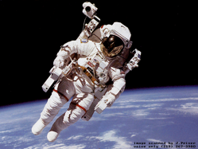

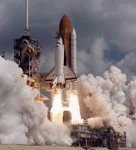
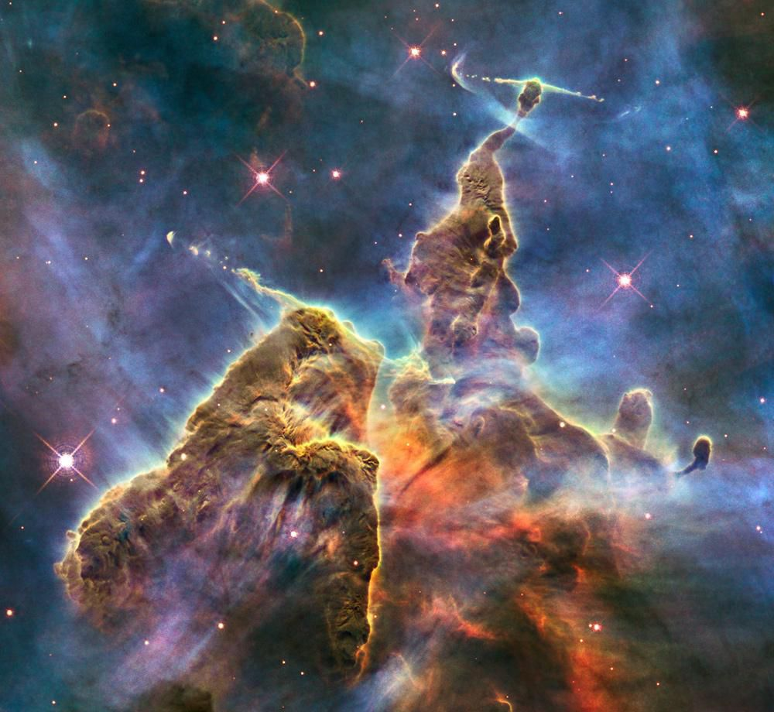
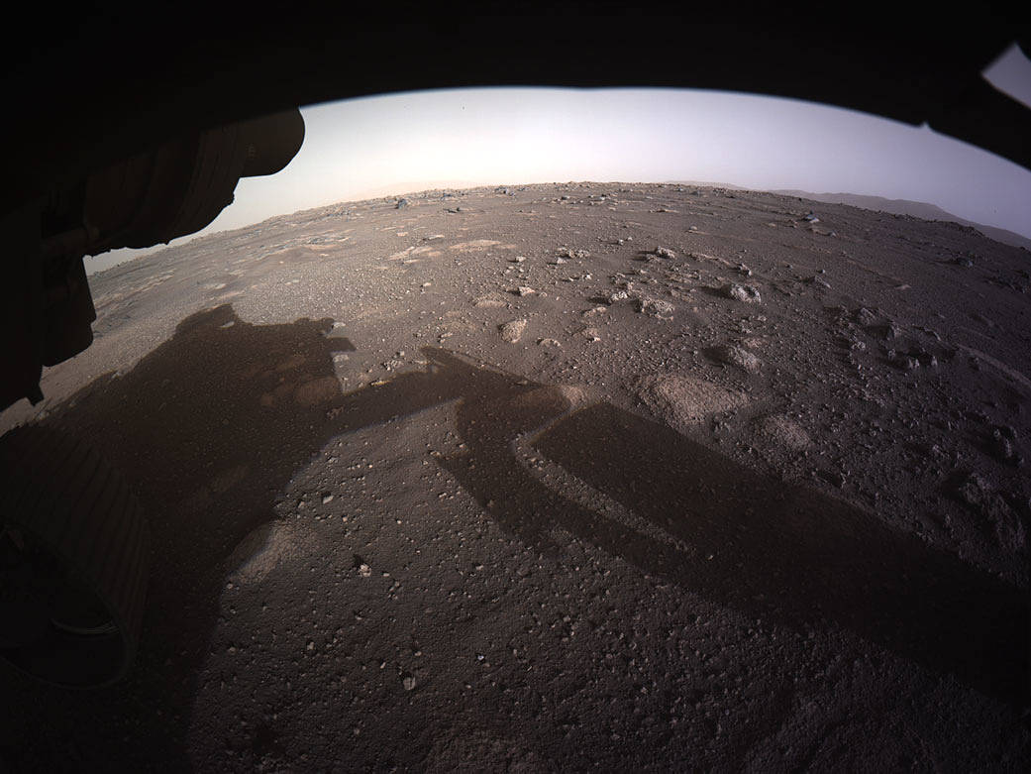
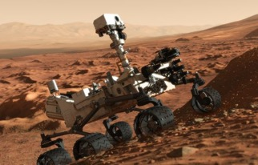
What does NASA do?
Fly people into space
Explore the planets and the Universe
Notes:
The mystic mountain: a three-light-year tall pillar of gas and dust stretching out of the Carina Nebula. Made mostly of cool hydrogen, the structure is created by stars releasing jets of gas , which is worn away by radiation from other nearby stars, giving it its eroded shape

Slide 5
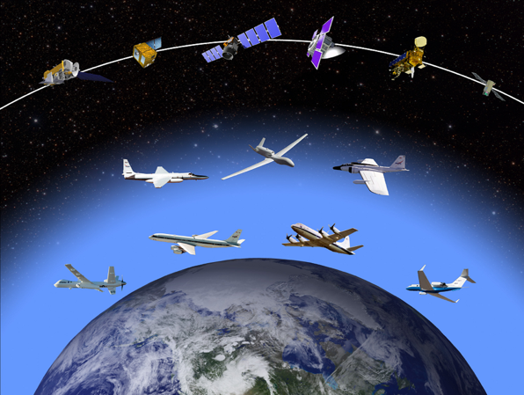
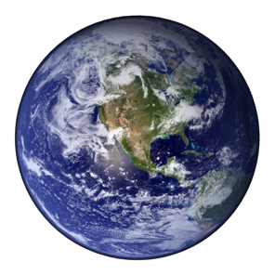
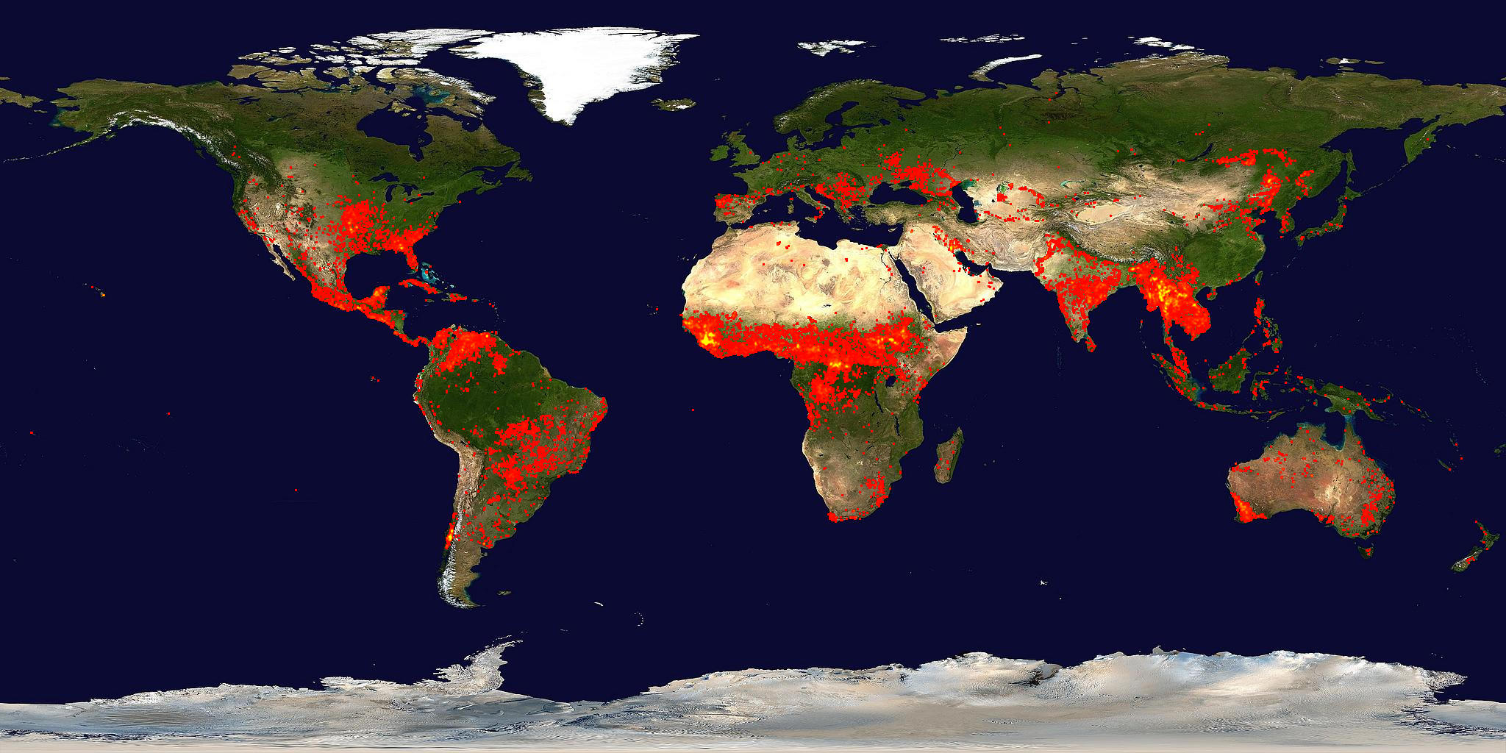
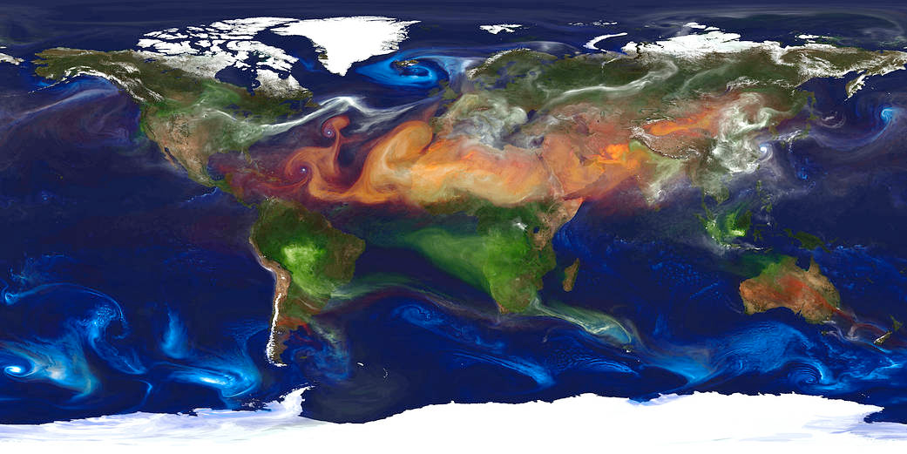
What Else Does NASA Do?
Study and Explore the Earth!
Because Earth is a planet too! In fact, Earth is the planet that NASA has explored the most
We want to understand:
  How is Earth changing?
  What is causing these changes?
  How can we better manage our natural resources?
  Can we improve our responses to natural disasters?
NASA Data is free for everyone all over the world to use
Notes:
MODIS fire map: The MODIS active fire product detects fires in 1-km pixels that are burning at the time of overpass under relatively cloud-free conditions using a contextual algorithm.
GEOS-5 simulation at a 10-kilometer resolution. Dust (red) is lifted from the surface, sea salt (blue) swirls inside cyclones, smoke (green) rises from fires, and sulfate particles (white) stream from volcanoes and fossil fuel emissions.

Slide 6
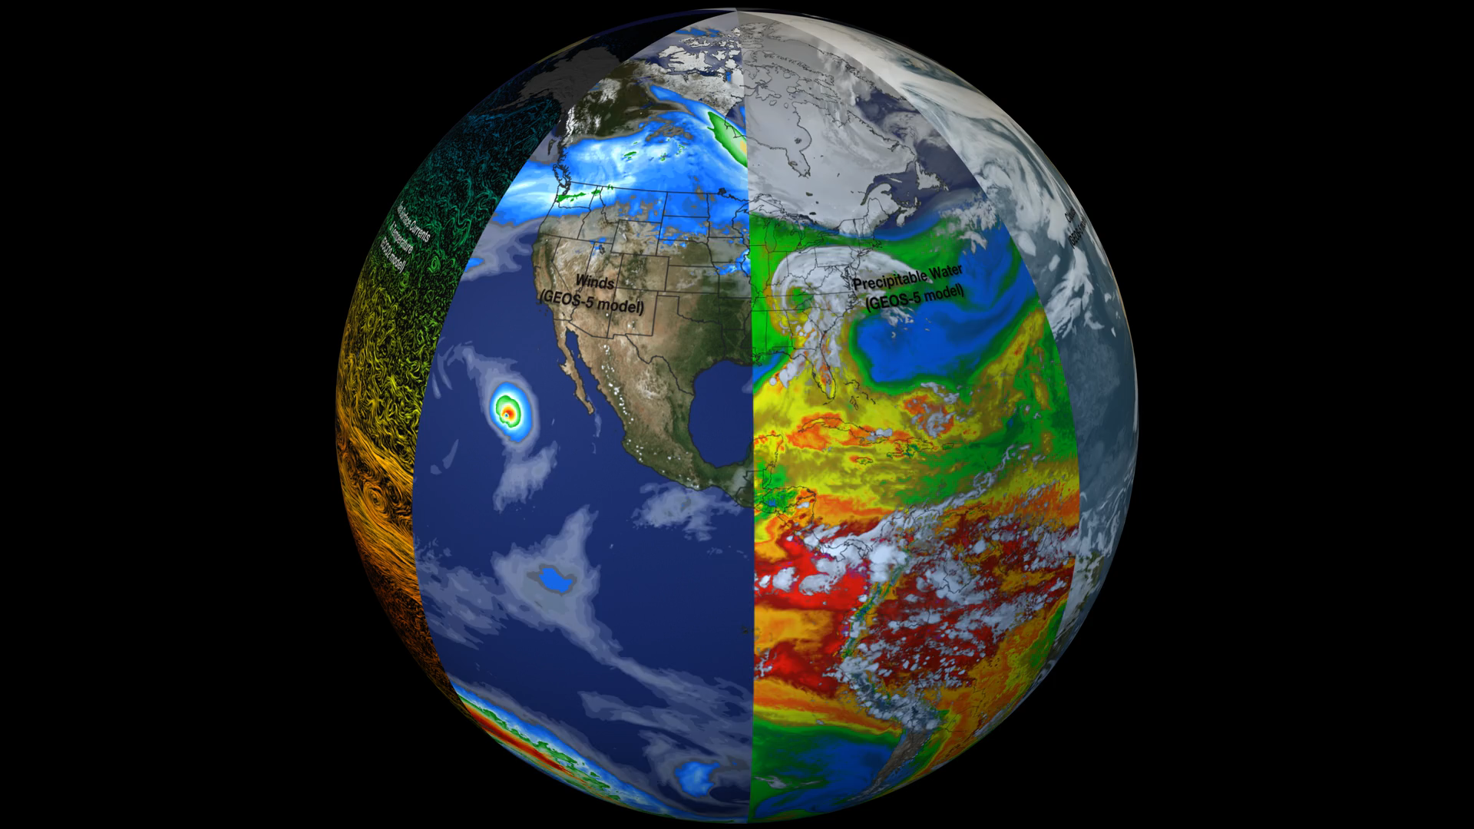
NASA Earth System Science
Atmospheric Composition
Carbon Cycle and Ecosystems
Climate Variability and Change
Earth Surface and Interior
Water and Energy Cycle
Weather and Atmospheric Dynamics
NASA Scientific Visualization Studio
svs.gsfc.nasa.gov/30701

Slide 7
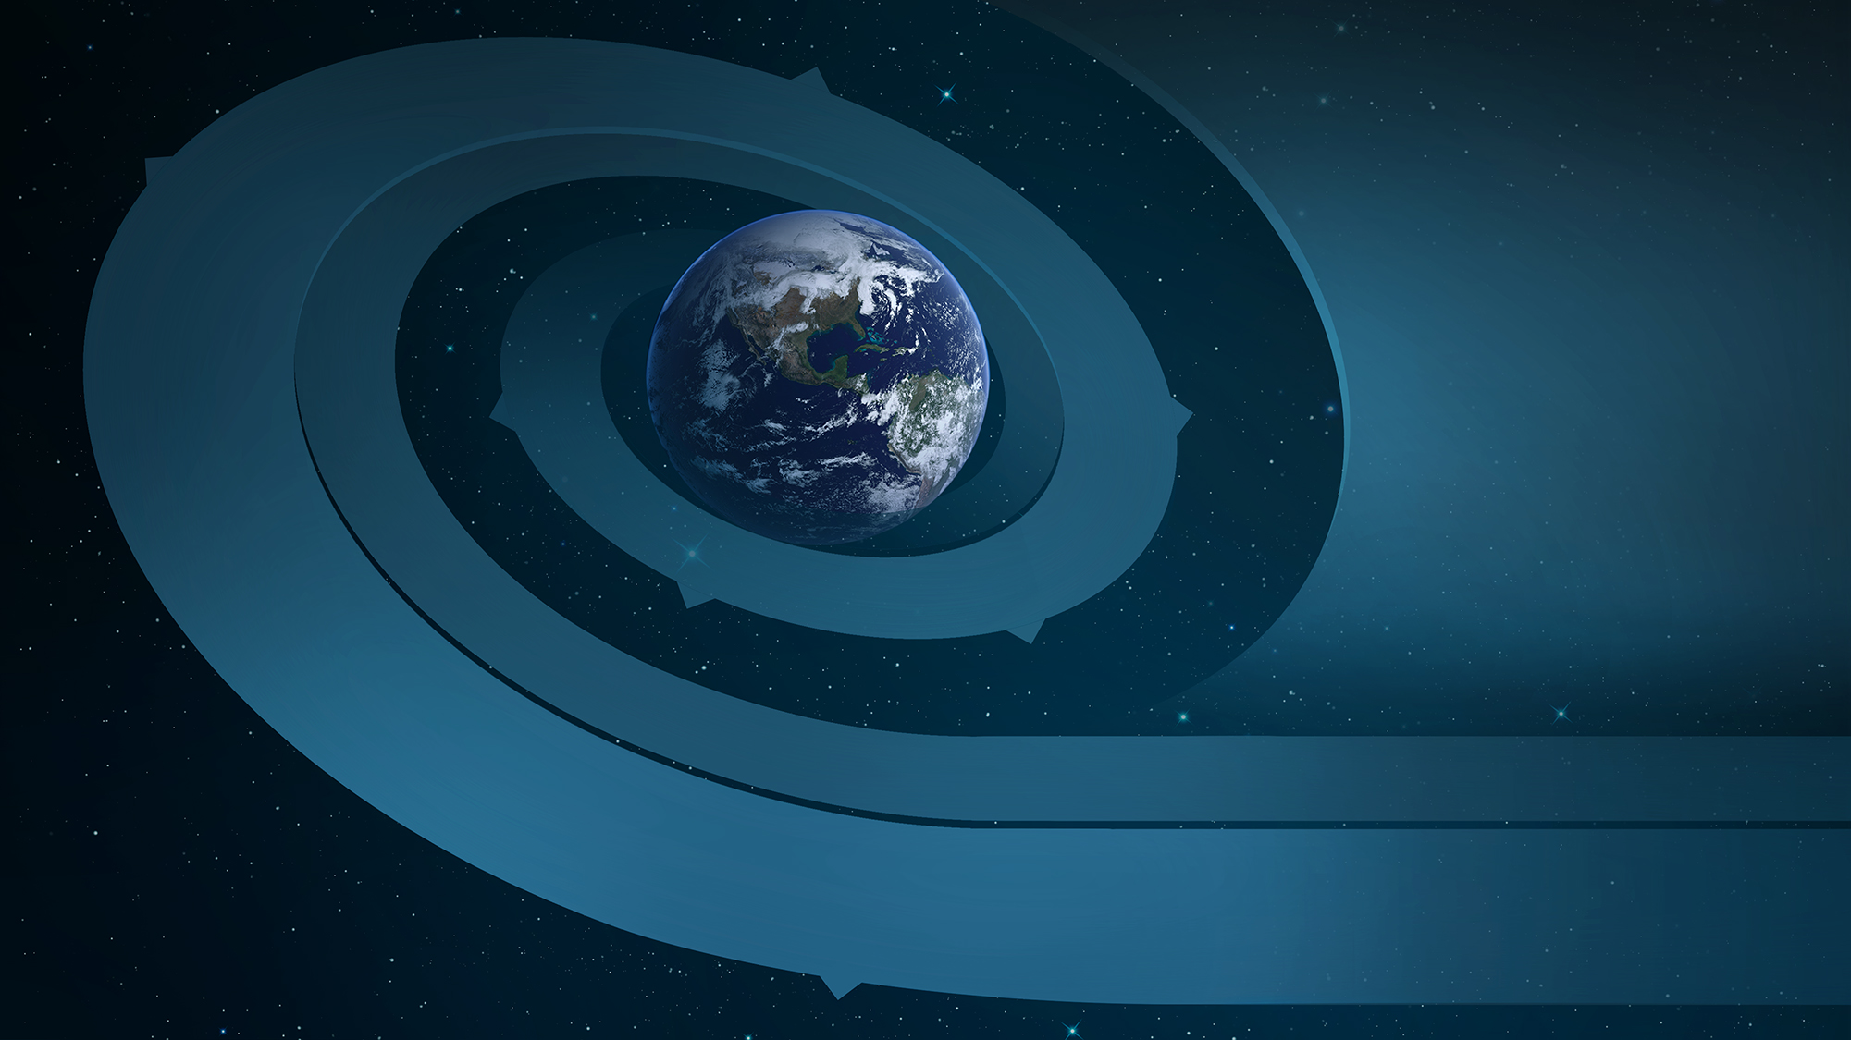



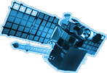












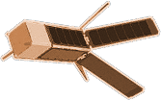




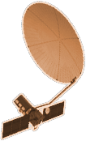



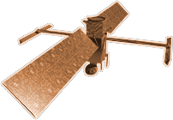


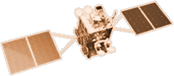




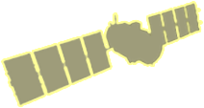
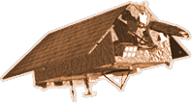

CYGNSS (8)
NISTAR, EPIC
2015
GRACE-FO (2)
SMAP
ICESAT-2
OCO-2
2020
GPM
SENTINEL-6
MICHAEL FREILICH
EARTH FLEET
GEDI
LANDSAT 8
LANDSAT-9
EMIT
SUOMI NPP
INVEST/CUBESATS
ECOSTRESS
CSIM-FD 2023
HARP 2022
CIRIS 2023
CTIM* 2022
HYTI* 2022
SNOOPI* 2022
NACHOS* 2022
NACHOS2* 2022
TROPICS (6)
1995
2010
OCO-3
LANDSAT 7
CALIPSO
NISAR
TERRA
AQUA
CLOUDSAT
SWOT
CLARREO-PF
AURA
2000
JPSS INSTRUMENTS
TSIS-1
2005
GEOCARB
LIS
OMPS-LIMB 2022
LIBERA 2027
TEMPO
SAGE III
PREFIRE (2)
MAIA
ISS INSTRUMENTS
KEY
PACE
INTERNATIONAL PARTNERS
U.S. PARTNER
ISS INSTRUMENT
JPSS INSTRUMENT
CUBESAT
LAUNCH DATE TBD
TSIS-2
GLIMR
ESO-1, 2, 3, 4
PREFORMULATION
FORMULATION
OPERATING
EXTENDED
SENTINEL-6B
INCUS
MISSIONS
11.30.21
2025

Slide 8
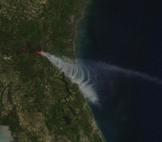
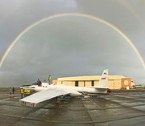
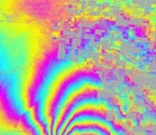

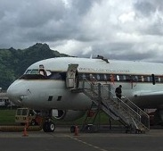
What Airborne Platforms Provide Earth Science
    Help bridge scales between the (typically) global scales of satellite observations and the very local observations of surface-based in situ measurements.
    Way of doing comprehensive process-oriented studies that can focus on specific regions and times of interest.
    Initial sense about Earth system parameters and their variability before satellite observations are possible.
    Focused calibration/validation observations (e.g., coincident measurements) for satellite remote sensing.
    Opportunities to test new instrumentation in an environment that can provide some similarities to space-based platforms/viewing.
    Targeted observations when needed for applications (e.g., disaster response).
    Opportunities for training of investigators who see through all phases of a project (instrument development, operation/use, analysis/interpretation, results dissemination, public communication).
Airborne Science is fully integrated with space-based measurements, surface-based measurements and modeling into an “integrated whole” with involvement of all components included in planning/design

Slide 9
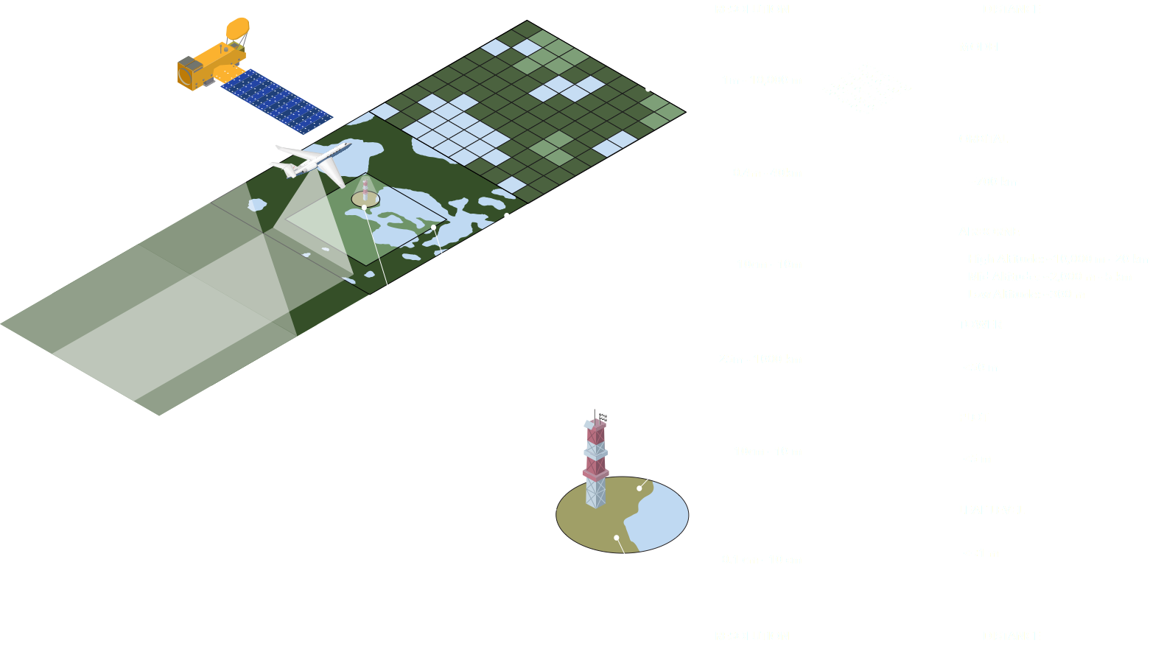
Scaling Strategy for Field Campaigns
Notes:
And of course we’re doing this as only NASA can, with a strategy that spans spatial scales from leaf to orbit.
During the course of this 10 year field campaign, we are making observations at plot, tower, airborne, and orbital scales and feeding this data into an integrated modeling framework.

Slide 10
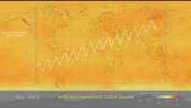
Aqua/AIRS Carbon Dioxide with Mauna Loa Carbon Dioxide - YouTube

Slide 11
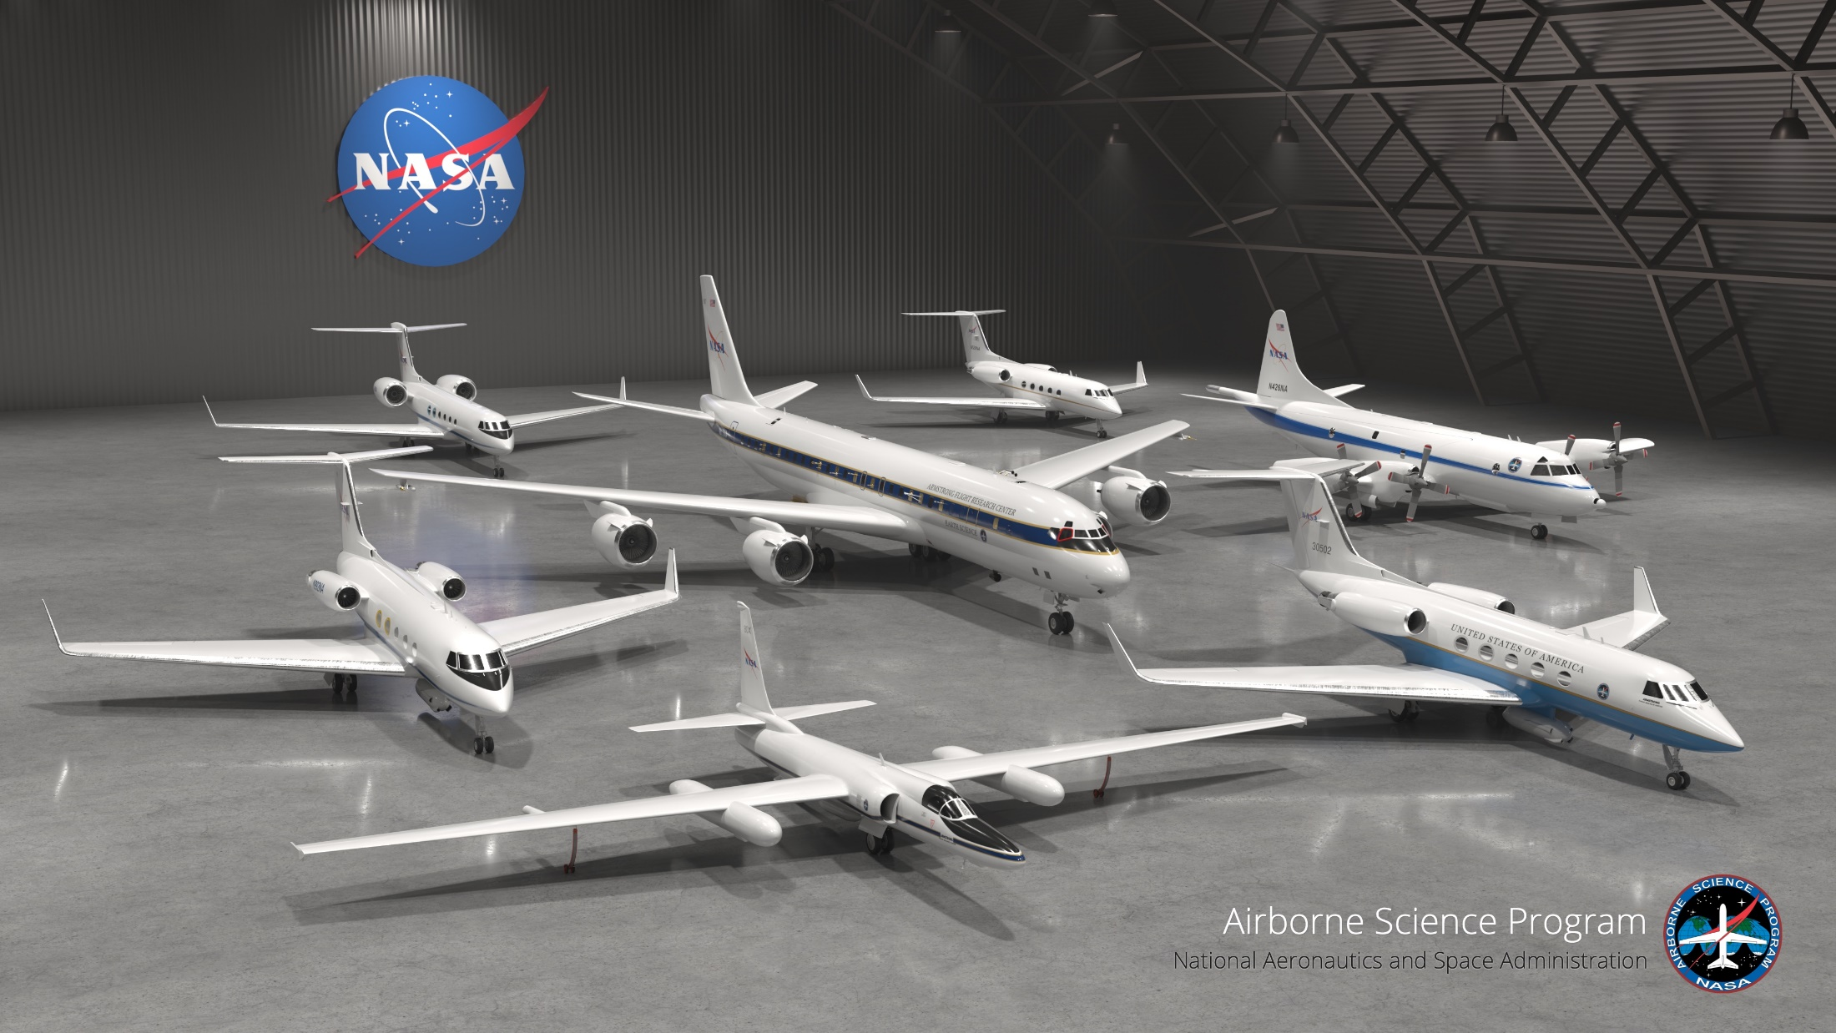

Slide 12
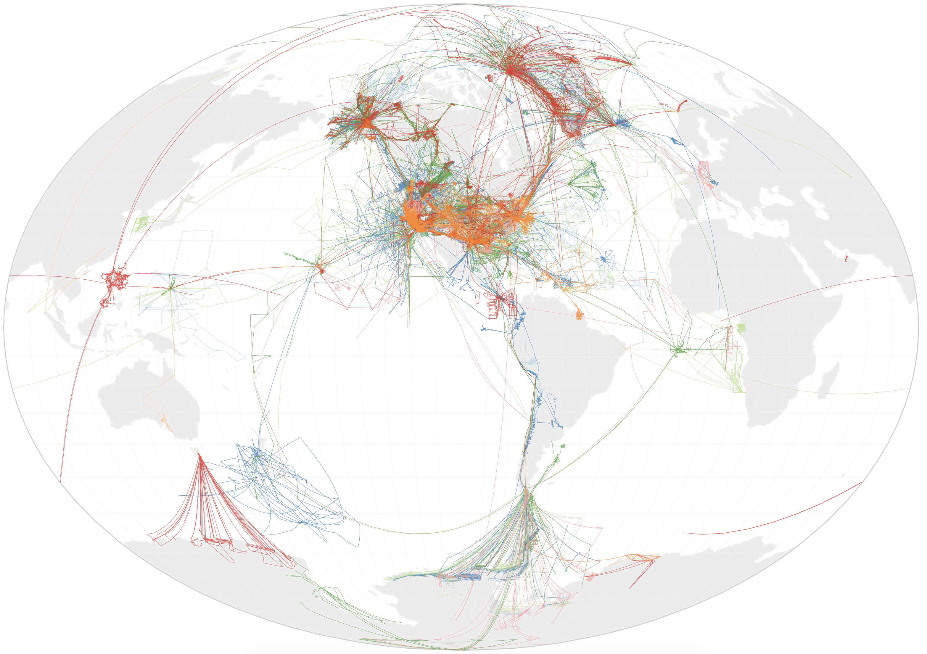
ASP Airborne Campaigns 2014-2021

Slide 13
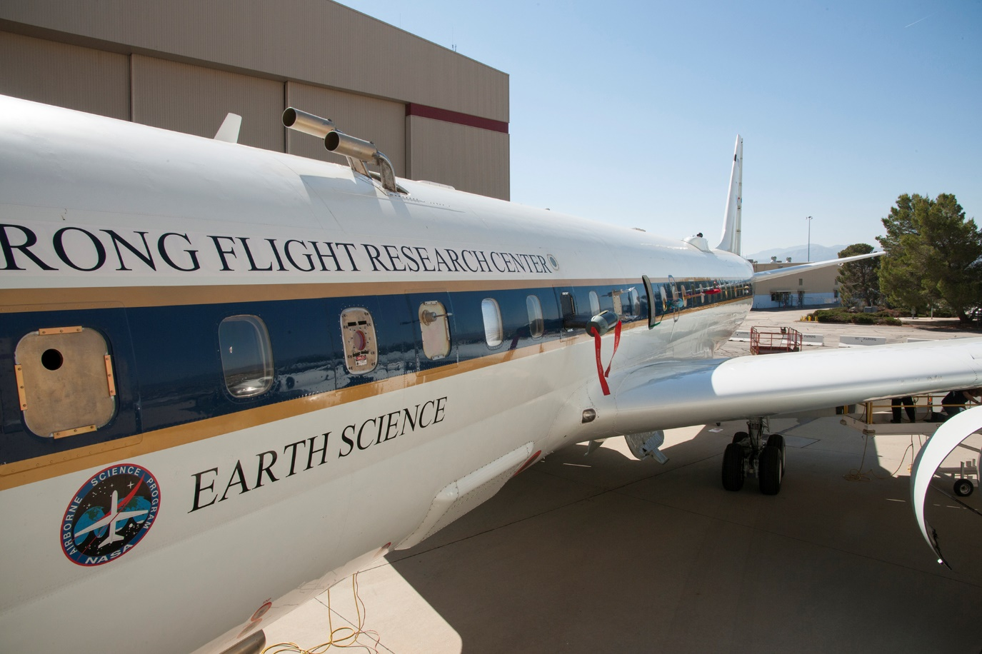
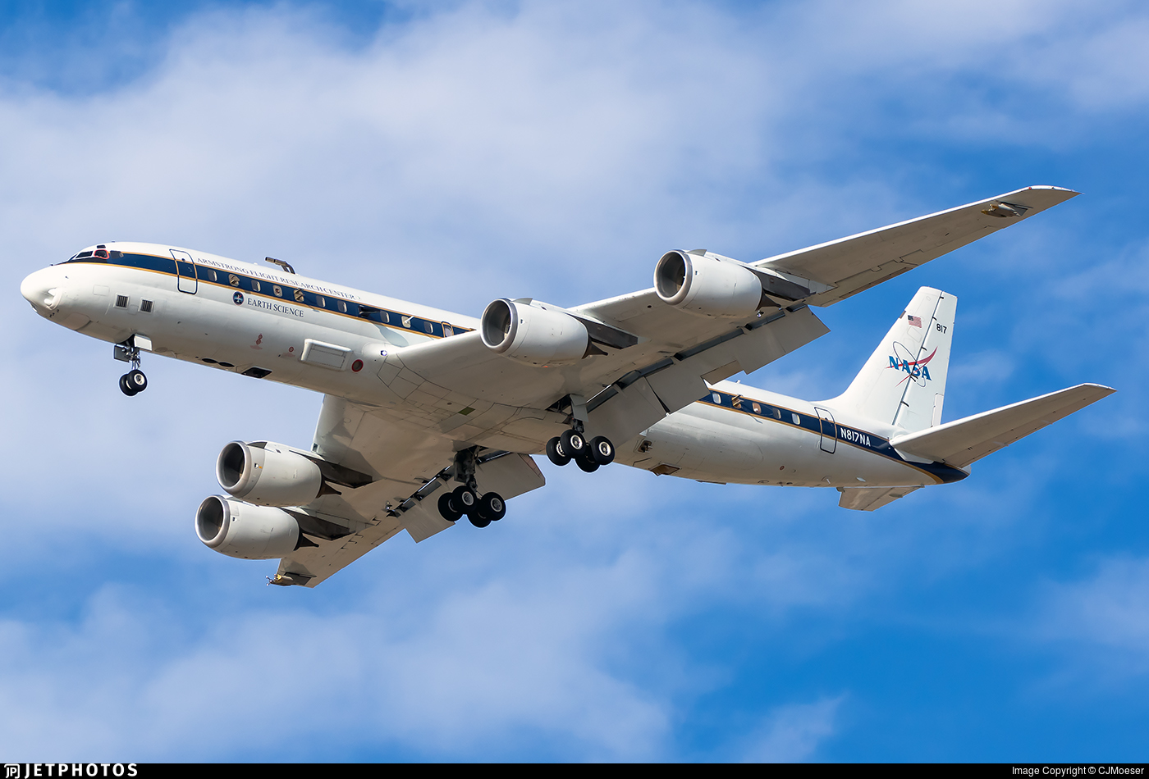
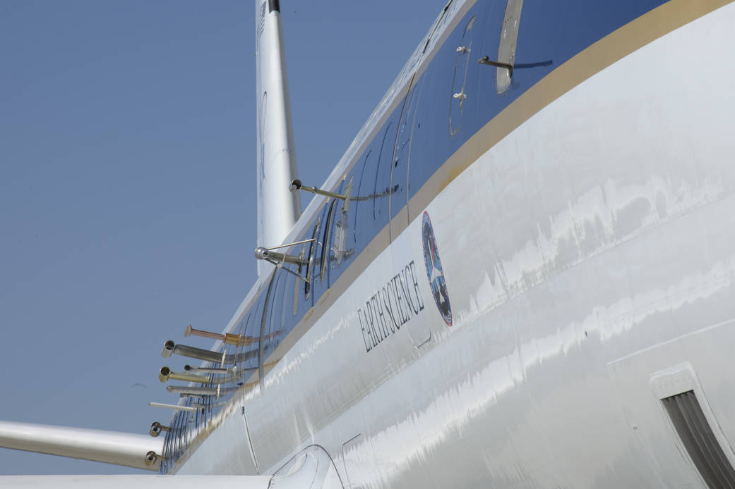
The NASA DC-8 Aircraft

Slide 14
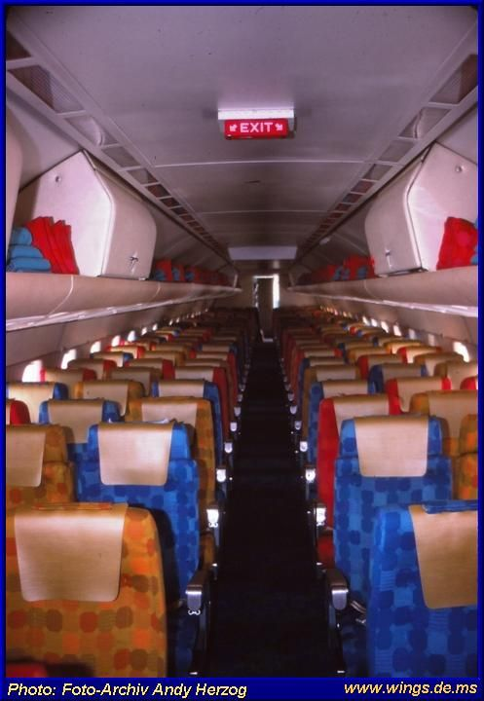
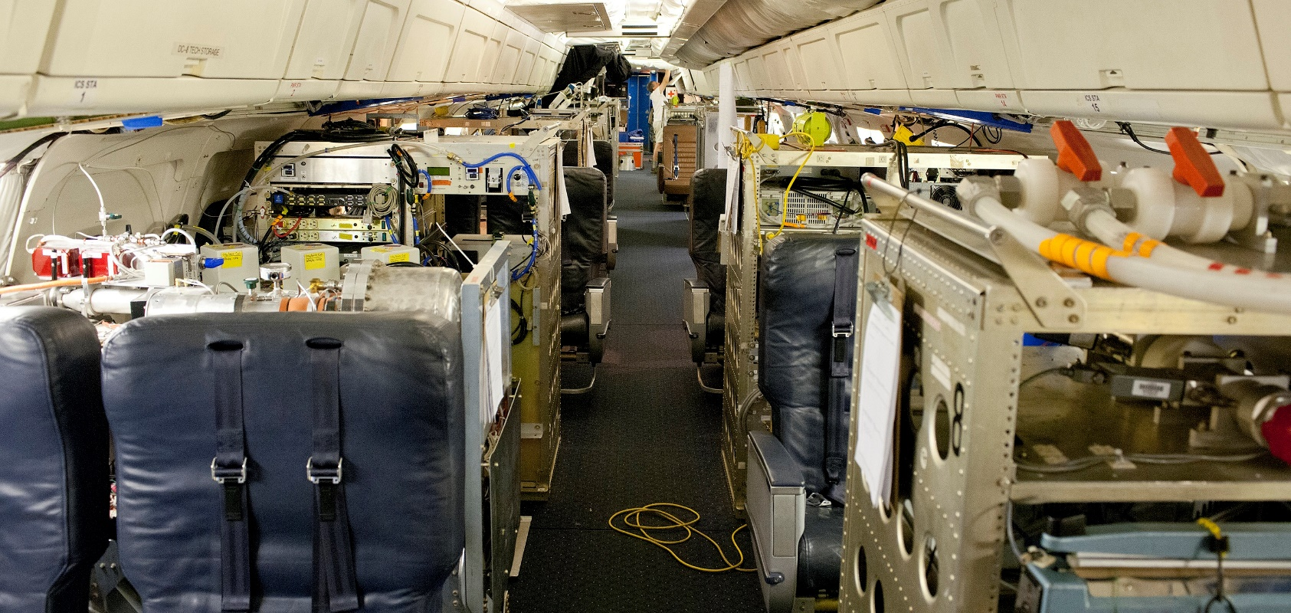

Slide 15
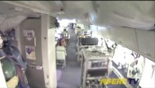
A time-lapse video of the DC-8 instrument upload - from the front of the DC-8 - in preparation for the ARCTAS mission. This instrument upload took about 16 days in real-time.

Slide 16
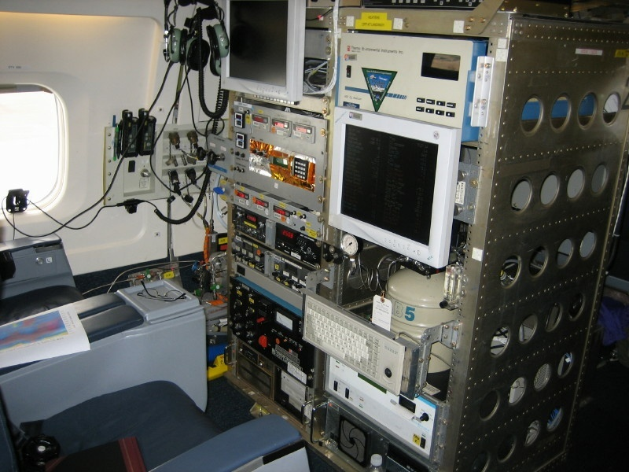
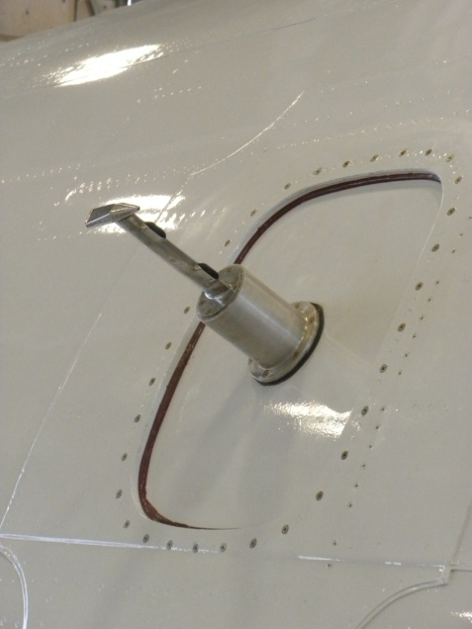
Utilizes a modified LI-COR model 6252 differential, non-dispersive infrared (NDIR) gas analyzer.
Achieves high precision by sensing the difference in light absorption between the sample and a reference gas of nearly the same CO₂ concentration
Notes:
Utilizes a modified LI-COR model 6252 differential, non-dispersive infrared (NDIR) gas analyzer
Achieves high precision by sensing the difference in light absorption between the sample and a reference gas of nearly the same CO₂ concentration

Slide 17
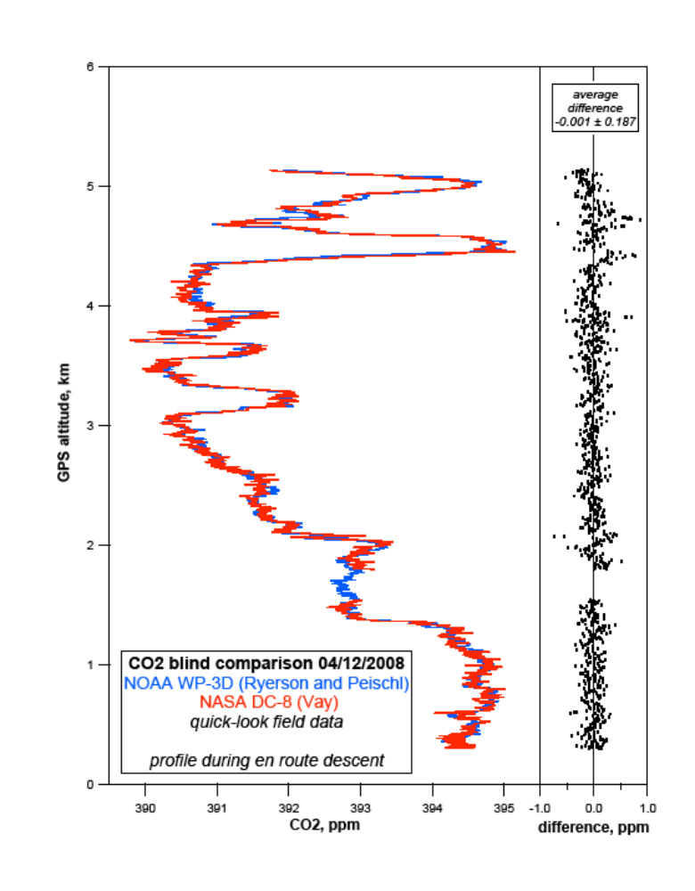
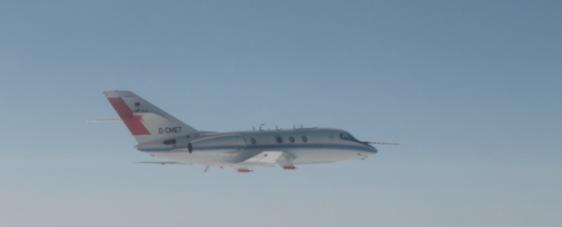
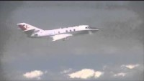
ARCTAS: In-flight inter-comparison

Slide 18
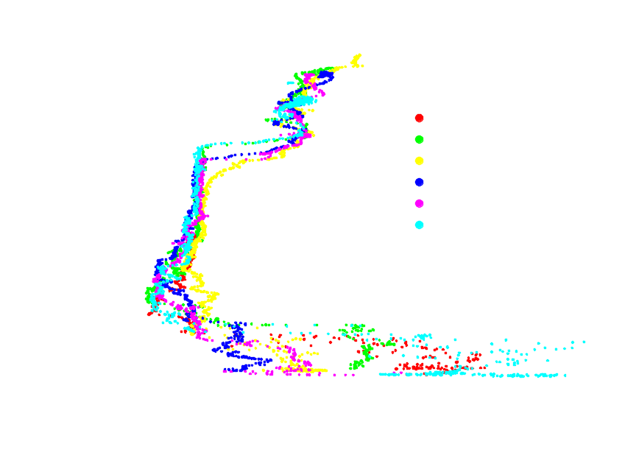
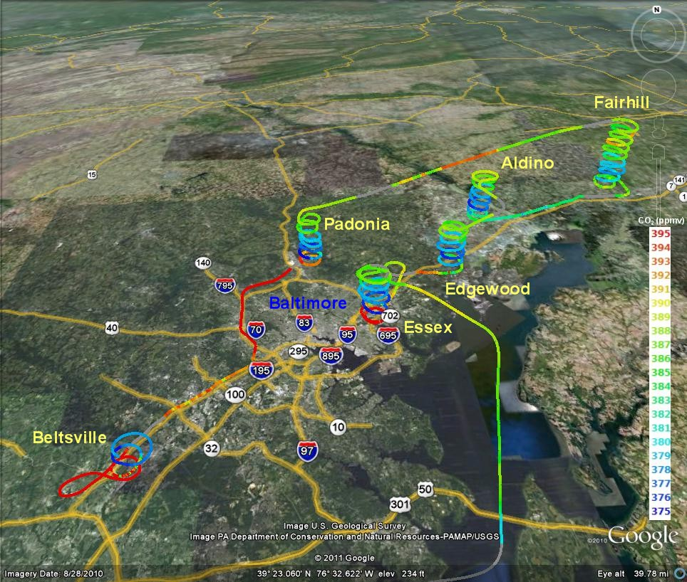

Slide 19
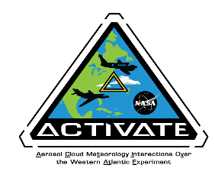
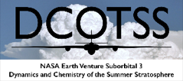
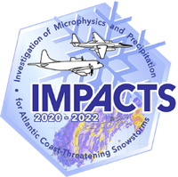
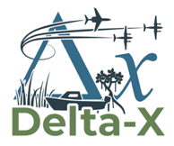

Earth Venture Suborbital – 3 Investigations
ACTIVATE - Aerosol Cloud meTeorology Interactions oVer the western ATlantic is investigating how aerosol particles change cloud properties in ways that affect Earth’s climate system. The investigation is focusing on marine boundary layer clouds over the western North Atlantic Ocean.
DCOTSS - Dynamics and Chemistry of the Summer Stratosphere will investigate how strong summertime convective storms over North America can change the chemistry of the stratosphere.
IMPACTS - Investigation of Microphysics and Precipitation for Atlantic Coast-Threatening Snowstorms is studying the formation of snow bands in East Coast winter storms.
Delta-X will investigate the natural processes that maintain and build land in major river deltas threatened by rising seas. This campaign is scheduled to fly over the Atchafalaya and Terrebonne Bay coastal wetlands and deltas in Fall and Spring of 2021.
SMODE – Sub-mesoscale Ocean Dynamics Experiment will investigate the potentially large influence that small-scale ocean eddies have on the exchange of heat between the ocean and the atmosphere.

Slide 20





IMPACTS Observational Strategy
Ground-based Network
New York State mesonet
Supplemental soundings from NOAA
Mobile Sounding units provided by SUNY Stony Brook and UIUC
Ground-based Radars from SUNY Stony Brook
126 sites spaced ~19 miles apart
Aircraft
Operating out of Warner Robbins (ER-2) and Wallops (P-3)
Active and passive remote sensing instruments on the ER-2
In-situ microphysical instruments and dropsondes on the P-3
Operations 6 week period within Jan-Mar timeframe

Slide 21








High Flying Interns:
NASA Student Airborne
Research Program (SARP) 2009-2020
Competitive summer internship for 28 junior/senior undergraduate STEM majors from across the US
Notes:
SARP Participants:
Conduct NASA Earth Science research, fly onboard a NASA research aircraft, take ground-truth data at field sites
Develop individual research projects in ocean science, terrestrial ecology, atmospheric chemistry, and aerosols using the data they collected, previous SARP data, as well as data from other NASA satellite, airborne, and ground sites.

Slide 22
The Impacts of the Pandemic
Airborne missions slowed down significantly beginning March 2020
  Transition from “in person” to mandatory telework
  Only mission critical travel March 2020-Fall 2021
  With COVID protocols in place, we have been able to slowly return to operating airborne missions safely
All NASA centers at Stage 2, will slowly transition to Stage 1 (75% capacity)
A lot of discussions surrounding the Future of Work - TBD

Slide 23




Working at NASA

Slide 24








Slide 25






Slide 26
Parting words
Being a woman in a male-dominated profession
  Be strong, Be confident, Be brave
  Do not transform yourself to fit in, but maintain your individualism and be proud
For any situation:
  Find your passion, do not be afraid of trying new things, it won’t always be easy
  Use setbacks to propel you forward
  Do not be a victim. Take ownership and responsibility for your actions
Surround yourself with people who support you, encourage you, believe in you
Look for opportunities, you never know when something might pop up. Don’t close any doors prematurely
You are stronger than you think you are!

Slide 27
A couple of quotes that drive me
"The dream that you don't fight for, will hunt you for the rest of your life.." Robots
“Lord, grant that I may always desire more than I can accomplish.” Michelangelo
"Since when does anyone have a clue as to what they want?" - Morgan Freeman as God in Bruce Almighty
“If a woman does not keep pace with her companions, perhaps it is because she hears a different drummer. Let her step to the music which she hears, however measured or far away” - Henry David Thoreau

Slide 28
Thank you!
Questions?

Slide 29
Backup Slides

Slide 30
Questions
What does your field of work entail?
Why are women important in your field of work?
How can women play an important role in your field?
What are some truths and myths about your field of work?
How has your work changed since the beginning of this pandemic?
How should students approach learning in school? What opportunities or platforms should they explore, especially if they are interested in your field of work?
How can parents guide their daughters in their career explorations?
What are some prospects in your field of work?
How will your field of work be of impact to Singapore, Asia, and the world in 5 to 10 years time (the time when the current batches of students graduate and step into the workforce)?

Slide 31
https://airbornescience.nasa.gov/

Slide 32


Slide 33
Features of Different Vantage Points for Earth System Science
Satellite
  Can provide global or near-global coverage
  Can potentially get long time series, but that will typically require overlap across sensors, platforms, and programs since lifetimes of individual satellites is limited (at least in terms of design lifetime)
  Consistent approach should yield measurements that can be applied globally (subject to appropriateness for environment)
  Significant resources can (must!) go into calibration/validation
  Open data policy and investment in capacity and tools can facilitate global sharing/use
  May not support full set of desired observations, but constellations can help by providing synergy
  May support routine/global observation, or may be targeted (depending on sensor, program, etc.)
  Orbital mechanics limits flexibility for observation (important for sensors with narrow swath widths)
  Measurement frequency may be low with LEO satellites; higher frequency requires higher orbits or constellations
  May allow for vertical profiling (especially through use of active remote sensing, or limb profiling/occultation)
Airborne
  May allow for more comprehensive set of observables (“load up a plane”)
  Can provide targetable platform for remote sensing (“virtual satellite”)
  May integrate in situ and remote sensing and get vertical profile information
  Allows for instruments to be calibrated before AND after flight
  May provide hands-on opportunities for students and early career professionals
  Can be very useful for satellite product validation (especially coincident measurements)
Surface
  Allows for sustained observations (mostly) around the world (better on land than sea!)
  Shorter-term campaigns can provide comprehensive data sets
  Ability to look up and see what’s under clouds (can do column and/or vertical profiles)

