Slide 1



Handheld Camera (HHC) Initial Test Results
2/18/2022
MSFC Engineering

Slide 2
Summary of Test Results
Thermal Vacuum: The Canon R5 (mirrorless) and Nikon D6 (DSLR) showed similar operational characteristics from -30C to +40C in a vacuum. Both cameras survived thermal vacuum testing. (Nikon Z9 was not available at the time vacuum testing occurred)
Radiation*: Read capability of 4 CFExpress cards was tested in proton environment.
*Radiation testing results are highly dependent on test setup, proton flux, and total fluence. The results of this presentation are NOT intended to drive product selection. Duplicate and independent testing is necessary to assess radiation tolerance for a specific environment.

Slide 3
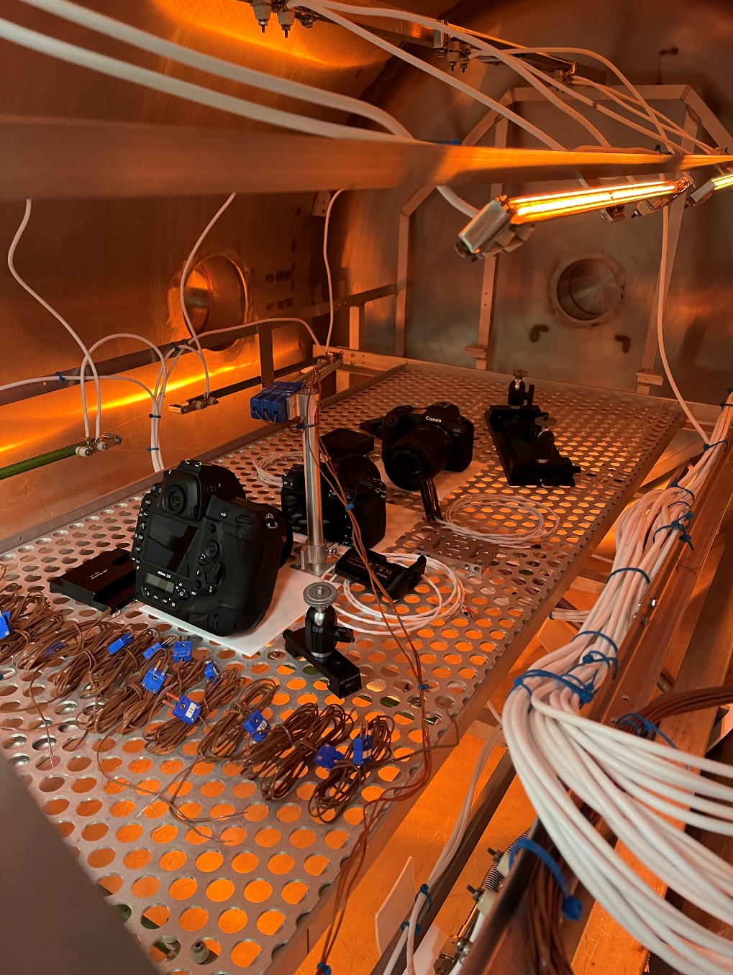
Thermal Vacuum Bakeout
Before placing test articles in thermal vacuum chamber for testing, a bakeout is required to outgas any volatiles in a controlled environment before entering the test chamber.
Cameras and supporting hardware were baked out at 50C for 72 hours

Slide 4
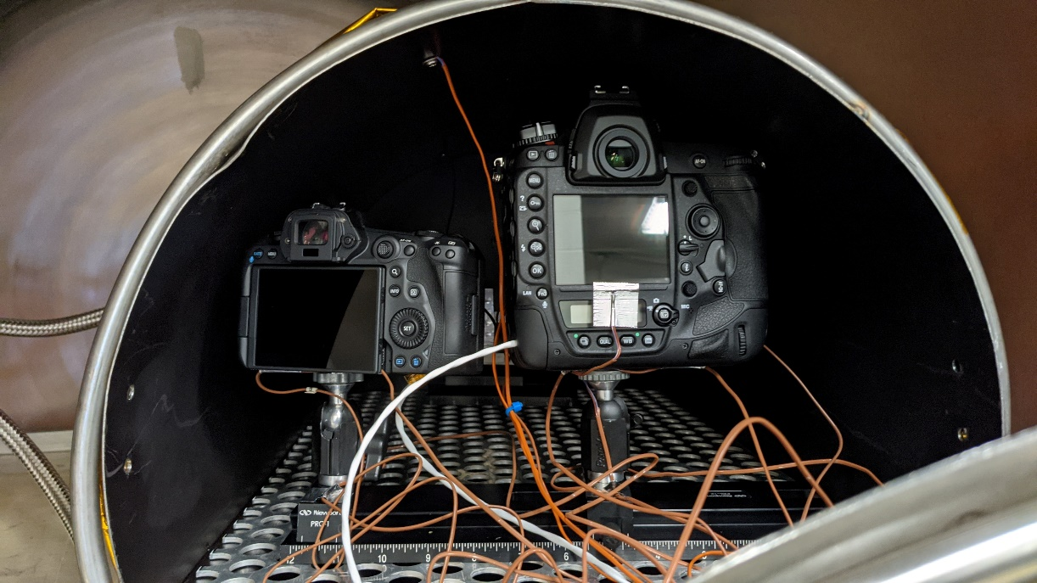
Test Setup
Cameras were placed inside a shroud within the vacuum chamber.
The shroud temperature was controlled which heated and cooled the cameras
Each camera had 4/5 thermocouples taped to body
Wifi/Bluetooth used to capture video and images
Photomarking (in background)
Thermal shroud
Nikon D6
Cannon R5
Shroud Lid

Slide 5
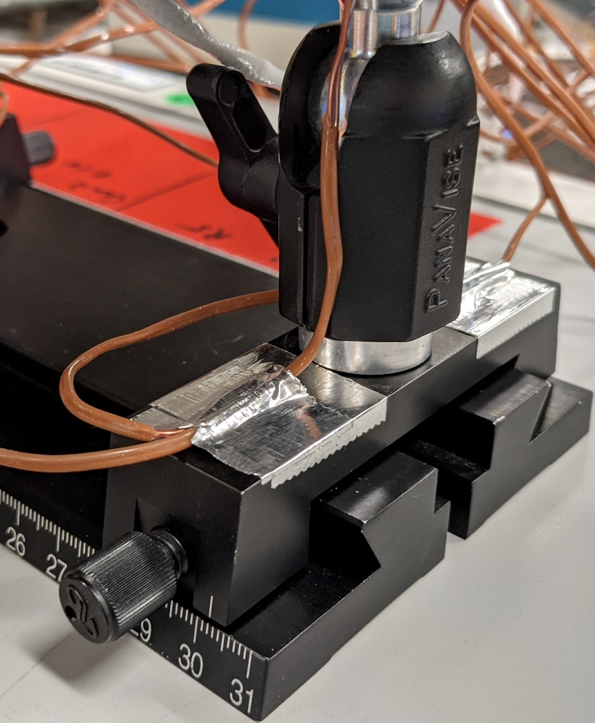
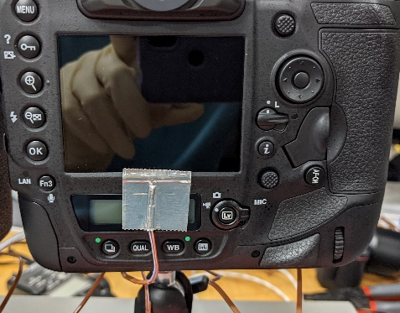
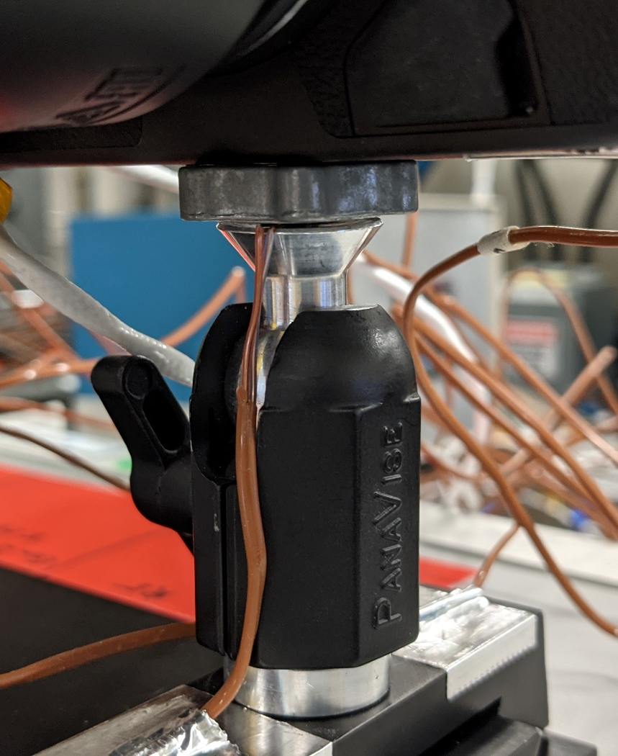
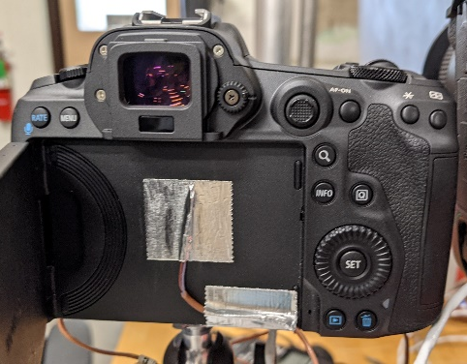
Test Setup Cont.
Cameras were mounted using ¼” mounting posts and were isolated from chamber
Thermocouples placed on base and top of mount to quantify heat transfer
D6
R5

Slide 6
Test Setup Cont.
Canon Lens: Canon 85mm F2
Nikon Lens: Nikkor 18-35mm F3.5-4.5
At each temp, cameras soaked for 1 hour once camera sensors were +- 1.3C of target temp
Overnight cold-soak was not performed (limited to 1-hour cold soak at each temperature). Thermal models and internal thermocouples are needed to determine exact amount of cold-soak required.
Temp data recorded at 1Hz rate
Voltage and current data was collected and stored for evaluation if necessary

Slide 7
Tests Performed
Video Recording
  All cameras set to 4K30 H.265
  Ambient and Hot side (21C, 30C, 40C): Cameras recorded video until overheating and self-shutdown with 5-minute cool down periods
  Cold side: 5 minutes of video recorded
Still Images
  Hot side (40C only): Images taken in 30 sec intervals until camera overheats. 5-minute cool down periods
  Cold side: 5 images taken in 30 sec intervals

Slide 8
Cameras Tested in Vacuum
Successfully tested R5 and D6, but experienced issues with Z7II
  Canon R5 – Operated from -30C to +40C. Thermal properties limit amount of video/images taken consecutively
  Nikon D6 – Operated from -30C to +40C. Thermal properties limit amount of video/images taken consecutively
    Record time was limited to prevent possible wifi connections seen during the testing of other Nikon products (Z7II)
  Nikon Z7II – Tested at ambient temp (~21C), but after first camera thermal dropout, experienced issues with reconnection, so could not test over full temp range.

Slide 9
Testing Notes
Due to the Z7II’s connectivity issues, the D6 was intentionally limited on its number of video recording sessions (did not want to risk losing connection if operation was like the Z7II)
The D6 was setup to capture both RAW and JPEG images
The R5 was set up for JPEG only, no RAW. The intention was to record both, but setting was missed during setup process.

Slide 10
Ambient Temp Test Takeaways
R5 – 5-minute rests between runs 3, 4, and 5
The slowly rising body temp peaks before each shutoff showing a lag between internal board temperatures and case temperatures.
This could indicate a potential to increase continued use time by modifying internal thermal design.

Slide 11
Video Recording Time vs Temp in Vacuum
5-minute rests
5-minute rests
5-minute rests

Slide 12
Number of Still Images vs Temp in Vacuum @ 40C
5-minute rest
5-minute rest

Slide 13
Radiation Testing

Slide 14
Compact Flash Summary
4 brands of Compact Flash Express cards were tested
  Lexar
  Sandisk
  ProGrade
  Sony
Only read functionality was tested (write testing will happen at a later date).
The Sandisk showed the highest probability of no upset at the predicted lunar environments.
No cards completely failed. A power cycle resolved all single event upsets.
Likelihood of an upset is defined as the probability of no upset over a defined time period

Slide 15
Compact Flash Calculations
Lexar256
 | WW | WD | 5Min + WW | 5Min + WD
Probability of No Occurences for 8 Hours | 66.98% | 16.51% | 62.48% | 15.40%
Sandisk128
 | WW | WD | 5Min + WW | 5Min + WD
Probability of No Occurrences for 8 Hours | 86.03% | 50.83% | 83.81% | 49.52%
Prograde
 | WW | WD | 5Min + WW | 5Min + WD
Probability of No Occurences for 8 Hours | 61.40% | 11.16% | 56.41% | 10.26%
Sony
 | WW | WD | 5Min + WW | 5Min + WD
Probability of No Occurences for 8 Hours | 77.12% | 31.11% | 73.72% | 29.74%
WW = Worst Week, WD = Worst Day

Slide 16
Backup

Slide 17
Vacuum Test Operations
 | Ambient (~21C to ~23C)
 | 1st Run Video Time | 2nd Run Video (5 minute cool) | 3rd Run Video (5 minute cool)
Nikon D6* | 20 min (stopped to preserve wifi connection) | N/A | N/A
Canon R5 | 23 min, 2 sec | 8 min, 54 sec | 6 min, 7 sec
Nikon Z7II** | 15 min, 40 sec | failed connection | failed connection
 | Hot (30C)
 | 1st Run Video Time | 2nd Run Video (5 minute cool) | 3rd Run Video (5 minute cool)
Nikon D6* | 24 min, 28 sec | N/A | N/A
Canon R5 | 25 min, 19 sec | 6 min, 43 sec | 5 min, 28 sec
 | Hot (40C)
 | 1st Run Video Time | 2nd Run Video (5 minute cool) | 3rd Run Video (5 minute cool)
Nikon D6* | 8 min, 57 sec | N/A | N/A
Canon R5 | 14 min, 39 sec | 6 min, 22 sec | 4 min, 9 sec
 | Hot (40C)
 | 1st Run Stills | 2nd Run Stills (5 minute cool) | 3rd Run Stills (5 minute cool)
Nikon D6 | 28 Images | 15 Images | 12 Images
Canon R5 | 34 Images | 12 Images | 10 Images
 | Cold 0C | Cold -10C | Cold -20C | Cold -30C
Nikon D6 | Successfully powered and captured video and stills | Successfully powered and captured video and stills | Successfully powered and captured video and stills | Successfully powered and captured video and stills
Canon R5 | Successfully powered and captured video and stills | Successfully powered and captured video and stills | Successfully powered and captured video and stills | Successfully powered and captured video and stills
* Due to perceived risk of connection loss like Z7II, only one run of video was taken at each temperature
** lost connection and could not reconnect. May not have overheated at 15 min, 40 sec.

Slide 18
Z7II Connectivity
Inside the closed chamber with ambient pressure, the Z7II recorded video for 45 minutes before we stopped recording. It could have continued recording video in this environment. We do not think the connectivity was due to the chamber material.
Once we reached 1x10e-5 torr, the camera could record video for 15 minutes, 40 seconds prior to losing connectivity and could not reconnect.

Slide 19
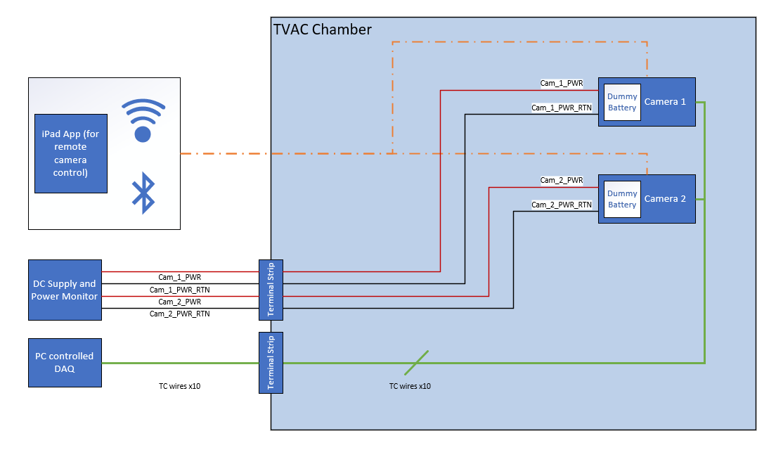
Thermal Vac Test Diagram

Slide 20
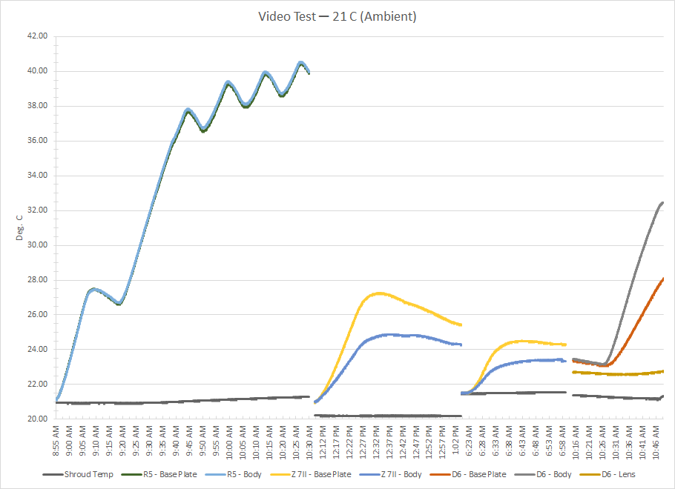
Temp Plots (Ambient)
Run #5
Run #4
Run #3
Run #2
Run #2 after sitting overnight in low-power mode
Run #1
Run #1

Slide 21
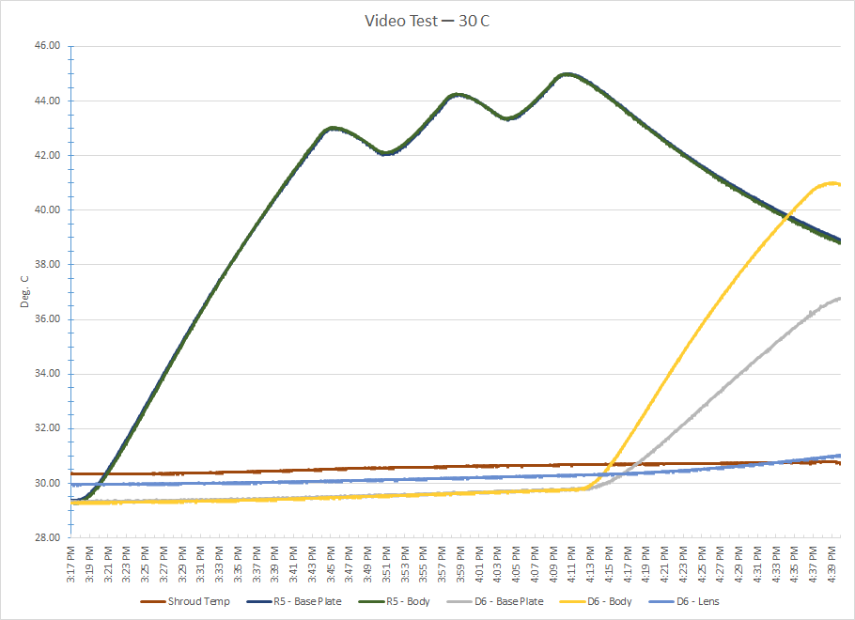
Temp Plots (30C)

Slide 22
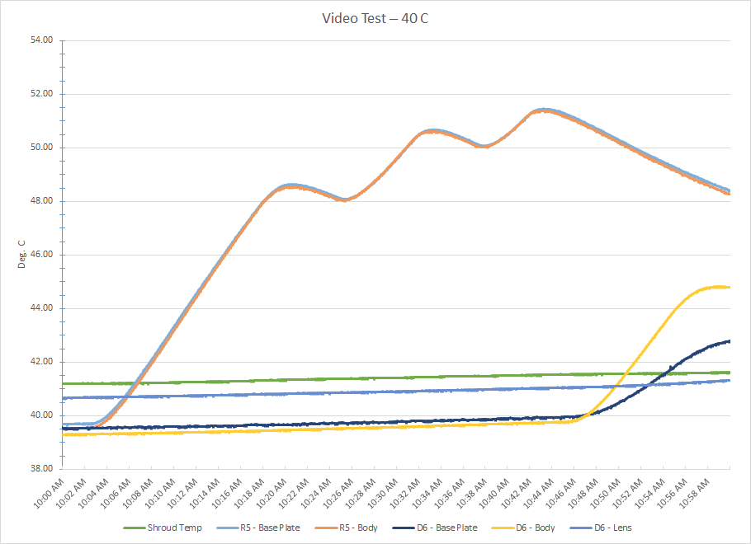
Temp Plots (40C)

Slide 23
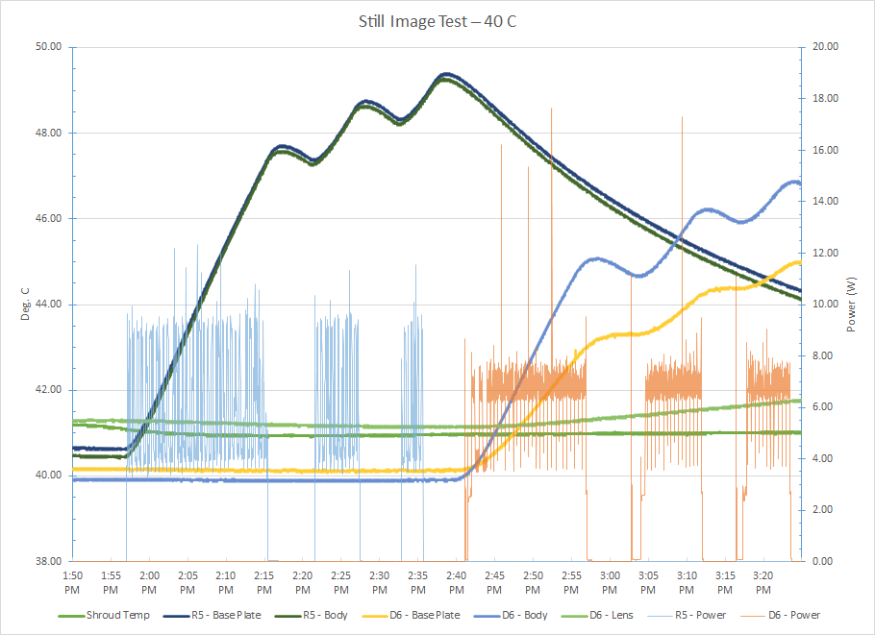
Temp Plots (40C)

Slide 24
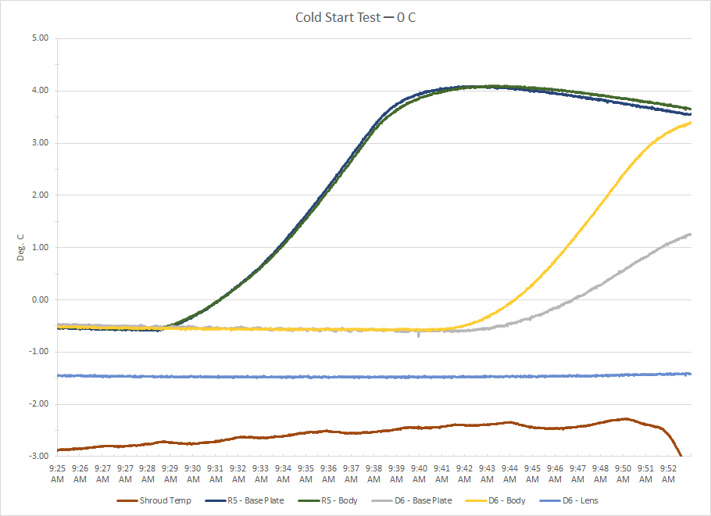
Temp Plots (0C)

Slide 25
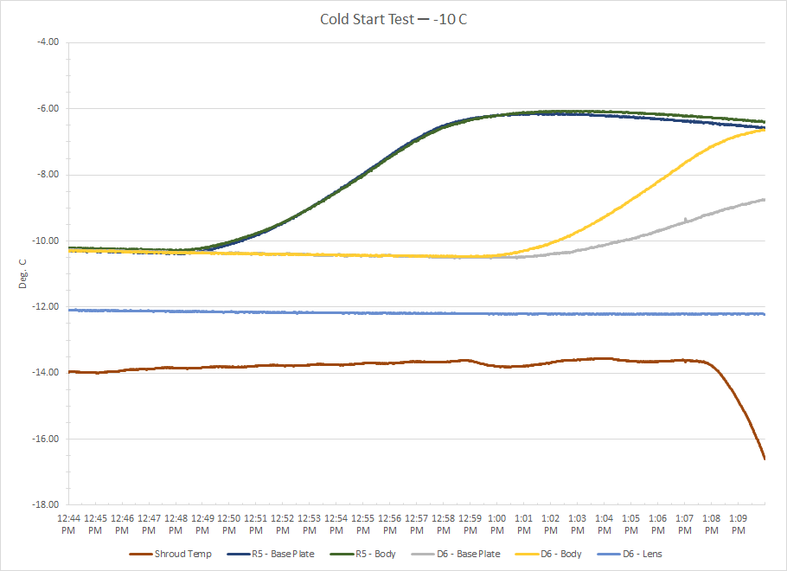
Temp Plots (-10C)

Slide 26
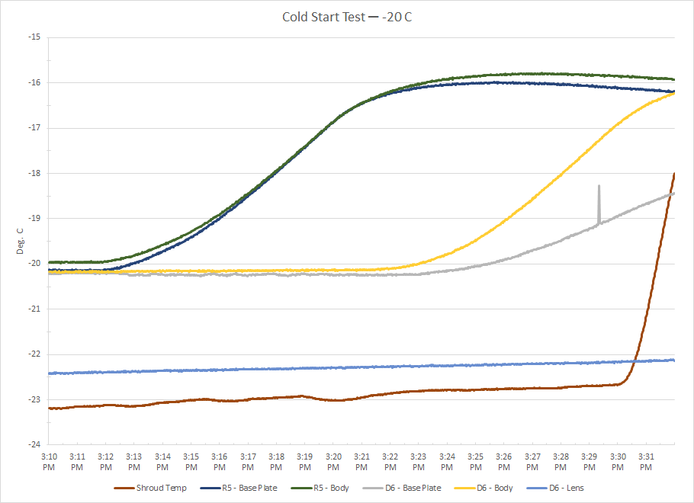
Temp Plots (-20C)

Slide 27
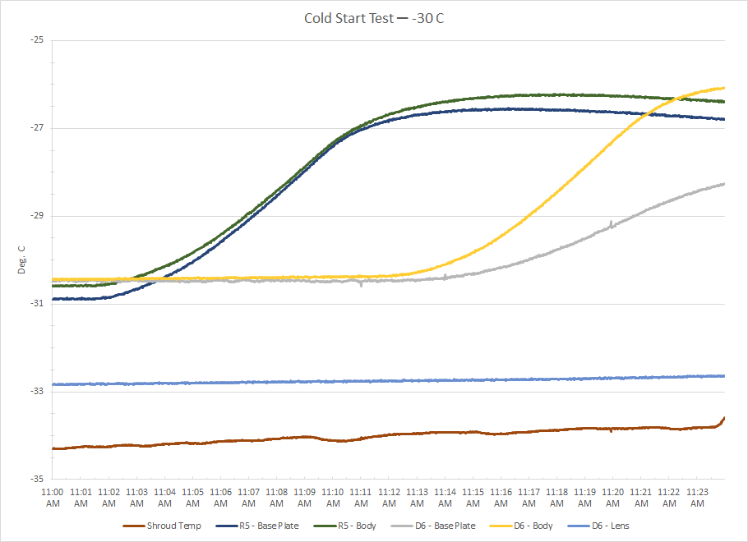
Temp Plots (-30C)

