Slide 1
The future of Space Human Factors
Charles Dischinger
NASA
Marshall Space Flight Center

Slide 2
Why do we have a discipline called Human Factors?
Notes:
This is something that those of you who have Dr. Crisman’s classes or others like you already know something about. I ask you to bear with with me, because I am asking you to think about HF from what might be a different perspective

Slide 3
Why do we have a discipline called Human Factors?
Very simply, because most engineers don’t know anything about humans
Notes:
This is not a criticism. I’m a biologist; I’ve had dozens of undergrad and grad hours in general biology and psychology, and much of that coursework has direct information about people. Except for those of you in Dr. Crisman’s classes, MOST of you have not looked at biology as a course of study , since HS.

Slide 4
Why do we have a discipline called Human Factors?
Very simply, because most engineers don’t know anything about humans
So HF specialists (discipline experts) are needed in design, to represent the human
  They have training in human capabilities and limitations, so they are
  Subject-Matter Experts in humans
    Most of us think we understand humans because we are one, and we know many
  They have the same responsibility to the human in the design that a materials analyst has to the metals or the composites in the design
Notes:
That is, the materials analyst evaluates the design goals in the context of available materials and their capabilities and constraints.
HF subject matter expert evaluates the design goals in the context of human capabilities and cponstraints

Slide 5
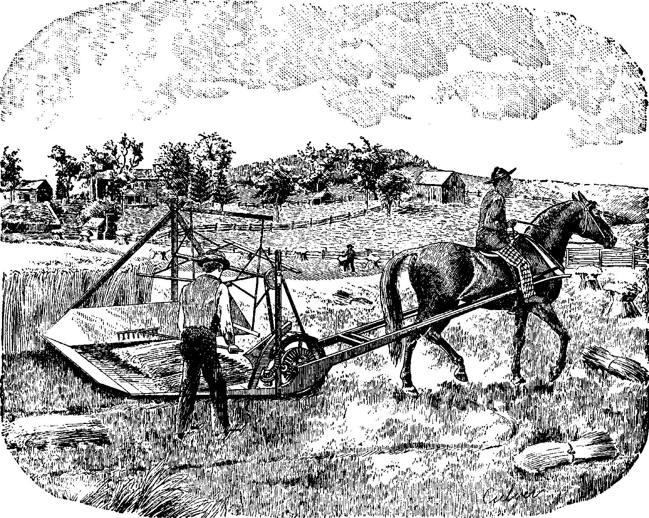
How did the need for HFE become realized?
Notes:
This is a 19th C machine

Slide 6
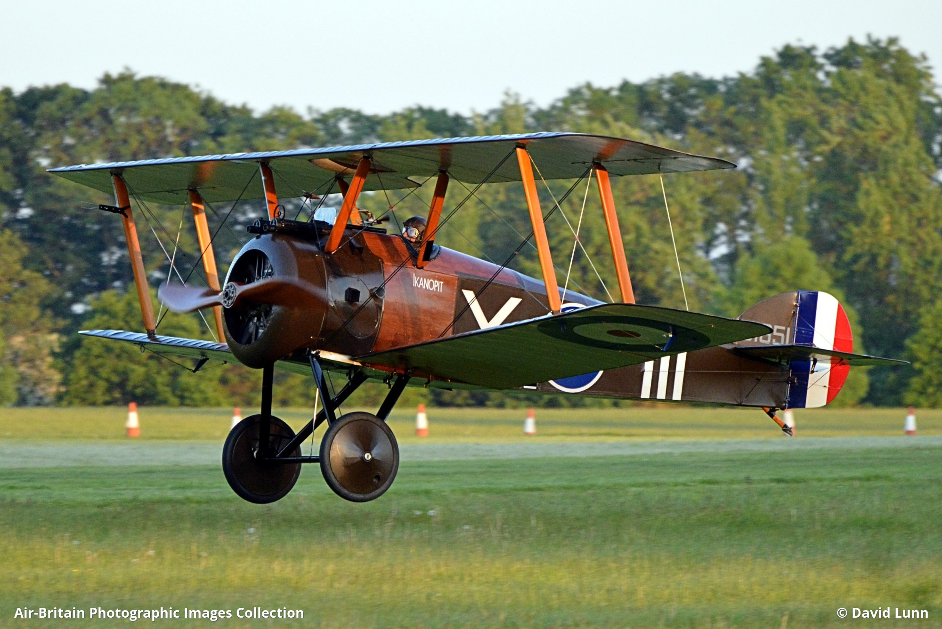
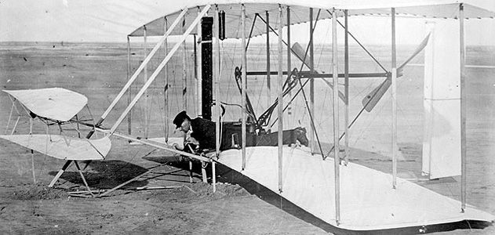
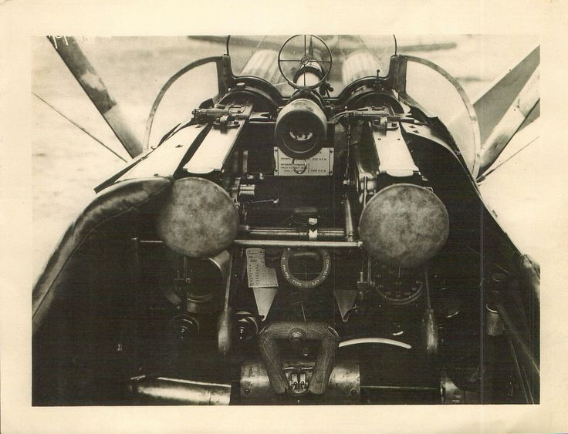
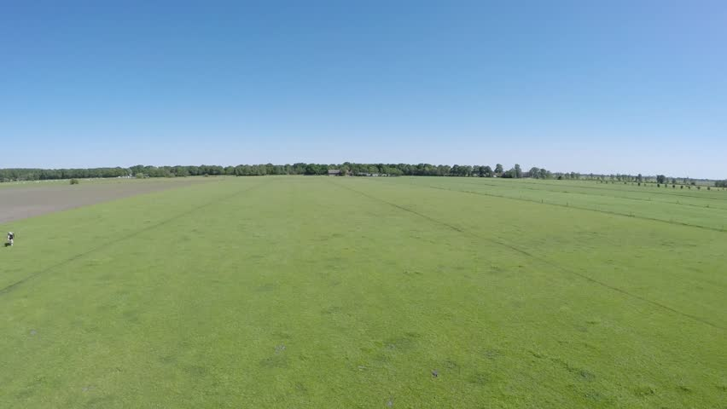
How did the need for HFE become realized?
Notes:
These are early 20th C machines. One on left is Wright Flyer; cockpit view is below. One on Rt is Sopwith Camel, about 15 y later, with cockpit view below

Slide 7
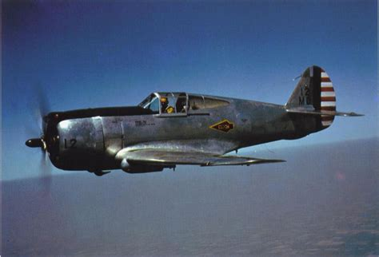
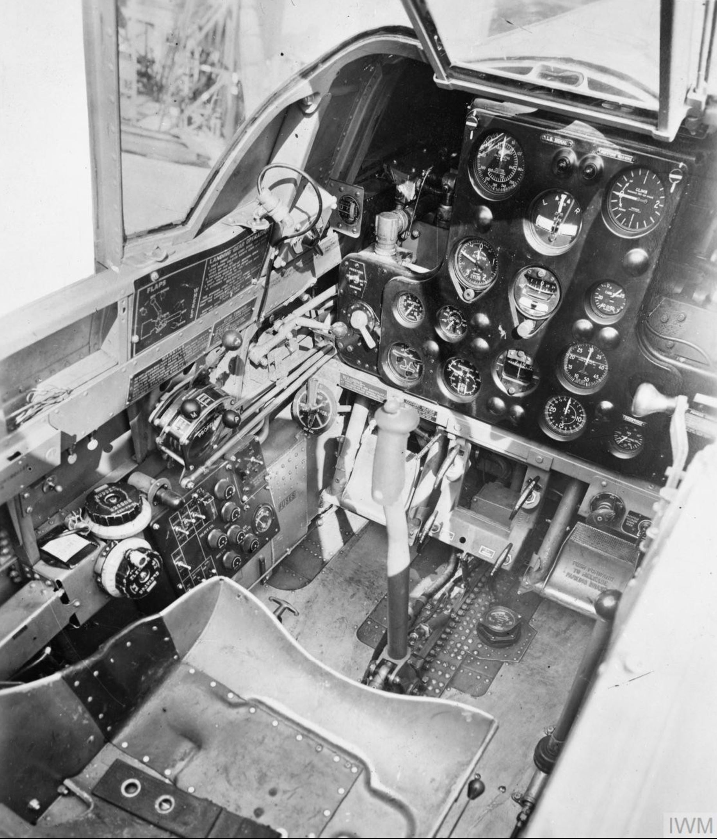
How did the need for HFE become realized?
Notes:
This is a machine from later in the 20th C: Curtiss P-36 (went into service in the UK and in other European countries before US entered WW2.
What is happening, in the machine:human systems, during the 20th C?
WHAT IS THE OPERATIONAL SYSTEM? What does the pilot need to know, and when? Psychs told them to place critical displays directly in front of the pilot
Increased amount of information led to pilot confusion during critical operations, so cockpit design became essential.

Slide 8
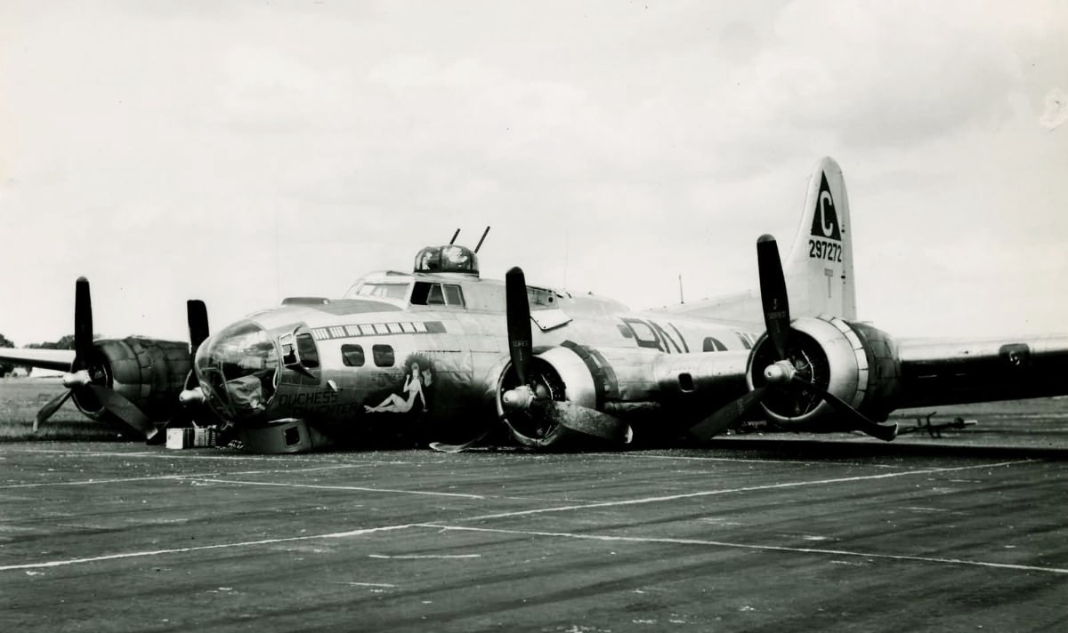
Another example
Notes:
B-17 ON THE RUNWAY. This happened many times. What observers said was that the plane touched down and then the landing gear collapsed

Slide 9
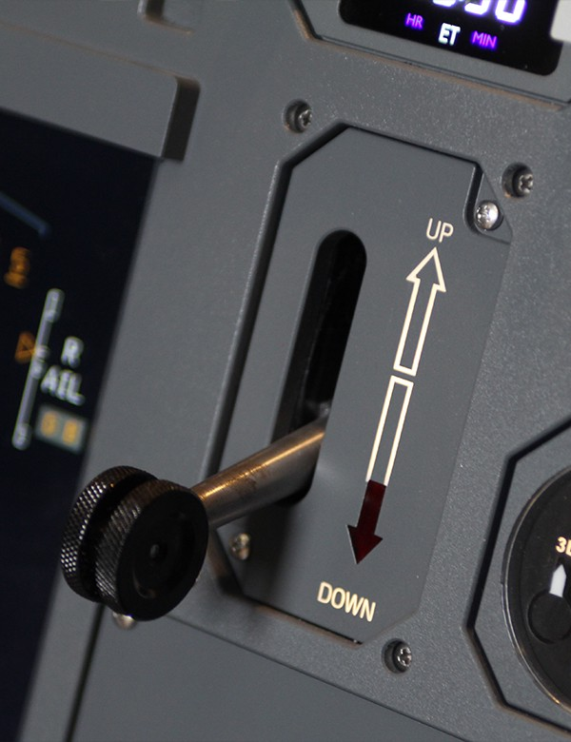
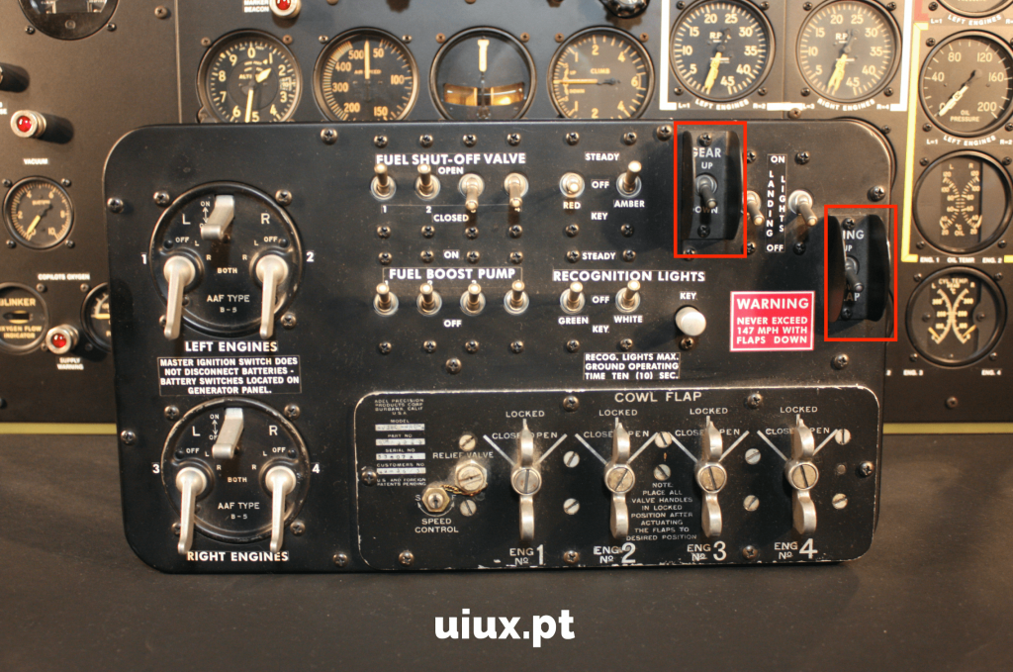
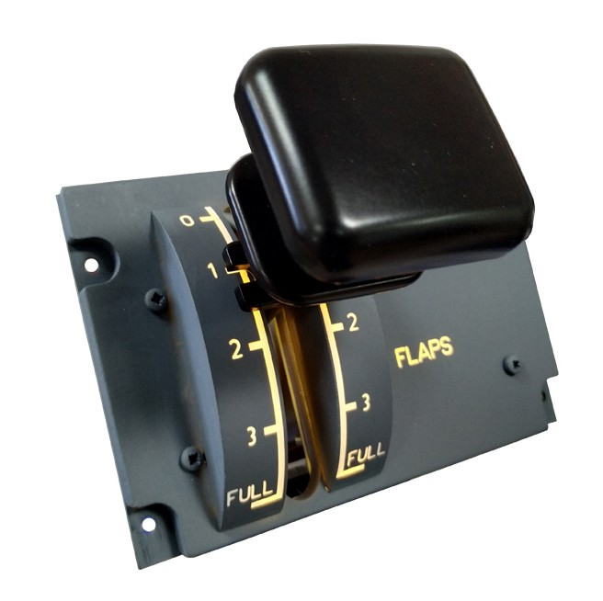
Another example
Notes:
Psychologist named Chapanis interviewed observers and pilots. Pilots said they had followed procedures. Chapanis noticed that the flaps and landing gear had identical switches that were co-located and were operated in sequence. In the high-workload period of landing, pilots frequently retracted the gear instead of the flaps. He realized pilots thought they were retracting flaps and were accidentally actuating the gear switch.

Slide 10
And that’s why there is HF
This is history, from my perspective
Notes:
People who know about human behavior know different things than people who know about avionics, structures, or power systems.

Slide 11
How many people operate the ISS?
Notes:
AS systems become more complex, they also talk to people more. There is a sense that more automation results in less human involvement.
People think the onboard crew operates the Station

Slide 12
How many people operate the ISS?
About 240 people per shift (3 shifts/day)
Notes:
AS systems become more complex, they also talk to people more. There is a sense that more automation results in less human involvement.
People think the onboard crew operates the Station

Slide 13
How many people operate the ISS?
About 240 people per shift (3 shifts/day)
When something goes wrong (anomaly), this number can swell to 1200/shift or more
What are they doing?
Notes:
I want to hear from you on this: why are all these people there?
Doing robotics, operating science experiments, operating ECLSS, monitoring subsystems (GN&C) and adjusting them – includes orbit correction to avoid debris
The reason I point this out is that people think the astronauts operate the ISS. They actually do very little

Slide 14
How does automation help?

Slide 15
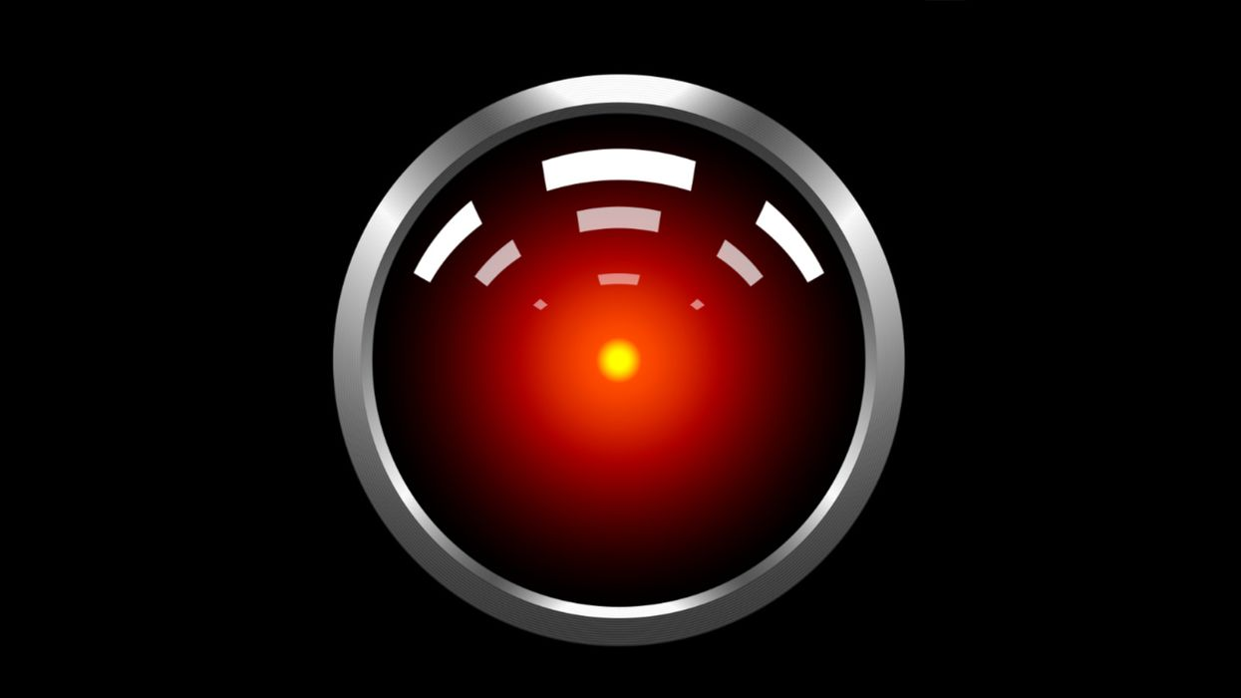
How does automation help?
Machines are getting smarter
Do we want this?
Notes:
Someone knows what this means; please describe it

Slide 16
How does automation help?
Machines are getting smarter
Do we want this?
“I’m sorry, Dave, I can’t do that”
Notes:
The problem isn’t even that automation might think it knows better than humans.
The problem is humans always have access to information that machines don’t, and we are much better than machines in seeing patterns in information that lead to unexpected decisions.

Slide 17
How does automation help?
Tesla killing driver (Florida, 2016)
Boeing 737
Notes:
NTSB found, among other things, that the automation (“Autonomy software”) did not recognize the side of a truck. The driver had been conditioned to trust the automation; he believed it was truly autonomous.
You all know things about the 737. The sw designers had such hubris that the sw they designed would perform better than pilots that they did not train pilots and DIDN’T EVEN TELL THEM
We all trust automation. Has anyone ever had their GPS sw take them to the wrong destination? How did you fix the problem? Was it to tell the sw that it was wrong and allow you to enter your actual locaiotn, so that you coud get to the desired one? Why didn’t you do that?

Slide 18
How will automation help in the future?
Must understand that there is always a human role
How will machines talk to people?
  How much should they tell them?
  When should they tell them?
  What should they tell them?
Notes:
ISS has 240 people to operate, on an easy day. How can automation take over their roles?
Remener the principle that you don’t need oil P, if plane is on fire

Slide 19
A big problem that is about Human-Centered Design
How to develop a tool that can tell us how much crew time is required for
  Eating
  Sleeping
  Personal hygiene
Notes:
These are pretty easy, but how about

Slide 20
A big problem that is about Human-Centered Design
How to develop a tool that can tell us how much crew time is required for
  Eating
  Sleeping
  Personal hygiene
  Exercise
  Maintenance
    Diagnosis
    Tool accumulation
    Disassembly
    Repair
    reassembly

