Slide 1
Evaluating convective wind signals using CYGNSS v3.1
Brent Roberts, Sarah Bang
NASA MSFC
Earth Science Branch
March 2022
NASA CYGNSS Science Team Meeting
2022 NASA CYGNSS Science Team Meeting ・ March 8, 2022 ・ jason.b.roberts@nasa.gov

Slide 2

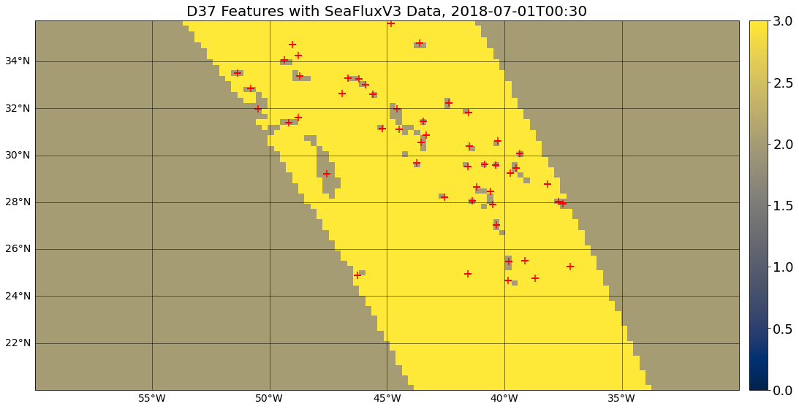
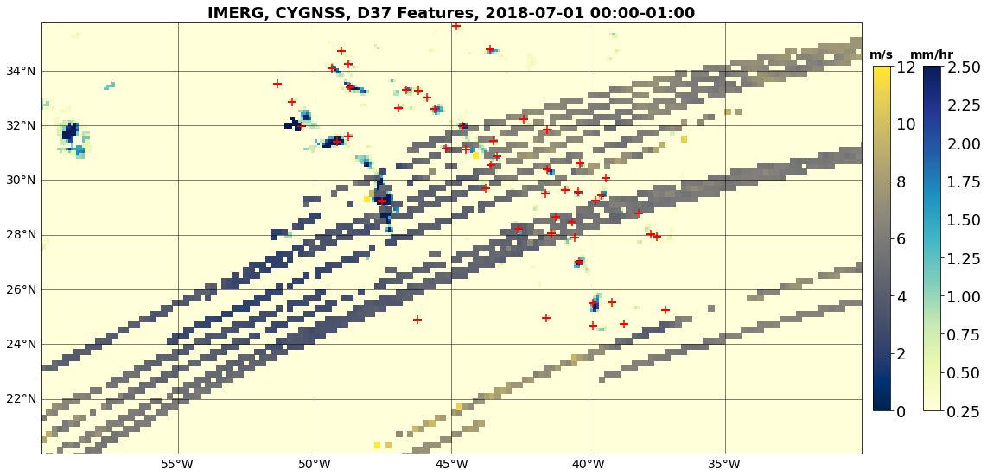
CYGNSS Performance in Convection
Motivation: CYGNSS observations are likely to provide their most added-value by sampling where typical microwave-based estimates of wind speed are missing due to the presence of very thick clouds and/or precipitation.
Goal: Provide an assessment of CYGNSS performance in these conditions
SeaFlux Observed=3, Missing=2, Crosses=37V-37H Minimum
IMERG and CYGNSS Observations
Missing
Δ37GHz Min
2022 NASA CYGNSS Science Team Meeting ・ March 8, 2022 ・ jason.b.roberts@nasa.gov

Slide 3
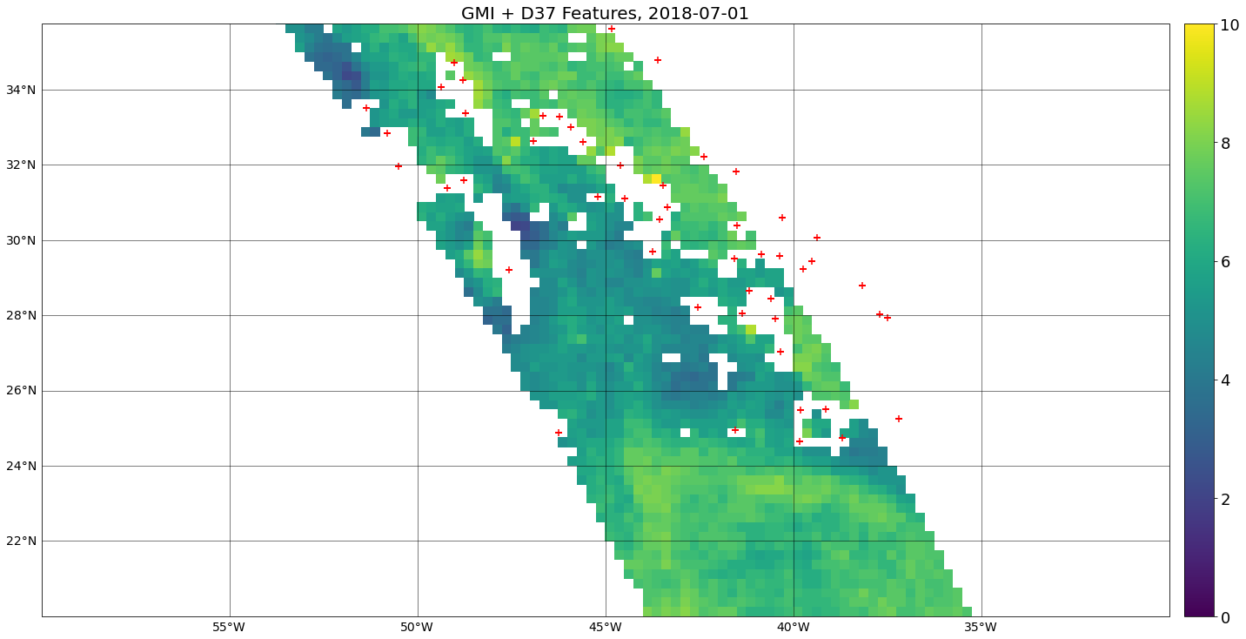
CYGNSS Performance in Convection
Motivation: CYGNSS observations are likely to provide their most added-value by sampling where typical microwave-based estimates of wind speed are missing due to the presence of very thick clouds and/or precipitation.
Goal: Provide an assessment of CYGNSS performance in these conditions
RSS GMI Wind Speeds, Crosses=37V-37H Minimum
IMERG and CYGNSS Observations
Missing
Δ37GHz Min
2022 NASA CYGNSS Science Team Meeting ・ March 8, 2022 ・ jason.b.roberts@nasa.gov

Slide 4
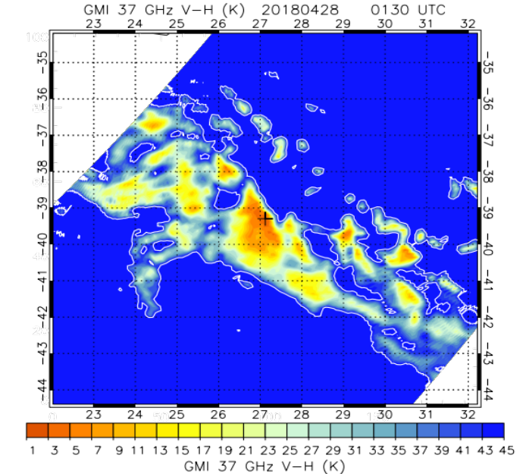
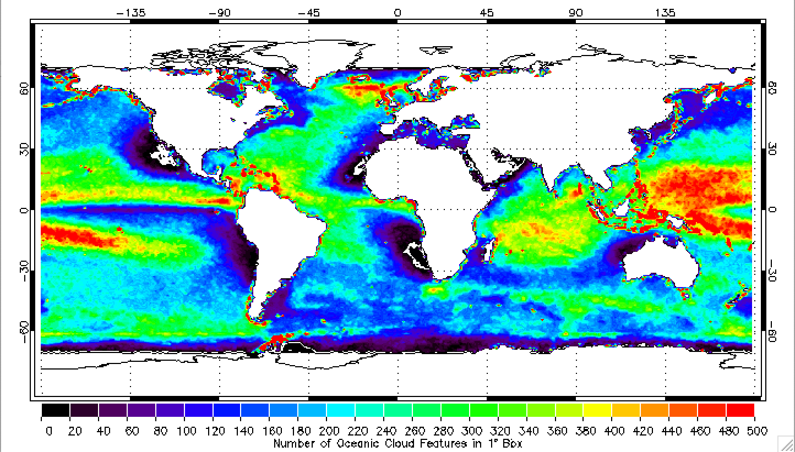
Detection of Convective Features
We have used feature identification algorithms applied to to swath-level observations of the Δ37=37V-37H GHz from GMI, AMSR2, and F16
  Specifically, we find features where Δ37<45K
  Zonal statistics are computed for these features
    GPROF Convective Rainfall
~19 million features
Feature Counts: March 2017 - NRT
Feature Metrics:
MinΔ37,
GPROF Precipitation,
GPROF Convective Rain
#Pixels<Thresholds,
Min PCT,
Temps @ MinΔ37,
etc.
Example Month
2022 NASA CYGNSS Science Team Meeting ・ March 8, 2022 ・ jason.b.roberts@nasa.gov

Slide 5
Wind Speed Intercomparisons
Collocation Criteria and Products:
Identify collocations — 25km, 30min — between:
  CYGNSS V3.1 L2
  CYGNSS V3.0 L2
  CYGNSS CDR 1.1
  Remote Sensing Systems:
    ASCAT-A, ASCAT-B, ASCAT-C,
    GMI, AMSR2, WindSat, SMAP, and SSMIS radiometers (F16, F17, F18)
  MERRA2
  ERA5
  IMERG
  Buoy data — GTMBA (TAO/PIRATA/RAMA), NDBC, Coriolis (UKMet/MeteoFrance)
Analyses (MW Wspd, RCG>10 , Equivalent neutral vs. actual winds taken into account):
Validation metrics against buoys and intercomparisons to other sensors and versions
Differences as a function of maximum convective rainfall
Track-based analyses
  Isolate wind speed changes from background
2022 NASA CYGNSS Science Team Meeting ・ March 8, 2022 ・ jason.b.roberts@nasa.gov

Slide 6
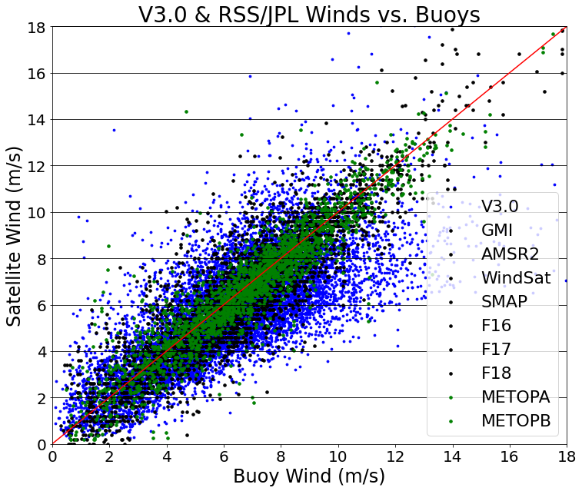
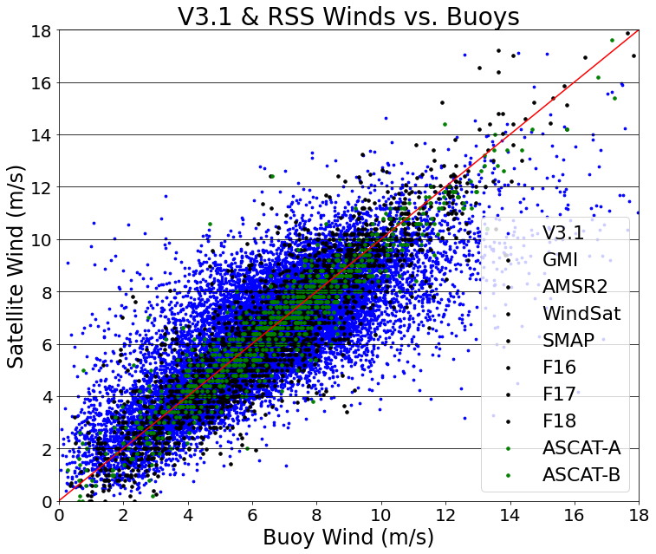
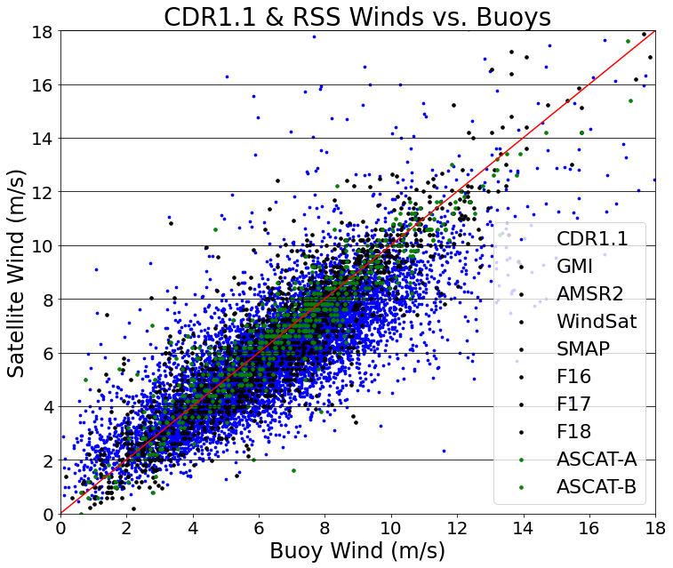
Comparisons with Buoys
V3.0 and CDR1.1 winds are around ~0.5 m/s to slow compared to buoys, better for V3.1
RSS winds from radiometers and scatterometers are very consistent with buoys and each other
RMSE of RSS winds is about 40% lower than CYGNSS observations
3.0
60min
3.1
30min
CDR 1.1
30min
CYGNSS (Blue)
Radiometers (Black)
Scatterometer (Green)
Triple-Collocations
V3.0(-0.52,1.98,0.72)
V3.1(-0.12,1.73,0.77)
CDR1.1(-0.47,1.72,0.78)
(Bias , RMSE , Rho)
RSS(-0.10,1.10,0.92)
RSS(-0.11,1.14,0.91)
2022 NASA CYGNSS Science Team Meeting ・ March 8, 2022 ・ jason.b.roberts@nasa.gov

Slide 7
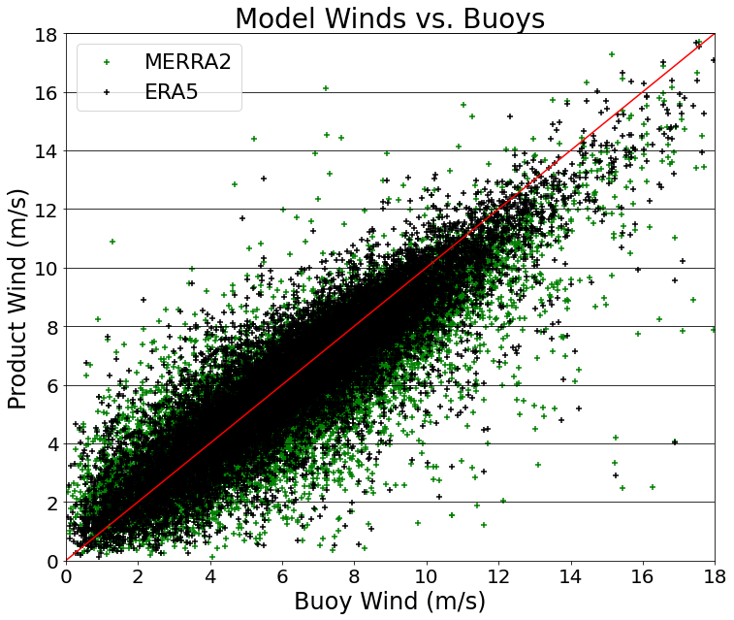
Comparisons with Buoys
Can see that the biases are strongly connected to MERRA2 and/or ERA5; to first order then the bias appears driven by the calibration target for the GMF
3.0
60min
3.1
30min
MERRA2 & ERA5
30min
CYGNSS (Blue)
Radiometers (Black)
Scatterometer (Green)
V3.0(-0.52,1.98,0.72)
V3.1(-0.12,1.73,0.77)
MERRA2(-0.55,1.53,0.85)
(Bias , RMSE , Rho)
RSS(-0.10,1.10,0.92)
ERA5(-0.19,1.19,0.90)
RSS(-0.11,1.14,0.91)
2022 NASA CYGNSS Science Team Meeting ・ March 8, 2022 ・ jason.b.roberts@nasa.gov

Slide 8
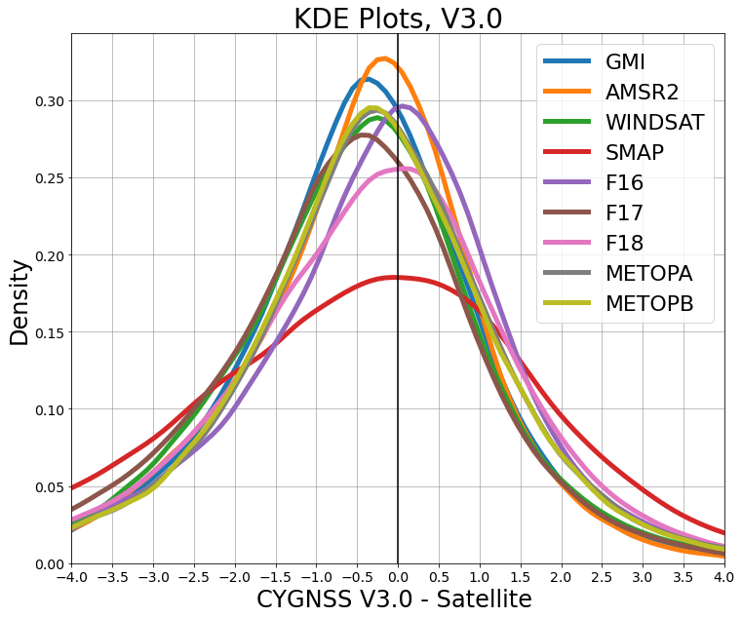
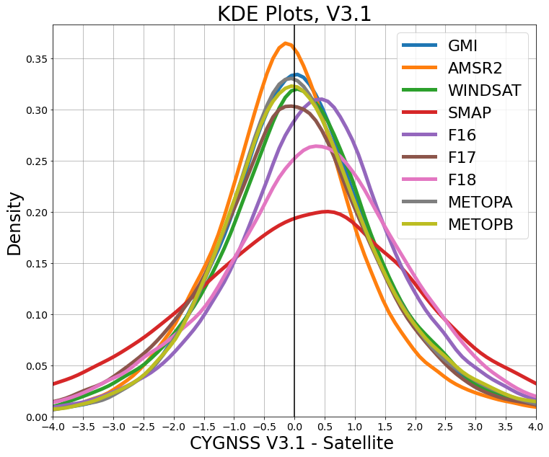
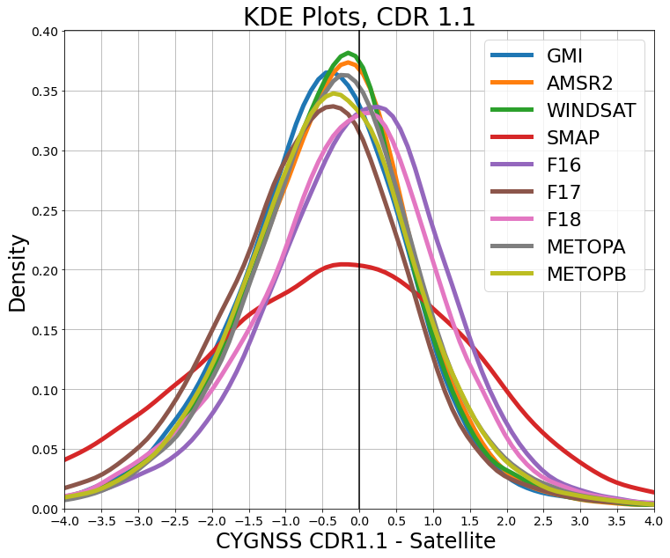
Comparisons against RSS Data Products
V3.1 is clearly more consistent with RSS data product suite
F16, F18 appear to be slightly less well calibrated compared to other datasets
  Not unreasonable given the worse resolution and known issues (e.g., warm load intrusion) with SSMIS
Note, SMAP is tuned to get high-wind conditions
V3.0
V3.1
CDR 1.1
2022 NASA CYGNSS Science Team Meeting ・ March 8, 2022 ・ jason.b.roberts@nasa.gov

Slide 9
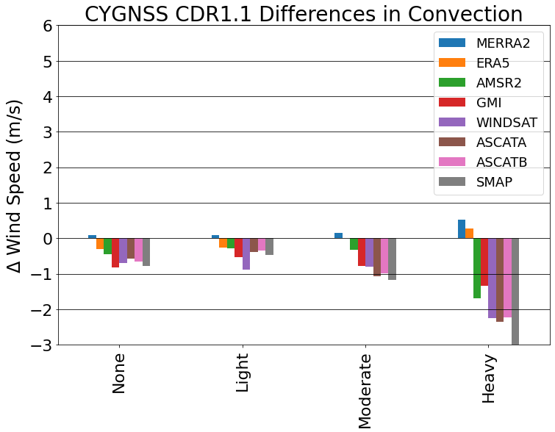
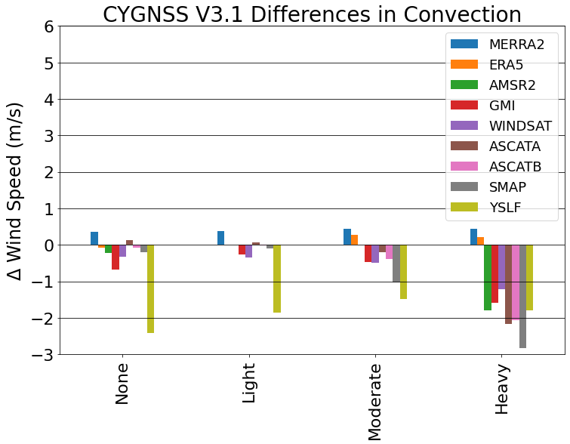
Satellite Winds in Convection
Stratified differences between CYGNSS and other satellite products (”Low-Frequency” and “All-Weather” retrievals) as a function of convective rainfall rate for associated features
CDR1.1 shows a consistently low bias even for low rainfall conditions that gets worse
V3.1 winds, however, are consistent with the RSS suite up to moderate conditions
YSLF winds are much closer to all the other products in heaviest rain conditions
CDR 1.1
V3.1
Mean wind speed difference of CYGNSS against alternative estimates (CYGNSS - ALT) as a function of maximum convective rainfall.
2022 NASA CYGNSS Science Team Meeting ・ March 8, 2022 ・ jason.b.roberts@nasa.gov

Slide 10
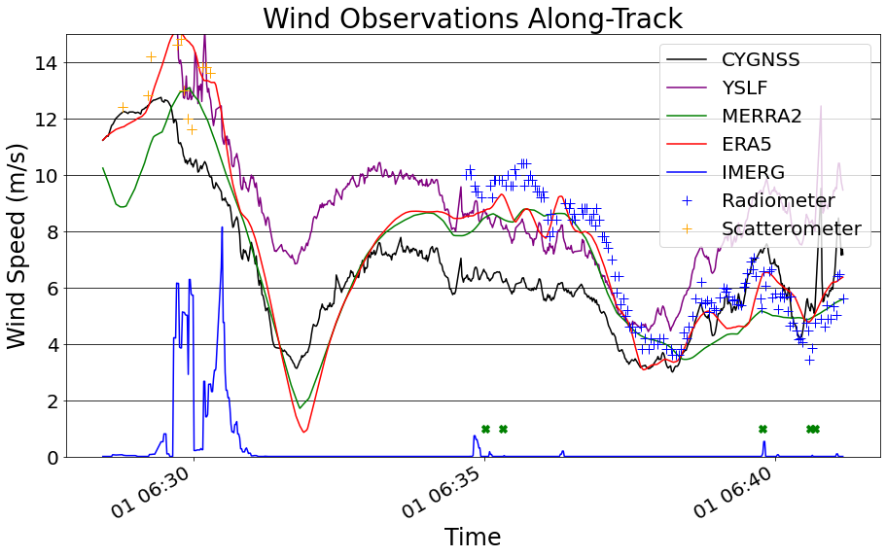
Identifying Convective Wind Signal Along-Track
Can we identify the convective wind signal? The individual tracks of CYGNSS generally cross different radiometer and scatterometer swaths. We subset all tracks where CYGNSS passed with 30min and 25km of a convective rainfall feature
Next, we de-mean the track wind speeds for all collocated products and then we can stratify the anomalous-wind (from track-background) to characterize the convective wind signal
YSLF
IMERG
MVE
Δ37 Min
Note: ~10-minute track
No Radiometer
2022 NASA CYGNSS Science Team Meeting ・ March 8, 2022 ・ jason.b.roberts@nasa.gov

Slide 11
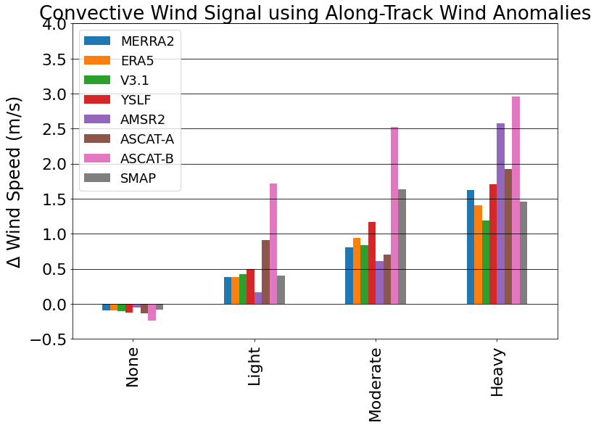
Convective Wind Signal - V3.1
CYGNSS MVE captures an increase in winds above the background up to 1.25 m/s moving from no rain to heavy rain.
YSLF winds show a stronger increase of 1.75m/s.
Overall, the radiometers, reanalysis, and CYGNSS indicate a robust wind increase of about 1.5 m/s as you move to heavy rain
The scatterometers show a stronger increase (~2 m/s). Is this unflagged rain contamination?
2022 NASA CYGNSS Science Team Meeting ・ March 8, 2022 ・ jason.b.roberts@nasa.gov

Slide 12
Summary:
CYGNSS V3.1 Winds in Convection
We evaluated the performance of CYGNSS against a suite of observations, reanalyses, and alternative satellite products. V3.1 winds exhibited a marked reduction in bias against buoys and general consistency with RSS radiometer and scatterometer estimates
When stratifying for the presence of convective rainfall, the V3.1 wind speeds are very consistent (+/-0.25m/s) with the RSS (low frequency/all-weather) suite until moderate to heavy-rainfall. There, the YSLF winds come in closer agreement with other datasets.
Developed a simple approach to characterize the convective wind signal. The V3.1 wind signals (FDS and YSLF) are consistent with reanalyses and radiometer estimates.
Next Steps
Fold in flux estimates ... but we would likely need YSLF estimates in convection
Extend analyses with more data
GEOS-FP: Gustiness parameterizations
2022 NASA CYGNSS Science Team Meeting ・ March 8, 2022 ・ jason.b.roberts@nasa.gov

