Slide 1
The Imaging X-ray Polarimetry Explorer
(IXPE)
Martin C. Weisskopf
NASA Marshall Space Flight Center
Presentation at HEAD Meeting
March, 2022

Slide 2
IXPE Mission Description
Launch December 9, 2021 on a Falcon 9 from KSC
600-km circular orbit at a nominal 0° inclination
2-year baseline mission, optional extension with GO program
Point and stare (with dither) at pre-selected targets
Malindi ground station - primary (Singapore - secondary)
Mission Operations Center (MOC) at the University of Colorado, Laboratory for Atmospheric and Space Physics (LASP)
Sciences Operations Center (SOC) at MSFC
Data archiving at NASA’s HEASARC
  During the first 3 months of the mission, including one month of orbital checkout, all IXPE data shall be made publicly available at the HEASARC within 30 days of the end of an observation, which is defined as when data for 90% of the scheduled observation time are received by the MOC.
  After the first 3 months of the mission, data shall be made available to the HEASARC within 1 week of the end of an observation, which is defined as when data for 90% of the scheduled observation time are received by the MOC.

Slide 3
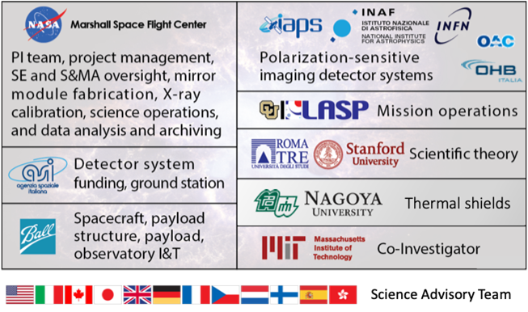
The IXPE Team
SAT currently comprises > 100 scientists from 12 countries

Slide 4
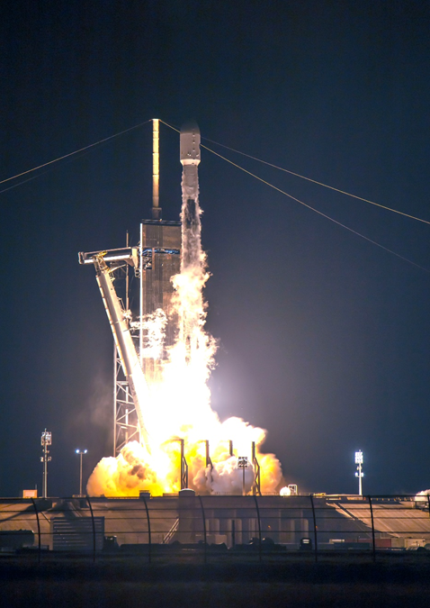
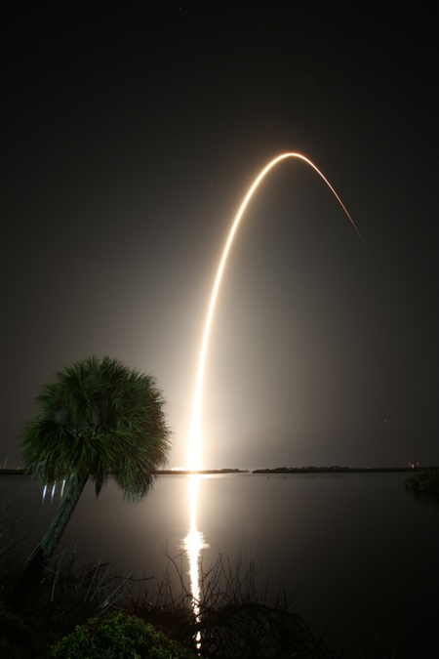
Launch (December 9, 2021)
Equatorial Orbit
600 km altitude

Slide 5
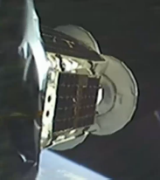
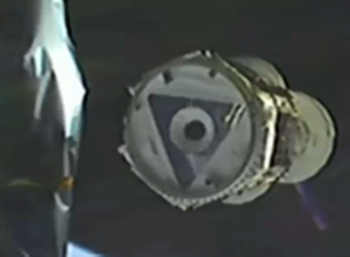
Release from the Falcon 9

Slide 6
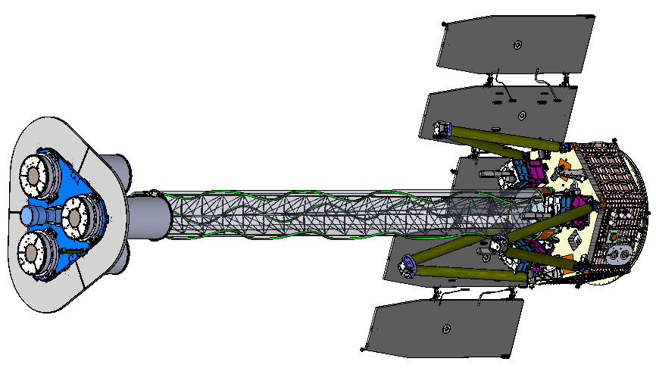
IXPE Deployed
MMA
(1 of 3)
DU
(1 of 3)
Forward Star Tracker
5.2 m total length
4.0 m focal length

Slide 7
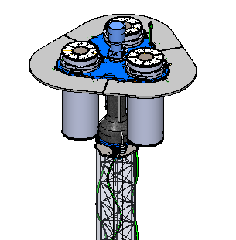
Shield and Collimator Suppress Background
Off-axis background
Shield
Detector unit
On-axis Target
X-ray
Shield
Mirror Module Assembly

Slide 8
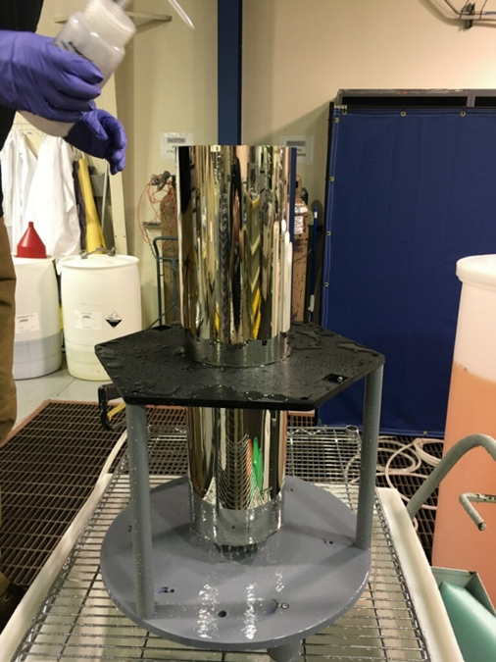
Optics Production Process
Mandrel fabrication
1. Machine mandrel from aluminum bar
2. Coat mandrel with electroless nickel (Ni-P)
3. Diamond turn mandrel to sub-micron figure accuracy
4. Polish mandrel to 0.3-0.4 nm RMS
5. Conduct metrology on the mandrel
Mirror-shell forming
6. Passivate mandrel surface to reduce shell adhesion
7. Electroform Nickel/Cobalt shell onto mandrel
8. Separate shell from mandrel in chilled water
Ni/Co electroformed IXPE mirror shell
(+)
(-)
(+)

Slide 9
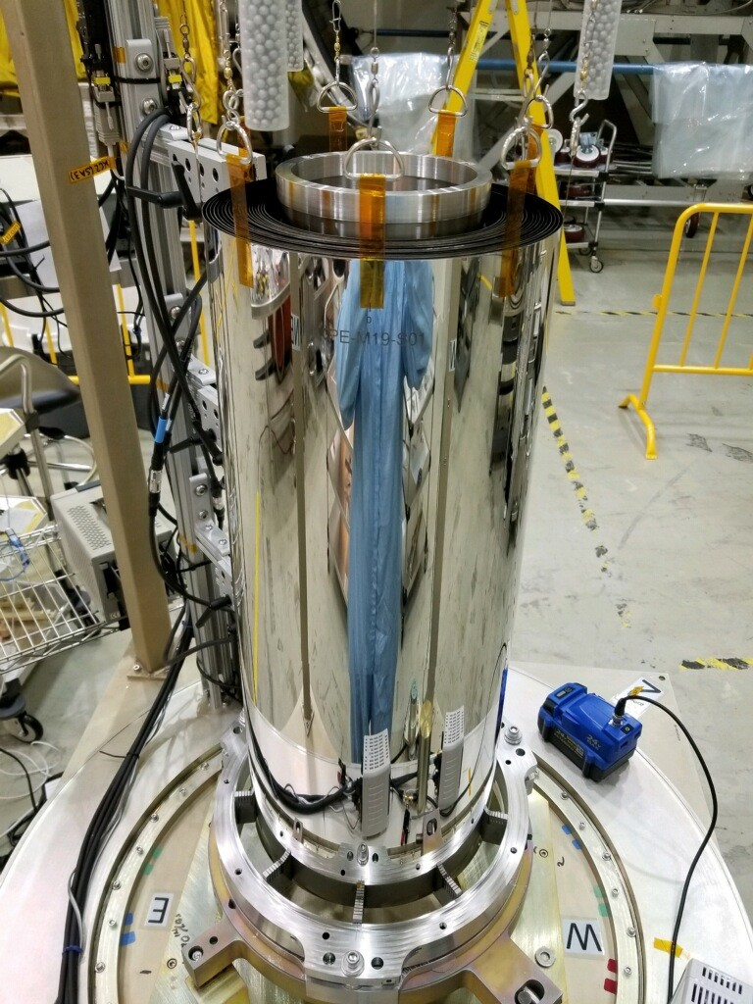
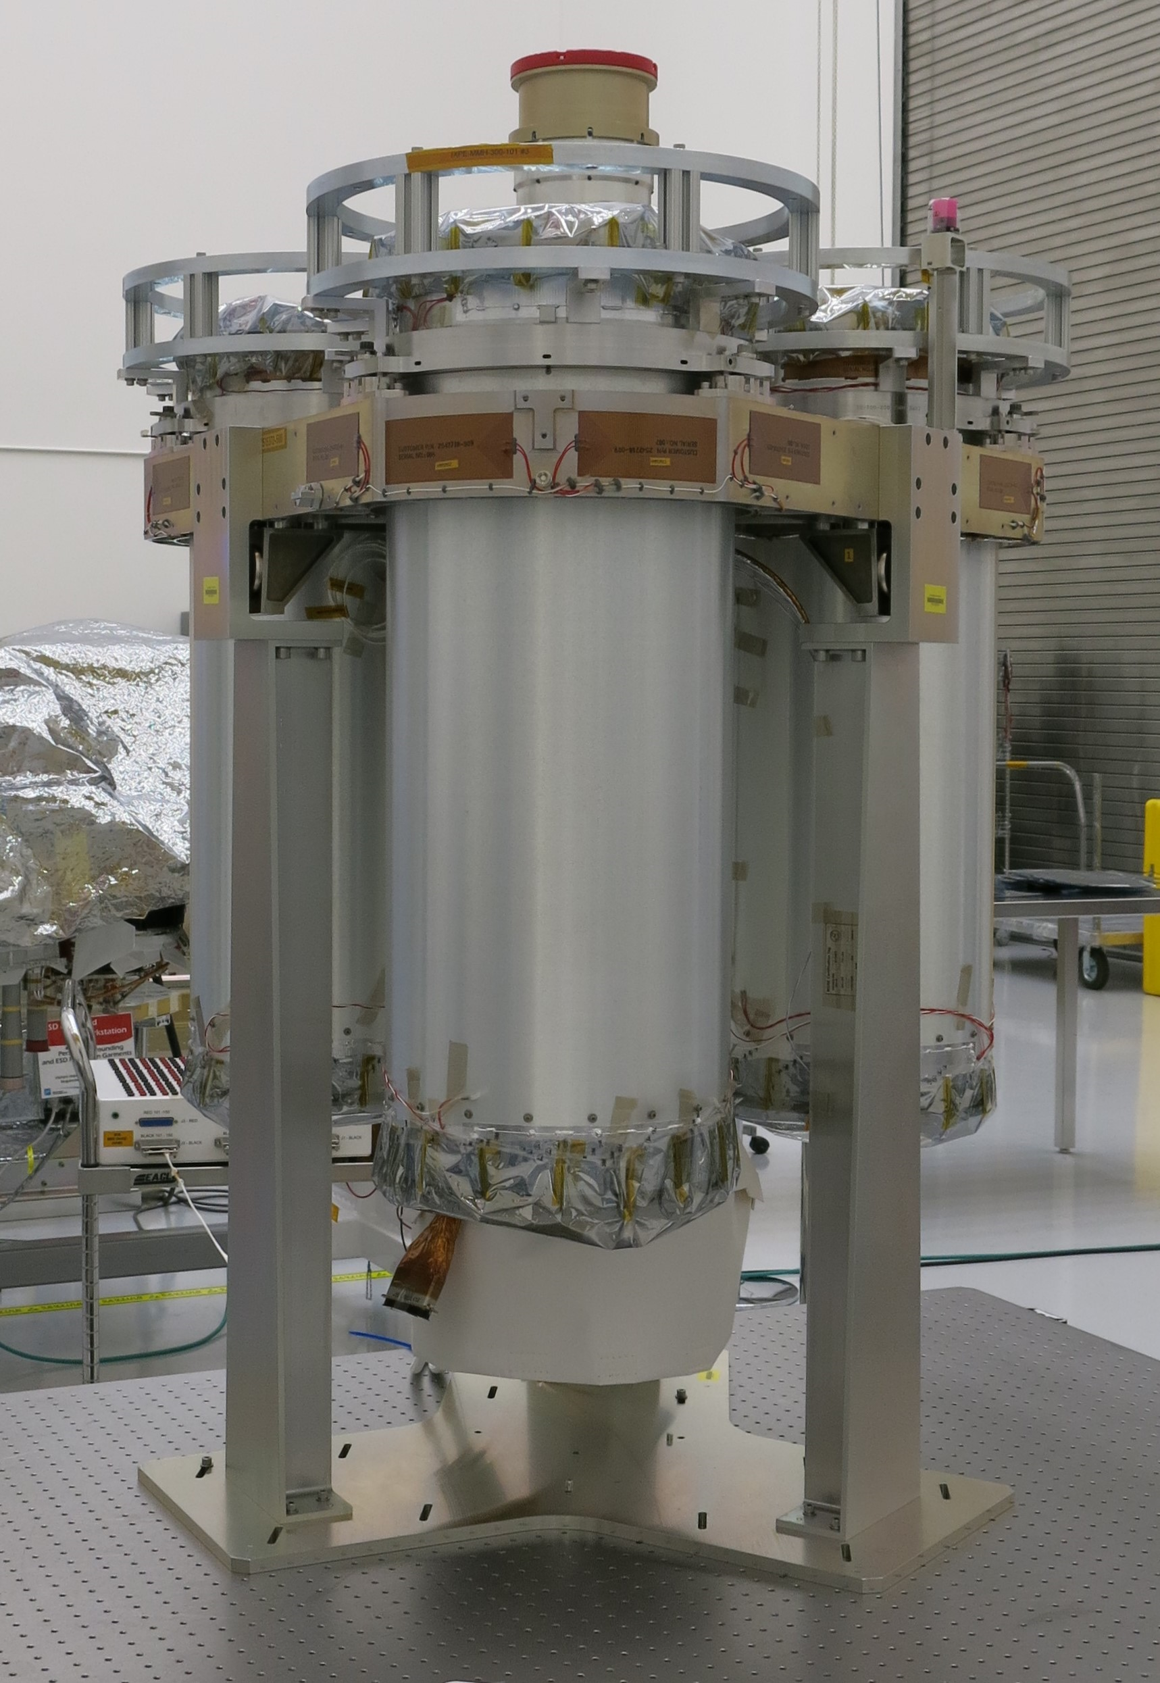
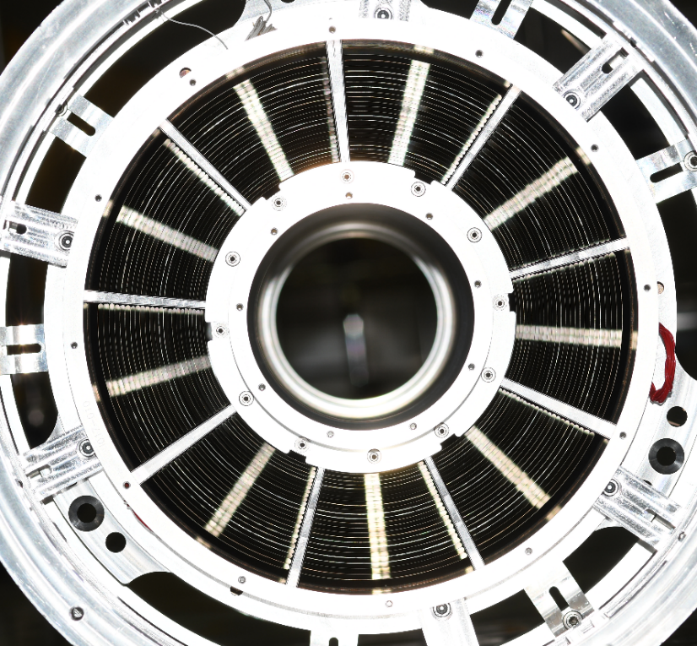
The Optics

Slide 10
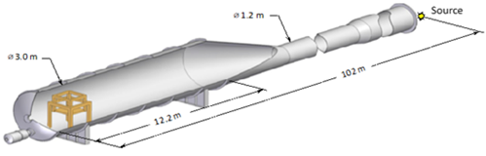
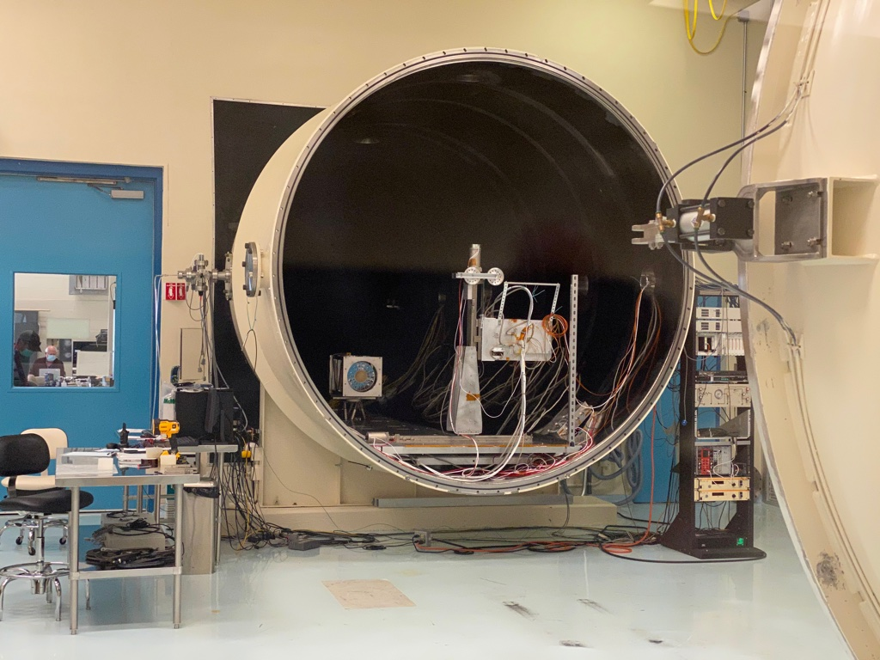
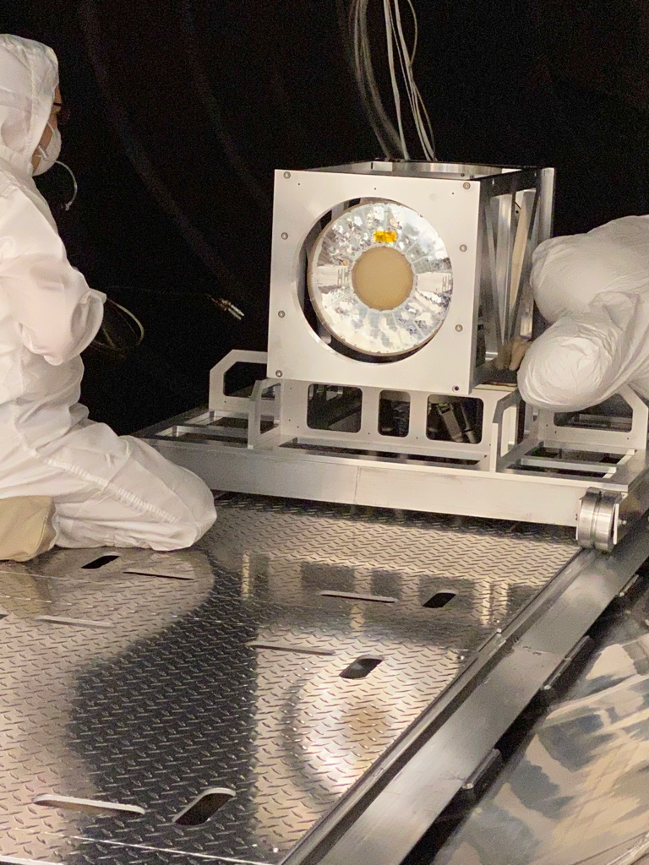
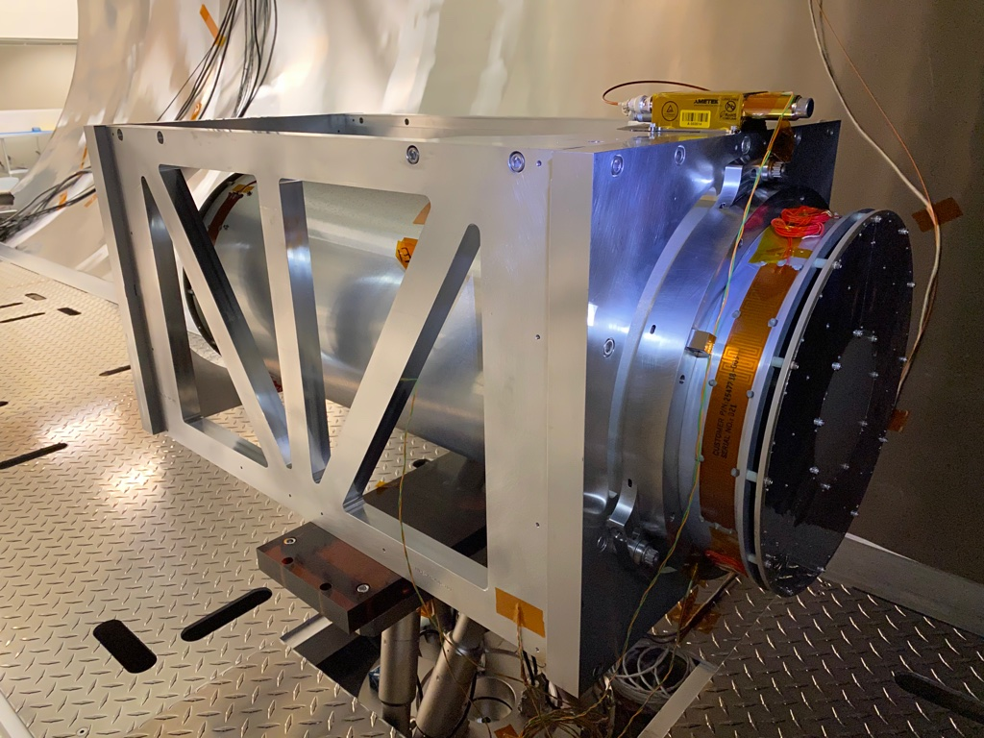
Calibration: MSFC Stray Light Test Facility

Slide 11
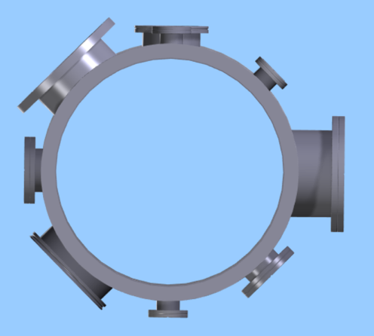
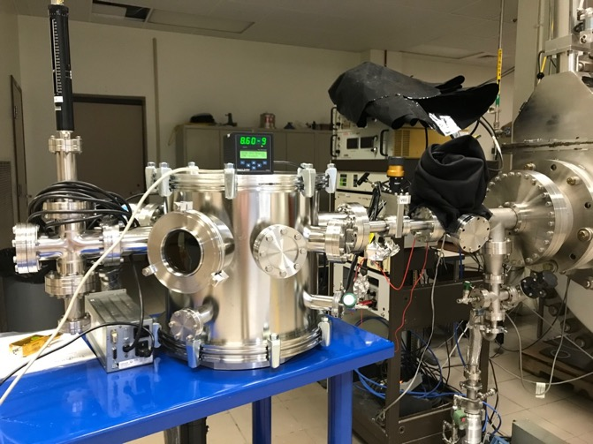
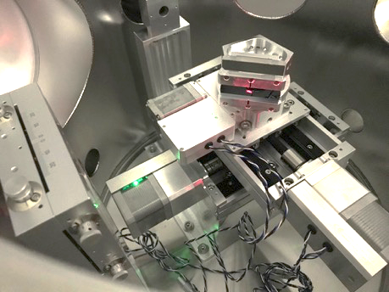
Polarized Sources
3 Polarized Sources
  Crystal Box
    Holds all X-ray sources
    Holds crystals — needed for polarized source
Non-Polarized Source
CF 4 5/8
Glass View Port ISO 160K
Translation Stage Port ISO 200K
Detector
~ 100 m
Translation-Rotation Stage
Source
Gas Gauge CF 2.75
Detector Box/ Stray Light Facility
CF 8
Turbo Pump CF 4.5
CF 2.75
10 Pin Electrical Feedthrough CF 2.75
Interior of Crystal Box, showing stages and crystal being aligned on turret
Energy | X-ray Tube | Crystal | Polarization
2.7 keV | Rh | Ge(111) | > 99%
4.5 keV | Ti | Si(220) | > 99%
6.4 keV | Fe | Si(400) | > 99%
Crystal Box attached to SLTF Beamline

Slide 12
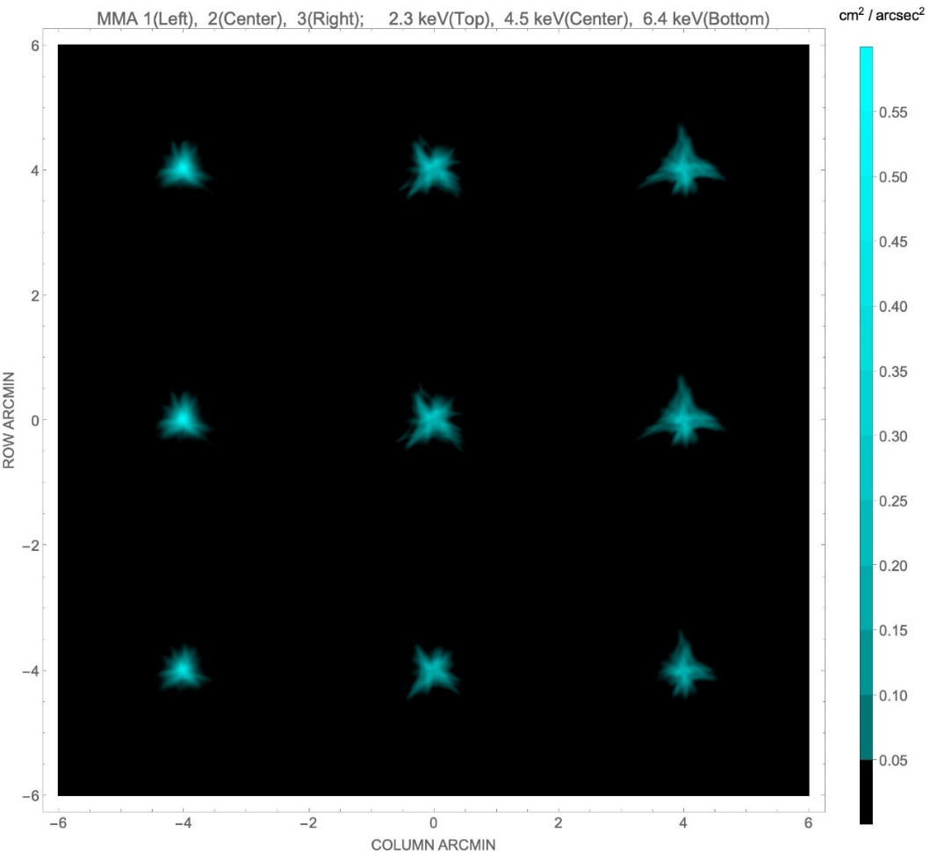
Angular Resolution
MMA | #1 | #2 | #3
6.4 keV | 18.9″ | 24.8″ | 24.2″
4.5 keV | 18.9″ | 25.0″ | 26.9″
2.3 keV | 18.7″ | 24.5″ | 26.7″
Values in the table are half-power diameters (HPDs) for the individual MMAs alone. These need to be adjusted for alignment errors, detector resolution, focus etc. to determine the on-orbit system-level resolution.
Based upon X-ray calibration, analysis, and on-orbit performance the system-level performance is ≈ 30″ HPD

Slide 13
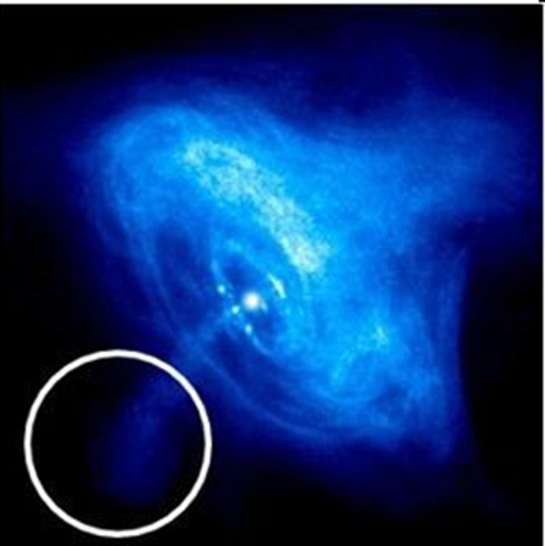
Imaging polarimetry
IXPE 30″ half-power diameter on Chandra image

Slide 14
Mirror Module Assembly Properties
Property | Value
Number of modules | 3
Mirror shells per module | 24
Inner, outer shell diameter | 162, 272 mm
Total shell length | 600 mm
Inner, outer shell thickness | 180, 250 µm
Shell material | Nickel cobalt alloy
Effective area per module | 163 cm² (2.3 keV) ~ 192 cm² (3-6 keV)
Angular resolution | ≤ 27 arcsec HPD
Detector limited FOV | 12.9 arcmin
Focal length | 4 m
Mass (3 assemblies) | 93.12 kg

Slide 15
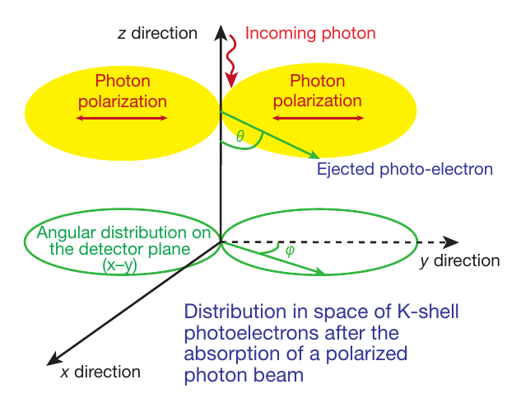
Polarization Detection Principle
The detection principle is based on the photoelectric effect

Slide 16
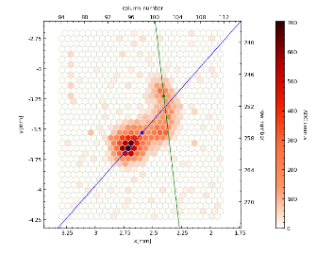
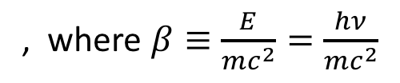
The Polarization-Sensitive Detectors
The distribution of the photoelectron initial directions determines the degree of polarization and the position angle
, where $β≡\frac{E}{mc^{2}}=\frac{hν}{mc^{2}}$

Slide 17
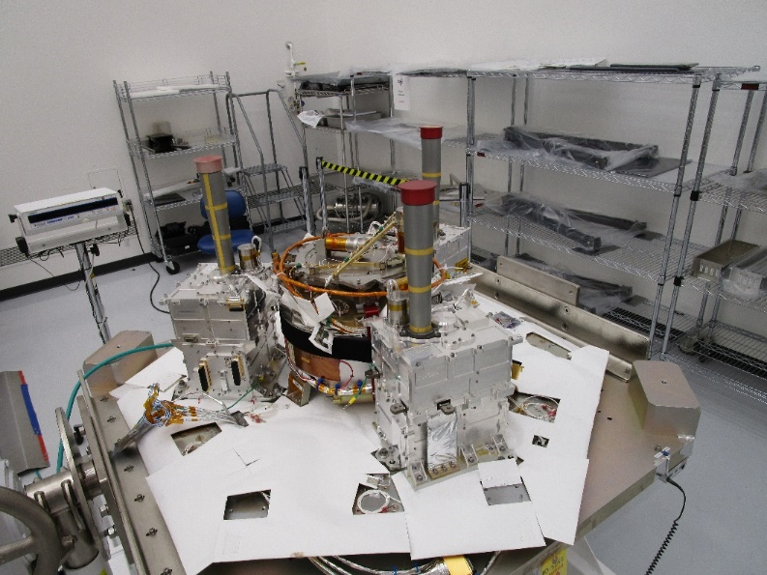
The Detectors
The Detector Units (DUs) mounted to the spacecraft top deck at Ball

Slide 18
Detector Properties
Parameter | Value
Sensitive area | 15 mm × 15 mm (13 x 13 arcmin)
Fill gas and composition | DME @ 0.8 atmosphere
Detector window | 50-µm thick beryllium
Absorption and drift region depth | 10 mm
GEM (gas electron multiplier) | copper-plated 50-µm liquid-crystal polymer
GEM hole pitch | 50 µm triangular lattice
Number ASIC readout pixels | 300 × 352
ASIC pixelated anode | Hexagonal @ 50-µm pitch
Spatial resolution (FWHM) | ≤ 123 µm (6.4 arcsec) @ 2 keV
Energy resolution (FWHM) | 0.57 keV @ 2 keV (∝ √E)
Useful energy range | 2 - 8 keV

Slide 19
Filter Calibration Wheel Assembly
Filter and Calibration Wheel (FCW), providing open, attenuator, and closed positions, plus four ⁵⁵Fe-powered calibration sources:
  Cal A – Bragg-reflected polarized 2.98-keV (Ag-L𝛼 fluorescence) and 5.89-keV (Mn-K𝛼)
  Cal B – unpolarized 5.89-keV spot
  Cal C – unpolarized 5.89-keV flood
  Cal D – unpolarized 1.74-keV (Si-K𝛼 fluorescence) flood

Slide 20
The Minimum Detectable Polarization (MDP)
R_{S} is the observed source counting rate
R_{B} is the observed background counting rate
t is the integration time
M is the modulation factor, i.e. the amplitude of the variation of the ensemble of position angles for a 100% polarized source

Slide 21
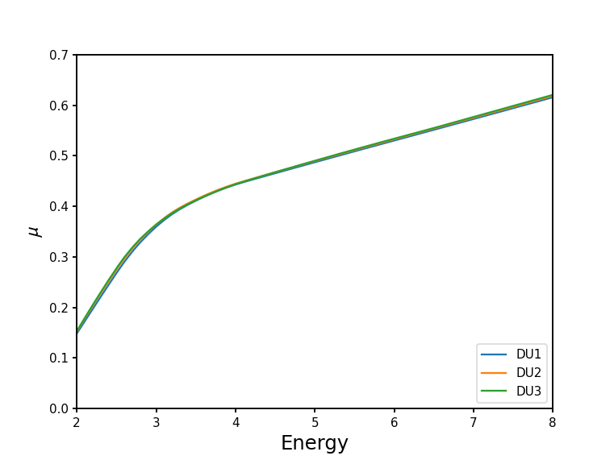
Modulation Function
M

Slide 22
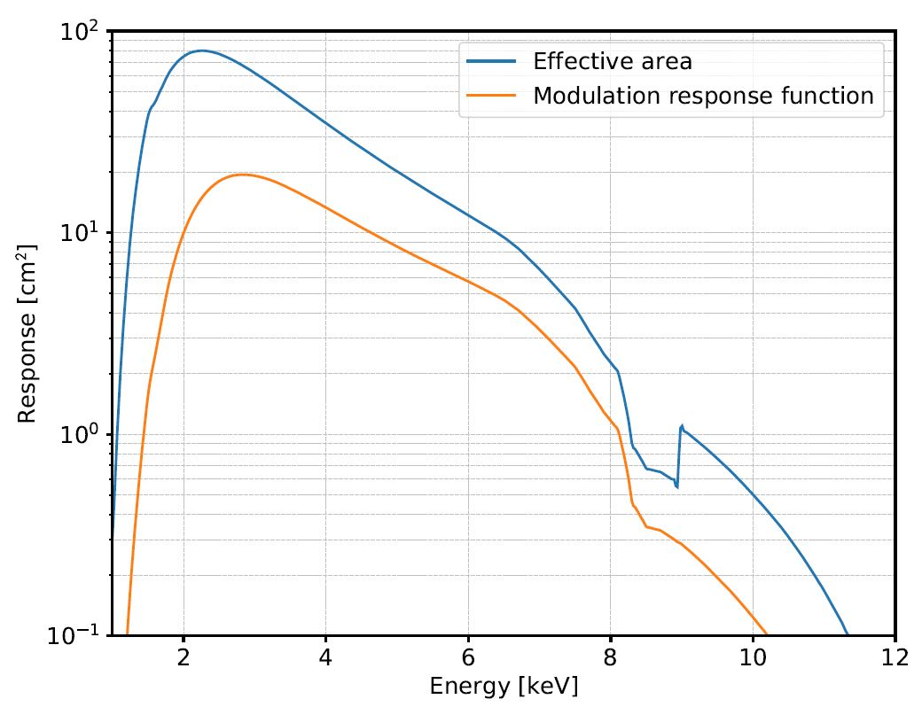
Response (3 Polarimeters)

Slide 23
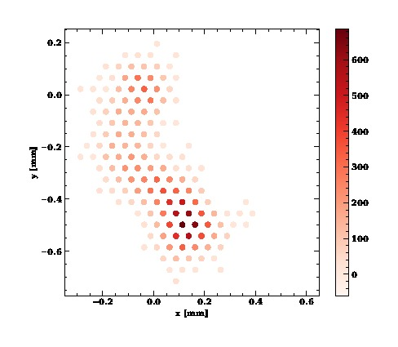

Analysis Based upon Neural Networks
Baseline moments analysis is a simple, effective, long-studied and well-understood method of extracting information from ionization tracks made by a photo-electron in the detector gas
Machine Learning (neural-network) techniques can extract more information from each track
  Improves position-angle (PA) measurements, especially at high energy
  Computes statistical and reconstruction errors for each event
  Mildly improves estimates of the energy and conversion point of each event

Slide 24
First Year Observations
OBJECTIVE 1: Active Galactic Nuclei (AGN)
  Obtain polarimetry of three (3) AGN to look for a correlation of polarization direction with the orientation of the AGN radio structure. [15]
OBJECTIVE 2: Microquasars (μ-Quasars)
  Obtain spectral polarimetry of two (2) microquasars to constrain the value of the black-hole spin parameter, in combination with information on the radio structure. [2]
OBJECTIVE 3: Radio Pulsars and Pulsar-Wind Nebulae (PWNe)
  Obtain polarimetric imaging of one (1) Pulsar Wind Nebula (PWNe) to constrain the magnetic-field geometry of the nebula and the phase-dependent polarization of the pulsar. [3]
OBJECTIVE 4: Supernova Remnants (SNR)
  Obtain spectral polarimetric imaging of one (1) Supernova Remnant (SNR) to constrain the magnetic-field structure of the X-ray emitting regions. [3]
OBJECTIVE 5: Magnetars
  Obtain phase-dependent polarimetry of one (1) magnetar to constrain the effects of vacuum polarization (birefringence in a strong magnetic field). [2]
OBJECTIVE 6: Accreting X-ray Pulsars
  Obtain phase-dependent polarimetry of three (3) classical accreting X-ray pulsars (high-magnetic-field binaries) to constrain models and geometries for the pulsing emission. Obtain polarimetry of two (2) millisecond X-ray pulsars (low-magnetic-field binaries) to constrain the geometry of the accretion-disk system. [8]
IXPE Year-1 observing plan:
33 planned targets, plus 36 days for
~6 transients or other targets of opportunity

Slide 25
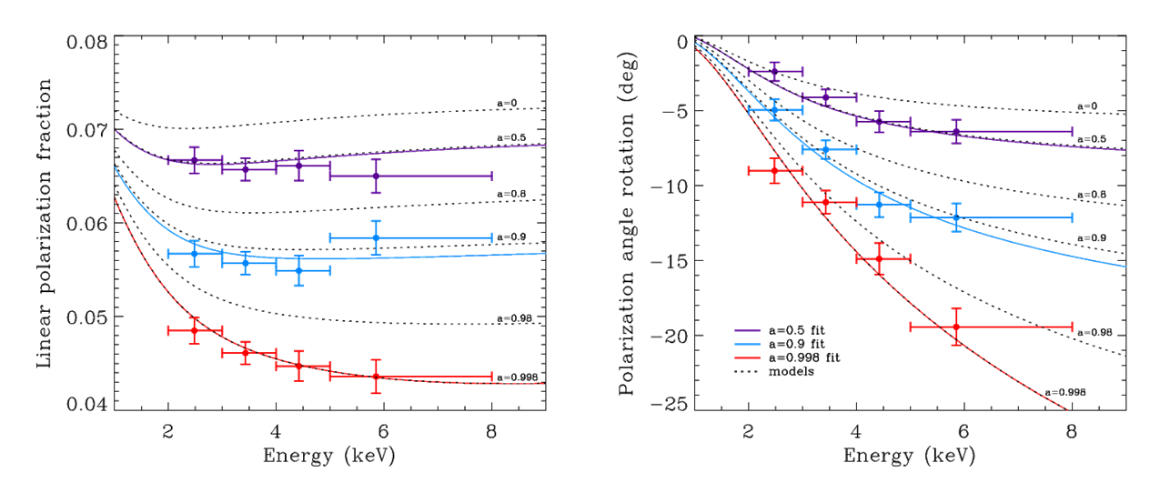
Microquasars
Microquasars
  Perform X-ray spectral polarimetry on microquasars to use the position angle to help localize the emission site (accretion disk, corona, jet)
  For a micro-quasar in an accretion-dominated state, scattering polarizes the disk emission.
  Polarization rotation versus energy is greatest for emission from inner disk.
    Inner disk is hotter, producing higher energy X-rays.
  Disk orientation from other experiments used to constrain GRX1915+105 model.
    a = 0.50±0.04; 0.900±0.008; 0.99800±0.00003 (200-ks observation)

Slide 26
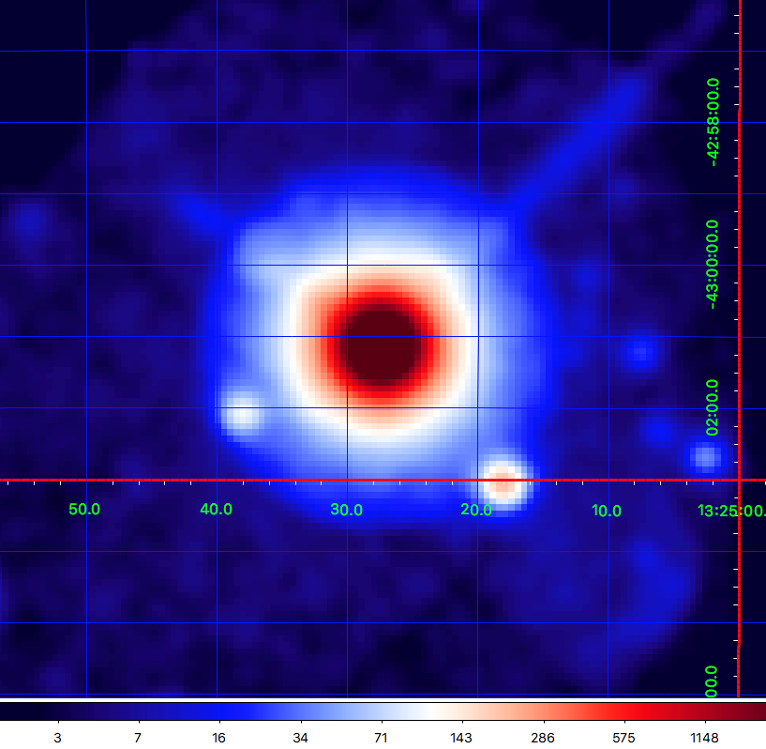
Active Galaxies: CEN A
Active galaxies are powered by supermassive BHs with jets
  Radio polarization implies the magnetic field is aligned with jet
  Different electron-acceleration models predict different dependence in X-rays
Region | MDP₉₉
Core | 1.4%
Knots C+F+G | 21%
ULXs | 25% 15%
ULX sources

Slide 27
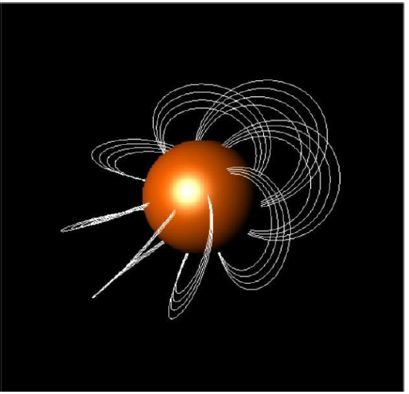
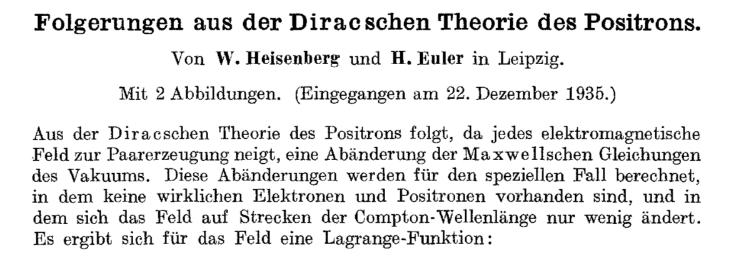
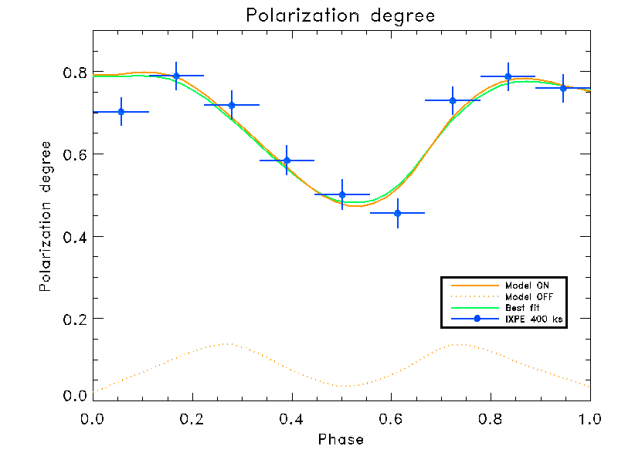
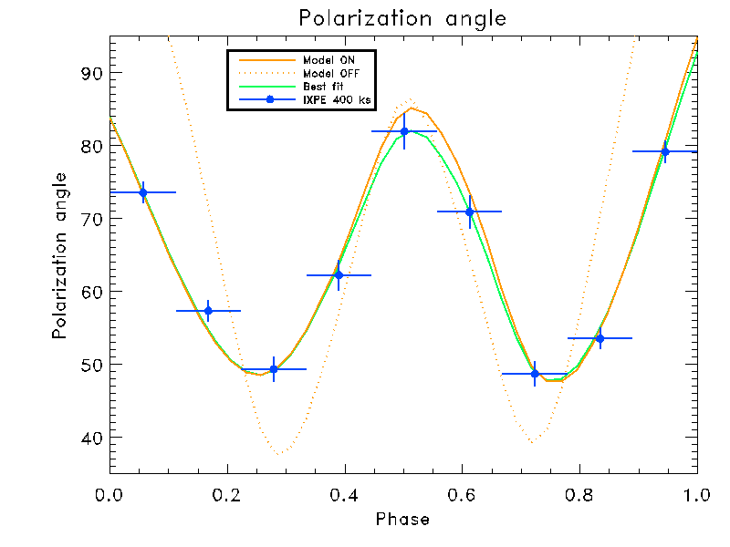
Magnetars: A Long-Searched Vacuum-Birefringence QED Effect
Weisskopf, V.C. (1936)
Uber die Elektrodynamik des Vakuums auf Grund der Quanten-theorie des Elektrons. Det Kgl Danske Viden Selskab Mat fys Medd XIV 6:1–36
Pulsing neutron stars with magnetic fields up to 10¹⁵ Gauss
Non-linear QED predicts magnetized-vacuum birefringence
An effect predicted more than 80 years ago but never verified
QED
NO QED

