Slide 1

Comparison of NASA and ECSS Standards for Additive Manufacturing Qualification and Certification for Spaceflight Application
Brian West¹, Additive Manufacturing & Digital Solutions Team Lead
Alison Park², Douglas Wells¹, Richard Russell²,
¹NASA Marshall Space Flight Center, ²NASA Langley Research Center
1st International Conference on Advanced Manufacturing for Air, Space and Land Transportation, Virtual
March 7-10, 2022

Slide 2

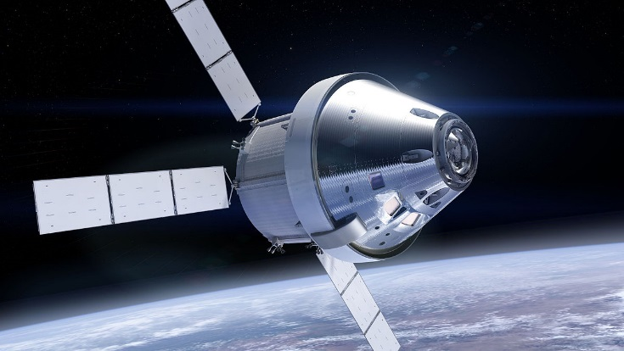
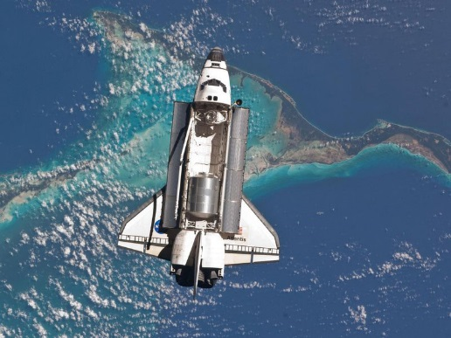
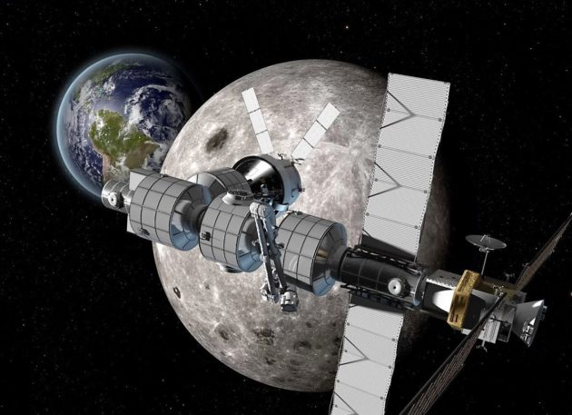
NASA’s Motivation for AM Standard Development
AM parts are already being use for NASA programs in critical applications
Human exploration of space, especially deep space, requires extreme reliability
Low Earth Paradigm
Deep Space Paradigm
250 miles vs 83,000,000+ miles
15-30 year life vs 50 to 100+ years
Replacement parts vs Limited replacement parts
Safe haven of earth vs no safe haven
Notes:
Current human space travel paradigm is based on 70 years of low-earth-orbit (250 miles) technology – Low Earth Paradigm
Low-Earth mission reliability is based on:
15 to 30 year life (e.g., ISS)
Replacement (spare) parts
Rapid fix by transport from earth
Safe haven on earth (one day – earth reentry)
Human exploration of deep space (Mars 83,000,000+ miles) will require a new paradigm based on new technology – Deep Space Paradigm
Deep-space mission reliability is based on:
50 to 100+ year life (all assets are valuable in deep space)
Limited replacement (spare) parts because of limited weight requirements
Extremely limited rapid fix by transport from earth (too far)
Safe haven on earth?? Separate deep-space platform?? (83 million miles – earth reentry)

Slide 3
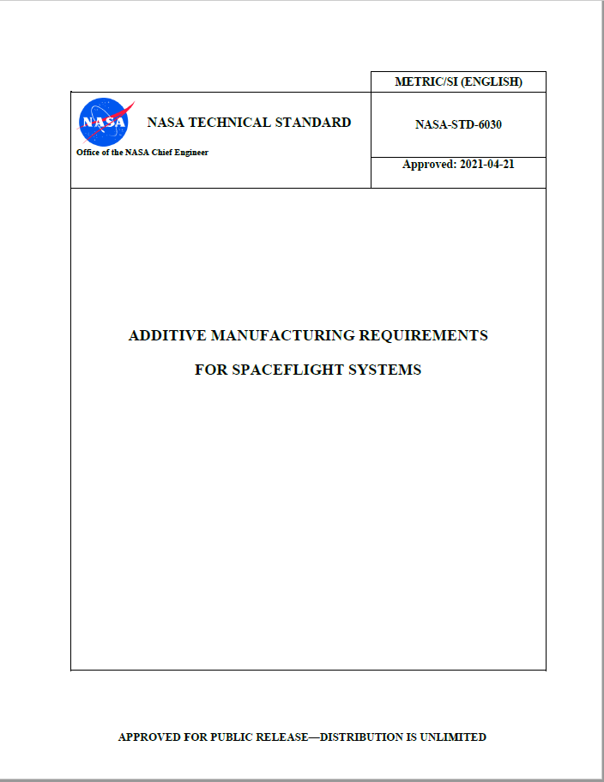
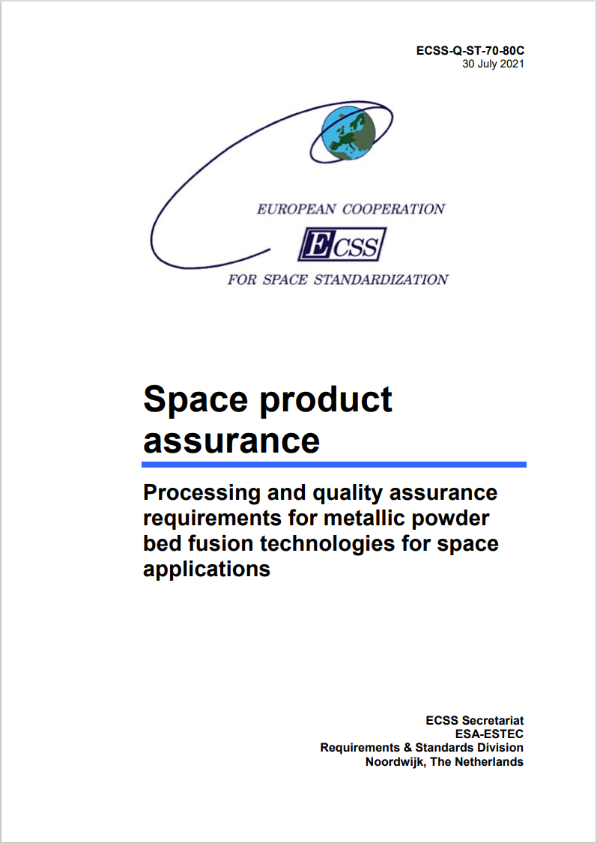
NASA & ECSS Standards
NASA
ECSS
NASA-STD-6030
Additive Manufacturing Requirements For Spaceflight Systems
115 “Shall” Statements, 190 pages
NASA-STD-6033
31 “Shall” Statements, 45 pages
Approved: 2021-04-21
ECSS-Q-ST-70-80C Space Product Assurance
Processing and quality assurance requirements for metallic powder bed fusion technologies for space applications
198 “Shall” Statements, 88 pages
Approved: 2021-07-30
High Level Similarities:
Both documents cover all things aerospace
Both documents are tailorable
Intended to work within existing organizational structures
Cover similar topic areas, differences are in the details
Disclaimer: I do not claim to be an expert in ECSS standards

Slide 4
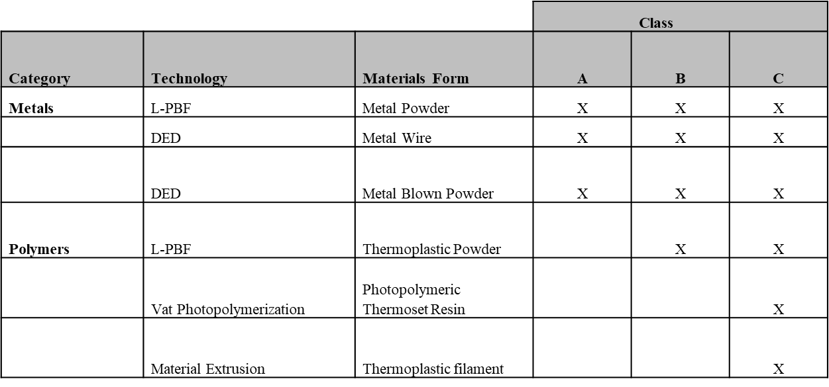
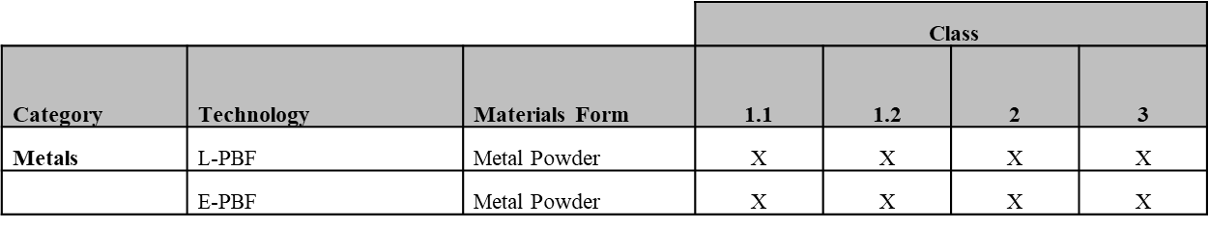
Applicability
NASA-STD-6030
ECSS-Q-ST-70-80C
Tailoring: Although this standard is developed for powder bed fusion based techniques, its principles can also be used as a reference for other metal-based and polymer-based processes. These include Wire Arc Additive Manufacturing (WAAM), Stereolithography (with metals), Binder Jetting, but also Selective Laser Sintering (SLS), Stereolithography (with polymers), Fused Deposition Modelling (FDM), and others. Section 1
3.4 Nomenclature shall/should/may/need not
Not Applicable: Adaptive technologies, where the heat input can change during the manufacturing process, are not allowed e.g. Electron beam powder bed fusion (E-PBF)
Tailoring: Use of technologies and materials not explicitly described in Table 1 requires approval by the CEO and the responsible NASA Materials and Processes (M&P) organization. Section 1.4.2
Appendix B: NON-CREWED AND ROBOTIC MISSION TAILORING GUIDELINES
Noteworthy Items:
Tailoring: NASA-Appendix B – 80C-Nomenclature
6030 covers a wider range of technologies
E-PBF would be a tailored Point Design in 6030
Notes:
Tailoring in 6030 is conducted once for a program during creation of the AMCP. In 80c its potentially on a part by part basis between the vendor and the design authority

Slide 5


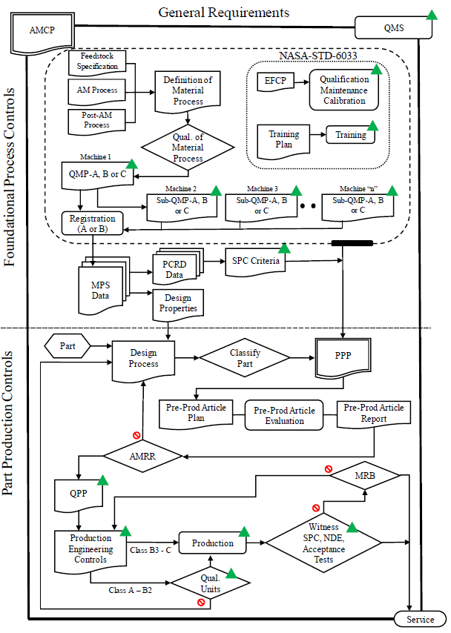
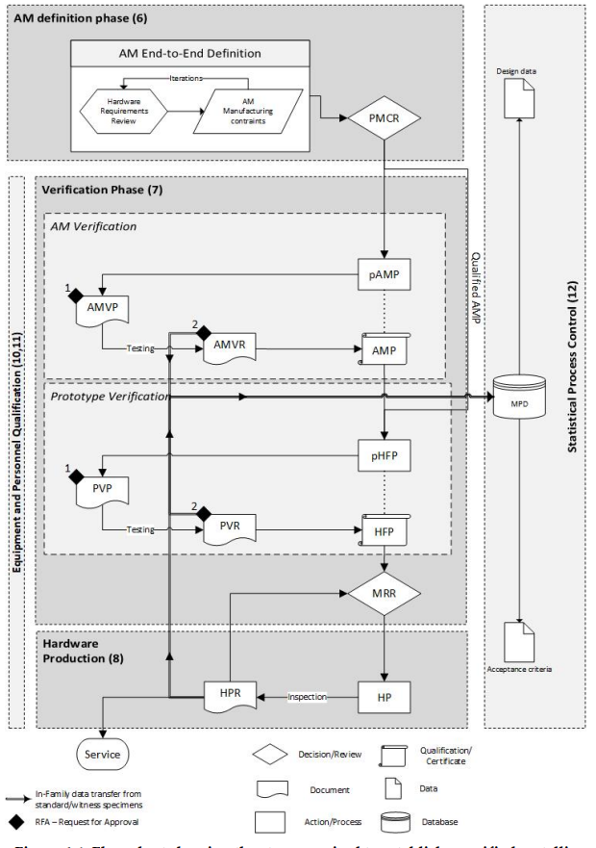
Organization
We all love flowcharts!
Existing organizational and requirement structures drive our specification structure
2 Focus area in NASA
Foundational Process Control
Part Production Controls
3 Phases in ECSS :
AM definition phase
Verification Phase
Production Phase
Notes:
Separation of M&P, Individual program structures
ECSS AM Definition Phase, Verification Phase, Production Phase.

Slide 6
Organization-AM Definition Phase
What are we doing?
Iterating Hardware Requirements and Manufacturing Constraints
Addressing:
1. An overview of all applicable, application-specific requirements
2. The safety class
3. The selected AM end to end manufacturing process
4. Design allowables from a MPD (if available)
5. AMP (if available and verifiable)
(From PMCR DRD)
Outcome:
Preliminary Manufacturing Concept Review (PMCR)
Notes:
The aim of the AM definition phase is to converge to a preliminary manufacturing concept, allowing for an early assessment of the envisaged AM project. Conducting a feasibility study before starting the AM definition phase intends to help identifying critical aspects at an early stage. The PMCR is the formal review where the conclusions of this feasibility study are documented and presented.

Slide 7
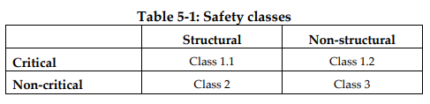
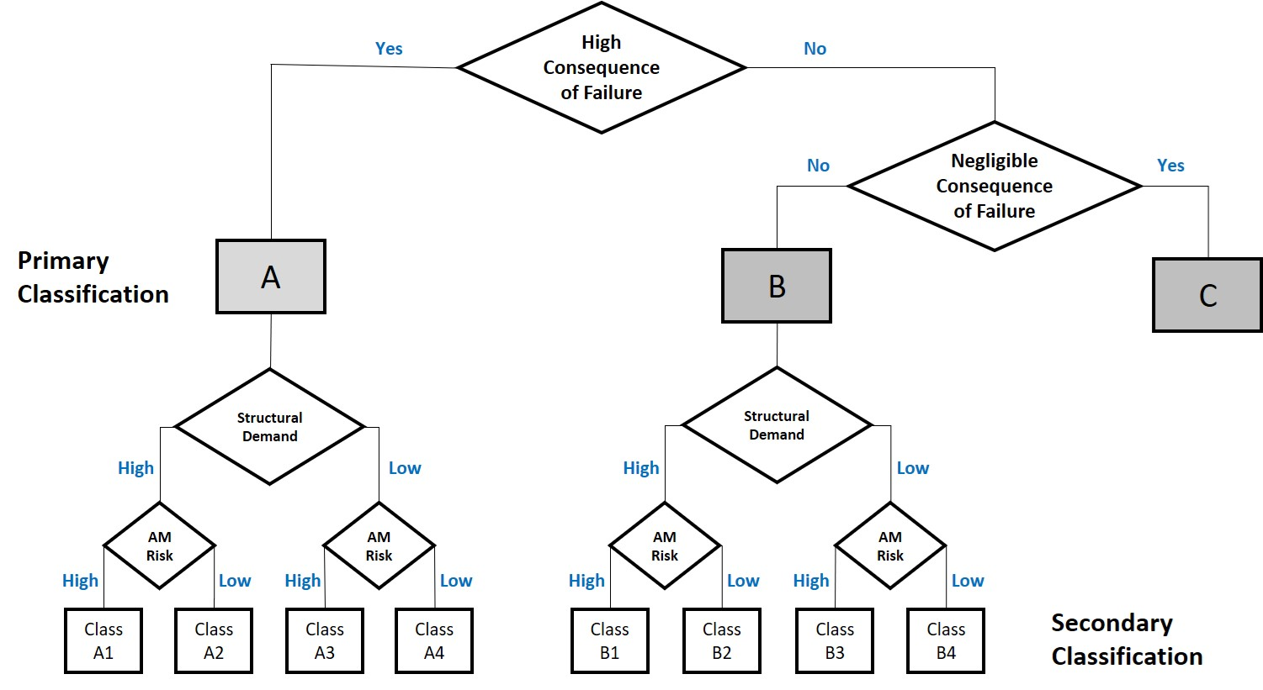
Classification
NASA-STD-6030
ECSS-Q-ST-70-80C
Critical: resulting in temporarily disabling but not life threatening injury, temporary occupational illness, major detrimental environmental effects, major damage to public or private properties, major damage to interfacing flight systems or major damage to ground facilities
Safety Class 1.1 and 1.2: Failure results in a loss of spacecraft, major components, loss of life, or loss of control of the spacecraft.
Safety Class 2: Failure can reduce the efficiency of the system but not cause the loss of the spacecraft.
Safety Class 3: Contained so that failure does not affect other flight elements. Require minimal integrity verification. Controls are mainly visual.
ECSS-Q-ST-70-80C, Safety Class Rough Translation:
1.1-1.2 2-3 3
Detailed Decision Path drives Classification
Each Specification Uses Classification to Drive Requirements

Slide 8
Classification
NASA-STD-6030
How its Defined
ECSS classification is defined by agreements by the customer and the design authority
NASA classification is a defined framework for all programs
How its Recorded
ECSS framework: Annex A, Preliminary Manufacturing Concept Review
NASA framework: AM Control Plan at a program level, then in the Part Production Plan at the part level
ECSS-Q-ST-70-80C, Safety Class Rough Translation:
1.1-1.2 2-3 3
Detailed Decision Path drives Classification
Each Specification Uses Classification to Drive Requirements

Slide 9
Organization- Verification Phase
What are we doing?
2 Phase Verification, Metallurgical verification and mechanical test
Addressing:
preliminary Additive Manufacturing Procedure (pAMP)
Additive Manufacturing Verification Plan and Report
Additive Manufacturing Procedure (AMP)
4. preliminary Hardware Fabrication Procedure (pHPF)
5. Prototype Verification Plan and Report
6. Hardware Fabrication Procedure (HPF)
pAMP
AMP
AMVP/AMVR
Outcome:
Additive Manufacturing Procedure
Notes:
Specimen level verification for AMP
The aim of this phase is to verify the AM end-to-end process through a dedicated test campaign. First, the preliminary Additive Manufacturing Procedure (pAMP) is established, defining acceptable powder characteristics, AM machine operation parameters, AM machine processing window(s), post processing parameters (e.g. pressure and working distance for jet blasting or heat treatment parameters), and NDT techniques. These parameters are then verified through rather low-cost tests (e.g. density cubes and tensile tests). Once the result of these are acceptable, the pAMP is established. After having established the pAMP, it is verified on specimen level (AMP), and on prototype level (HFP). The main principle is that preliminary procedures (pAMP and pHFP) are converted to verified procedures (AMP and HFP) through dedicated test campaigns (AMVP and PVP). This logic is also shown in Figure 4-1.

Slide 10
Verification Phase
Verification, First Steps
Table 7-1: 9 Tensile, 3 density, 3 Metallography, Customized test if requested
Preliminary Additive Manufacturing Procedure (pAMP)
Similar to AM process definition in a QMP for 6030
Additive Manufacturing Verification Plan and Report (AMVP, AMVR)
Mechanical Properties
6030: MPS. 10 builds
ECSS-Q-ST-70-80C: 2 builds, A-basis design allowables for witness threshold, MMPDS for Matreials Properties database
Both documents scale material testing depending on classification
6030: Explicit QMP A, B, C
ECSS-Q-ST-70-80C: exclusions in requirements for certain classes, e.g. 1480036: no CT or fatigue for 1.2
Both documents base metallurgical evaluation on MSFC-SPEC-3717
ECSS-Q-ST-70-80C requires top and bottom meltpool assessment
Customized tests in ECSS-Q-ST-70-80C cover thin section, crack growth, fracture, environmental testing
Must be required by the customer
Required for Class A and B in 6030
AMP collects the AM process (pAMP) with verification of material performance (AMVP,AMVR) for the given application

Slide 11
Organization- Verification Phase
What are we doing?
2 Phase Verification, Prototype Verification
Addressing:
preliminary Additive Manufacturing Procedure (pAMP)
Additive Manufacturing Verification Plan and Report
3. Additive Manufacturing Procedure (AMP)
4. preliminary Hardware Fabrication Procedure (pHFP)
5. Prototype Verification Plan and Report
6. Hardware Fabrication Procedure (HFP)
Outcome:
Manufacturing Readiness Review
Notes:
Specimen level verification for AMP

Slide 12
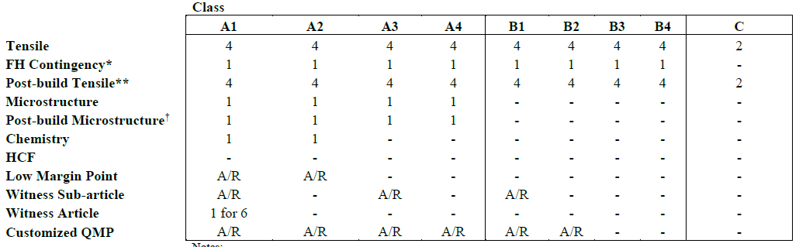
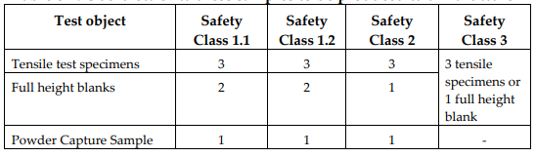
Verification Phase
Second phase of AM verification: Prototype verification and pHPF
Build configuration traceable back to specific machine process
6030 uses the part production plan to lock the QMP to the part
ECSS-Q-ST-70-80C: Prototype Verification Plan and Report (PVP, PVR)
Contains content from the Part Production Plan and Pre-Production Articles in 6030
Inspection
ECSS-Q-ST-70-80C: 100% X-Ray CT in addition to traditional NDT requirements
6030: 100% NDT using tradition methods, Representative quality indicators for CT
Testing with acceptance
Each Energy Source
Overlap Zones
Density-Metallography
Powder Capsule - Plan
Both require a full height contingency sample for density, tensile, or metallography
Preproduction article
6030 contains specific requirements on destructive testing
ECSS-Q-ST-70-80C notes this can be an option to resolve areas where 100% inspection is not possible
HPF locks the AMP, safety class, configuration, PVR, and Witness testing together with a conclusion on verification of PASS or FAIL.
Manufacturing readiness review of all content required for final approval prior to production
ECSS
NASA

Slide 13
Organization- Hardware Production
What are we doing?
Hardware Production
Addressing:
Reference to HFP
Witness specimens test results
NDT results
Reference to the shop traveler
Reference to Non-Conformance Reports or Waivers
Outcome:
Service!
Notes:
Specimen level verification for AMP

Slide 14
Production
Training
ECSS-Q-ST-70-80C: Supervisor and Operator information in section 9
6030: differ to industry or cognizant engineering organization
Maintenance
ECSS-Q-ST-70-80C: Maintenance and Repair in section 9
6030: differ to OEM
Both documents invoke SPC
ECSS-Q-ST-70-80C: methods shall be agreed by the supplier and the customer
6030 contains specific language for process control reference distributions and witness acceptance criteria
At NASA it can be difficult to add requirements after a document is put on contract!
If it is not specific and linked to a Shall statement its not required
Result: the standards must be written to address the highest risk hardware
We can tailor requirements away but very difficult to add them due to cost/schedule impacts
Integrate with the existing ecosphere of aerospace standards
Deliverables
ECSS-Q-ST-70-80C: 9 DRDs: PMCR, AMP, AMVP, AMVR, HFP, HPR, PVP, PVR, PMP
NASA-STD-6030: 2 Deliverables: AM Control Plan and Part Production plan

Slide 15
Conclusion
The ECSS and NASA documents are similar in content
Gap assessment would be needed for common application and tailoring specifics
Many differences likely driven buy existing policy framework and operational procedures
Structure drives breakdown of requirements, e.g. material properties approval, structures, materials
NASA relies on insight into supporting documents to lock process relying on AMCP and PPP to control the process
Future Work
Digging deeper into the ECSS standard and supporting documents.
This overview was high level
Will not be long before someone compliant to one set needs to work in the other
Handbook in work for NASA-STD-6030 that we hope will contain examples.
It would be an informative exercise to mirror an example using the ECSS framework
Contact:
Brian West
brian.m.west@nasa.gov

