Slide 1
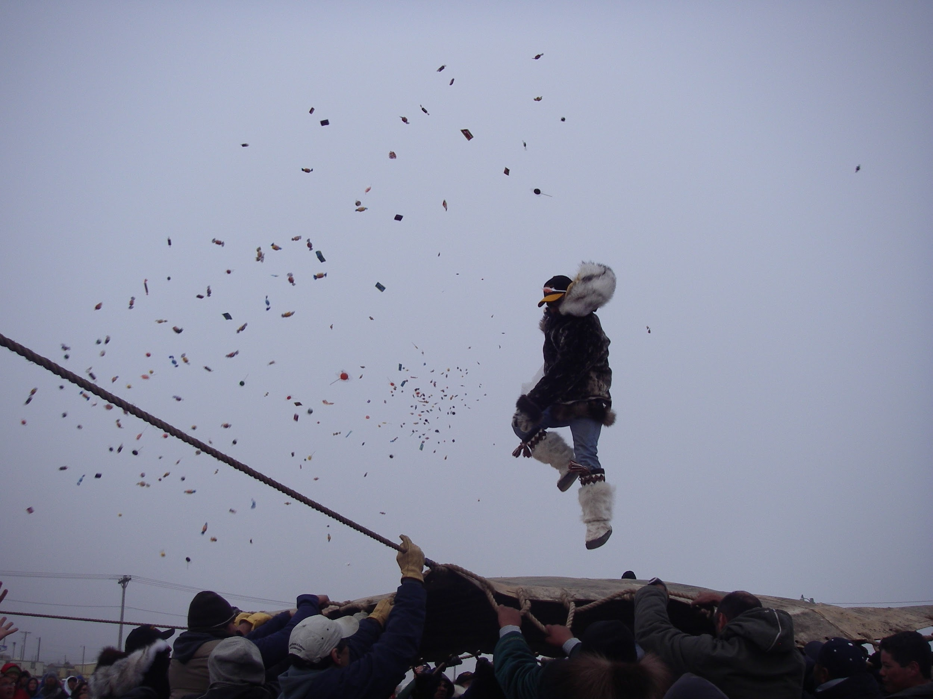





2017-2021 Arctic Research Plan – A Modeling Perspective
IARPC
Richard Cullather & Wilbert Weijer
Photo by Rob Wilder (PolarTREC 2007), Courtesy of ARCUS

Slide 2
IARPC Research Plan 2017 - 2021
IARPC is a subcommittee of the National Science and Technology Council
Coordination across 14 federal agencies
Policy drivers:
  Enhance the well-being of Arctic residents
  Advance stewardship of the Arctic environment
  Strengthen national and regional security
  Improve understanding of the Arctic as a component of planet Earth
Nine research goals, 34 research objectives, & 123 performance elements

Slide 3
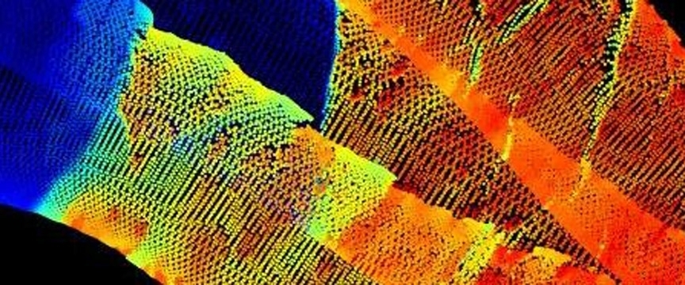
IARPC Modeling Sub-Team
Enhancing understanding of the integrated Arctic system through the use of regional and global earth system models
Objectives and Performance Elements
9.2 Advance understanding of Arctic processes, feedbacks, & interactions using global and regional models
  Arctic interactions with mid-latitudes; with global ocean circulation
  Snow; clouds and aerosols; sea ice; ocean stratification; stratosphere/troposphere interaction; radiative energy budget
9.3 Enhance prediction capabilities
  Development of variable resolution global models; of regional models
  CMIP6; ISMIP6; NOAA-EMC Arctic Testbed; reanalyses
https://www.iarpccollaborations.org/members/milestones/teams/14

Slide 4
MST in the 2017 – 2021 Arctic Plan
Identify & report key developments in Arctic modeling.
Highlight current work in team meetings.
Connect with Performance Elements in the Research Plan.
Recent Activities in Arctic Modeling
MOSAiC / YOPP
CMIP6 - PAMIP, SIMIP, ISMIP
Seasonal prediction
Data assimilation and reanalysis
High-resolution modeling
Validation toolkits
Marine biogeochemistry
Coastal environment modeling

Slide 5
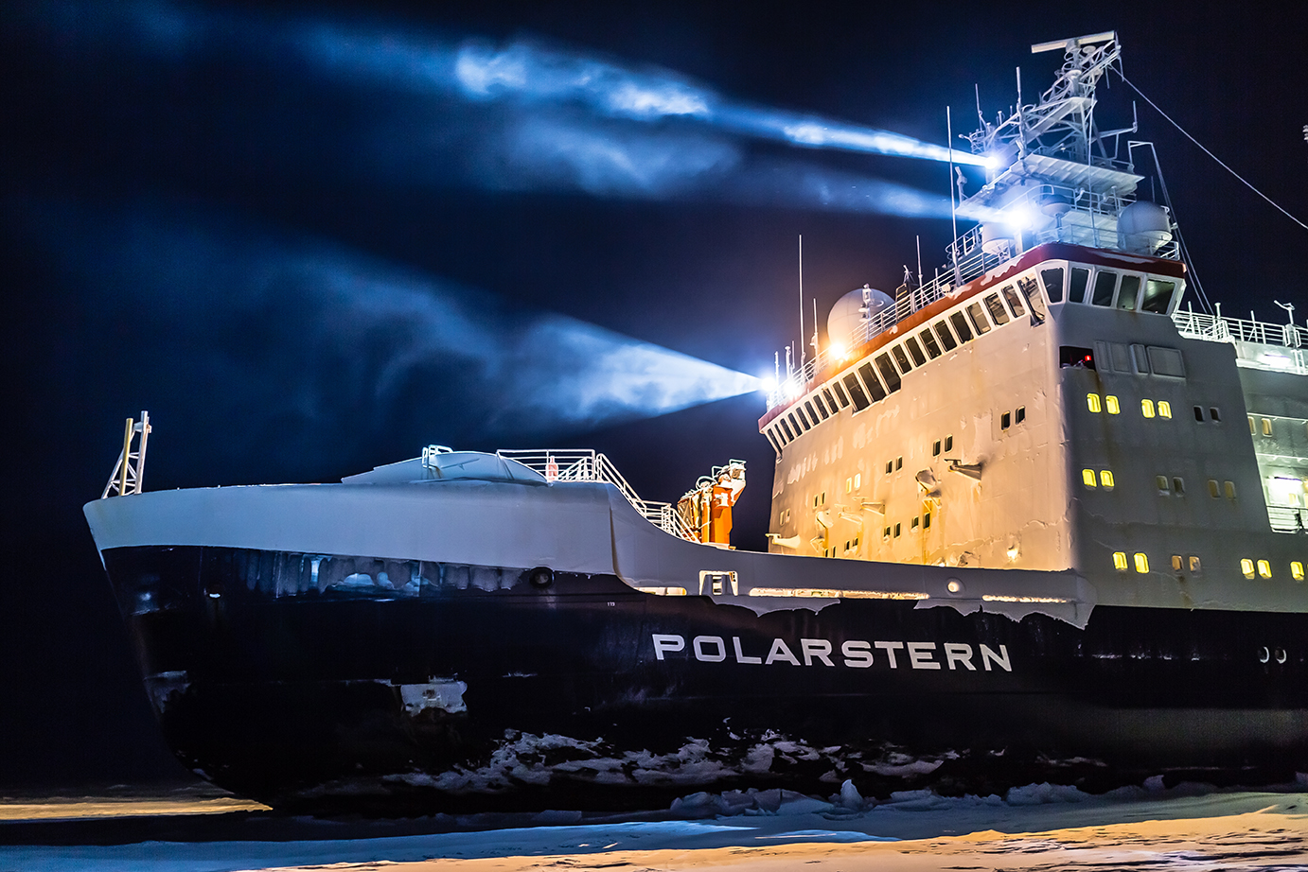
YOPP (NOAA, DOD) / MOSAiC (NSF, NOAA, DOE, NASA, DOD)
MST meetings - Mar 2018, Oct 2020, Apr 2021: David Bromwich, Rick Allard, Eugene Petrescu, Matthew Shupe, Chris Cox, Don Perovich, Amy Solomon, Marika Holland.
Data availability for model evaluation
YOPP-MOSAiC coordinated model intercomparison projects
  Stable boundary layer
  Mixed-phase clouds
  Atmosphere-snow interaction
  Ocean-sea ice-atmosphere coupling
PROMIS - PaRamertizations for Optics, Mass, Ice and Snow
  Albedo Modeling
  Snow processes and heterogeneity
  Ocean heating and lateral melting

Slide 6
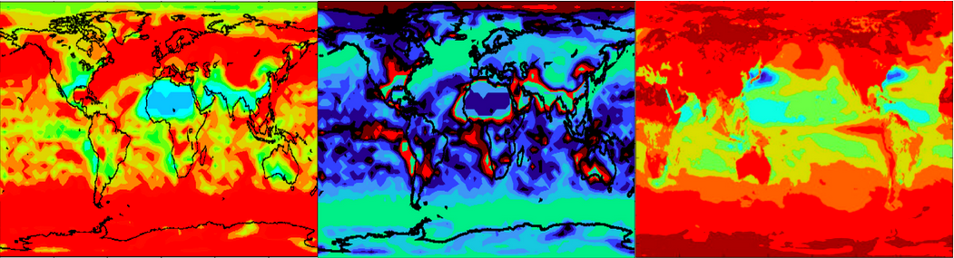
CMIP6 (NSF, NOAA, NASA, DOE)
CMIP-approved MIPs
ISMIP6 - Mar 2017, Mar 2019, Nov 2020: Sophie Nowicki, Jeremy Fyke, Andy Aschwanden, Alice Barthel, Jason Briner, Heiko Goelzer
PAMIP - Apr 2019: Doug Smith, Yannick Peings, Stephanie Hay
SIMIP - Feb 2019, Jan 2021: Alexandra Jahn, David Bailey, Michael Winton, Abigail Smith, Ed Blockley
Intriguing initial conclusions
SIMIP - Historical sea ice area spread and mean not much different than CMIP5, higher CO2 sensitivity, ice-free September likely before 2050
PAMIP - Limited mid-latitude response detected, no dependence on resolution

Slide 7
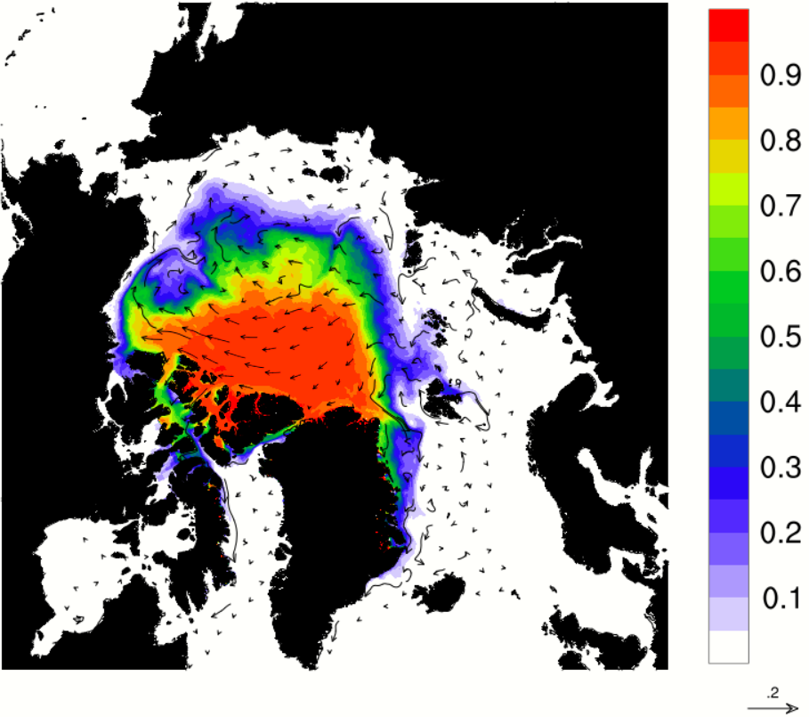
Seasonal Prediction (NSF, NASA, NOAA, DOD, DOE, etc.)
MST Meetings - Oct 2017, Aug 2020: Ed Blanchard-Wrigglesworth, Jinlun Zhang, Rick Allard
Increased need for S2S sea ice predictions
Improvements to seasonal prediction systems
  Improved ice physics - sea ice consortium
  Increased spatial resolution, larger ensemble numbers
  Use of satellite-observed ice thickness in initial conditions

Slide 8

Data Assimilation and Reanalysis
(NSF, NOAA, NASA, DOE)
MST Meetings - Aug 2020, Aug 2021, Sep 2021: Chelsea Parker, Brant Dodson, David Bromwich, Nikki Privé, Thorsten Markus, Colleen Iversen, Mathieu Morlighem
New / ongoing projects in reanalysis: Arctic System Reanalysis, PolarMERRA
Challenges of assimilation/assimilation experiments in the Arctic
  Need for observing studies: MOSAiC, ARISE
  Spatial resolution
  Adequate model treatment of polar processes: clouds, boundary layer, etc.
Application of models in observing system design

Slide 9
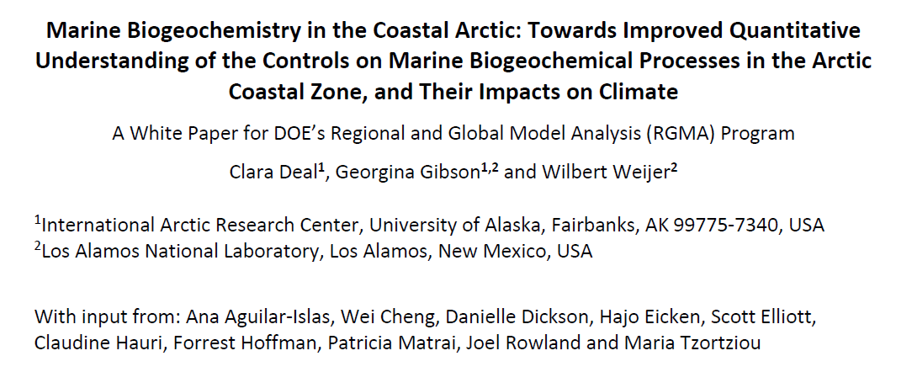
Marine Biogeochemistry Modeling
(DOE, NSF, NOAA, NASA)
Joint MST-MECT Meetings – Oct/Nov 2018, Oct/Nov 2019: Clara Deal, Nicole Jeffery, Georgina Gibson, Hendrik Tolman, Keith Moore, Jackie Grebmeier, Seth Danielson, Oluwaseun Ogunro
Deliverable: White Paper
  Key recommendations on observations, data accessibility, model/data integration, modeling and model initialization
  Need for stronger integration between observational and modeling communities
https://www.osti.gov/biblio/1559949/

Slide 10
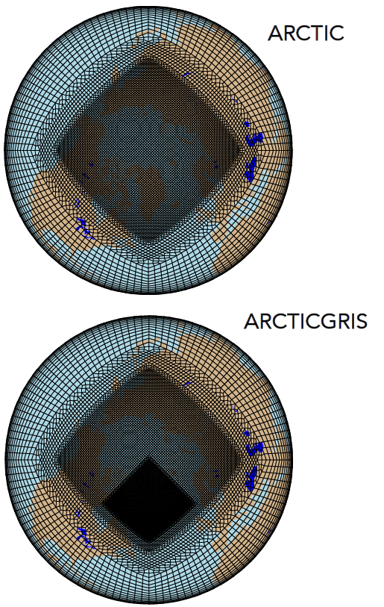
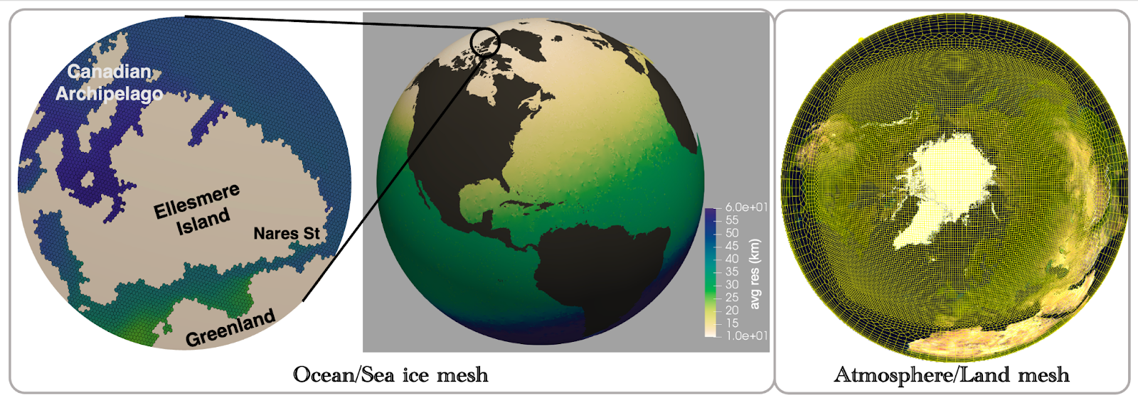
Arctic Variable Resolution Modeling
(DOE, NOAA, NASA, NSF, …)
MST Meetings - Jul 2020, : Milena Veneziani, Colin Zarzycki
Exciting new developments in regional grid refinement capabilities
  E3SM
  CESM2
E3SM-Arctic: Ocean/sea ice (left), atmosphere (right)
CESM2

Slide 11
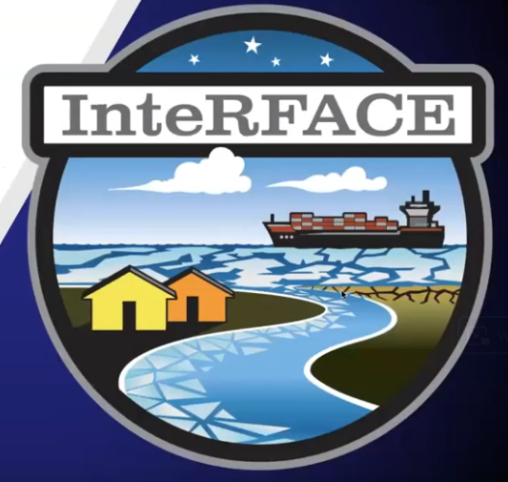
Modeling of Arctic Processes and Human Interactions
(DOE, USGS, NOAA …)
MST Meetings –
  Feb 2020, Jul 2021: Joel Rowland, Andrew Roberts, Ethan Coon, Siwa Msangi, Bob Vallario, Stephanie Waldhoff (InteRFACE)
  Jul 2021: Brian Wee, Jeremy Littell (Integrated Ecosystem Modeling)
  Feb 2022: Amy MacFadyen, Tor Nordam (Oil spill modeling)
New DOE project InteRFACE
  Linking Earth System Model development and analysis (E3SM) to multi-sector dynamics (GCAM)
    Shipping
    fossil resource production
    housing and mobility
    marine subsistence & livelihood
    health

Slide 12
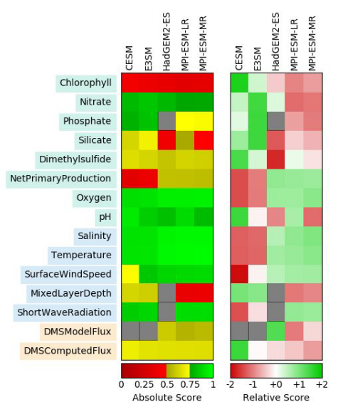
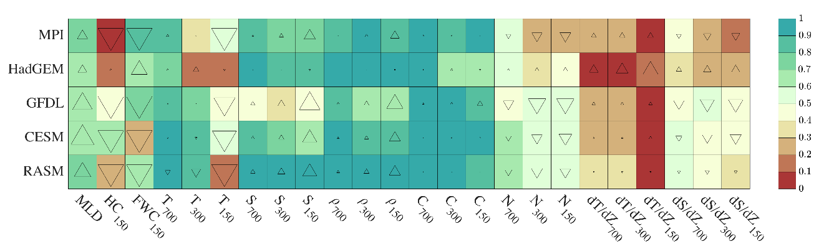
Validation Toolkits
(DOE, NSF, NASA, …)
MST Meetings –
  Aug 2018, Oct 2018: Forrest Hoffman, Nathan Collier, Oluwaseun Ogunro (ILAMB, IOMB)
  Sep 2018: Katherine Evans, Joe Kennedy, Alex Gardner (LIVVKit, CmCt)
Powerful benchmarking software: Land surface, ocean, ice sheets
  Software verification: Did we build what we intended?
  Numerical verification: Are we solving the equations correctly?
  Performance validation: Did we build what the users need?
  Uncertainty quantification: How confident can we be in our predictions?
ILAMB
IOMB

Slide 13
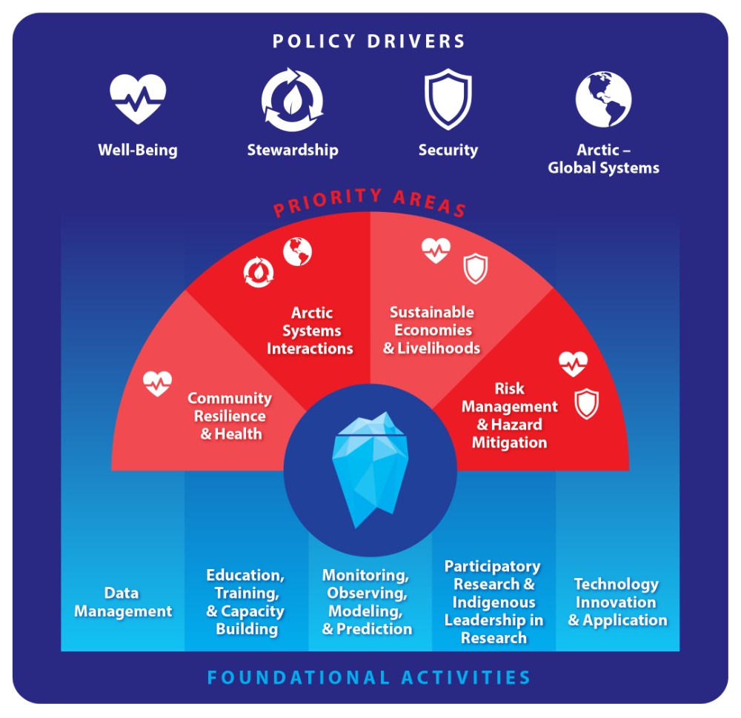
Summary
2022 – 2026 Arctic Research Plan
Agency-funded research has made considerable – though uneven – progress on basic modeling issues for the Arctic
More aspects of the Earth system in global models
Process modeling development
  Ice sheets
  Sea ice
  Biogeochemistry
Development of sub-seasonal to seasonal forecasting systems, and reanalysis

