Slide 1


Open Source Science for ESO Mission Processing Study
Workshop #2
March 1-4, 2022
OpenNEX Perspective
Ian Brosnan & Jennifer Dungan

Slide 2

Project Goals and Objectives
Meaningful Science
High Performance & Cloud Computing
“Big” Remote Sensing Data
Modeling & Analysis
The NASA Earth Exchange was conceived to enable scientific collaboration with big data next to compute, to reduce the community’s need to both move large datasets and to facilitate sharing of redundant code and workflows.
NEX Team:
Ian Brosnan
Jennifer Dungan
Weile Wang
Andy Michaelis
Hiro Hashimoto
Taejin Park
TJ Vandal
Kate Duffy
Alberto Guzman
Wen ”Irene” Yip
Notes:
NEX has evolved from a series of awarded grants to an NASA capability with a mix of core and competed funding.
Please help us understand the intent of your project’s processing system:
What are the key and driving requirements?
Who are the customers and stakeholders?
What external factors constrain your solution?

Slide 3
Project Goals and Objectives
Sandbox Server
(Prototyping & Development)
NEX overcame the challenge of finding, ordering, waiting, downloading, pre-processing and performing large-scale computing with big data.
New challenges…security constraints and on-boarding logistics, including mailing physical RSA fobs, training, identification/authentication.
OpenNEX was conceived to overcome these barriers and to explore early cloud offerings.
OpenNEX is a banner for several ‘low TRL’ activities with sponsors in AIST, ACCESS, R&A, and Applied Science
“requirements”: access must be available to all in the global Earth science community and drive re-use of community-contributed data and workflows
NAS HECC
Large-scale processing
Datastore
NASA and Community-contributed
Front-facing Website
(Registration, KM, Searchable)
NAS HECC + Cloud
Prototyping & Large-scale processing
Datastore & Cloud
NASA & Community-contributed
Notes:
Please help us understand the intent of your project’s processing system:
What are the key and driving requirements?
Who are the customers and stakeholders?
What external factors constrain your solution?

Slide 4
OpenNEX Activities
Data, Workshops & Space Apps Challenge (2012)
Data hosted on S3 (SAA)
Accessible virtual machines, scientific workflows, and user guides
Expert speakers
On-demand computing
‘Naïve users’ developed new applications in 48 hours, demonstrating speed and efficiency are improved by bringing data, compute, workflows, and knowledge together
      Drunk Puppy Tea Theatre
Transparent Code Migration between HPC & Cloud (2015)
Enhance NASA data and information access through transparently packaging, moving, and deploying science algorithms, tools, and services (Containers)
NEX ←→OpenNEX (AWS)
Document and provide training to the NEX User Working Group through OpenNEX
Workflow Recommendations and Reuse / AppStore (2018)
Develop a recommendation tool within NEX to facilitate component and workflow reuse and enable virtual collaboration
Leverage social network analysis to extract hidden knowledge of operational scenarios from user behavior
Provide a workflow development environment that recommends components as workflows are being developed
Notes:
NASA Earth Exchange (NEX), and her public cloud version OpenNEX, have become platforms supporting scientific collaboration, knowledge sharing and research for the entire Earth science community. To date, a number of custom tools and capabilities have been integrated into the platforms. However, such integration has to undergo a case-by-case manual process thus lacks scalability. This timely project builds an App Store onto OpenNEX as a building block. Climate data analytics tools/programs can be easily uploaded, shared, organized, searched, and recommended like photos and videos on the YouTube. The foundation of our App Store is a provenance server, which not only records metadata but also execution history of climate data analytics apps including the input data and parameters, output data and products, who runs the app for which purpose, and how apps may be chained into workflows. Researchers can thus understand, reproduce, and repurpose existing apps and workflows. Machine learning approaches are applied to mine provenance to provide recommend-as-you-go services for Earth scientists, such as to recommend suitable apps and workflow snippets. A browser-based workflow tool is also provided for researchers to explore the provenance server and design value-added workflows. Scalability, sustainability, extensibility, usability, adaptability, security and privacy are considered in the App Store.

Slide 5
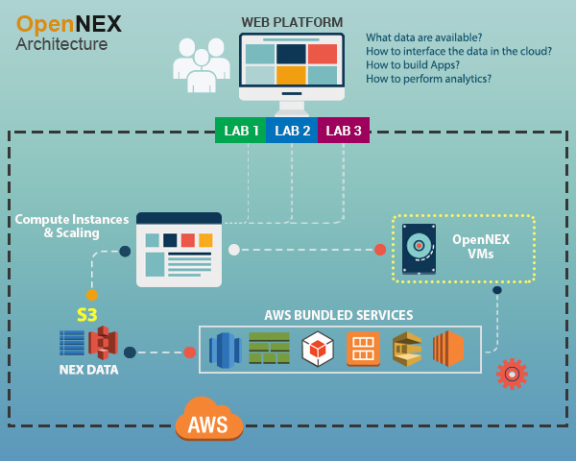
System Architecture: AWS Data, Workshops & Space Apps
Notes:
Please provide an Overview Diagram of the Data Processing System which shows the following:
Main functions of the system
External Interfaces of the system (Identify internal & external to the organization)
Users of the system
Data flow across External Interfaces

Slide 6
System Architecture: Enabling Transparent Code-to-Data Migration between HPC, Cloud, and Beyond
Notes:
Please provide an Overview Diagram of the Data Processing System which shows the following:
Main functions of the system
External Interfaces of the system (Identify internal & external to the organization)
Users of the system
Data flow across External Interfaces

Slide 7
System Architecture: Workflow Recommendations & Reuse
To make workflow development faster and help Earth scientists leverage best practices.
Develop a recommendation tool to facilitate component and workflow reuse and enable virtual collaboration.
Leverage social network analysis to extract hidden knowledge of operational scenarios from NEX user behaviors
Provide a workflow development environment that recommends components as workflows are being developed
Web Plugin (VisTrails)
Social Network Analysis Engine for People-Data-Module-Workflow Networks
Notes:
Please provide an Overview Diagram of the Data Processing System which shows the following:
Main functions of the system
External Interfaces of the system (Identify internal & external to the organization)
Users of the system
Data flow across External Interfaces

Slide 8
Open Science and Community Collaboration
For NEX, open science evolved first from bringing big data and computing together with expertise as a science enabler to making them increasing accessible to the science community, and developing efficient tools that will allow future users to understand, reproduce, and repurpose existing applications and workflows.
Many of our OpenNEX projects have concluded and been incorporated in our day-to-day work.
Grants for innovation in open science and community collaboration yield results.
Still have to overcome resistance to change, and cultural differences between science, information technology and cybersecurity.
Dis-incentives to share code and software for re-use (not disincentives to collaborate, but to cede competitive advantages).
The valley-of-death remains a challenge…which projects continue, how do they continue, and where? Rapid evolution, funding, focus, and interest…
Notes:
We would like to understand your project’s approach to building an open science community. Here are some questions to help frame your response:
What does open science mean to your project?
What barriers have your project faced?
How has your project enabled community collaboration?

