Slide 1

All optical methods to evaluate defects and performance of sensor materials
Brett Setera, Ian Emge, Ching Hua Su*, Bradley Arnold, Fow-Sen Choa, Brian Cullum and N. B. Singh
University of Maryland Baltimore County, 1000 Hilltop Circle, Baltimore MD 21235
*NASA Marshall Space Flight Center, Huntsville, AL 35824
Email: singna@umbc.edu
Thanks to NASA Marshall Space Flight Center and
Northrop Grumman for support

Slide 2
All optical methods to evaluate defects and performance of sensor materials
Outlines
Objectives
Background
Bulk, thin film and nano sensor materials
Characterization methods and problems
All optical methods
  Birefringence interferometry
  Reflectance studies
Experimental results
Summary
Thanks to NASA Marshall Space Flight Center and
Northrop Grumman for support

Slide 3
All optical methods to evaluate defects and performance of sensor materials
Objectives
To develop fast and low cost all optical methods to estimate defects in sensor materials
Background and approach
Sensor materials defects due to doping and inhomogeneity is a very important detectors and sensor performance
The dispersion which depends on defects and stoichiometry for the photons of varying energies and their interactions has a strong correlation of n and k
We are developing a low-cost two optical methods entitled as
  birefringence interferometry (BI)
  and measurement of refractive index (n) for defect estimation.
These methods do not require capital investment and are fast since these do not require extensive sample preparation
These methods are fast and inexpensive

Slide 4
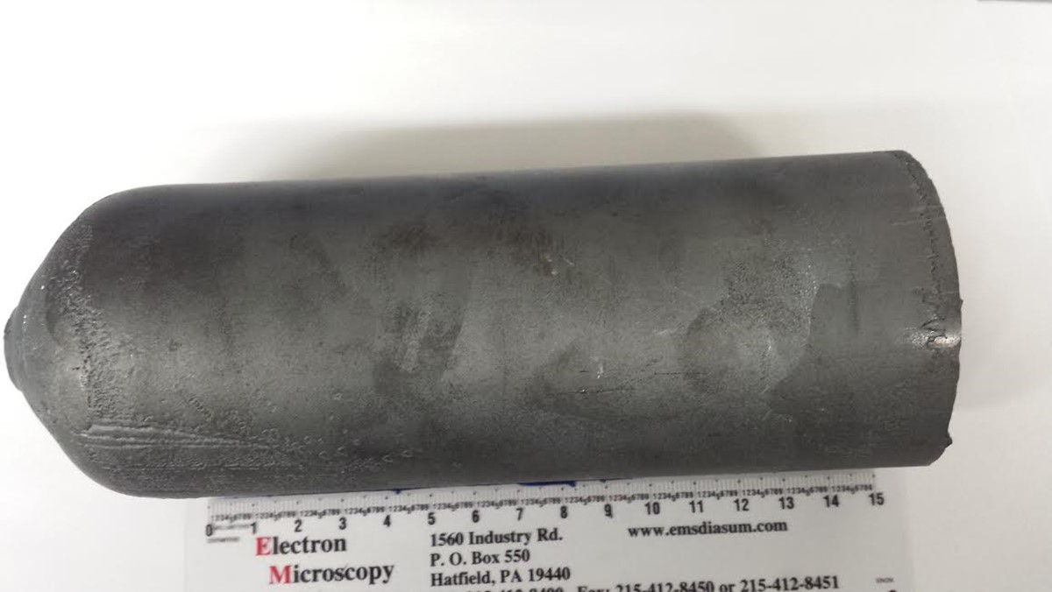
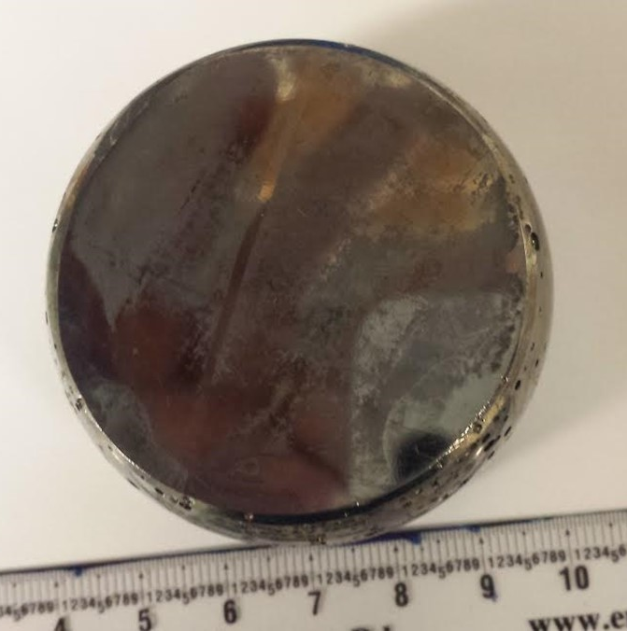
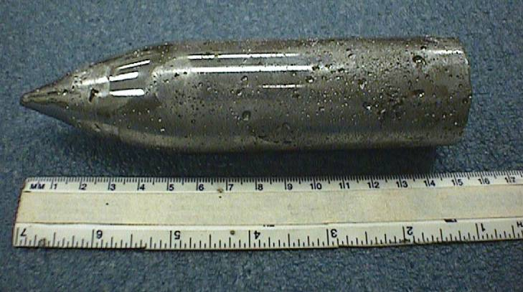
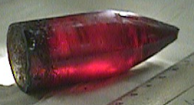
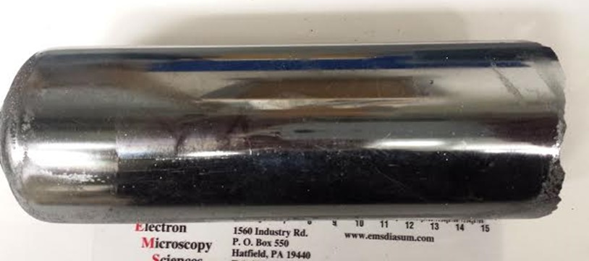
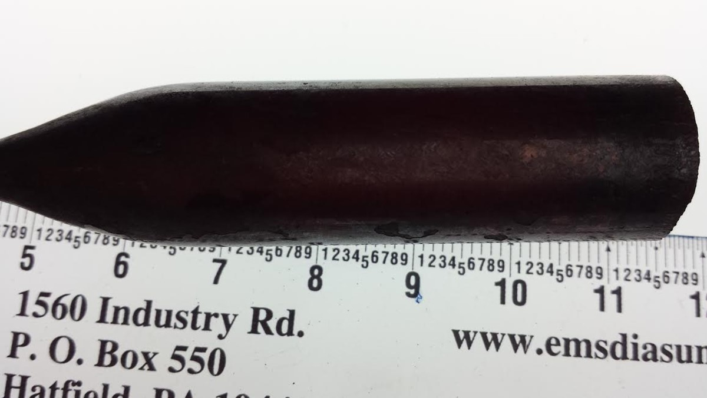
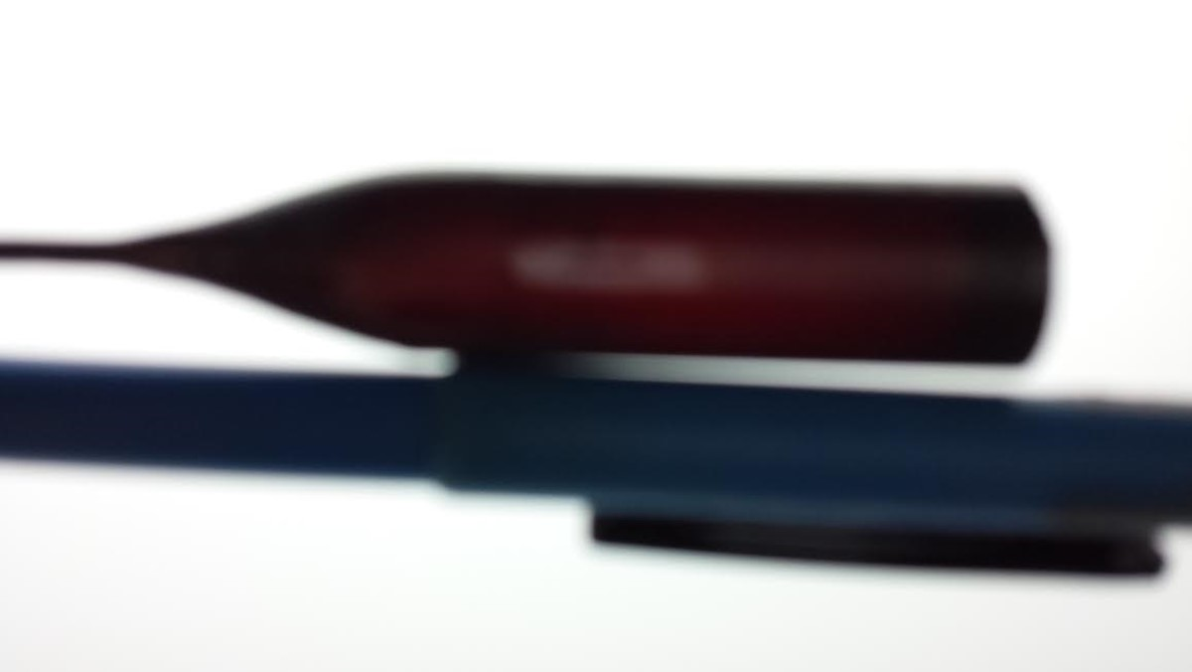
We have large diameter telluride and selenides:
CZT, Tl₃AsSe_{3,} TlGaSe₂ and AgGaGe₃Se₈ crystals available
7 cm and 5 cm diameter CZT crystals. Grown in Large Bridgman Bore Furnace(LBBF)

Slide 5
Typical established characterization methods
Morphological characterization
  Scanning electron microscopy
  Transmission electron microscopy
  Polarizing microscope
  Etchpit methods
  Surface morphology; Auger studies
Quality, crystallinity and compositional evaluation
  Xray diffraction studies
  X-ray topography
  X-ray fluorescence studies
Electrical characterization
  Electrical resistivity
  Mobility
  Bandgap and breakdown voltage
  Voltage-current characteristics
  Dielectrics and polarity
Most of the morphological and quality characterization involves costly fabrication

Slide 6
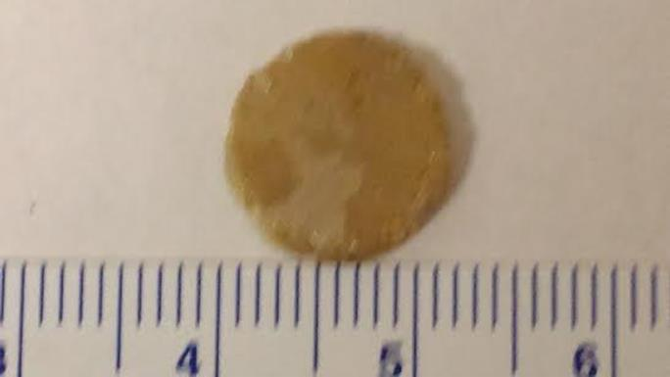
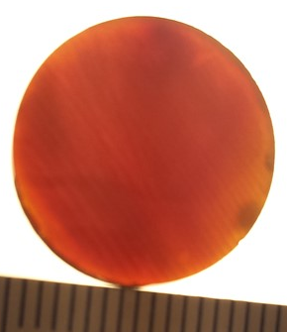
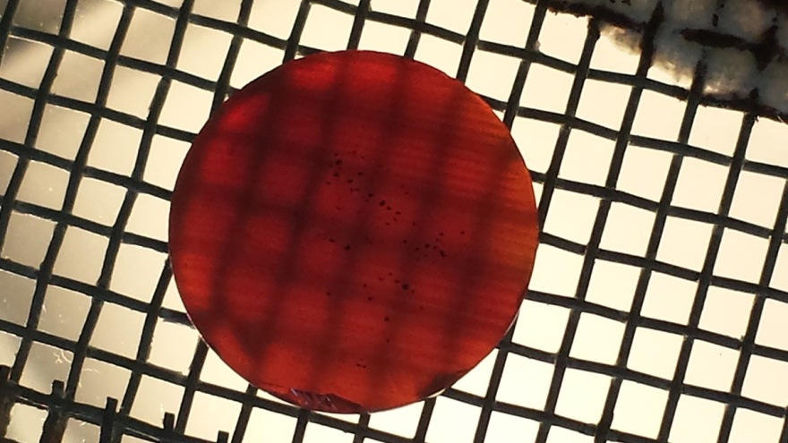
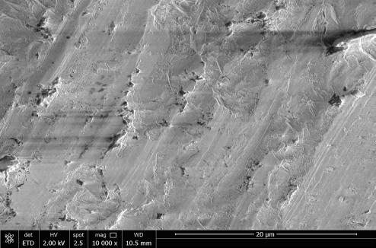
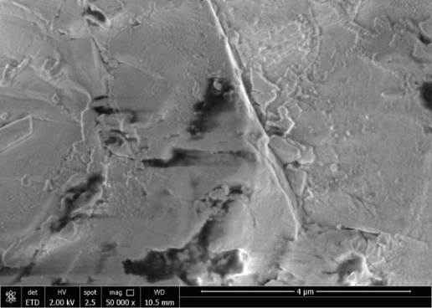
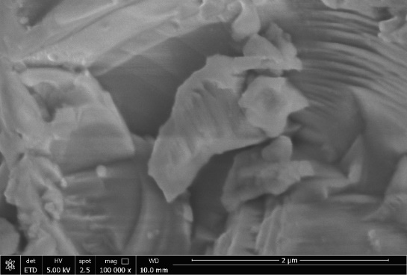
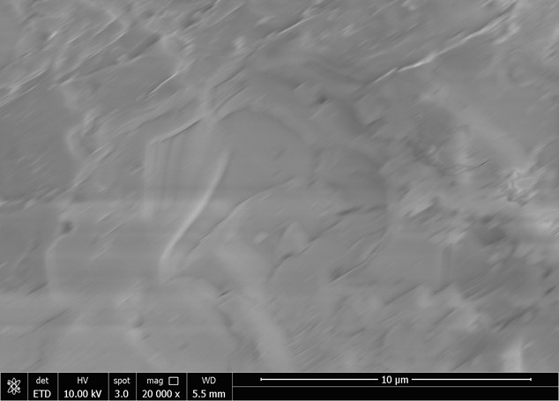
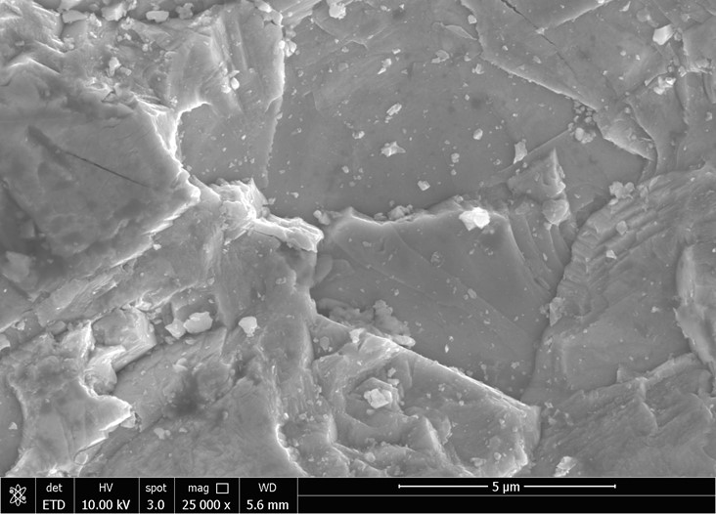
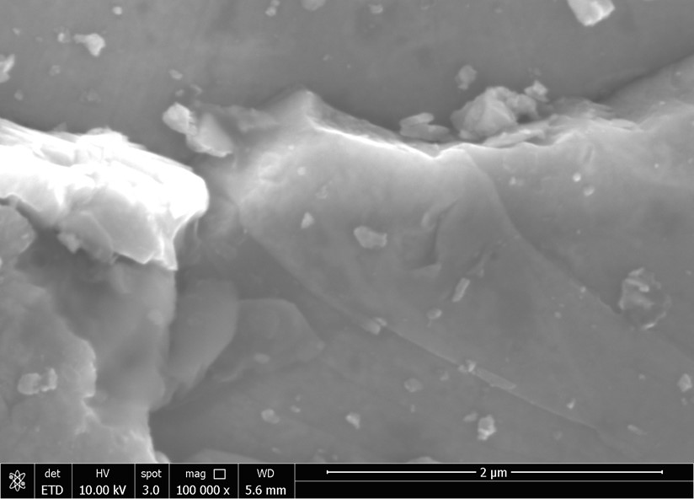
Examples of morphological characterization of materials: doping can cause significant defects
Bulk transparency
Bulk inclusions, voids and misorientations
Faceted and nonfaceted crystals in the bulk
Ching Hua Su et al. Optical Materials 60, 474-480 (2016)

Slide 7
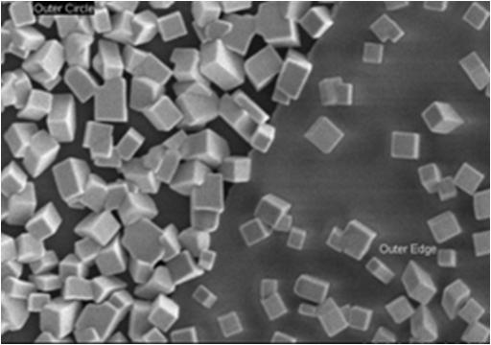
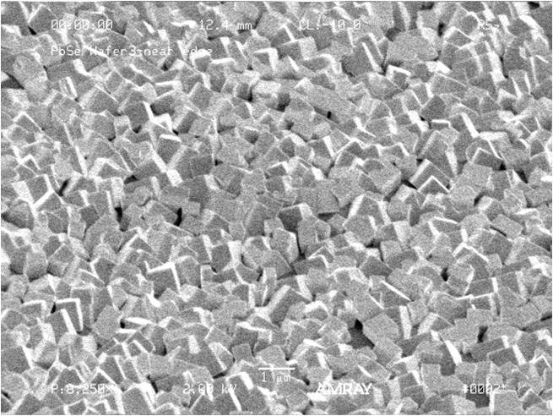
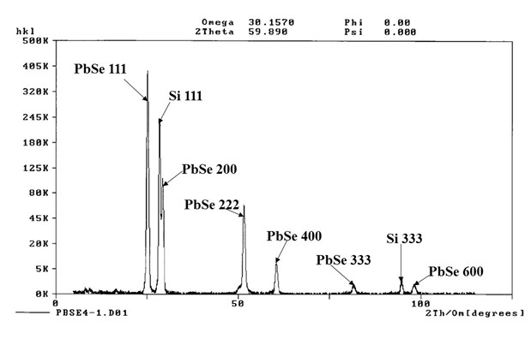
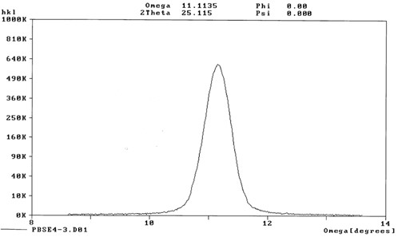
Examples of materials crystallinity and quality evaluation: (111) orientation was observed FWHM = 0.374 degree showed high quality grains
XRD Shows both {001} and {111} PbSe Grains
FWHM= 037 degree
Su et al., Optical Engineering 56, (2017) 077106

Slide 8
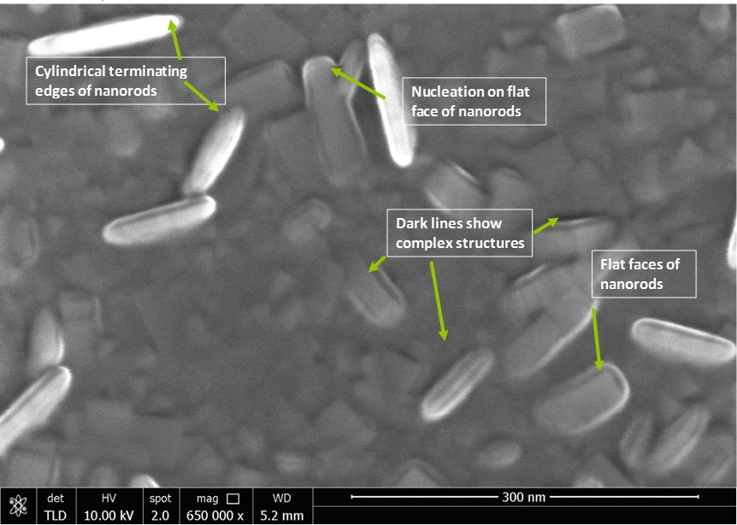
Morphological evolution with processing
Nanorods with flat faces and round edges on the top of
thin film of cuboids and rectangular PbSe crystals

Slide 9
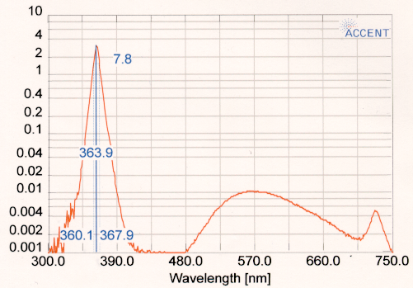
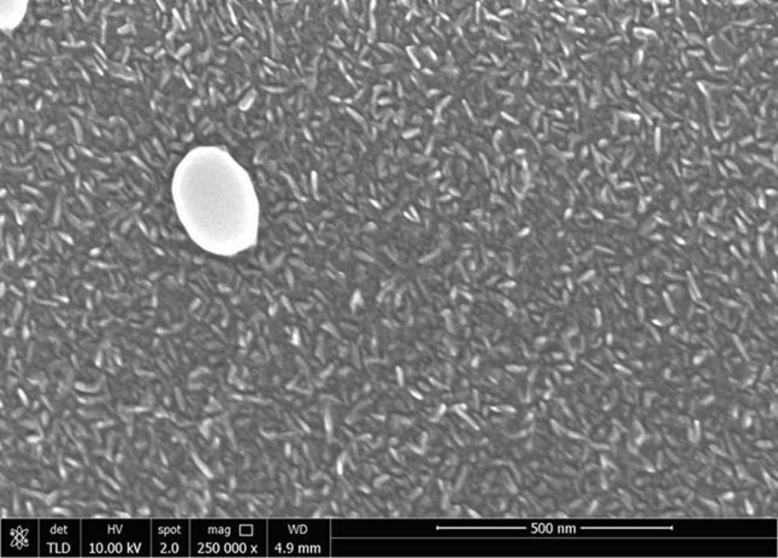
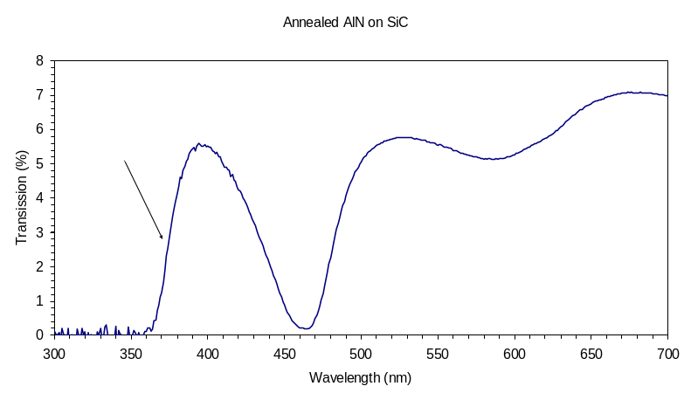
Examples of electrical characterization
(111)Su et al., Crystal 10 (2020) 551, and Singh, Coriell, Su, et al
“Growth mechanism of nanowires”Proceeding of SPIE, Vol. 986304-1

Slide 10
All optical methods to evaluate defects and performance of sensor materials
Background:
Since defects (point, line and compositional) in the bulk and single crystalline films affect the refractive index and also surfaces (reflectance), one can develop techniques based on these parameters.
Since doping with dopants of different sizes and valency cause defects, these properties can chane
Even in materials no difference in ordinary (n₀) and extraordinary (n_{e}) refractive index, defects can generate difference and hence birefringence interferometers can be useful.
These two methods will save huge time involved in sample preparation and hence cost.
We will show some data on:
  Reflectance studies
  Birefringence studies
Our studies are for complex multinary semiconductors

Slide 11
Background
Surface Reflectance measurements using 3D Printed Designs
  Commonly used devices for reflectance measurement can be expensive and have limited adaptability to samples of different shapes and composition
  Reflectance Probe fiber optics often range in price from 750$-1800, Integrating Spheres are >1,300$
  Some current effective measurement tools are “inserts” into other spectroscopy machines, which inhibit shared usage in a multiuse lab and require time to set up
  Low cost and easily printed in house 3D-materials may be able to mitigate these problems
Quick collection of surface reflectance data
Adaptability of measurement devices to samples of varying size and shape
Made with inexpensive materials for multifunctional multicomponent complex semiconductor crystals
Exploring the applications of 3D-printing in reflectance spectroscopy

Slide 12
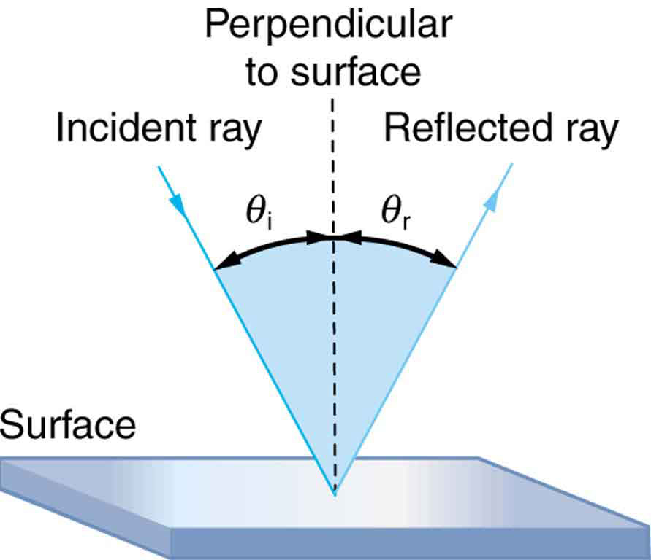
Surface Reflectance measurements using 3D Printed Designs
Purpose
Background
Design
Testing
Summary
Design used in reflectance studies

Slide 13
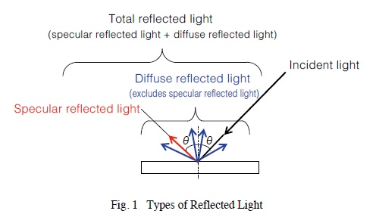
Reflectance measurements
Reflectance is measured by shining light on a sample and measuring the light reflected from the sample.
Reflected light consists of specular reflected light and diffuse reflected light, which when combined together is referred to as total reflected light (specular reflected light plus diffuse reflected light).
Fig. shows a diagram of these types of light. The light shown onto the sample is called the incident light and the angle formed between the incident light and sample is called the angle of incidence.
Schematics of measurements

Slide 14
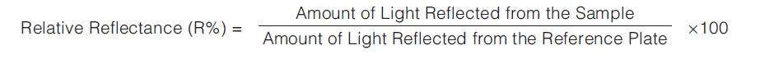
Some important points for reflectance measurements
Specular reflected light is the light reflected from shiny mirror-like surfaces at the same angle as the incident angle.
Diffuse reflected light is the light reflected in all directions from rough surfaces, such as paper and powder surfaces.
Total reflected light is the total combination of specular and diffuse reflected light. Total reflected light is often measured when measuring samples that have both rough and shiny characteristics, such as plastic and painted samples.
Reflectance measurements measure either the relative or absolute reflected light
Relative reflectance measurements calculate the proportional amount of reflected light measured from a sample surface, relative to the amount of reflected light measured from a reference plate, such as barium sulfate or a mirror.
The relative reflectance is calculated based on assuming the reference plate has a reflectance of 100 %. Therefore, it is very important to manage reference plates properly because different reflectance values can be obtained if reference plates are substituted or if they become contaminated or change characteristics.
Relative reflectance is measured relative to a reference plate

Slide 15
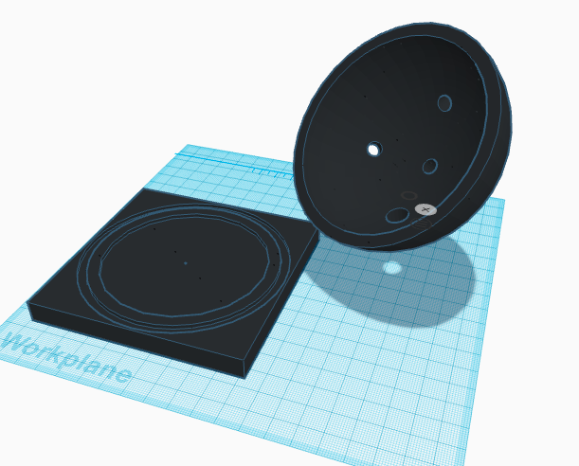
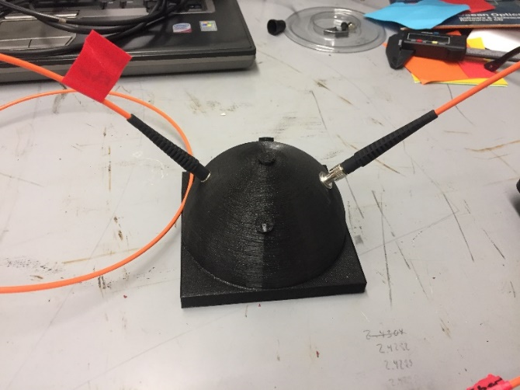
Designs for Measurement : Dome concept
The Dome design allows for measurement with 45° incident angle with a dome shaped cover that
blocks ambient light. It locks into a base plate
The design is tailored for measuring
thin film samples on substrates that are approximately 2-5mm in height and <75mm in width
Black PLA used in first designs to reduce possible interference from ambient light and eliminate possible reflectance within the apparatus that is not reflecting off of the sample
For final design, white PLA is used because the measurements are relative reflectance, and any ambient light will be subtracted out along with the reference profile
The use of white PLA did not impact peak positions compared with the black PLA V design. The white PLA design did improve S:N ratio for other reasons (explained in next slide)
The Dome design is tailored to measure thin film reflectance

Slide 16
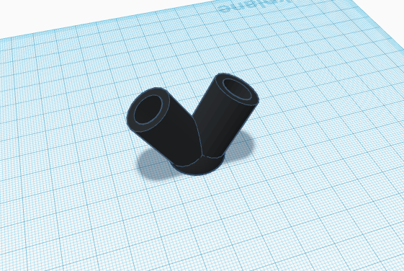
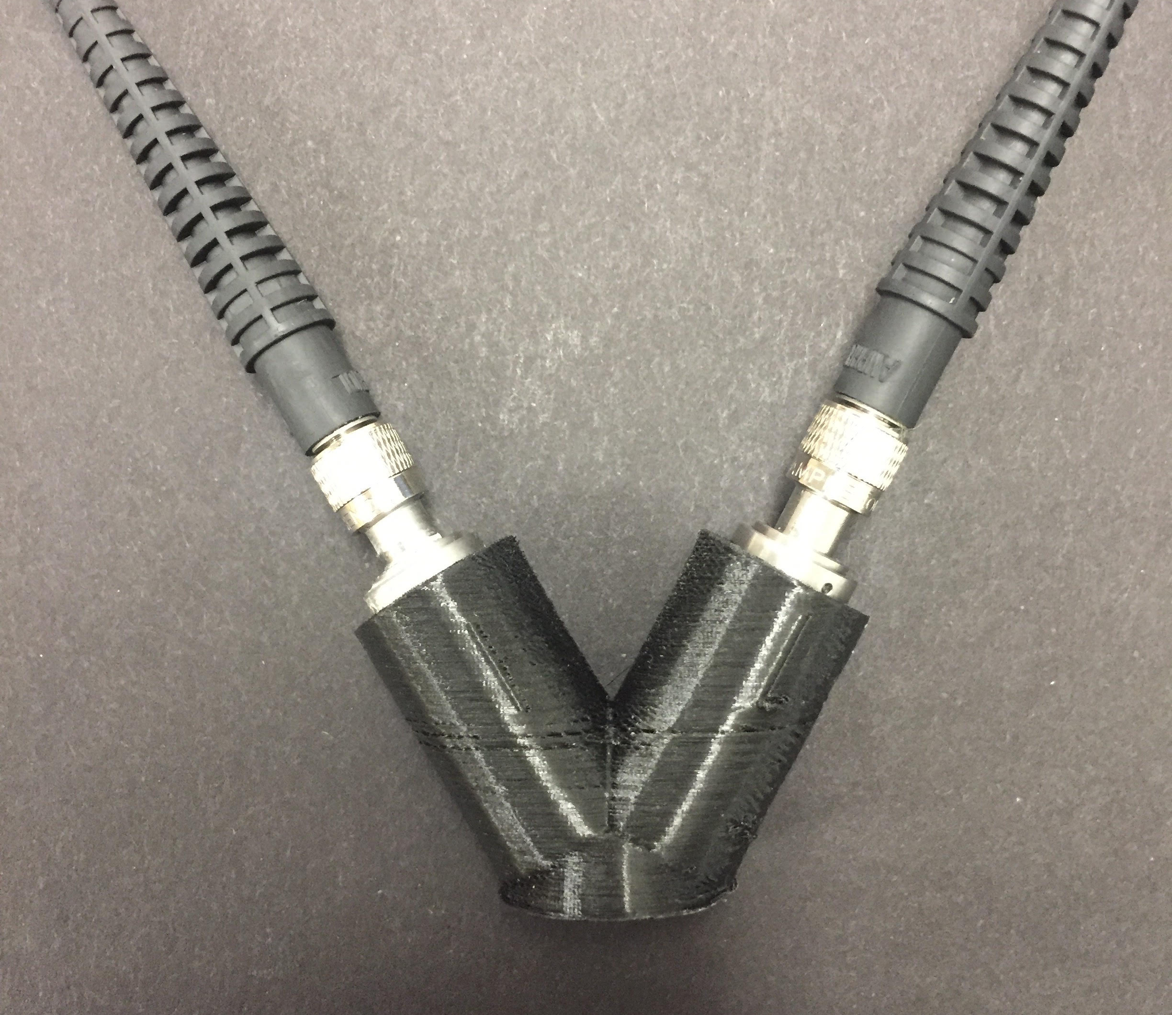
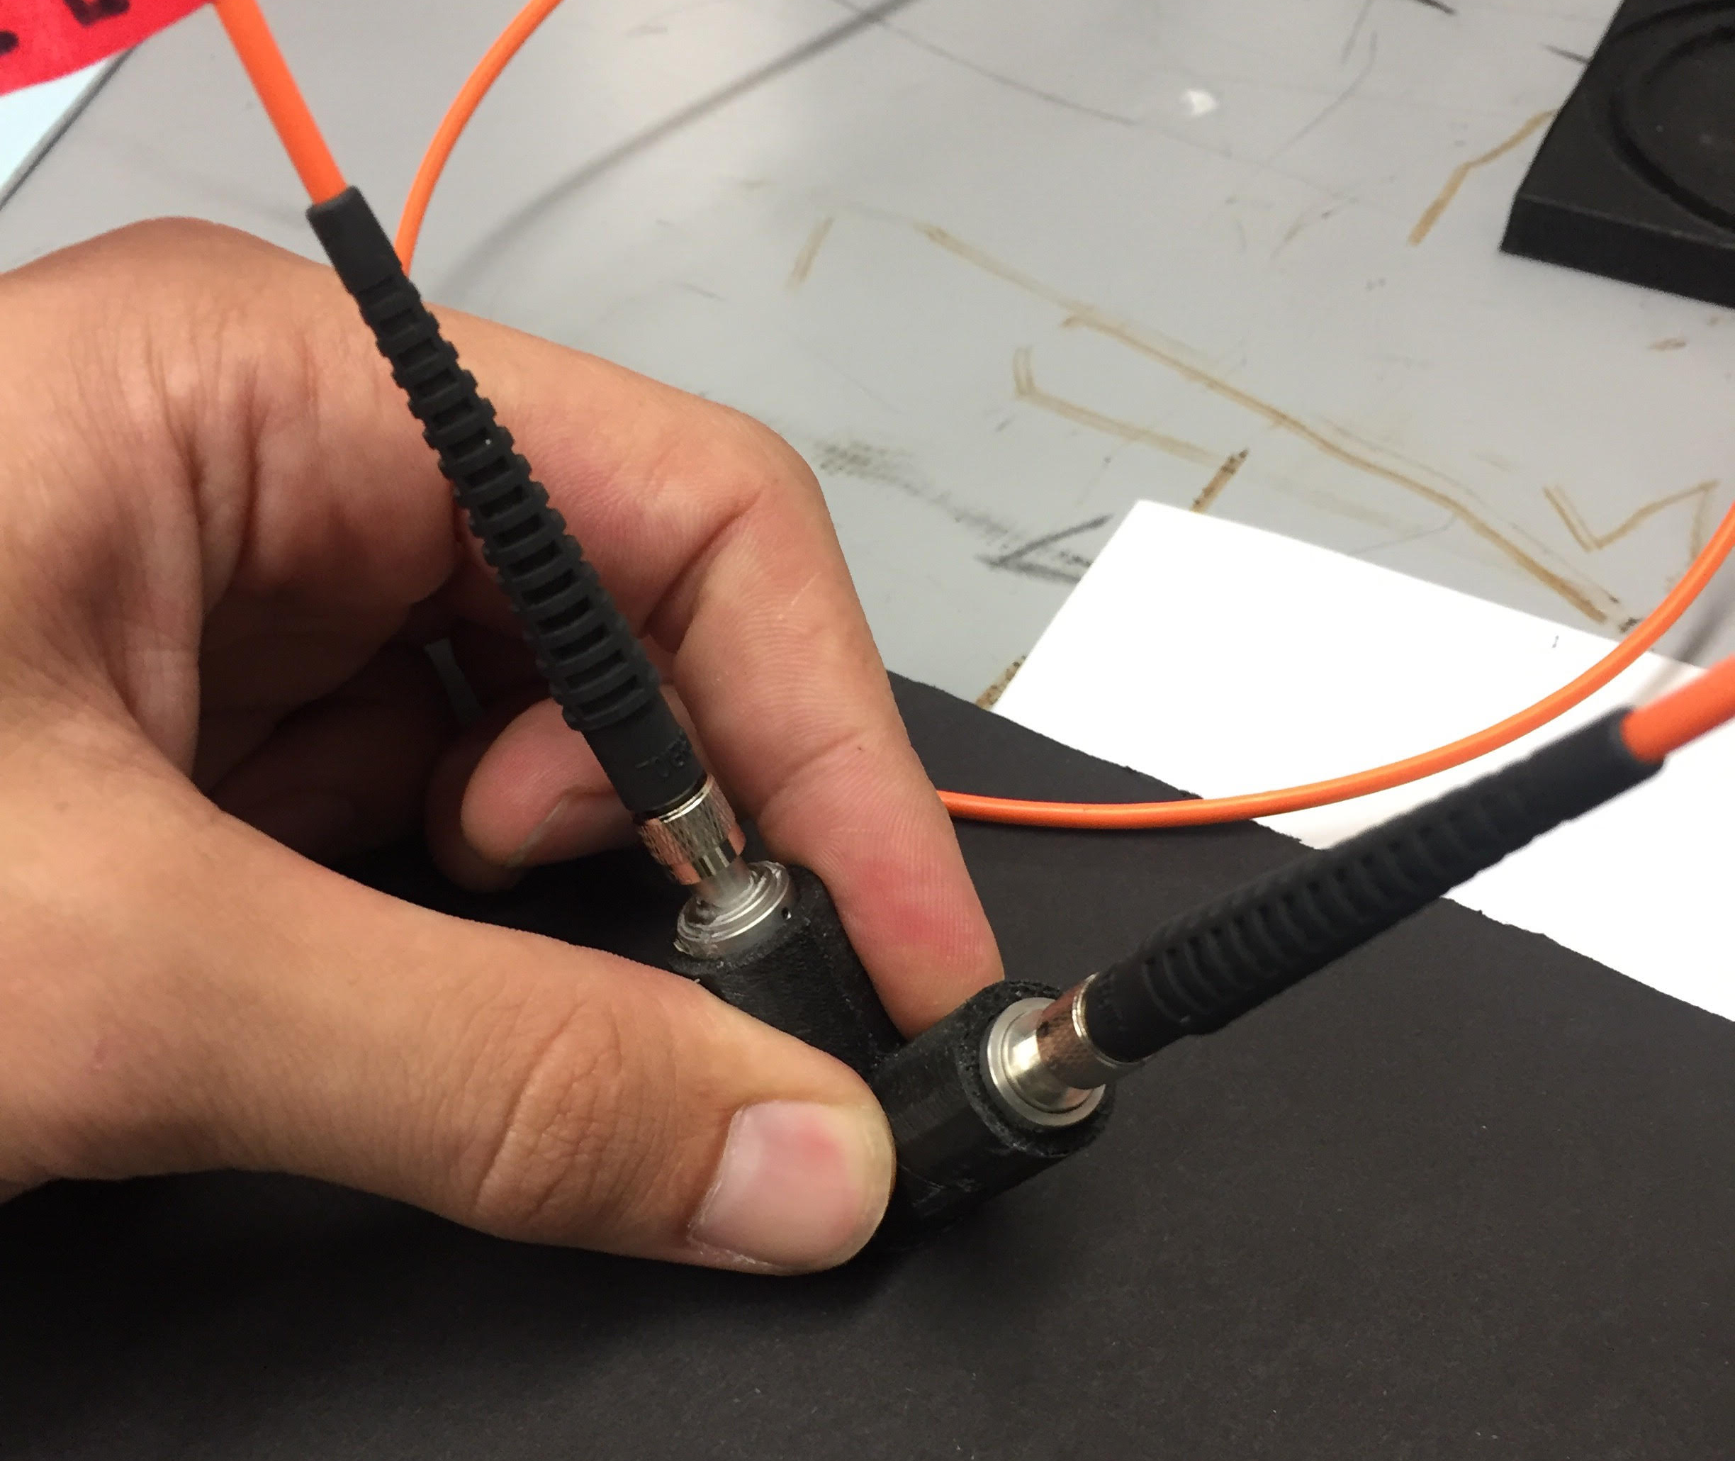
Designs for Measurement: V design
The V design allows for measurements with a 30° incident angle and is adaptable to samples of various sizes
and shapes
The design has two ports for fiber optics connections
The V Design allows more flexibility in sample size and shape

Slide 17
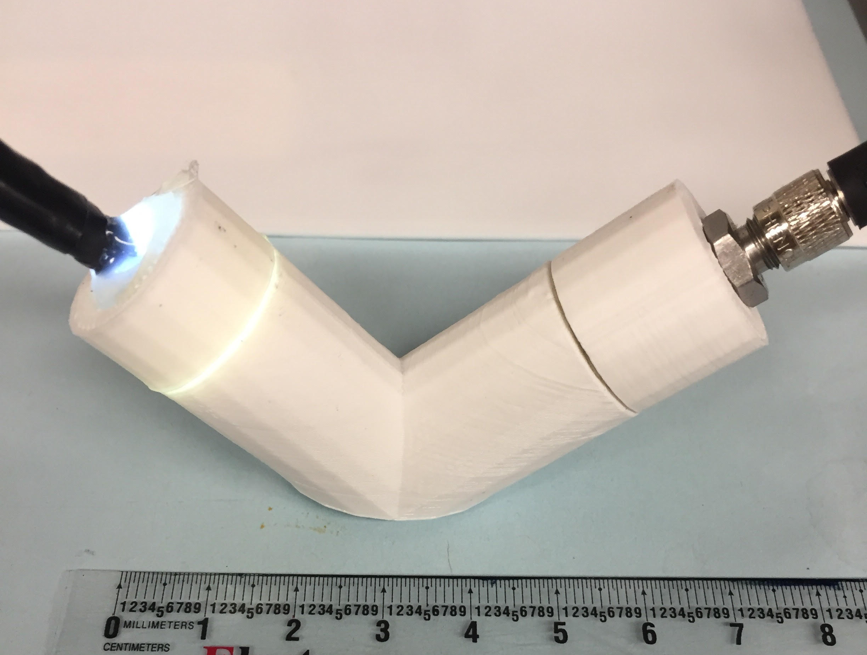
Measured LED Lamp Profile
For each measurement, the lamp profile was used as the maximum reference values in the 400-650nm spectrum
These conditions require the sample to be less reflective than the standard used (either the photo paper or the mirror)

Slide 18
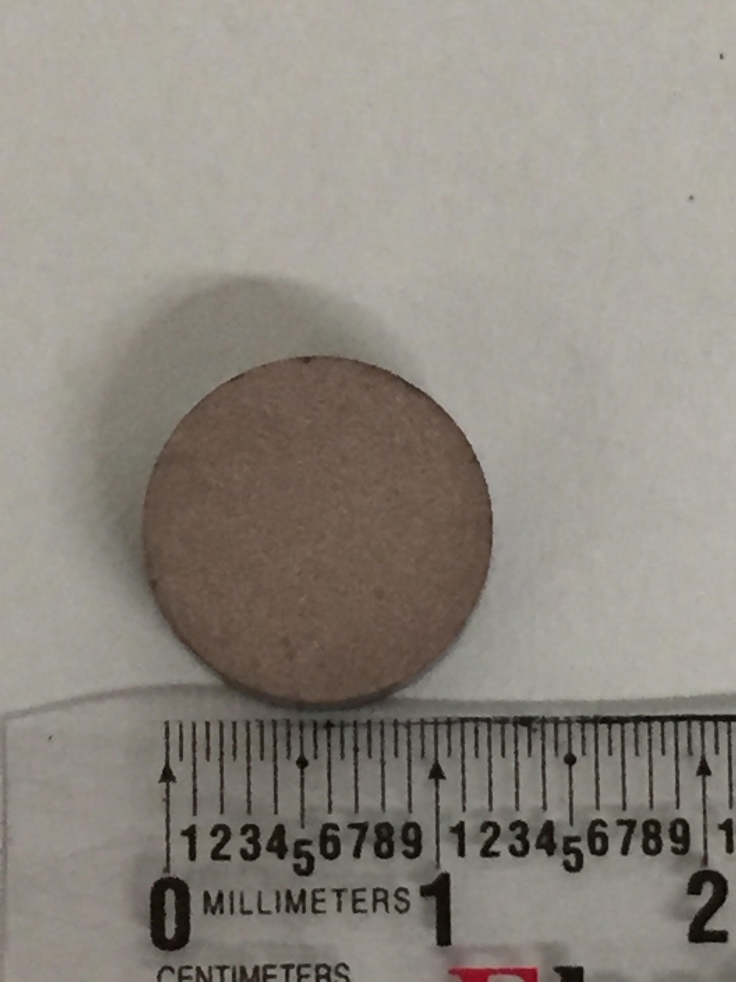
AlSiC material with large defects
Peak Position | 0.544μm | 0.588μm | 0.610-0.633μm
%R | Absorbed (0%R) | Absorbed (0%R) | Absorbed (0%R)

Slide 19
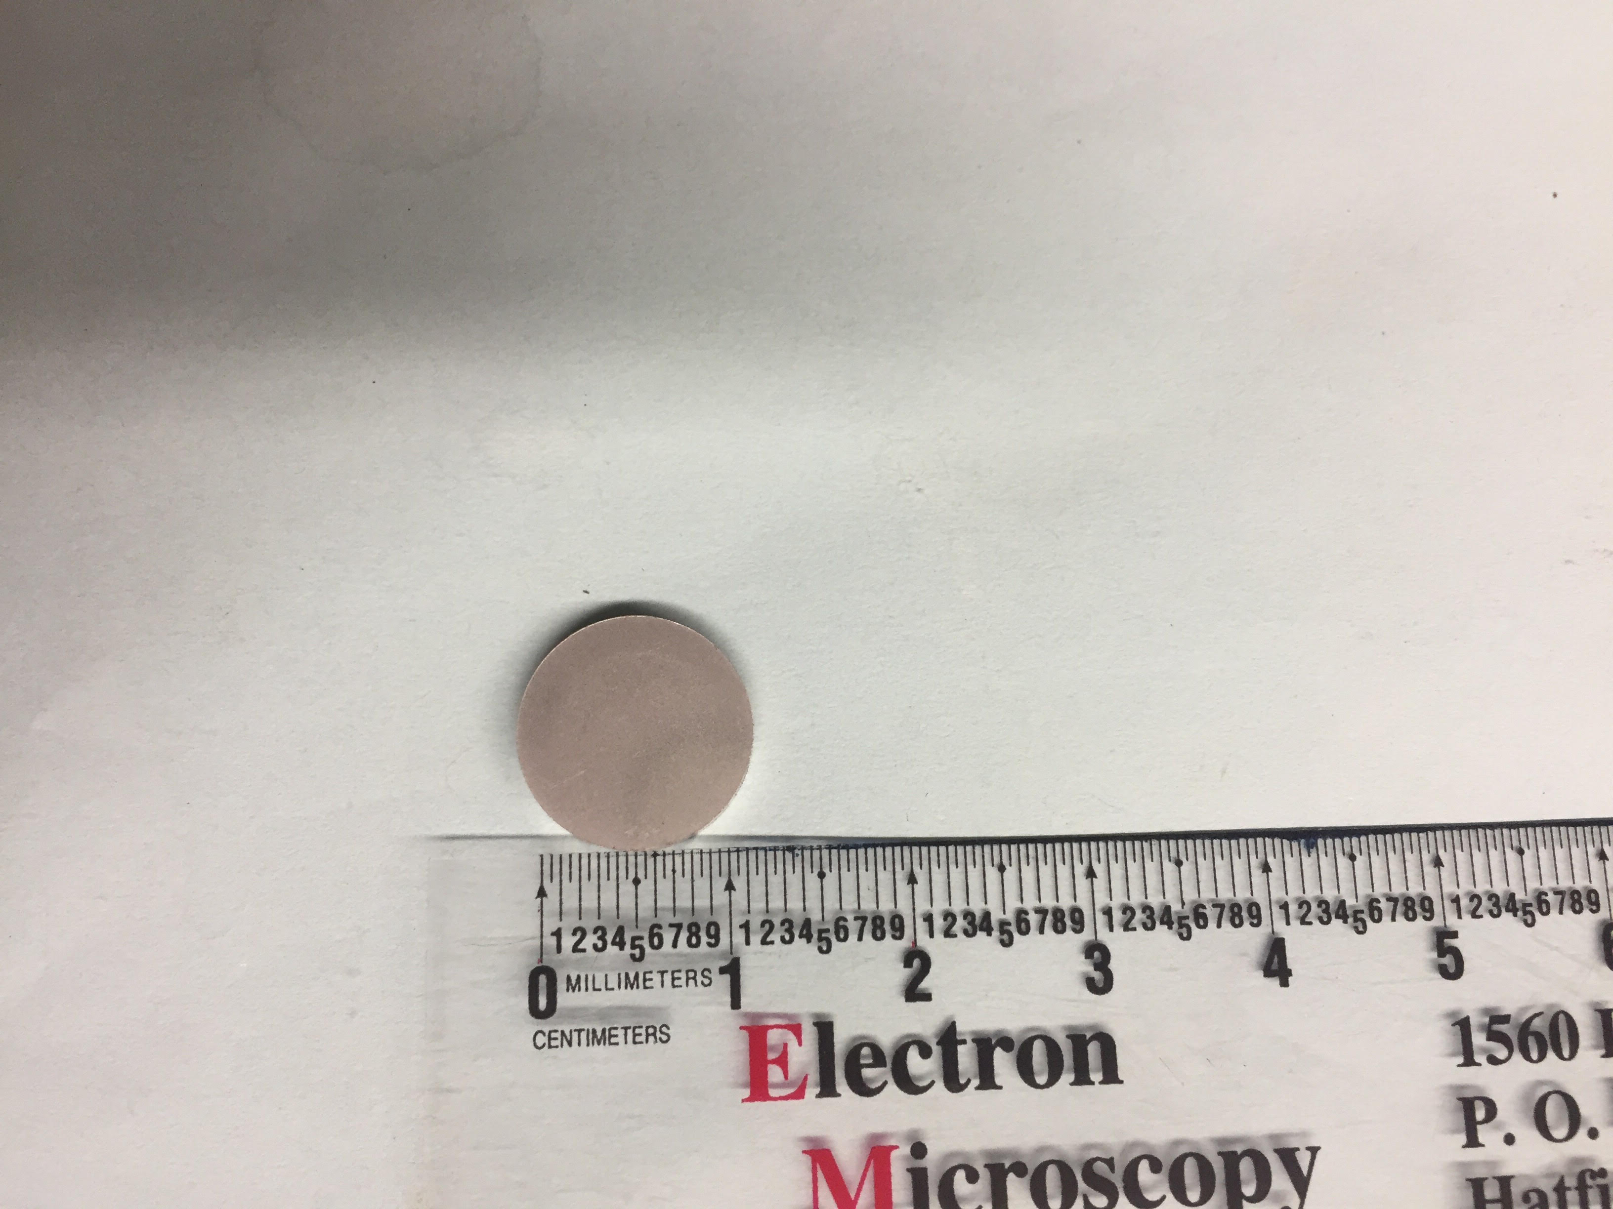
Polished AlSiC with relatively lower defects
Peak Position | 0.544μm | 0.588μm | 0.610μm | 0.633μm
%R | Absorbed (25%R) | Absorbed (31%R) | Absorbed (0%R) | Absorbed (23%R)

Slide 20
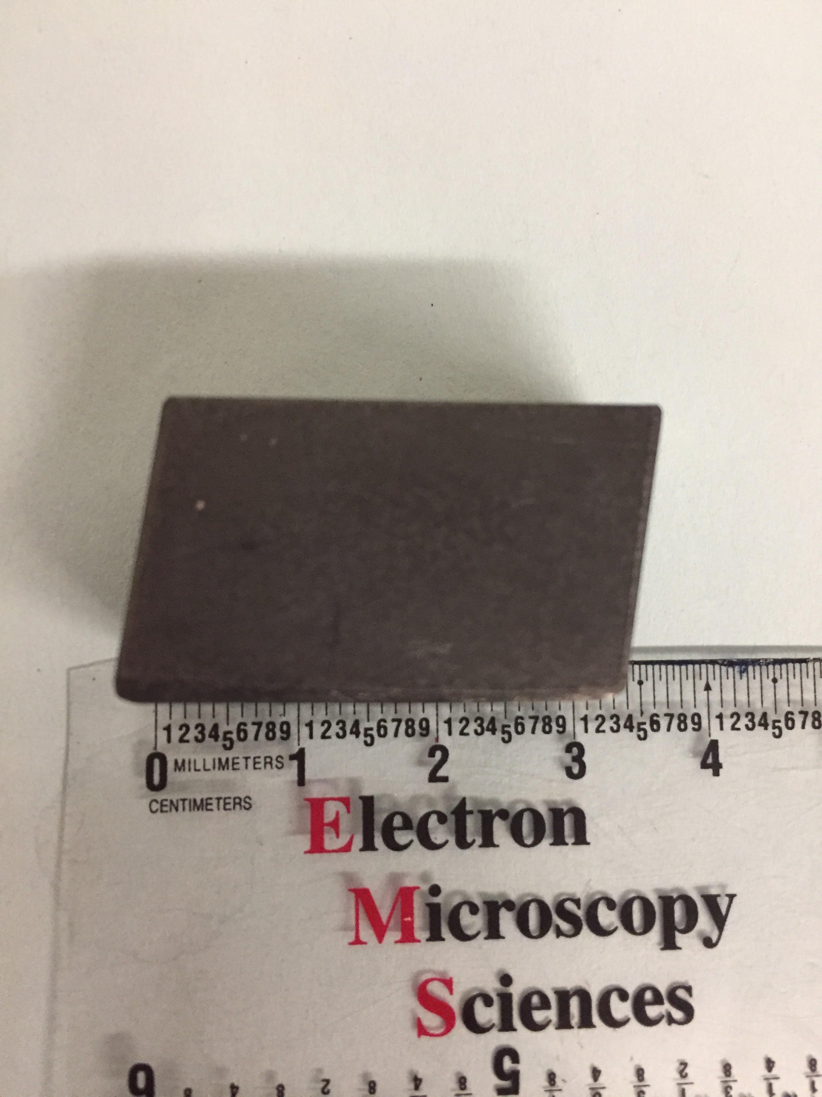
Mercurous Bromide with low defects
Peak Position | 0.544μm | 0.588μm | 0.610μm | 0.633μm
%R | Absorbed (12%R) | Absorbed (13%R) | Absorbed (0%R) | Absorbed (5%R)

Slide 21
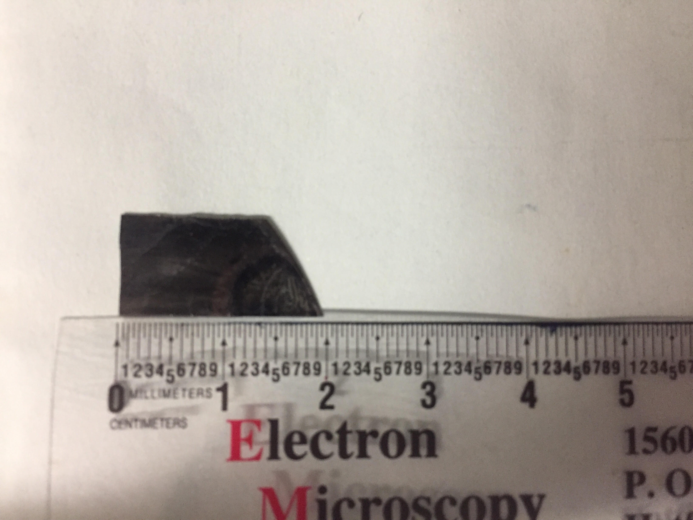
Thin Film studies: PbSe Thin Film Sample with large defects
Peak Position | 0.544μm | 0.610μm | 0.633μm
%R | Absorbed (20%R) | Absorbed (0%R) | Absorbed (13%R)

Slide 22
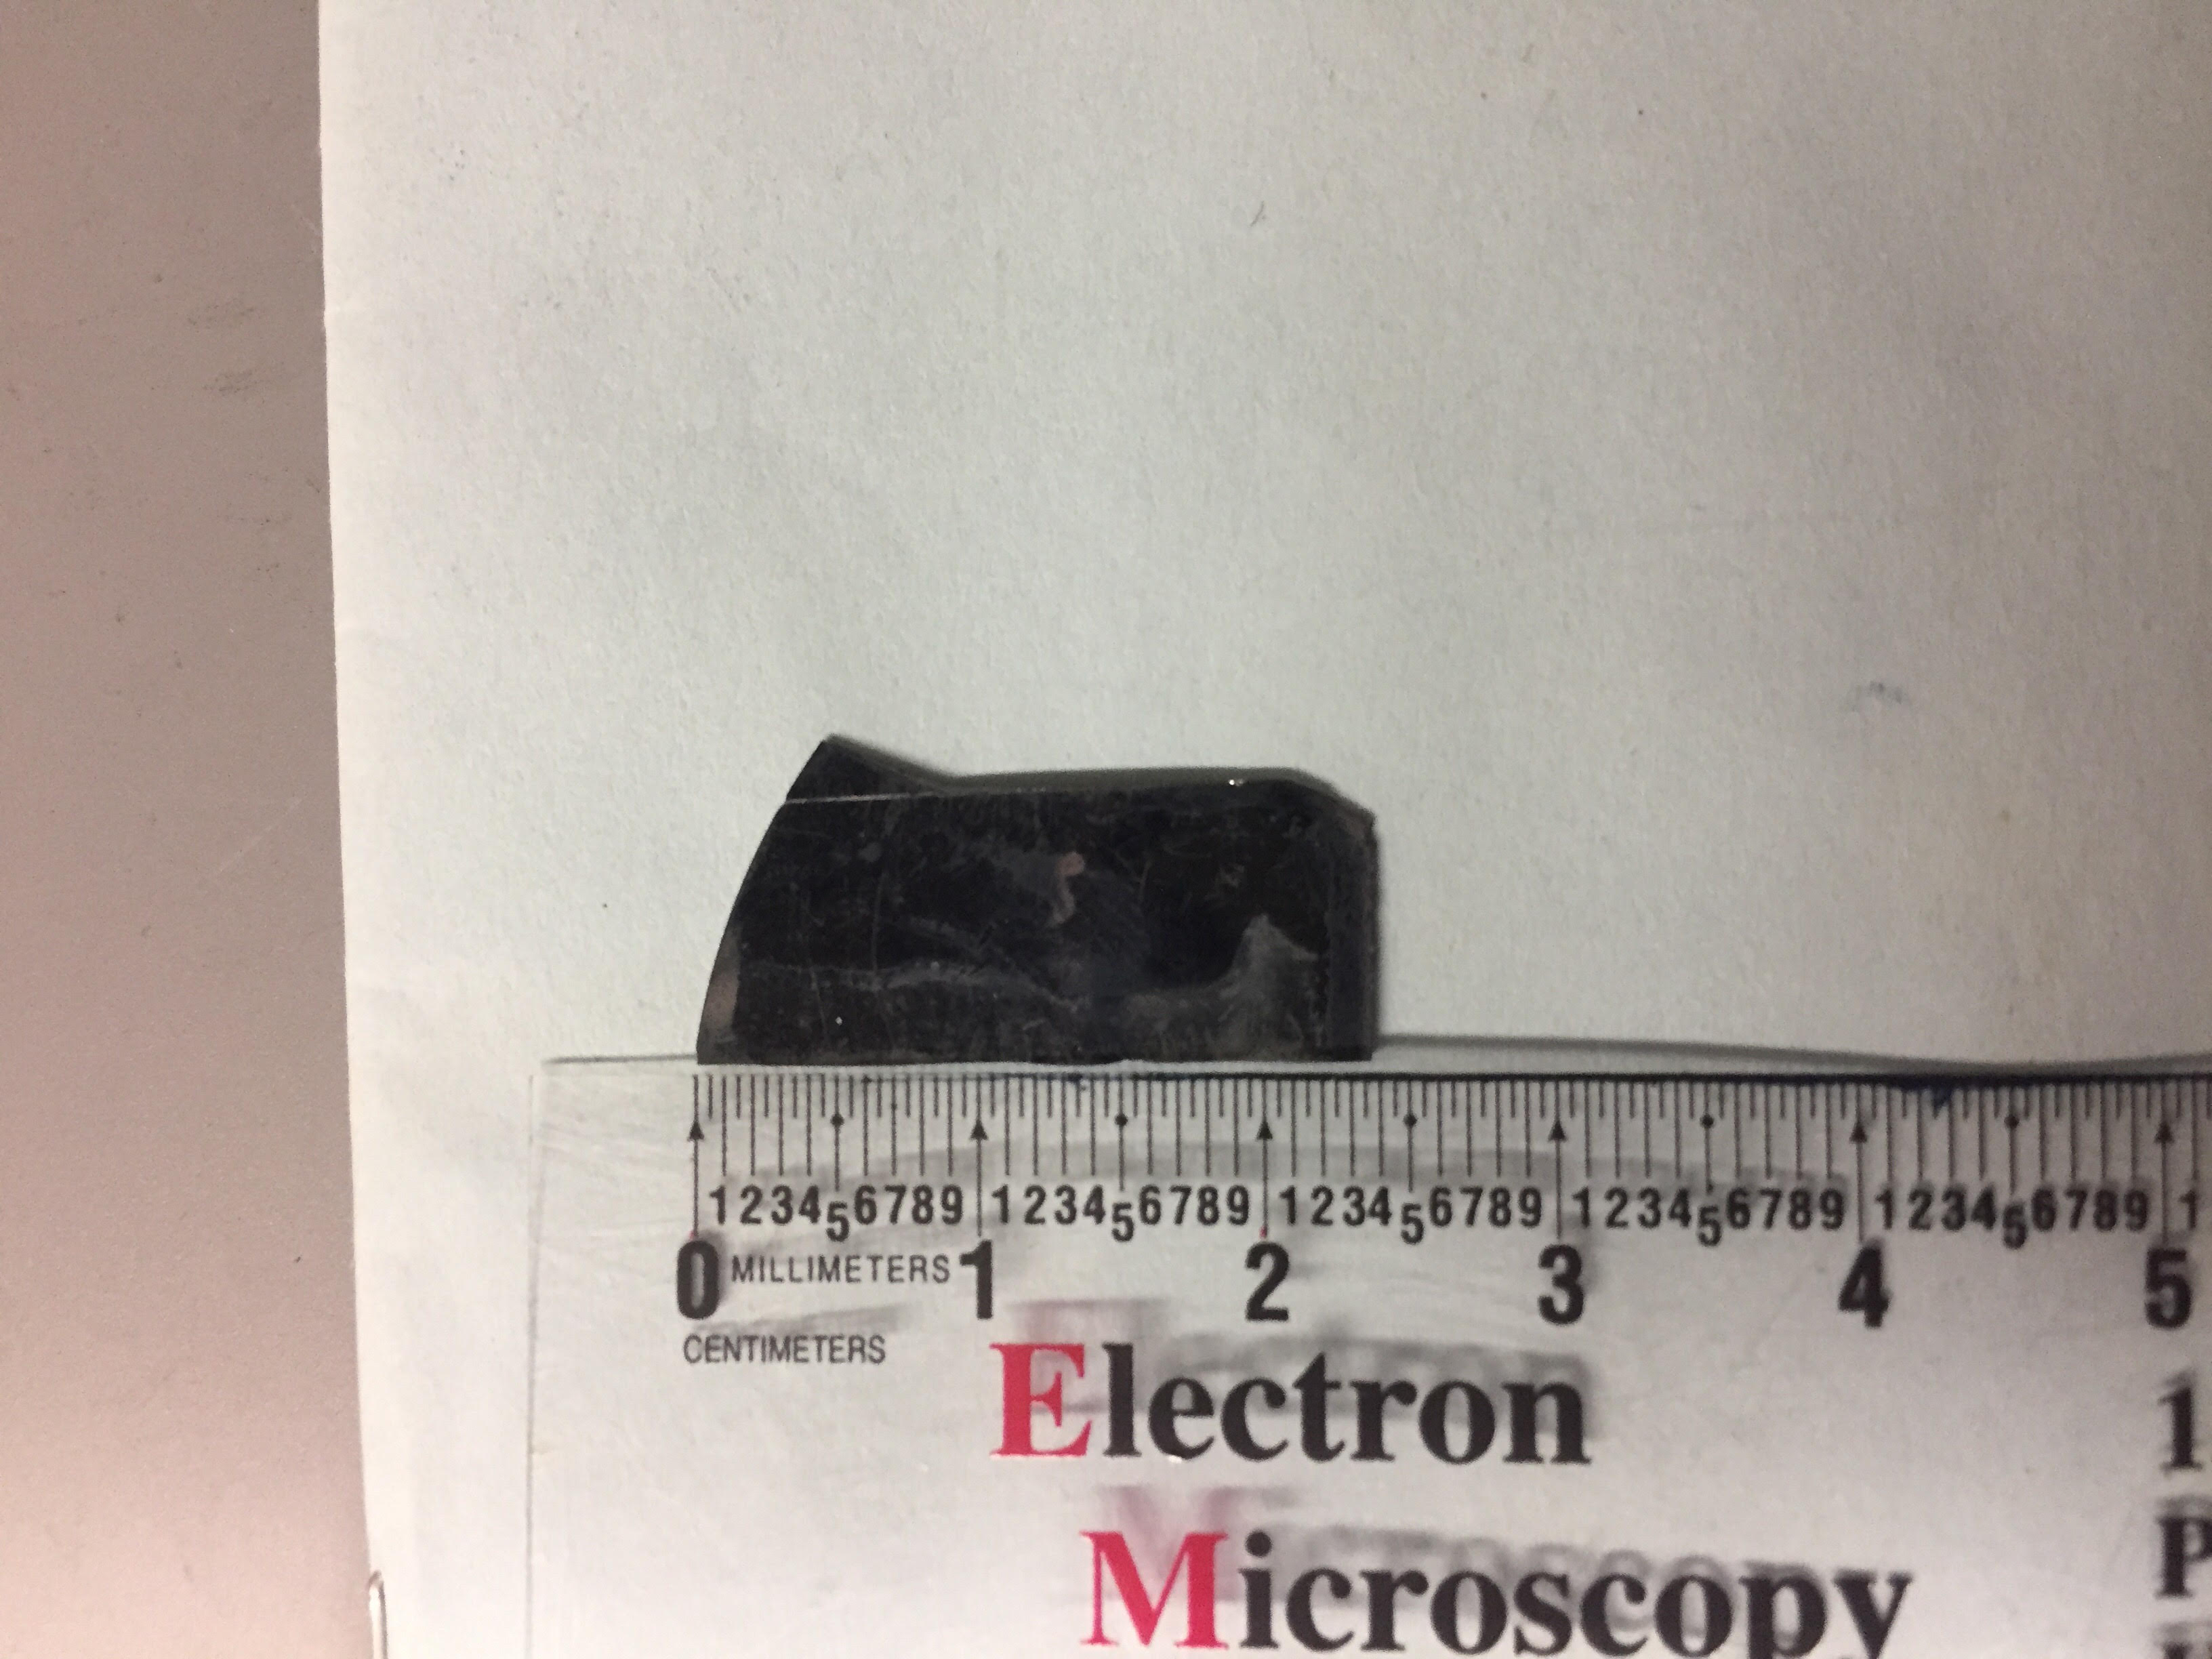
Thin Film studies: PbSe Thin Film Sample with lower defects, shows smaller absorption
Peak Position | 0.544μm | 0.588μm | 0.610μm | 0.633μm
%R | Absorbed (12%R) | Absorbed (15%R) | Absorbed (0%R) | Absorbed (5%R)

Slide 23
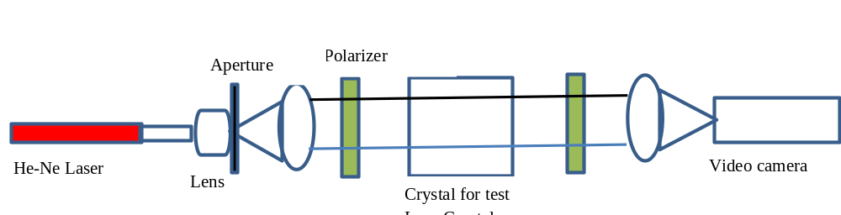
Crystal characterization by use of birefringence interferometry
Following equations provide a quantitative relationship. The phase difference, φ, between the two beams is determined by
φ = n₀L – n_{e}L = L(n₀-n_{e}) ….(1)
Introducing a distortion in the refractive index Δ(n_{o}-n_{e}) due to defects etc can be given as:
φ + Δ φ = L[n_{o} – n_{e} + Δ(n₀-n_{e})] ….(2)
From the equation (2) we obtain the change in phase, Δφ, as a function of Δ(n_{o}-n_{e}):
Δ φ = L Δ (n_{o} – n_{e}) ….(3)
As the Δ (n_{o} – n_{e}) varies over the aperture of the crystal, we get a corresponding change in Δφ. A change in 2 π in Δφ produces a one fringe change in the output from the interferometer. This parameter will provide data about distortion due to the defects caused by doping or growth parameters.

Slide 24
Summary
We have designed low-cost reflectance measurement system
Preliminary studies based on multicomponent materials show encouraging results.
Low defect materials show less absorption
More refinements are underway
We have designed the concept of birefringence studies.
We plan to study industriall important materials such as ZnS, ZnSe, GaSe, Tl₃AsSe₃, Hg₂Cl₂, Hg₂Br₂, and several other crystals.
Both techniques show potential for bulk and thin film crystals .
Further refinements in both techniques are required

Slide 25
Thank you very much for your time

