Slide 1
DAWN Wind Observations and
Aeolus Validation During CPEX-AW
Kristopher Bedka¹, Zhaoyan Liu¹, John Cooney³, Dave Emmitt², Steve Greco²,
Michael Kavaya¹, Sam Chen¹, John Marketon¹, Sharon Rodier⁴, and Amin Nehrir¹
¹ NASA Langley Research Center (LaRC)
² Simpson Weather Associates
³ NASA Postdoctoral Program
⁴ Science Systems and Applications, Inc.
Aeolus 3rd Anniversary Conference, 28 March - 1 April, Taormina, Italy

Slide 2
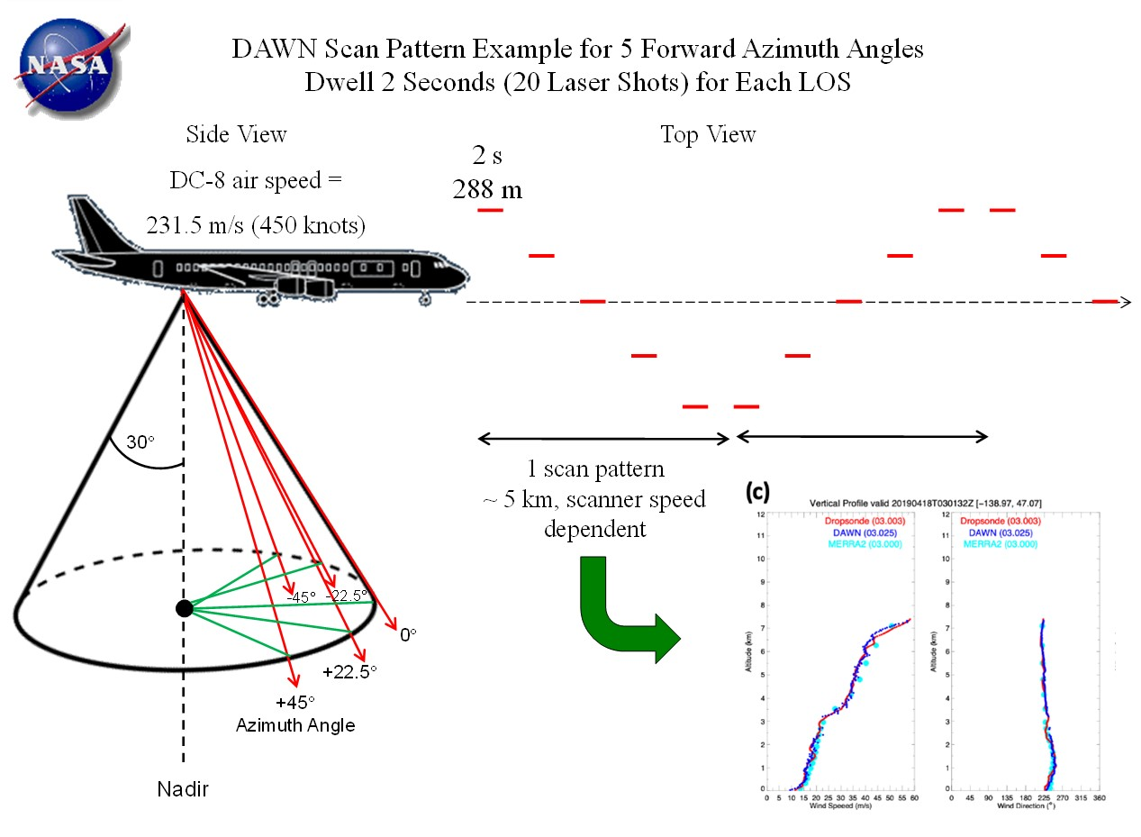
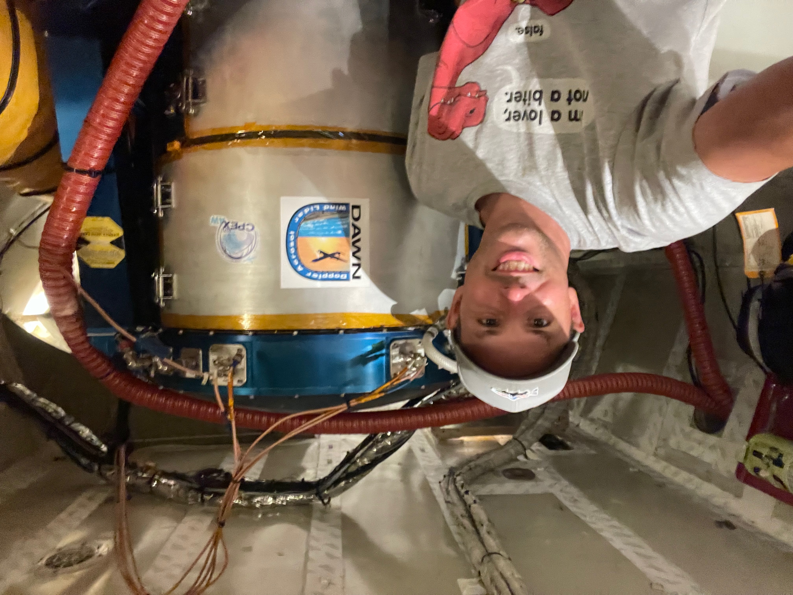
DAWN Instrument Summary
The Doppler Aerosol WiNd (DAWN) lidar generates pulses at 10 Hz with 80-100 mJ energy at a ~2 micron wavelength.
  Pulses are sent through a silicon wedge scanner that redirects pulses 30° off nadir into the atmosphere. Wedge rotates across a user-selected number of lines of sight (LOS)
  Aircraft INS/GPS and transmitted laser pulse frequency used to derive Doppler shift and wind velocity along each LOS
    Data from multiple LOS combined to derive a wind vector
  Nominal operation: 5 LOS x 20 pulses/LOS -> 5 km spacing between profiles
  PBL modules on 9/1 and 9/4: 2 LOS x 20-40 pulses/LOS -> 2 - 3.5 km spacing
DAWN data products provided at 33 m vertical spacing between levels
  DAWN pulse duration, data recording and signal FFT analysis yields 90 m minimum vertical range resolution, but data oversampled to 33 m
  DAWN data products: Wind speed/direction, U/V component profiles, depth of integration needed to get signal for wind retrieval, number of LOS being scanned and number used in wind retrieval, SNR, QC flags, aircraft INS/GPS, profile date/time/lat/lon
  Vertical integration up to ~1.2 km depth used to derive winds in areas with weak aerosol returns
  See Bedka et al. (AMT, 2021) for more details and examples

Slide 3
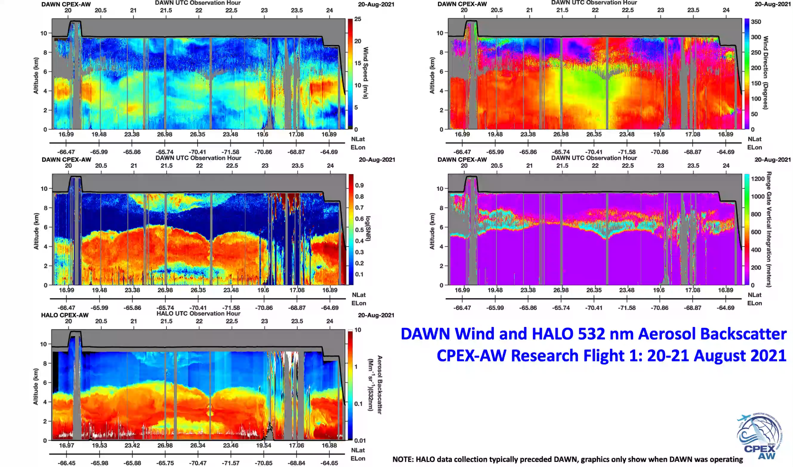
CPEX-AW Flight Overviews

Slide 4
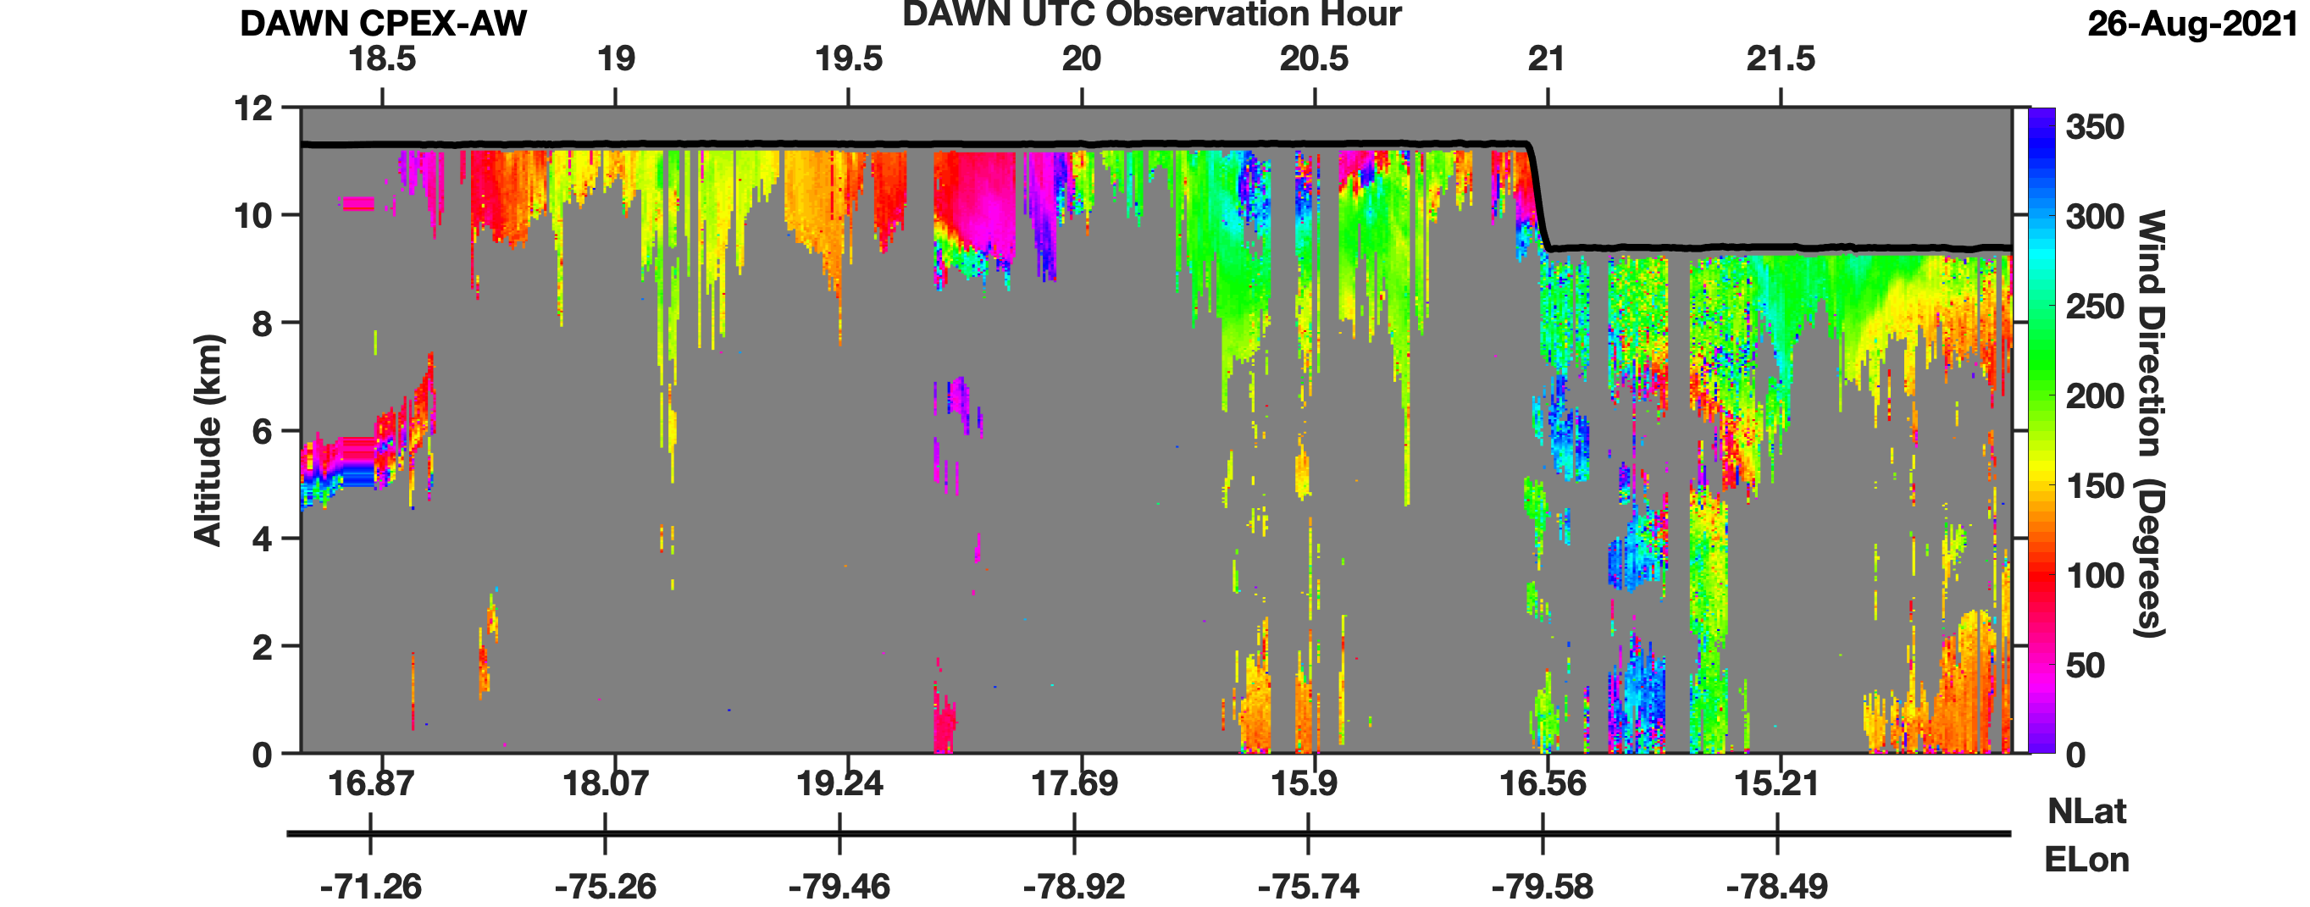
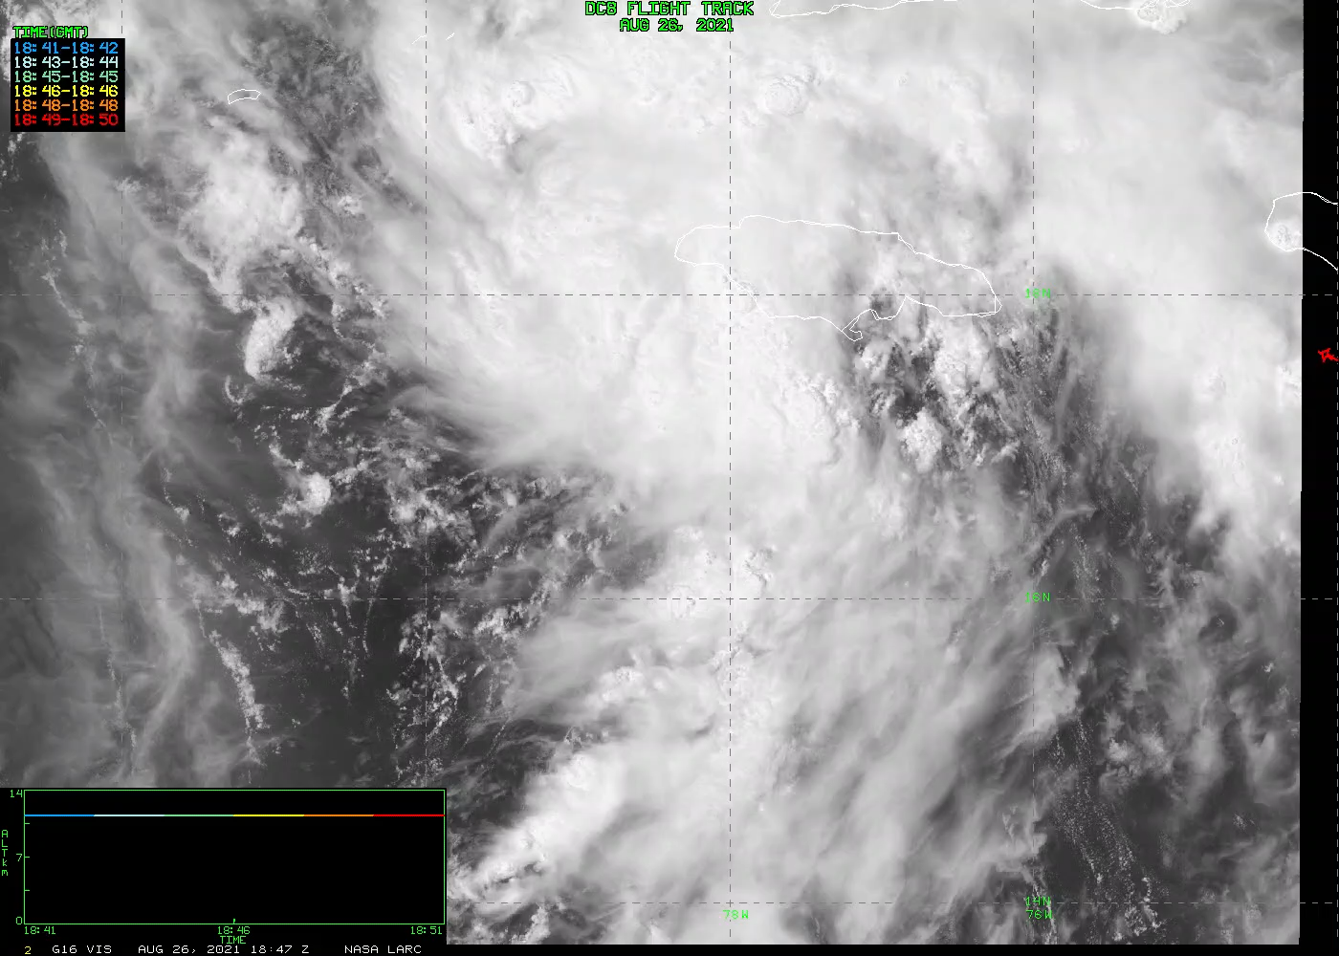
Examples of Mesoscale Features Resolved By DAWN
Tropical Storm Ida Outflow
GOES-16 1-Minute Visible
26 August 2021
DAWN wind direction within cirrus canopy of Ida reveals cyclonic flow and center of circulation

Slide 5
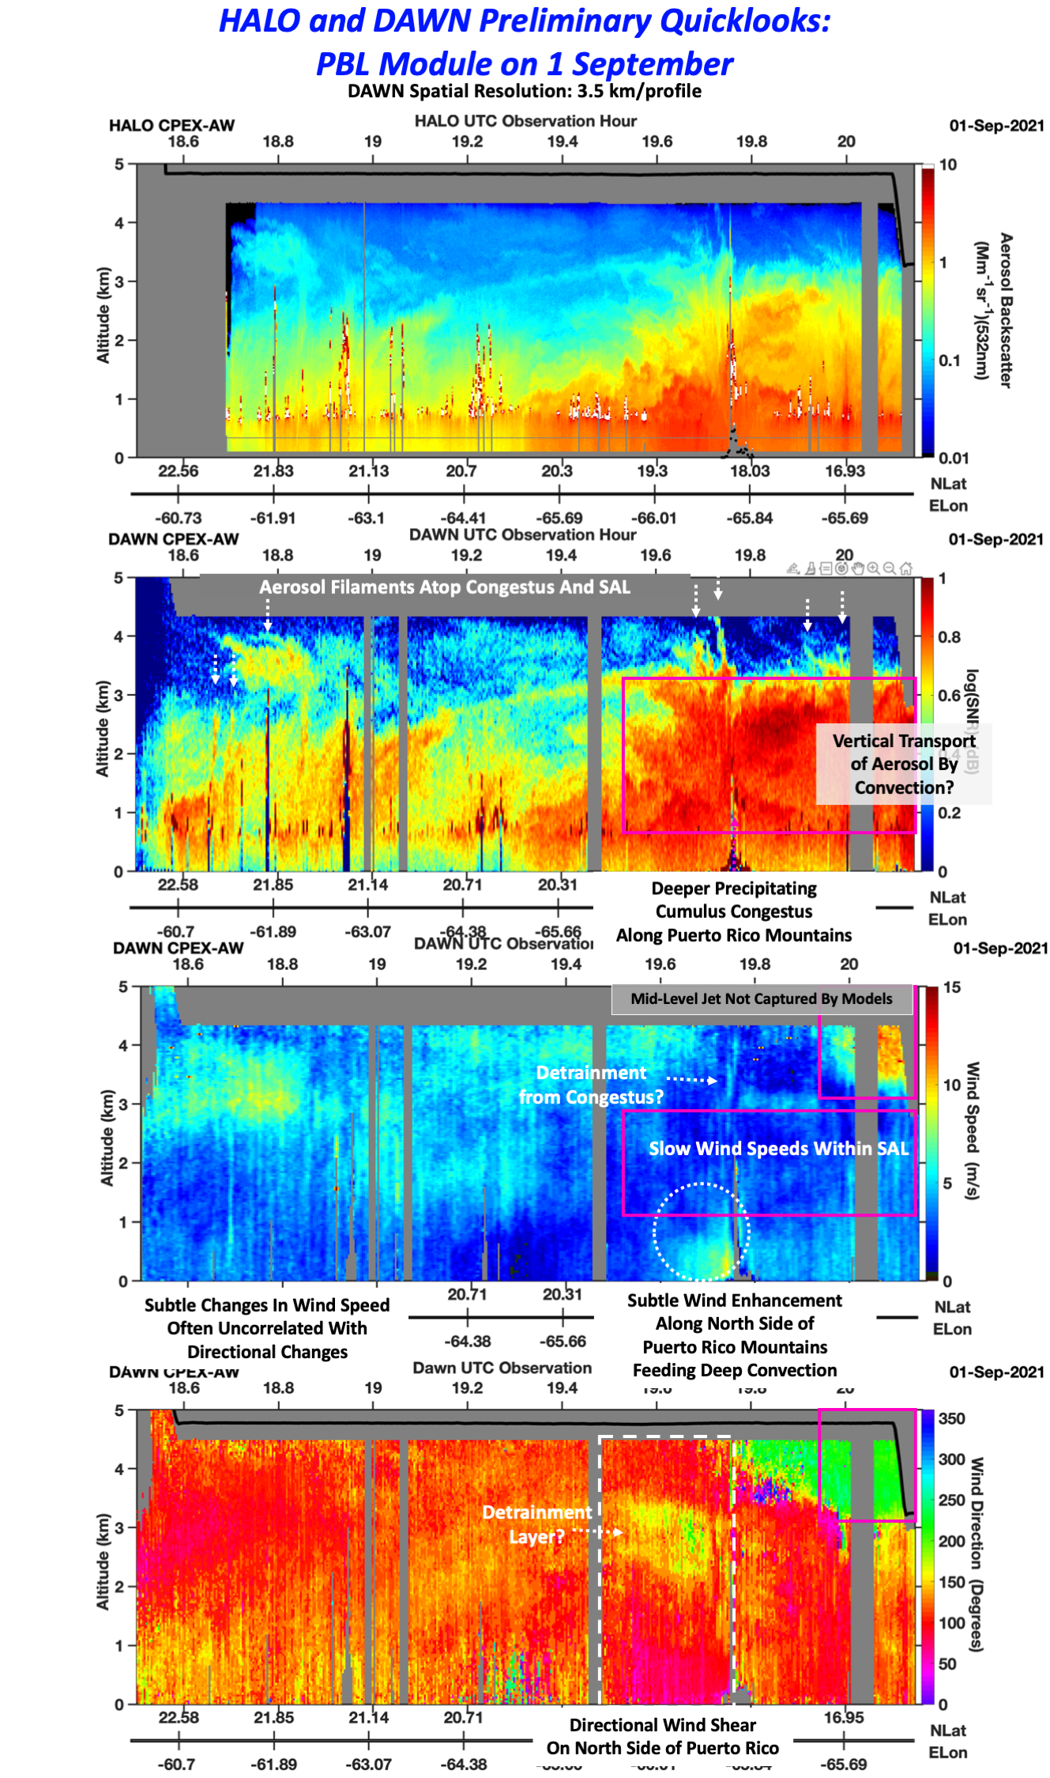
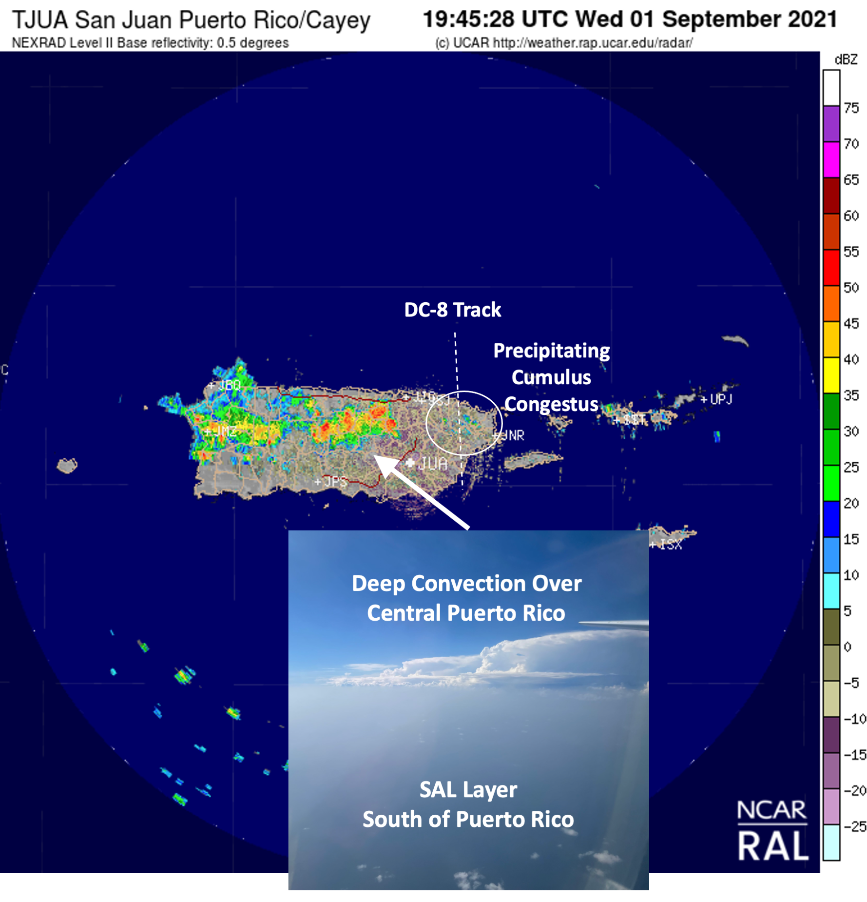
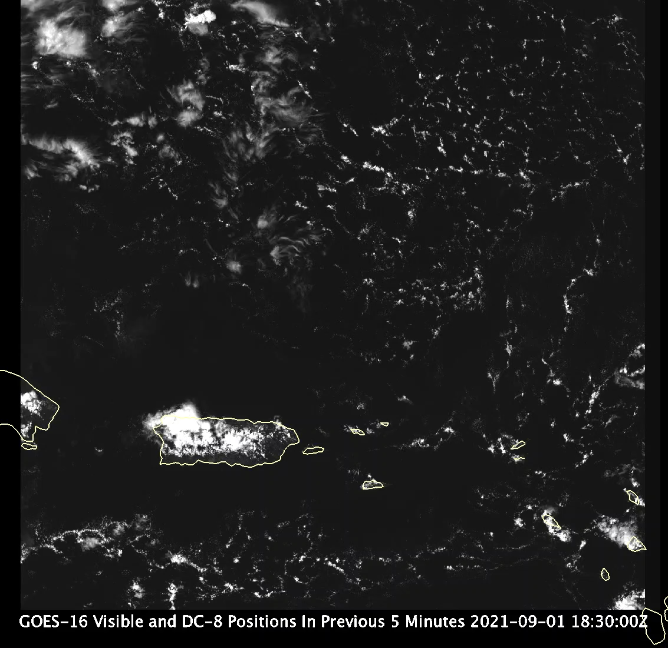
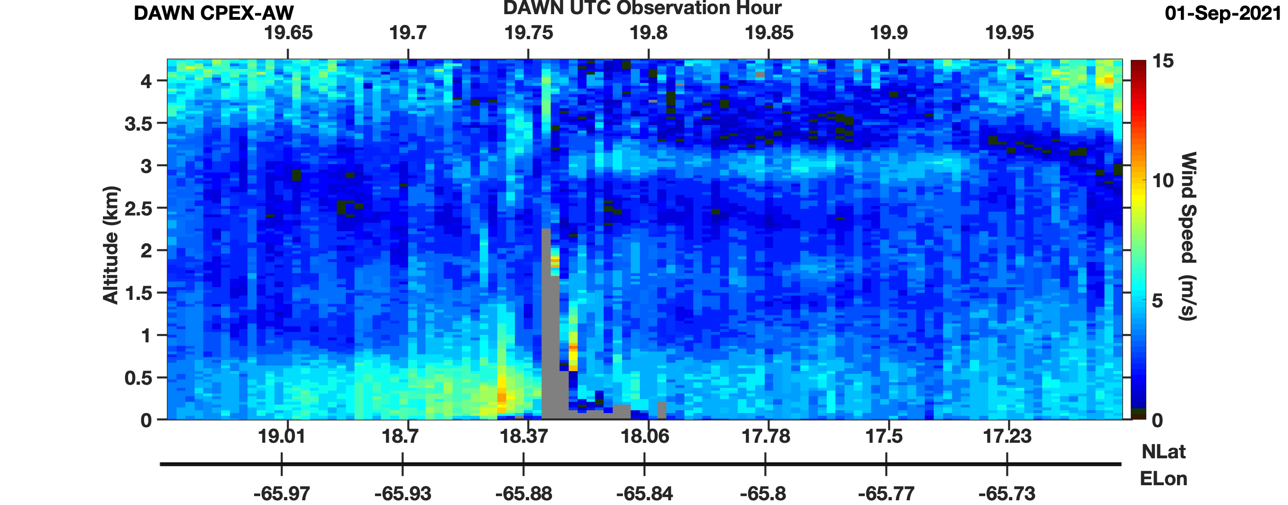
Examples of Mesoscale Features Resolved By DAWN
PBL Module and
Puerto Rico Convection
2 LOS Scan Patterns on 1 and 4 September
Low Altitude Legs Provide Novel Datasets For PBL Science
Wind acceleration below 0.6 km converging into Puerto Rico mountains to force convection and possible lofting urban pollution from
San Juan region

Slide 6
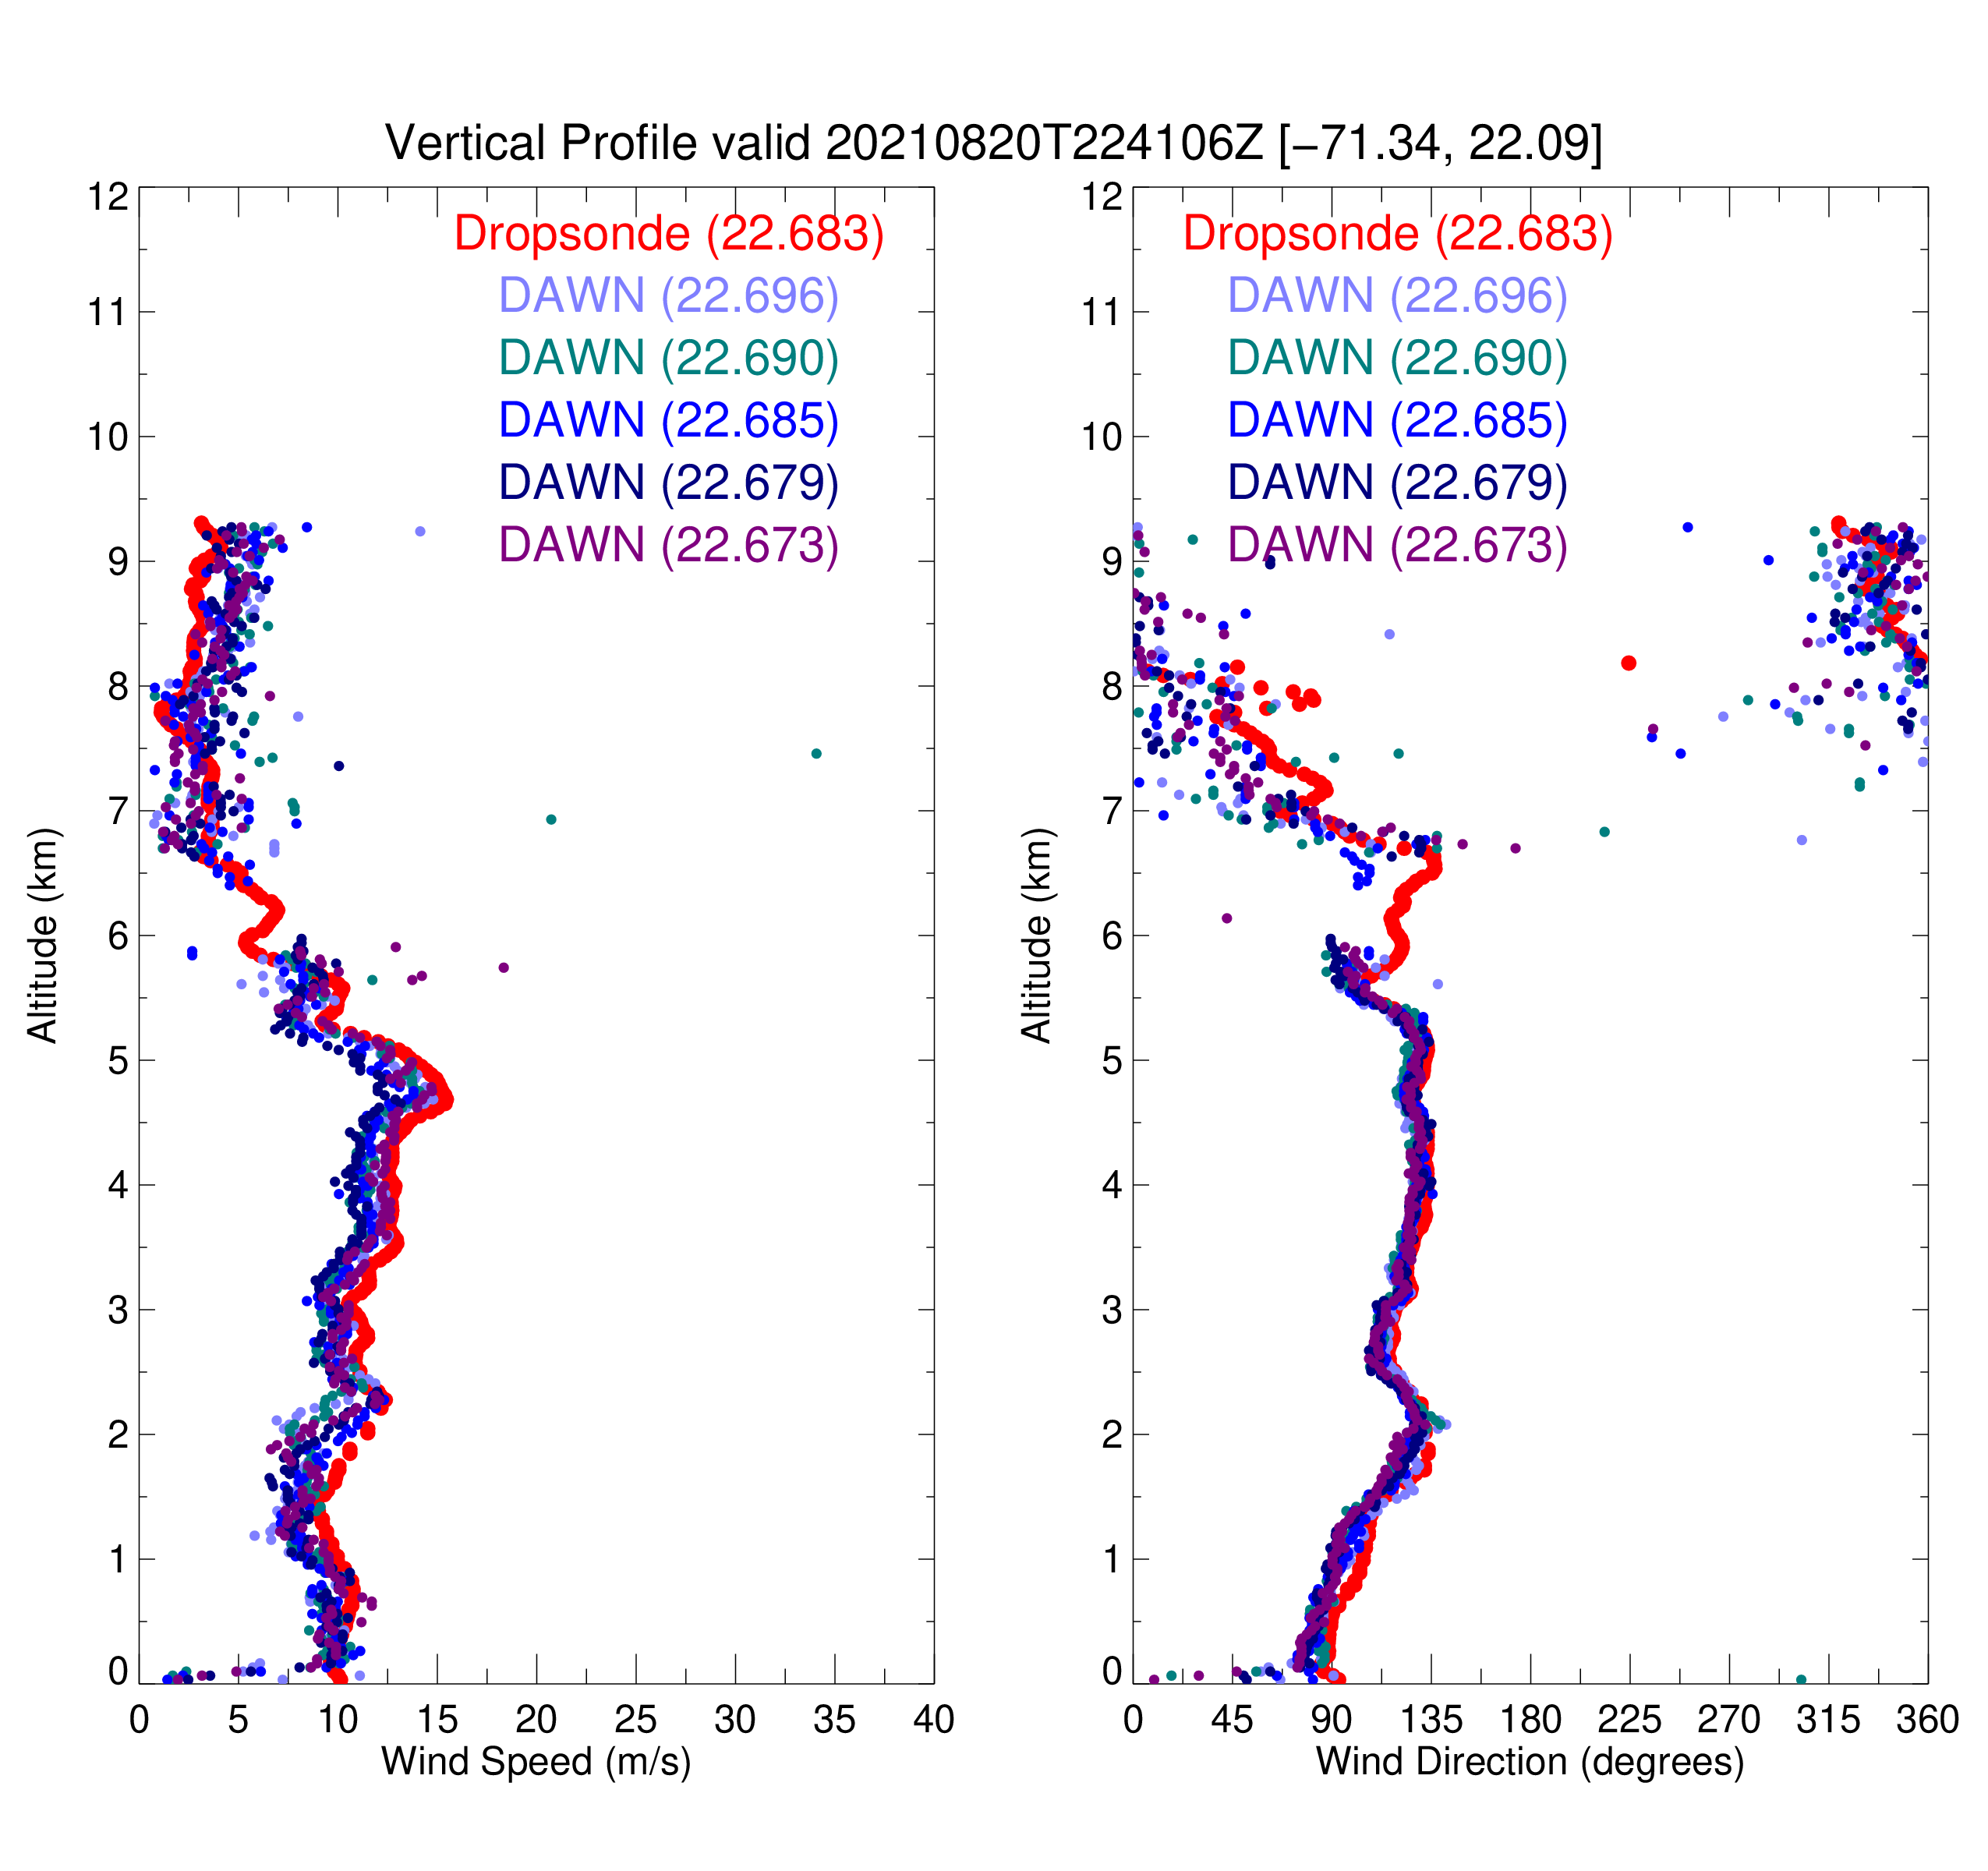
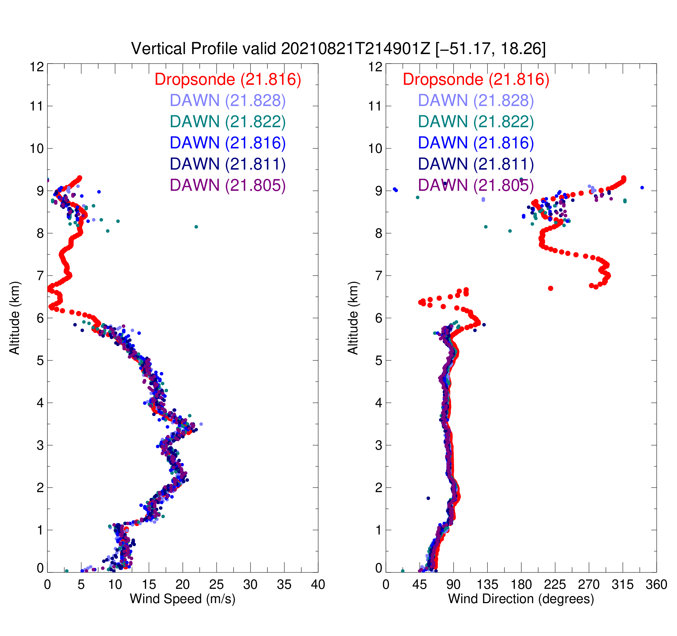
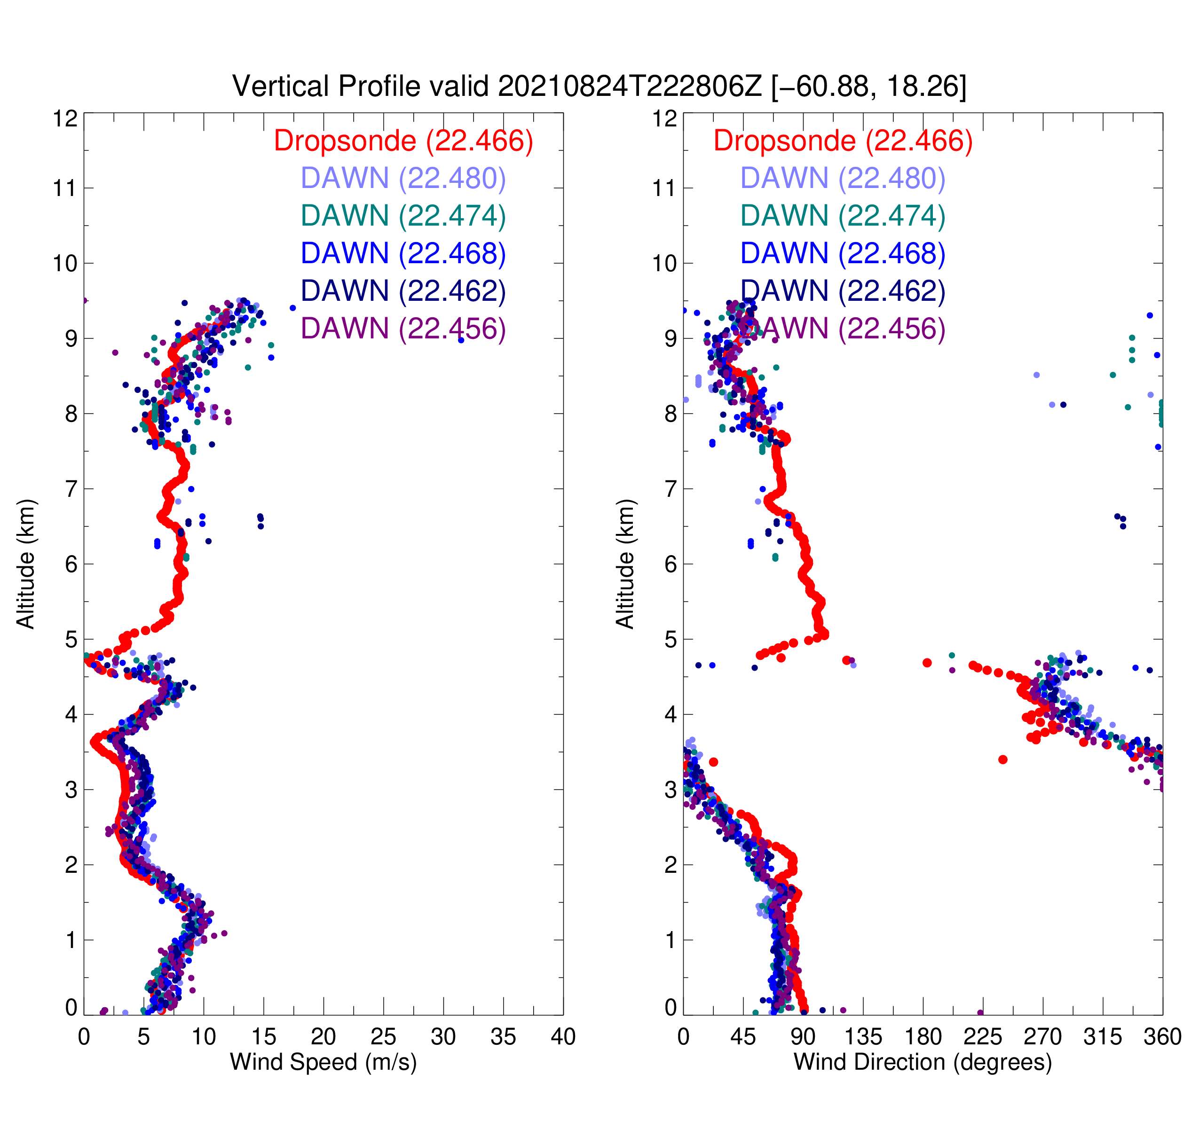
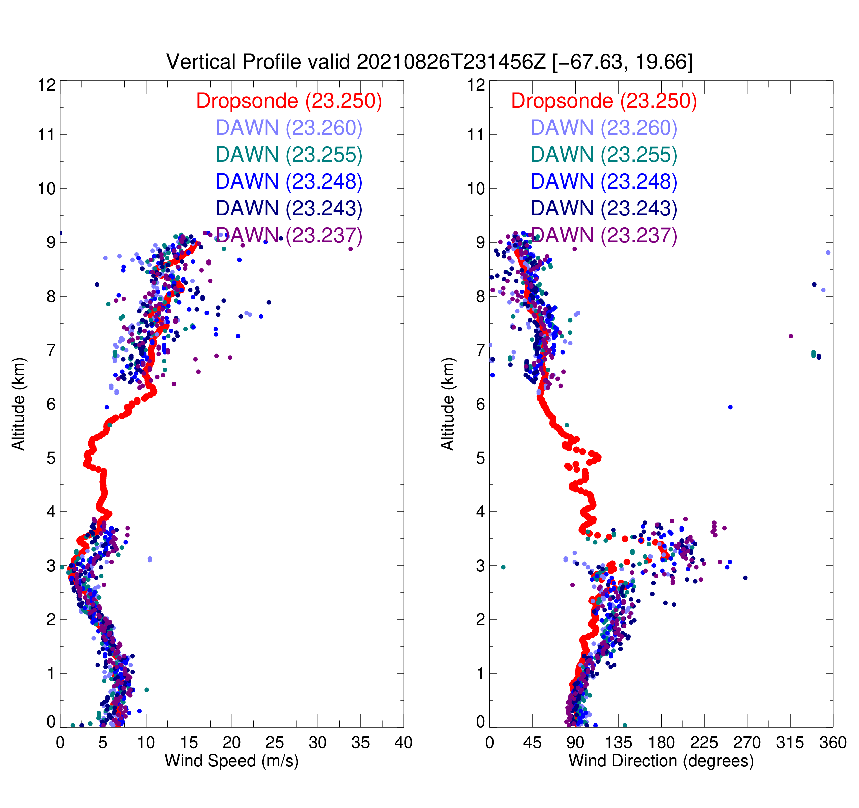
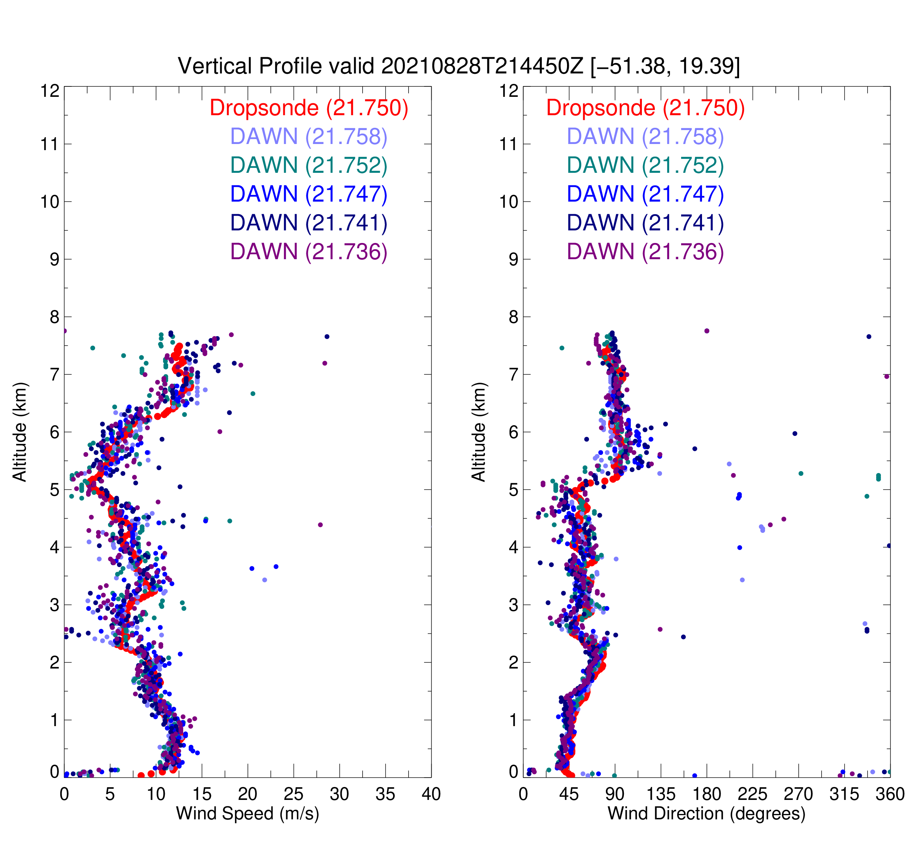
Examples of DAWN Comparisons With AVAPS Dropsonde
During Aeolus Overpasses
RF01
RF02
RF03
RF04
RF05

Slide 7
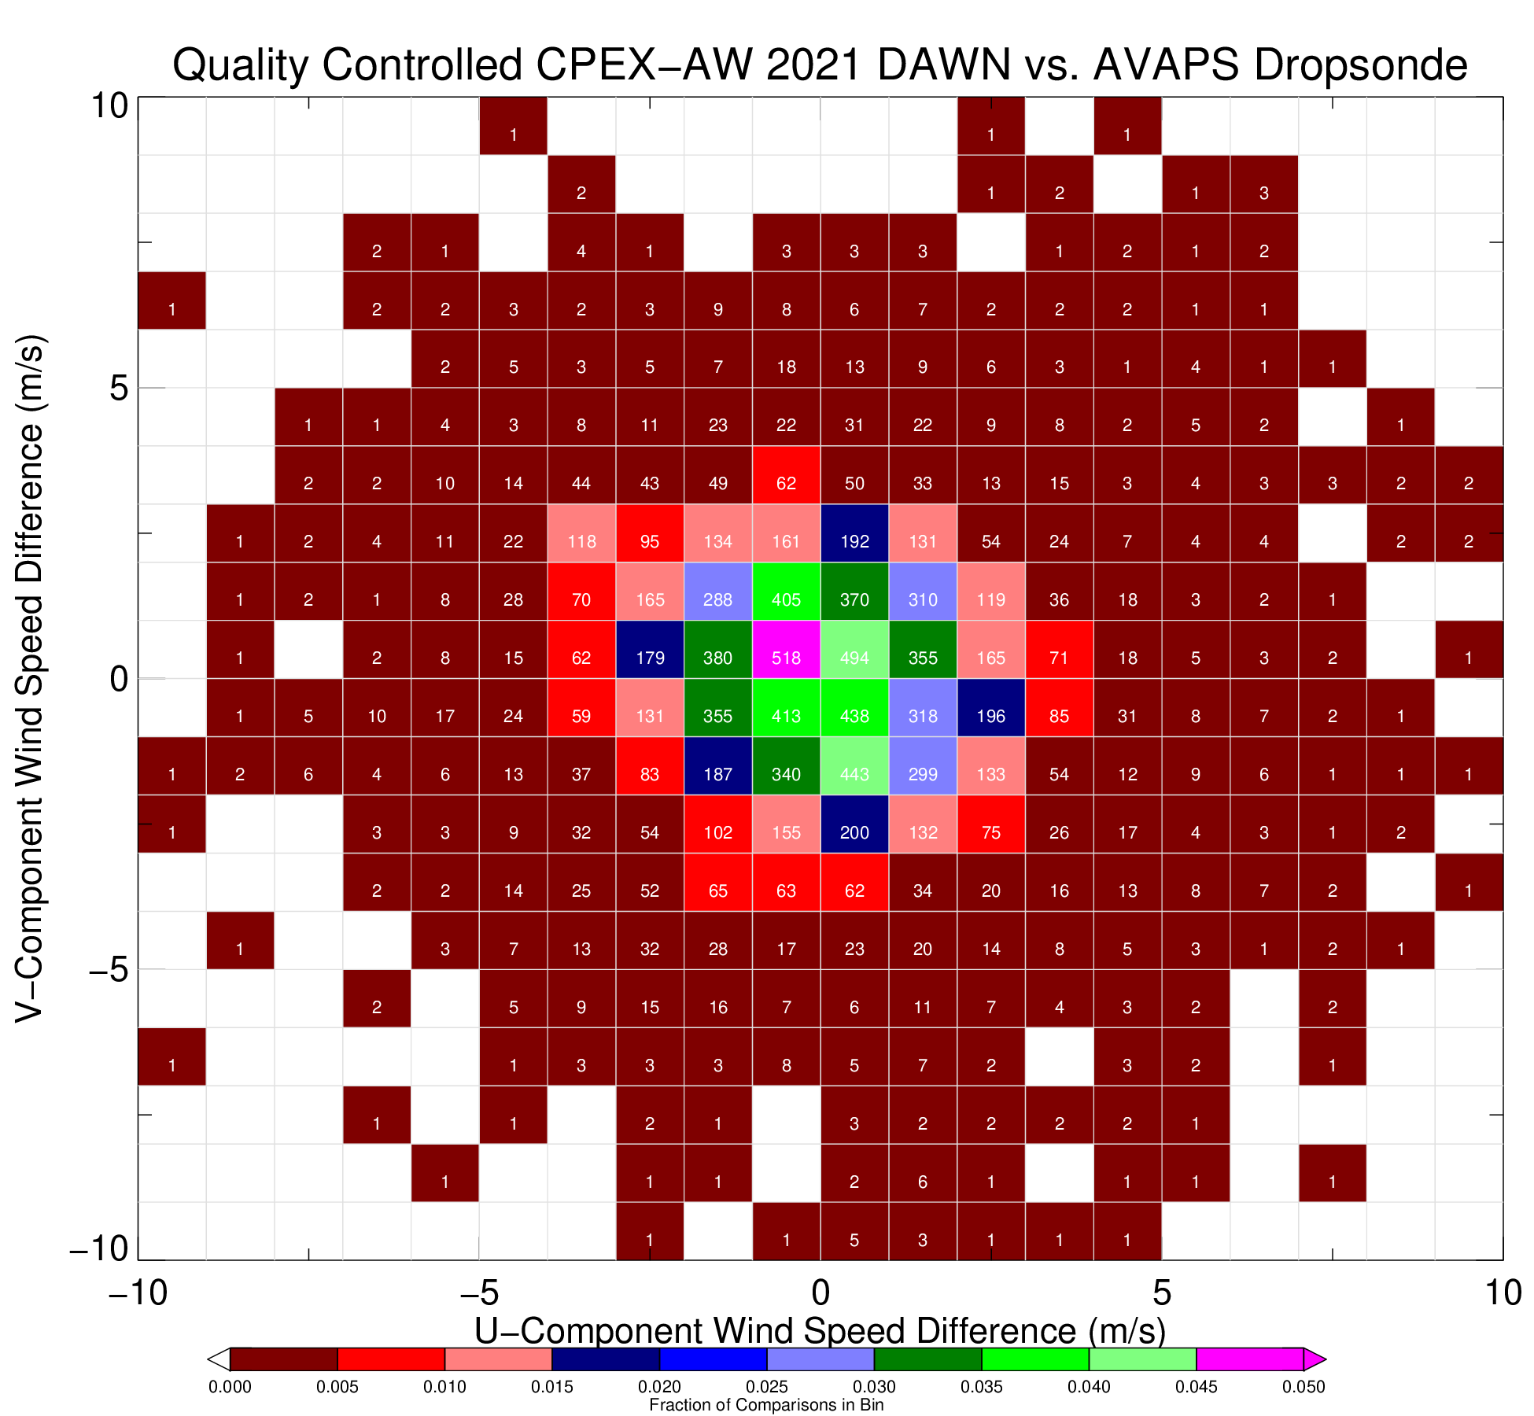
DAWN Validation With AVAPS Dropsonde
~11,000 DAWN vertical levels matched with AVAPS
Sondes separated into two categories: 1) drops into opqaue cloud layer near aircraft and 2) drops into broken cloud or clear sky
Clear Sondes (N=10,160)
-0.27 m/s mean difference, 2.08 m/s RMS
Opaque Cloud / Convection Sondes (N=898)
-1.07 m/s mean difference, 2.38 m/s RMS
Greater differences in cloud attributed to spatial variability with some potential contribution of vertical motions projected onto DAWN LOS
+/- 2 m/s

Slide 8
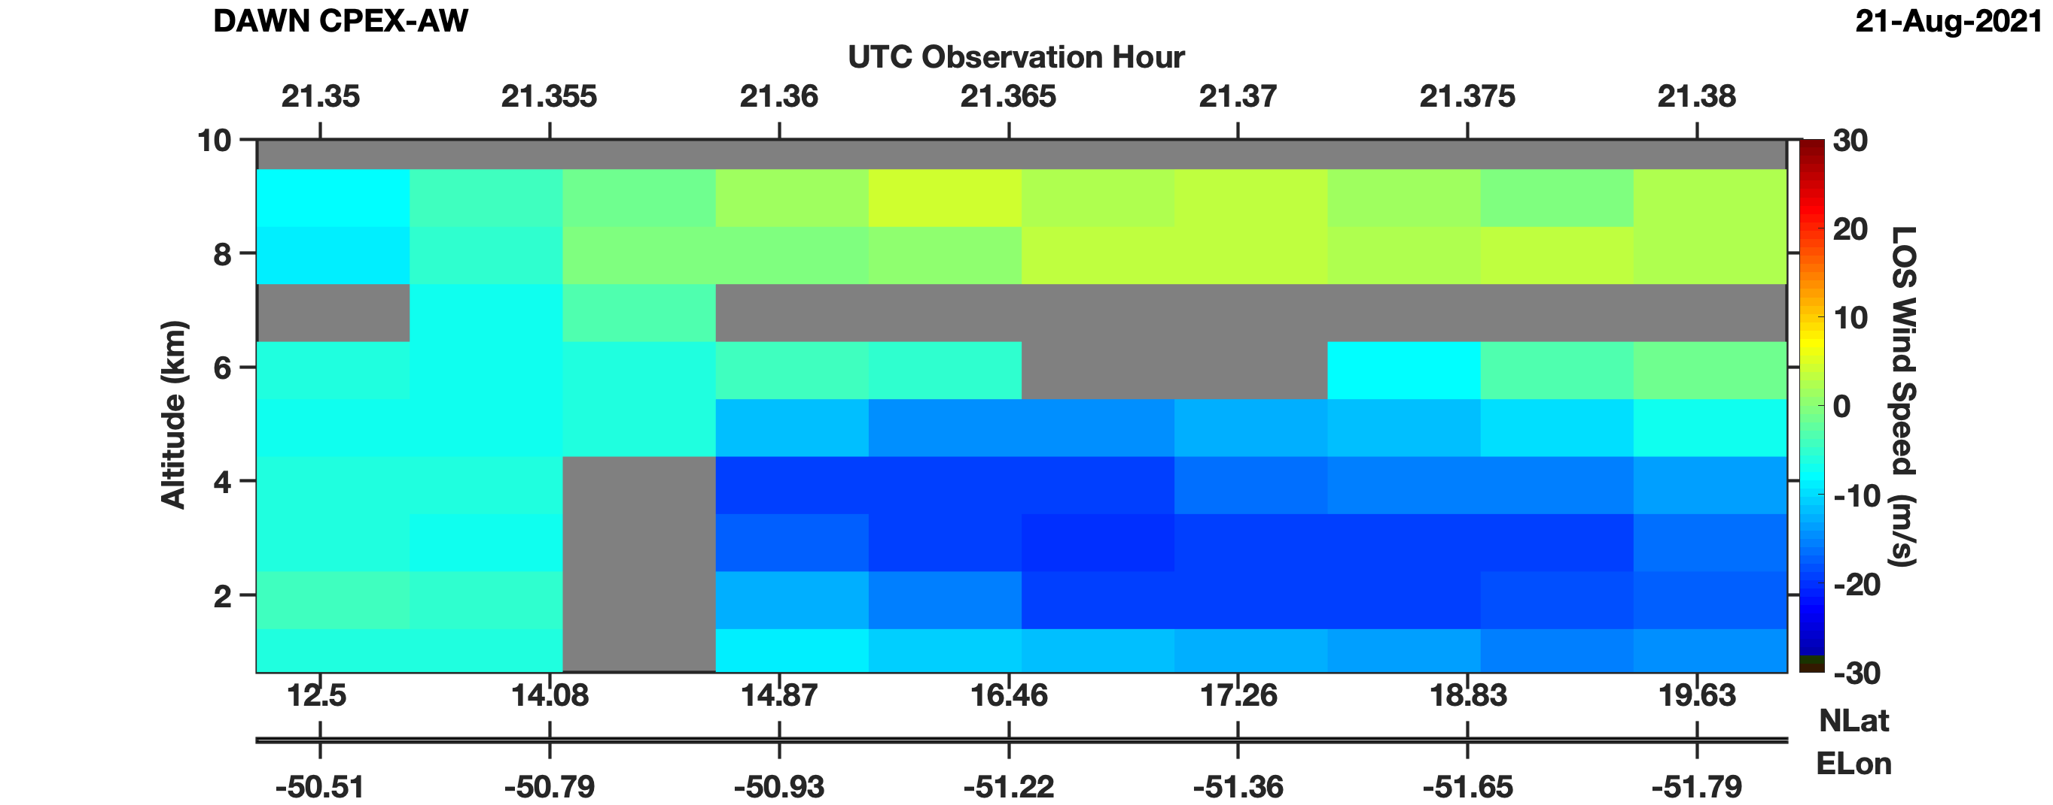
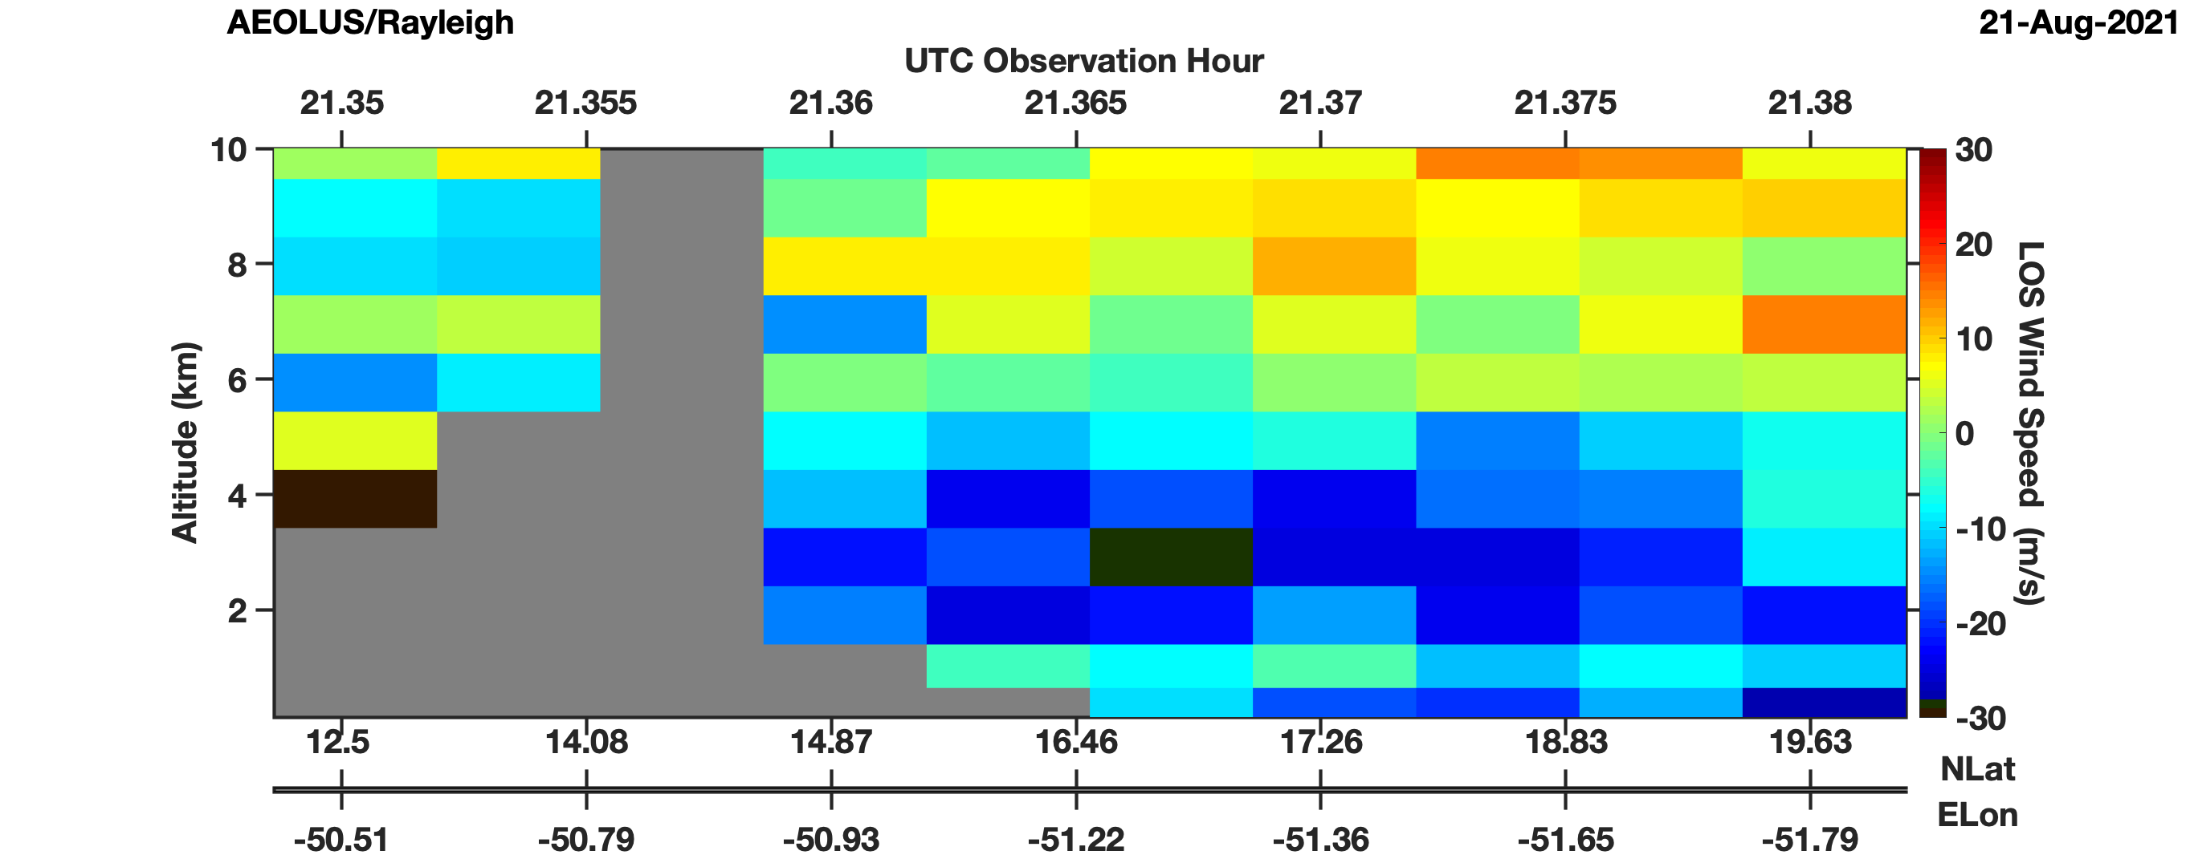
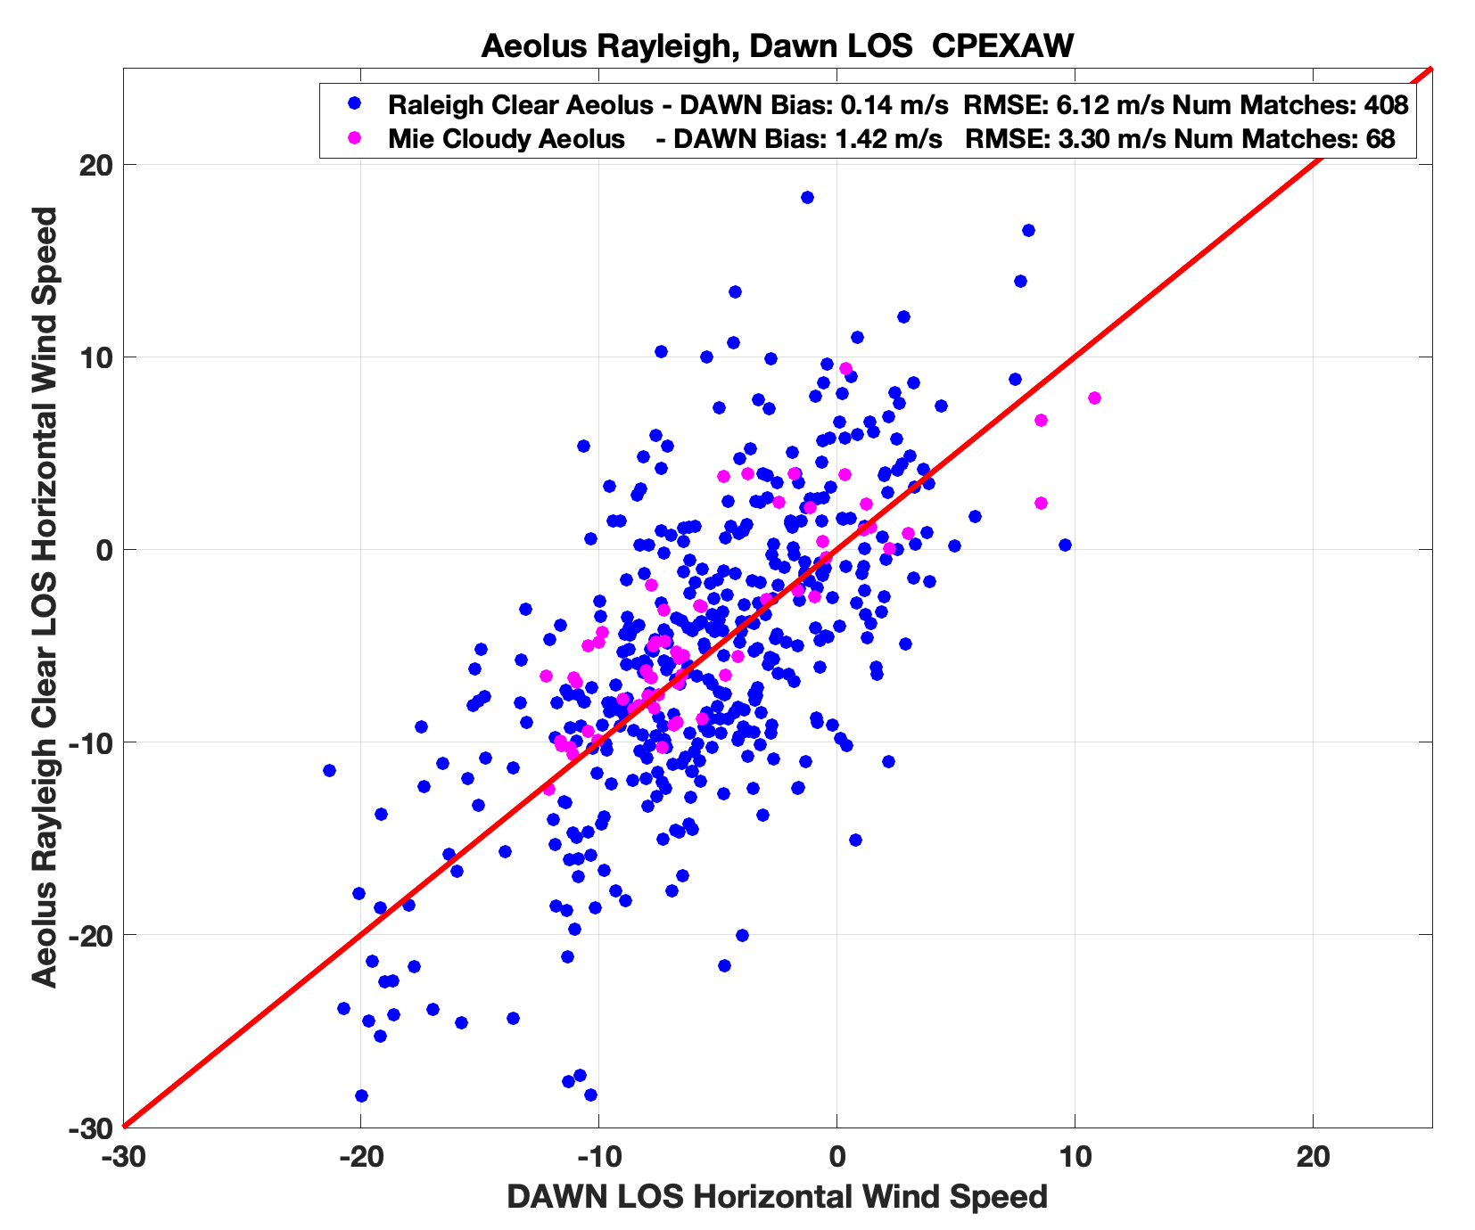
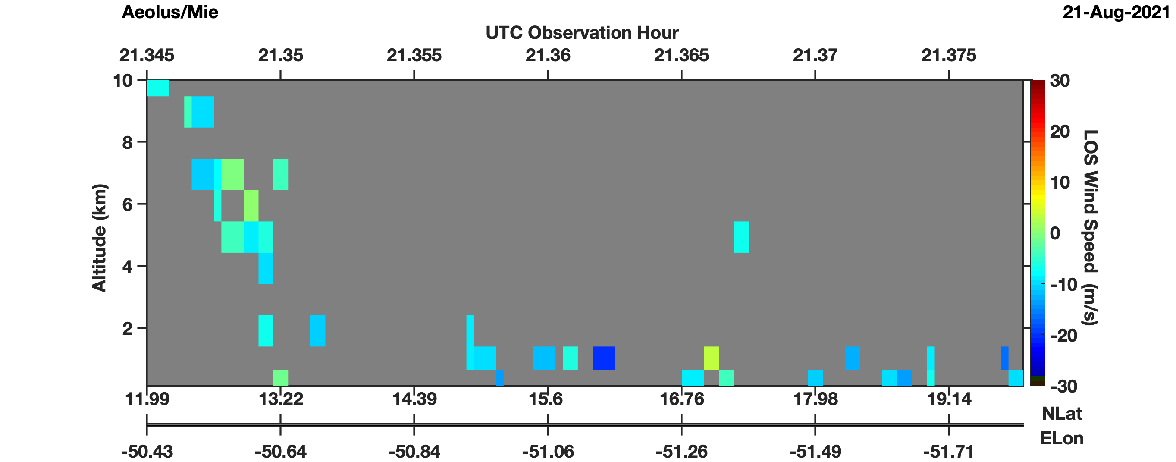
DAWN Comparisons With Aeolus
21 August 2021
DAWN Averaged To Aeolus Rayleigh Resolution
Aeolus Rayleigh Clear
Aeolus Mie Cloudy
DAWN data averaged to Aeolus Mie and Rayleigh resolutions. DAWN outliers removed from averaging. DAWN vector winds projected to Aeolus beam orientation
Mie Cloudy (Rayleigh Clear) Expected Error of 5 m/s (8 m/s) used to filter Aeolus data
Data compared for 5 flights (Flights 1-5) where DC-8 flew simultaneously or close in time to Aeolus
Aeolus well correlated with DAWN with 0.14 (1.42) m/s bias and 3.30 (6.12) m/s RMSD for Mie (Rayleigh)

Slide 9
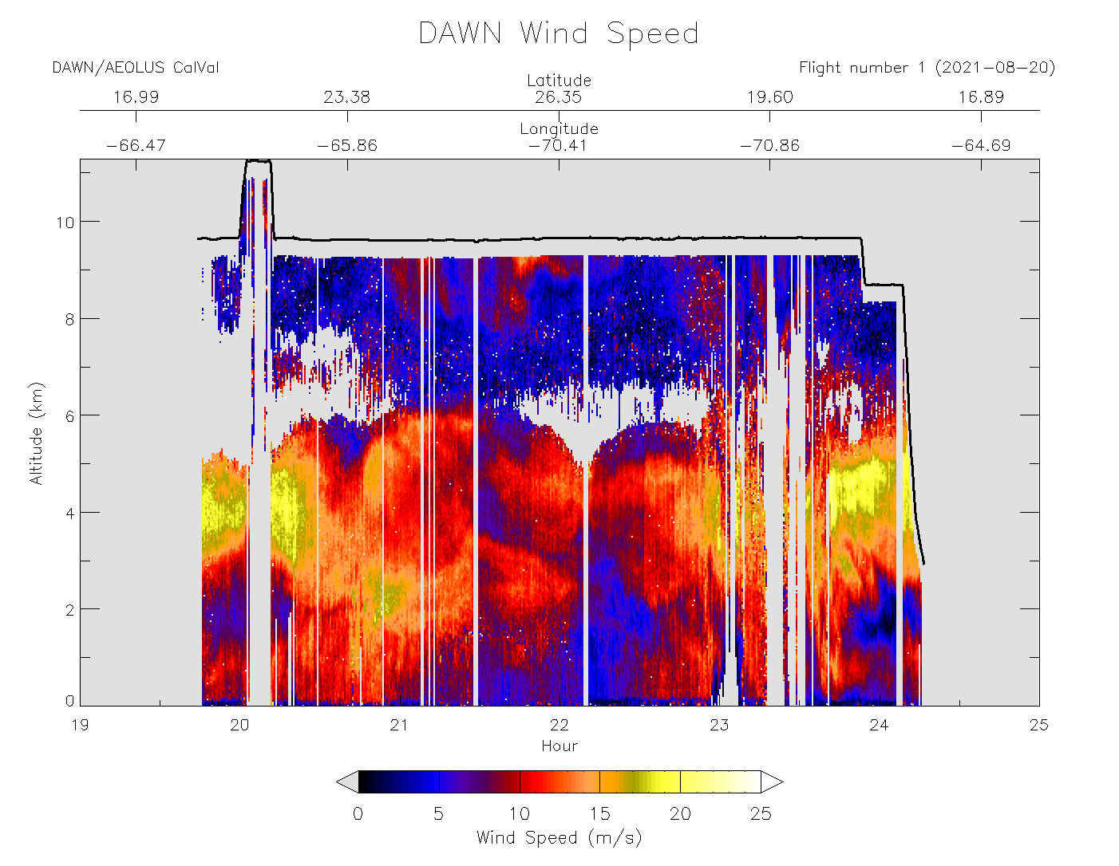
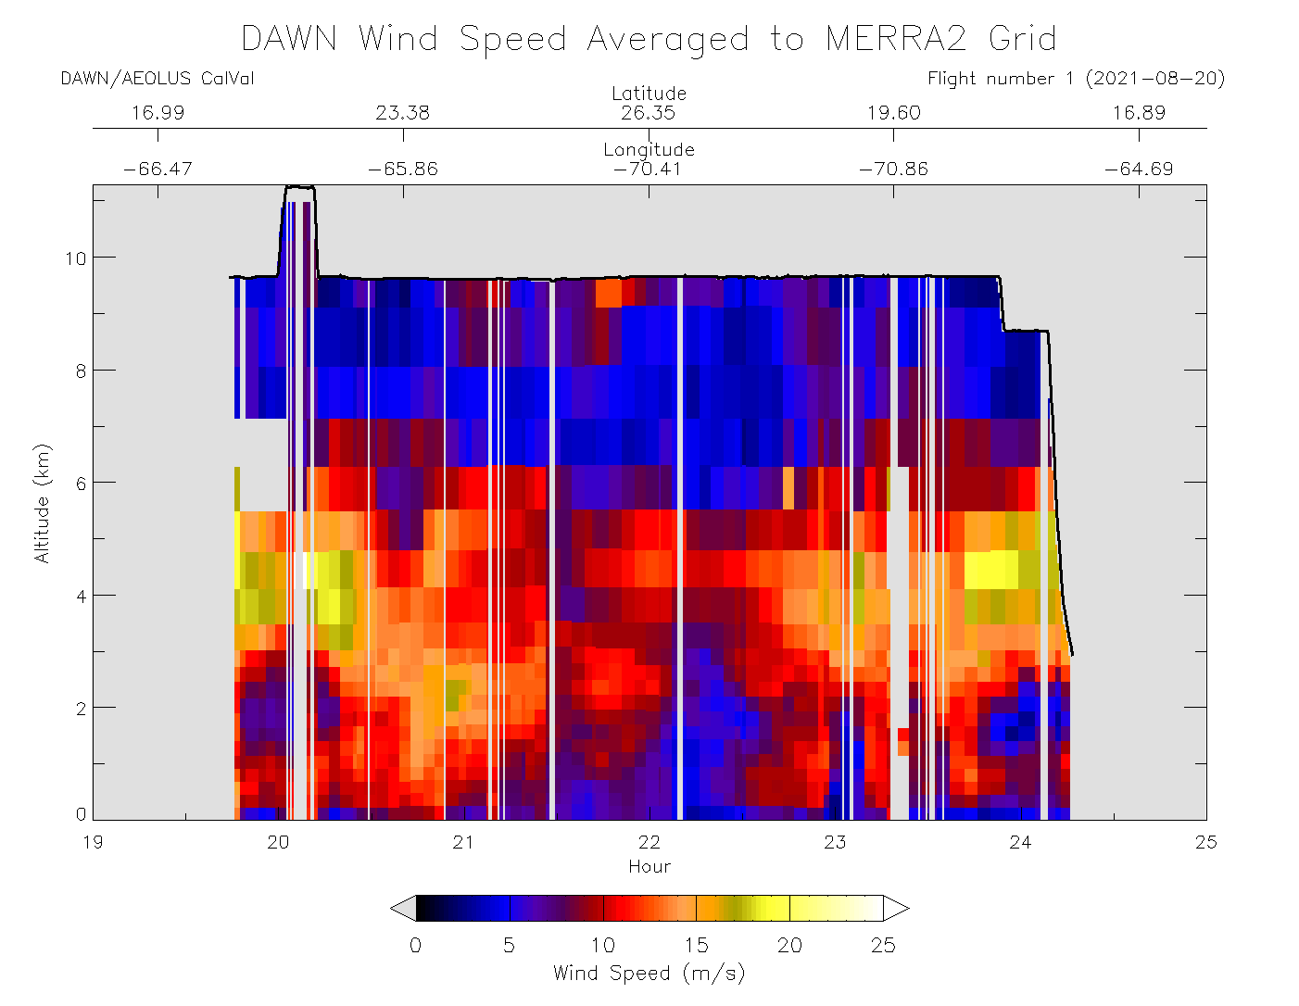
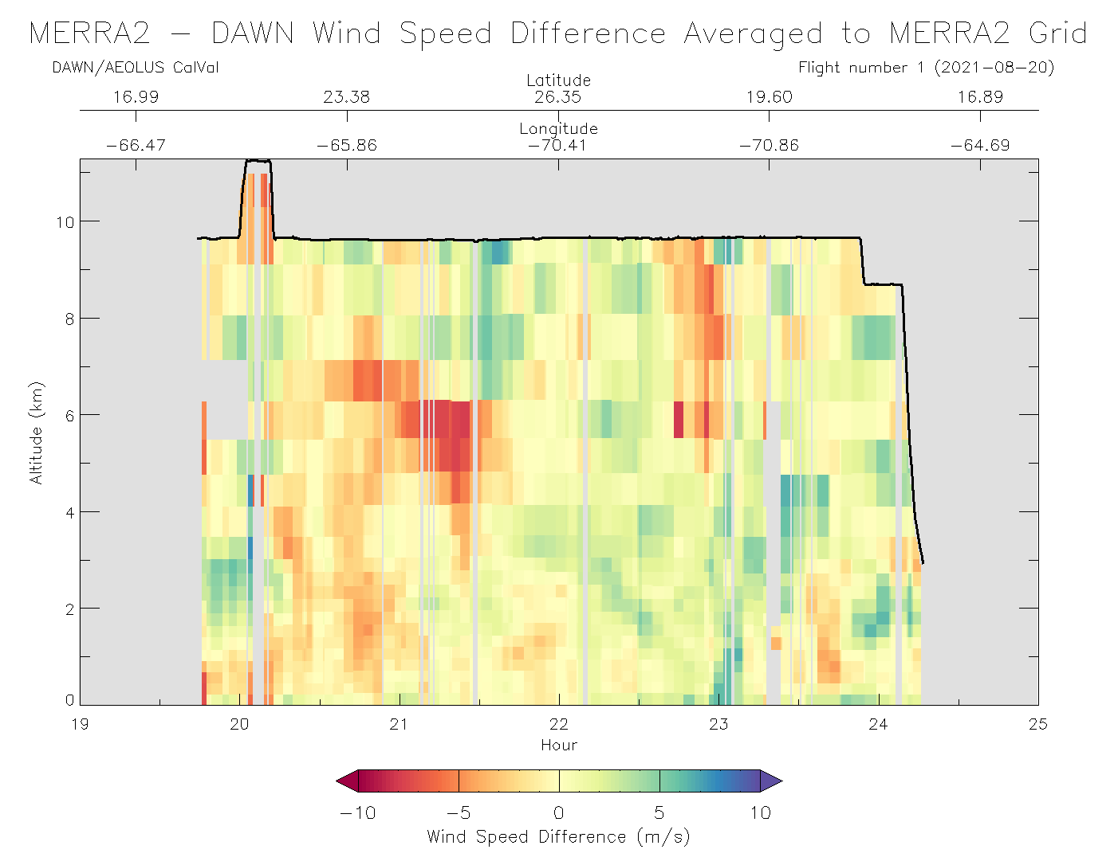
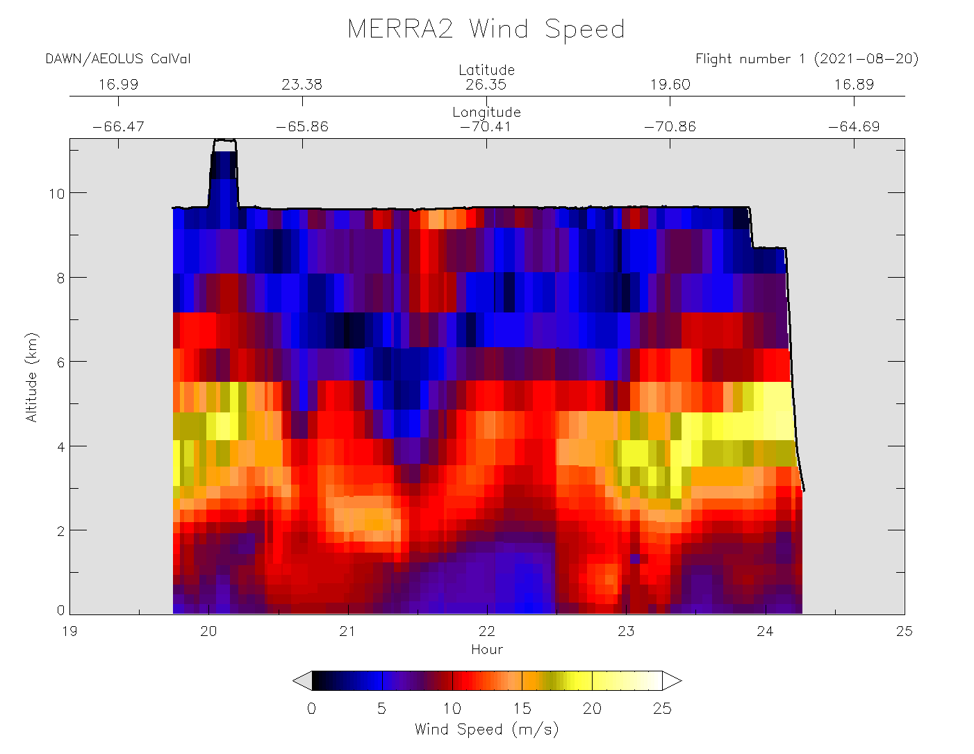
DAWN
MERRA-2
Comparison
20 August 2021
DAWN wind speed averaged to MERRA-2 vertical resolution
DAWN compared in time to nearest 3-hourly MERRA-2 analysis
MERRA-2 underestimated speed atop the SAL layer and in a narrow filament later in flight, but speeds generally agree +/- 5 m/s

Slide 10
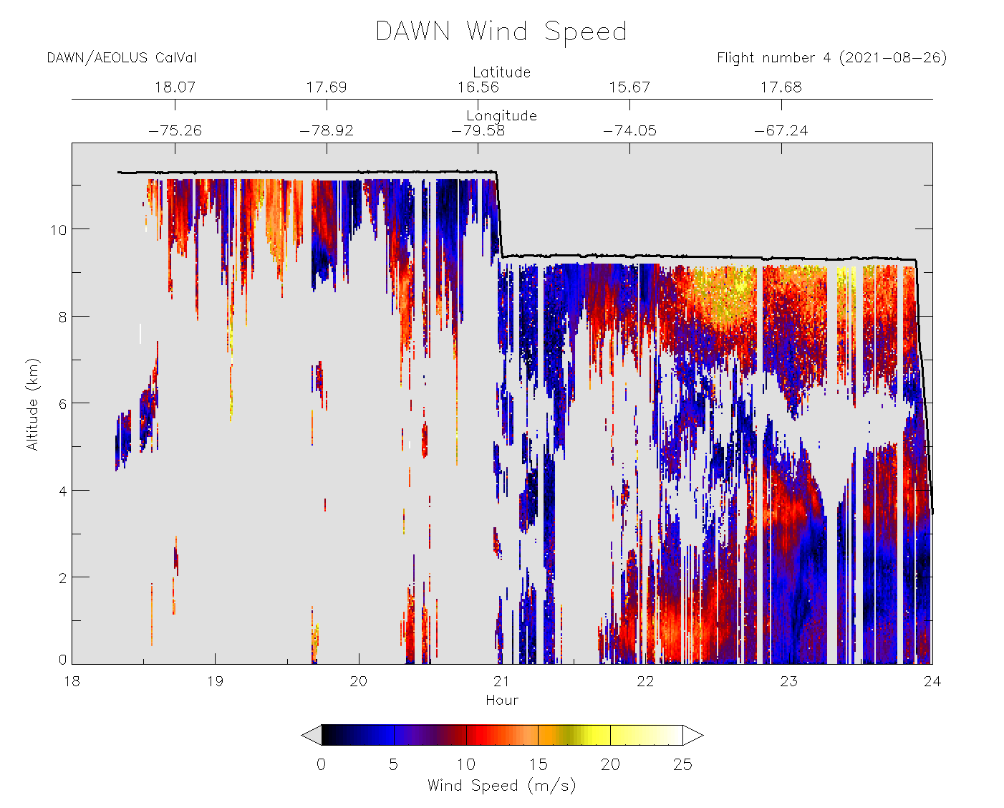
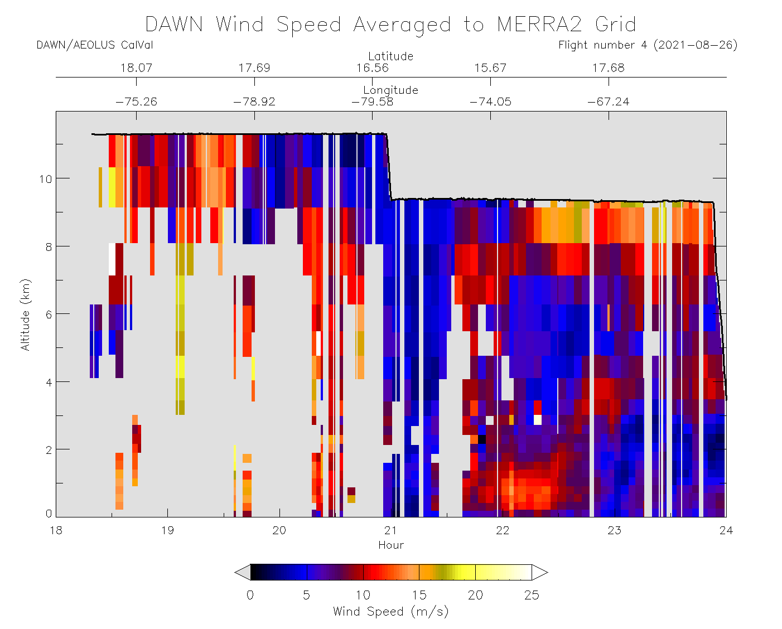
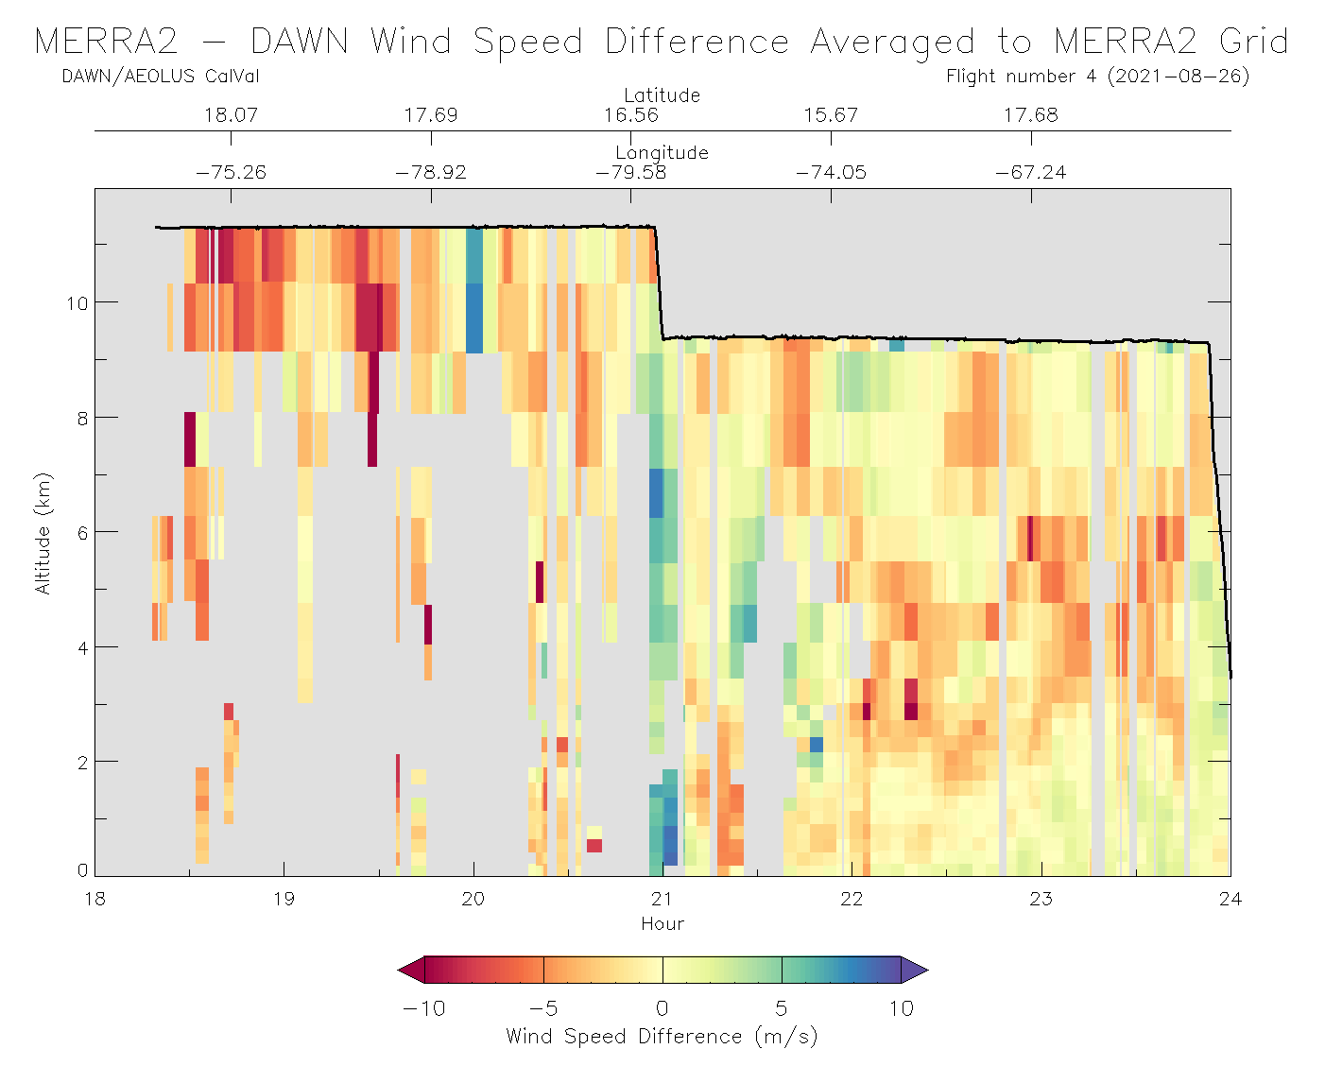
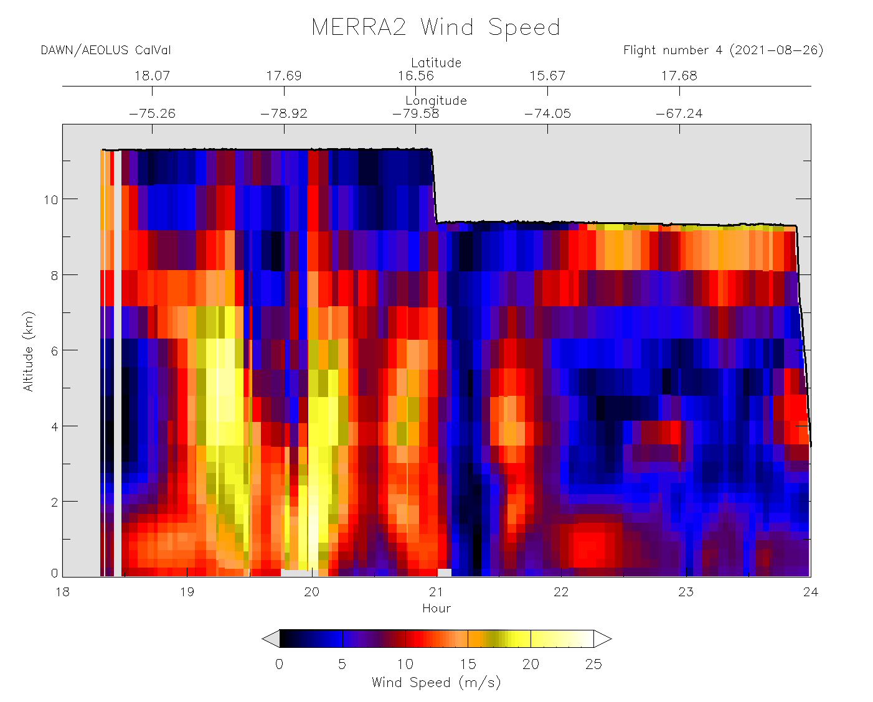
DAWN
MERRA-2
Comparison
26 August 2021
MERRA-2 not depicting Tropical Storm Ida outflow very well, and more often underestimating wind speed than Flight 1

Slide 11
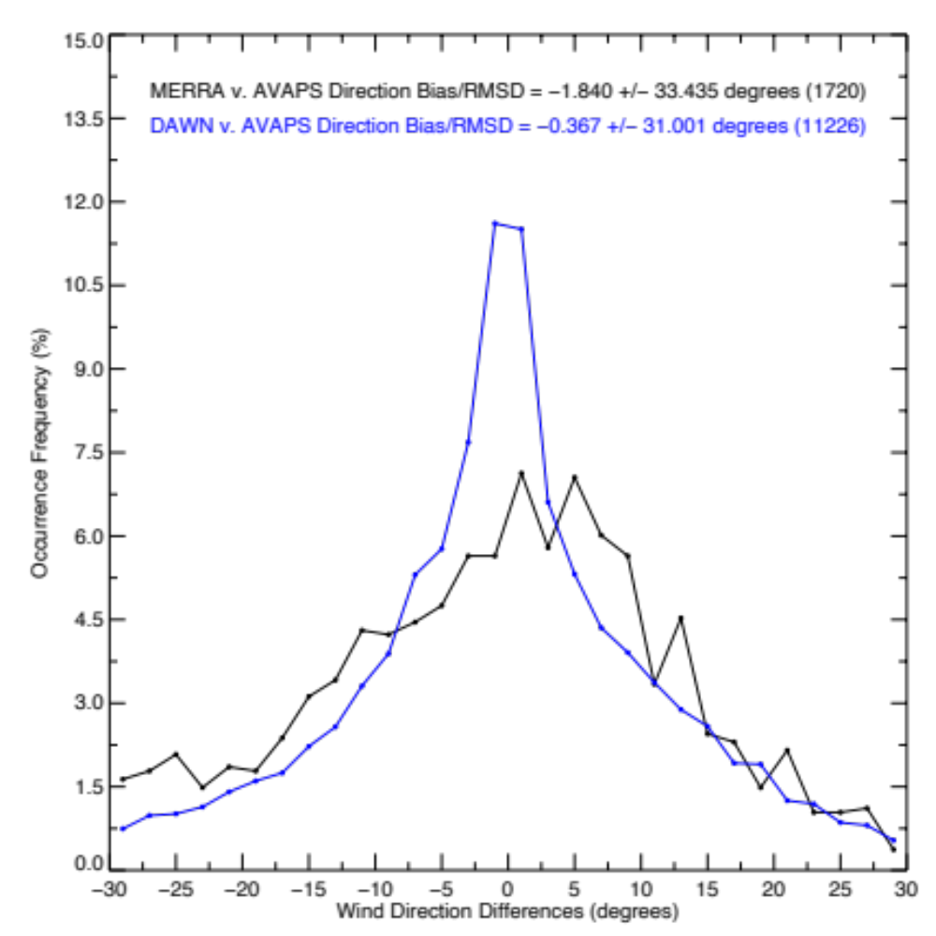
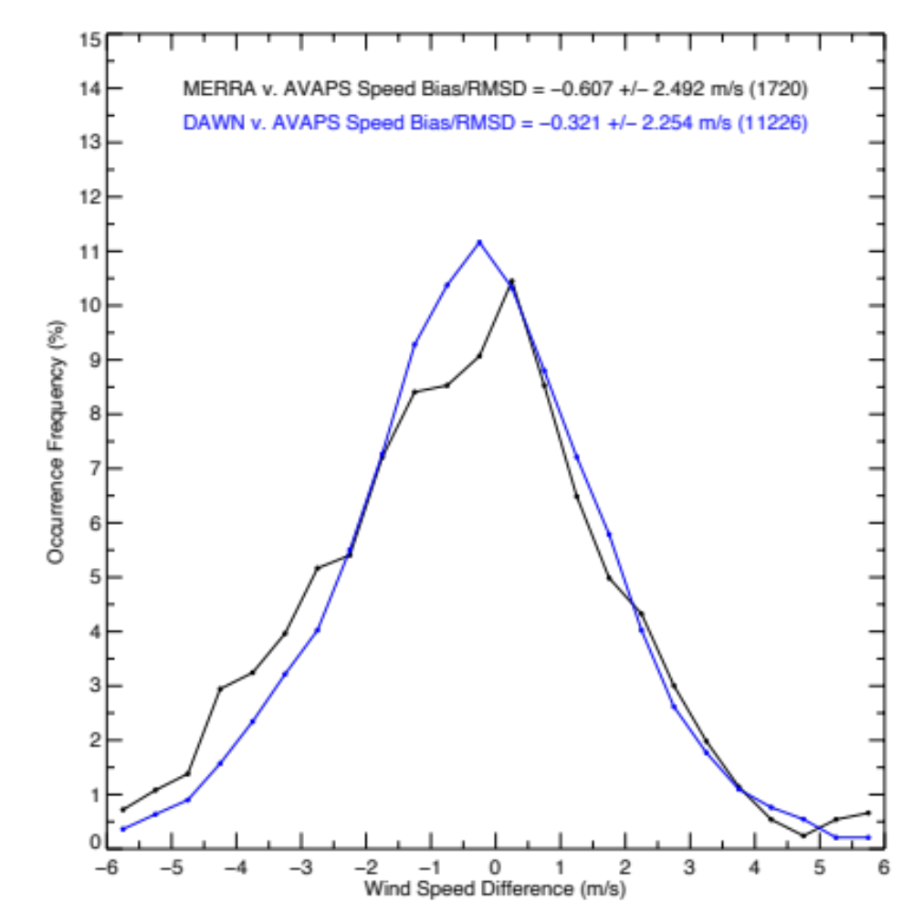
DAWN and MERRA-2 vs. AVAPS Dropsonde
DAWN averaged to MERRA-2 vertical resolution. U and V component outliers > 10 m/s removed
MERRA-2 wind speed uncertainty only slightly greater than DAWN, but with ~2x the slow speed bias
MERRA-2 direction exhibits greater uncertainty

Slide 12
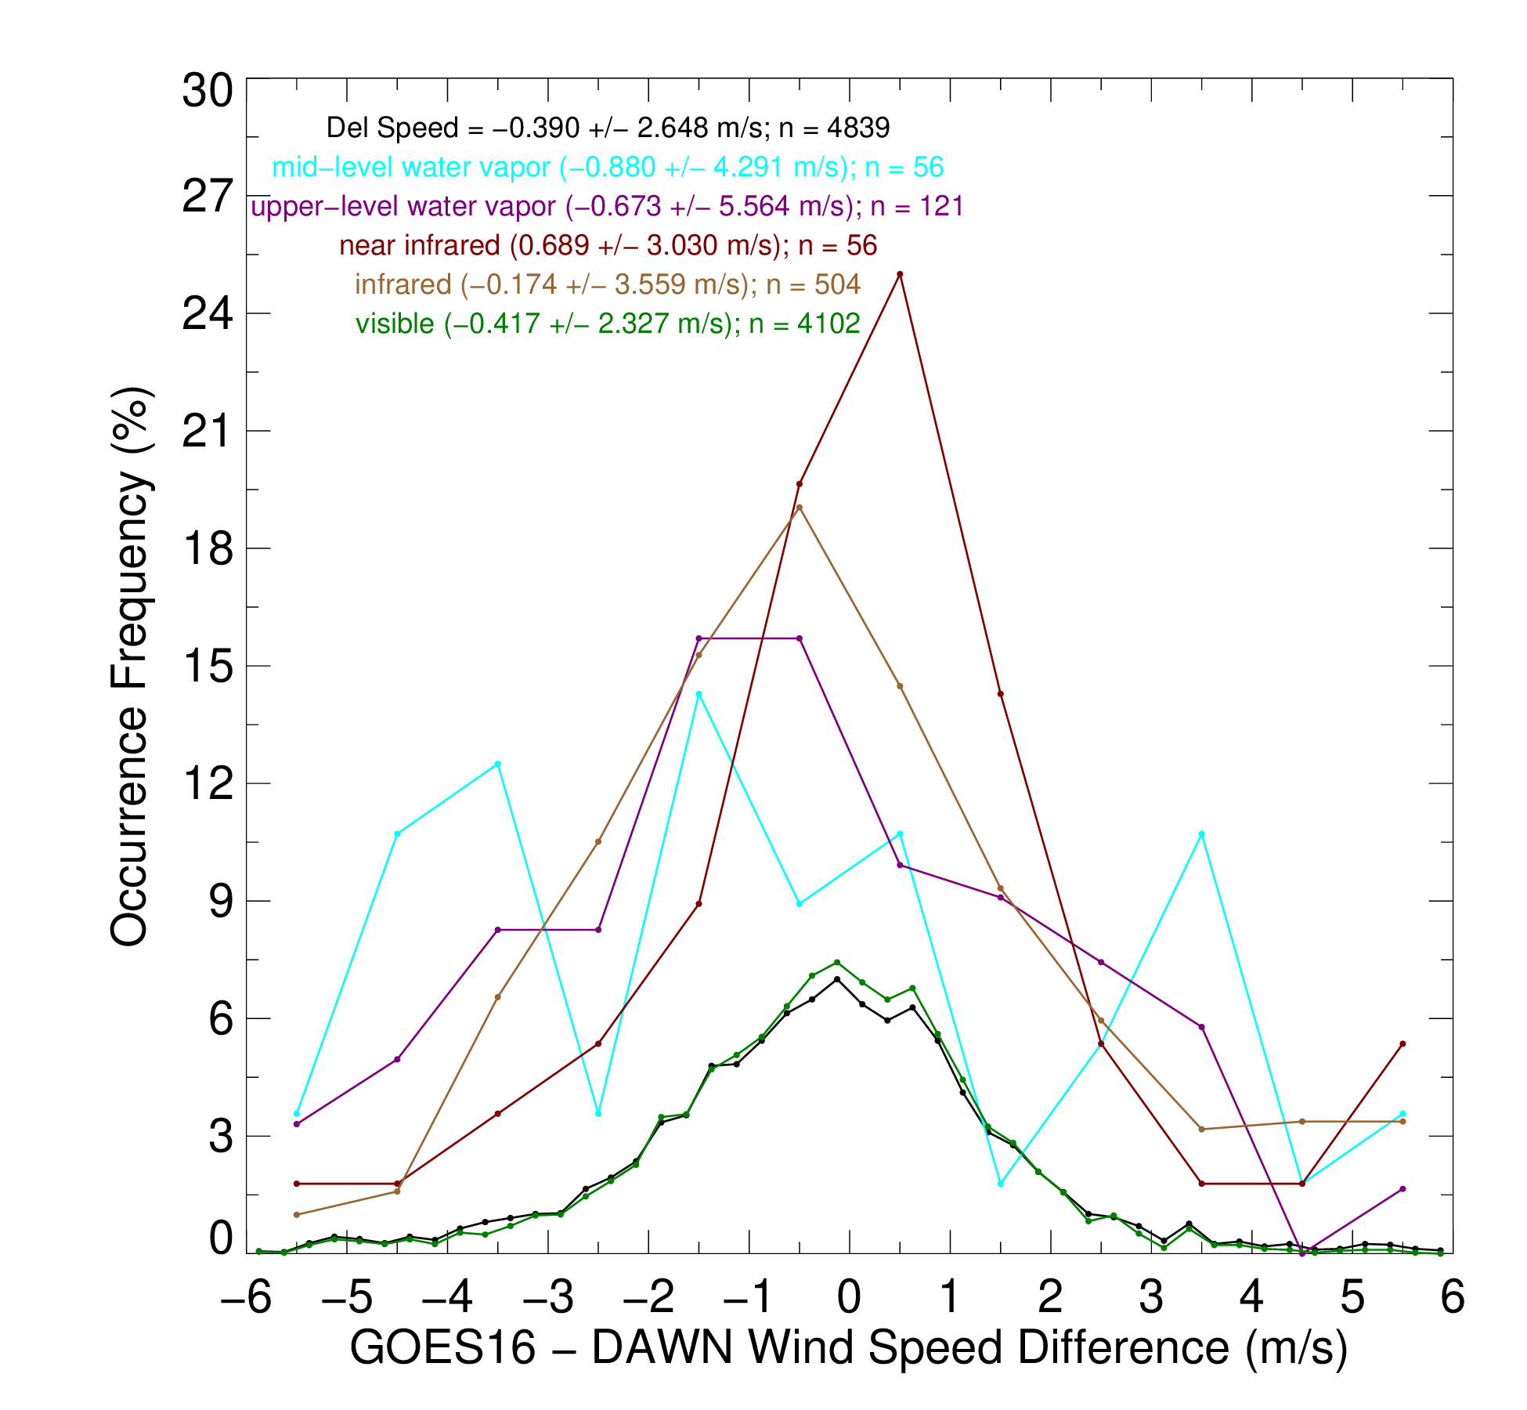
DAWN Validation of GOES-16 AMVs
DAWN – GOES-16 Operational AMV Comparisons
4839 Matches Throughout CPEX-AW Using Full Disk, CONUS, and Mesoscale Scans
Match Criteria: Closest DAWN wind profile spatial match within 15 mins and 250 m vertical. AMV pressure converted to height using MERRA-2
Results
Visible AMVs quite precise. 2.33 m/s RMS and 75% of VIS AMVs within 20% of DAWN speed
10.3 micron IR window AMVs 1.2 m/s less precise than visible
Water vapor AMV height assignment and reduced sample size likely contributing to greater disagreement (4.3 to 5.6 m/s). Better understanding these differences requires additional analysis

Slide 13
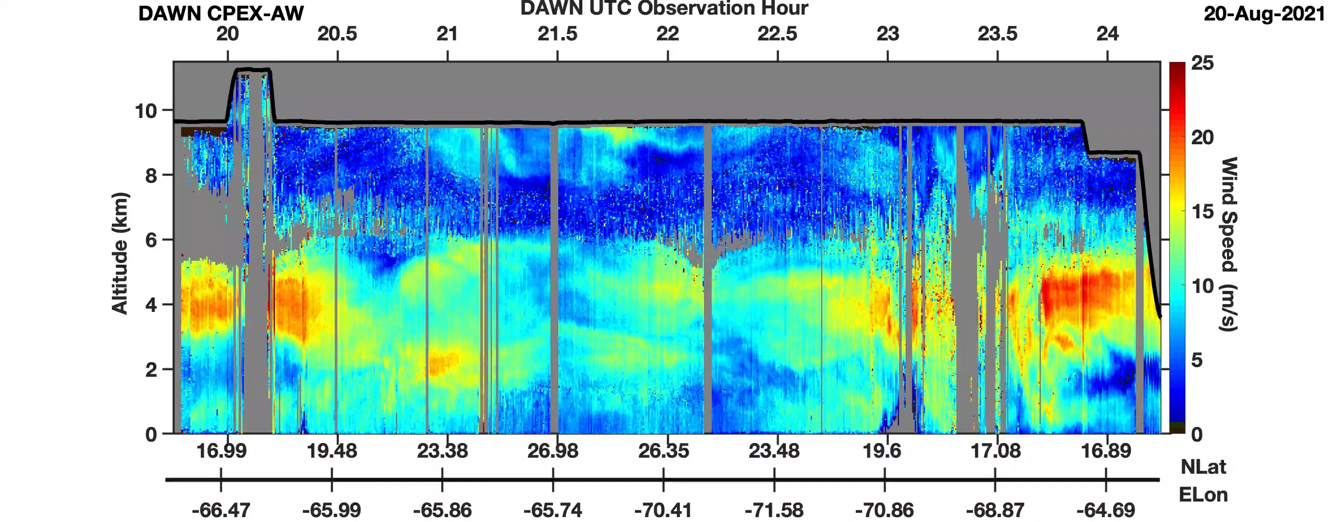
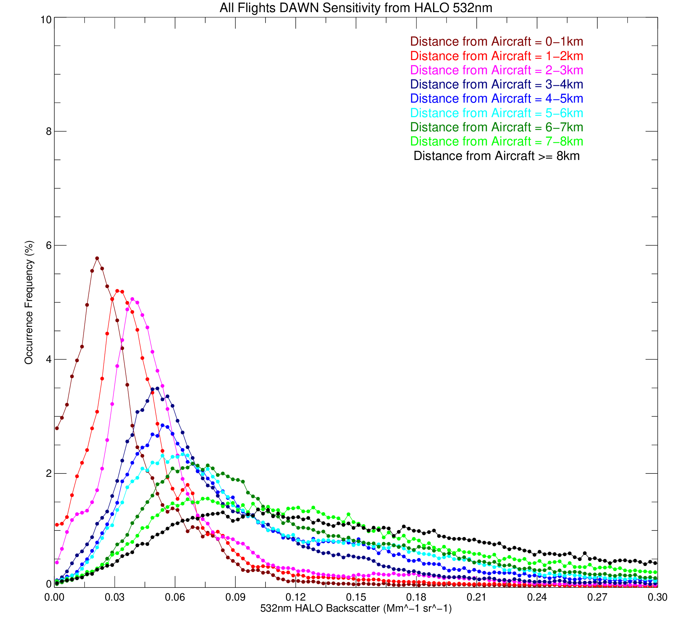
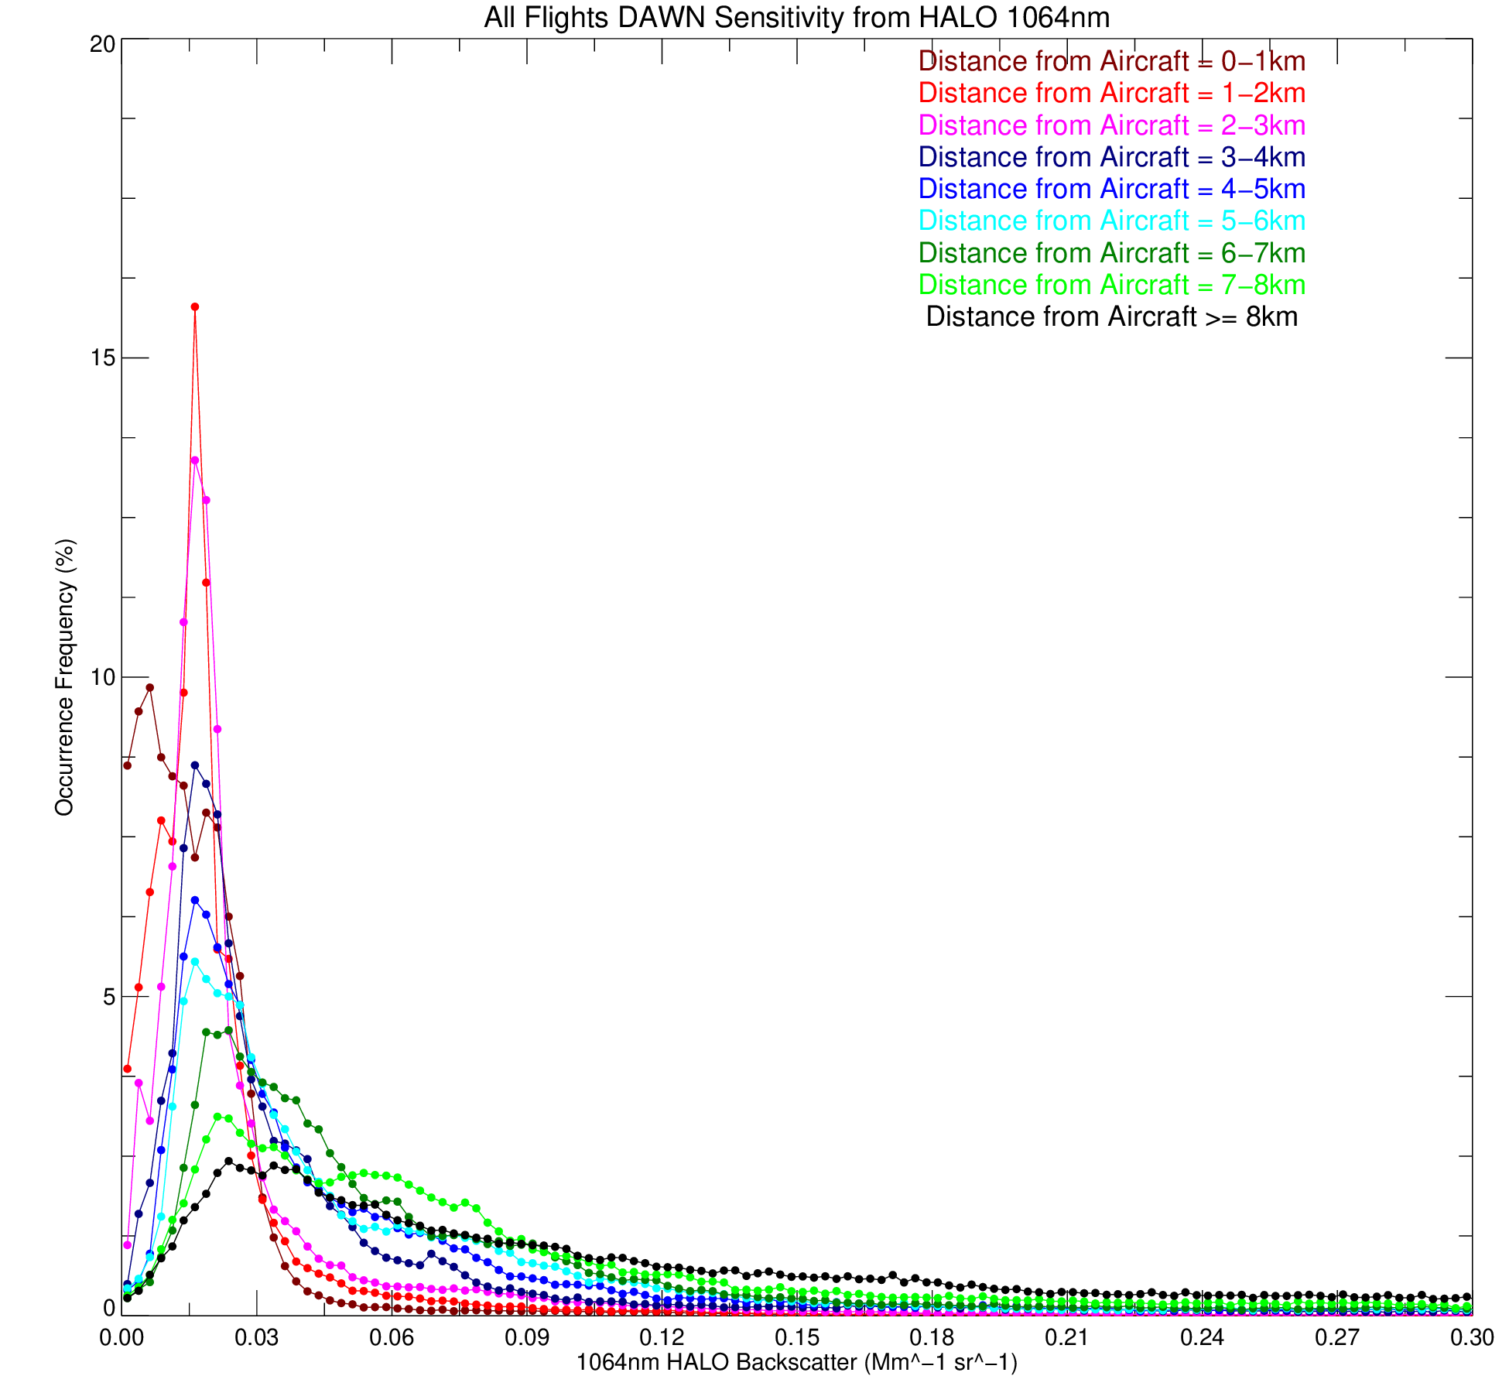
DAWN Wind Retrieval Sensitivity
Relative to HALO Backscatter
Question: What is the lower limit of aerosol backscatter that DAWN can retrieve wind?
Method: Time sync and average HALO backscatter to DAWN 33 meter wind product resolution for 5 Aeolus Cal/Val flights in 2019 and 7 CPEX-AW flights in 2022
Focus on low backscatter region; winds are regularly retrieved for backscatter > 3e-7
Answer to Question: Assuming <= 100 shot integration typical of DAWN operations, winds most often retrieved using single range gate data at 2+ km from aircraft from 4.5e-8 (2e-8) backscatter at 532 (1064) nm
Winds can be retrieved from 10^-9 backscatter with > 300 m vertical integration
Decrease in sensitivity as a function of range clearly evident -> shift in peaks to the right with increasing distance from aircraft
HALO 532 nm
Aerosol Backscatter Coincident with DAWN Wind Retrieval
HALO 1064 nm
Aerosol Backscatter Where DAWN Retrieved Wind
1.5E-8
1.5E-8

Slide 14
Summary and Current / Future Work
Despite an instrument hardware issue that has been fixed since the deployment, DAWN collected ~42 hours of high precision/resolution wind observations throughout CPEX-AW 2021
Analysis of a set of existing wind retrievals and reanalysis indicates wind uncertainty ranging from ~2 to 6 m/s over the days and tropical regions sampled by CPEX
10 Hz single shot LOS winds for cloud process and PBL studies to be released Spring 2022. Wind retrieval using sequential 5-look scan patterns to increase data integration and vertical coverage will also be explored
DAWN and HALO data assimilation in convection-permitting model simulations (e.g. Shu-Hua Chen, Zhaoxia Pu)
DAWN to operate during CPEX-AW 2022. DAWN also to collect some data during NASA High Ice Water Content (HIWC) convection research campaign (Jacksonville, Florida July 2022), to be paired with 1- to 5-min GOES-16 imagery enabling AMV and convection process studies
DAWN being used as truth wind dataset to analyze optical flow AMV retrieval from 1-minute
GOES-16/17 imagery (Jason Apke et al., JAMC, In Prep 2022)
DAWN being used in ground testing for NASA LaRC next-generation airborne wind lidar instrument -> Aerosol Wind Profiler (AWP)

Slide 15
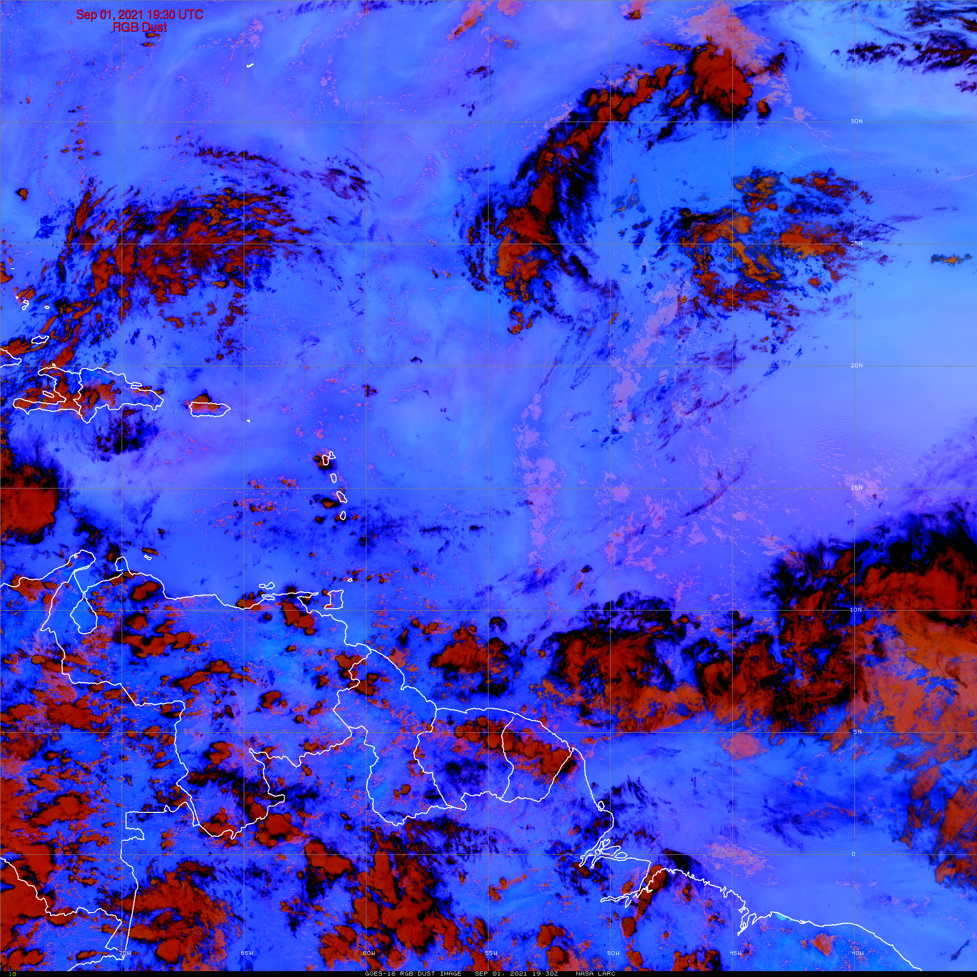
GOES-16 Dust RGB: 1 September 2021, 1930 UTC

Slide 16
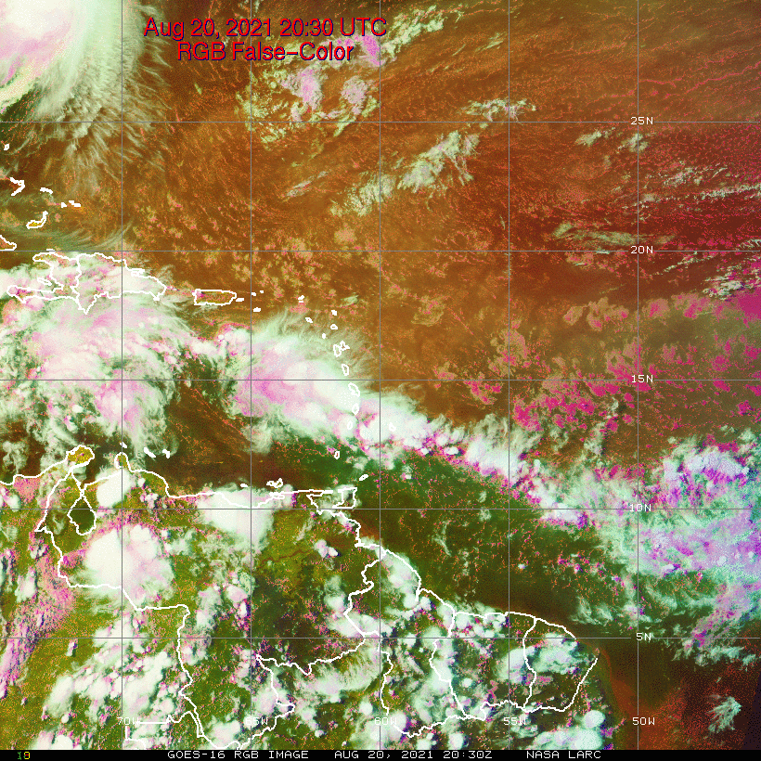
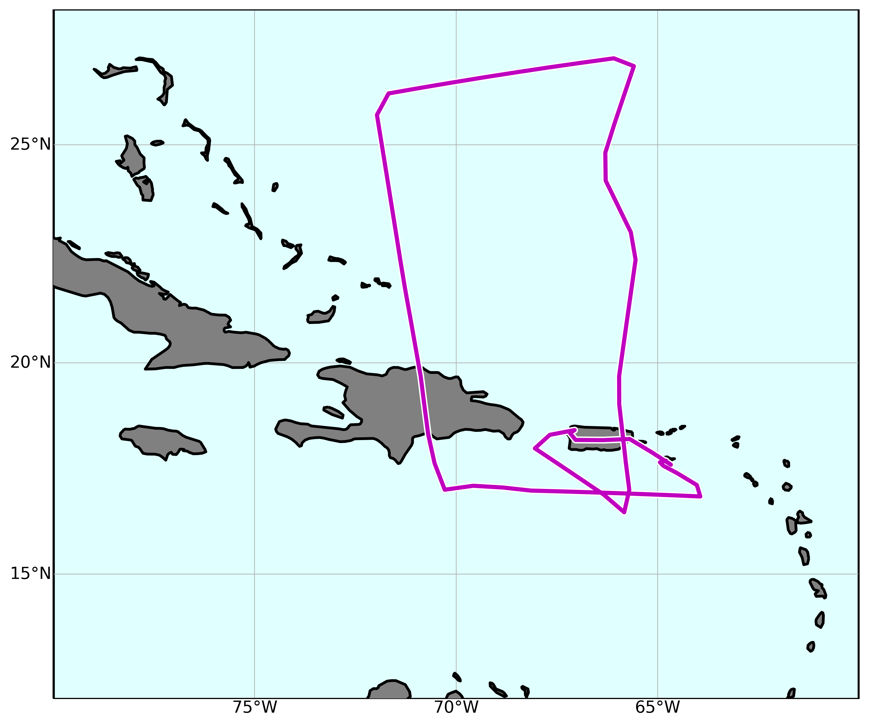
GOES-16 RGB
20 August 2021
SAL
Tropical Airmass

Slide 17
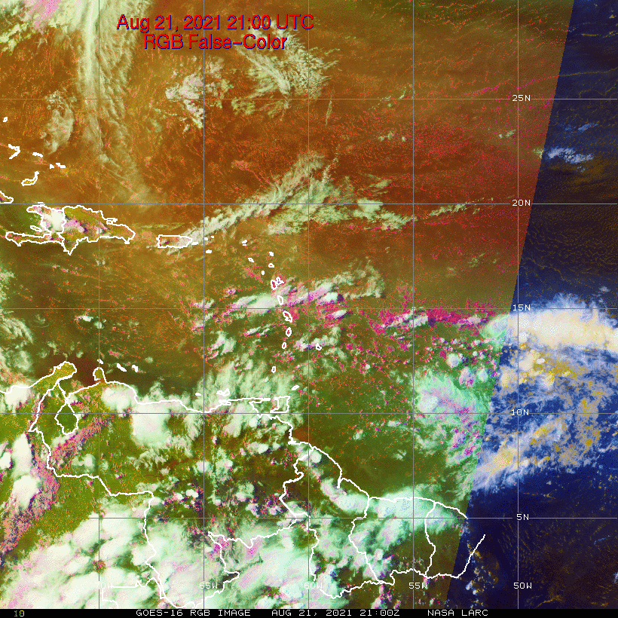
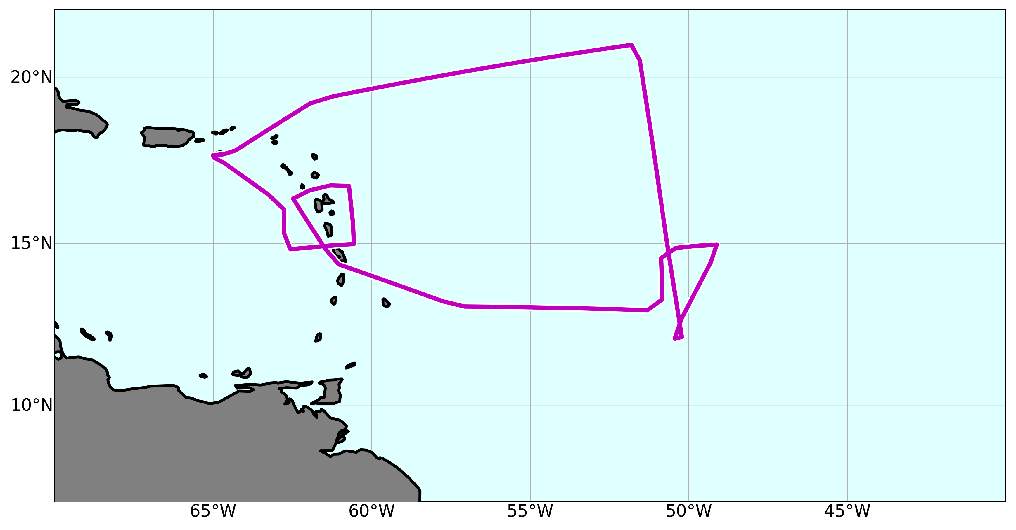
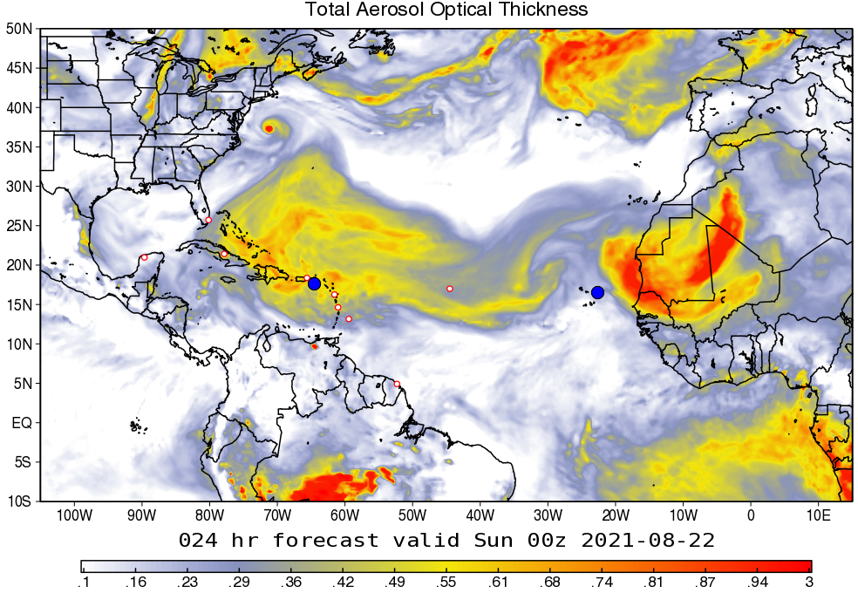
GOES-16 RGB
21 August 2021
Thicker Dust
Thinner Dust
Tropical Airmass

