Slide 1
ISS Plug-in Plan (IPiP) 101
Traci Charles – IPiP Lead
281.244.7649, traci.l.charles@nasa.gov
IPiP Team Distribution List
jsc-dl-ipip@mail.nasa.gov
https://home.iss.nasa.gov/om/ipip

Slide 2
Overview
Agenda
Introduction
What is a Plug-in?
UOP/SUP Power Requirements
IPiP Schedule
IPiP Forms
FAQs and Notes
Conclusion
Backup
  Form Completion Guide
  US Lab UOPs: Most Requested Aisle-Deployed Locations
  Acronym List

Slide 3
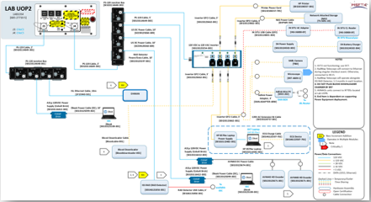
Introduction
The IPiP Team coordinates and develops an integrated plug-in plan each Increment for Payload and Systems hardware. IPiP delivers the baselined plan to FOD/ PLUTO for real-time execution.
  Example of Baselined IPiP Schematic

Slide 4
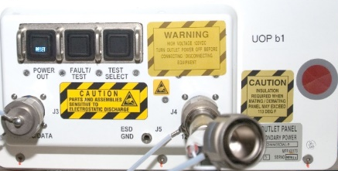
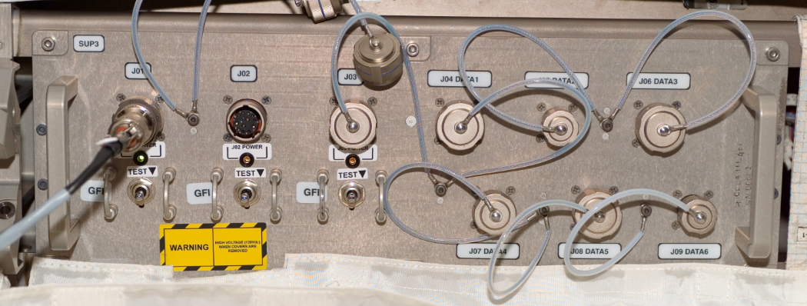
What is a Plug-in?
IPiP tracks end items (also called portable loads) that are IVA hardware which receive power from the ISS EPS Secondary Hardware Subsystem through a UOP or SUP
  UOPs are located in US Lab, US Airlock, Nodes, and JEM
  SUPs are located only in Columbus Module
IPiP does NOT track items that receive power from the following
  Internal Camera Ports (ICPs)
  ExPRESS Racks
  Russian Segment: specifically, items designed for operation ONLY in the Russian Segment
Utility Outlet
Panel (UOP)
COL Standard
Utility Panel (SUP)

Slide 5
UOP/SUP Power Requirements
End Item Hardware using a UOP or SUP must:
Draw a voltage of 120 VAC, 120 VDC, or less
Utilize a current of less-than the hardware maximum
  12A for UOP
  10A for SUP
Cable Item
or SSE Hardware
Power Conversion Item
Cable
Item
End Item
Hardware

Slide 6
IPiP Schedule
I-8m
IMT
~I-8m Kickoff
First Call for IPiP Forms
I-6m
IMT
~I-6m
Pre-IOR Call for IPiP Forms
I-4m
IOR
Present IPiP, PLUTO & IP Approved Hardware
~I-1m
I-1.5m
IP + PLUTO Baseline
Meeting
Post IP + PLUTO Baseline Data to IPiP Website
CoFR

Slide 7
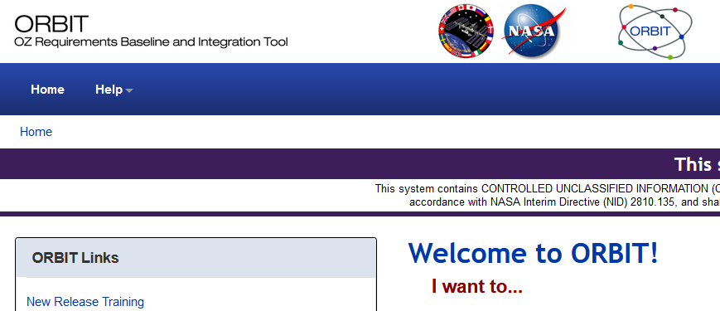
IPiP Form for Payloads
Change Evaluation Forms (CEFs)
Payloads need a CEF for each Increment in which they operate
  One IPiP CEF cannot be used for multiple Increments and must be cloned for subsequent ones
Located on the ORBIT website
  See Backup slides for form completion help
ORBIT Website

Slide 8
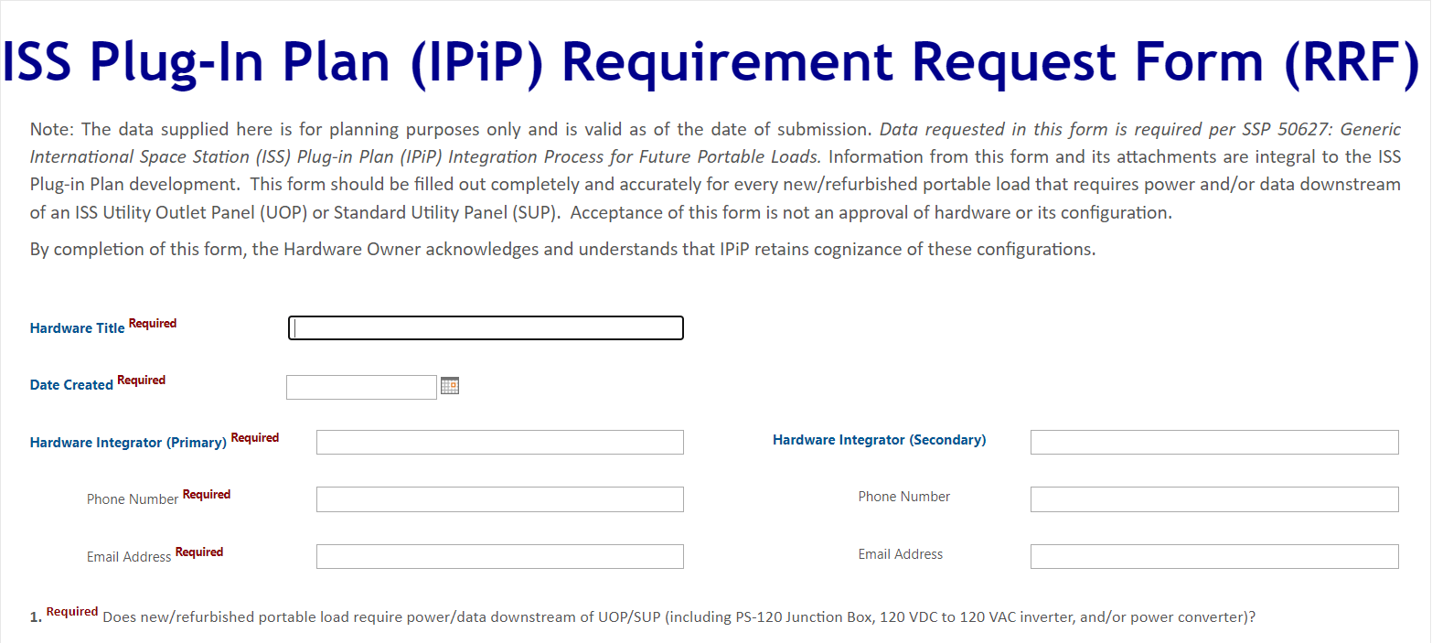
IPiP Form for Systems
Requirement Request Forms (RRFs)
Systems need an RRF that indicates each Increment in which they operate
  One IPiP RRF may be used for multiple Increments if the planned Increments are all listed
Located on the IPiP RRF SharePoint site
  See Backup slides for form completion help
RRF SharePoint

Slide 9
FAQs and Notes
Who should complete the CEF or RRF?
  Technical personnel such as PIMs or project engineers. The PD or other technical POC may submit as needed and as coordinated with the PIM. The submitter must have access to the NDC domain as the forms are within the NASA firewall
Do I need a new CEF if my payload slips to a later Increment?
  Not necessarily
    If the CEF is still open, no new CEF is needed. Updating the Increment field is sufficient
    If the CEF is not still open, the IPiP Team will walk you through the next steps
Do I really need to clone my CEF each Increment for my payload?
  Yes, otherwise, the IPiP Team has no way to track that the hardware needs to be incorporated in the Increment Baseline

Slide 10
FAQs and Notes, ctd
Do I need to pass PQ and EMI testing prior to incorporation into the IPiP Baseline?
  Yes, and inform the IPiP Team when the results are complete. If results will be in VERITAS, inform IPiP when they are uploaded
  Some exceptions may apply on a case-by-case basis
Power outlets are in short supply and generally timeshare power connections with other users, based on ISSP requirements and priorities. Deployment of hardware depends upon availability of crew time to deploy IPiP support hardware such as PS-120 Junction Boxes, AC Inverters, etc.

Slide 11
Conclusion
Cutoff for IPiP completed request forms is at Increment-2 months
  Request forms and supporting data not fully processed at that time will not be included in the IPiP Baseline Configuration and will require a Chit to be added to the real-time plug-in power plan
  In-work and baselined data are posted on the IPiP Increment Products Webpage

Slide 12
BACKUP

Slide 13
Form Completion Guide
CEFs
  From the ORBIT website
    Select Launch Application > “ORBIT Functions” > Research Planning (RIFD) > “New Change Package”, Change package label = Plug-in Plan for “Hardware Title” > “Create CP”
RRFs
  From the IPiP RRF SharePoint site
    Select “new item” at the upper left side and complete the fields. This site retains responses upon clicking “Submit.” If you need to stop for any reason, click “Save” and continue it at a later time
Additional instructions for both CEFs and RRFs are linked on the IPiP RRF Sharepoint site

Slide 14
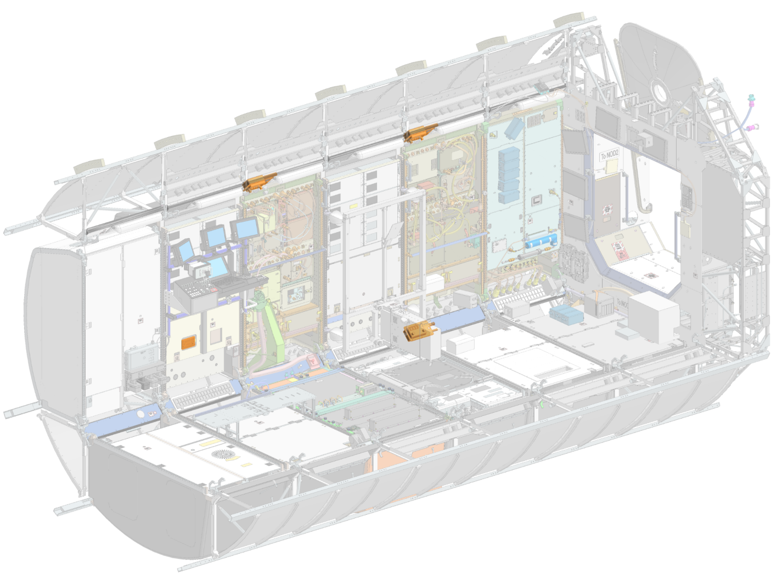
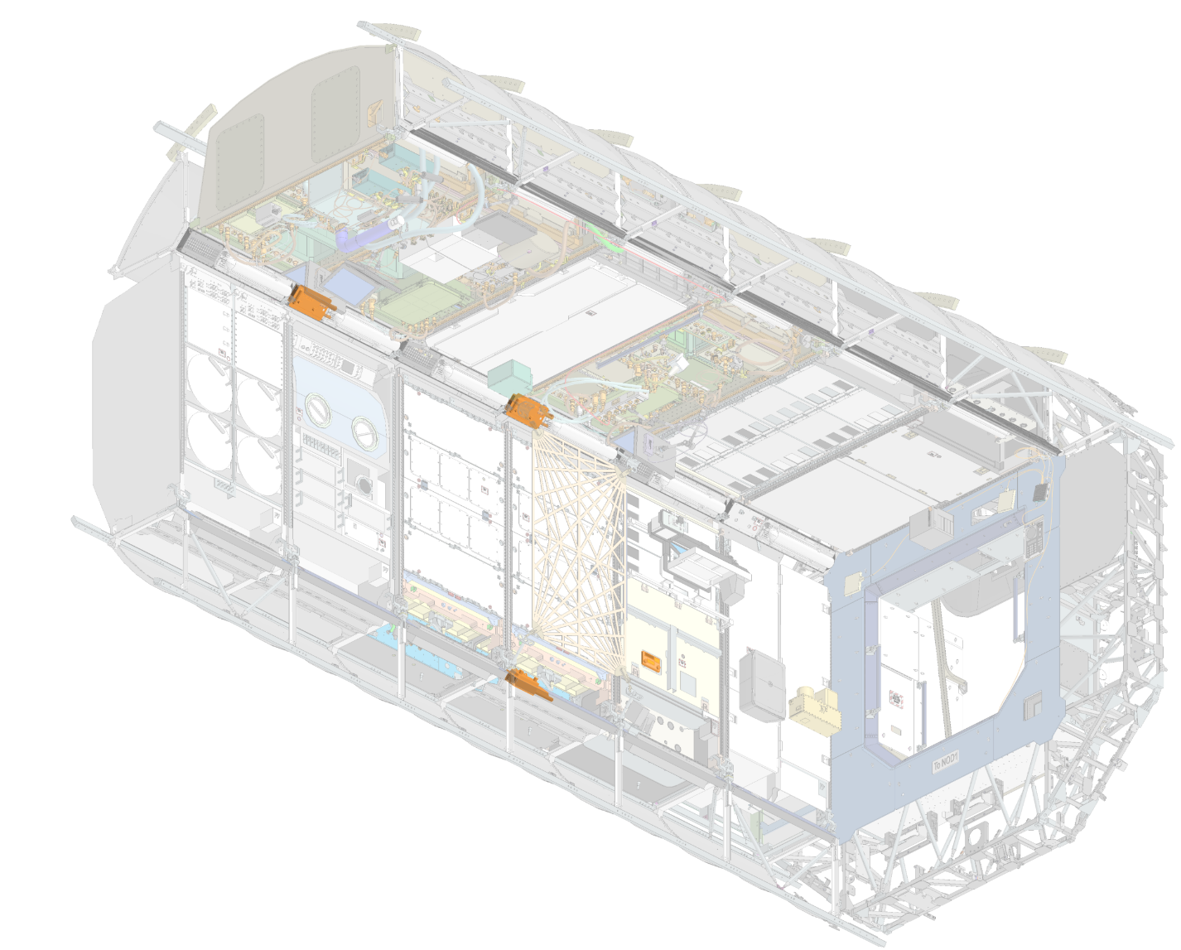
US Lab UOPs: Most Requested Aisle-Deployed Locations
LAB UOP3
LAB1OP2
LAB UOP4
LAB1OP4
LAB UOP7
LAB1P5
LAB UOP5
LAB1PD2
LAB UOP1
LAB1OS2
USL Forward-Port-Deck
LAB UOP2
LAB1OS4
LAB UOP8
LAB1S5
LAB UOP6
LAB1SD4
USL Aft-Starboard-Overhead

Slide 15
Acronym List
Acronym | Definition |  | Acronym | Definition
AC | Alternating Current |  | IVA | Intravehicular Activity
CEF | Change Evaluation Form |  | JEM | Japanese Experiment Module
CoFR | Certification of Flight Readiness |  | NDC | NASA Domain Credential
COL | Columbus |  | ORBIT | OZ Requirements Baselining and Integration Tool
CP | Change Package |  | PD | Payload Developer
EMI | Electromagnetic Interference |  | PIM | Payload Integration Manager
EPS | Electrical Power System |  | PLUTO | PLug-in port UTilization Officer
FOD | Flight Operations Directorate |  | POC | Point of Contact
HSFTIC | Human Space Flight Technical Integration Contract |  | PQ | Power Quality
I-# | Increment minus [timeframe] |  | RIFD | Research Investigation & Facility Database
ICP | Internal Camera Port |  | RRF | Requirement Request Form
IMT | Increment Management Team |  | SUP | Standard Utility Panel
IOR | Increment Operations Review |  | UOP | Utility Outlet Panel
IPiP | ISS Plug-in Plan |  | USL | US Lab
ISS | International Space Station |  | VAC | Volts Alternating Current
ISSP | International Space Station Program |  | VDC | Volts Direct Current

