Slide 1
An Incomplete History of the NASA Radiation Protection Standard for Fatal Cancer
S. Robin Elgart
Space Radiation Element Scientist
NASA Human Research Program
Notes:
Hi Everyone! For those of you who don’t know me, I’m Robin Elgart the Space Radiation Element Scientist for NASA’s Human Research Program. First I want to take the organizers for inviting me here to speak with you about the evolving space radiation recommendations and standards. Today I'll be giving you what amounts to an incomplete history of the NASA radiation protection standard for fatal cancer. I do want to mention that although i’m focusing on the fatal cancer standard today, there are other standards and limits that apply to non-cancer outcomes.

Slide 2
Overview
Introduction
Coevolution of Radiation Risk Recommendations and NASA Standards (1958 – 2022)
Summary
Notes:
I don’t have a ton of time so I’ll start y’all off with a brief introduction, then jump right into the coevolution of the recommendations for radiation health risks and the NASA standards, and round out with a quick summary.

Slide 3
Introduction
NASA was given the authority by congress “to make, promulgate, issue, rescind, and amend rules and regulations governing the manner of its operations and the exercise of the powers vested in it by law”
  National Aeronautics and Space Act – 1958 §203(b)(1)
  https://catalog.archives.gov/id/299868
NASA aims to minimize risks of spaceflight by defining Permissible Exposure Limits (PELs) or Outcome Limits (POLs)
Space radiation recognized as a health risk early in the space program
Notes:
In order to enable human spaceflight, NASA was given the authority by congress ““to make, promulgate, issue, rescind, and amend rules and regulations governing the manner of its operations and the exercise of the powers vested in it by law” under the National Aeronautic and Space Act of 1958.

Slide 4

Pre-NCRP Recommendations
Radiation risk for space flight initiated in 1961
  Ad hoc National Academy of Sciences (NAS) working group under the Space Science Board
Radiobiological Factors in Manned Space Flight (NAS/NRC, 1967)
  “Risk-versus-gain philosophy”
  Emphasis on perspective and consideration of other inherent risks
  Cancer recognized as “principal somatic late effect”
  Proposed a reference “doubling dose” of approximately 4 Sv
Re-examined in 1983 with new risk estimates from epidemiology
  Same philosophy
  Reduced reference dose to 2 Sv
“the Panel had neither the competency nor the responsibility to evaluate the gain or benefit, but should evaluate potential radiation risk in probabilistic terms.”
“…by comparison, radiation risks were not a first order problem”
“the primary reference risk should correspond to an added probability of radiation-induced neoplasia over a period of about 20 years equal to the natural probability for the specific population under consideration.”
Notes:
“the Panel had neither the competency nor the responsibility to evaluate the gain or benefit, but should evaluate potential radiation risk in probabilistic terms.”
“…by comparison, radiation risks were not a first order problem”
“the primary reference risk should correspond to an added probability of radiation-induced neoplasia over a period of about 20 years equal to the natural probability for the specific population under consideration.”
Equivalent to approx. 4 Sv for the astronaut cohort at the time (specific age group)
Compliance was not mandatory – self-regulation since Apollo

Slide 5
Executive Order 12196 (1980)
“That approval is based on whether the benefit outweighs and justifies the risk”
Mandates all federal agencies comply with Occupational Safety and Health Administration (OSHA) standards
Ionizing radiation is a workplace hazard due to known health risks
  29 CFR 1910.96 – Occupational Health and Safety Administration (OSHA)
29 CFR 1960.18 allows adoption of supplemental standards with OSHA’s approval if “no appropriate OSHA standards” exist
OSHA delegated to Nuclear Regulatory Commission (NRC) to established occupational radiation dose limits for adults (10 CFR 20.1201)
https://www.archives.gov/federal-register/codification/executive-order/12196.html
Notes:
Based on the following:
Limited risk to a small population
Before each mission NASA would conduct a formal radiation hazard appraisal
Pre-flight exposure calculations
Based on proposed mission plan and time line
Radiation environment model
Detailed spacecraft mass distribution model
Radiation transport program
Updated as appropriate
Detailed crew exposure records would be maintained
Adherence to the ALARA principle
Formal operational procedures

Slide 6
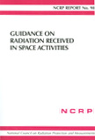
1989 NCRP Report No. 98
Guidance On Radiation Received In Space Activities
“Occupational standards that are used on the ground should not be applied directly to circumstances in space.”
Emphasizes perspective: “…with the other attendant and much larger risks involved in space activities, it seemed inappropriate to be unduly restrictive about radiation exposures.”
“…recommends that for all but exceptional exploratory circumstances in space (e.g., Mars mission, or some such), a career radiation risk limit of three percent for all ages and both sexes be adopted.”
3% lifetime risk equated to approx. 1.5 Sv
  “for the several hundred thousand members of the public with homes having radon levels about 10 times the average, the lifetime risk is also of the order of three percent.”
~ 2X the level for higher exposed terrestrial workers
  Compared to Age x 10 mSv guide value
~ 1/6 background fatal cancer risk for males
~ 1/5 background fatal cancer risk for females
Based on 10-yr career
“permit a reasonable number of missions”
  17 90d space station missions over a 10-yr period for a 25-yr-old male
Notes:
Older astronauts could participate in more
Females would be more limited
For longer careers, risk would decrease

Slide 7
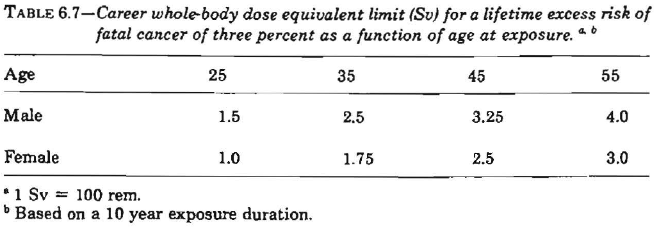
1989 NCRP Report No. 98
Guidance On Radiation Received In Space Activities
Recognized recommendations would change
  More information about radiation risks would become available
  Better assessment tools
Exceptions
  “No specific limits are recommended for personnel
  involved in exploratory space missions, for example,
  to Mars.
  Also, there may be circumstances that require special
  exploratory extravehicular activity that no one can predict
  and, thus, for which specific limits would have little meaning.
  For planning purposes, however, it is recommended that in these cases, in addition to the application of the principles of ALARA, the career limits proposed in Table 6.7 be adhered to as guidelines, rather than as limits, wherever possible.”
In 1990 OSHA approved the use of these recommendations as supplementary exposure standards for NASA (NASA Standard 3000 Vol1)

Slide 8
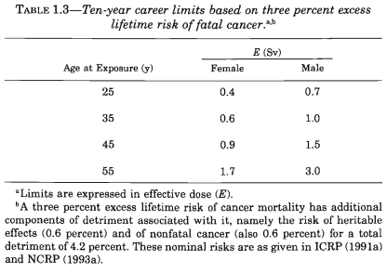
2000 NCRP Report No. 132
Radiation Protection Guidance for Activities in Low-Earth Orbit
Again recommended 3% excess risk limit
  More restrictive due to updated risk estimates (Table 1.3)
“The NCRP continues to recommend gender and age differences in dose limits…because the overall risks per unit dose for women appear higher than for men due to the greater probability of women developing some radiation induced cancers, such as stomach, thyroid and breast (Tables 5.8, 5.9, 5.13), the longer average lifespan of women, and the decrease in risk with age for both sexes.”

Slide 9
2000 NCRP Report No. 132
Radiation Protection Guidance for Activities in Low-Earth Orbit
“It would be a mistake to think in terms of a given dose as corresponding to a precisely known risk of cancer…”
  Uncertainty in specification of the dose
    “…skin or badge dose is likely to exaggerate the effective dose and to be very conservative about the actual risks entailed since they would be substantially less”
  Uncertainty in risk estimates
    “…risk estimates be presented as a distribution rather than a single value.”
    “Estimates of risk on which dose limits for astronauts are based should be recognized as very conservative and possibly subject to modified values when more precise information becomes available.”
“In this report, the guidance is also only intended to be applied for radiation exposures incurred during missions in LEO. Future NCRP reports will deal with other space situations.”

Slide 10
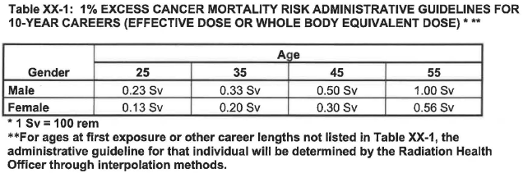
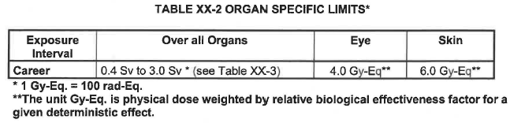
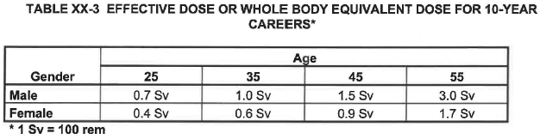
Space & Life Sciences Directorate Change Request (August 2001)
  CR #: SM-FI-0 1 0-1
Set “Administrative Guidelines” for missions
  Require Aerospace Medicine Board (AMB) approval to exceed
      >0.2 Sv within 365-d period prior to and including the mission
      OR
      Excess cancer risk >1% (Table XX-I)
Career Exposure Limits
  Cannot be exceeded
  Includes total occupational exposure and 0.1 Sv “buffer dose”
  Organ specific (Table XX-2) and whole body (Table XX-3) limits
“The goal of this evaluation is to ensure that there is a reasonable rationale for selecting that astronaut, when doing so would push that candidate's excess lifetime risk above the Administrative Guidelines. An increase in excess fatal cancer risk above 1% exceeds what is reasonably achievable for LEO operations.”
Notes:
“In compensation for frequent crew return delays and possible solar particle events, a buffer dose of 0.1 Sv will be added to the sum of the astronaut's career occupational exposure to date plus the projected mission exposure (as determined by the RHO) as criteria for crew selection.”

Slide 11
January 2003(ish)
Letter from SA Director to the Astronaut Office
Subject: Revision of NASA Supplementary Radiation Standards for Astronauts
Outlines changes to radiation standards
  Career Risk Limits (Table 1)
    3% increased fatal cancer risk
      Occupational radiation exposures
      Assumes 10-yr career
    “NASA will assure that this risk limit is not exceeded at a 95% confidence level”
      Estimated using modified NCRP 126 methodology
Provides rationale for update
  Changes to risk estimates
  ALARA “is intended to ensure that dose limits are not approached”
    Define the “ALARA Limit”
    “95% confidence levels for career cancer risks…to account for the uncertainty in quality factors.”

Slide 12
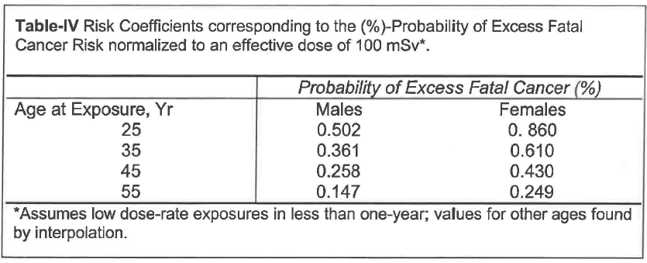
January 2003(ish)
Letter from SA Director to the Astronaut Office
What does this look like in terms of career dose limits?
(mSv)
(mSv)
199
277
388
680
116
164
233
402
*Uses 1% as a proxy for 3% increased fatal cancer risk at the 95% confidence interval
Notes:
Should be referring to NCRP 132 Table I

Slide 13
2007 NASA Standard 3001 Volume 1 (updated in 2014)
4.2.10 Space Permissible Exposure Limit for Space Flight Radiation Exposure Standard
4.2.10.1 Planned career exposure for radiation shall not exceed 3 percent risk of exposure-induced death (REID) for fatal cancer.
4.2.10.2 NASA shall assure that this risk limit is not exceeded at a 95 percent confidence level using a statistical assessment of the uncertainties in the risk projection calculations to limit the cumulative effective dose (in units of Sievert) received by an astronaut throughout his or her career.
4.2.10.3 Exploration Class Mission radiation exposure limits shall be defined by NASA based on National Council on Radiation Protection (NCRP) recommendations.
4.2.10.4 Planned radiation dose shall not exceed short-term limits as defined in table 4 in Appendix F supporting material for the radiation standard.
4.2.10.5 In-flight radiation exposures shall be maintained using the “as low as reasonably achievable” (ALARA) principle.

Slide 14
2020 Radiation Standard Review
Office of the Chief Health and Medical Officer initiated a review of the radiation standard
Clinical Panel (March 2020)
  Mortality (REID) preferred for setting exposure limits
  Incidence (REIC) important for discussing risk posture and crew insight
  NASA should consider an exposure limit higher than 3% REID
  Atomic bomb survivor data needs to be supplemented with an emphasis on radiation induced cancer from occupational cohorts.
  Encourage conversation with astronauts to include their input in risk limits and communication
NAS Study (July 2020 – July 2021)
  Assessed radiation standard framework proposed by NASA
    DOSE LIMIT centered on the MEAN 3% REID for a 35-year-old female
  Provided recommendations
    Proceed
    Re-examine metrics
    Inform
    Communicate
    Waiver protocol and process
    Communication research
  Did NOT assess the risk model
  Did NOT assess the proposed risk level chosen by NASA to determine dose limit

Slide 15
2022 NASA Standard 3001 Vol 1 RevB
Shifted from a RISK limit to a DOSE limit
Anchored using the 3% MEAN REID for a 35-year-old female case
4.8.2 Career Space Permissible Exposure Limit for Space Flight Radiation
[V1 4030] An individual astronaut’s total career effective radiation dose due to space flight radiation exposure shall be less than 600 mSv. This limit is universal for all ages and sexes.
https://standards.nasa.gov/sites/default/files/standards/NASA/B//2022-01-05-NASA-STD-3001-Vol1-Rev-B-Final-Draft-Signature-010522.pdf
Notes:
Considered the most protective case

Slide 16
Evolution of Radiation Standards
NCRP Report 98
SA Director Standard Update
Space Science Board Initiates ad hoc Radiation Risk working group
NCRP Report 132
NASA Standard 3001 Vol1 RevA
1958
1974
1990
2006
2022
1966
1982
1998
2014
Radiobiological Factors in Manned Space Flight Report
NASA Standard 3001 Vol1
Space Act Agreement
1% Administrative Guidance
NASA Standard 3001 Vol1 RevB
NASA Standard 3000 Vol1
Notes:
1967 Radiobiological Factors in Manned Space Flight

Slide 17
Historical NASA Crew MISSION Doses
Badge Dose, mGy
650 mSv
NCRP Guidance for Radiation Worker Lifetime Limit for 65yo
600 mSv
NEW NASA Career Radiation Limit
Effective Dose, mSv
Mars Mission
1000
Mars Mission, mSv
Skylab, Mir and ISS
100
50 mSv/yr
Radiation Worker Annual Limit
Hubble Missions
10
Apollo and Shuttle
Mission Dose
Gemini
3.6 mSv
Average US Annual Background Dose
Mercury
1
NOTE: Log Scale
0.1
0
200
400
600
800
Astronaut, i
Modified from Cucinotta et al. Radiat Res (2008)

Slide 18
Summary
NASA recognizes the risk of exposure to space radiation on human health
Recommendations and standards for space radiation protection have evolved since the inception of the space program
  Anchored around a 3% risk value
LEO
All Missions
35-yr old | 1958-1983 | 1983-1989 | 1989-2000 | 2000-2003 | 2003-2022 | 2022
Male | 4 Sv* | 2 Sv* | 2.5 Sv | 1.0 Sv | ~0.3 Sv | 0.6 Sv
Female | N/A | 2 Sv* | 1.75 Sv | 0.6 Sv | ~0.2 Sv | 0.6 Sv
*Reference doubling dose

Slide 19
Thank you for your attention!
jsc-hrp-space-radiation-element@mail.nasa.gov

Slide 20
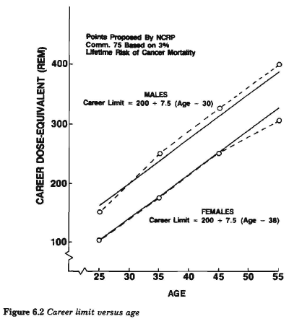
Operationally Calculating Limits with NCRP 98
Determine sex, age, and total dose
Compare to limits in Table 6.7 or Figure 6.2

Slide 21
1989 NCRP Report No. 98
Guidance On Radiation Received In Space Activities
NCRP terrestrial radiation worker recommendations (NCRP Report No. 91, 1987)
  If ALARA (As Low as REASONABLY Achievable) is applied…
    Annual limit: 50 mSv/yr
      50 mSv/yr → 2.5 Sv career dose → 5% excess risk of cancer mortality
        Based on a lifetime risk of 2 x 10-2/Gy
      “Annual repeated radiation exposure at the present limit 50 mSv (5 rem) y-1 is discouraged”
      The “expectation” is that on average workers only receive approx. 2 mSv/yr
        <1% excess risk
    “Lifetime guide value” = Age X 10 mSv
    Single onetime dose for nonstandard situations: 100 mSv
Similar ICRP recommendations
  “The ICRP protection system is aimed at keeping average exposures and most individual exposures low. However, there may be some special tasks or roles within radiation work operations which necessitate higher exposures from the same skilled operators. These should not exceed 50 mSv (5 rem) in a year, but they may approach it.”
  NCRP Report 98: Guidance on Radiation Received in Space Activities: Recommendations of the National Council on Radiation Protection and Measurements. Bethesda, Md: National Council on Radiation Protection and Measurements; 1989.

Slide 22
1989 NCRP Report No. 98
Guidance On Radiation Received In Space Activities
Radiation workers
Fatal accidents in other occupations
Average occupational radiation exposure
  2.1 mSv – too restrictive
  “…results in smaller risks than those experienced in chemical industries (Schottenfeld and Haas, 1979).”
“It seems more reasonable to compare…with a more highly exposed radiation worker”
  50 mSv annual or 2.5 Sv lifetime limit
    Assumes 50 yr career
  Corresponds to approx. 5% lifetime risk
“Safe” occupations: risk <10⁻⁴/yr
  Lifetime risk approx. 1 %
  All known radiation occupations (0.25x10⁻⁴)
  “given the exceptional character of space travel, comparison with the safest occupations on the ground seems unreasonable.”
“More Hazardous”: risk >10⁻³/yr
  Lifetime risk >5%
  “Comparison of the radiation risks with the most hazardous occupations...is also unreasonable because crew members have other additional risks to face.”
“Less Safe” occupations: risk 10⁻⁴ – 10⁻³/yr
  Lifetime risk approx. 2-5%
  “comparison... with the middle group of "less safe" occupations with lifetime risks of about three percent seems the most reasonable.”
  NCRP Report 98: Guidance on Radiation Received in Space Activities: Recommendations of the National Council on Radiation Protection and Measurements. Bethesda, Md: National Council on Radiation Protection and Measurements; 1989.

Slide 23
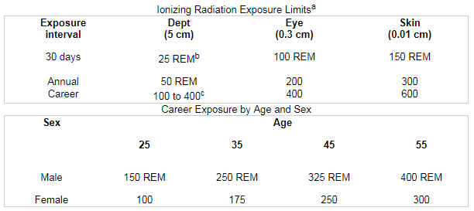
1995 NASA Standard 3000 Vol 1 Rev B
Figure 5.7.2.2.1-1 Ionizing Radiation Exposure Limits for Spaceflight
*NCRP Report No 98 numbers expressed in Rem
FOOTNOTES:
  These space flight crew ionizing radiation dose-equivalent limits, recommended to NASA by the National Council on Radiation Protection and Measurement, (Guidance on Radiation Received in Space Activities-NCRP Report No. 98, July 31, 1989) have been legally adopted as the Agency's supplementary standard in accordance with 29 CFR 1960.18.
  This table is expressed in conventional units due to common usage by the discipline. The SI unit is Sievert (Sv), which is equivalent to 100 rem.
  The career depth dose-equivalent limit as based upon a maximum 3 percent lifetime excess risk of cancer mortality. The total dose-equivalent yielding this risk depends on sex and age at start of exposure. The career dose-equivalent limit is approximately equal to:
    200 + 7.5 (age - 30) rem for males (up to 400 rem maximum)
    200 + 7.5 (age - 38) rem for females (up to 400 rem maximum)
Reference: NASA CR-3855, Vol. II, Raasch, R. F., Peercy, R. L., and Rockoff, L. A., Space Station Crew Safety Alternatives Study, Final Report Vol. II - Threat Development, Rockwell International, NASA - LaRC, 6-85 Table 7-3; NASA-STD-3000 - 416

Slide 24
2000 NCRP Report No. 132
Radiation Protection Guidance for Activities in Low-Earth Orbit
Changes in knowledge and terrestrial guidance
  Increased fatal cancer risk estimates
    Pierce et al. (1996) cancer mortality estimates
      4x10⁻²/Sv for low-dose and low-dose-rate exposure in an adult worker population
  New, more restrictive terrestrial limits issued
    Changed risk estimates using NCRP methodology (NCRP Report No. 116, 1993)
      ICRP: 20 mSv/yr averaged over 5 yr → 3-4% maximum lifetime risk
      NCRP: 50 mSv/yr; Age x 10 mSv cumulative → approx. 3% maximum lifetime risk
“Simply ensuring that limits are not exceeded is inadequate radiation protection policy in space as it is on the ground.”
  Principles of radiation protection
    Justification
      Expected societal benefit outweighs societal costs
    ALARA
      “Appropriate balance between the dose averted and the mission objectives.”
      Economic and social factors
    Limitation
      Ensure acceptable levels of risk are not exceeded

Slide 25
2000 NCRP Report No. 132
Radiation Protection Guidance for Activities in Low-Earth Orbit
NCRP 98 methodology determined 3% excess mortality based on 2 comparisons
  Terrestrial radiation workers
  Fatal accidents for “less-safe” industries
    Reinforced 1st approach
Accident rate dropped substantially since previous recommendations
  Still useful for perspective
  “The NCRP now considers the comparison with lifetime risks associated with the occupational exposure limits recommended for workers on the ground to be the most direct and the most valid”

Slide 26
Space & Life Sciences Directorate Change Request (August 2001)
Describes justification and motivations
  “ALARA is a legal requirement for radiation protection of astronauts. The goal of this evaluation is to ensure that there is a reasonable rationale for selecting that astronaut, when doing so would push that candidate's excess lifetime risk above the Administrative Guidelines. An increase in excess fatal cancer risk above 1% exceeds what is reasonably achievable for LEO operations. Motivations for implementing these ALARA approaches include:
    Methods used to project cancer risks in low Earth orbit (LEO) are estimated to have an uncertainty of ± 300% and may not be conservative.
    Historical data in LEO, shows that 0.2 Sv effective doses are reasonably achievable for long duration space-flights in the ISS orbit.
    Fatality rates for the less safe industries from which the basis for 3% excess fatal cancer risk limit is derived, continue to improve making acceptable standards for risk limitation subject to change in the future.
    Increases in average life-span in the future will most likely lead to increases in lifetime cancer risks from radiation exposure.
    The total detriment from radiation exposures is not included in the current risk limits including hereditary effects and non-cancer mortality effects. Such effects may be added in future requirements.”
  “The NASA legal limits are accepted by the agency from recent recommendation changes by the NCRP”
  “Whereas monthly and annual limits primarily exist to prevent the short-term physiological effects of exposure, career limits exist to contain radiation risk within a 3% increased lifetime cancer mortality.”
  CR #: SM-FI-0 1 0-1

Slide 27
2014 NASA Standard 3001 Vol 1 RevA
4.2.10 Space Permissible Exposure Limit for Space Flight Radiation Exposure Standard
4.2.10.1 Planned career exposure to ionizing radiation shall not exceed 3 percent Risk of Exposure-Induced Death (REID) for cancer mortality at a 95 percent confidence level to limit the cumulative effective dose (in units of Sievert) received by an astronaut throughout his or her career.
4.2.10.2 Planned radiation dose shall not exceed career and short-term limits as defined in Table 1, Dose limits for Short-Term or Career Non-Cancer Effects (in mGy-Eq. or mGy).
4.2.10.3 Lifetime fatality risks for non-cancer circulatory and CNS diseases shall be limited as defined by career dose limits in Table 1.
4.2.10.4 Exploration Class Mission radiation exposure limits shall be defined by NASA based on NASA-requested recommendations from the National Academy of Sciences, the Institute of Medicine, and the National Council on Radiation Protection (NCRP).
4.2.10.5 In-flight radiation exposures shall be maintained using the as low as reasonably achievable (ALARA) principle.

Slide 28
Recommendations and Standards
Year | Recommendation | Standard Update
1958-1983 | Radiobiological Factors in Manned Space Flight (NAS/NRC, 1967) Reference doubling dose of 4 Sv
1983-1989 | Reference doubling dose updated to 2 Sv using same methodology
1989-2000 | NCRP Report 98 Dose limited to 3% risk | NASA Standard 3000 Vol1 (Updated in 1995) Presents NCRP Report 98 Career Exposures by Age and Sex Table Submitted to OSHA and approved March 1990
2000 | NCRP Report 132 Updated 3% risk limit
2001 |  | Change Request #SM-FI-0 1 0-1 Administrative Guideline: 1% or 0.2 Sv in 365-d period Career Exposure Limit: 3% including 0.1 Sv buffer dose
2003 |  | Revision of NASA Supplementary Radiation Standards for Astronauts Career exposure to radiation is limited to not exceed 3% increased fatal cancer risk NASA will assure that this risk limit is not exceeded at a 95% confidence level
2007-2022 |  | NASA Standard 3001 Vol1 §4.2.10 (Updated in 2014) Planned career exposure for radiation shall not exceed 3 percent REID for fatal cancer NASA shall assure that this risk limit is not exceeded at a 95 percent confidence level
2022 |  | NASA Standard 3001 Vol1 RevB §4.8.2 An individual astronaut’s total career effective radiation dose due to space flight radiation exposure shall be less than 600 mSv This limit is universal for all ages and sexes

Slide 29
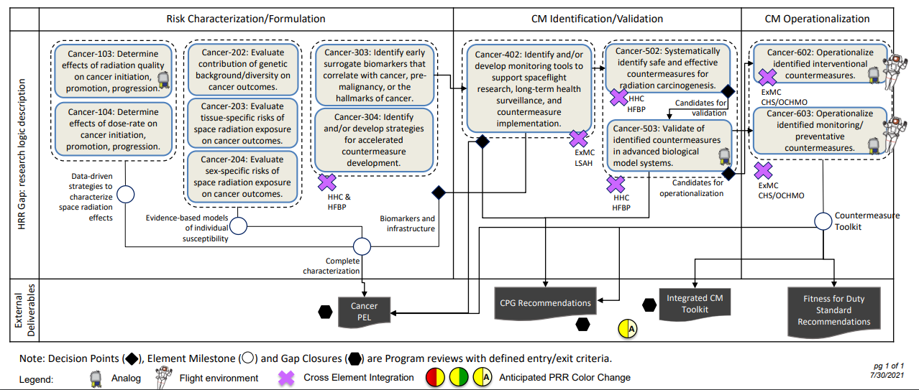
Cancer Risk Strategy
https://humanresearchroadmap.nasa.gov/schedules/?i=96
Notes:
As and example, here is the Risk Strategy for the Risk of Radiation Carcinogenesis (or cancer for short). I call these “bubble charts” You’ll see that there are a number of bubbles. That fall in to three categories: Risk Characterization, Countermeasure Identification/Validation, and Countermeasure Operationalization. I do want to note that these charts do not necessarily read like a timeline from left to right. The main point I want to make here though is that when you are drafting your proposals, do your research on the risks and gaps. Read all the information we have laid out here because it will help explain our thinking and get you into our heads (which is objectively a terrifying place to be – although there are hamsters). Once you’re ready to write, make it EASY on us. We have a LOT of proposals to read, and we don’t want to have to make any leaps between what you are proposing and what we need. Because if you make us guess, we will likely guess wrong. It may seem obvious to you, but i promise you, it is not obvious to me. Spell it out plain and simple.
Make it easy on us – tell us how you fit into this strategy
Don’t make us guess – because we will guess wrong

Slide 30
More Resources
Space Radiation Element
  https://www.nasa.gov/hrp/elements/radiation
NASA Human Research Roadmap – link to risks, gaps, and funding priority (green = low, red = high)
  https://humanresearchroadmap.nasa.gov
  www.nasa.gov/hrp/research
NASA Task book – Summaries of current and previously funded projects
  https://taskbook.nasaprs.com/tbp/welcome.cfm
Life Science Data Archive – Can request past data and search tissue repository
  https://lsda.jsc.nasa.gov/
  https://lsda.jsc.nasa.gov/Biospecimen
  Instructions – https://www.nasa.gov/hrp/elements/radiation/tissue-sharing
NASA GeneLab – Space-related omics database. Users can upload, download, share, store, and analyze spaceflight and spaceflight-relevant data from experiments.
  https://genelab.nasa.gov/
NASA Technical Reports Server: Access to NASA metadata records, full-text online documents, images, and videos
  https://ntrs.nasa.gov/
The Health Risks of Extraterrestrial Environments (THREE) – Open access space radiation literature
  https://three.jsc.nasa.gov

Slide 31
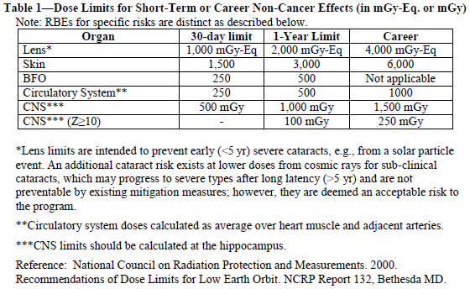
Introduction
NASA protects astronauts from excessive space radiation exposure
  Defined as Space Permissible Exposure Limits (SPELs)
    Short term SPELs (Table 1)
      Prevent deterministic effects (non-cancer)
    Career/Lifetime SPELs
      Minimize long term health effects
      Non-cancer: Table 1
      Cancer 3% REID at 95% confidence level
        NASA Standard 3001 VolA Rev1 4.2.10.1
NASA was given the authority by congress “to make, promulgate, issue, rescind, and amend rules and regulations governing the manner of its operations and the exercise of the powers vested in it by law”
  National Aeronautics and Space Act – 1958 §203(b)(1)

