Slide 1
Thermal Protection System Thermal-Structural Challenges
Material Models, Damage, and Certification
James P. Smith
James.p.smith@nasa.gov
Nasa Johnson space center

Slide 2
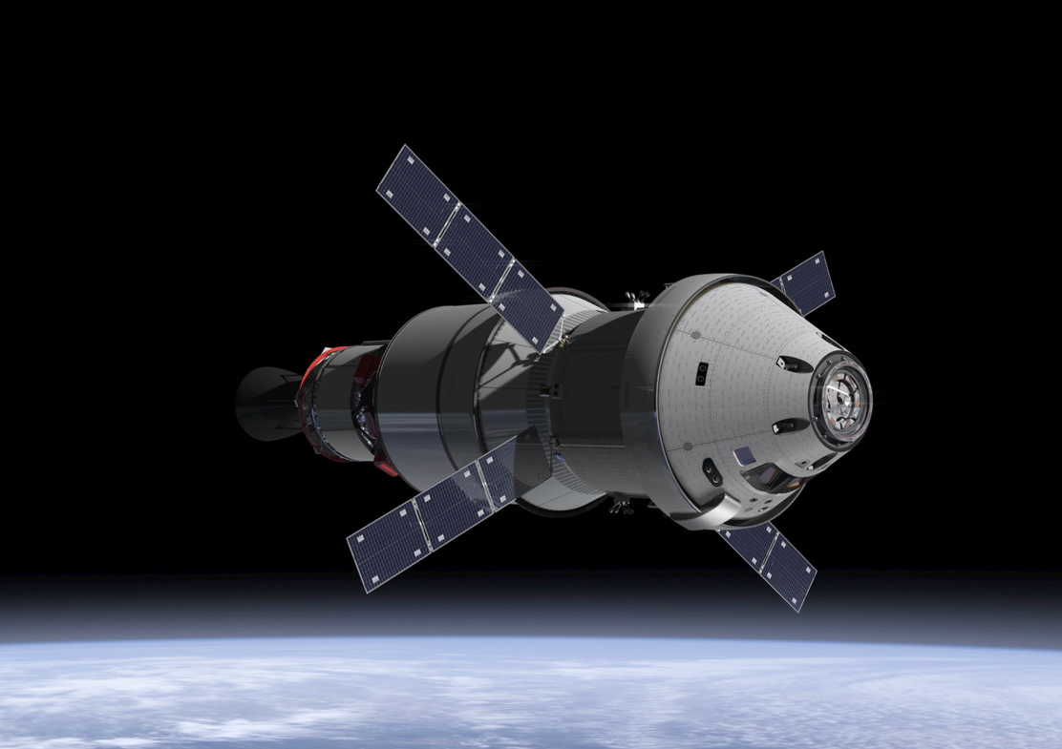
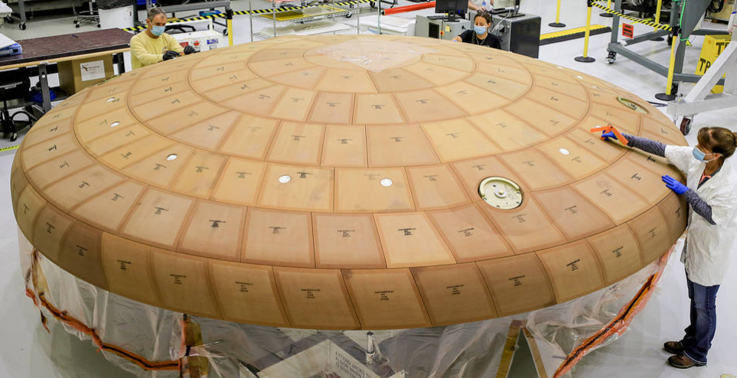
introduction
Structural certification of TPS materials is a challenge due to the complexities they bring in the mechanical realm
Certification can have dependencies on the heat shield design as a whole and not just the TPS material
As a case study, consider the Orion system
  AVCOAT material is inherently nonlinear, exhibiting linear elastic brittle behavior at some temperatures, nonlinear viscoelastic/viscoplastic behavior at other temperatures, complex damage mechanics, etc, yet we often simplify the system into established modalities (e.g., treat as simple isotropic or orthotropic material)
    Is it stress relaxation or shrinkage?
    Is fracture/damage tolerance important?
  Composite substrate
  Metallic backbone
  Polymer adhesive between AVCOAT and composite
  Elastomer gap filler

Slide 3
Certification Challenges
Material property characterization
  Temporal dependencies – Stress relaxation, drying
  Spatial dependencies – Cure/drying can be dependent on location in block due to neighboring thermal mass of block form
  Temperature dependencies – Mechanical properties (stiffness, strength, strain to failure, fracture toughness, coefficient of thermal expansion), thermal properties (conductivity, specific heat)
  Failure modes – stress, strain, interactions
  Neo-Hookean materials – elastomeric gap filler exhibits polymeric chain damage
Analysis
  Use of “slice in time” linear elastic analysis for nonlinear systems
  Decoupling of thermal/structural - potential issue if internal voids open up
Qualification and acceptance testing
  Application of thermal and mechanical conditions changes the system – additional drying, gap filler damage

Slide 4
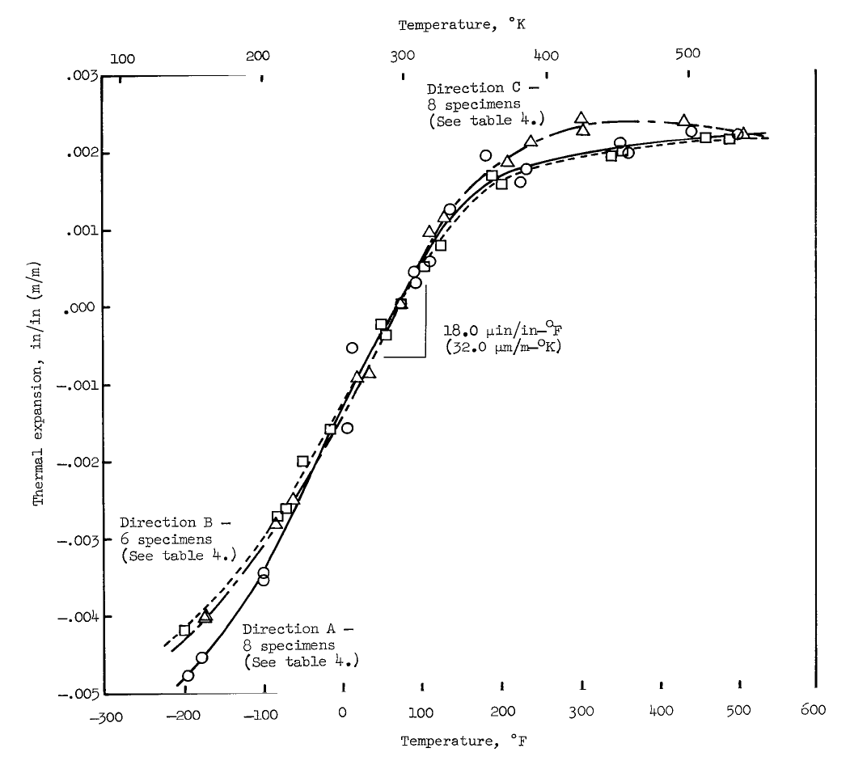
Example of Temperature and Temporal Dependency
NASA Technical Note NASA TN D-2991 “Thermophysical Properties of Six Charring Ablators from 140 to 700 K and Two Chars from 800 to 3000 K” for Apollo implementation provides properties for the monolithic form (i.e., injected in honeycomb)
Coefficient of thermal expansion tests show drastic decrease above a particular temperature
Is the phenomenon truly CTE, shrinkage of the material, or a creep (relaxation) behavior?
What is happening???

Slide 5
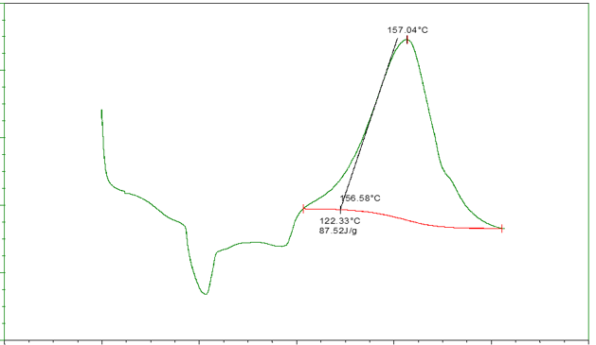
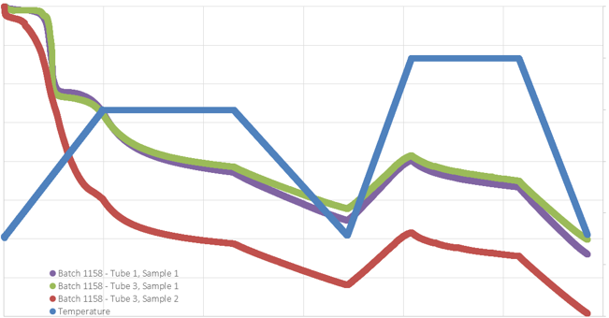
Stress Relaxation or Shrinkage
EFT-1 investigations for AVCOAT cracking utilized various tests to better characterize AVCOAT
  Differential Scanning Calorimetry (DSC) – Understand the heat required to increase the temperature of a sample; indicator of the degree of cure of the specimen
    ASTM-E698 and ASTM-E2041 to extract chemical cure parameters
  Thermomechanical Analysis (TMA) – Understand the volumetric change as a function of thermal state
  Dynamic Mechanical Analysis (DMA) – Understand the viscoelastic characteristics as a function of temperature
  Coefficient of Thermal Expansion (CTE) – Understand the free expansion of the material due to temperature
Using knowledge gained from DSC, TMA, DMA, and CTE tests help better characterize the material
Clear dependencies on both temperature and time
Heat Flow
Indication of full cure
Temperature
Shrinkage effect
Cure profile
Strain
CTE effect
Temperature
Time

Slide 6
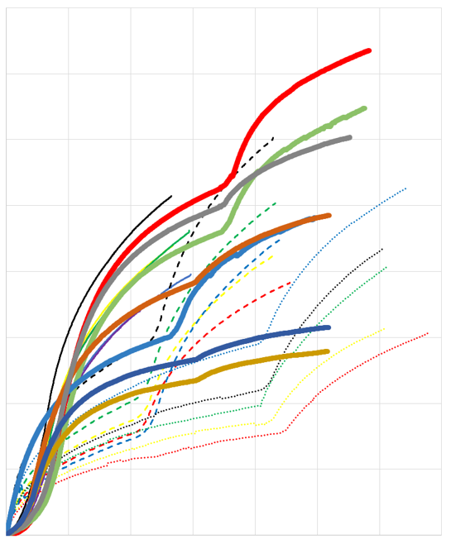
Stress Relaxation or Shrinkage
TMA tests performed on AVCOAT specimens shows significant variability in the amount of shrinkage strain
  “Green” state material undergoing 1+ intermediate cures and a final cure
  Specimens having already undergone one intermediate cure and receiving additional intermediate and final cure cycles
Inflection points are indicators of transitioning from lower temperature intermediate to higher temperature final cure
Shrink strains are representative of ground processing, but the phenomenon is also evident under post-processing heat loads
Must also consider how on-the-vehicle acceptance testing involving elevated temperatures can affect additional shrinkage
  Typically, if below the previous “bake” temperature the amount of additional drying is low
Cumulative shrink strain
Accumulated time where shrinkage observed

Slide 7
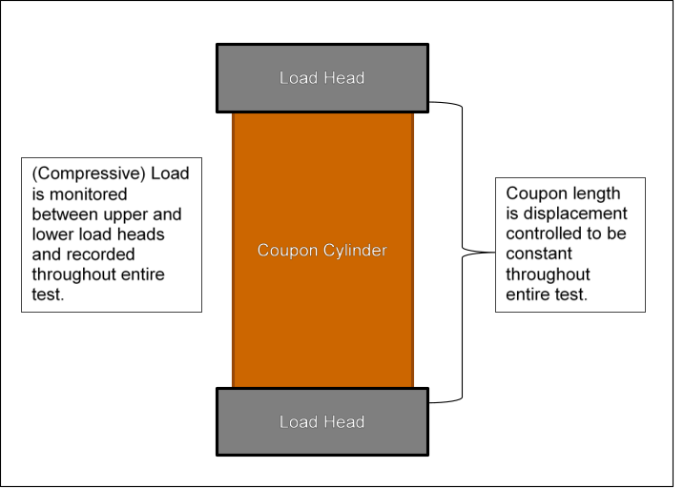
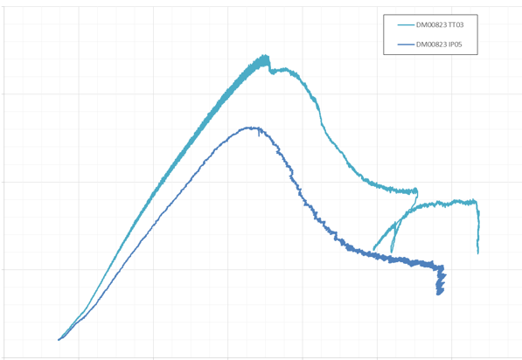
Stress Relaxation or Shrinkage
AVCOAT, when under compression and above a certain temperature, exhibits a decrease in compressive stress
Some have attributed this to stress relaxation and taken credit for the stress reduction without fully understanding the mechanisms involved
Testing performed during Orion EFT-1 made clear the effects of material shrinkage
Can get masked by coefficient of thermal expansion effects
Under compression shrinkage is beneficial, but under tension it is detrimental
  Restrained thermal growth tests show expected increase in compression as temperature increases followed by a drop in stress
Compressive stress under fixed constraint and increasing temperature
Compressive Stress
Temperature

Slide 8
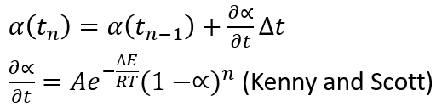

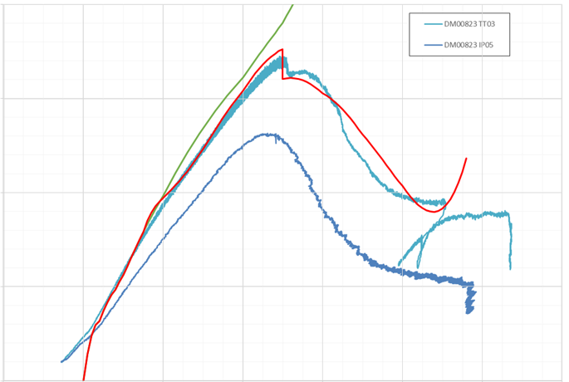
Stress Relaxation or Shrinkage
AVCOAT was found to be fully cured chemically via the DSC testing
However, even after full chemical cure AVCOAT is still moist (i.e., it has moisture content)
TMA test results provide insight on how the moisture of fully chemically cured AVCOAT bakes off and causes shrinkage
  Can utilize chemical cure kinetic models to model this phenomenon as well (degree of cure, cure rate)
  Can utilize shrink models to relate degree of cure, or rather degree of drying, to shrink strain
  Shrink strain is an additional strain component that contributes along with the thermal and mechanical strain
DMA test results give insight into stress relaxation
Importance of test-to-analysis correlation
Analysis, no shrinkage
Analysis, shrinkage

Slide 9
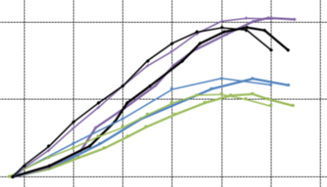
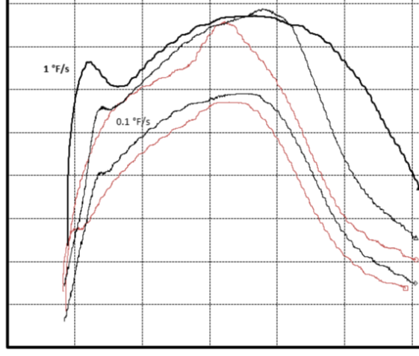
Stress Relaxation or Shrinkage
More recent CTE free expansion and restrained thermal growth tests have been completed
  Different temperature rates – Can be problematic due to the thermal properties causing a temperature gradient through the specimen → What temperature to use to report property as a function of temperature?
  For the same specimen geometry, RTG data clearly shows the difference between a “slow” and “fast” heating rate
  RTG data exhibits characteristics of constant CTE, drying shrinkage, modulus reduction as function of temperature, relaxation, and material failure
Model the test to better understand what is happening
All is good in compression, but what about if the material is in tension?
Expansion
Temperature
Compressive Stress
Temperature

Slide 10
Failure Modeling of TPS MAterials
Critical junctions on the Orion heat shield involve a variety of materials – linear elastic with brittle failure modes, neo-Hookean with polymer chain damage effects, nonlinear elastic, and also AVCOAT
Need to understand the TPS failure modes within material and also at TPS boundaries
Challenge of using stress-based approaches sensitive to mesh discretization for margin assessments
Energy approaches investigated to better quantify structural integrity and damage tolerance
  Test campaign to characterize fracture toughness or energy release rate
  Implementation of analytical approaches in the FEM to get energy release rates and expected flaws such as debonds or internal voids
    Cohesive Zone Modeling (CZM) elements
    Virtual Crack Closure Technique (VCCT)

Slide 11
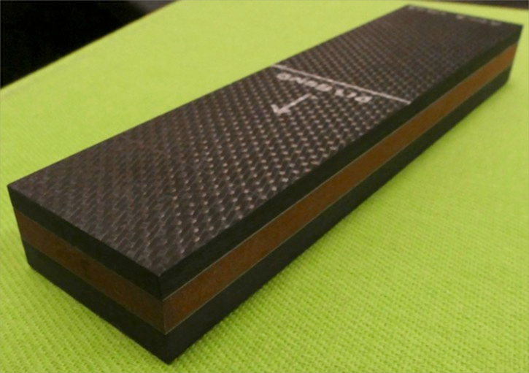
Avcoat system fracture toughness characterization
To extract a fracture toughness of the AVCOAT-to-composite bond interface, pathfinder asymmetric double cantilever beam (ADCB) tests were performed at NASA/LaRC at both cold (well below Tg) and hot temperature (well above Tg)
The cold tests were highly successful with the failure propagating along the bond interface
The hot tests, however, were not as successful as the initial flaw meandered away from the bond interface and into the AVCOAT parent material
Composite
Structural adhesive (thin light colored line)
AVCOAT
Structural adhesive
Composite

Slide 12
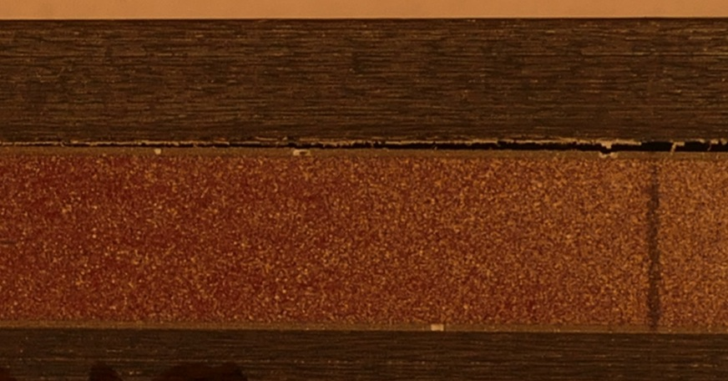
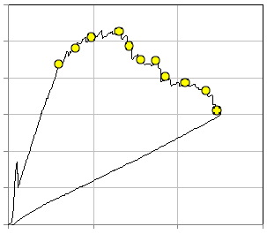
Avcoat system fracture toughness characterization
Typical cold temperature test with failure propagating along the interface
Able to extract a reliable Gc from the load-displacement curve
Wax insert region
Disbond growth region
Load
Displacement
Disbond growth direction

Slide 13
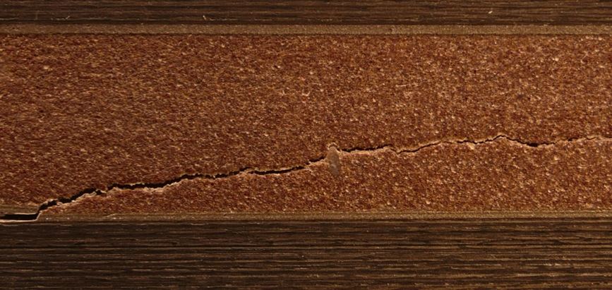
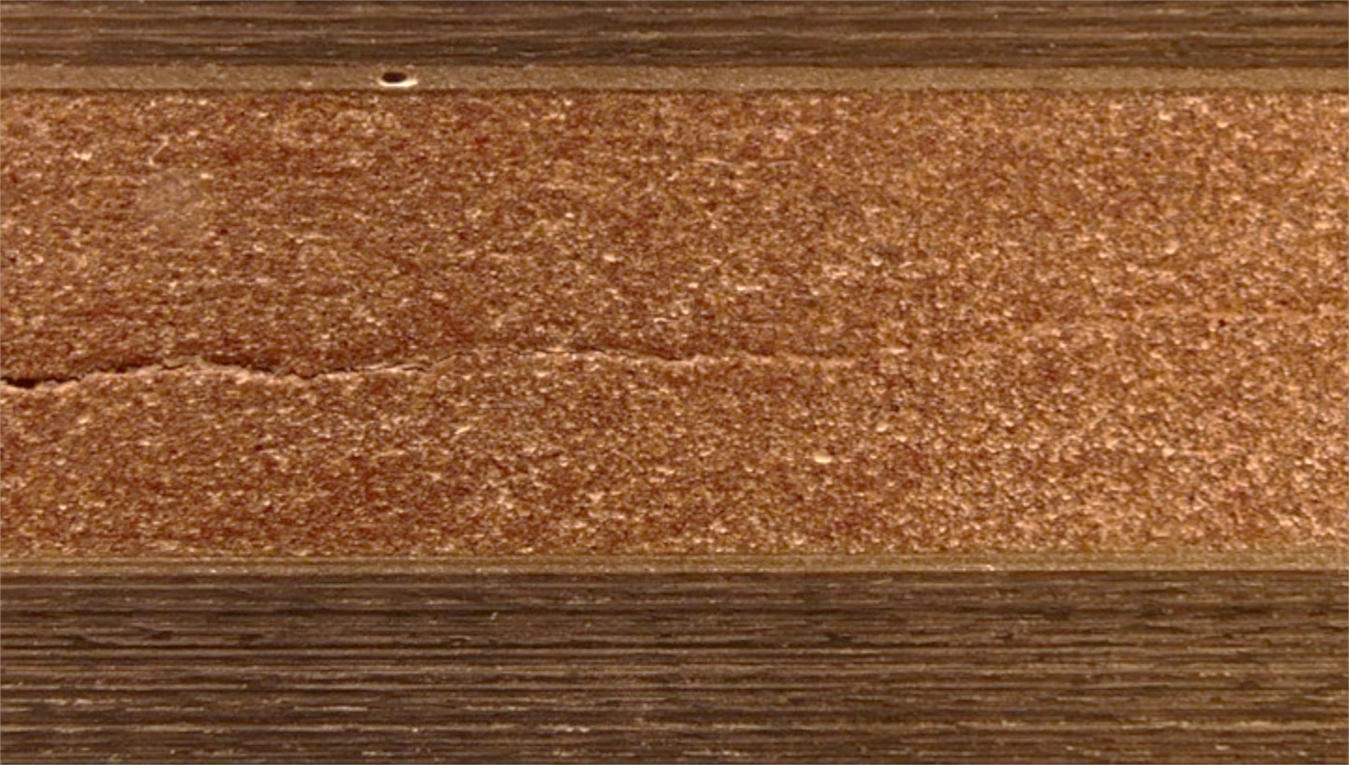
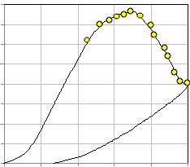
Avcoat system fracture toughness characterization
Hot temperature ADCB specimen showing propagation away from interface
Can still extract the propagation Gc but will need analysis to better instruct how to evaluate
Crack growth direction
Load
Displacement

Slide 14
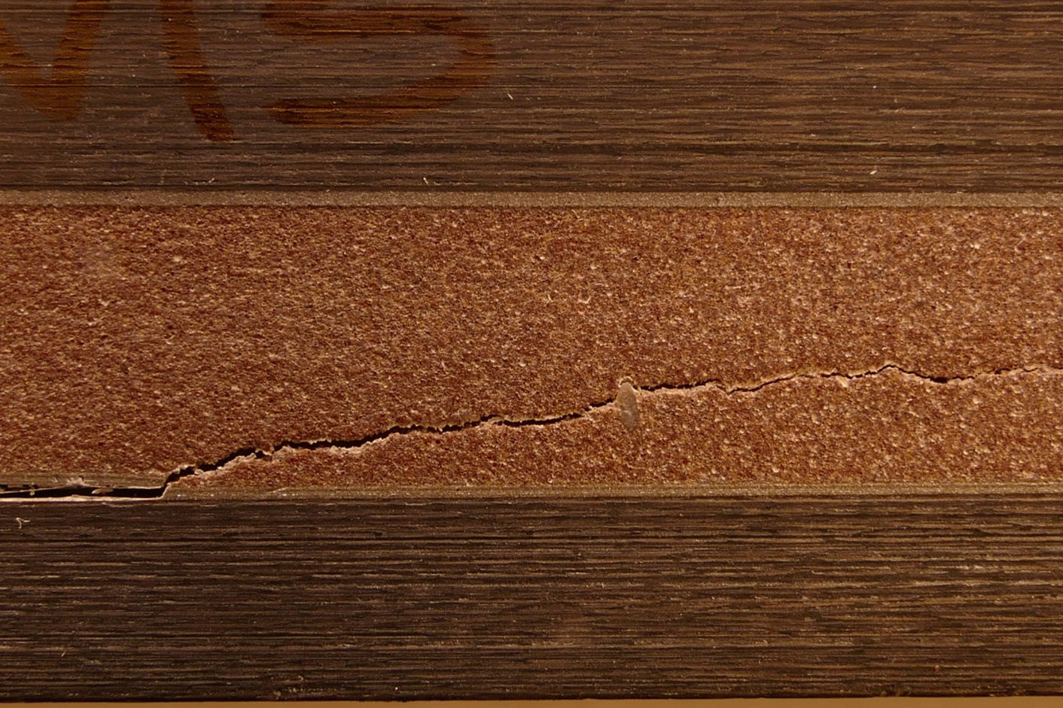
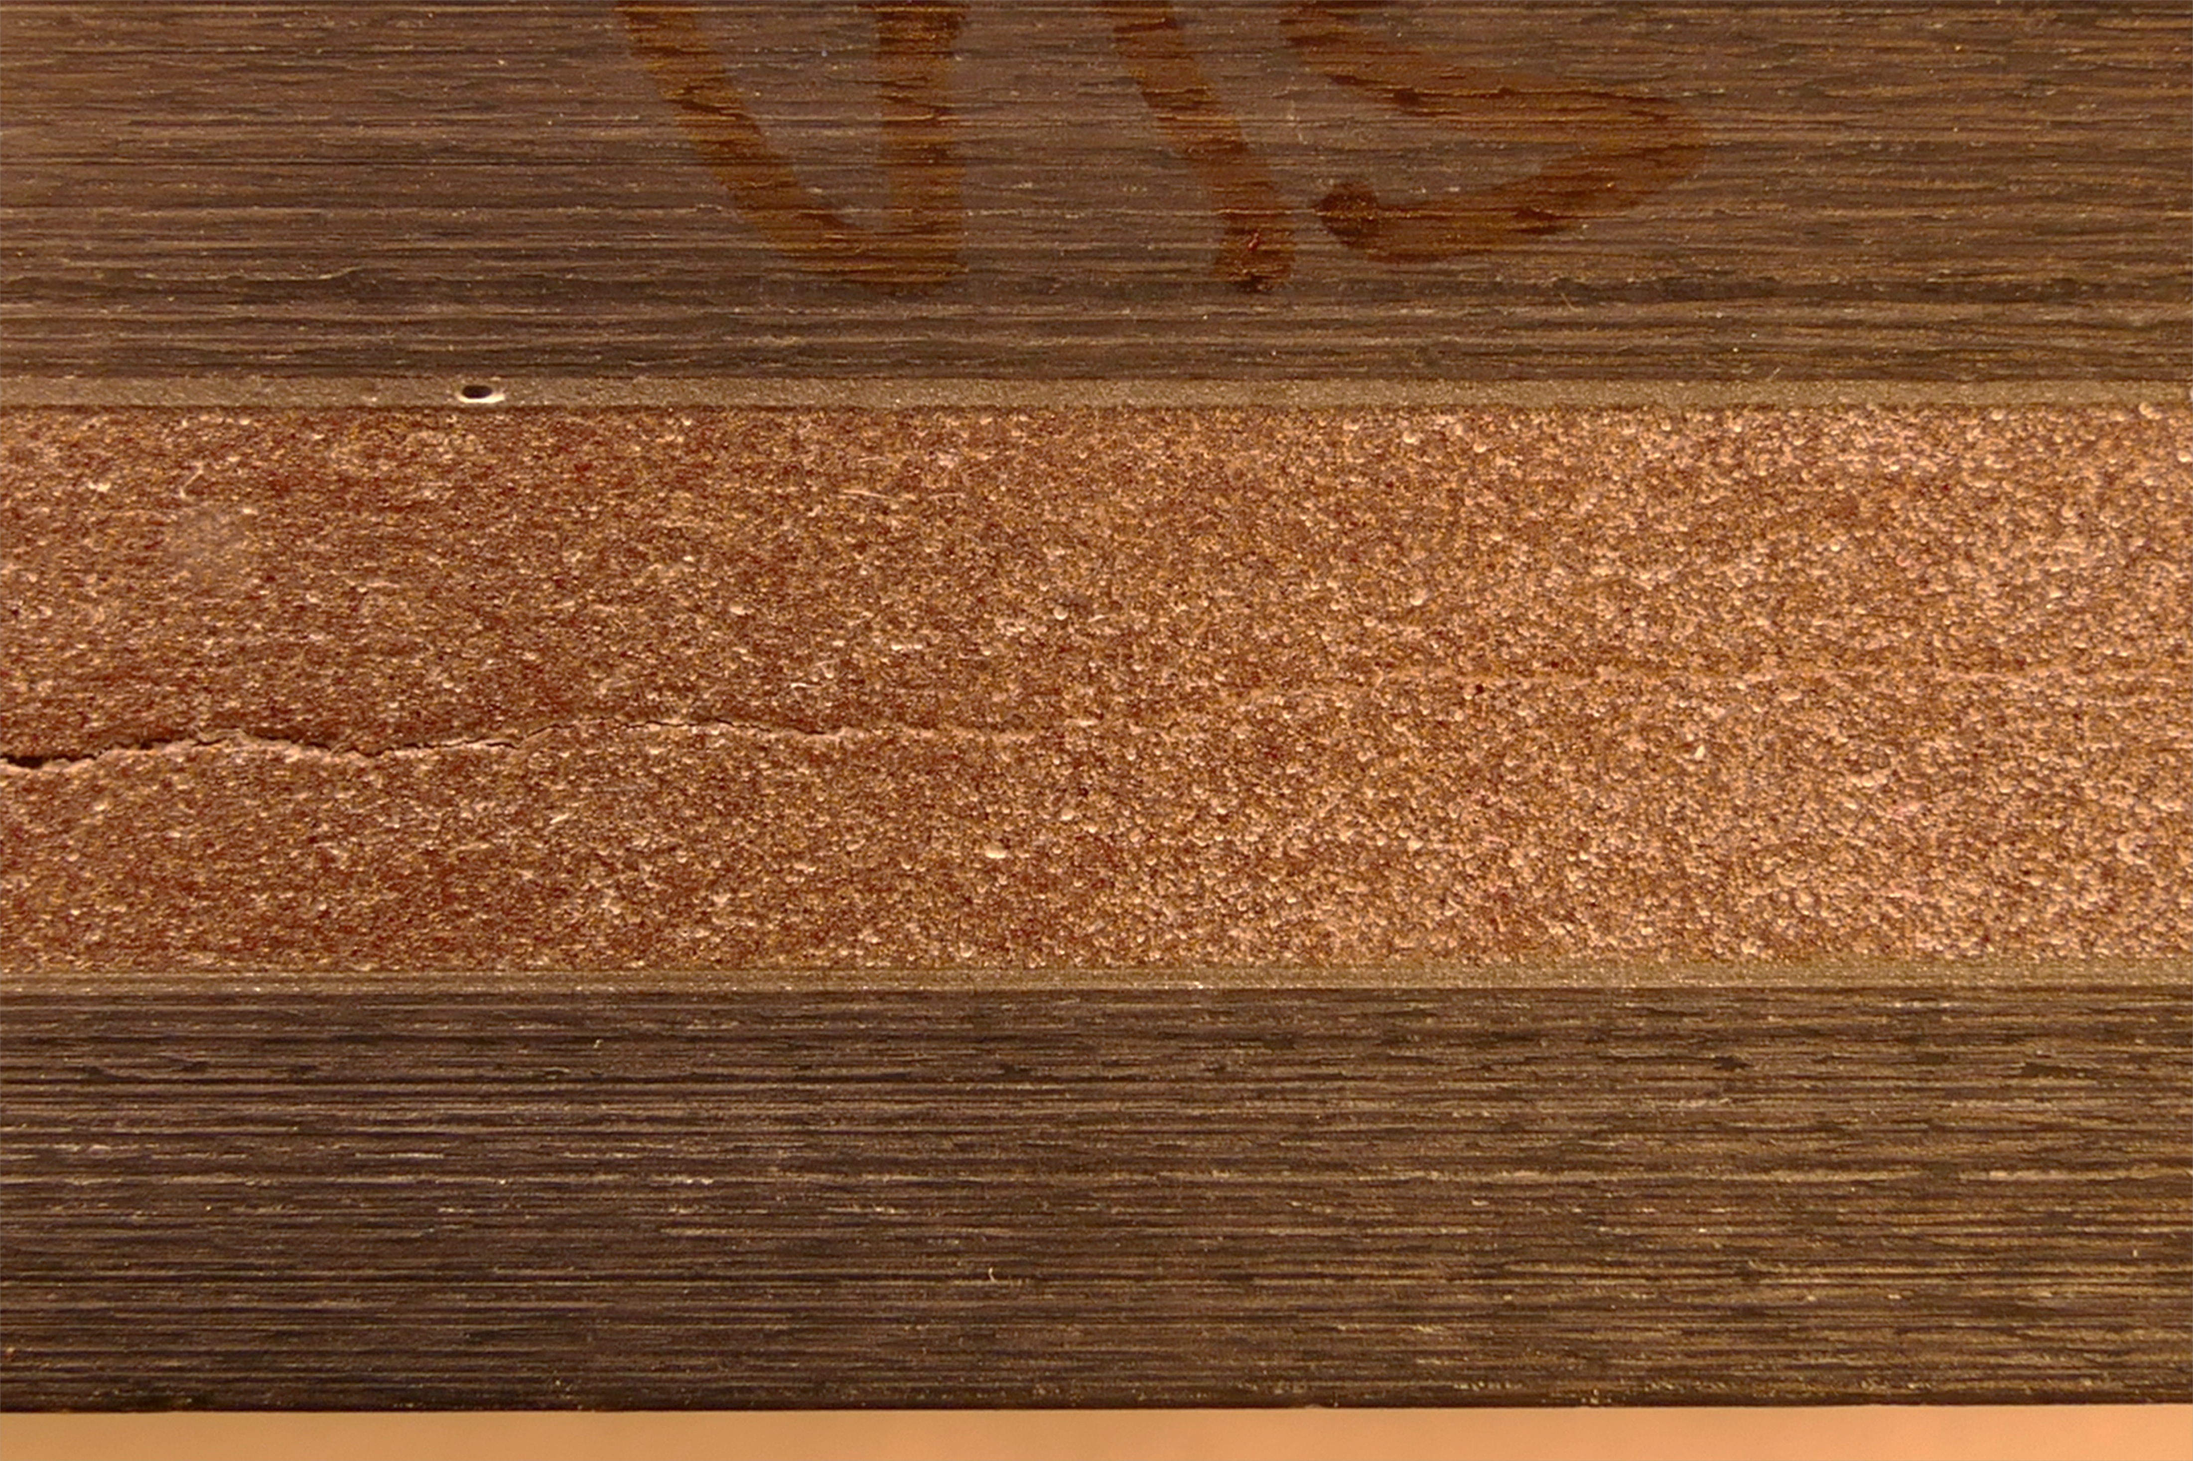
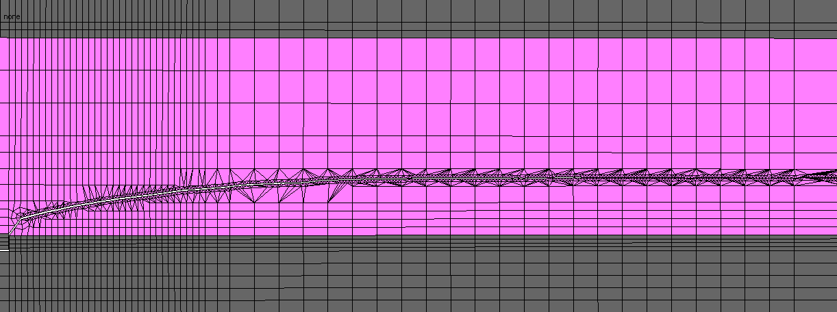
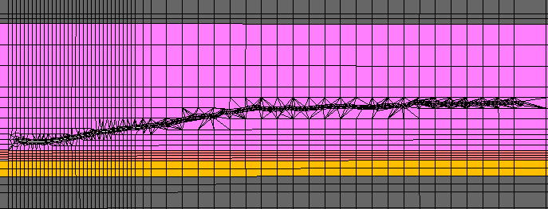
Avcoat system fracture toughness characterization
2D FEM generation of the ADCB test specimen utilizing temperature dependent properties
  VCCT with direct crack growth and mesh cutting/remeshing
Two cases considered: with and without thermal stress due to the CTE mismatch of materials
  Important to include appropriate stress state
Again, modeling test is important to fully understand the test results
Without thermal stress
Crack growth direction
With thermal stress
Crack growth direction

Slide 15
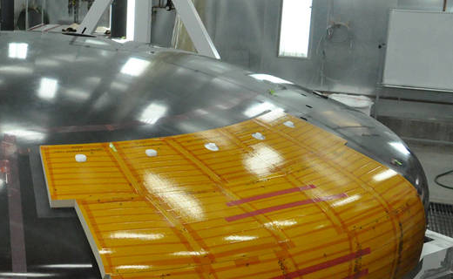
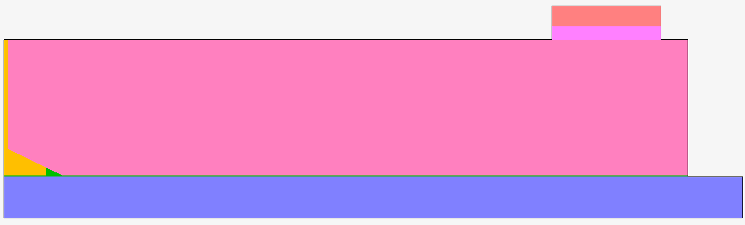
Implementation of damage models into system flexures
With the knowledge gained from fracture toughness testing and correlation, confidence gained in modeling a more complicated 4-point bending specimen representative of the Orion heat shield block architecture to better understand test data
Implementation of damage is dependent on the material/interface and/or temperature range being assessed
  CZM (fracture-based) at the interfaces to the adhesive layer
  VCCT (fracture-based) within the TPS material
  Delamination (stress-based) within the material or at the material interface of the gap filler
  Stress limit (stress-based) within the TPS material (for comparative purposes)
F(t)
Symmetry Plane

Slide 16
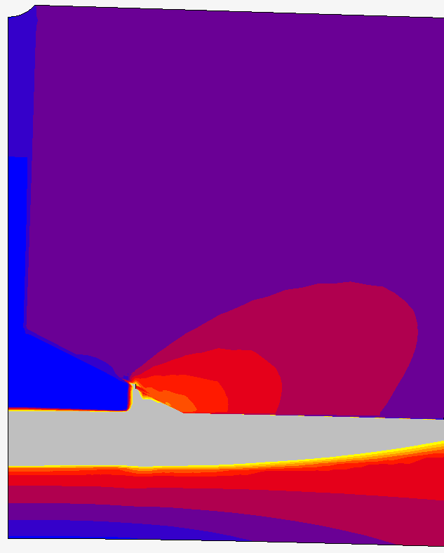

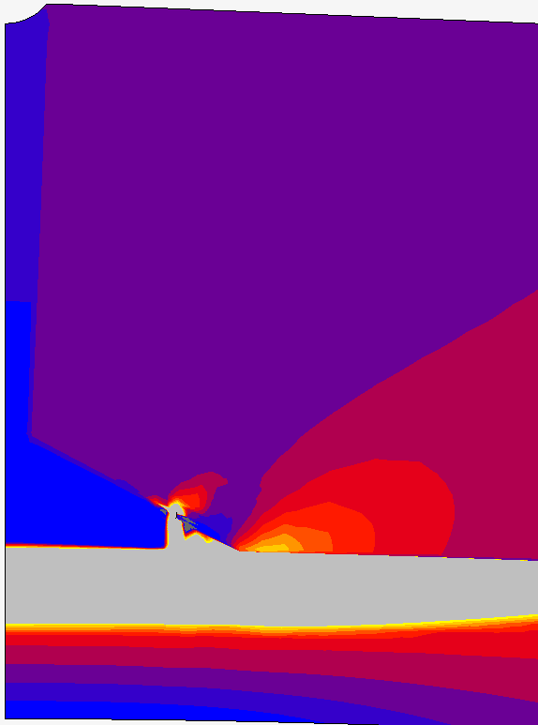
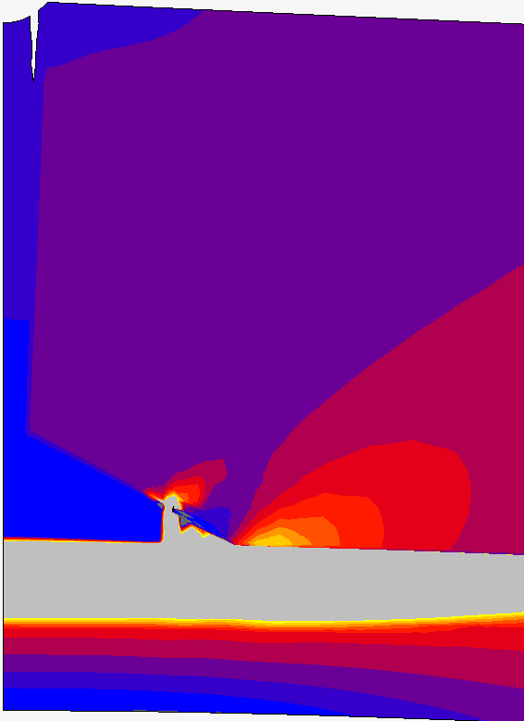
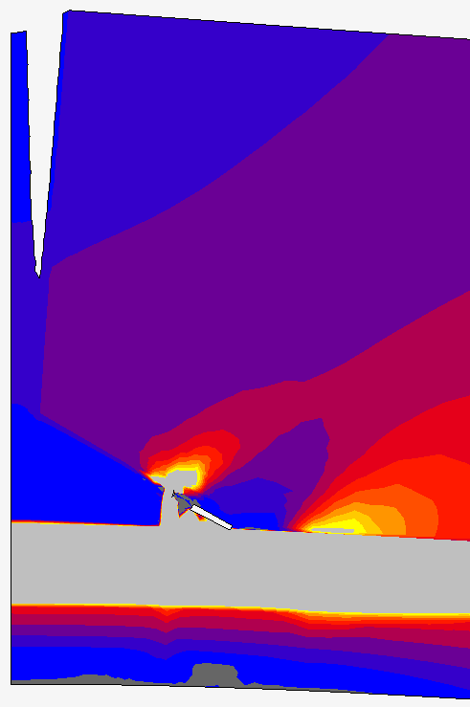
Implementation of damage models into system flexures
Representative response showing interface failure at the adhesive interface, followed by delamination failure within the gap filler, and continued adhesive interface failure
Flaw propagating at adhesive interface prior to delamination failure
Thermal loading followed by mechanical loading
Max principal stress shown

Slide 17
Key Findings
Understand your materials
  Constitutive behavior – mechanically and thermally, all dependencies
  Non-traditional effects – shrinkage, relaxation
  Failure modes – strain to failure, stress limit, fracture energy
Model the behaviors by simulating the material characterization tests, big and small
  Every test is an opportunity to learn what the material is trying to tell you
  Thermal engineers should understand structural mechanics and structural engineers should understand heat transfer to effectively communicate
Make sure your qualification and acceptance tests are appropriate
  Will ground testing affect the reliability of the system, and if so, do you understand the degree to which it does?
Listen to Mother Nature – we may be smart, but she is smarter and is always there to teach us

