Slide 1
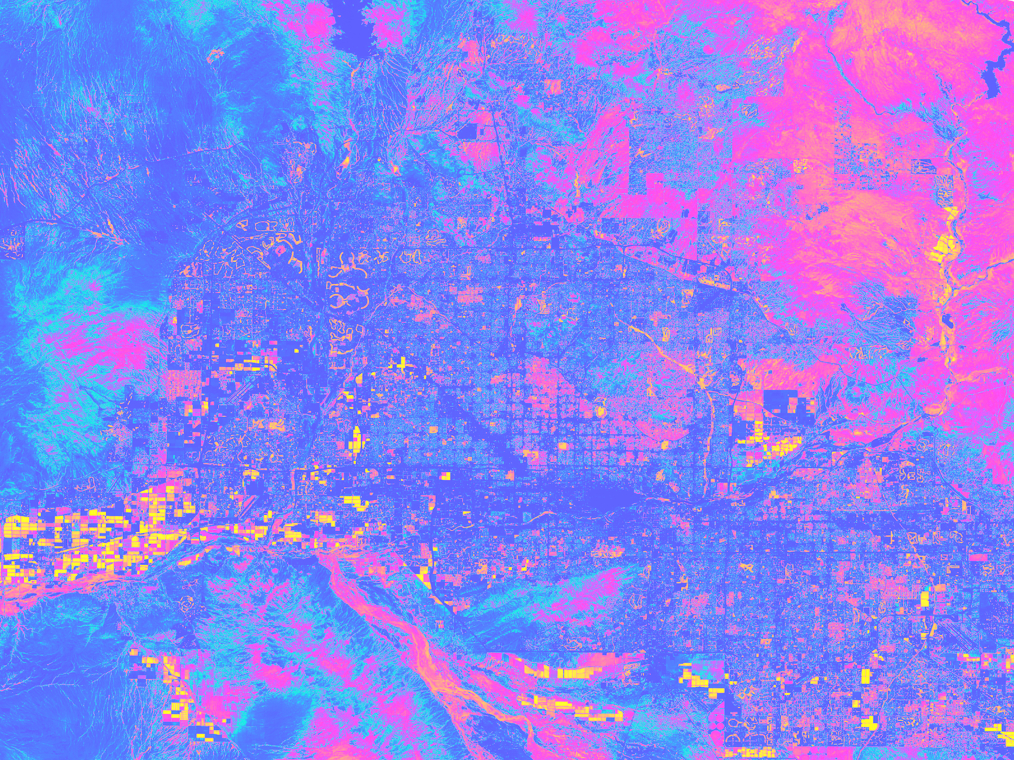
Phoenix
Climate
Employing NASA Earth Observations to Conduct Site Suitability Analyses on Residential Tree Planting Initiatives in Phoenix, AZ
Alison Bautista
Gloria Liu
Haley Stuckmeyer
Ben Schafermeyer
Notes:
Title: Employing NASA Earth Observations to Conduct Site Suitability Analyses on Residential Tree Planting Initiatives in Phoenix, AZ
Group members: Alison Bautista, Gloria Liu, Haley Stuckmeyer, Ben Schafermeyer

Slide 2
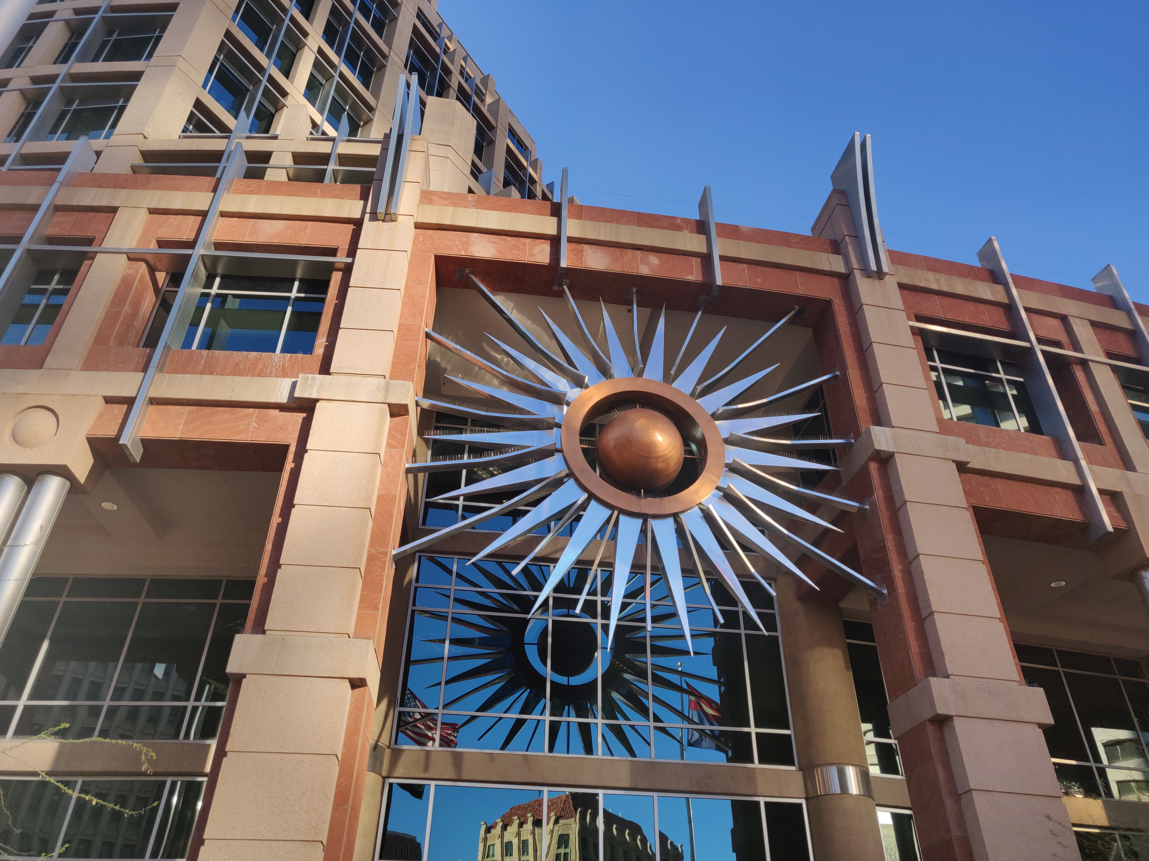
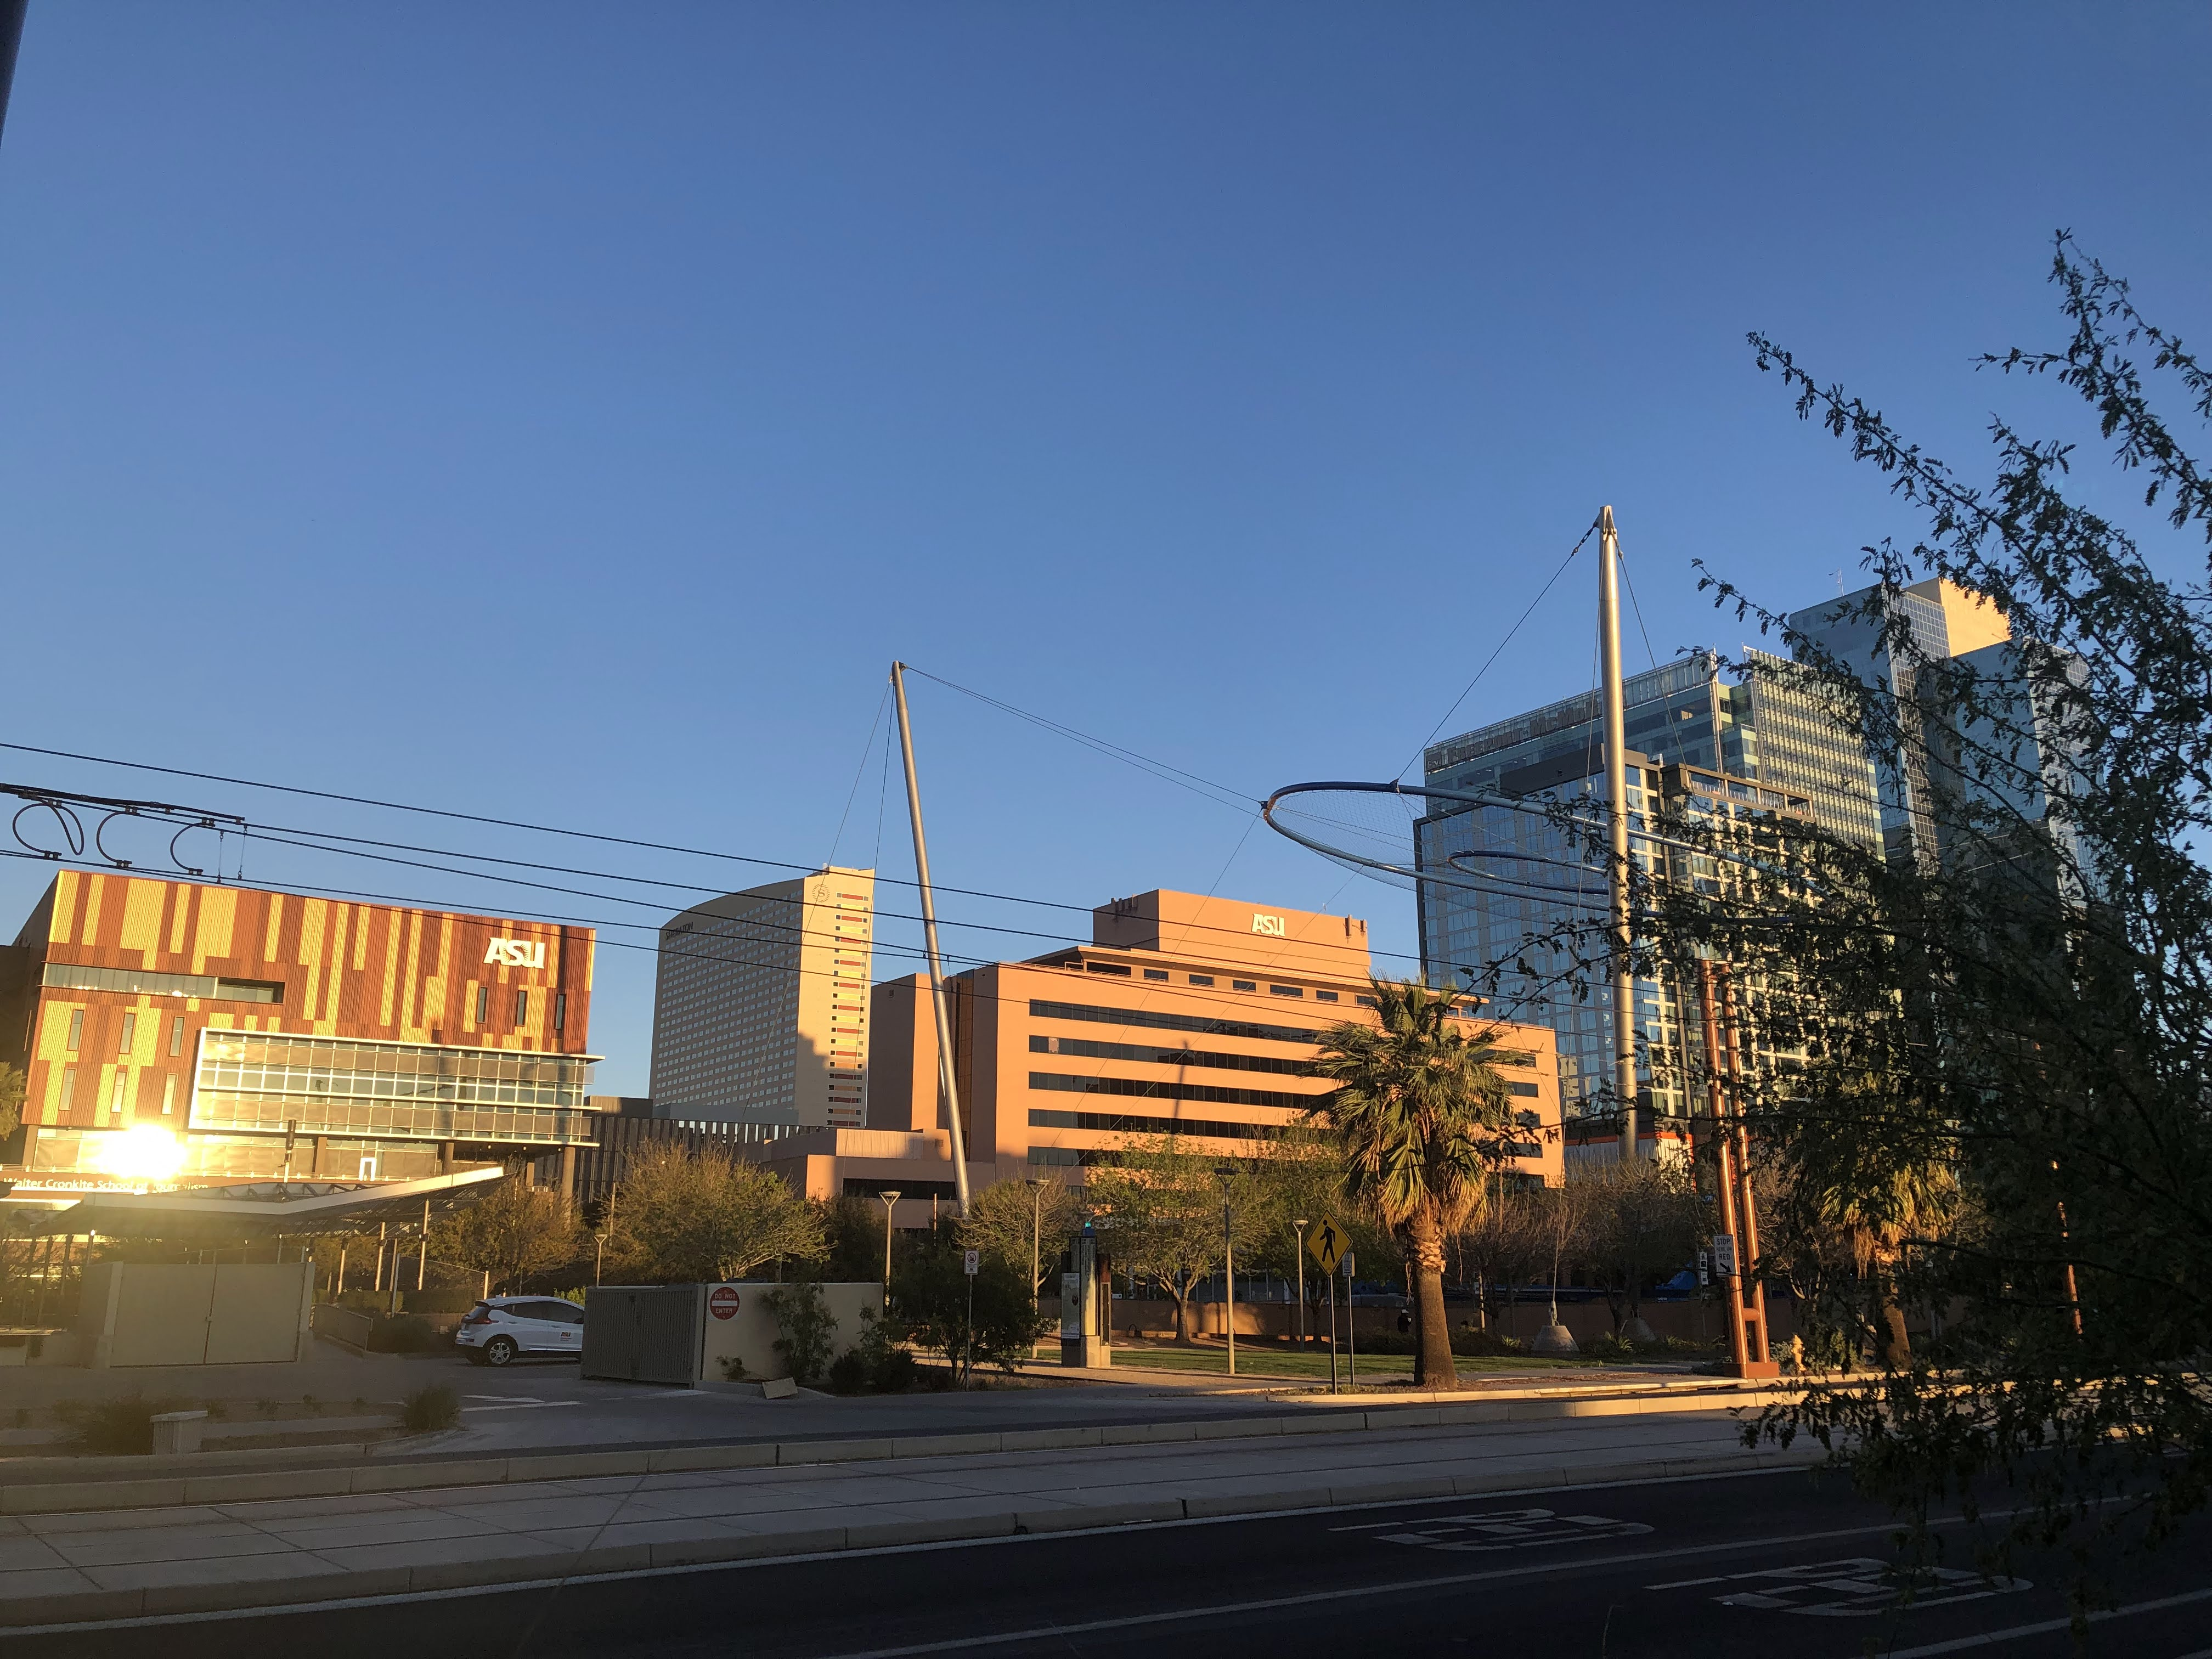
Project Partners
City of Phoenix: Office of Heat Response and Mitigation
Arizona State University
Image Credit: Haley Stuckmeyer & Alison Bautista
Notes:
Our project partners include several offices in the City of Phoenix government, including the Office of Heat Response and Mitigation, the Office of Sustainability, and the Streets Department. We are also partnered with the Urban Climate Research Center at Arizona State University.
Image Credit: Haley Stuckmeyer & Alison Bautista (Phoenix Climate Team)

Slide 3
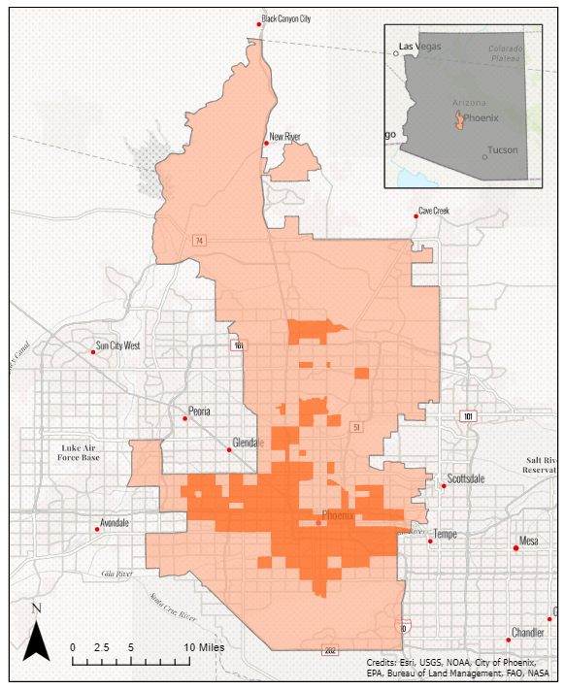
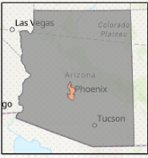
Project Study Area
2016-2019
Phoenix, Arizona – The Valley of the Sun
1.6 million residents (US Census, 2020)
Average summer daytime temperature: 106°F
Köppen classification: dry subtropical desert (Chen, 2013)
Qualified Census Tracts (QCTs)
50% of households are low-income
Population of all QCTs does not exceed 20% of total area population
0
5
10
miles
Notes:
The city of Phoenix is shown here in light orange, and has a population of 1.6 million as of 2020. With a Koppen classification of dry subtropical desert, and an average summer daytime temperature of 106 degrees Fahrenheit, Phoenix is a city where shade cover is paramount to comfort. The city offices we are partnered with have received funding from the American Rescue Plan Act for use specifically within Qualified Census Tracts. Qualified census tracts are census tracts designated from the department of Housing and Urban Development where at least 50% of households are low-income, meaning an income of less than 60% of the area median income, and the population of all QCTs in Phoenix cannot exceed 20% of the total Phoenix population (320,000 people). The qualified census tracts of Phoenix are shown in dark orange.
Basemap: Esri, USGS, NOAA, City of Phoenix, EPA, Bureau of Land Management, FAO, NASA

Slide 4
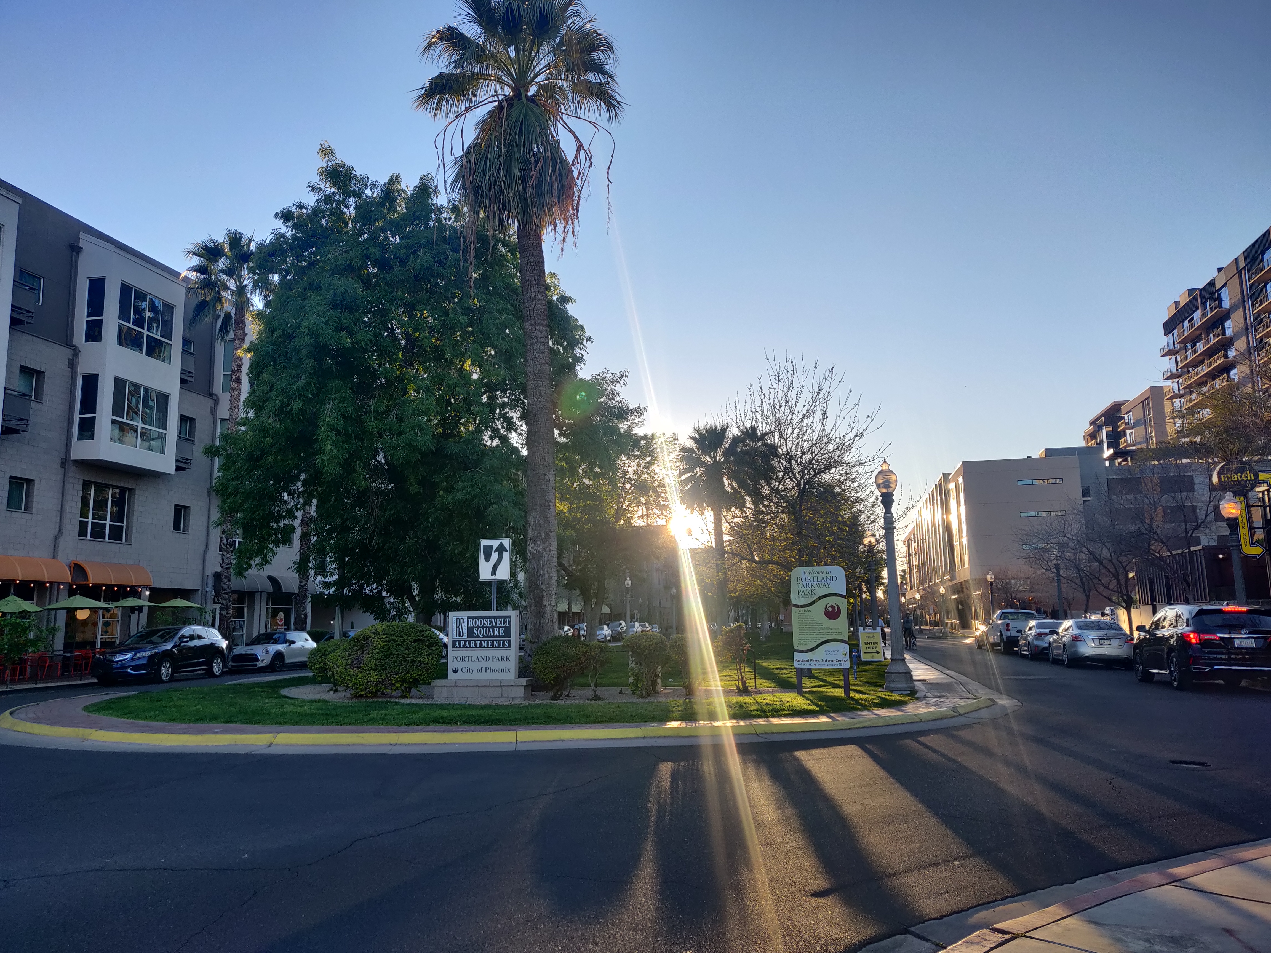
Urban Heat
Risks
Impervious surfaces, such as roofs, parking lots, and roads, trap and retain significantly more heat than their vegetated counterparts. Waste heat from AC units and vehicles also exacerbate urban heat effects. These factors result in higher nighttime and average temperatures in the City of Phoenix.
Opportunities
323 heat-associated deaths in 2020 in Maricopa County, a 62.3% increase from 2019 (Stratford 2020 Maricopa County Health)
It takes an acre of trees to offset the carbon dioxide produce by driving a car 26,000 miles (American Arborists)
Health
Health
Hottest large city in the US, 5th most populous (US Census Bureau)
The net cooling of a healthy tree is equivalent to 10 air conditioners (US Forest Service)
Environment
Environment
10 – 11% of Phoenix is urban trees – the rest is mostly comprised of impervious surfaces and open soil/rock (City of Phoenix)
Large scale vegetated areas can be as much as 13°F cooler than non-green city centers (Harlan et al. 2006)
Design
Design
Image Credit: Haley Stuckmeyer & Alison Bautista
Notes:
There are many causes of urban heat- such as air pollution, geographical location, and city design. For the purposes of our project, we are focusing on impervious surfaces, or surfaces that are non porous- preventing groundwater from interacting with the ground. Impervious surfaces trap and retain significantly more heat than their vegetated counterparts, which absorb the water and maximize cooling. Because of this, Phoenix is warming, resulting in hotter days and nights.
Risks:
There are numerous risks associated with urban heat, from a health, environmental, and design perspective. In 2019, there were 323 heat-associated deaths in Phoenix – a 62.3% increase from 2019.
Phoenix is the hottest city in the US and also the 5th most populous- so this problem is affecting a rather large amount of people/
Only 10-11% of Phoenix is comprised of urban trees, the rest is mostly impervious surfaces and open soil/rock).
However, within these risks, we also see opportunity for change and ways that we can combat these risks. First, It takes only an acre of trees to offset the carbon dioxide from driving a car 26,000 miles.
The net cooling of a tree is equivalent to 10 ACs
Large scale vegetated areas can be as much as 9 degrees cooler than non-green city centers.
All of these opportunities can connect back to the risks that come with urban heat, and our project really focuses on this design portion of it. We are helping the city select residential areas to be a part of the tree-planting program, to ultimately increase the tree canopy and identify areas suitable for large scale planting initiatives.
Image Credit: Haley Stuckmeyer & Alison Bautista (Phoenix Climate Team)
Links:
https://www.fs.usda.gov/detail/r9/home/?cid=STELPRD3832558
https://www.americanarborists.net/tree-tips/2017/july/what-trees-are-best-suited-for-the-changing-clim/
https://www.phoenix.gov/parkssite/Documents/PKS_Forestry/PKS_Forestry_Infographic_Urban_Forestry_Benefits_Costs.pdf
https://www.maricopa.gov/ArchiveCenter/ViewFile/Item/5240

Slide 5
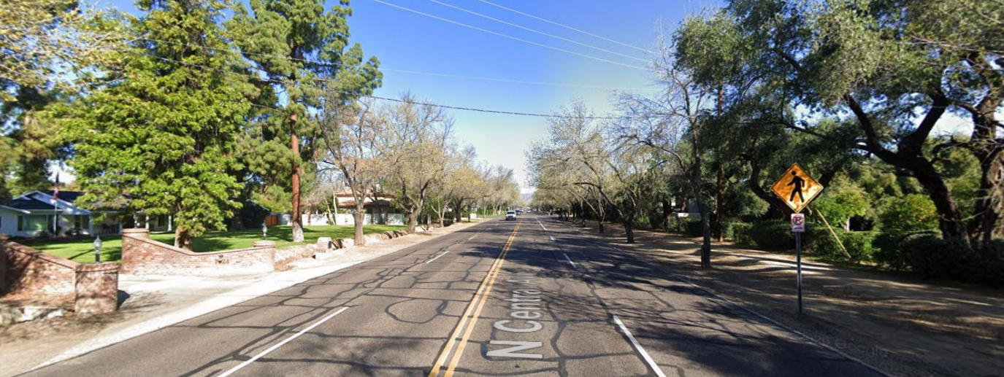
Environmental Justice
...fair treatment and meaningful involvement of all people regardless of race, color, national origin, culture, education, or income (NASA NEPA)
Image Credit: Google Street View
Notes:
One main component of focus within our project is Environmental Justice. Environmental Justice recognizes that not all environmental problems are felt equitably, where more vulnerable communities often bear the brunt of climate change.
Images: Lower income neighborhood has a much less developed tree canopy than a wealthier neighborhood.
Image Credit: Google Street View

Slide 6
Heat Vulnerability In Phoenix
Factors influencing heat vulnerability
Income
Race/ethnicity
Education
Age
AC accessibility
Greenness
Built environment
 | Edison-Eastlake | Maricopa County
Median Income | $10,708 | $53,596
Owner occupied | 16% | 63%
% white population | 51% | 80%
% Hispanic (ethnicity) | 76% | 70%
% Black population | 7% | 5%
% Foreign Born | 29% | 15%
% Use public transportation | 7% | 2%
Table credit: The Nature Conservancy
information reported by the Nature's Cooling Systems Project
Notes:
Heat vulnerability in Phoenix is directly tied to demographic factors, making environmental justice an important component in City policy. Some important factors impacting heat vulnerability are listed: income (lower incomes are more vulnerable); race (non-white population at higher risk); education level; Age (elderly are more vulnerable); access to air conditioning (can be related to income and home ownership); greenness of neighborhood (evapotranspiration); and built environment (impervious surfaces & public transportation). A study by Sharon Harlan in 2013 showed that higher neighborhood income and education, younger white populations, greener landscapes, AC, and cooler microclimates in suburban neighborhoods were associated with reduced heat vulnerability and fewer deaths than inner city neighborhoods (Harlan 2013).
The table at right displays a real-world comparison of demographic factors associated with heat vulnerability. Edison Eastlake census block groups ($10k median income, 76% Hispanic, 7% public transit usage, 16% owner occupied) vs Maricopa county ($53k median income , 30% Hispanic population, 2% transit usage)
Table reference: https://keep.lib.asu.edu/items/141449/view , page 14

Slide 7
Tree Cover and Temperature
Regional tree coverage and NDVI
Case study: Edison Eastlake neighborhood
92.4° F
5.3%
0.156
88.6° F
8%
0.200
Edison Eastlake Block Group Avg
Maricopa County Block Group Avg
Nighttime Land Surface Temperature
Tree Coverage
NDVI
information reported by the Nature's Cooling Systems Project
Notes:
With the demographics of Edison Eastlake In mind, we can look at the other important variable in urban heat: Greenness. Edison Eastlake has an average NDVI value (used to measure greenness) of 0.156, below the Maricopa county average of 0.2. Average tree cover is also lower than the county average, at 5.5% vs 8.8%. these factors contribute to a nighttime land surface temperature average of 92.4 degrees Fahrenheit, nearly 4 degrees higher than the Maricopa county average.
Diagram reference: https://keep.lib.asu.edu/items/141449/view , page 22

Slide 8
Urban Heat Solutions
Heat Mitigation
Changing types of surfaces
Planting trees & shrubs
Heat Adaptation
Public water fountains
Reducing GHG
Opening cooling centers
information reported by the Nature's Cooling Systems Project
Notes:
Urban heat can be addressed from two ends, heat mitigation, and heat adaptation. The Venn diagram shows how mitigation, adaptation, and a combination of both can be used to reduce the impact of urban heat. Our project focuses on mitigation, reducing heat and increasing shade by increasing tree canopy cover. A combined approach of these methods will yield the best results for community members dealing with excessive heat.
Diagram reference: https://keep.lib.asu.edu/items/141449/view , page 7

Slide 9
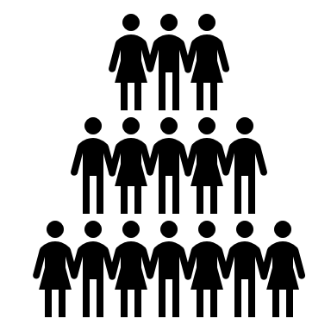
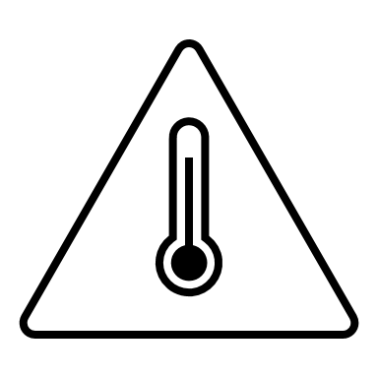
Community Concerns and City Plans
Sustainable Infrastructure
Accessible Public Transit
Tree Canopy Growth
Community Concerns
Equity
Heat-related Illness
Notes:
5 foundational concerns of the Phoenix community regarding urban heat are:
1. how will the city meet its tree canopy growth goals
2. what are ways that the impact of extreme heat can be lessened in the city of Phoenix
3. Ensuring that all communities are adequately prepared for rising temperatures
4. How pedestrians can be protected from extreme heat
5. Maintaining trees/infrastructure to ensure longevity of the cooling programs

Slide 10
Community Concerns and City Plans
City Response:
Tree and Shade Master Plan
Proposed ARPA Residential Tree Planting Program
Raise awareness
Preserve, protect, and increase
Sustainable, maintainable infrastructure
Double tree canopy to 25% by 2030
Provide trees for residents of Qualified Census Tracts
Support tree health with paid community foresters and water infrastructure
2050 Climate Action Plan
American Forests Tree Equity Pledge
Expansion of Cool Corridors
Increase shade coverage
Heat management services
$500,000 from American Forests
Distributed to other nonprofits to support tree equity projects in areas with low A.F. tree equity scores
Notes:
To address these concerns, the city has created several different regulatory frameworks, as well as participated in federal programs:
1. Tree and Shade Master plan: first published in 2010, The Phoenix tree and shade master plan outlined general steps to reach a goal of 25% average canopy cover by 2030. These steps involved; raising awareness of the benefits of urban forestry (partnership establishment, demonstration projects, etc.), preserving and protecting existing tree cover, and treating current/future urban forestry as infrastructure projects, ensuring their role in city planning. The end goal of this plan is to increase tree canopy to an average of 25% across the city of phoenix
2. the 2050 climate action plan, last revised in 2021, sets larger goals for environmental sustainability. This report includes all residents being within a five-minute walk from a greenspace & water (cool corridor) and increasing overall canopy coverage, develop resources and services for citizens to manage heat.
3. a proposed American Rescue Plan Act (ARPA) residential tree planting program would provide trees for residents of QCTs, along with supporting tree health through trained foresters
4. finally, the city of Phoenix has Pledged to address tree equity with American forests. This pledge has consisted of a $500,000 contribution from A.F., with the city of Phoenix distributing those funds amongst other partners to initiate tree equity projects. Source: https://www.phoenix.gov/newsroom/environmental-programs/2197
Prior work has been done in this domain, including the Heat Action Climate Plan prepared by the Nature Conservancy

Slide 11
Proposed ARPA Tree Planting Program:
City of Phoenix Objectives
Funding
$7.5M for Residential Tree Equity Accelerator in Qualified Census Tracts
End Product Objectives
Multiple homes per neighborhood
Up to 4 trees per home
Engage 5,000 households
Increase tree canopy in low tree equity neighborhoods from 3.5% to 10.5%
Selection Process
Low tree equity score
High heat vulnerability
Single family homes with plantable area
Notes:
the City of Phoenix hopes to secure funding for $7.5 million to implement a residential tree equity accelerator in qualified census tracts. This money will be used to make a targeted investment in underserved neighborhoods to increase canopy cover. The selection process will involve a neighborhoods tree equity score, heat vulnerability, and single family homes with suitable planting area. The end product for the city will address multiple homes within a neighborhood, with 5,000 households engaged across selected neighborhoods. Each home will have access to up to 4 trees. The city of Phoenix hopes to increase tree cover from 3.5% to 10.5% in low tree equity neighborhoods with this proposed program. Our DEVELOP project aims to help identify these underserved communities and potential homes for the City of Phoenix.

Slide 12
Project Objectives
Create a tool that identifies priority neighborhoods and parcels for investment by the City of Phoenix's Residential Tree Planting program
Data-backed (NASA Earth observations + other data)
Focused on tree equity
Qualified Census Tracts
Aligns with community concerns
Neighborhood == census block group
Primary output:
A priority ranked list of census block groups
Identified parcels by available planting area
Notes:
Create a tool that helps determine residential areas within qualified census tracts that should be prioritized for the City of Pheonix's Residential Tree Planting program to make a targeted investment to increase tree canopy in underserved neighborhoods. We want this tool to be data-backed and focused on tree equity.
Using the tool, create a ranked list of census block groups within qualified census tracts to be prioritized for residential tree planting investment.
Neighborhood == census block group

Slide 13
Road Map
Bus Ridership & Pedestrian Movement
City of Phoenix
Icarus data
Social Vulnerability
US Census Bureau
Heat Vulnerability Index
Emphasis on tree canopy
Plantable Land Area
Parcels with single family zoning
+
Ranked Census Blocks
Qualified Census Tracts (QCTs)
Top 25 HVI scores selected
Tree Canopy Data
American Forests
Heat Data & NLCD
Landsat 8
Notes:
Four main components in site suitability Analysis: Tree Canopy Score from the American Forests, Social Vulnerability Index from the US Census Bureau, Heat and National Land Coverage Data from Landsat 8, and bus ridership and pedestrian movement modeling from the City of Phoenix and Icarus project from ASU.
All Datasets are normalized and combined for the heat vulnerability index using a weighted mean
From there, the block groups in QCTs are ranked based upon this score and the top ones were selected for the parcel analysis of plantable land area

Slide 14
Road Map
Social Vulnerability
US Census Bureau
+
Notes:
Section Break

Slide 15
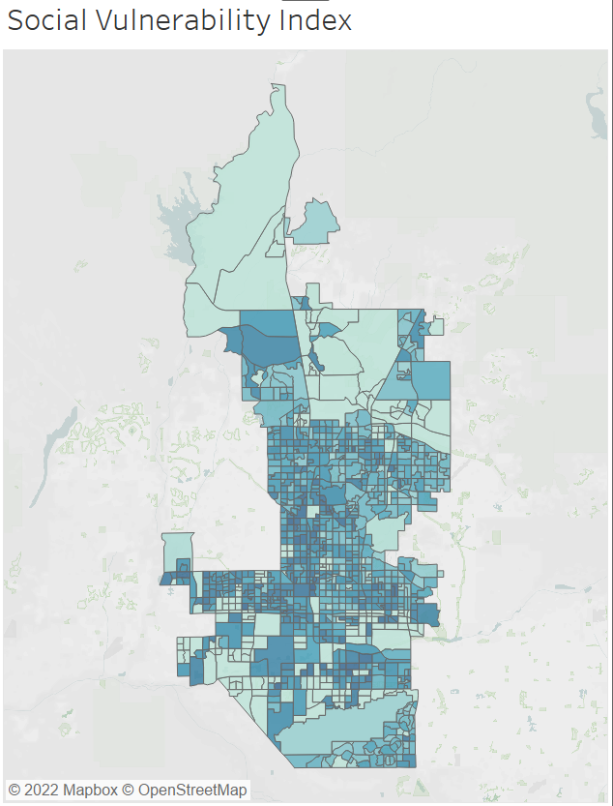
Social Vulnerability Index
Social Vulnerability Index
2019 American Community 5 Year Survey – Block Groups
% non-white
% 65 and older
% 9 and younger
% no vehicle
% income below poverty line
% no high school diploma
% living in crowded homes
% unemployed
Per capita income
Statistical Analysis R
Percentile Rank normalized by population size
Average of Percentile Rank
Social Vulnerability Index
Higher SVI Score = More Vulnerable to Heat
Notes:
To create the social vulnerability index, I mainly utilized the tidycensus package available in R Studio. Using the CDC Social Vulnerability Index as a guideline, I extracted these 9 variables from the 2019 American Community 5 year survey, which is the most recent census data available through this package. I incorporated these variables because they were the main socioeconomic demographic variables available at our scale of analysis, which is the block group. After extracting each variable and calculating their percentages, I began the normalization process. I began by calculating the percentile rank of each variable. I also normalized each score by its population size. To do this, I multiplied each percentile rank by its population proportion out of the entire city of phoenix. This was an important step to make to help insure that block groups with a lower population (such as ones that are in an industrial zone) would have a lower score than block groups that have a relatively high population.
Using the percentile rank in this scenario was important to help scale each of the variables equally: for example, per capita income was not in a decimal format, and calculating the percentile rank normalized it to be comparable to other variables.
Percentile Rank: the percentile rank (PR) of a given score is the percentage of scores in its frequency distribution that are less than that score. For example, a percentile rank of 95% indicates that its score is higher than 95% of all the others.
After calculating the percentile rank, I calculated the average of the ranks of all the variables.
This average percentile rank normalized by population size is the SVI Score for each of the block groups.

Slide 16
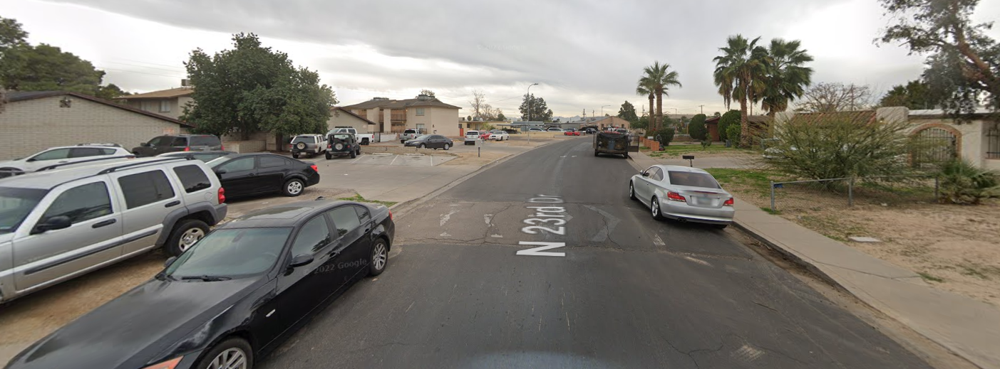
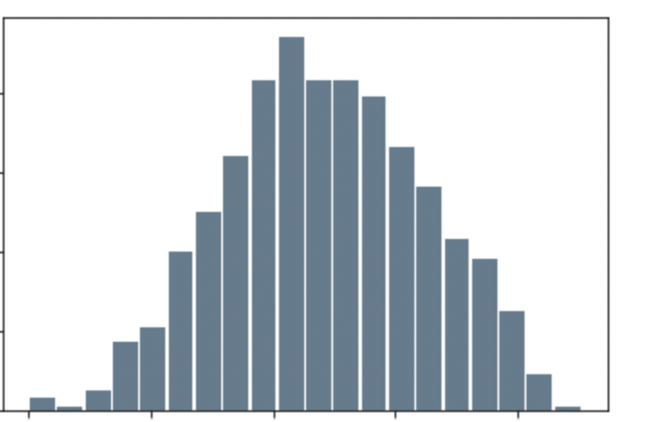
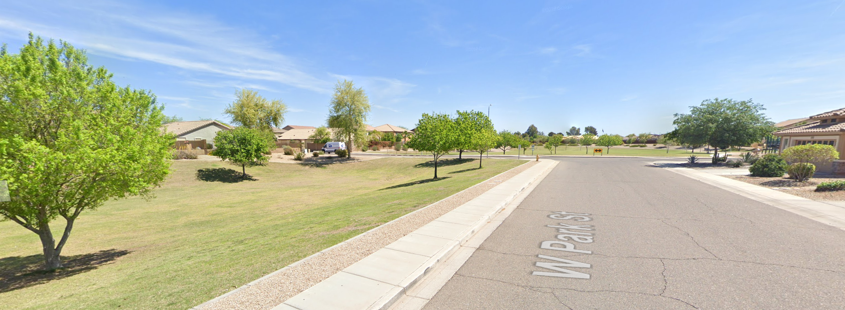
Social Vulnerability Index Results
Distribution of SVI among block groups
80
60
Ffrequency
40
20
0
0.0
0.2
0.4
0.6
0.8
SVI
Highest Score: 0.88
Lowest Score: 0
Average: 0.4
Standard Deviation: 0.24
Image Credit: Google Street View
Notes:
The highest SVI Score is located in West Encanto Village, directly east of highway 17 and north of Osborn Rd. As you can see from a quick google street view image, there are crowded living quarters with very few trees. This is also a neighborhood that has very low HS graduation rates, and it predominantly a community of color. One of the lowest SVI Scores of 0.1 is seen in the bottom image. This is a wealthier suburb in Laveen Village. Based upon this image, you can see that there is much more greenery and space. There is no crowded living situations and most people here live within the upper-middle income bracket. In fact, the only reason why the SVI Score isn't even lower is because there is a relatively high percent of young children in this area- most other variables are nearly 0.
Image Source: Google Street View
Image Credit: Google Street View

Slide 17
Road Map
+
Tree Canopy Data
American Forests
Notes:
Section Break

Slide 18
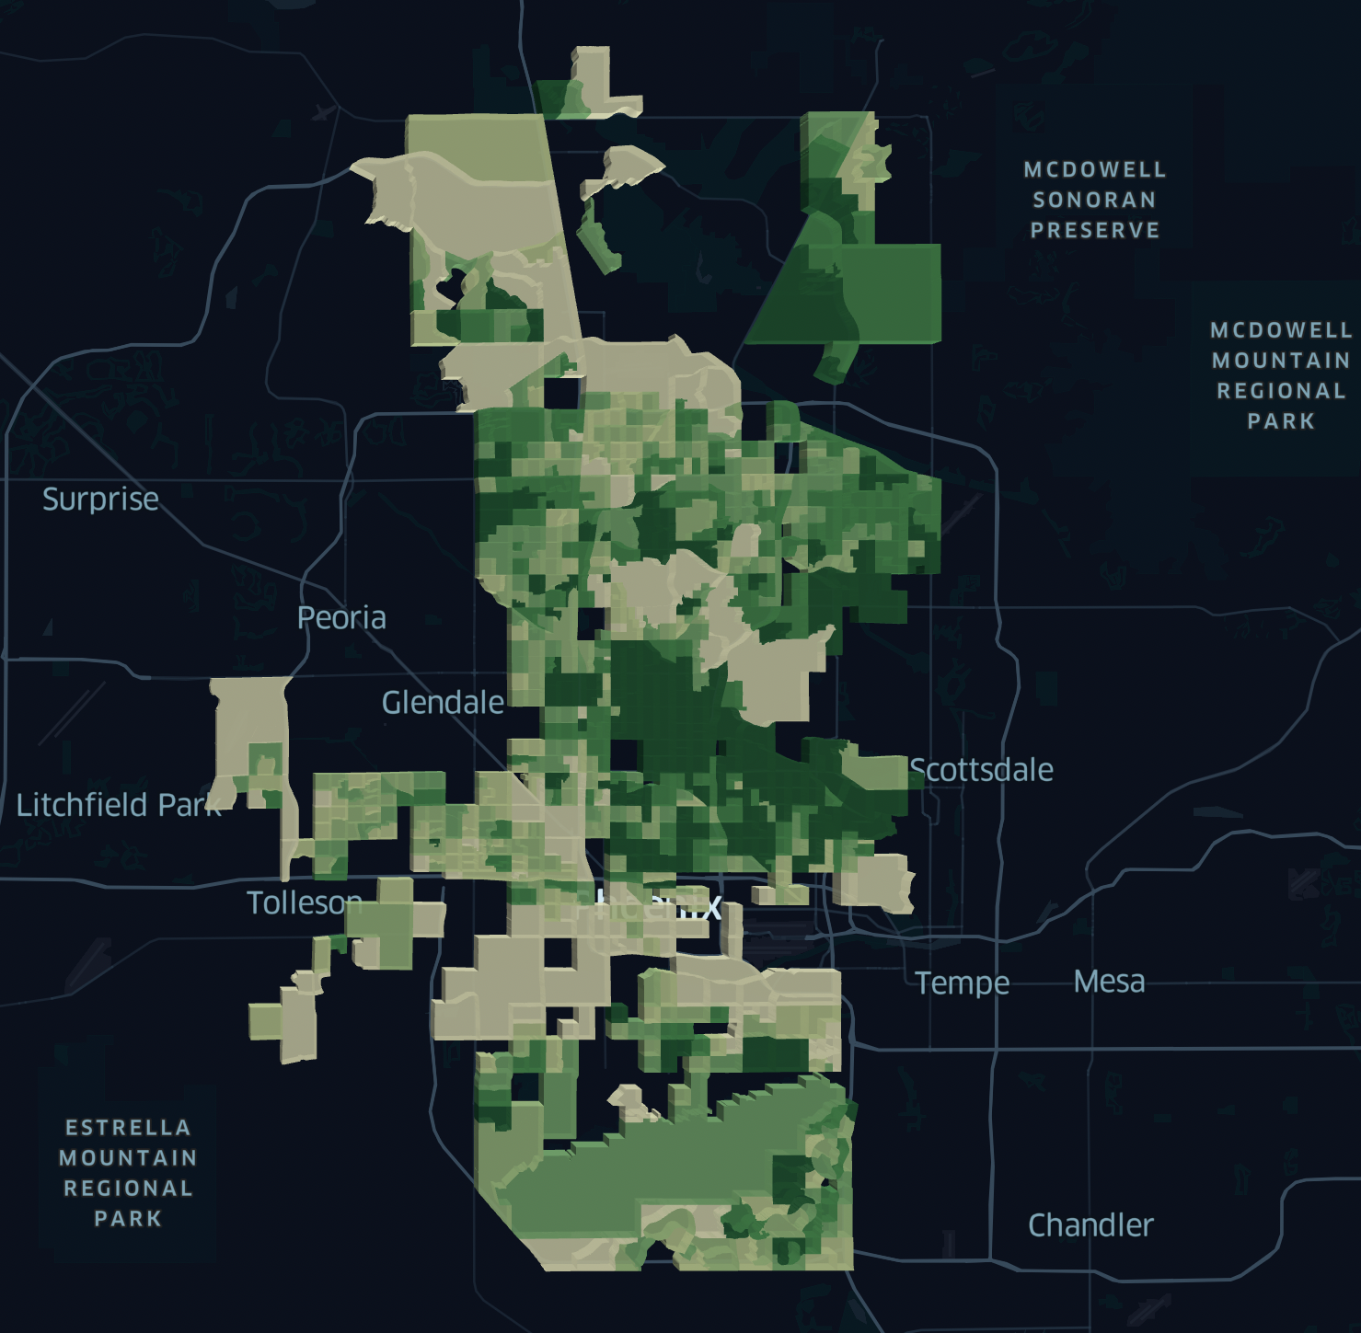
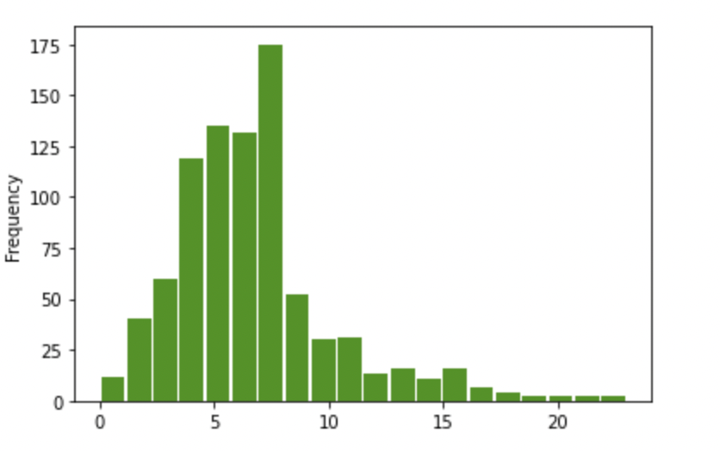
Methodology:
Tree Canopy
% Tree Canopy
0.00 – 4.00
4.01 – 5.00
5.01 – 6.00
6.01 – 7.00
Tree canopy data acquired from American Forests' Tree Equity project
7.01 – 9.00
9.00 – 23.00
Distribution of Tree Canopy % cover among Block Groups
175
150
125
100
75
50
25
0
Frequency
0 5 10 15 20
Tree Canopy % Cover
Notes:
We sourced tree canopy percent cover from the American Forests Tree Equity project, which is originally sourced from Earth Define. The dataset also included tree canopy coverage goals that were calculated using the American Forests methodology that we opted not to use. Their method sets lower tree canopy targets for higher population density areas, but higher population density areas are often those that are most underprioritized and in need of investment. We took the opposite approach, of prioritizing higher density areas, and also simply prioritizing areas with lower tree canopy instead of setting a specific tree canopy goal per block group.
The image visualizes tree canopy coverage in Maricopa county, using kepler.gl, an open source geospatial analysis. We used this tool to initial explorations and visualize the data, and was used to create various data visualizations in this slide
Basemap: Mapbox via kepler.gl

Slide 19
Road Map
+
Heat Data & NLCD
Landsat 8
Notes:
Section Break

Slide 20
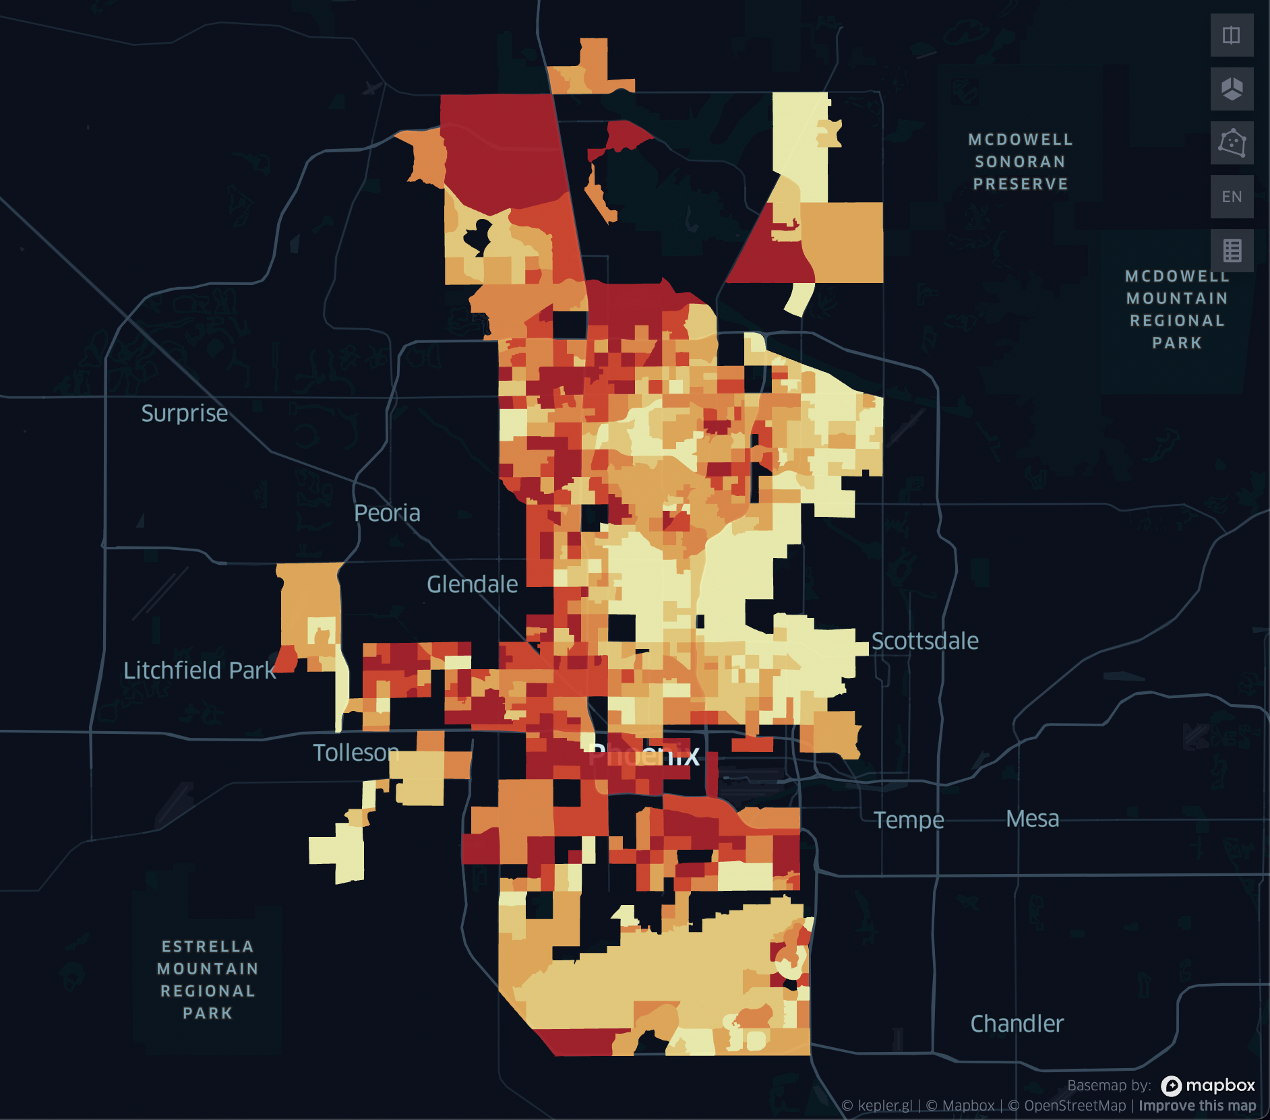
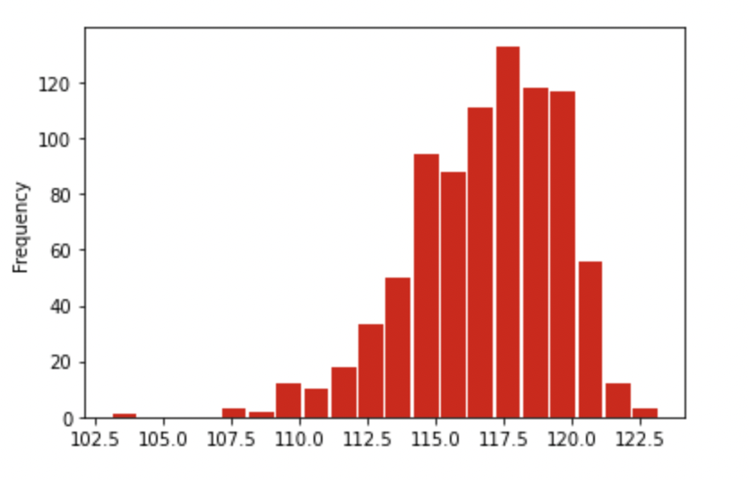
Methodology: Heat
LST (deg F)
103.0 – 114.3
Daytime Land Surface Temperature (LST) Data from Landsat 8 TIRS (May – Sept, 2015-2019)
Percent Impervious Cover - Land cover data from National Land Cover Database (2019)
114.4 – 115.97
115.98 – 117.23
117.24 – 118.29
118.30 – 119.52
119.53 – 123.19
Distribution of LST by Block Group
120
100
80
60
40
20
Frequency
0
102.5 105.0 107.5 110.0 112.5 115.0 117.5 120.0 122.5
LST in F
Notes:
We used the Landsat 8 thermal infrared sensor to obtain daytime LST, we felt like daytime LST was a good enough approximator of heat. We took all images available for May to September for 2015-2019, found the LST for each block group, and took the median for LST's collected for each block group, which was all done in Google Earth Engine. The image here is the median LST per block group that we used in our analysis, with the darker red regions corresponding to higher heat, and the lighter regions for cooler temperatures (cooler is not that much cooler).
Used land cover data from National Land Cover Database from 2019 to find the average percent of impervious surface per block groups. Impervious surfaces like concrete, asphalt, and buildings, contribute to increase in the urban heat island effect.
The Landsat 8 Thermal Infrared Sensor was used to obtain daytime land surface temperature. The Landsat-based National Land Cover Database 2019 release was used to determine impervious surface coverage in our study area.
Spatial Resolution: 100 meters
Temporal Resolution: 16 days
Basemap: Mapbox via kepler.gl

Slide 21
Road Map
Bus Ridership & Pedestrian Movement
City of Phoenix
Icarus data
+
Notes:
Section Break

Slide 22
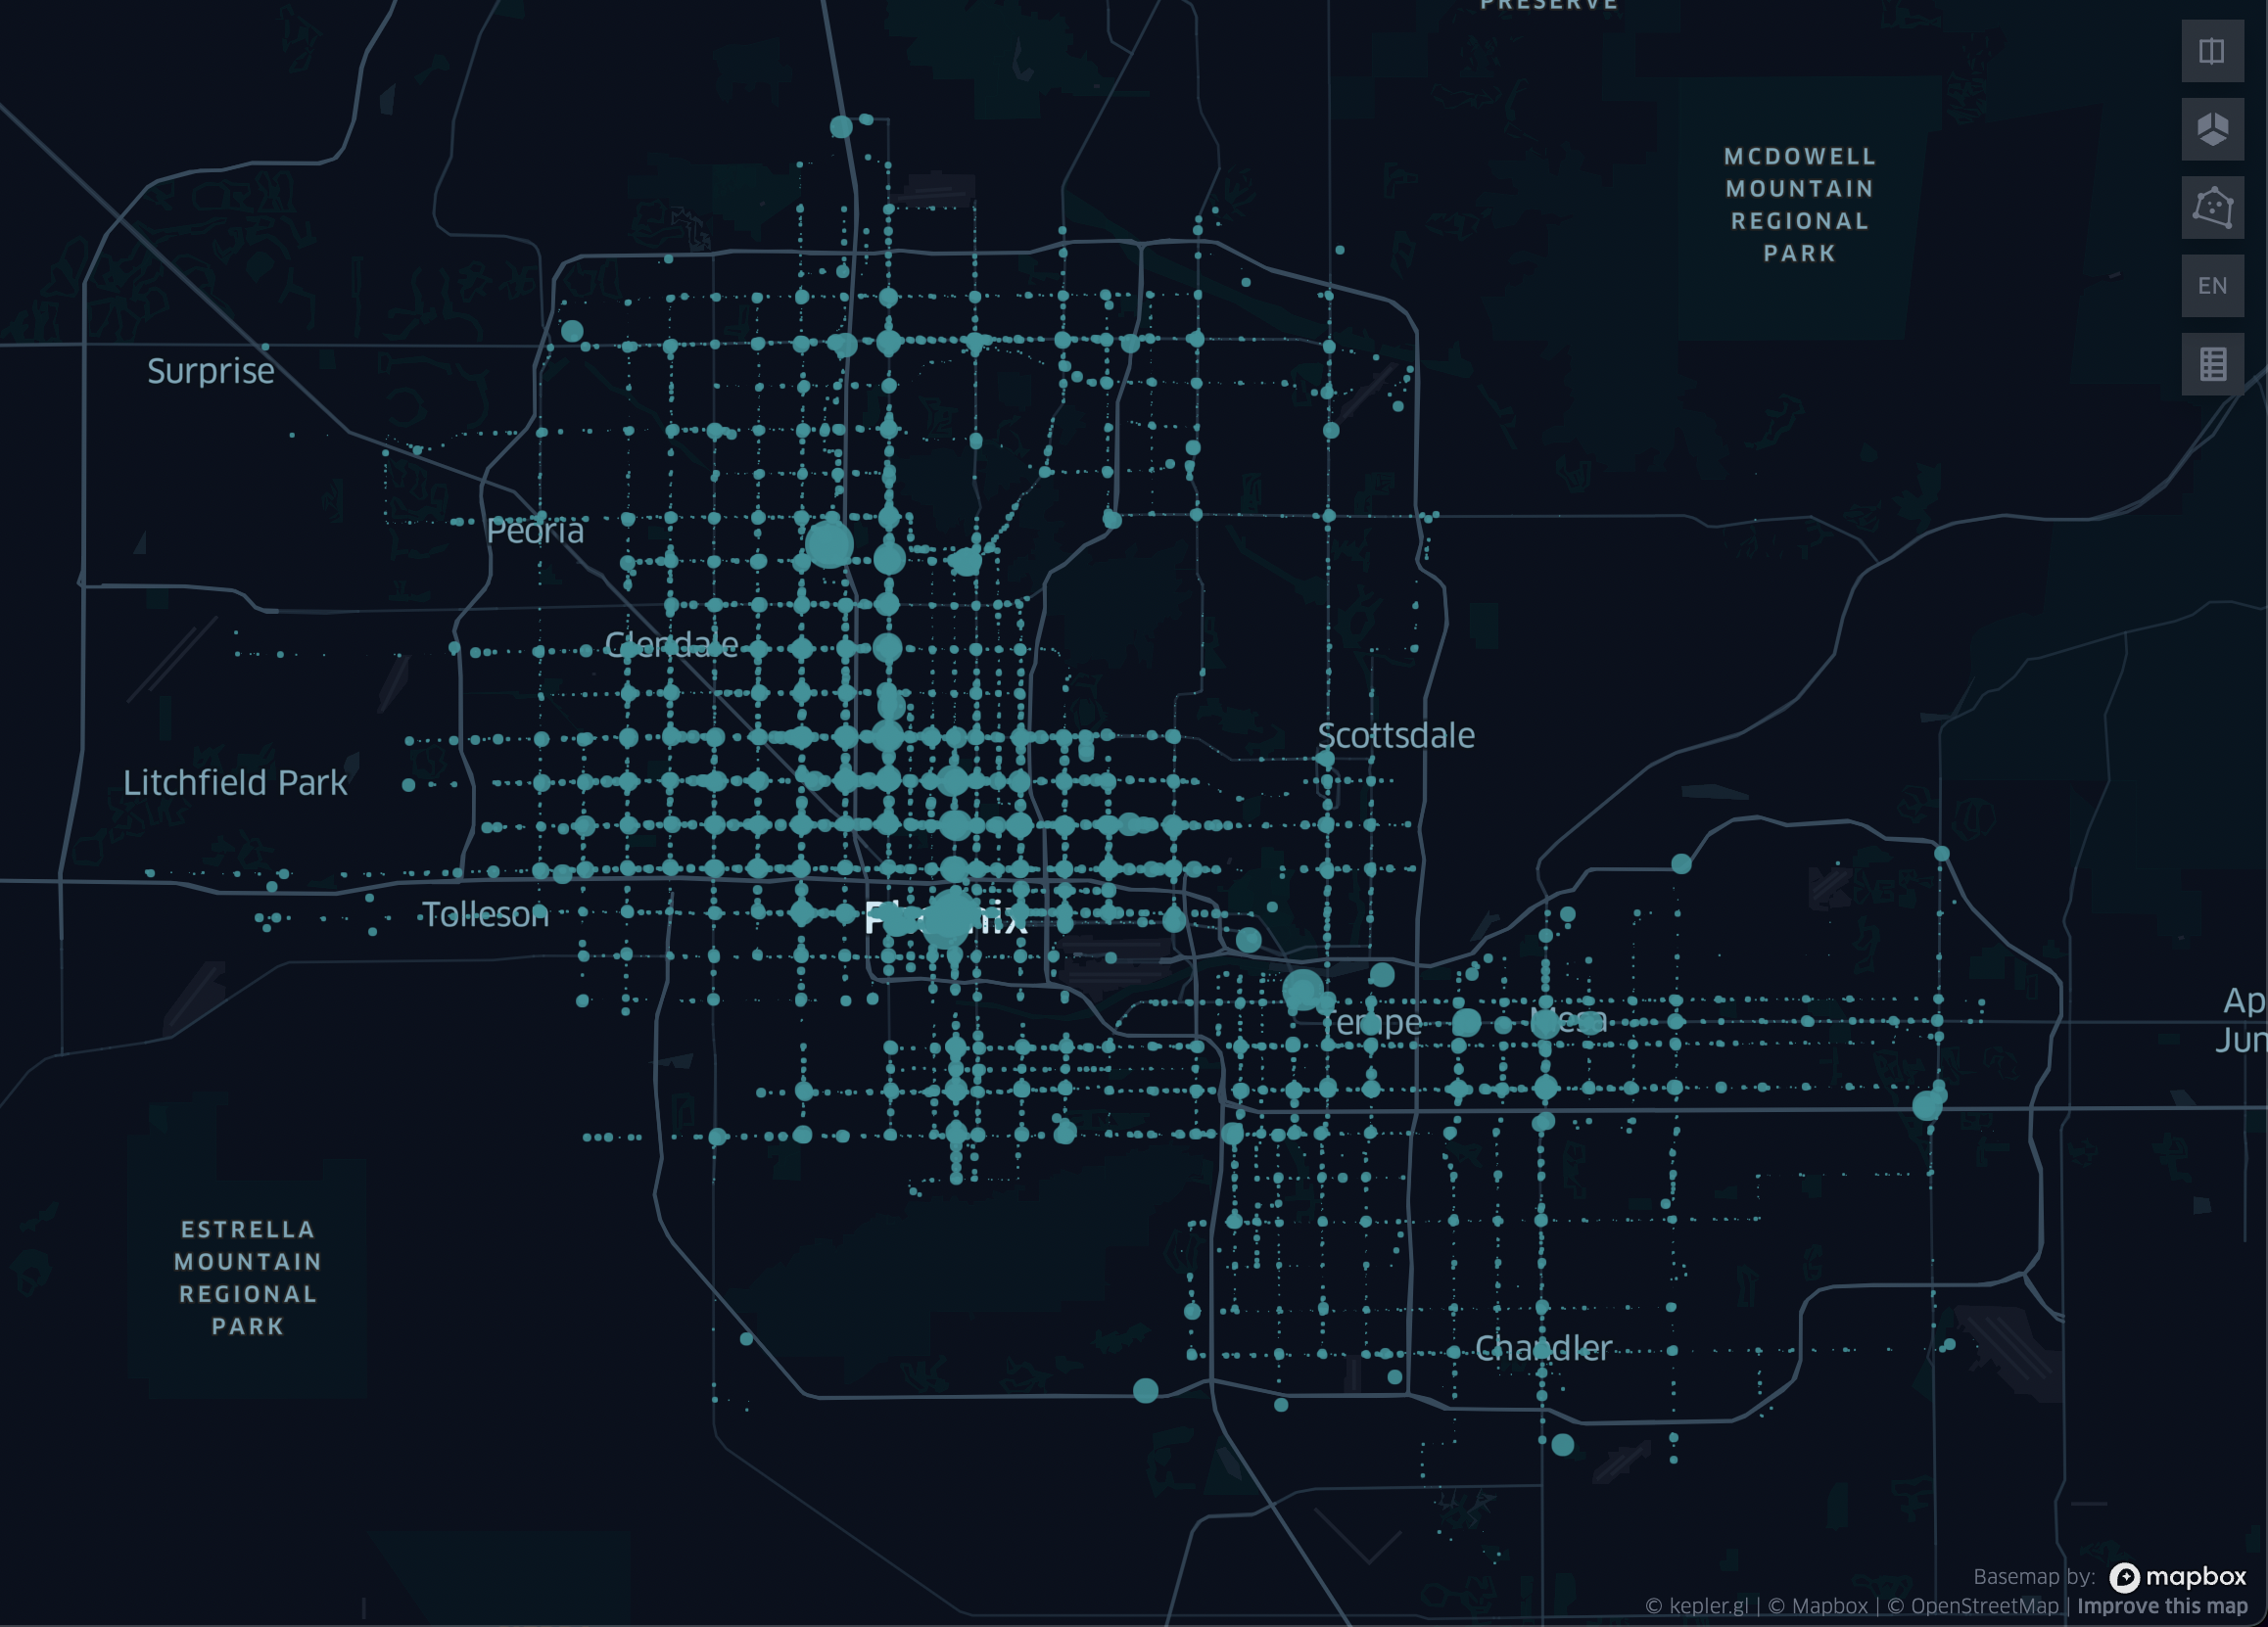
Methodology: Bus Ridership
Average weekday bus boardings from 2018-2019, totaled by the block group the bus stop is in
Notes:
We downloaded bus ridership data valley metro open data, and averaged weekday values from 2018-2019. We got a total boardings per block group by adding up all the boardings of bus stops that were within that block group. There might be more sophisticated ways of analyzing this bus data but this gave us a rough idea of how much transit was being used in each block groups, which was what we needed. The image here is a visualization of bus stop boardings around the county, each circle is a bus stop, with larger circles meaning higher bus boardings at that stop
Higher transit use -> more time outside waiting for buses and more heat exposure, may indicate higher transit dependency and lower car access
Basemap: Mapbox via kepler.gl

Slide 23
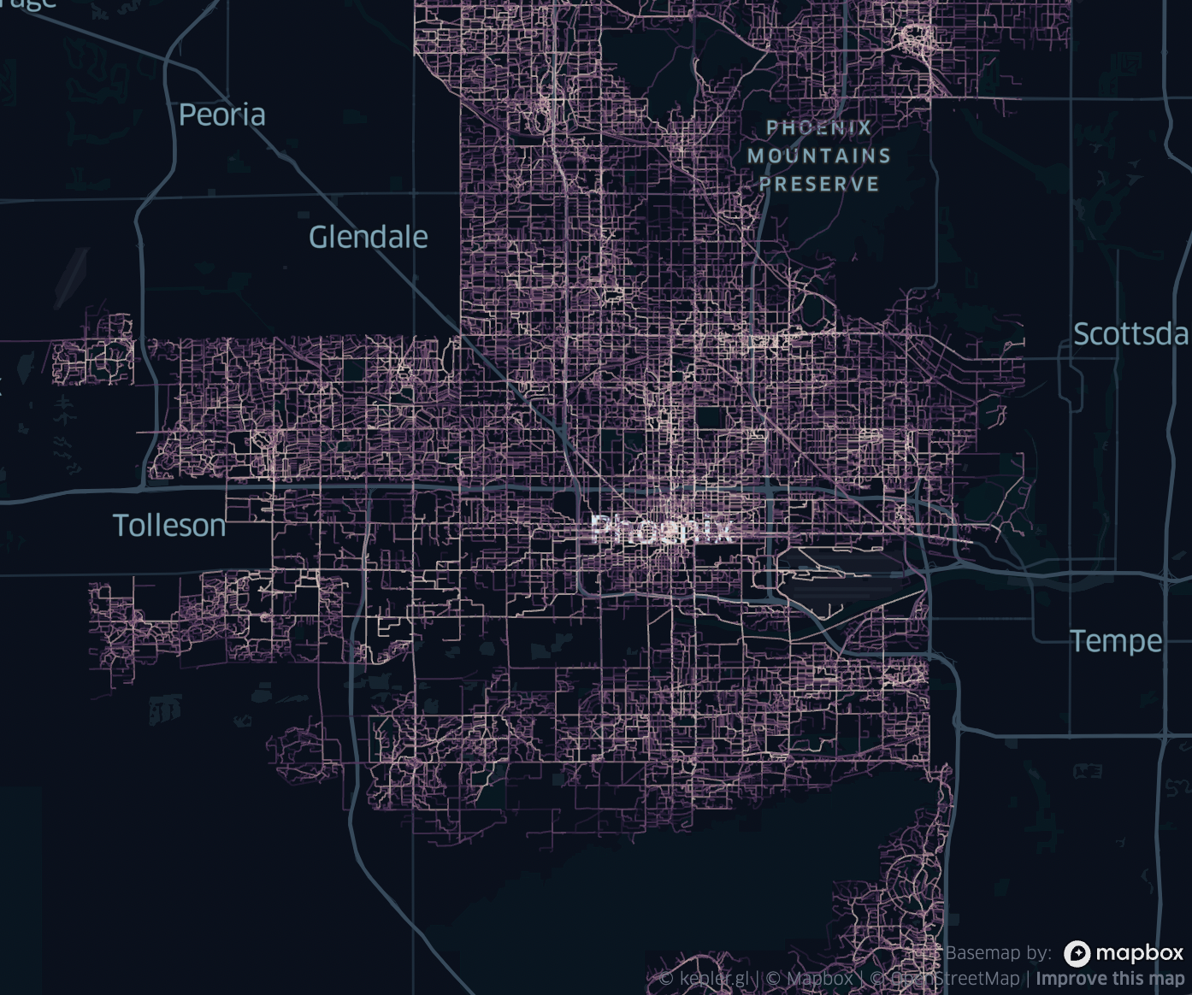
Methodology: Bike/Pedestrian Heat Exposure
Bike/Pedestrian heat exposure data sourced from Icarus project
Icarus – Activity-based model
Data simulated from June 30th, 2017 for 24 hours, for 1.05 million walking and .149 million biking trips
MRT > 60° C
Notes:
Bike/Pedestrian heat exposure data sourced from Icarus project, prepared by Rui Li from ASU
Icarus project
Icarus is an activity based model studying emergent behavior. What does this mean? The model is helpful for studying the big picture – how people are moving around phoenix/Maricopa county, less useful for finding out what specific trips looked like or what individuals did
This is helpful since we're trying to understand how generally people are moving around, and also don't care about specific individual trips
The model was built using trips carried out by 3.8 million travelers
The data we are using was simulated from June 30th 2017 for 24 hours, for 1.05 million walking and .149 million biking trips
Data is link segments (point a to b) and how many walking/biking trips where the person experienced was MRT > 60 C degrees (this MRT estimation taken from Dr Ariane Middel's group's method)
Image is how the data looks like, with the lighter segments being more popular/used segments, and the purple segments being the less used
Basemap: Mapbox via kepler.gl
The simulation was carried out for 2017 June 30th, 24 hours, for 1.05 million walking and 0.149 million biking trips. The weather of the simulation day was hot and dry, with the Air temperature between 25.29 °C (77.5 °F) before sunrise to 43.15 °C (109.7 °F) around 15:00. Air temperature is usually what we get from the weather report. The Mean Radiant Temperature (MRT) for the simulation day was estimated to be 25.29 °C (77.5 °F) to 66 °C (150.8 °F). The MRT estimation is done by Dr. Ariane Middel's group following the method described in Middel et al., 2017. The MRT is significantly higher than the Air Temperature because it considers the environment heat flux from environmental radiants, such as sunlight.
Image credit: Gloria Liu

Slide 24
Road Map
Heat Vulnerability Index
Emphasis on tree canopy
+
Notes:
Section Break

Slide 25
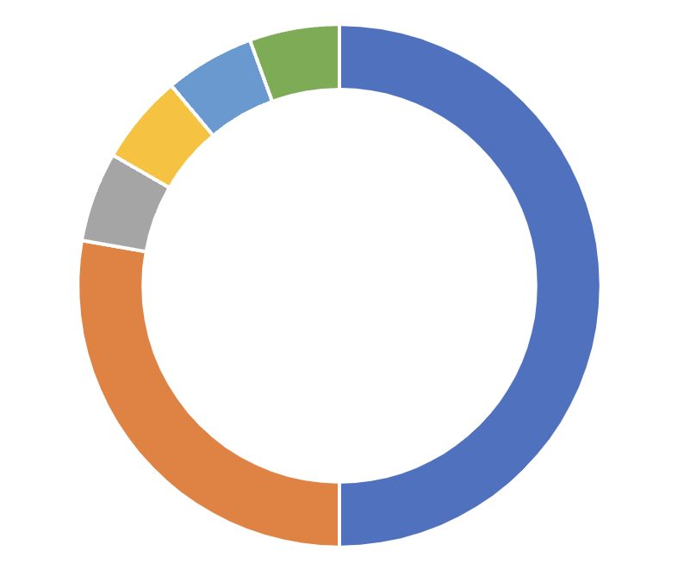
Methodology: Heat Vulnerability Index
LST
Bus Ridership
% Impervious Surfaces
Bike/Ped Heat Exposure
Normalize variables
Weighted mean with SVI_{weight} = 9 and TreeCanopy_{weight} = 5
Social Vulnerability Index
% Tree Canopy
Index Breakdown
Notes:
To find our final heat vulnerability index that we did our final ranking off of, we used a weighted mean.
Normalized variables on a 0-1 scale to account for differently scaled numbers, using a statistical python library.
Differently scaled numbers - For example, tree canopy and impervious surfaces being on % scales, and bike/ped heat exposure being on trips per km.
Weighted the social vulnerability index by 9 because there are 9 variables in the SVI, by weighted we mean multiply the normalized number by the weight, add up the weighted variables and divide by the total weights, equation on next slide
Justifying using a weighted mean - https://halshs.archives-ouvertes.fr/halshs-02485376/file/Rufat_2019_How_Valid_Are_Social_Vulnerability_Models.pdf
"Our study also evaluated alternatives to SoVI and SVI. Compared to these more established models, the weighted index based on expert knowledge had higher validity, explaining both human and housing related impacts. However, previous work found the rankings of hierarchical indices to be highly sensitive to the choice of weighting scheme (Tate 2012)."
Weighted index based on expert knowledge has possibly higher validity

Slide 26
Road Map
+
Ranked Census Blocks
Qualified Census Tracts (QCTs)
Top 25 HVI scores selected
Notes:
Section Break

Slide 27
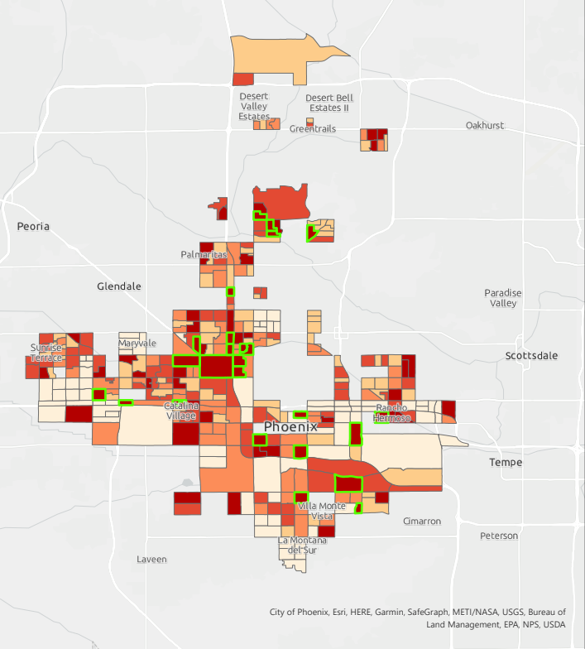
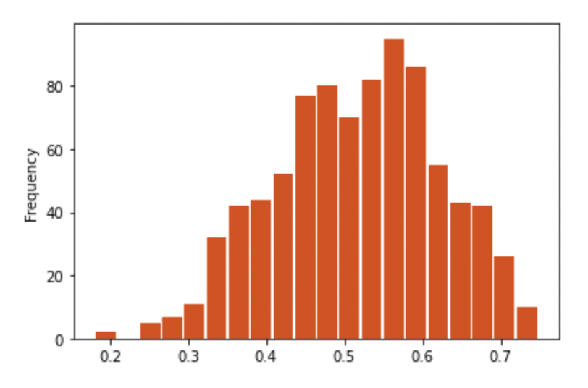
Block Group Selection:
Top 25 Scores
Phoenix Heat Vulnerability Index
Weighted Average Score
0.00
Total Block Groups in Qualified Census Tracts (QCTs): 339
Range of Scores: 0 – 0.747
Average Score: 0.46
Standard Deviation: 0.26
Top 25 Scores Range: 0.70-0.747
0.01 – 0.55
0.56 – 0.60
0.61 – 0.65
0.66 – 0.75
Distribution of HVI among block groups
80
60
frequency
40
20
0
.2
.3
.4
.5
.6
.7
3 miles
HVI
Notes:
The top 25 block groups were selected based on their weighted average score, highlighted in green. These block groups are very widespread throughout the city, so selecting these block groups is useful for a smaller scale analysis and assessing the feasibility of plantable land area in each parcel.
There does, however, appear to be some clustering patterns, so we decided to run a spatial clustering analysis to identify larger neighborhoods that could be more useful as a macro scale perspective on the site suitability analysis

Slide 28
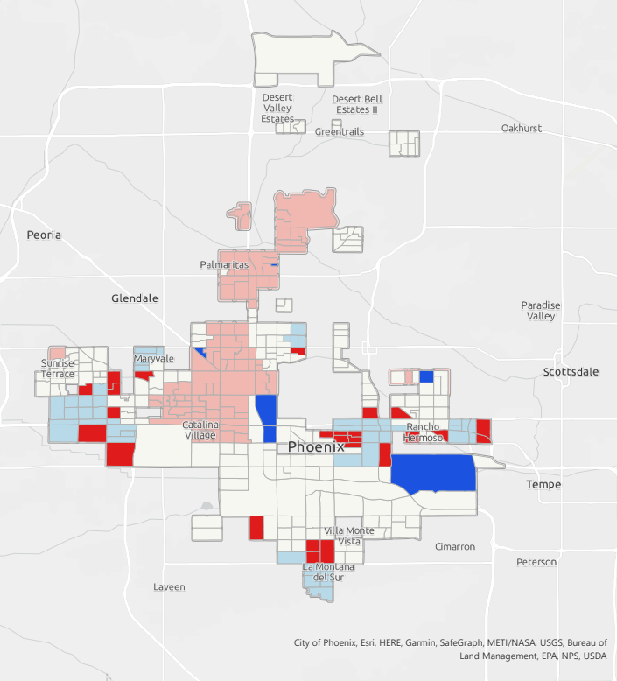
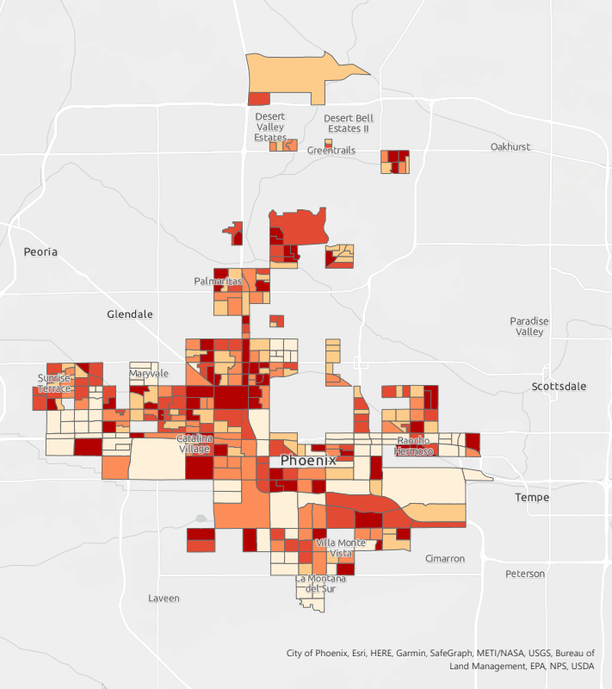
Cluster Analysis for Qualified Census Tracts
Phoenix Anselin Local Moran's I Analysis
Phoenix Heat Vulnerability Index
High-High cluster
Weighted Average Score
High-Low outlier
Low-High outlier
0.00
Low-Low cluster
0.01 – 0.55
Not significant
0.56 – 0.60
0.61 – 0.65
0.66 – 0.75
3 miles
3 miles
Notes:
In addition to ranking the top 25 block groups within the qualified census tracts, we also conducted a spatial cluster analysis.
Anselin Local Moran's I Analysis to identify local clusters and local spatial outliers:
- calculates z and p scores as measures of statistical significance
- a high positive z-score for a block group indicates that the surrounding block groups have similar values. HH indicates a statistically significant cluster of high values and LL for a statistically significant cluster of low values
- a low negative z score indicates a block groups that is a spatial data outlier. A negative z score will indicate id the feature has a high value but is surrounded by block groups with low values (HL), and vice versa for low values surrounded by block groups with high values (LH)
We use this spatial analysis for larger area selection, as it does not highlight all of the top ranked block groups in our analysis. This makes this analysis more applicable to a larger scale analysis and regions within the city to focus on.
Our team decided to use this analysis to inform spatial pattern clustering. These clusters were selected based upon natural clustering patterns we can identify ourselves as well as each area's historical/environmental justice backgrounds. Here, we can see the pitfalls of conducting a site suitability analysis from a purely quantitative lens: we lose the actual needs and concerns of the communities in which we are hoping to uplift and focus on. This tree program is an opportunity to promote equity to historically oppressed communities, and this analysis does not take this into account.

Slide 29
Results: Top Areas for ARPA Tree Planting Program
Phoenix Heat Vulnerability Index
Weighted Average Score
Five main areas of interest:
Alhambra: Council Districts 4/5
W Grand Ave, HW 17
West Encanto Village: Council District 4
N Black Canyon Highway, N 19th Ave
Maryvale: Council District 5
N 83rd, N 67th
Central City South: Council District 8
S 19th Ave, S 7th St
South Phoenix: Council Districts 7/8
S 7th Ave, 16th St
0.00
0.01 – 0.55
0.56 – 0.60
0.61 – 0.65
0.66 – 0.75
Maryvale
Alhambra
Encanto Village
South-Central Phoenix
South Phoenix
3 miles
Notes:
Our team decided to use this analysis to inform spatial pattern clustering. We chose to highlight three areas in particular: the neighborhoods of Alhambra, Encanto Village, Maryvale, and South Phoenix as these are the areas that have numerous block groups that display a need for an increase in their tree canopy.
Alhambra: working class neighborhood crime rate is 165% greater than the national average, large BIPOC Populations
West Encanto Village: High BIPOC and poverty rates
Maryvale: Largest amount of crime, high poverty rates
Central City South: History of redlining, low tree canopy coverage, crowded living
South Phoenix: this area is known for post war homes, and one of the least expensive areas to purchase a home in the valley. Poorest, most diverse and socio-economically challenged area of Phoenix

Slide 30
Road Map
Plantable Land Area
Parcels with single family zoning
+
Notes:
Section Break
Four main components in site suitability Analysis: Tree Canopy Score from the American Forests, Social Vulnerability Index from the US Census Bureau, Heat and National Land Coverage Data from Landsat 8, and bus ridership and pedestrian movement modeling from the City of Phoenix and Icarus project from ASU.
All Datasets are normalized and combined for the heat vulnerability index using a weighted mean
From there, the block groups in QCTs are ranked based upon this score and the top ones were selected for the parcel analysis of plantable land area

Slide 31
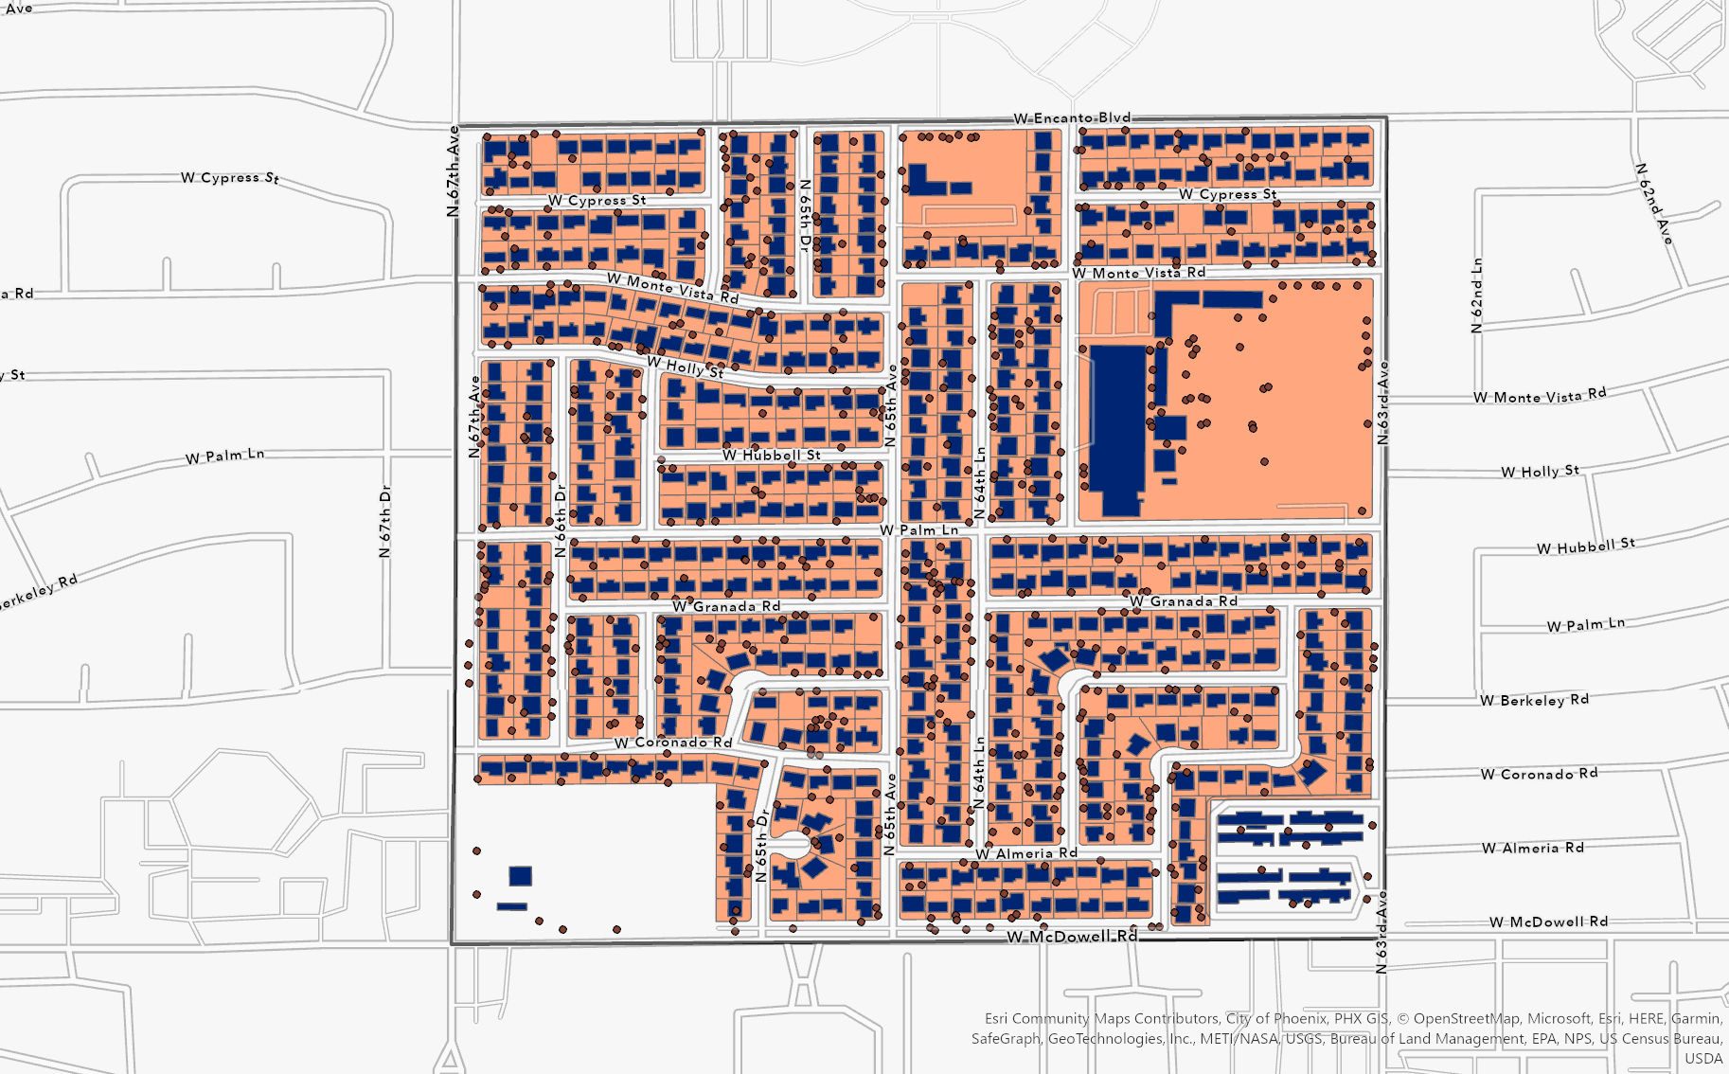
Methodology: Parcel Selection
Phoenix Heat Vulnerability Index
Weighted Average Score
0.00
0.01 – 0.55
0.56 – 0.60
0.61 – 0.65
0.66 – 0.75
200 meters
3 miles
Notes:
After identifying our larger areas of need, the top 25 most vulnerable block groups were selected for a sample parcel analysis in order to determine the feasibility of a tree-planting program dependent on residents planting trees in their own yards. This is a very zoomed in example of the data layers in one block group used to determine the top parcels within our top 25 most vulnerable block groups. Here the parcels are shown in (pink), the building footprints on each parcel are shown in (dark blue), and the tree locations are shown as points.
Data Sources:
Accessor data – Maricopa County
Central A/C
Zoning data
Tree count – LiDAR-Derived Tree Locations - metro-Phoenix, Arizona (2014)
Building Footprint – Microsoft

Slide 32
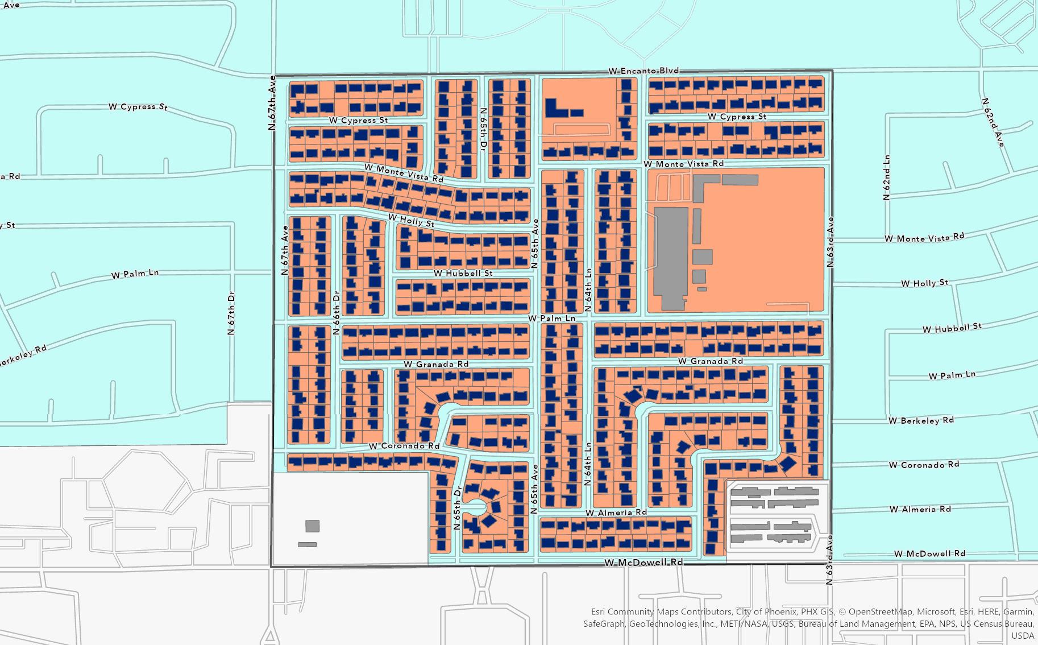
Methodology: Parcel Selection by Area
Parcel Area (orange) – Total Building Area (purple)
Single Family Residential Zones
Schools and Churches
Schools and Churches
Currently occupied
2,411 Parcels
200 meters
Notes:
First the parcels were filtered to application areas of interest to this program, as single-family homes are most likely to participate in a tree-planting program in the initial stages. The zoning codes for single family residences are shown in (light blue), then schools and churches still within these zones and shown in gray were deleted. Any parcels without buildings were ignored as they would not have tenants to participate in tree planting. After these filters we ended up with 2,411 parcels in these 25 block groups. The first criteria of parcel ranking was the amount of available space for trees on the property. Parcel area was determined from parcel data obtained from the city of phoenix, and building area was determined from building footprints obtained from Microsoft Bing Maps. Building area was summarized within parcels, then subtracted from parcel area. The area of potentially plantable area on each parcel was any area not covered by a building.

Slide 33
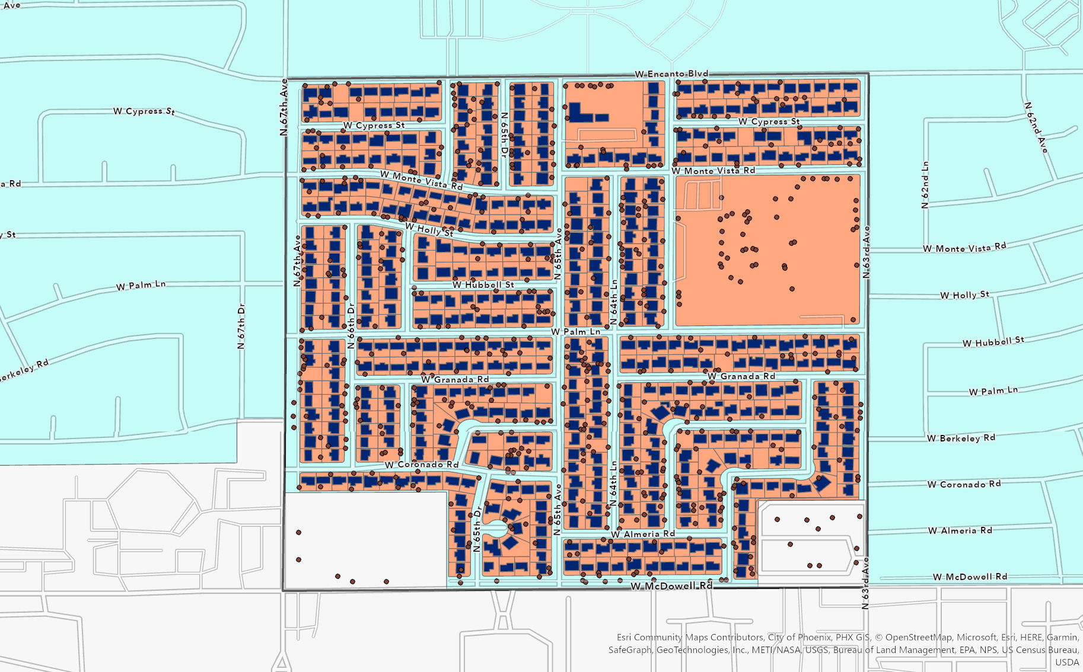
Methodology: Parcel Selection by Tree Coverage
Parcels with Building Footprints and Tree Points
Single Family Residential Zones
Schools and Churches
Schools and Churches
Currently occupied
Tree points summarized within parcel polygons
Prioritized parcels with less trees and adequate available land area
200 meters
Notes:
Then current tree cover on those residential parcels was determined. The LiDAR-derived tree points from 2014 were available from Arizona State University GeoData and managed by the ASU Map and Geospatial Hub. They were counted within each parcel, and then divided by the parcel area to get the number of existing trees per square foot of the parcel. The parcels were then ordered by existing tree canopy, then available land area to get a list of the top parcels lacking trees with the highest planting space available. Any parcel with less than 2 trees and 5,000 square feet or more were additionally added to a high-priority list.

Slide 34
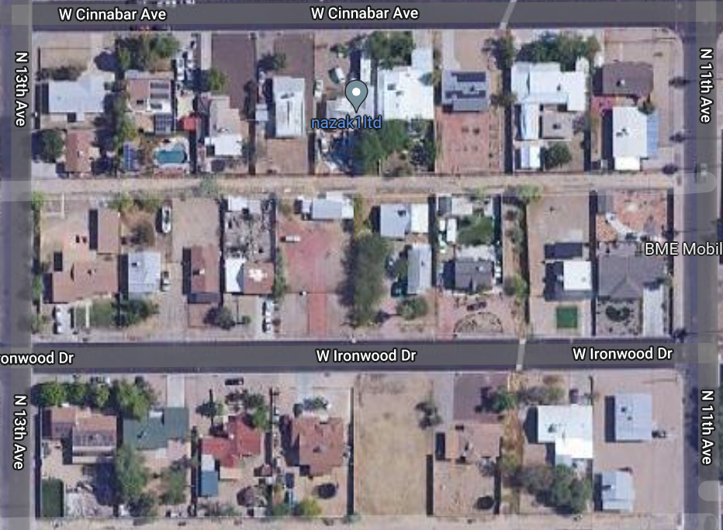
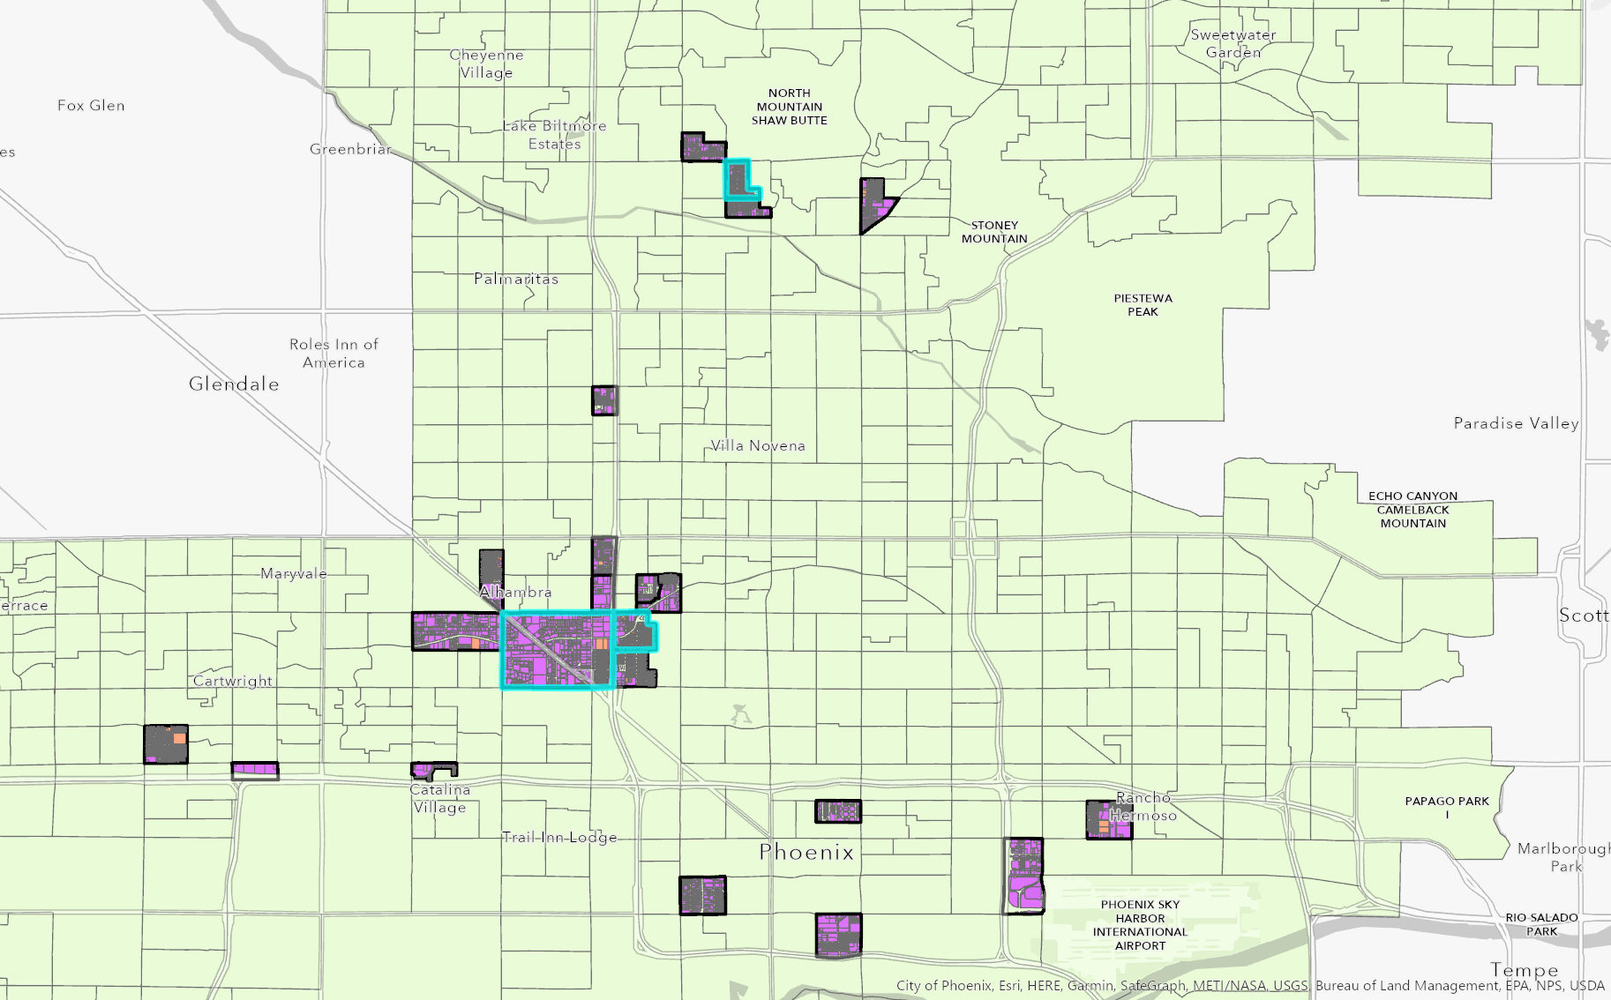
Results: Selected Parcels
1 mile
Image Credit: Google Maps
Notes:
After ordering the parcels by existing tree count per sq foot and available land area, we found that the parcels most in need of added tree canopy tended to be located in their own clusters. The top 100 parcels of low existing tree cover and high available area for planting were found in just 10 block groups. From this small exploratory sample, these three block groups highlighted in blue in northwest and north Phoenix contained 57 of the top 100 parcels, and this block group in the north had 26 of those. As an example of the types of parcels this methodology selected, we can see from just a small section of this northern block group that the parcels selected in red in fact look fairly tree-sparse compared to their neighbors.

Slide 35
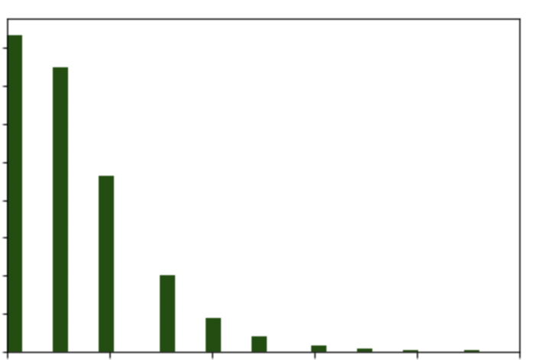
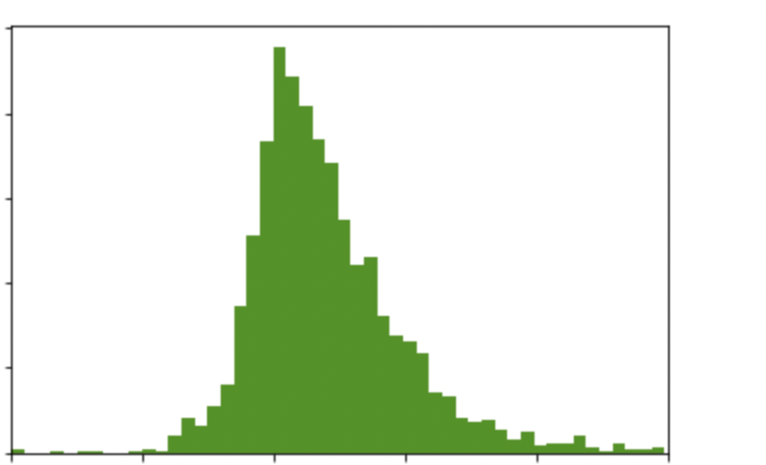
Results: Parcel Descriptions
Tree Count in top 25 Block Groups: 3,133 trees
Per parcel:
Range of Scores: 0 – 33
Average Score: 1.3
Standard Deviation: 1.6
Available Planting Area per parcel (sq. ft)
Range of Scores: 686 – 244,047
Average Score: 5,172
Standard Deviation: 6,419
Distribution of Available Planting Area per Parcel*
Distribution of Available Planting Area per Parcel*
250
800
700
200
600
500
150
Frequency
Frequency
400
100
300
200
50
100
0
2
4
6
8
10
0
2,000
4,000
6,000
8,000
10,000
Number of Trees
Available planting area (sq.ft.)
*outliers above 99th percentile omitted for clarity of plotting
Notes:
In the top 25 block groups within the 2,411 parcels analyzed, there were 3,133 trees. The amount of trees per parcel with a building ranged from 0-33, with an average of 1.3 trees per parcel. Half of the parcels analyzed had 1 or less trees, and only 7 parcels had more than 10 trees. These large parcels were typically made up of multiple single family homes on a single parcel. 835 of these parcels had 0 trees according to the 2014 lidar derived tree points. 90% of homes in these parcels had 3 or less trees, so homes with 2 or less trees (the 75th percentile) were considered high-priority for these parcels.
Available area in each parcel not covered by a building ranged from 686 to just under 250,000 square feet. The average available land area in these parcels was around 5,000 square feet and 95% of these parcels had under 7,500 square feet of available land area. 75% of these parcels had less than 5,500 square feet of available area, and those were prioritized as high-priority for tree planting.

Slide 36
Conclusions
This methodology applies principles from heat vulnerability research to the City's specific plans for heat mitigation in residential areas.
Five areas were selected for prioritization for tree planting
In the most vulnerable 25 block groups, there were 3,133 trees on parcels analyzed. In order to triple tree cover on these parcels, <10,000 additional trees would be needed.
These results are expandable based on program changes, and the methods used are adaptable to include additional block groups and parcels.
Notes:
The methods used in this study applied principles from heat vulnerability research to the city's specific needs for heat mitigation in residential areas. In doing so, 6 areas were identified as candidates for this tree planting program, as they were most feasibly accessible clusters of highly vulnerable block groups. In the most vulnerable 25 block groups, there were 3,133 trees on the 2,411 single family residential parcels analyzed. In order to triple the tree cover on these parcels, about 9,400 more trees would be needed.
These results set a priority for all block groups within Phoenix's qualified census tracts, so the program may be able to expand past the initial selected areas. Additionally, the methods used for cluster and parcel selection are adaptable to include more and different parcel types in the future.

Slide 37
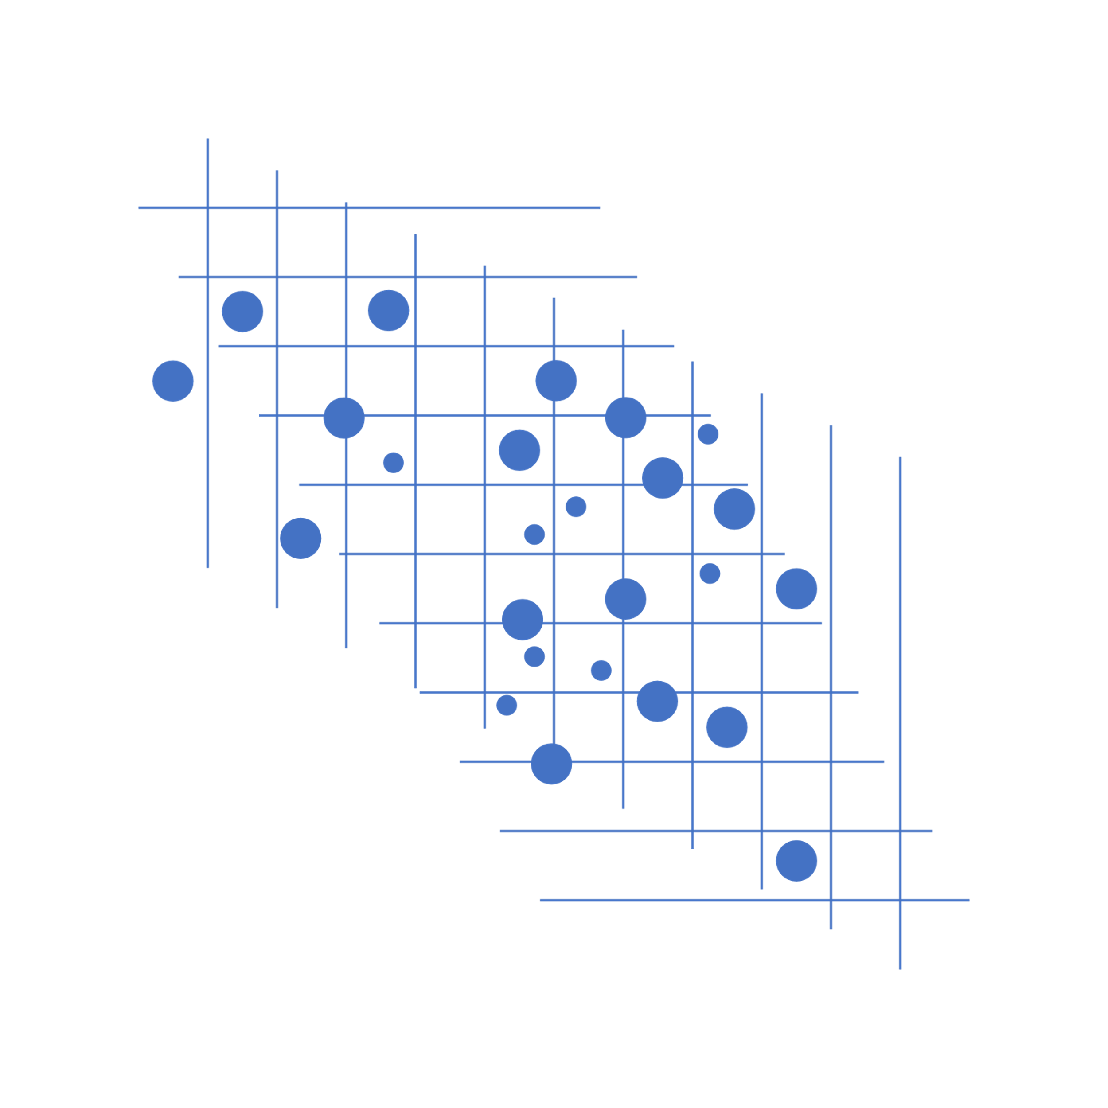
Project Limitations and Uncertainties
Social Vulnerability Index:
Socioeconomic variables from the American Community Survey are error-prone at this fine of a scale
Variables relevant to heat vulnerability may change
Heat data:
A coarse spatial resolution makes temperature measurement at the sub-block group level difficult
Parcel data:
Open-source building data is incomplete
LiDAR-derived tree locations are only available from 2014
Notes:
Limitations of the data were largely products of desired high spatial-resolution of the data. The American Community Survey is a good tool for general demographic trends but has high standard error at fine resolution like census blocks. Additionally, the variables that confer heat vulnerability in one location may not be translatory to another location, especially with Phoenix's unique status of urban heat vulnerability within an arid desert.
Land surface temperature was the limiting factor of finer spatial analysis for this study, as it is available at the 100 meter scale. Additional temperature datasets are available such as Mean Radiant Temperature, but these are limited in scope and not proper for a residential plot analysis.
Lastly, as we analyze and report data as fine as the parcel-scale, we have to acknowledge the patchiness of available data sources. Upon spot checks with satellite imagery, building data was mostly accurate with a lack of buildings such as trailer homes, and lidar-derived tree points may be less accurate at this fine of scale and were not up to date as the last available year was 2014.
These limitations to the data may be resolved with community outreach and surveys, especially to determine the validity and currency of parcel feasibility. The creation of a ranked list of many parcels will give the city flexibility to determine the most valid top-priority parcels by having the ability to move down the list systematically.

Slide 38
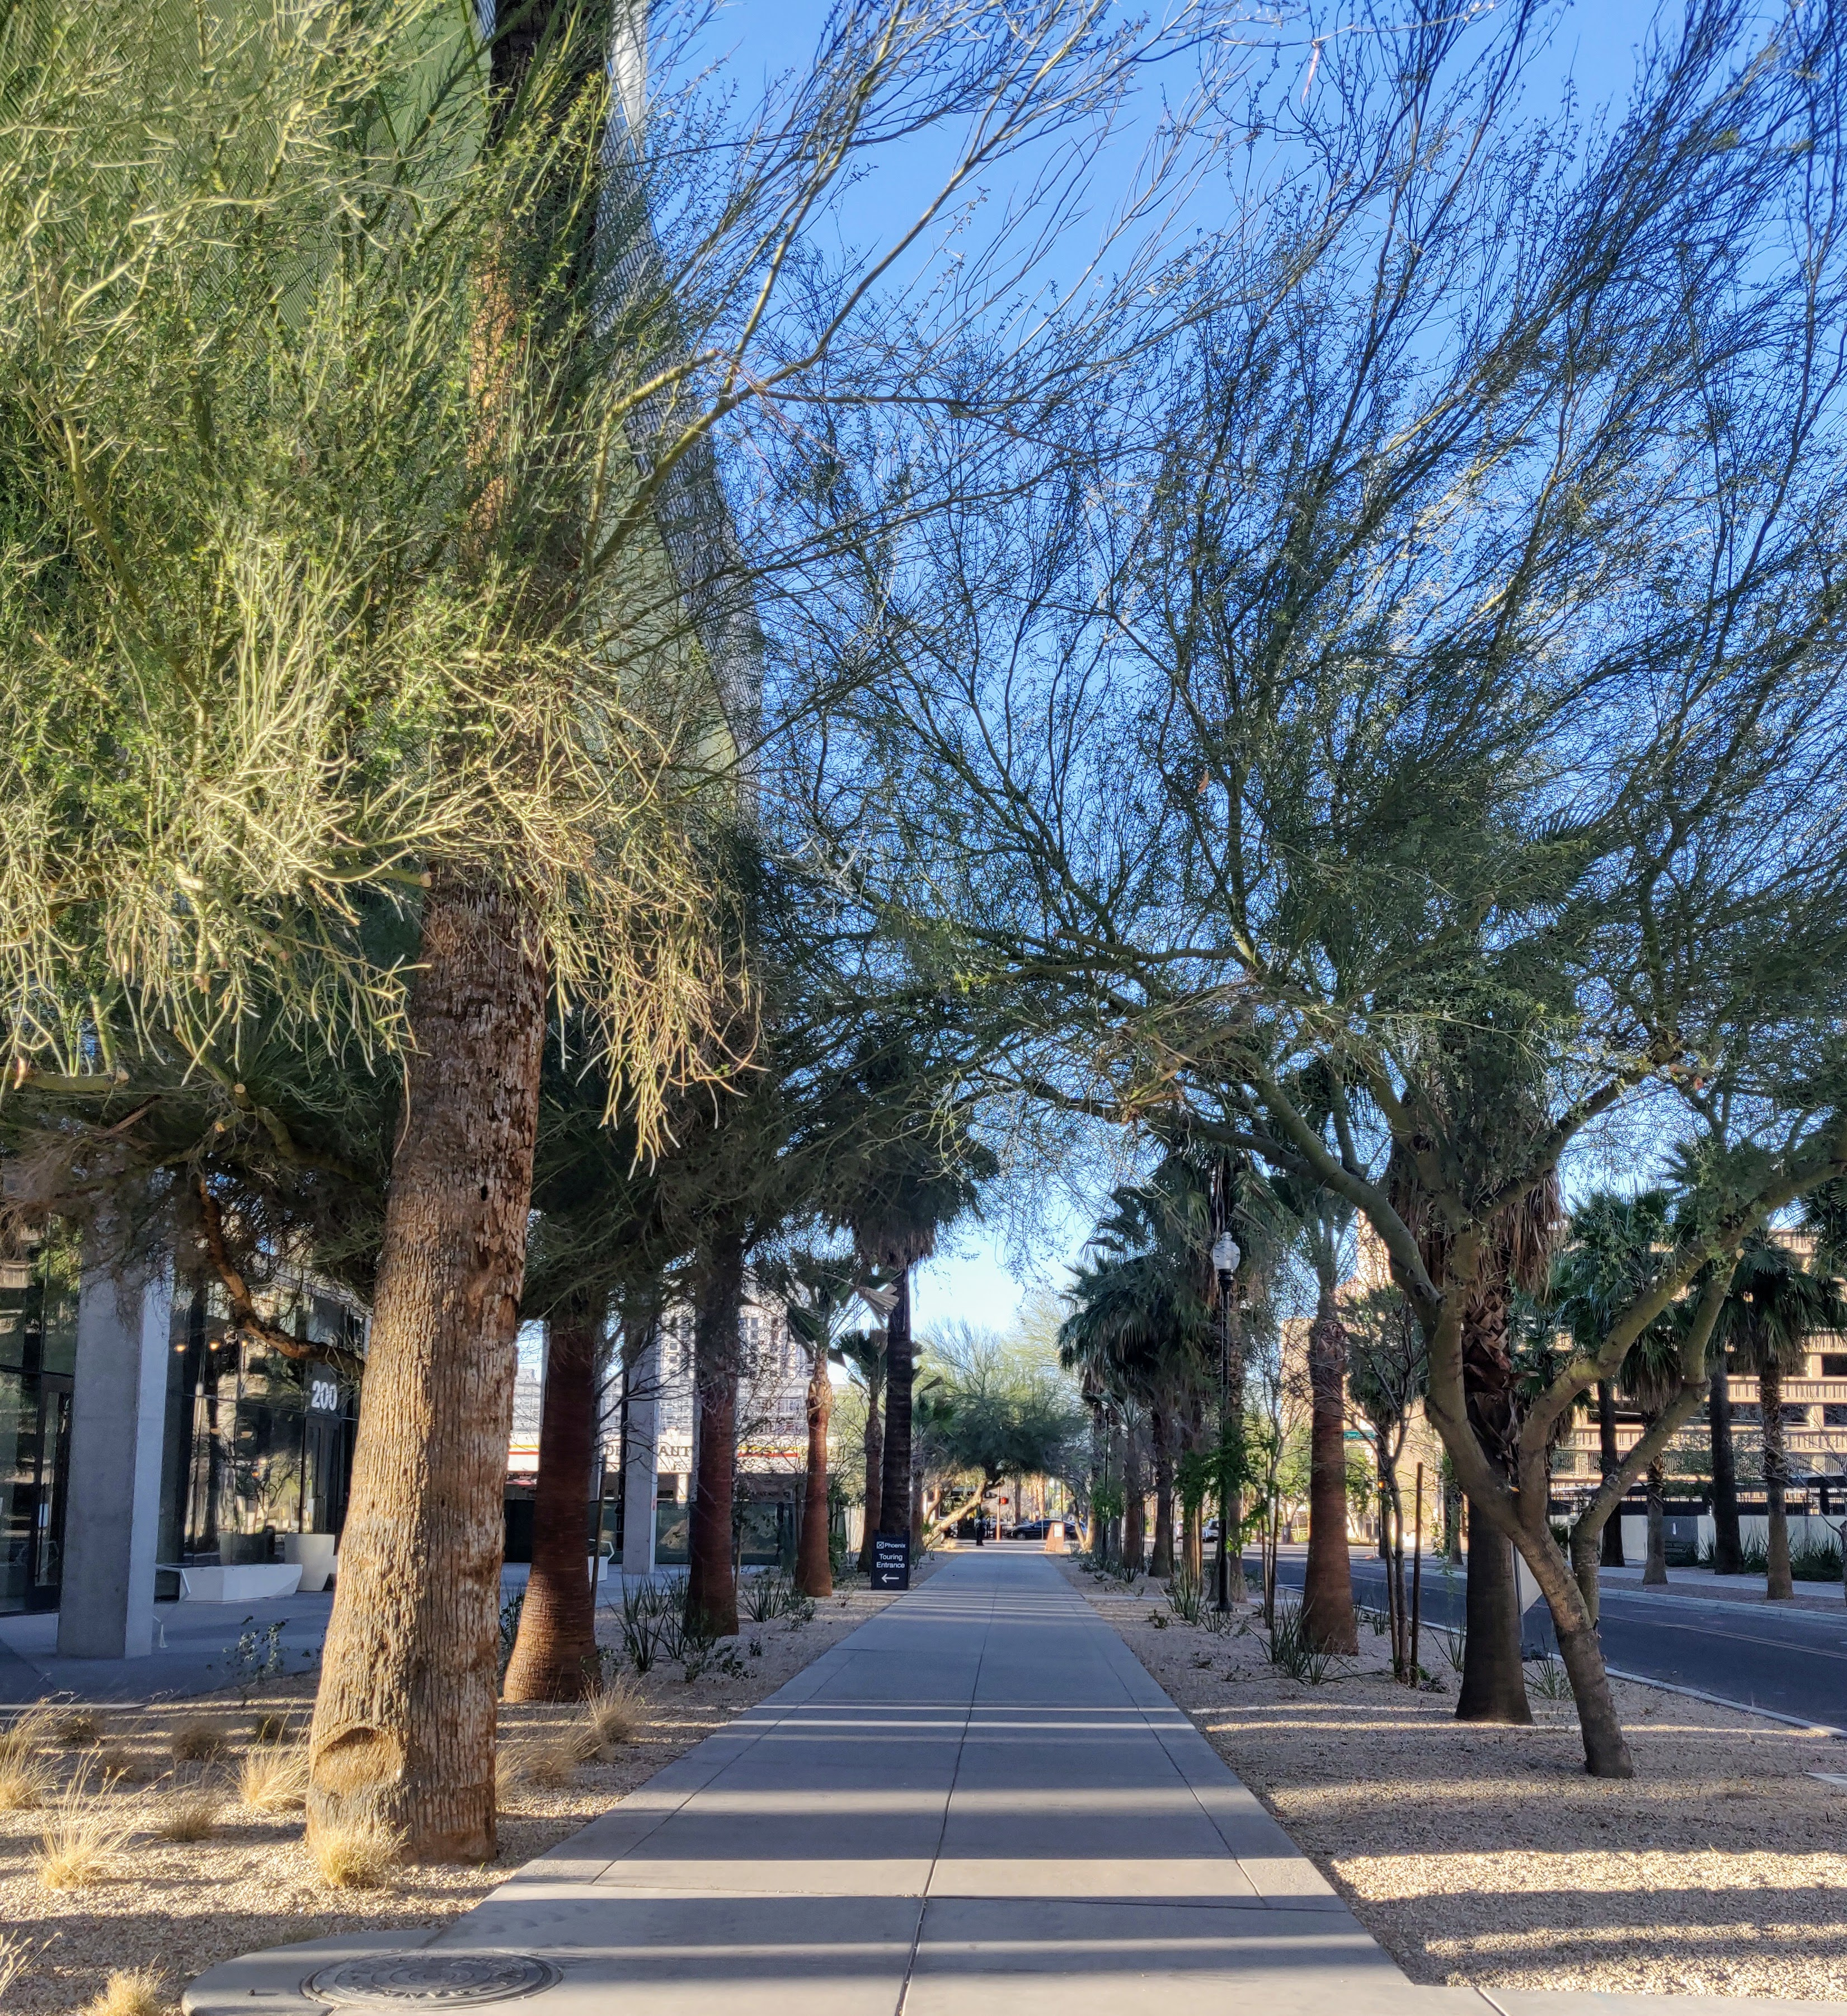
Future Work
Expansion
Larger-scale analysis of more residential parcels within the city
Expansion to other residential areas
Improvements
Correlational relationships between variables
ENVI-met modeling of microclimatic changes due to tree planting
Beyond Quantitative Analysis
Outreach to community-based organizations
Surveying residents in QCTs
Image Credit: Haley Stuckmeyer & Alison Bautista
Notes:
These findings will be given to the City of Phoenix as part of the American Rescue Plan Act tree planting program. These methods may also be helpful for determining future areas of cool corridor, cool pavement, or other heat mitigation strategies.
The methods used in this project may be expanded to determine parcel rankings of larger areas of the city, and could include the analysis of other residential areas not prioritized in this study such as multifamily residential buildings.
Improvements to these analyses include:
-determining correlational relationships between socioeconomic, heat, and tree cover variables
-use of a Principal component analysis
-modeling such as ENVI-met to determine the impacts on heat of a neighborhood due to proposed tree planting locations in specific parcels
Beyond Quantitative Analysis:
Environmental Justice application: engage with community-based organizations to ensure that community members and voices are uplifted and included in the planning process.
Engaging homeowners who qualify for the program with surveys and other forms of communication- perhaps offer a streamlined application process for these communities
Image Credit: Haley Stuckmeyer and Alison Bautista (Phoenix Climate Team)

Slide 39
We would like to extend a special thank you to our Science Advisors, Mentors, and Fellow for their direction and support:
Dr. David Hondula (Arizona State University, City of Phoenix)
Lance Watkins (Arizona State University)
Rui Li (Arizona State University)
Ryan Hammock (NASA DEVELOP, Fellow/Lead)
Michelle Litwin (City of Phoenix)
Notes:
Maps throughout this work were created using ArcGIS® software by Esri. ArcGIS® and ArcMap™ are the intellectual property of Esri and are used herein under license.

Slide 40
References
American Forests (2021). Tree Equity Score Project. https://www.treeequityscore.org/
American Arborists (2017). What Trees Are Best Suited for the Changing Climate?
https://www.americanarborists.net/tree-tips/2017/july/what-trees-are-best-suited-for-the-changing-clim/
Chen, D. and H. W. Chen (2013): Using the Köppen classification to quantify climate variation and
change: An example for 1901–2010. Environmental Development, 6, 69-79,
doi:10.1016/j.envdev.2013.03.007.
City of Phoenix. (2021). Climate Action Plan. https://www.phoenix.gov/oepsite/Documents/2021ClimateActionPlanEnglish.pdf
City of Phoenix. (2010). Tree and Shade Master Plan. https://www.phoenix.gov/parkssite/Documents/PKS_Forestry/PKS_Forestry_Tree_and_Shade_Master_Plan.pdf
City of Phoenix (2015) Urban tree planting - Phoenix, Arizona. https://www.phoenix.gov/parkssite/Documents/PKS_Forestry/PKS_Forestry_Infographic_Urban_Forestry_Benefits_Costs.pdf
City of Phoenix, The Nature Conservancy (2020). Nature's Cooling Systems Project. https://www.phoenix.gov/oepsite/Documents/Agenda%20Item%206%20NCS_PP%20020220_ab.pdf
City of Phoenix (2022). "Phoenix Receives Major Donation for Urban Forest". https://www.phoenix.gov/newsroom/environmental-programs/2197
Flanagan, B. E., Gregory, E. W., Hallisey, E. J., Heitgerd, J. L., & Lewis, B. (2011). A social vulnerability index for disaster management. Journal of Homeland Security and Emergency Management, 8(1). https://doi.org/10.2202/1547-7355.1792
Golden, J. S (2004). The Built Environment Induced Urban Heat Island Effect in Rapidly Urbanizing Arid Regions – A Sustainable Urban Engineering Complexity. Environmental Sciences, 1(4), 321-349. https://doi.org/10.1080/15693430412331291698
Notes:
1. This graph from Maricopa county demonstrates how urban heat disproportionately impacts BIPOC communities.
Source: https://www.maricopa.gov/ArchiveCenter/ViewFile/Item/5240

Slide 41
References
Harlan, S. L., Brazel, A. J., Prashad, L., Stefanov, W. L., & Larsen, L. (2006). Neighborhood microclimates and vulnerability to heat stress. Social Science & Medicine (1982), 63(11), 2847–2863. https://doi.org/10.1016/j.socscimed.2006.07.030
Harlan, S.L., *J.H. Declet-Barreto, W.L. Stefanov, D.B. Petitti (2013) “Neighborhood Effects on Heat Deaths: Social and Environmental Predictors of Vulnerability in Maricopa County, Arizona.” Environmental Health Perspectives, 121(2), 197-204.
Maricopa County Health (2020) Heat-Associated Deaths in Maricopa County, AZ. https://www.maricopa.gov/ArchiveCenter/ViewFile/Item/5240
NASA NEPA. (2022). Environmental justice. https://www.nasa.gov/emd/environmental-justice
The Nature Conservancy (). Heat Action Planning Guide, https://www.nature.org/content/dam/tnc/nature/en/documents/Phoenix-Arizona-Heat-Action-Plan.pdf
US Census Bureau. (2022). Quick Facts Phoenix, AZ. https://www.census.gov/quickfacts/phoenixcityarizona
US Forest Service (2022). International Forests Day. https://www.fs.usda.gov/detail/r9/home/?cid=STELPRD3832558
Zhang, Y., B. Turner II. (2020.) "Land-cover mapping of the central Arizona region based on 2015 National Agriculture Imagery Program (NAIP) imagery ver 1". Environmental Data Initiative. https://doi.org/10.6073/pasta/e671ed549a55fda3338b177a2ad54487.

