Slide 1

The Earth Science Data and Information System Project (ESDIS)
Open Source Science for the Earth System Observatory Mission
Science Data Processing Study Workshop 2
March 3, 2022
Notes:
Introduction

Slide 2
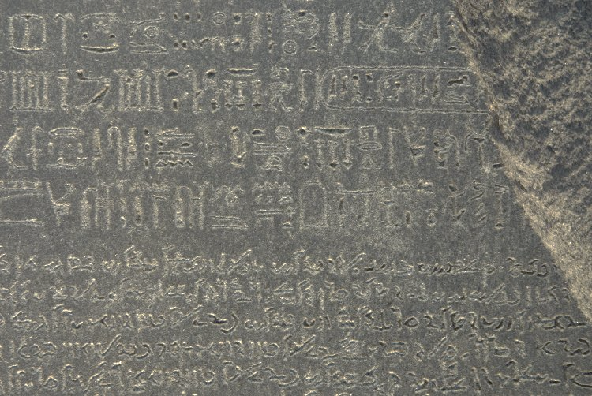
Interpreting the Data System Acronyms
ESDS – Earth Science Data Systems is the name of the NASA Headquarters Program Office that funds the ESDIS Project.
ESDIS is the acronym name for the Project at GSFC that. currently manages Earth science data systems for EOS and other assigned missions
EOSDIS is the acronym name for the System that was developed to manage NASA’s Earth Observing System mission data. It has evolved over the years.
SIPS – Science Investigator-led Processing Systems
DAAC – Distributed Active Archive Center
Earthdata is the name of the website that describes the ESDIS Project, the EOSDIS system, and HQ’s Earth Data Systems program.
This Photo by Unknown Author is licensed under CC BY-NC-ND
Notes:
Let’s start off with some the acronyms

Slide 3
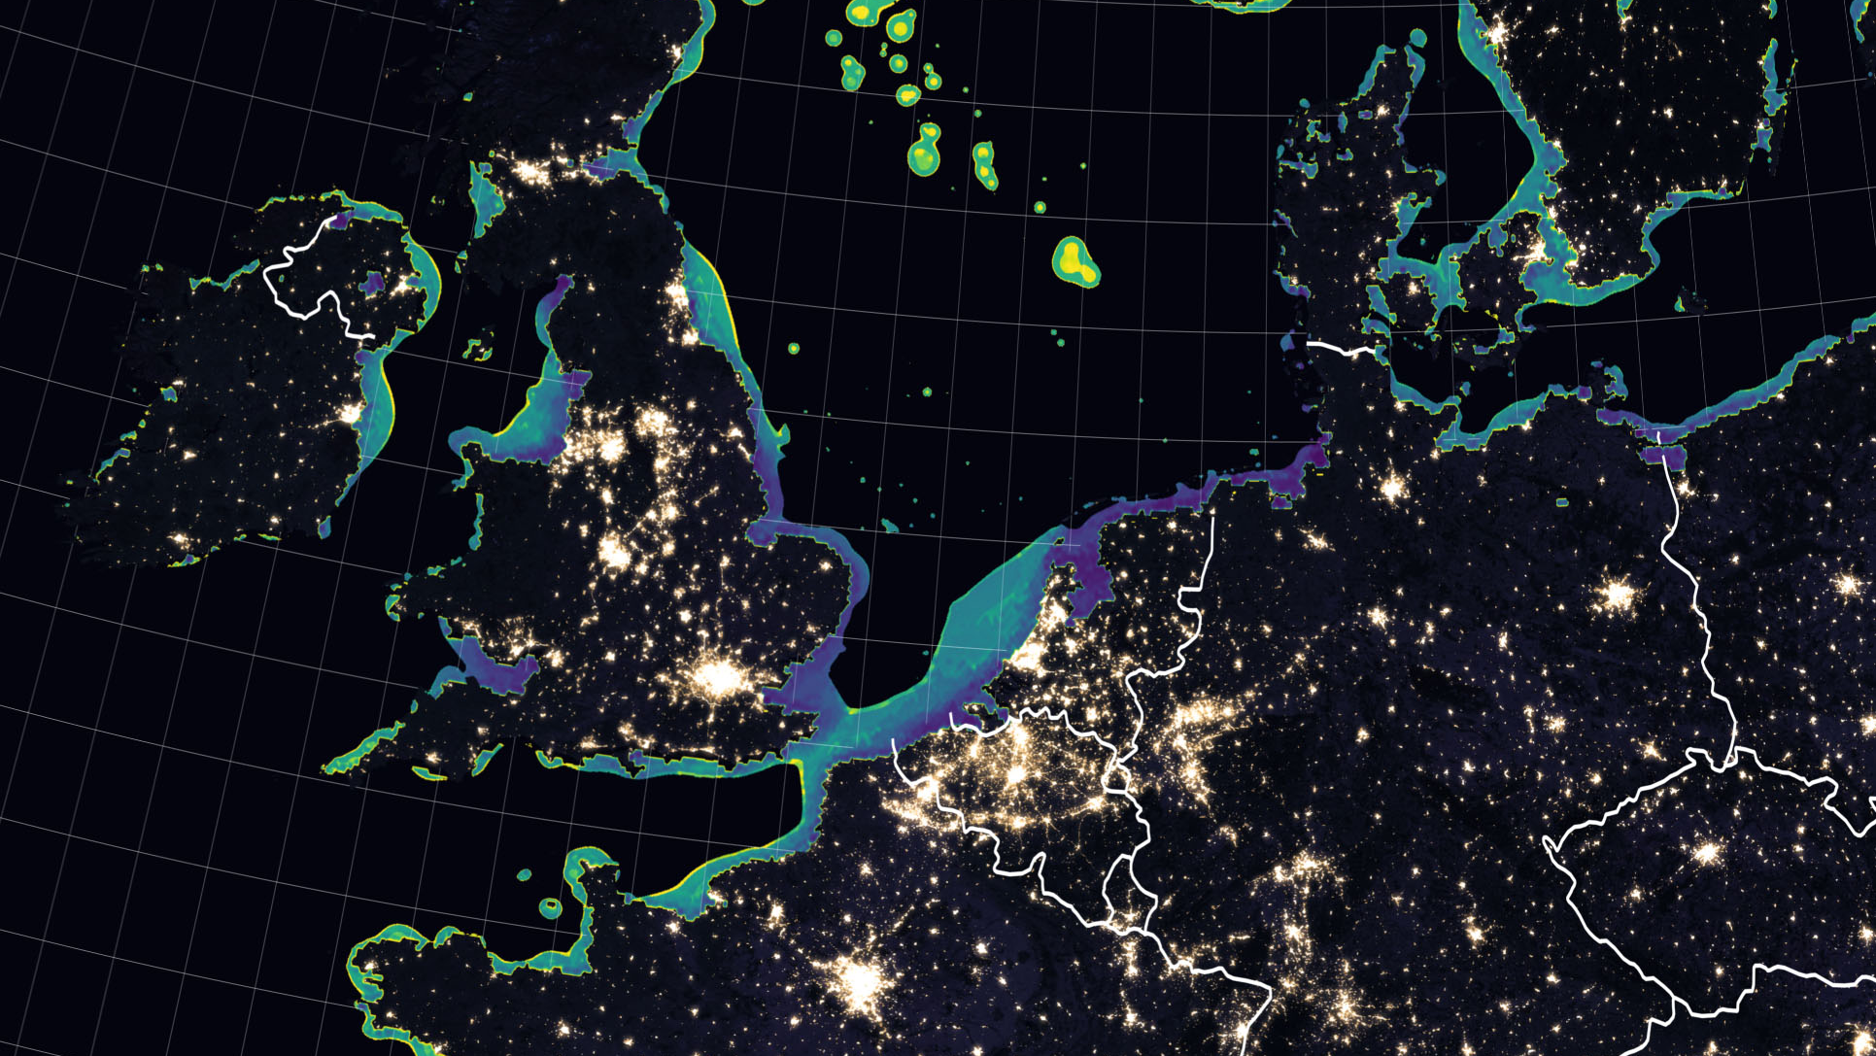
Earth Science Data and Information System (ESDIS)
The ESDIS Project manages the science systems of the Earth Observing System Data and Information System (EOSDIS). EOSDIS is a comprehensive distributed Earth science data and information system designed to support NASA's Earth science missions.
EOSDIS is designed to ingest, archive, distribute, visualize, all types of Earth Science data which include field campaign measurements, airborne data, in situ data, model data, ancillary products used for processing and other related datasets.
The ESDIS Project provides and controls all aspects of the effort including but not limited to requirements, design, acquisition, development, operations, maintenance and decommission.

Slide 4

ESDIS Goals
Provide scientific data stewardship for all data collections and ensure data integrity
Provide a unified and simplified environment for a diverse and distributed community of Earth Science and Applications users to discover, obtain, and analyze data sources.
Evolve, grow and adapt to new sources of data and new data systems technologies
Expand the user community and engage with users to enhance and improve user access to data and other resources.
Partner with other organizations, US agencies, and Nations to share data and make it easier to integrate for science

Slide 5

What is EOSDIS?
EOSDIS is a heterogenous and distributed system of processing systems, data archives, networks, and the people who operate, maintain and further develop its capabilities.
EOSDIS is a comprehensive distributed Earth science data and information system designed to support NASA's Earth science missions.
EOSDIS is designed to ingest, archive, distribute, visualize, all types of Earth Science data which include field campaign measurements, airborne data, in situ data, model data, ancillary products used for processing and other related datasets.
Some common elements within EOSDIS are:
  Data
  SIPS
  DAACs
  Enterprise infrastructure

Slide 6



















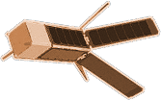



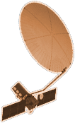



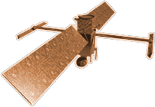


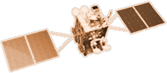







CYGNSS (8)
NISTAR, EPIC
2015
GRACE-FO (2)
SMAP
ICESAT-2
OCO-2
2020
GPM
SENTINEL-6
MICHAEL FREILICH
EARTH FLEET
GEDI
LANDSAT 8
LANDSAT-9
EMIT
SUOMI NPP
INVEST/CUBESATS
ECOSTRESS
CSIM-FD 2023
HARP 2022
CIRIS 2023
CTIM* 2022
HYTI* 2022
SNOOPI* 2022
NACHOS* 2022
NACHOS2* 2022
1995
2010
TROPICS (6)
LANDSAT 7
CALIPSO
OCO-3
TERRA
NISAR
AQUA
CLOUDSAT
SWOT
CLARREO-PF
AURA
2000
JPSS INSTRUMENTS
TSIS-1
2005
GEOCARB
LIS
OMPS-LIMB 2022
LIBERA 2027
TEMPO
SAGE III
PREFIRE (2)
MAIA
ISS INSTRUMENTS
KEY
PACE
INTERNATIONAL PARTNERS
U.S. PARTNER
ISS INSTRUMENT
JPSS INSTRUMENT
CUBESAT
LAUNCH DATE TBD
TSIS-2
GLIMR
ESO-1, 2, 3, 4
PREFORMULATION
FORMULATION
OPERATING
EXTENDED
SENTINEL-6B
MISSIONS
06.23.21
2025

Slide 7
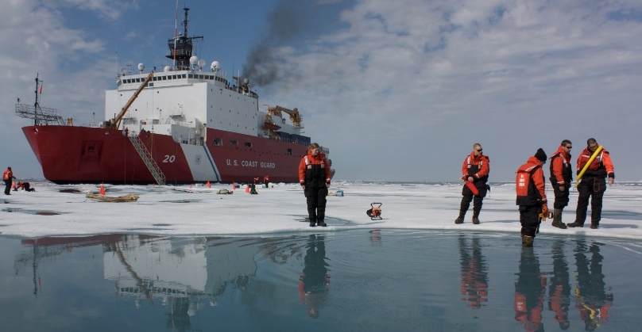
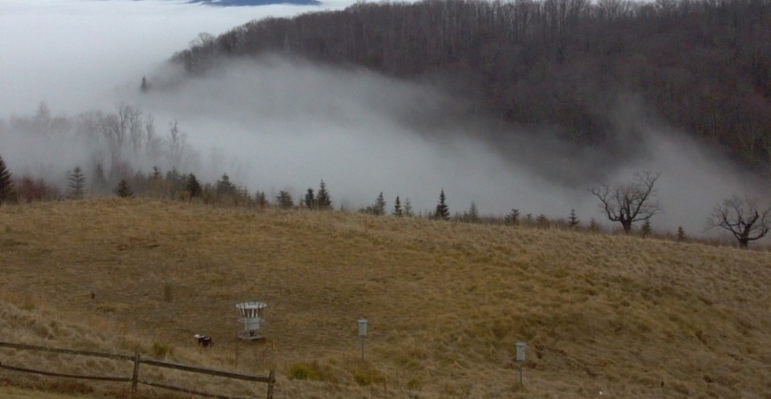
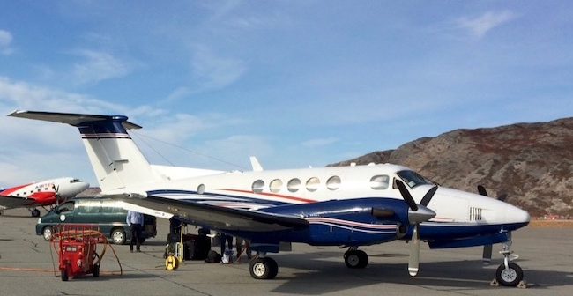
Other sources of data in EOSDIS
While much of the data that comes to EOSDIS is derived from satellite observations, there are other sources of data critical to scientific and applications-based research and use.
Some of these non-satellite sources include:
  Airborne instruments
  Field campaigns
  New data from NASA-funded research
These data sources are often used in concert with or supporting the satellite data within EOSDIS.

Slide 8
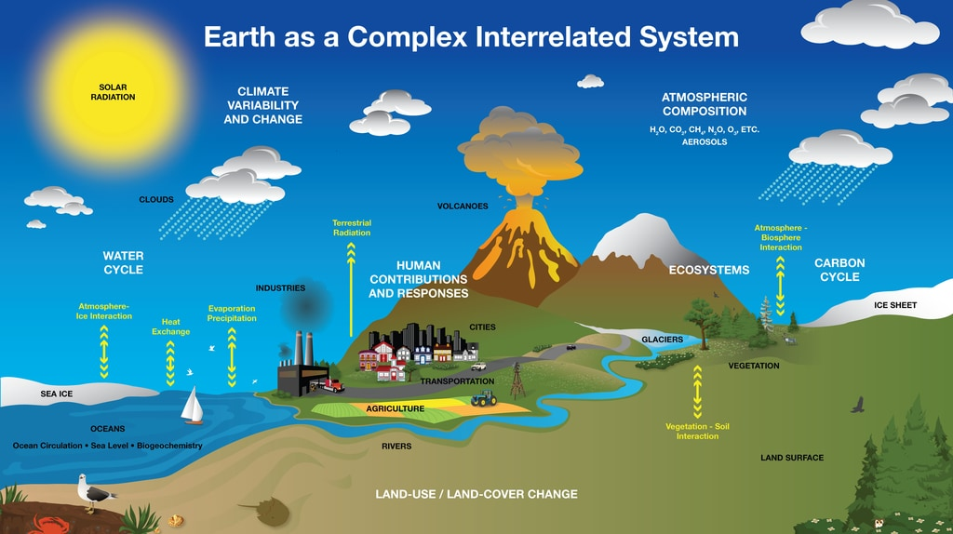
EOSDIS Archives and Distributes Data about the Whole Earth System
Atmosphere
  Winds & Precipitation
  Aerosols & Clouds
  Temperature & Humidity
  Solar radiation
Ocean
  Surface temperature
  Surface wind fields & Heat flux
  Surface topography
  Ocean color
Cryosphere
  Sea/Land Ice
  Snow Cover
Land
  Cover & Usage
  Soil Moisture
  Topography & elevation
  Temperature
Human Dimensions
  Population & Land Use
  Human & Environmental Health

Slide 9
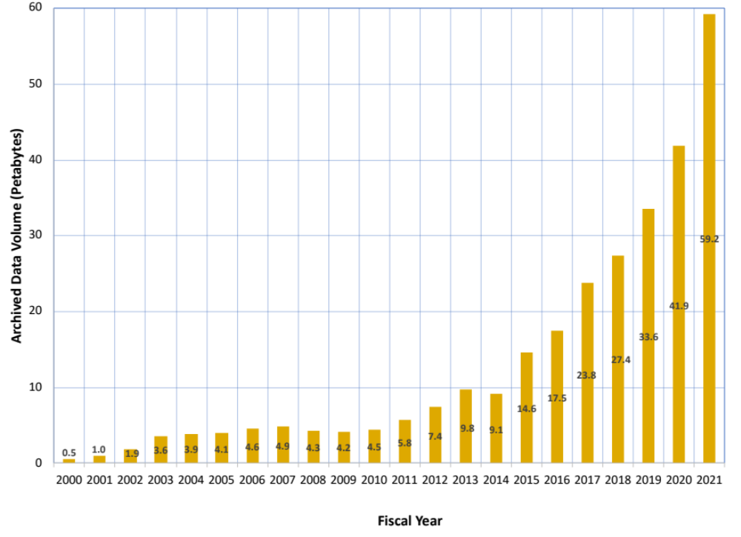
Total EOSDIS Accumulated Data Archive Volume (Petabytes)
Trend: FY2000-FY2021
Important Events
FY2003 | Addition of ICESAT product
FY2008-FY2009 | Deletion of MODIS Collection 4 products
FY2013 | Addition of AQUARIUS and ICEBRIDGE products
FY2014 | Deletion of over 10 million files (2 PB) of data by ASF as part of their consolidation and transition of data to new media
FY2015-FY2019 | Reprocessing Collection 6 & 6.1 MODIS Terra and Aqua data products
FY2016 | Addition of SNPP, GPM and ALOS PALSAR products
FY2017 | Addition of OB.DAAC
FY2018-2019 | Addition of SENTINEL 1A/1B and JPSS-1 products
Notes:
Launch of SWOT and NISAR –unprecedented volumes
In 2023, NISAR will contribute over 50 PB high resolution SAR data per year alone.

Slide 10
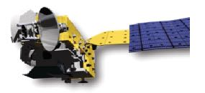
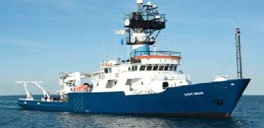
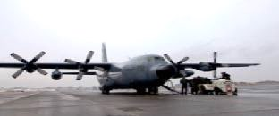
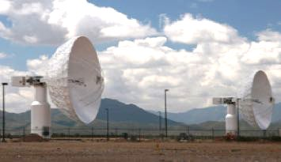
Earth Observing System Data and Information System
-EOSDIS-
DAACS
Users
Research
distribute
Applications
data downlink
subset
Education
EOSDIS
Public
archive
capture and clean
process
SIPS
EOSDIS
Mission Systems
Science Systems

Slide 11
Generalized Data Product Life Cycle
Science Team
SIPS
DAAC
HQ
Proposal
Concept
Proposal
I & T
Approval
Interface tests
Interface tests
DMP
Algorithm(s)
ATBD
ATBD
Approval
MOSS tests
MOSS tests
Prod. Gen. S/W
S/W
Cal/Val
QA
Std. Prod.
Process
Reprocess
Std. Prod.
Archive
DOI
Landing Page
Publish
Distribute
Improve Product
Prod. Gen. S/W
Gather Preservation (PCS) Items
PCS Items
S/W
(Next Version)

Slide 12
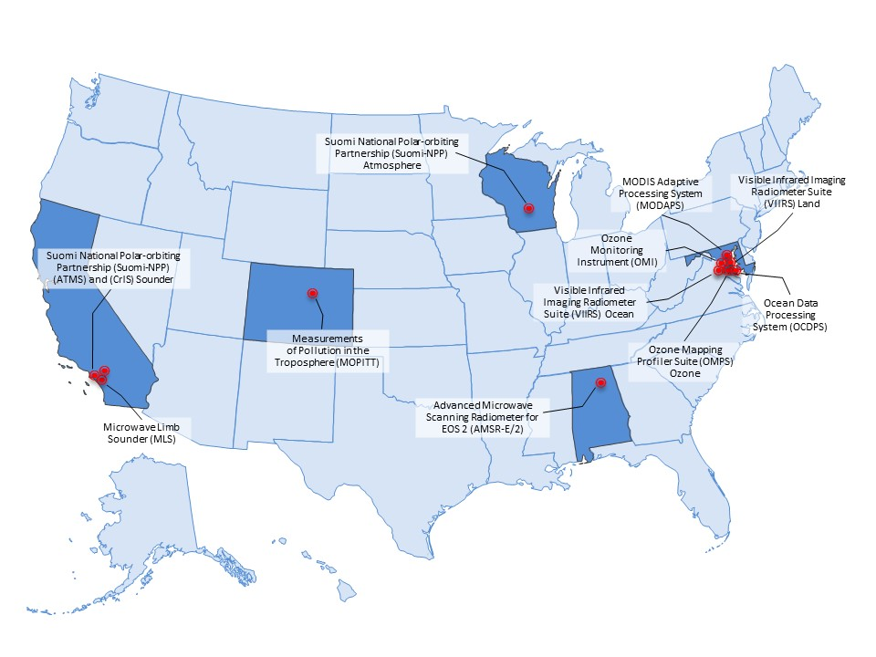
Who are the SIPS?
The Science Investigator-led Processing Systems (SIPS) generate EOS/SNPP/JPSS mission instrument science products and deliver them to the Distributed Active Archive Centers (DAAC) for archive and distribution
  SIPS are managed by Principal Investigators (PIs)
    PIs and their standard products are selected via NASA HQ Science Program awards
  Working Agreements document the arrangements made with each PI or designated Team Lead (TL)
  EOS/SNPP/JPSS SIPS are funded by ESDIS. PIs/TLs submit budget estimates annually to the ESDIS project
A few EOS product generation systems developed early in the EOS mission cycles were designed to receive product generation software packages from the PI and would process this data at that DAAC
  These include AIRS, SOUNDER, ASTER, MISR, CERES, LIS
The acronym SIPS is now being used by missions outside of EOSDIS, e.g. ICESAT-2 SIPS is part of the ICESat-2 Project Scientist’s systems

Slide 13
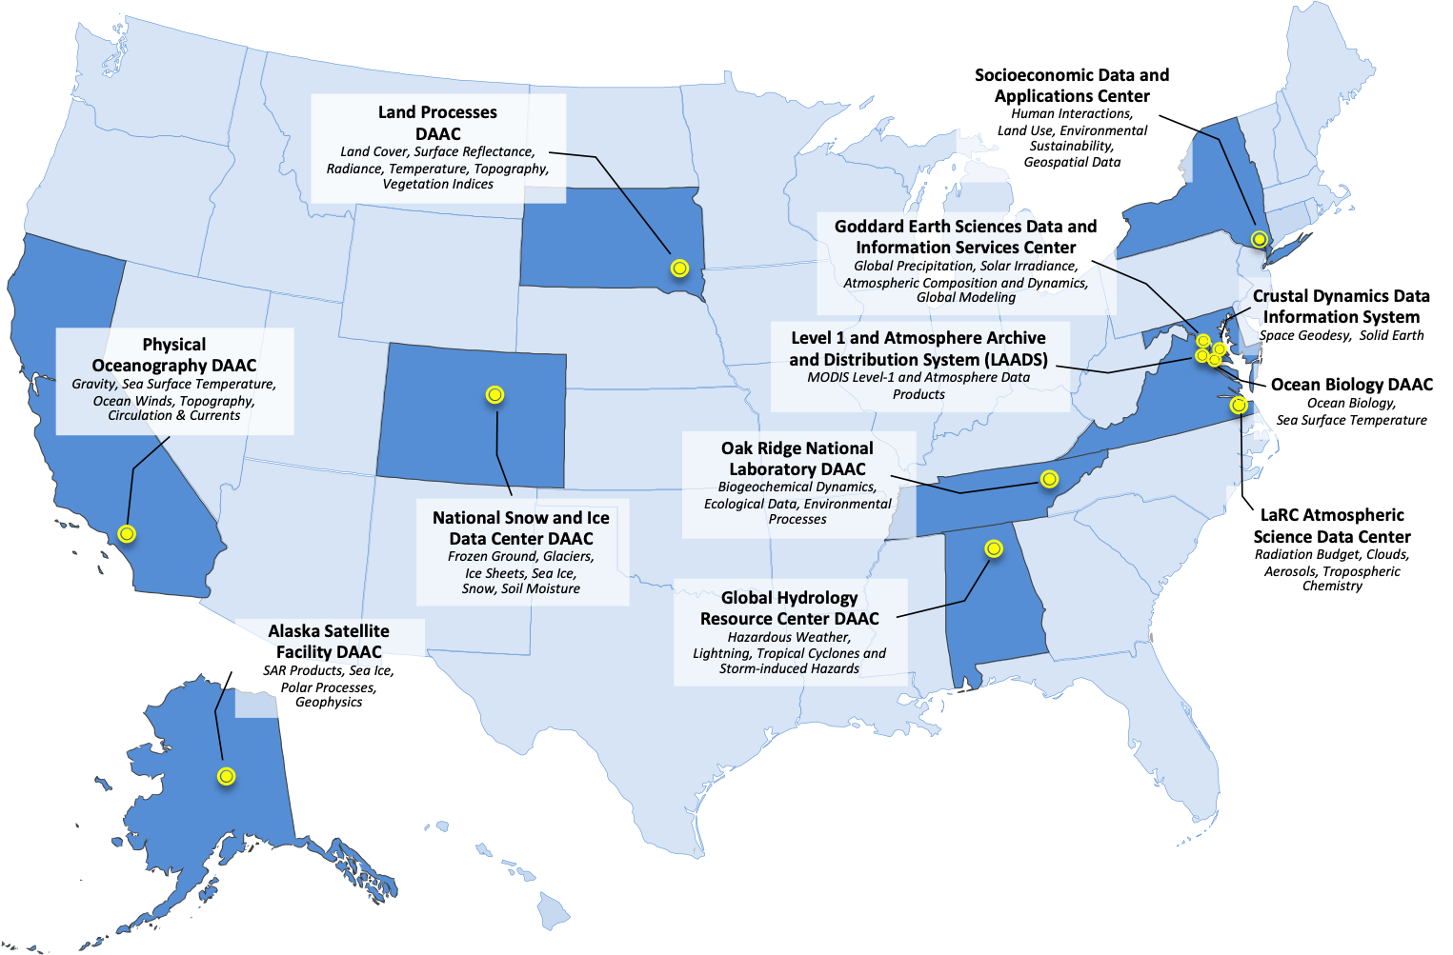
EOSDIS Distributed Active Archive Centers (DAAC)s
Who are the DAACs?

Slide 14
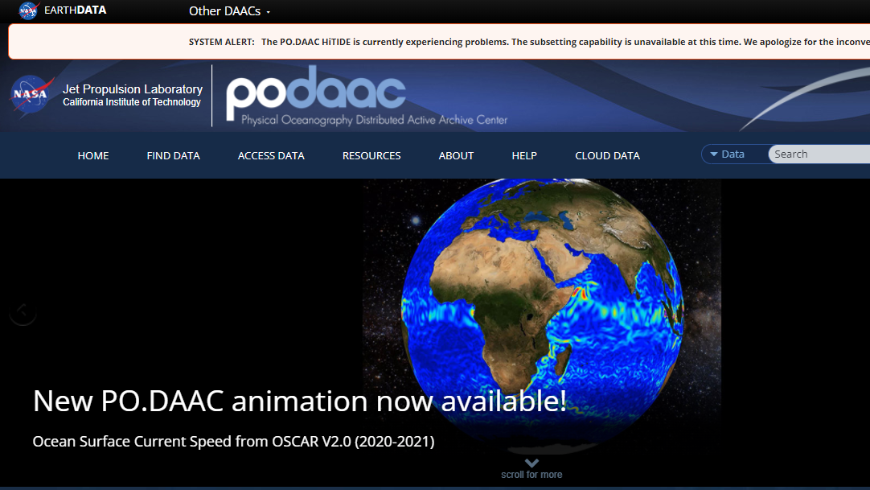

Slide 15
What does a DAAC do?
Data and metadata
              Serve as primary point of contact for mission science teams
              Ensure quality and fitness for purpose of the organization's data and metadata assets
              Support identification/creation of simulated data product for early adopters
              Ingest science data products into cloud
              Archive additional documents associated with the data (preservation content)
              Distribute data products to the public
Information management
  Capture and catalog scientific information from publications into searchable databases linked to data resources
Open-source software support
  Support open-source software development projects
Cross-mission science and modeling
  Address cross-mission and division science and provide support for modeling communities to better integrate and fuse observational data into models
User support
                Answer scientific questions about data and information, evaluate and merge community contributions to open-source software, address technical questions, and develop unique software to serve science and applications communities.
                Support Early Adopter activities across a variety of communities
                Develop and operate tools, services, tutorials, hack weeks and other resources for specific science communities and applications users
And so much more…..

Slide 16
ESDIS and DAACs with ESD Representatives
NASA Headquarters
Science Mission Directorate (SMD)
Goddard Space Flight Center (GSFC)
D. Andrucyk
Heliophysics
Earth Science
K. St. Germain
400
500
600
Astrophysics
Planetary
Flight Projects
C. Simmons
Engineering and Technology (ETD)
Software Engineering
Division (SED)
Applied Science
L. Friedl
Flight
C. Webb
Technology
P. Millar
420
Research
and Analysis
J. Kaye
Earth Science
Data Systems
K. Murphy
Earth Science
J. Volosin
Program Executive for Earth Science Data Systems
K. Baynes
423
Earth Science Data and Information System (ESDIS)
A. Mitchell
Near
Real-time Applications
S.Mcclain
Applications
N. Searby
SAR Systems
G. Bawden
Land Processes
W. Turner
Earth Surface and Interior
B. Phillips
Atmospheric Dynamics
W. McCarty
Upper Atmosphere Research
K. Jucks
Atmospheric Radiation
B. Lefer
L1 and Atmos. Data
H. Maring
Cryosphere Science
T. Markus
Ocean Biology & Biogeochemistry
L. Lorenzoni
Terrestrial Ecology
H. Margolis
Physical Oceanography
N. Vinogradova-Shiffer
LANCE
Socioeconomic
DAAC
ASF SAR
DAAC
Land Processes
DAAC
Crustal Dynamics
DIS
DAAC
Global Hydrology
Resource Center
DAAC
GSFC Earth
Sciences DISC
DAAC
Atmospheric Sciences
DAAC
L1 Atmosphere Archive & Distribution System
DAAC
National Snow and Ice
DAAC
Ocean Biology
DAAC
ORNL DAAC
Physical Oceanography
DAAC
LEGEND
Program
Scientists
Application
Scientists
Application & Program
Scientists
DAAC
Operations
Data
System

Slide 17
Importance of Discipline Orientation
Discipline matters to the science team AND the science user community AND applications community.
Discipline affects how data is used. Each discipline has unique data format and access needs .
DAACs connect users to data. DAACs understand their user communities’ data needs and are experts on the tools and services to required to promote use of NASA data. Determination of metadata, understanding the use of data and formats for a discipline community.
This expertise builds on years of DAAC experience working with science teams and managing data for discipline communities.
Each DAAC is aligned with an ESD Program scientist. DAAC help ESD Program scientists build their collections, address science topics, and serve as a link to the community.
DAACs have active User Working Groups that are representatives of their disciplines to advise on how to improve NASA’s data resources for the community. Over 20 years, these groups have contributed to solid improvements in the NASA services and collections.

Slide 18
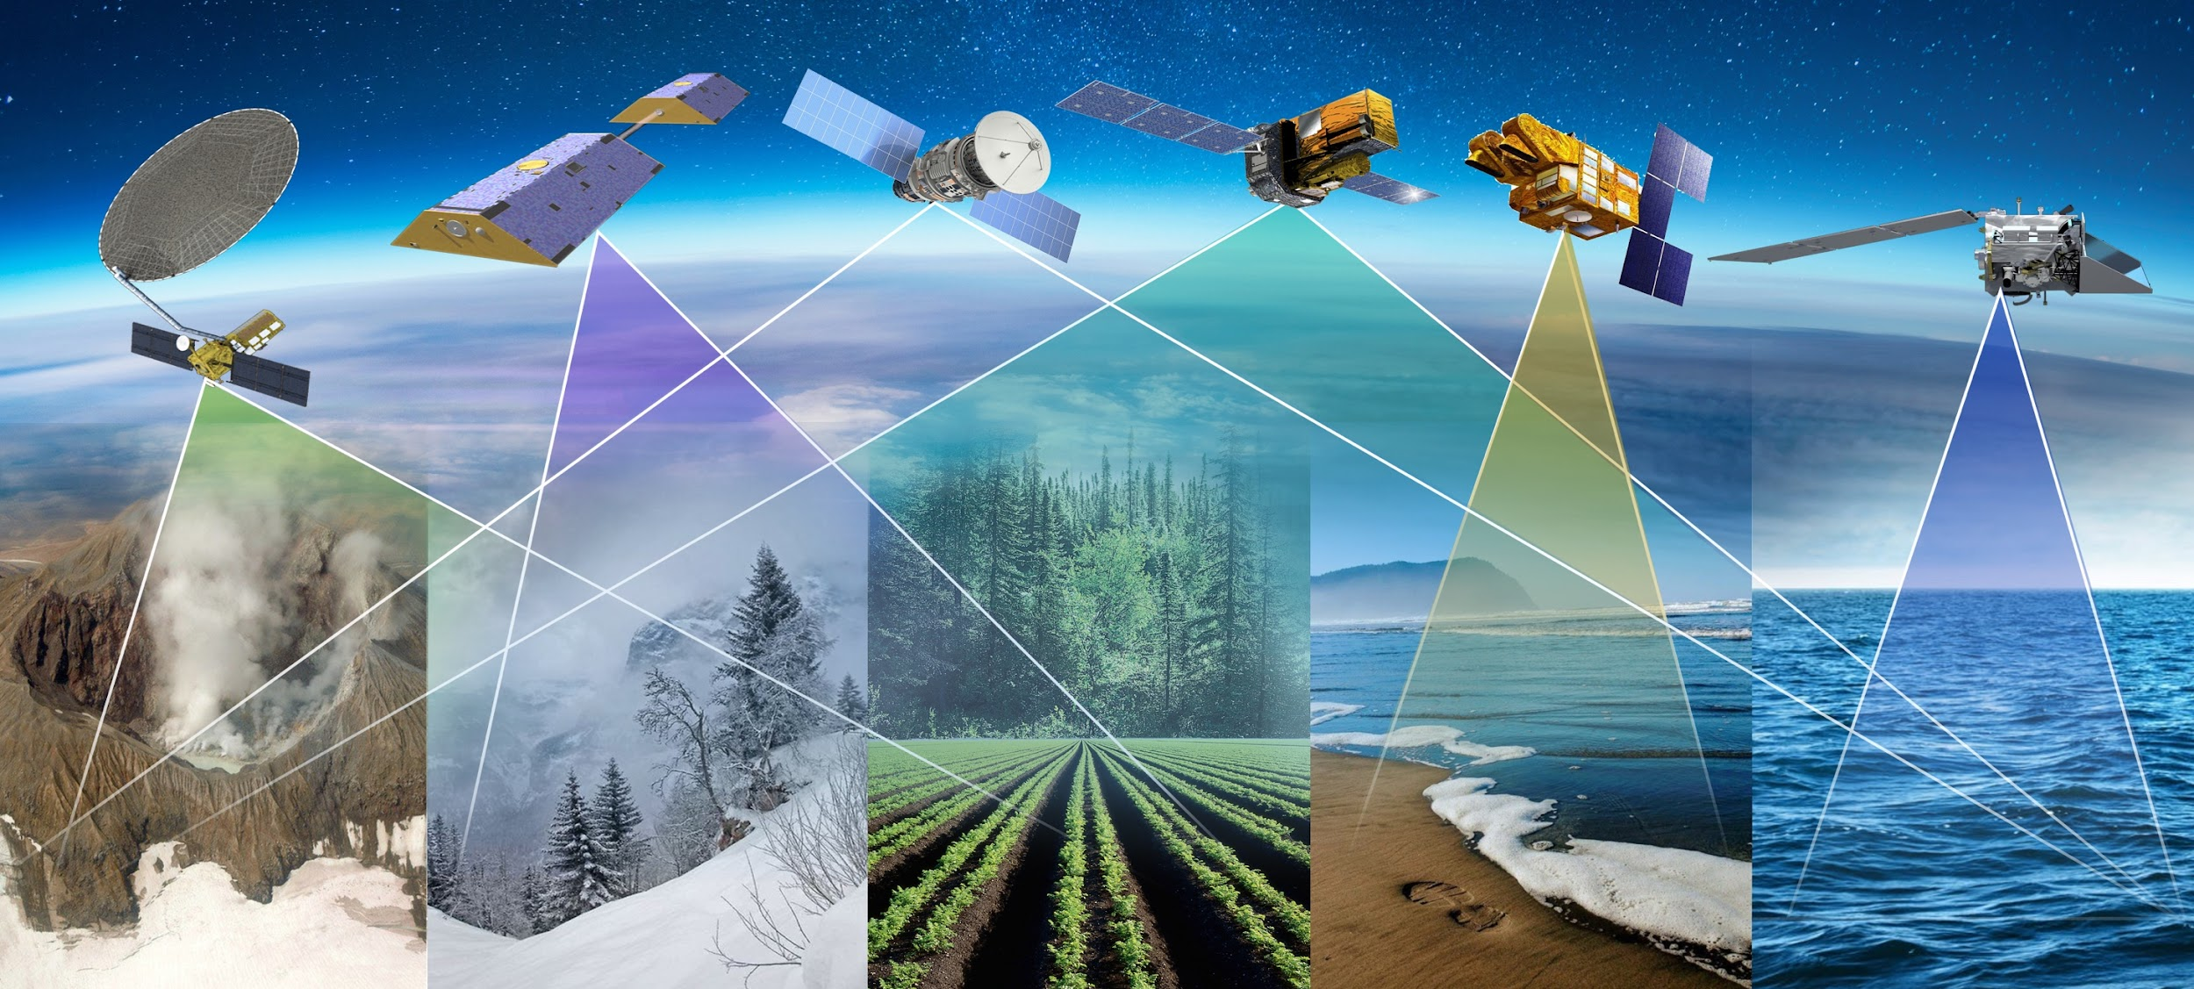

NASA’s Earth System Observatory Core and associated marine missions in the late 2020s
MC
GLIMR
NISAR
AOS
SBG
PACE
SOLID EARTH
Aerosols - ASDC
Gasses - ASDC
Surface Deformation - CDDIS, ASF
Surface Composition - LP DAAC, ASF
Geologic Hazards - CDDIS, ASF
Human Impacts - SEDAC
WATER CYCLE
Precipitation — GHRC
Ice Mass Evolution - NSIDC
Snow Albedo and Melt — NSIDC
Total water storage - PO.DAAC
Human Impacts - SEDAC
ECOSYSTEMS AND NATURAL RESOURCES
Boundary Layers — LP DAAC, GES DISC, ASDC
Ecosystem Structure — ORNL
Vegetation Type/Physiology — ORNL, LP DAAC
Human Impacts - SEDAC
LAND-SEA CONTINUUM
Phytoplankton, Organic Matter, Ecosystems— OB DAAC, PO.DAAC
Cloud, Boundary layers-ASDC, GHRC, PO.DAAC
Human Impacts - SEDAC

Slide 19
ESDIS enterprise tools
Earthdata: The EOSDIS website https://earthdata.nasa.gov will increase visibility to the interdisciplinary use of data and demonstrate how data are used.
High Performance Data Search and Discovery
  Common Metadata Repository (CMR): Provide sub-second search and discovery services across the Sentinel and other EOSDIS holdings.
  Earthdata Search Client: Data search and order tool https://search.earthdata.nasa.gov
Imagery and Data Visualization Tools
  Global Imagery Browse Services (GIBS): full resolution imagery in a community standards-based set of imagery services
  Worldview: highly responsive interface to explore GIBS imagery and download the underlying data granules https://earthdata.nasa.gov/labs/worldview/
  Giovanni: Quick-start exploratory data visualization and analysis tool
Near Real-Time Capabilities: Provided by “LANCE” (Land Atmosphere Near real-time Capability for EOS) which produces products within < 3 hours of observation. Near real-time capabilities are co-located with the standard science production facilities.
EOSDIS Metrics System (EMS): collects and reports on data ingest, archive, and distribution metrics across EOSDIS
Earthdata Infrastructure (EDI DevOps): platform for requirement management, code development, testing and deployment to operations
User Support Tool (UST): user relationship management and issue resolution (Kayako)
Earthdata Log-in (User Registration System): provides a centralized and simplified mechanism for user registration and account management for all EOSDIS system components.
Earthdata Forum: Interactive forum that allows SMEs to respond to users’ science data questions

Slide 20
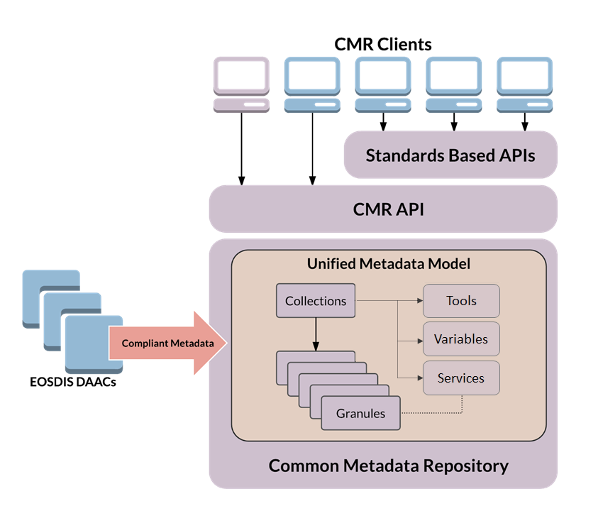
What is Common Metadata Repository (CMR)?
A Project! A Database! An API!
Backbone for search and discovery:
Earthdata Search, International Directory Network (IDN) and other Search Portals
Integrated tools, services, APIs:
Earthdata Search client
CMR Curation Dashboard
Metadata Management Tool (MMT)
draftMMT (dMMT) for non-NASA providers
OpenSearch, Catalog Service for the Web (CSW), SpatioTemporal Asset Catalog (STAC)
All open-source: https://github.com/nasa/
Notes:
https://earthdata.nasa.gov/eosdis/science-system-description/eosdis-components/cmr
Earth Observing System Data and Information System (EOSDIS)
Distributed Active Archive Center (DAAC)
Application Programming Interface (API)

Slide 21
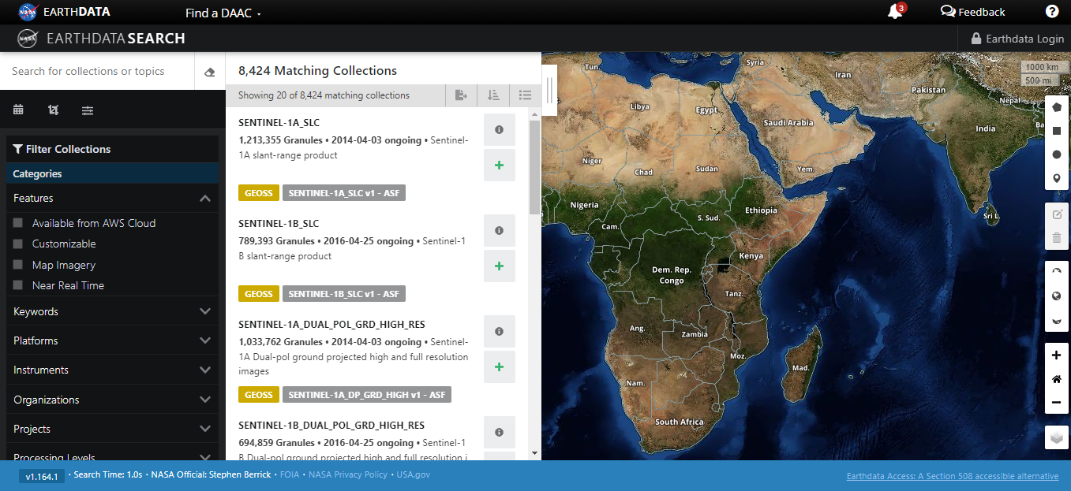
EARTHDATA Search: Accessing DAAC Data Sets
https://search.earthdata.nasa.gov/search

Slide 22
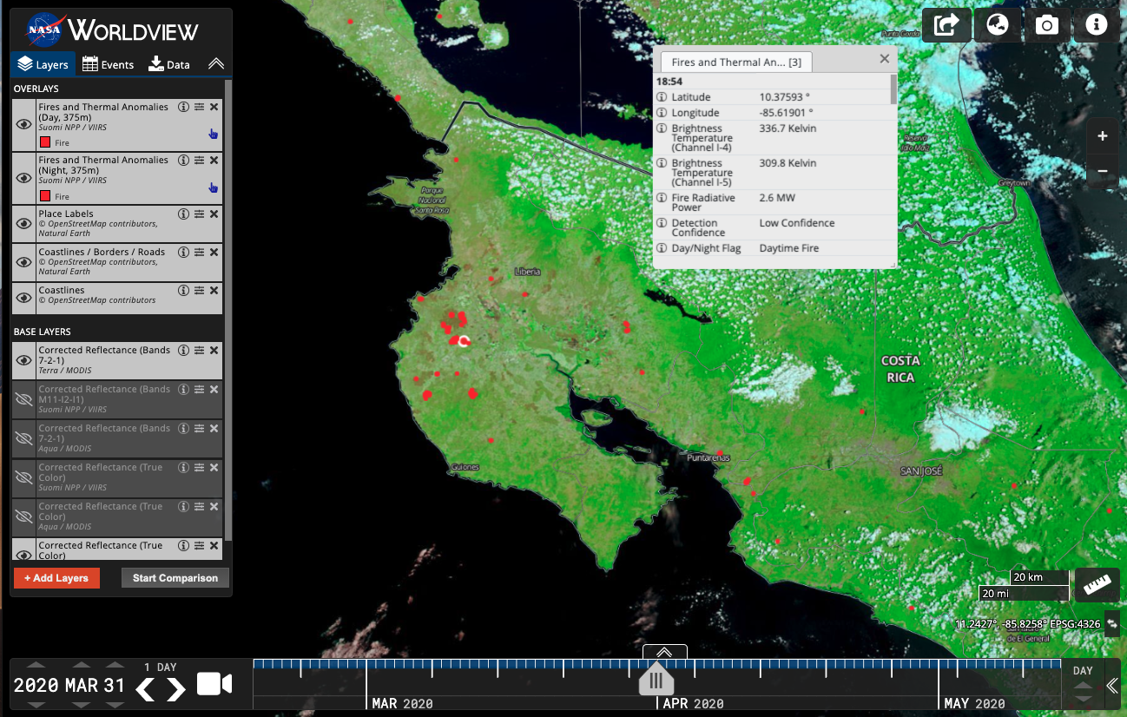
EOSDIS Worldview
https://worldview.earthdata.nasa.gov
General-purpose, open source visualization tool for ~1000 NASA EOSDIS satellite products
Browse imagery in full resolution from mission start through the present, often within 3 hours of observation
Compare coincident data retrievals across missions and time
Create and share custom animations or image snapshots
Download underlying data from DAACs via upcoming links to Earthdata Search
Includes Active Fire, Chlorophyll a, AOD, SST, PAR, etc...
Worldview showing showing active fires in the Guanacaste Region of Costa Rica. The fires, from VIIRS SNPP are overlaid in red, are on a MODIS Terra corrected reflectance (7-2-1) image from 31 March 202.0 (https://go.nasa.gov/2H9aFYi)
Notes:
Why we have this – what is its purpose and who does it serve

Slide 23
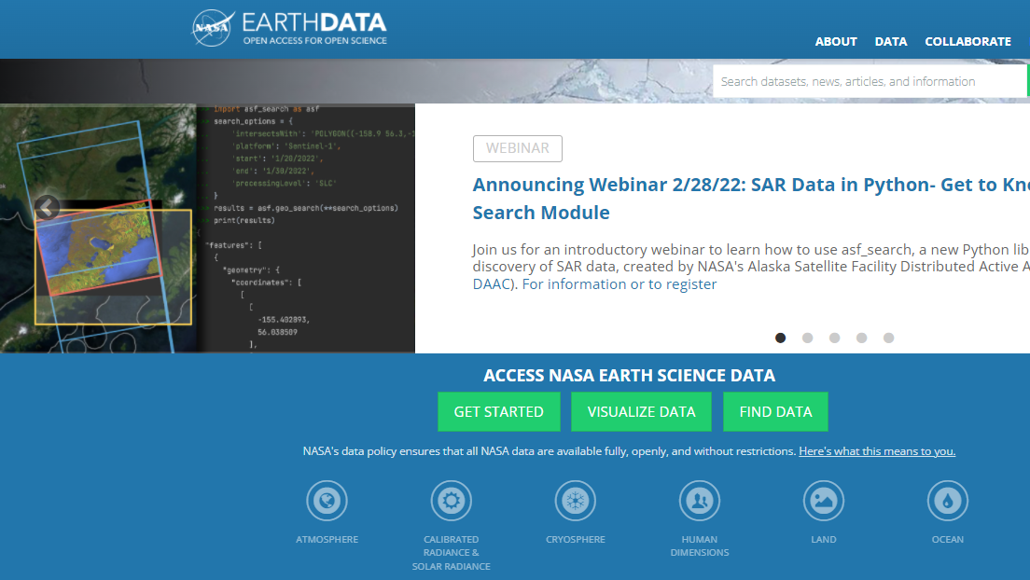
Earthdata Website
is the central location for finding NASA’s Earth science data.
Earthdata.nasa.gov

Slide 24
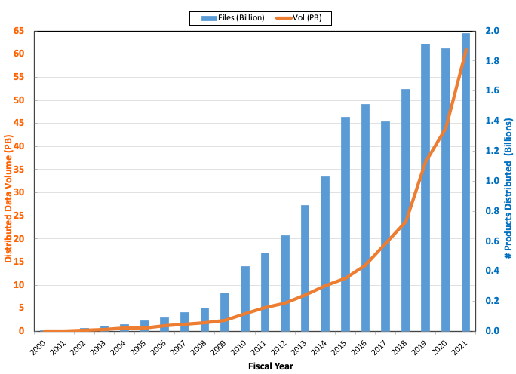

EOSDIS Yearly Total Data Volume (PB) and Number of Products (Billions) Distributed to End Users
Notes:
s -

Slide 25

Old way of doing business...

Slide 26

Hey, we’re going to have an EOSDIS “Data Lake”!

Slide 27
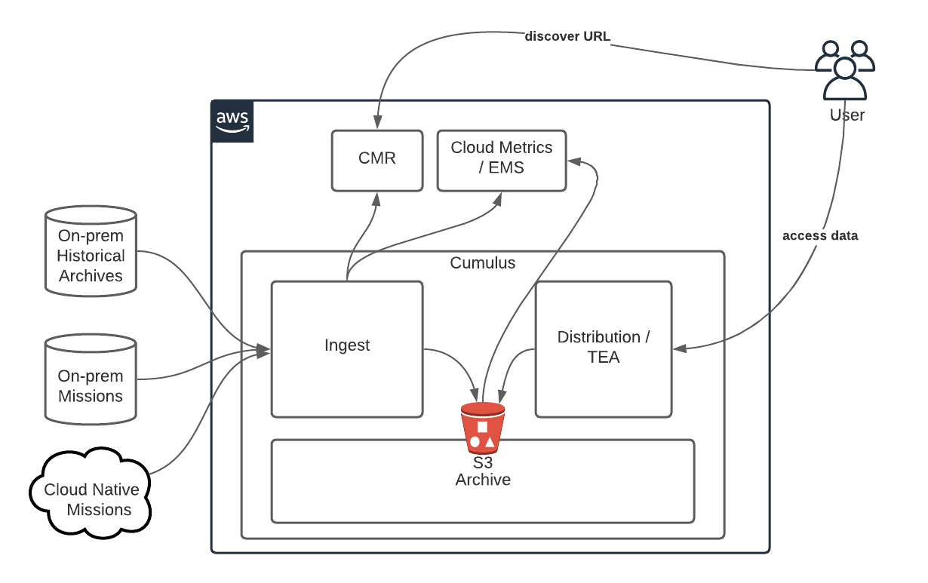

Earthdata Cloud (EDC)
“Managed” commercial cloud for EOSDIS
Improves the efficiency of NASA’s data systems operations – maintaining free/open data policy
Architected for EOSDIS applications and mission data ingest, archive, distribution
Operational July 2019, DAAC focused needs.
Routine systematic onboarding of mission data by DAACs.
NASA Earthdata Cloud (EDC) – http://earthdata.nasa.gov

Slide 28

Benefits of Cloud
By hosting EOS data in the cloud, EOSDIS is able to realize several end user benefits:
Power: Any user can access big processing power “next to” Big Data.
Performance: Data can be offered in a form enabling high-performance analysis.
Freedom from Data Transfers: Users need not move Big Data.
Freedom from Data Management: Users need not store and manage Big Data.
Data Co-location: Users can easily work with multiple EOSDIS datasets together.
Choice: Users can still download data if they prefer.

Slide 29
Understanding User Needs and Assessing Performance
DAAC User Working Groups – Provide assessments and recommendations based on unique DAAC mission requirements
DAAC Customer Satisfaction
  Annual Online survey of all DAAC users to evaluate satisfaction and measure performance
  Performed by CFI Group, the American Customer Satisfaction Index (ACSI) is the #1 national indicator of customer satisfaction for more than 225 companies and 130 Federal programs
EOSDIS Metrics System – collects complex metrics on ingest, archive and distribution for evaluation of system performance.
  Enables ESDIS to characterize use of the EOSDIS, and report to NASA Headquarters and OMB.
User Services Working Group – DAAC User Services personnel work together to best service science communities
  User feedback – via Kayako
  Personal interaction with users

Slide 30

For more information visit: earthdata.nasa.gov
Notes:
For more information, feedback, questions, please check out the Earthdata website
... or reach out to your DAAC Manager and DAAC staff.
We really do look forward to questions and comments from you.
And, many thanks for your continued support to ESDIS and NASA.

