Slide 1

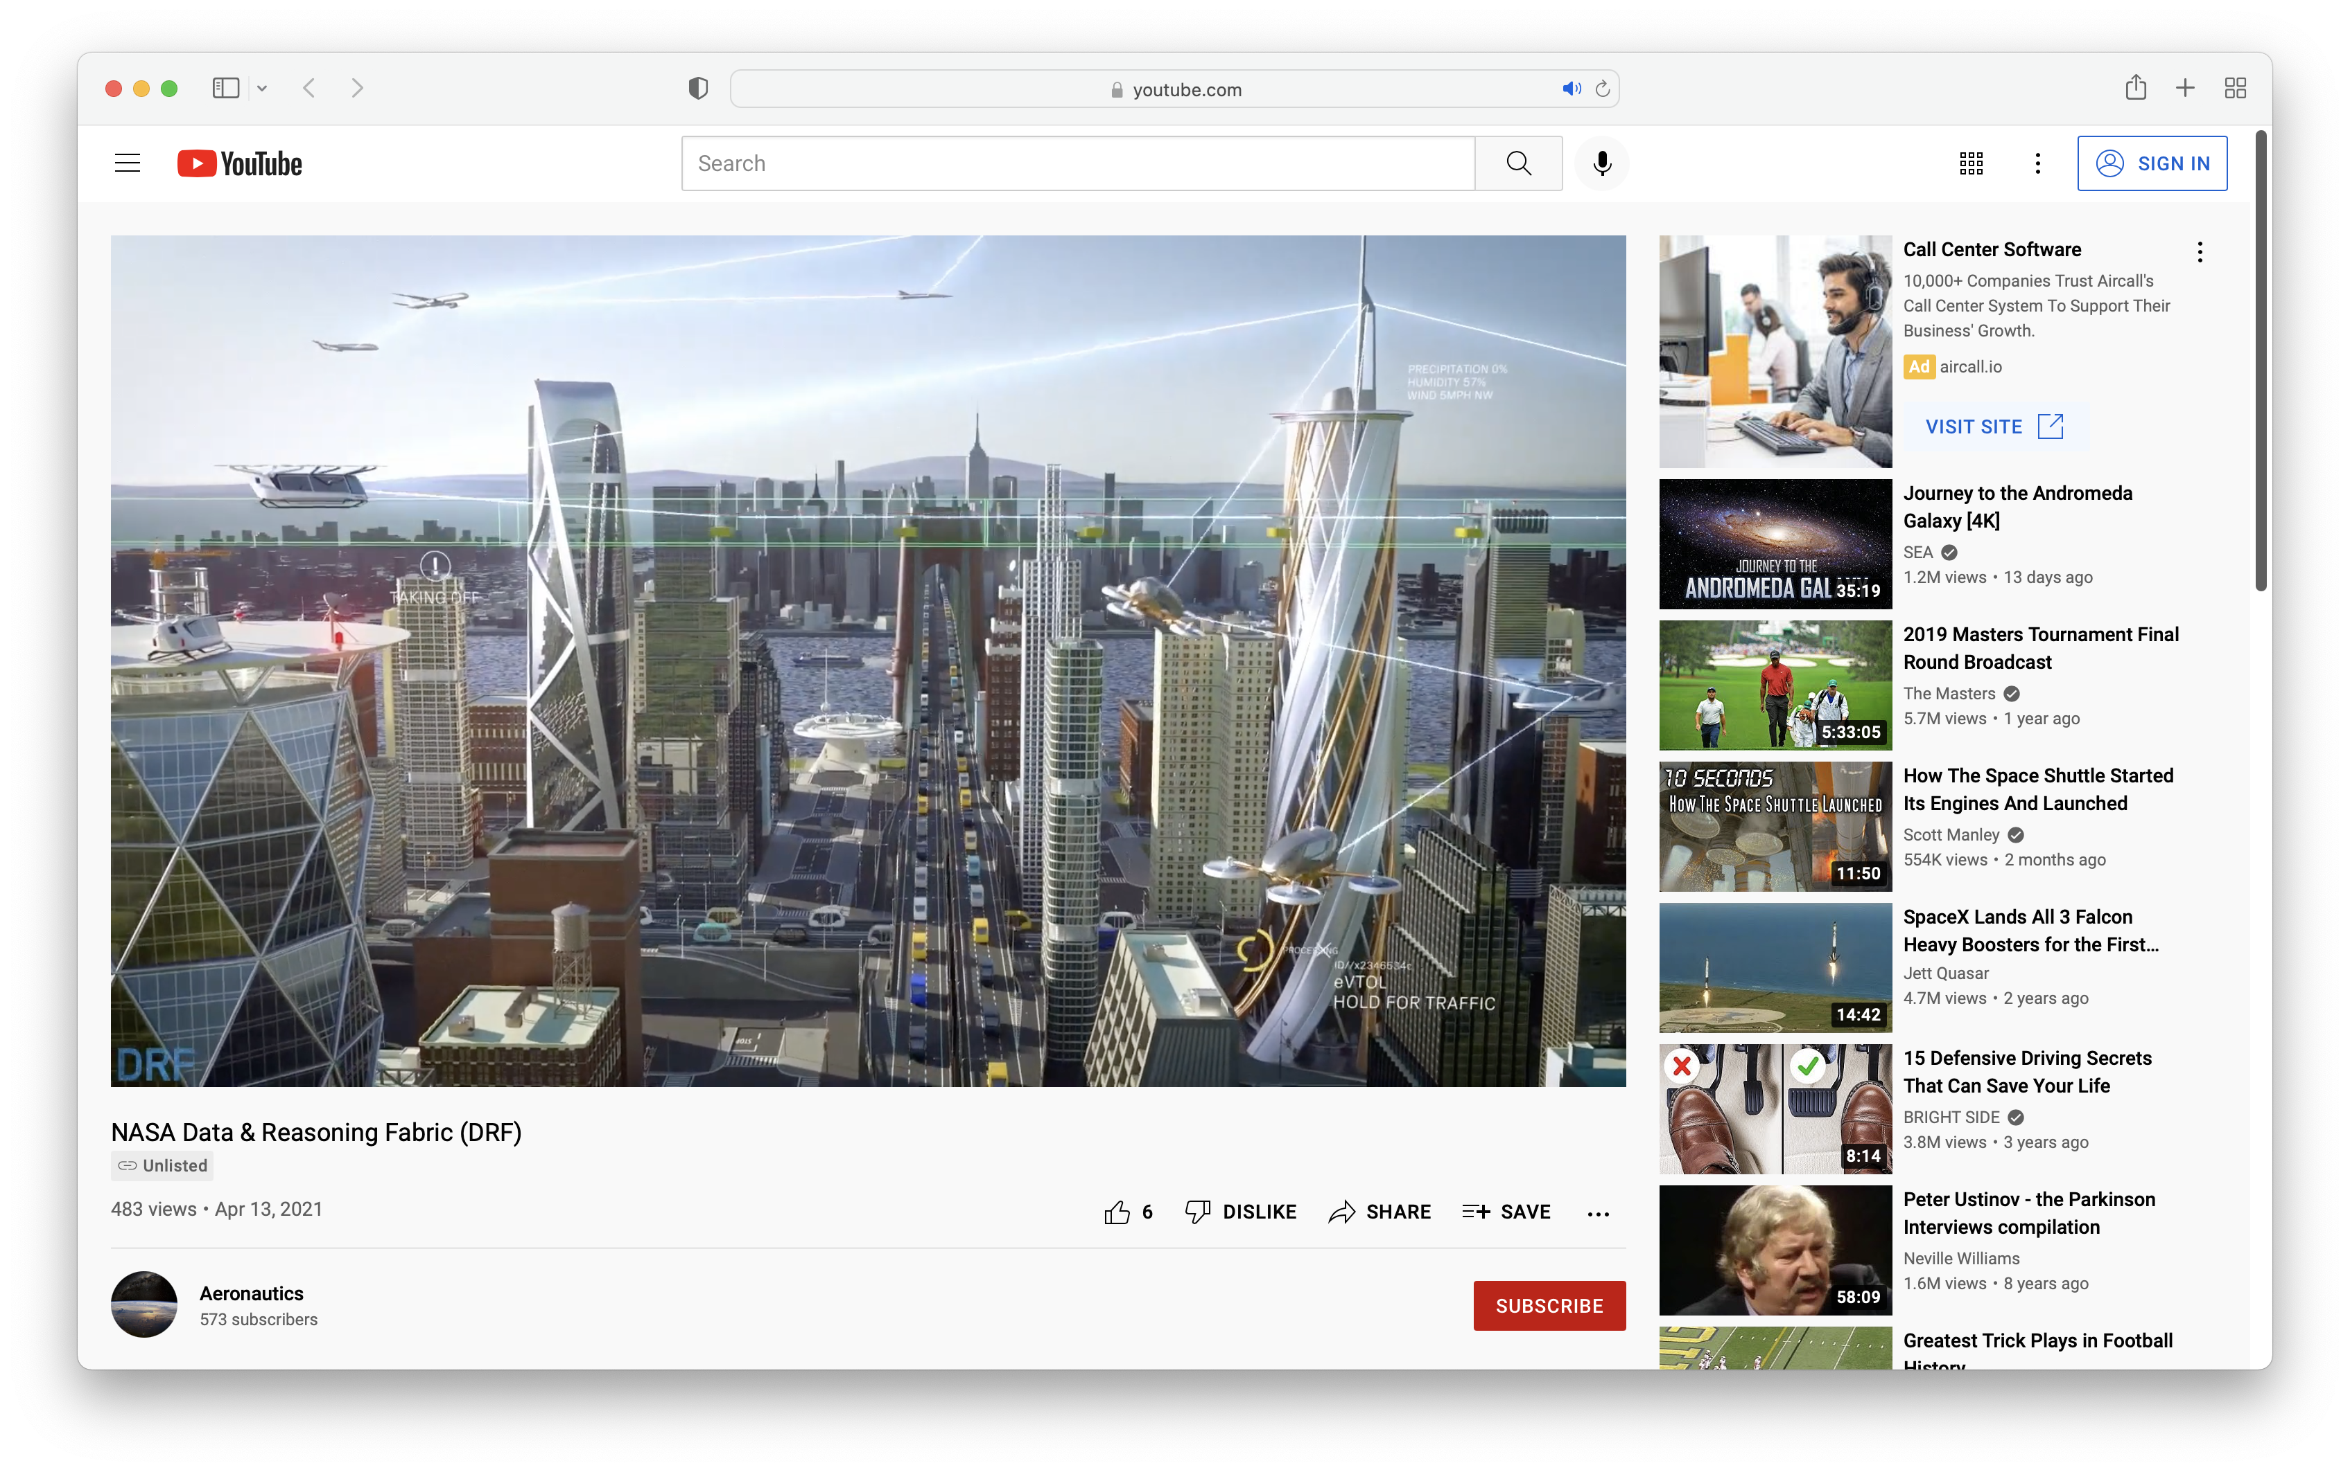
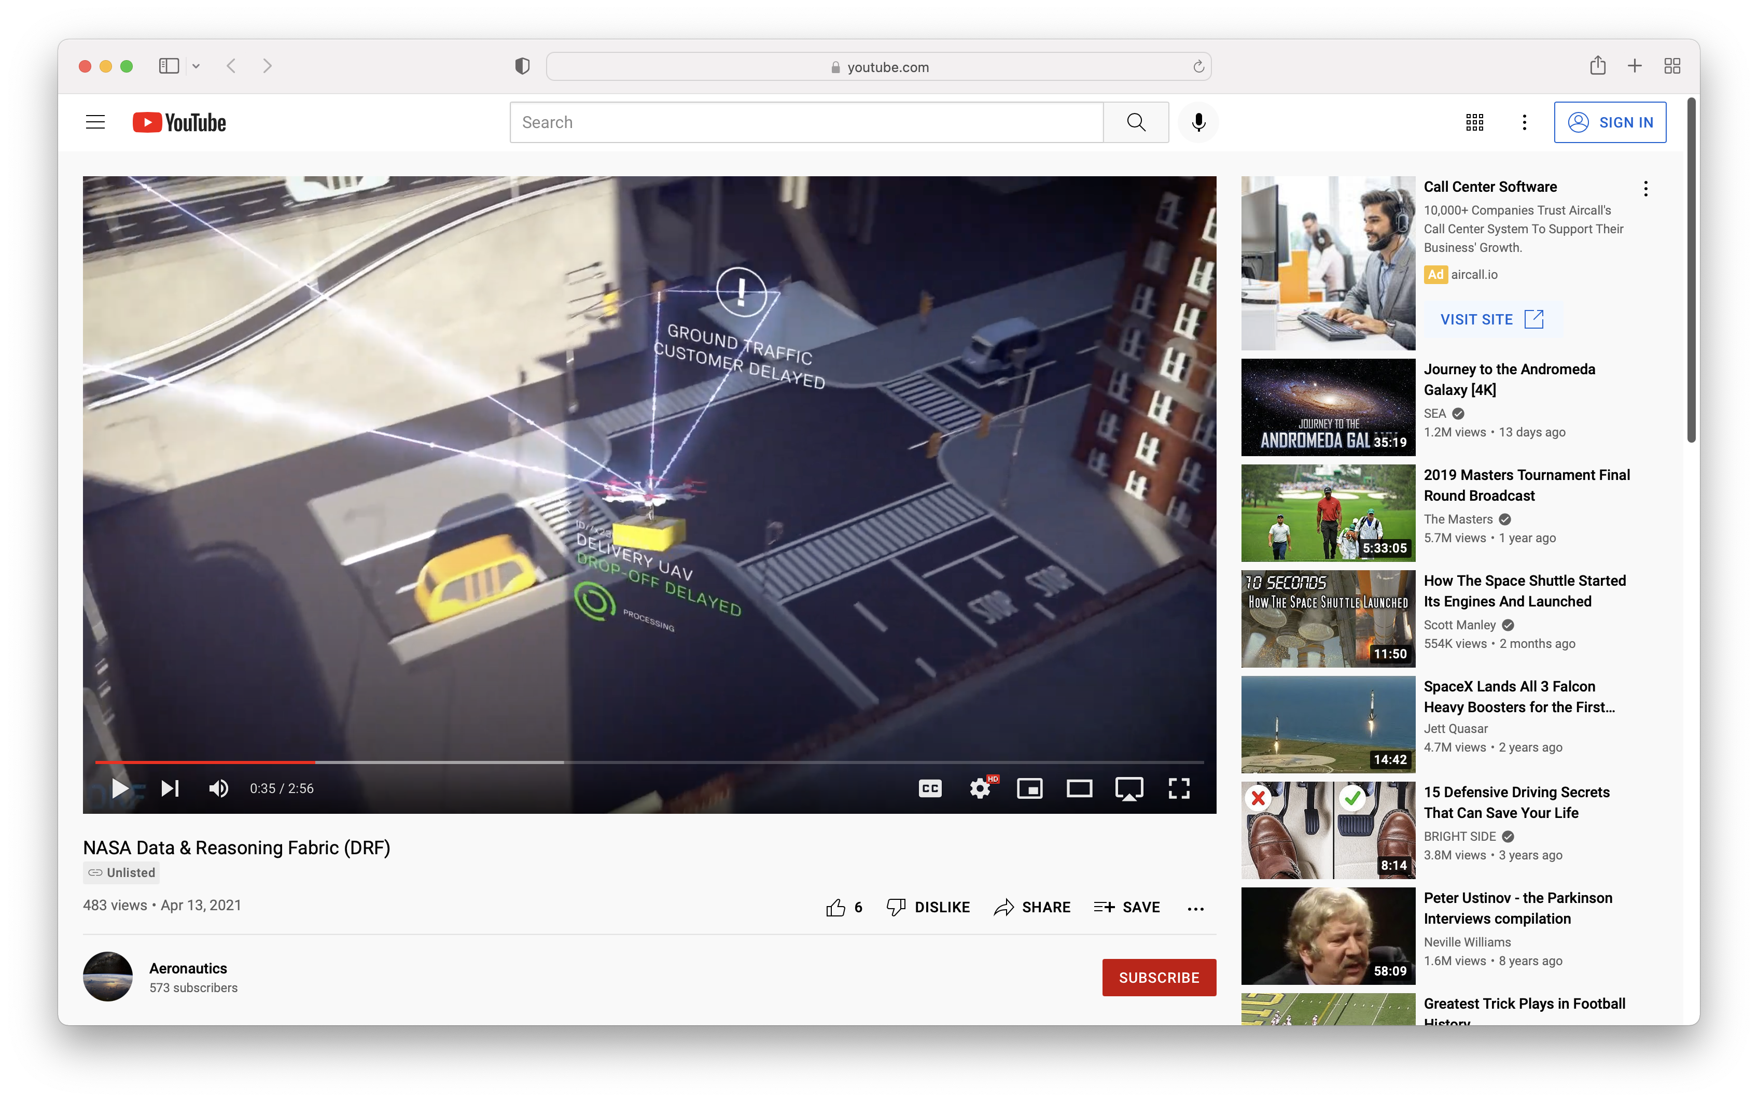
NASA DATA & REASONING FABRIC (DRF)
seamlessly connect information and decision making to enable the full potential of future air mobility to advance human society
Current Barrier
Quality of life is impacted by growing travel times in dense urban areas and access to mobility options is limited in rural areas. Converting to a 3D mobility system vastly increases mobility options for all, but every vehicle will need to be increasingly aware of EVERYTHING affecting their flight in real time to maintain safety in that new ecosystem.
DRF is the Solution
The envisioned density of operations will be achieved only if ​decision processes continue to move from purely human ​decisions to autonomous machine-intelligence based ​decisions with human oversight. DRF is a groundbreaking technology which seamlessly connects data to decision-making.
  Sends autonomous air vehicles any information critical for safe flight and obtains their data to inform others
  Intelligently processes and decides what data is of most importance for safe flight, much as humans do today
  Access to timely data created with intelligent reasoning allows for high tempo operations: more vehicles to safely use the same airspace
DRF is a “full-stack” behind future autonomous advanced air mobility maturing urban air mobility.
DRF enables safe, fully autonomous, omnipresent UAM operations even in complex environments.
Notes:
Note: This should be your 30-second elevator pitch for high level execs or congressional staffers.

Slide 2
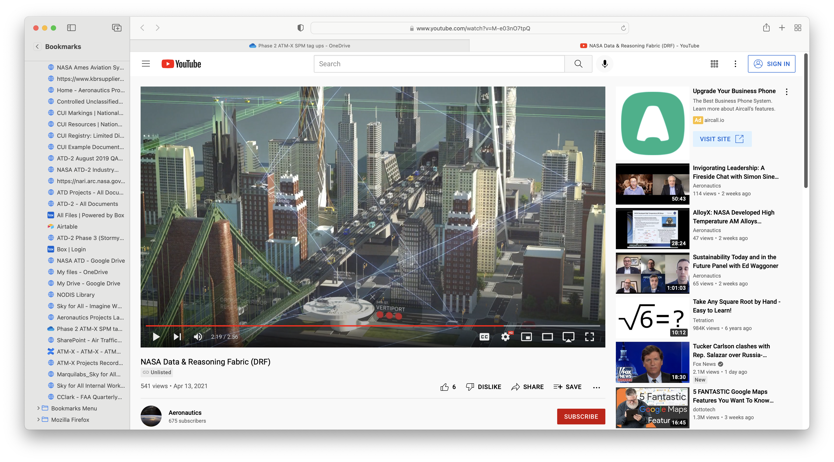
The Challenge
NASA’s historical focus on innovative aeronautics technology has resulted in people having access to time-saving convenience, comfort, and safety in air travel. NASA Aeronautics has historically led the nation and the world in developing continually improving advanced technologies. New challenges must be overcome to realize the advantages of uncrewed, remote transportation, whether it is for packages, people, safety, or myriad other commercial and government needs, and all within an increasingly complex and crowded airspace.
DRF Benefits
We believe DRF will enable the
future of air mobility by guiding
reasoning and decision-making processes between aerial vehicles and ground-based systems to increase efficiency and safety of operations. Our software will provide external entities a backbone to enable automated interactions between services with involvement from NASA technical teams. DRF will:
The Expectation
Enter Data & Reasoning Fabric (DRF), NASA’s innovative initiative to organize safe, efficient, environmentally friendly and quiet air mobility. For over two years, NASA researchers, in the Convergent Aeronautics Solution (CAS) Project under the Transformative Aeronautics Concepts Program (TACP), have been working to develop a data connection ecosystem that will address the challenge of significant increases in the amount of required data, the reasoning behind them, and the transmission to users. A self-sustaining ecosystem will provide data that is reliable, accurate and current, with intelligent reasoning behind it that will facilitate data-driven decision making.
UTILIZE unique architecture that will enable the Advanced Air Mobility (AAM) ecosystem to combine diverse sets of data on demand and make decisions instantaneously
ENABLE high quality and redundancy for safety
ACT as catalyst to address critical data challenges in building advanced air mobility infrastructure where industry data sharing and reasoning is needed
SUPPORT processing and sharing of massive multi-sensor monitoring data from aircraft performance models to adaptive flight controls to prescriptive analytics to improve battery technologies
ENABLE a framework to process available new policies and regulatory approaches from many governing bodies
PROVIDE on demand data and reasoning solutions for vehicles and operators
Notes:
This slide should complete your 2-minute elevator pitch for execs and staffers, in addition to slide 1.

Slide 3
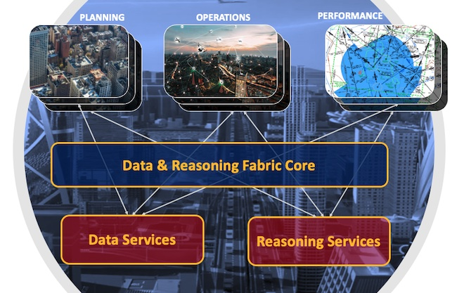
Data Services
DRF Data Services enables the discovery and delivery of reliable, high-integrity datasets on weather, traffic, vertiport status, and so on in a marketplace and offered by authorized service providers. It develops and functionalizes data services and metadata models for the DRF data life cycle.
Data services provided through the DRF Core ensures quality, consistency, and democratization of data for the future of air mobility operations. Many of these services will be executed autonomously by smart, unmanned, and/or reasoning agents to enable wide-scale acceptance and usability.
DRF Core
The Core is an open and scalable framework to connect nodes across vehicles, edge and cloud infrastructure to seamlessly work together.
Key functions:
Trusted data exchange including compute-to-data paradigms
Data privacy and protection
Allows for the migration of reasoning services at the edge
Accessible data marketplace for all
Data exchange and AI reasoning services for in- time decision making by humans and machines
Plug and play data and reasoning services
Extensible and application-agnostic
Local Governments & Advanced Air Mobility Service Providers
Reasoning Services
The DRF Reasoning Services leverage DRF Core and Data Services, utilizing artificial intelligence and machine learning, to offer decision-making services that provide logical sequences and predictions in a robust and timely fashion.
Reasoning services for operators of many automated vehicles include multi-vehicle trajectory generation, diagnostics and monitoring of vehicle health, risk assessment, environmental situational awareness, and information management. The reasoning services will be able to migrate to edge of the infrastructure, where the data exists, to support low latency decisions.
Information &
Decision Support
Services
Fabric
A connected interwoven “fabric” of digital systems enables an ecosystem that can send aircraft specific, tailored information wherever it is needed. By enabling dynamic reasoning using deep data sources, the data and reasoning fabric web-like ecosystem supports advanced air mobility, allowing all users to quickly find, verify, purchase, and securely use data from data providers and reasoning services owned by many small and large industry and government organizations.
DRF Accelerator
The Accelerator includes prototype instantiations of key DRF features, including data and reasoning services. This leverages data service, reasoning service and end user partnerships to validate the capabilities of DRF.
The Accelerator validates the minimum viable system concept of the Fabric by combining the first release of the DRF Core, reference implementations of services and service consumers, functional data services, reasoning services and associated simulations, a DRF framework software architecture, and partnerships with key stakeholder communities in representative use cases.
Notes:
This is the technical slide that tells the informed engineer what you’re doing in broad terms.

Slide 4
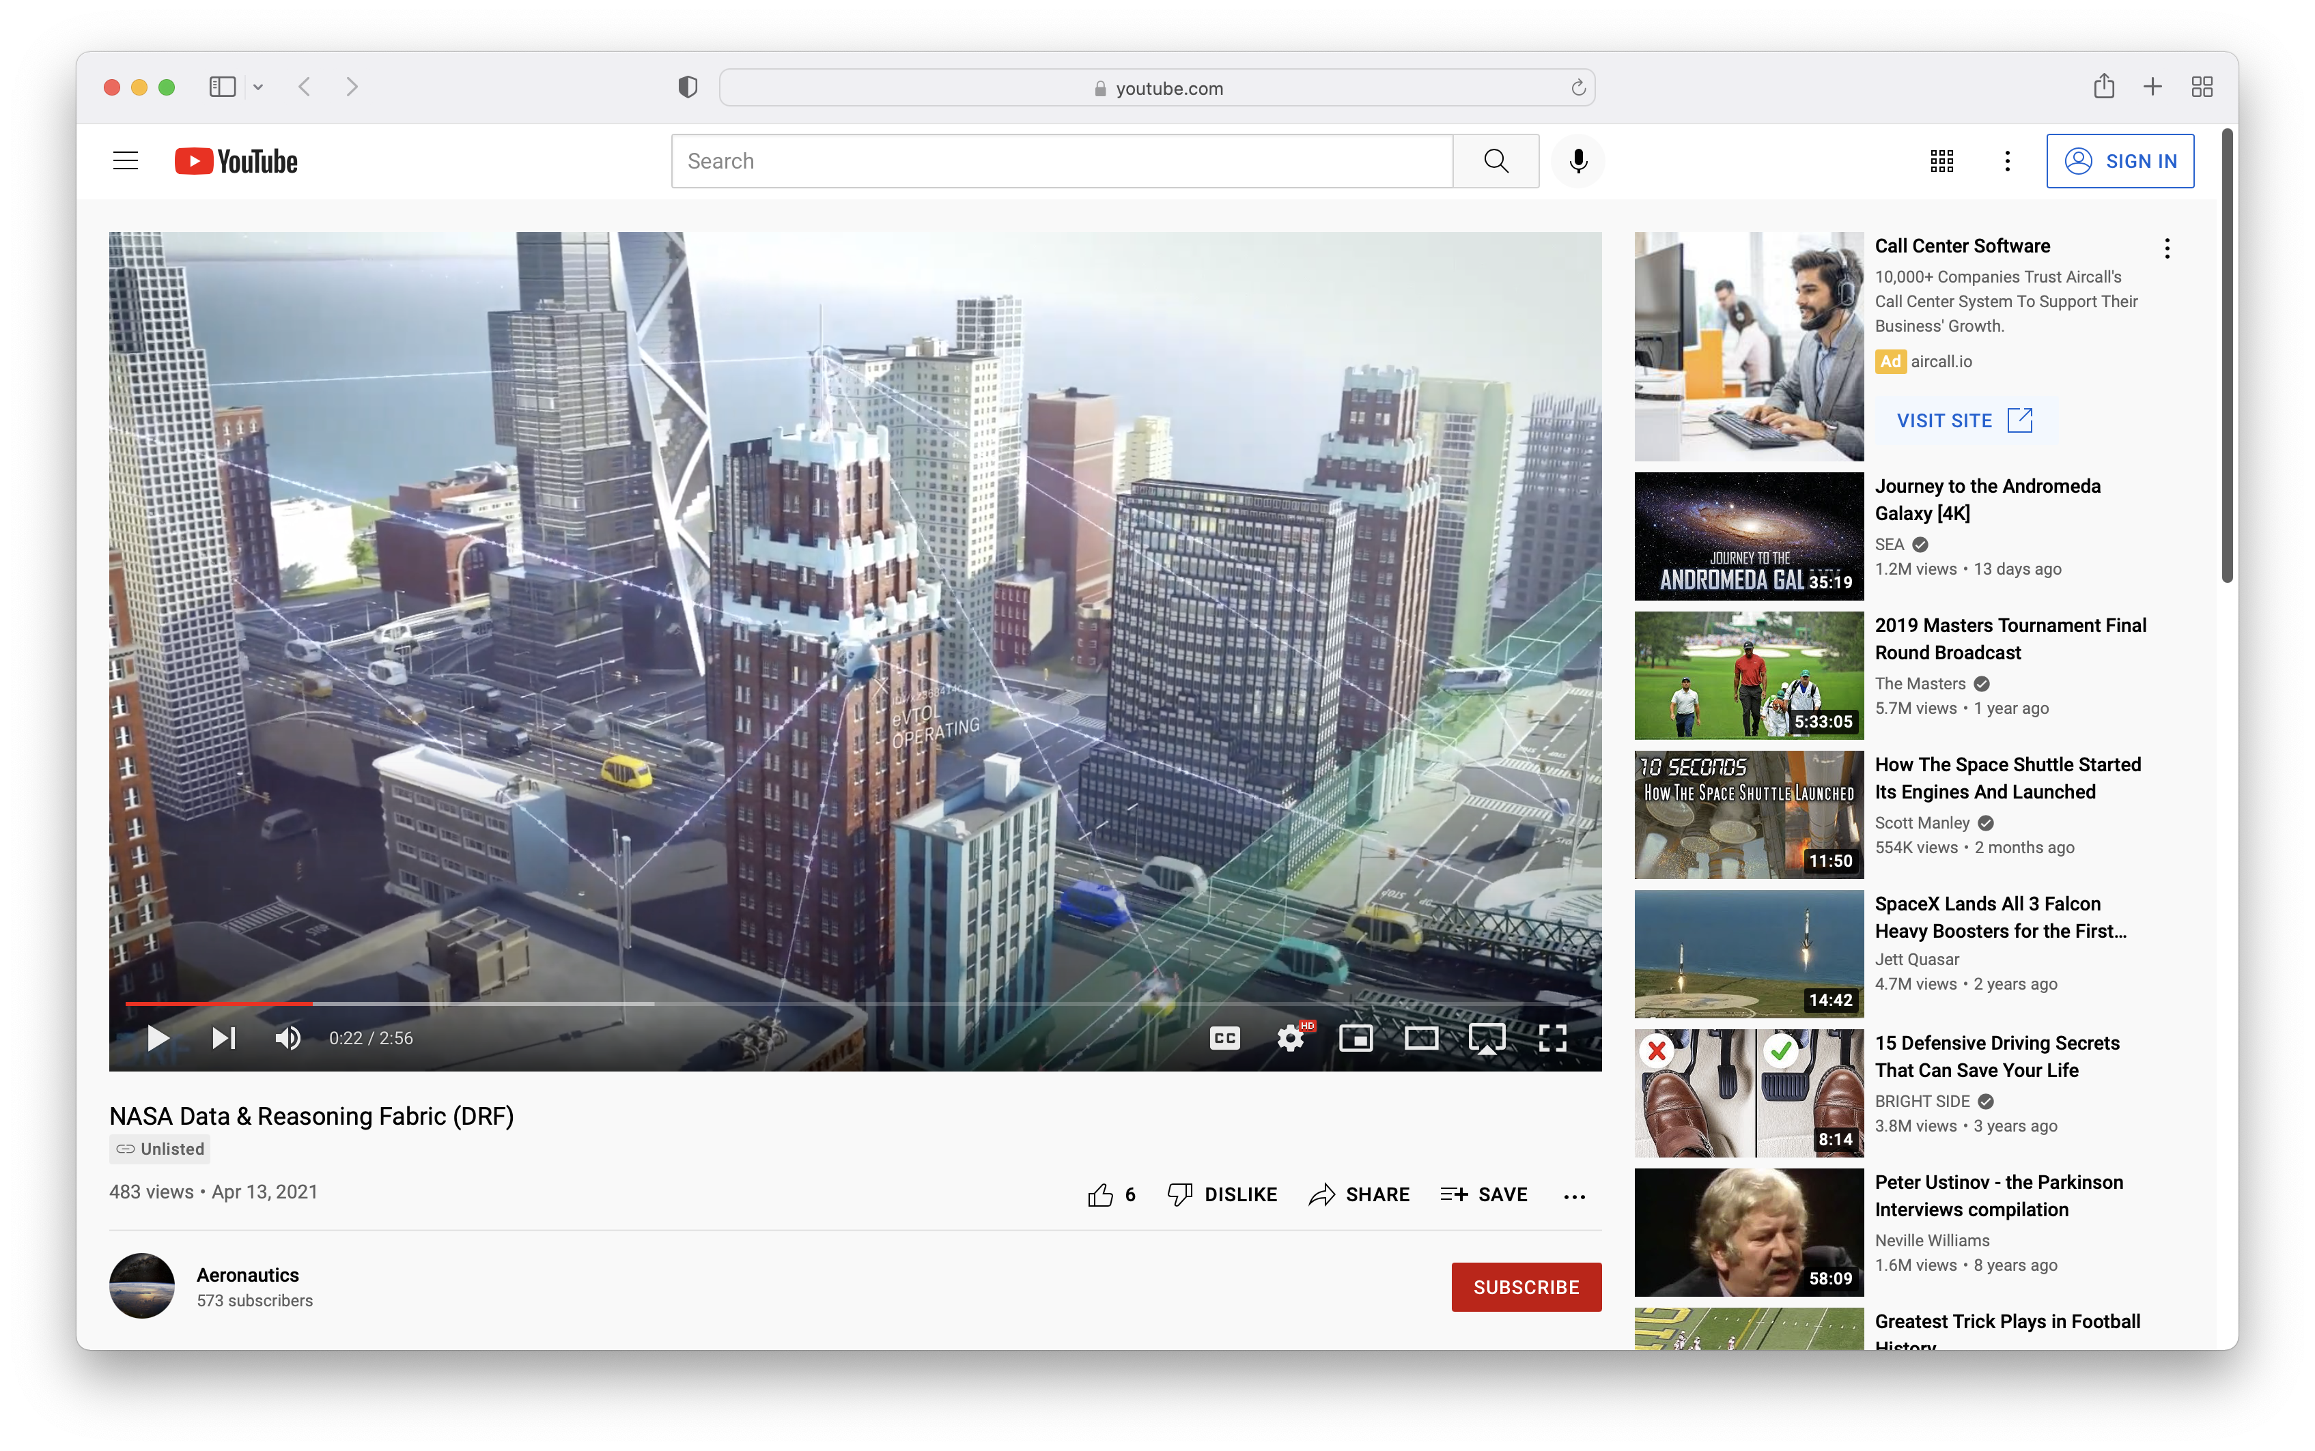
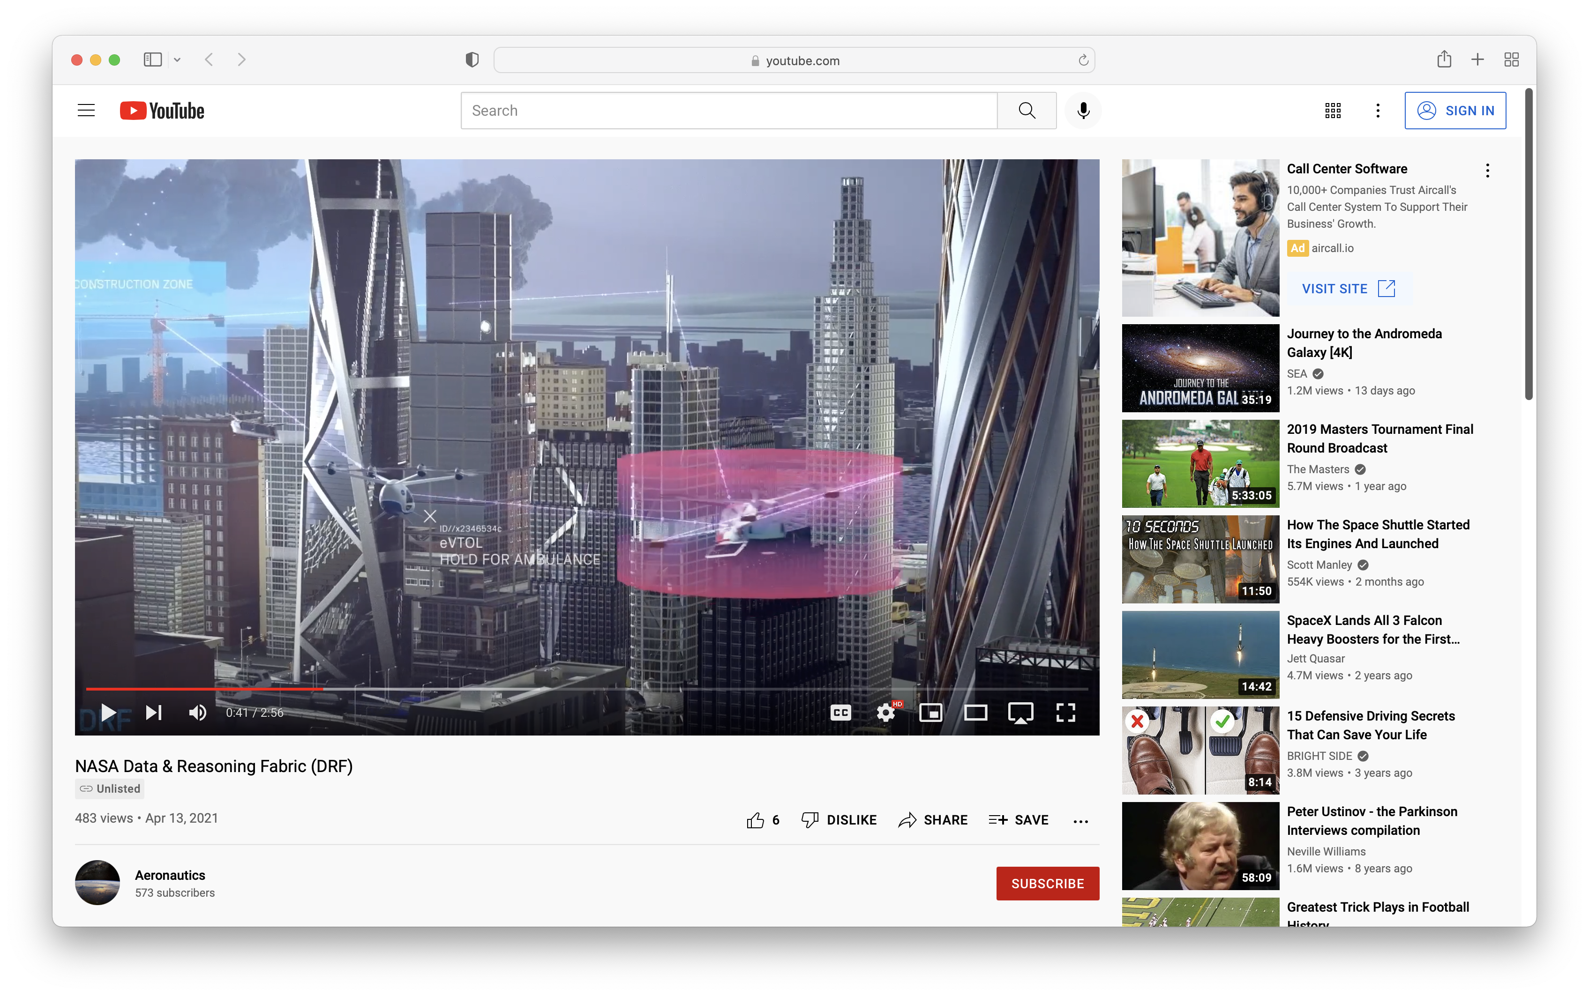
Working Together
Collaborate with NASA to support the National Airspace System to give all stakeholders confidence in a path to continued innovation and increased capability in the traditional and emerging airspace system.
NASA envisions that stakeholders and partners will join NASA in this endeavor to advance Smart Skies for all.
Get Involved
Connect With Us
Join NASA in building an inventive information infrastructure that can assemble and provide real time useful information for autonomous vehicles to enable the future of air mobility.
The DRF team seeks collaboration and partnerships with service providers and end users, including data providers, infrastructure operators, and flight operators to fully develop, test, and exercise DRF capabilities.
Website
Email
Concept Video
Article
Feature
Notes:
This slide encourages action by the reader.
Add links to final version.

Slide 5
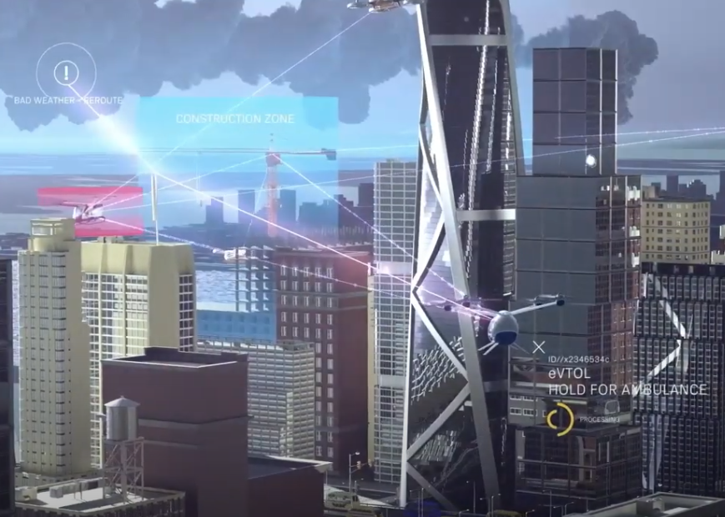
Architecture - Set of rules, policies, standards and models that govern and define the type of data collected and how it is used, stored, managed and integrated within an organization and its database systems.
Ecosystem – Spans foundational economic pillars of production, consumption, and their interactions with the goal of allocating scarce digital and physical resources.
Additional DRF Concepts
Advanced Air Mobility (AAM) – An air transportation system that moves people and cargo between places previously not served or underserved by aviation – local, regional, intraregional, urban – using revolutionary new aircraft.
Reasoning – systems generating logical sequences and predictions using available data and knowledge in a robust and timely fashion.
Credits: NASA / Aeronautics Research Mission Directorate (ARMD) / Transformative Aeronautics Concepts Program (TACP) / Convergent Aeronautics Solution (CAS) Project

