Slide 1
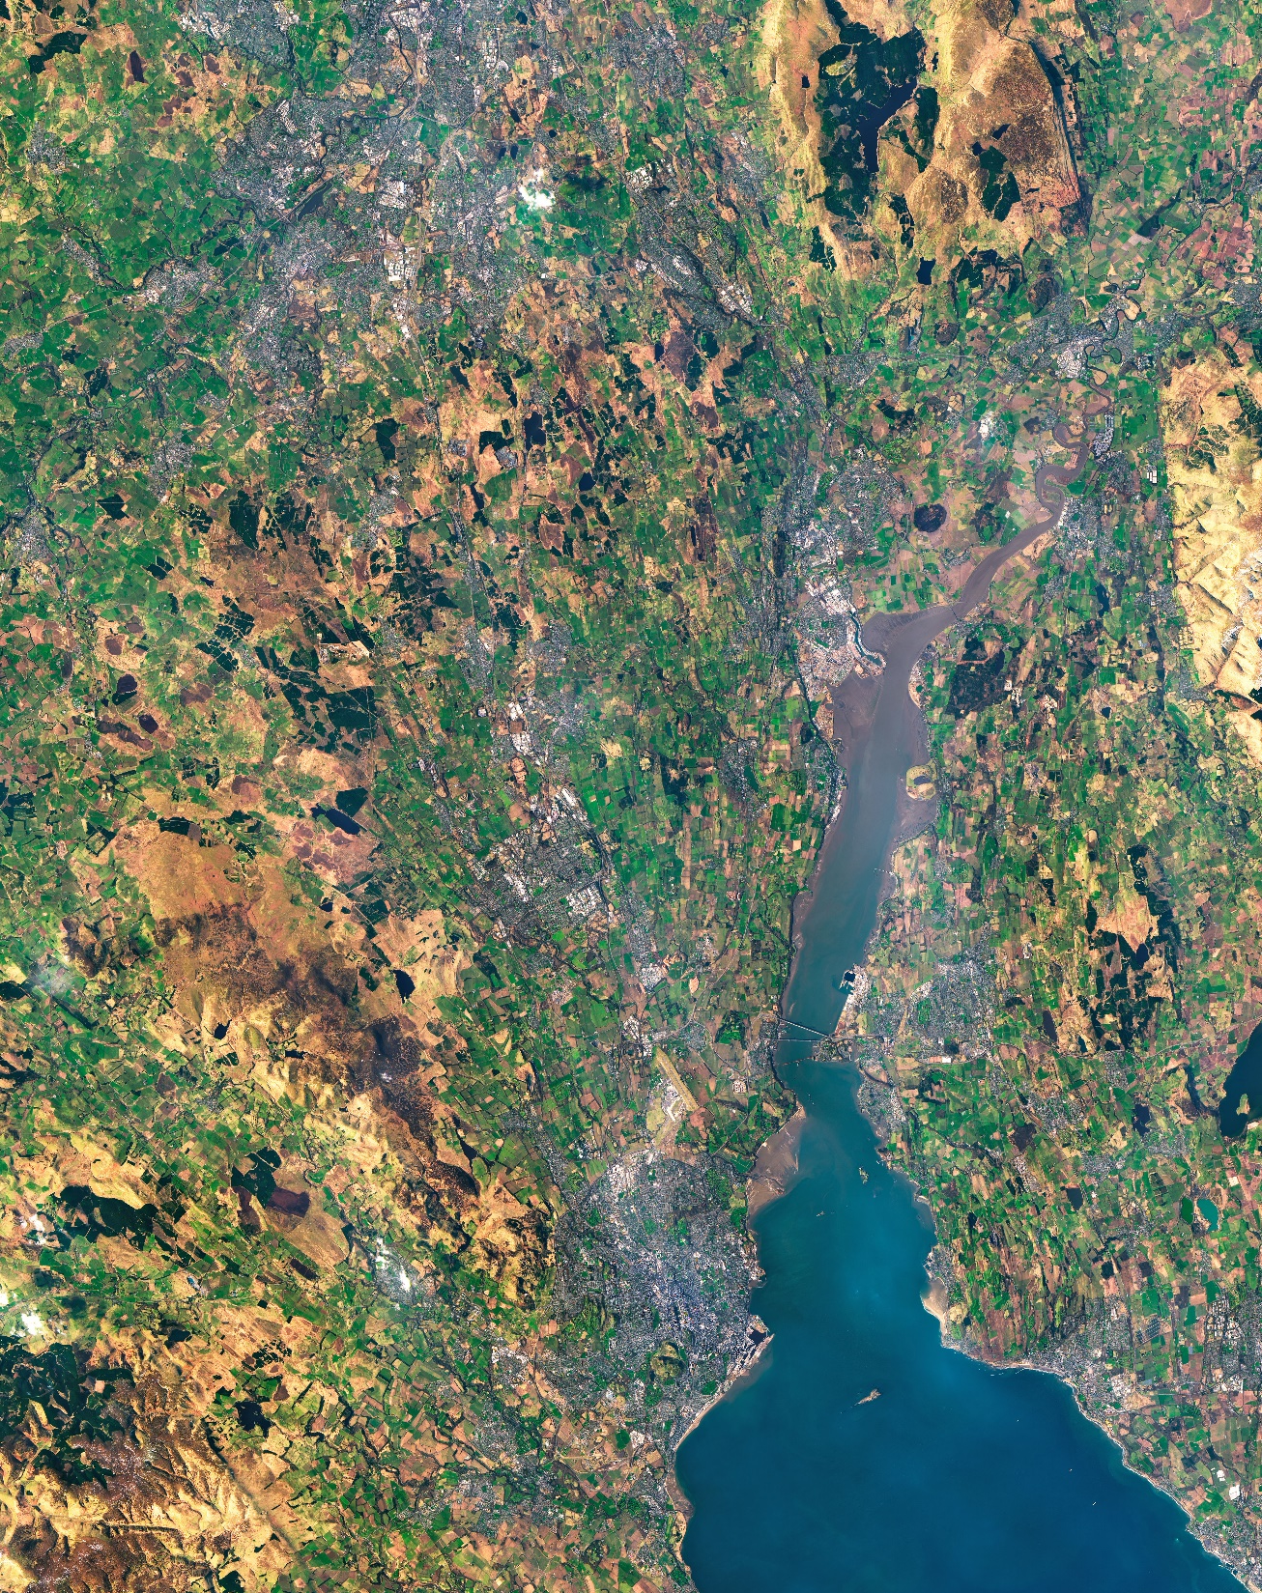
An Introduction to NASA DEVELOP & Project Applications of Airborne Data
Dr. Kenton Ross, DEVELOP Chief Scientist

Slide 2
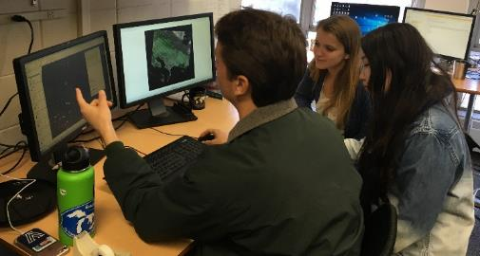
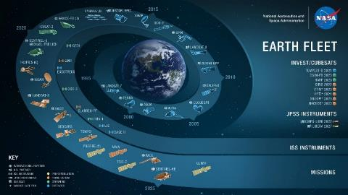
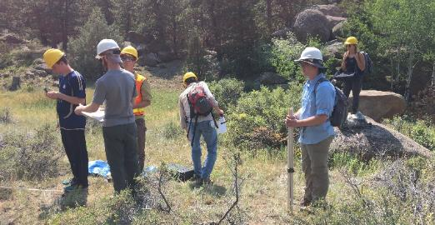
ABOUT DEVELOP
Empowered Participants + Earth Observations + Engaged Decision Makers
“Shaping the future by integrating Earth observations into global decision making”
DEVELOP bridges the gap between NASA Earth Science and society, building capacity in both its participants and end-user organizations to better prepare them to use remote sensing to address environmental challenges that face society.
Part of NASA’s Applied Sciences’ Capacity Building Program, DEVELOP addresses these challenges by conducting interdisciplinary feasibility projects to examine community concerns around the globe through the lens of NASA Earth observations.

Slide 3
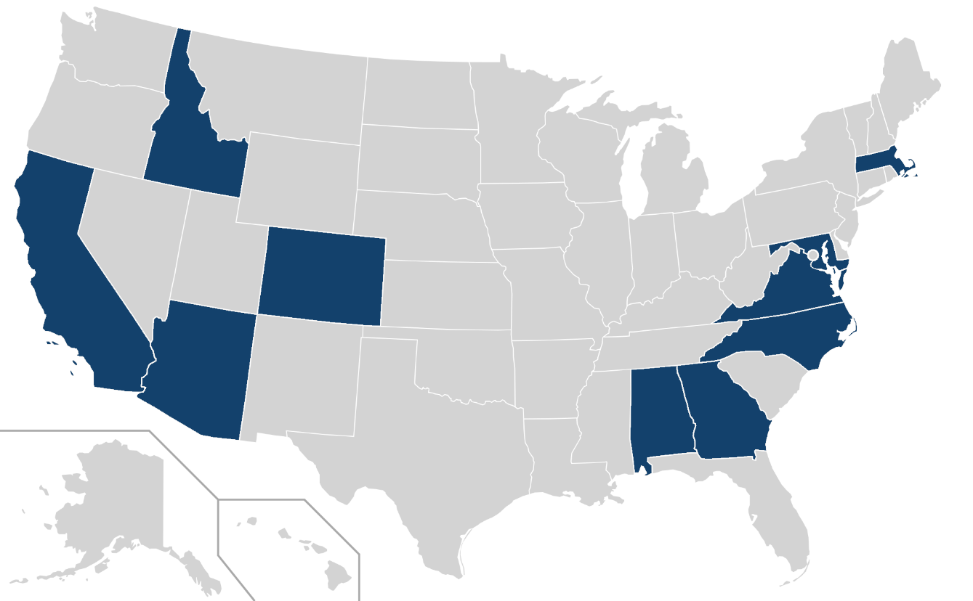
DEVELOP LOCATIONS
DEVELOP Office Locations*
(virtual since spring 2020)
9
Alabama – Marshall
Arizona – Tempe
California – Ames
California – JPL
Colorado – Fort Collins
Georgia – Athens
Idaho – Pocatello
Maryland – Goddard
Massachusetts – Boston
North Carolina – NCEI
Virginia – Langley
7
3
5
8
11
4
10
2
1
6

Slide 4
ABOUT PARTNERS
Project Partners
Any organization can partner with DEVELOP – state & local governments, federal agencies, tribal governments, non-profits, for-profits, international organizations, academia, etc.
LOCAL GOVERNMENT
STATE GOVERNMENT
FEDERAL GOVERNMENT
2021 Summer Term
Partner Sectors
NON-PROFIT
INSTITUTIONAL SECTOR
FOR-PROFIT
CONSORTIA
ACADEMIA
INTERNATIONAL

Slide 5
PROJECT DEVELOPMENT
Project Development Process
Idea Generation & Partner Engagement
Proposal Writing & Approvals
Project Execution & More Iteration
Initial engagement w/potential partner – DEVELOP listens to interests, priorities, needs, and understand their decision-making process.
Generate project idea – identify: study area, thematic focus area, actionable decision, potential end-products
Initial ideas reviewed by DEVELOP National Program Office.
If approved, DEVELOP Fellows draft a proposal – including the partner in review and iteration.
Proposals reviewed and approved by HQ, those selected are scheduled for a specific term and listed in the DEVELOP application.
Communication lines are reopened with partners following approvals.
Partners regularly meet with DEVELOP team during the term to discuss progress and preliminary results.
Project findings, end-products, and methodologies are handed off at the end of the term.

Slide 6









ABOUT PROJECTS
Project Characteristics
50+ projects take place each year – at their core they share these characteristics:
Highlight the applications and capabilities of NASA Earth observations
Address community concerns relating to decision-making for real-world environmental issues
Co-created with partner organizations that can benefit from using NASA Earth observations to enhance decision making by providing decision support tools
Conducted in 10-week terms (spring, summer, and fall) by small teams with diverse backgrounds
Create a consistent set of deliverables
Research is conducted under the guidance of Science Advisors and mentors from NASA and partner organizations
Align with at least one of the nine NASA Applied Sciences Program’s National Application Areas

Slide 7
ABOUT PROJECTS
DEVELOP Earth Observation Data Sources
Sources can include: satellites, airborne missions, model outputs, future sensor proxy datasets, in situ measurements, etc.
Key consideration – can partner can access the data & continue/replicate the project findings if they are so inclined
DEVELOP project use of airborne EO data in applications or applications research:
May be used directly as decision support data
May be used as proxy data for future spaceborne sensors
May be used as a standard of comparison for spaceborne sensors

Slide 8
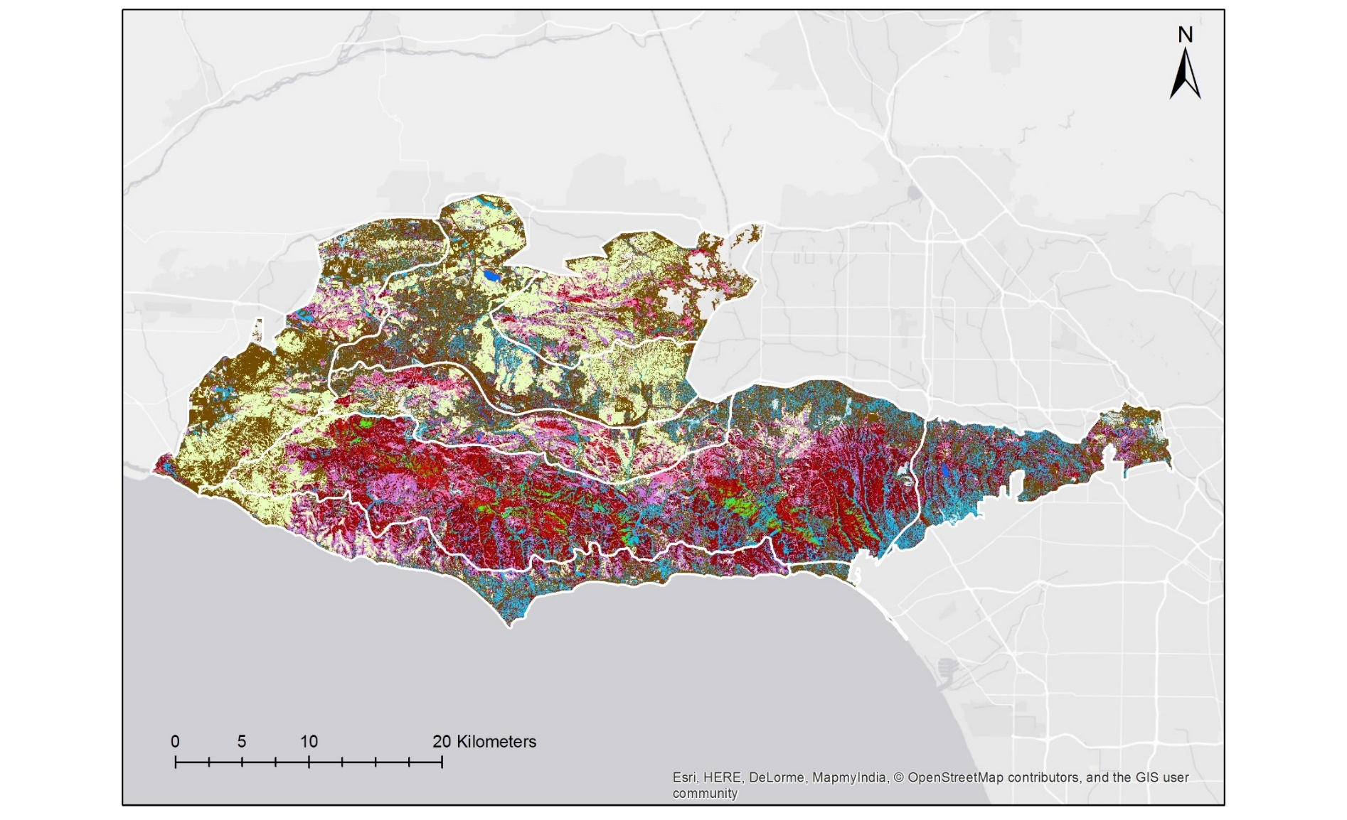
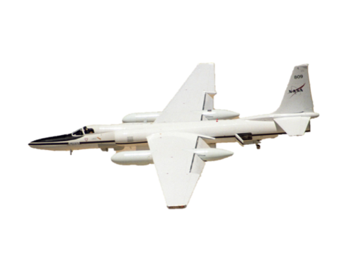
PROJECT EXAMPLE
Santa Monica Mountains Eco Forecasting (2017)
Utilizing NASA EO to Determine Drought Dieback and Insect-related Damage in the Santa Monica Mountains, California
Santa Monica Mountains Species Map
Land Cover / Species Mapped
Annual grass
Ceanothus megacarpus
Ceanothus spinosus
Chaparral - common
Coastal sage – drought deciduous
Coastal sage – summer active
Malosma laurina
Coast live oak woodland
Riparian
Substrate
Water
Data Source: AVIRIS
https://develop.larc.nasa.gov/2017/fall/SantaMonicaMountainsEcoII.html

Slide 9
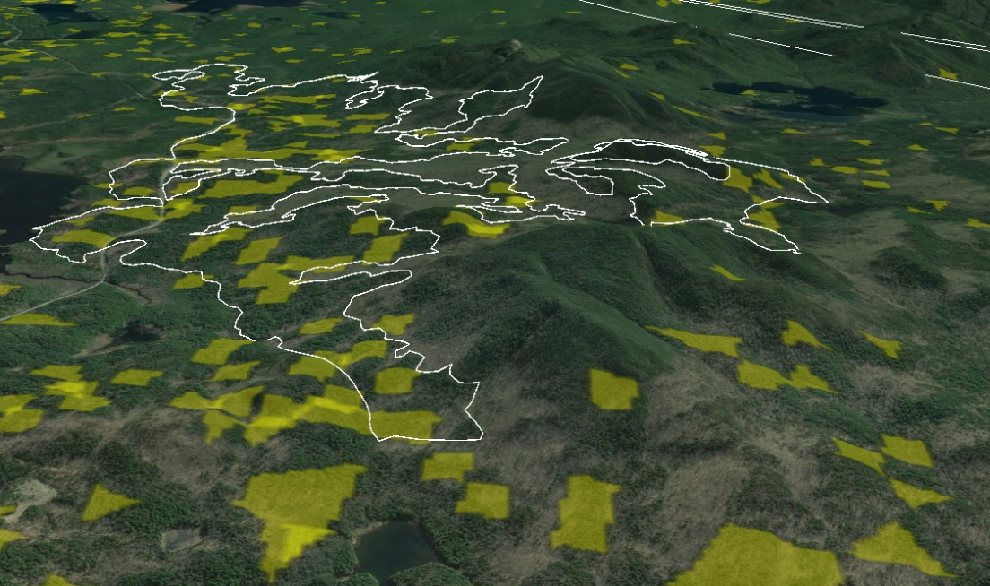
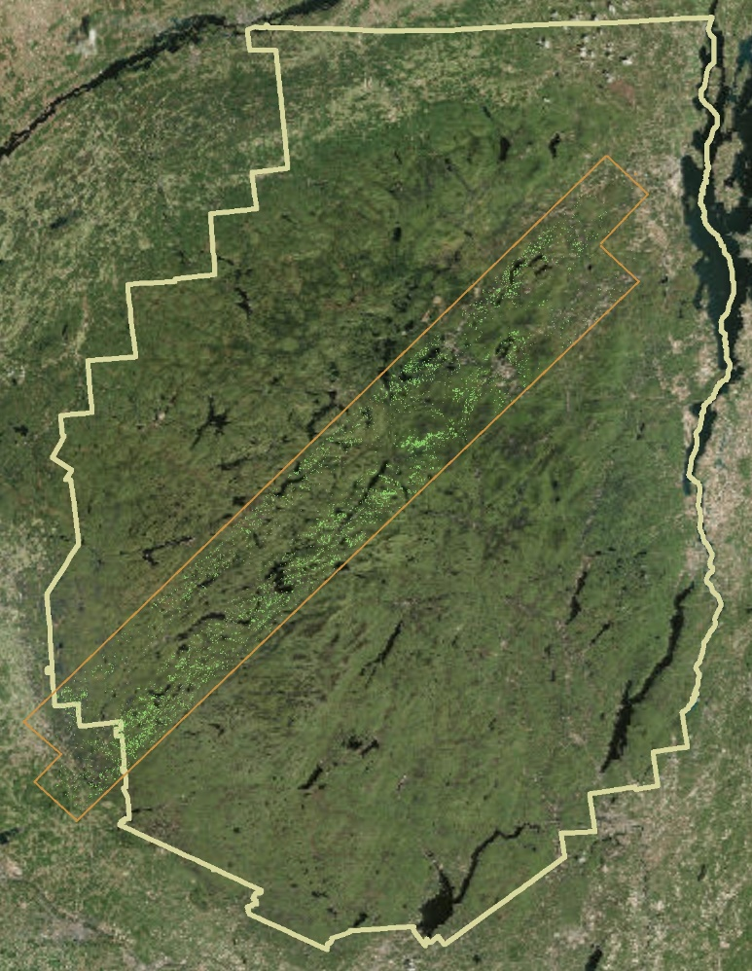
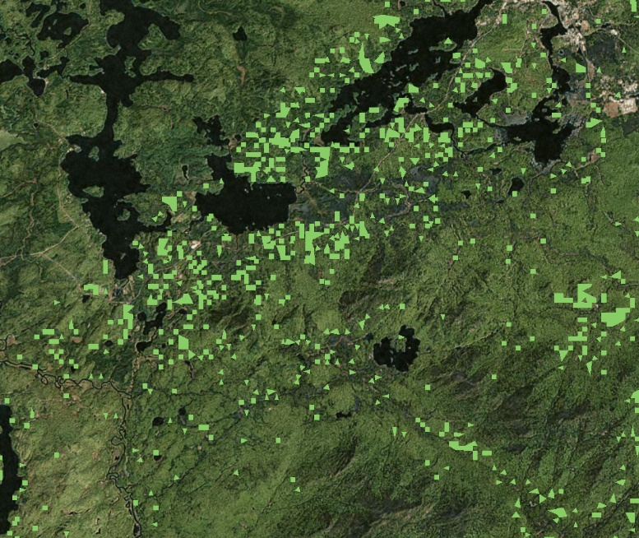
PROJECT EXAMPLE
Data Source: AVIRIS
New York Eco Forecasting (2017)
Hemlock Stands
Adirondack Park
AVIRIS Coverage
Comparing the Efficiency of Space-Based Imagery to AVIRIS Airborne Data for the Identification of Hemlock Forests to Mitigate Invasive Species Expansion
https://develop.larc.nasa.gov/2019/summer/NewYorkEcoII.html

Slide 10
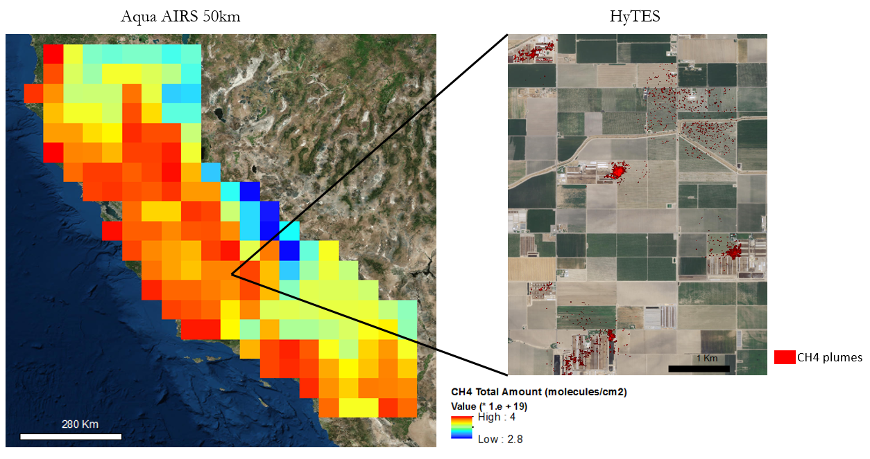
PROJECT EXAMPLE
California Health & Air Quality (2017)
Identifying Methane Emissions Patterns from Dairy Farms Using Aircraft Remote Sensing Observations and Image Classification
Data Source:
AVIRIS-NG & HyTES
https://develop.larc.nasa.gov/2017/summer/CaliforniaHealthAQ.html

Slide 11
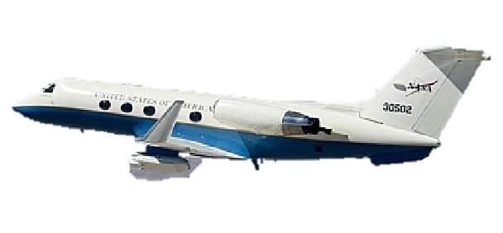
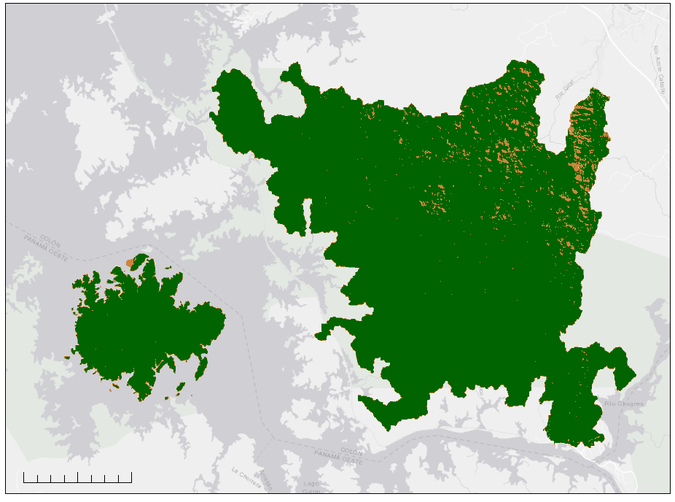
PROJECT EXAMPLE
Panama Water Resources (2019)
Data Source:
UAVSAR
Land Cover Change Between 2/6/10 and 3/14/15
Characterizing Vegetation Water Use in the Panama Canal Watershed to Inform Water Management in the Panama Canal
Land Cover Type | Average Area
Forested | 96%
Non-Forested | 4%
Average Overall Accuracy Compared w/In Situ Data:
73.8%
https://develop.larc.nasa.gov/2019/fall/PanamaWater.html

Slide 12
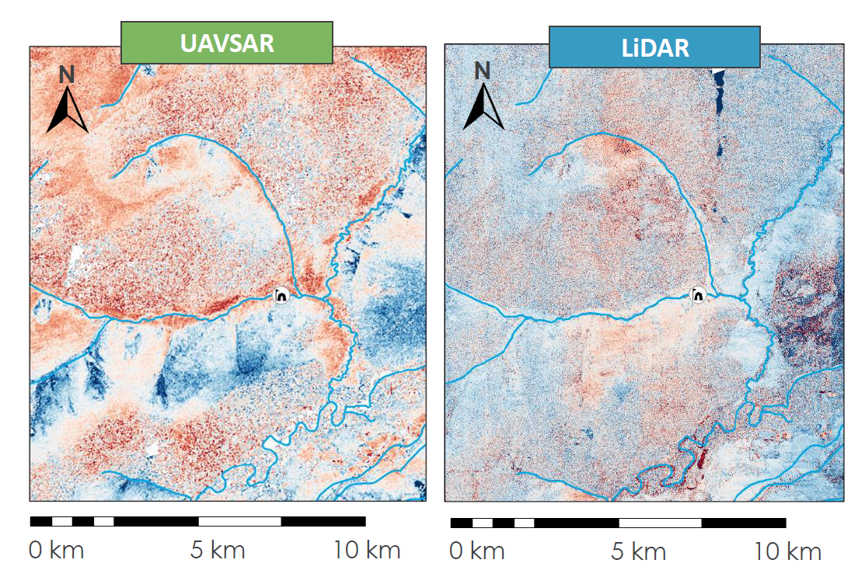
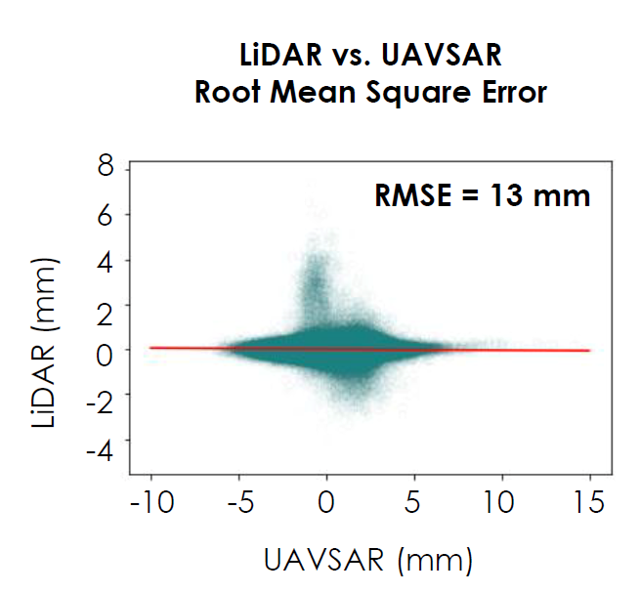
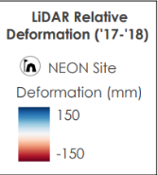
PROJECT EXAMPLE
Alaska Transportation & Infrastructure (2020)
Identifying Permafrost Subsidence Using NASA Earth Observations to Pinpoint Road & Infrastructure Vulnerability in Fairbanks, Alaska
Data Source:
UAVSAR
https://develop.larc.nasa.gov/2020/summer/AlaskaTI.html

Slide 13
SUMMARY
NASA Airborne Sensors Used in the Last Decade:
AirSWOT
AVIRIS
AVIRIS-NG
HyTES
UAVSAR
DEVELOP Use of Airborne Data
DEVELOP projects often explore how NASA airborne data can aid partners in understanding the feasibility of using EO to support decisions.
The use of NASA airborne EO has been a strong capacity building tool for many DEVELOP participants.
A key to success in the DEVELOP projects was NASA scientists with expert knowledge of the airborne sensor data. NASA scientists will have to continue in this role until the community knowledge/capacity is built up as for many of the spaceborne EO data.

Slide 14
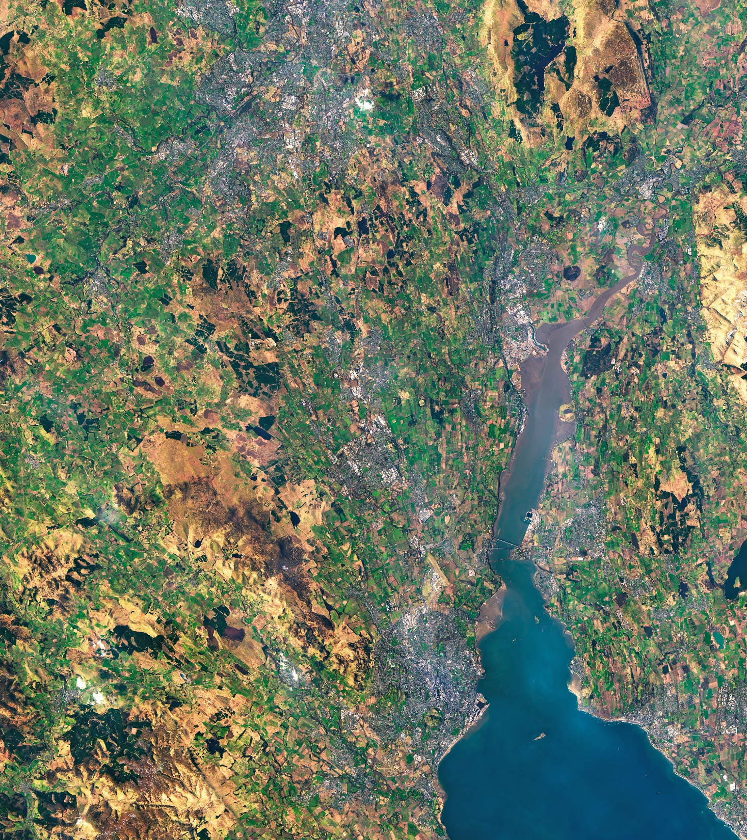
Thank You.
Questions? Ideas?
Kenton.W.Ross@nasa.gov

