Slide 1
Entry, Descent, and Landing (EDL) Instrumentation
Jose A. B. Santos
NASA Ames Research Center
19 April 2022

Slide 2
Outline
What is EDL Instrumentation?
Overview of sensors used in EDL instrumentation suites
Examples of EDL instrumentation flown on NASA missions (2012-Present)

Slide 3
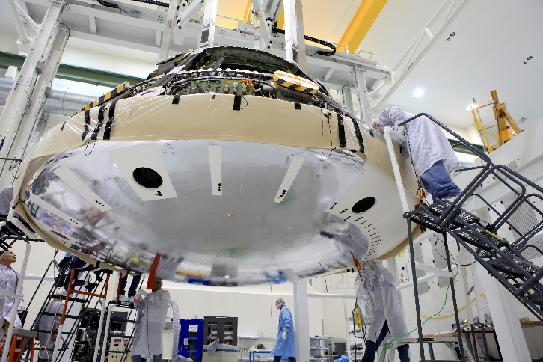
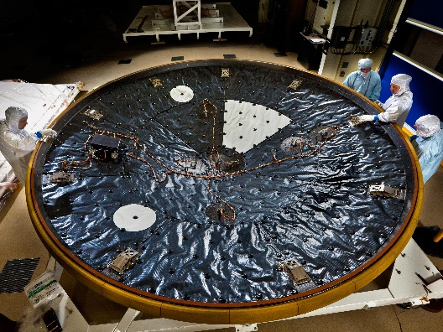
What is EDL Instrumentation?
For spaceflight missions involving atmospheric entry, the environment experienced by a spacecraft cannot be fully replicated on the ground
Taking measurements in the flight environment is the “gold standard” for:
  Validating predictive modeling tools
  Reducing risk on future EDL missions
EDL Instrumentation can consist of in-situ sensors embedded within the aeroshell, or remote observations
  Focus of this presentation is on NASA in-situ sensors
Orion EFT-1 heat shield
MEDLI instrument suite

Slide 4
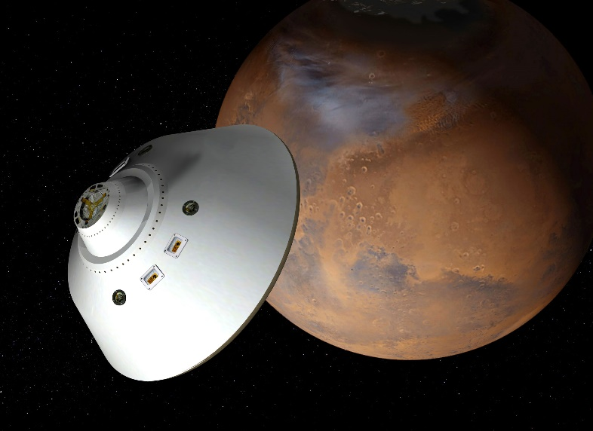

Benefits of EDL Instrumentation
NASA has significant science and human exploration goals for Mars
  Mars Sample Return Campaign
  Artemis missions
There is a need to increase our knowledge of how vehicle systems perform to reduce risk on future missions
  Atmospheric Models
  Aerothermodynamics and TPS material response models
  Reduce TPS sizing margins
  Entry system Aerodynamics models
  Separate atmospheric and aerodynamic performance issues (not possible with Inertial Measurement Unit data alone)
(Courtesy: NASA.gov)

Slide 5
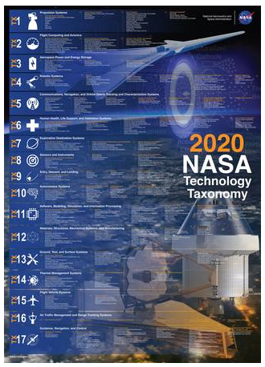
EDL Instrumentation: Additional Context
The 2020 NASA Technology Taxonomy articulates the technology development disciplines needed to enable future space missions
  Item TX09.4.6 covers “Instrumentation and Health Monitoring for EDL”
NASA’s competed Discovery and New Frontiers class missions are required to propose an Engineering Science Investigation (ESI) suite
  Dragonfly is the first New Frontiers mission to fulfill this requirement
2023-2032 Planetary Decadal Survey white paper on EDL Instrumentation
  Summarizes state-of-the-art for EDL instrumentation
  Describes current challenges and new measurements or capabilities needed for EDL instrumentation

Slide 6
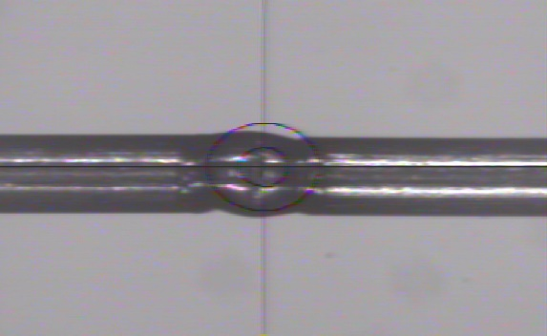
Thermocouples
Operating Principle:
  Measure temperatures difference between hot and cold junctions by measuring the voltage from Seebeck effect
  Must be two dissimilar metals
  ASTM E-230 and NIST provide additional details
Used in an EDL instrumentation suite to measure heat shield and backshell TPS material temperatures during atmospheric entry
  Infer surface heat flux
  Characterize performance of the TPS material
  Identify onset of transition from laminar to turbulent flow
Metal 1 (+)
T_{hot}
Measure voltage here
T_{ref}
Metal 2 (-)
TC bead weld (“hot junction”)

Slide 7
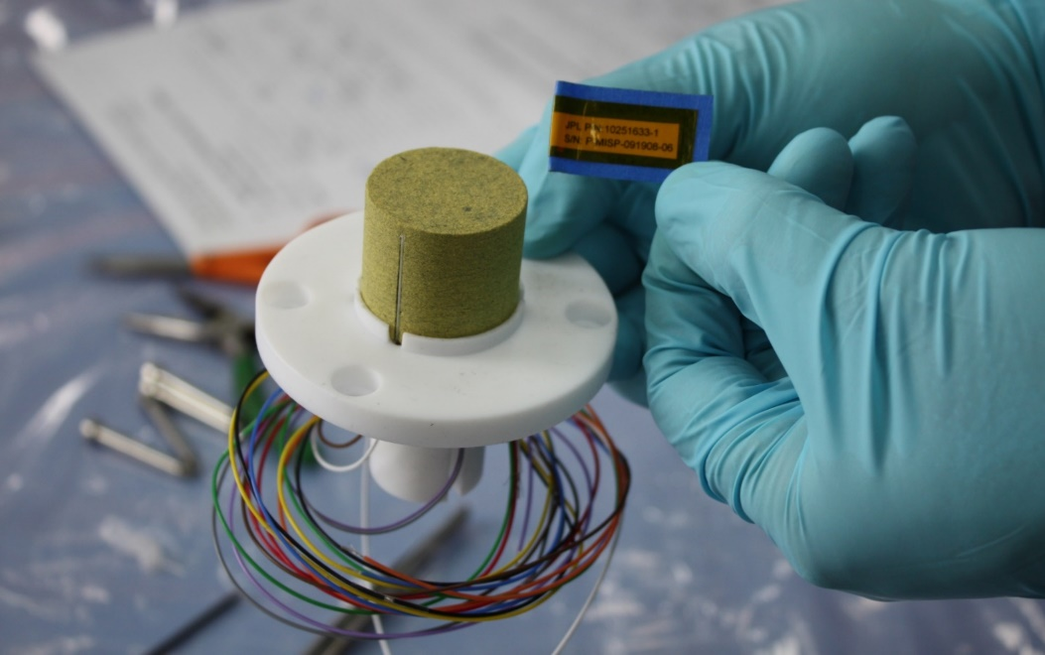
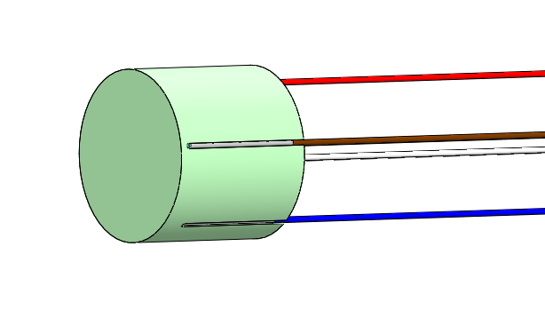
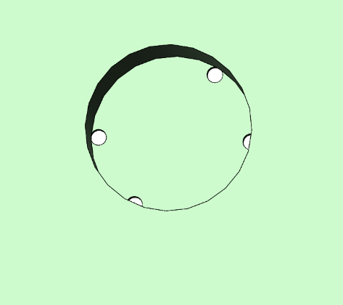
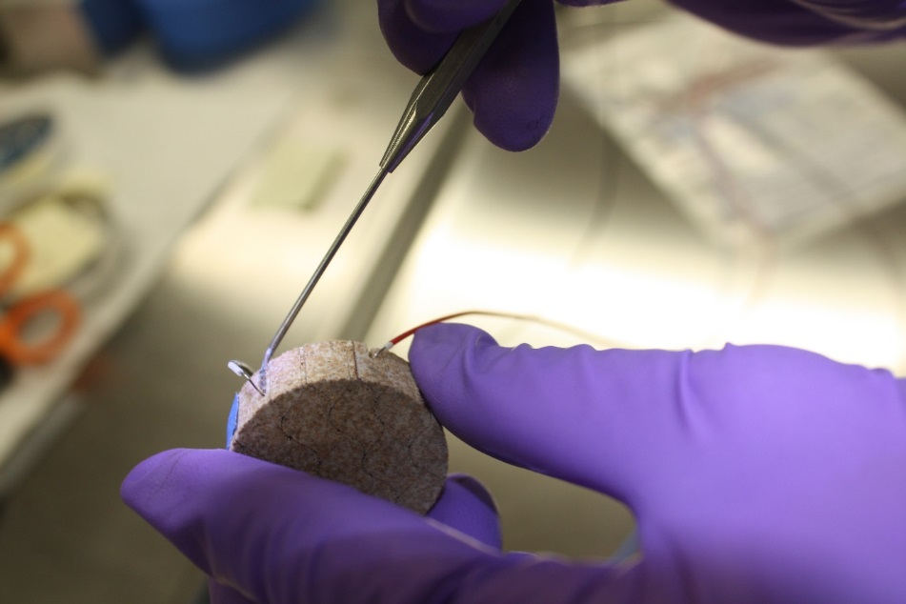
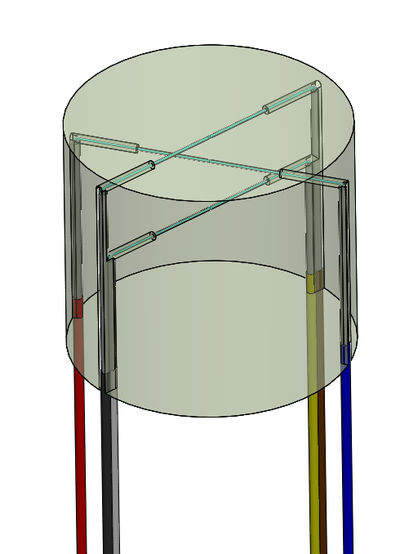
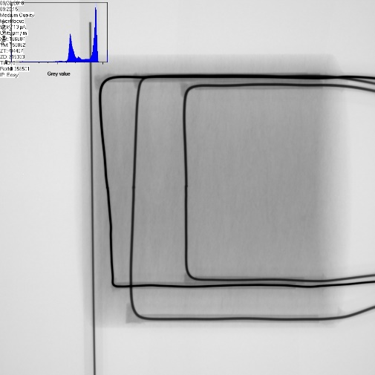
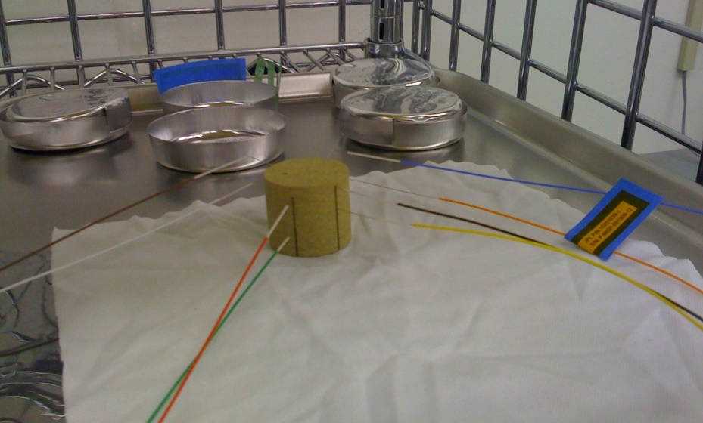
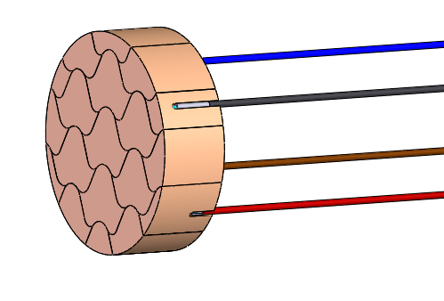
Thermocouple Plugs
Heatshield:
HS TC plug is installed into counterbore with RTV-560 applied at the bottom face and sidewall
Lead wires fed through the structure to route to data system
RTV-560
Thermocouple plug fabrication
X-ray image

Slide 8
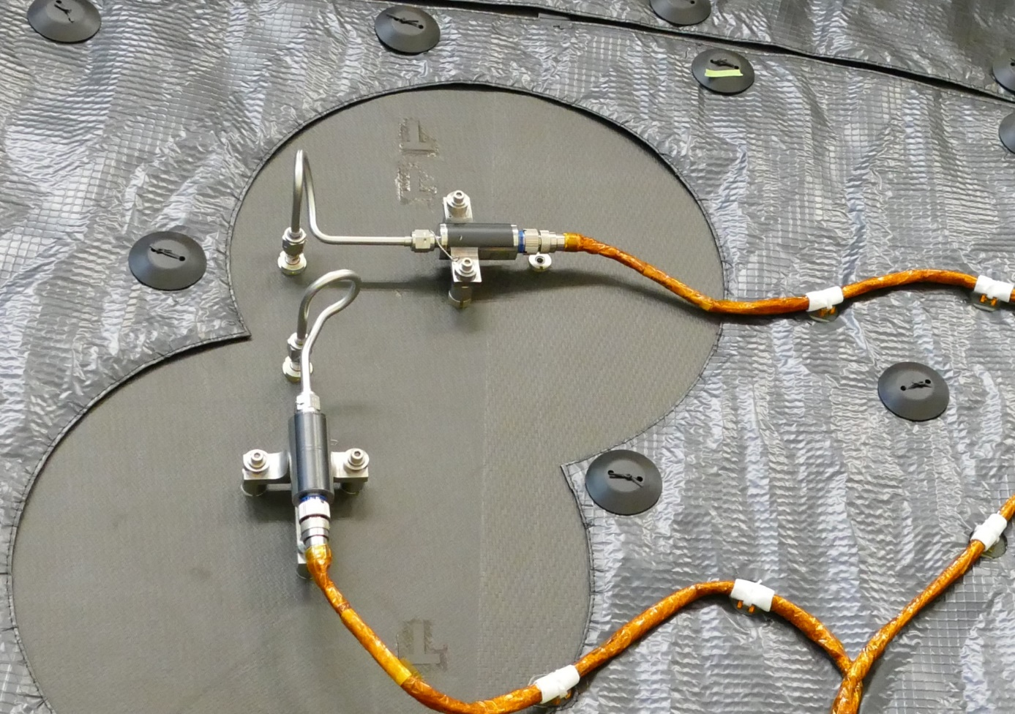
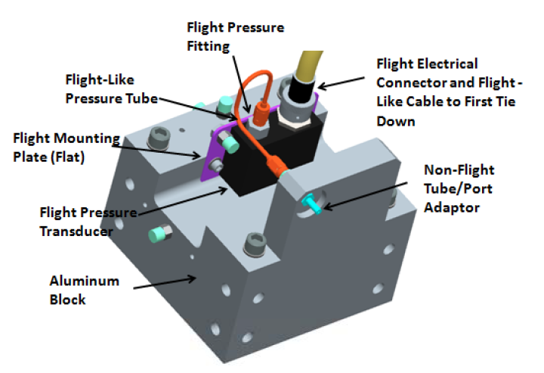
Pressure Transducers
Measure surface pressure in-situ on the heat shield or backshell of an entry vehicle
Data are used to reconstruct freestream density and vehicle attitude
  Angle of attack
  Angle of sideslip
Accommodation onto a flight aeroshell requires a hole through the TPS material and substructure
Tubing is used to provide the pressure path to a transducer
MEDLI2 Hypersonic and Supersonic pressure transducers installed on the Mars 2020 heat shield
(Courtesy: NASA/JPL-Caltech)
CAD image of Orion EFT-1 pressure transducer test configuration

Slide 9
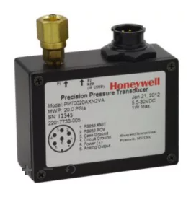
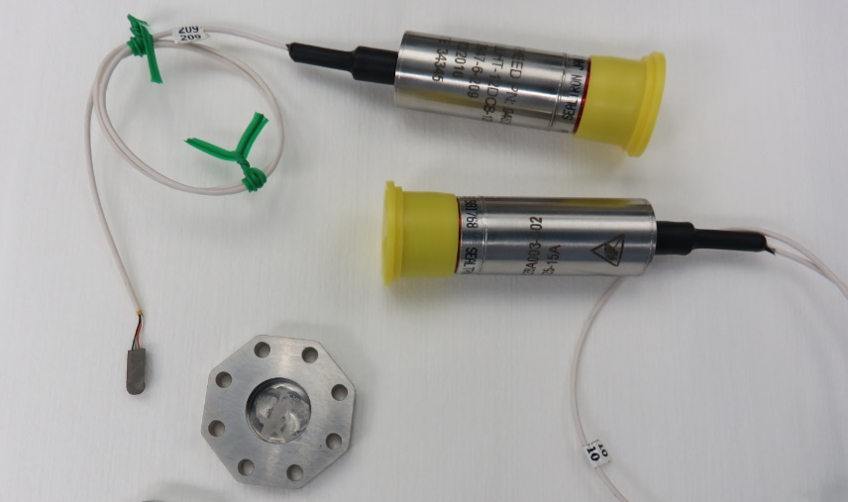
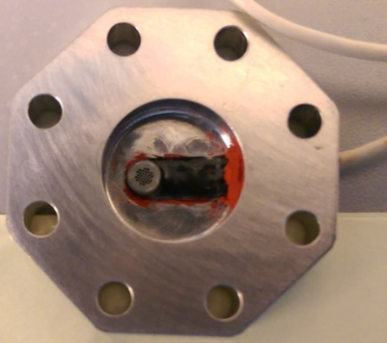
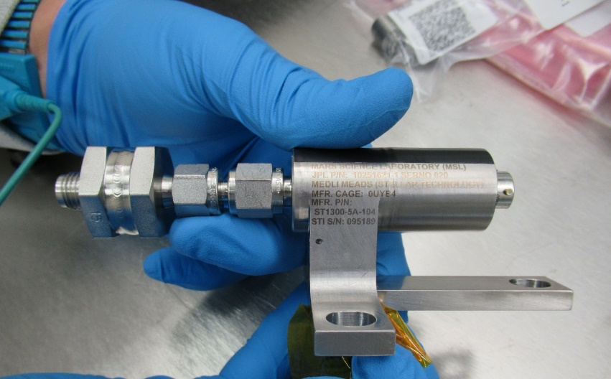
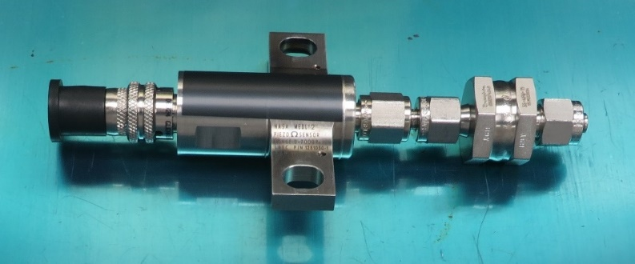
Pressure Transducers
Artemis 1 shoulder pressure transducer
Commercial and NASA built units have flown
Various sensing technologies:
  Piezoresistive strain gage
    Honeywell PPT: Micromachined silicon die with piezoresistive strain gauges
    NASA LaRC in-house design for MEDLI2
  Variable Reluctance for very low pressure applications
    Two variable reluctance sensors with a diaphragm in-between
    Commercial unit for MEDLI2
Orion EFT-1 pressure transducer
Design considerations:
  Absolute vs differential
  Calibration
  Tubing and port design
MEDLI2 Supersonic transducer
MEDLI / MEDLI2 Hypersonic transducer

Slide 10
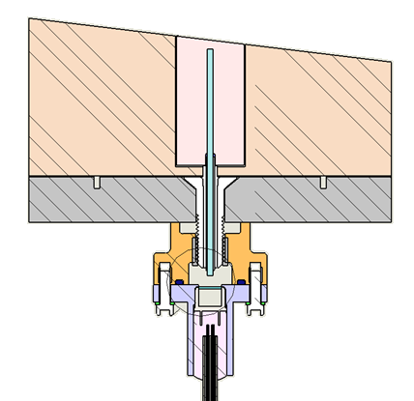
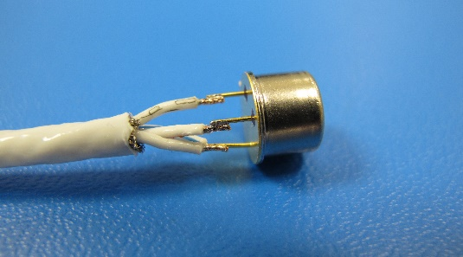
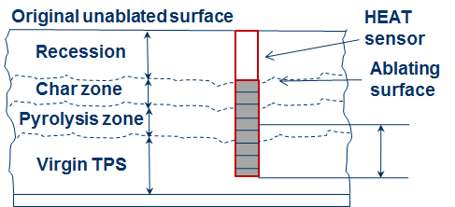
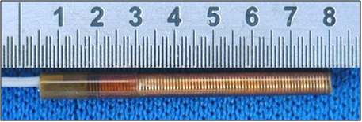
Recession Sensors
Optical Recession Sensor for Artemis 2
  Blank holes at different depths are drilled in TPS
  When the receding surface reaches the tip of blank hole, the drilled hole opens up
  UV from shock layer is detected by the photodiode when drilled hole opens
  Ideal response is a step function at time of opening
  Qualified for flight on Artemis 2; will be installed on Artemis 2 heat shield later this year
“HEAT” sensor
  Two wires wound around a hollow Kapton tube
  Resistance measurement is correlated to the uncharred length of the sensor
  History:
    Flown on MSL and Orion EFT-1
    Evolved from NASA’s ARAD sensor
UV from shock layer
Ablation direction
TPS
Photo diodes
Optical Recession Sensor (ORS)
Hollow aErothermal Ablation and Temperature (HEAT) sensor

Slide 11
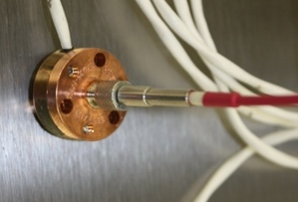
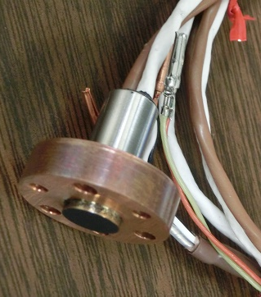
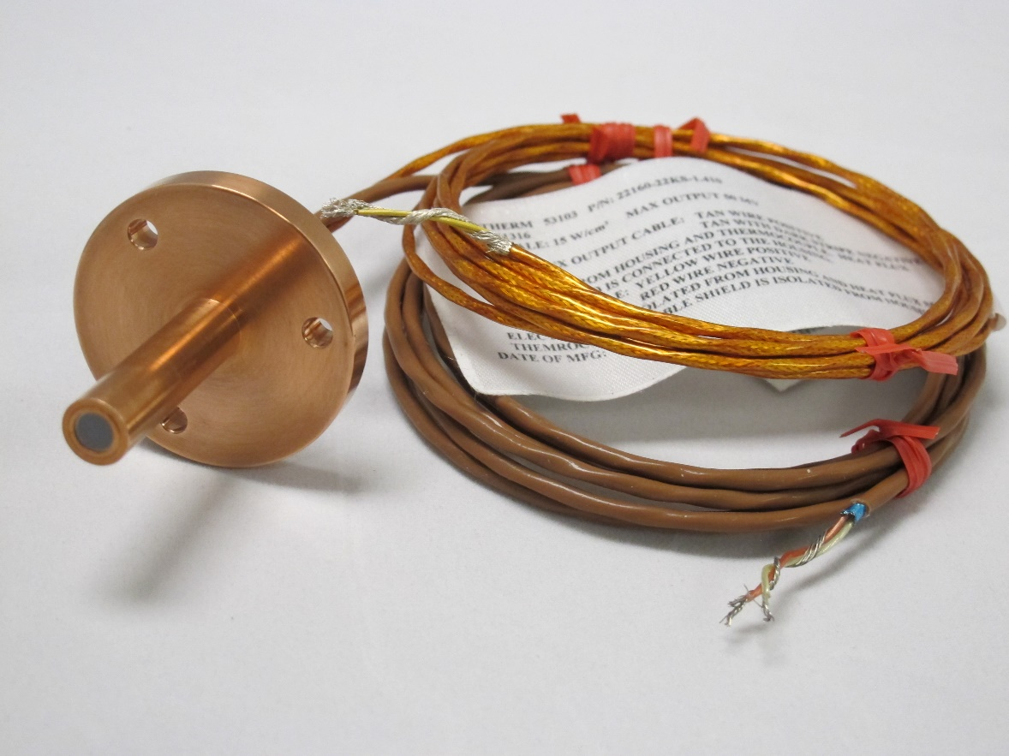
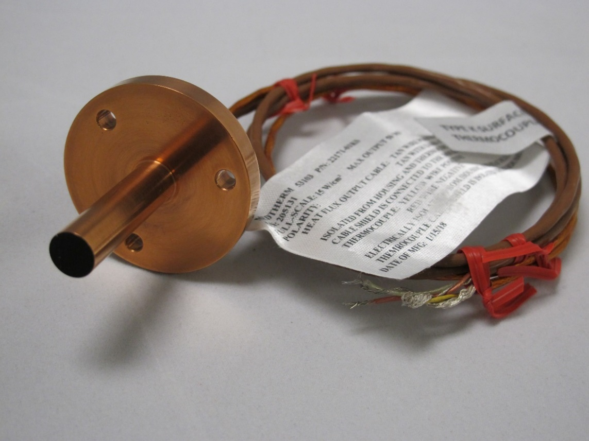
Heat Flux Sensors and Radiometers
Direct measurement of heat flux incident on a heat shield or backshell
Thermopile is commonly used for the sensing element
Total heat flux sensor detects combined convective and radiative heating
EFT-1 Heat shield Radiometer
Radiometers incorporate a window to block out convective heating contribution
  If installed at the surface, deposition of TPS ablation products on a sensor’s window can block or reduce the heat flux reading
  If recessed beneath the surface, radiation from the TPS cavity can be a significant contribution of the measurement
MEDLI2 Backshell Radiometer
MEDLI2 Backshell Total Heat Flux Sensor

Slide 12
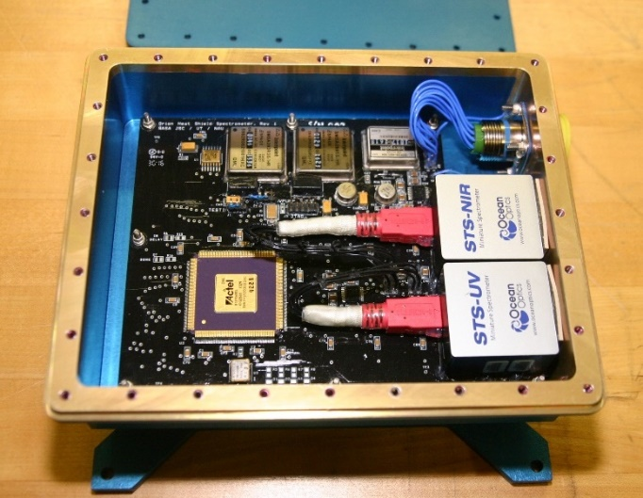
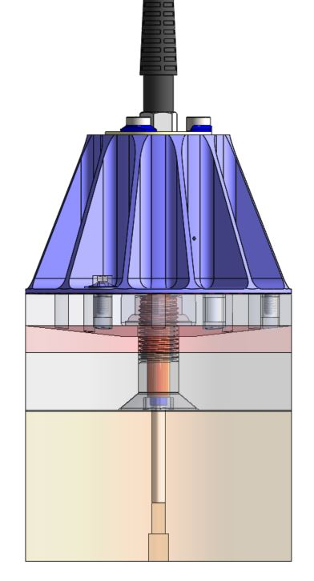
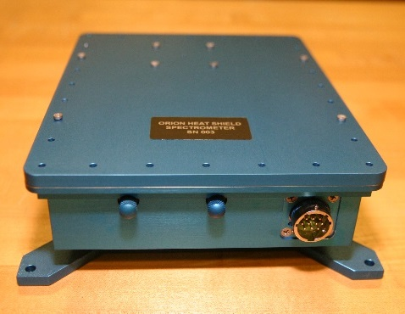
Spectrometers
Spectrometers provide wavelength information on shock layer radiation
Artemis 2 spectrometer
  COTS units qualified to meet environmental and functional requirements of the mission
  Optical sub-assembly to provide light path and mounting scheme for fiber optic cable
  Fiber optic cable is routed to housing containing two spectrometers
Planned for flight on Artemis 3-5 missions
Optical Fiber
Mounting
fixture
Adhesive
TPS
Representative core of the heat shield
Images of Artemis 2 spectrometer housing

Slide 13
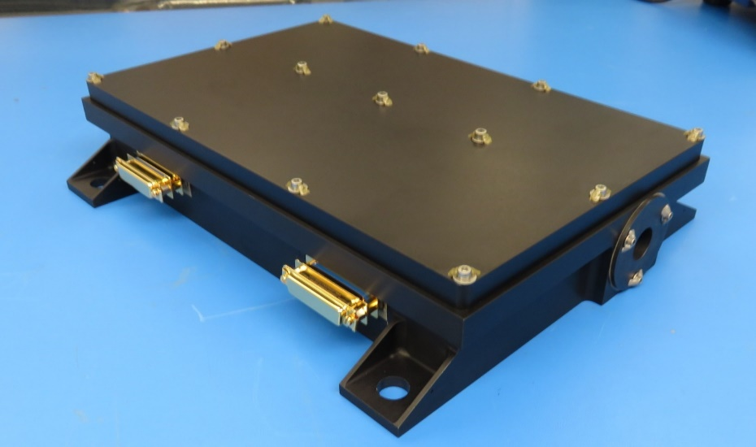
Data Acquisition Systems (DAS)
Destinations such as Mars, Venus, and Titan pose many challenges for EDL data acquisition systems, including radiation, environmental loads, and volume constraints.
It is not always possible to tie into the main mission’s avionics system.
  Separate, dedicated DAS for the EDL Instrumentation is often required
High cost associated with qualifying a standalone DAS for spaceflight
  Custom design
  Electrical and mechanical interfaces
  Qualification testing to meet temperature (often colder than -100 °C) and dynamic load requirements
The high cost prohibits smaller mission classes such as Discovery and New Frontiers from using MEDLI-like systems, therefore limiting the EDL science that can be conducted by NASA.
MEDLI2 Support System Electronics (SSE)

Slide 14
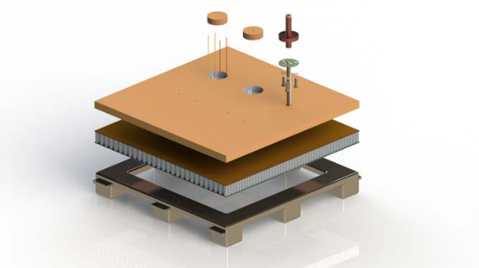
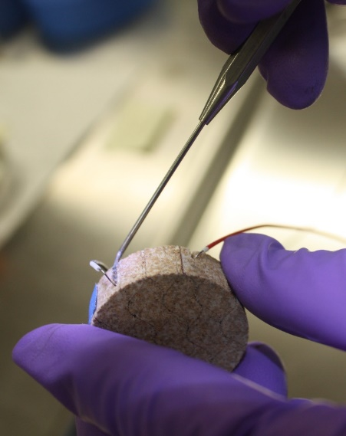
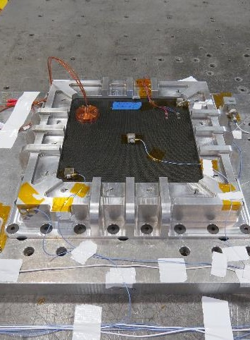
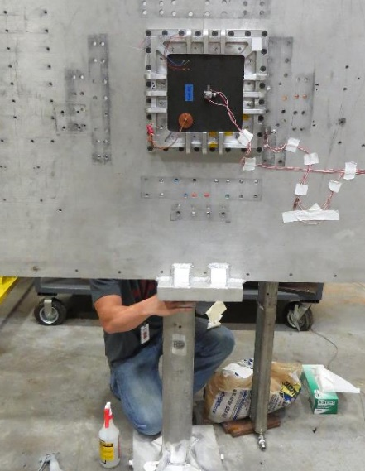
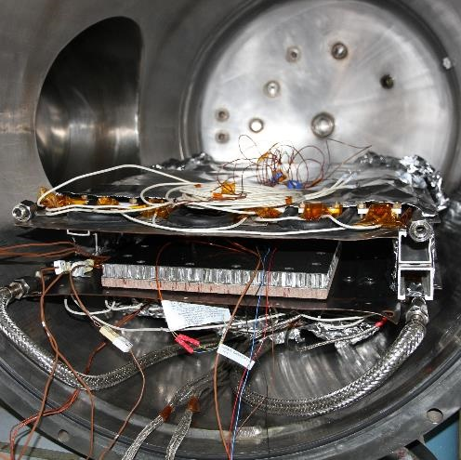
Making a Sensor “Spaceflight ready”
Design
Build
Test: Vibe
Shock
TVac
Arc Jet
Development Environmental Testing
  To gain insight into design compatibility or functionality in expected environments
Do No Harm Testing
  Must prove via test that the addition of instrumentation will not cause harm to the overall mission
  Typically integrated into an assembly to mimic flight-like installation and interfaces
Qualification (“Qual”) Testing
  Performed on dedicated Qualification Models of flight hardware (which is not intended to fly) in order to qualify the hardware design for the maximum expected flight environment plus margin, including margin on environmental duration or cycles.
Flight Acceptance / Protoflight Testing
  Protoflight or Flight Acceptance testing is performed on instrumentation which is intended to be flown. This testing verifies workmanship of the as-built sensor providing confidence in flight operation.
Unique Challenges to Space Missions:
  Extreme Low Temperatures During Long Cruise Phase
  Maintaining Calibration of Sensors
  Contamination Control and Planetary Protection

Slide 15
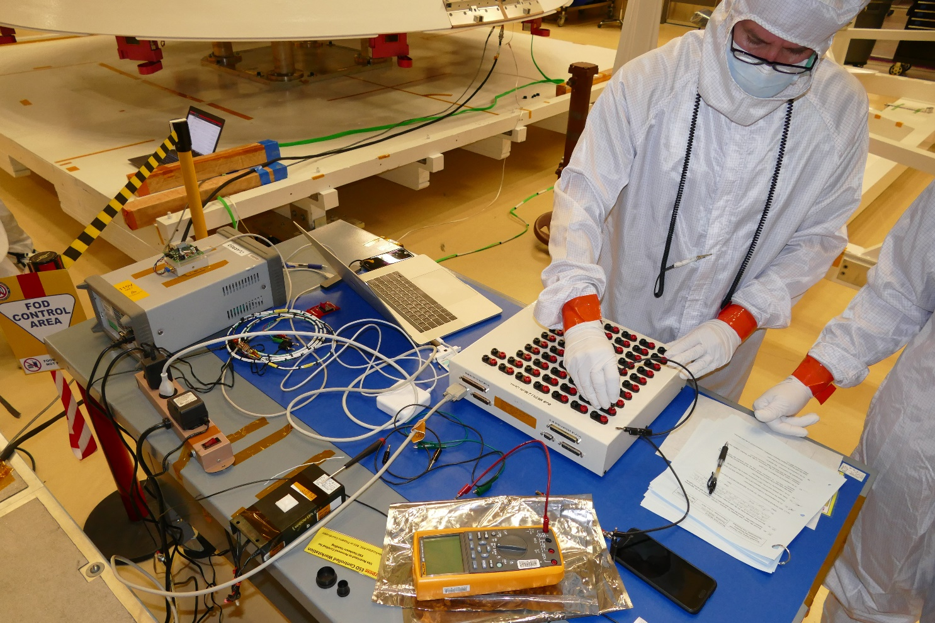
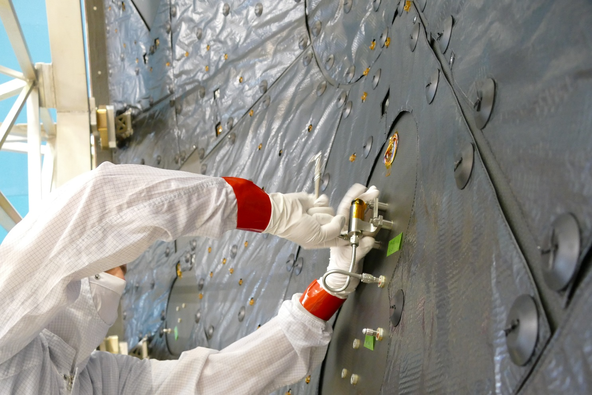
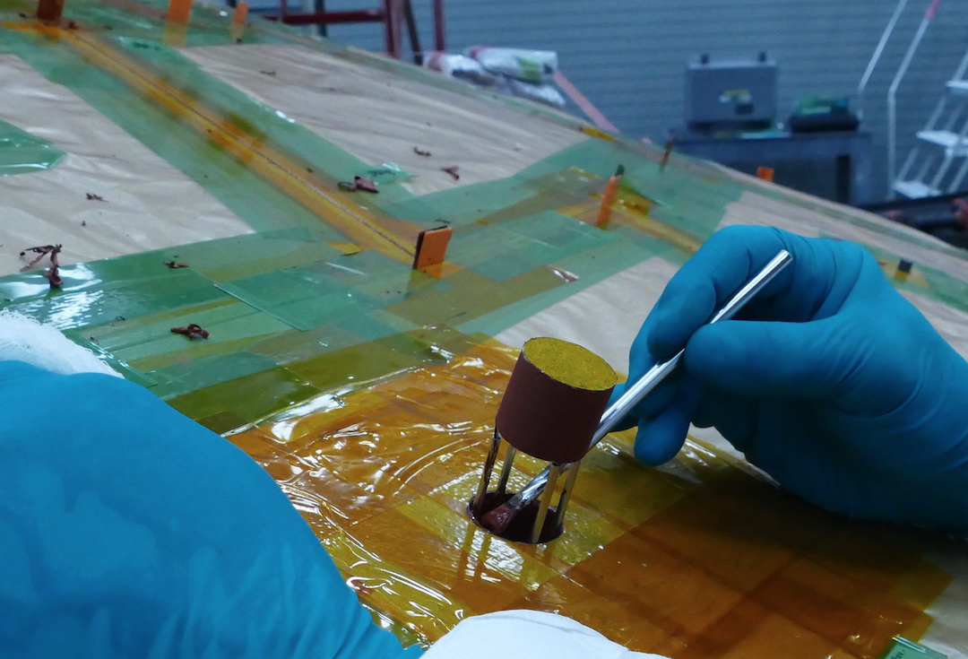
Accommodation onto Flight Aeroshell
Mounting and installation
Mechanical and electrical interfaces
Assembly, Integration, and Test (AI&T)
MEDLI2 Post-Delivery functional testing
MEDLI2 pressure transducer installation
MEDLI2 thermocouple plug installation
(Courtesy: NASA/JPL-Caltech)
(Courtesy: NASA/JPL-Caltech)

Slide 16
NASA Flight Missions with EDL Instrumentation
2012 - Present Day
Planned

Slide 17

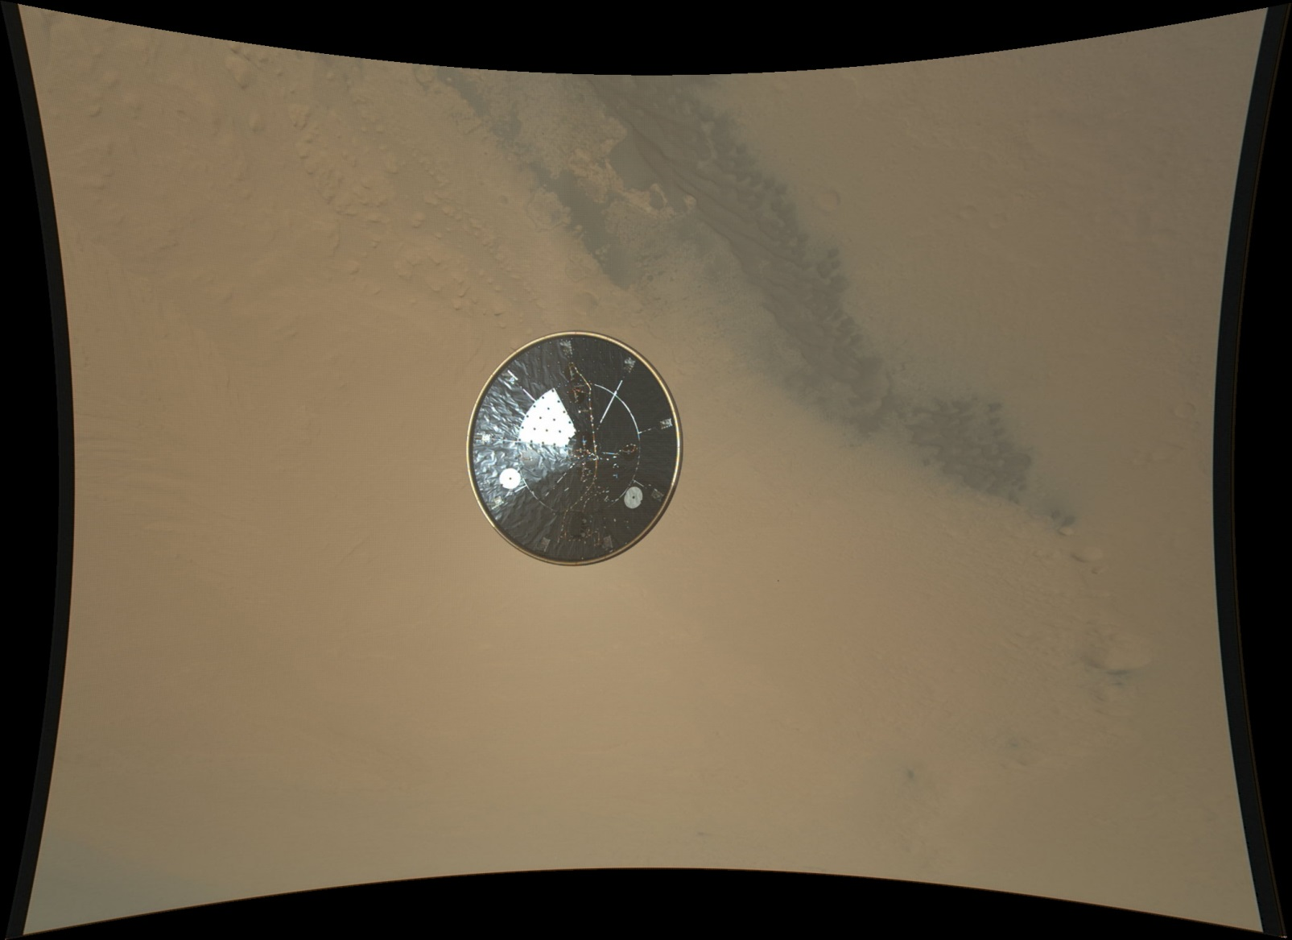
MEDLI (2012)
Instruments:
  7 heat shield TC plugs
  7 hypersonic range pressure transducers
  1 Support System Electronics box
Measured Pressure
  Confirmed spacecraft aerodynamics
  Independently measured attitude
  Determined density profile
  Determined wind component
Measured Temperature and Ablation
  Verified heating levels on spacecraft surface
  Determined maximum total material ablation
  Validated material response at Mars conditions
View of the Mars Science Laboratory heat shield acquired by the Mars Descent Imager (known as “MARDI”)

Slide 18
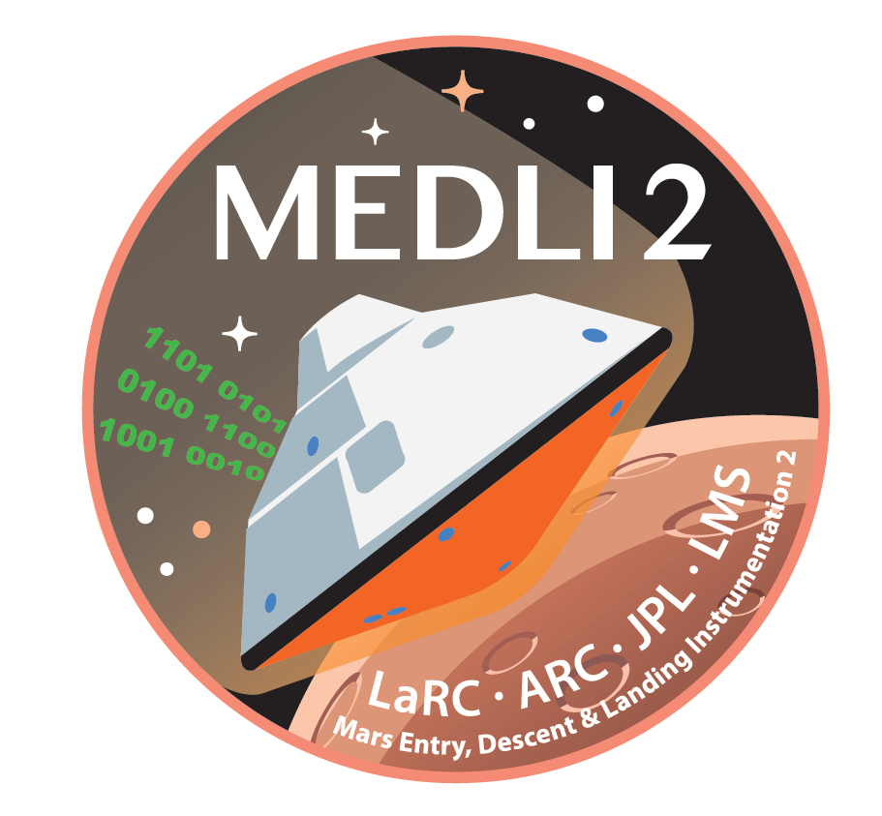
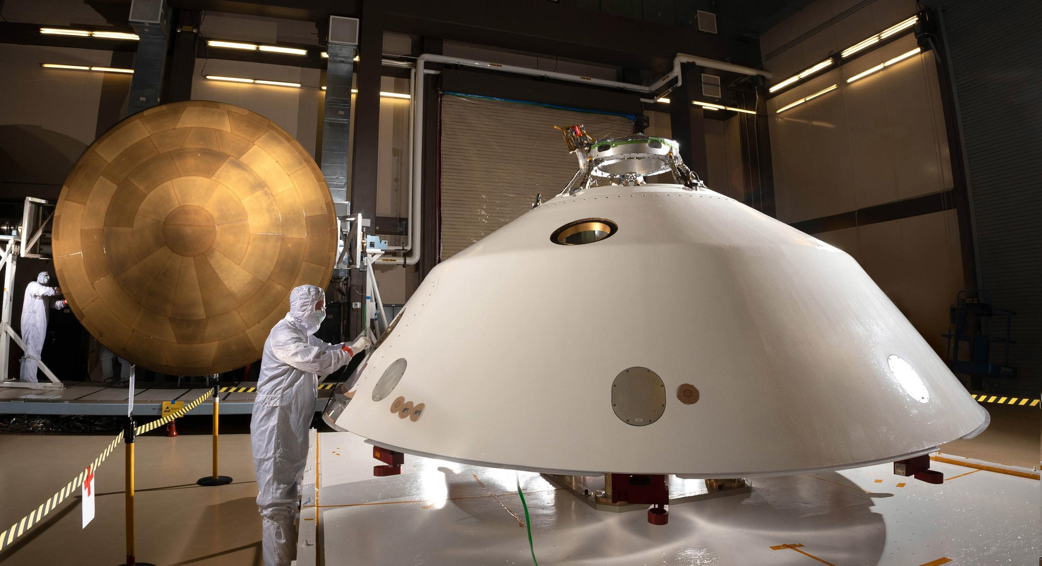
MEDLI2 (2021)
Instrumented Thermal Plugs x11
Pressure Transducer X1
Radiometer X1
Heat Shield
Total Heat Flux sensor X2
Backshell
Supersonic Pressure Transducers X6
Hypersonic Pressure Transducers X1
Instrumented Thermal Plugs x6

Slide 19

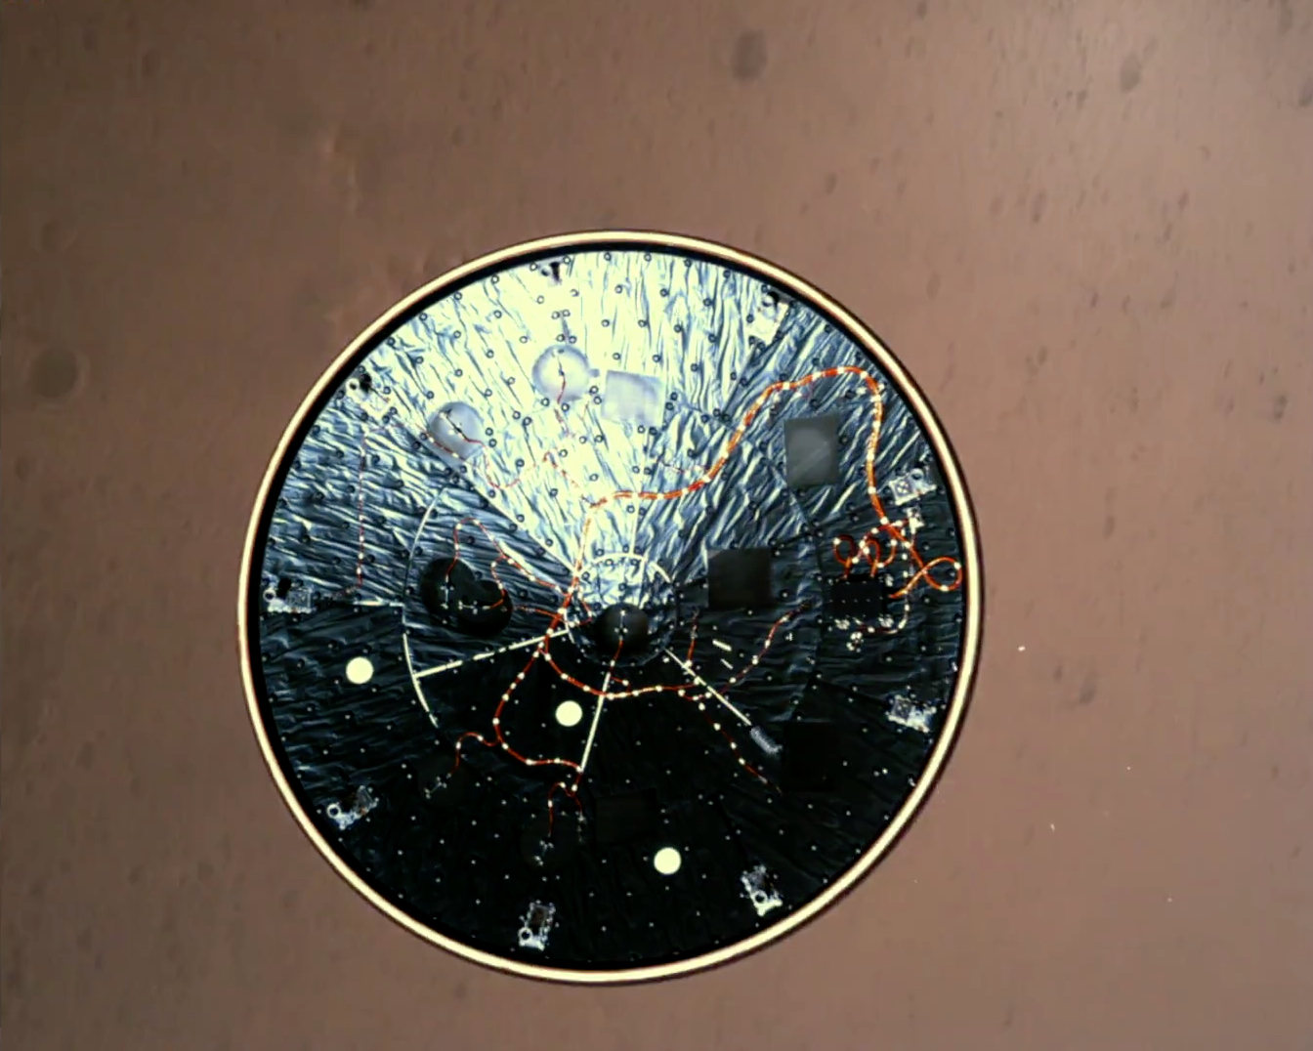
MEDLI2 Hardware on the Mars 2020 Heatshield!
This view is from the Rover Descent Camera about 5 to 6 seconds after Heat Shield Release. The entry vehicle is about 4 km AGL and moving at about Mach 0.6.
Pressure Sensors
Temperature Sensors
Temperature Sensors
Temperature Sensors
Electronics
(SSE)
All MEDLI2 sensors worked perfectly and returned data! Several papers have been published.
Pressure Sensors
Temperature Sensors

Slide 20
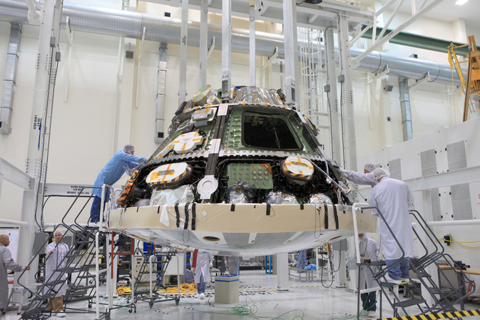
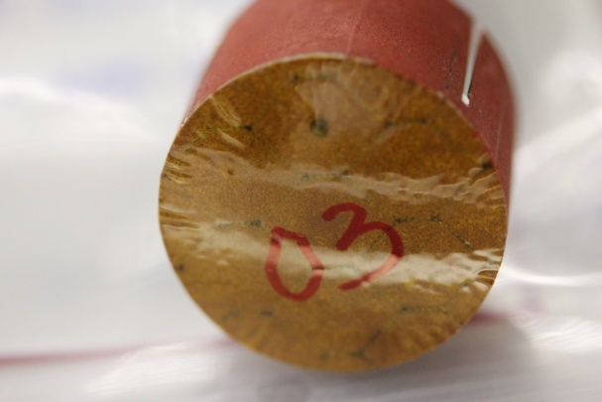
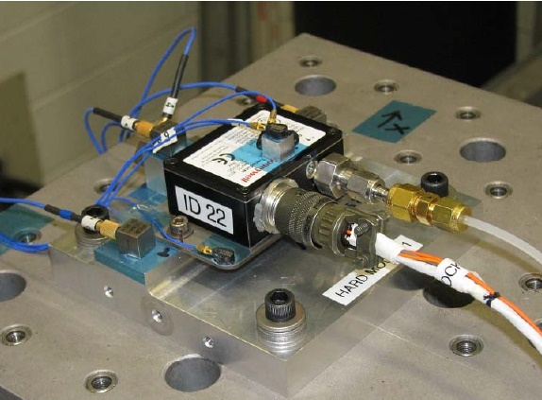
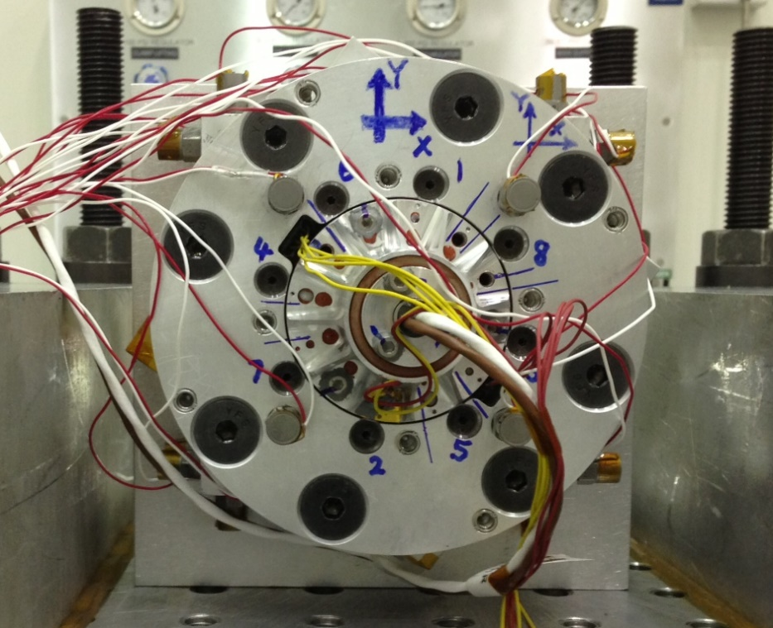
Orion Exploration Flight Test-1
Heat Shield GFE Instruments:
  34 Thermocouple Plugs
  9 Flush Air Data Systems (pressure transducers)
  2 Radiometers
Successfully flown in Dec. 2014 – all sensors returned valuable flight data!
TPS samples were extracted and instruments recovered in 2015
Heat Shield Installed
Instrumented Plug before installation
FADS Testing
Radiometer Testing

Slide 21

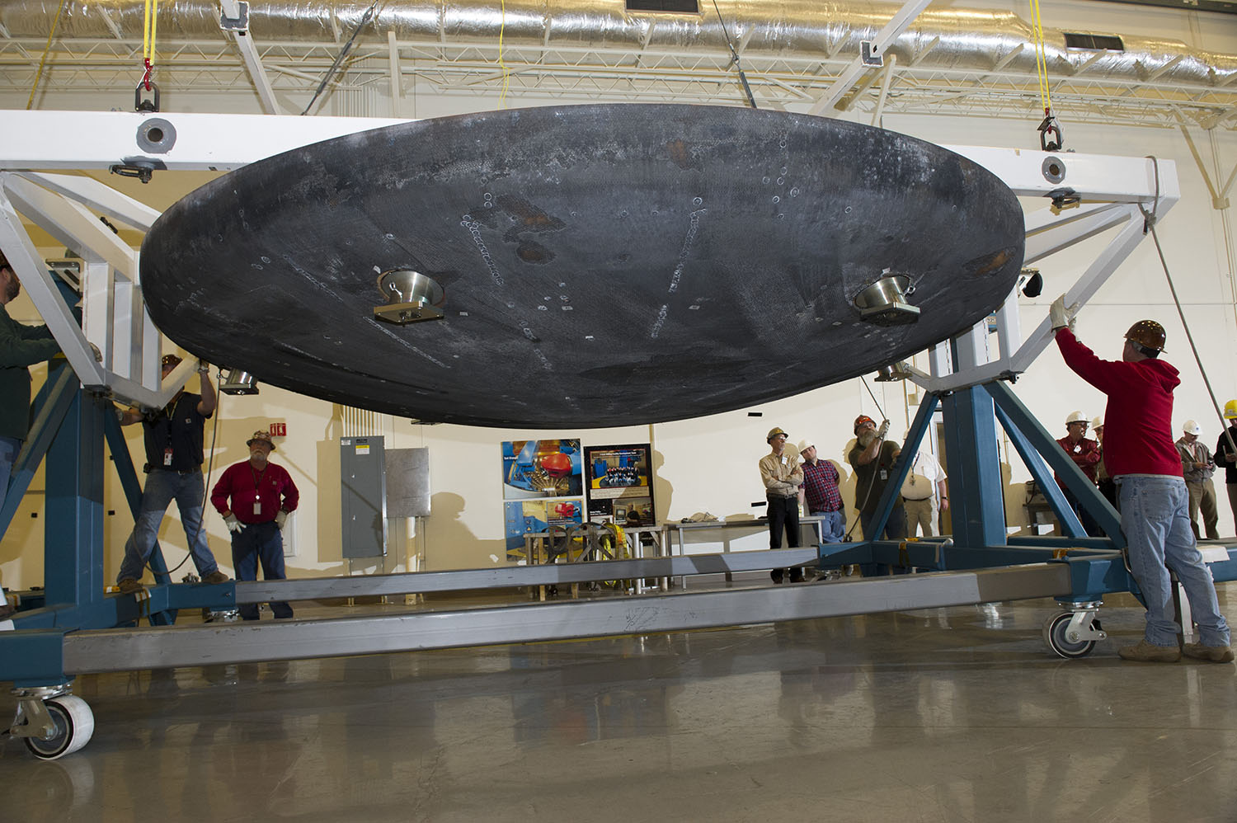
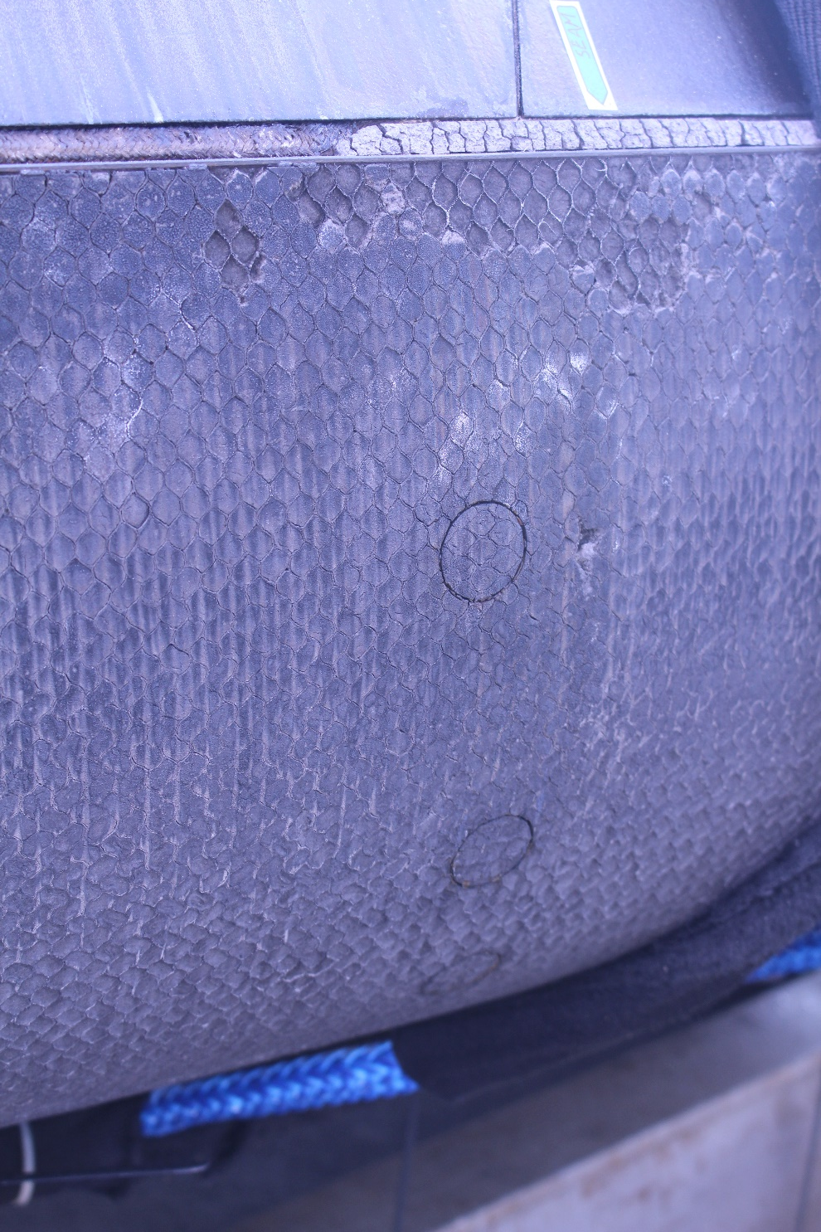
Orion EFT-1 Post-Flight Photos
Close-up view of TC plug after recovery of the EFT-1 capsule
Post-Flight EFT-1 heat shield at NASA Marshall Space Flight Center
Image of EFT-1 heat shield shoulder upon recovery from water landing

Slide 22




Artemis 1 (Uncrewed)
Sensors will support flight test objectives:
  Determine the aerodynamic environment
  Determine aerothermodynamic environments and TPS performance
Instruments:
  43 TC plugs
  2 Radiometers
  14 FADS acreage pressure transducers
  7 shoulder pressure transducers
Heat shield thermocouple plug
Heat shield radiometer

Slide 23







Artemis 2 (Astronaut crew onboard)
Heat Shield GFE Sensors:
  15 TC plugs
  2 Radiometers
  8 FADS pressure transducers
  6 Optical Recession Sensors
Backshell GFE Sensor:
  1 Radiometer
Artemis 2 Heat Shield Spectrometer Optical Sub-assembly
Artemis 2 Heat Shield Optical Recession Sensor (ORS) – plug and diode housing
Sensor layout
Artemis 2 Backshell Radiometer
Artemis 2 Heat Shield Thermocouple (TC) plug

Slide 24






Dragonfly Entry Aerosciences Measurements (DrEAM) – Titan Entry in early 2030s
Dragonfly Sensors for Thermal Reconstruction (DragSTR)
  In-depth thermocouples to reconstruct the aerothermal environment and understand the material response of the Thermal Protection System (TPS)
Dragonfly Atmospheric Flight Transducers (DrAFT)
  Surface pressures on heatshield to understand flow and dynamics
COmbined Sensor System for Titan Atmosphere (COSSTA)
  Backshell sensors for radiative & total heat flux, pressure and temperature. Main focus is to understand radiative heating from CN.
Data Acquisition System (DAS)
  DLR is also providing the data acquisition system for all the DrEAM instruments
(Thermal plugs used for MEDLI2)
(Aerothermal sensors used for ExoMars)
(Pressure transducers used for MEDLI2)
(DAS box used for ExoMars)

Slide 25
EDL Instrumentation Future Needs
Physical Parameter | Sensor | Sensor Accuracy and/or Resolution | Type of TPS
 |  |  | Rigid Ablator | Flexible | Woven
TPS In-Depth Temperature | Thermocouple | ± 50°C at 1,260°C | ● | ½ | ●
 | Fiber Optic Sensing System | ± 5°C at 350°C | ● | ½ | ●
Total heat flux | Thermopile or Schmidt-Boelter sensor | ± 1 W/cm² at 15 W/cm² | ● | ● | ●
Radiative heat flux | Radiometer | ± 1 W/cm² at 15 W/cm² (excluding effects of TPS) | ● | Ó | ●
 | Spectrometer | 1 nm spectral resolution | ½ | Ó | ●
TPS Surface Pressure | Pressure transducer | ± 1% forebody at 34 kPa ± 4 Pa aftbody at 680 Pa | ● | Ó | ●
TPS Recession | Recession sensor (e.g., optical) | ± 0.1 cm at 400 W/cm² | ½ | Ó | ●
TPS Surface Shear Stress | Under development | (To be determined) | Ó | Ó | Ó
Legend: ● = Flight proven, fully capable sensor ½ = Flight qualified and/or scheduled on upcoming missions ● = Potentially capable (development and/or qualification needed) Ó = No existing measurement capability; sensor R&D necessary
Future work is needed to advance the state-of-the-art towards a goal of having flight-proven sensors across the board

Slide 26
Questions?

