Slide 1
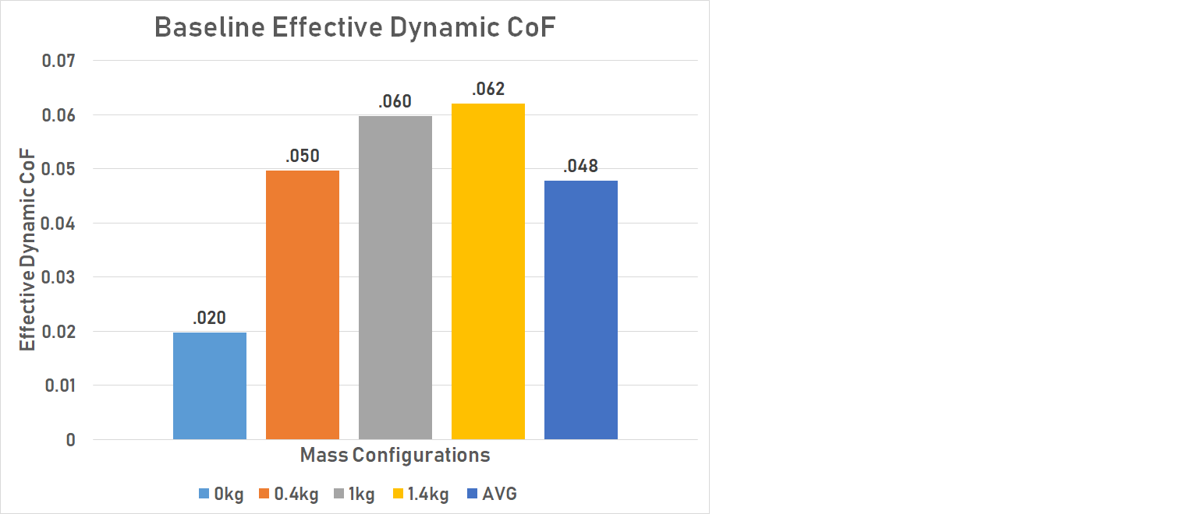
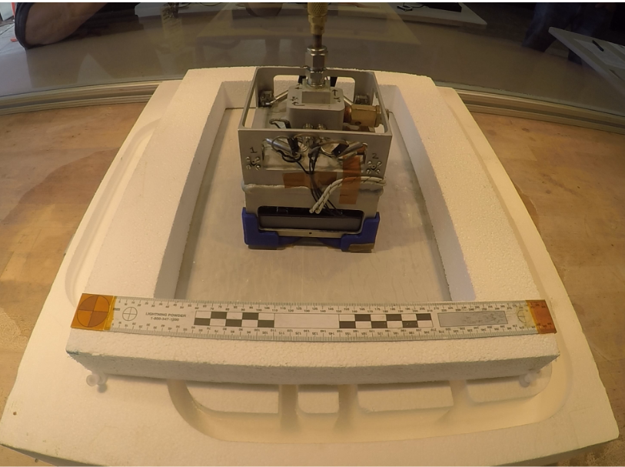
Small Sat Simulated Space Environment MagLev Testbed
National Aeronautics and Space Administration
Johnson Space Center (JSC) / White Sands Test Facility (WSTF) 2021 JSC Technology Showcase: FY21 CIF IRAD
Jeremy Bruggemann – jeremy.bruggemann@nasa.gov, Jarrett Kaczmarski – jarrett.l.kaczmarski@nasa.gov
Technology Taxonomy Area (TX): 1.1.1 Integrated Systems and Ancillary Technologies; 4.2.3 Small-Body and Microgravity Mobility; 4.5.7 Modeling, Simulation, Analysis, and Test of Rendezvous, Prox Ops and Capture; 5.6.3 Orbital Debris Mitigation; 10.4.2 Test and Evaluation of Autonomous Systems; 17.5.3 GN&C Verification and Validation Tools and Techniques; 17.5.4 GN&C Ground Testbeds/Test Facilities;
TRL: start 3 / current 3
FY21 IRAD PROJECT Overview
Development of a ground-based planar testbed with a near frictionless, vacuum environment for small spacecraft allows for higher fidelity, 3 degree of freedom (3DoF) testing of fully integrated propulsion systems and control algorithms prior to launch. This provides empirical data at a relatively low cost that can be used to reduce risk of on-orbit failures thereby mitigating contributions of small spacecraft to the growing orbital debris issue.
INNOVATION
White Sands Test Facility (WSTF) is investigating the use of high temperature super conducting (HTSC) materials to induce magnetic levitation of a small spacecraft, or a constellation of small spacecraft, to provide this 3 DoF testbed within one of WSTF’s existing space environment simulation chambers.
Outcome
High fidelity, planar space like environment test bed and test article platform with minimal to no interference to on-board instrumentation and controls. Provides no external forces induced from test set up – beyond effective coefficient of friction, minimal weight penalty from the test article platform.
Allows for procedural and maneuvering controls evaluation prior to launch, reducing risk to system and primary payload(s).
Effective dynamic coefficient of friction anticipated to be improved upon with further development of test platform and magnetic configurations.
INFUSION SPACE / EARTH
Upon further technology characterization, infusion will be pursued with Small Spacecraft Technology Program (SSTP) for continued development of the expanded platform size and vacuum capability integration.
Prior to down select of ECI and POLARIS this past year SEEKER had expressed interest in utilizing this testbed for further development of technologies based on initial on-orbit performance. Similar opportunities will be sought with other small spacecraft programs.
PARTNERSHIPS / collaborations
This collaboration under the MIRO Program has been proceeding in parallel and conjunction with University of Texas El Paso (UTEP) Cold Gas Demonstrator (CGD) CubeSat.
In addition to the works under IRAD and MIRO, development pathways with the Rocket Propulsion Test (RPT) Office and Small Spacecraft Technology Program (SSTP) are being sought to bring this technology to the industry in support of continued Earth orbit missions, Lunar Missions and Mars precursor missions.
Future Work
Efforts being pursued for follow-on design for the increase in testbed scale, different propellant media capabilities, satellite constellation testing and single-axis micro-thrust measurement testing. Funding to be sought from IRAD, RPT, SSTP and other entities.
UTEP CGD Ambient Demonstration Test
DAA# 20220005005

